Slide 1


Mahmoud Abd-Elhay , Manar Al-islam farag
Undergradute students , 2nd year of
Nuclear engineering,Alexandria university

Slide 2
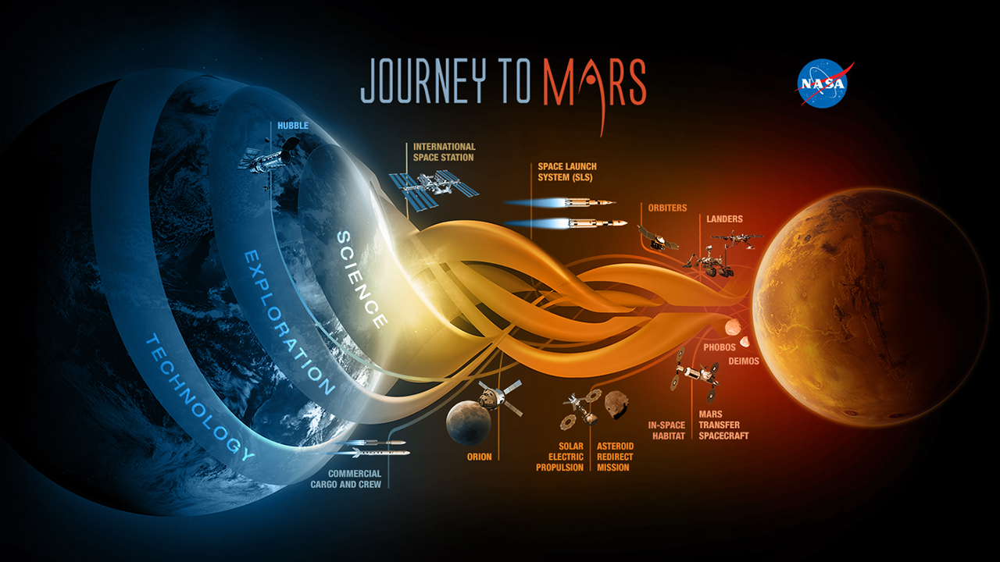
- This research was sponsered by NASA , during The
“ NASA Space Apps “ competition .
- The task was to get an independent source of energy on Mars for long journeys.

Slide 3

SO, What is the relation between what you present and our school ?!!!

Slide 4
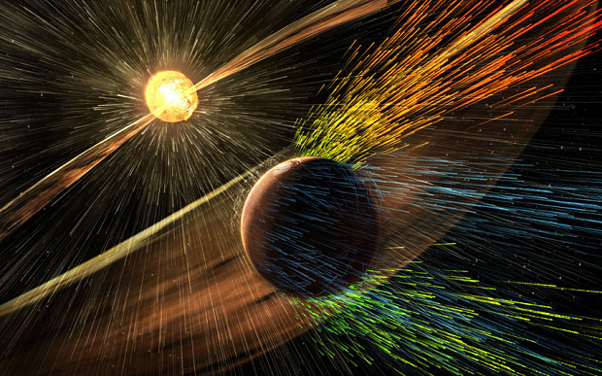

Slide 5
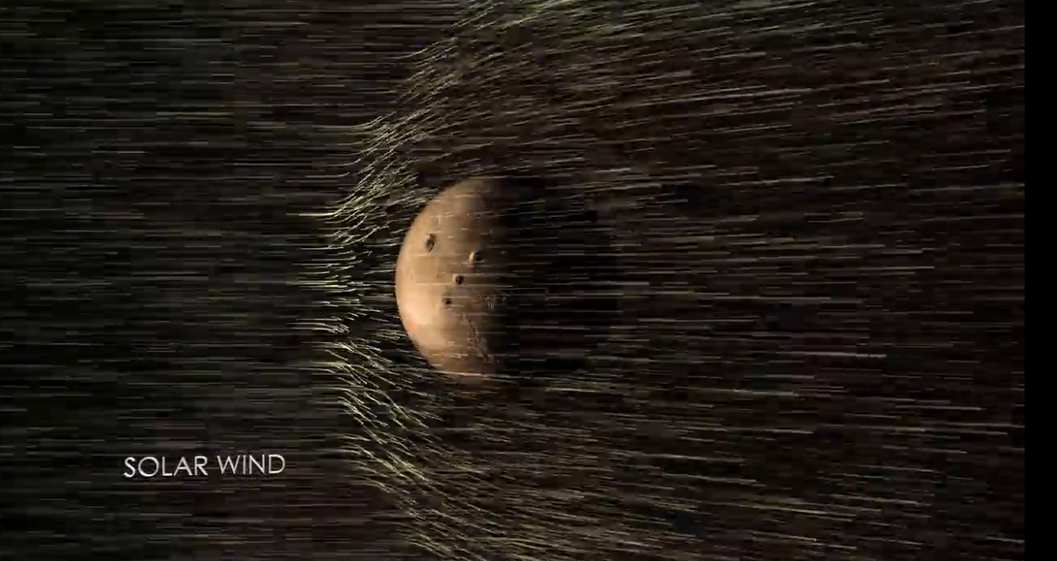

Slide 6
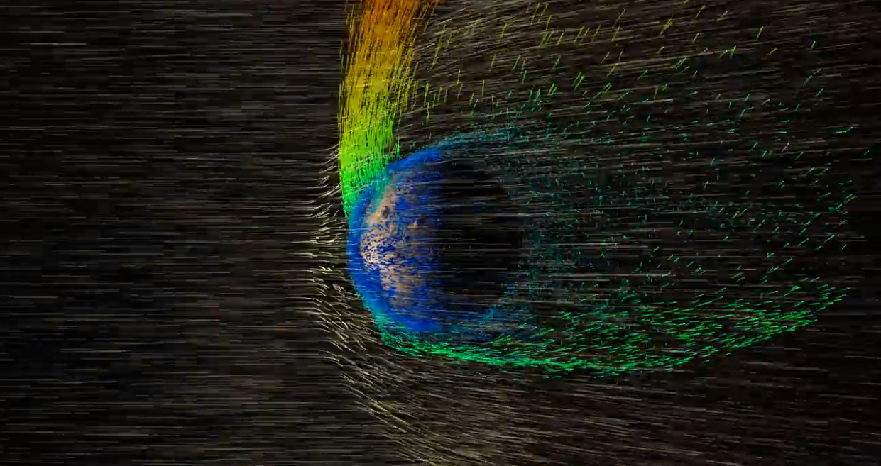

Slide 7
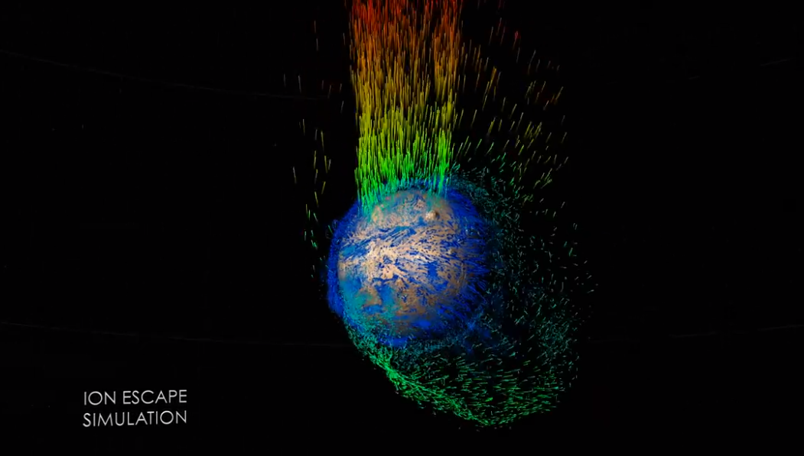

Slide 8
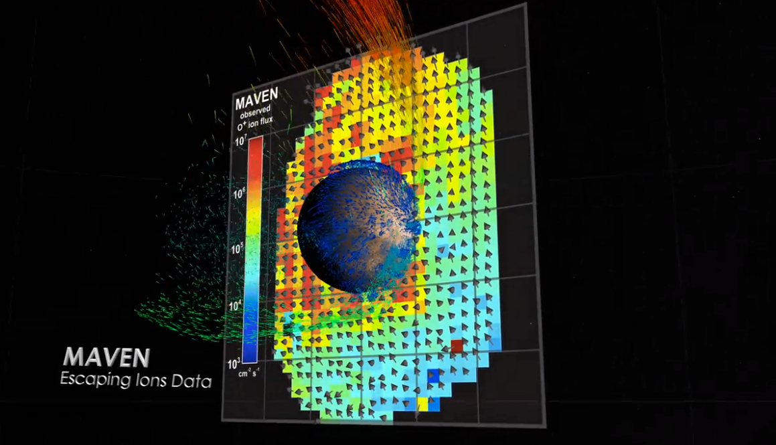

Slide 9
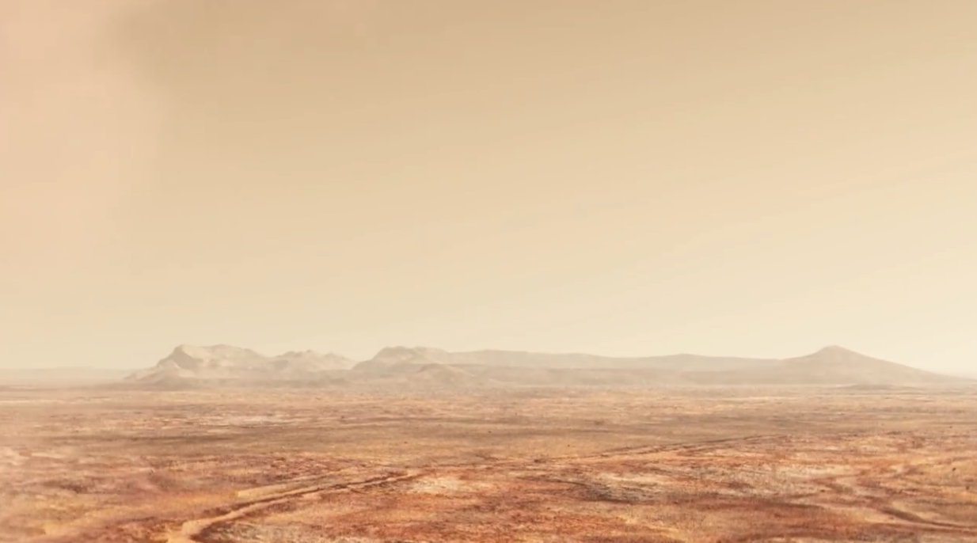
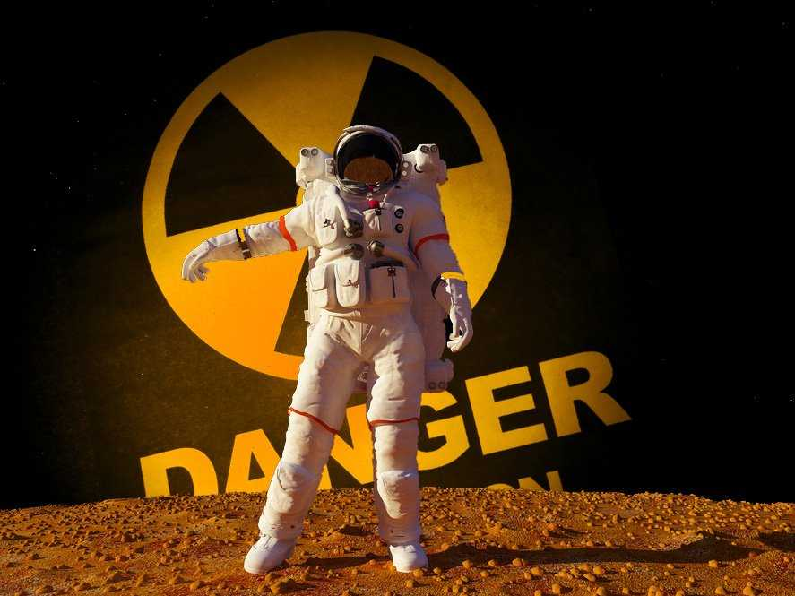
-Mars is extremelly Radioactive , because it does not have a thick atmosphere so most of cosmic rays and solar wind can reach it's surface.
-By analysing these particles , NASA found that 95% of cosmic rays are protons , and 85% of particles which hit the surface of Mars are also protons .

Slide 10

And so on ,what is the relation between particles and generating energy ?

Slide 11
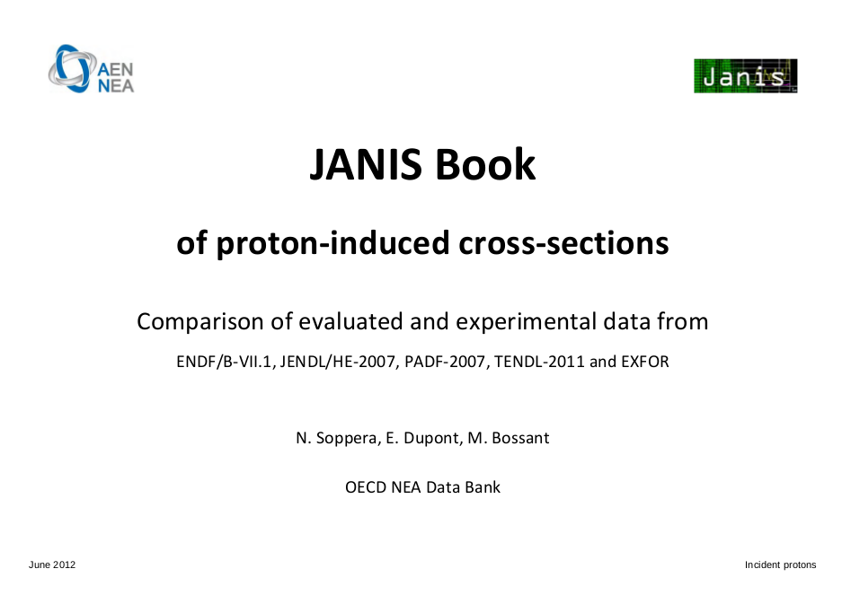
Our idea is to use the natural accelerating particles -especially Protons- to make a NUCLEAR reaction with a material to produce energy
The best reaction with proton from the data we found in “JANIS book “ was
Proton with fixed lithium7
Do you want to build a Nuclear Reactor

Slide 12
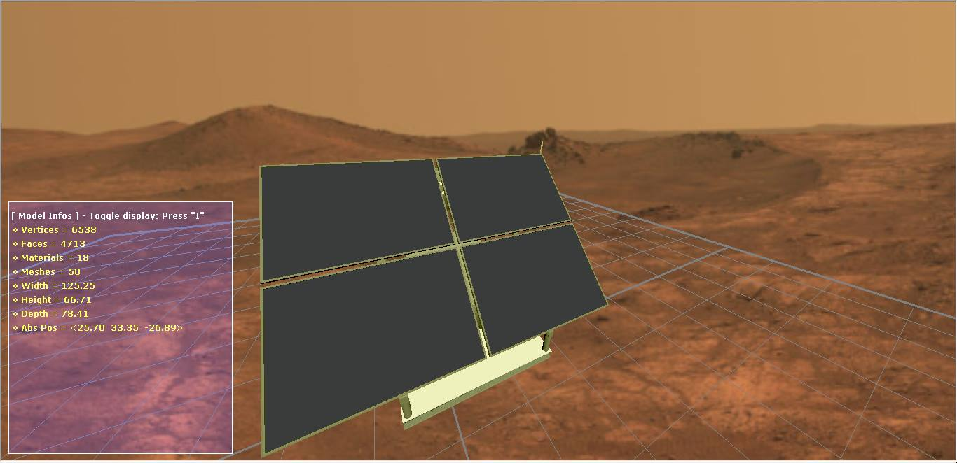
Radiation cell

Slide 13
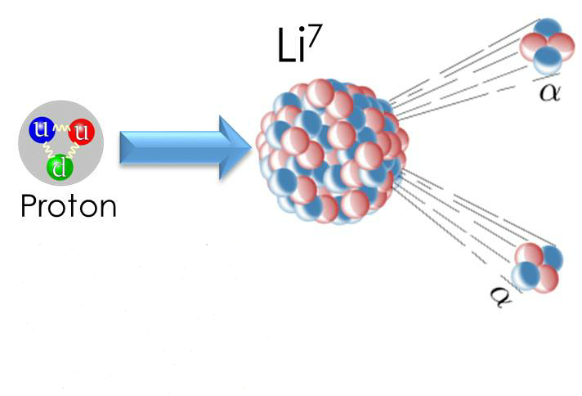
Proton Lithium 7 Reaction

Slide 14
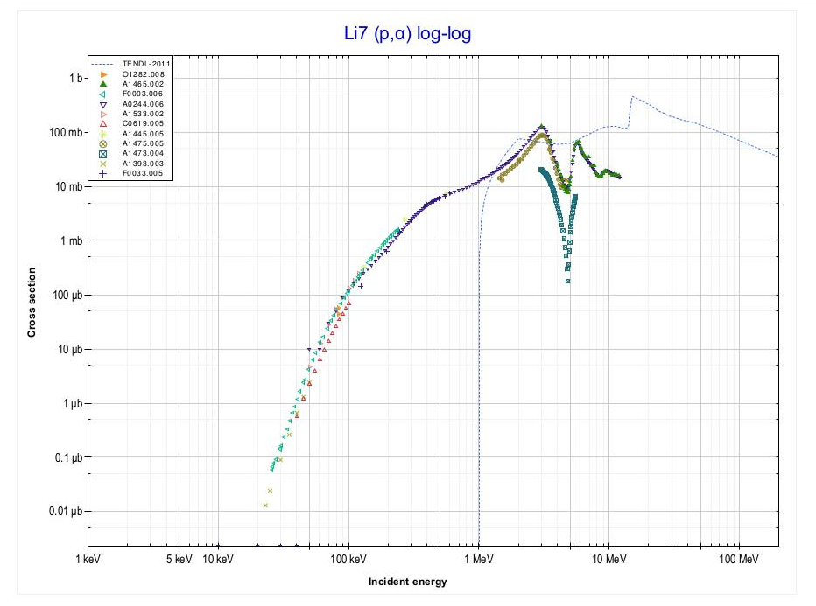
We will use radiation to make nuclear reaction
cross section

Slide 15
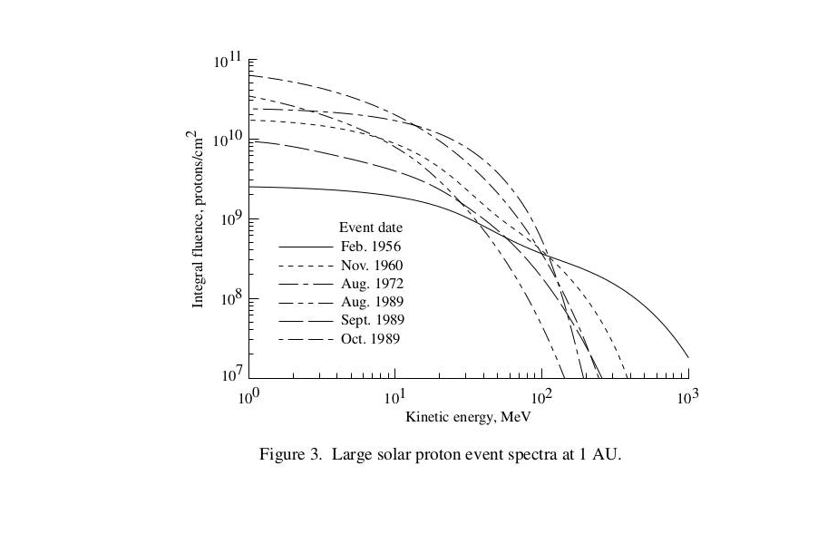
Proton Flux

Slide 16
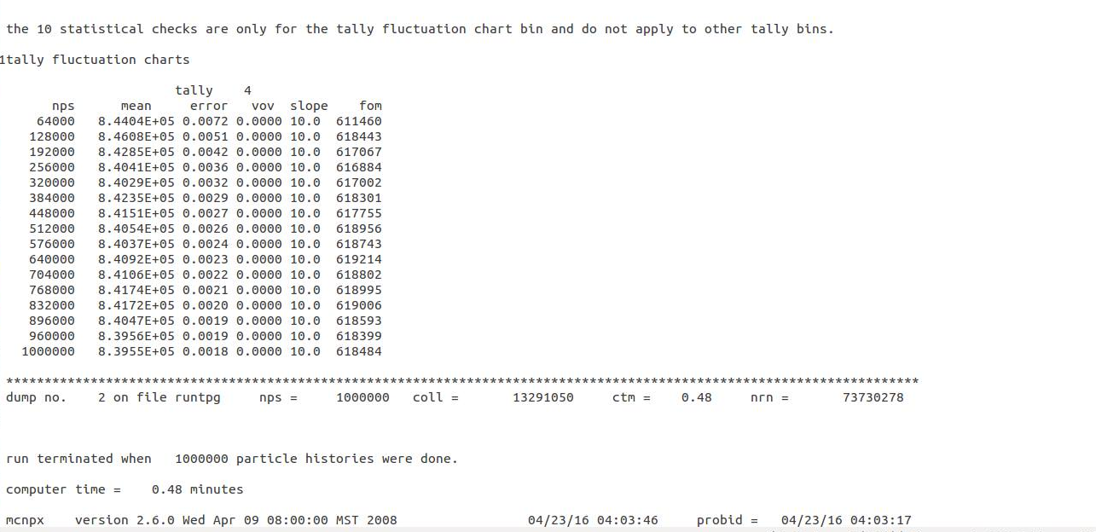
The maximum rate of proton lithium reaction

Slide 17
Then the product 2 Alpha particles -each with 8 MeV- will diffuse in rest Li 7 .
Diffusion will cause Ionization of Li7 .
The electron will be free .

Slide 18
we can enrich the cell concentration of electron by adding a very thin layer of silicon .
Si 28 increase electron current of cell, by make more collision with ‘Alpha‘ .

Slide 19
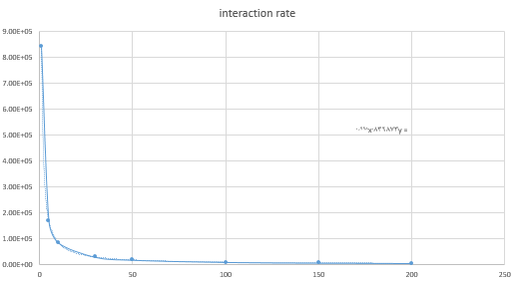


Thickness is inversely proportional to the rate of lithium nuclear reaction
y=

Slide 20
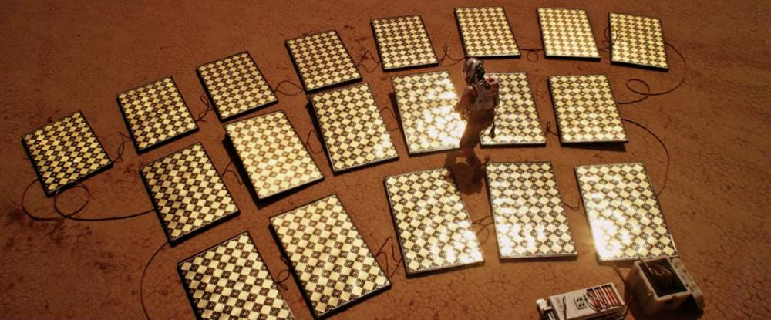
Radiation Cells recharging Lithium ion battery

Slide 21


