Slide 1
Physical Cosmology I
6th Egyptian School for HEP
Thermal History
Amr El-Zant (CTP@BUE)

Slide 2
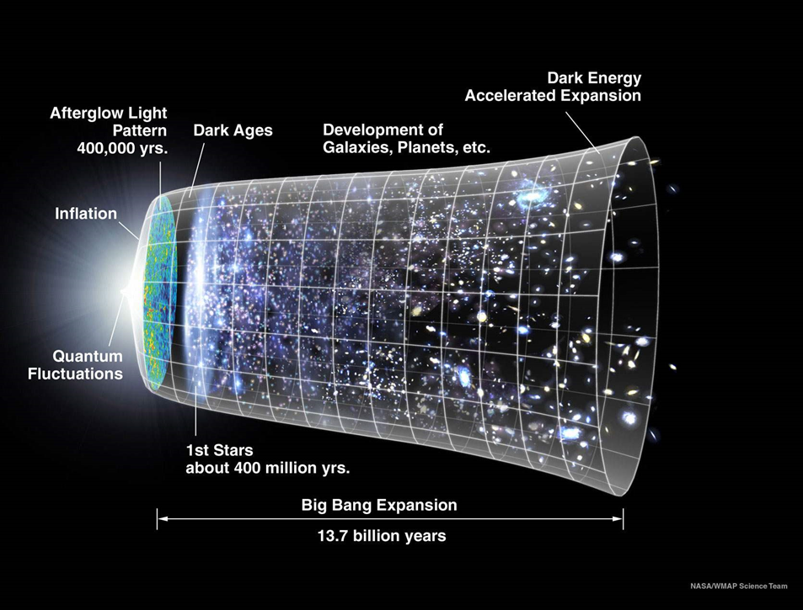
Google ‘Cosmic History’ → Images:
Things Like
This talk

Slide 3
Subject Matter
Our universe is expanding → Should have been ‘hot’ in the past
As T rises:
Atoms ionize
Nuclei disassociate → individual protons neutrons → quarks-gluons
- SM phase transitions (electroweak, QCD) expected. Others (GUT) predicted
mass nuclei
→ At some level universe is testing ground for HEP

Slide 4
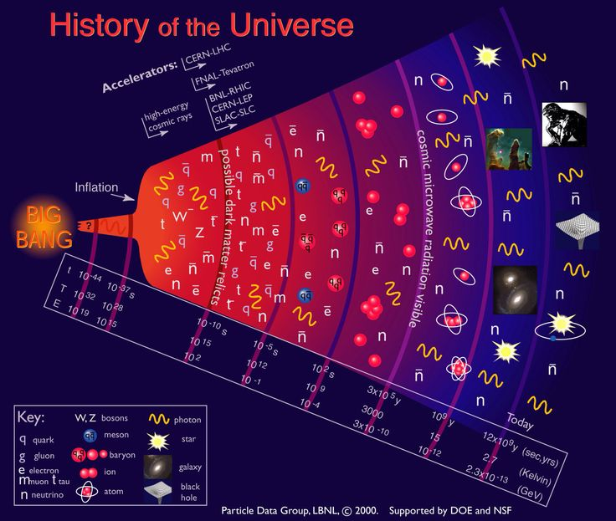
Google some more: A Thermal Bath of
Particles and Antiparticles that Leaves Relics
Tightly coupled, highly interacting, system
Couple of proper refs
Kolb & Turner: The Early Universe (standard text)
Daniel Baumann Tripos lectures Chapter 3
www.damtp.cam.ac.uk/user/db275/Cosmology.pdf
(which I follow to some extent)

Slide 5
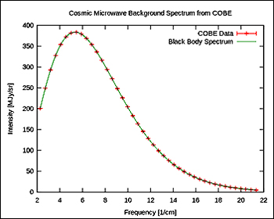
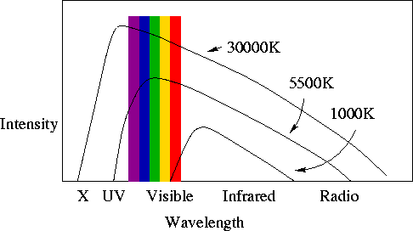

The Cosmic Microwave Background
Tells us of prior thermal equilibrium
Current temperature of spectrum: 2.728 Kelvin
Current energy density of CMB:
The average energy per photon
~ k T ~ h ν (since distn ~ $e^{−\frac{E}{kT}} )$
→ photon number density ~
Compare with < one proton per cubic meter!
Entropy ~ large ratio; well conserved
in comoving vol

Slide 6
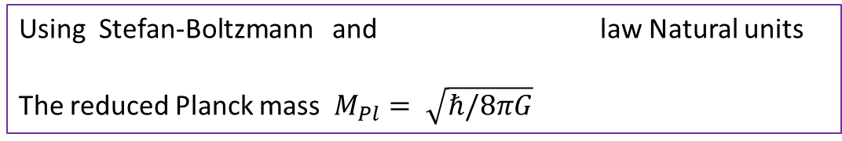
Units, rates (and ‘~convention’!)
Using ‘natural units’: c = ħ = G = k_{B} = 1
Temperature, energy, momentum and mass are in electron volts
Length and time are in inverse electron volts
In these units, during radiation era gives
Expansion rate
Already twiddle ‘~’ sign reappearing!
→ we will be making mainly order of magnitude (factor ten) estimates
Using Stefan-Boltzmann and law Natural units
The reduced Planck mass $M_{Pl}= \sqrt{ℏ/8πG}$

Slide 7
Relativistic Degrees of Freedom g*
Expansion influenced by number of relativistic degrees of freedom (essentially number of species and their internal degrees of freedom; e.g. spin)
The total energy density of relativistic species is
(using Stefan-Boltzmann again in natural units)
(similar relation for entropy s~ ρ/T )
These act as ‘radiation’ with pressure 1/3 ρ
Annihilation → states transferred to photon bath → entrop. Consderved
A thermal particle is relativistic if
A particle is in the thermal equilibrium if: interaction rate with thermal bath > expansion rate

Slide 8

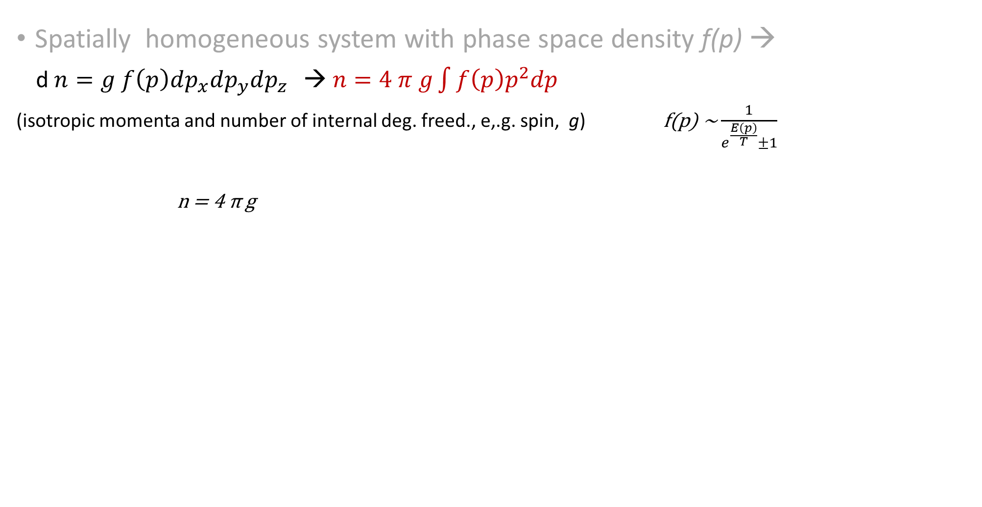

Number densities in Thermal Equilibrium
Spatially homogeneous system with phase space density f(p) →
d $n=g f\left(p\right)dp_{x}dp_{y}dp_{z }$ → $n=4 π g\int{f\left(p\right)p^{2}dp }$
(isotropic momenta and number of internal deg. freed., e,.g. spin, g) f(p) ~ $\frac{1}{e^{\frac{E\left(p\right)}{T}}±1}$
n = 4 π g
Chemical equilib. → particles are created – annihilated so as to keep these distn
→
Non-relativistic parts → more difficult to make → lose out and suppressed
Relativistic
Non-relativistic
$$n \sim g T^{3}$$
$$n \sim g {(mT)}^{\frac{3}{2}} e^{−\frac{m}{T}}$$
As T → 0 a massive particles should vanish… !
‘Normal matter’; should vanish; it’s existence suggests violations of baryon number and charge parity conservation
→ Baryogenesis through particle antipart asymmetry (probably BSM)

Slide 9
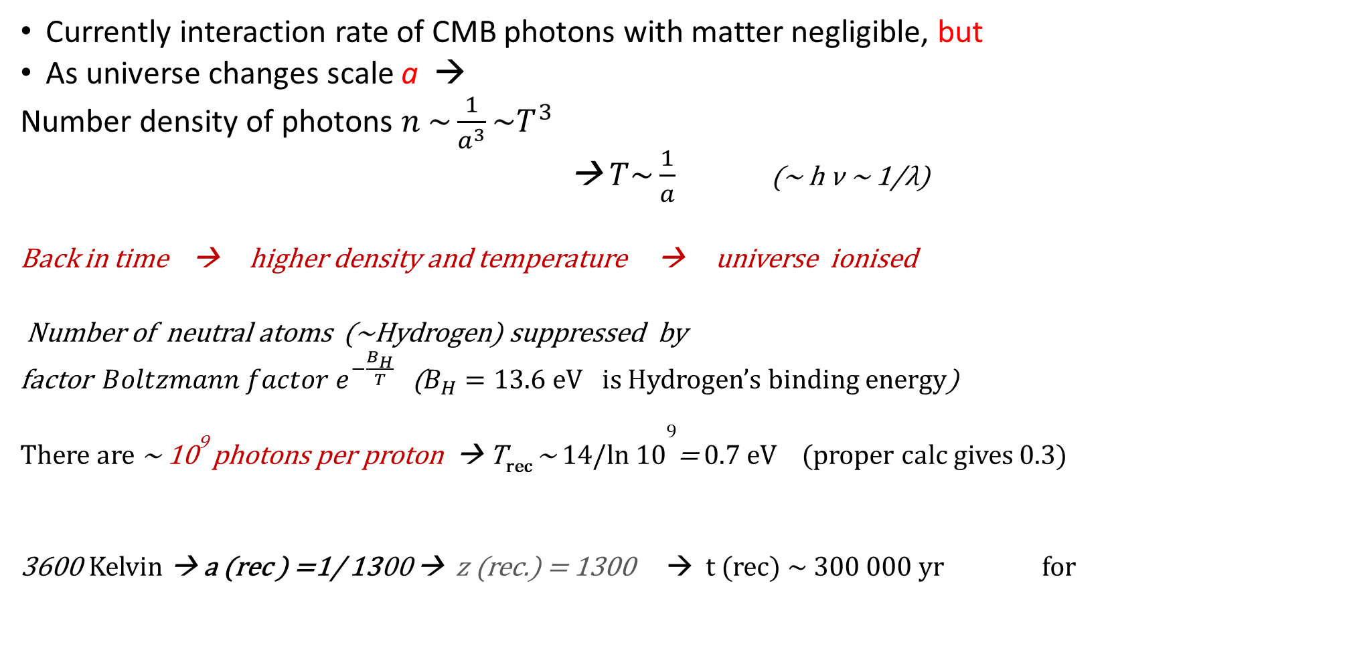
Era of Tightly Coupled Plasma
Currently interaction rate of CMB photons with matter negligible, but
As universe changes scale a →
Number density of photons $n \sim \frac{1}{a^{3}}\sim T^{3}$
→ $T\sim \frac{1}{a}$ (~ h ν ~ 1/λ)
Back in time → higher density and temperature → universe ionised
Number of neutral atoms (~Hydrogen) suppressed by
factor ${Boltzmann factor e}^{−\frac{B_{H}}{T}}$ ($B_{H}=13.6$eV is Hydrogen’s binding energy)
There are ~ 10⁹ photons per proton → T_{rec} ~ 14/ln 10⁹= 0.7 eV (proper calc gives 0.3)
3600 Kelvin → a (rec ) =1/ 1300 → z (rec.) = 1300 → t (rec) ~ 300 000 yr for

Slide 10



Cosmic Plasma Coupling
Gas fully ionized → strongly interacts with photons by Thompson scattering:
Electron placed in EM field → → oscillates
radiates back
Crossection ~ power radiated / mean incident energy flux
~ Square of classical electron radius
interaction rate
(note relative vely ~ c = 1 here!)

Slide 11
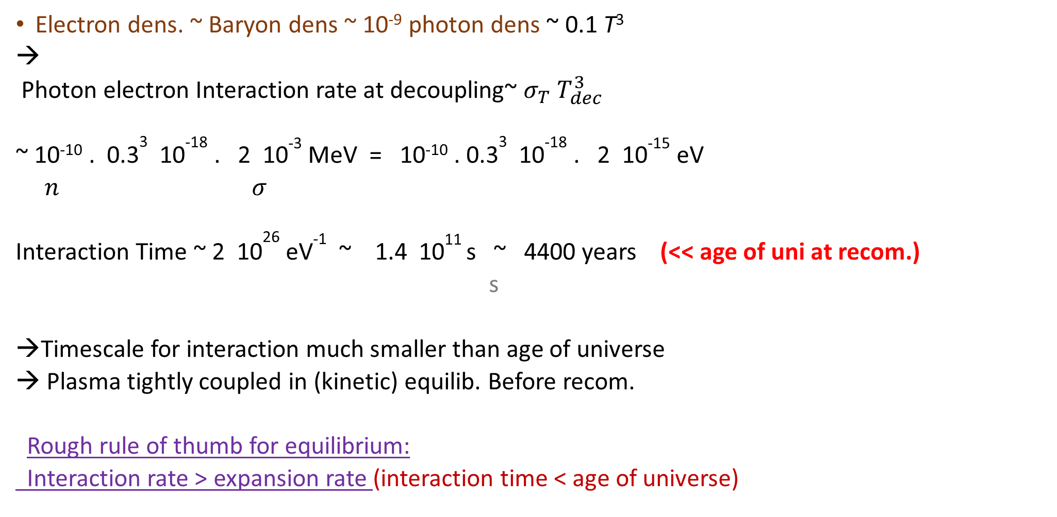
Interaction Rate of Coupled Plasma
Electron dens. ~ Baryon dens ~ 10⁻⁹ photon dens ~ 0.1 T³
→
Photon electron Interaction rate at decoupling~ $σ_{T} T_{dec}^{3}$
~ 10⁻¹⁰ . 0.3³ 10⁻¹⁸ . 2 10⁻³ MeV = 10⁻¹⁰ . 0.3³ 10⁻¹⁸ . 2 10⁻¹⁵ eV
$n σ$
Interaction Time ~ 2 10²⁶ eV⁻¹ ~ 1.4 10¹¹ s ~ 4400 years (<< age of uni at recom.)
s
Timescale for interaction much smaller than age of universe
Plasma tightly coupled in (kinetic) equilib. Before recom.
Rough rule of thumb for equilibrium:
Interaction rate > expansion rate (interaction time < age of universe)
6.582119×10⁻¹⁶
Similar process of binding in QCD phase trans. And BBN

Slide 12
Neutrino Decoupling
Neutrinos are coupled to electrons through weak interactions
Much looser than Thompson coupling → early decoupling
Below electroweak scale (~100 GeV) but
In relativistic limit → crossection
(‘four Fermion’ interaction)
Neutrinos thus decouple at (recall H ~ T² in rad era)
→ When scales ~ 3 million times smaller than recombination ~ 1 s after start of expansion

Slide 13
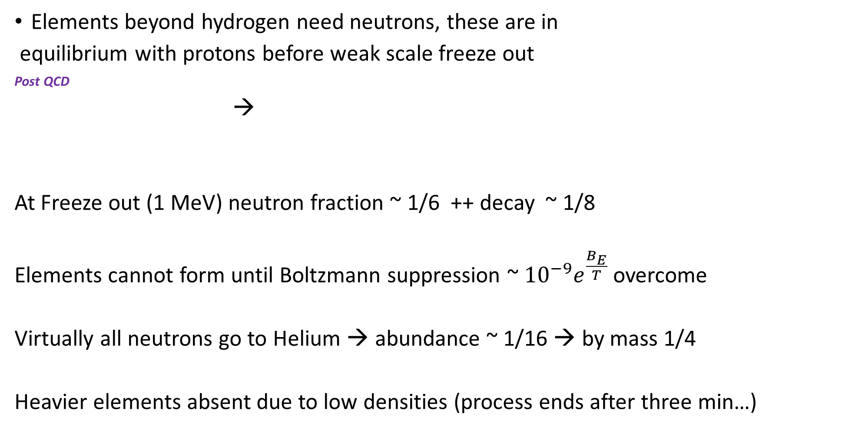
Cosmological Element Production (BBN)
Elements beyond hydrogen need neutrons, these are in
equilibrium with protons before weak scale freeze out
Post QCD
→
At Freeze out (1 MeV) neutron fraction ~ 1/6 ++ decay ~ 1/8
Elements cannot form until Boltzmann suppression ~ ${10}^{−9}e^{\frac{B_{E}}{T}}$ overcome
Virtually all neutrons go to Helium → abundance ~ 1/16 → by mass 1/4
Heavier elements absent due to low densities (process ends after three min…)

Slide 14
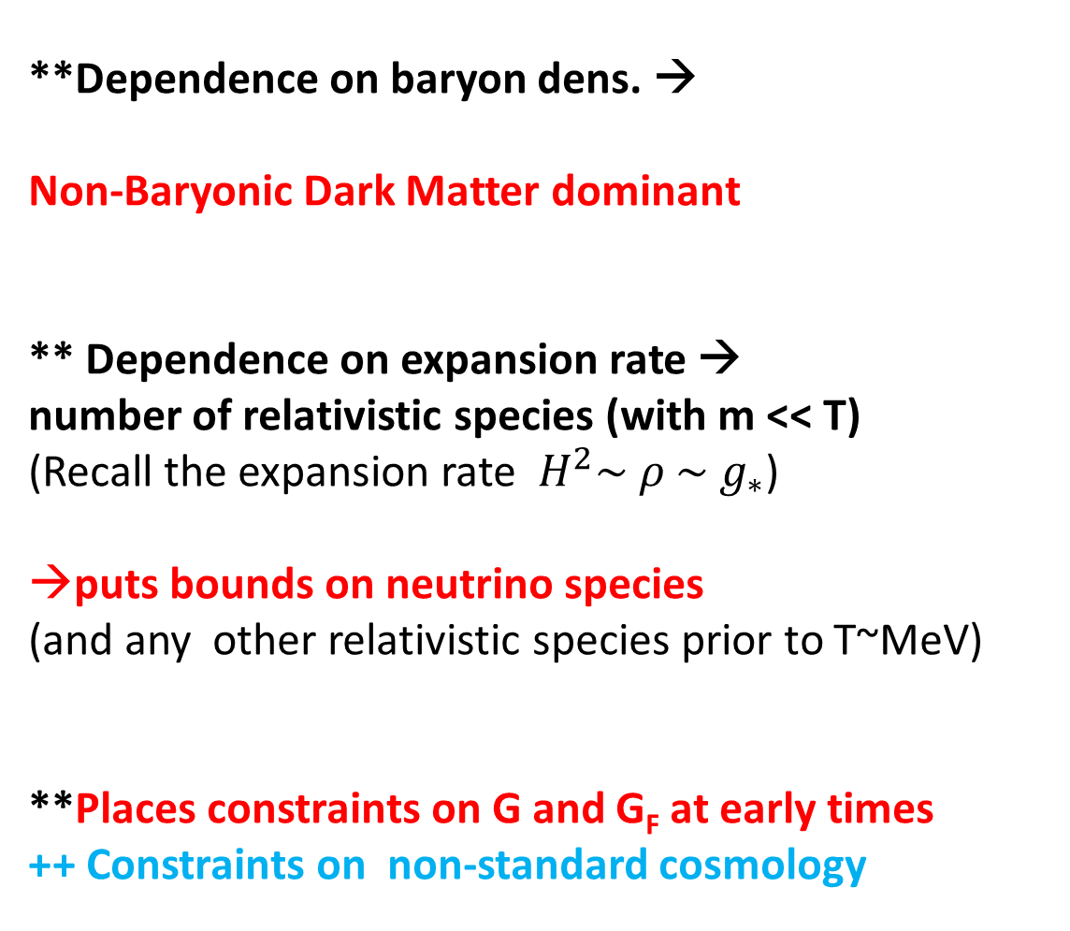
Of BBN and BSM
**Dependence on baryon dens. →
Non-Baryonic Dark Matter dominant
** Dependence on expansion rate →
number of relativistic species (with m << T)
(Recall the expansion rate $H^{2}\sim ρ \sim g_{∗}$)
puts bounds on neutrino species
(and any other relativistic species prior to T~MeV)
**Places constraints on G and G_{F} at early times
++ Constraints on non-standard cosmology
Vertical line Baryon fraction ~ 5 %

Slide 15
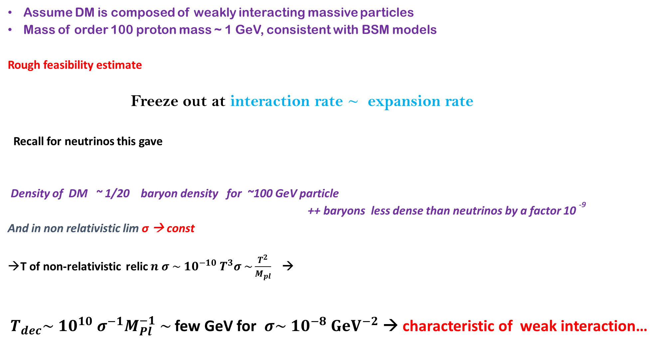
What Then is the DM: A WIMP Miracle?
Assume DM is composed of weakly interacting massive particles
Mass of order 100 proton mass ~ 1 GeV, consistent with BSM models
Rough feasibility estimate
Freeze out at interaction rate ~ expansion rate
Recall for neutrinos this gave
Density of DM ~ 1/20 baryon density for ~100 GeV particle
++ baryons less dense than neutrinos by a factor 10 ⁻⁹
And in non relativistic lim σ → const
T of non-relativistic relic $n σ \sim 10^{−10} T^{3}σ \sim \frac{T^{2}}{M_{pl}}$→
$T_{dec}\sim 10^{10} σ^{−1}M_{Pl}^{−1} \sim$few GeV for $σ\sim 10^{−8} GeV^{−2}$ → characteristic of weak interaction…

Slide 16
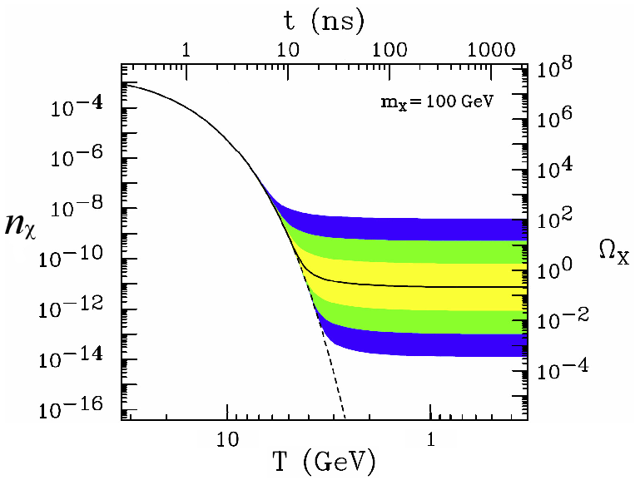

The Miracle more precisely
Use Boltzmann equation for comoving number density
The equilibrium abundance is Boltzmann suppressed
(Recall non-relativistic $n \sim g {(mT)}^{\frac{3}{2}} e^{−\frac{m}{T}})$ )
It is suppressed in the right way →
proper abundance for weak decoupling

Slide 17
Nevertheless…
Cm² ~ 4 * 10 ⁻²⁸ GeV⁻²
Direct detection constraints from Akerib et. al. (2016)
Experimental constraints → WIMP miracle wither away?
(Also appears withering at LHC…)

Slide 18
Some Alternatives
Sterile neutrinos (can be produced from oscillations with regular ones)
‘Warm dark matter’ in keV range
Axions (introduced to solve CP violation problem in QCD re neutron’s electric dipole moment)
Tiny mass but dynamical friction effect leads to similar behavior as cold dark matter
Non-thermal production of WIMPS or WDM
e.g., from direct decay of Inflaton like field → escapes thermal constrains if equilibrium is not established (e.g., produced after T_decoup.)
This is normally accompanied by ‘entropy production’ (decay of field into relativistic particles) which can adjust expansion rate and thus the DM abundance (diluting it)
→ Constrained by BBN and CMB

Slide 19
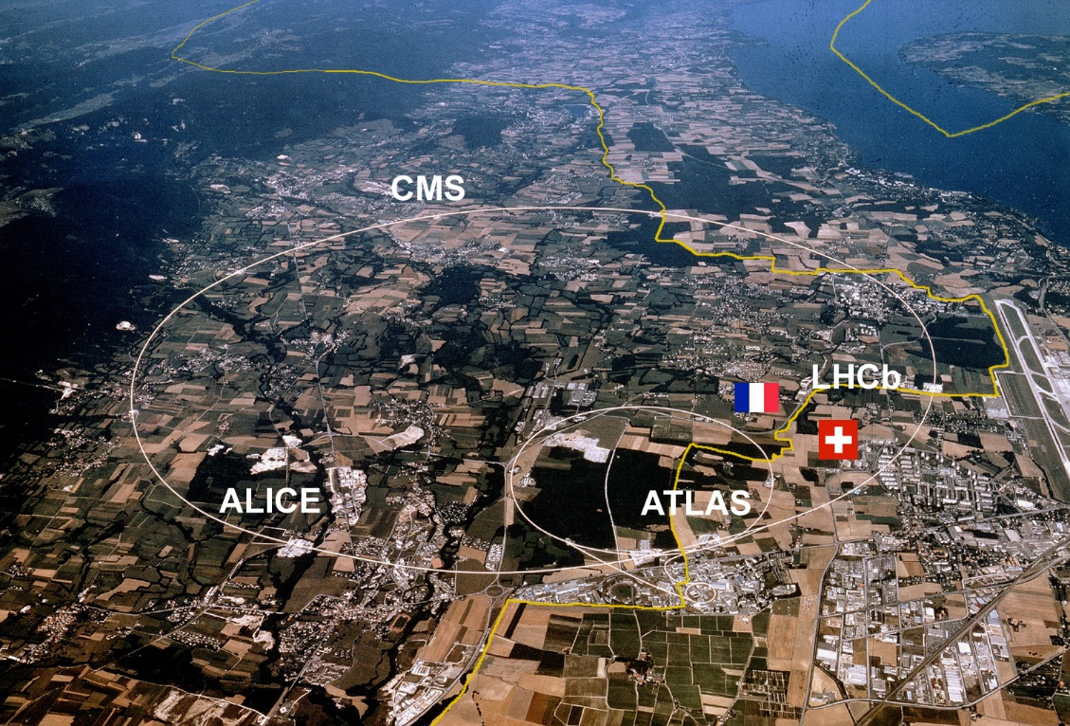
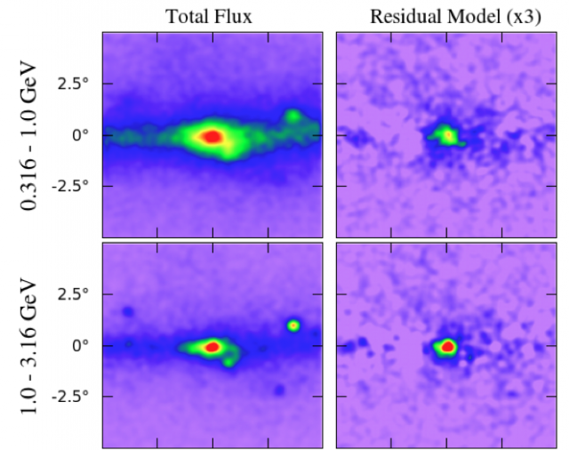
Searching for Dark Matter
Detection experiments (DM in the room!)
LHC (at CERN)
Annihilation Signals (in the sky)

Slide 20
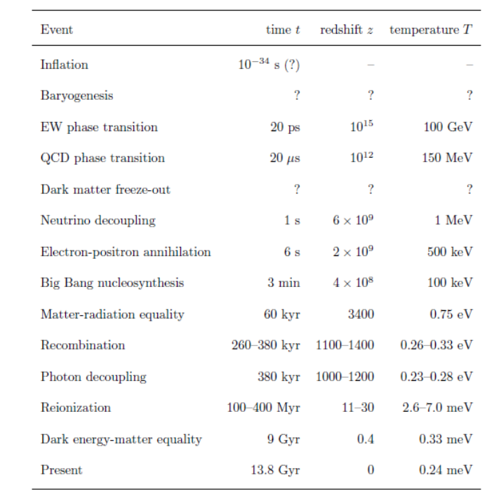
Overview of Evolution
From lecture notes by Daniel Baumann

Slide 21


