Slide 1
EXSO EP HSE
AD Hall
18 November 2016
LASER SAFETY
Reminder
S. DETRAZ
EP LSO deputy

Slide 2
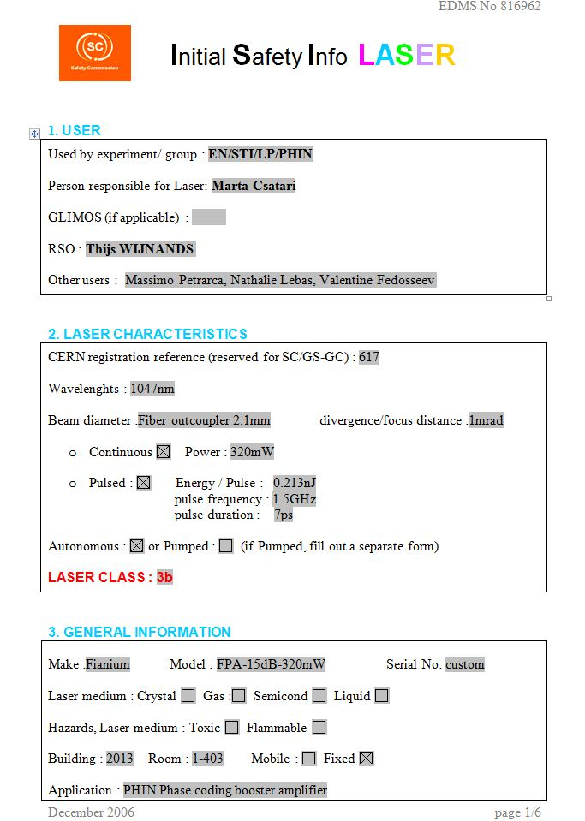
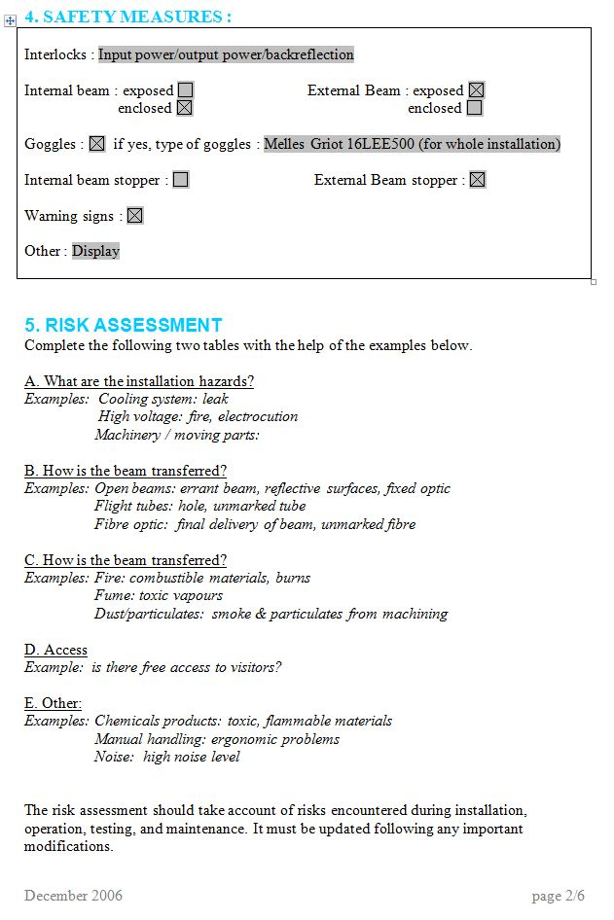
REGISTRATION
Every class 3B or 4 laser has to be registered in the CERN laser database.
To register a new laser the owner has to send an ISI form to his LSO. This form will be forwarded to HSE. In return the laser user will receive a CERN ID number that should be written on the laser.
When a laser leave CERN or is decommissioned the LSO should also be informed.
Unfortunately, because of the difficulty to maintain such a database, we can find in the database many lasers that are not used anymore and also many operating lasers that are not registered. LSO will ask laser users to update the database by sending the missing ISI forms.

Slide 3
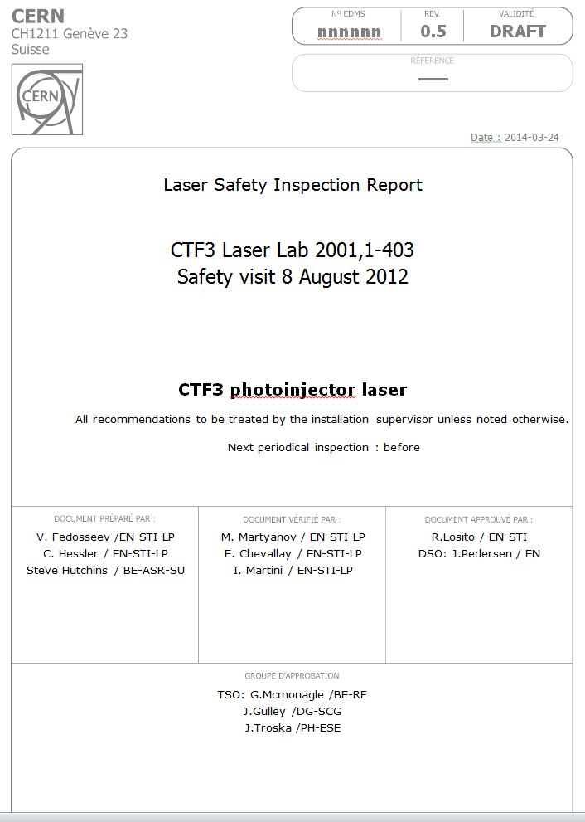
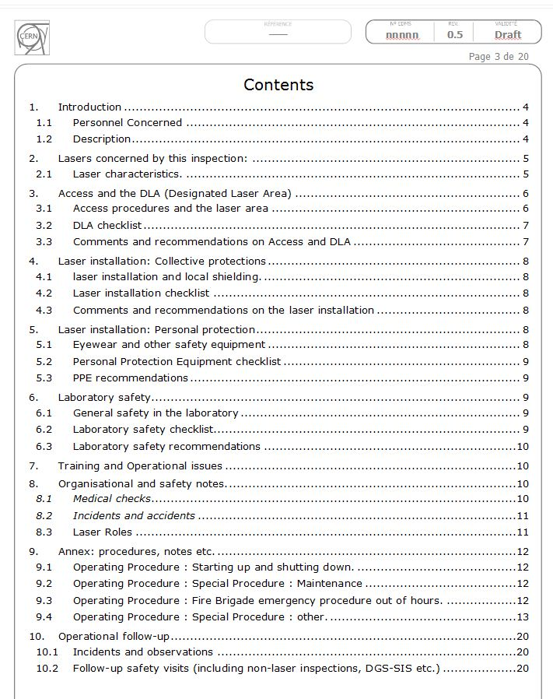
RISK ANALYSIS & REPORT
For complex laser installation, the ISI risk assessment becomes difficult to use. In these cases an alternative safety assessment is needed for the entire DLA. Individual lasers must still be registered and numbered.
For these installations the laser safety document (“laser safety inspection report”) must include:
Installation description with schematics and/or pictures.
Laser list with their beam parameters and ID numbers.
Documented risk assessment.
Checklist of safety related features.
Engineering and administrative controls.
Operating procedures (including alignment & emergency).
PPE calculation & selection

Slide 4
PREVENTION & PROTECTION MEASURES
Where the nature of the activity does not permit the risk to be eliminated or a lower class of laser substituted, the risk shall be reduced to a minimum by application of prevention and protection measures in the following order of priority:
Engineering controls
Administrative controls
Personal protection equipment
“The most common misconception laser users have about laser-protective eyewear is that it is the first line of defense against laser radiation. In reality, although critically important, it should be the last line of defense. Beam containment will do more for the laser user than laser protective eyewear”.
Entryway safety controls:
Nondefeatable area or entryway safety controls
Defeatable area or entryway safety controls
Procedural area or entryway safety controls
The procedural method is not an engineered safety control method and should be limited to specialized and exceptional operations.
The interlock system must be fail safe. IEC 61508 or ISO 13849 should be used to evaluate the reliability of the interlock (we generally need a SIL 2 or 3 level or PL d or e).

Slide 5
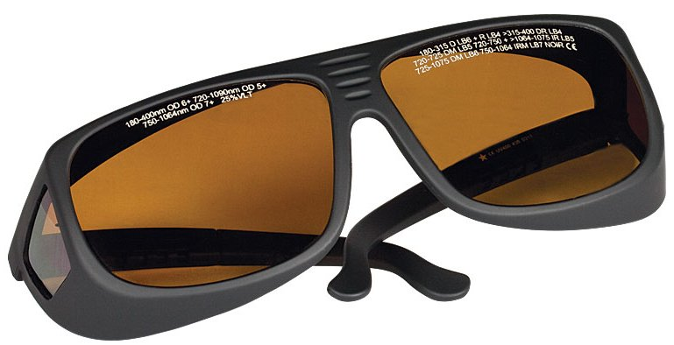
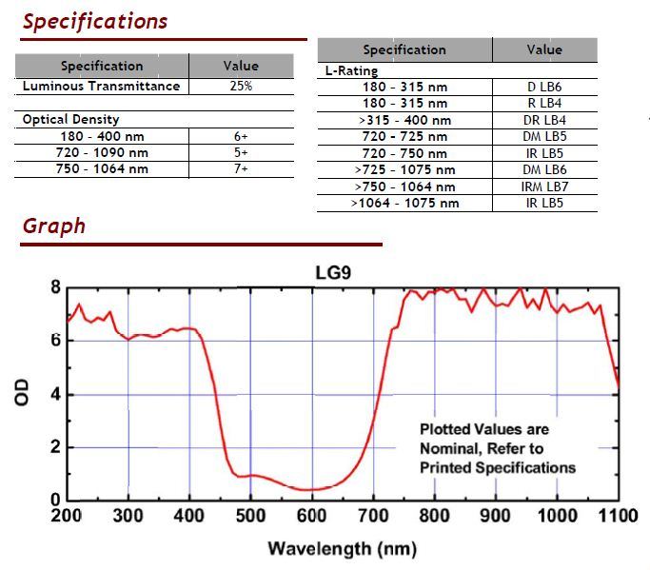
LASER SAFETY EYEWEAR SELECTION
CE marking mandatory
L or LB scale rating mandatory
Inscription (refer to EN207 standard):
e.g.:
720-725 DM LB5
720-725: Wavelength range in nm,
DM: Test condition (continuous (D) and
short pulses<1ns (M)),
LB5: Scale number (LBx since 2010).
With EN207: Eyewear are tested for minimum Optical Density but also for filter resistance to the beam power

Slide 6
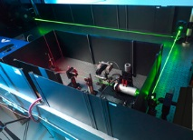
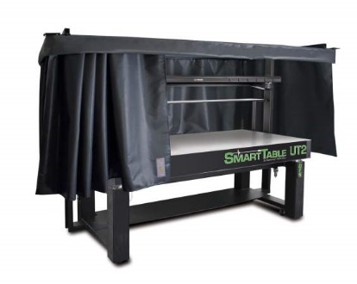
OPTICAL TABLE
Not acceptable: no beam confinement on the optical table.
High risk for people working around especially with a work station.
Multiple beam stops: requires a very good beam path and optics understanding.
Forgetting a stray beam could easily happen.
This setup should be limited to small and simple experiments.
MUCH BETTER

Slide 7
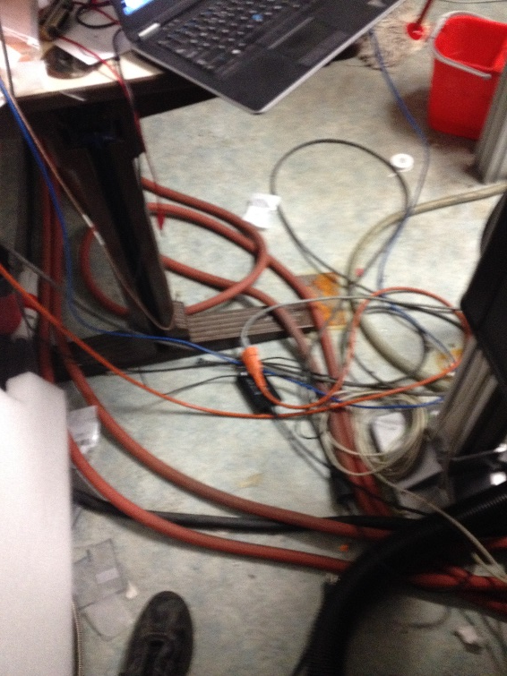
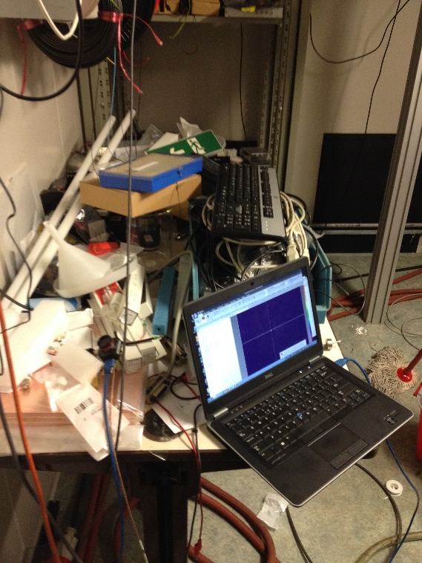
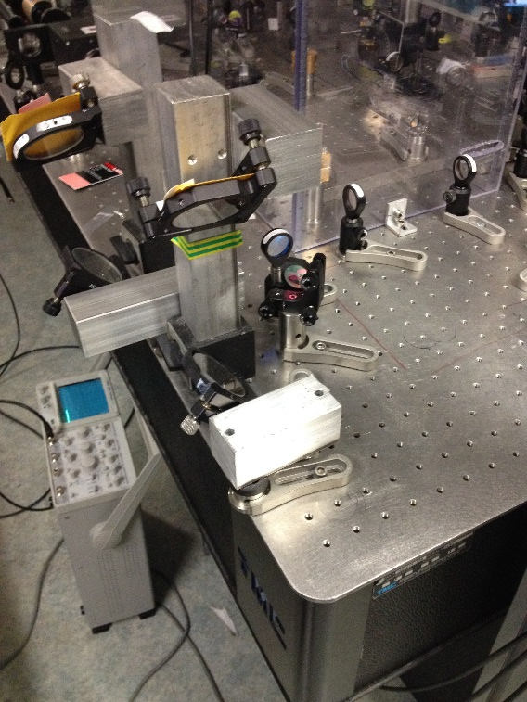
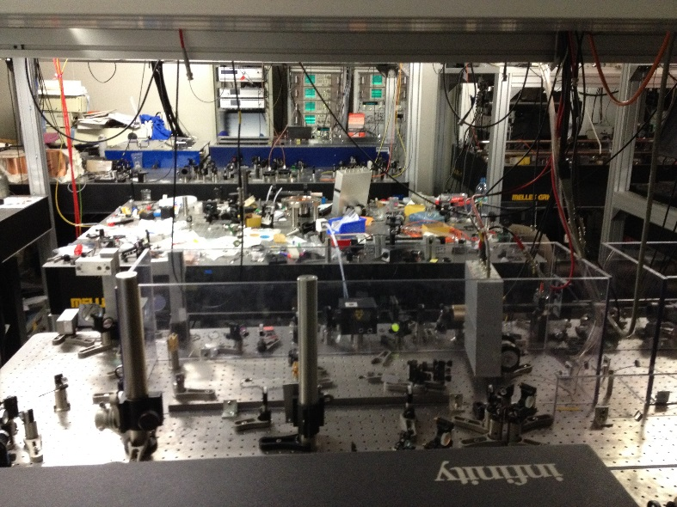
LAB SAFETY MANAGEMENT
Beam transferred to a 2nd optical table using a periscope.
No enclosure = Very high risk!
In future, the experiment will use multiple optical tables with numerous laser and wavelengths.
Some separation (optical table guarding, curtains, panels) will be necessary.
Water hoses over electrical wires:
Trip & electrical hazards!
Messy environment

Slide 8
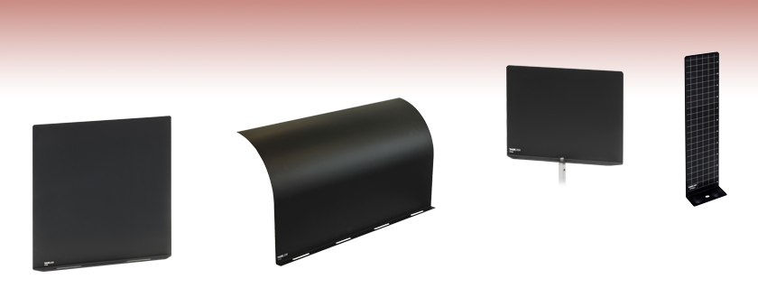

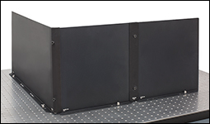

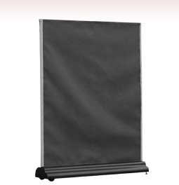

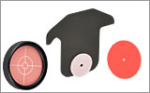
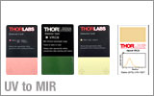
Barriers, beam blocks, black aluminium foil, alignment targets, viewing aids…

