Slide 1

STAR
Jet quenching overview
Mateusz Ploskon

Slide 2
Outline
Jet quenching and its measurements
Full jet reconstruction in heavy-ion collisions?
Recent measurements of jets at STAR/RHIC
Outlook

Slide 3
Jets in p+p and Au+Au
Au+Au Collision
Jet
parton
parton
p+p collision
Jet
We use the jets to probe the medium!
Nice idea… but there is a price to pay…

Slide 4
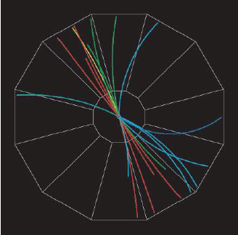
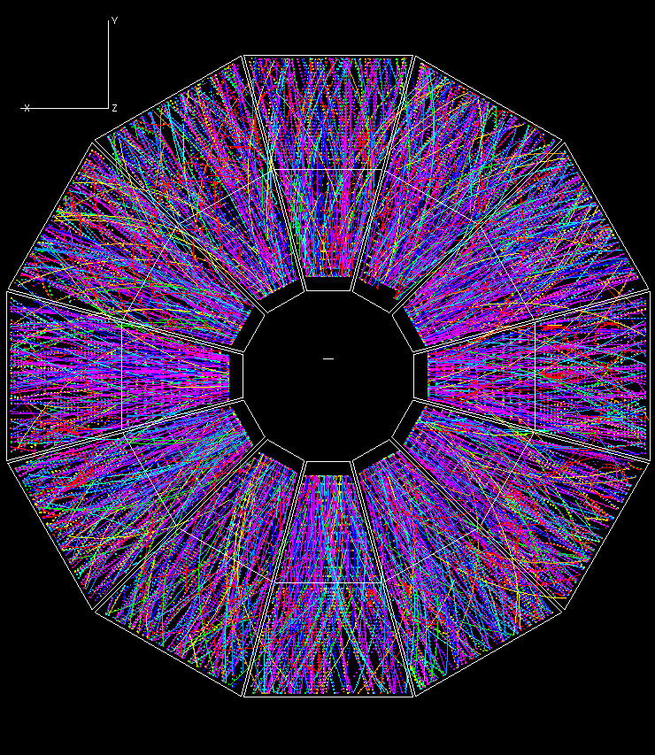
Finding jets?
p+p Collision
Au+Au Collision
xy plane
STAR TPC Event Display

Slide 5
Jet quenching observations in heavy-ion collisions at RHIC

Slide 6
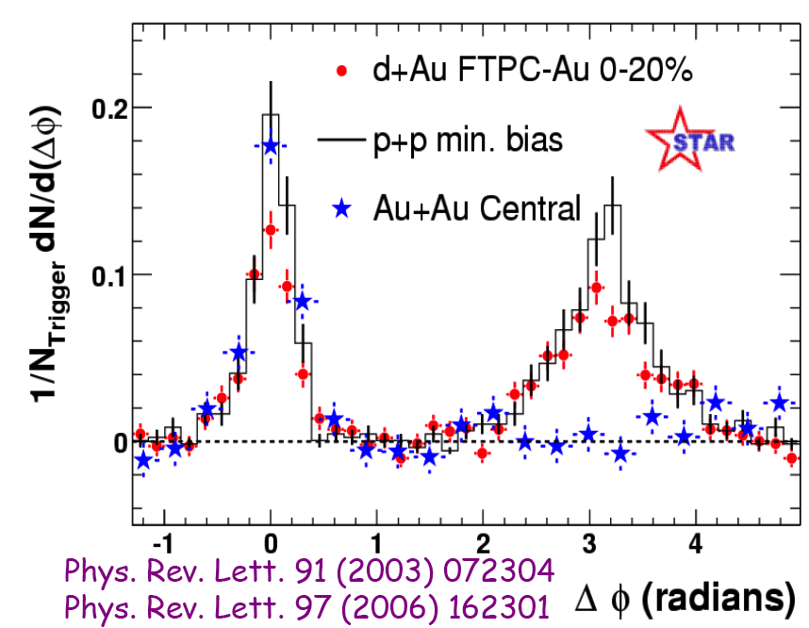
Jet quenching: recoil jet suppression via leading hadron azimuthal correlations
Leading particle
4< p_{T}^{trig} < 6 GeV/c
p_{T}^{assoc} > 2 GeV/c
Azimuthal
Correlation
~ 180 deg
Strong modification of the recoil-jet indicates
substantial partonic interaction within the medium

Slide 7
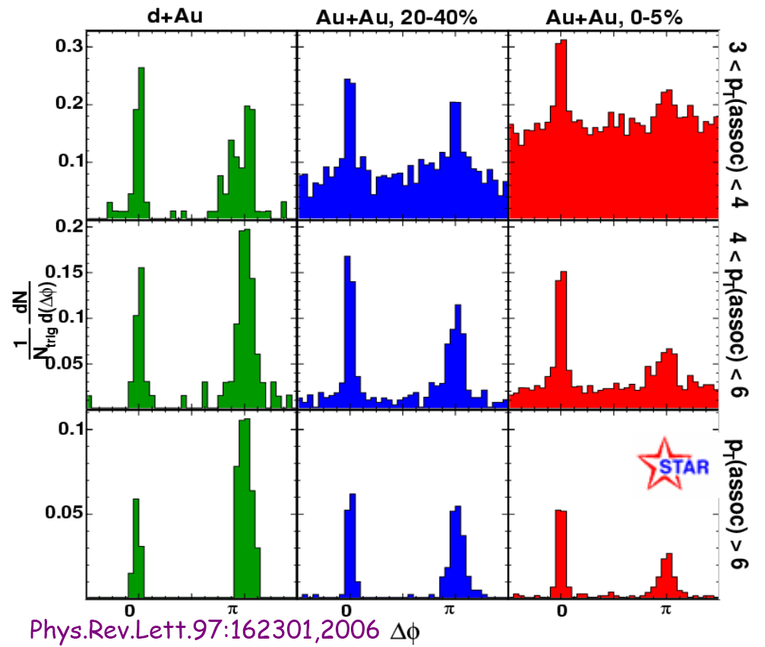
Di-hadron correlations with high-pt associated hadrons
Reaperance of the away side peak at high-assoc.-pT:
similar suppression as in the inclusive spectra
unmodified shape
Most central
Differential measurement of jets
w/o interaction
-> limitation of the LO probes
High-pT

Slide 8
From hadronic to energy flow observables
Single and di-hadron triggered observables:
  Approximate jet (axis etc.)
  Single-hadron and di-hadron observables fold production spectra with probability of partonic energy loss
    Weak constrains on energy loss (upper and lower limits only)
    Suffer from (geometrical?) bias towards non-interacting jets
Need for more differential measurements to probe partonic energy loss
Full jet reconstruction

Slide 9
Full jet reconstruction
R
Fragmentation
Hard scattering

Slide 10
Motivation and Strategy
Physics of full jet reconstruction in heavy ion collisions
R
Example: Measure energy flow into “cone” of radius R
Energy shift?
Jet
R=0.4
p+p
Absorption?
Au+Au
π⁰
Momentum conservation
Jet reconstruction: recover the full jet energy
Allow complete exploration of
  Collision geometry
  Fragmentation patterns
Compare Au+Au and p+p jet spectra
Caveat: initial state nuclear effects
Cross-section ratio AuAu/pp
Strong constrains
for quenching models
1

Slide 11
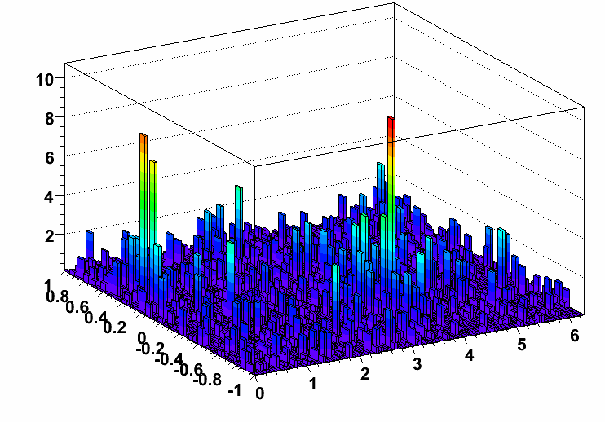
Heavy Ion collisions and background characterization
Single di-jet event from a central Au+Au (STAR):
- Two jet peaks on top of the HI background (underlying event)
Real Data
Central assumption:
Signal and background can be factorized
φ
η
φ
Main uncertainty: underlying event non-uniformities induce uncertainties on background estimation => jet energy resolution
Extra handle: utilize multiple jet algorithms and their different sensitivity to heavy-ion background.

Slide 12
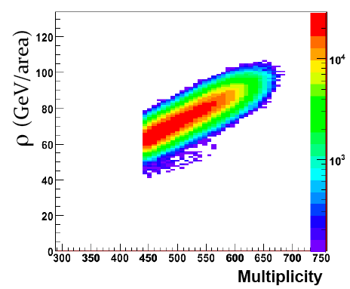
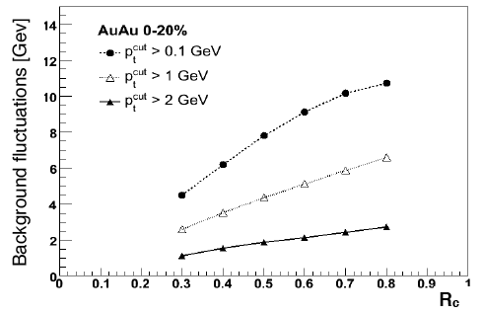
Background
Background level in central Au+Au
Single parameter sufficient to characterize the BG(?)
BG non-uniformities
-> BG level fluctuations
-> Not necessarily Gaussian

Slide 13
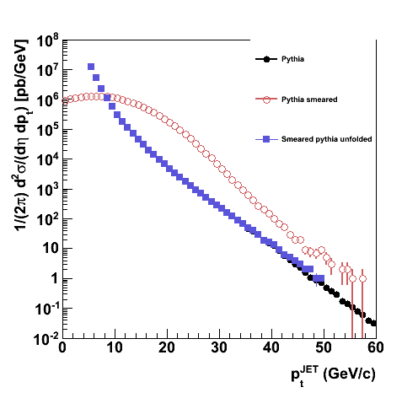
Spectrum unfolding
Background non-uniformity (fluctuations) and energy resolution introduce pT-smearing
Correct via “unfolding”: inversion of full bin-migration matrix
Check numerical stability of procedure using jet spectrum shape from PYTHIA
Pythia
Pythia smeared
Pythia unfolded
unfolding
Procedure is numerically stable
Correction depends critically on background model
        → main systematic uncertainty for Au+Au

Slide 14
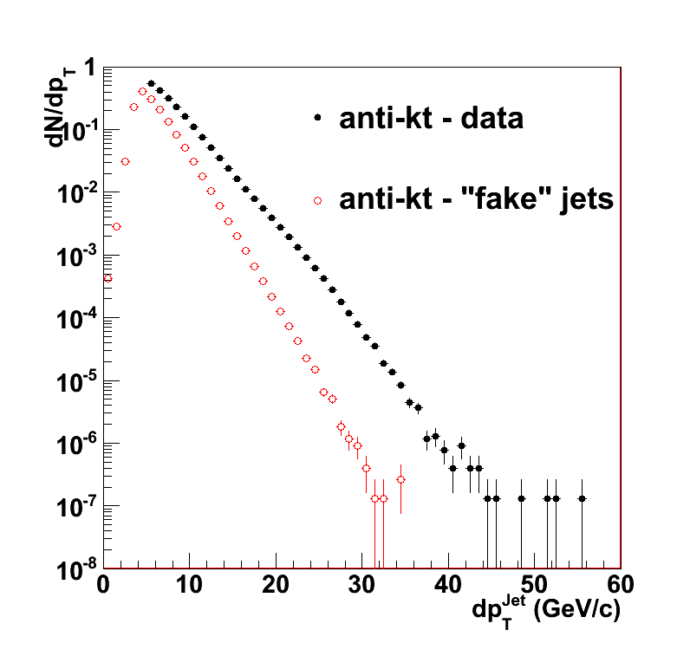
Fake jet contamination/STAR
“Fake” jets: signal in excess of background model from random association of uncorrelated soft particles (i.e. not due to hard scattering)
“Fake” jet rate estimation:
Central Au+Au dataset (real data)
Randomize azimuth of each charged particle and calorimeter tower
Run jet finder
Remove leading particle from each found jet
Re-run jet finder
STAR Preliminary

Slide 15
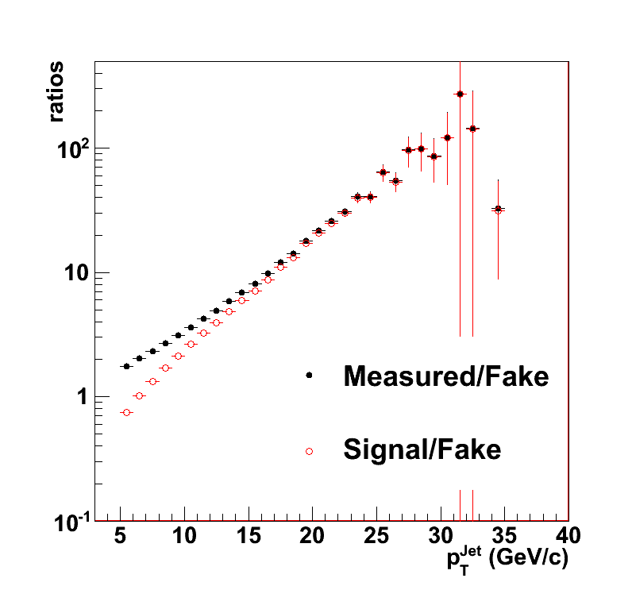
Fake jet contamination/STAR
“Fake” jets: signal in excess of background model from random association of uncorrelated soft particles (i.e. not due to hard scattering)
“Fake” jet rate estimation:
Central Au+Au dataset (real data)
Randomize azimuth of each charged particle and calorimeter tower
Run jet finder
Remove leading particle from each found jet
Re-run jet finder
STAR Preliminary

Slide 16
Systematic corrections
Trigger corrections:
  p+p trigger bias correction
  p+p Jet patch trigger efficiency
Particle level corrections:
  Detector effects: efficiency and pT resolution
  “Double* counting” of particle energies
    * electrons: - double; hadrons: - showering corrections
    All towers matched to primary tracks are removed from the analysis
Jet level corrections:
    Spectrum shift:
      Unobserved energy
      TPC tracking efficiency
    BEMC calibration (dominant uncertainty in p+p)
    Jet pT resolution
    Underlying event (dominant uncertainty in Au+Au)
Full assessment of jet energy scale uncertainties
Data driven correction scheme
Weak model dependence: only for single-particle response, p+p trigger response
No dependence on quenching models

Slide 17
Systematic corrections
p+p trigger (coincidence) biases recorded jet population – jet Et dependent correction
Offline vertex cuts -> x-section calculation
Reaction trigger influencing jet spectra
Trigger corrections:
  p+p trigger bias correction
  p+p Jet patch trigger efficiency
Particle level corrections:
  Detector effects: efficiency and pT resolution
  “Double* counting” of particle energies
    * electrons: - double; hadrons: - showering corrections
    All towers matched to primary tracks are removed from the analysis
Jet level corrections:
    Spectrum shift:
      Unobserved energy
      TPC tracking efficiency
    BEMC calibration (dominant uncertainty in p+p)
    Jet pT resolution
    Underlying event (dominant uncertainty in Au+Au)
Full assessment of jet energy scale uncertainties
Data driven correction scheme
Weak model dependence: only for single-particle response, p+p trigger response
No dependence on quenching models

Slide 18
Systematic corrections
Jet patch trigger efficiency:
Patch 1x1 (in pseudo-rap. and azimuth) requesting ~7.5 GeV neutral energy (p+p only)
Large bias at low jet-pt (x2 at 20 GeV/c), but persists up to 30 GeV/c
Trigger corrections:
  p+p trigger bias correction
  p+p Jet patch trigger efficiency
Particle level corrections:
  Detector effects: efficiency and pT resolution
  “Double* counting” of particle energies
    * electrons: - double; hadrons: - showering corrections
    All towers matched to primary tracks are removed from the analysis
Jet level corrections:
    Spectrum shift:
      Unobserved energy
      TPC tracking efficiency
    BEMC calibration (dominant uncertainty in p+p)
    Jet pT resolution
    Underlying event (dominant uncertainty in Au+Au)
Full assessment of jet energy scale uncertainties
Data driven correction scheme
Weak model dependence: only for single-particle response, p+p trigger response
No dependence on quenching models

Slide 19
Systematic corrections
Relevant constant for EMCAL (response of calorimeter)
Dead/hot tower corrections/removal
High-pt track quality/applicability
Trigger corrections:
  p+p trigger bias correction
  p+p Jet patch trigger efficiency
Particle level corrections:
  Detector effects: efficiency and pT resolution
  “Double* counting” of particle energies
    * electrons: - double; hadrons: - showering corrections
    All towers matched to primary tracks are removed from the analysis
Jet level corrections:
    Spectrum shift:
      Unobserved energy
      TPC tracking efficiency
    BEMC calibration (dominant uncertainty in p+p)
    Jet pT resolution
    Underlying event (dominant uncertainty in Au+Au)
Full assessment of jet energy scale uncertainties
Data driven correction scheme
Weak model dependence: only for single-particle response, p+p trigger response
No dependence on quenching models
Calculate jet neutral energy fraction
(NEF)
and apply pT corrections according to the fraction of carried jet energy by charge particles
- Different efficiencies in p+p and Au+Au

Slide 20
Systematic corrections
Trigger corrections:
  p+p trigger bias correction
  p+p Jet patch trigger efficiency
Particle level corrections:
  Detector effects: efficiency and pT resolution
  “Double* counting” of particle energies
    * electrons: - double; hadrons: - showering corrections
    All towers matched to primary tracks are removed from the analysis
Jet level corrections:
    Spectrum shift:
      Unobserved energy
      TPC tracking efficiency
    BEMC calibration (dominant uncertainty in p+p)
    Jet pT resolution
    Underlying event (dominant uncertainty in Au+Au)
Full assessment of jet energy scale uncertainties
Data driven correction scheme
Weak model dependence: only for single-particle response, p+p trigger response
No dependence on quenching models
Several possibilities:
MIP, constant E-fraction, complete removal of the “matched energy”
Minimize the effect.

Slide 21
Systematic corrections
Trigger corrections:
  p+p trigger bias correction
  p+p Jet patch trigger efficiency
Particle level corrections:
  Detector effects: efficiency and pT resolution
  “Double* counting” of particle energies
    * electrons: - double; hadrons: - showering corrections
    All towers matched to primary tracks are removed from the analysis
Jet level corrections:
    Spectrum shift:
      Unobserved energy
      TPC tracking efficiency
    BEMC calibration (dominant uncertainty in p+p)
    Jet pT resolution
    Underlying event (dominant uncertainty in Au+Au)
Full assessment of jet energy scale uncertainties
Data driven correction scheme
Weak model dependence: only for single-particle response, p+p trigger response
No dependence on quenching models
Energy scale correction -> “Shift”
Estimate the unobserved jet energy and apply “average” correction
#neutron ~ #proton (?)

Slide 22
Systematic corrections
Trigger corrections:
  p+p trigger bias correction
  p+p Jet patch trigger efficiency
Particle level corrections:
  Detector effects: efficiency and pT resolution
  “Double* counting” of particle energies
    * electrons: - double; hadrons: - showering corrections
    All towers matched to primary tracks are removed from the analysis
Jet level corrections:
    Spectrum shift:
      Unobserved energy
      TPC tracking efficiency
    BEMC calibration (dominant uncertainty in p+p)
    Jet pT resolution
    Underlying event (dominant uncertainty in Au+Au)
Full assessment of jet energy scale uncertainties
Data driven correction scheme
Weak model dependence: only for single-particle response, p+p trigger response
No dependence on quenching models
Energy scale correction -> “Shift”
TPC inefficiencies – averaged correction

Slide 23
Systematic corrections
Trigger corrections:
  p+p trigger bias correction
  p+p Jet patch trigger efficiency
Particle level corrections:
  Detector effects: efficiency and pT resolution
  “Double* counting” of particle energies
    * electrons: - double; hadrons: - showering corrections
    All towers matched to primary tracks are removed from the analysis
Jet level corrections:
    Spectrum shift:
      Unobserved energy
      TPC tracking efficiency
    BEMC calibration (dominant uncertainty in p+p)
    Jet pT resolution
    Underlying event (dominant uncertainty in Au+Au)
Full assessment of jet energy scale uncertainties
Data driven correction scheme
Weak model dependence: only for single-particle response, p+p trigger response
No dependence on quenching models
5% uncertainty on calibration translates to large uncertainty on x-section!
Ongoing very active work to reduce it.

Slide 24
Systematic corrections
Trigger corrections:
  p+p trigger bias correction
  p+p Jet patch trigger efficiency
Particle level corrections:
  Detector effects: efficiency and pT resolution
  “Double* counting” of particle energies
    * electrons: - double; hadrons: - showering corrections
    All towers matched to primary tracks are removed from the analysis
Jet level corrections:
    Spectrum shift:
      Unobserved energy
      TPC tracking efficiency
    BEMC calibration (dominant uncertainty in p+p)
    Jet pT resolution
    Underlying event (dominant uncertainty in Au+Au)
Full assessment of jet energy scale uncertainties
Data driven correction scheme
Weak model dependence: only for single-particle response, p+p trigger response
No dependence on quenching models
Studies with di-jets in p+p (benchmarked with Pythia detector/particle jets)
- Correction by unfolding

Slide 25
Systematic corrections
Trigger corrections:
  p+p trigger bias correction
  p+p Jet patch trigger efficiency
Particle level corrections:
  Detector effects: efficiency and pT resolution
  “Double* counting” of particle energies
    * electrons: - double; hadrons: - showering corrections
    All towers matched to primary tracks are removed from the analysis
Jet level corrections:
    Spectrum shift:
      Unobserved energy
      TPC tracking efficiency
    BEMC calibration (dominant uncertainty in p+p)
    Jet pT resolution
    Underlying event (dominant uncertainty in Au+Au)
Full assessment of jet energy scale uncertainties
Data driven correction scheme
Weak model dependence: only for single-particle response, p+p trigger response
No dependence on quenching models
Background subtraction -> smearing – correction by unfolding

Slide 26
Systematic corrections
Trigger corrections:
  p+p trigger bias correction
  p+p Jet patch trigger efficiency
Particle level corrections:
  Detector effects: efficiency and pT resolution
  “Double* counting” of particle energies
    * electrons: - double; hadrons: - showering corrections
    All towers matched to primary tracks are removed from the analysis
Jet level corrections:
    Spectrum shift:
      Unobserved energy
      TPC tracking efficiency
    BEMC calibration (dominant uncertainty in p+p)
    Jet pT resolution
    Underlying event (dominant uncertainty in Au+Au)
Full assessment of jet energy scale uncertainties
Data driven correction scheme
Weak model dependence: only for single-particle response, p+p trigger response
No dependence on quenching models

Slide 27
What is a “jet” in HI collisions?

Slide 28


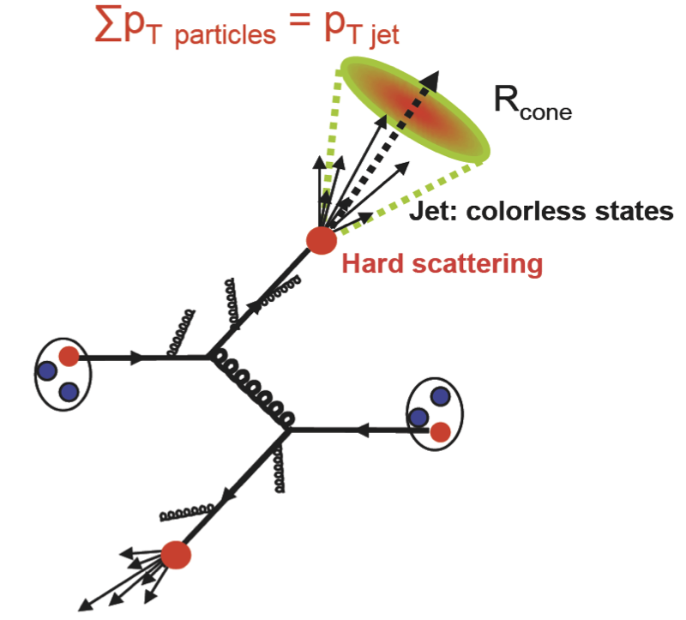
What is a jet?
A spray of collimated showers/particles
  - Hardly ever better defined...
  Direct indication of fragmenting parton
  Good assumption: approximate parton/jet energy by reconstructing energy of individual particles/constituents
  Jets (unlike single hadrons) are objects which are “better” understood/calculable within pQCD
S.D Drell, D.J.Levy and T.M. Yan, Phys. Rev. 187, 2159 (1969)‏
N. Cabibbo, G. Parisi and M. Testa, Lett. Nuovo Cimento 4,35 (1970)‏
J.D. Bjorken and S.D. Brodsky, Phys. Rev. D 1, 1416 (1970)‏
Sterman and Weinberg, Phys. Rev. Lett. 39, 1436 (1977) ...

Slide 29
What is a jet in HI Collision?
Measure A: vacuum fragmentation
Measure B: vacuum fragmentation
+ medium induced radiation
Unmodified fragmentation?
Loss of yield ⬄ energy deficit
Modified “fragmentation” pattern?
No loss of yield ⬄ full jet energy?

Slide 30
“Finding” jets
Particles {p_{i}}
Jets {j_{k}}

Slide 31
“Finding” jets
Recombination scheme
Algorithm
Resolution parameter
Jet definition
Particles {p_{i}}
Jets {j_{k}}

Slide 32
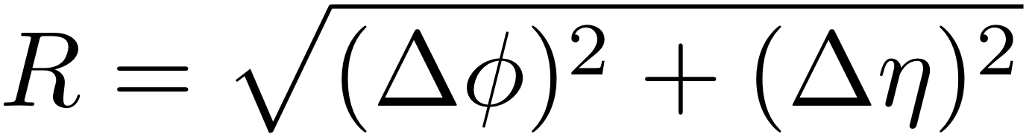
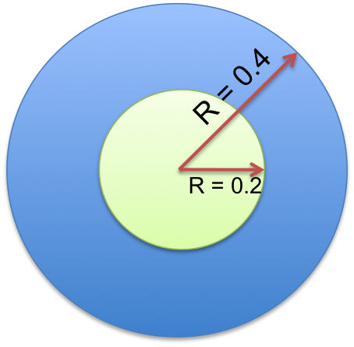
Jet algorithms
Anti-k_{t} expected to be less susceptible to background effects in heavy ion collisions
R
Sequential
recombination
algorithms
Cone based
algorithms
Fragmentation
K_{T} jet
anti-kT jet
Hard scattering
Algorithms: k_{t} and anti-k_{t} from FastJet*
  Resolution parameter R = 0.4, 0.2
  Jet acceptance: |η^{JET}| < 1.-R
  Recombination scheme: E-scheme with massless particles
*Cacciari, Salam and Soyez, JHEP 0804 (2008) 005 [arXiv:0802.1188]

Slide 33
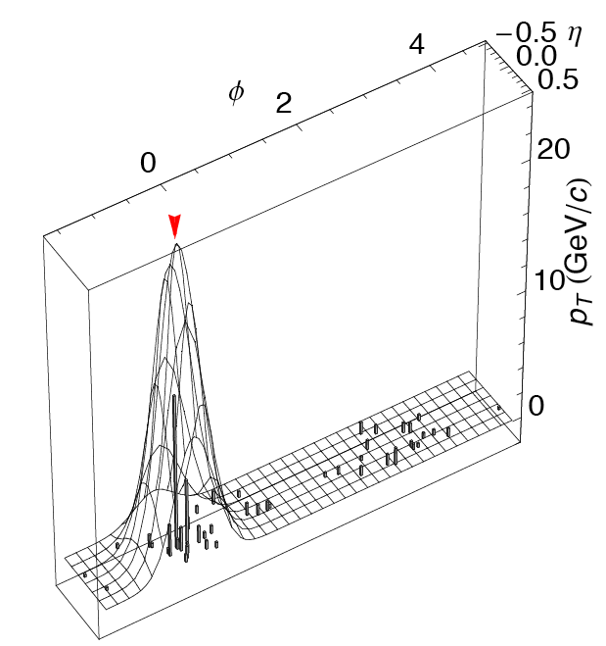
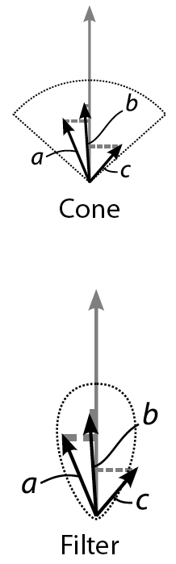
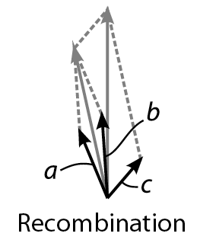
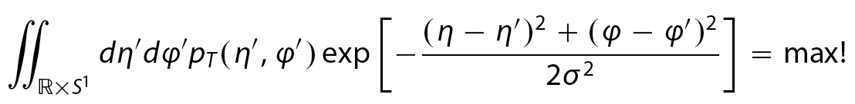
Jet algorithms
Results from STAR
Yui Shi Lai, arXiv:0806.1499, QM 2009
Seedless, infrared and collinear safe
Optimizes S/B (focus on the “core” of the jet)
Robust against background
Results from PHENIX

Slide 34
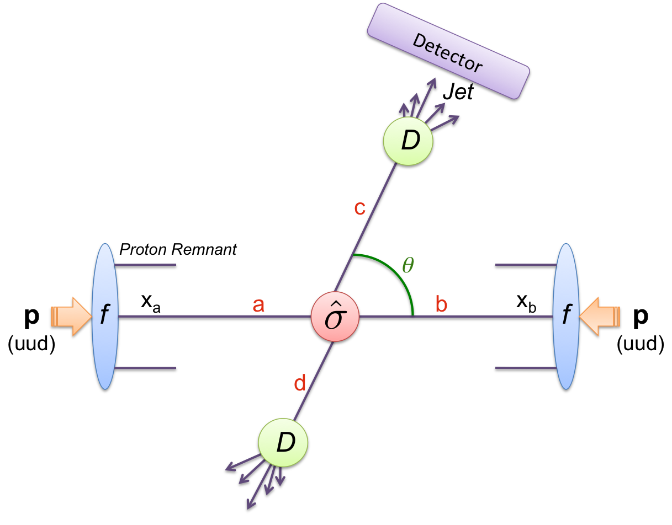
Jet measurements at RHIC

Slide 35
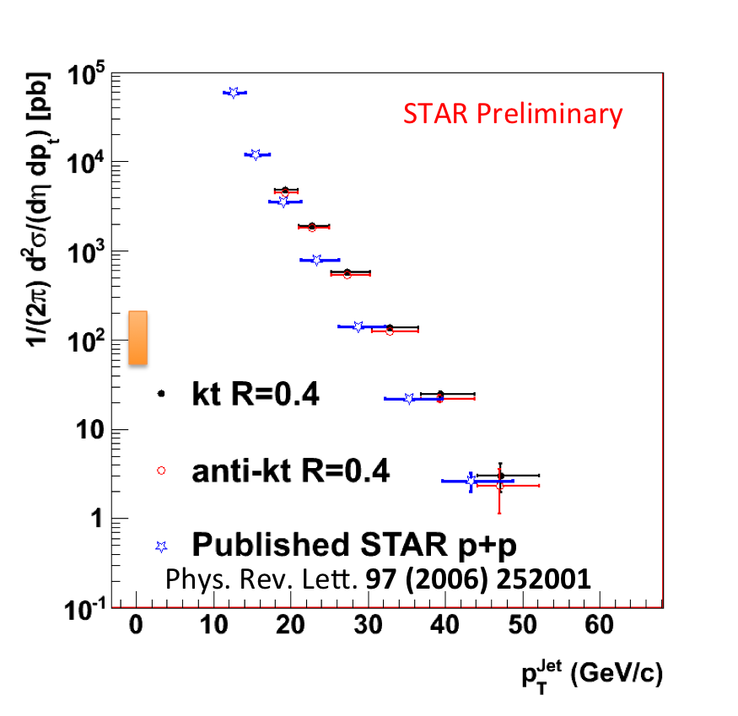
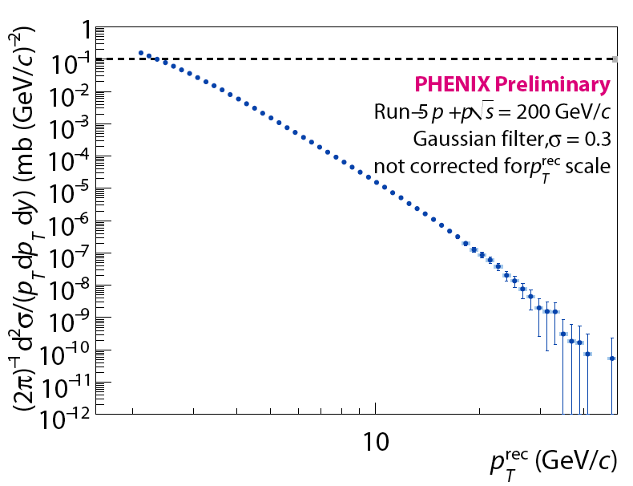
Inclusive jet cross-section in p+p at sqrt(s_{NN}) = 200 GeV – new algorithms

Slide 36
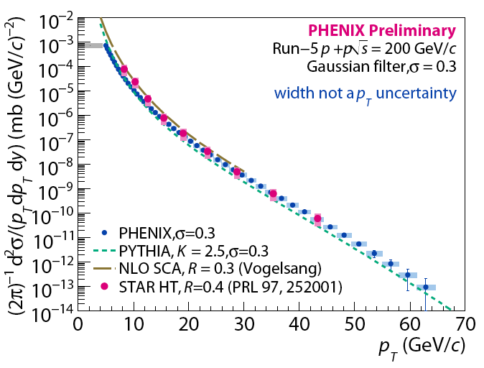
Inclusive jet cross-section in p+p at sqrt(s_{NN}) = 200 GeV – new algorithms

Slide 37
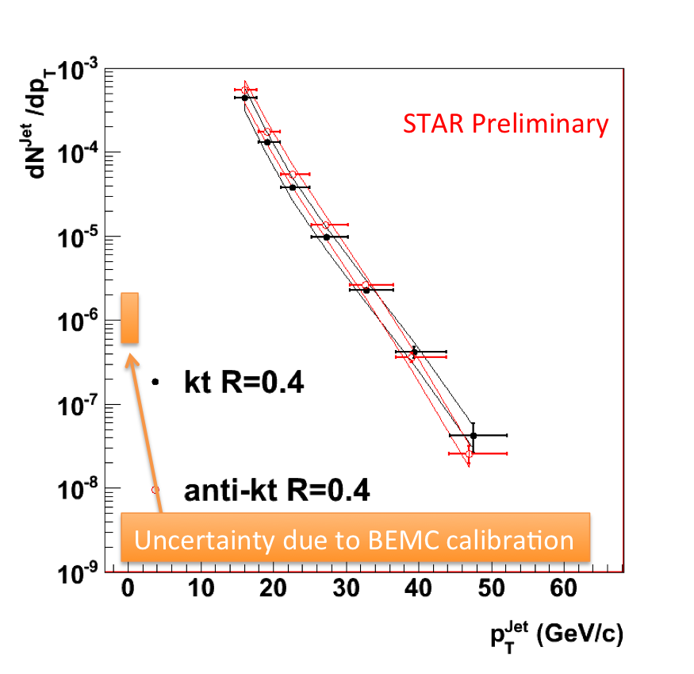
Jet yields in heavy-ion collisions:
Central Au+Au sqrt(s_{NN}) = 200 GeV
Fully corrected jet spectrum
Exactly the same algorithms and jet definitions used as compared to p+p
Bands on data points represent estimation of systematic uncertainties due to background subtraction
Au+Au @ sqrt(s_{NN})=200GeV/c
10% most central

Slide 38
“R” systematics

Slide 39
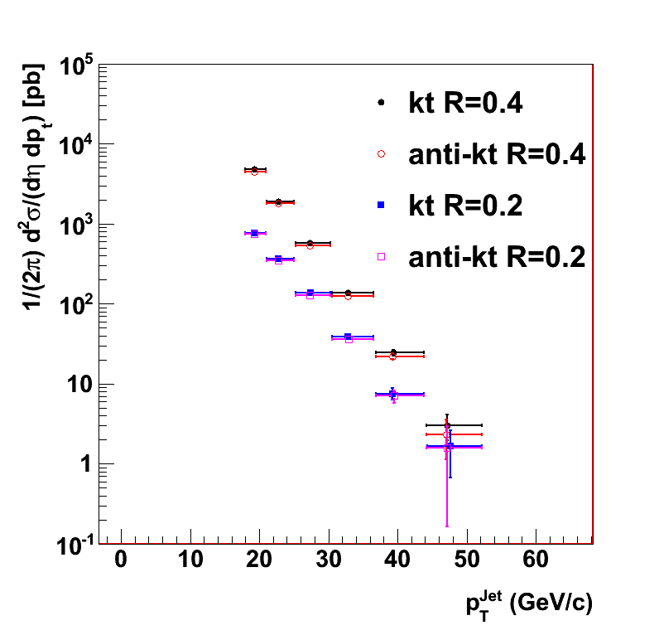
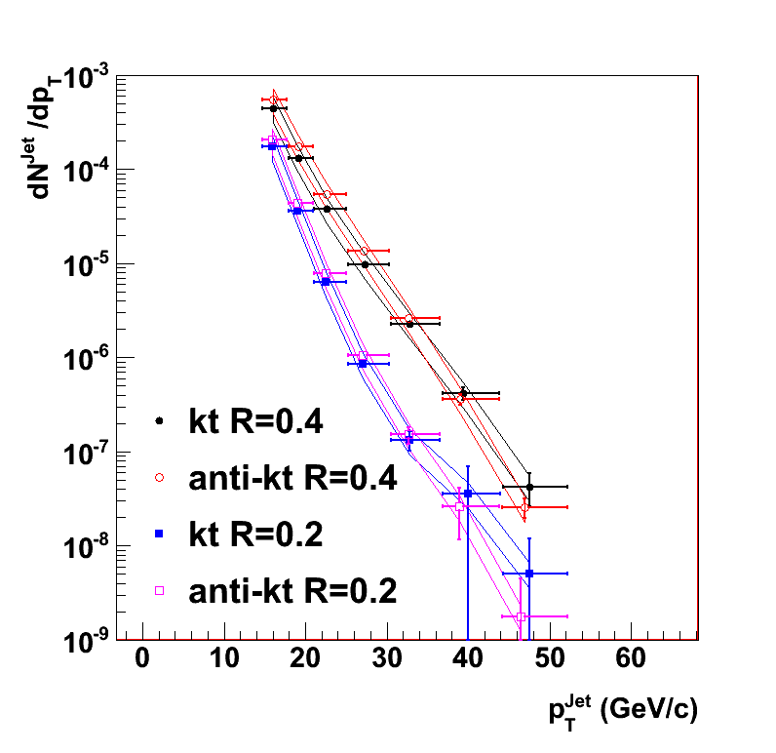
Inclusive jet spectrum: p+p and central Au+Au (R=0.4 and R=0.2)
p+p
Au+Au central
STAR Preliminary
STAR Preliminary

Slide 40
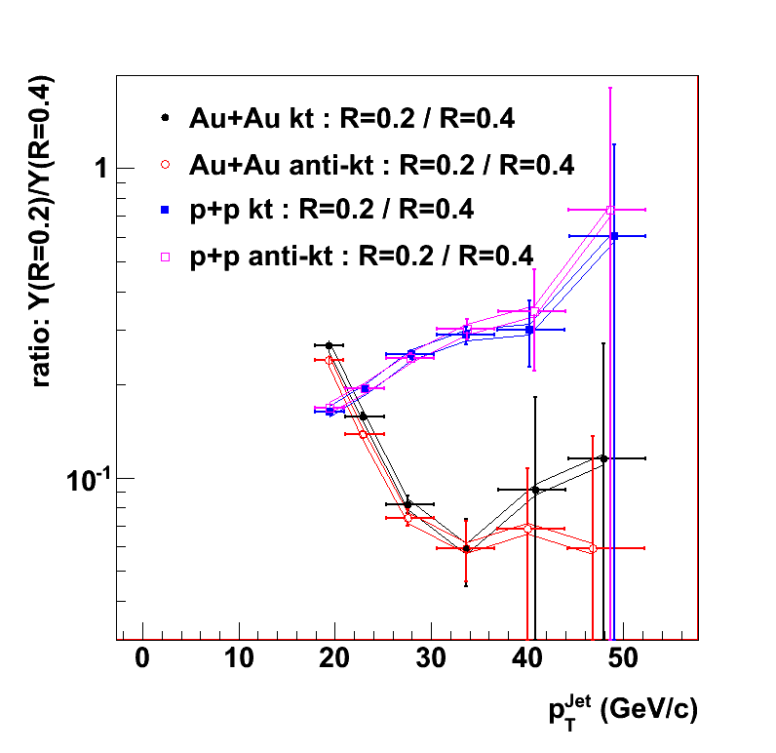
Cross-section ratios in p+p and Au+ Au with R=0.2/R=0.4
Many systematic effects cancel in the ratio
p+p
Au+Au
STAR Preliminary
p+p: “Narrowing” of the jet structure with increasing jet energy
Au+Au: Strong broadening of the jet energy profile

Slide 41
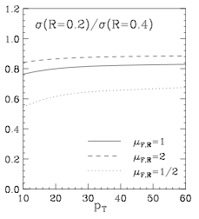
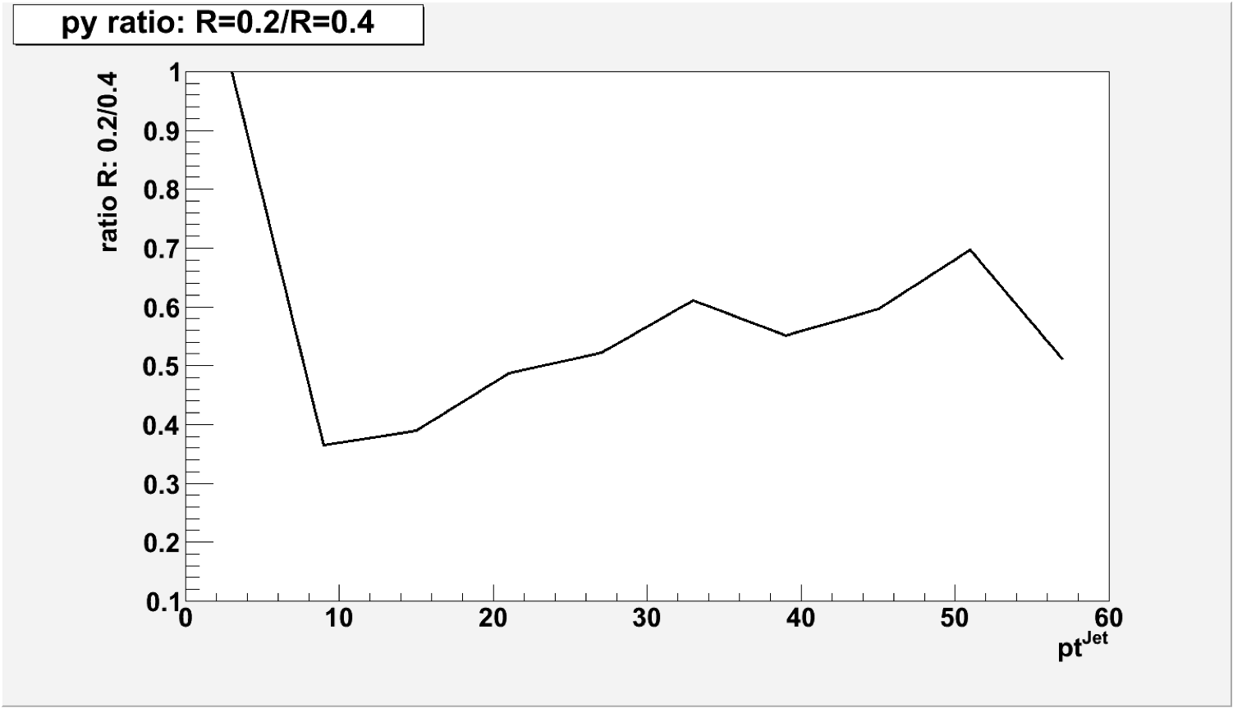
Ratio R=0.2/R=0.4 in pp @ sqrt(s)=200 GeV/c
Pythia – detector level – anti-kt
Corrected for underlying event
NLO Calculation
Simultation
W. Vogelsang
D. De Florian ⬄ Ratio is FLAT!
Private comm.
Ratio much smaller with strong tend

Slide 42
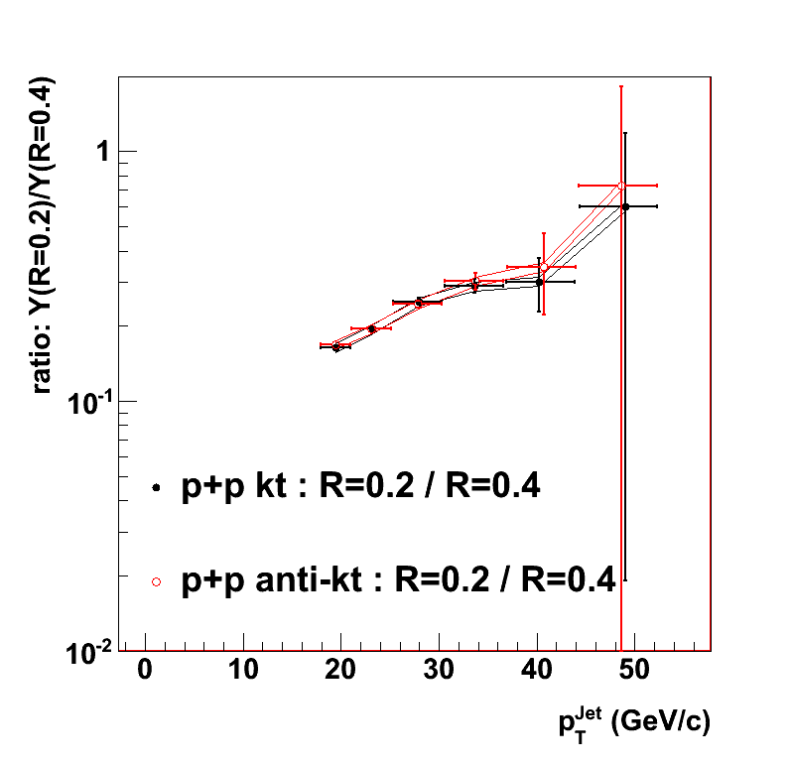
Ratio R=0.2/R=0.4 in pp @ sqrt(s)=200 GeV/c
STAR Preliminary Data
Pythia
NLO Calculation
W. Vogelsang
D. De Florian ⬄ Ratio is FLAT!
Private comm.
Ratio much smaller with strong tend

Slide 43
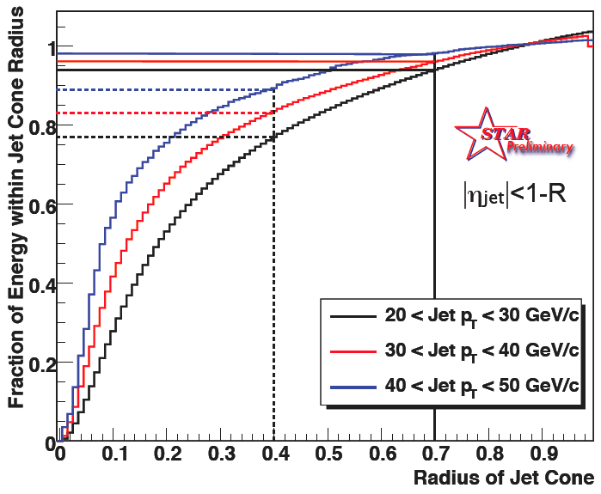
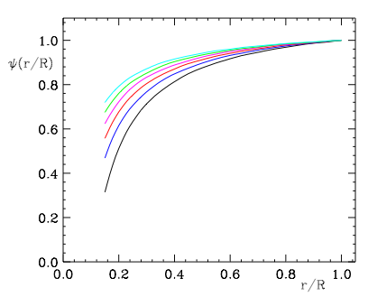
Jet shapes at RHIC and Tevatron
Tevatron
NLO
W. Vogelsang
D. De Florian
Private comm.
The curves are from bottom to top for pt=40,80,130,190,260,360 GeV.

Slide 44
Jet R_{AA}
Cross-section ratio AuAu/pp
1

Slide 45
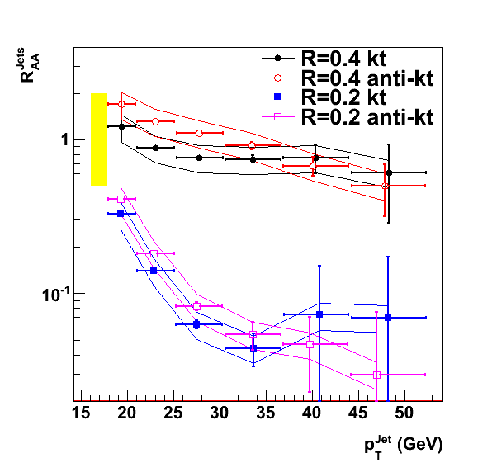
R_{AA} Jets and Energy flow in smaller “cone” radii
R=0.4
R_{AA}: yield per
binary NN
collision
STAR Preliminary
R=0.2
Significant drop of R_{AA} as a function of jet p_{T} for R=0.2 as compared to R=0.4
Jet energy not fully recovered in small “cones” – shift towards lower p_{T}

Slide 46
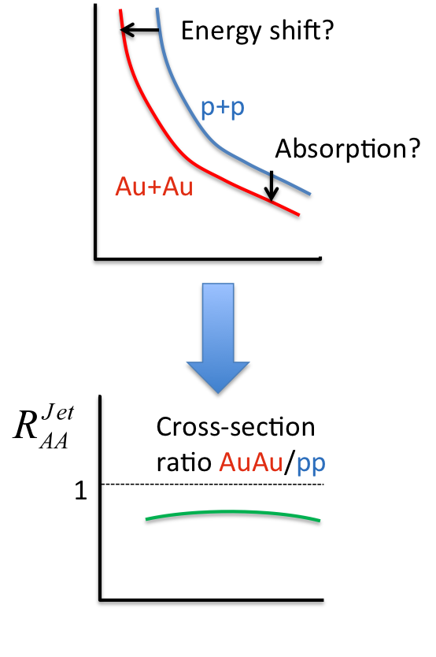
R_{AA} Jets and Energy flow in smaller “cone” radii
For a fixed R:
R=0.4
R_{AA}: yield per
binary NN
collision
STAR Preliminary
R=0.2
Significant drop of R_{AA} as a function of jet p_{T} for R=0.2 as compared to R=0.4
Jet energy not fully recovered in small “cones” – shift towards lower p_{T}

Slide 47
Jet fragmentation patterns
R
Fragmentation
Hard scattering

Slide 48
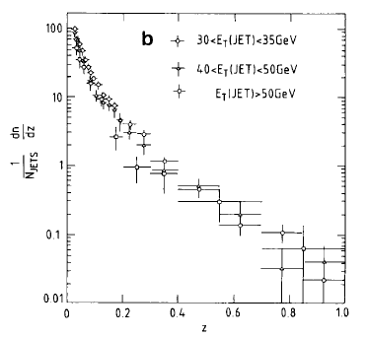

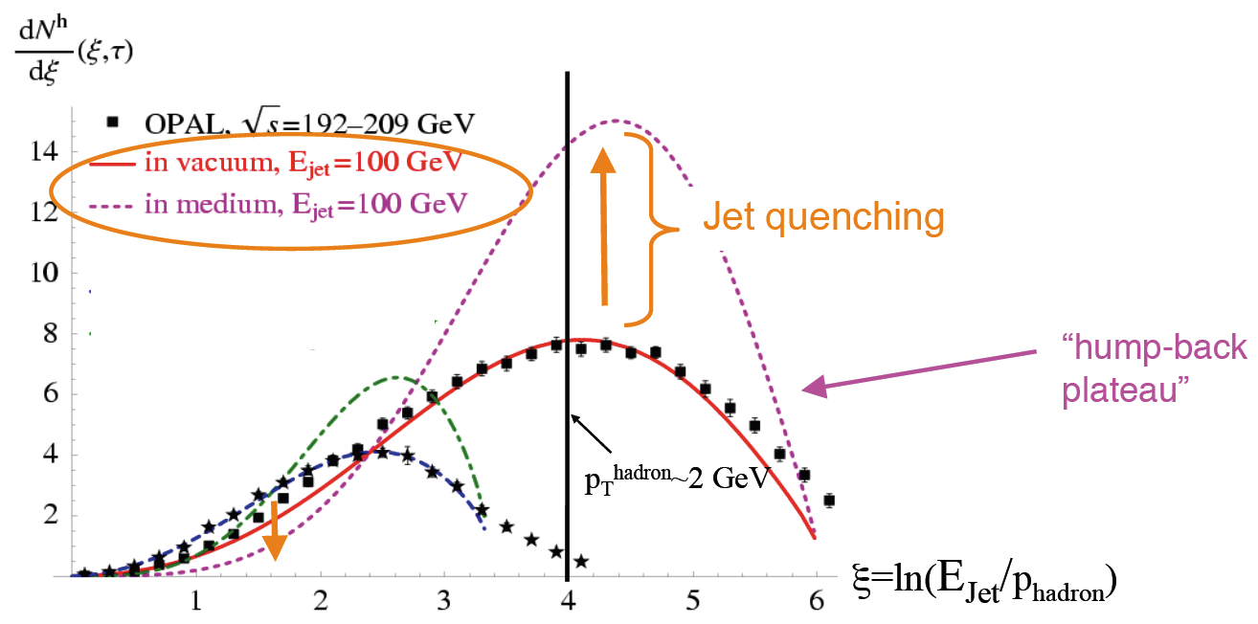
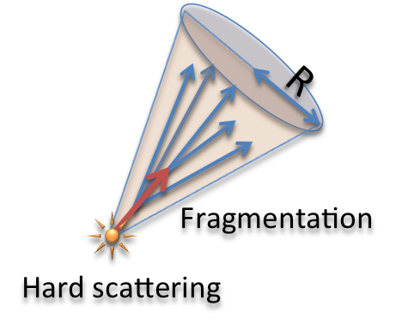

Fragmentation pattern - measurement
Fraction of jet energy carried
by each constituent
arXiv:0806.0305v1 [hep-ph]
CERN SPS
ppbar at sqrt(s) = 540 GeV
T. Renk
CERN LEP

Slide 49
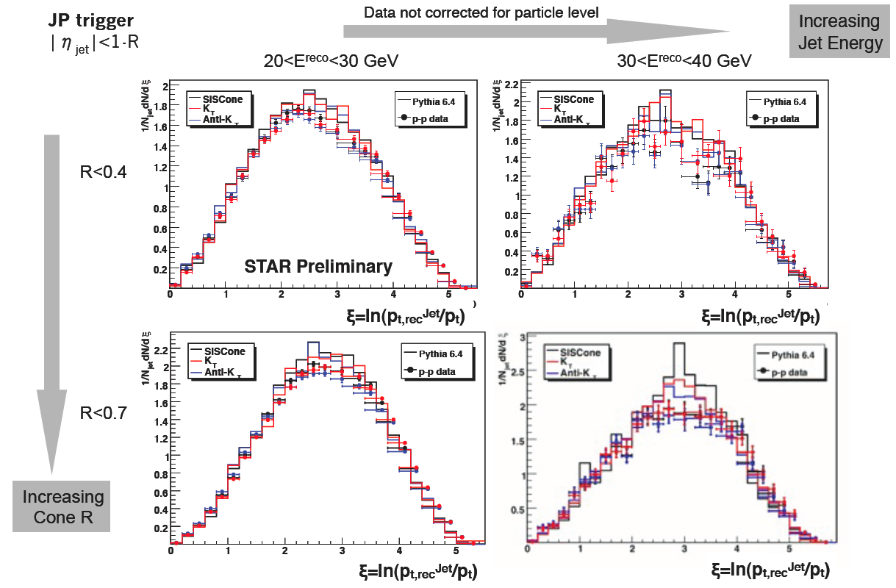
Fragmentation Reference: p+p
Increasing
Jet Energy
Increasing
“Cone” R
Good agreement between measurements at RHIC and PYTHIA

Slide 50
Further observables
Jet shapes
Intra-jet distributions
3-jet observables
…

Slide 51
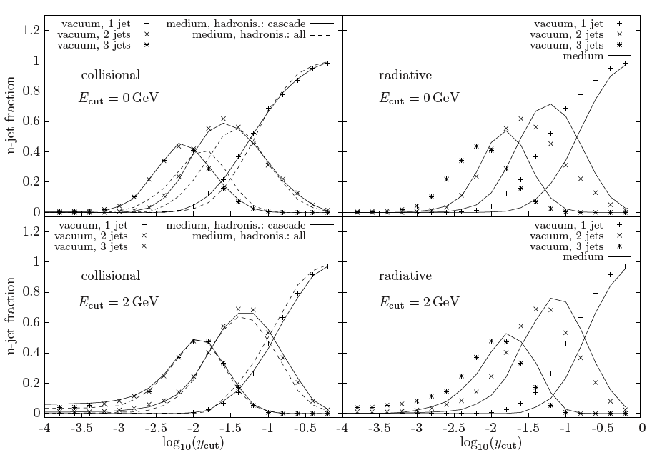
Subjets
Count sub-jets when y_{ij} > y_{cut} :
JEWEL – MC
model of quenching
Subjet distributions:
+ Insensitive to hadronization
+ Quenching signal with bg suppressing pt cut
Suffer from energy irresolutions:
  where
C. Zapp et al.
arXiv:0804.3568 [hep-ph]

Slide 52
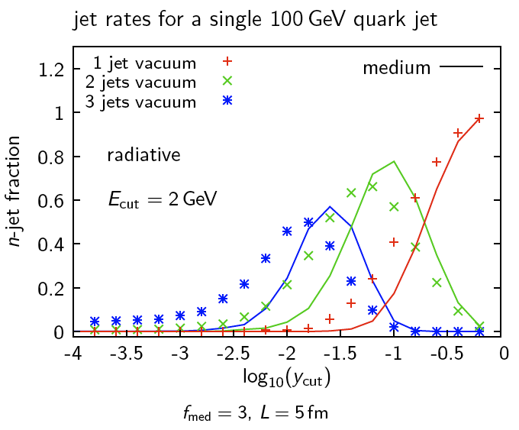
Subjets
Count sub-jets when y_{ij} > y_{cut} :
Subjet distributions:
+ Insensitive to hadronization
+ Quenching signal with bg suppressing pt cut
Suffer from energy irresolutions:
  where
JEWEL – MC
model of quenching
C. Zapp et al.
arXiv:0804.3568 [hep-ph]

Slide 53
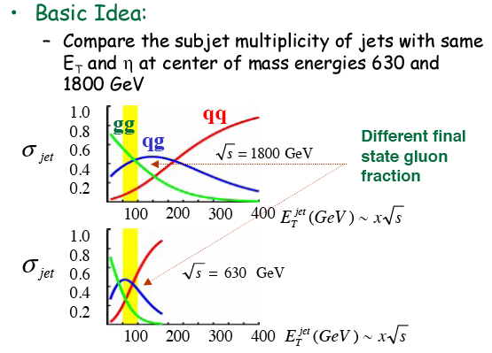
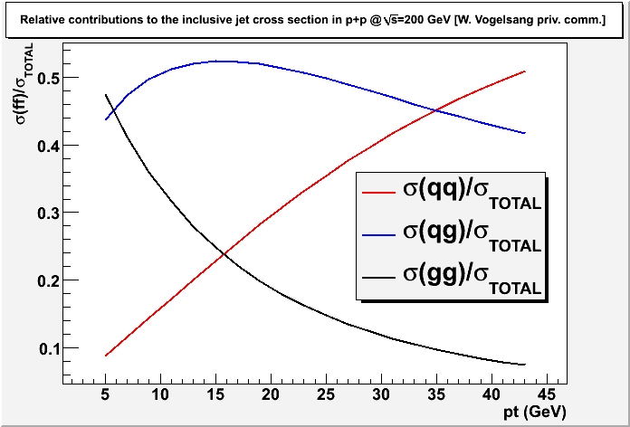
Subjets at Tevatron(D0)
Reclustering (re-run of a kt algor) on a jet -> recombination into n-subjets separated by y_{min} cut -> used for q-g jet discrimination
Vogelsang: pp @ 200 GeV
RHIC
RHIC will measure pp@500 GeV
LHC?

Slide 54
Summary
HI collisions create dense, hot colored medium, opaque to energetic partons
Hadronic observables provide limited constrains for understanding of the partonic energy loss -> need for full jet reconstruction:
Full jet reconstruction:
  Qualitatively new tool for assessment of the jet quenching in terms of energy flow (rather than hadronic observables)
  Precision of the background estimation - crucial in AA
  HI: Significant radiation “outside” R=0.4
  Broadening of jet energy profile?
  “Detailed” studies of jet-medium interactions possible?

Slide 55
Outlook
Full jet reconstruction at LHC:
  Algorithms developed for pileup removal at LHC applicable to HI collisions
  New algorithms being defined and explored
  Pioneering analyses at RHIC provide tools and analysis techniques directly applicable at LHC
  Many data driven corrections already found and explored

Slide 56
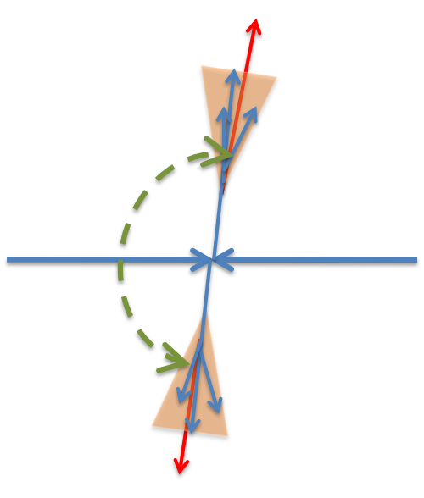
Di-Jet measurements

Slide 57
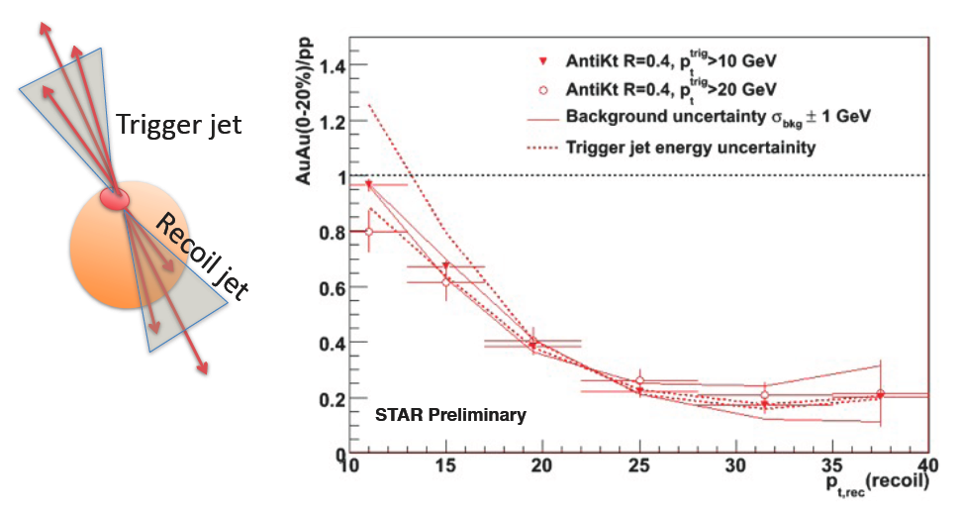
Di-jets in Au+Au
Trigger selection -> Biased population:
Significant suppression of recoil jet spectrum
Comparable to single particle R_{AA}

Slide 58
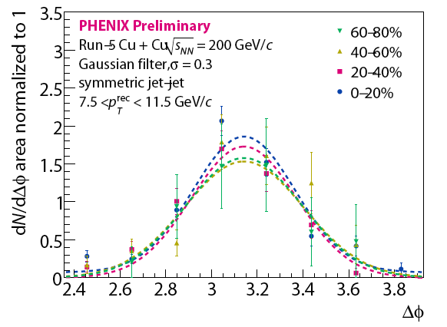
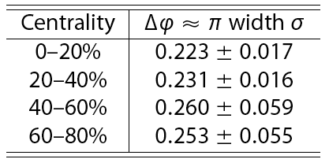
Di-jets in Cu+Cu
No centrality dependent
broadening within uncertainties!

Slide 59
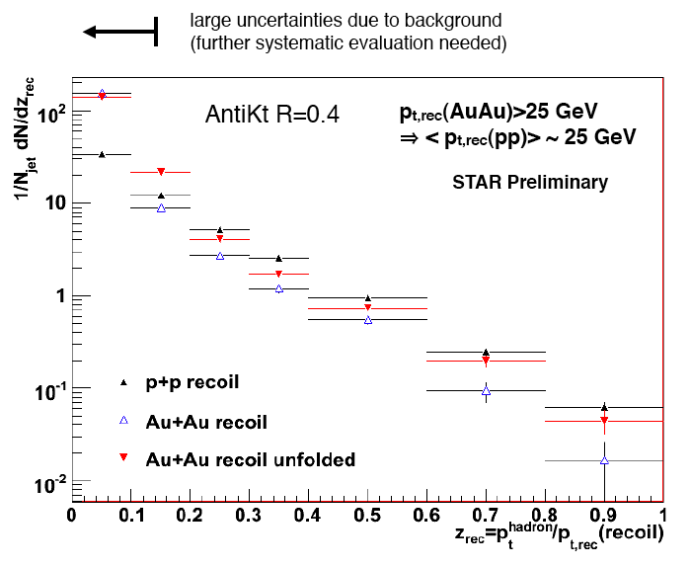
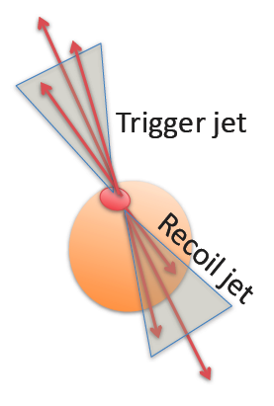
Jet fragmentation pattern in Au+Au

Slide 60
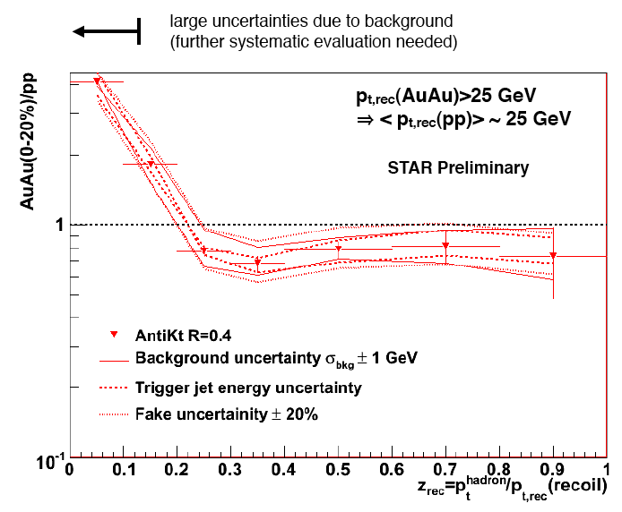
Fragmentation: ratio AuAu/pp

Slide 61
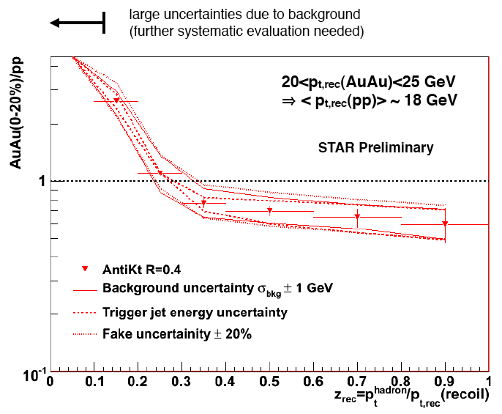
Fragmentation: ratio AuAu/pp

Slide 62
Fragmentation: ratio AuAu/pp
Modification? of the fragmentation for
lower jet pT < pT,rec(pp) > ~18GeV

Slide 63
R_{AA} in Cu+Cu:
Centrality systematics
Cross-section ratio AuAu/pp
1

Slide 64
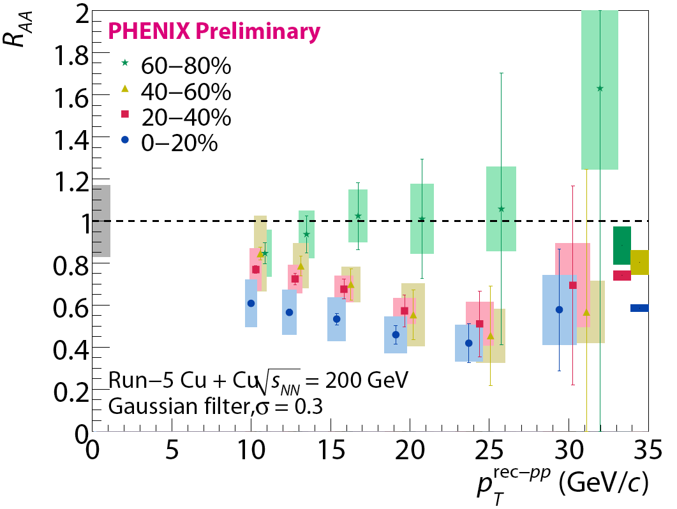
Jet R_{AA} in Cu+Cu

Slide 65
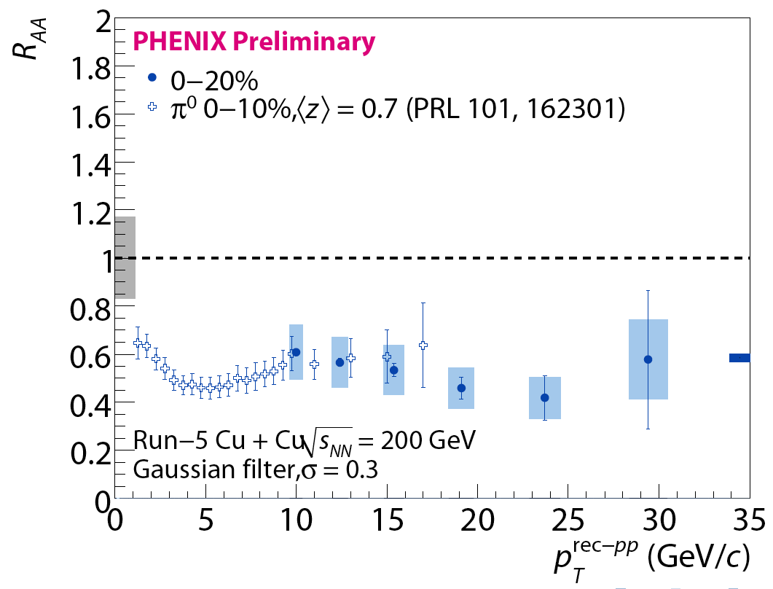
Jet R_{AA} in Cu+Cu
“Similar” suppresion for
Single particle and jets!

