Slide 1
WHDG Brick and
Comparing WHDG to ASW-SH
William Horowitz
The Ohio State University
July 7, 2009
With many thanks to Brian Cole, Ulrich Heinz, and Yuri Kovchegov

Slide 2
Outline
Context
Pedagogy
(Some) brick results
Comparing WHDG to ASW-SH
Pedagogy
Surprise!
Conclusions

Slide 3
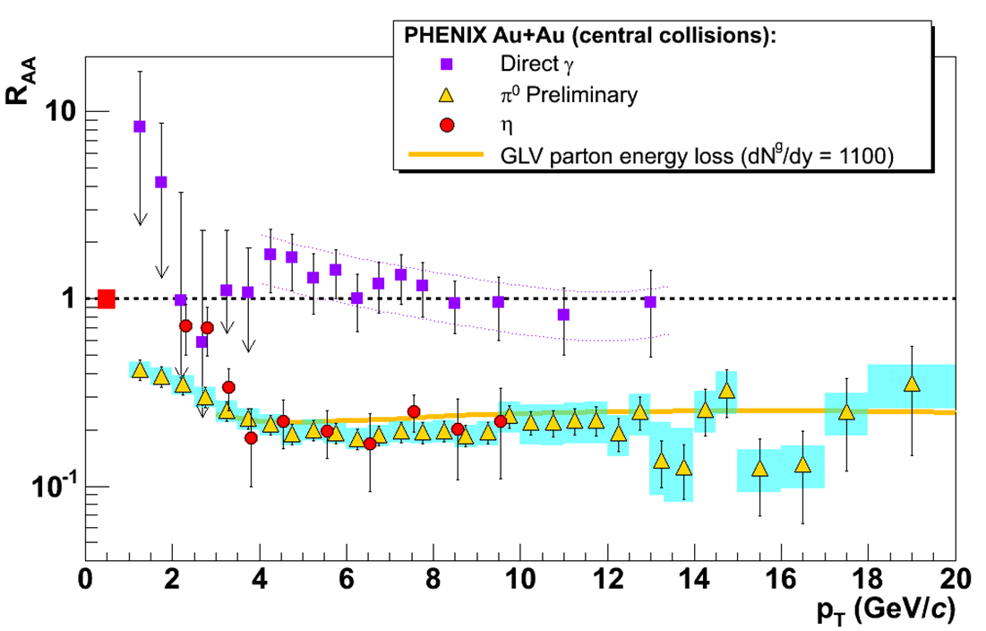
pQCD Success at RHIC:
(circa 2005)
Y. Akiba for the PHENIX collaboration, hep-ex/0510008
  Consistency: R_{AA}(η)~R_{AA}(π)
  Null Control: R_{AA}(γ)~1
  GLV Prediction: Theory~Data for reasonable fixed L~5 fm and dN_{g}/dy~dN_{π}/dy

Slide 4
Trouble for High-p_{T} wQGP Picture
  v₂ too small
  NPE supp. too large
π⁰ v₂
WHDG
C. Vale, QM09 Plenary (analysis by R. Wei)
NPE v₂
STAR, Phys. Rev. Lett. 98, 192301 (2007)
Pert. at LHC energies?
PHENIX, Phys. Rev. Lett. 98, 172301 (2007)

Slide 5
Multiple Models
WHDG, Nucl.Phys.A784:426-442,2007
Bass et al., Phys.Rev.C79:024901,2009
  Inconsistent medium properties
  Distinguish between models
Bass et al.

Slide 6
Quantitative Parameter Extraction
Vary input param.
Find “best” value
Need for theoretical error
PHENIX, PRC77:064907,2008

Slide 7
pQCD Rad. Opacity Exp. (I)
All orders in L/λ expression for dN_{g}/dx
    N_{g}: number of emitted gluons
    x: “momentum fraction carried by gluon”
      Small x regime, x << 1
  Assumed length scales: μ ⁻¹ << λ << L
    Debye screening mass μ
    Mean free path λ
    Medium length L
  Localized scattering centers; partons see many centers and radiate coherently (crucial!)

Slide 8
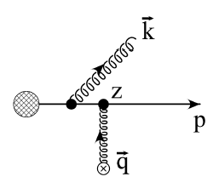
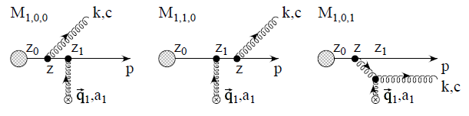
pQCD Rad. Opacity Exp. (II)
m_{g}
Eikonality assumed
    p⁺ >> p⁻
    k⁺ >> k⁻
  Radiation emitted forward
  Parent parton continues moving forward
  Partons move on straight-line paths
First order in opacity
  Interference w/ vacuum rad. crucial
M
TECHQM @ CERN

Slide 9
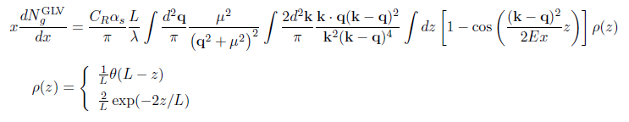
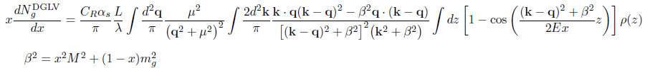
FOO dN_{g}/dx
    WHDG Rad: μ, M, m_{g} depend on T

Slide 10


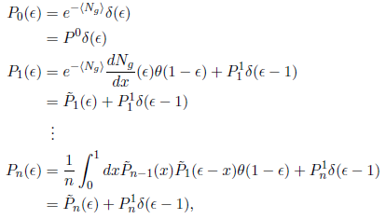

dN_{g}/dx to P(ε)
  Opacity expansion => dN_{g}/dx
    Single gluon emission spectrum
  Approx. multi-gluon fluct. w/ Poisson conv.
    Prob. to lose mom. frac. ε: p_{f} = (1- ε)p_{i}
    Assumes incoherent emission of non-Abelian gluons

Slide 11

WHDG Collisional Loss
  Gaussian distribution
    Mean loss for light quarks:
      Braaten-Thoma, PRD44, 2625 (1991)
  Width given by Fluctuation-Dissipation theorem
  Poisson conv. not well approx
  by Gaussian for realistic,
  small num of scatterings
    See Simon Wicks’ thesis

Slide 12
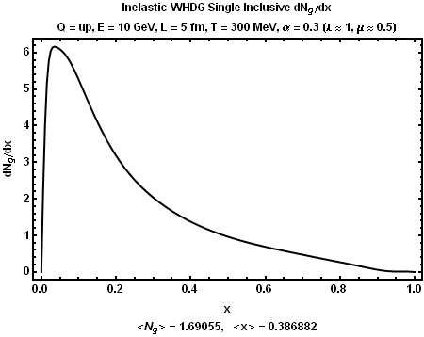
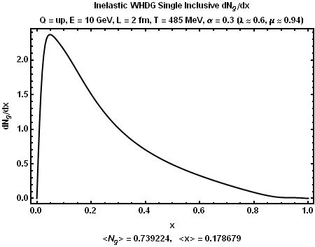
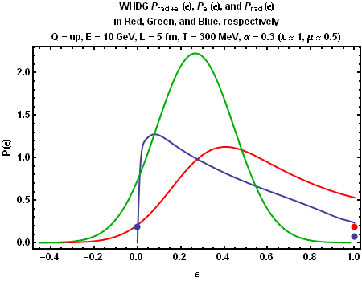
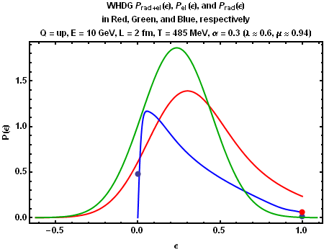
Typical Results
Original Brick
Wiedemann Brick <ε> = .4

Slide 13
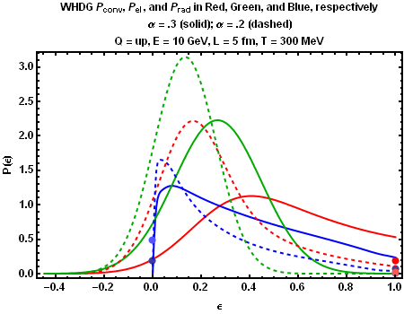
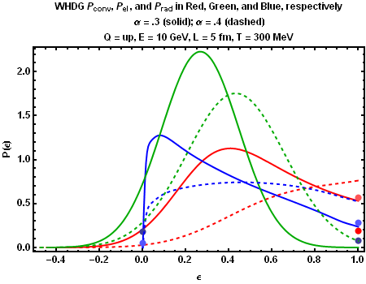
Running α_{s}?
  α_{s} = .2, .3
  Not surprisingly, changes in α_{s} make huge difference to P(ε)
  α_{s} = .3, .4

Slide 14
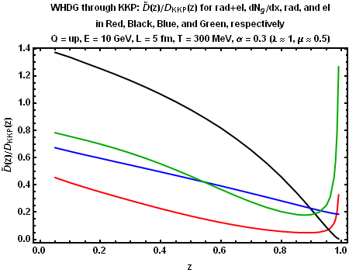
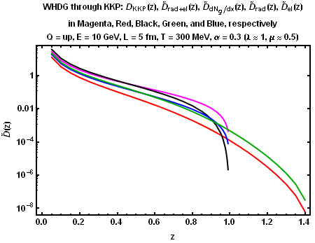
WHDG thru KKP
  Facilitate comparison between WHDG and HT
  Elastic gain => D(z > 1) > 0

Slide 15
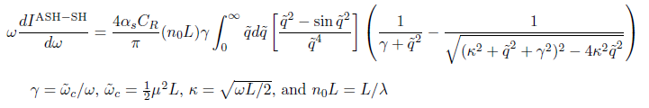
FOO dN_{g}/dx
    WHDG Rad: μ, M, m_{g} depend on T

Slide 16
Differences
WHDG Rad
    m_{g} = μ/√2
    M = μ/2
    k_{max} = 2 x (1-x) E
    ρ_{exp}(z)
    L/λ(T)
    q_{max} = √(3 μ E)
    α_{s} = .3
ASW-SH
    m_{g} = 0
    M = 0
    k_{max} = x E
    ρ_{theta}(z)
    L/λ = 1
    q_{max} = ∞
    α_{s} = 1/3

Slide 17
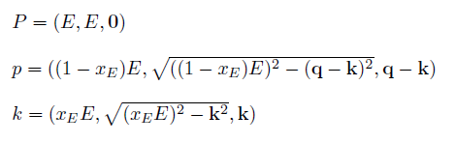



Where Did k_{max}’s Come From? (I)
DGLV
  Light cone momenta
      Note x₊ def.!
      Always on-shell
ASW-SH
  4-momenta
      Note x_{E} def.!
      Always on-shell
The same in the eikonal limit!

Slide 18


Where Did k_{max}’s Come From? (II)
DGLV
  Light cone momenta
      Note x₊ def.!
      Always on-shell
      k_{T} < x₊ E⁺ = 2 x₊ E
      Forward travel
ASW-SH
  4-momenta
      Note x_{E} def.!
      Always on-shell
      k_{T} < x_{E} E
      Forward travel
Same physics: cutoff when gluons radiated at 90º

Slide 19
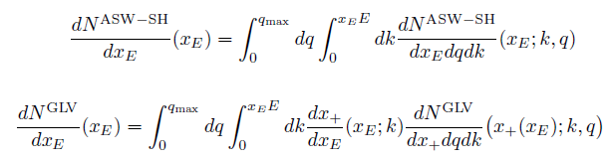
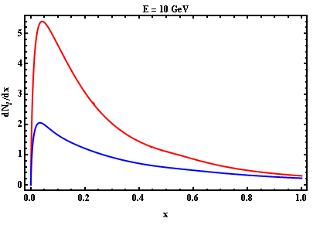
Compare Apples to Apples
Differences must be due to non-eikonality
    GLV(x_{E}) in red; ASW-SH(x_{E}) in blue

Slide 20
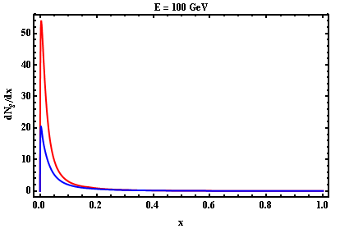
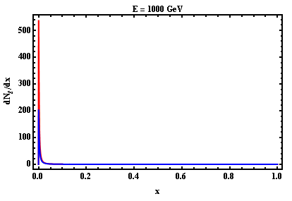
Large E Limit
  GLV(x_{E}) in red; ASW-SH(x_{E}) in blue
  For most values of x, naïve interpretation holds
    What’s going on at small x?

Slide 21
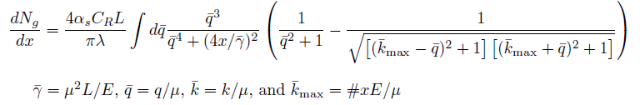

Interpretation
Physically:
  Typical k_{T} ~ μ => typ. ω ~ μ
    System wants to radiate lots of glue at x ~ μ /E
    BUT, this is right at our k_{T} cutoff:
      k_{T} ~ μ < μ ~ k_{T, max}: the system will always take advantage of all the “phase space” we give it
Analytically:
  More natural way to write dN_{g}/dx

Slide 22
Consequences
At large energies, <N_{g}> is E ind.
  Large irreducible systematic uncertainty for some observables
  For T = 485 GeV, L = 2 fm, α_{s} = 0.3:
    <N_{g}> ≈ 1, k_{max} = x E
    <N_{g}> ≈ 2, k_{max} = 2 x E
  Note that R_{AA} becomes insensitive to details of k_{max} (goes to 1)

Slide 23
Conclusions
  Current phen. comparisons of pQCD to data unsatisfactory
  WHDG not oversuppressed
Opacity expansion suffers from large systematic errors
  Strong dependence on k_{max} = # x E
    # is not specified by framework
  Similar dependence on IR cutoff, m_{g}
  Irreducible?
Consequences for other models, parameter extractions?

Slide 24
Supplement

Slide 25
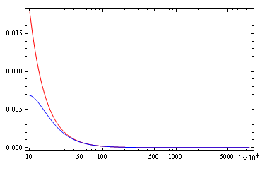
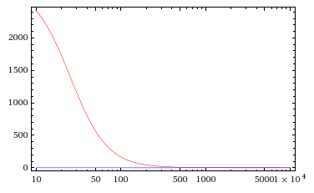
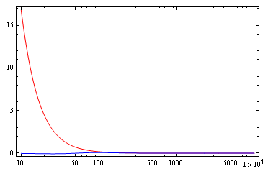
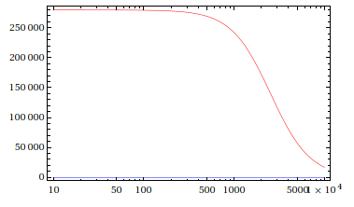
Eikonality Sets in for all x
X = .1
X = .001
E
E
X = .01
X = .00001
E
E

