Slide 1
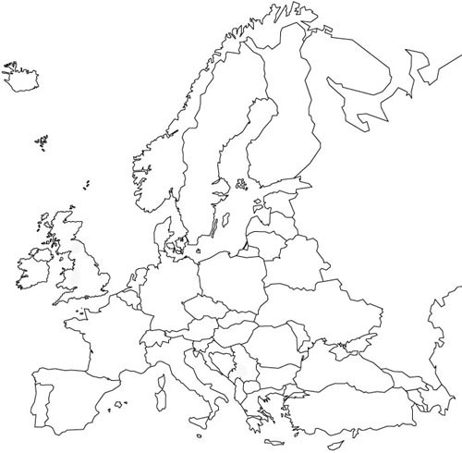



“Light exotics”
Hans Fynbo
University of Aarhus, Denmark
INTC meeting
CERN, May 18, 2009

Slide 2
Light exotics?
Decay
REX-beam
¹¹N
unbound
¹²N
20.2 ms
¹³N
20.4 m
¹⁴N
¹⁵N
¹⁶N
7.13 s
¹⁷N
4.17 s
¹⁸N
0.63 s
¹⁹N
329 ms
Z
⁸C
unbound
⁹C
125 ms
¹⁰C
19.3 s
¹¹C
20.4 m
¹²C
¹³C
¹⁴C
5730 y
¹⁵C
2.45 s
¹⁶C
0.747 s
¹⁷C
193 ms
¹⁸C
92 ms
⁷B
unbound
⁸B
770 ms
⁹B
unbound
¹⁰B
¹¹B
¹²B
20.20 ms
¹³B
17.33 ms
¹⁴B
13.8 ms
¹⁵B
10.4 ms
¹⁶B
unbound
¹⁷B
5.1 ms
⁶Be
unbound
⁷Be
53 d
⁸Be
unbound
⁹Be
¹⁰Be
1.6 10⁶ y
¹¹Be
13.8 s
¹²Be
23.6 ms
¹³Be
unbound
¹⁴Be
4.35 ms
⁵Li
unbound
⁶Li
⁷Li
⁸Li
840 ms
⁹Li
179 ms
¹⁰Li
unbound
¹¹Li
8.5 ms
¹²Li
unbound
¹³Li
unbound
³He
⁴He
⁵He
unbound
⁶He
808 ms
⁷He
unbound
⁸He
119 ms
⁹He
unbound
¹⁰He
unbound
¹H
²H
⁴H
unbound
⁵H
unbound
⁶H
unbound
⁷H
unbound
³H
12.323 y
⁷H
n
10.25 m
N

Slide 3
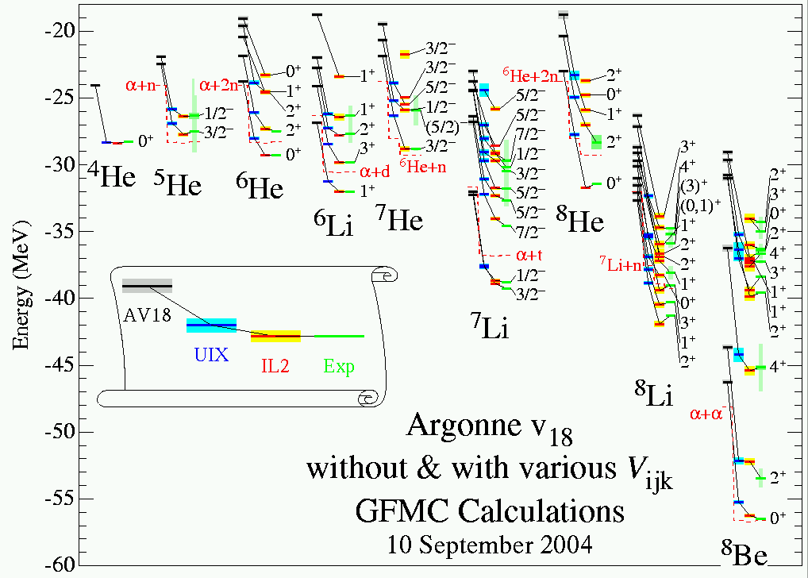
Pieper and Wiringa (ANL)
Described in
NP A751 516c (2005)

Slide 4
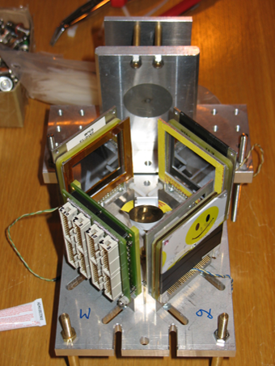
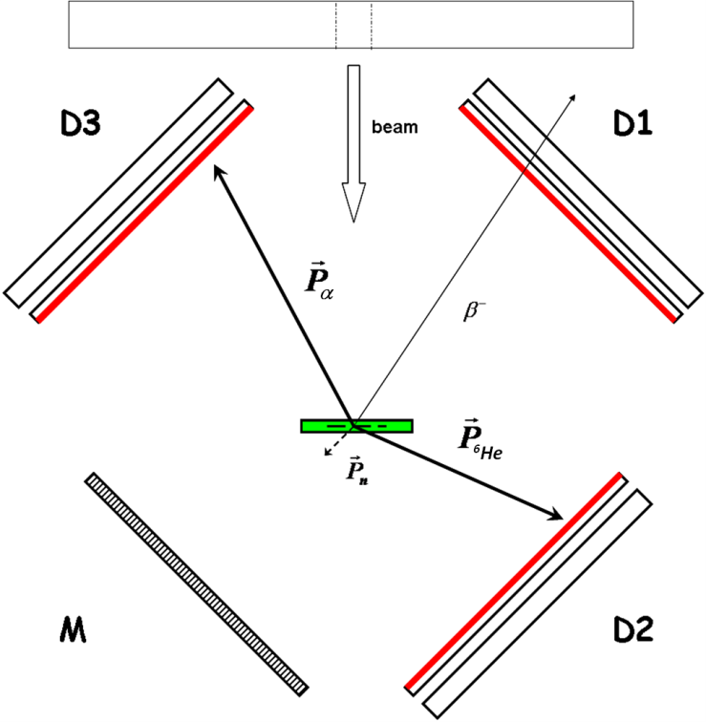
Experimental set-up for decays
20-60keV ISOLDE beam

Slide 5
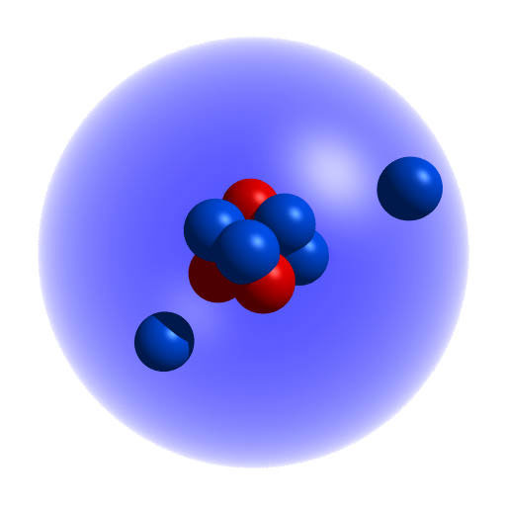
¹¹Li β-delayed charged particle emission
IS417
¹¹Li
β⁻
3/2⁻
18.30
17.9
15.7
⁹Li+d
1/2-
⁸Li+t
3/2-
5/2-
5/2⁻
10.59
10.06
¹⁰Be*+n
8.88
8.33
7.91
⁷He+α
2α+3n
⁶He+α+n
∼
∼
M. Madurga et al. Nucl. phys. A810 (2008) 1
M. Madurga et al. Phys. Lett. B (2009), In press
1/2⁺
0.0
¹¹Be

Slide 6
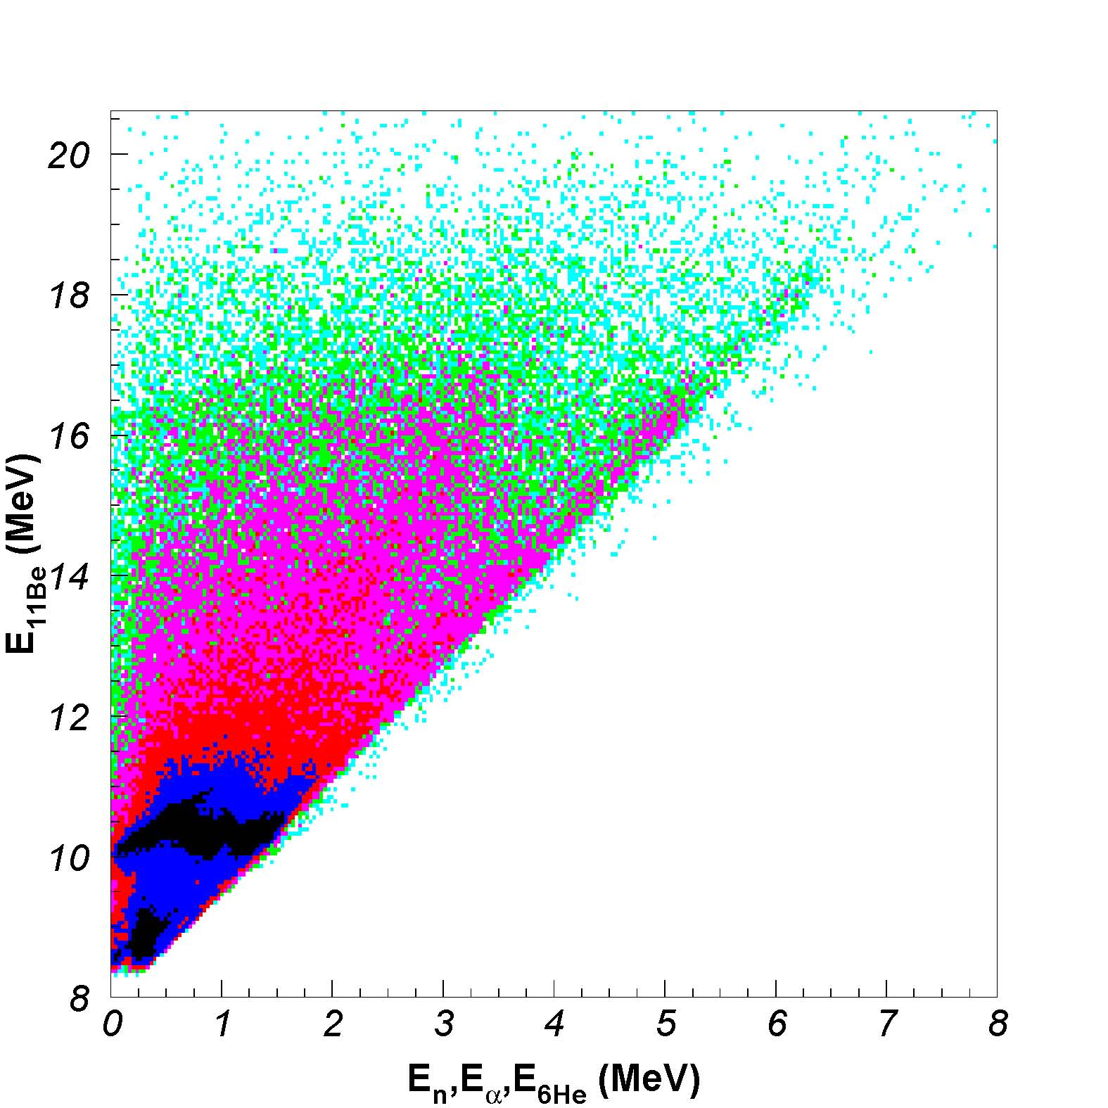
Identification of the ¹¹Be→α+⁷He→α+⁶He+n channel.
IS417
Sequential 3-body break-up
+⁷He
MeV
E’ → ⁷He(gs)
E_{11Be}
Q₁
3/2-
8.33
Q₂
7.91
0.421
7He(gs)
E’
6He++n

Slide 7
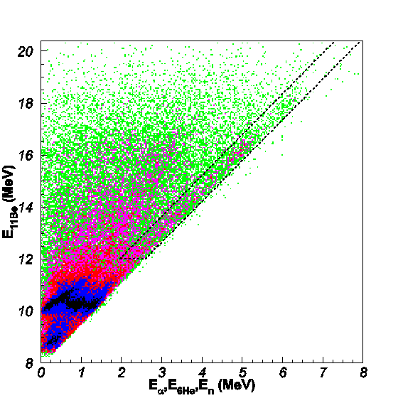
¹¹Be excitation spectrum evidence of a new level
IS417
Characterization of 11Be* states
R-Matrix analysis
Multiple channel Monte-Carlo simulation.
7He(gs) gate
This work |  | M.J.G. Borge et al, NPA 613(1997)199
E₀ (MeV) | Γ (MeV) | E₀ (MeV) | Γ (MeV)
16.3(1) | 0.7(1) | ---- | ----
18.4(3) | 1.6(6) | 18.2(2) (Be) 18.0(1) (He) 18.15(15) (H) | 1.4(4) (Be) 0.8(1) (He) 1.3(3) (H)

Slide 8
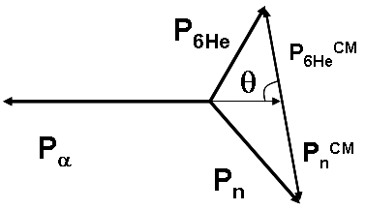
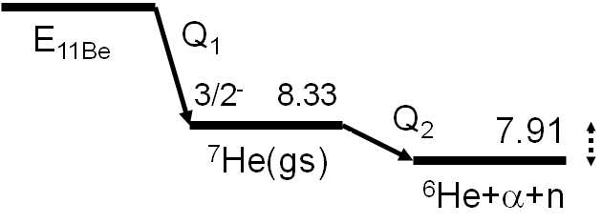
Spin and Parity
IS417
11Be(18.4 MeV)
J ≠ 0, 1/2
Rev. Mod. Phys. 25(1953)729
11Be(16.3 MeV)
DATA
1/2⁻
3/2⁻
5/2⁻
Notes:
b

Slide 9
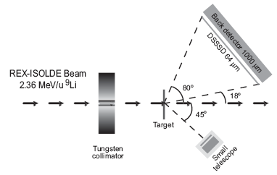
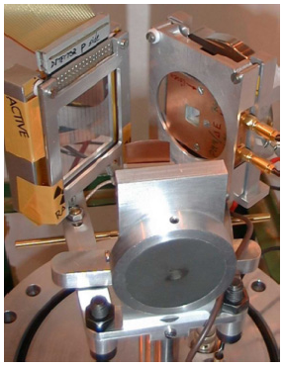
Experimental setup for REX transfer
IS376
Components in setup
One DSSSD (thick window) backed by Si-pad detector to form telescope and one smaller telescope (three layers; 10, 300 and 700 μm)
6.4 μm deuterated polypropylene target
2-3MeV/u REX beam

Slide 10
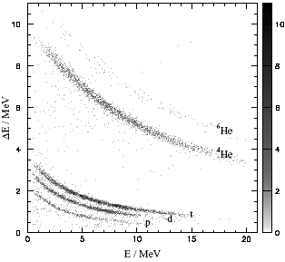
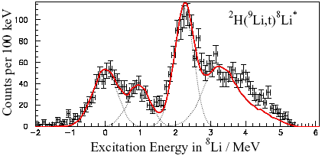
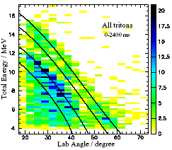
⁹Li+²H→t+⁸Li*
IS376
Example of neutron transfer from ⁹Li to a deuteron – forming a triton
⁸Li
⁹Li
d
»
»
t
⁹Li+²H → ?
Detector
⁹Li+²H→⁸Li+t
⁹Li+²H→⁸Li+t
H.B.Jeppesen et al. Nucl. phys. A748 (2005) 374
H.B.Jeppesen et al. Phys. Lett. B635 (2006) 17.

Slide 11
⁹Li+²H→p+¹⁰Li*
IS376
⁹Li+p elastic scattering
⁹Li+²H →p+¹⁰Li*
⁹Li+¹²C Compound
Stable background
H.B.Jeppesen et al. Phys. Lett. B642 (2006) 449.

Slide 12
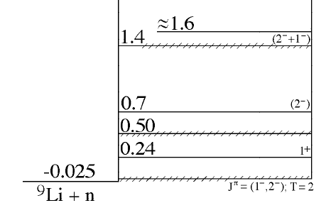
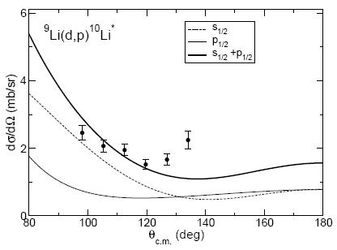
Comparison to theory
IS376
CCBA calculations
  Performed by A.M. Moro
  Only potential-depth varied
  (2 free parameters)
3/2⁻ + s/p → (1⁻, 2⁻, 1⁺, 2⁺)
Conclusion:
Need s- and p-wave component to describe energy spectrum
H.B.Jeppesen et al. Phys. Lett. B642 (2006) 449.

Slide 13
New Experimental developments
IS376
IS430
IS446
New 32×32 strip 60µm DSSSD + 1500µm Si-pad

Slide 14
¹¹Be+d/p @ 2.25 MeV/u
IS430
Also new data for ⁸Li and ⁹Li beams
¹¹Be+d
¹¹Be+p
17µm deuterated polyethylene
13µm polyethylene

Slide 15
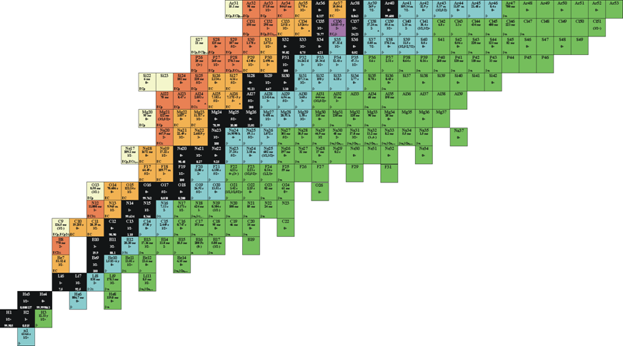
Future plans
Data under analysis
  ¹¹Be+d, ^{8,9}Li+d
  β−decay of ¹⁷Ne
  α−decay of ²²¹Fr
Approved experiments
  ¹¹Be+d with mini-ball
  Decay and reactions Z=6
  β2p of ³¹Ar
Under discussion
  Transfer reactions with triton and ^{6,7}Li targets
  β-decay of ⁸He, ⁹C, other β2p cases

Slide 16
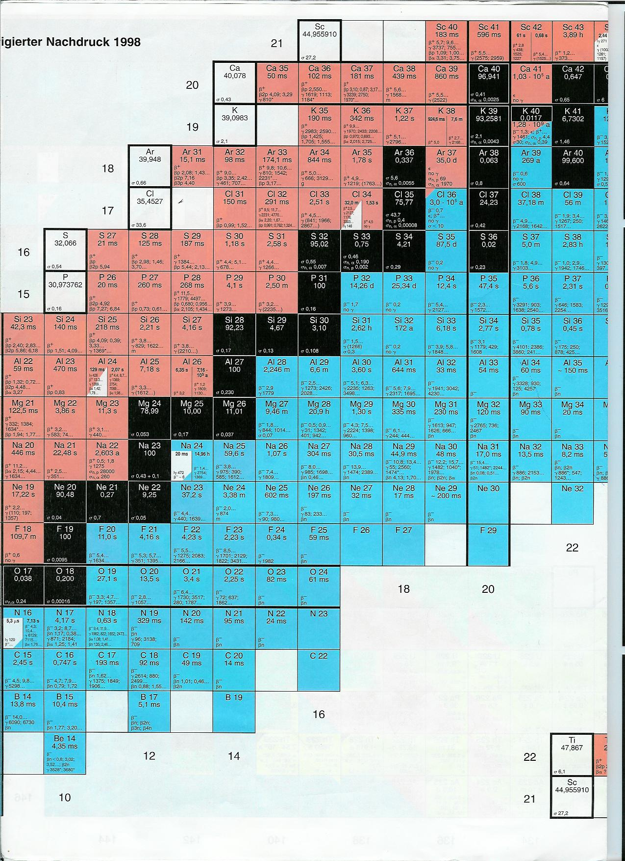
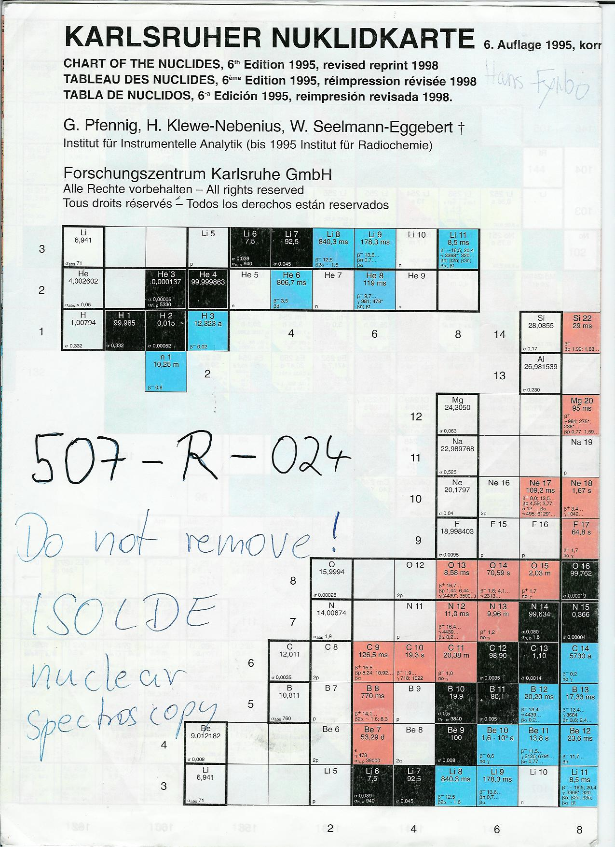
1st Region of interest
Gap in knowledge especially for neutron-rich C,N and O isotopes
Region previously difficult to access due to chemical properties

Slide 17
Beam development
Release studies of C/CO
  HfO, MgO, CaO etc.
  Quarts-coated target container and transfer line?
Development of ECR-IS and plasma-IS
Notes:
Problem with release from old materials
Why quartz coating ?
Plasma iosource efficiency ansd mini mono
What is known from off-line ?

Slide 18
New possibilities with C-beams
Neutron-rich C-isotopes
  Their β-decay can now be studied
  Feasible for at least ¹⁷⁻¹⁹C
  First step target test to confirm improved yield
Proton-rich C-isotopes
  Now feasible with REX (>10³/sec)
  ERS ⁹C+p → ¹⁰N* → ⁹C+p
Notes:
Mod 22C
19C halo
15C halo properties s1/2
17C d5/2
Sd orbitaler ligger tæt

Slide 19
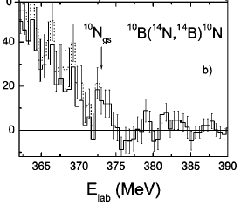
⁹C+p → ¹⁰N* → ⁹C+p
Very little known about ¹⁰N
¹⁰Li mirror partner
A. Lépine-Szily et al PRC 65 (2002) 054318
No spin assignment
Probably not gs. seen! http://www.tunl.duke.edu
3/2⁻ + s/p → (1⁻, 2⁻, 1⁺, 2⁺)
Notes:
Similar experience with 9Li beam.

Slide 20
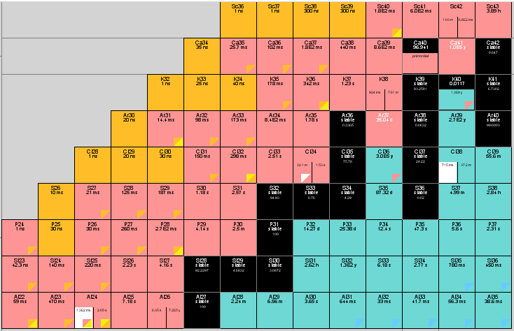
2nd Region of interest

Slide 21
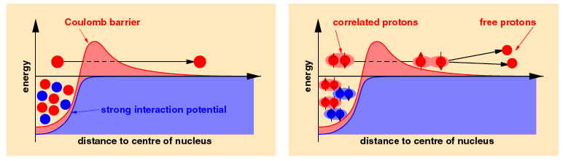
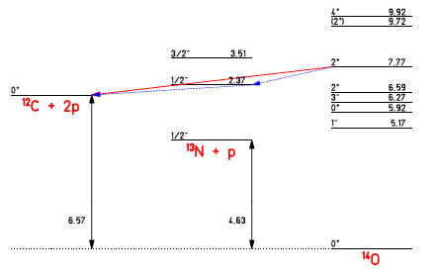
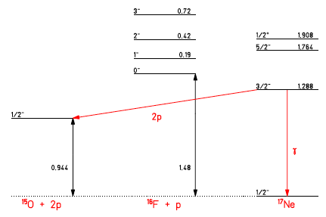
Two-proton emission
Rep. Prog. Phys. 71 (2008) 46301
Not yet observed
Observables : (Partial) lifetime, and energy and angular correlations

Slide 22
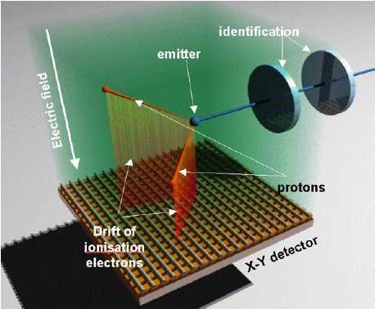
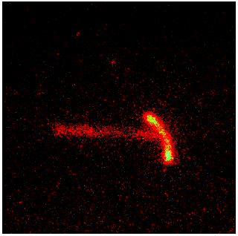
Two-proton emission
⁴⁵Fe → ⁴³Cr + 2p
Bordeaux
Warsaw

Slide 23
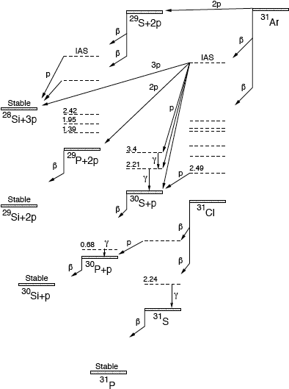
³¹Ar-decay
Many states
Many states

Slide 24
³¹Ar - a new look
Study ³⁰S levels
Many states
Many states
Astrophysical interest :
²⁹P(p,γ)³⁰S and
³⁰S(p,γ)³¹Cl
reactions
Search for
direct 2p-decay
+
study ³¹Cl levels

Slide 25
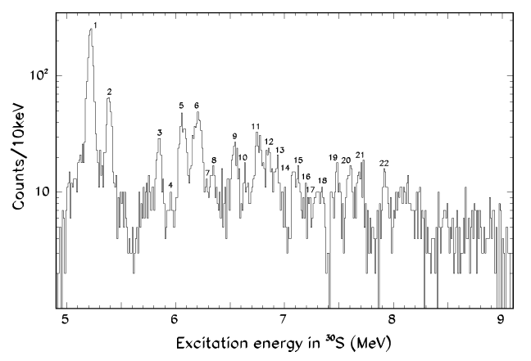
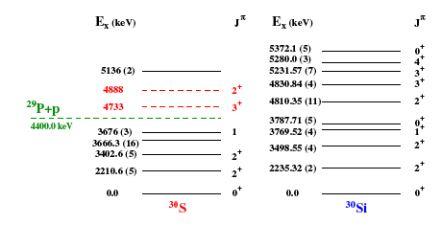
³¹Ar-decay : ³⁰S-spectroscopy

Slide 26
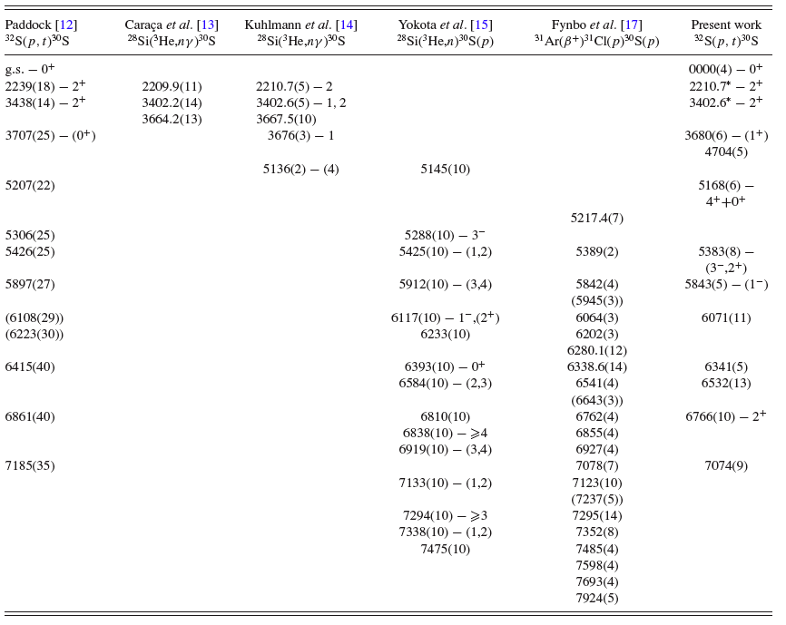
³¹Ar-decay : ³⁰S-spectroscopy
β-decay data competitive!
low energy region unclear
Search for 4704keV level
Search for other new levels
measure Γ_{p}/Γ_{γ} for levels
PRC 76 (2007)
045803, MSU
²⁹P(p,γ)³⁰S reaction

Slide 27
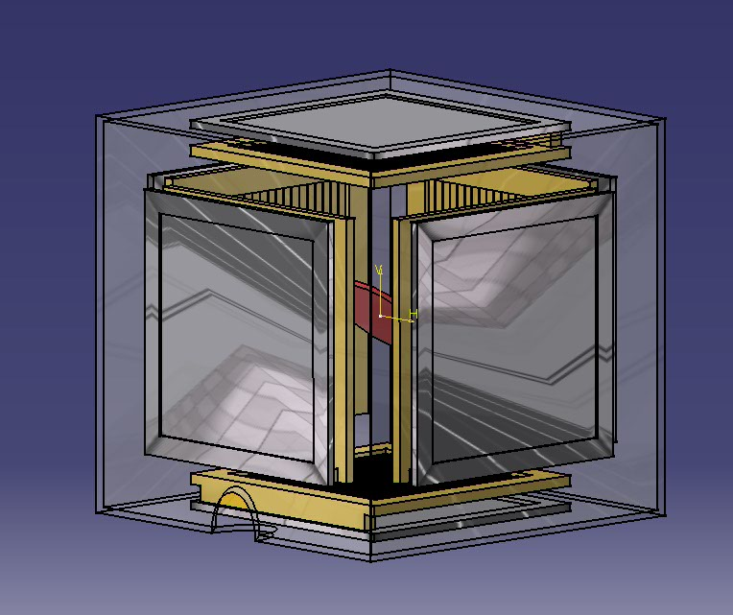
Setup
Efficiencies:
Charged particles
1p : 60-75% (25%)
2p : 35% (5%)
Gammas
Orders of magnitude
more than last
Yield
Up by a factor ~10 due to Ion-source improvement
Surrounded by 3 Ge clover detectors

Slide 28
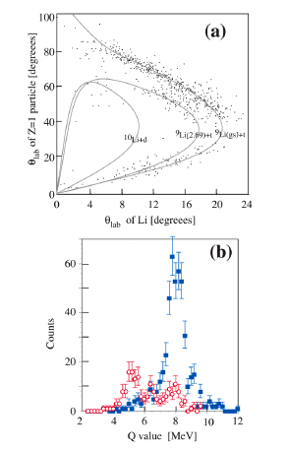
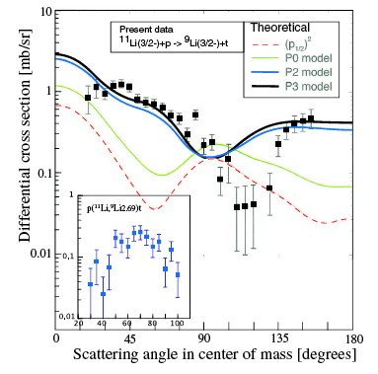
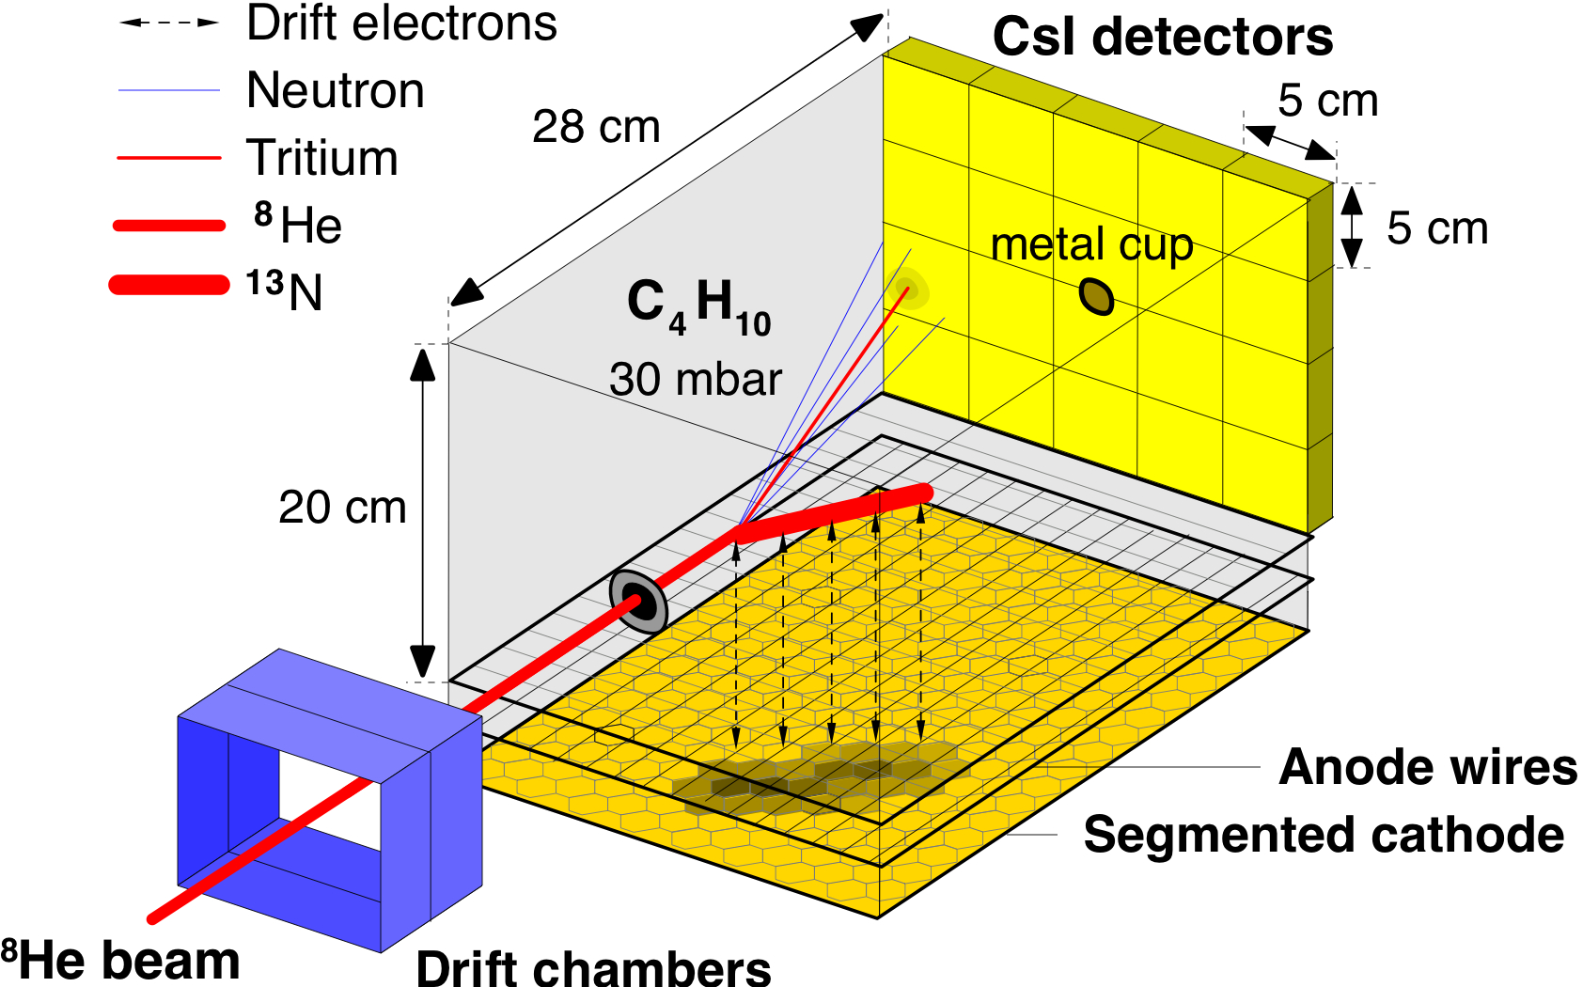
p(¹¹Li,⁹Li)t
Triumf
30% s²
Other REX possibilities
⁹Li(t,p)¹¹Li, ¹¹Be(t,p)¹³Be,
⁸Li(^{6,7}Li,α)^{11,12}Be
⁹Li(^{6,7}Li,α)^{10,11}Be
All will benefit from 10MeV/u @ HIE-ISOLDE
^{11,9}Li
¹¹Li beam
I. Tanihata et al. PRL 100, 192502 (2008)
3 MeV/u, ~2-5×10³/s

Slide 29
“Collaboration”
K. Riisager, H.O.U. Fynbo, H. Jeppesen, C. Diget, H. H. Knudsen, S. Hyldegaard,
O. Kirsebom, J.S. Johansen.
Department of Physics and Astronomy, Århus University, Denmark
C. Forssen, H. Johansson, B. Jonson, K. Larsson, T. Nilsson, G. Nyman, E. Tengborn,
M. Zhukov.
Fundamental Physics, Chalmers University of Technology, Gothenburg, Sweden
M.J.G. Borge, O. Tengblad, A. Perea, Ricardo Dominguez-Reyes, J. A. Briz,
M. Carmona-Gallardo, L. Fraile
Instituto Estructura de la Materia, CSIC, Madrid, Spain
Most experiments done
in collaboration with other groups

