Slide 1
The experimental research program at the
collinear laser spectroscopy beam line COLLAPS
2006-2009
Gerda Neyens
for the COLLAPS collaboration
Max Planck Institute, Heidelberg, Germany: K. Blaum (collaboration leader), D. Yordanov
University of Mainz, Germany: W. Nörtershäuser, M. Schug, J. Krämer, A. Krieger, R. Neugart
University of Leuven, Belgium: G. Neyens, M. Bissell, P. Vingerhoets, M. De Rydt, G. Ory,
P. Lievens, M. Avgoulea
GSI-Darmstadt, Germany: C. Geppert
University of Manchester, UK: J. Billowes, B. Cheal, E. Mané, F. Charlwood
University of Birmingham, UK: G. Tungate, D. Forrest
ISOLDE/CERN, Geneva, Switserland: M. Kowalska
University of New York, USA: H. Stroke
IPN-Orsay K. Flanagan

Slide 2
The experimental research program at the
collinear laser spectroscopy beam line COLLAPS
2006-2009
PURPOSE:
Study fundamental properties of exotic nuclei
in order to investigate the nucleon-nucleon interaction
at the extremes of isospin
GOALS:
Measure SPIN Ι
MAGNETIC MOMENT, g-factor μ = g.Ι
STATIC QUADRUPOLE MOMENT Q
MEAN SQUARE CHARGE RADIUS <r²>
of exotic isotopes produced at ISOLDE.

Slide 3
The experiment set-up and measuring techniques

Slide 4
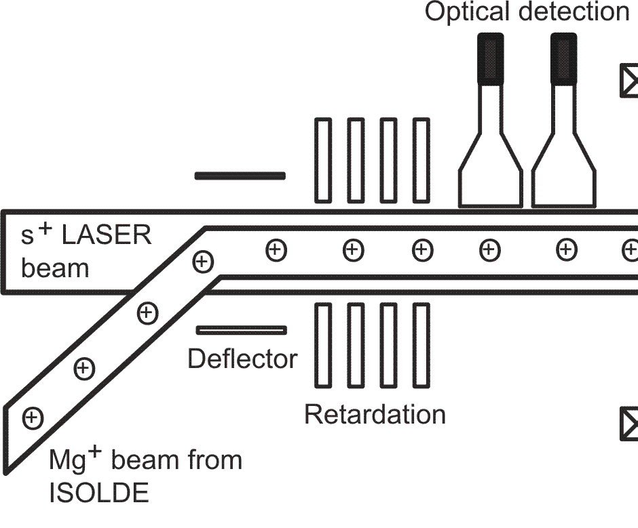
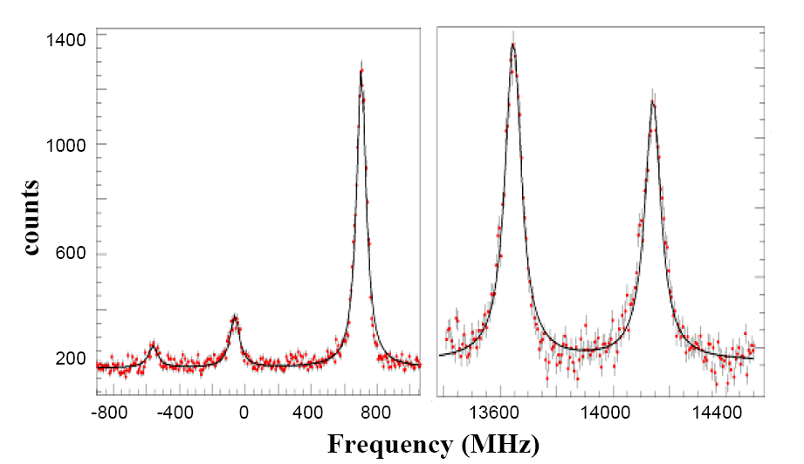
The COLLAPS beam line … … and its experimental techniques
(1) collinear laser spectroscopy with optical detection
Cu hyperfine structure:
²P_{3/2}
F’_{i}
~Q,μ
LASER
beam
²S_{1/2}
F₂
∼μ,Ι
F₁
⁶⁸Cu, I^{π}=1⁻
Doppler tuning voltage
ion beam
from ISOLDE
Photon counts
scan hyperfine structure levels:
ν_{scan}=ν_{laser}γ(1+β)
β ∼ U^{1/2}
measure fluorescent photon decay

Slide 5
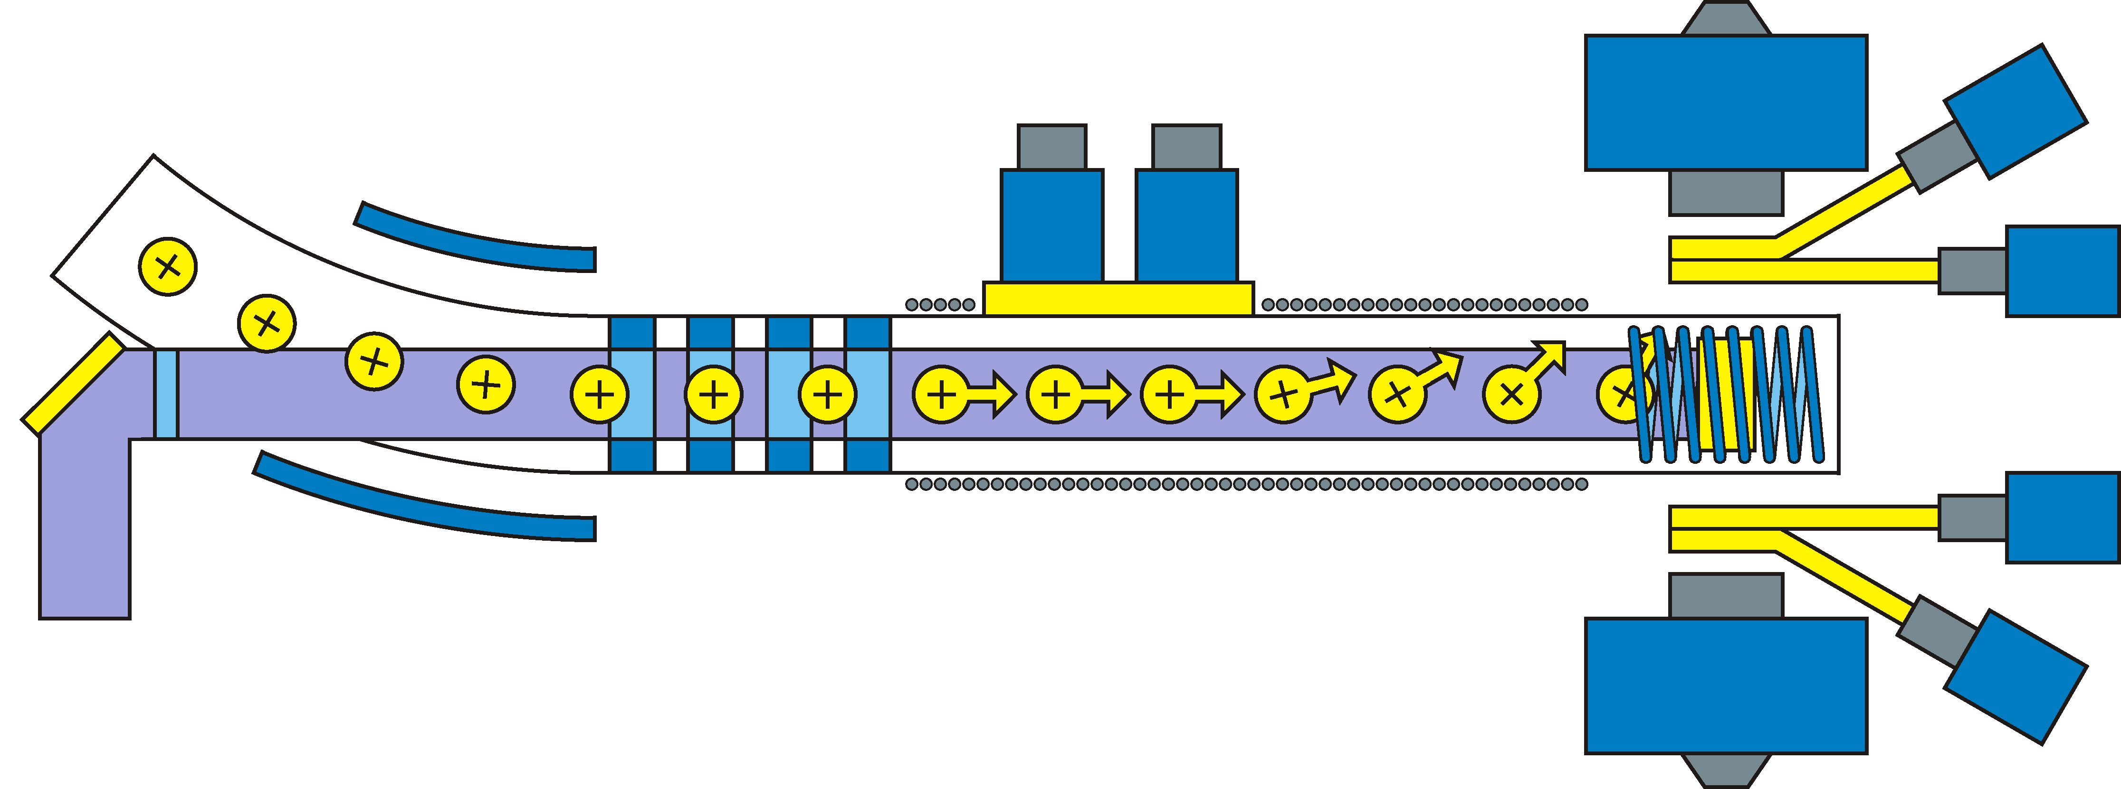
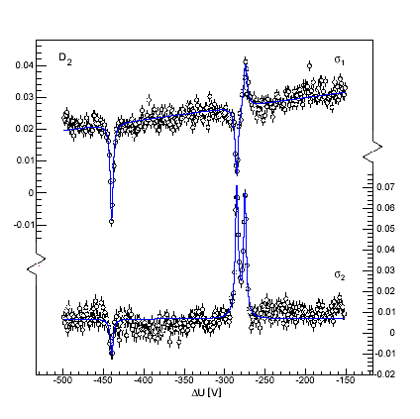
The COLLAPS beam line … … and its experimental techniques
(2) collinear laser spectroscopy with β-asymmetry detection
Photon counters
Magnet coil
Ion beam
β-scintillators
crystal
Doppler tuning
β-scintillators
Laser beam
Magnet coil
Resonant optical pumping with circularly polarized
laser light to polarize the atoms and nuclei
Detection of HFS via
asymmetric nuclear β-decay
-2
-1
0
1
2
m_{F2}
³¹Mg
(N_{u}-N_{d})/(N_{u}+N_{d})
-2
-1
0
1
2
m_{F1}
Total atomic spin F gets polarized through pumping !
➔ Nuclear spin polarization !
Dopple tuning voltage

Slide 6
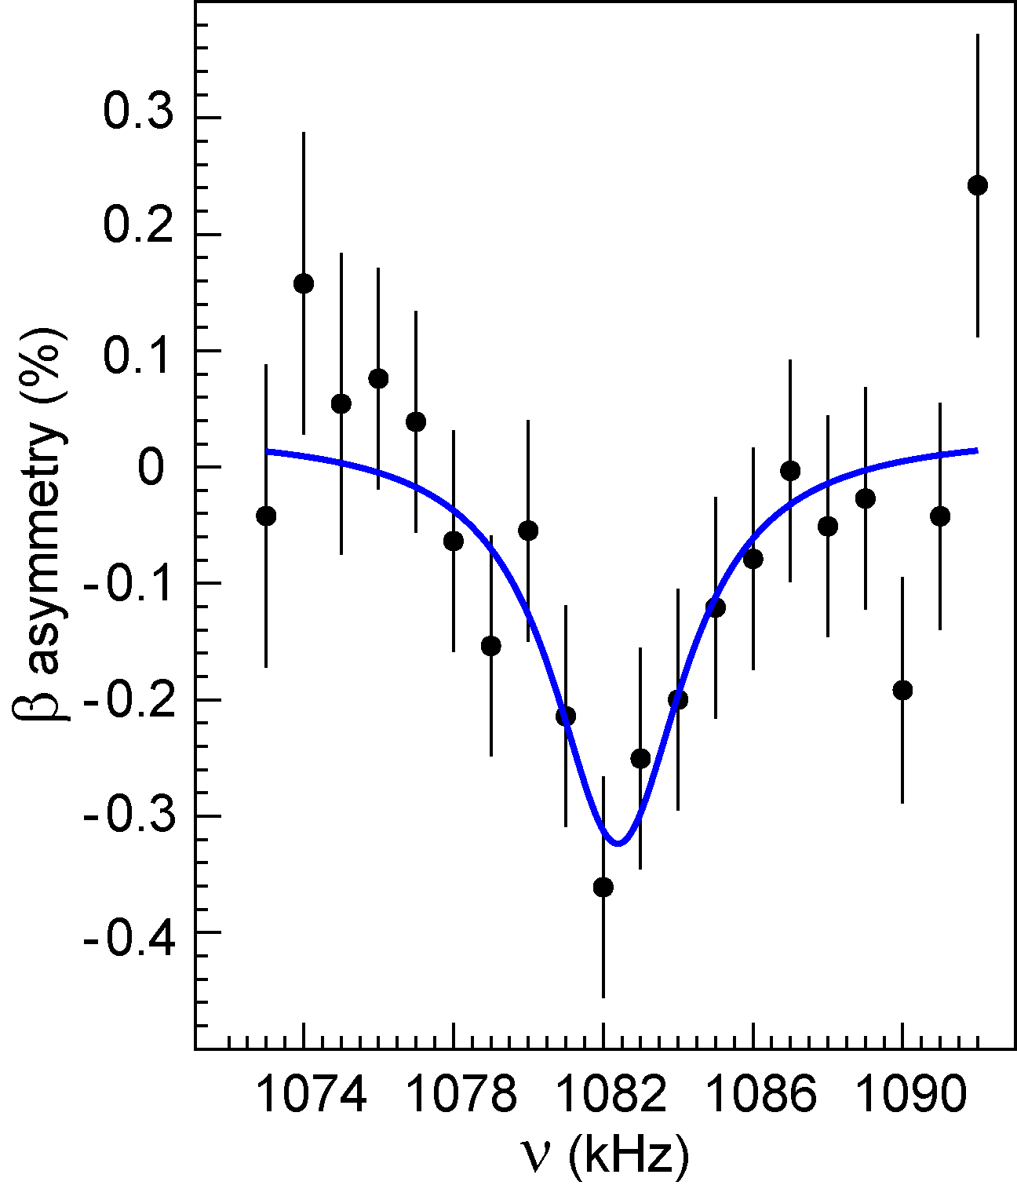
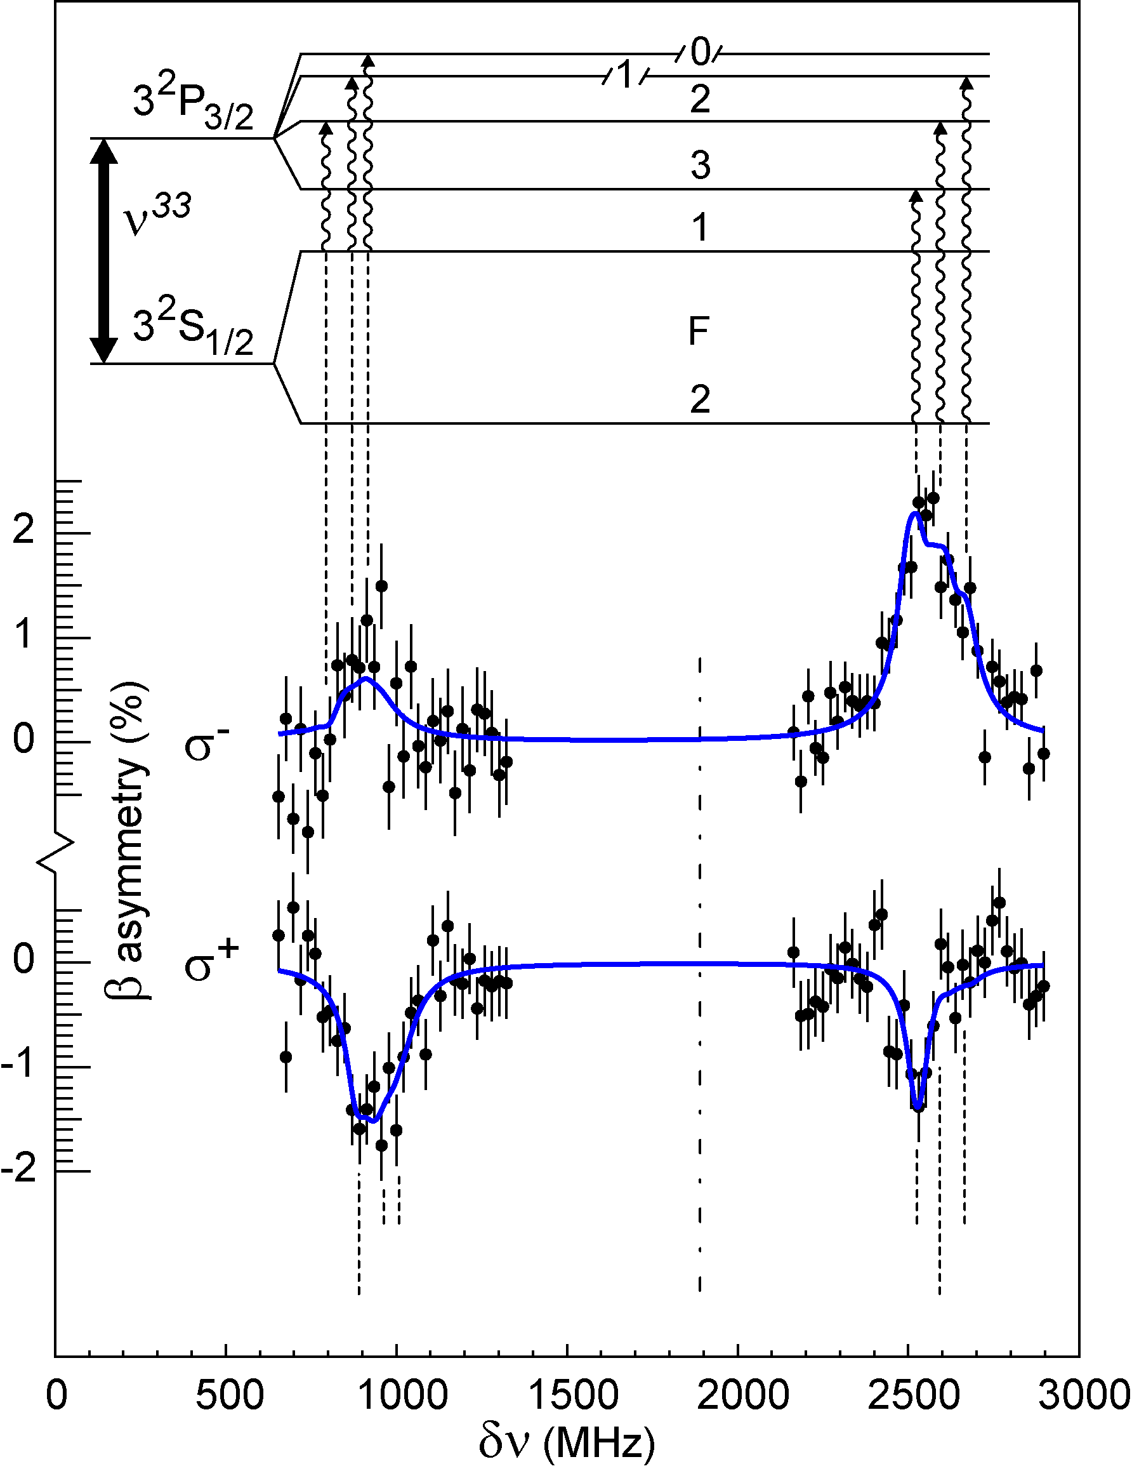
The COLLAPS beam line … … and its experimental techniques
(3) β-nuclear magnetic resonance on polarized nuclei
Photon counters
Magnet coil
Ion beam
β-scintillators
crystal + rf-coil
Doppler tuning
β-scintillators
Laser beam
Magnet coil
Scan the rf-frequency → g-factor
Set tuning voltage to select polarized beam
³³Mg, NMR
m=3/2
I=3/2
m=1/2
β-asymmetry(%)
ω_{L}
β-asymmetry(%)
m=-1/2
m=-3/2
Zeeman splitting
³³Mg, HFS
RF-frequency (kHz)
Relative laser frequency (MHz)

Slide 7
A selection of results from previous experiments

Slide 8
IS427: Nuclear moments and charge radii of magnesium isotopes from N=8 up to N=20
Collaboration: Leuven (spokesperson), Mainz, CERN, Heidelberg
Proposal submitted in 2003, addendum in 2006.
Status report: May 2008
Beam times: 2004, 2005, 2006, 2007. Final beam time: september 2009
13
12
8
20
11
νd_{5/2}
νs_{1/2}
νd_{3/2}
νf_{7/2}
Highlights:
Measurement of nuclear spins by combining HFS and β-NMR measurements !
Parity assignment based on measured sign of magnetic moment
➔ determine ground state structure
Anomalous spin for ³¹Mg and ³³Mg
  normal parity
³¹Mg, I^{π} = 1/2+ → (sd)⁻³
³³Mg, I^{π} = 3/2- → (fp)³
pure 2p-2h intruder ground states !
G. Neyens et al., Phys. Rev. Lett. 94, 022501 (2005) ³¹Mg
D. Yordanov et al., Phys. Rev. Lett. 99, 212501 (2007) ³³Mg
³¹Mg (N=19)
³³Mg (N=21)
pf
f_{7/2}
20
20
d_{3/2}
sd

Slide 9
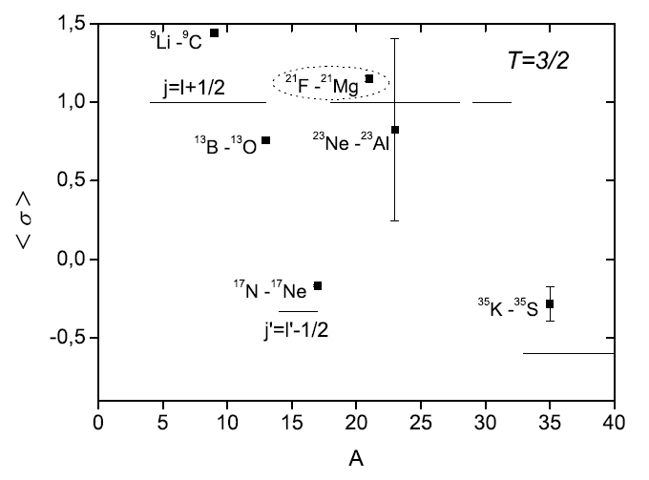
IS427: Nuclear moments and charge radii of magnesium isotopes from N=8 up to N=20
13
12
11
10
²¹F
20
8
N=Z
Highlights:
(2) Spin/parity of ²¹Mg = 5/2⁺
Mirror (a)symmetry in T=3/2 mirror pairs
p_{3/2}
d_{5/2}
j=l+1/2
Spin expectation value <σ> = 1.15(2)
  (larger than Schmidt value =1)
- understood in large scale shell model
due to very mixed proton configuration: <σ>_{SM} =1.11
- including isospin non-conserving effects: 1.15
j=l-1/2
J. Kraemer et al., Phys. Lett. B (2009), submitted

Slide 10
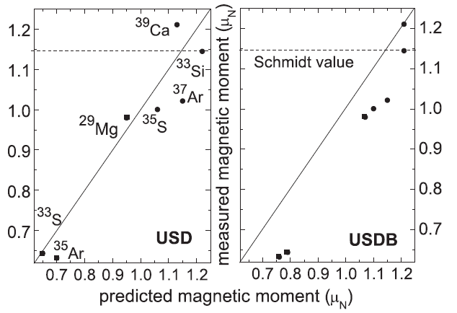
IS427: Nuclear moments and charge radii of magnesium isotopes from N=8 up to N=20
Highlights:
(3) Magnetic moments of N=17 and N=19 isotones (particle or hole in νd_{3/2})
→ better agreement with the USD interaction than with recent USDB interaction
(with free-nucleon g-factors)
M. Kowalska et al., Phys. Rev. C77, 034307 (2008)

Slide 11
IS439: Nuclear moments, spins and charge radii of copper isotopes from N=28 to N=50
by collinear fast-beam laser spectroscopy
Collaboration: Leuven (spokesperson), Mainz, CERN, Manchester, Birmingham, GSI, New York
Proposal submitted in 2005.
Status report : January 2007.
Beam times: 2006, 2007, 2008 Final beam time: foreseen 2010
Cu → 1 proton outside Z=28 ➔ πp_{3/2} ➔ all odd-Cu ground states assigned I=3/2 up to ⁷⁵Cu
N=40
42
44
46
48
N=50
⁶⁴Zn
⁶⁵Zn
⁶⁶Zn
⁶⁷Zn
⁶⁸Zn
⁶⁹Zn
⁷⁰Zn
⁷¹Zn
⁷²Zn
⁷³Zn
⁷⁴Zn
⁷⁵Zn
⁵⁹Cu
⁶⁰Cu
⁶¹Cu
⁶²Cu
⁶³Cu
⁶⁴Cu
⁶⁵Cu
⁶⁶Cu
⁶⁷Cu
⁶⁸Cu
⁶⁹Cu
⁷⁰Cu
⁷¹Cu
⁷²Cu
⁷³Cu
⁷⁴Cu
⁷⁵Cu
⁷⁶Cu
⁷⁷Cu
⁷⁸Cu
⁷⁹Cu
Z=28
⁵⁸Ni
⁶⁰Ni
⁶¹Ni
Z=28
⁶⁴Ni
⁶⁵Ni
⁶⁶Ni
⁶⁷Ni
⁶⁸Ni
⁶⁹Ni
⁷⁰Ni
⁷¹Ni
⁷²Ni
⁷³Ni
⁷⁴Ni
⁷⁵Ni
⁷⁶Ni
⁷⁷Ni
⁷⁸Ni
⁶²Ni
ν(p_{3/2},f_{5/2}p_{1/2})
ν1g_{9/2}
Evolution of the 5/2- and 1/2- proton energies in odd-Cu isotopes as function of N
πp_{1/2}
1/2⁻
πf_{5/2}
5/2⁻
N=40
Inversion ??
200 ns
1.5 μs
πp_{3/2}
3/2⁻
⁵⁷Cu
⁵⁹Cu
⁶¹Cu
⁶³Cu
⁶⁵Cu
⁶⁷Cu
⁶⁹Cu
⁷¹Cu
⁷³Cu
⁷⁵Cu
S. Franchoo et al., PRC 64, 054308 (2001)
I. Stefanescu et al., PRL 100, 112502 (2008) J.M. Daugas, Ph.D. Thesis, Ganil

Slide 12
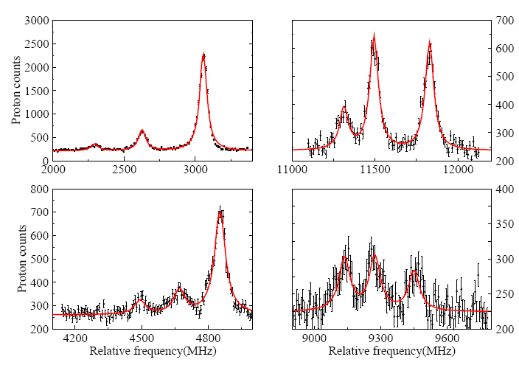
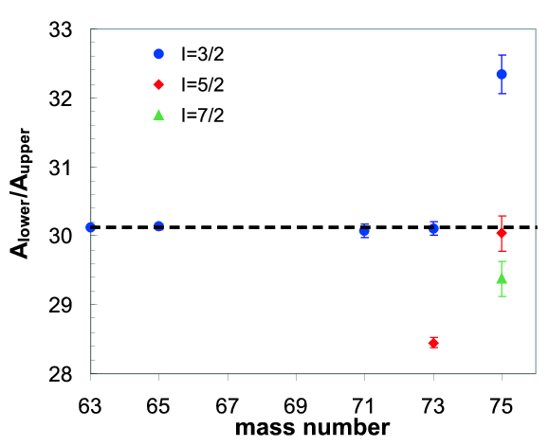
IS439: Nuclear moments, spins and charge radii of copper isotopes from N=28 to N=50
by collinear fast-beam laser spectroscopy
Resulting highlights:
Spins and magnetic moments of ^{71,73,75}Cu using bunched-beam (ISCOOL)
  collinear laser spectroscopy (reduction of optical background with factor 10⁴)
  → inversion of πp_{3/2} and πf_{5/2} levels at N=46
⁷³Cu, I=3/2
ratio of A-factors = constant
if correct spin used in fit
(negligible hyperfine anomaly)
I=3/2
⁷⁵Cu, I=5/2
I=5/2
I=7/2
K.T. Flanagan, P. Vingerhoets et al., papers in preparation

Slide 13
IS439: Nuclear moments, spins and charge radii of copper isotopes from N=28 to N=50
by collinear fast-beam laser spectroscopy
Resulting highlights:
Quadrupole moments of odd-Cu isotopes
Minimum at N=40 (looks like a ‘shell gap’ effect)
Core polarization when adding neutrons into νg_{9/2} is similar as for removing
neutrons from the pf-orbits.
|Q_{s}| (efm²)
1/2⁻
B(E2, 1/2 → 3/2) (10 e²fm⁴)
B(E2)
B(E2, ½ → 3/2):
Same trend as g.s. Q below N=40
Above N=40, the decay rate increases strongly
Q
3/2⁻
→ Suggests that above N=40 the 1/2-
is collective
νg_{9/2}
K.T. Flanagan, P. Vingerhoets et al., papers in preparation

Slide 14
IS439: Nuclear moments, spins and charge radii of copper isotopes from N=28 to N=50
by collinear fast-beam laser spectroscopy
Resulting highlights:
Odd-odd ^{62-70g}Cu isotopes:
  evolution of the single particle structure in the 1⁺ states
deduced from their magnetic moments
N=40
πp_{3/2}(νf_{5/2})^{-n}
νf_{5/2}
-1
-1
2
νp_{1/2}
νp_{1/2}g_{9/2}
μ_{exp}(1⁺)
-1
μ_{emp}(πp_{3/2}νp_{1/2})1⁺
⁶⁶Cu: positive sign measured
→ mixing between νf_{5/2}⁻¹ and νp_{1/2}⁻¹
μ_{emp}(πp_{3/2}νf_{5/2})1⁺
K.T. Flanagan, P. Vingerhoets et al., papers in preparation

Slide 15
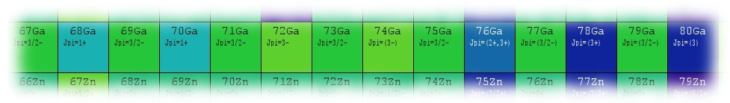
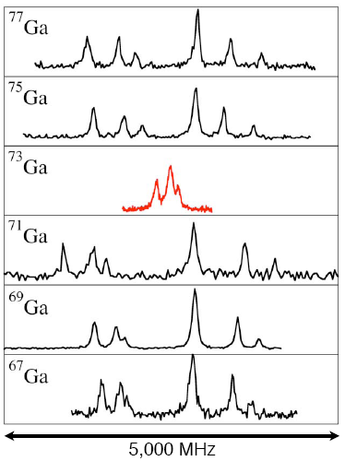
IS457: Laser spectroscopy of Gallium isotopes using the ISCOOL ion cooler/buncher.
Collaboration: Manchester (spokesperson), Birmingham, Leuven, Mainz, CERN, New York,
Jyvaskyla, GSI
Proposal submitted in 2007
Beam times: 2008, 2009
Continuation (addendum) considered.
Ga → 3 protons outside Z=28 ➔ π(p_{3/2})³
➔ all odd-Ga ground states assigned I=3/2 up to ⁷⁹Ga
3/2
3/2
Resulting highlights:
??
From HFS: ground state spins of odd-Ga isotopes:
⁶⁷Ga (N=36) to ⁷⁷Ga (N=46): I=3/2
exception: ⁷³Ga !!
⁷⁹Ga (N=48): I=3/2 or I=5/2 not resolved !
→ run last week gives answer !
3/2
3/2
3/2
B. Cheal, E. Manét al., papers in preparation

Slide 16
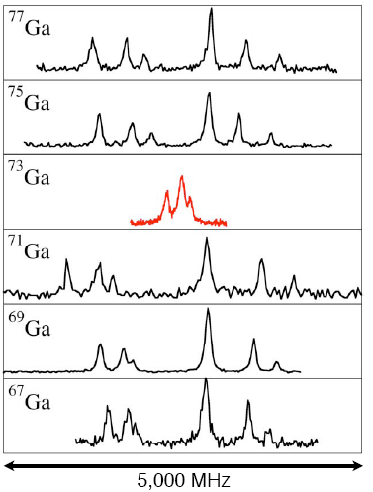
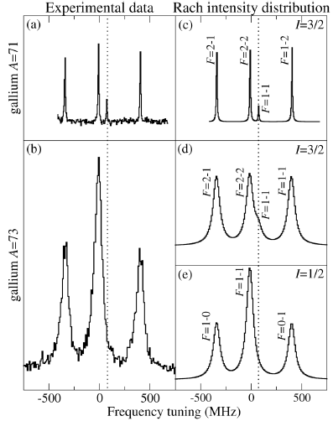
IS457: Laser spectroscopy of Gallium isotopes using the ISCOOL ion cooler/buncher.
Resulting highlights: (2) The strange case of ⁷³Ga
P3/2 ➔ S1/2 transition: 6 lines for I=3/2
4 lines for I=1/2
P1/2 ➔ S1/2 transition: 4 lines for I=3/2
3 lines for I=1/2
⁷¹Ga
⁷³Ga
I=1/2 !!

Slide 17
IS457: Laser spectroscopy of Gallium isotopes using the ISCOOL ion cooler/buncher.
Resulting highlights:
Magnetic moments and quadrupole moments of the odd-Ga ground states
→ ^{75,77}Ga have similar g-factor as ^{67,69,71}Ga
BUT ! NOT similar structure ➔ Q < 0 : shape change in ^{75,77}Ga !
→ g-factor of the 1/2 g.s. of ⁷³Ga is very different
➔ different single particle structure !? SHAPE CHANGE AT N=42
→ g-factor of ⁷⁹Ga smaller than stable Ga BUT Q-moment similar as in stable Ga
➔ ??
N=40
N=50
N=40
N=50
I=3/2
I=5/2
I=3/2
I=3/2
I=5/2
I=1/2
B. Cheal, E. Manét al., papers in preparation

Slide 18
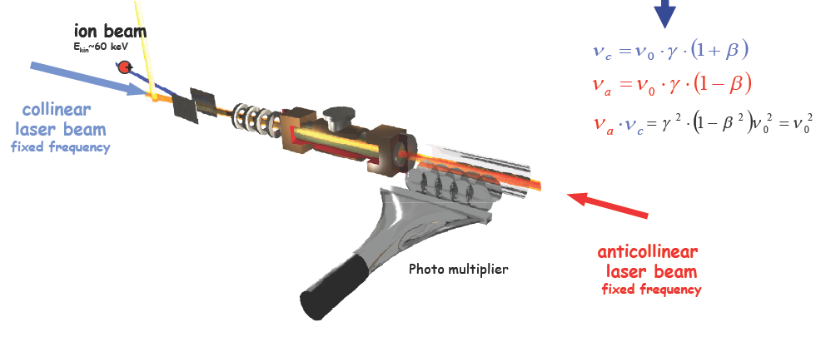
IS449: Nuclear charge radius measurements of radioactive beryllium isotopes
Collaboration: Mainz (spokesperson), CERN, GSI Darmstadt, Heidelberg, Tübingen, Ulm
Proposal submitted in 2006 Experiment: 2008
Method to study Be isotope shifts (resonance frequency with precision of 1 MHz required !)
→ frequency comb based collinear-anticollinear laser spectroscopy

Slide 19
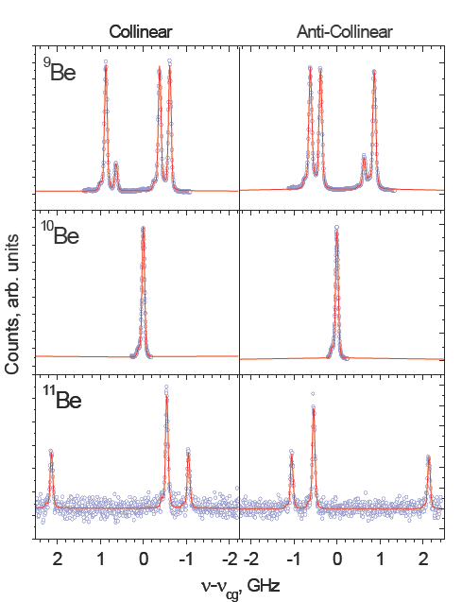
IS449: Nuclear charge radius measurements of radioactive beryllium isotopes
The charge radius of the ¹¹Be halo nucleus
is larger than its ¹⁰Be core
➔ center of mass motion (+core polarization?)
The charge radius of the ¹¹Be halo nucleus
is smaller than its matter radius
= direct proof of halo nature in ¹¹Be
Halo !
W. Nörtershäuser et al., Phys. Rev. Lett. 102, 062503 (2009)
Matter radii: Ozawa, Suzuki and Tanihata, NPA693 (2001)

Slide 20
Summary on the status of running COLLAPS experiments
IS427: Nuclear moments and charge radii of magnesium isotopes from N=8 up to (and beyond) N=20
Collaboration: Leuven (spokesperson), Mainz, CERN, Heidelberg
Proposal submitted in 2003, addendum in 2006.
Status report: May 2008
Beam times: 2004, 2005, 2006, 2007. Final beam time: September 2009
Output till now : - 4 papers in refereed journals (2 PRL) + 4 conf. proceedings
- 3 Ph.D theses (M. Kowalska, Univ. Mainz, 2007
D.T. Yordanov, K.U. Leuven, 2007
J. Kramer, Univ. Mainz, in preparation)
- 1 master thesis (K.U. Leuven)
IS480: Charge radii of magnesium isotopes by laser spectroscopy: a structural study over the sd shell
Collaboration: Heidelberg (spokesperson), Mainz, Leuven, CERN
Proposal submitted in 2008.
Beam time: scheduled august 2009 - final

Slide 21
Summary on the status of running COLLAPS experiments
IS439: Nuclear moments, spins and charge radii of copper isotopes from N=28 to N=50 by collinear fast-beam laser spectroscopy
Collaboration: Leuven (spokesperson), Mainz, CERN, Manchester, Birmingham, GSI, New York
Proposal submitted in 2005.
Status report : January 2007.
Beam times: 2006, 2007, 2008 Final beam time: foreseen 2010
Output till now: - 3 papers in preparation (K.T. Flanagan, P. Vingerhoets et al.)
- 1 Ph.D. thesis in preparation (P. Vingerhoets, K.U. Leuven)
- 1 master thesis (G. Ory, K.U. Leuven, 2009)
IS457: Laser spectroscopy of Ga isotopes using the ISCOOL ion cooler/buncher.
Collaboration: Manchester (spokesperson), Birmingham, Leuven, Mainz, CERN, New York,
Jyvaskyla, GSI
Proposal submitted in 2007
Beam times: 2008, 2009
Addendum considered for study of neutron-deficient Ga isotopes
Output till now: - papers in preparation (B. Cheal et al.)
- 1 Ph.D. thesis (E. Mané, Univ. Manchester, 2009)

Slide 22
Summary on the status of running COLLAPS experiments
IS449: Nuclear charge radius measurements of radioactive beryllium isotopes
Collaboration: Mainz (spokesperson), CERN, GSI Darmstadt, Heidelberg, Tübingen, Ulm
Proposal submitted in 2006 to perform these measurements at ISOLTRAP.
Addendum submitted in 2008 → move the measurements to the COLLAPS beam line
and use a collinear/anti-collinear laser set-up to reach the required precision.
Beam time: 2008
Addendum considered to extend to ¹²Be.
Output till now: - paper in PRL
- 2 Ph.D. theses in preparation (M. Zakova, D. Tiedemans, Univ. Mainz)
- 2 master thesis (M. Schug, A. Krieger, Univ. Mainz)
IS484: Ground-state properties of K-isotopes from laser and β-NMR spectroscopy
Collaboration: Leuven (spokesperson), Heidelberg, Mainz, CERN
Proposal submitted in 2009.
Beam time: foreseen 2010 +

Slide 23
CONCLUSIONS
High-resolution collinear laser spectroscopy is a very powerful tool
for measuring fundamental properties of exotic nuclei
With the installation of ISCOOL, the sensitivity of the optically detected HFS
    measurements has been improved by 2-3 orders of magnitude
    (background reduction by more than 4 orders of magnitude !)
The combination of β−asymmetry detected HFS and β-NMR is a very powerful
tool for measuring ground states spins of short-lived isotopes
in nuclei with small HFS
(4) Thanks to the high precision and the direct measurement of nuclear observables
many surprising nuclear structure results have been obtained.

