Slide 1
Status report MINIBALL
J. Van de Walle for the MINIBALL collaboration

Slide 2

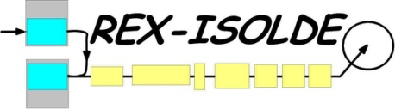
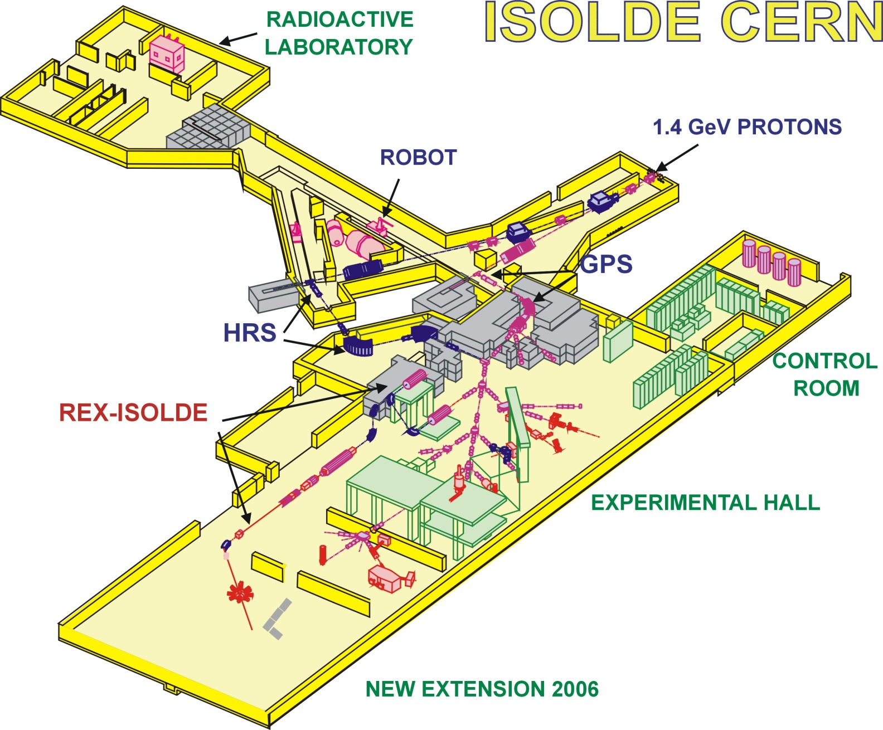
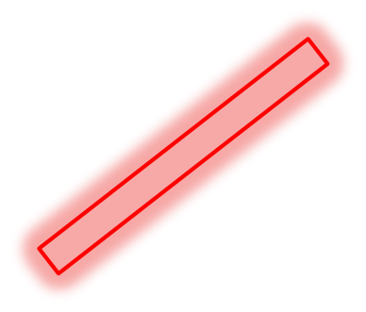

MINIBALL
MINIBALL
Beam line layout ;
9-gap X-ray background ;
estimating # of shifts ;
measurement principle coulex ;

Slide 3
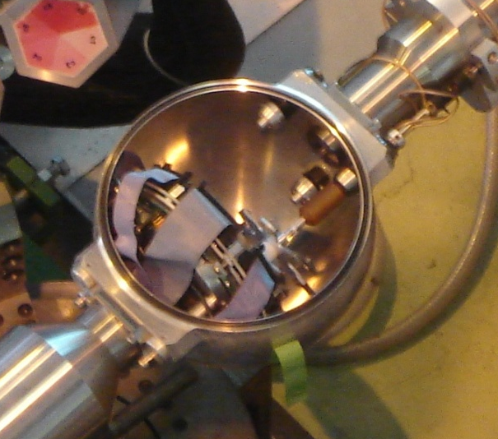
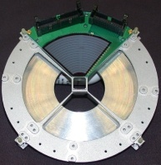
Beam line layout
Target Chamber
1/ Coulex
- One forward CD 15-55° ;
- 6 secondary targets ;
- 8 cm sphere ;

Slide 4
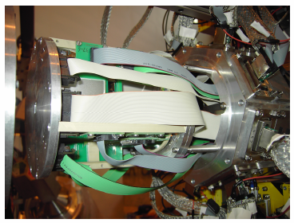
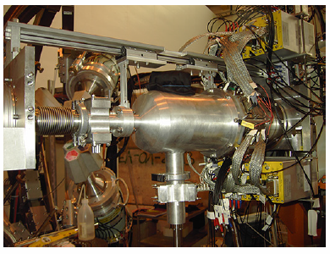
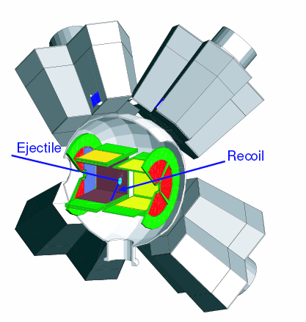
Beam line layout
Target Chamber
1/ Coulex
- One forward CD 15-55°
- 6 secondary targets
- 8 cm sphere
2/ Transfer
- backward (2007-2008) + forward (2009) CD
- ΔE-E_{rest} barrel backward + forward (2008)
- more material - lower γ efficiency (< 300 keV)

Slide 5
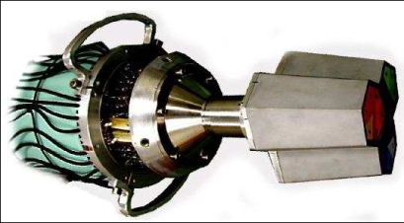
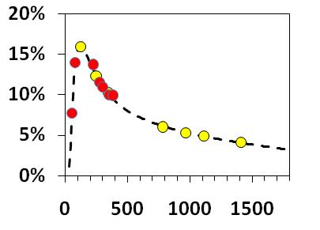
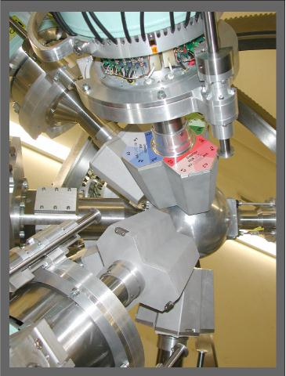
Beam line layout
8 Cluster detectors
Absolute Efficiency [%]
Energy [keV]

Slide 6
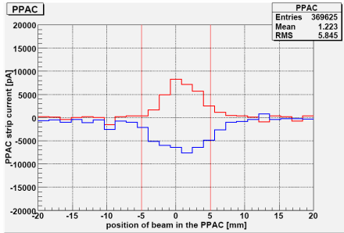
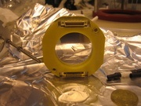
Beam line layout
FC
FC
PPAC
- Two faraday cups (FC) in 2009 to steer stable and intense "pilot" beam (≈1-3 epA)
- One Parallell Plate Avalenche Counter (PPAC) : profile of the beam in X and Y

Slide 7
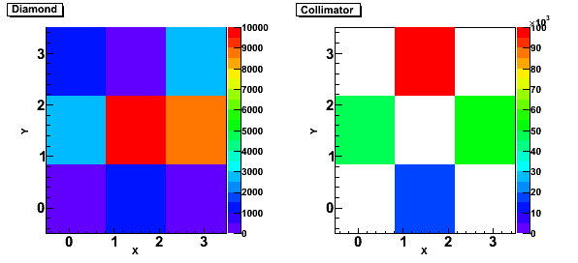
Beam line layout
9 mm
FC
FC
PPAC
- Two faraday cups (FC) in 2009 to steer stable and intense "pilot" beam (≈1-3 epA)
- One Parallell Plate Avalenche Counter (PPAC) : profile of the beam in X and Y
- Transfer chamber : 9 diamond detectors in square configuration on the target ladder +
"Active" collimator in front ;
↔ Coulex chamber : no beamdiagnostics on the target ladder

Slide 8
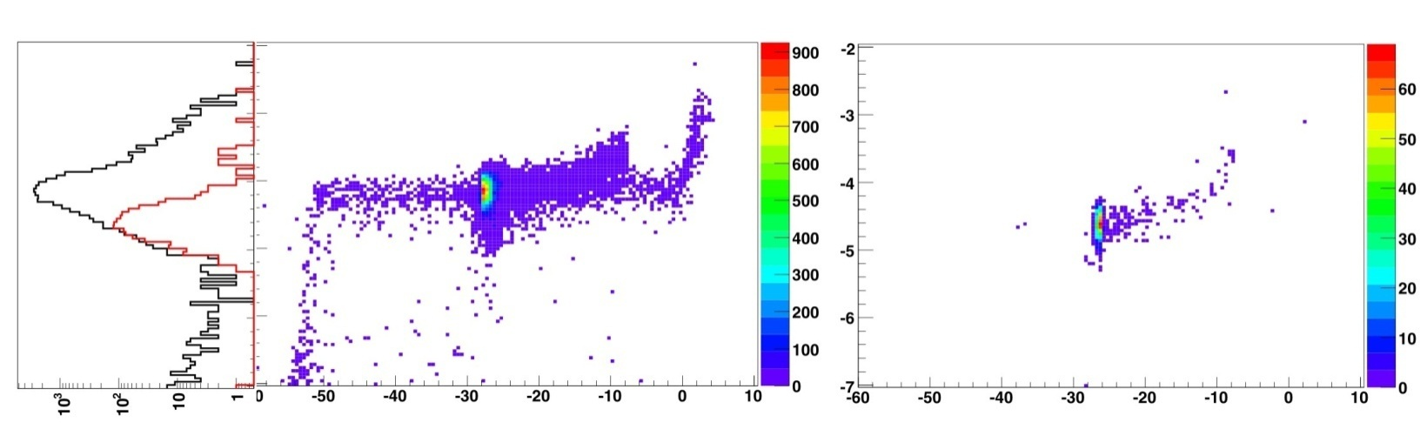
Beam line layout
Beam diagnostics (composition)
1/ Bragg chamber (ex. ¹⁷F beam)
2/ ΔE(gas)-E_{rest}(Si) (ex. ⁷⁸Ga/⁷⁸Zn/⁷⁸Rb)
with stripper foil after 9-gap
¹⁷O⁸⁺ + ¹⁷F⁸⁺
¹⁷F⁹⁺
~ Z
A
A

Slide 9
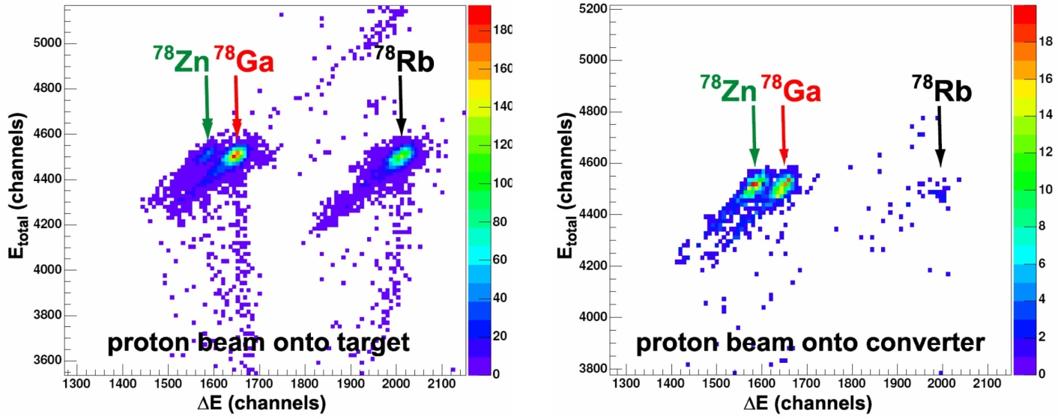
Beam line layout
Beam diagnostics (composition)
1/ Bragg chamber (ex. ¹⁷F beam)
2/ ΔE(gas)-E_{rest}(Si) (ex. ⁷⁸Ga/⁷⁸Zn/⁷⁸Rb)

Slide 10
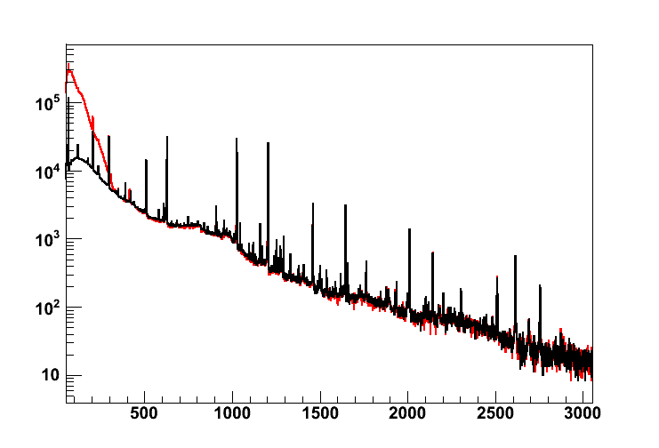
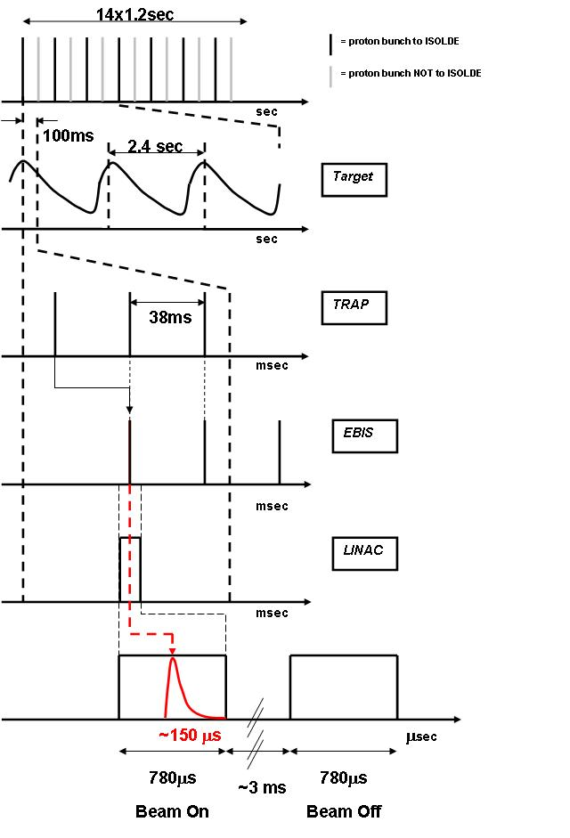
9-gap X-ray background
Counts
γ-ray energy [keV]
"Beam On"
"Beam Off"

Slide 11
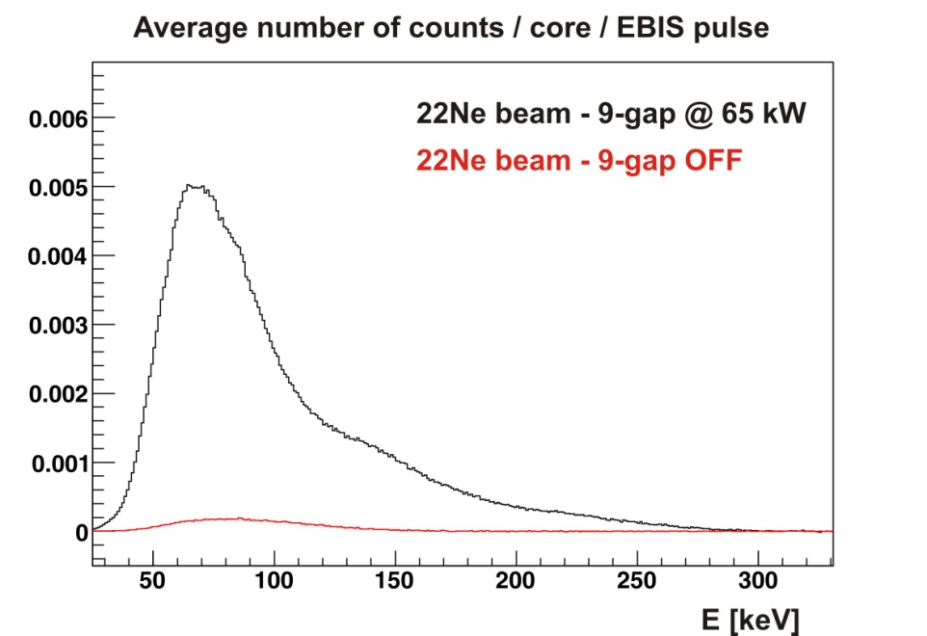
9-gap X-ray background
1/ It IS related to the 9-gap ONLY,
with or without beam

Slide 12
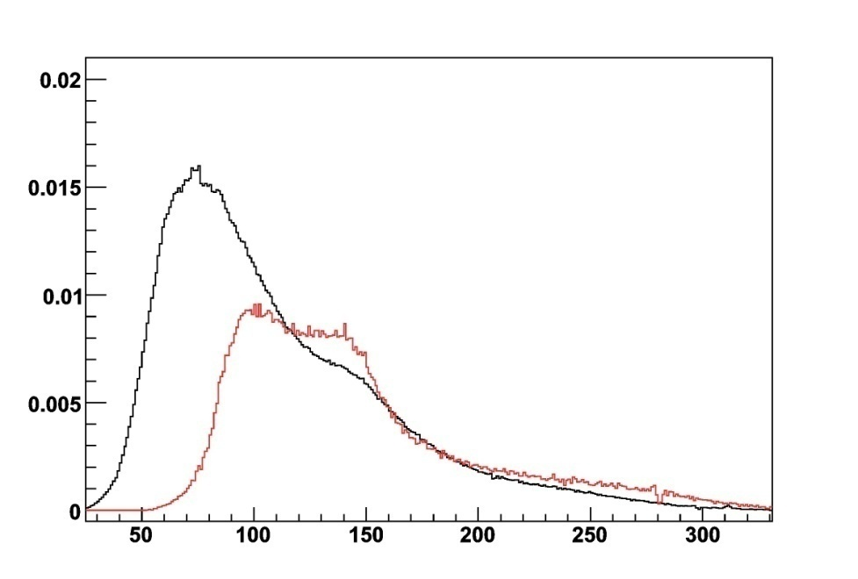
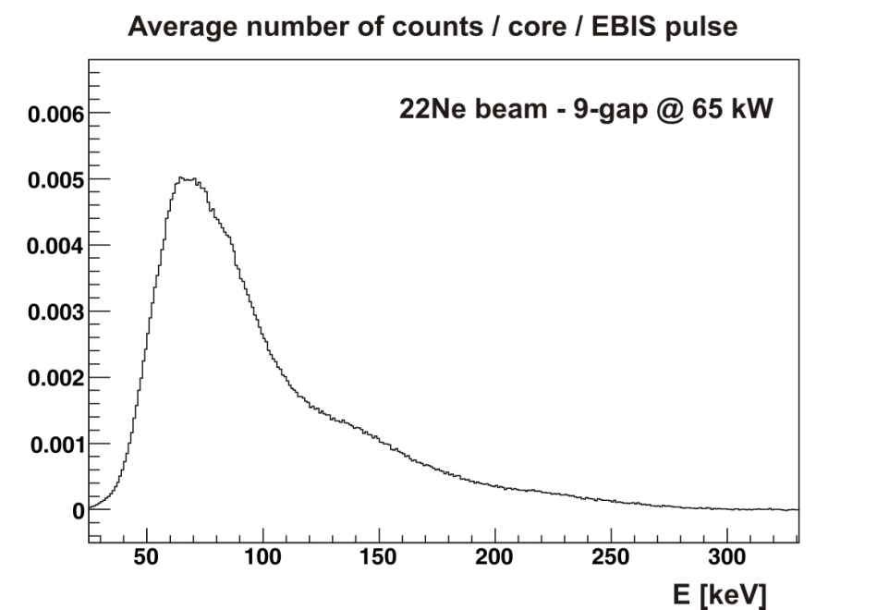
9-gap X-ray background
1/ It IS related to the 9-gap ONLY,
with or without beam
86 kW - 2008
2/ It did not help to move the setup
8 meter more downstream -
change of the spectrum
80 kW - 2004

Slide 13
9-gap X-ray background
1/ It IS related to the 9-gap ONLY,
with or without beam
2/ It did not help to move the setup
8 meter more downstream -
change of the spectrum
3/ The integrated X-ray background
strongly depends on the power of
the 9-gap resonator
!!! Large decrease in background when
valve after 9-gap is closed !!!
ex. 65 kW ⇒ 85 kW : background x 4 !

Slide 14
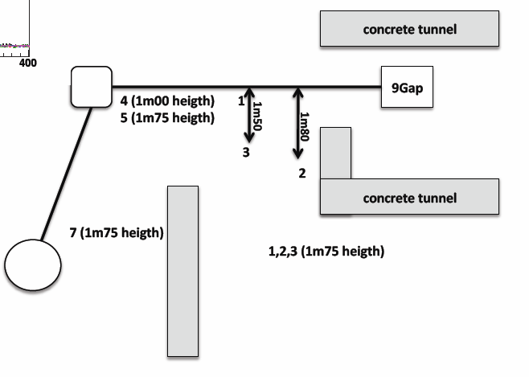
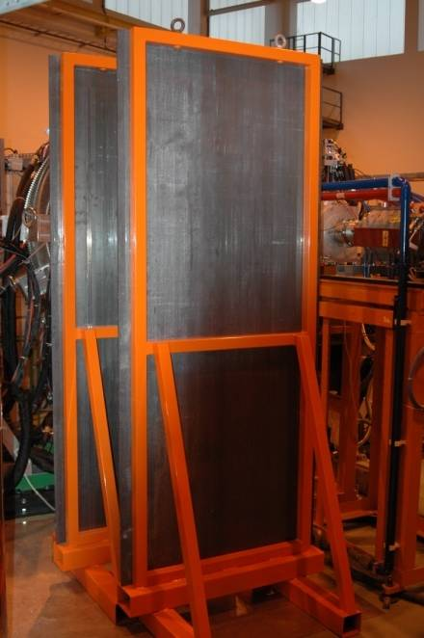
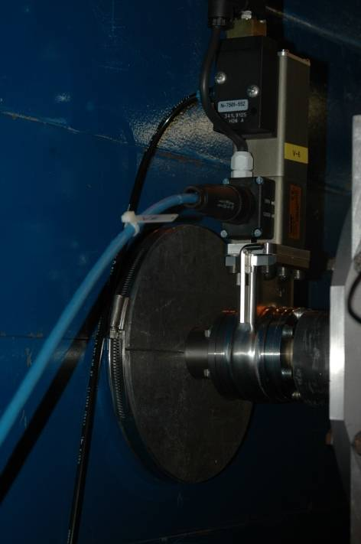
9-gap X-ray background
Measures taken :
1/ Lead collimator after 9-gap + smaller tube
2/ Lead shields close to MINIBALL
3/ TUNNEL (2009)
4/ Endcap of tunnel (2010)

Slide 15
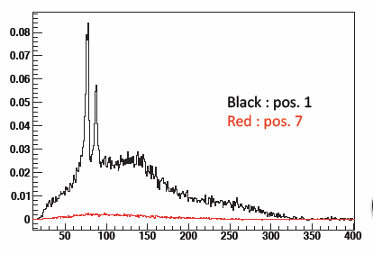
9-gap X-ray background
Measures taken :
1/ Lead collimator after 9-gap + smaller tube
2/ Lead shields close to MINIBALL
3/ TUNNEL (2009)
4/ Endcap of tunnel (2010)
- first test with coaxial detector
- 9-gap @ 65 kW
- different positions around 9-gap
Number of 9-gap γ's in detector
per EBIS pulse

Slide 16
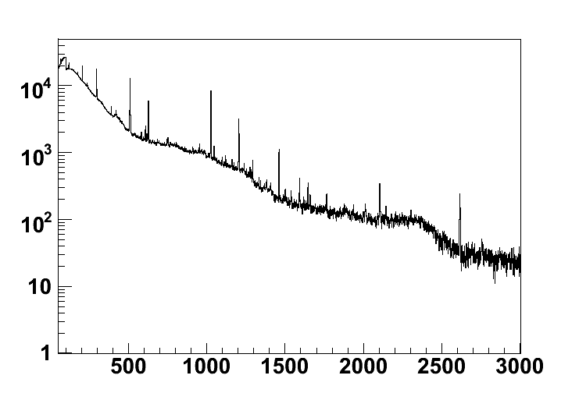
9-gap X-ray background
Does this prevent us from observing low energy γ-rays ?
Counts
γ-ray energy [keV]

Slide 17
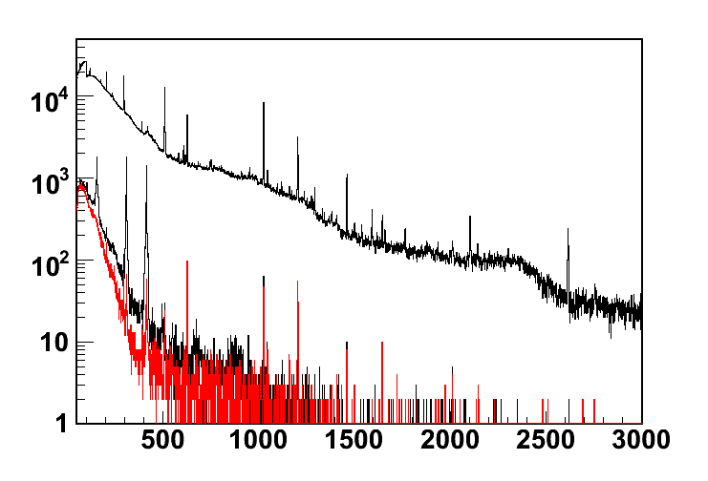
9-gap X-ray background
Does this prevent us from observing low energy γ-rays ? NO
Counts
γ-ray energy [keV]

Slide 18
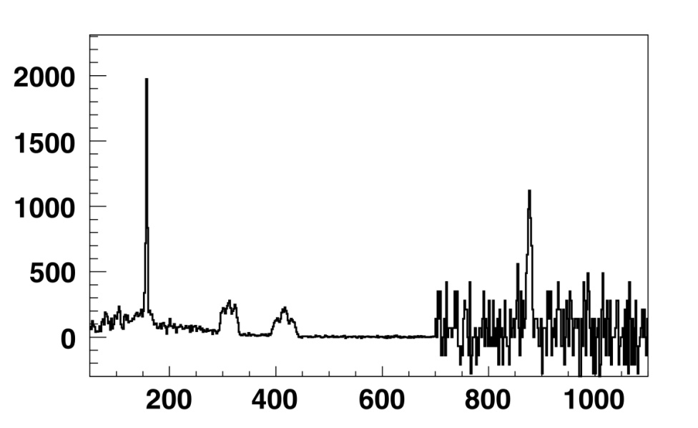
9-gap X-ray background
Does this prevent us from observing low energy γ-rays ? NO
x 70
Counts
Counts
γ-ray energy [keV]
γ-ray energy [keV]

Slide 19
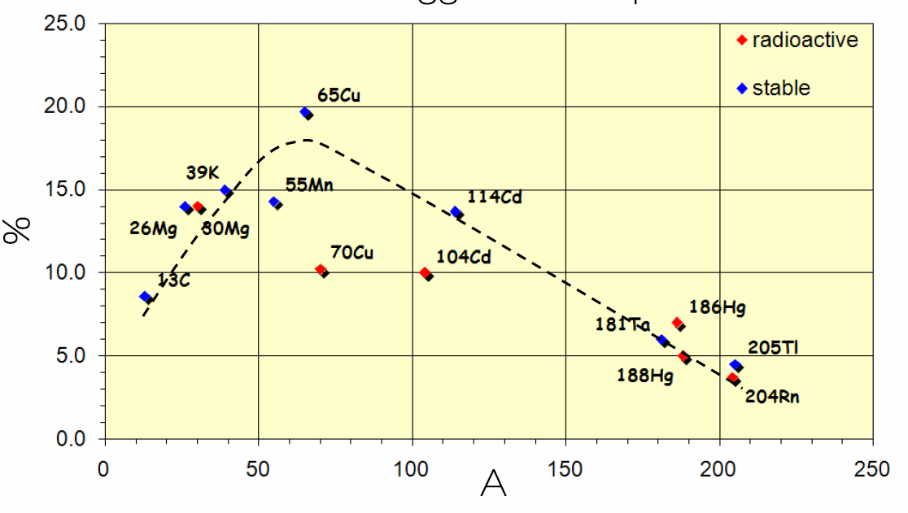
Estimating # of shifts
0h
24h
proton scan + separator setup + yield measurement (1 day)
low energy part : REXTRAP + EBIS transmission (1 day)
⇒ stable beam from ISOLDE !

Slide 20
Estimating # of shifts
0h
24h
proton scan + separator setup + yield measurement (1 day)
low energy part : REXTRAP + EBIS transmission (1 day)
high energy part : linac transmission (1 shift)
⇒ stable beam from EBIS or ISOLDE
≡ "pilot" beam, close in A/q to Radioactive Beam
⇒ efficiency ≈ 60-80 %
⇒ involves MINIBALL in the end
x 0.6-0.8 for "stable pilot beams"

Slide 21
Estimating # of shifts
0h
24h
proton scan + separator setup + yield measurement (1 day)
low energy part : REXTRAP + EBIS transmission (1 day)
high energy part : linac transmission (1 shift)
⇒ stable beam from EBIS or ISOLDE
≡ "pilot" beam, close in A/q to Radioactive Beam
⇒ efficiency ≈ 60-80 %
⇒ involves MINIBALL in the end
Overall efficiency : 2% (A≈200) → 16% (A≈60)
Depends on : mass, scaling of linac, expertise, ...
x 0.6-0.8 for "stable pilot beams"

Slide 22
Estimating # of shifts
0h
24h
proton scan + separator setup + yield measurement (1 day)
low energy part : REXTRAP + EBIS transmission (1 day)
high energy part : linac transmission (1 shift)
radioactive beam ≡ shift request to INTC
⇒ Final Beam Tuning (1/2 - 1 shift)
⇒ Check of electronics
MINIBALL requests at least 1 shift of radioactive
beam before the real physics run can start !

Slide 23
Estimating # of shifts
0h
24h
proton scan + separator setup + yield measurement (1 day)
low energy part : REXTRAP + EBIS transmission (1 day)
high energy part : linac transmission (1 shift)
radioactive beam ≡ shift request to INTC
⇒ Final Beam Tuning (1/2 - 1 shift)
⇒ Check of electronics
⇒ Physics can start
⇒ 1/2 shift for mass change !

Slide 24
Estimating # of shifts
0h
24h
⇒ 1 shift "setup" time with radioactieve beam for MINIBALL is enough !
⇒ 1/2 shift for mass change (scaling the system)
⇒ Schedule : foresee 2 shifts before OR after experiment WITH linac + EBIS availability (*)!
(*) MINIBALL requests calibration run with stable beam from EBIS (should NOT be included in shift request !)
- during proton scan and separator setup ;
- after the experiment ;
Why ? positioning of Germanium detectors with (d(²²Ne,²³Na)p)

Slide 25
Estimating # of shifts
Efficiency of the system depends on expertise of REX & ISOLDE teams,
thus : 2-16 % is "realistic" BUT
⇒ what about "downtime" (e.g. PSB, linac, target, ... typically 1/2-1 shift) ?
⇒ what about "lower then expected yields" ?
INFORMATION IS ONLINE :
isolde.cern.ch
- details of all runs (thanks to REX-team) ;
- ISOLDE yield database soon to be updated with links to REX details ;
www.miniball.york.ac.uk
- WIKI pages with ALL available documentation

Slide 26
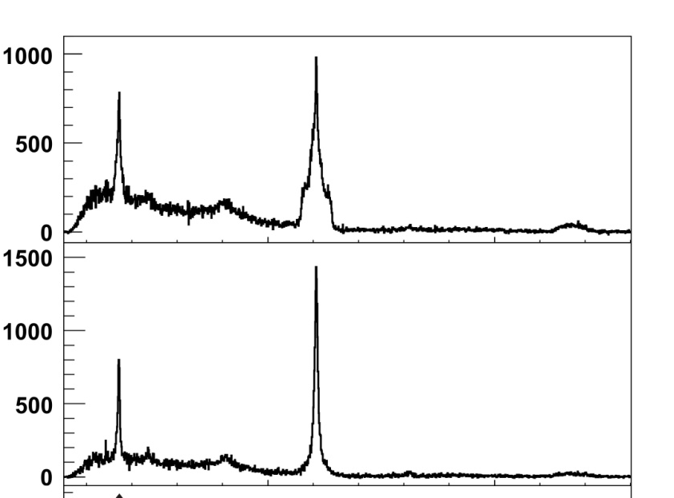
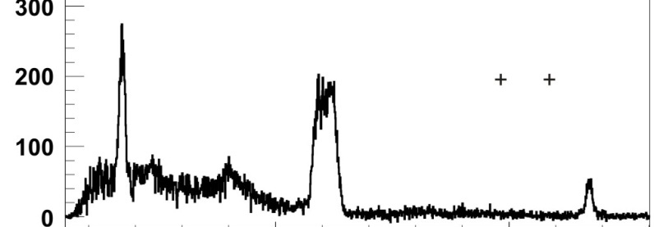

Measurement principle Coulex
ex. : ⁷⁴Zn coulex
Low energy : few low lying levels excited ;
Normalization governed by TARGET :
N_{beam} ∼ σ_{beam}(B(E2),Q₂₊,…) unknown
N_{target} ∼ σ_{target}(B(E2),…) known
NOT Doppler corrected
N_{beam}
N_{target}
Doppler corrected
for beam particles
Counts
Doppler corrected
for target particles
Energy

Slide 27
Measurement principle Coulex
ex. : ⁷⁴Zn coulex
Low energy : few low lying levels excited ;
Normalization governed by TARGET :
N_{beam} ∼ σ_{beam}(B(E2),Q₂₊,…) unknown
N_{target} ∼ σ_{target}(B(E2),…) known
NOT Doppler corrected
N_{beam}
N_{target}
Doppler corrected
for beam particles
Counts
If normalization is hampered by beam contamination :
- Make use of selective laser ionization (RILIS) ;
- Make use of known Coulex of contaminant (if known) ;
- Make use of beam diagnostics (ΔE-E_{rest} / Bragg) for Z<40 ;
Doppler corrected
for target particles
Energy

Slide 28
The MINIBALL collaboration
Steering Committee
P. Van Duppen (KU Leuven, Belgium. chair), G. Lo Bianco (U Camerino, Italy), M. Gorska (GSI, Germany), P. Reiter (U. Koln, Germany), R. Krucken (TU Munich, Germany), D. Jenkins (U. York, UK), Y. Blumenfeld (CERN)
22 universities/institutes and ≈ 100 physicists involved in experiments @ CERN
+ campaigns with MINIBALL detectors @ GSI, LLN, Koln, ...
(during winter shutdown @ CERN)

Slide 29
MINIBALL Publication list 2006-2009
[1] First use of post-accelerated isomeric beams for Coulomb excitation studies of odd-odd nuclei around N=40
G. Georgiev et al., International Journal of Modern Physics E 15, 1505 (2006)
[2] Coulomb Excitation of ⁸⁸Kr and ⁹²Kr in inverse kinematics
D. Mucher et al., Progress in Particle and Nuclear Physics 59, 361-363 (2007)
[3] Measurement of the Sign of the Spectroscopic Quadrupole Moment for the 2⁺₁ State in ⁷⁰Se : No Evidence for Oblate Shape
A. Hurst et al., Physical Review Letters 98, 072501 (2007)
[4] Coulomb excitation of the odd-odd nuclei ^{68,70}Cu; first use of post-accelerated isomeric beams
I. Stefanescu et al., Physical Review Letters 98, 122701 (2007)
[5] Sub-Barrier Coulomb Excitation of ¹¹⁰Sn and its Implications for the ¹⁰⁰Sn Shell Closure
J. Cederkall et al., Physical Review Letters 98, 172501 (2007)
[6] Coulomb Excitation of Neutron Rich Zn isotopes : First Observation of the 2⁺₁ State in ⁸⁰Zn
J. Van de Walle et al., Physical Review Letters 99, 142501 (2007)
[7] Coulomb excitation of neutron-rich ^{138,140,142}Xe at REX-ISOLDE
T. Kröll et al., European Physical Journal Special Topics 150, 127-129 (2007)
[8] Interplay between single-particle and collective effects in the odd-A Cu isotopes beyond N=40
I. Stefanescu et al., Physical Review Letters 100, 112502 (2008)
[9] 0⁺_{gs}→2⁺₁ transition strengths in ¹⁰⁶Sn and ¹⁰⁸Sn
A. Ekström et al., Physical Review Letters 101, 012502 (2008)
[10] Coulomb excitation of ⁶⁸Ni₄₀ at “safe” energies
N. Bree et al., Physical Review C 78, 047301 (2008)
[11] Low Energy Coulomb Excitation of Neutron Rich Zinc isotopes
J. Van de Walle et al., Physical Review C 79, 014309 (2009)
[12] In-Trap Decay of ⁶¹Mn and Coulomb Excitation of ⁶¹Mn/⁶¹Fe
J. Van de Walle et al., accepted for publication in Eur. Phys. J. A (2009)
[13] M. Scheidlitz et al, to be published
[14] Electric quadrupole moments of the 2⁺₁ states in 100,102,104Cd
A. Ekstrom et al., to be submitted
6 Physical Review Letters
2 Physical Review C
4 Other refereed Journals
2 Upcoming aiming at Pysical Review C
Average delay between experiment and publication = 1-2 year

Slide 30
MINIBALL Publication list 2006-2009
International Conferences
[C1] Coulomb Excitation of Neutron-Rich Cd Isotopes at REX-ISOLDE
T. Kröll et al., AIP Conf. Proc. 831, 119 (2006)
[C2] A new setup for transfer reactions at REX-ISOLDE
V. Bildstein et al., Prog. in Part. and Nucl. Phys. 59, 386-388 (2007)
[C3] Quadrupole collectivity of neutron-rich nuclei around ¹³²Sn
T. Kröll et al., AIP Conf. Proc. 1012, 84 (2008)
[C4] One nucleon transfer reactions around ⁶⁸Ni at REX-ISOLDE
N. Patronis et al., AIP Conf. Proc. 1012, 416 (2008)
[C5] Sub-barrier Coulomb excitation of ^{106,108,110}Sn
A. Ekström et al., AIP Conf. Proc. 1012, 296 (2008)
[C6] Coulomb Excitation of the N=50 Nucleus ⁸⁰Zn
J. Van de Walle et al., AIP Conf. Proc. 1012, 291 (2008)
[C7] Lifetime measurements and Coulomb excitation of light Hg nuclei
A. Petts et al., AIP Conf. Proc. 1090, 414 (2009)
[C8] Shell structure and shape changes in neutron rich krypton isotopes
D. Mücher et al., AIP Conf. Proc. 1090, 587 (2009)

Slide 31
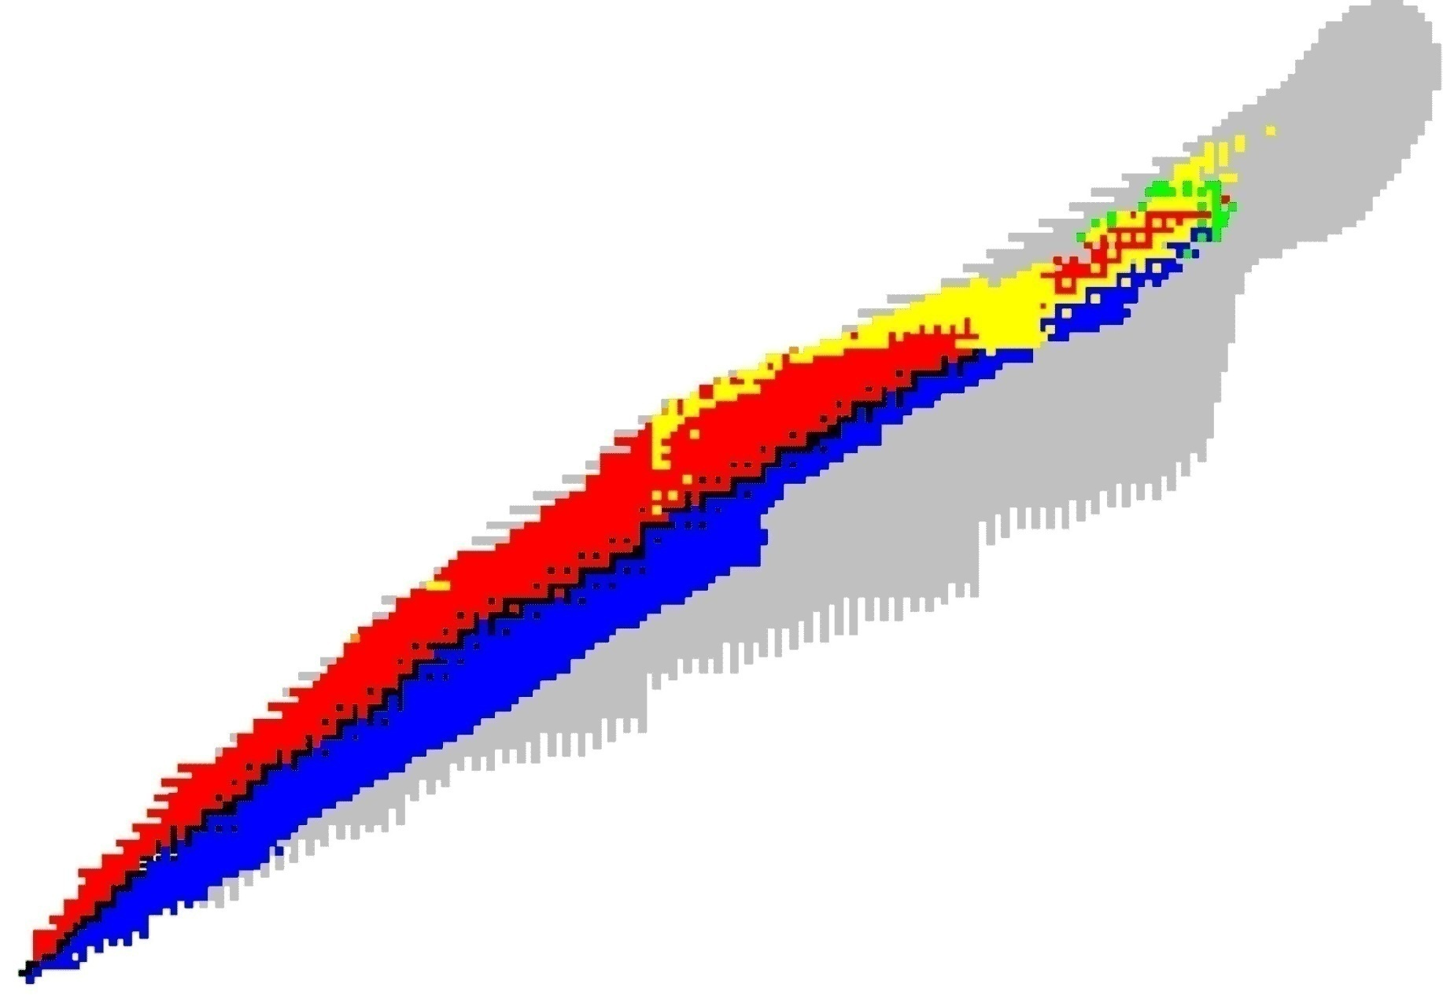
MINIBALL experiments at CERN
Evolution of Shell Structure
the “island of inversion” : ^{30,31,32}Mg (H. Scheit, P. Reiter et al.)
region around ⁶⁸⁻⁷⁸Ni (Z=28, N=40-50) : ⁶⁸Ni, ^{67,69,71,73}Ci, ^{68,70(m)}Cu, ^{74,76,78,80}Zn, ⁶¹Mn, ⁶¹Fe
region around ¹⁰⁰Sn : ^{106,108,110}Sn, ^{100,102,104}Cd (J. Cederkall, A. Ekstrom et al.)
region around ¹³²Sn : ^{138,140,142,144}Xe, ^{122,124,126}Cd, ¹⁴⁰Ba (Th. Kroll, R. Kruecken, Th Behrens et al.)
N=82
Z=82
N=40
N=50
Z=50
^{106,108,110}Sn
^{122,124}Cd
^{138,140}Xe
^{140,148,150}Ba
Z=28
^{74,76,78,80}Zn
^{67,69,71,73}Cu, ⁶⁸Cu, ^{70(m)}Cu
⁶⁸Ni
^{30,31,32}Mg
20

Slide 32
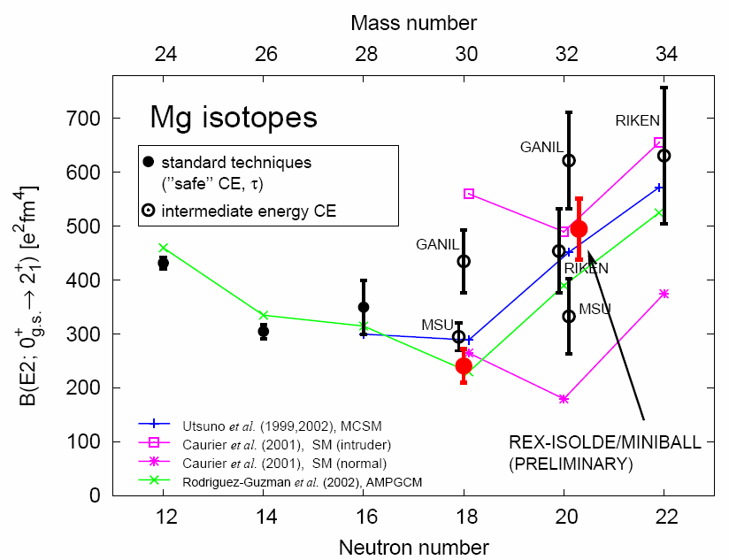
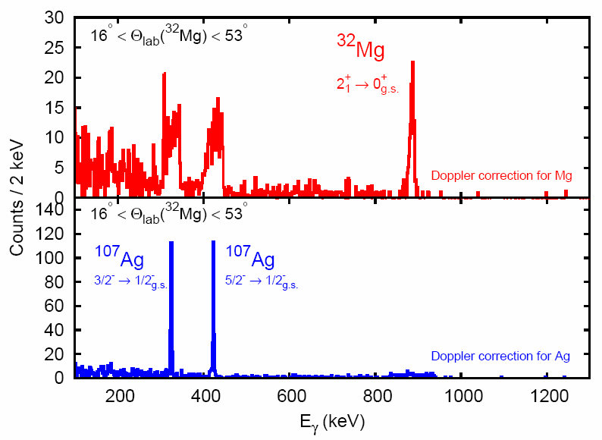
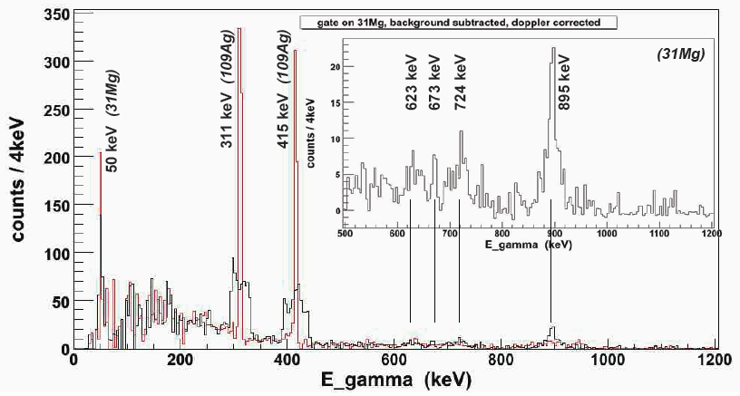
MINIBALL experiments at CERN
the “island of inversion” : ^{30,31,32}Mg
O. Niedermaier et al. PRL 94, 172501 (2005) VERY FIRST !!!
M. Scheidlitz, P. Reiter et al. in preparation
Coulomb excitation :
- Coulex ^{30,32}Mg (2002,2004)
- Coulex ³¹Mg (2007)
- Coulex ^{28,29,30}Na (2009)

Slide 33
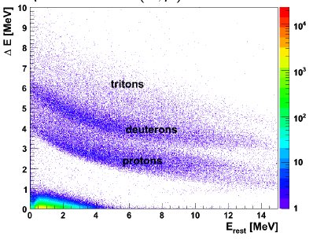
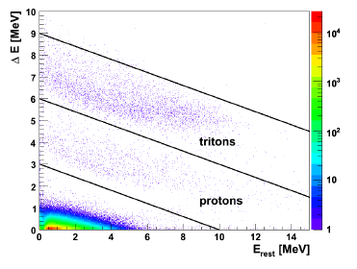
MINIBALL experiments at CERN
the “island of inversion” : ^{30,31,32}Mg
d(³⁰Mg,³¹Mg)p
2007
Transfer reactions :
- d(³⁰Mg,³¹Mg)p (2007)
- t(³⁰Mg,³²Mg)p (2008)
t(³⁰Mg,³²Mg)p
≈ 2000 protons
V. Bildstein, K. Wimmer, et al. 2007-2009
(ISOLDE workshops)
2008
Coulomb excitation :
- Coulex ^{30,32}Mg (2002,2004)
- Coulex ³¹Mg (2007)
- Coulex ^{28,29,30}Na (2009)

Slide 34
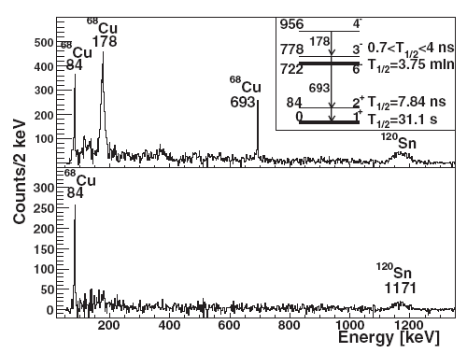
MINIBALL experiments at CERN
region around ⁶⁸⁻⁷⁸Ni (Z=28, N=40-50) : ⁶⁸Ni, ^{67,69,71,73}Ci, ^{68,70(m)}Cu, ^{74,76,78,80}Zn, ⁶¹Mn, ⁶¹Fe
(5⁻)
1350
(4⁻)
956
(5⁻)
506
πp_{3/2}⊕νg_{9/2}
(3⁻)
778
0.7 ns <T_{1/2} <4 ns
6⁻
722
T_{1/2}=3.75 min
1⁺
242
T_{1/2}= 6.6 s
β⁻
(4⁻)
228
2⁺
84
T_{1/2}=7.84 ns
3⁻
101
πp_{3/2}⊕νp_{1/2}
0
0
T_{1/2}= 33 s
1⁺
T_{1/2}=31.1 s
6⁻
T_{1/2}= 45.5 s
β⁻
β⁻
⁶⁸Cu₃₉
⁷⁰Cu₄₁

Slide 35
MINIBALL experiments at CERN
region around ⁶⁸⁻⁷⁸Ni (Z=28, N=40-50) : ⁶⁸Ni, ^{67,69,71,73}Ci, ^{68,70(m)}Cu, ^{74,76,78,80}Zn, ⁶¹Mn, ⁶¹Fe
(5⁻)
1350
(4⁻)
956
(5⁻)
506
πp_{3/2}⊕νg_{9/2}
(3⁻)
778
0.7 ns <T_{1/2} <4 ns
6⁻
722
T_{1/2}=3.75 min
1⁺
242
T_{1/2}= 6.6 s
β⁻
(4⁻)
228
2⁺
84
T_{1/2}=7.84 ns
3⁻
101
πp_{3/2}⊕νp_{1/2}
0
0
T_{1/2}= 33 s
1⁺
T_{1/2}=31.1 s
6⁻
T_{1/2}= 45.5 s
β⁻
β⁻
⁶⁸Cu₃₉
⁷⁰Cu₄₁
First post-accelerated isomeric beams !
Stefanescu et al. PRL 98, 122701 (2007)

Slide 36
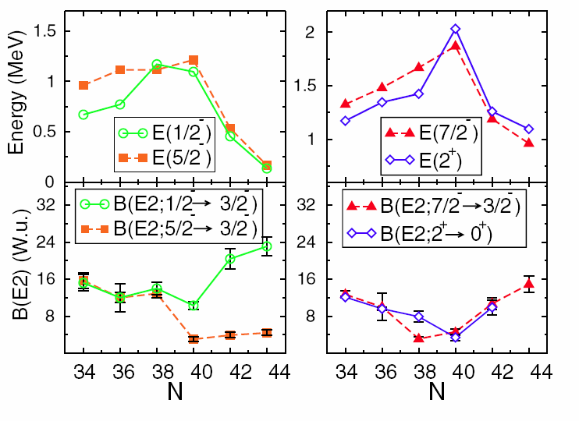
MINIBALL experiments at CERN
region around ⁶⁸⁻⁷⁸Ni (Z=28, N=40-50) : ⁶⁸Ni, ^{67,69,71,73}Ci, ^{68,70(m)}Cu, ^{74,76,78,80}Zn, ⁶¹Mn, ⁶¹Fe
^{67,69,71,73}Cu
50
50
g_{9/2}
○○○○○○○○○○
g_{9/2}
○○○○○○○○○○
40
40
p_{1/2}
○○
p_{1/2}
ll
f_{5/2}
○○○○○○
f_{5/2}
llllll
p_{3/2}
l○○○
p_{3/2}
llll
28
28
f_{7/2}
llllllll
f_{7/2}
llllllll
sd-shell
sd-shell
π
ν
Identification of
1/2⁻ "collective" state
7/2⁻ "collective" state (coupling of πp_{3/2} to 2⁺ in Ni)
Stefanescu et al. PRL 100, 112502 (2008)

Slide 37
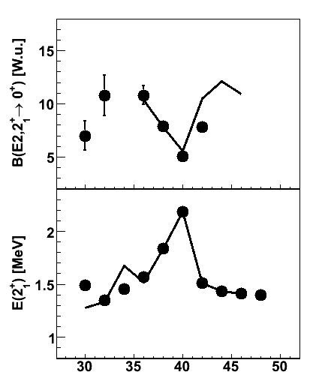
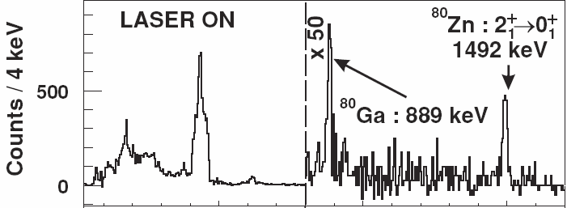

MINIBALL experiments at CERN
region around ⁶⁸⁻⁷⁸Ni (Z=28, N=40-50) : ⁶⁸Ni, ^{67,69,71,73}Ci, ^{68,70(m)}Cu, ^{74,76,78,80}Zn, ⁶¹Mn, ⁶¹Fe
⁸⁰Zn
J. Van de Walle et al. PRL 99, 142501 (2007)
+ PRC 79, 014309 (2009)
50
50
g_{9/2}
○○○○○○○○○○
g_{9/2}
llllllllll
40
40
p_{1/2}
○○
p_{1/2}
ll
f_{5/2}
○○○○○○
f_{5/2}
llllll
p_{3/2}
ll○○
p_{3/2}
llll
28
28
Z
f_{7/2}
llllllll
f_{7/2}
llllllll
sd-shell
sd-shell
π
ν
Notes:
37

Slide 38
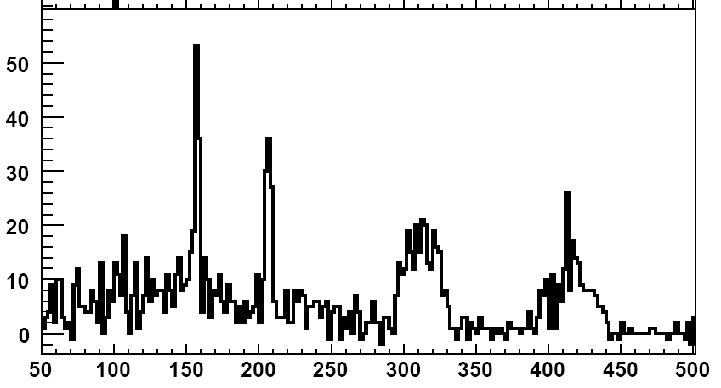
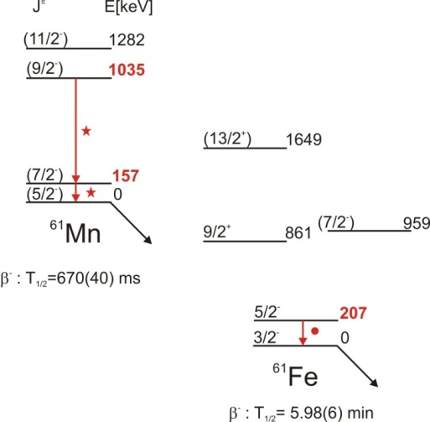
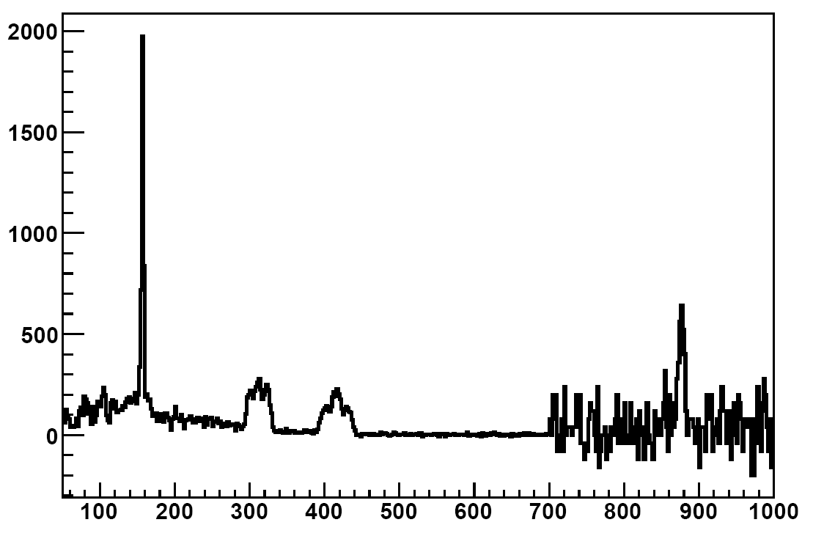
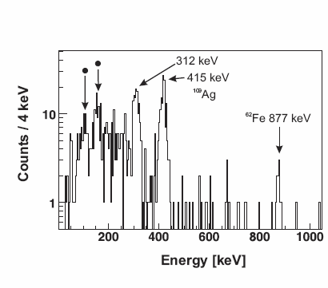
MINIBALL experiments at CERN
Counts
⁶¹Mn
⁶¹Fe
Energy [keV]
⁶¹Mn, ⁶¹Fe, ⁶²Mn, ⁶²Fe
J. Van de Walle et al., accepted for EPJA
Counts
⁶¹Mn
X 40
⁶¹Mn
¹⁰⁹Ag
312 keV 415 keV
Energy [keV]
Notes:
38

Slide 39
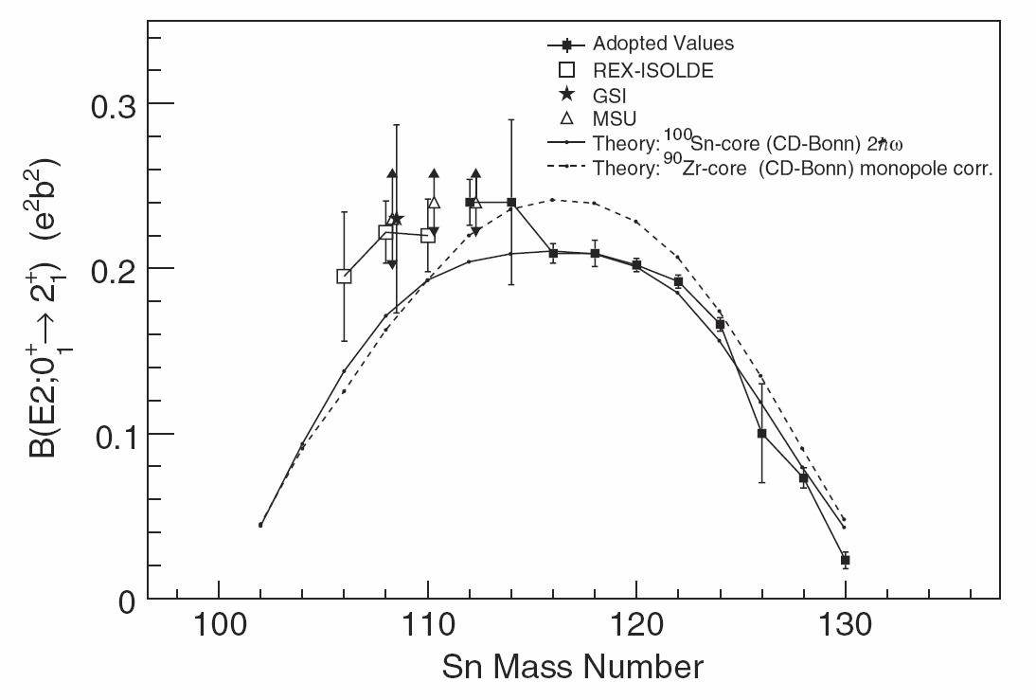
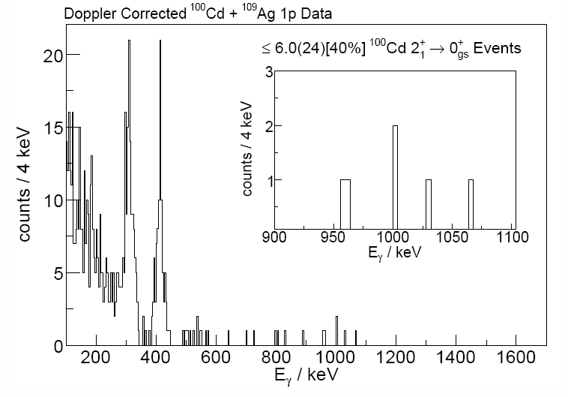
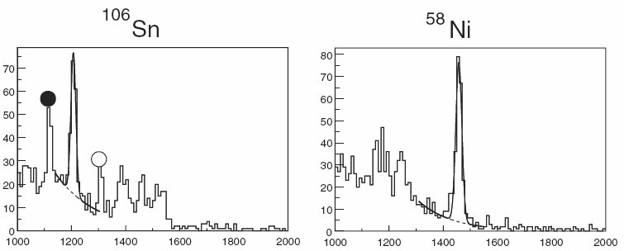
MINIBALL experiments at CERN
region around ¹⁰⁰Sn : ^{106,108,110}Sn, ^{100,102,104}Cd (J. Cederkall, A. Ekstrom et al.)
J. Cederkall et al. PRL 98, 172501 (2007)
A. Ekstrom et al. PRL 101, 012502 (2008)
A. Ekstrom et al. in preparation for PRC
¹⁰⁶Sn
¹⁰⁰Cd 3x10³ pps
Notes:
39

Slide 40
MINIBALL experiments at CERN
Evolution of Shell Structure + upcoming
the “island of inversion” : ^{30,31,32}Mg (H. Scheit, P. Reiter et al.) + ^{28,29,30}Na
region around ⁶⁸⁻⁷⁸Ni (Z=28, N=40-50) : ⁶⁸Ni, ^{67,69,71,73}Ci, ^{68,70(m)}Cu, ^{74,76,78,80}Zn, ⁶¹Mn, ⁶¹Fe
+ d(⁷⁸Zn,⁷⁹Zn)p + ⁷²Zn g-factor + d(⁶⁶Ni,⁶⁷Ni)p + ⁶²Fe/⁶²Mn
region around ¹⁰⁰Sn : ^{106,108,110}Sn, ^{100,102,104}Cd (J. Cederkall, A. Ekstrom et al.)
+ ^{103,105,107}Sn
region around ¹³²Sn : ^{138,140,142,144}Xe, ^{122,124,126}Cd, ¹⁴⁰Ba (Th. Kroll, R. Kruecken, Th Behrens et al.)
+ ¹²⁸Cd
N=82
Z=82
N=40
N=50
Z=50
^{106,108,110}Sn
^{122,124}Cd
^{138,140}Xe
^{140,148,150}Ba
Z=28
^{74,76,78,80}Zn
^{67,69,71,73}Cu, ⁶⁸Cu, ^{70(m)}Cu
⁶⁸Ni
^{30,31,32}Mg
20

Slide 41
MINIBALL experiments at CERN
Shape Co-existence
⁷⁰Se and ⁹⁶Sr
^{202,204}Rn
^{182,184,186,188}Hg
N=82
^{182,184,186,188}Hg
Z=82
N=40
N=50
Z=50
⁷⁰Se
⁹⁶Sr
Z=28
20

Slide 42
MINIBALL experiments at CERN
Determining the sign and magnitude of the spectroscopic Quadrupole Moment … How ?
Combining lifetime measurements and Coulomb excitation
  ☹ Accurate Lifetime measurement needed (non-trivial for rare isotopes)
  Relatively low statistics in Coulomb excitation
  (since only integrated cross section is needed)
From the sensitivity to diagonal matrix element in Coulex ( ⇒ Q₂₊= 0.7479 <2⁺||M(E2)||2⁺>)
  No external input needed
  ☹ High statistics needed

Slide 43
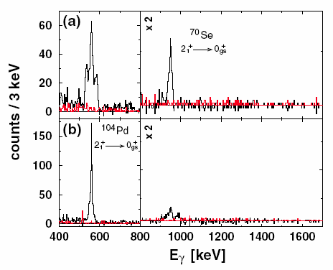
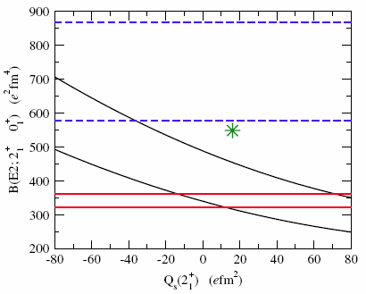
MINIBALL experiments at CERN
⁷⁰Se
A.M. Hurst et al. PRL 98, 072501 (2007)
J. Ljungvall et al. PRL 100, 102502 (2008)

Slide 44



MINIBALL experiments at CERN
PRELIMINARY
Analysis by N. Bree (KU Leuven)
Counts
413 keV (¹⁸⁸Hg)
Q₂₊ = +1.5 b (oblate)
592 keV (¹⁸⁸Hg) +
558 keV (¹¹⁴Cd)
Q₂₊ = 0 b (spherical)
Hg <0+||E2||2+>
Energy [keV]
Diff Cross Section
(b/srad)
1208
4⁺
1005
4⁺
881
2⁺
592
824
0⁺
413
2⁺
413
0
0⁺
Center-of-mass angle

Slide 45
MINIBALL experiments at CERN
Shape Co-existence : upcoming
⁷⁰Se and ⁹⁶Sr + ⁹⁶Kr,⁷²Kr
^{202,204}Rn + ^{222,224}Ra ^{220,222}Rn
^{182,184,186,188}Hg + ^{198,200,202}Po + ^{188,190,192}Pb
+ rare earth isotopes (LOI)
N=82
^{182,184,186,188}Hg
Z=82
N=40
N=50
Z=50
⁷⁰Se
⁹⁶Sr
Z=28
20

Slide 46
MINIBALL experiments at CERN
Astrophysics
¹⁷F : analysis ongoing

Slide 47

Conclusion
Successes due to available beams at REX-ISOLDE
Well understood setup and analysis method
Combining know-how from different
universities and institutes
Extensive online documentation for users
Direct reactions are starting up ...
waiting for ...

