Slide 1
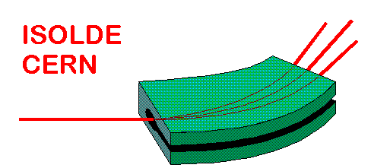

Solid state physics @ ISOLDE:
Status report to the INTC
Monday 18 May 2009
Karl Johnston

Slide 2
SSP investment: money & people
Maintenance and operation | CERN | 150 k€ /year
Positions (100%) | CERN | 1
Participating Countries | 21
Participating Institutes | 41
Postdocs/professors | 50
Graduate Students (estimate) | 30
Outline of talk
        Infrastructure upgrades
        Solid state experiments at ISOLDE
        Recent highlights
        Forthcoming developments

Slide 3
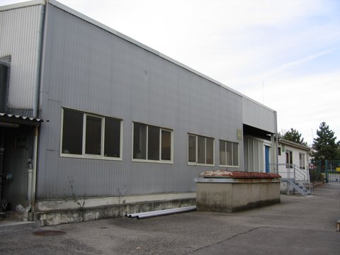
Solid State Extension, building 115
Conversion of half of old workshop in building 115 into lab for solid state physics (April 2008).
More space for experiments
Consolidation of PAC techniques, all now located within the ISOLDE “zone”. Often these half-lives are short (e.g. ^{199m}Hg = 42.6 mins).
Separation of preparation and measuring areas.
Installation of CERN network (general and technical) and wireless repeater.

Slide 4
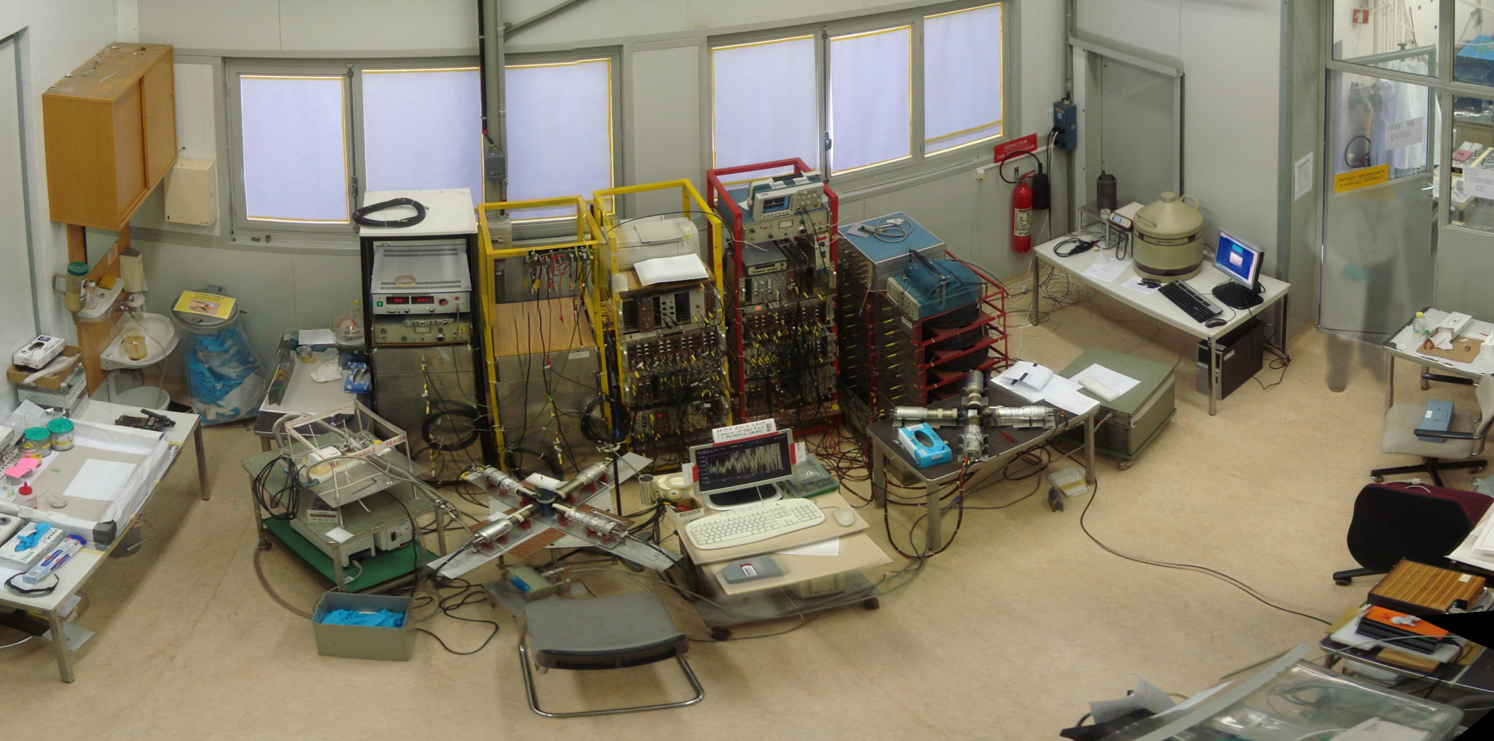
Solid State Extension, building 115

Slide 5
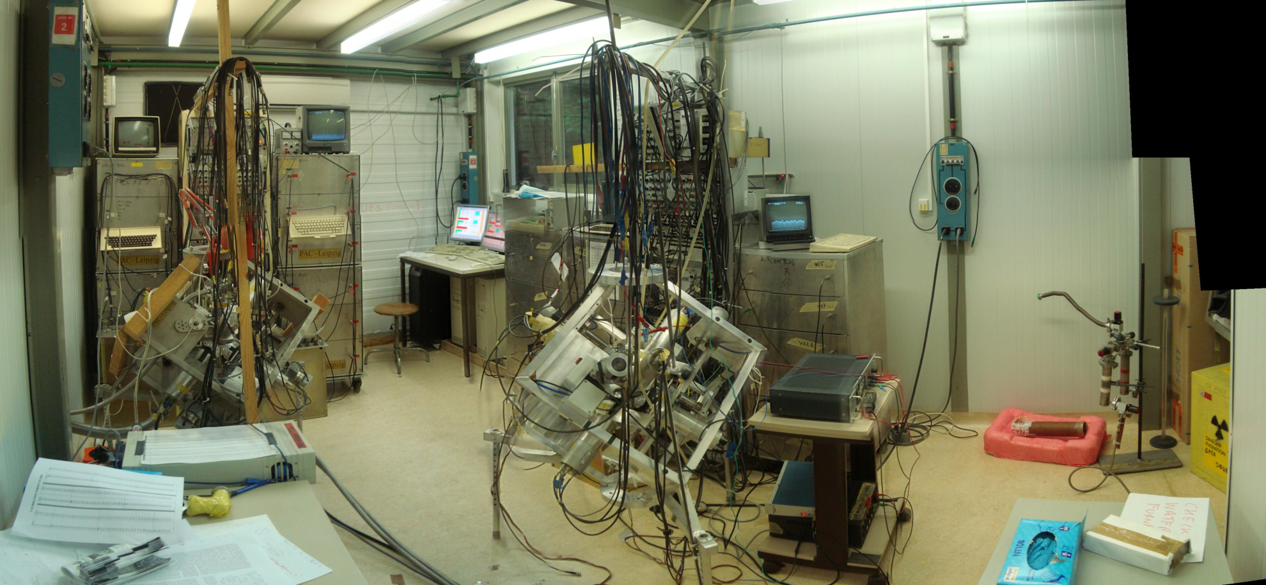
Solid State Extension, building 115

Slide 6
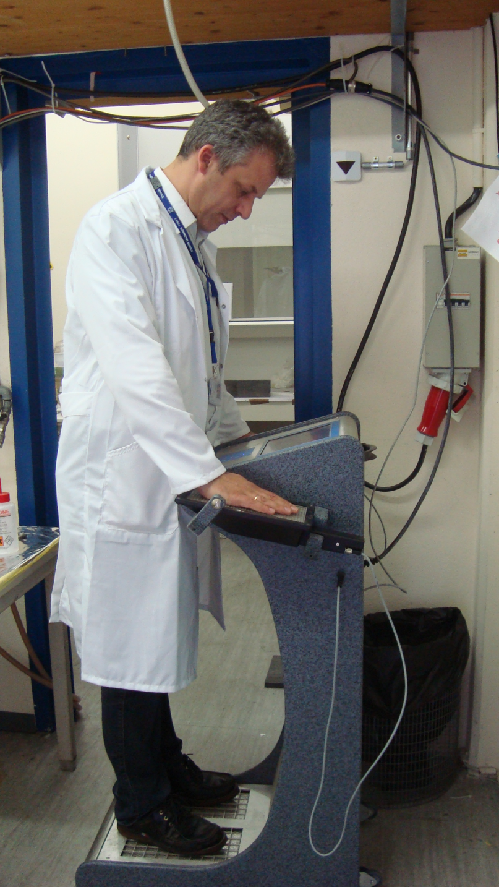
Lab upgrades: Safety
Installation of new Hand-foot monitor. RAMSES-monitoring system. Installed Summer 2008.
  Capable of detecting α-contamination in addition to β and γ.
  Integrated into technical network.
CERN-standard hand monitors (AD-6 doseratemeter and AD-k contamination probe) ordered. To replace non-standard Berthold probe.
Installation of new smoke and fire detectors. (April 2009).

Slide 7
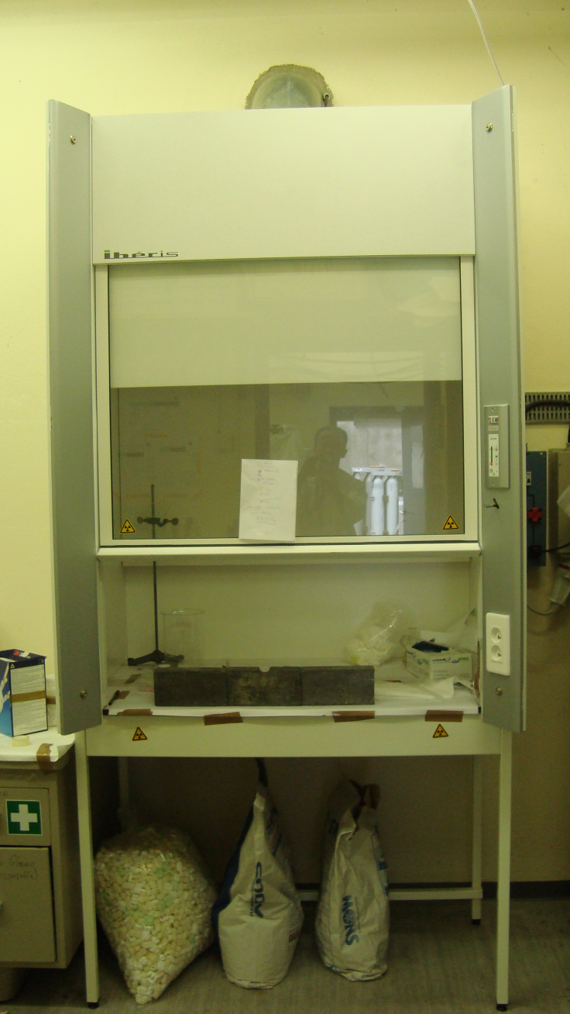
Lab upgrades: Chemistry
General improvements for handling, using and storing chemicals. Especially important for biophysics experiments.
New fume cupboard, installed September 2008.
Proper chemical storage facilities, ordered…
More space available as a result of lab extension.

Slide 8
RIB solid state physics as applied nuclear physics
Nuclear probes
Interactions
Methods
Radioactive
Nuclei
➔ γ, α, β
Hyperfine
Interaction
Mößbauer effect
γγ angular correlation
Nuclear Magnetic resonance
Nuclear orientation
Radioactive
decay
DLTS
Photoluminescence
Tracer Diffusion
Muons
➔ ß⁺
Coulomb
Interaction
Nuclear
Physics
Emission Channeling
Ion Channeling
Backscattering
Elastic Recoil
Resonant Scattering
Neutron Scattering
Solid state physics
applications
Ions
Scattering,
Diffraction
Neutrons
Nuclear
Reaction
Nuclear Reaction Analysis
Positrons
ß⁺-e⁻
Interaction
Positron Annihilation
Positron Angular Distribution
Positron Energy Distribution

Slide 9
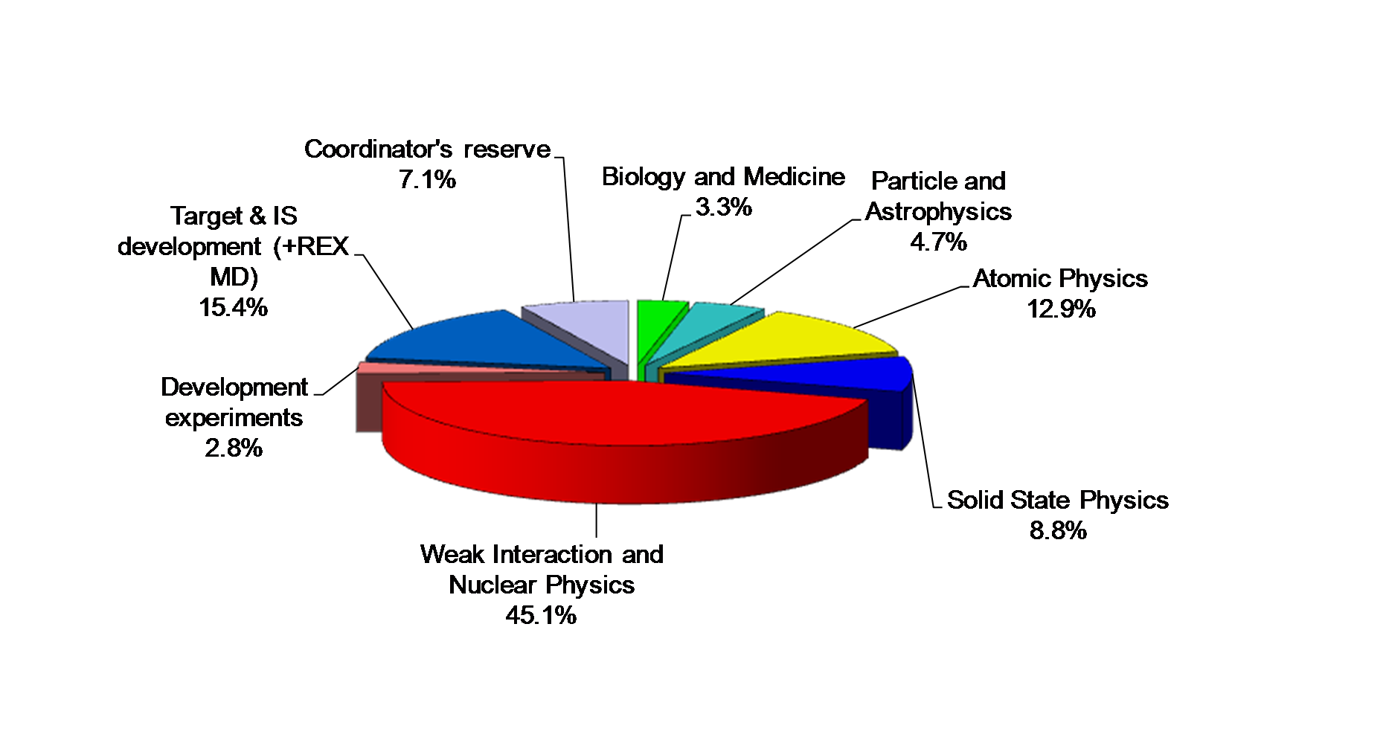
Breakdown of ISOLDE running period 2008

Slide 10
Breakdown of SSP experiments @ ISOLDE
15 running experiments for 2009

Slide 11
SSP & Bio Experiments @ ISOLDE
LOI81 | Radioactive probe studies of coordination mechanisms of heavy metal ions from natural waters to functionalized magnetic nanoparticles | Vitor Amaral CICECO, Aveiro, Portugal | (BIO)PHYSICS (cleaning waters)
IS492 | Defects in ZnO, CdTe, and Si: Optical, structural, and electrical characterization | Manfred Deicher TPUS, Saarbrücken, Germany | SEMICONDUCTORS (defects characterization)
IS489 | Radiotracer diffusion in semiconductors and metallic compounds using short-lived isotopes | Manfred Deicher TPUS, Saarbrücken, Germany | SEMICONDUCTORS (diffusion)
IS488 | Ag(I), Pb(II) and Hg(II) binding to biomolecules studied by Perturbed Angular Correlation of γ-rays (PAC) spectroscopy: Function and toxicity of metal ions in biological systems | Lars Hemmingsen RVAUDNS, Frederiksberg, Denmark | BIOPHYSICS (detoxification In vitro - in vivo-plants)
IS487 | Study of Local Correlations of Magnetic and Multiferroic Compounds | Vitor Amaral CICECO, Aveiro, Portugal | MULTIFERROIC oxides (magnetism, charge & lattice ordering - …
IS486 | Crystal field investigations of rare earth doped wide band gap semiconductors | Ulrich Vetter PIUG, Göttingen, Germany | SEMICONDUCTORS (wide band gap)
IS481 | The role of In in III-nitride ternary semiconductors | Katharina Lorenz ITN, Sacavém, Portugal | SEMICONDUCTORS (ternary)
IS472 | High Resolution optical spectroscopy in isotopically-pure Si | Karl Johnston TPUS, Saarbrücken, Germany | SEMICONDUCTORS (fundamental)
IS464 | (n,p) emission channeling measurements on ion-implanted beryllium | Uli Köster ILL, Grenoble, France | Semiconductors (R&D)
IS453 | Emission channelling lattice location experiments with short-lived isotopes | Ulrich Wahl ITN, Sacavém, Portugal | SEMICONDUCTORS & OXIDES (lattice location dopants)
IS450 | Diffusion of ⁵⁶Co in GaAs, ZnO and Si_{1-x}Ge_{x} systems | Jyrki Räisänen ALUH, Helsinki, Finland | SEMICONDUCTORS (diffusion)
IS448 | Pb(II) and Hg(II) binding to de novo designed proteins studied by ^{204m}Pb- and ^{199m}Hg PAC spectroscopy: clues to heavy metal toxicity | Lars Hemmingsen RVAUDNS, Frederiksberg, Denmark | BIOPHYSICS (detoxification)
IS443 | Mössbauer studies of dilute magnetic semiconductors | Marco Fanciulli INFN, Milano, Italy | SEMICONDUCTORS (magnetism)
IS432 | Diffusion of ⁵²Mn in GaAs | Jyrki Räisänen ALUH, Helsinki, Finland | SEMICONDUCTORS (diffusion)
IS425 | Radioactive probes on ferromagnetic surfaces | Wolf-Dietrich Zeitz HMI, Berlin, Germany | (INTER) SURFACES (fundamental)

Slide 12
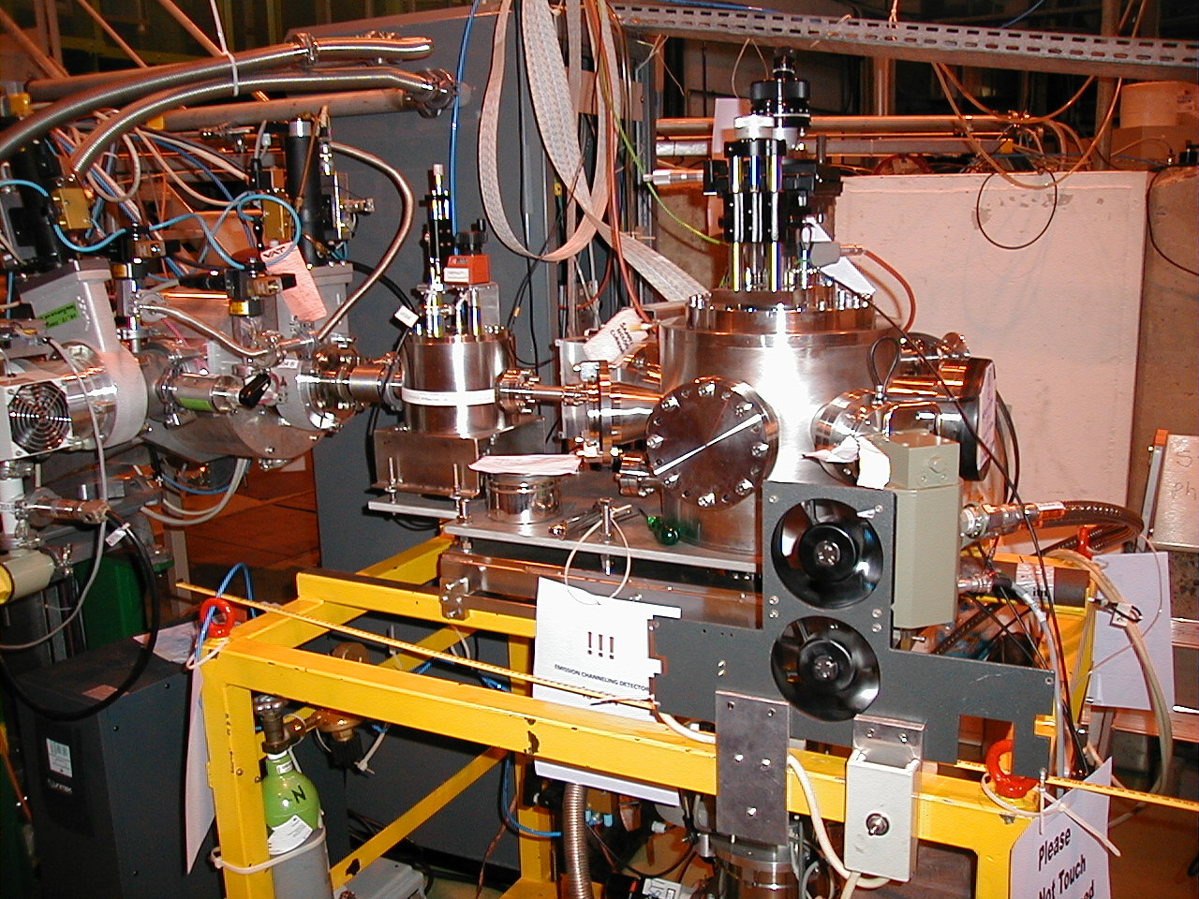
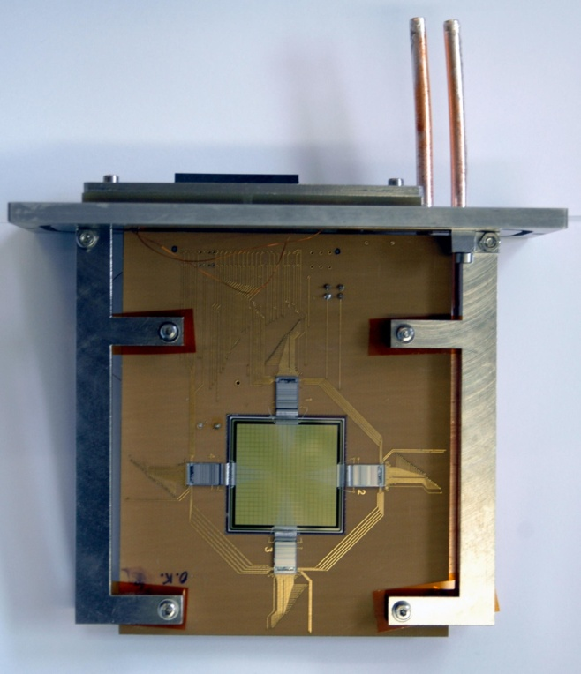
New online methods I: Emission Channelling (IS453)
NEW pad-Si FAST 2D electron detector
NEW cooling system
down to 50K

Slide 13
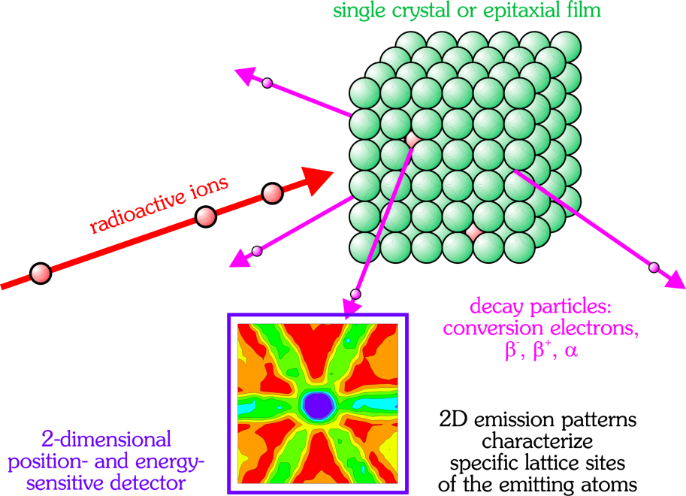
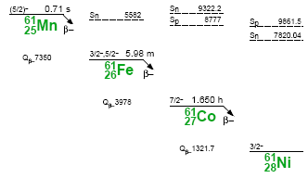
Recent Highlights I: online emission channelling
β⁻ emission channeling patterns
from ⁶¹Co in GaN
Lattice location of:
electrical, optical and magnetic dopants in wide-band gap materials
ZnO, AlN, InN, diamond
&
spintronic materials
Plan for 2009: Mg
⁶¹Co on substitutional Ga sites

Slide 14
New online methods II: Diffusion (IS489)
¹¹¹Ag Implantation
550 … 900 K
CdTe
Ø = 6 mm
d = 800 µm
thermal
treatment
¹¹¹Ag
CdTe
CdTe:¹¹¹Ag
T_{diff} = 570 K
t_{diff} = 30 min
“Normal” diffusion profile
Symmetrical diffusion profile,
depletion of surface regions
1...30 µm
(H. Wolf et al., Phys. Rev. Lett. 94 (2005) 125901)

Slide 15
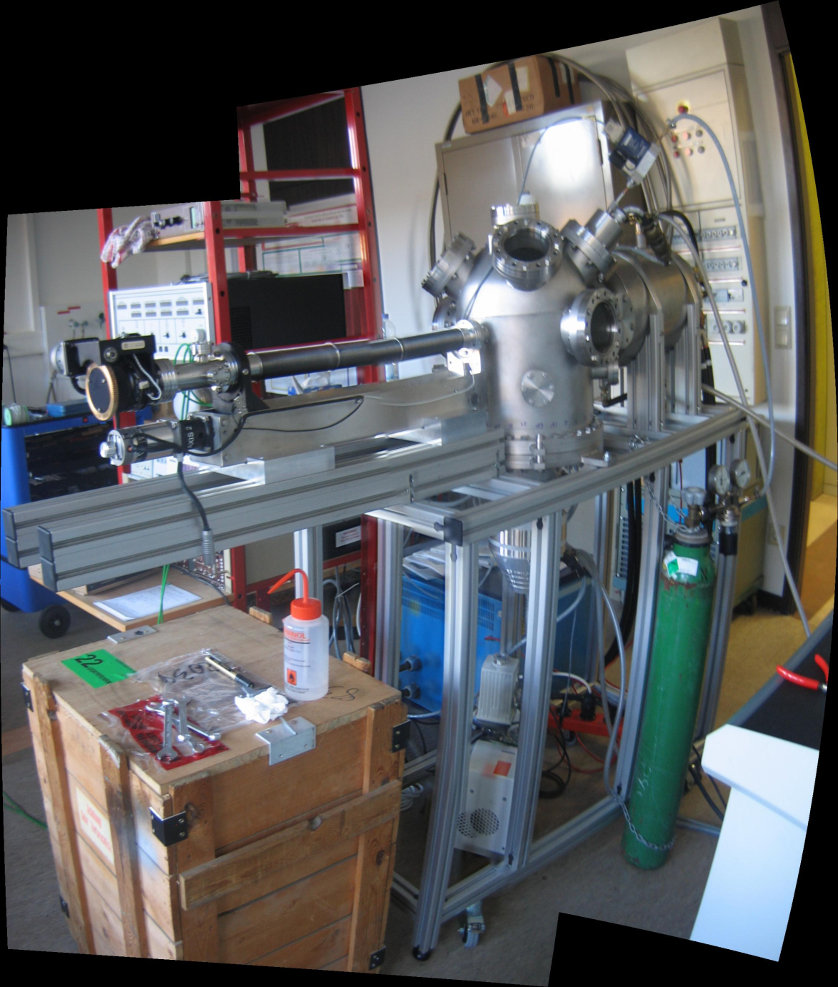
New online methods II: Diffusion (IS489)
High-vacuum chamber for tracer diffusion measurements has been constructed.
Will allow in-situ implantation, annealing, sectioning of the sample by ion-sputtering and measurement of sample
Changing of samples without breaking vacuum
Will facilitate the study of radioactive isotopes for tracer diffusion studies with half-lives down to minutes.
Delivery to ISOLDE: Summer 2009

Slide 16
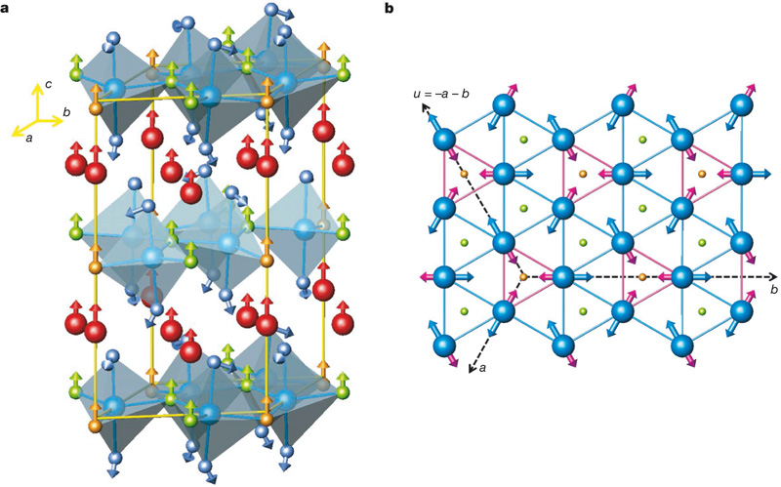
Recent Highlights II: Multiferroic materials
Strongly correlated electron systems:
Subtle entanglement of
spin, charge, orbital
and lattice degrees of freedom
HTC Superconductivity
Colossal magnetoresistance
Charge Ordered/Orbital Ordered
Complex multi-scale world with:
Intrinsic Inhomogeneities
Clusters or stripes
Phase segregation

Slide 17
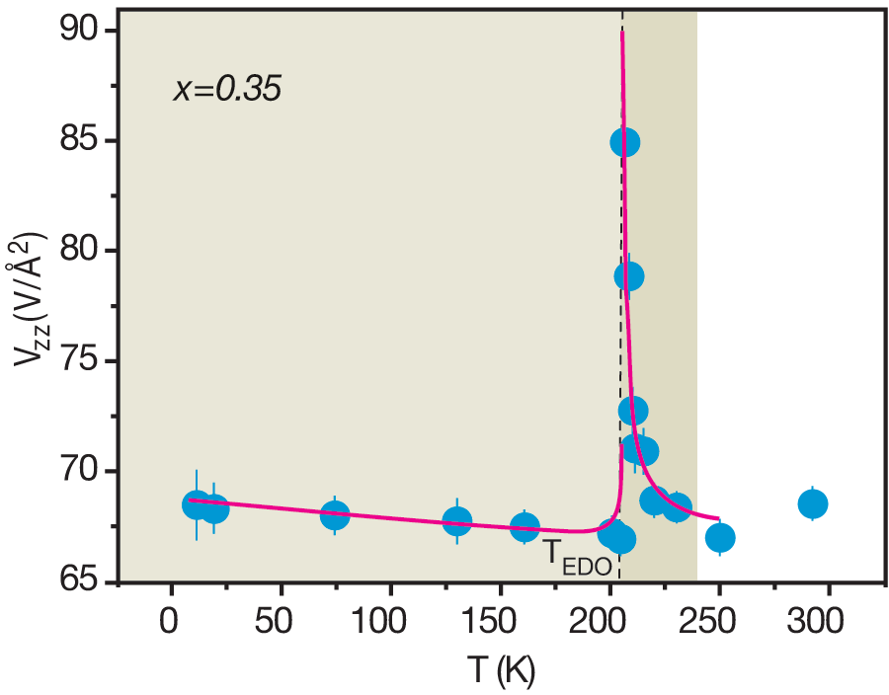
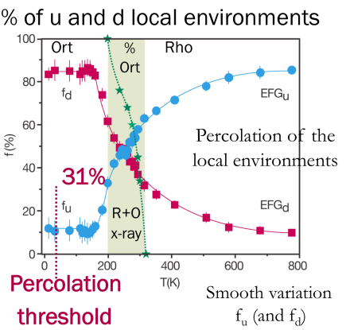
Recent Highlights II: Multiferroic materials
Local Correlations of Magnetic and Multiferroic Compounds
NEW: Pr_{1-x}Ca_{x}MnO₃
Local probing of first-order dielectric phase transition below T_{co}
PRL100, 155702 (2008)
…for the next 3 years:
TO BE STUDIED:
Local environment in multiferroic compounds
Manganites: R MnO₃ ( R= Y, Lu, Ho,Tb, Dy )
Nickelates: R NiO₃ ( R= Y, Lu )
TO BE STARTED:
Spin-driven ferroelectricity
Chromites: M CrO₂ ( M= Cu, Ag)
Spinels: D Cr₂X₄, ( D= Cd, Hg, Co, Fe and X=O, S, Se)
NEW: LaMnO_{3.12}
Percolative transition on ferromagnetic insulator manganites:
Unrelated to correlated polaron clusters
PRB73, 100408 (2006)
What we can learn:
Competition between charge and orbital order
Local distortions, polaron correlations and magneto-structural effects

Slide 18
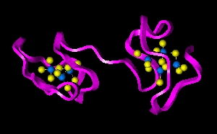
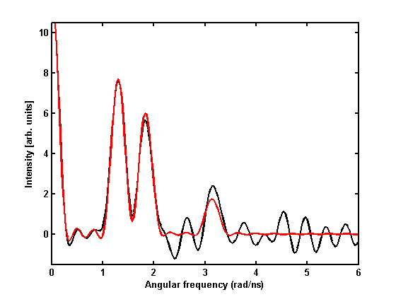
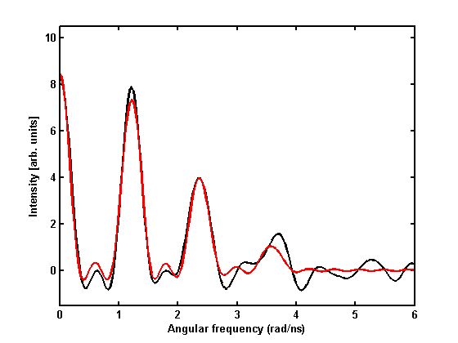
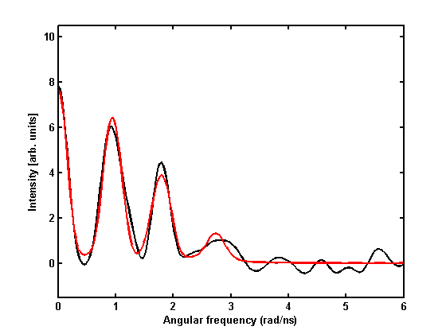
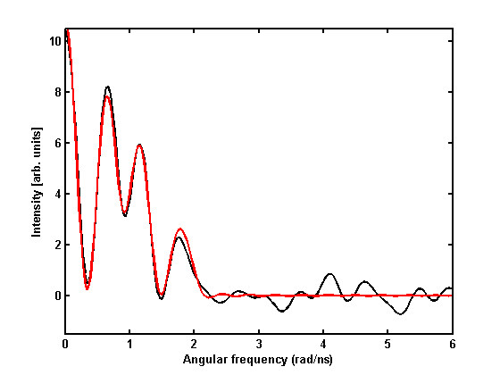
Recent Highlights III: Biophysics
Study areas:
  Multiple metal ion binding sites in biomolecules
  (DNA, RNA, MTs)
  De novo designed proteins
  Metal ion mediated protein folding & misfolding
  In vivo PAC studies
Hg(salen)‏
Hg(2-mercaptoanilin)2
Hg(1-methylimidazole)₂Cl₂
Hg(2,2’-bipy)₂Cl₂

Slide 19
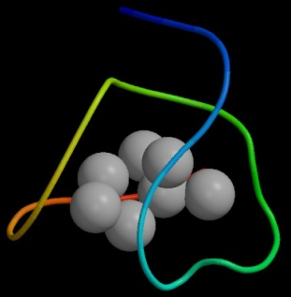
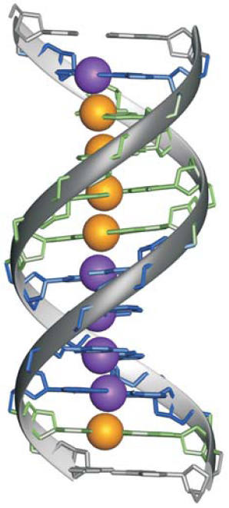
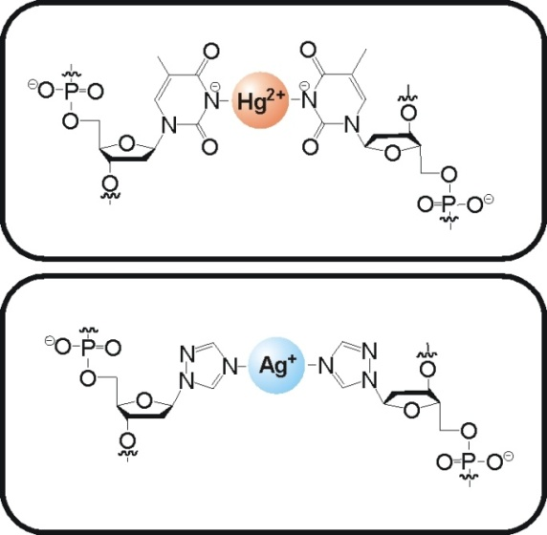
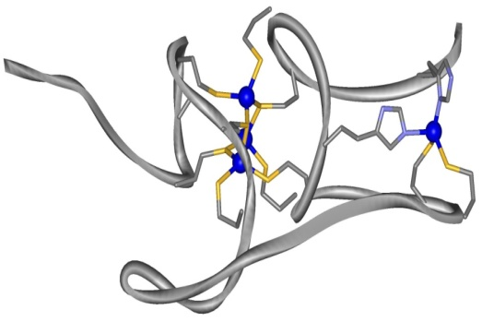
Recent Highlights III: Biophysics
Directions for 2009
Molecular wires based on metal-modified nucleic acids
Ag(I), Hg(II), and Pb(II) coordination environments in metallothioneins (MTs)
Aims:
  Determining the coordination environments of Ag(I), Hg(II), and Pb(II) in the MT species formed by substitution of Zn(II) in several Zn-MT forms: Plant MTs and yeast CUP1
  Study different heavy metal/protein stoichiometries
Structure?
Zn₄β_{E}-E_{c}-1 (wheat)
Johannsen, Paulus, Düpre, Müller, Sigel, J. Inorg. Biochem., 2008, 102, 1141-1151

Slide 20
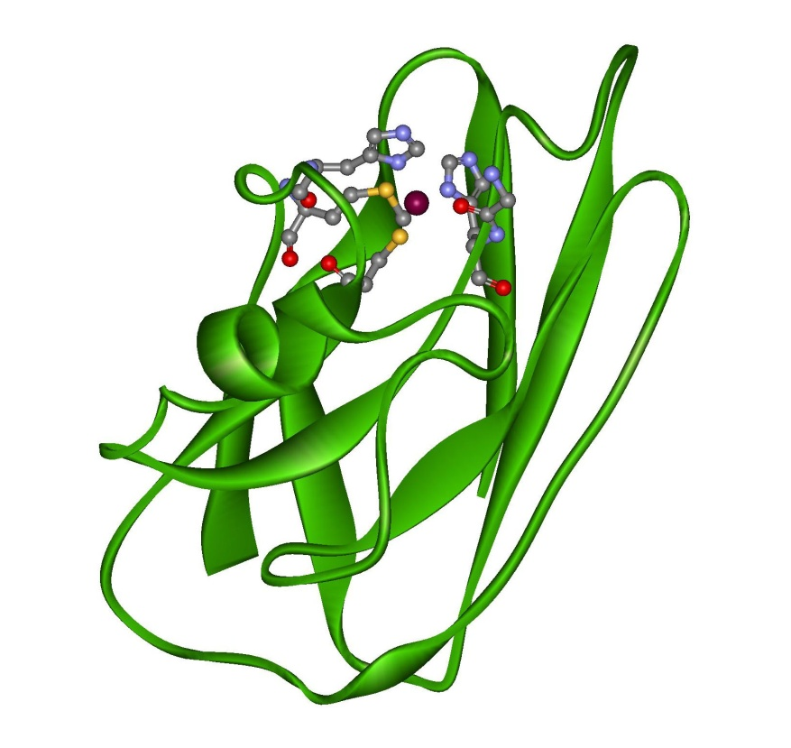
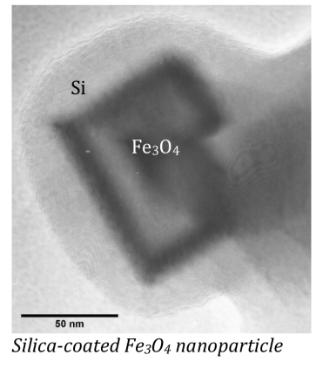
Developments in Biophysics: nanoparticles & polarised beams
LOI 81 – “Cleaning Water”
Functionalization of magnetic Fe₃O₄ particles, namely by grafting dithiocarbamate (DTC) groups to the particles surface.
Azurin – an example of a
Cu(I)/Cu(II) dependent electron
transporting protein
Cu(I)/Cu(II) are essential in many redox processes and electron transport in biology, e.g. in photosynthesis.
Cu(I) is “invisible” in most (except X-ray and nuclear) spectroscopic techniques: a closed shell ion
Measurements of spectroscopic properties (such as electric field gradients) for Cu(I) in proteins would have considerable impact in biophysics / bioinorganic chemistry
Other element of particular interest: Zn (Again, Zn(II) is a closed shell ion).

Slide 21
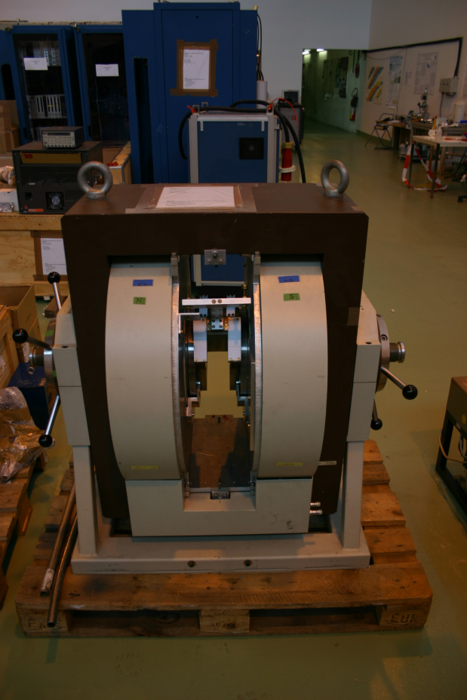
Other future developments
Beta-NMR investigation of materials. Using polarised beams delivered from REX. Initially intended for biophysics, also possible for materials.
New proposals and collaborations with Qatar (positron annihilation), India (Kolkata), Korea.
Laplace DLTS. New proposal expected for the November session of INTC. Highly sensitive way of electrically characterising semiconductors; new collaboration with University of Manchester.
SSP/Biophysics Workshop @ University of Saarbrucken in July 2009.

Slide 22
Summary:
Solid state physics at ISOLDE covers a wide range of materials and areas:
Semiconductors:
  Si, Ge, SiGe, diamond,
  III-V, nitrides, II-VI, ZnO…
  Electrical doping, transition metals, rare earths, H,
  Diluted magnetic semiconductors
High-T_{c} superconductors and perovskites
Magnetism (manganites, CMR)
Low dimensional systems:
surfaces, interfaces, multilayers
Biophysics… proteins, DNA, in vivo experiments
Outlook for the near future is healthy: new materials, new questions, new labs, new methods…even if some of the probes remain the same.

