Slide 1

The ALICE Dashboard
T1/T2 ALICE tutorial
Pablo Saiz, Julia Andreeva, Benjamin Gaidioz, Ricardo Rocha, Irina Sidirova
IT-GS-MND

Slide 2
Overview
Dashboard structure
Dashboard in production
  Job Monitoring
  SAM
  FTS monitoring
  Site status board
Conclusions

Slide 3
Dashboard Framework
Multiple clients: cli, web
Multiple output formats: plain text, csv, xml, xhtml
Collectors of information
Common configuration and management
Web / HTTP Interface
Agents
Data Access Layer (DAO)
DB reading and writing via DAO layer
Connection pooling
Easy to add interface for a different backend
Oracle DB

Slide 4
Dashboard activities
COMMON applications
ALICE, ATLAS, CMS, LHCb,
Vlemed
Job monitoring
Site reliability
Experiment specific applications
Accounting information from Apel and Gratia for ATLAS (prototype)
Experiment Dashboard
Data management monitoring for ATLAS
CMS
Integration and commissioning
Production monitoring for ATLAS and CMS
(prototypes)
Task monitoring for CMS analysis users (ATLAS on the way)
Transfer monitoring for ALICE
IO rate monitoring between WN and SE (prototype)
Site availability
based on the
results of SAM tests
Job Robot
monitoring

Slide 5
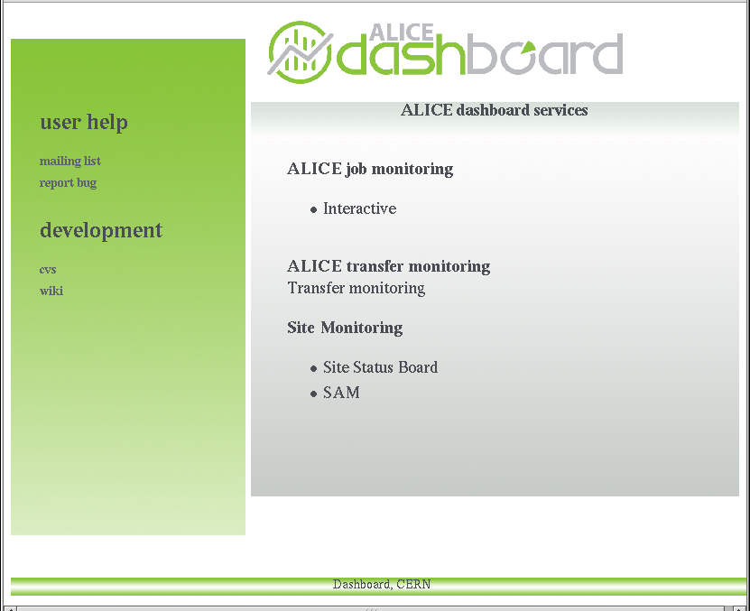
http://dashboard.cern.ch/alice
T1/T2 ALICE tutorial -- Pablo.Saiz@cern.ch 5

Slide 6
Job Monitoring
Display all the jobs submitted by a VO
  Follow the status of the jobs
Collect information from different sources
  RGMA, IC Real Time Monitor, BDII, MonALISA, …
Very useful for VO managers, site admin, users
Possibility to get the output in different formats
Deployed for ALICE, ATLAS, CMS, LHCb and VleMed

Slide 7
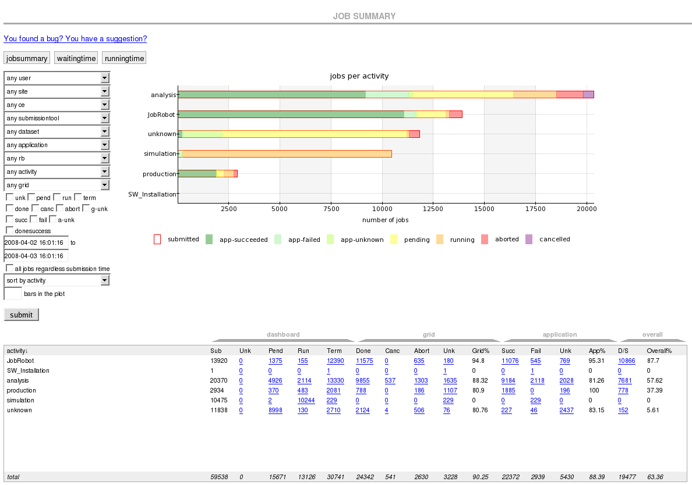

Job Monitoring

Slide 8
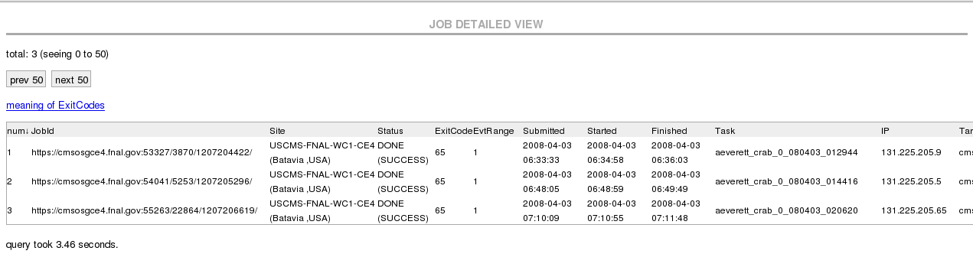
Job Monitoring

Slide 9
FTS reliability
Daily report on the success of transfers
Drill down list of errors
Integrated in the ALICE environment
Extremely useful during the different ALICE challenges: PDC06, PDC07, CRC08
Working on making it generic

Slide 10
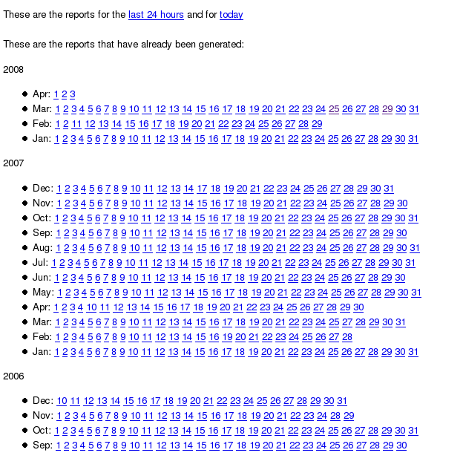
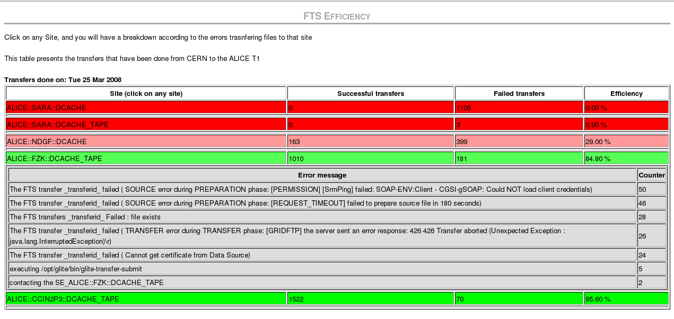
FTS reliability

Slide 11
SAM monitoring
Service Availability Monitoring
Clickable plots to drill down:
  Site availability → Service availability → Service tests
Links to the SAM results
Originally, only for CMS
  ATLAS requested a similar interface
  Ongoing work to make it generic

Slide 12
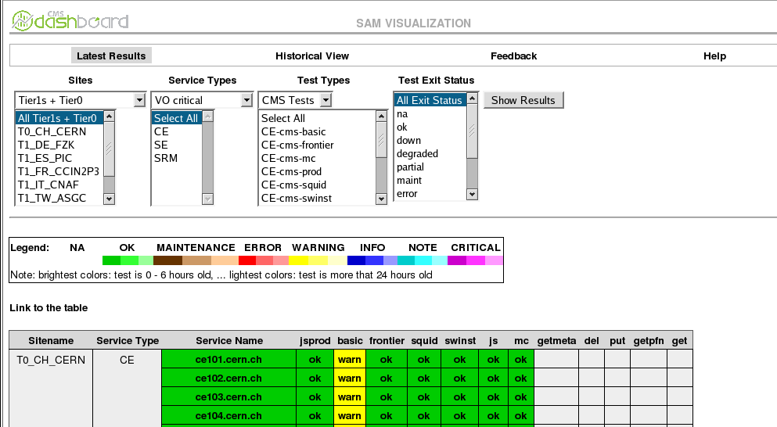
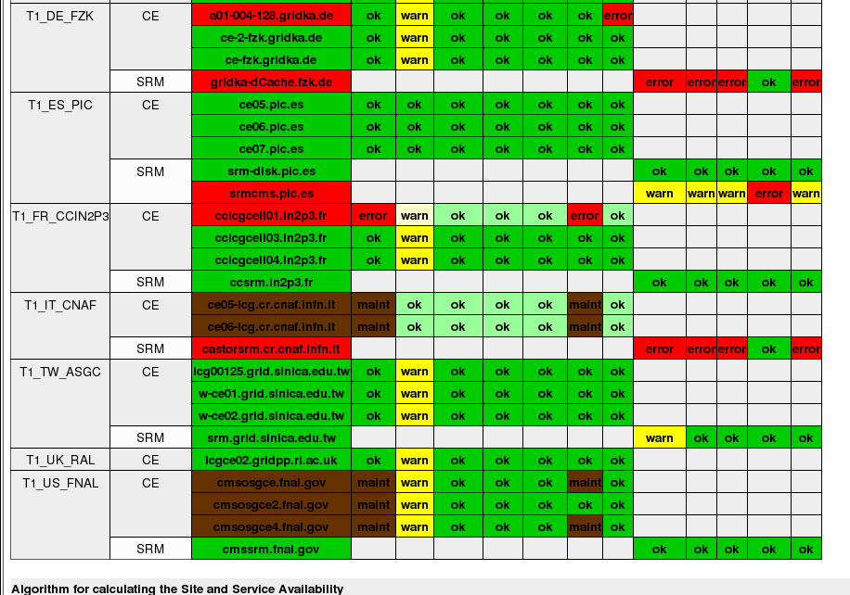
SAM monitoring

Slide 13
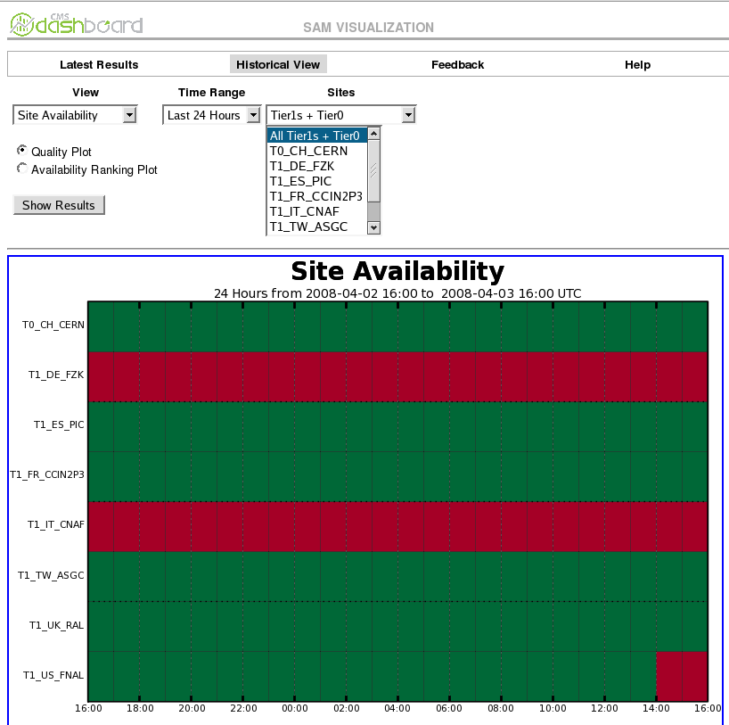
SAM monitoring

Slide 14
Site Status Board
Table with status of the different sites for CMS
Easy definition of new ‘metrics’
  The ‘metrics’ can come from different sources
Links to more detailed information
Gridmap view
Used for CMS site commissioning and offline shifts
  Deployed for LHCb and ALICE

Slide 15
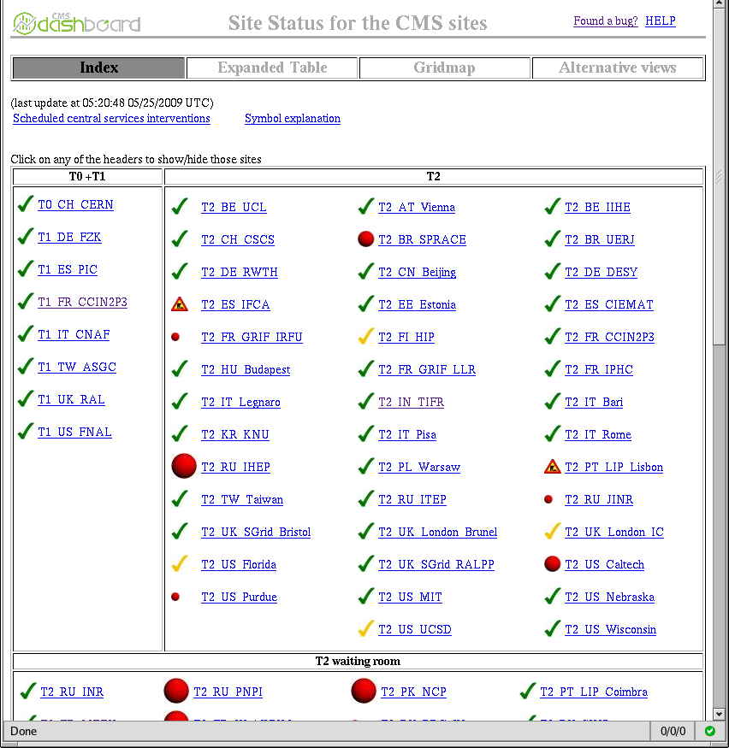
Site Status Board

Slide 16
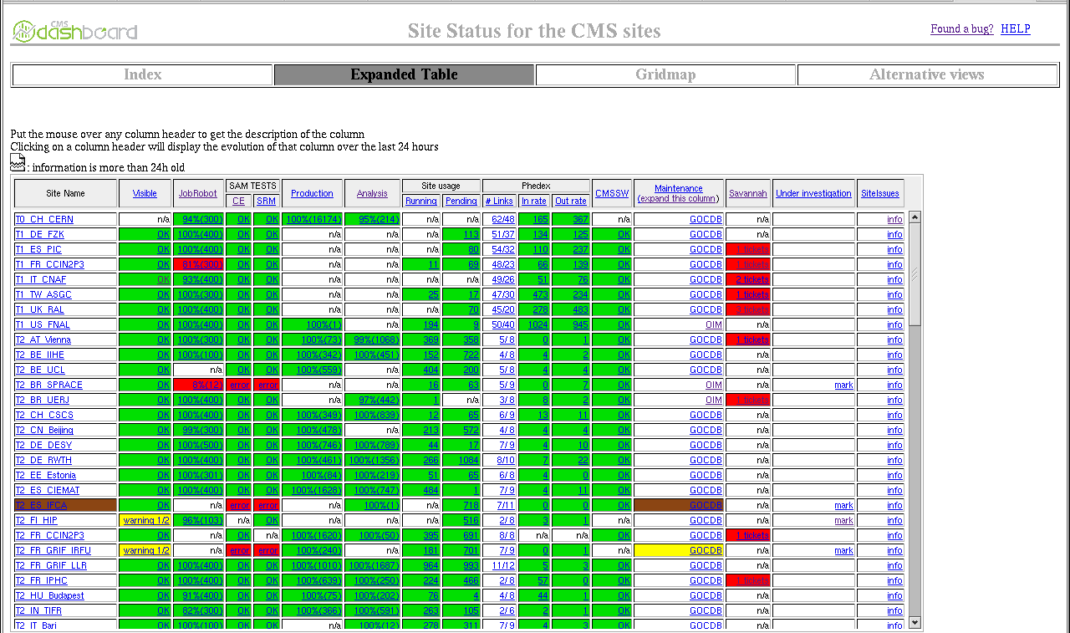
Site Status Board

Slide 17
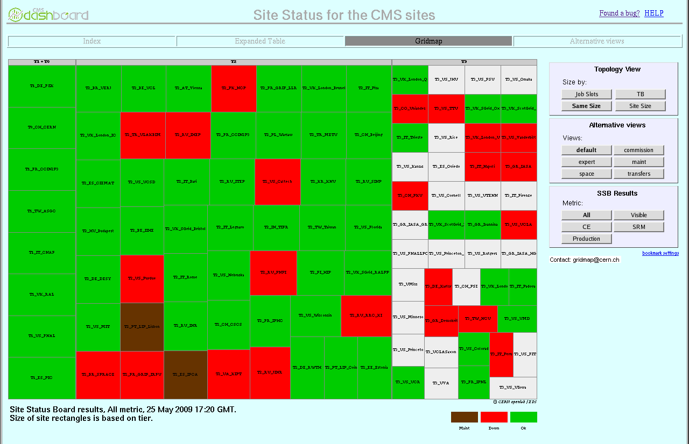
SSB gridmap
T1/T2 ALICE tutorial -- Pablo.Saiz@cern.ch 17

Slide 18
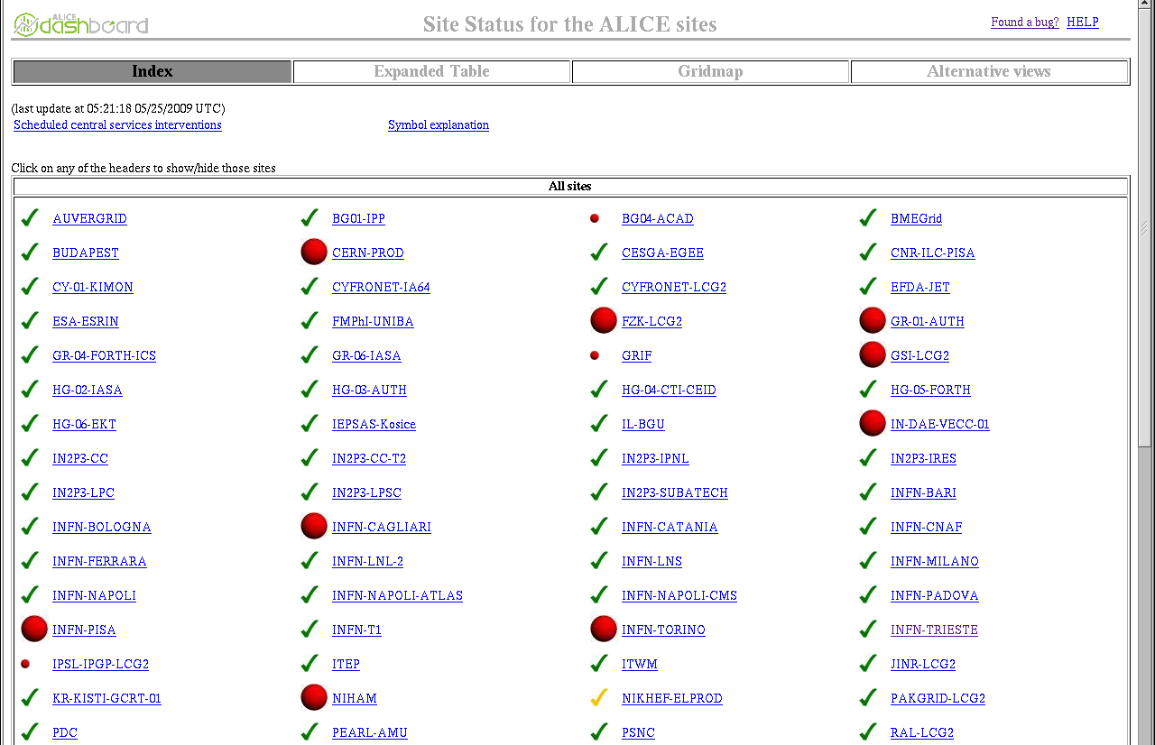
ALICE SSB
For the time being, only SAM tests and maintenance

Slide 19
Conclusions
Several applications provided
  Job Monitoring
  FTD/FTS reliability
  SAM framework
  Site Status Board
http://dashboard.cern.ch/alice
T1/T2 ALICE tutorial -- Pablo.Saiz@cern.ch 19

