Slide 1
Monitoring with MonALISA
Costin Grigoras <costin.grigoras@cern.ch>

Slide 2
What is MonALISA ?
Caltech project started in 2002
http://monalisa.caltech.edu/
Java-based set of distributed, self-describing services
Offers the infrastructure to collect any type of information
Can process it in near real time
The services can cooperate in performing the monitoring tasks
Can act as a platform for running distributed user agents

Slide 3

MonALISA software components and the connections between them
Clients
HL services
Data consumers
Multiplexing layer
Helps firewalled endpoints connect
Proxies
Agents
MonALISA services
Data gathering services
Network of
JINI-Lookup Services Secure & Public
Registration and discovery
Fully Distributed System with no Single Point of Failure

Slide 4



Subscriber/notification paradigm
ML Service
Lookup
Service
Registration
Discovery
AGENTS
Predicates & Agents
Data Store
Data (via ML Proxy)
ML Client
Applications
Configuration Control (SSL)
FILTERS / TRIGGERS
Dynamic Loading
Monitoring Modules
Push or Pull, depending on device

Slide 5
MonALISA service includes many modules; easily extendable
The service package includes:
  Local host monitoring (CPU, memory, network traffic , processes and sockets in each state, LM sensors, APC UPSs), log files tailing
  SNMP generic & specific modules
  Condor, PBS, LSF and SGE (accounting & host monitoring), Ganglia
  Ping, tracepath, traceroute, pathload and other network-related measurements
  Ciena, Optical switches
  Calling external applications/scripts that return as output the values
  XDR-formatted UDP messages (such as ApMon).
New modules can be added by implementing a simple Java interface.
Filters can also be defined to aggregate data in new ways.
The Service can also react to the monitoring data it receives, more about the actions it can take later.
MonALISA can run code as distributed agents
  Used by VRVS/Evo to maintain the tree of connections between reflectors
  Establishment of optical paths between two network endpoints for particular data transfers

Slide 6
Embeddable APlication MONitoring library
ApMon is a collection of libraries in various languages (C, C++, Java, Perl, Python), all offering a simple API to sending monitoring information
Based on the XDR open format of data packing
Implemented over UDP to minimize the impact on the monitored application
Allows applications to send particular values and also provides local host monitoring
  The Perl version is used by AliEn to send monitoring information from each service and JobAgent to the site local MonALISA instance
  The C/C++ implementations are used in ROOT (TMonalisaWriter), Proof and Xrootd. CMS also uses ApMon to send monitoring information from all jobs to a single point
Can also be used stand-alone, in a wrapper application that loops forever, sending the default host monitoring parameters + any other interesting values (like some services’ status)
It can be configured by API, local configuration file or URL of one

Slide 7
Data storage model
MonALISA keeps a memory buffer for a minimal monitoring history
In addition, data can be kept in configurable database structures
The service keeps one week of raw data and one month of averaged values
The client creates three averaged structures
Parallel database backends can be used to increase performance and reliability
Memory buffer
Volatile storage
Short term,
high resolution
Medium term,
lower resolution
Persistent storage (DB)
Long term,
low resolution
time
Request at highest resolution
Response

Slide 8
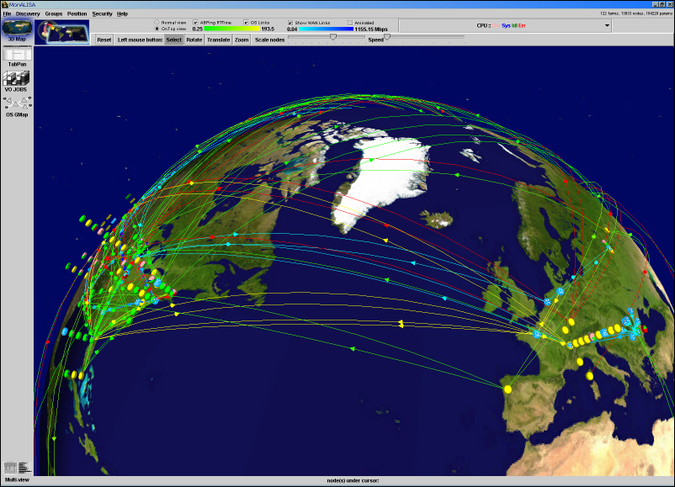
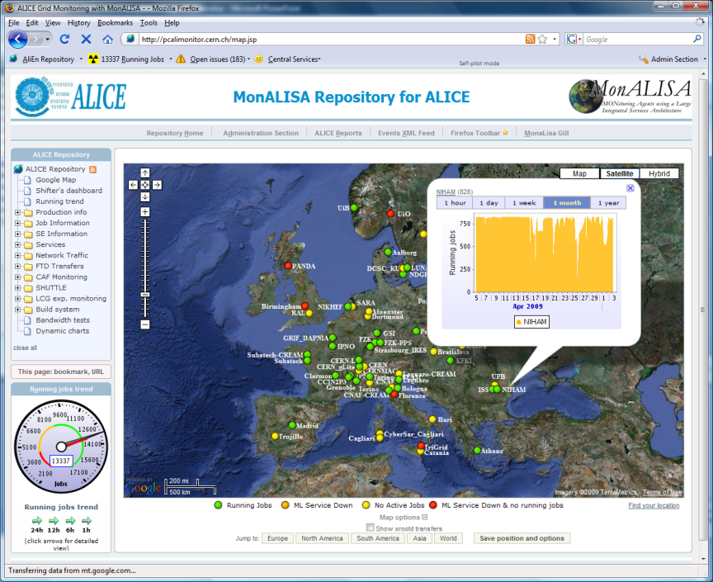
Clients
GUI client
  Interactive exploring of all the parameters
  Can plot history or real-time values
  Customizable history query interval
  Subscribes to those particular series and
  updates the plots in real time
Storage client (aka Repository)
  Subscribes to a set of parameters and
  stores them in database structures suitable
  for long-term archival
  Is usually complemented by a web
  interface presenting these values
  Can also be embedded in another
  controlling application
WebServices clients
  Limited functionality: they lack the
  subscription mechanism

Slide 9

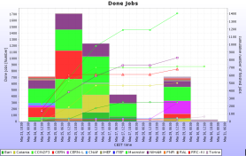
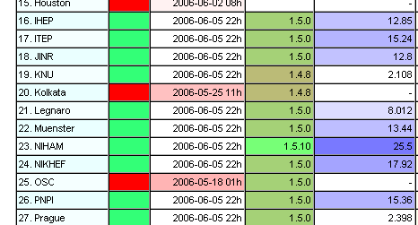
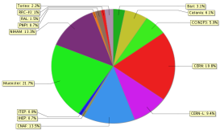
AliEn monitoring architecture
AliEn
CE
Cluster
Monitor
AliEn
IS
AliEn
Optimizers
AliEn
Job Agent
ApMon
AliEn
TQ
ApMon
ApMon
AliEn
Brokers
ApMon
ApMon
AliEn
SE
job
slots
ApMon
net
In/out
ApMon
AliEn
Job Agent
cpu
time
run
time
ApMon
processes
vsz
free
space
jobs
status
load
MySQL
Servers
ApMon
MonALISA
AliEn Site
MonALISA
@CERN
sockets
rss
ApMon
AliEn
Job Agent
migrated
mbytes
ApMon
active
sessions
CastorGrid
Scripts
Aggregated Data
ApMon
API
Services
AliEn
CE
Cluster
Monitor
AliEn
SE
ApMon
ApMon
ApMon
ApMon
AliEn
Job Agent
Queued
JobAgents
open
files
nr. of
files
ApMon
job
status
MonALISA
Repository
MonALISA
LCG Site
Alerts
AliEn
Job Agent
cpu
ksi2k
Actions
ApMon
disk
used
Long History
DB
AliEn
Job Agent
MyProxy
status
ApMon
LCG Tools
http://pcalimonitor.cern.ch/
9

Slide 10
AliEn MonALISA service
Started with
  alien StartMonaLisa
Should be started with the same environment as the rest of the AliEn services
  X509_USER_PROXY in particular
It receives information from each component
Performs functional tests of each AliEn service running on the VoBox
If necessary will receive commands to restart the services
Self-monitoring through cron scripts, so _don’t_ remove the line
This solves most problems with the AliEn VoBox services, including restart of the VoBox itself

Slide 11
Monitoring the ALICE Grid in numbers
85 sites defined
9000 worker nodes
14000 parallel jobs
27 central machines
More than 1.1M parameters
Storing only aggregated data where possible we have reached >35000 active parameters in the database
We store new values at ~100Hz
15000 dynamic pages / day
1 client/web server + 3 database instances
170GB of history

Slide 12
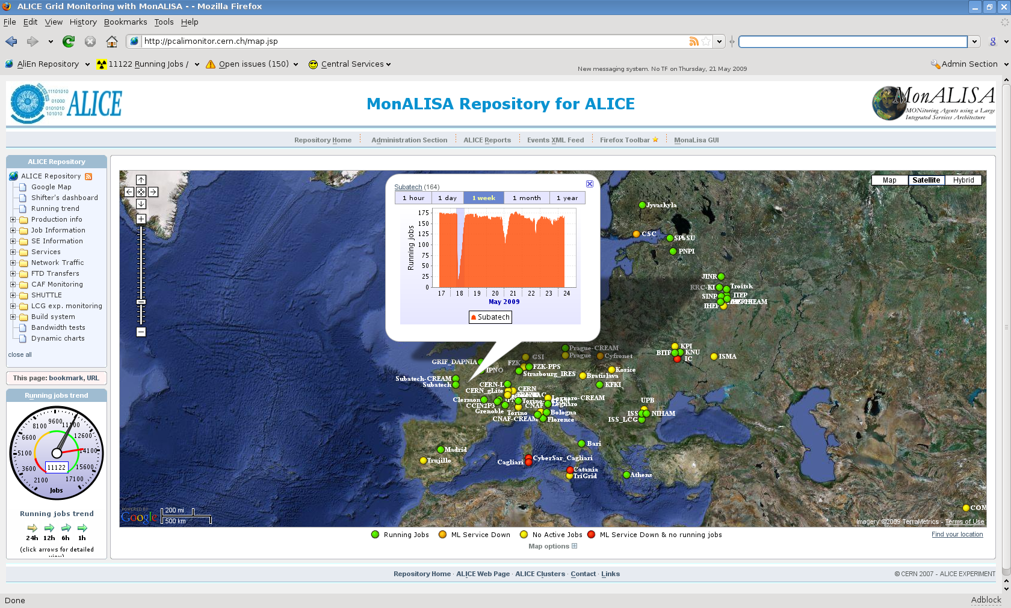
MonALISA Repository for ALICE: http://pcalimonitor.cern.ch

Slide 13
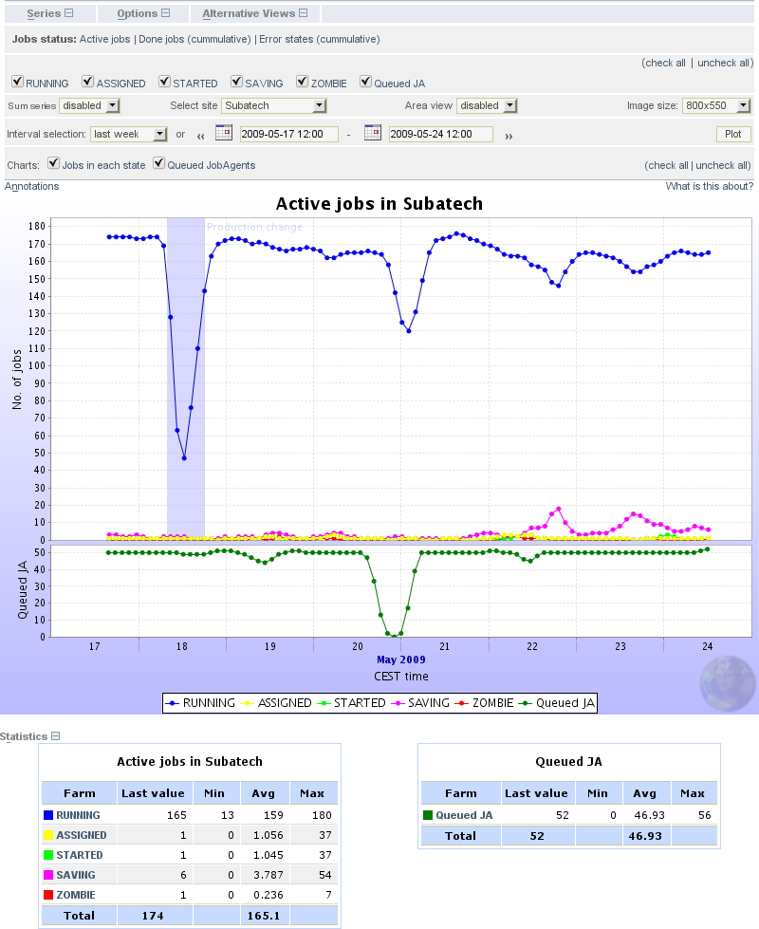

Slide 14
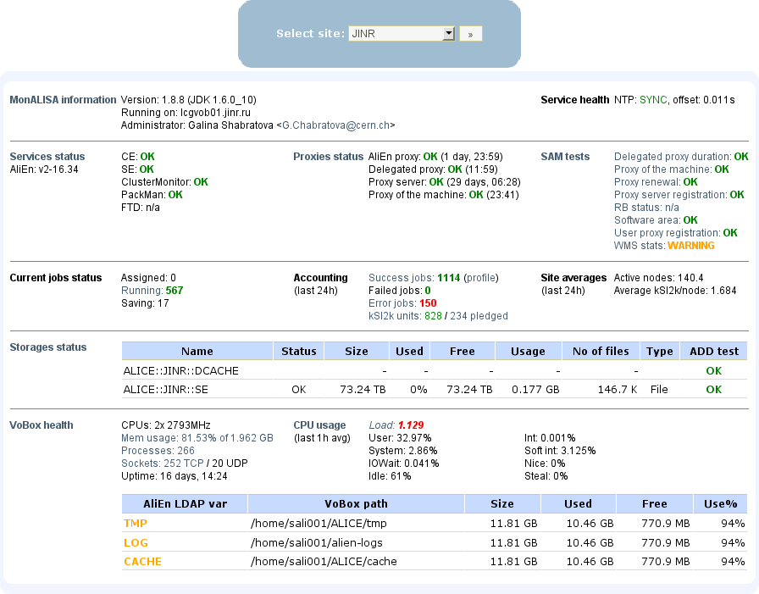
Services -> Site services -> Site overview

Slide 15
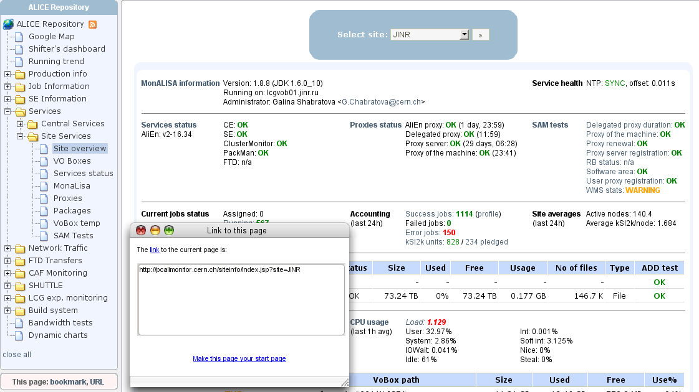
Services -> Site services -> Site overview

Slide 16
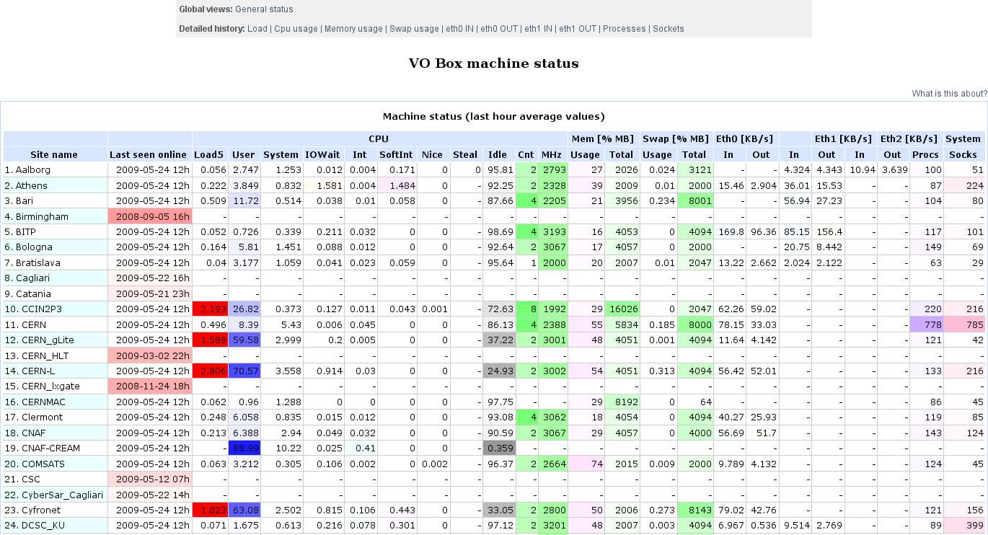
Services -> Site services -> VO Boxes

Slide 17
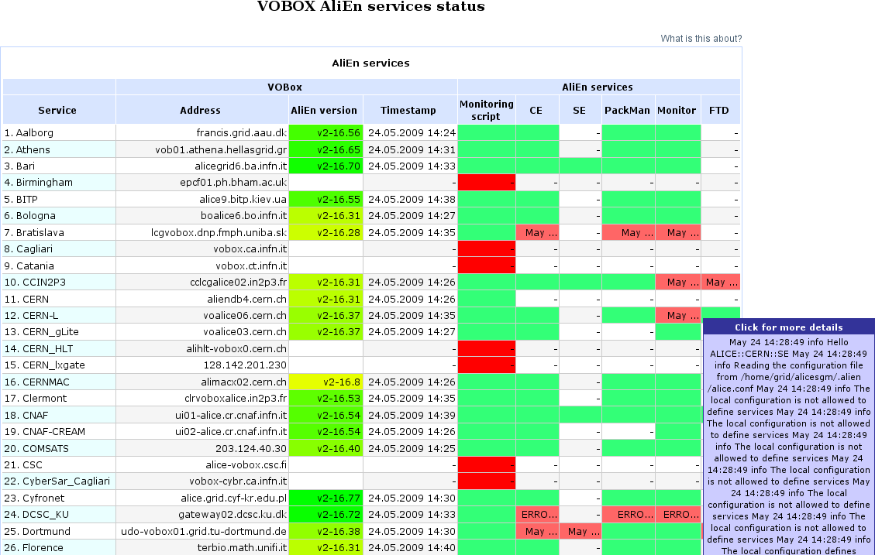
Services -> Site services -> Services status

Slide 18
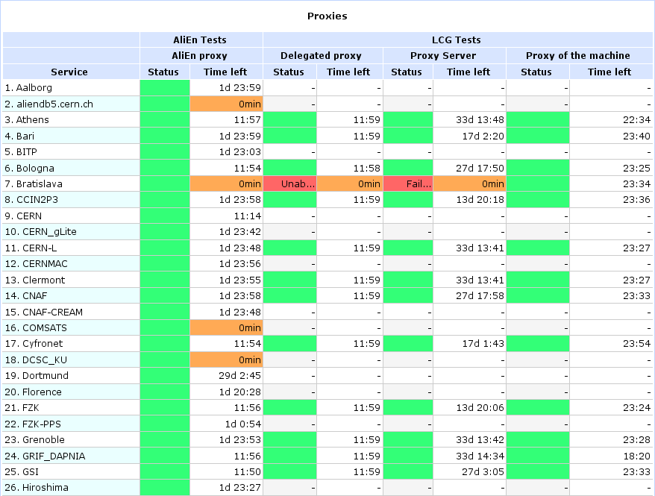
Services -> Site services -> Proxies

Slide 19
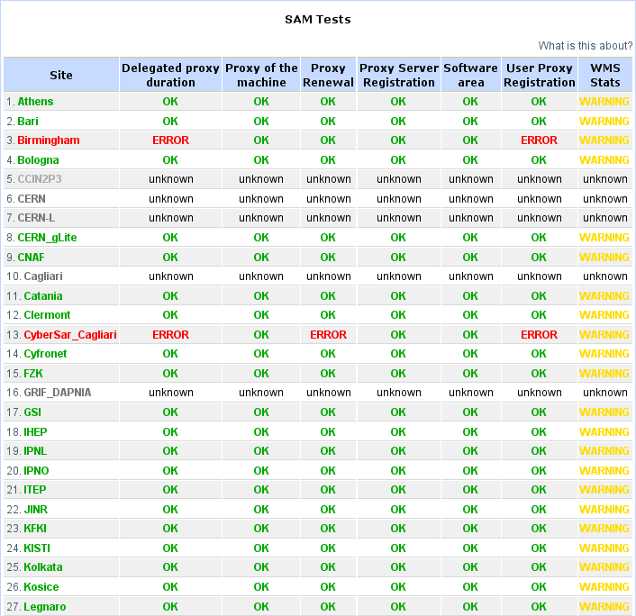
Services -> Site services -> SAM tests

Slide 20
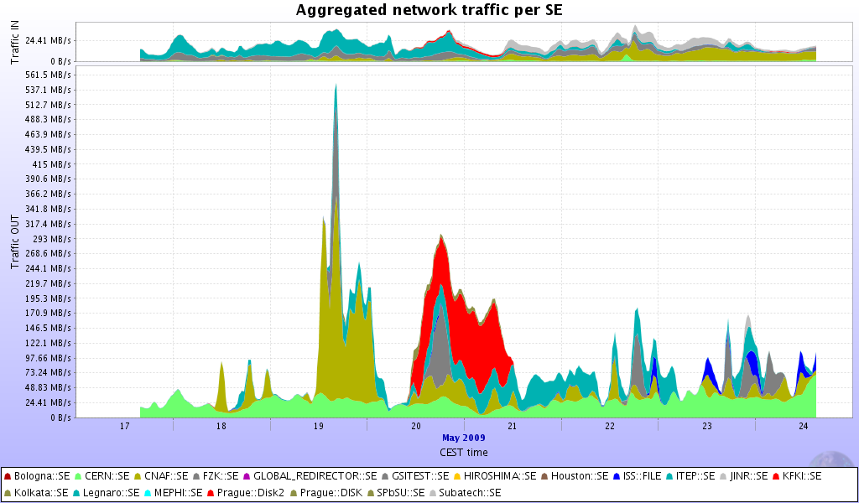
SE Information -> xrootd -> SEs overview

Slide 21
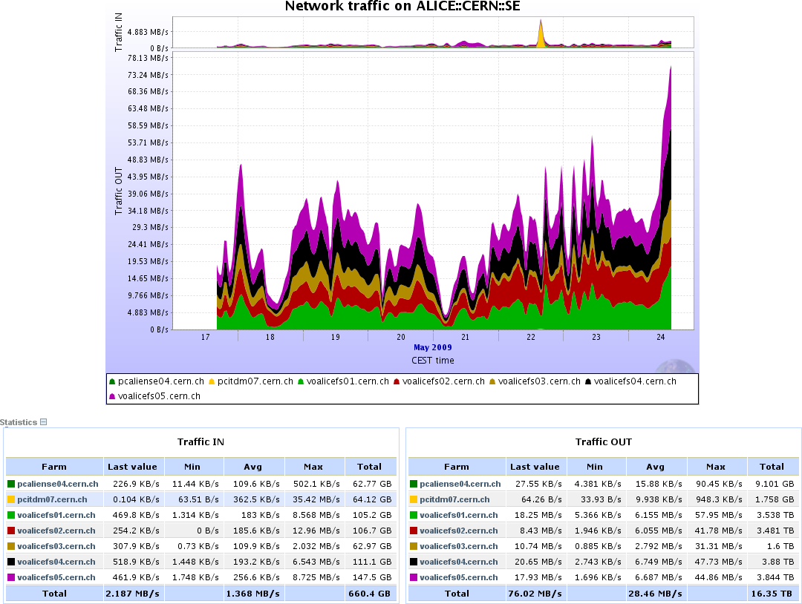
SE Information -> xrootd -> Per SE details

Slide 22
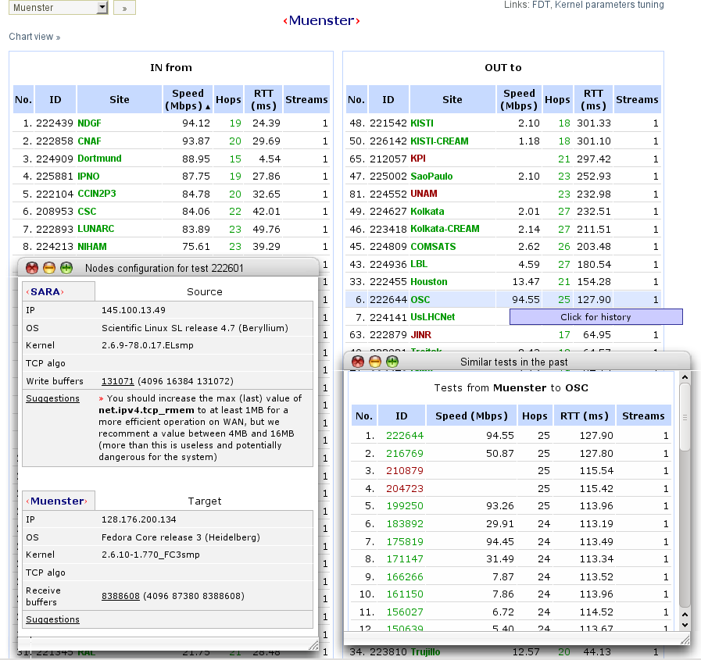
Bandwidth tests

Slide 23
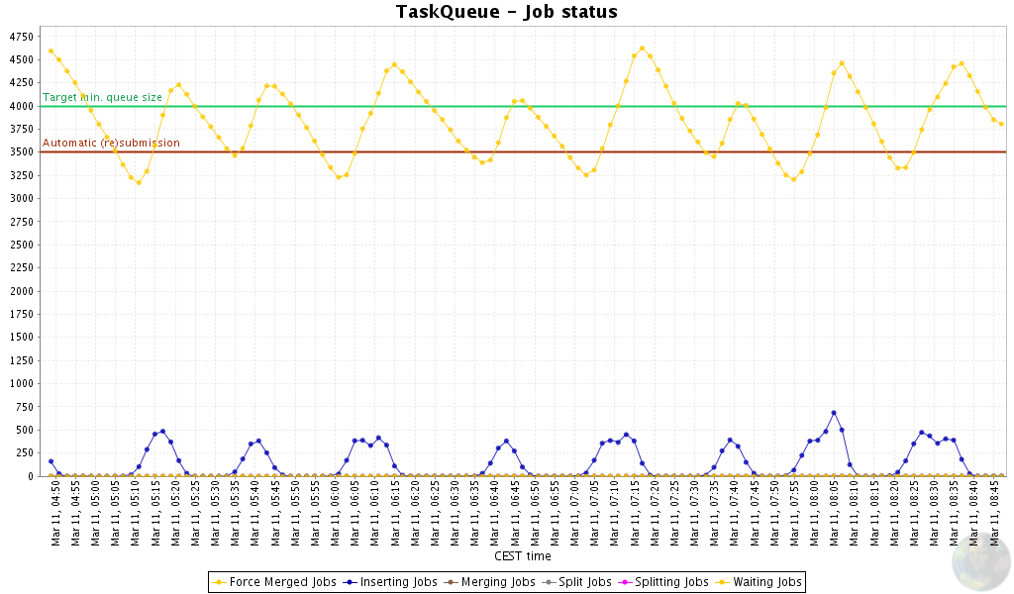









Automatic actions
Decisions taken upon:
Absence/presence of some parameter(s)
Values above/below predefined thresholds
Arbitrary correlations between values
User-defined code
Action types:
Notifications
RSS/Atom feeds
Annotation of charts with the events
Calling external programs
Logging
Running custom code
Traffic
Jobs
Hosts
Apps
ML Service
SSL
Global
ML
Services
Actions
SSL
Temperature
Humidity
A/C Power
…
ML Service
Sensors
Local
decisions
Global decisions
Actions

Slide 24
Automatic actions in ALICE
Restart of services if the VoBox functional tests fail
  Only if central services are ok
  Send mail if the restart doesn’t solve the problem
  Try again every 12 hours
Storage elements testing from the central point
  Notifications if tests fail
Maintaining the DNS aliases of central services
  Remove offline or overloaded services
  Automatically adding new service instances
MC production jobs (LPM)
Other notifications (proxies, SAM tests, central services)

Slide 25
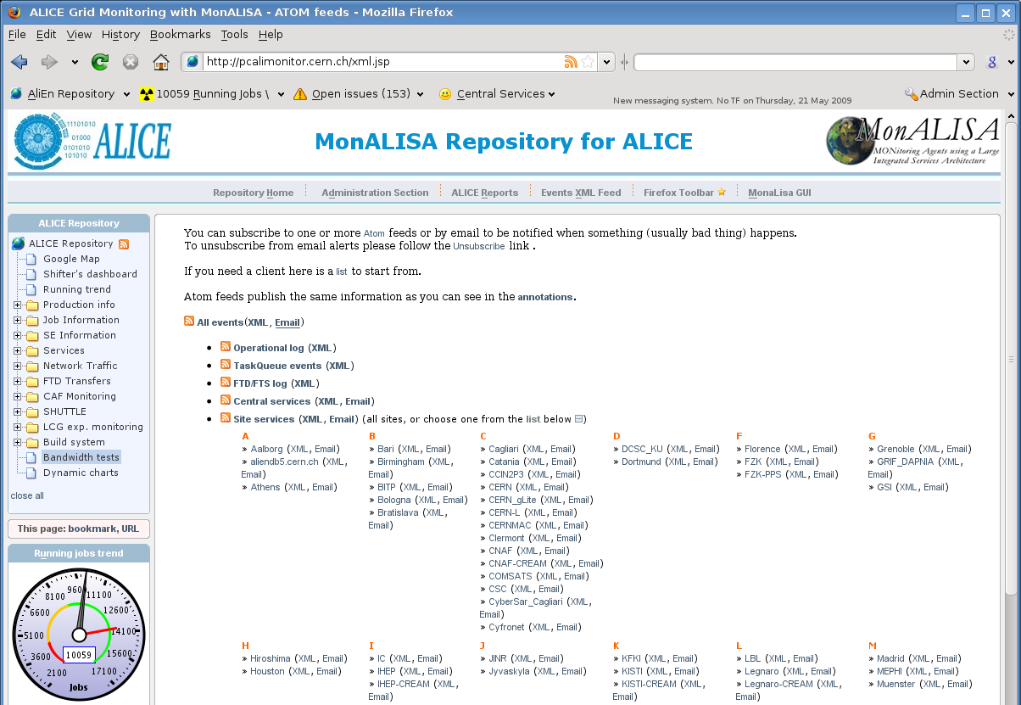
Notifications

Slide 26
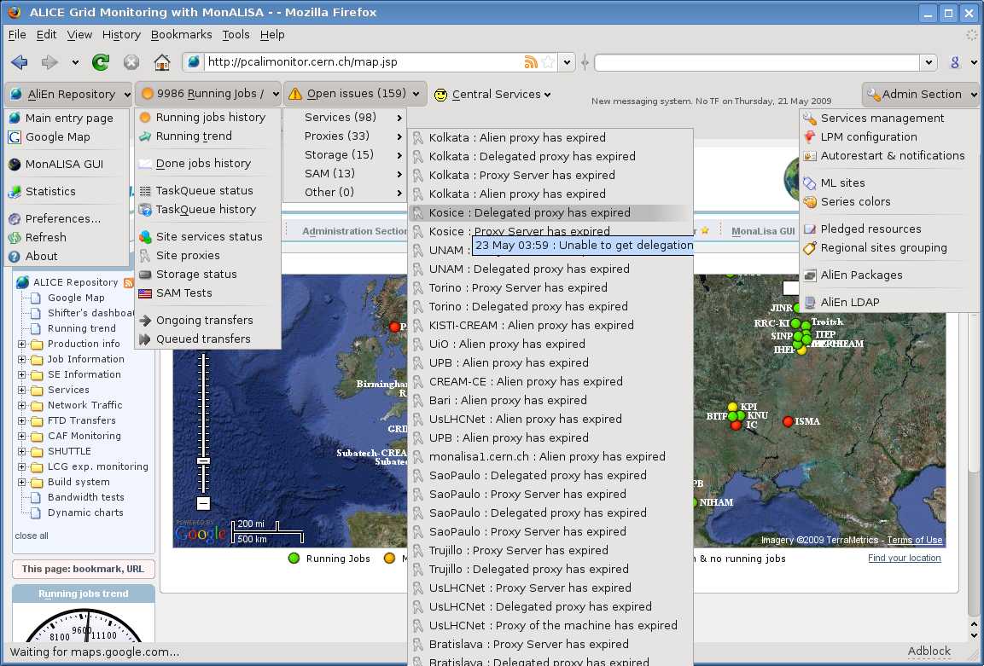
Firefox toolbar expanded

Slide 27
Site monitoring
Using a small ApMon daemon on each WN
  Or SNMP, Ganglia …
Send data to the MonALISA service running on the VoBox
Run your own Repository to archive data, display it and implement your own automatic actions
GSI: http://lxgrid2.gsi.de:8080/
Muenster: http://gridikp.uni-muenster.de:8080/
CAF: http://pcalimonitor.cern.ch/stats?page=CAF/machines

