Slide 1
AliEn central services
Costin Grigoras <costin.grigoras@cern.ch>

Slide 2
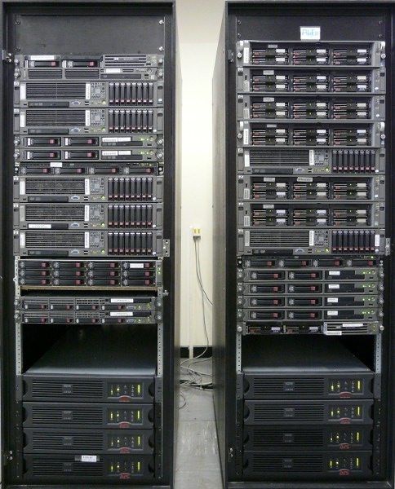
Hardware overview
27 machines
  Mix of SLC4, SLC5, Ubuntu 8.04, 8.10, 9.04
100 cores
20 KVA UPSs
2 * 1Gbps uplinks

Slide 3
AliEn services
Several instances under a common
DNS alias
Authen
Proxy
PackMan
Optimizers (Jobs, Transfers, Catalogue,PackMan…)
API servers

Slide 4
DNS load balancing of central services
Each machine reports through ML to the central repository the full status of each machine, including:
  Operational status of each service (tested every 15m)
  Load on the machine, CPU, memory and swap utilization
  No. of connected sockets
A weighted score is generated based on the parameters above, updating every minute the CERN DNS aliases with the IP addresses of the machines that are not overloaded.
The IP aliases are queried by users or site services when connecting to the central services; by using them we distribute the load evenly between the active machines and limit the damage that can be caused to the central services.

Slide 5
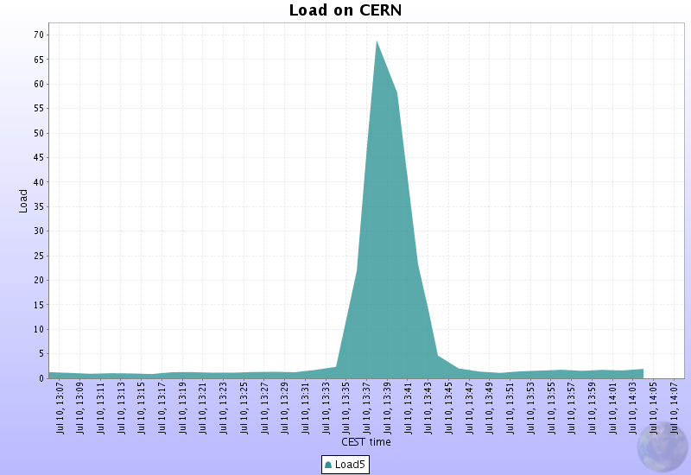
DNS load balancing in action
Wed Jul 9 07:23:24 CEST 2008 : alice-proxy 137.138.99.136 137.138.99.137 137.138.99.141
Thu Jul 10 13:40:38 CEST 2008 : alice-proxy 137.138.99.137 137.138.99.141
Thu Jul 10 13:44:52 CEST 2008 : alice-proxy 137.138.99.136 137.138.99.137 137.138.99.141

Slide 6
Information sources
LDAP
  Services’ configuration
  Users & Roles
MySQL
  Transfer Queue: 3M transfers
  Task Queue: 27.7M jobs
  Users (sync with LDAP): 700
  Catalogue: 85M entries
MySQL Backup (replication)

Slide 7
Build servers
AliEn & AliROOT
32 and 64 bit
SLC4 and SLC5
Most of them virtual machines (VirtualBox)
Other build machines:
  SLC4 on Itanium
  OSX in 32 and 64 bits

Slide 8
Monitoring
MonALISA Repository
  Storage client
  Web interface
  One database backend
Two more database backends
  Redundancy
  Load sharing

Slide 9
More services
6TB storage
  Shared AliEn installation
  Backup (configuration & DB)
alien.cern.ch website
Xrootd global redirector
(more details from Fabrizio later)
ALICE::CERN::SE redirector
BitTorrent tracker and seeder
(see Pablo’s talk)
ALICE Offline Project Management & Shift Management

Slide 10
Plans
Installing more power to the room
  Scheduled for today, should be transparent
3 new racks
  Next week we are planning to move the hardware to them
    One day downtime, will be announced
2 new 16-cores (Nehalem) machines
  We’ll try to replace several old machines with virtual machines or services on the base machine

