Slide 1
The (B)right future of software installation
S. Bagnasco, L. Betev, F. Carminati, F. Furano, C. Grigoras, A. Grigoras, P. Mendez Lorenzo, A. Peters, P. Saiz

Slide 2
What is the best method to install software?
  What to install
  Where/when to do it
  How should it be done
2

Slide 3



What to install
Two types of packages:
  Experiment software:
  , GEANT3, AliRoot
  GRID interface:
Requirements
  Self-contained
  Platform dependent
  User space
  Size does matter
3

Slide 4
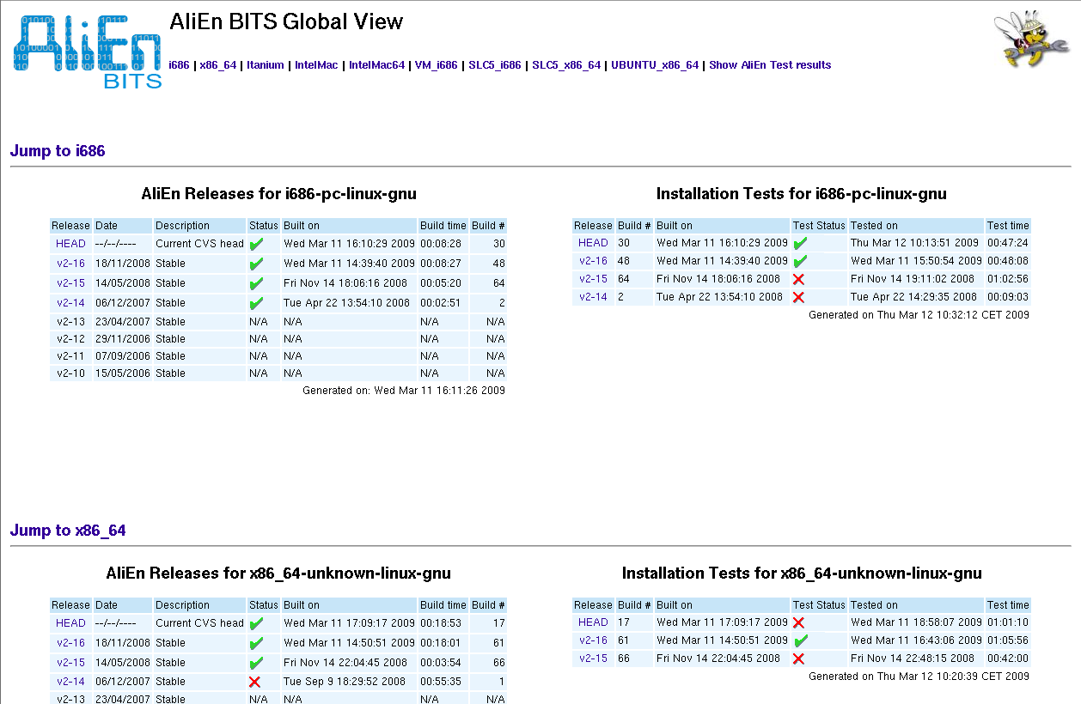
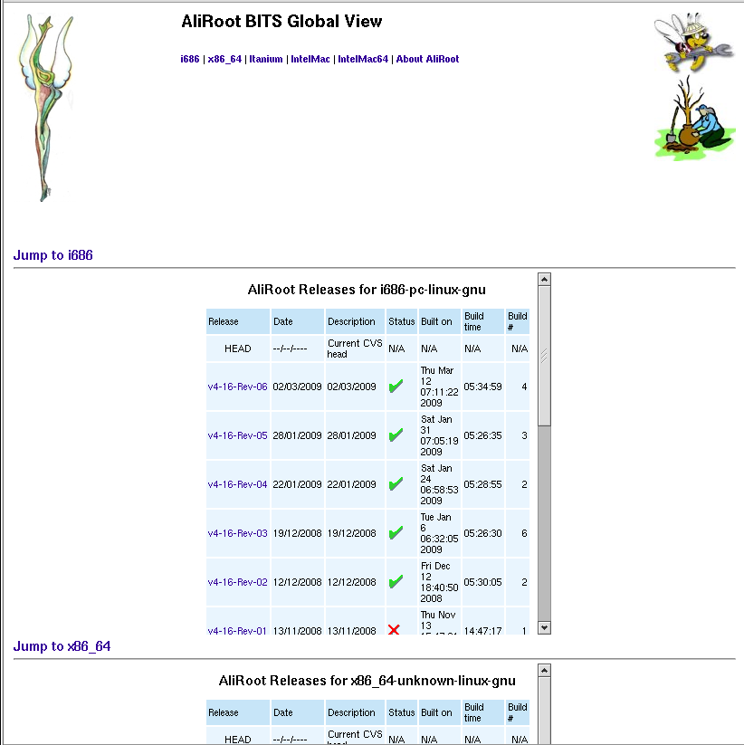
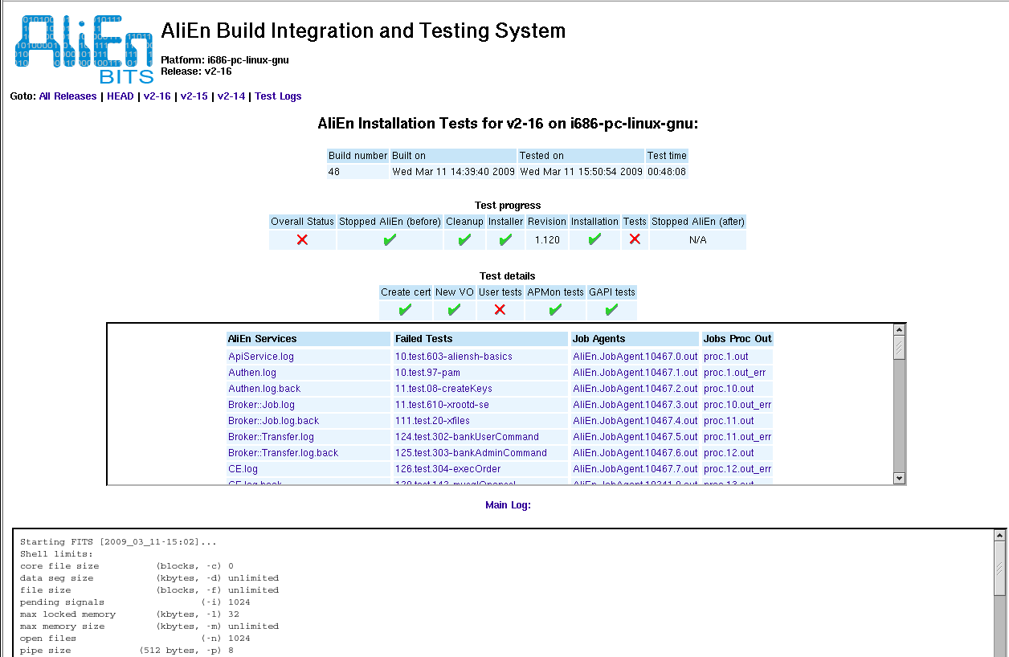
Build & Test systems
4

Slide 5
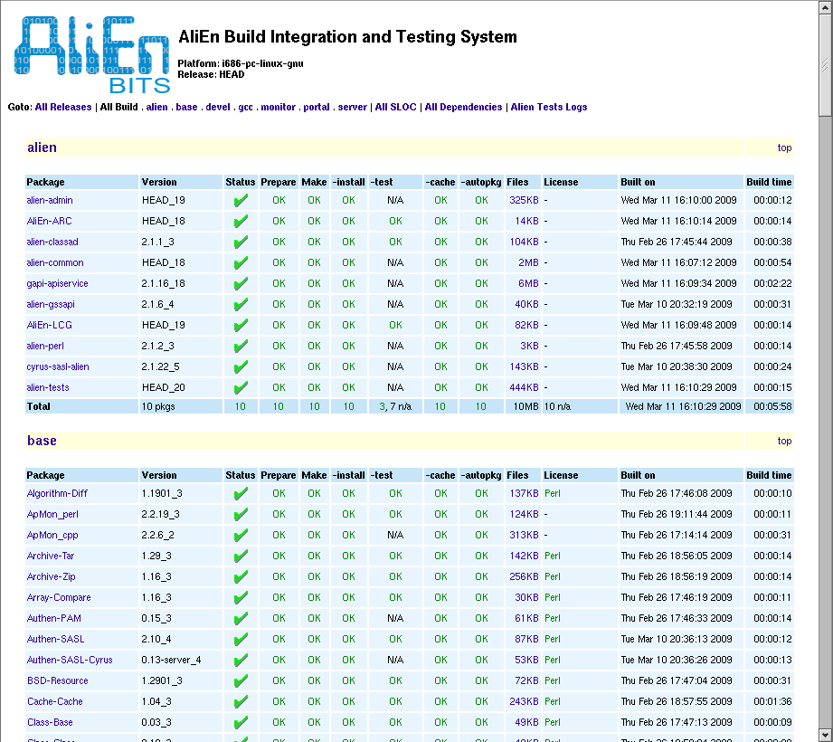
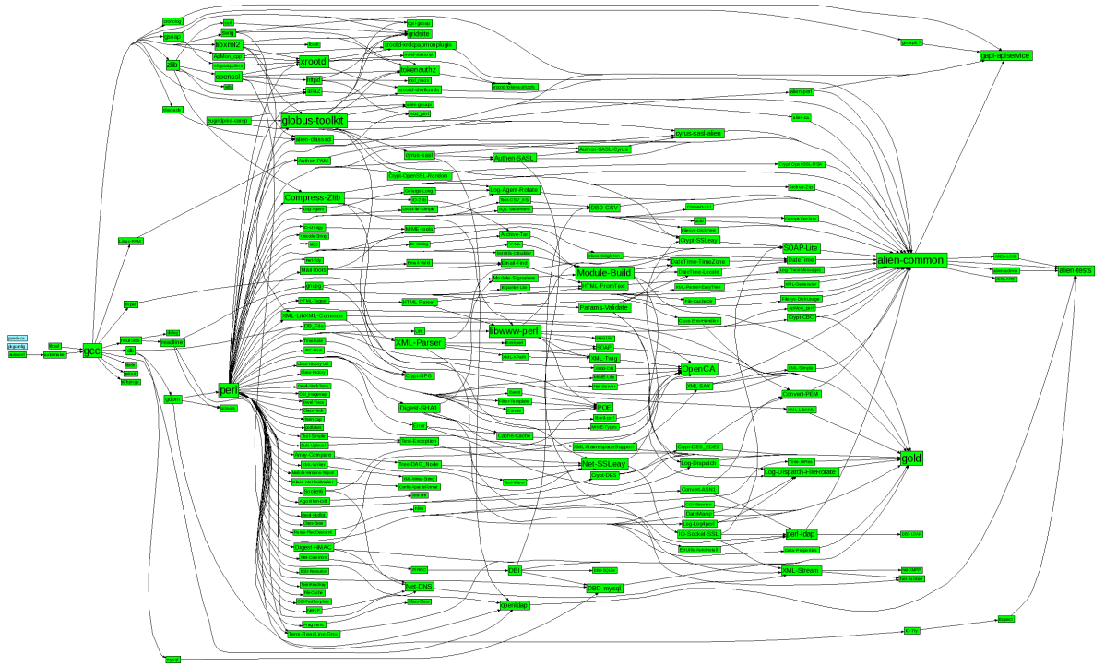
More than 200 individual packages
Easy to add new packages, move to new platform, get files from different sources, apply patches, define dependencies ...
5

Slide 6
Packaging & size
Combine all the required grid packages into distributions
  Full installation: 155 MB, mysql, ldap, perl, java...
  VO-box: 122 MB, monitor, perl, interfaces,
  User: 55 MB, API client, gsoap, xrootd
  Worker node: 34 MB, min perl, openssl, xrootd
Experiment software:
  AliRoot: 160 MB
  ROOT: 60 MB
  GEANT3: 25MB
300 MB to run jobs
6

Slide 7
Where and when to do it
Current scenario
  One installation (per platform) per site
  On a shared area
    Might be slow
    Security risk
  AliEn installation:
    New sites: running a script
    Updating a site: triggered by a VO admin
  Experiment software:
    Install on demand according to the jobs
    Before submitting JobAgents
Do we need it?
7

Slide 8
Can we do something better?
Automatic installation on every worker node
Automatic
Self-contained
User space
Small software (300 MB)
Job Agents (can run more that one small job)
8

Slide 9
How to do it
Landing on a virgin worker node
Sending a small script that:
  Finds a scratch area in a local disk
  Installs latest version of AliEn
    Simple requirements: wget
  Starts a Job Agent
    JobAgent will install required experiment software
  After finishing, removes everything
    Or leaves it for the next agent... (still to be evaluated)
But how to get the files…
9

Slide 10
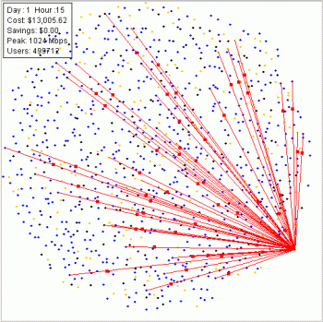
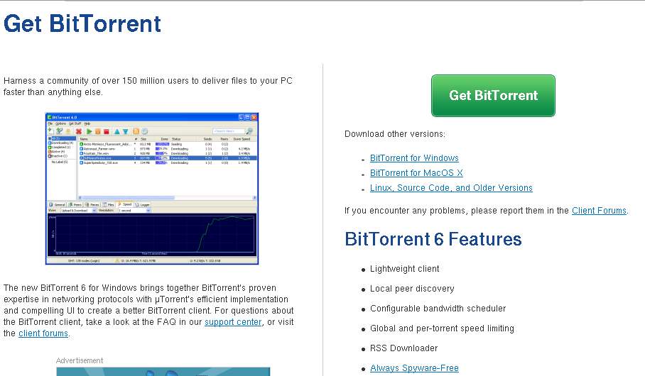
Let’s go mainstream!!
More than 150 million users!!
http://bittorrent.com
10

Slide 11
Torrent technology
Download
& seed
alitorrent.cern.ch
Download
& seed
Tracker
Download
& seed
Site B
Seeder
Site A
Download
& seed
Download
& seed
Download
& seed
Notes:
Define tracker and seeder.
Tracks which client has which files (and piece)
Seeder= client with a complete file waiting for connections

Slide 12
Transfer files
Torrent files created from the build system
One seeder at CERN
  Standard tracker and seeder.
Get torrent client from ALICE web server
  Aria2c
Download the files and install them
Seed the files while the job runs
12

Slide 13
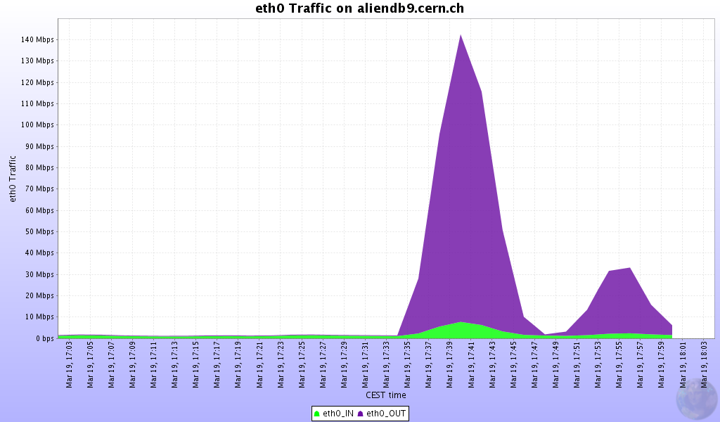
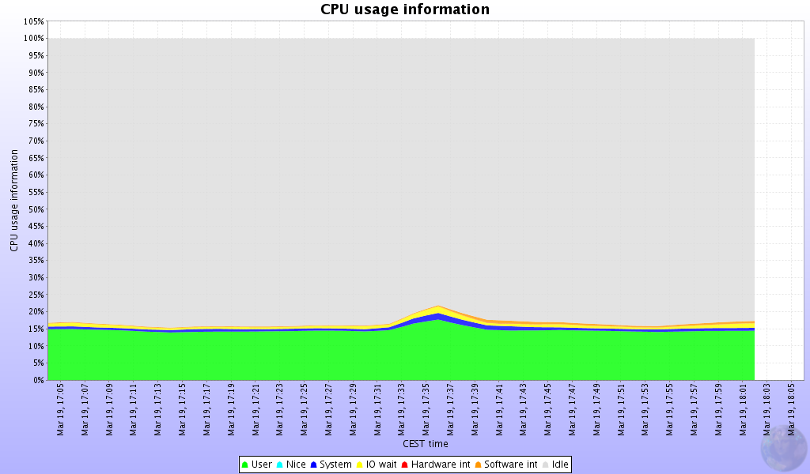
Load on the server
600 clients at CERN:
600x300MB=180GB
Downloaded from the server: 7GB
Fetched from other wn:
173GB
Negligible CPU load
Network load limited by conf
Network load does not increase with more clients
13

Slide 14
Security
Working in collaboration with CERN Security team
Peer-peer is allowed for professional usage
Torrent files have checksums to detect corrupted files/wrong files
Only VO admin can register files in tracker
Signing the packages
14

Slide 15

Security concerns
What if a wn modifies a file?
  Torrent technology detects and prevents it
    Each chunk is individually signed
    The whole file can be also signed with a certificate
Can any user transfer files?
  NO. Only VO admin can register files in the tracker
Do site admins have to open ports on wn?
  Only within the site
File
chunk
chunk
chunk
....
....
chunk
chunk
15

Slide 16
Next steps
Involve more sites
  Do we need more seeders?
    One main seeder should be enough
    Otherwise, add seeder to (some) voboxes, or to other machines
Larger scale
  We have verified up to O(1000) jobs
Reuse downloaded files on the same wn
16

Slide 17
Software installation
Build and test system for multiple platforms
  Small, self-contained packages
GRID software updates triggered by VO admin
Automatic installation on every worker node
Using torrent technology to transfer files
  Already tested by millions of users
  Reduce inter-site transfers
  No extra requirements on worker nodes
No need for a shared area
Same algorithm could be used by other VOs
17

Slide 18
Great! How to use it
To install alien:
  wget http://alien.cern.ch/alien-torrent-installer
Any file in the catalogue registered with torrent://…
  This can be used for packages
  Or for any other data…
May 27, 2009

Slide 19
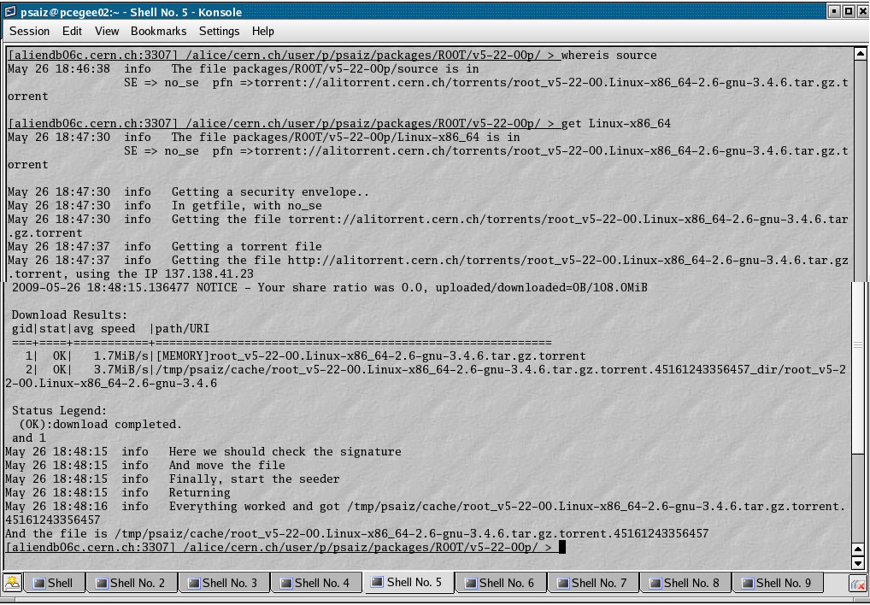
Example
Please, try it now!!
File downloaded using torrent
May 27, 2009

Slide 20
Please, try it out...
Login to your vobox
  ssh ...
Make sure that you have a valid proxy
  alien proxy-info
Connect to alien:
  alien
Go to my directory:
  cd /alien/cern.ch/user/p/psaiz/packages/ROOT
Check where the file is:
  whereis v5-22-00p/Linux-x86_64
Get the file:
  Get v5-22-00p/Linux-x86_64
May 27, 2009

Slide 21
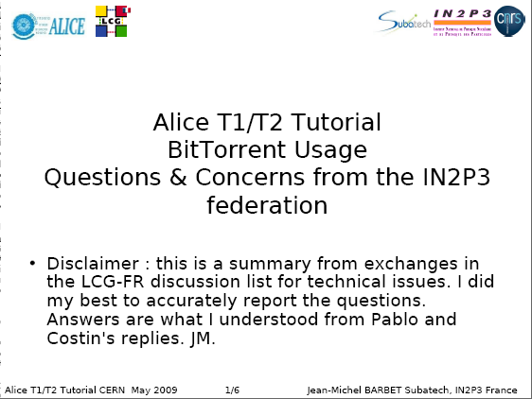
French questionnaire
May 27, 2009

Slide 22
Jean-Michel questionnaire (I)
Cache on every worker node?
  For the time being, no cache. Everything deleted after the job finishes.
If a worker node runs 8 jobs simultaneously…
  … there will be 8 different installations
It seems stupid to install the software 8 times if the machine runs 8 Alice jobs.
  If this is a bottleneck, we will reuse the files. At the moment, we want to stress the download
Will the cleaning be done if a job crashes ?
  Yes, it will. Cleaning done automatically by CREAM, LCG-CE ...
Compiling on every worker node?
  No! Distributing binary code
May 27, 2009

Slide 23
Jean-Michel questionnaire (II)
Could one user overwrite software of another user?
  No! Each job runs inside an LCG sandbox
If a file is corrupted, it will be very difficult to find where it came from
  Torrent does corruption detecion
How will local clients prefer using local seeder instead of all going to the CERN seeder ?
  Torrent protocol. It favours closer seeders with high connectivity
If the central machine is hacked, all wn are exposed
  Yes, but:
    Machine well under control
    Are there other options? SE hacked? Build systems hacked? CVS server hacked?
May 27, 2009

Slide 24
Jean-Michel questionnaire (III)
Single Point of Failure: CERN tracker
  No. We could register alternative PFN
The network traffic between worker nodes will increase and in an uncontrolled manner.
  The network traffic from your nfs will decrease
Do we have to open ports on worker nodes?
  No!
It would be nice to have a multi-vo solution…
  This setup can be used by other VOs: convince them!!
May 27, 2009

