Slide 1
Mopos Front End
PickUp Adaptor
Beam Calibrator
LogAmp
Power supply
Mecanics

Slide 2
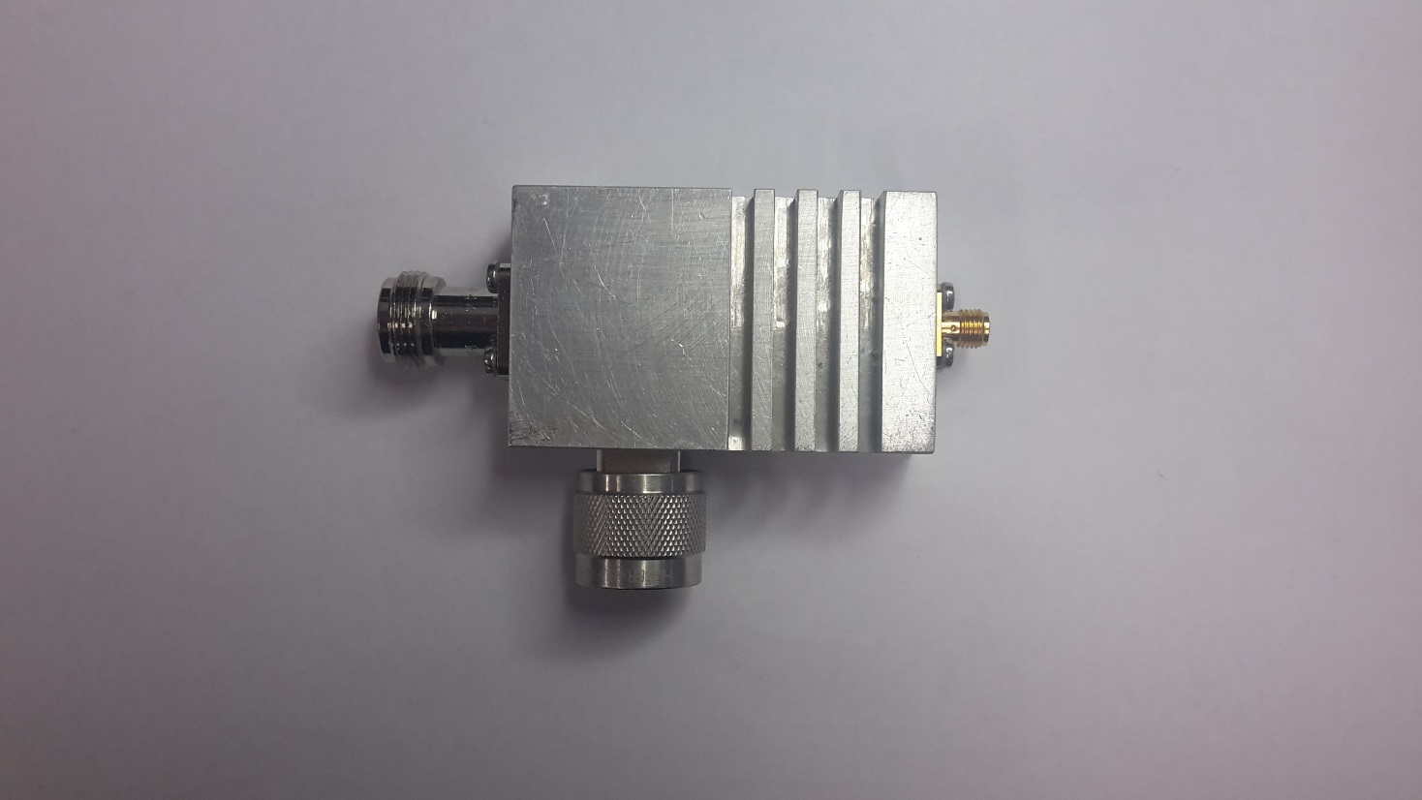
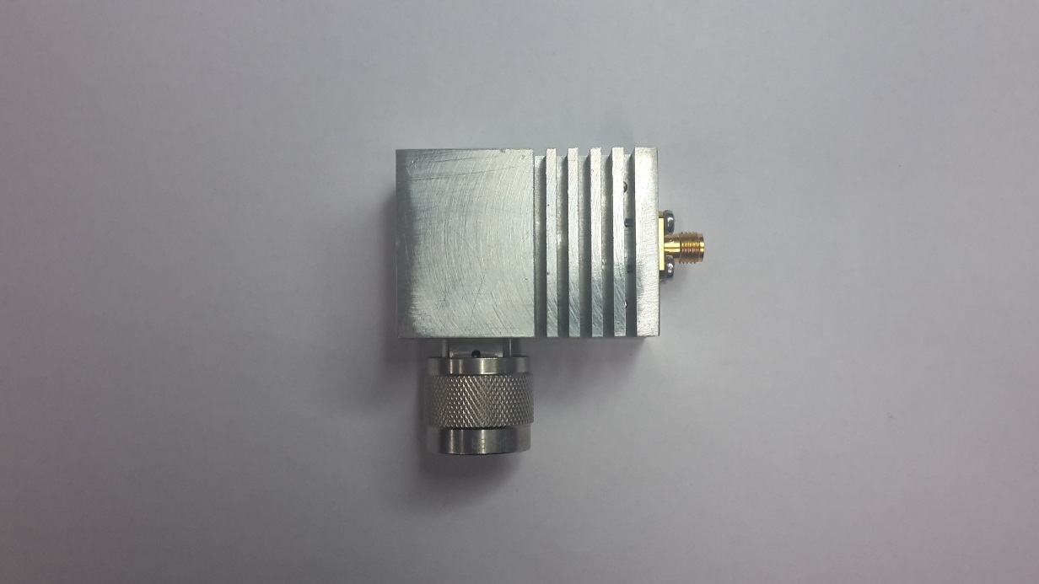
Adaptor
Two Way (Old & New Mopos in parallel) : 80 pc (not yet paired)
Single : 500 pc in production (expected before the end of 2016)

Slide 3
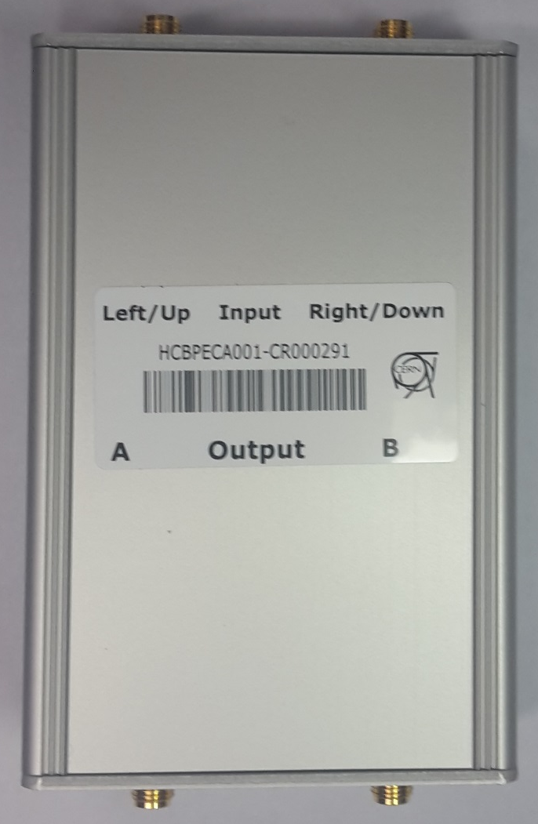
Beam Calibrator
100 pc in stock (not tested)
200 pc foreseen in 2017 (all components excepted pcb in stock)

Slide 4
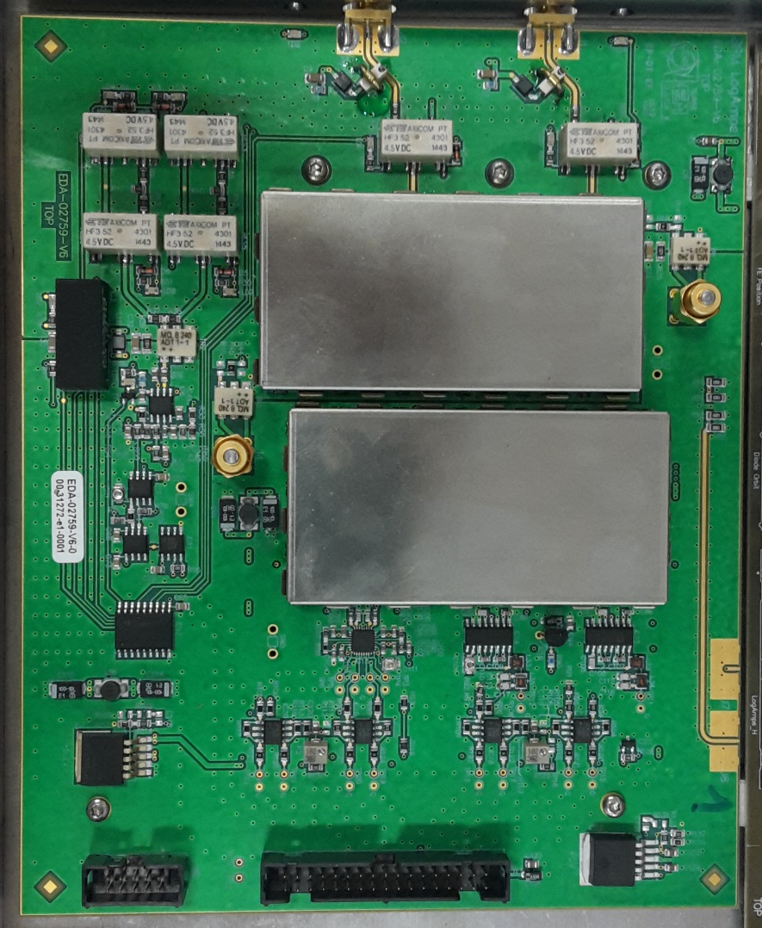
LogAmp
2 pc (V6) ready
To be tested with beam in HCA4
Production (Betty) 500pc in 2017 ?

Slide 5
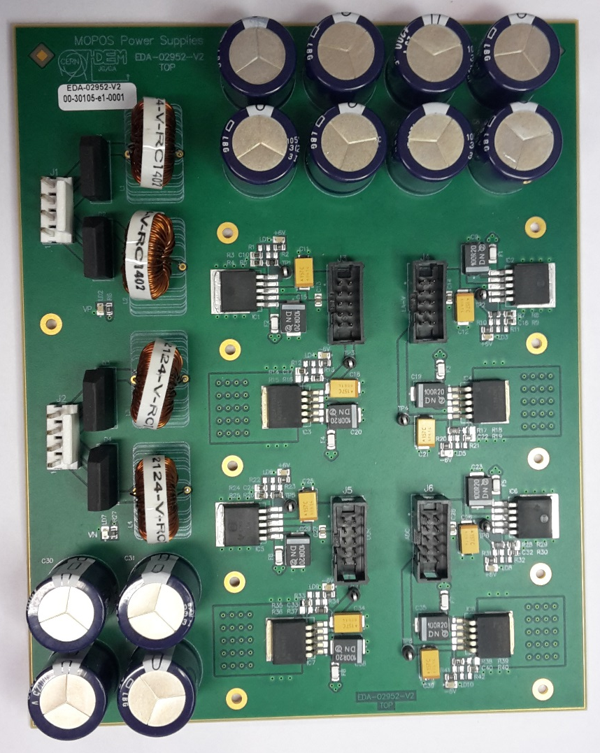
Power Supply
260 pc ready

Slide 6
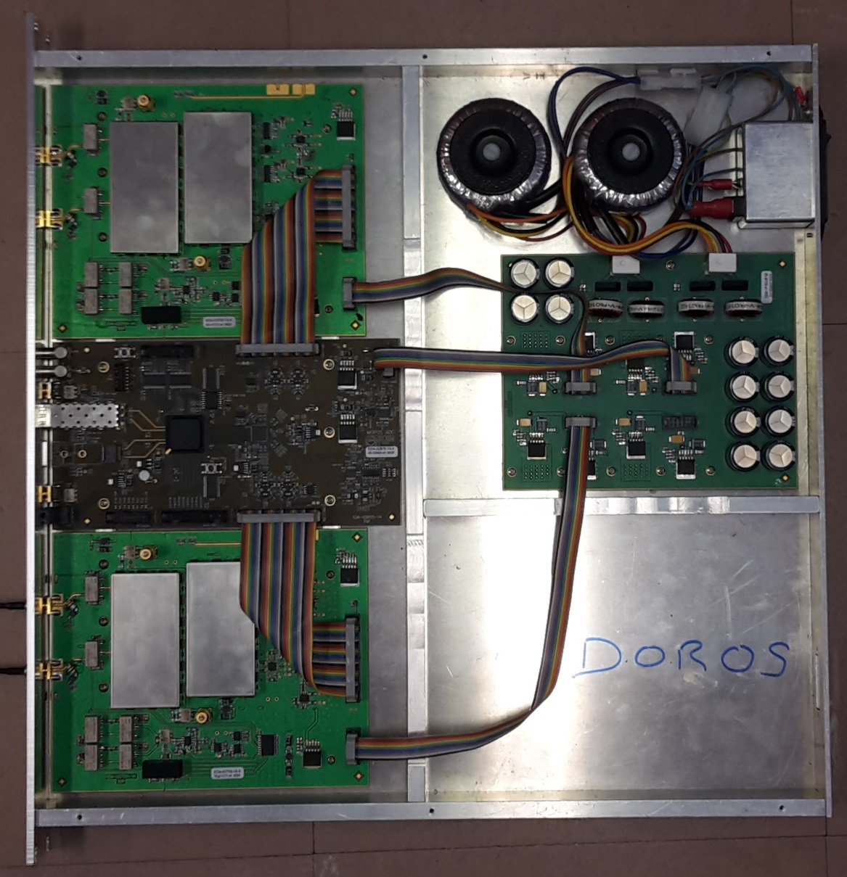
Pizza Box
Mecanics
  ~30 pc in Stock
  200 to be ordered
  DOROS requirement ?
Transformer + Cabling
  ~250 pc ready
Flat Cable
  6 x 200 to be ordered

