Slide 1

(02/11/2016)
MOPOS Project
Status Review & Plans
Manoel Barros Marin
BE-BI-QP

Slide 2
MOPOS Project
Outline:
Digital FE production status
Installation & radiation monitoring campaign
Status Review & Plans
BE-BI-QP

Slide 3
MOPOS Project
Outline:
Digital FE production status
Installation & radiation monitoring campaign
Status Review & Plans
BE-BI-QP

Slide 4
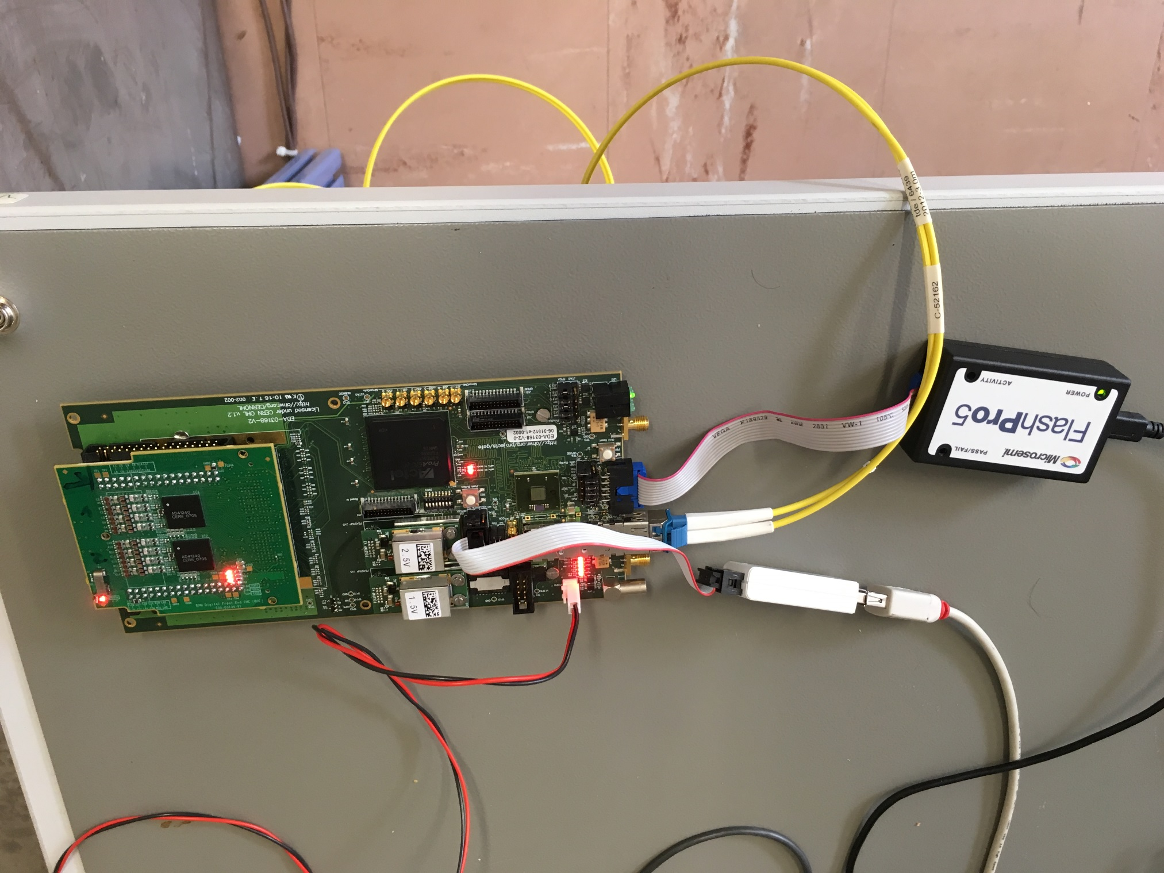
Digital FE (GEFE + BDF) production status
(1 of 3)
Introduction
  MOPOS Digital Front-End (DFE) composed by:
  General purpose rad-hard carrier: Gbt-based Expandable Front End (GEFE) (EDA-03168-V2)
  MOPOS specific mezzanine: Bpm Digital front-end Fmc (BDF) (EDA-03134-V1)
High-Speed Optical Link
FPGA
ADCs

Slide 5
Digital FE (GEFE + BDF) production status
(2 of 3)
GEFE Production Status
  Pre-Production Stage
  Pre-production prototype successfully developed and tested
  - Reception test in laboratory
  - Radiation test in CERN facility (CHARM) (Target TID: ~750 Gy)
  Production Stage
  ~350 pieces to be produced (216 BPM positions -> ~62% of spares)
  Foreseen by Q3 of 2017
  Custom rad-hard components already procured:
  - Transceiver ASIC (GBTx): 500 pieces
  - Optical Transceiver (VTRx SM): 500 pieces
  - DCDC converters (FEASTMP): 1000 pieces (2 per GEFE)
  COTS components already procured and successfully tested in radiation at PSI (except FPGA)
  Microsemi ProAsic3 FPGA:
  - Order to be placed by January 2017 (~350 pieces)
  - Radiation test at CHARM by May 2017

Slide 6
Digital FE (GEFE + BDF) production status
(3 of 3)
BDF Production Status
  Pre-Production Stage
  First prototype successfully developed and tested
  - Reception test in laboratory
  - No dedicated radiation test required (COTS components shared with GEFE except voltage regulator)
  Pre-production prototype foreseen by Q1 2017
  - Replace COTS voltage regulator by rad-hard version.
  - Minor modifications
  Production Stage
  ~350 pieces to be produced (216 BPM positions -> ~62% of spares)
  Foreseen by Q3 of 2017
  Custom rad-hard component already procured:
  - ADC (AD41240): 1000 pieces (2 per GEFE)
  COTS components already procured and successfully tested in radiation at PSI (except FPGA)
  Radiation test with final FW at CHARM by May 2017 (for final FW and FPGA qualification)
  - Radiation test at CHARM by May 2017

Slide 7
MOPOS Project
Outline:
Digital FE production status
Installation & radiation monitoring campaign
Status Review & Plans
BE-BI-QP

Slide 8
Installation & radiation monitoring campaign
  Higher radiation levels in SPS that expedited
  Significant difference between 2013 and 2015 reports from Radiation Protection
  Radiation levels during operation cannot be quantified yet due to SPS performance improvements
  Study ongoing for finding the most appropriate positions in terms of radiation dose
  Collaboration with Radiation Working Group (RadWG) and Monitoring & Calculations Working Group (MCWG)
  RadWG
  - Advise about radiation effects mitigation techniques in electronics (e.g. TMR, encodings, etc.)
  - Assistance in radiation tests
  - RadMons installation (final positions decided before December 2016)
  - One per BPM position (216) at the rack level
  - Several BPM positions at the centre of the magnets (radiation levels may be lower there)
  - Installation during EYETS 2016/2107
  MCWG
  - Advise about radiation effects mitigation at system level (e.g. placement, shielding, etc.)
  - Assistance in RadMons data analysis and FLUKA simulations

Slide 9
Thank you
manoel.barros.marin@cern.ch
BE-BI-QP

Slide 10
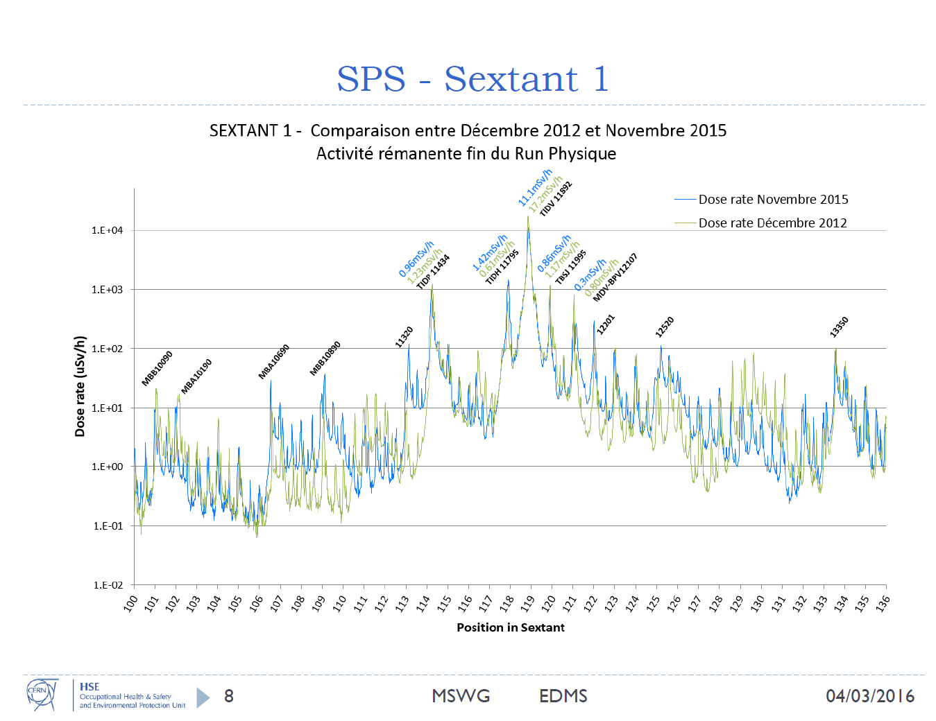

Slide 11
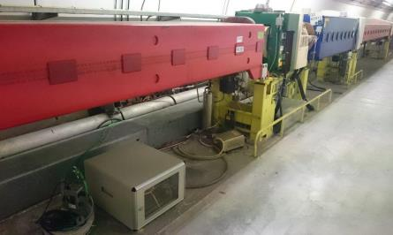
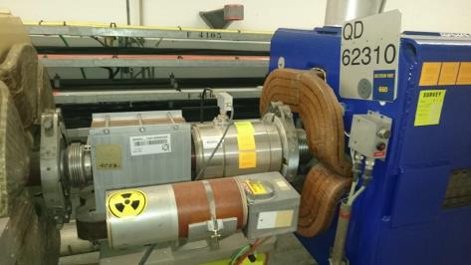
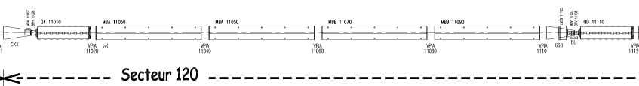
MOPOS request
Request: estimation of radiation levels in racks positions (electronics for Beam Position Monitors - BPM)
BPM
RadMon
Rack
X
BLM
X
RPL
33
93
97
X
BLM
X
RPL
Corinna Martinella EN-EA

Slide 12
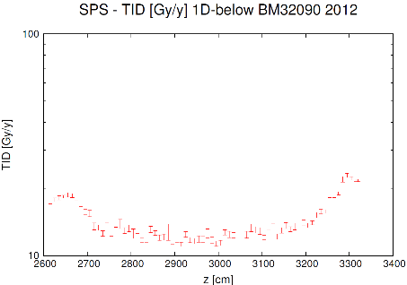
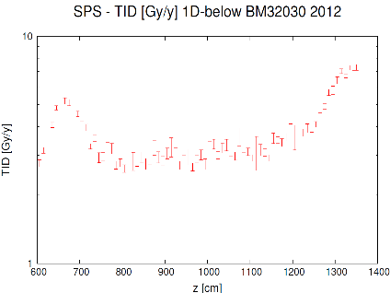
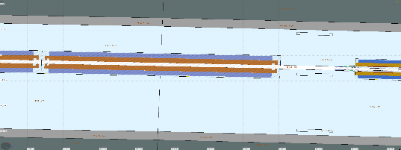
Shielding effect of the magnet
MBB.32030 end
MBB.32030 start
MBB.32090 end
MBB.32090 start
Simulations J. Saraiva
Simulation for MBB.32090 and MBB.32030 at floor level:
Based on 2012 pattern of losses (each 40cm).
Shielding effect of the magnets: reduction of factor of 2 in both situations.
Different pattern of losses (increasing in the middle for MBB.32020).
2600
2700
2800
2900
3000
3100
3200
3300
3400
Corinna Martinella EN-EA

