Slide 2
Linac4 LowLevel RF
Longitudinal painting : Chopper-PIMS-Debuncher
Grégoire Hagmann, Philippe Baudrenghien

Slide 3
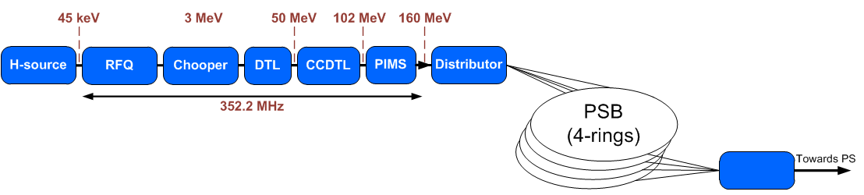
Linac4 LowLevel RF
Longitudinal painting “actors”
Debuncher
Chopping pattern
Voltage modulation (PIMS11, PIMS12)
Phase modulation

Slide 4
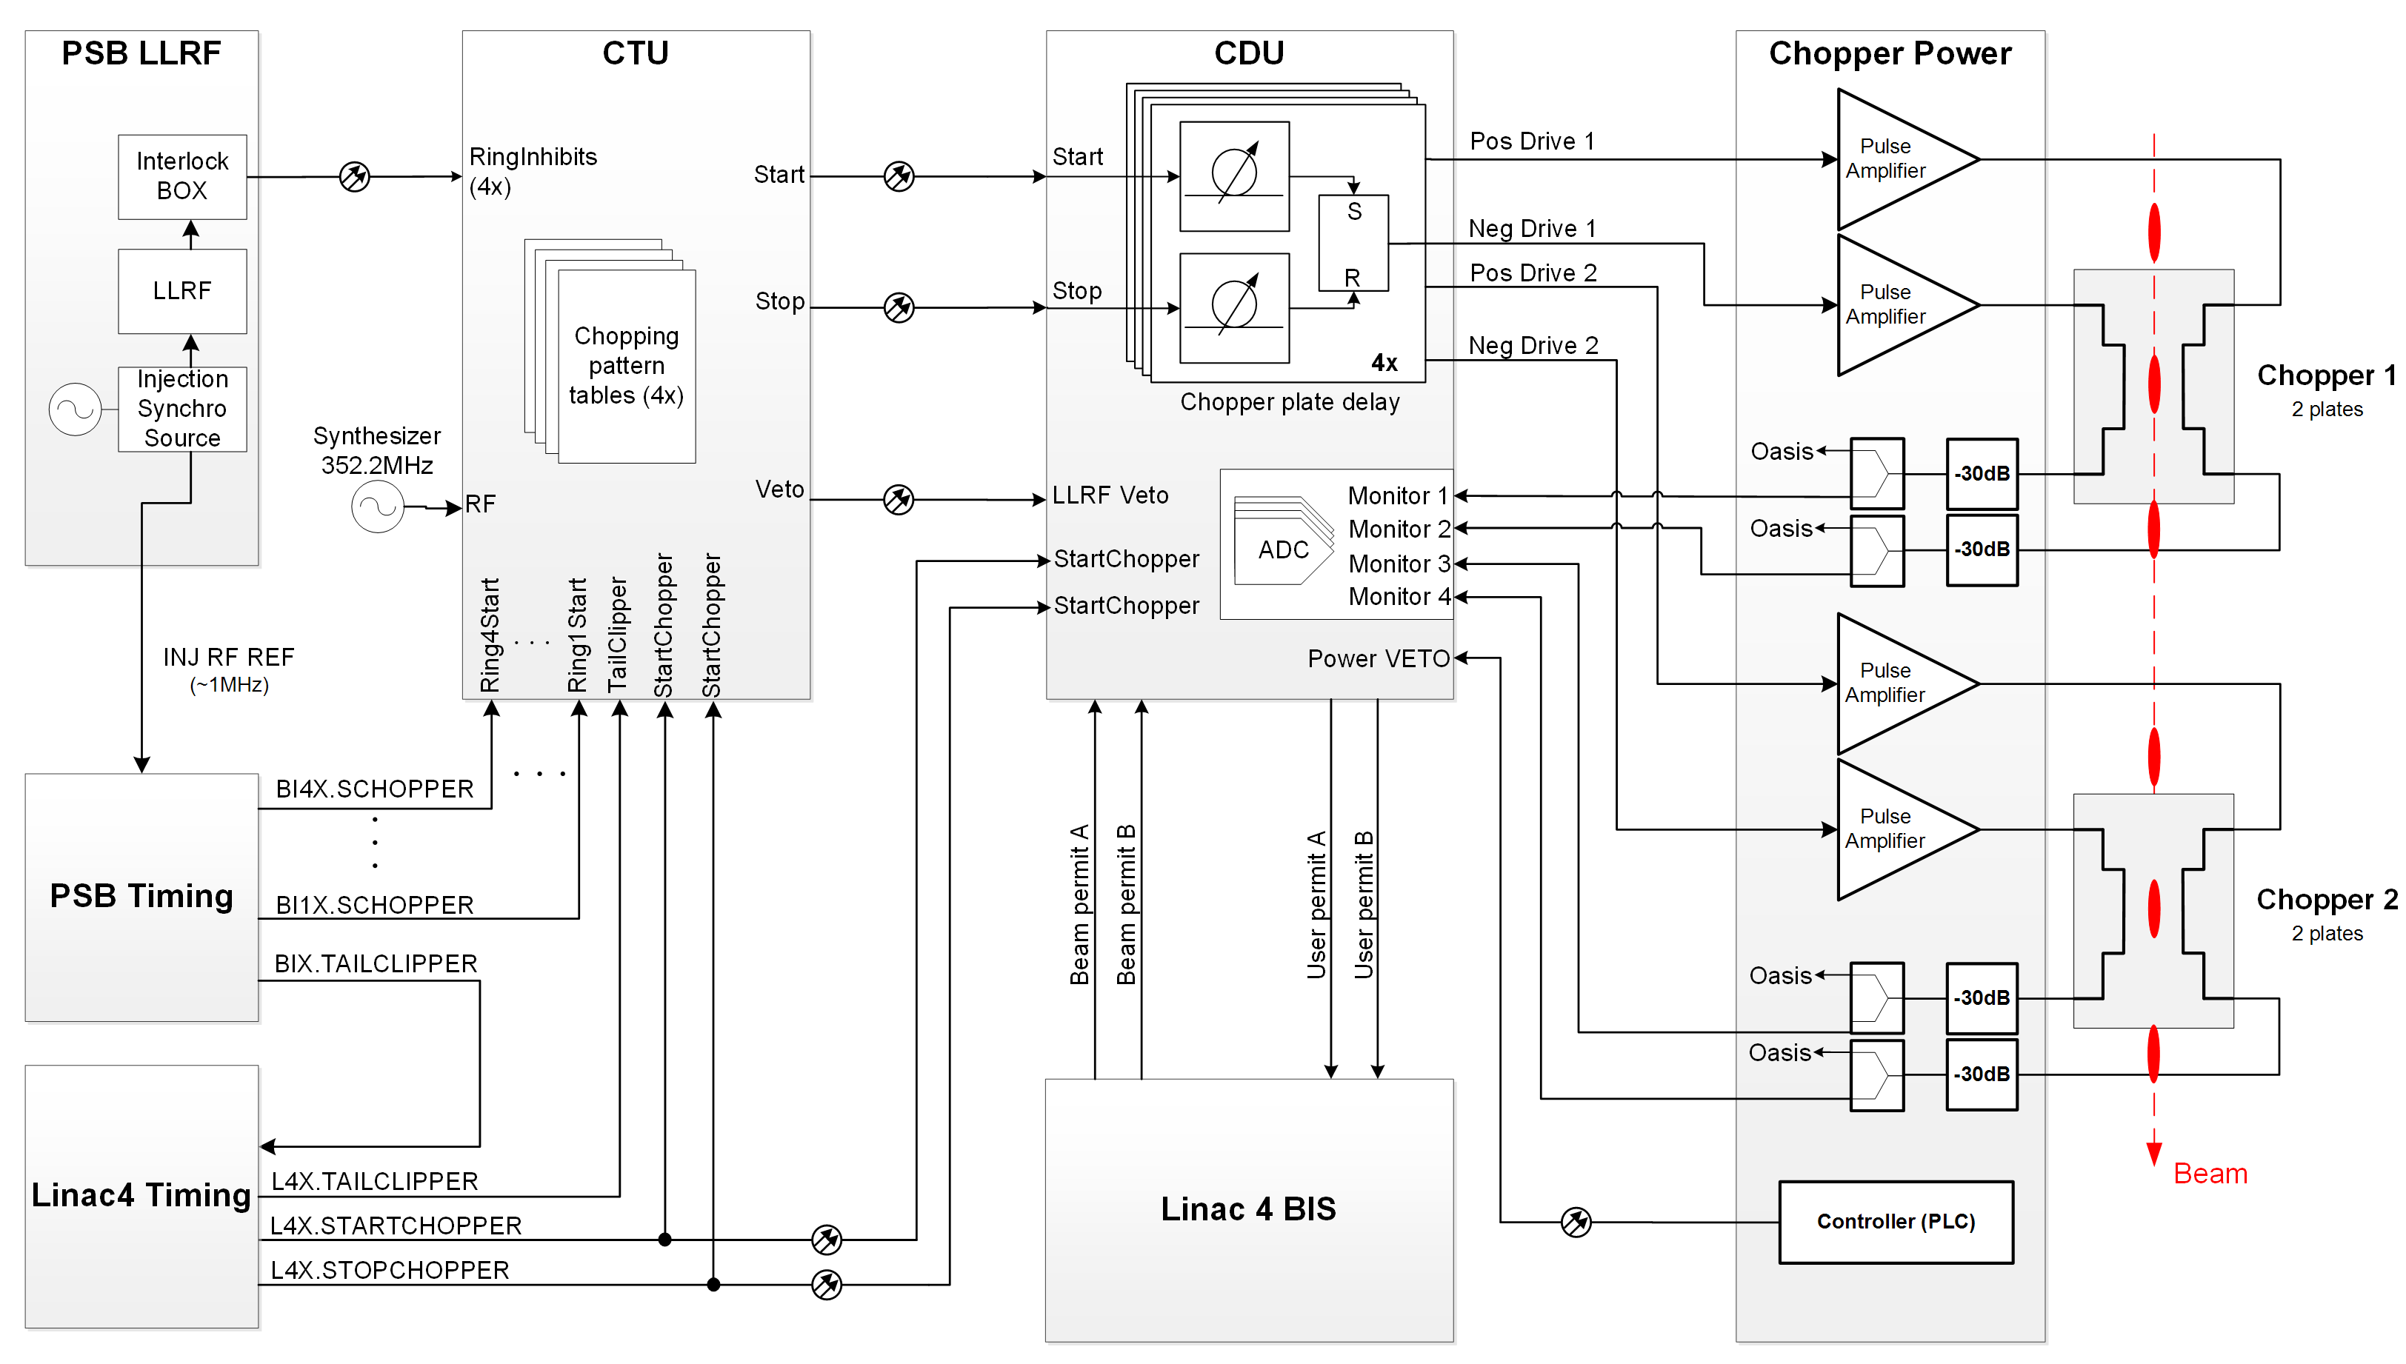
Linac4 Chopper – CTU
“Chopper Trigger Unit”

Slide 5
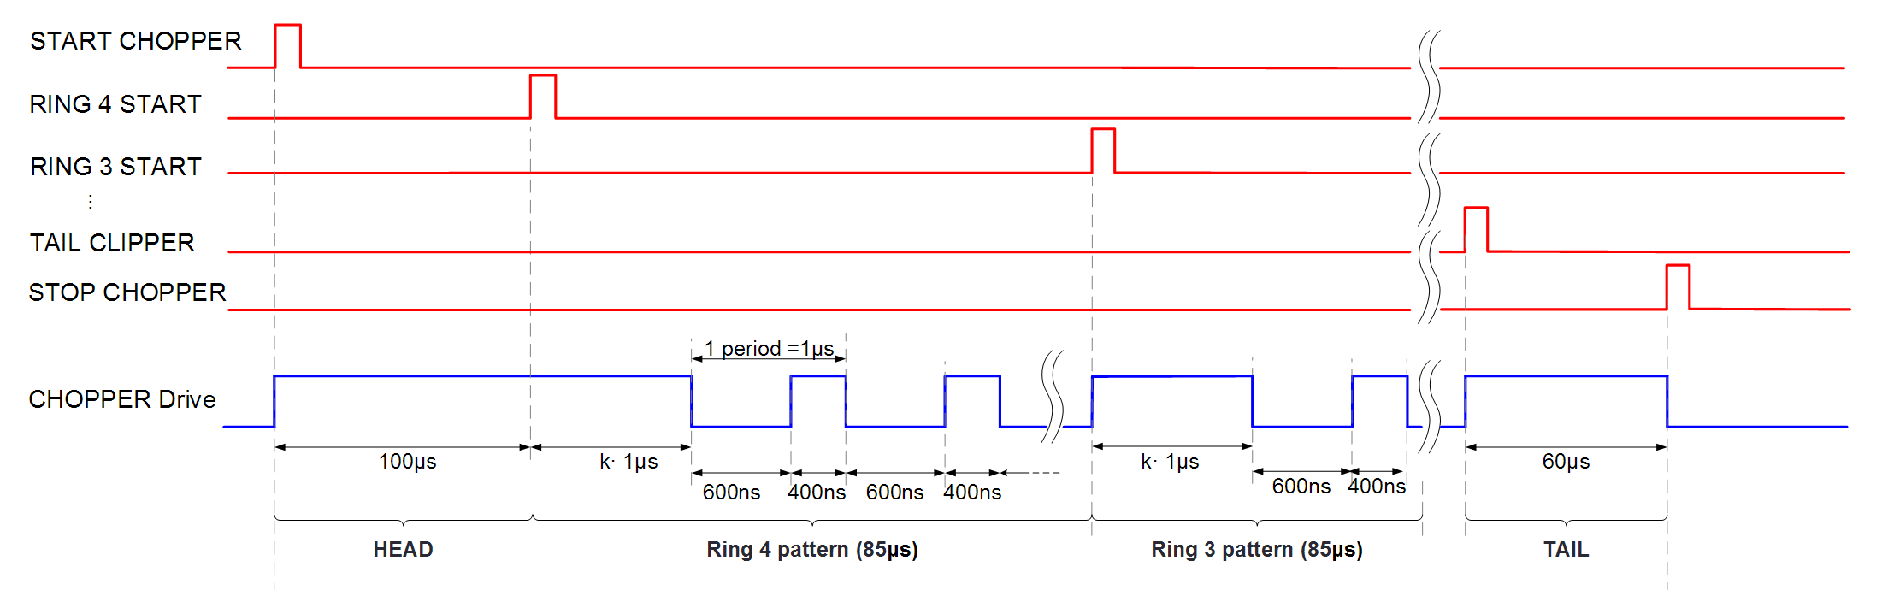
Linac4 Chopper – CTU
Simple chopping pattern algorithm (periodic)
Offset
Ton
Start Chopping
Toff
Toff
Stop Chopping

Slide 6
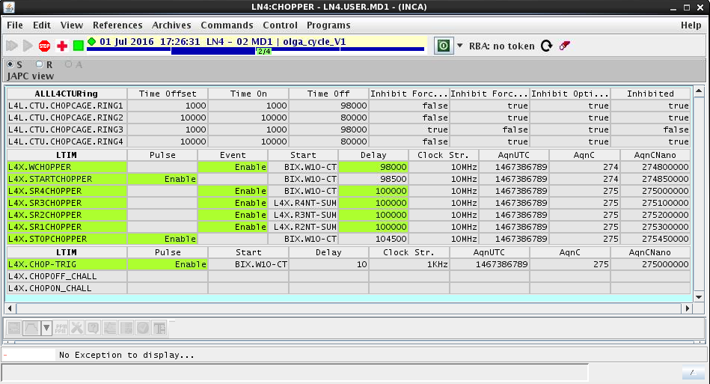
Linac4 Chopper – CTU
Simple chopping pattern algorithm
LN4:CHOPPER Working set (Chopping pattern)
=> Simple chopping pattern algorithm (working set)
Chopping pattern
Chopper timings
Obsolete timings

Slide 7
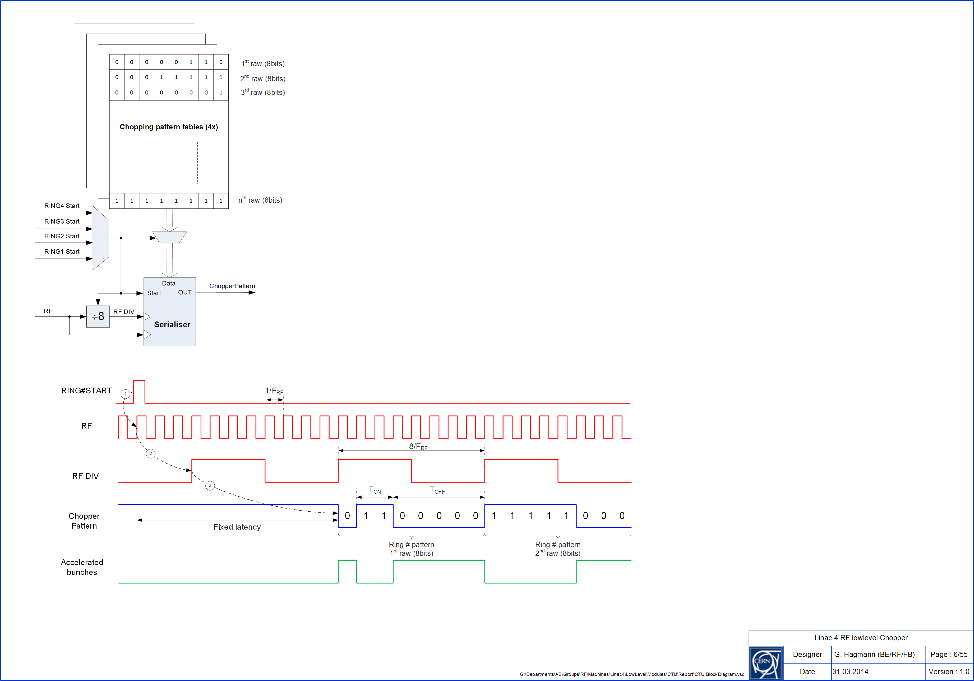
Linac4 Chopper – CTU
Complex chopping pattern algorithm
Direct access to the Chopping pattern tables (FESA class property)
Need higher level application to compute the chopping pattern
Resolution: 1bits = 1/352.2MHz
LSB first
Last bit shall bit ‘1’
Chopping pattern
tables (4x)

Slide 8
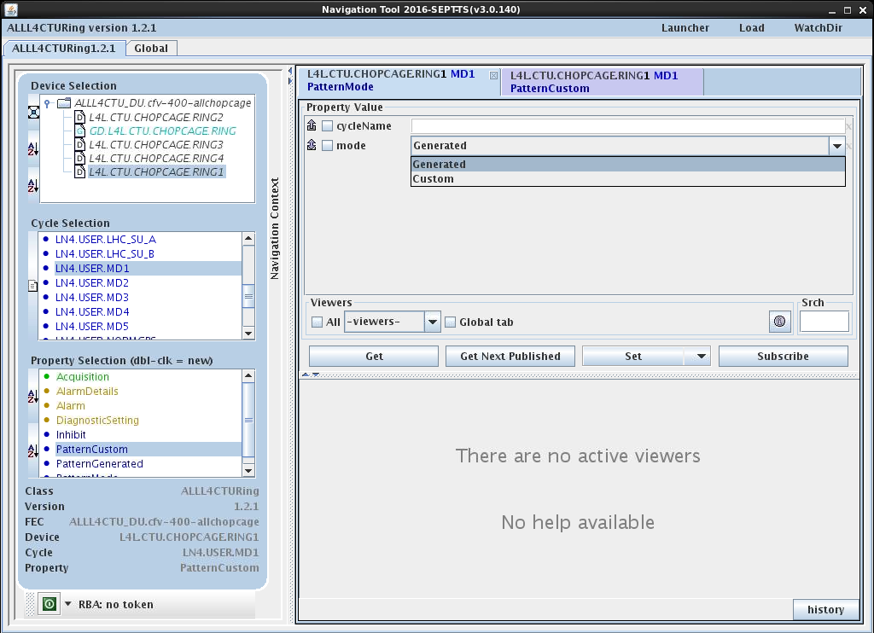
Linac4 Chopper – CTU
Complex chopping pattern algorithm
FESA class spec on EDMS (doc n° 1729215)
FESA class ALLL4CTURing
4 devices (1 per ring)
Mode → Custom

Slide 9
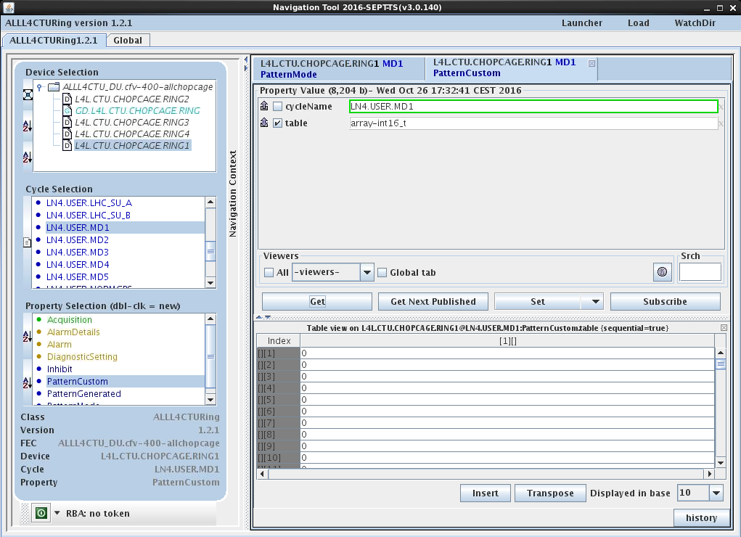
Linac4 Chopper – CTU
Complex chopping pattern algorithm
FESA class spec on EDMS (doc n°…)
FESA class ALLL4CTURing
4 devices (1 per ring)
Integer array
(4096 x 16bits)
Max ring length 186us

Slide 10
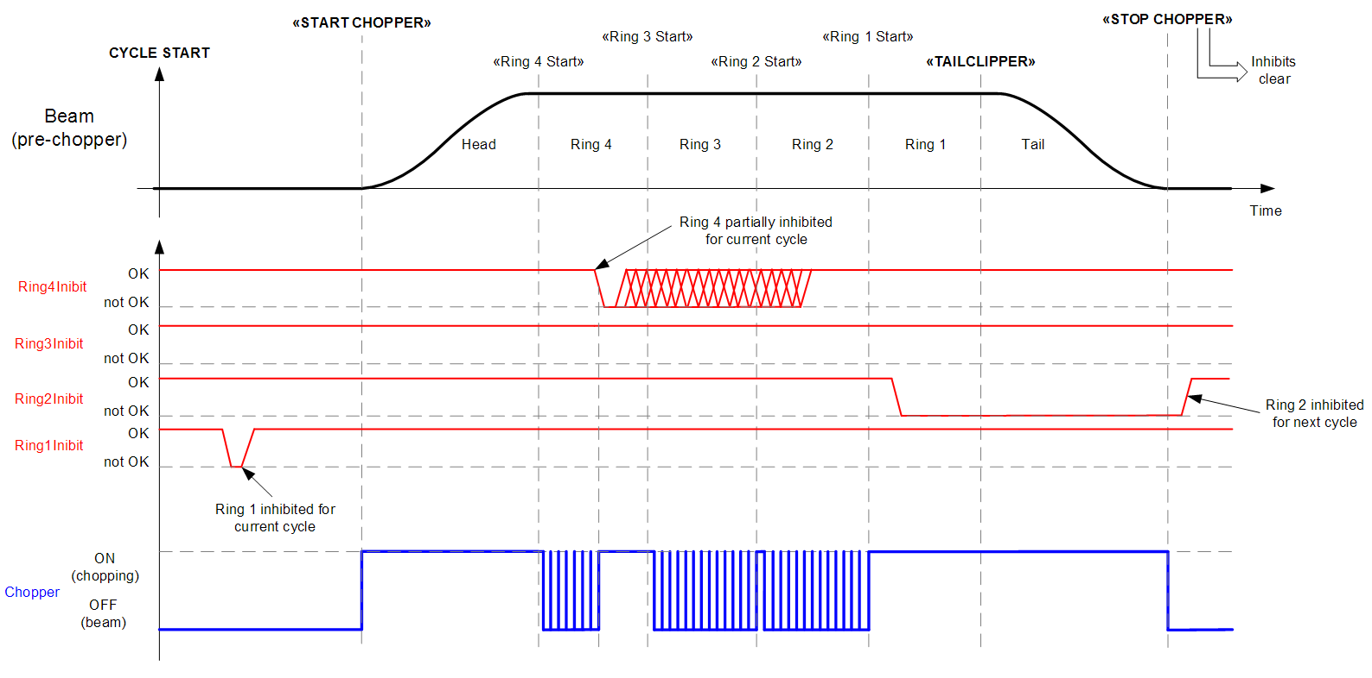
Linac4 Chopper – CTU
Ring Inhibit
1 asynchronous interlock per PSB ring (optical fiber)
Ring sequence not affected
Ring 4 inhibit
Ring 2 inhibit
(next cycle)
Ring 1 inhibit

Slide 11
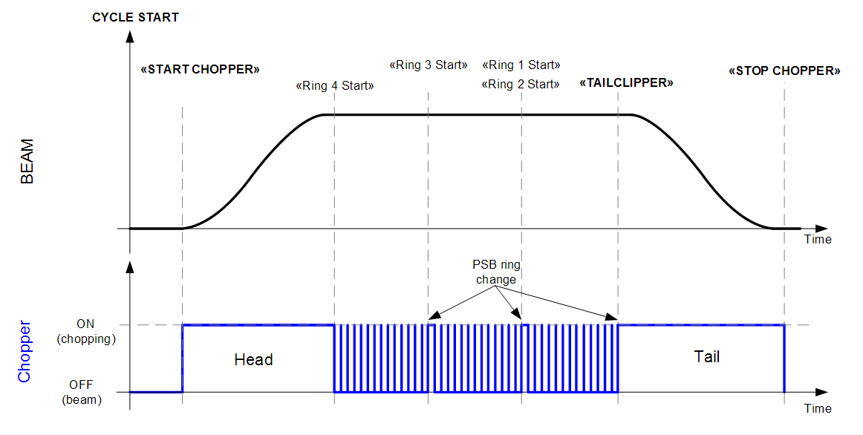
Linac4 Chopper – CTU
Ring Blanking (nb turns=0)
From timing
Ring sequence affected
Timing prioritization: TailClipper → Ring 1 Start → Ring 2 Start → Ring 3 Start → Ring 4 Start
Ring 2 blanking
Ring 1 advanced

Slide 12
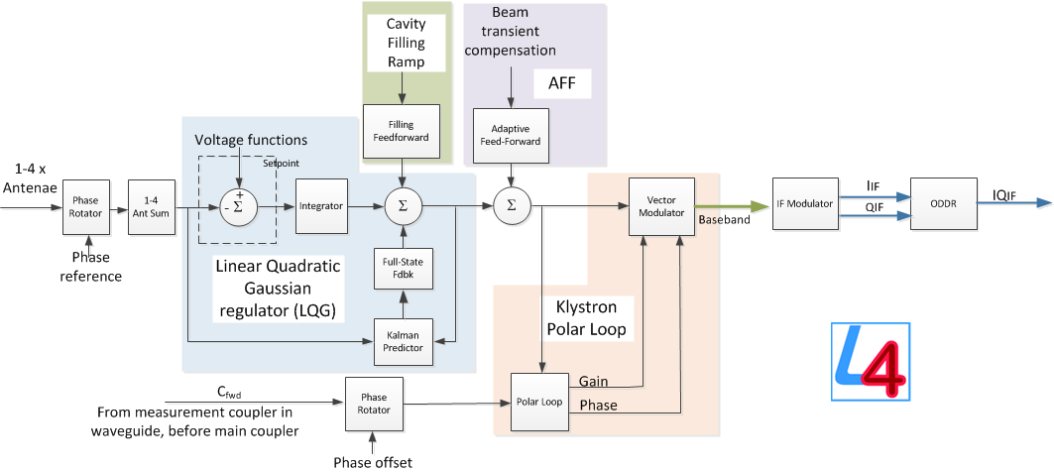
Linac4 Cavity controller
Voltage modulation (CavityLoops)
Will be available for any cavity!
Scalar or vectors (IQ)

Slide 13
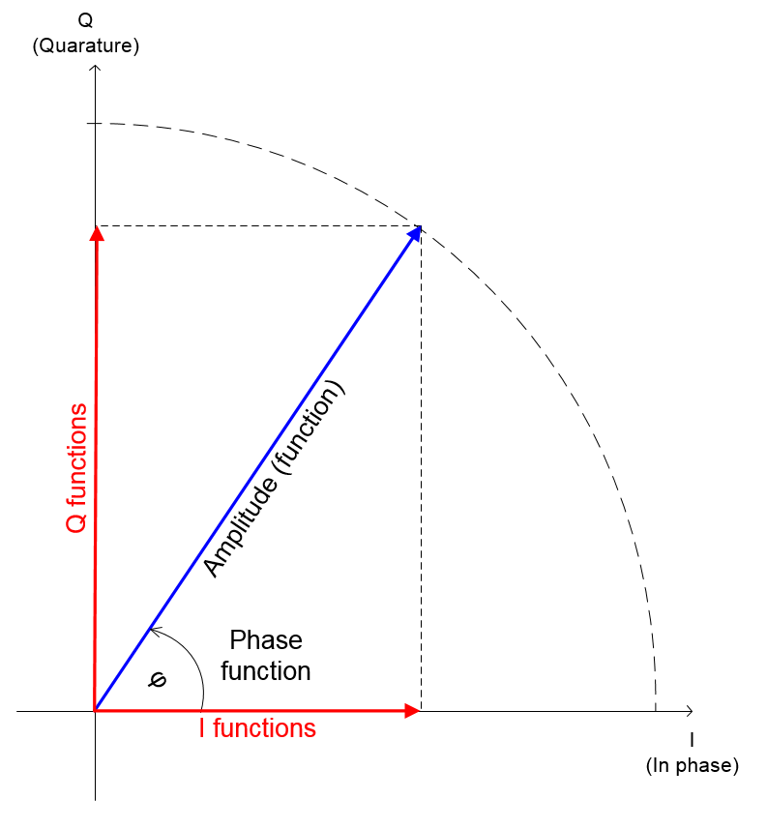
Linac4 Cavity controller
Cartesians or polar coordinates
Inca in polar (Amplitude/phase)

Slide 14
Linac4 Cavity controller
Voltage modulation (amplitude or phase)
Functions (IQ) for Voltage Setpoint (fesa)
Functions (amplitude/phase) in INCA
  To be driven by higher level application
  Make rule needed to convert from amplitude/phase to IQ
RF feedback will make the cavity field follow these functions
Playback at RF on (100us before BIX.W10-CT)
2048 cells arrays (one for I, one for Q)
  Samping rate RF/4 = 88.05MHz
  Interpolation by 64 => function resolution = 256/RF = ~727ns (1.37MHz)
  Function length ~1.5ms (OK?)
Boolean (in INCA) to select scalars or functions

Slide 15
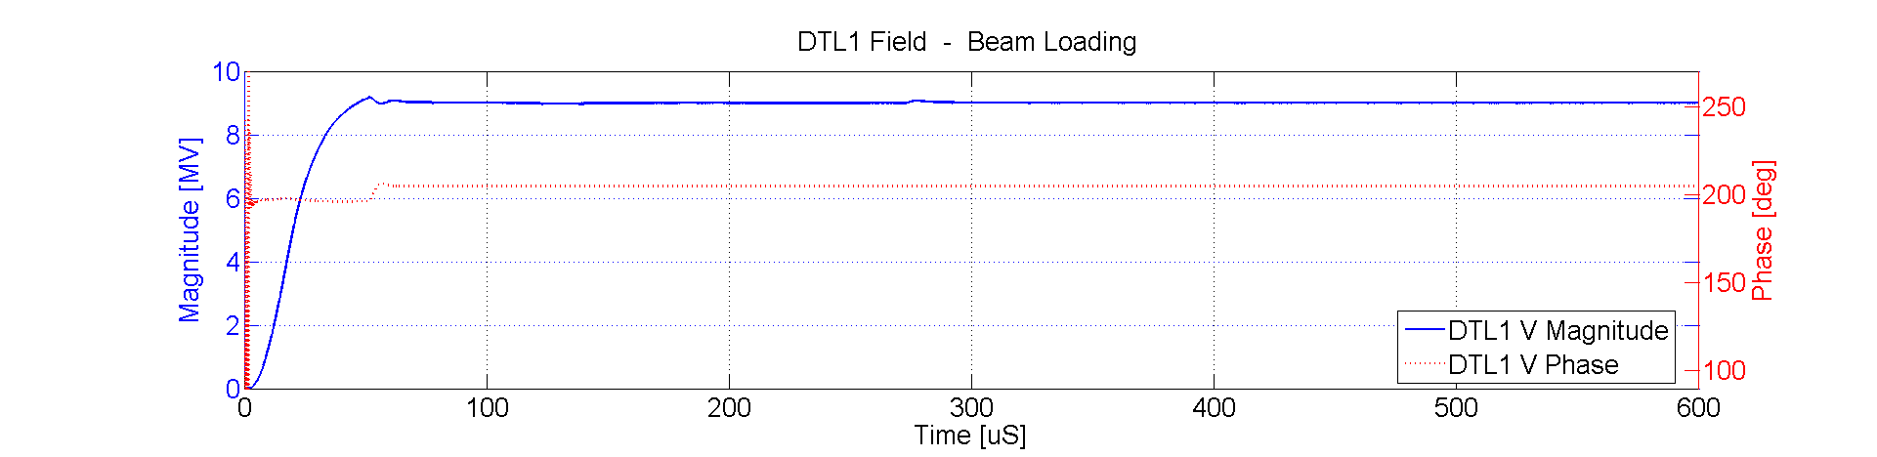
Linac4 Cavity controller
RF on – Beam pulse
RF ON
DTL1 Field
…
RFon transient
Beam pulse (voltage modulation)
…
Functions for voltage setpoint

Slide 16
Linac4 Summary
4 functions for chopping pattern (1 per ring)
  Start playback at PSB Ring start timings
  Resolution: 1/RF
2 functions per cavity for voltage set points (amplitude/phase)
  Start playback at RF ON timing (currently 100us before BIX.W10-CT)
  Resolution: 256/RF

Slide 18
Reference
[1] C. Carli, et Al., SYNCHRONIZATION BETWEEN LINAC4 AND THE PS BOOSTER, CERN 2010

