Slide 1
Oracle Database In-Memory feature at CERN
Emil Pilecki
Notes:
Introduce myself: 8 years data engineering, data analytics (make sense)

Slide 2

About Emil
Senior DBA at CERN
  First joined CERN in 2000, staff member as of 2012
Previously DBA team lead at Hewlett-Packard Poland
16 years of experience with Oracle databases
Specializes in:
  High availability solutions – RAC, Data Guard
  Database performance and testing
  Oracle In-Memory
  Data warehousing

Slide 3

About CERN
CERN - European Laboratory for Particle Physics
Founded in 1954 by 12 countries for fundamental physics research – Higgs boson discovery in 2012
Today 22 member states + world-wide collaborations
    About ~1000 MCHF yearly budget
    13000 employees and users from 110 countries
Over 100 Oracle databases, mostly RAC
    Running Oracle 11.2.0.4 and 12.1.0.2
    750 TB of production data files, NAS as a storage

Slide 4
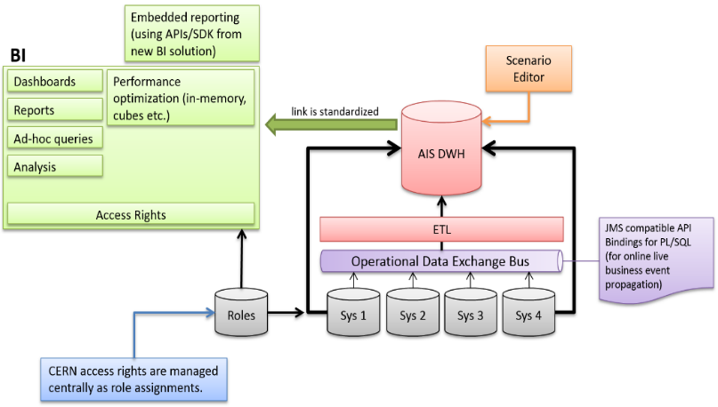
Administrative Data Warehouse
Currently in production, uses In-memory feature
Supports CERN reports, dashboards and data analytics
  HR data and personal records
  Financial data, orders/purchases
  Resource usage planning
  Electronic recruitment and others
Unique data source for all BI
applications – for data consistency
Bi-temporal data model – full change tracking

Slide 5

Reporting Before In-memory
Many different reporting / analytics applications
  Completely separated for performance reasons
  Data model optimized for each application
  Data consistency was a serious issue
Maintenance cost was huge
  Several teams of developers + DBAs
Performance far from satisfactory
  Some complex queries used to run for hours
Simply speaking – it was a mess!

Slide 6

Reporting with In-memory (ADW)
In-memory – natural choice for BI applications
Early tests at CERN (12.1 beta) very promising
  Purchased license in December 2014
Unified Administrative Data Warehouse
only possible with In-memory
  Designed specifically for In-memory
  In production since July 2015
Greatly improved performance!
Significantly reduced maintenance cost

Slide 7
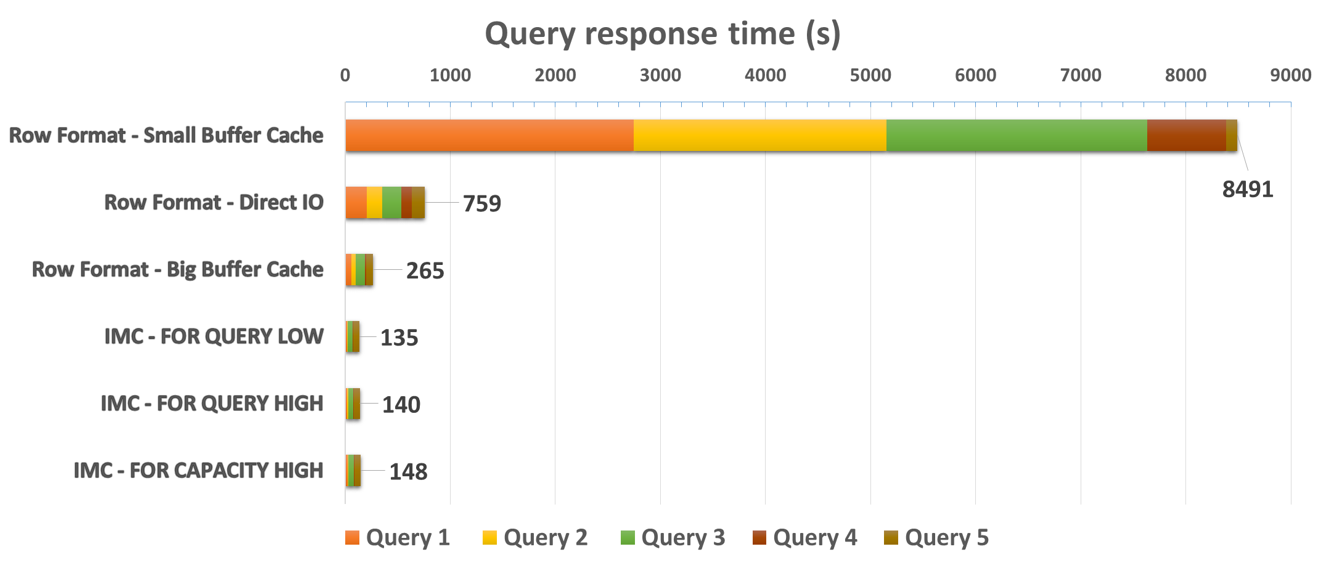
ADW In-memory Benefits
Realistic gain in PRODUCTION
Queries on average
10x faster!
IMC vs Direct IO
5.6x faster!
IMC vs Small BC
63x faster!!
IMC vs Big BC
2x faster

Slide 8

In-memory – Conclusion
Use for Business Intelligence, Data Warehousing,
Data Analytics and Reporting, including ad-hoc
Biggest benefit for very wide tables and when
queries select only few out of many columns
Queries scan big data sets – full table scan
Data sets fit entirely in memory (compressed)
Big performance boost guaranteed for such use-cases!
Simplification! also reduces maintenance costs
Graphic: www.oracle.com

Slide 9




Thank you for your attention!

