Slide 1

Advanced Detectors for Nuclear, High Energy and Astroparticle Physics
Bose Institute Kolkata
15-17 February 2017
Comparison of Silicon, Germanium and Diamond sensors for Using it in HEP Detector Applications
Shyam Kumar¹ , Raghava Varma¹, K.Das Gupta¹, Pradeep Sarin¹, S.K. Deb²
Department of Physics, IIT Bombay, Mumbai¹
CRNTS, IIT Bombay, Mumbai²
Email: shyam055119@gmail.com
Thanks for ALICE Utilization and Upgrade Project and IRCC, IIT Bombay for Support

Slide 2
Outline
Important properties of HEP detectors
Simulation for Charge created by MIP
Comparison of Radiation damage
Particle Identification capabilities
MPCVD System designing
Growth of diamond film and Characterization
Summary and Future Plan

Slide 3
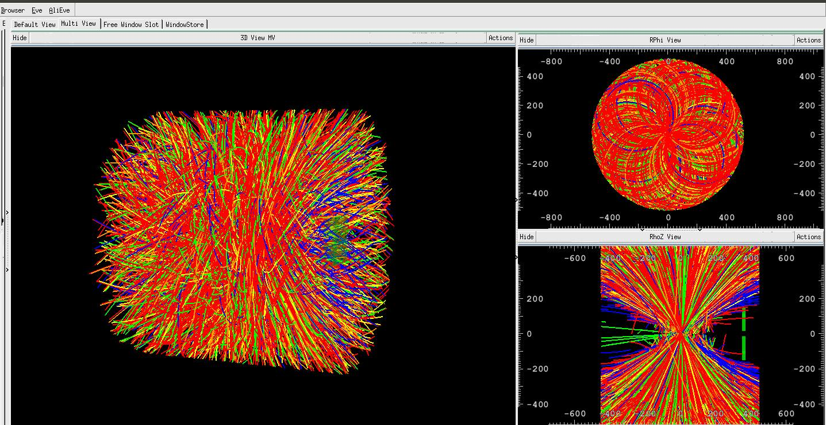
Important properties of HEP detectors
pb-pb collision in ALICE @5.02 TeV
Particle colors:
Blue: Electrons
Green: Muons
Red: Pions
Yellow: Kaons
Orange: Protons
PMD
AliAOD.root
High precision tracking=> Semiconductor detectors
Typical choice of semiconductors are Si, Ge and Diamond
Material should have following properties:
High signal to noise ratio for good position resolution
2. Low material budget for less multiple scattering
3. Fast pulse timing for less pile up
4. Low radiation damage
5. Particle Identification capabilities
In this talk we will compare Si, Ge and Diamond and will try to figure out the suitable material for High energy and high luminosity experiments

Slide 4
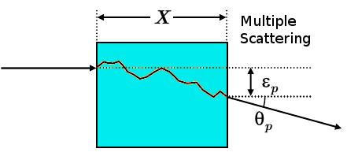
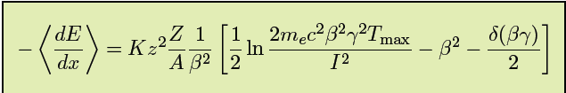
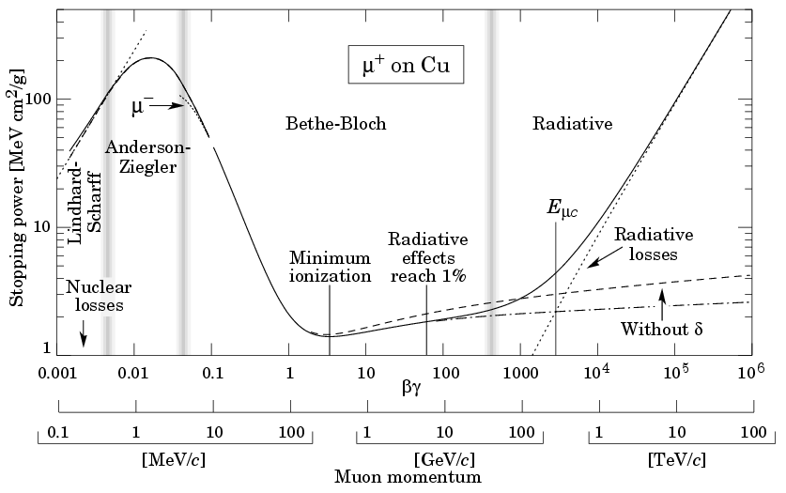
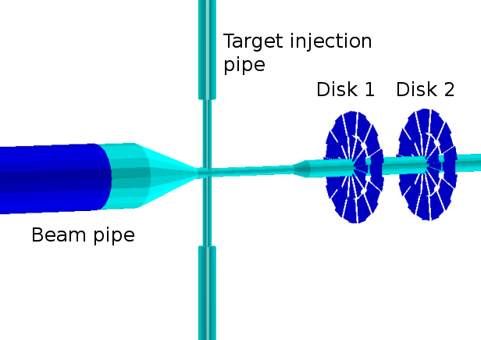
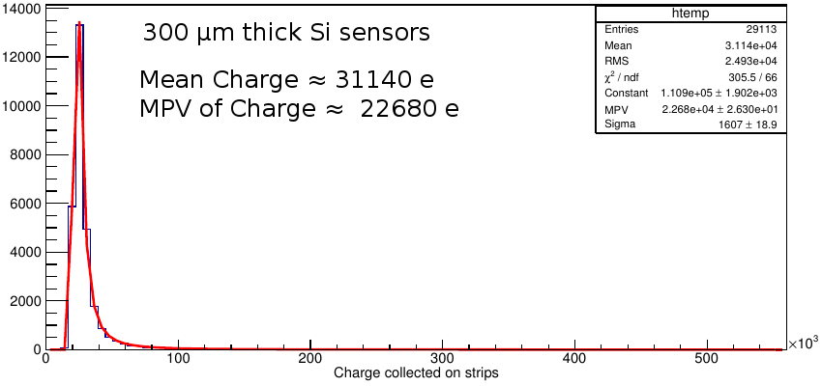
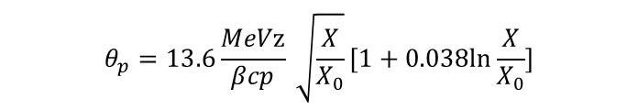
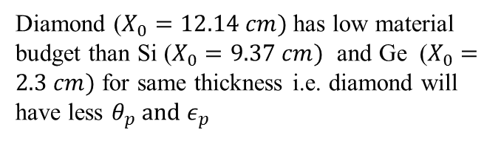
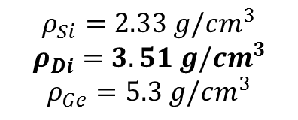

Simulation for Charge created by MIP
Diamond has low multiple scattering
$$ρ_{Si}=2.33 g/cm^{3}$$
$$ρ_{Di}=3.51 g/cm^{3}$$
$$ρ_{Ge}=5.3 g/cm^{3}$$
Diamond ($X_{0}=12.14 cm)$has low material budget than Si ($X_{0}=9.37 cm)$ and Ge ($X_{0}=2.3 cm)$ for same thickness i.e. diamond will have less ${θ_{p} and ε}_{p}$
$$θ_{p}=13.6\frac{MeVz}{βcp} \sqrt{\frac{X}{X_{0}}}[1+0.038ln\frac{X}{X_{0}}]$$
Ref: “Particle Detectors”, C. Grupen and B. A. Shwartz
$$ε_{p}≈\frac{1}{\sqrt{3}}θ_{p}X$$
Double sided strip sensors
Simulation and Digitization in
PANDA Root
40 cm
60 cm
Geometry used for Simulation

Slide 5
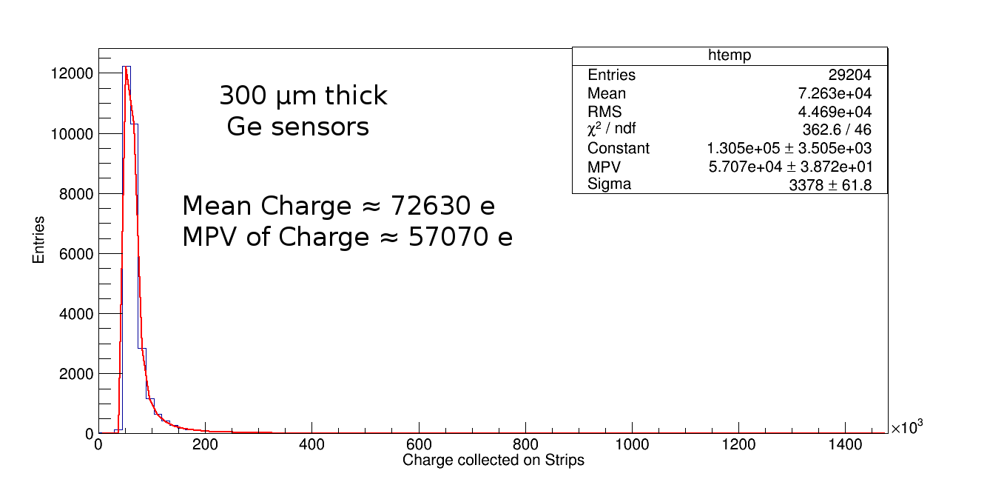
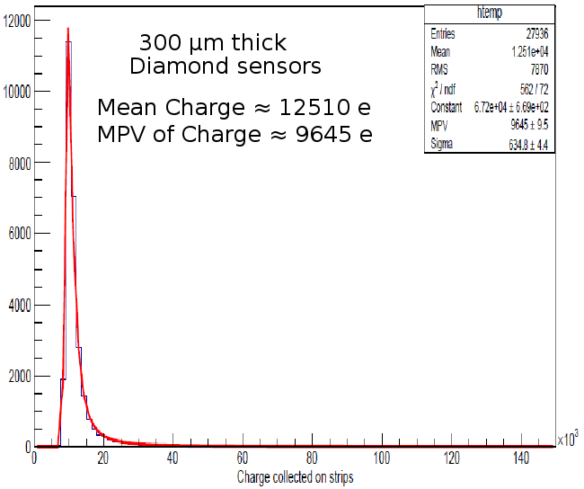
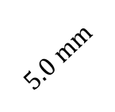

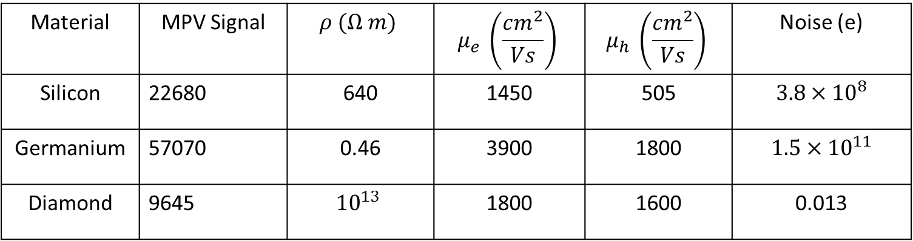
Signal to Noise ratio for Sensors $(5.0×5.0×0.3 mm^{3})$
$$5.0 mm$$
MIP
$σ=q\left(n_{e}μ_{e}+n_{h}μ_{h}\right)$ for Intrinsic material $n_{e}=n_{h}=n_{i}$
Thickness=0.3 mm
$$5.0 mm$$
Material | MPV Signal | $$ρ (Ω m)$$ | $$μ_{e} \left(\frac{cm^{2}}{Vs}\right)$$ | $$μ_{h} \left(\frac{cm^{2}}{Vs}\right)$$ | Noise (e)
Silicon | 22680 | 640 | 1450 | 505 | $$3.8×{10}^{8}$$
Germanium | 57070 | 0.46 | 3900 | 1800 | $$1.5×{10}^{11}$$
Diamond | 9645 | $${10}^{13}$$ | 1800 | 1600 | 0.013

Slide 6
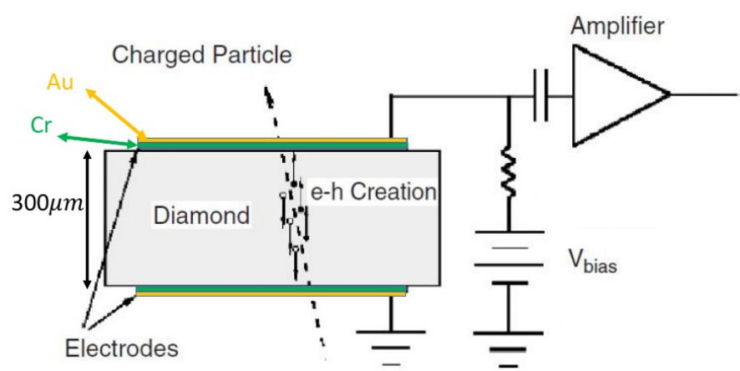
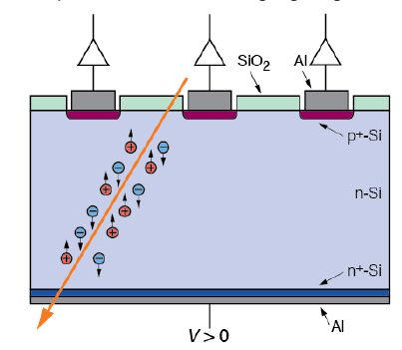
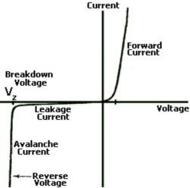
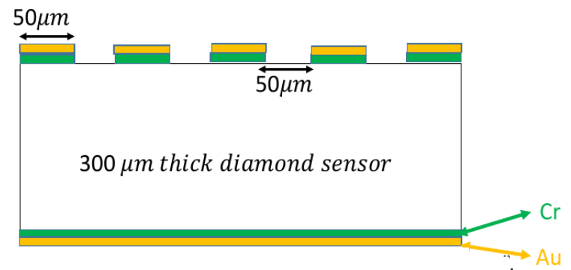
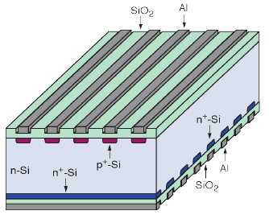
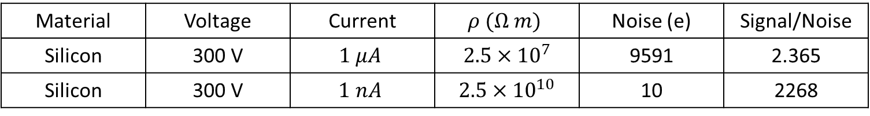
Signal to Noise ratio for intrinsic Si, Ge are very small so we can not use them intrinsic material but diamond can be used as intrinsic material
The intrinsic noise can be reduced by increasing some how resistivity=> p-n junction in reverse bias condition
Just rough numbers
Silicon sensor reverse biased: $5.0×5.0×0.3 mm^{3}$
Material | Voltage | Current | $$ρ (Ω m)$$ | Noise (e) | Signal/Noise
Silicon | 300 V | $$1 μA$$ | $$2.5×{10}^{7}$$ | 9591 | 2.365
Silicon | 300 V | $$1 nA$$ | $$2.5×{10}^{10}$$ | 10 | 2268
Diamond
Si and Ge same detector concept

Slide 7
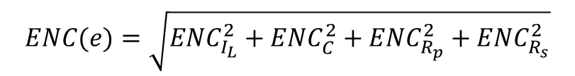
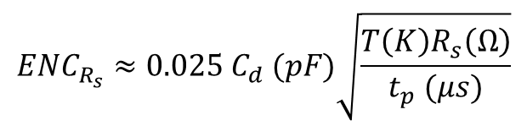
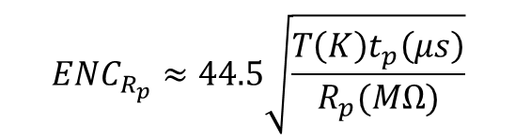

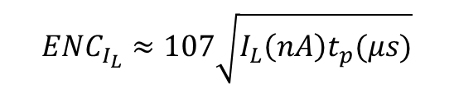
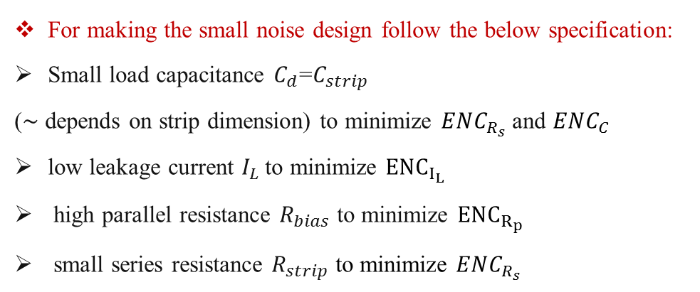
Signal to Noise Ratio: Expressed in terms of ENC (Equivalent Noise Charge)
$$ENC(e)=\sqrt{ENC_{I_{L}}^{2}+ENC_{C}^{2}+ENC_{R_{p}}^{2}+ENC_{R_{s}}^{2}}$$
$$ENC_{I_{L}}≈107\sqrt{I_{L}\left(nA\right)t_{p}(μs)}$$
1. Shot Noise due to $I_{L}$:
$$ENC_{R_{p}}≈44.5\sqrt{\frac{T\left(K\right)t_{p}\left(μs\right)}{R_{p}(MΩ)}}$$
2. Parallel thermal noise:
$$ENC_{R_{s}}≈0.025 C_{d} (pF)\sqrt{\frac{T\left(K\right)R_{s}\left(Ω\right)}{t_{p} (μs)}}$$
3. Series thermal noise from metal strip resistance:
4. Preamplifier noise:
$ENC_{C}=a+b C_{d}(pF)$ , a and b preamplifier design parameters
For making the small noise design follow the below specification:
Small load capacitance $C_{d}$=$C_{strip}$
(∼ depends on strip dimension) to minimize $ENC_{R_{s}}$ and $ENC_{C}$
low leakage current $I_{L}$ to minimize $ENC_{I_{L}}$
high parallel resistance $R_{bias}$ to minimize $ENC_{R_{p}}$
small series resistance $R_{strip}$ to minimize $ENC_{R_{s}}$
Ref: Evolution of Silicon sensor technology in Particle Physics: pages: 27-28
Frank Hartmann

Slide 8
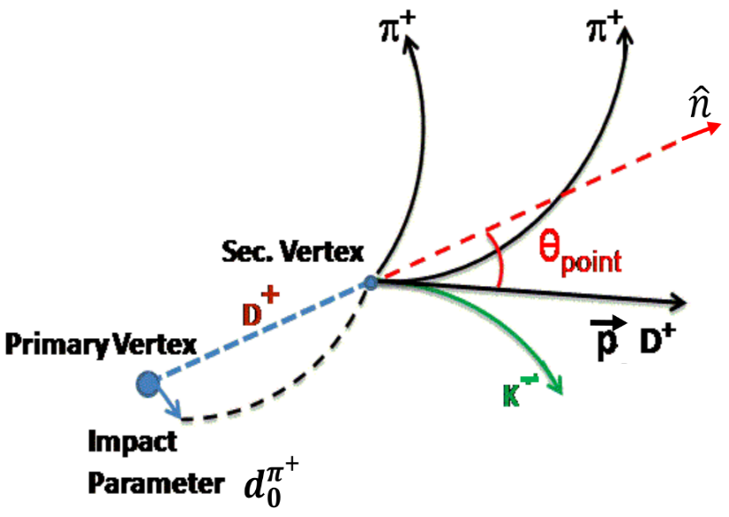

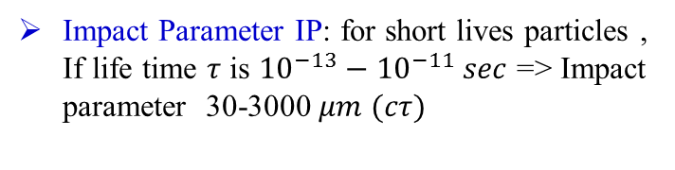
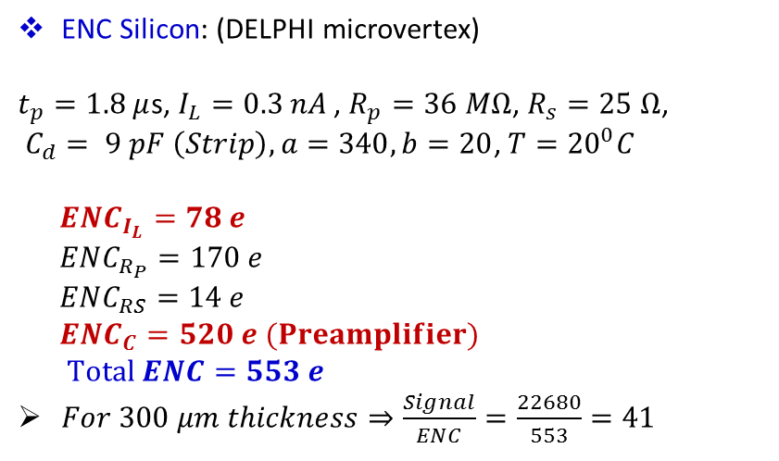

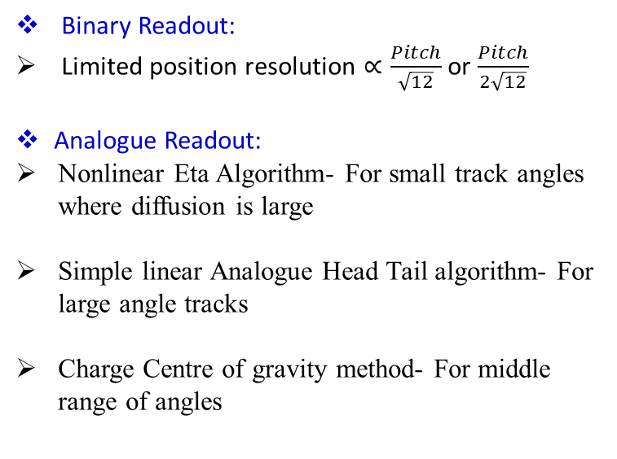
ENC Silicon: (DELPHI microvertex)
$t_{p}=1.8 μ$s, $I_{L}=0.3 nA$ , $R_{p}=36 MΩ$, $R_{s}=25 Ω$,
$C_{d}= 9 pF \left(Strip\right), a=340, b=20$, $T={20}^{0}C$
$ENC_{I_{L}}=78 e$
$ENC_{R_{P}}=170 e$
$ENC_{RS}=14 e$
$ENC_{C}=520 e (Preamplifier)$
$Total ENC=553 e$
$For 300 μm thickness⇒\frac{Signal}{ENC}=\frac{22680}{553}=41$
ENC Diamond: (Estimation)
$t_{p}=5.0 n$s, $I_{L}=1 pA$ , $R_{p}=36 MΩ$, $R_{s}=25 Ω$, ${ C}_{d}=2 pF , T={20}^{0}C$
$$Low Noise Viking Amplifier: ENC_{C}=135+13 C_{d}$$
$ENC_{I_{L}}=0.24 e$
$ENC_{R_{P}}=9 e$
$ENC_{RS}=61 e$
$ENC_{C}=$ 161 e
$Total ENC=172 e$
$$For 300 μm thickness⇒\frac{Signal}{ENC}=\frac{9645}{172}=56$$
Ref: First measurements with a diamond microstrip detector, NIM, Research A 354 (1995) 318-327
Binary Readout:
Limited position resolution $∝\frac{Pitch}{\sqrt{12}}$ or $\frac{Pitch}{2\sqrt{12}}$
Analogue Readout:
Nonlinear Eta Algorithm- For small track angles where diffusion is large
Simple linear Analogue Head Tail algorithm- For large angle tracks
Charge Centre of gravity method- For middle range of angles
Impact Parameter IP: for short lives particles , If life time $τ$ is ${10}^{−13}−{10}^{−11} sec$ => Impact parameter 30-3000 $μm$ $(cτ)$
Best Position resolution $∝\frac{Pitch}{\frac{Signal}{ENC}}$
Ref: “Spatial resolution of silicon microstrip detectors”,
R. Turchetta, Nuclear Instruments and Methods in Physics

Slide 9
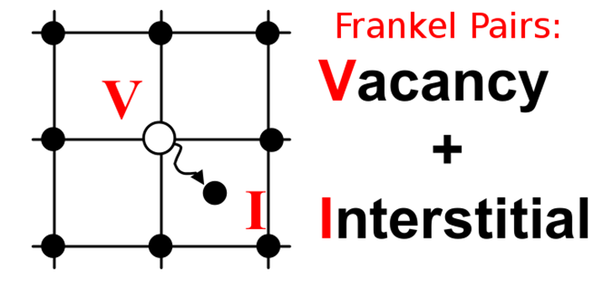
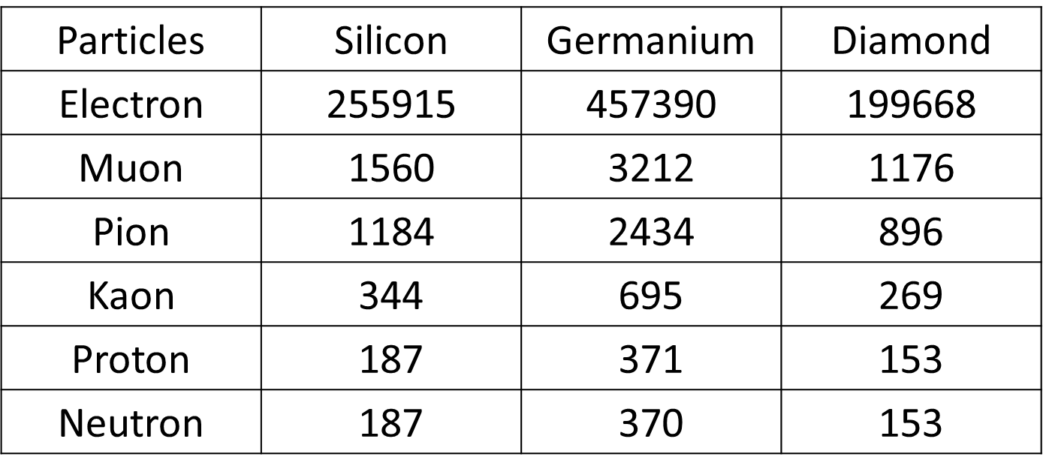

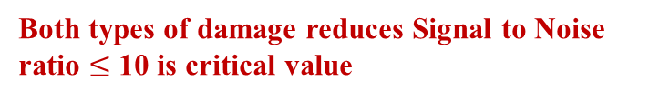
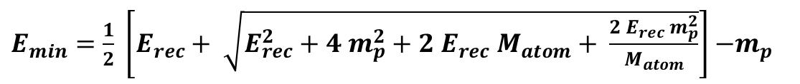
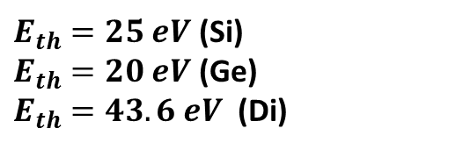

Comparison of Radiation damage
Fluka Simulation
Surface damage: Ionizing energy loss due to electron stopping=> Not present in diamond sensors as no oxide layer
Bulk damage: Non-Ionizing energy loss due to Nuclear stopping
DOSE Equivalent: For real experiments
Both types of damage reduces Signal to Noise ratio $≤$ 10 is critical value
$E_{min}=\frac{1}{2} \left[E_{rec}+ \sqrt{E_{rec}^{2}+4{ m}_{p}^{2}+2{ E}_{rec} M_{atom}+ \frac{{2 E}_{rec} m_{p}^{2}}{M_{atom}}}\right]$ $−m_{p}$
${Table 1. E}_{min}$ of incident particles in eV
$$S=S_{electronic}+S_{nuclear}$$
$E_{th}=25 eV$ (Si)
$E_{th}=20 eV$ (Ge)
$E_{th}=43.6 eV$ (Di)

Slide 10
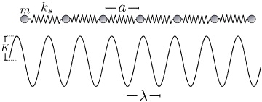


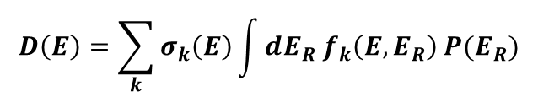
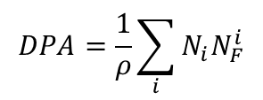
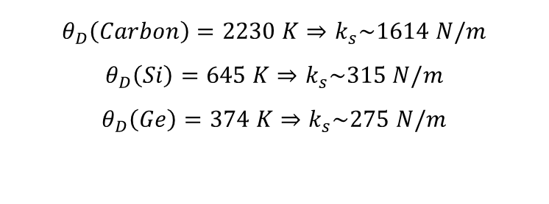
$$D\left(E\right)=\sum_{k}{σ_{k}\left(E\right)\int{dE_{R}{ f}_{k}\left(E,E_{R}\right)}}P(E_{R})$$
Diamond has low radition damage than others
$300 μm$ thick material
$$k_{s} \sim m_{atom}ω_{D}^{2}$$
$$ℏω=kθ_{D}$$
$$DPA=\frac{1}{ρ}\sum_{i}{N_{i}N_{F}^{i}}$$
Particles
$$θ_{D}\left(Carbon\right)=2230 K⇒k_{s}\sim 1614 N/m$$
$$θ_{D}\left(Si\right)=645 K⇒k_{s}\sim 315 N/m$$
$$θ_{D}\left(Ge\right)=374 K⇒k_{s}\sim 275 N/m$$
Thanks to Michael Moll (RD50), CERN
and Moritz Guthoff, CMS (CERN)
SEU: Single Event Upset (Random in time) may cause loss of data but temporary most of the time
In diamond, there will be no surface damage , bulk damage will be smallest and also less number of Single Event Upset (simple concept of detector as compared to Si, CMOS, LGAD)
Si1MeVNeutronEquivalent: For real experiments
Bulk damage

Slide 11


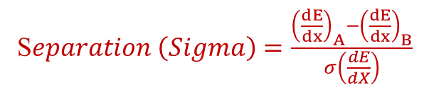
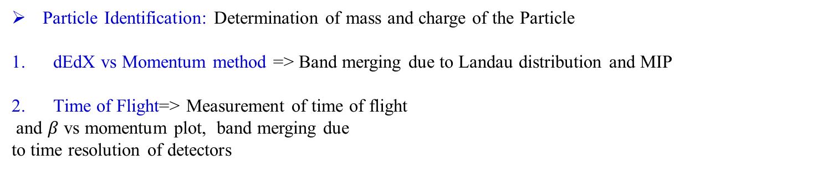
Particle Identification capabilities
Particle Identification: Determination of mass and charge of the Particle
dEdX vs Momentum method => Band merging due to Landau distribution and MIP
Time of Flight=> Measurement of time of flight
and $β$ vs momentum plot, band merging due
to time resolution of detectors
Diamond can be used as dEdX detector
$$dEdX considered up order of β^{2}$$
S$eparation \left(Sigma\right)=\frac{{\left(\frac{dE}{dx}\right)}_{A}−{\left(\frac{dE}{dx}\right)}_{B}}{σ\left(\frac{dE}{dX}\right)}$
S$eparation \left(Sigma\right)=\frac{{Tof}_{A}−{Tof}_{B}}{σ_{t}}$

Slide 12
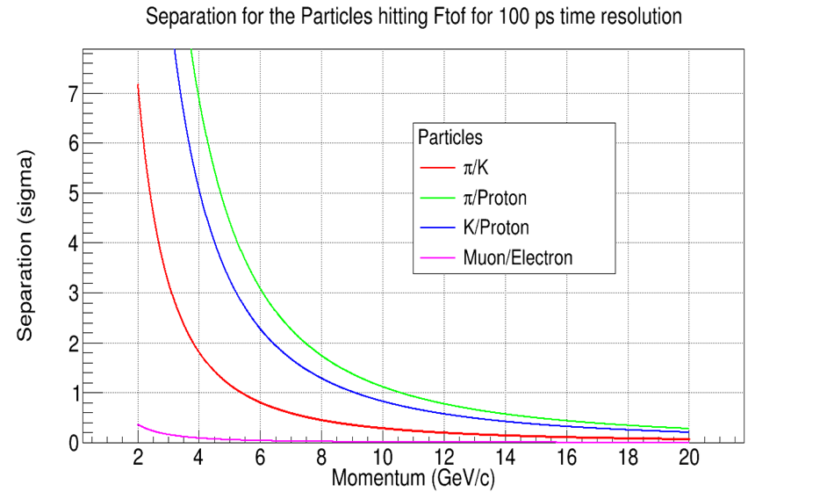
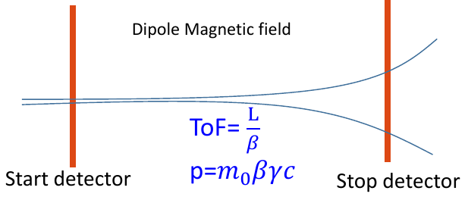
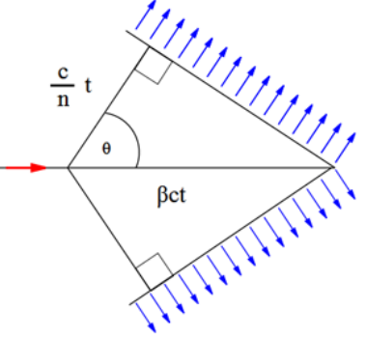


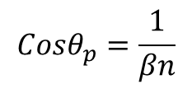


Diamond can also be used as ToF detector
$$t=t_{2}−t_{1}$$
$$σ_{t}=\sqrt{σ_{t_{1}}^{2}+σ_{t_{2}}^{2}}$$
$$σ_{t}≤100 ps (diamond)$$
L= 6.4 m
3. Cherenkov PID:
$$Cosθ_{p}=\frac{1}{βn}$$
Refractive Index n= 2.417 ??????

Slide 13
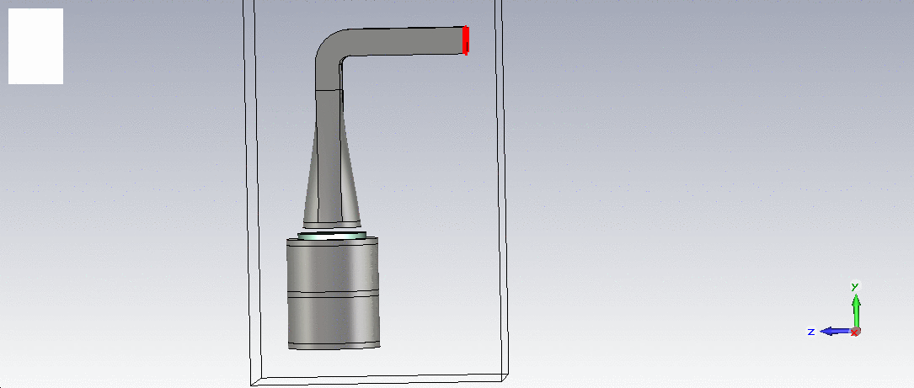
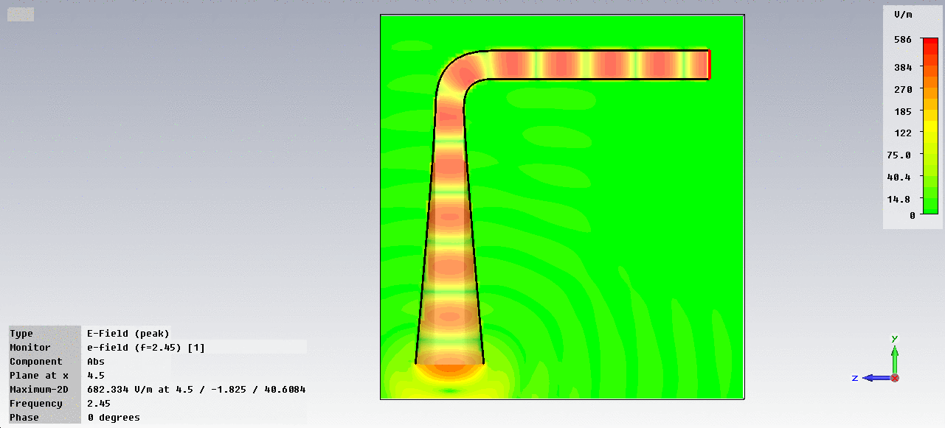
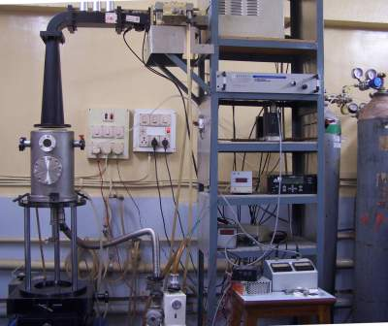
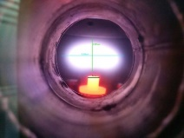
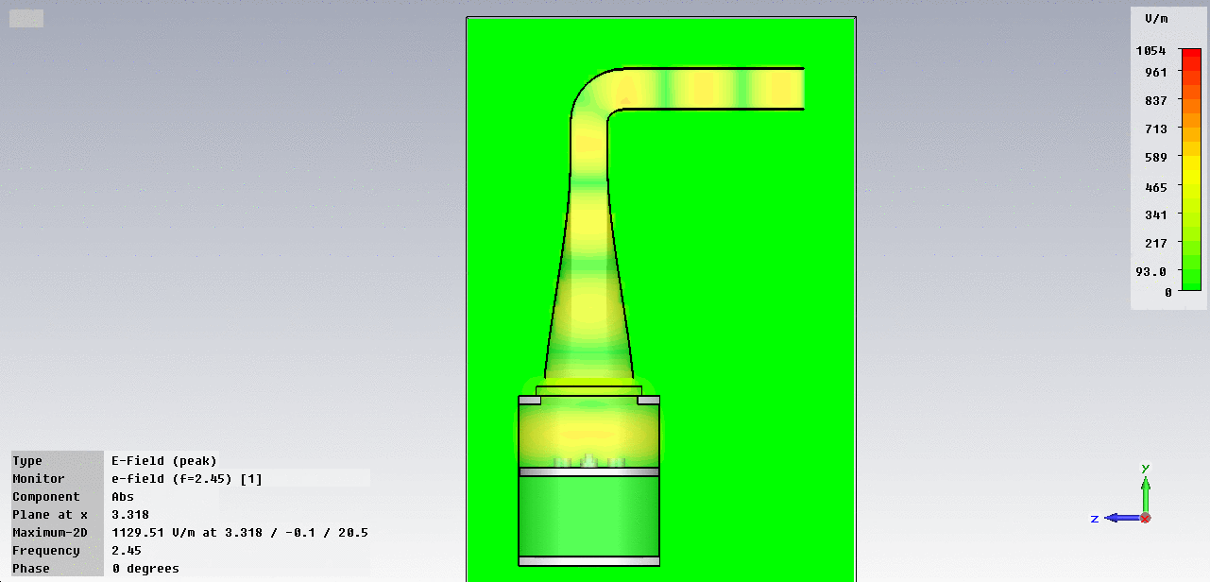

Computer Simulation Technology
MPCVD System designing
Used also in accelerator designing
MPCVD : Microwave Plasma Chemical Vapour Deposition System & Resonant Cavity
Real System in Lab
TE10 mode
TE11 mode

Slide 14







Growth of diamond film and Characterization
Thanks to Aman Bajaj, Sushant Raniwala, Krishna Chaitanya and Nilormi (summer student)
Growth Parameters of Diamond film:
HPHT diamond (100) substrate
Hydrogen=250 sccm and Methane=2.0 sccm
Pressure 90-91 torr (atmospheric pressure=760 torr)
Temperature =916-938 $℃$
Power Input = 0.7 kW
Power reflected = 0 kW
Deposition time=198.5 hrs
Thickness of film $≈$ 1 mm (grown)
1 mm thick diamond
Diamond looking yellow due to Nitrogen content
Diamond Picture
Range of G Band ~ 1500-1600 $cm^{−1}$
Range of D Band ~ 1300-1400 $cm^{−1}$
2D Band ~ 2650-2700 $cm^{−1}$
Raman Spectroscopy
Electronic grade diamond has N in Parts per billion level (ppb)

Slide 15
Characterization techniques
C-DLTS: Capacitance Deep Level Transient Spectroscopy
XPS (X-ray photoelectron spectroscopy): For elemental composition
I-DLTS: Current Deep Level Transient Spectroscopy
TSC: Thermally Stimulated Currents
RL: Recombination Life-time Measurements
PC: Photo Conductivity Measurements
PL –Photoluminescence
Raman Spectroscopy
IV-CV Characteristics: For leakage current and capacitive noise determination
Atomic Force Microscopy (AFM)
Transient current technique (TCT): For electron and hole mobility determination
HRXRD: High Resolution X-ray Diffraction
Ref. Diamond nitrogen vacancy impurity ppt, April 2013, physics 6530, Stefan Thonnard
N-V Center reduces CCE

Slide 16




Diamond film shows the good XRD and Raman spectrum
2 $θ=$119.443
2 $θ=$119.443
High Resolution XRD @ Department of Physics IIT Bombay
Diamond peak
at $1332 cm^{−1}$
Diamond peak
at $1332 cm^{−1}$
Raman Spectroscopy @ CRNTS, IIT Bombay

Slide 17










I-V looking promising
Ohmic Contact: Thermal Evaporation (Both side)
Cr/Au: 20 nm/100 nm
Slow Annealing of the sample up to 605 K
Thick film
Resistance = $2.5×{10}^{14} Ω$
Contact made @ CEN, IIT Bombay
Sample 407 : $5.0×5.0×0.4 mm^{3}$
$$ρ=2×{10}^{11}Ωm$$
I-V done at BARC, Thanks to Amit and Dr. Anita Topkar (Electronics division BARC)
Sample 407
Diamond peak
at $1332 cm^{−1}$
Resistance = $1.3×{10}^{14} Ω$
Red Laser =632.8 nm
$$ρ=2.5×{10}^{11}Ωm$$

Slide 18









Transient Current Technique (TCT) measurement for diamond
$300 μm$ thick material
$Am^{241}$- $α$ source of energy, 5486 KeV (85%), 5443 KeV (13%) and 5388 KeV (1%)
$$α$$
Silicon
IEL $≈$ 5485.9 KeV
NIEL $≈$ KeV
Signal=5485900/3.6
= 1523861 e-h pairs
Germanium
IEL $≈$ 5485.8 KeV
NIEL $≈$ KeV
Signal=5485800/2.96
= 18,53311 e-h pairs
Diamond
IEL $≈$ 5485.9 KeV
NIEL $≈$ KeV
Signal=5485900/13.6
=403375 e-h pairs
$$ε=2.73 E_{g}+0.55 eV$$
Ref: Electron-Hole-Pair Creation Energies in Semiconductors , PRL, Volume 35, Number 32
Range of $α$in Material: Fluka simulation (Ionizing Energy Loss (IEL))
Experimental measurement:
3.5$×$ 3.5 $×$ 0.4 $mm^{3}$ diamond (IIA technologies)
$α$ will stop with in $15 μm$of diamond
Curve highly useful in cancer treatment (Medical Applications)
Bragg’s Peak
Gain of cividec amplifier= +40 dB =>
$\frac{v_{out}}{v_{in}}=100$
$$v_{out}=100 v_{in}=100 ×50 Ω×I_{in}$$
$$I_{in}(mA)=\frac{v_{out} (mV)}{5000}$$
$$Q_{collected}=\int{I_{in}} dt$$

Slide 19




Timing of diamond pulse of the order of ns
$CCE=\frac{Q_{collected}}{Q_{created}}×$100 = $\frac{Q_{collected}}{403375}×$100
Cividec Amplifier CERN, used for testing

Slide 21
Summary and Future Plan
Diamond has good signal to noise ratio, fast timing, low material budget, low radiation damage and good particle identification capabilities, so it will be a good choice for HEP experiments
Diamond has large e-h pair creation energy so less disturbance in charge center of gravity
Diamond can also be used for the detection of slow and fast neutrons
We have grown diamond film up to 1 mm thickness it has nitrogen, I will do cutting and polishing and will test again
We have also tested good quality diamond from IIA technologies
The only problem with diamond we don’t have large area high quality diamond
Still working on growing high quality diamond in Lab
FLUKA Simulation used Ref : "FLUKA: a multi-particle transport code"
A. Ferrari, P.R. Sala, A. Fasso`, and J. Ranft,
CERN-2005-10 (2005), INFN/TC_05/11, SLAC-R-773
Thank You !!!

Slide 22








Diamond as Neutron detectors
n
Fast neutrons
$$α$$
⁹Be
$$n interacts with 6 Li in 6LiF layer (95\%)$$
$$n directly interact with carbon12C$$
$$n+^{6}Li→Tritium+α+4.8 MeV$$
$$n+^{12}C→α+^{9}Be−5.7MeV$$
Tritium (2.73 MeV) and $α \left(2.06 MeV\right)$ emitted at ${180}^{0}C, only α or Tritium is detected$
14.1 MeV n, with $α$ and ⁹$Be having a total energy of 8.4 MeV$
Ref: CVD Diamond Neutron Detectors, Arnaldo Galbiati
Diamond Pulse time Estimation $(d=400 μm thick)$ at E field = $1V/μm$:
$$t_{e}=\frac{d}{v}=\frac{d^{2}}{μ_{e}V}=\frac{16×{10}^{−8}}{0.18×400 }=2.2ns$$
$$t_{h}=\frac{d}{v}=\frac{d^{2}}{μ_{e}V}=\frac{16×{10}^{−8}}{0.16×400 }=2.5 ns$$
Experimental $t_{e}≈3.2 ns and t_{h}≈3.2 ns$

Slide 23






Comparison of Material budget [For geometry in Slide 4]
$$X_{0}=716.4\frac{A [\frac{g}{mol}]}{Z\left(Z+1\right) ln\left(\frac{287}{\sqrt{Z}}\right)} g/cm^{2}$$
$$\frac{X}{X_{0}}=\frac{X_{1}}{X_{01}}+\frac{X_{2}}{X_{02}}….\frac{X_{n}}{X_{0n}}$$
1000000 Geantino particle with multiplicity 5 of 0.1- 0.5 GeV/c

Slide 25





Raman Spectra taken as a function of depth
Diamond peak
at $1332 cm^{−1}$

Slide 26






Atomic force Microscopy (AFM) [Polishing of 407 is compared to thick film]
407 film
$$R_{a}=0.675 nm$$
$R_{q}=1.11 nm$
407 film
Thick film
$$R_{a}=4.47 nm$$
$R_{q}=7.13 nm$
Thick film
AFM @ Department of Physics IIT Bombay

Slide 27


TE10 to TE11 mode converter simulation
Single Port $S_{11}$ – reflection coefficient,
For two Ports $S_{11}, S_{12}, S_{21} and S_{22}$
Frequency= 2.45 $±$ 0.020 GHz
Decibel-milliwatts (dBm)= Decibel watt (dBW) +30
S parameter $≈$ -50 dBW = -20 dBm=10 $μW$
MPCVD : Advantages
Electrode less process=> No Plasma sheath
formation take place
Plasma density is high
Stability of Plasma up to many days
Ability to scale up the process over large substrates
Quality of film grown is high

Slide 28
Energy loss vs momentum up to order of $β^{2}$
Energy loss vs momentum up to order of $β^{2}$

Slide 29
Energy loss vs momentum up to order of $β^{2}$

Slide 30


Silicon
dEdX band separation is good in diamond
Diamond

Slide 31


Large and Small Trapezoid used for Simulation in PANDAROOT
large
small

Slide 32


Energy deposited in $300 μm$ thick sensors (Geant3) PANDA Root

Slide 33



Frankel Pairs distribution for 1 GeV proton in 300 $μm thick$Si

Slide 34


Frankel Pairs distribution for 1 GeV proton in 300 $μm thick$Si

