Slide 1
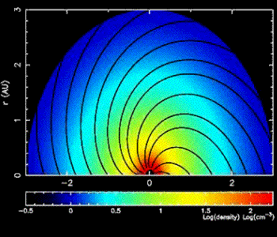
Review of Diffusive Shock Acceleration Modeling of Solar Energetic Particle Events
G.P. Zank
Gang Li, Olga Verkhoglyadova, Junxiang Hu
Center for Space and Aeronomic Research (CSPAR)
Department of Space Science
University of Alabama in Huntsville

Slide 2
Particle Acceleration at Interplanetary Shocks
Review particle acceleration by interplanetary shocks:
Interplanetary shock acceleration is fundamentally time-dependent
Interplanetary shock acceleration is fundamentally multi-dimensional spatially
Insights and extensions from basic steady-state 1D models
Unsteady diffusive shock acceleration at a quasi-parallel and quasi-perpendicular shocks for protons and heavy ions
New 2D model: iPATH

Slide 3
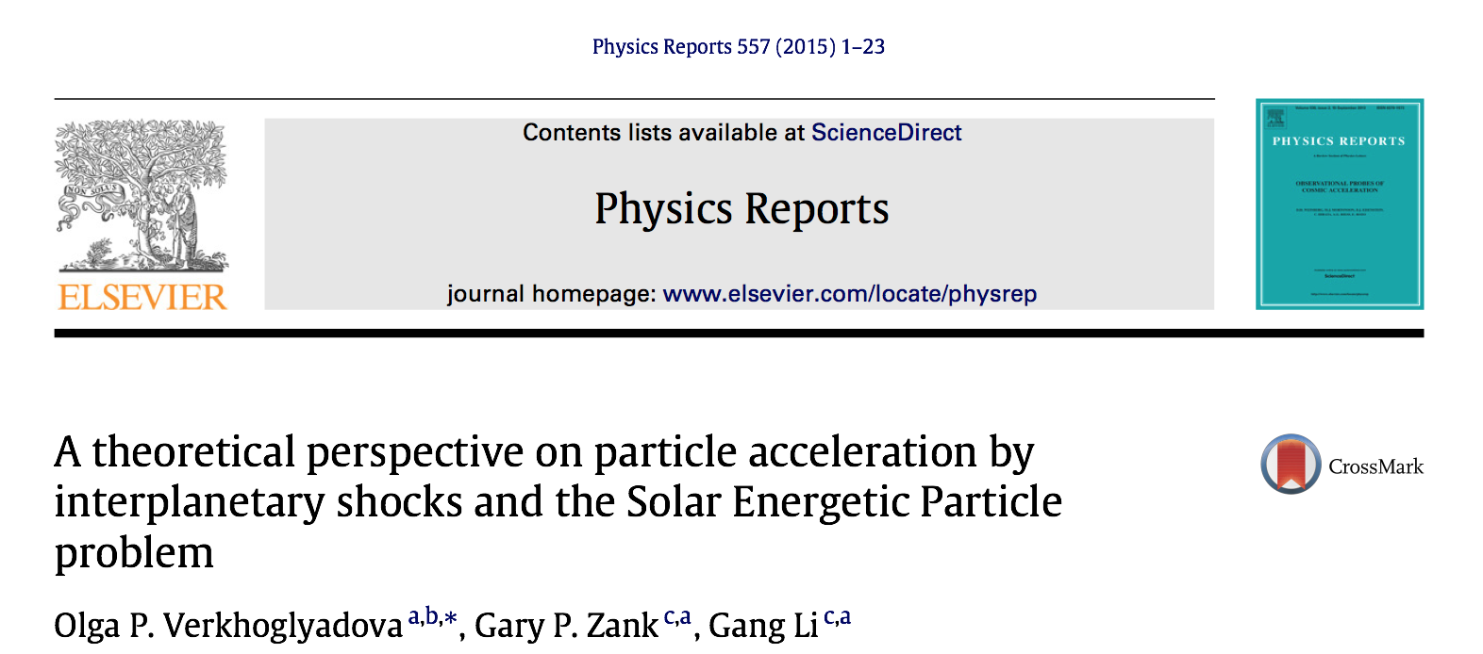
Further details related to the 1D time-dependent modeling can found here.

Slide 4
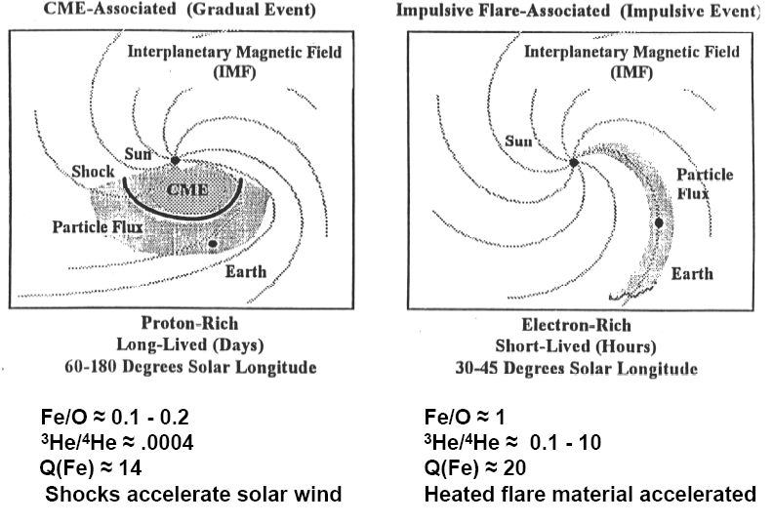
Two Classes of Solar Energetic Particle Events
Criteria summarized by Reames (1995)

Slide 5
Basic diffusive shock acceleration theory
Parallel shock
shock
U₁
U₂
Acceleration time can be very long.
Can accelerate thermal-energy
particles – often regarded as good "injectors"
B
Perpendicular shock
shock
Acceleration time is very short compared to a parallel shock
Cannot easily accelerate low energy
particles – often regarded as poor "injectors"
U₁
U₂
B₁
B₂

Slide 6
Diffusive shock acceleration
The accelerated particle intensities are constant downstream of the shock and exponentially decaying upstream of the shock.
The scale length of the decay is determined by the momentum dependent diffusion coefficient (steady state solution).
Trapped particles
convect
cool
diffuse.
Escaped particles
Transport to 1 AU (weak scattering).

Slide 7
-perp
Shock geometry
-parallel
Red dot (spacecraft) connected to quasi-perpendicular shock initially and the connection gradually evolves to much more quasi-parallel configuration.

Slide 8
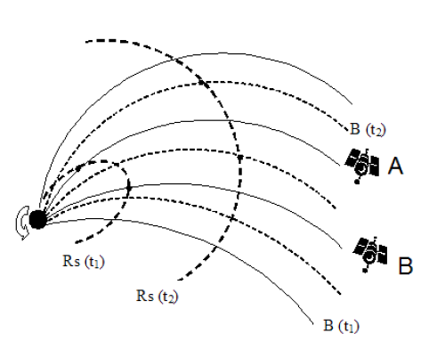
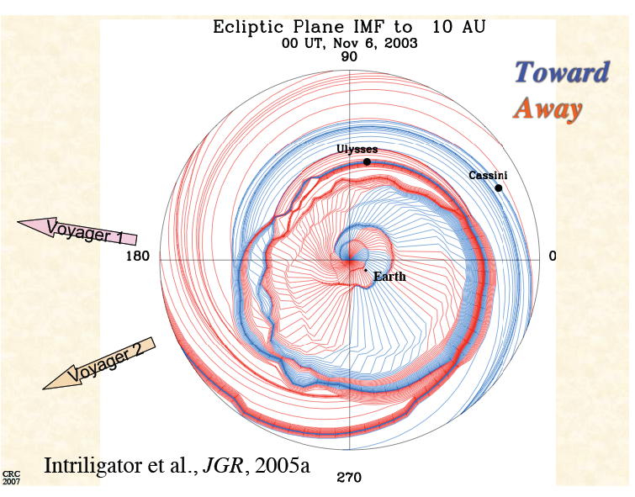
Shock geometry

Slide 9
Time scales for the SEP/ESP problem
Shock propagation in an inhomogeneous solar wind – expanding, decelerating, decreasing magnetic field strength, in situ turbulence convection, decay, driving, variability of shock normal
Particle acceleration time scales; maximum energy, shock obliquity
Variability in generation of shock turbulence by streaming energetic particles; particle trapping and escape
Diffusive time scales (diffusive mfp)
Transport time scales/length scales (transport mfp)
The shock itself introduces a multiplicity of time scales, ranging from shock propagation time scales to particle acceleration time scales at parallel and perpendicular shocks, and many of these time scales feed into other time scales (such as determining maximum particle energy scalings, escape time scales, etc.).

Slide 10
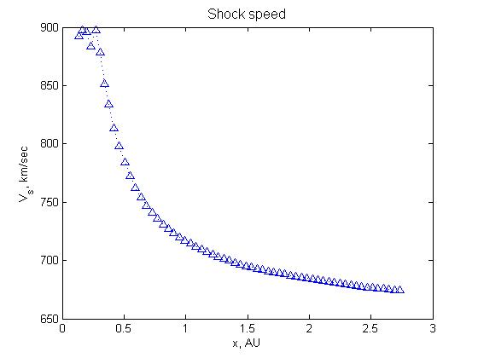
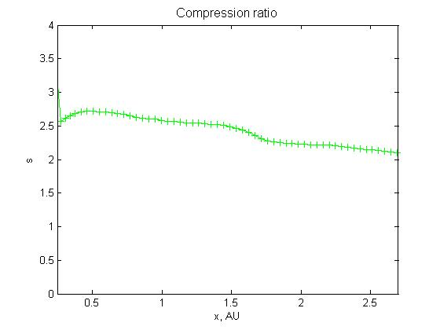
Shock position, velocity and compression ratio are computed from 0.1 AU to up to several AU.
Simulation results of the shock velocity dependence on radial distance from the Sun. The decaying shock propagates from 0.1 AU, reaching a compression ratio of about 1.8 at 1AU. The modeling was performed for 61 shells.
SEP Event # 215 (shock arrival at ACE: Sept. 29, 2001, 09:06 UT)

Slide 11
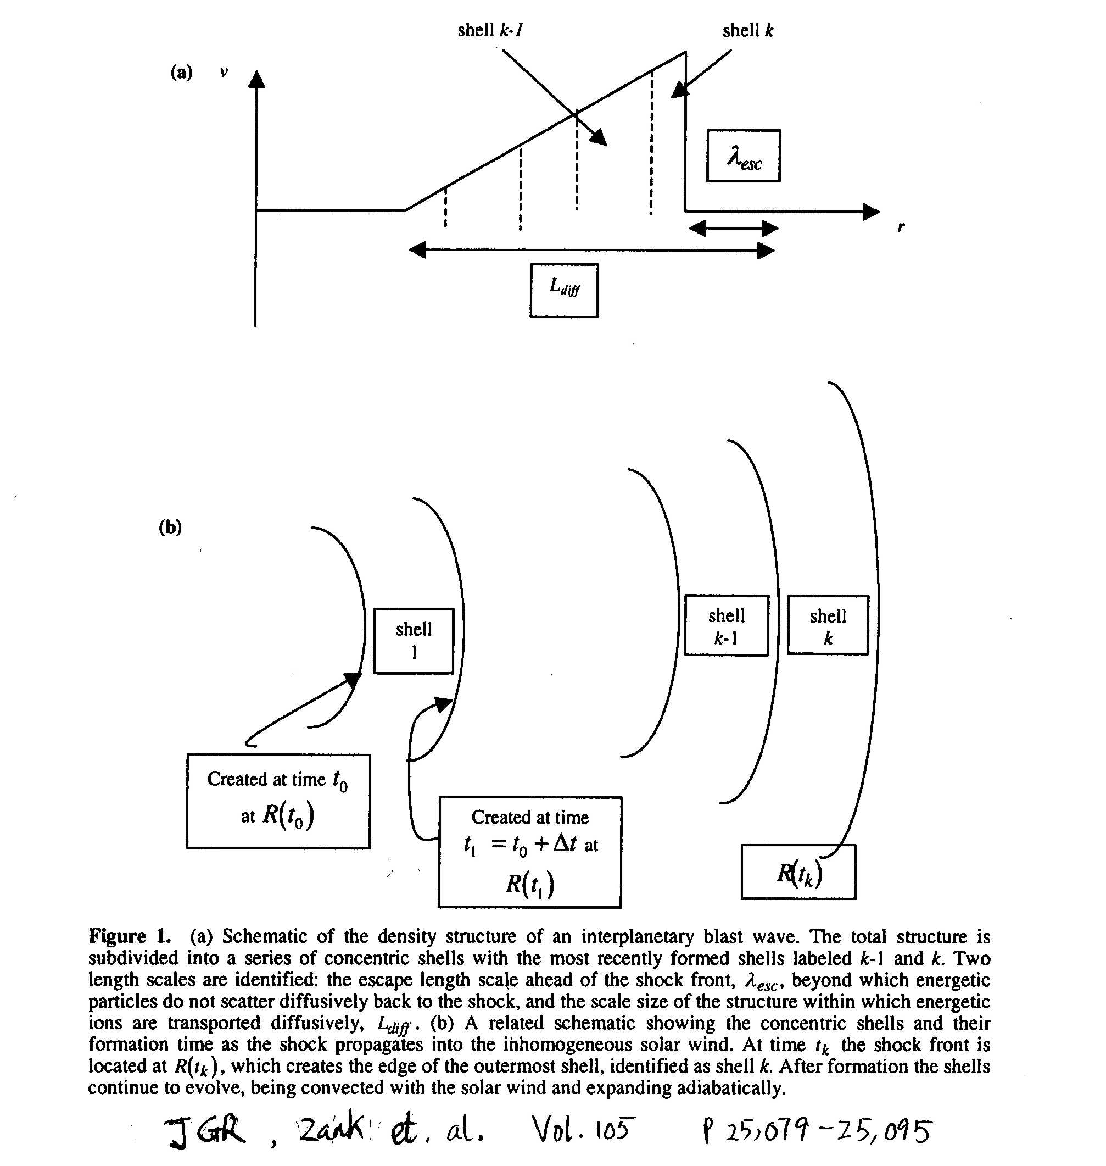
Shock dynamical time scale:
Post-shock complex time scales: Convection, adiabatic expansion
Magnetic field change:
Example:
Sedov-Taylor blast wave

Slide 12
Post-shock complex time scales: Convection, adiabatic expansion, growth of post shock region and weakening of shock front.

Slide 16
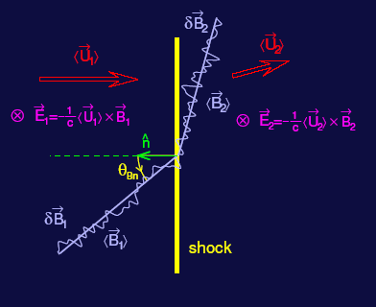
Particle acceleration time scales
U and K_{xx} change discontinuously across the shock (Giacalone)

Slide 17
Maximum particle energy
The maximum particle energy can be determined by equating the dynamic timescale of the shock with the acceleration timescale (Drury, 1983; Zank et al., 2000).

Slide 18
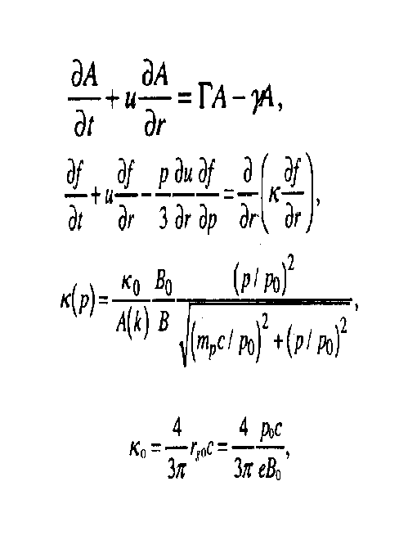
Diffusion coefficient at parallel shock
Near the shock front, Alfven waves are
responsible for particle scattering. The
particle distribution f, and wave energy
density A are coupled together through:
Gordon et al., 1999 used to evaluate wave intensity. P_max, N_inj, p_inj, s, etc.
Bohm limited applied when wave energy density per log bandwidth exceeds local solar wind magnetic energy density.

Slide 19
Maximum particle energy at quasi-parallel shock:
Age Strength Magnetic field heliocentric dependence

Slide 20
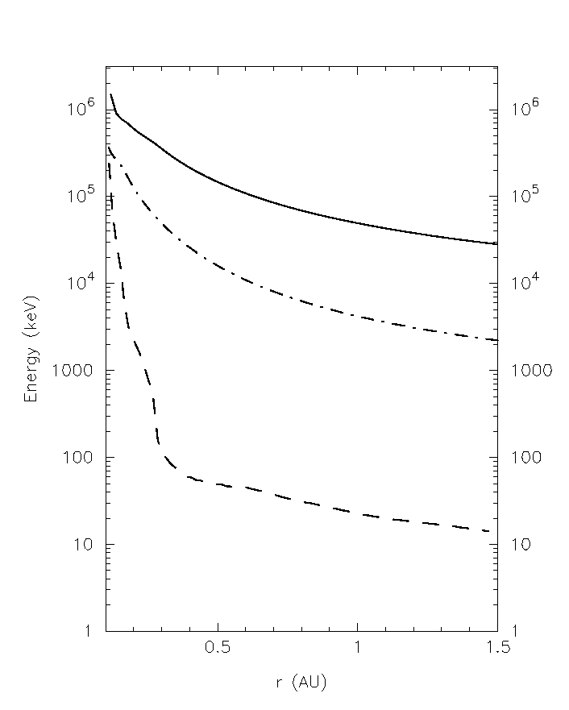
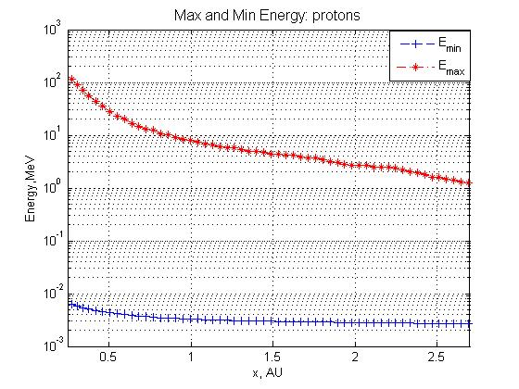
Maximum energies for protons
Maximum energy keV
r (AU)
SEP Event # 215 (shock arrival at ACE: Sept. 29, 2001, 09:06 UT)
Strong, medium, weak shock examples
The maximum particle momentum obtained for a strong shock at early times can be as high as a few GeV – consistent with observations by Kahler [1994].

Slide 21
What happens to the turbulence excited by the streaming protons?
For quasi-|| shocks, turbulence excited by usual streaming instability; amplified on shock transmission
Shell picture nice for describing the evolution of turbulence in downstream region – simplest is to assume WKB description as shell is convected outward and expands or to include turbulent dissipation.

Slide 22
Need to solve at the shock:
Local shock accelerated distribution:
Local maximum energy
Injection rate per unit area
Injection momentum
Area of shock wave

Slide 23
Particle Transport
Particle transport obeys Boltzmann(Vlasov) equation:
The LHS contains the material derivative and the RHS describes various “collision” processes.
Collision in this context is pitch angle scattering caused by the irregularities of IMF and in quasi-linear theory
The result of the parallel mean free path λ// , from a simple QLT is off by an order of magnitude from that inferred from observations, leading to a 2-D slab model.
Allows a Monte-Carlo technique.

Slide 24
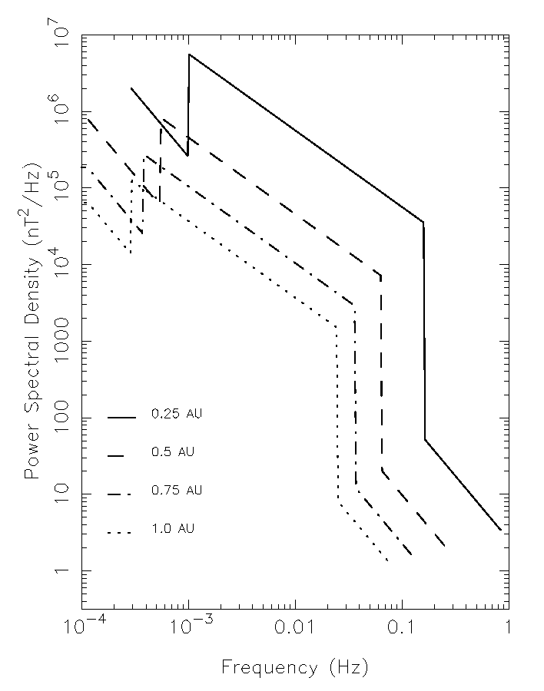
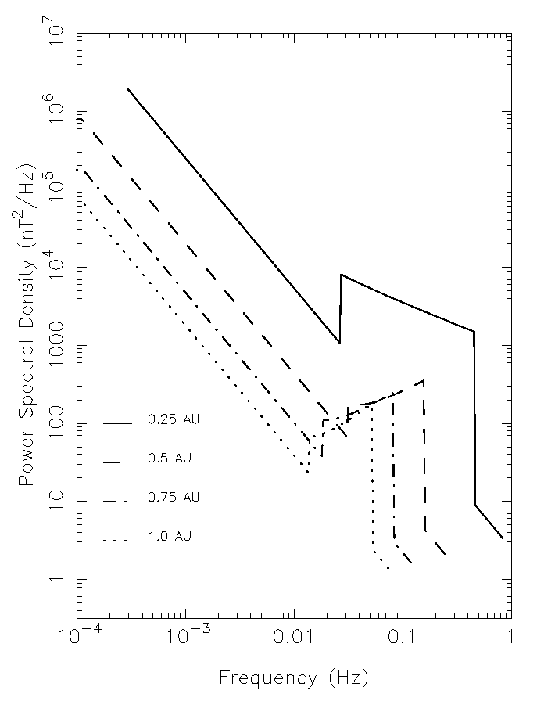
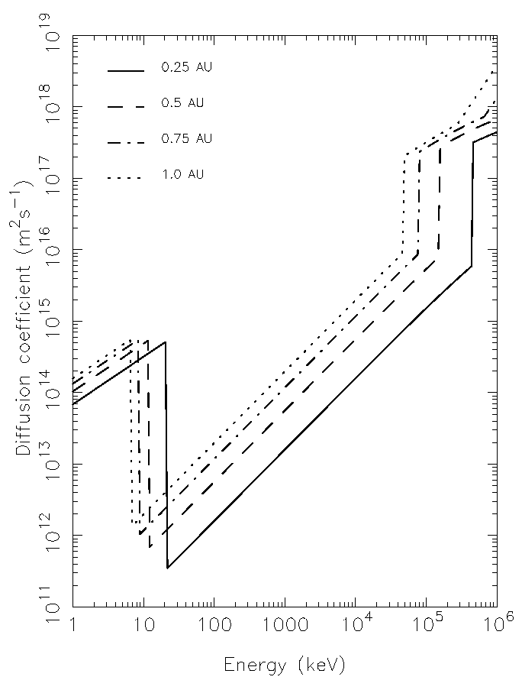
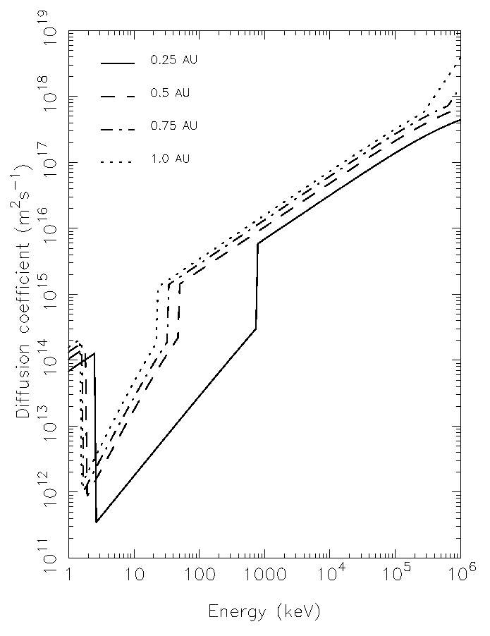
Wave spectra and diffusion coefficient at shock
Wave intensity
Diffusion coefficient
Strong shock
Weak shock

Slide 25
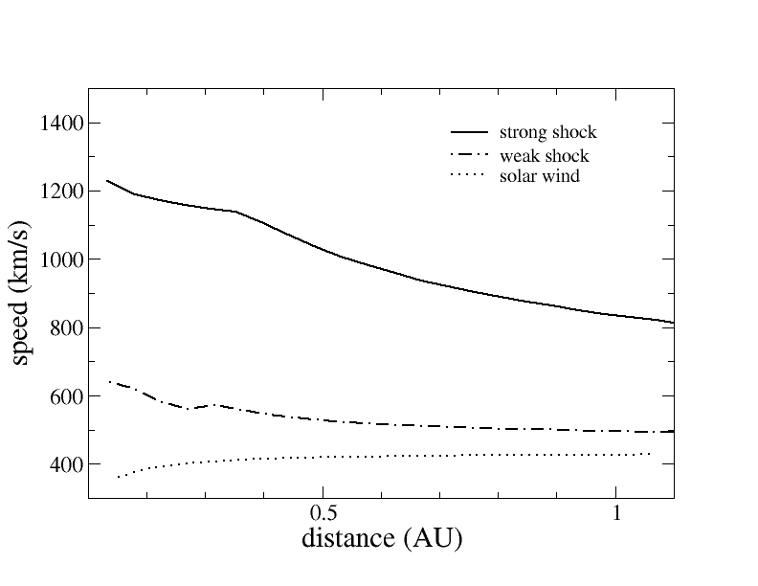
HEAVY IONS (CNO and Fe)
CNO: Q = 6, A = 14
Fe: Q = 16, A = 54
Effect of heavy ions is manifested through the resonance condition, which then determines maximum energies for different mass ions and it determines particle transport – both factors that distinguish heavy ion acceleration and transport from the proton counterpart.
Shock speeds for strong and a weak shock.

Slide 26
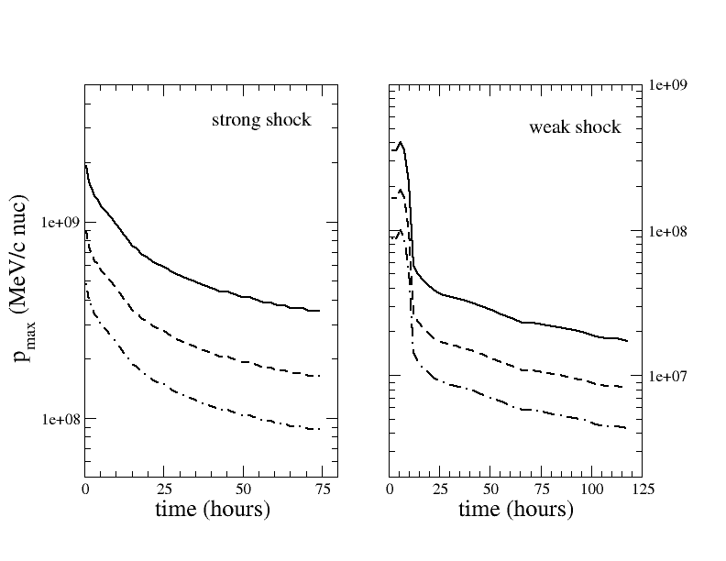
Maximum accelerated particle energy
The maximum energy accelerated at the shock front. Particles having higher energies, which are accelerated at earlier times but previously trapped in the shock complex, will “see” a sudden change of κ. The maximum energy/nucleon for CNO is higher than iron since the former has a larger Q/A, thus a smaller κ.
protons
CNO
Fe
Bohm approximation used throughout strong shock simulation but only initially in weak shock case.

Slide 27
WHAT ABOUT WAVE EXCITATION UPSTREAM?
Quasi-linear theory (Lee, 1983; Gordon et al, 1999): wave excitation proportional to cos ψ i.e.,
at a highly perpendicular shock.
SHOCK
U_down
INTERPLANETARY MAGNETIC FIELD
U_up

Slide 28
INTEGRAL FORM OF THE NONLINEAR GUIDING CENTER THEORY
Matthaeus, Qin, Bieber, Zank [2003] derived a nonlinear theory for the perpendicular diffusion coefficient, which corresponds to a solution of the integral equation
Superposition model: 2D plus slab
Solve the integral equation approximately (Zank, Li, Florinski, et al, 2004):
modeled according to QLT.

Slide 29
Maximum and injection energies
Remarks: 1) Parallel shock calculation assumes wave excitation
implies maximum energies comparable
3) Injection energy at Q-perp shock much higher than at Q-par
therefore expect signature difference in composition

Slide 30
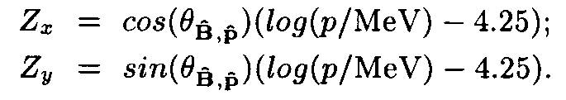
Time evolution of number density in phase space
Snap shots of the number density observed at 1 AU prior to the shock arrival at t = 1/20, 2/20, …. T, with a time interval of 1/20 T in (v_par, v_perp)-space.
Coordinates:
B field along positive Zx direction
Particle energies from innermost to outermost circle are K = 4.88, 8.12, 10.47, 15.35, 21.06, 30.75, 50.80, 100.13 MeV respectively.
The next figures exhibit the following characteristics:
At early times, more high energy particles cross 1 AU along +B direction, followed by lower energies later.
Number density of higher energy particles at later times exhibits a “reverse propagation” feature corresponding to A < 0.
The gap at Θ = 90 degree reflects that particles must have a component along B to be observed.

Slide 31
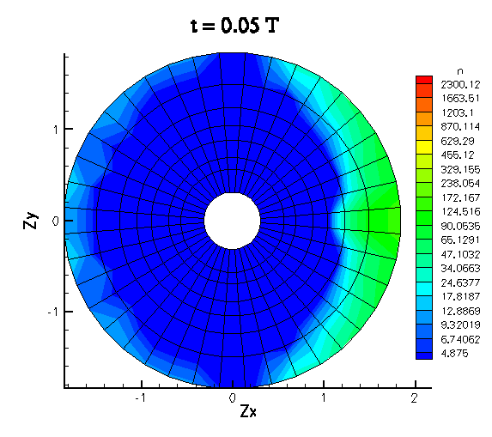
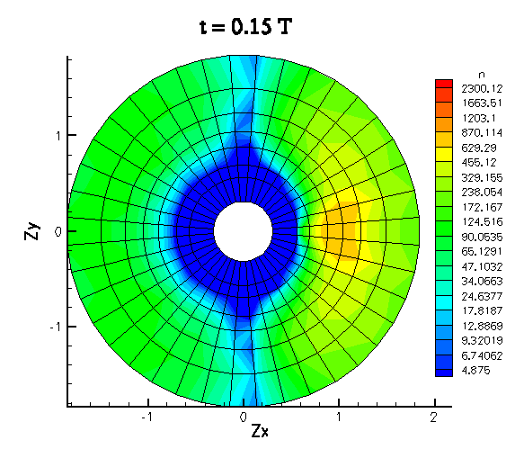
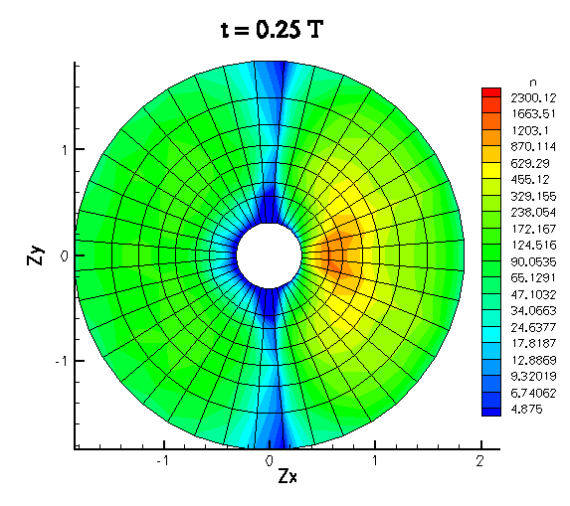
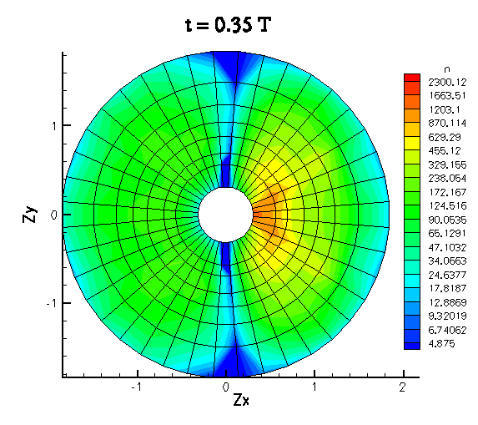
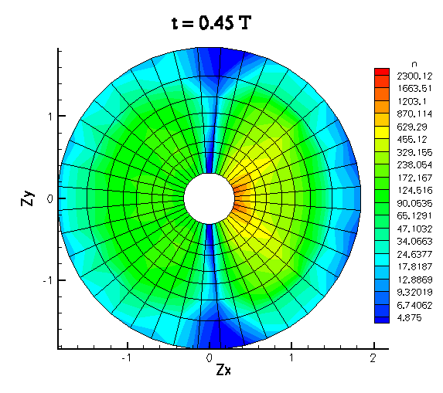
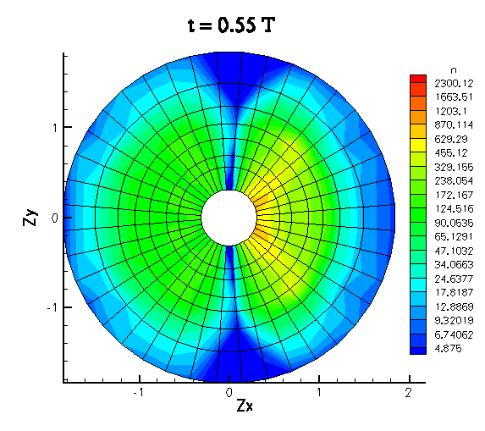
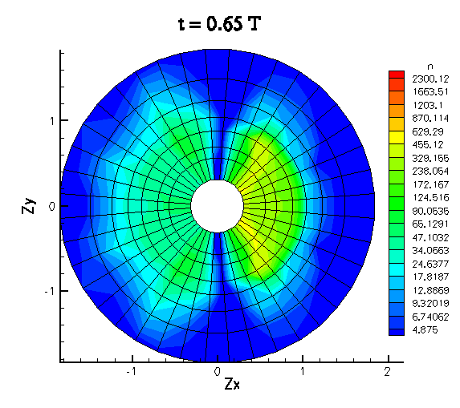
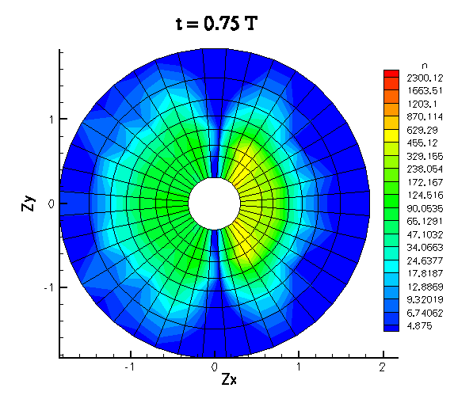
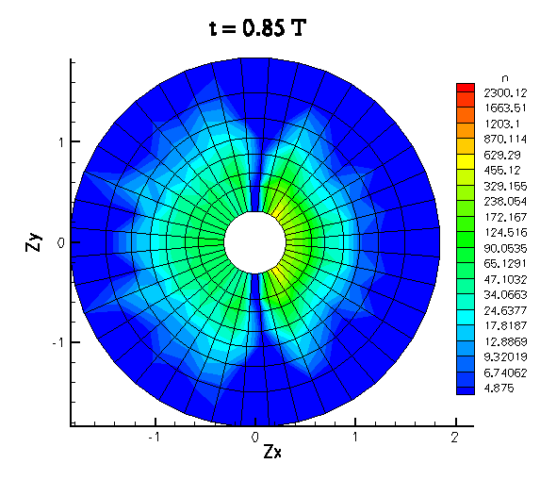
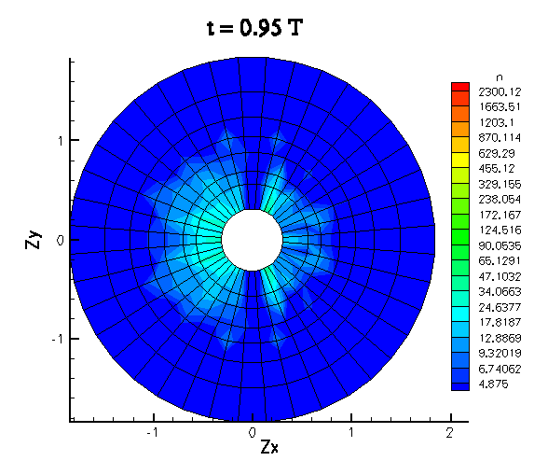
Phase space evolution – time sequence
At t=0.85 T, we can see clearly that there are more backward propagating particles than forward ones between 20<K<30 MeV.
At t=0.95 T, it is more pronounced for K~10 MeV.

Slide 32
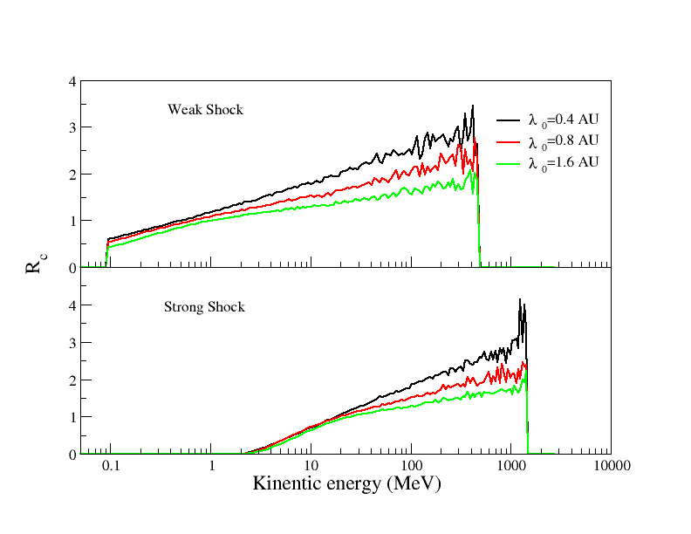
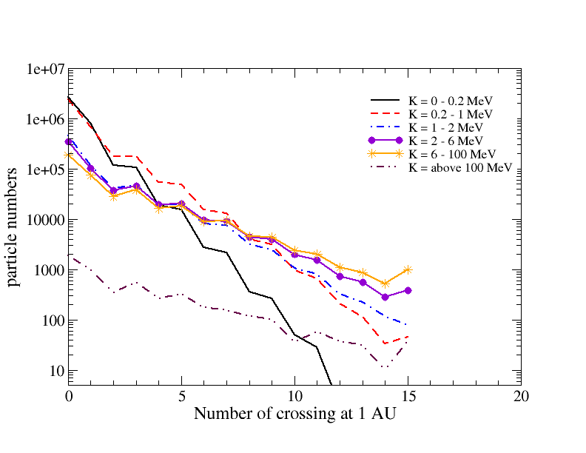
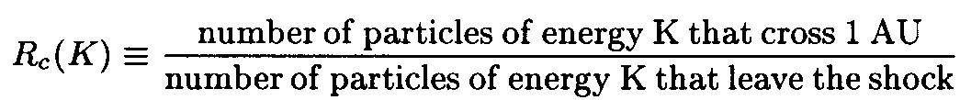
Multiple particle crossings at 1AU
Due to pitch angle scattering, particles, especially of high energies, may cross 1 AU more than once, and thus from both sides. In an average sense, a 100 MeV particle has Rc ~ 2, or on average, two crossings. Histogram shows that some particles may cross as many as 15 times. A smaller mfp leads to a larger Rc since particles with smaller mfp will experience more pitch angle scatterings.

Slide 33
Dynamical spectra of iron ions averaged over consecutive ~5hrs time intervals until shock arrival at 1AU. ULEIS and SIS measurements are shown by blue diamonds and triangles, respectively. The straight line shows the theoretical limit for a power-law spectrum corresponding to shock parameters at 1 AU. Note the enhanced background at early times prior to the shock arrival at ~ 1AU.
SEP Event # 215 (shock arrival at ACE: Sept. 29, 2001, 09:06 UT)

Slide 34
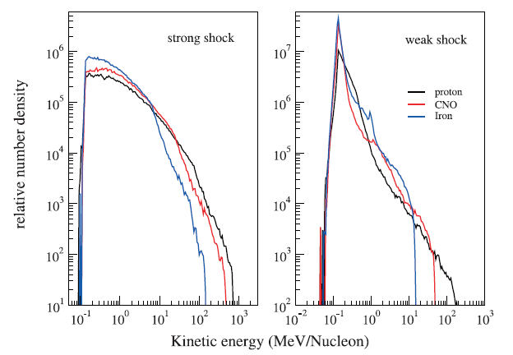
Event integrated spectra
NOTE change in Fe/O ratio at about 10 MeV/nuc
Iron Q = 14, A =56
CNO Q = 6. A = 14
Similar spectral indices at low energies, with Iron slightly softer.
Roll-over feature at high energy end with approximately (Q/A)² dependence.
Count only those particles before the shock arrival.

Slide 35
Event-integrated spectra for (a) protons, (b) oxygen and (c) iron ions. Modeling results are shown in red. ULEIS and SIS measurements integrated over the same time interval are shown by blue diamonds and triangles, respectively. The straight line shows the theoretical limit for a power-law spectrum corresponding to shock parameters at 1 AU. (Zank et al 2007; Verkhoglyadova et al. 2009 ).
SEP Event # 215 (shock arrival at ACE: Sept. 29, 2001, 09:06 UT)

Slide 36
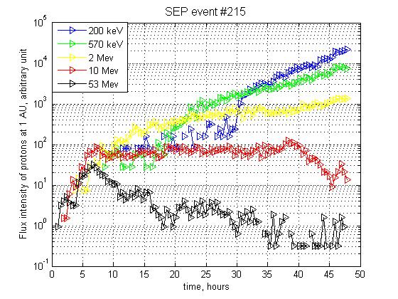
Time intensity profiles
Protons
SEP Event # 215 (shock arrival at ACE: Sept. 29, 2001, 09:06 UT)
s=2.5

Slide 37
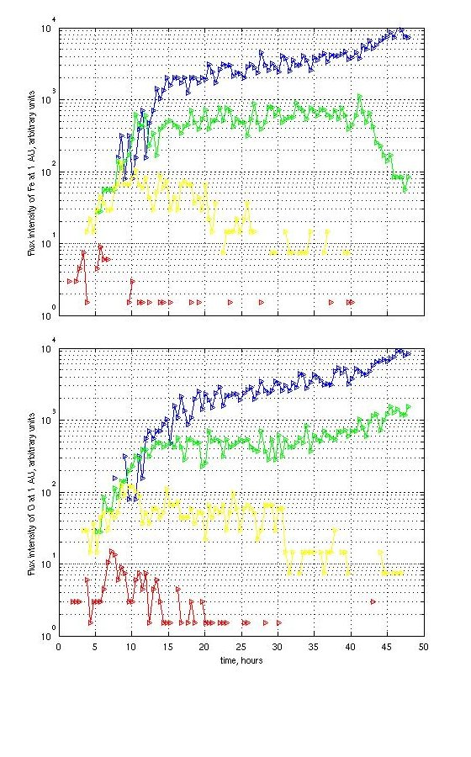
Time intensity profiles
Iron
0.2 MeV/nuc.
Time intensity profiles of iron and oxygen ions. Representative energies are (from top to bottom): 0.2, 0.57, 2 and 10 MeV/nucleon. Time is in hours starting from the shock launch at 0.1 AU until the
shock arrival at 1 AU
0.57 MeV/nuc.
2 MeV/nuc.
10 MeV/nuc.
NOTE change in Fe/O ratio after 40 hours
Oxygen

Slide 38
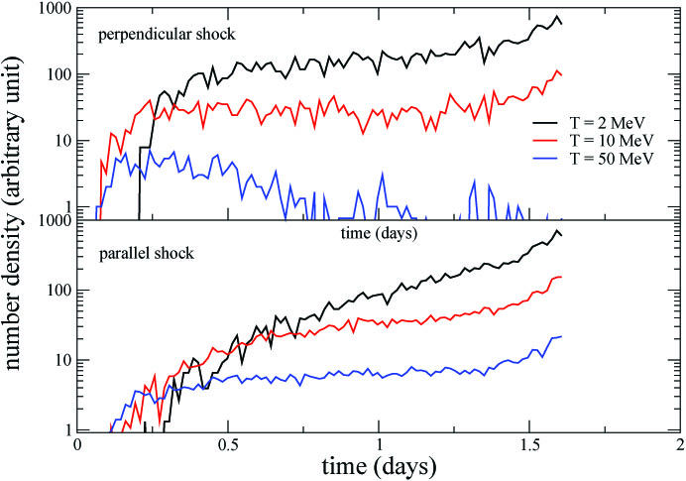
Intensity profiles emphasize important role of time dependent maximum energy to which protons are accelerated at a shock and the subsequent efficiency of trapping these particles in the vicinity of the shock. Compared to parallel shock case, particle intensity reaches plateau phase faster for a quasi-perpendicular shock – because K_perp at a highly perpendicular shock is larger than the stimulated K_par at a parallel shock, so particles (especially at low energies) find it easier to escape from the quasi-perpendicular shock than the parallel shock.

Slide 39
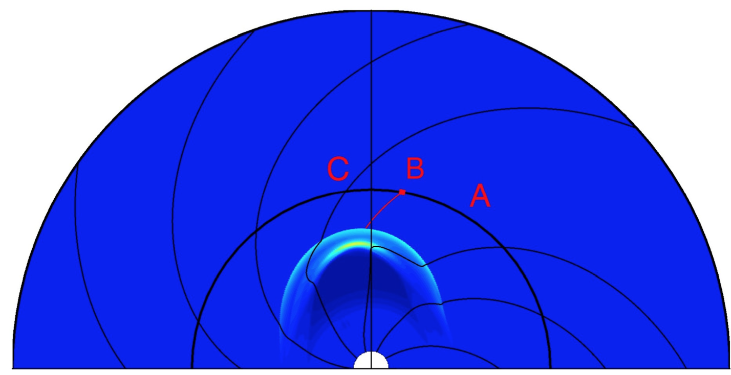
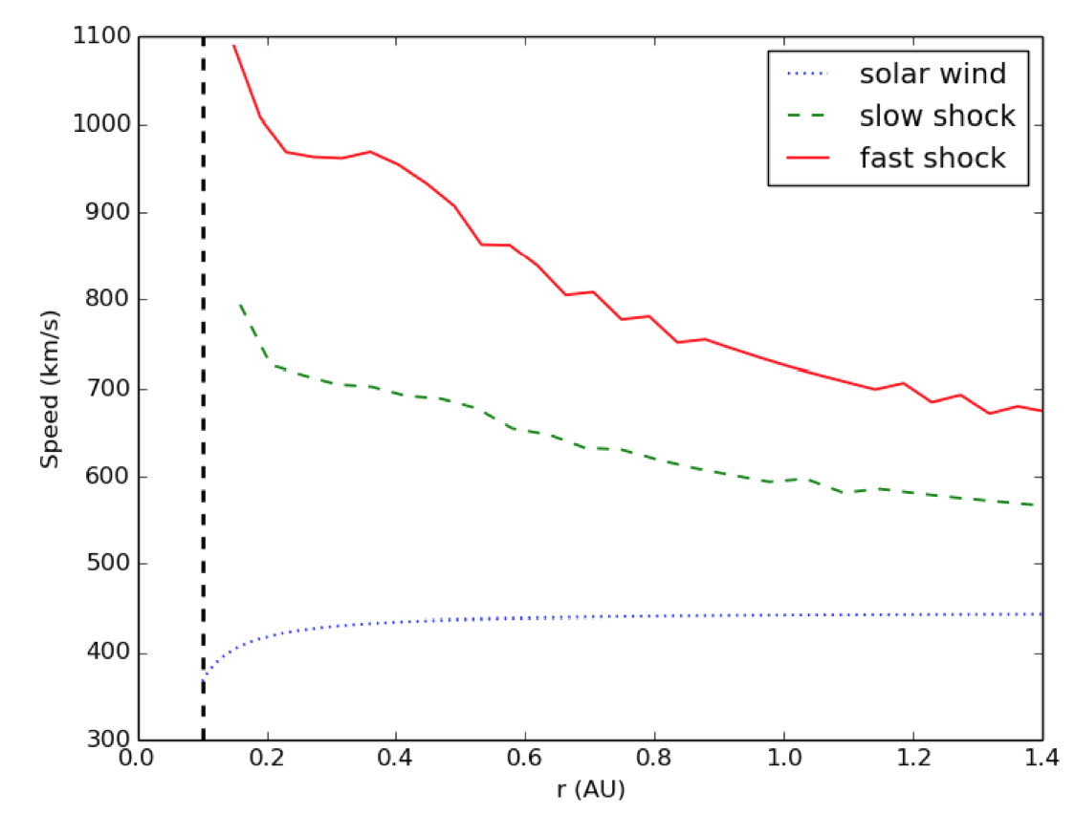
Modeling Particle Acceleration and Transport at a 2 2D CME-Driven Shock
Junxiang Hu, Gang Li, Xianzhi Ao, G.P. Zank, and O. Verkhoglyadova
submitted
Fast CME-driven shock. Simulation domain 0.1 to 2 AU. The color scheme is the normalized density nr². The bold black semi-circle at 1 AU is Earth orbit. Three reference points A, B and C, at longitudes of 60◦, 80◦ and 100◦
Inset: Two shock radial speed examples at nose.

Slide 40
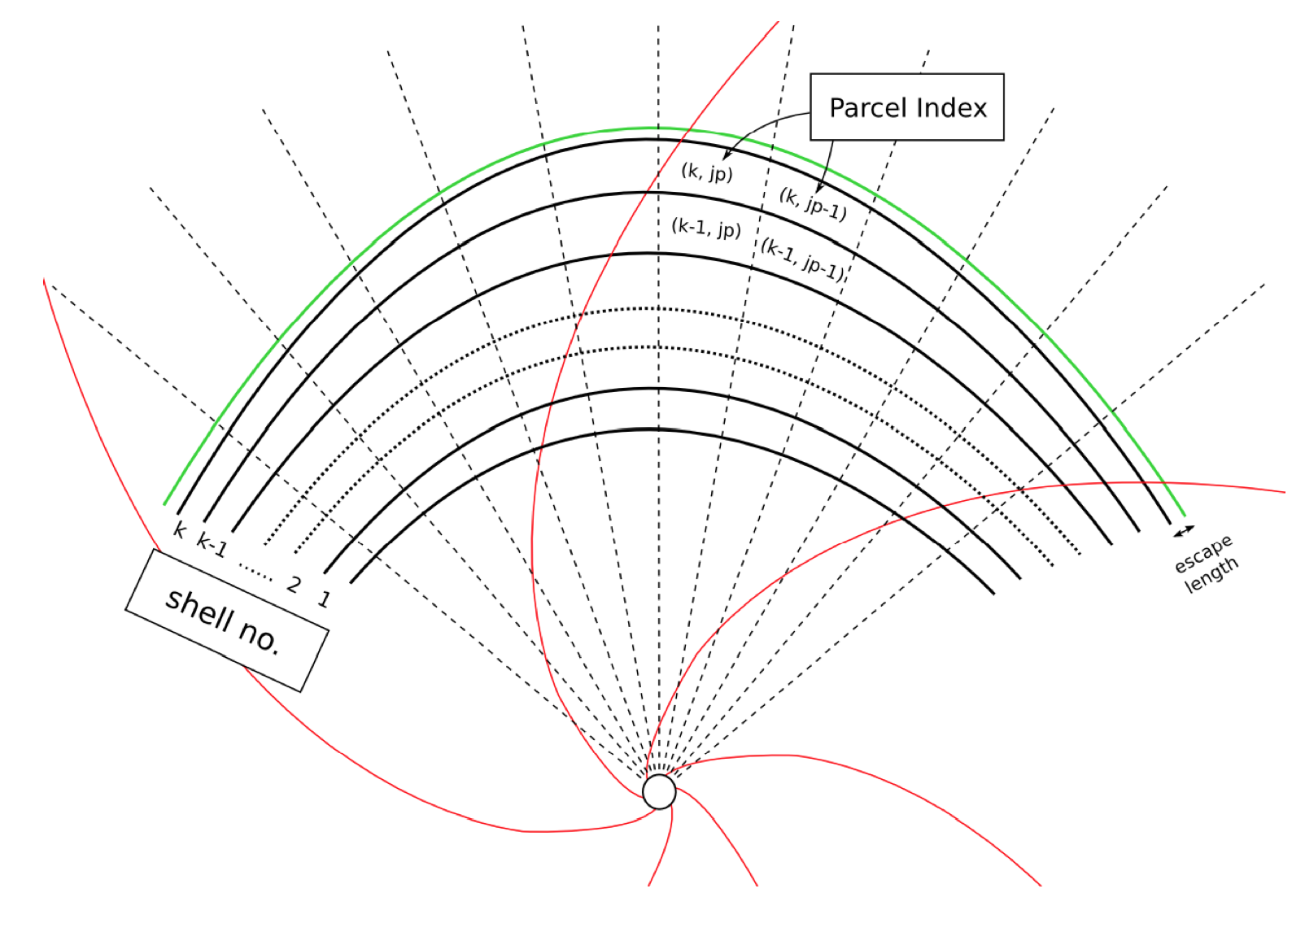

Slide 41
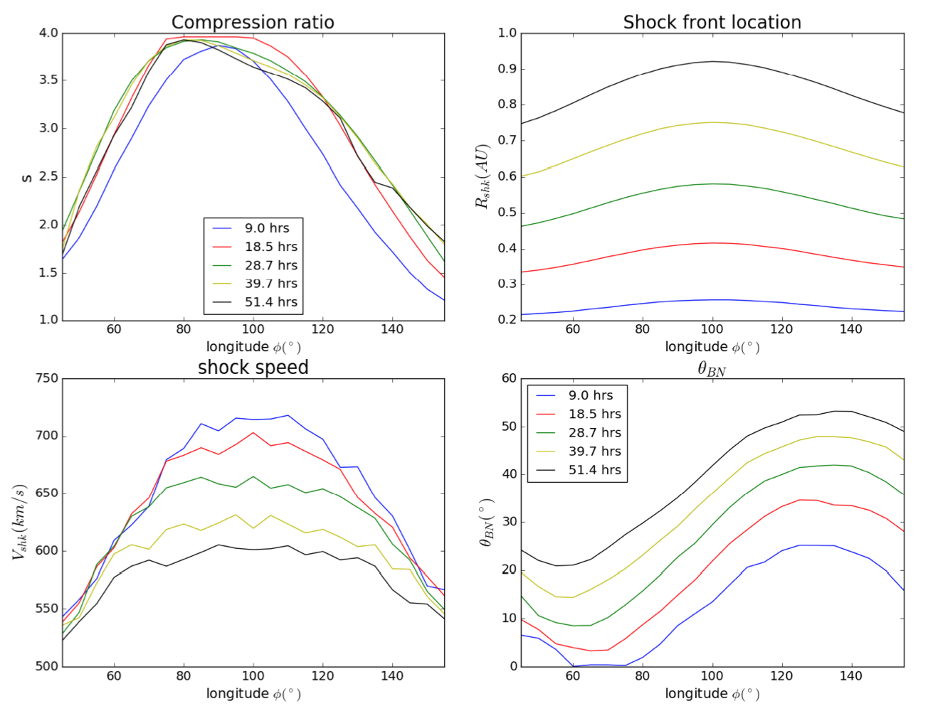
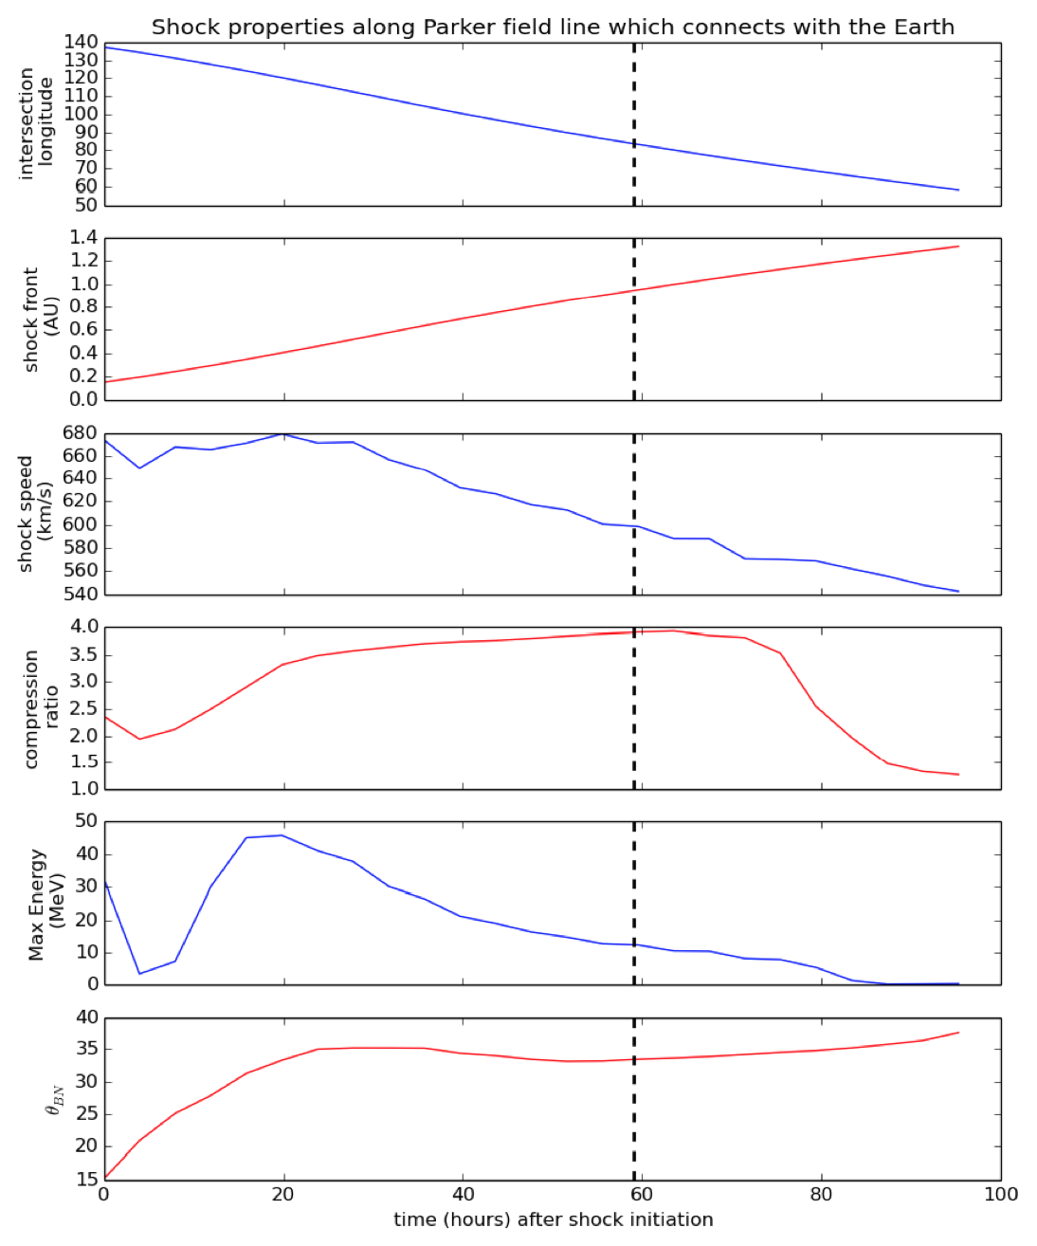
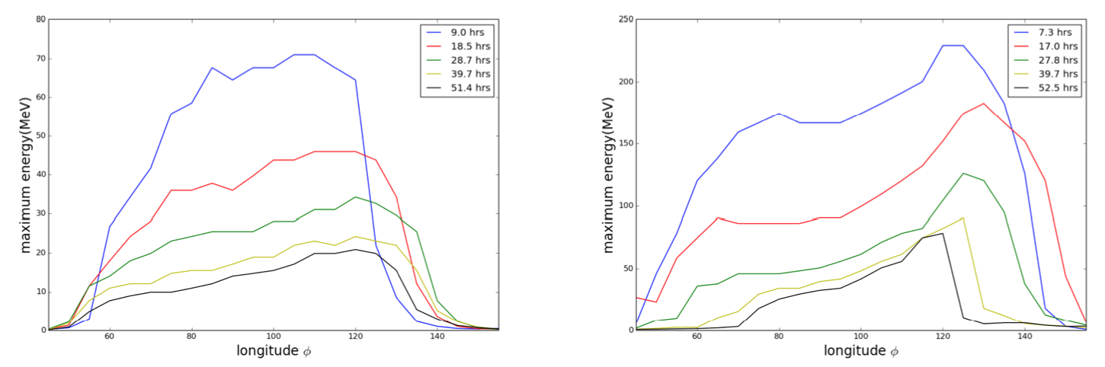
Slow shock (X2)
Fast shock (X3)

Slide 42
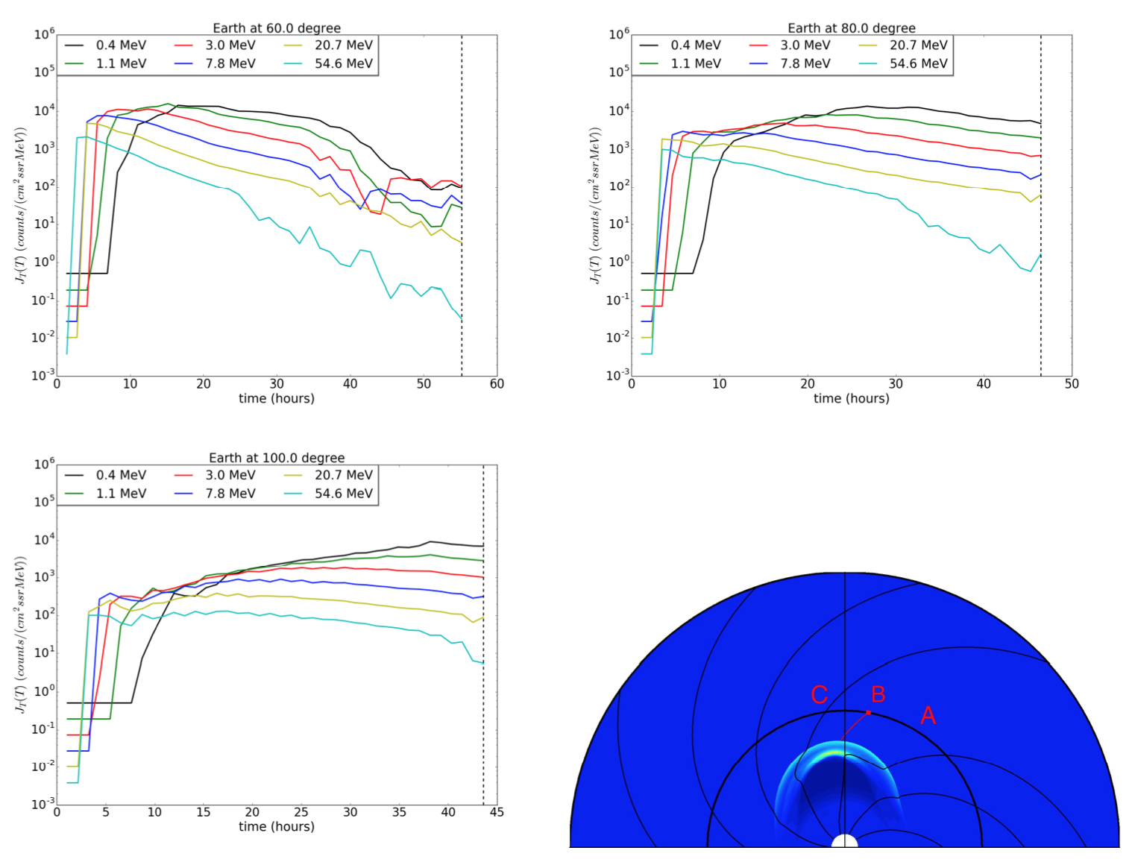
Time intensity profiles for protons at three different reference locations at 1 AU for the slow shock case.

Slide 43
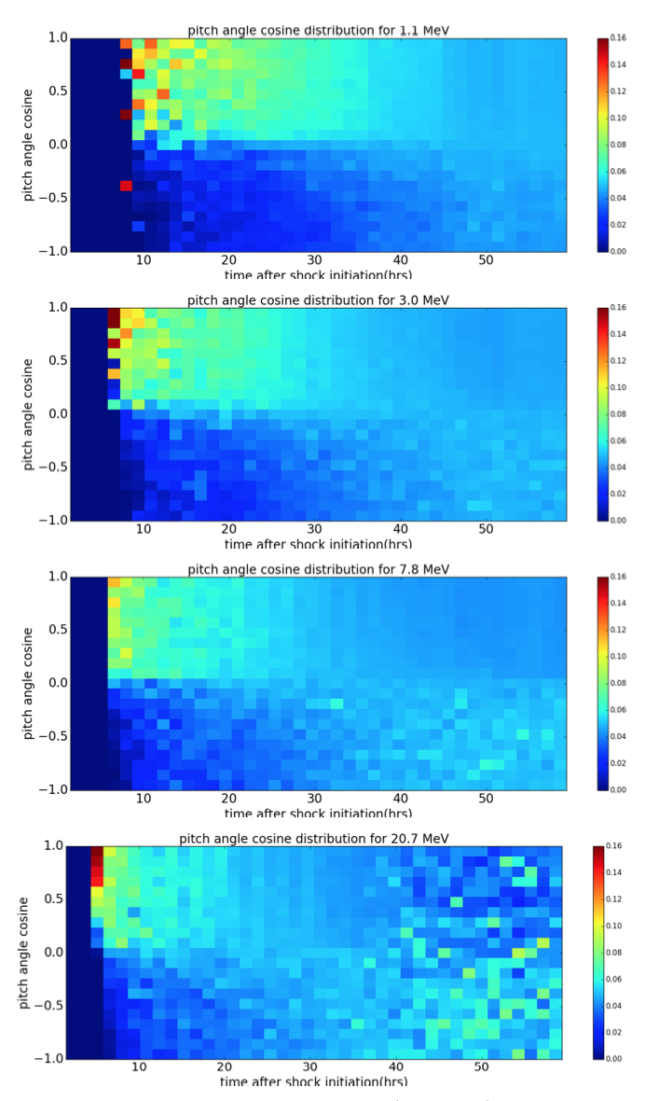
Pitch angle distributions at B (φ = 80◦) for four different energies

Slide 44
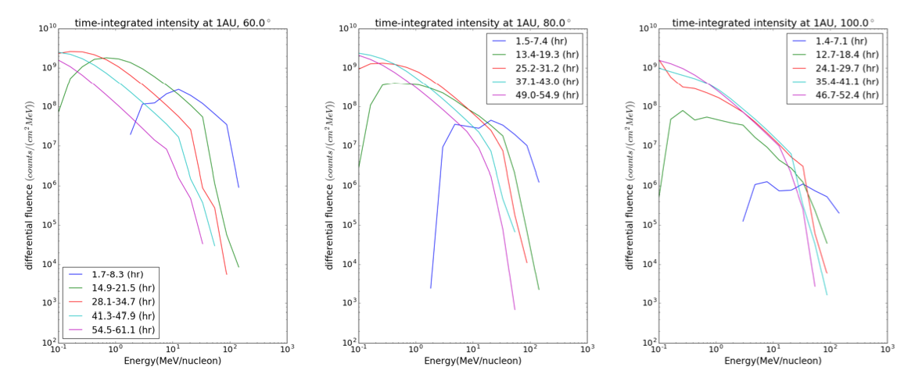
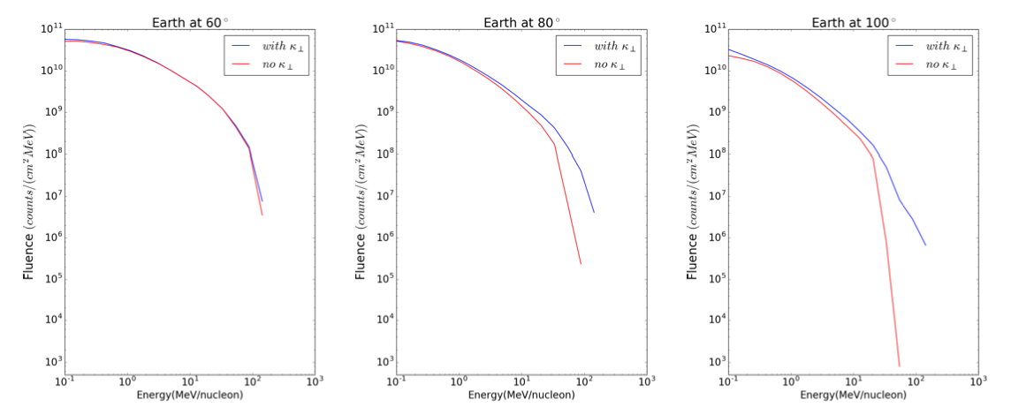
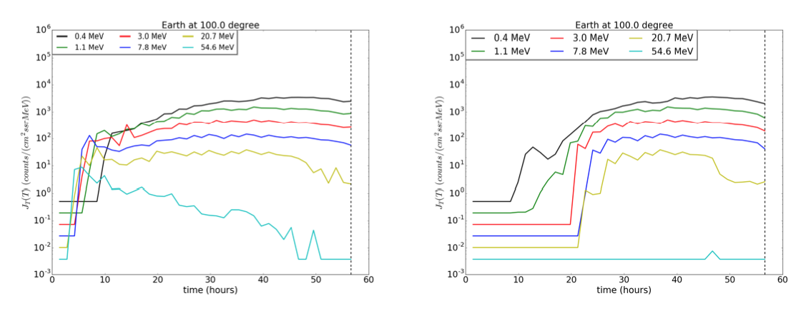
Time-integrated proton fluence at 1 AU. Left to right, point A (φ= 60◦), B (80◦), and C (100◦).
Event integrated proton fluence at 1AU. The red line shows results without κ⊥ and blue with κ⊥.
Time intensity profiles for 6 energies at C (100◦). Left is for protons with κ⊥ and right is for protons without κ⊥.

Slide 45
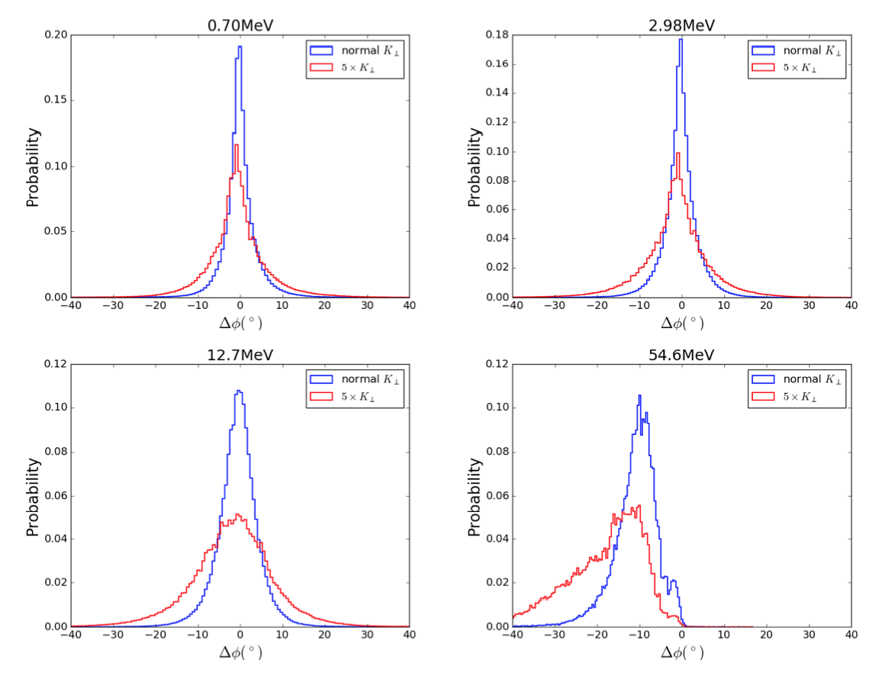
Longitudinal spreading ∆φ of particles from its original field line on which it was accelerated at the shock. The histogram shows the angular separation between the two Parker field lines L_{f} and L_{i}, where L_{f} is the Parker field when the particle arrives 1 AU and L_{i} is the Parker field line when the particle leaves the shock. Blue lines use extended NLGC theory for κ⊥ (Shalchi et al 2006. Red lines -- κ⊥ increased by a factor of 5.

Slide 46
Conclusions:
1D PATH model can explain observations of many quasi-parallel events such as e.g., the large SEP event of Dec. 13, 2006.
Based on the PATH model we can describe/understand main features of ion spectra and intensity profiles.
Provides basis for developing and understanding 2D/3D iPATH model with perpendicular diffusion included.
Different charge states for the particles and SW suprathermals will be included in iPATH model.

