Slide 1
Methodology of Real-Time Space Radiation Dose Estimates Using Onboard Vehicle Dosimeters
Christopher J. Mertens and Tony C. Slaba
NASA Langley Research Center
Hampton, Virginia USA

Slide 2
Motivation
Need to Assess Biological Impacts to Astronauts in Real-Time during Solar Energetic Particle (SEP) Events
NASA Real-Time Dose Assessment Guideline
  Minimize the Dependence on Physics Transport Codes
  Maximize Use of Onboard Dosimeter Data
The General Approach
  Optimize Use of Vehicle Dosimeter Measurements to Estimate Body Dose Quantities at Crew Location
  The Body Dose Quantities are Inputs to Acute Radiation Risk Models Used to Assess Biological Impacts
    Predict incidence/severity of Acute Radiation Syndrome (ARS)
    Predict incidence/magnitude of Performance Decrement
This Real-Time Approach will be Tested on the EM-1 Flight

Slide 3
Main Objective & Assumptions
Focus of this Study
  Part I of General Approach to Real-Time Biological Impact Assessment
  Estimate of SEP Absorbed Dose at Crew Locations Using Measurements at the Dosimeter Locations
Main Objective
  Evaluate Two Independent Methodologies for Estimating Dose at Crew Locations Using Dosimeter Measurements
Assumptions
  Dosimeter Measurements are Simulated (HZETRN code)
  A 15% Standard Deviation is Assumed for Measurement Noise
  Only Absorbed Dose in Silicon is Estimated at Crew Locations
  SEP Events Assumed Isotropic

Slide 4
Outline
Method 1: Dosimeter Dose-Depth Fit
  Description of Method
  Test Method 1 for EM-1 Dose at Crew Locations from Distribution of SEP Event-Accumulated Doses
Method 2: Dosimeter Dose-Database Fit
  Description of Method
  Test Method 2 for EM-1 Dose at Crew Locations from Distribution of SEP Event-Accumulated Doses
Down Select to One Operational Method
Assess Operational Methodology for Time-Dependent SEP Events
Summary & Next Steps

Slide 5
Description of Method 1: Dose-Depth Fit

Slide 6
Dose-Depth Fit: Basic Approach
Fit Power-Law in Depth to Onboard Dosimeter Measurements
Dose measurement from detectors (i)
Effective depth of detector (i)
Dose delivered to detectors at position x_{i} by “true” radiation environment along ray paths Ω

Slide 7
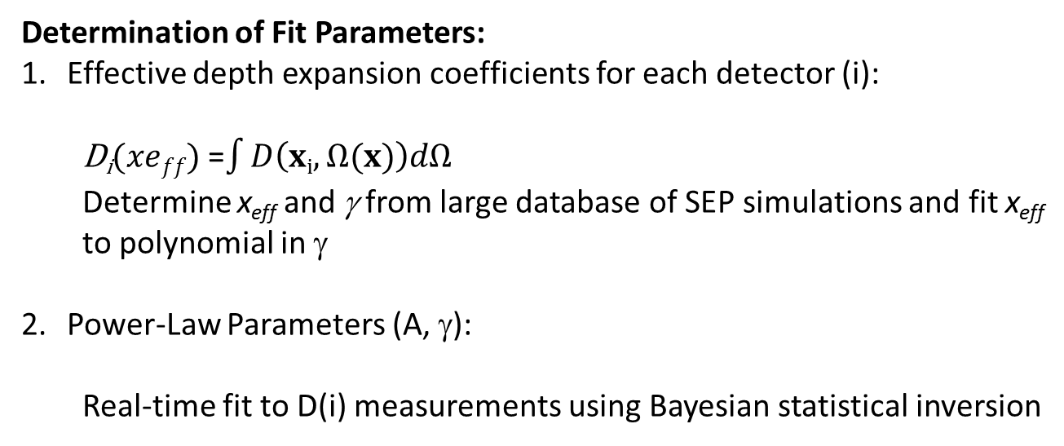
Dose-Depth Fit: Basic Approach
Dose-depth power-law representation requires iterative approach to obtain self-consistent solution of these two equations
Determination of Fit Parameters:
Effective depth expansion coefficients for each detector (i):
  D_{i}$(xeff)$ =$\int{D\left(xi,Ω(x)\right)dΩ}$
  Determine x_{eff} and γ from large database of SEP simulations and fit x_{eff} to polynomial in γ
Power-Law Parameters (A, γ):
  Real-time fit to D(i) measurements using Bayesian statistical inversion

Slide 8
The Inverse Problem
Vector of Measurements
Model of Measurement
Measurement Error
Statement of inverse problem: Find model parameters x that “optimally estimate” the measurements y to within the measurements error ε
Solution of inverse problem: Find model parameters x, given the measurements y, that maximize the posteriori pdf P(x|y)
(Bayes’ theorem on inverse probabilities)

Slide 9
The Inverse Problem
Assuming Gaussian Statistics
Measurement noise variance matrix
a-priori
a-priori variance matrix
Define the cost function
Solution: the maximum likelihood solution x_{s} to the Bayesian statistical inverse problem satisfies (i.e., minimizes the cost function):

Slide 10
Optimal Solution of Inverse Problem
Solution Vector:
Solution Covariance Matrix:
Jacobian Matrix:
Forward Model Approximation:

Slide 11
Develop Effective Depth Parameterizations for EM-1 Vehicle

Slide 12
EM-1 Effective Depth
Calculate Database of Dose-Depth Curves (0-100 g/cm²) for 65 Historical SEP Events Using HZETRN
  SEP/GLE Database (1956-2006): Tylka et al. (38th COSPAR Assembly)
Calculate Dose at EM-1 Dosimeter & Crew Locations for the Same 65 Historical SEP Events Using HZETRN
From Dose-Depth Curve, Find Effective Depth that Reproduces Dose at EM-1 Dosimeter & Crew Locations for Each SEP Event
Catalogue (x_{eff}, γ) for Each SEP Event at the Dosimeter & Crew Locations
Use (x_{eff}, γ) Catalogue to Fit Effective Depth (x_{eff}) to Polynomial in Power-Law Index (γ) for Each Dosimeter & Crew Locations

Slide 13
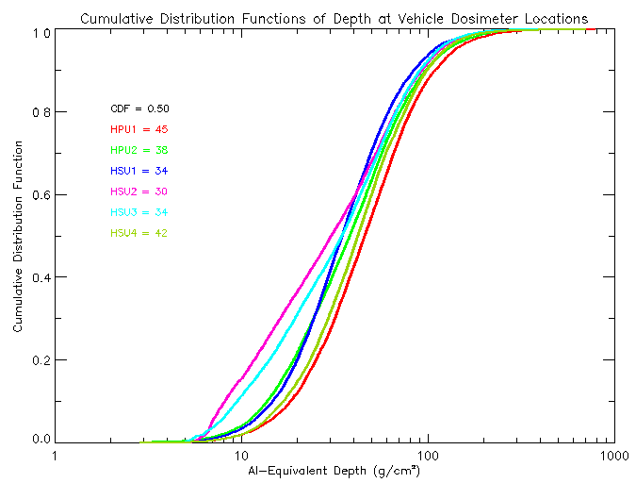
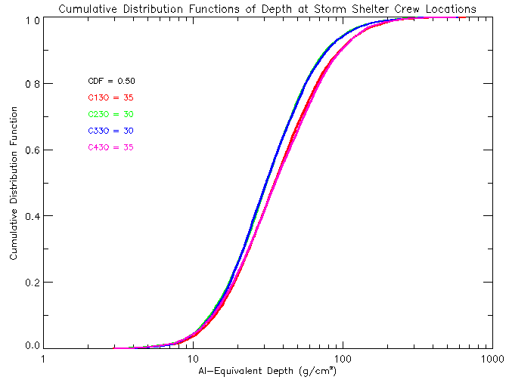
EM-1 Cumulative Depth Distribution
Vehicle Dosimeter Locations
Storm Shelter Crew Locations

Slide 14
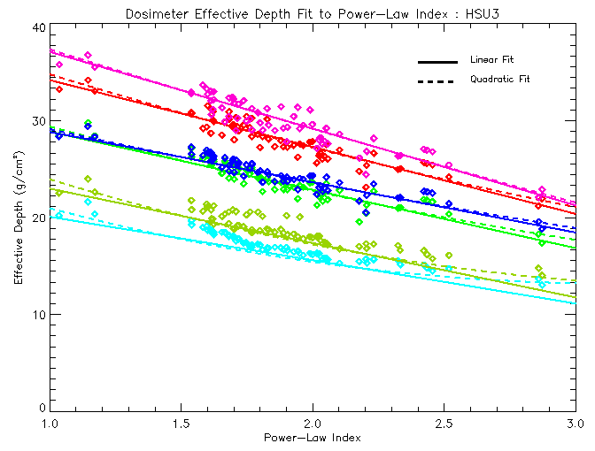
Effective Depth: EM-1 Detectors

Slide 15
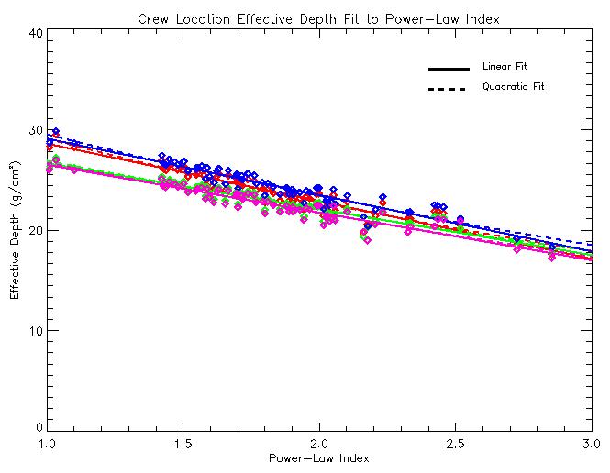
Effective Depth: EM1 Crew Locations

Slide 16
Test Dosimeter Dose-Depth Fit Approach for EM-1 Vehicle

Slide 17
Test Set-Up -1
Simulate EM-1 Dosimeter Measurements (HZETRN)
Estimate Dose at EM-1 Crew Locations
  Use Dose-Depth Fitting Method to Derive Parameters (A, γ) Based on Simulated EM-1 Dosimeter Measurements
  Estimate Dose at Crew Locations Using Fit Parameters (A, γ) and Effective Depth Parameterization
Simulate Dose at EM-1 Crew Locations (HZETRN)
Compare Dose-Depth Fit Estimate of Dose at Crew Location with Simulated Dose (HZETRN)
Simulated SEP Event Test Cases Based on Random Selection of SEP Spectral Parameters

Slide 18
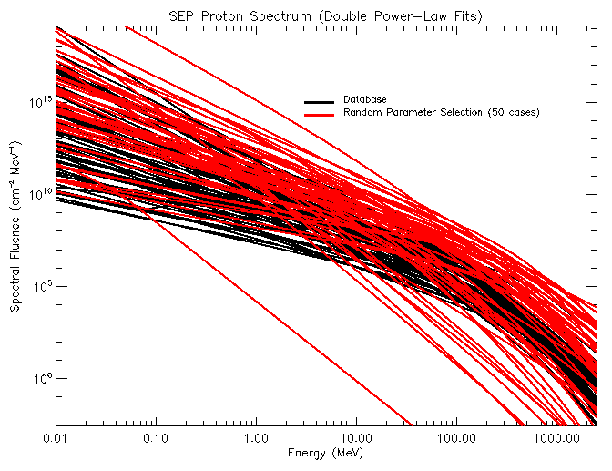
SEP Spectra for Algorithm Testing

Slide 19
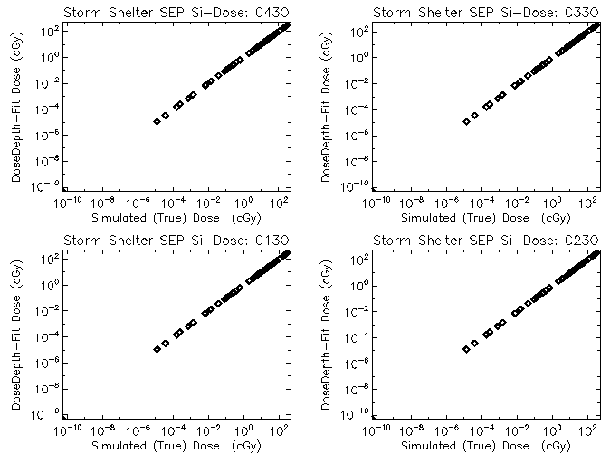
Estimated vs “True” Si-Dose
Storm Shelter Crew Locations

Slide 20
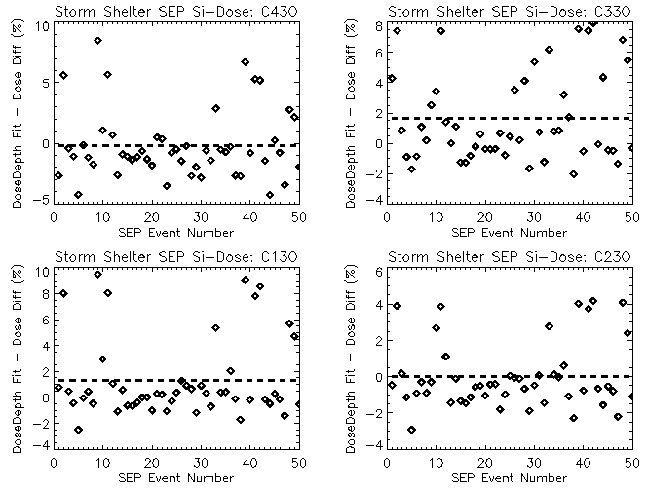
Estimated vs “True” Si-Dose Diff
Storm Shelter Crew Locations
Absolute Average Difference < 3%
Maximum Difference < 10%

Slide 21
Test Set-Up -2
Simulate EM-1 Dosimeter Measurements (HZETRN)
  Perturb measurements by random noise (15% STD)
  50 Random Samples
Estimate Dose at EM-1 Crew Locations
  Use Dose-Depth Fitting Method to Derive Parameters (A, γ) Based on Simulated EM-1 Dosimeter Measurements
  Estimate Dose at Crew Locations Using Fit Parameters (A, γ) and Effective Depth Parameterization
Simulate Dose at EM-1 Crew Locations (HZETRN)
Compare Dose-Depth Fit Estimate of Dose at Crew Location with Simulated Dose (HZETRN)
Simulated SEP Event Test Cases Based on Random Selection of SEP Spectral Parameters

Slide 22
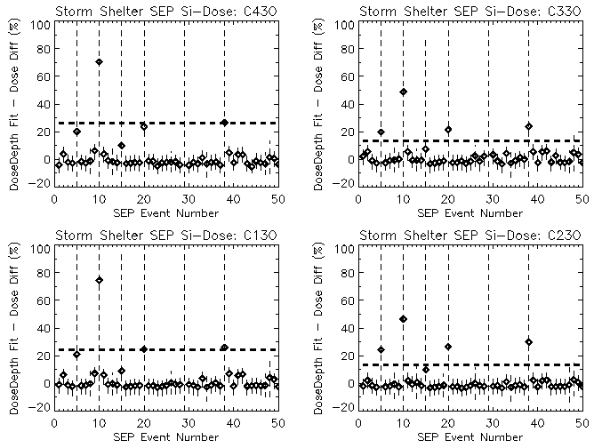
Estimated vs “True” Si-Dose Diff
Storm Shelter Crew Locations
Absolute Average Difference < 35%
Maximum Difference ~ 1200%

Slide 23
Description of Method 2: Dose-Database Fit

Slide 24
Dose-Database Fit: Basic Approach
Compute Normalized Variance-Weighted Average Measured Dose
Compute Normalized Dose Calculated from the SEP Event Database at the Dosimeter Locations
Find SEP Event that Minimizes the Square Residual Between the Measured & Database Normalized Average Dose

Slide 25
Optimal Solution for General LSQ
Define the cost function
Solution: the maximum likelihood solution x_{s} to the Bayesian statistical inverse problem satisfies (i.e., minimizes the cost function):
Solution Vector (General LSQ):

Slide 26
Test Dosimeter Dose-Database Fit Approach for EM-1 Vehicle

Slide 27
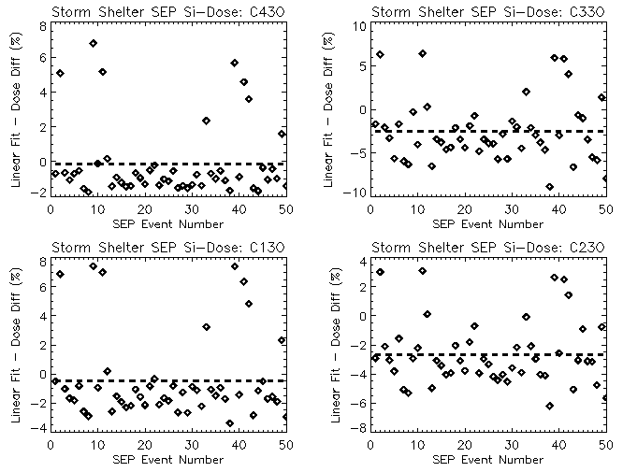
Estimated vs “True” Si-Dose Diff
Storm Shelter Crew Locations
Absolute Average Difference < 4%
Maximum Difference ~ 10%

Slide 28
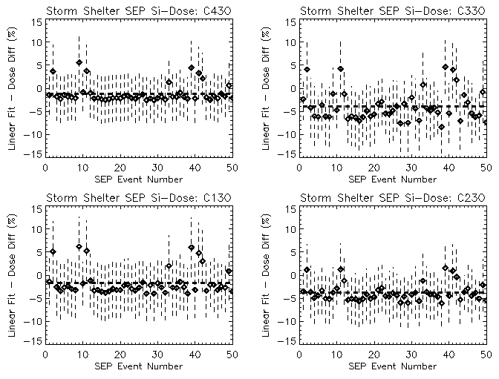
Estimated vs “True” Si-Dose Diff
Storm Shelter Crew Locations
Absolute Average Difference < 7%
Maximum Difference ~ 10%

Slide 29
SEP Database with Time Evolution
Down Select to Dose-Database Fit Approach as Operational Approach
  More robust (less sensitive to noise perturbations in dosimeter measurements) compared to Dose-Depth Approach
  Straightforward Approach to get Body Dose Quantities
Test Dosimeter Dose-Database Fit Approach for EM-1 Vehicle Using Time-Dependent SEP Event Database
  Database Based on IMP-8/GME Measurements (Jim Adams)
  479 SEP Events (1973-2001)
  ~190,000 30-Minute Time Intervals

Slide 30
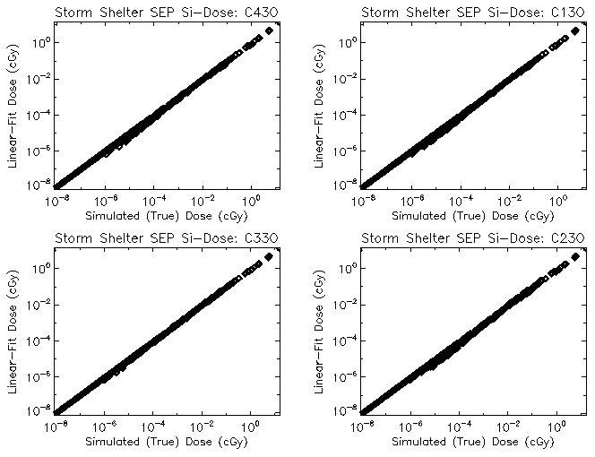
Estimated vs “True” Si-Dose
Storm Shelter Crew Locations
Event Accumulated Dose

Slide 31
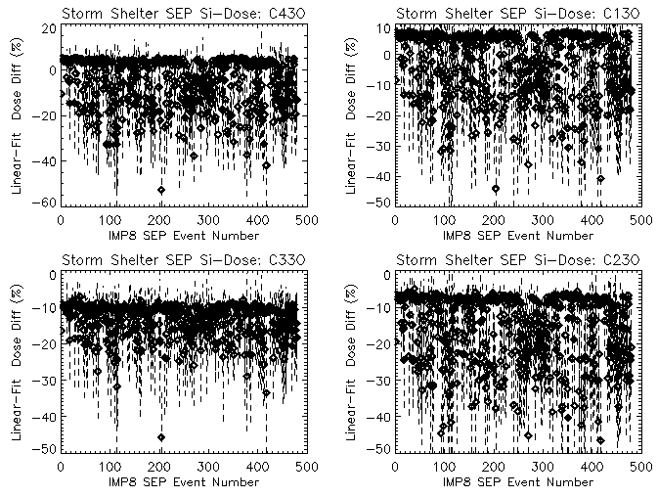
Estimated vs “True” Si-Dose Diff
Storm Shelter Crew Locations
Error bars are STD Over
Event Sub-Intervals
Absolute Average Difference < 20%
Maximum Difference ~ 80%

Slide 32


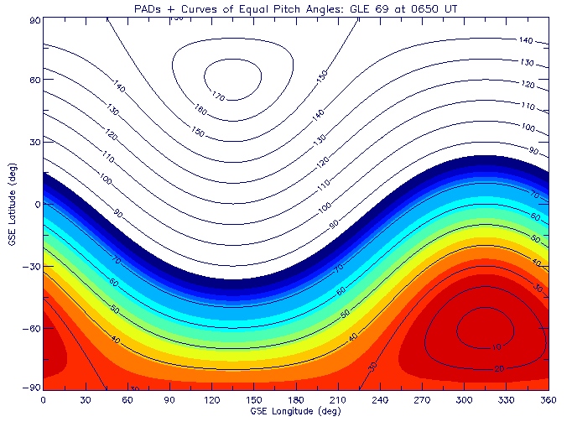
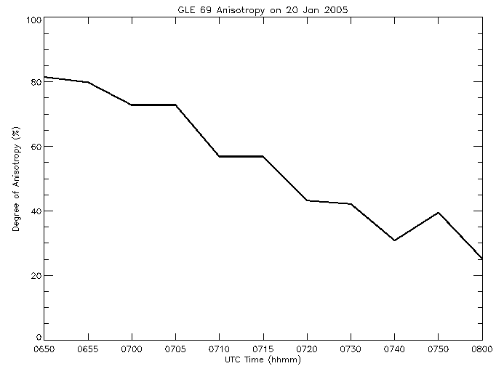
Example SEP Anisotropy: GLE69
Highly collimated proton beam during initial phase of GLE
Anisotropy persists at ~10-30% for more than 12 hours after peak flux
GLE69 Parameterization: Bombardieri et al., Astrophys. J., 682, 1315-1327, 2008

Slide 33
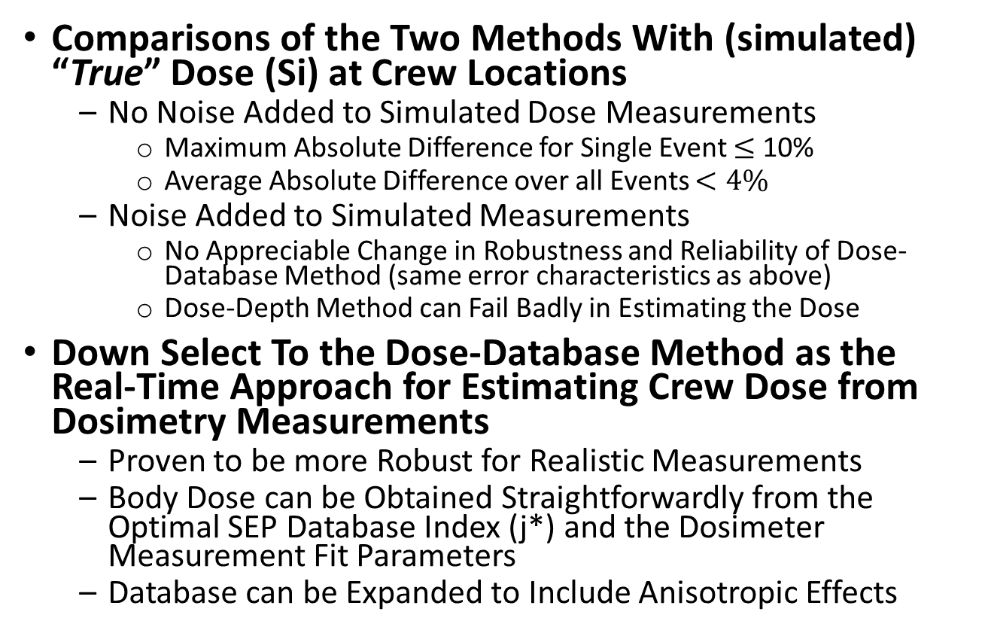
Summary
Comparisons of the Two Methods With (simulated) “True” Dose (Si) at Crew Locations
  No Noise Added to Simulated Dose Measurements
    Maximum Absolute Difference for Single Event $≤$ 10%
    Average Absolute Difference over all Events $<4\%$
  Noise Added to Simulated Measurements
    No Appreciable Change in Robustness and Reliability of Dose-Database Method (same error characteristics as above)
    Dose-Depth Method can Fail Badly in Estimating the Dose
Down Select To the Dose-Database Method as the Real-Time Approach for Estimating Crew Dose from Dosimetry Measurements
  Proven to be more Robust for Realistic Measurements
  Body Dose can be Obtained Straightforwardly from the Optimal SEP Database Index (j*) and the Dosimeter Measurement Fit Parameters
  Database can be Expanded to Include Anisotropic Effects

Slide 34
Next Steps
Expand Database of Dose-Database Method
  Include Anisotropic Effects
  Include Wider Range of SEP Spectral Shapes Using the IMP-8 Time-Dependent Event Database
  Include Body Dose Quantities and Integrate Dose Output with Acute Radiation Risk Models
Re-evaluate Updates to Dose-Database Method

Slide 35
Backup Slides

Slide 36
Solution Diagnostics
Estimated Relative Parameter Error:
Limited value (even misleading); doesn’t account for correlated errors
Convergence Test and Quality Control:
Includes correlated errors
Goodness Test:
Probability close to one means the optimally estimated parameters fit the measurements better than any other set of parameters

