Slide 1
The GeV-TeV Sun
Annika Peter
Center for Cosmology and AstroParticle Physics
The Ohio State University

Slide 2
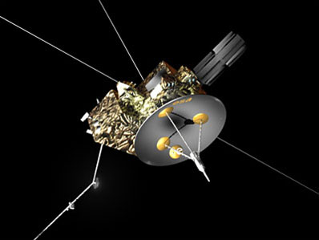
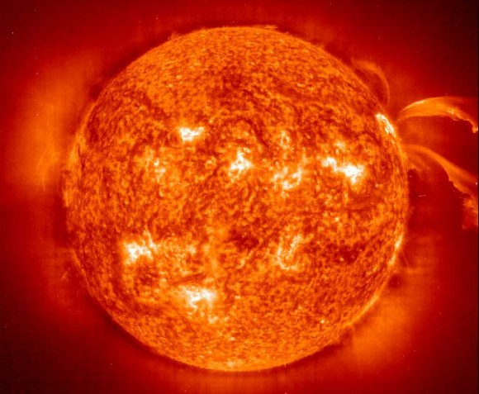
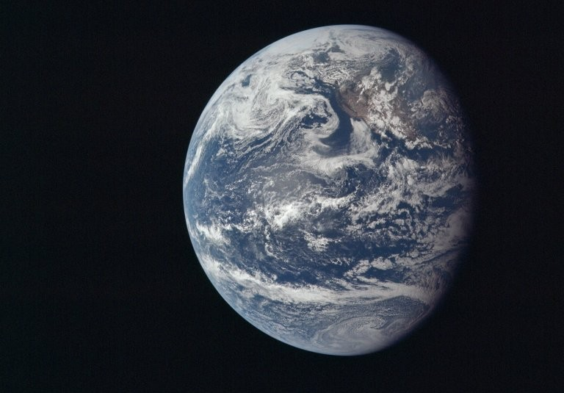
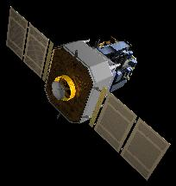
Sun as a source of cosmic rays
photons
charged particles
NASA/ESA

Slide 3
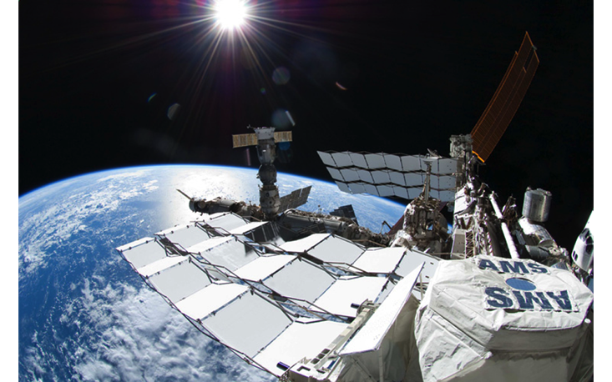
Sun as a nuisance for (Galactic) cosmic rays
charged particles
NASA/ESA

Slide 4
Sun as a detector of (Galactic) cosmic rays
charged particles
Ng, Beacom, Peter, Rott 1508.06276
Zhou, Ng, Beacom, Peter 1612.02420
Ng, Beacom, Peter, Rott 1703.10280
Tang, Ng, Zhou, Beacom, Peter, Rott in prep.
NASA/ESA

Slide 5
How do we use the Sun as a GCR detector?

Slide 6
Hadronic Cosmic Rays
Seckel, Stanev, Gaisser (SSG) 1991
ν
ν
ν
ν

Slide 7
Leptonic Cosmic Rays: Inverse Compton (IC)
Photons only
Extended
1 GeV-range peak comes from: E ~γ²E_{,photon}

Slide 8
What do we learn?

Slide 9
If magnetic fields < 1 AU unimportant…
Gamma rays
Neutrinos
Leptonic IC
Inherits spectral shape from primaries until Klein-Nishina effect kicks in.
Diffuse (10’s of degrees), brightest toward the middle (except for the very middle)
Disk only
Inherits spectral shape from primaries.
Angular shape from neutrino absorption, amplitude “calorimetric”.
Hadronic limb
Inherits spectral shape from primaries
Bright, but small angular extent

Slide 10
If magnetic fields < 1 AU unimportant…
Gamma rays

Slide 11
If magnetic fields < 1 AU unimportant…
Gamma rays
Data
Prediction w/B fields

Slide 12
What’s going on?
A multimessenger approach

Slide 13
What’s going on?
1. Propagation in the inner heliosphere
(any additional modulation?)
2. Propagation and interaction in chromo/photosphere

Slide 14
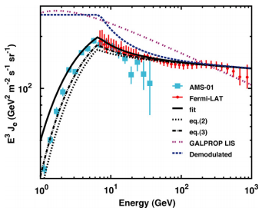
What physics matters?
Insignificant extra modulation below 10 GeV primary
Lepton-induced IC
Hadron-induced γ
Hadron-inducedν
Only modulation matters (everything else well-quantified).
No extra modulation
0.3 AU in projection
0.08 AU in projection
Abdo+ 2011 Fermi Collaboration

Slide 15
What physics matters?
Lepton-induced IC
Hadron-induced γ
Hadron-inducedν
Only modulation matters (everything else well-quantified).
The modulation between the Earth and a few tenths of AU appears small.
Prediction reasonably consistent with observations, at least for < 10 GeV.

Slide 16
Hadron-induced γ: what to explain
1. High level of flux
???
Solar disk
Limb
~1 TeV primaries

Slide 17
Hadron-induced γ: what to explain
1. High level of flux
2. Time variability
Solar min
Solar max
~100 GeV primaries

Slide 18
What physics matters?
Lepton-induced IC
Hadron-induced γ
Hadron-inducedν
Only modulation matters (everything else well-quantified).
The modulation between the Earth and a few tenths of AU appears small.
Prediction reasonably consistent with observations, at least for < 10 GeV.
Need to explain high flux to at least 100 GeV (1 TeV primaries).
Need to explain the strong time varaibility below ~ 10 GeV (100 GeV primaries).
Modulation can’t do it.
We’re left with the interplay between coronal/chromospheric fields and the interplay with interaction probability

Slide 19
Hadronic Cosmic Rays
Seckel, Stanev, Gaisser (SSG) 1991
Magnetic fields = illumination of the disk
ν
ν
ν
ν

Slide 20
Magnetic fields and interactions
Optical depth for protons ~ optical depth for gammas
Solar Minimum
Weak field = many interactions
fewer gammas escape?
Solar Maximum
Strong field = few interactions
Where do particles get mirrored?

Slide 21
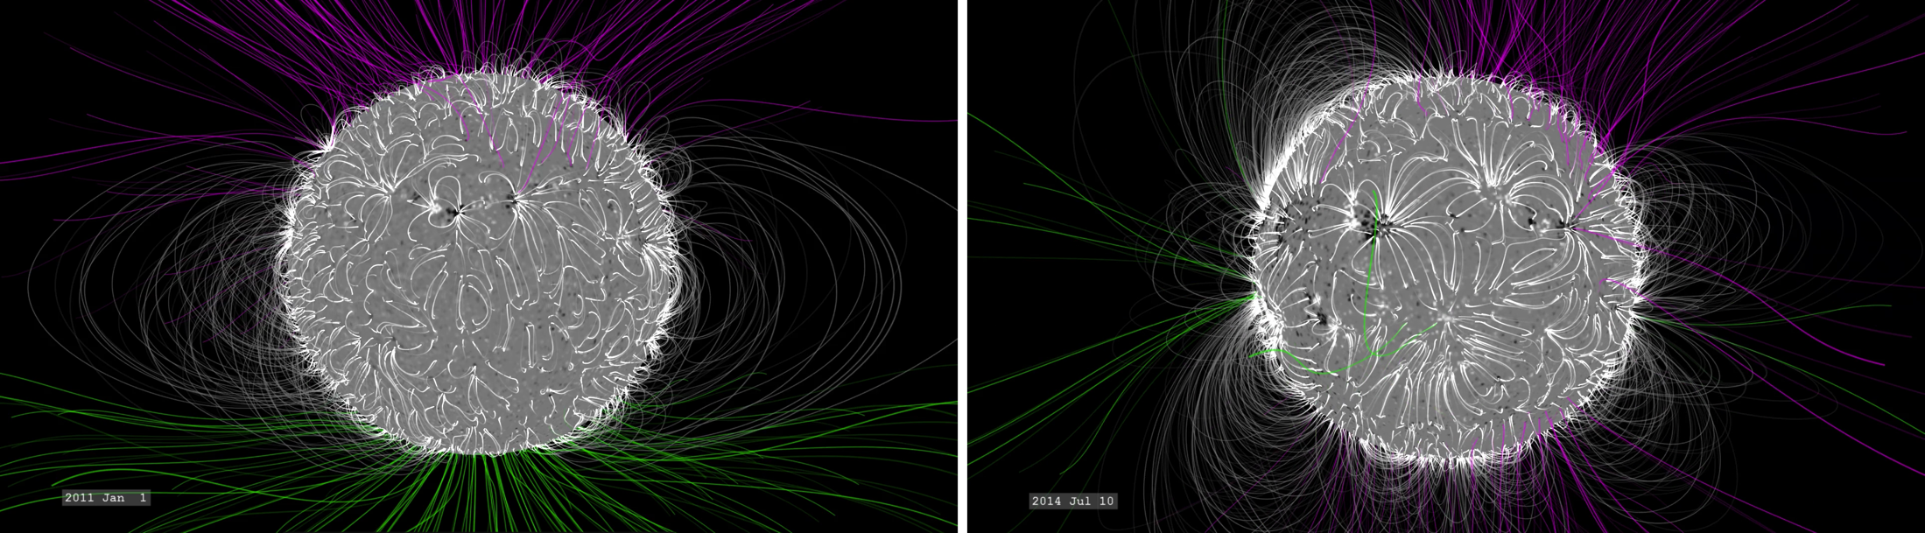
Magnetic fields and interactions
Image credit: NASA
Where do cosmic rays hit the Sun?

Slide 22
Magnetic fields and interactions
Protons 0.3-100 TeV
Tibet Air Shower array

Slide 23
What physics matters?
Lepton-induced IC
Hadron-induced γ
Hadron-inducedν
Only modulation matters (everything else well-quantified).
The modulation between the Earth and a few tenths of AU appears small.
Prediction reasonably consistent with observations, at least for < 10 GeV.
Need to explain high flux to at least 100 GeV (1 TeV primaries).
Need to explain the strong time varaibility below ~ 10 GeV (100 GeV primaries).
Modulation can’t do it.
We’re left with the interplay between coronal/chromospheric fields and the interplay with interaction probability.
Learn about magnetic fields?

Slide 24
Hadron-inducedν
Limited energy resolution
Energy resolution
No modulation, all particles interact
SSG nominal
←→
Magnetic fields

Slide 25
What physics matters?
Lepton-induced IC
Hadron-induced γ
Hadron-inducedν
Only modulation matters (everything else well-quantified).
The modulation between the Earth and a few tenths of AU appears small.
Prediction reasonably consistent with observations, at least for < 10 GeV.
Need to explain high flux to at least 100 GeV (1 TeV primaries).
Need to explain the strong time varaibility below ~ 10 GeV (100 GeV primaries).
Modulation can’t do it.
We’re left with the interplay between coronal/chromospheric fields and the interplay with interaction probability.
Modulation.
Total interaction probability.
Learn about magnetic fields?

Slide 26
Summary
Lepton-induced IC matches predictions reasonably well—little extra modulation between 0.1 and 1 AU. (Fermi collab. 2011)
Hadron-induced γ’s a poor fit to theory models—sensitive to propagation in corona/chromosphere, partial interaction probability. (Ng+,Zhou+ 2016)
Hadron-induced ν’s should be detected in km^3 experiments soon, sensitive to corona/chromosphere and the TOTAL interaction probability. (Ng+2017)
ν
ν
ν
ν

Slide 27
Hadron-induced γ: what to explain

