Slide 1
SUSY flavour /
Flavour sector in BSM scenarios
Andreas Crivellin
Theory Group of the Laboratory for Particle Physics
Prague, 08.06.2017

Slide 2
Outline
Introduction:
New Physics and Flavour anomalies
  b→sμμ
  b→cτν
  ε’/ε
  a_{μ}
  Loop effects of heavy scalars and fermions
  Simultaneous explanations with LQs
Conclusions
Andreas Crivellin

Slide 3
Finding NP in Flavour Observables
At colliders one produces many (up to 10¹⁴) heavy quarks or leptons and measures their decays into light flavours
Experiment
Direct searches
Standard Model
New Physics
Flavour observables
Flavour observables are sensitive to higher energy scales than collider searches
Andreas Crivellin

Slide 4
Hints for NP and LFUV
Lepton Flavour Universality Violation (LFUV)
LFUV
Electron channels:
SM like
b→sµµ
5-6σ
R(D⁽*⁾)
4σ
a_{µ}
3σ
τ→µνν
2σ
Talk of Pere Masjuan Queralt
ε‘/ε
≈ 3σ
See talks of
Christopher
Sachrajda and
Kei Yamamoto
Andreas Crivellin

Slide 5
a_{μ} explanations
MSSM
  tan(ß) enhanced slepton loops
Scalars
  Light scalars with enhanced muon couplings
Z’
  Very light with τμ couplings (m_{τ} enhancement)
Leptoquarks
  m_{t} enhaned effects
e.g. D. Stockinger, hep-ph/0609168
e.g. A. Broggio et at. arXiv:1409.3199
A.C. et al. arXiv:1507.07567
e.g. W. Altmannshofer, C. Chen, P.S.B. Dev, A. Soni, arXiv:1607.06832, …
e.g. A. Djouadi, T. Kohler, M. Spira, J. Tutas, Z.Phys. C46 (1990)
E. Leskow, A.C., G. D'Ambrosio, D. Müller
arXiv:1612.06858
Chiral enhancement or very light particles
8

Slide 6
Scalar Leptoquarks in a_{μ}
Chirally enhanced effects via top-loops
Left-, right- handed muons-top
coupling
E. Leskow, A.C.,
G. D'Ambrosio,
D. Müller
arXiv:1612.06858
Z→μμ at future colliders
8

Slide 7
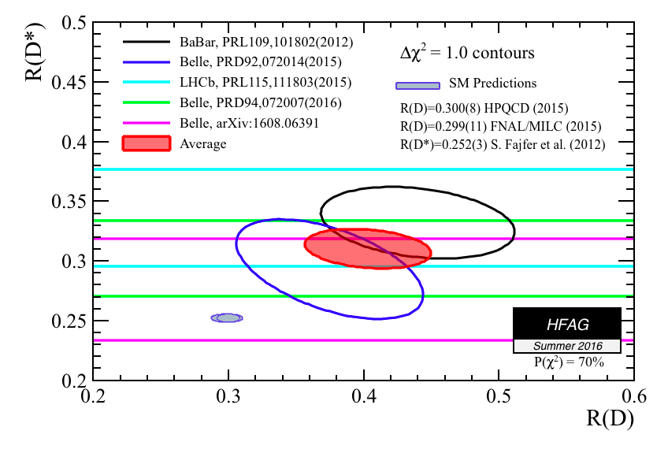
R(D) & R(D*)
See talks of Guy Wormser and Jorge Camalich
Charged scalars
  Problems with
  q2 distributions
  and B_{c} lifetime
W’
  Strong constraints
  from direct LHC searches
Leptoquark (also in the RPV MSSM)
  Strong signals in qq→ττ searches
Faroughy et al. arXiv:1609.07138
Explanation difficult
8

Slide 8
R(D⁽*⁾) and b→sττ (model-independent)
Large couplings to the second generation needed in
order avoid collider bounds
Cancelation in b→sνν needed: C⁽¹⁾=C⁽³⁾
B_{s}→ττ
very strongly enhanced
See also R. Alonso, B. Grinstein
and J. Martin Camalich, 1505.05164

Slide 9
b→sμμ model-independent analysis
Several 2-3σ deviations in more than 130 observables
  P5’
  R(K)
  R(K*)
  B_{s}→ϕμμ
6 NP operators
See talk of Jorge Camalich
and Jessica Prisciandaro
Model
independent fit
5-6 σ better than SM
B. Capdevila, AC, S. Descotes-Genon, J. Matias and J. Virto, arXiv:1704.05340 [hep-ph].

Slide 10
b→sμμ explanations
Z’
Leptoquarks
Loop effects
U. Haisch et al. 1308.1959, Buras et al. 1311.6729
W. Altmannshofer et al. 1403.1269, AC. et al. 1501.00993, …..
Gudrun Hiller, Martin Schmaltz
arXiv:1411.4773
B. Gripaios, M. Nardecchia, S.A. Renner.
arXiv:1412.1791
D. Bečirević, N. Košnik, O. Sumensari,
R. Zukanovich Funchal, arXiv:1608.07583
L. Calibbi, AC. T. Ota, PRL 2015
…
B. Gripaios, M. Nardecchia, S. Renner, arXiv:1509.05020
Even high scale NP explanations possible

Slide 11
ε‘/ ε explanations
Z’
MSSM
A. Buras, et al.
arXiv:1507.08672
A. Buras and F. De Fazio,
arXiv:1512.02869
T. Kitahara, U. Nierste,
P. Tremper, arXiv:1604.07400
M. Endo, et al. arXiv:1608.01444
A. Crivellin, G. D'Ambrosio,
T. Kitahara and U. Nierste,
arXiv:1703.05786

Slide 12
Implications for New Particles
R(D⁽*⁾)
a_{μ}
MSSM
Lepto-quarks
b→sμμ
ε'/ε
Z’ gauge boson
Andreas Crivellin

Slide 13
Z’ bososns
in b→sμμ

Slide 14
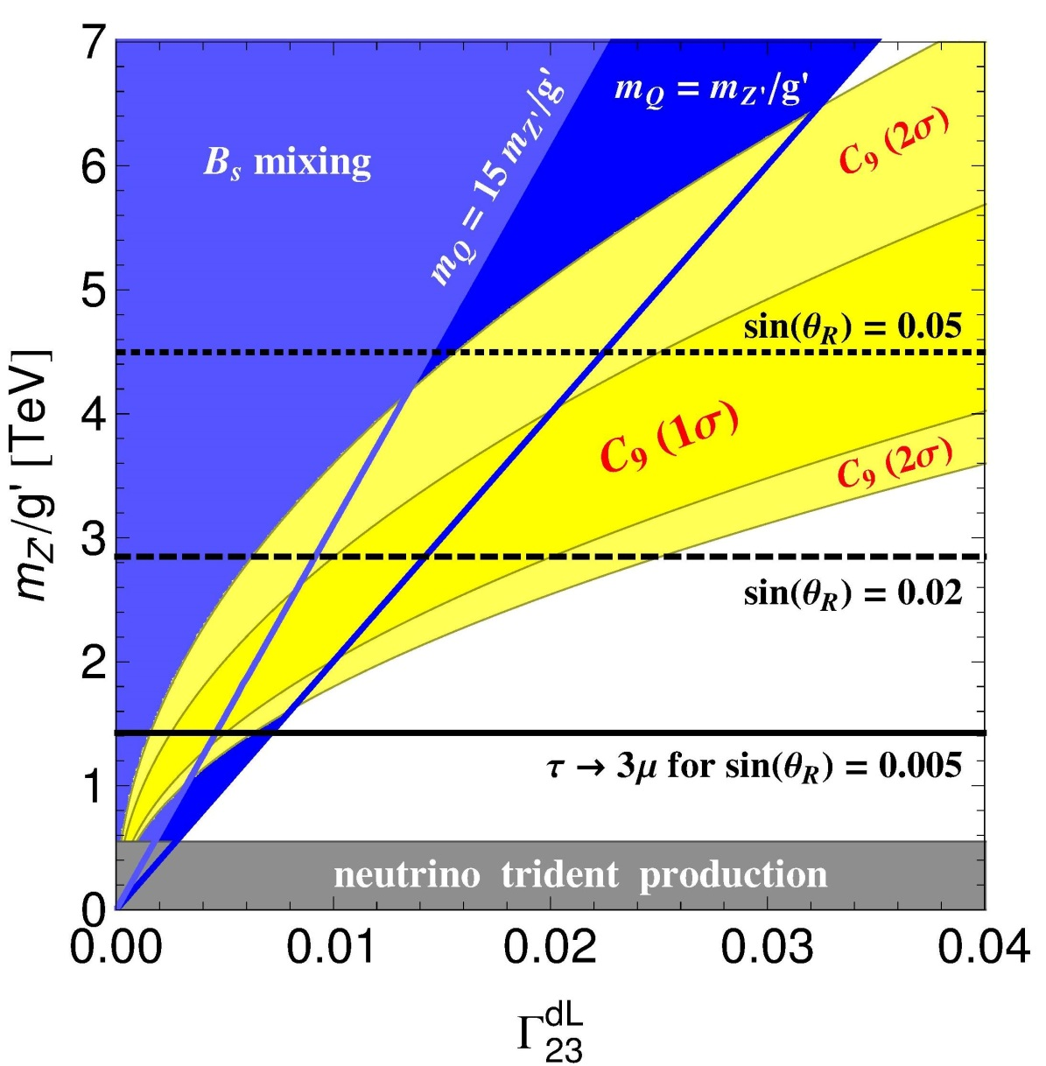
Z’ solution for b→sµµ with VLQ
b→sμμ
B_{s} mixing
allowed regions

Slide 15
Solution with horizontal U(1) charges
Avoid vector-like quarks by assigning charges to baryons as well
  Same mechanism in the quark and lepton sector
L_{μ}-L_{τ} in lepton sector
  Good symmetry for the PMNS matrix
  Effect in but not
First two quark generations must have the same charges because the large Cabibbo angle would lead to huge effect in Kaon mixing
Anomaly freedom
Q(L)=(0,1,-1) Q(B)=(a,a,-2a)

Slide 16
Dynamical explanation of the charges
A.C., J. Fuentes-Martin, A. Greljo and G. Isidori arXiv:1611.02703
Quark Sector
Lepton Sector
Symmetry
breaking
Energy scale
Standard Model

Slide 17
Solution with two Z’s
2 Z’ bosons
  Z₁ coupling
  mainly
  to leptons
  Z₂ coupling
  mainly
  to quarks
Low energy
phenomenology
unchanged
Different collider signatures
8

Slide 18
Heavy new scalars
and fermions
In b→sμμ
Pere Arnan, A.C., Lars Hofer and Federico Mescia, arXiv:1608.07832

Slide 19
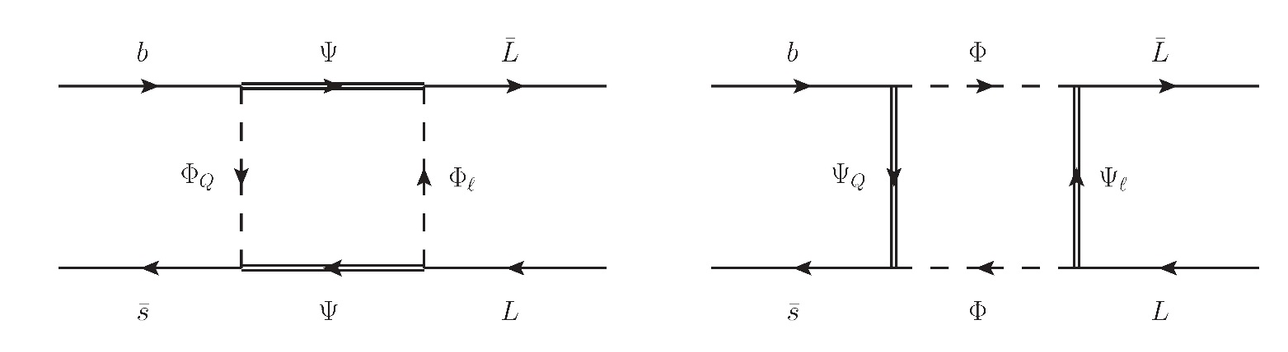
New Scalars and Fermions in b→sμμ
Possible representations
2x6x4 possibilities

Slide 20
Constraints from B_{s} mixing
constructive
Lattice results prefers destructive interference MILC, 1602.03560
Majorana representations
destructive
Destructive interference with Majorana fermions

Slide 21
b→sμμ and B_{s} mixing
Relative effect
in B_{s} mixing
b→sμμ
Explanation with O(1) couplings

Slide 22
Simultaneous Explanation of
R(D), R(D*), a_{μ}
and b→sμμ

Slide 23
R(K), R(K*) and μ→eγ with LQs
Three LQs give
a good fit
  Scalar triplet
  Vector singlet
  Vector triplet
Simultaneous
effect in b→sμμ
and b→see
generate μ→eγ
AC, D. Mueller, A. Signer, Y. Ulrich,
arXiv:1505.xxxx

Slide 24
R(D⁽*⁾), b→sμμ and a_{μ} with LQs
Scalar leptoquark singlet + triplet with Y=-2/3
Cancelation in b→sνν imposed
AC, D. Mueller, T. Ota arxiv:1703.09226
2 out of 3 can be explained

Slide 25
Conclusions
Current hints for NP in b→sμμ the flavor sector point towards
  Leptoquarks
  Z’ models
a_{μ} can be explained with
  Leptoquarks
  MSSM
R(D*) and R(D*) can be explained with
  Leptoquarks (also in the RPV MSSM)
NP
SUSY? You can make any model supersymmetric!
Andreas Crivellin

Slide 26


