Slide 1
Hyperboloids in architecture
(and in science fiction)
BGL-17 in Gyöngyös
László Jenkovszky
jenk@bitp.kiev.ua

Slide 2
Plan:
Hyperboloid geometry: the doubly deformed hyperboloid surface is shaped by moving STRAIGHT lines in opposite directions, thus creating a curved surface (instead of a flat one), Moire effect;
V.G. Shukhov’s (Владимир Григорьевич Шухов) and his constructions; double curved surfaces made of straight line elements;
Illustrations (constructions);
Appendix: Garin’s hyperboloid (by A.K. Tolstoi);

Slide 3
By wrapping and sticking a saddle (below) on gets a hyperboloid (next slide).

Slide 5
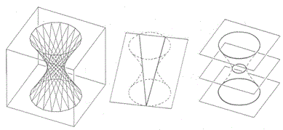

Slide 6
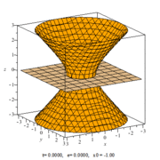

Slide 7
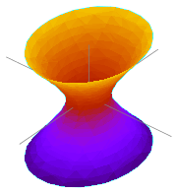

Slide 8


Slide 9
Владимир Григорьевич Шухов (V.G. Shukhov):
Born: 1853 in Грайворон (Belgorod region), near the present border between Ukraine and Russia; Died: 1939;
Aristocratic and decent parents;
Outstanding engineer: apart from architecture, contributed also to the constructer of oil pipe-lines and storag (1878, in collab. with the Nobel family), cracking (1931); military applications (maritime mines, artillery,…);
Decorated with highest State awards; elected corresponding member of the Russian Academy of Sciences (1928).

Slide 11
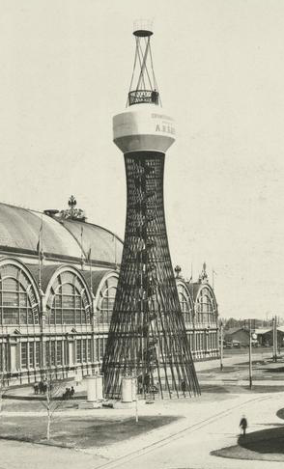

Slide 12
Famous hyperboloids:
Nizhny Novgorod, May 28, 1896 (patent of the Russian Empire, #1896), 25.5 (37) m. high, 123 000 liters reservoir on the top; conserved, moved to Polibino, Lipeck (cело Полибино, Липецкой обл.) ;
Shukhov’s (about 200) towers: Moscow (Shabolovka, 1919-1922, 150 m., Russia’s highest construction by that time!), Oka river, Krasnodar, Konotop, Petushki, lighthous in Kherson, Kievskij and Kazanskij railway stations in Moscow, GUM, high-voltage lines’ supports, 128 m. high (in N. Novgorod), power stations’ coolers, skyscrapers,... ;
Russian, US and Argentina’s ships; Kobe port tower, 108 m., Japan, resisted the 7 magnitude earthquake in 1995!; Sydney’s TV tower; Guangzhou, 600 m. (China); the 318 m. Aspire tower (Doha, Qatar), with a swiming pool on its top; Oscar Nymaier (Brazil), Gaudi (Catalunia), Le Corbousier, Szekeres Gerő (Marosvásárhely),...

Slide 18


Slide 19


Slide 20
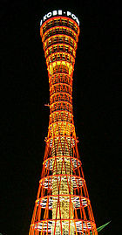

Slide 21


Slide 23
APPENDIX:
Science fiction, thriller: novel (1925-1927), movie:
“Engineer Garin’s hyperboloid”, by A. Tolstoi

Slide 24
A. Tolstoi (Алексей Николаевич Толстой):
Born in 1883 (Samara reg. ), died in Febr. !945;
Emigrated from Russia between 1918 – 1923 (Turkey, Paris, Germany);
“Red count” (»Красный граф»); prolific writer, bonvivant (merried 4 times, 10 children, dozens of grand children); decorated by highest Soviet awards (e.g. 3 highest level Stalin awards (1941, 43 and 46 (post-h.), etc.);
Buried at the Novodevichij monastry (pantheon), Moscow.

Slide 25
Thanks to:
Máté Csanád, Tamás Csörgő, and Máté Novák!
jenk@bitp.kiev.ua

Slide 26
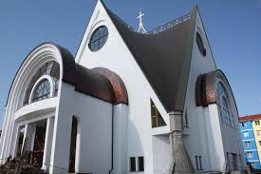
Greek-Catholic Church in Reghin, Romania
Is it an ruled surfaces, (line surface), so its curvature is zero.
A parabolic hyperboloid, which also has a zero curvature.
designer: Gerő Szekeres (architect)

Slide 27
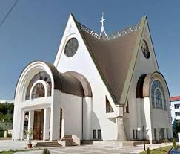
This is natural Euclidean “shape” embedded in the a 3-dimensional spaces. It has nothing to do with Bolyai-Lobachevsky's geometry.

Slide 28
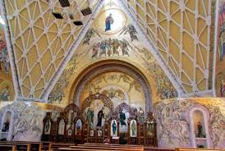
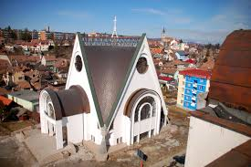

Slide 29
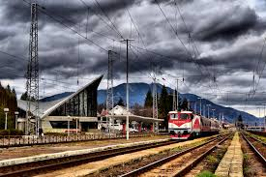
They have already been created in Romanian architecture: The railway station Predal building. This is also a zero-curvature line surface.
designer: Irina Rosetti (architect)
Irina C. Rosetti (n. 15 noiembrie 1941, România) este o arhitectă română ce trăiește la Paris. S-a distins prin clădirile moderne industriale pe care le-a proiectat și construit în anii '70 în România.

Slide 30
