Slide 1


INITIAL energy density in P+P and A+A collisions
Universe 3 (2017) 1, 9 arXiv:1609.07176
MANUSCRIPT IN PREPARATION
10th Bolyai-Gauss-Lobachevsky Conference
August 21-25, 2017
Eszterházy University, Károly Robert Campus, Gyöngyös, Hungary
24 Aug 2017
M. Csanád, T. Csörgő, Z-F. Jiang, C-B. Yang.

Slide 2
INTRODUCTION
Goals of high energy heavy ion physics
The Bjorken estimate of initial energy density

Slide 3
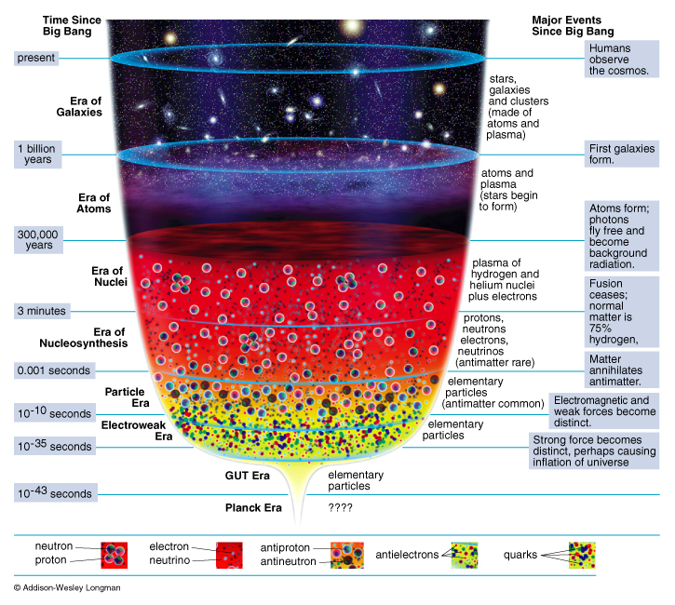
Heavy ion physics and the early Universe
Time evolution: → cooling
Phase transitions, crossovers
Atoms ionize at: few 1000 K
Nuclei melt at: million K
Hadrons melt at: 10¹² K

Slide 4
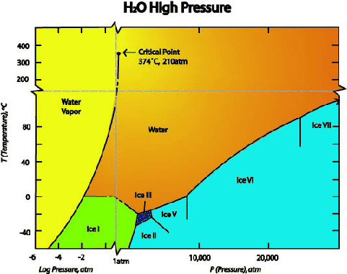
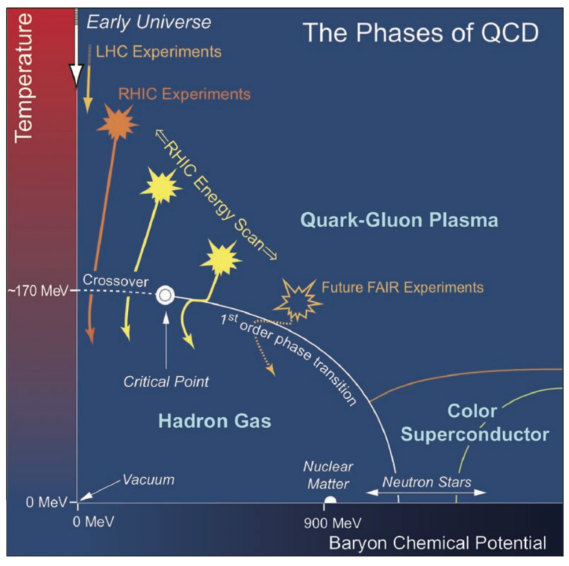
Phase diagram of the strongly interacting matter
Hadron gas, quark medium, many other phases
Compare to the phases of water

Slide 5
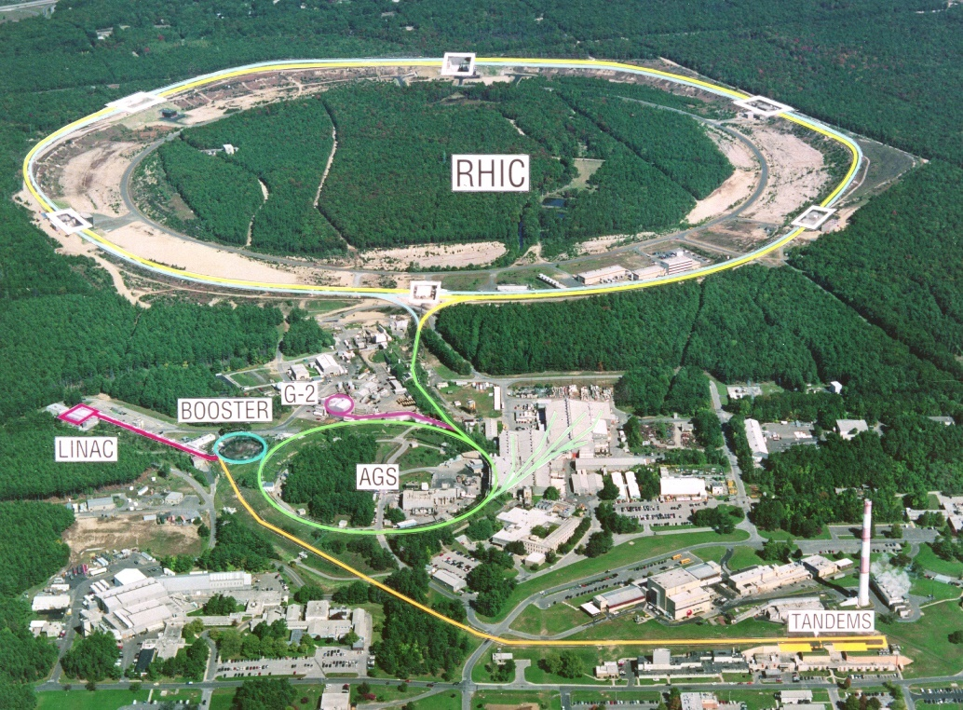
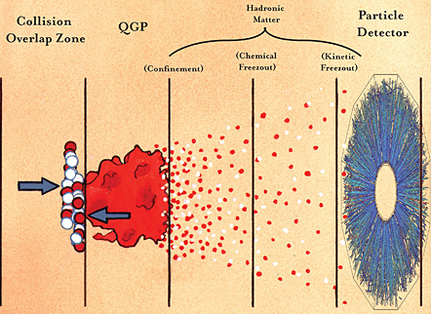
Little Bangs
How to investigate these phases? Particle accelerators!
High initial energy density and pressure
Quark matter recreated in A+A; how about p+p?

Slide 6
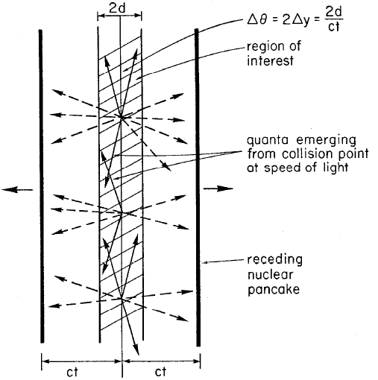


The Bjorken-estimate
The original idea: energy density based on dE/dy
QGP critical $ε_{c} \sim 1$ GeV/fm³ (from $εc=(6−8)T_{c}^{4}$)
Result (~2000x cited)
Needs correction!
Ref.: Phys.Rev. D27 (1983)
$$E=N\frac{dE}{dy}Δy=N\frac{dE}{dy}\frac{1}{2}\frac{2d}{t}=εAd$$
$$ε_{Bj}=\frac{1}{R^{2}πτ_{0}}\frac{dE}{dη}=\frac{\left\langle E\right\rangle }{R^{2}πτ_{0}}\frac{dN}{dη}$$

Slide 7
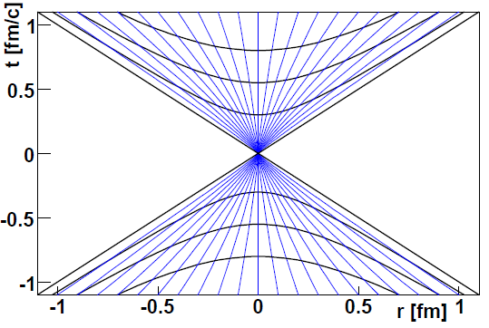
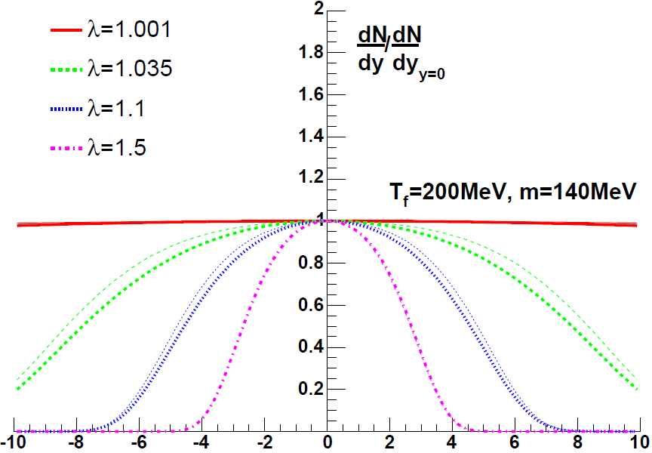

A solution of relativistic hydro
Velocity: tanh(λη)
Acceleration: λ≠1
Density: (τ/τ₀)^{λ}
dN/dy not flat!
Compare this to data!
dN/dy measurement yields advanced initial $ε$ estimate
Significant correction at RHIC!
M. Nagy, T. Csörgő, M. Csanád: Phys.Lett. B663 (2008) 306-311 (nucl-th/0605070)

Slide 8
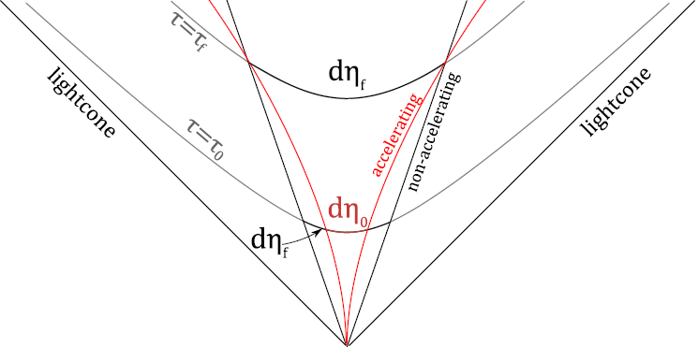

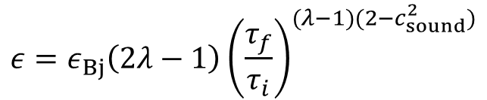
An advanced estimate
Fact: $dN/dy$ not flat
Finiteness & acceleration
Analytical investigation:
  Acceleration parameter λ
Two modifications:
  $yη$ & $ηfinal ηinitial$
Work by acceleration!
Correction w.r.t. EoS:
$$ε=ε_{Bj}\left(2λ−1\right){\left(\frac{τ_{f}}{τ_{i}}\right)}^{(λ−1)(2−c_{sound}^{2})}$$
E.g.: J.Phys.G35 (2008) 104128 (arXiv:0805.1562)

Slide 9
HOW DOES THIS WORK?
In A+A collisions: very well!

Slide 10
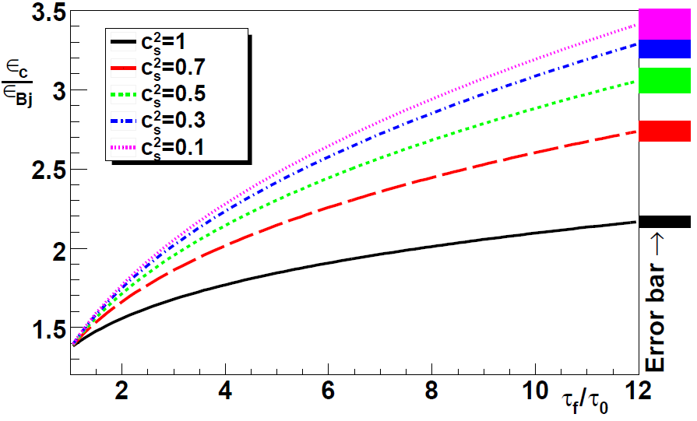
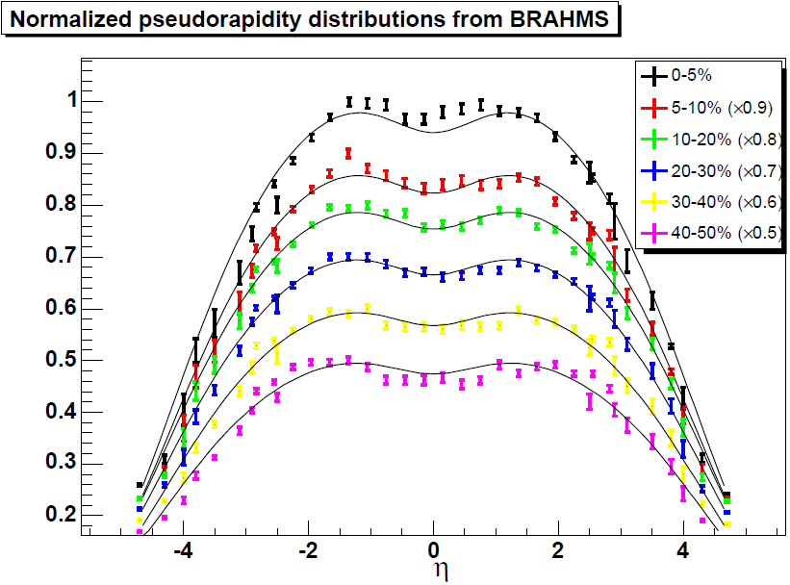
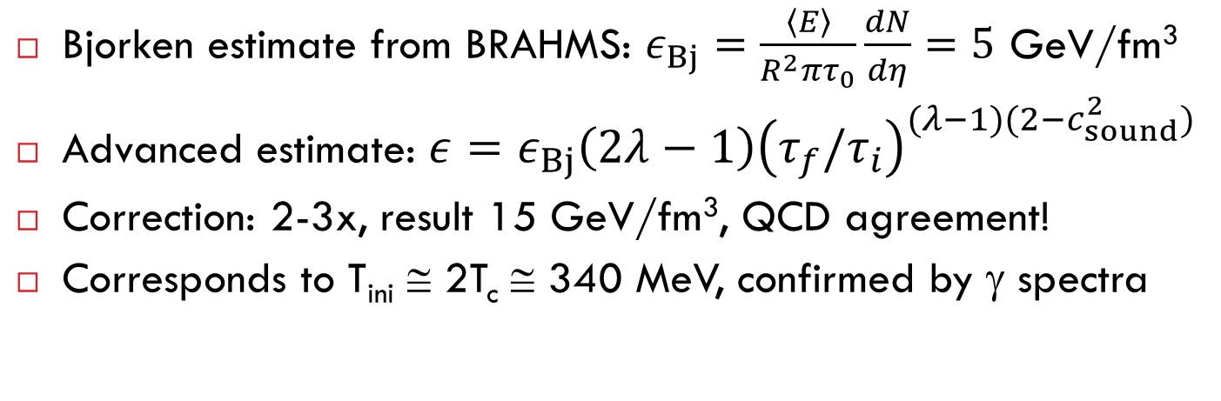
Initial energy density at RHIC
Bjorken estimate from BRAHMS: $ε_{Bj}=\frac{\left\langle E\right\rangle }{R^{2}πτ_{0}}\frac{dN}{dη}=5$ GeV/fm³
Advanced estimate: $ε=ε_{Bj}\left(2λ−1\right){\left(τ_{f}/τ_{i}\right)}^{(λ−1)(2−c_{sound}^{2})}$
Correction: 2-3x, result 15 GeV/fm³, QCD agreement!
Corresponds to T_{ini} ≅ 2T_{c} ≅ 340 MeV, confirmed by γ spectra

Slide 11
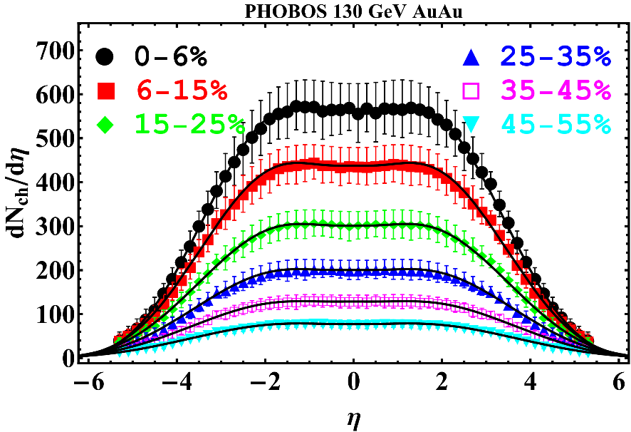
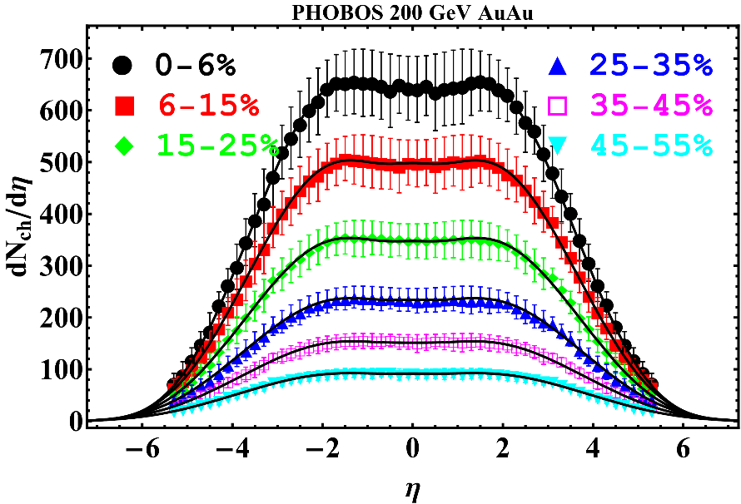
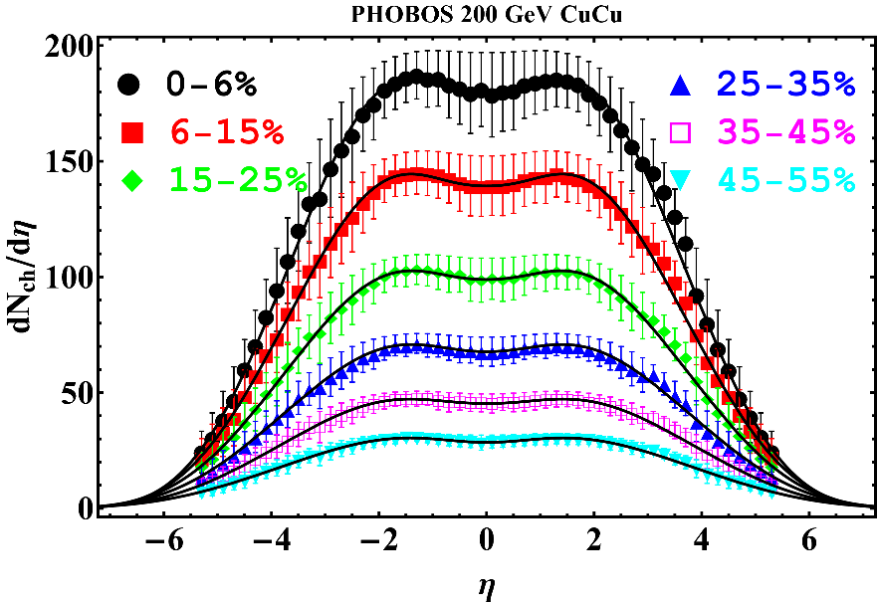
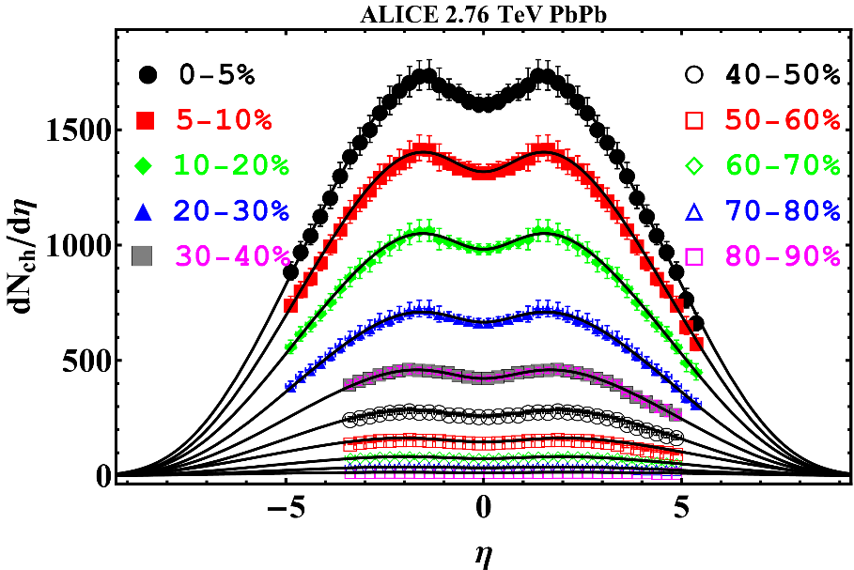
Pseudorapity densities in A+A from RHIC to LHC: well described

Slide 12
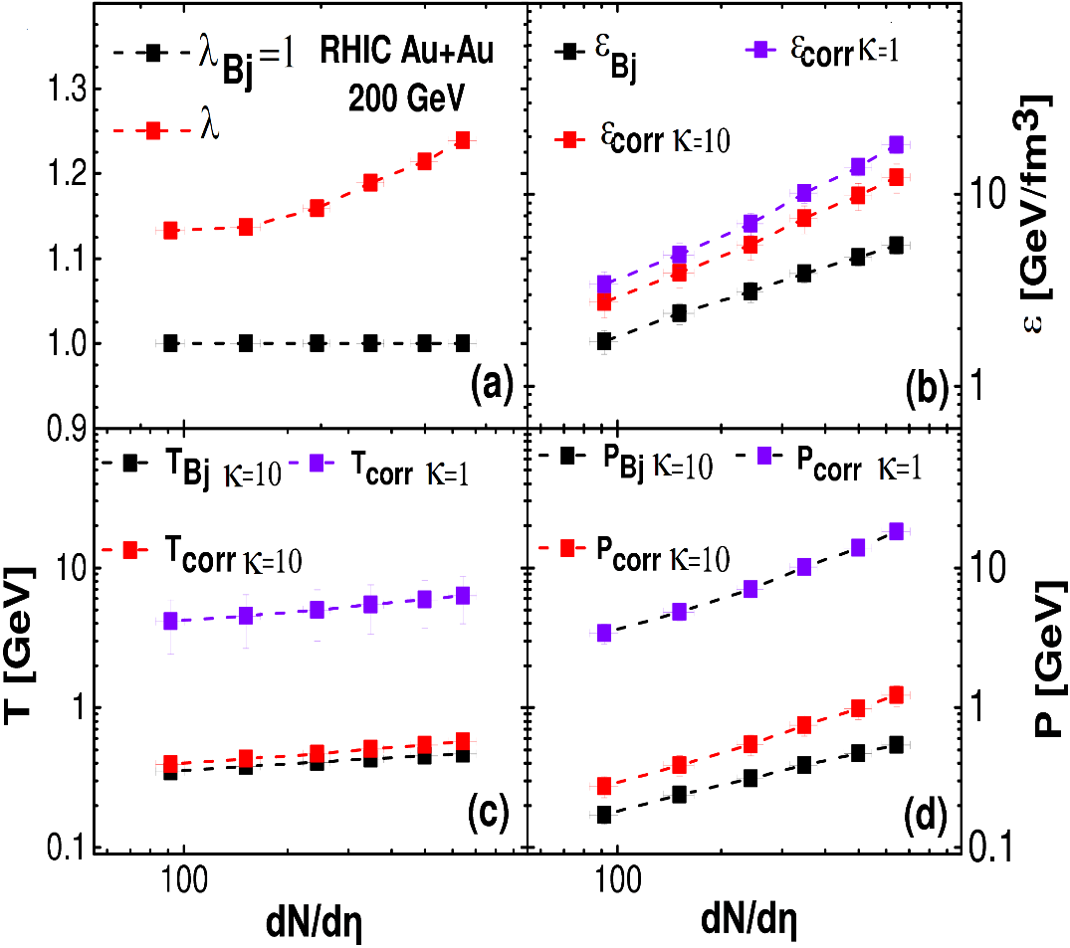
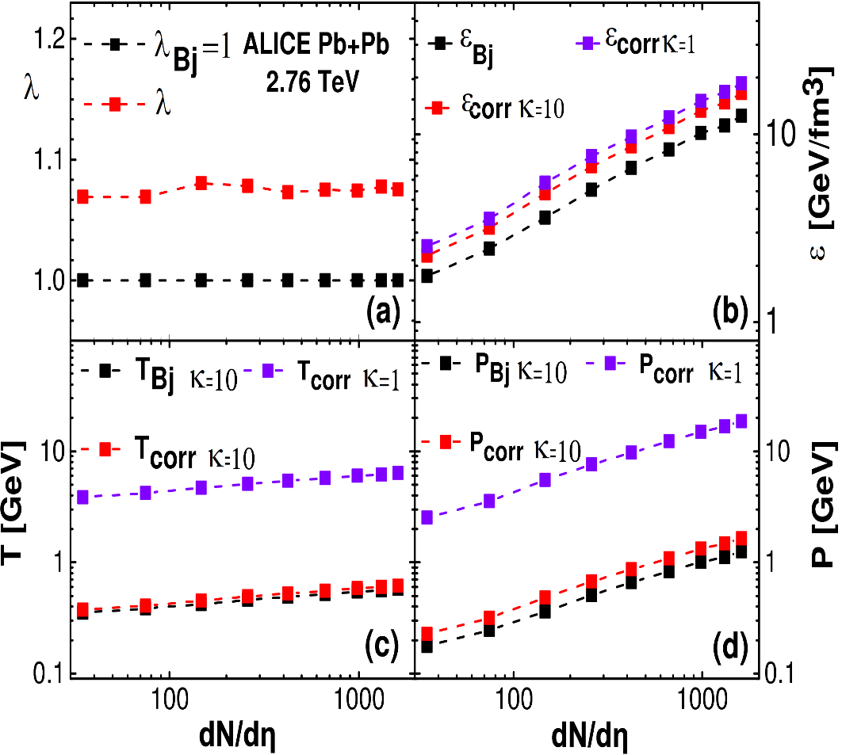
Energy densities in AA, RHIC to LHC
Effect of acceleration and equation of state
Large energy densities, well above critical

Slide 13
WHAT ABOUT PP COLLISIONS?
Can an sQGP created there as well?
Yes, depending on multiplicity

Slide 14
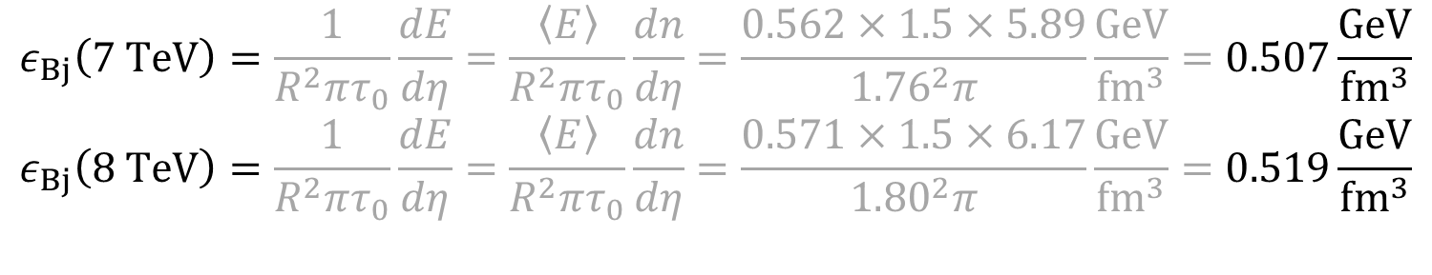
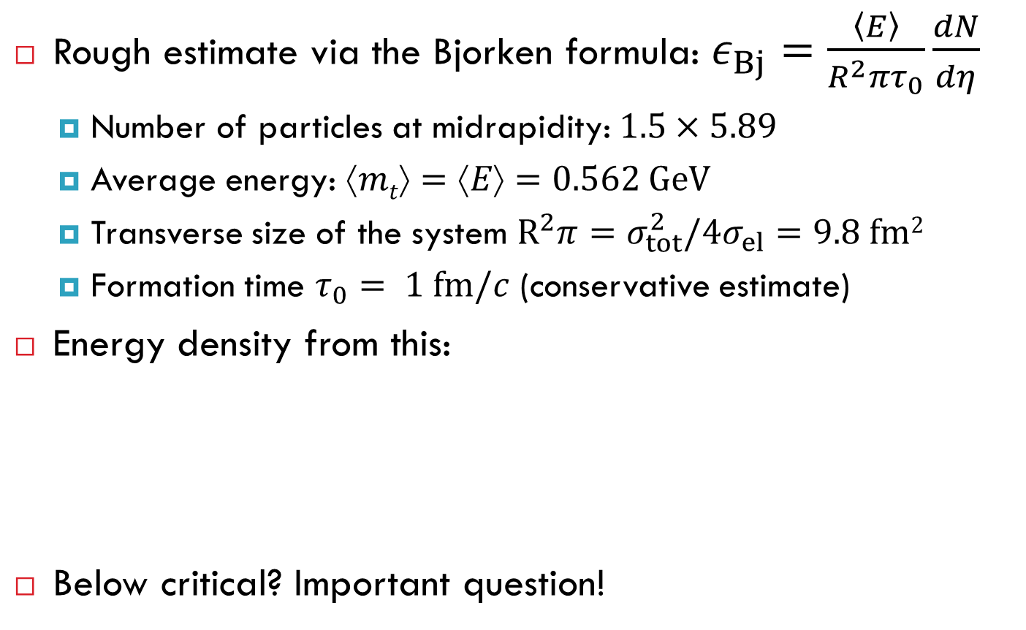
Initial energy density in pp at 7 TeV
Rough estimate via the Bjorken formula: $ε_{Bj}=\frac{\left\langle E\right\rangle }{R^{2}πτ_{0}}\frac{dN}{dη}$
  Number of particles at midrapidity: $1.5×5.89$
  Average energy: $↑mt=↑E=0.562 GeV$
  Transverse size of the system $R^{2}π=σ_{tot}^{2}/4σ_{el}=9.8 fm2$
  Formation time $τ_{0}= 1 fm/c$ (conservative estimate)
Energy density from this:
Below critical? Important question!
$$ε_{Bj}\left(7 TeV\right)=\frac{1}{R^{2}πτ_{0}}\frac{dE}{dη}=\frac{\left\langle E\right\rangle }{R^{2}πτ_{0}}\frac{dn}{dη}=\frac{0.562×1.5×5.89}{{1.76}^{2}π}\frac{GeV}{fm^{3}}=0.507\frac{GeV}{fm^{3}}$$
$$ε_{Bj}\left(8 TeV\right)=\frac{1}{R^{2}πτ_{0}}\frac{dE}{dη}=\frac{\left\langle E\right\rangle }{R^{2}πτ_{0}}\frac{dn}{dη}=\frac{0.571×1.5×6.17}{{1.80}^{2}π}\frac{GeV}{fm^{3}}=0.519\frac{GeV}{fm^{3}}$$

Slide 15
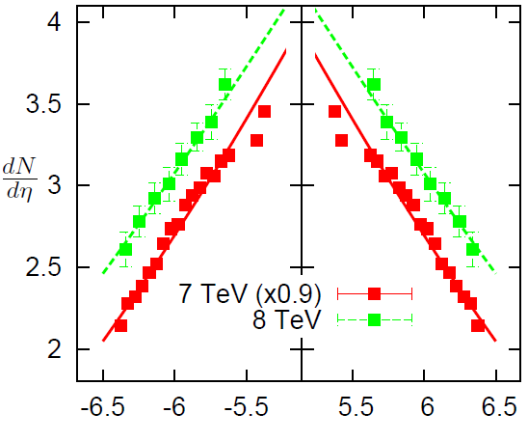
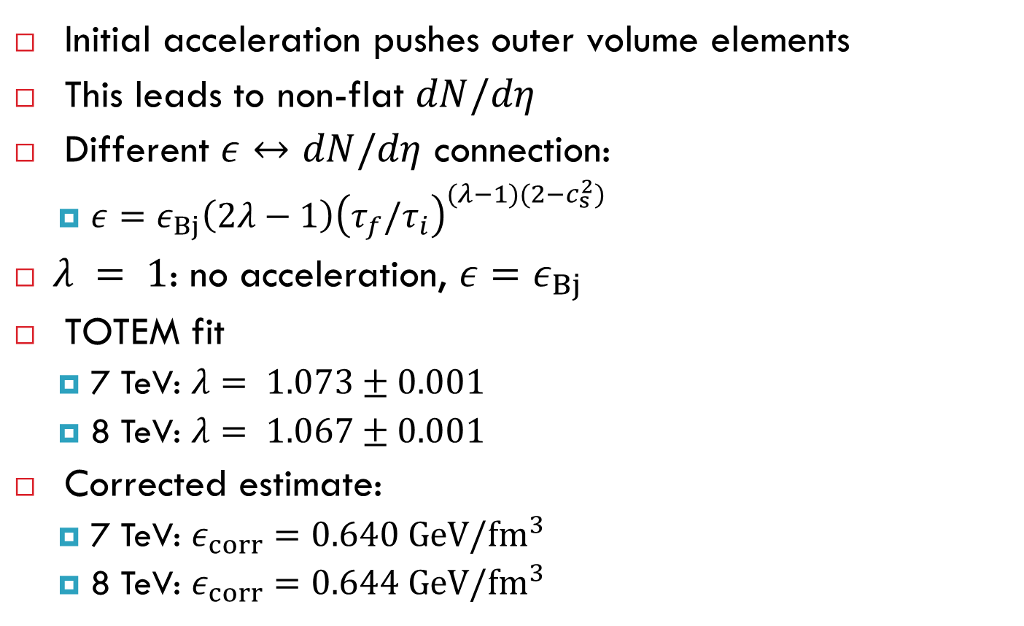
Correction from initial acceleration
Initial acceleration pushes outer volume elements
This leads to non-flat $dN/dη$
Different $ε↔dN/dη$ connection:
  $ε=ε_{Bj}\left(2λ−1\right){\left(τ_{f}/τ_{i}\right)}^{(λ−1)(2−c_{s}^{2})}$
$λ = 1$: no acceleration, ${ε=ε}_{Bj}$
TOTEM fit
  7 TeV: $λ= 1.073±0.001$
  8 TeV: $λ= 1.067±0.001$
Corrected estimate:
  7 TeV: $ε_{corr}=0.640 GeV/{fm}^{3}$
  8 TeV: $ε_{corr}=0.644 GeV/{fm}^{3}$
η

Slide 16
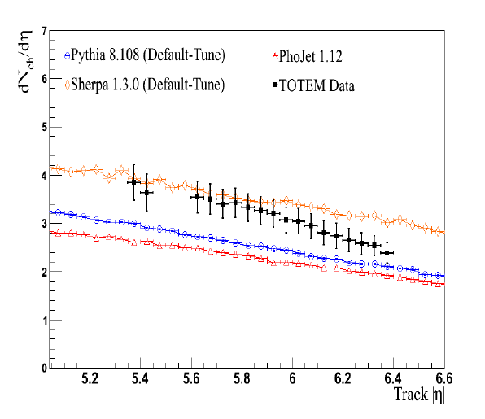
Comment: dN/dη @ LHC is not trivial
Not trivial for MC models
TOTEM Coll., EPL, 98 (2012) 31002

Slide 17
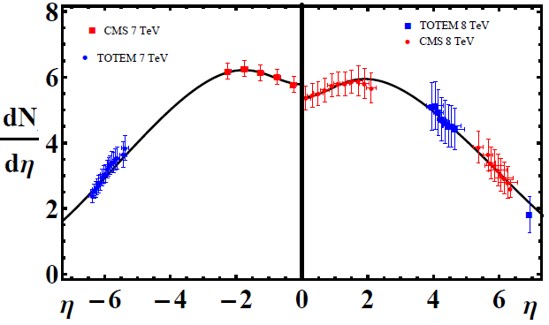

TOTEM & CMS data combined
7 TeV: $λ=1.076$, 8 TeV: $λ=1.066$
Very small change compared to „TOTEM only” fit
7 TeV:$ε_{corr}=0.645 GeV/{fm}^{3}$ (was 0.640)
8 TeV: $ε_{corr}=0.641 GeV/{fm}^{3}$ (was 0.644)

Slide 18
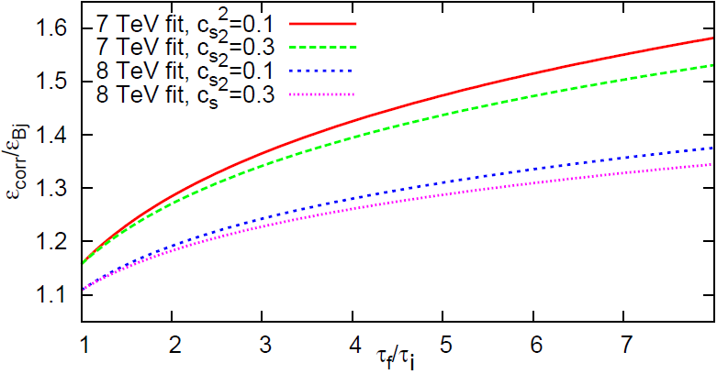

Dependence on initial time and c_{sound}
Recall the correction factor:
$ε_{corr}=ε_{Bj}\left(2λ−1\right){\left({τ_{f}}/{τ_{i}}\right)}^{(λ−1)(2−c_{sound}^{2})}$

Slide 19
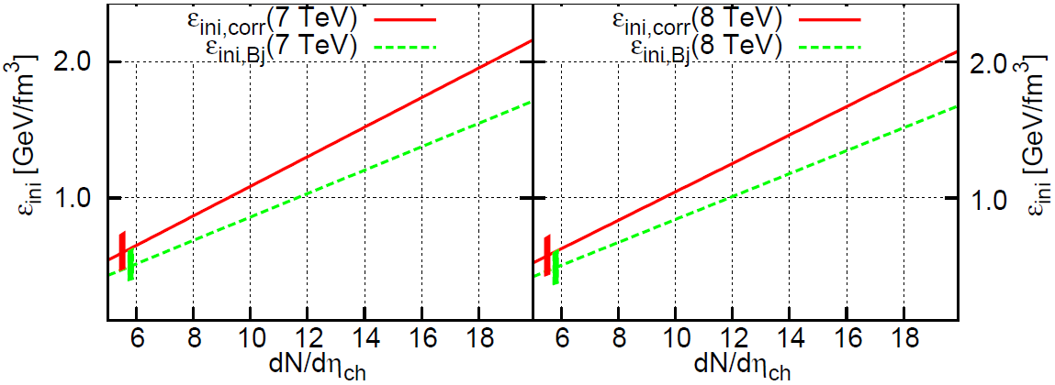

Dependence on multiplicity
Several multiplicity classes, 6-20, even 40-50 seen!
Initial energy density estimate above 1 GeV/fm³, if:
  Bjorken estimate: $dN_{ch}/dη>12$
  Corrected estimate: $dN_{ch}/dη>9$

Slide 20
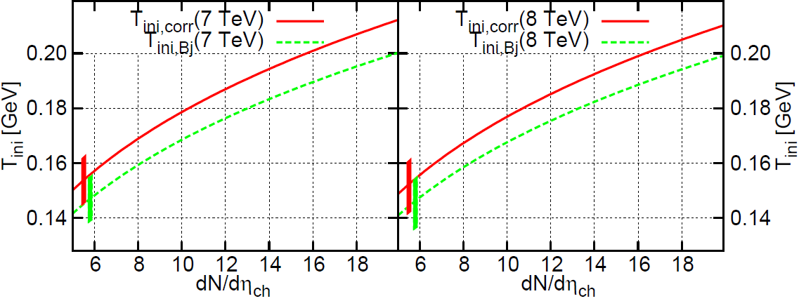

Initial temperature estimate
Temperature from $ε\sim T4$
Values above 150-170 MeV reached

Slide 21
Is it unprecedented? Consequences?
Bjorken and Landau worked out hydro for pp and pA
Success of hydro to describe h+p, with <n> = 7-8...
Phys.Lett. B422 (1998) 359-368
Bjorken: it is not hadrons that play billiard balling
If p+p is a complex system:
  Gamma/pi0 ratio
  Radial flow
  Elliptic flow, scaling
  HBT radii, scaling
  Low mass dilepton enhancement
  Direct photon enhancement
R_{AA} might not be the best measure: divide by length scale?

Slide 22
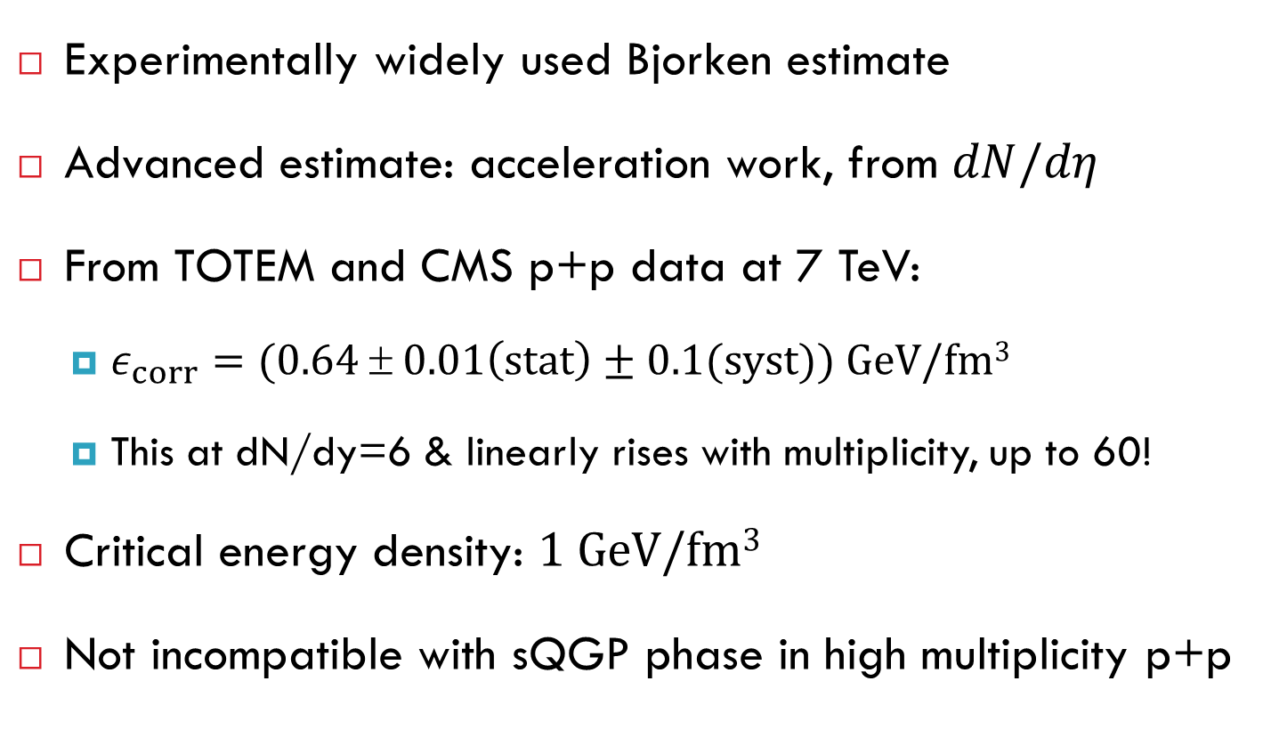
Summary
Experimentally widely used Bjorken estimate
Advanced estimate: acceleration work, from $dN/dη$
From TOTEM and CMS p+p data at 7 TeV:
  $ε_{corr}=(0.64 ± 0.01\left(stat\right)±0.1(syst)) GeV/fm3$
  This at dN/dy=6 & linearly rises with multiplicity, up to 60!
Critical energy density: $1 \text{GeV}\text{/}\text{fm}\text{3}$
Not incompatible with sQGP phase in high multiplicity p+p

Slide 23


Thank you for your attention
@

Slide 24
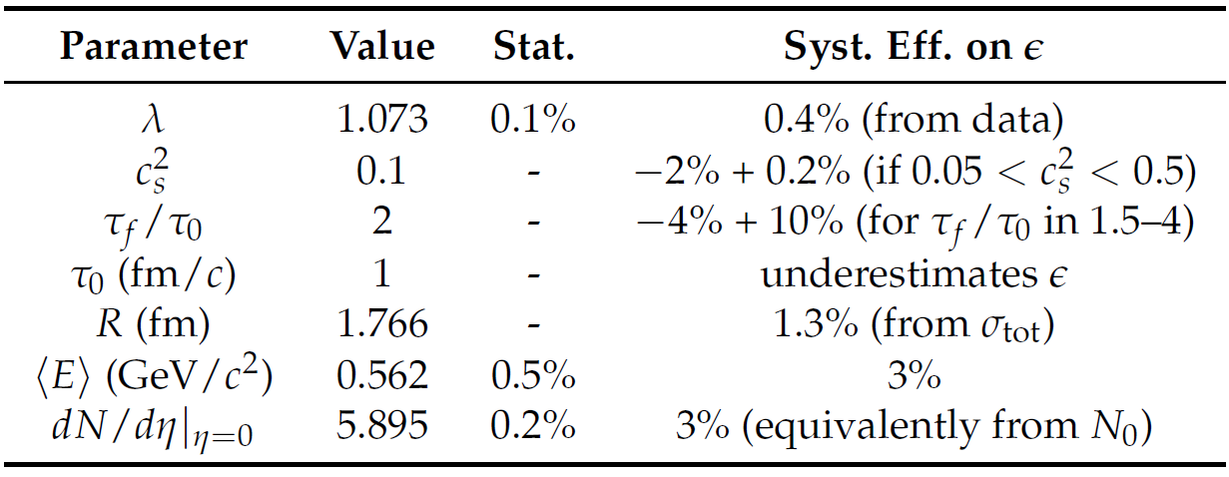

Systematic uncertainties
All sources of uncertainties at 7 TeV:
Conclusion at 7 TeV:
  $ε_{corr}= (0.64 ± 0.01{\left(stat\right)}_{−0.10}^{+0.14}(syst)) GeV/fm3$

Slide 25
Sources of uncertainties
For the correction factor ε/ε_{Bj} :
  Fit parameter λ
  Statistical error (from the data)
  Speed of sound c_{s}²
  Duration τ_{f}/τ_{i}
For the original Bjorken-estimate:
  Main uncertainty source: multiplicity at midrapidity dN/dy
  Area (if taken from cross-section): very precise
  Formation time
  Average transverse mass

