Slide 1
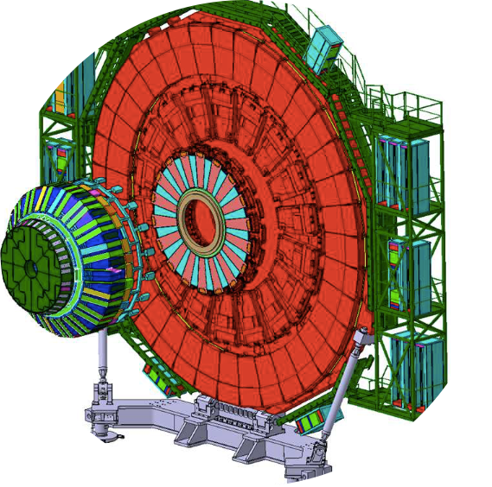
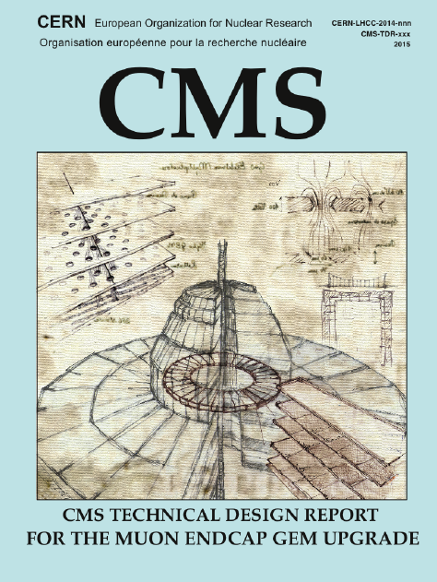
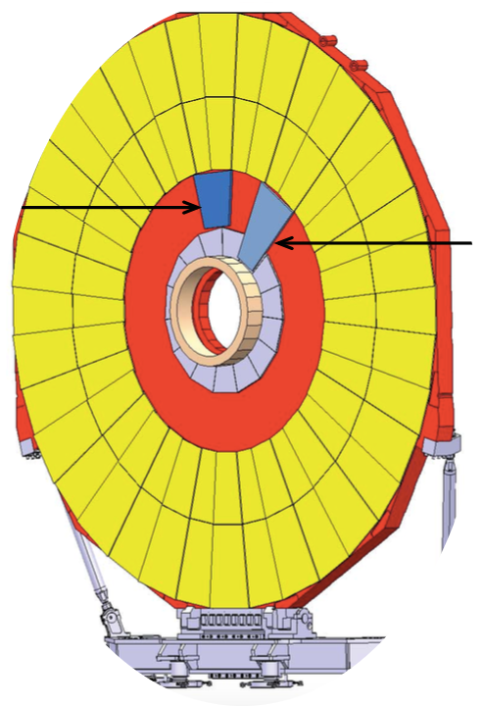
Micro-pattern Gaseous Detectors GEM for Upgrade of the CMS Muon System
Archana Sharma
CERN
Vilnius (Lithuania)
14-12-2016

Slide 2
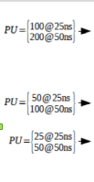
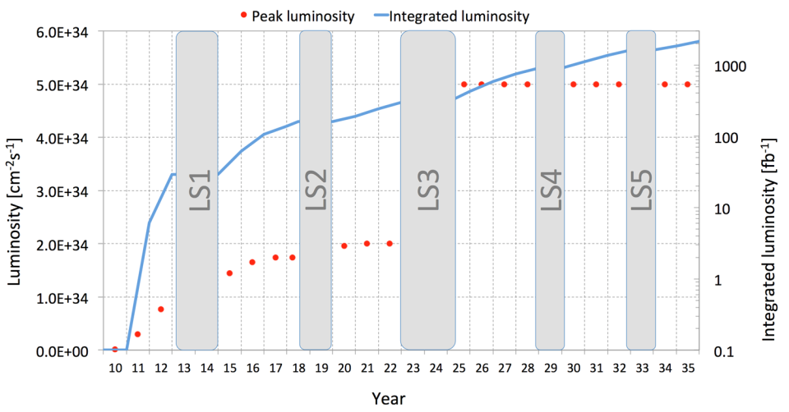
LHC future scenarios
Run 1
Run 2
Run 3
Run 4
>3000 fb⁻¹
PU ∼140-200
30 fb⁻¹
PU ∼40
300 fb⁻¹
PU ∼50
GE2/1, ME0, RPC installation
CMS Upgrade
Phase I Upgrade
Phase II Upgrade
LHC:
Run2:
L=1.7e34, PU 40→factor 2 increase wrt 2012
L=1x design lumi by LS2
Run3:
L=2x design lumi by LS3, and integrate 300fb-1 by 2022
Use PU=50 for upgrade studies
HL-LHC:
• Lumi-level at 5x design and integrate 3000 fb-1
PU=140 for upgrade studies

Slide 3
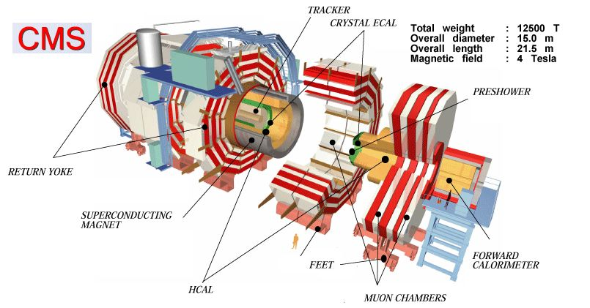
Compact Muon Solenoid

Slide 4
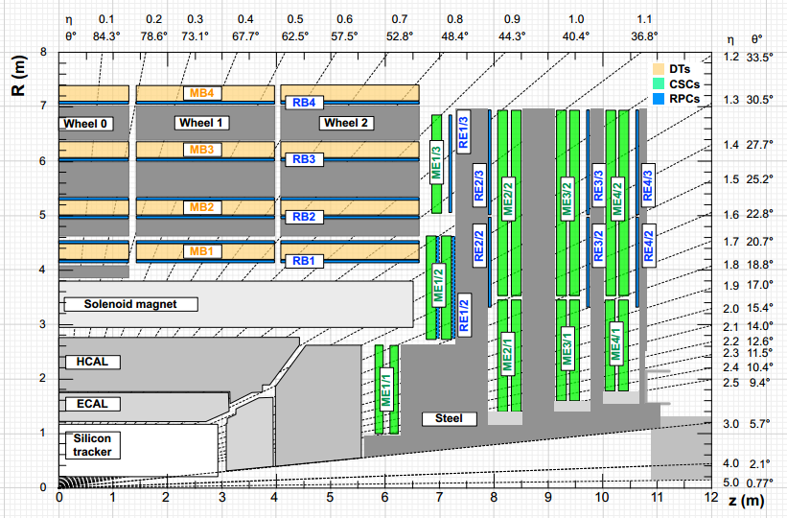
The CMS Muon system
Highly hermetic and redundant muon system, with at least four stations on a muon path in all directions
3 technologies:
Drift Tubes and Cathode Strip Chambers (for tracking and triggering);
Resistive Plate Chambers (for triggering).
  Eta coverage:
  |η|<1.6: 4 layers of CSCs and RPCs, DTs
  the |η|≥1.6: CSCs only;
GOALS:
robust, redundant and fast identification of the muons
Level-1 trigger has access to muon information only
Momentum measurement: the muon system is relevant for high pt muon (>100 GeV) and in the high η region (large lever arm of the muon system)

Slide 5
High η region upgrade with MPGD for Phase 2
Objectives:
  Sustain triggering at current trigger thresholds
  Increase offline muon identification coverage
  Maintain existing envelope by mitigating aging effects

Slide 6
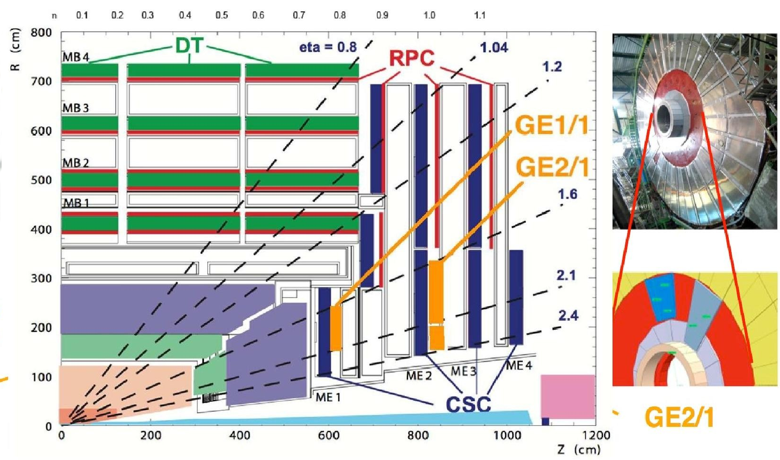
CMS: Gas Detector technologies
Drift Tubes (DT)
Central coverage: |η | < 1.2
Measurement and triggering
12 layers each chamber: 8 in φ, 4 in z
Cathode Strip Chambers (CSC)
Forward coverage: 0.9 < |η| < 2.4
Measurement and triggering
6 layers each chamber: each with φ, z
Resistive Plate Chambers (RPC)
Central and Forward coverage:
|η | < 2.1
Redundancy in triggering
2 gaps each chamber, 1 sensitive layer
Gas Electron Multiplier (GEM)
Fast triggering and precise tracking
Endcap coverage : 1.6 < |η| < 2.4
Phase-II

Slide 7
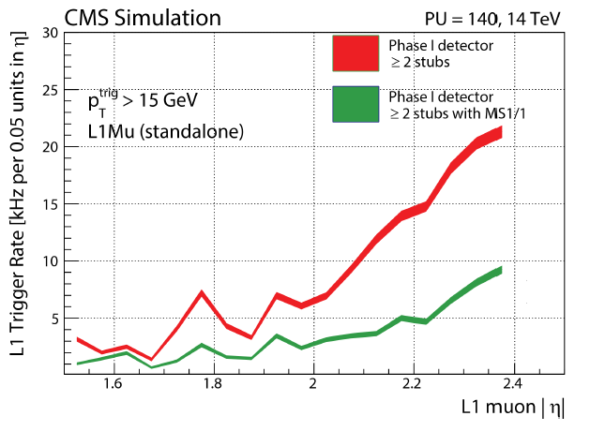
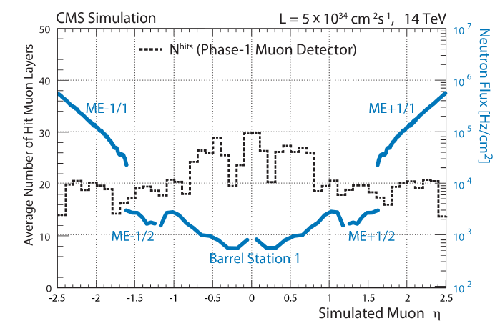
Forward Muon system : challenges
High luminosity can adversely affect muon system performance
The forward region |η|≥1.6 is very challenging
  Redundancy: the highest rates in the system vs fewest muon layers → few handles for the new Track finder postLS2 and for the track-trigger in HL-LHC
  Rate : in 10’s of kHz/cm² and higher towards higher eta and worse momentum resolution
  Longevity: Accumulated charge after many years of LHC operation
  Electronics: High occupancy/rate and latency increases exceed capabilities of the existing electronics
  Eta coverage:
  |η|<1.6: 4 layers of CSCs , RPCs, DTs
  the |η|≥1.6: CSCs only;
The issues affect already the postLS2 operations and will be exacerbated in Phase 2

Slide 8
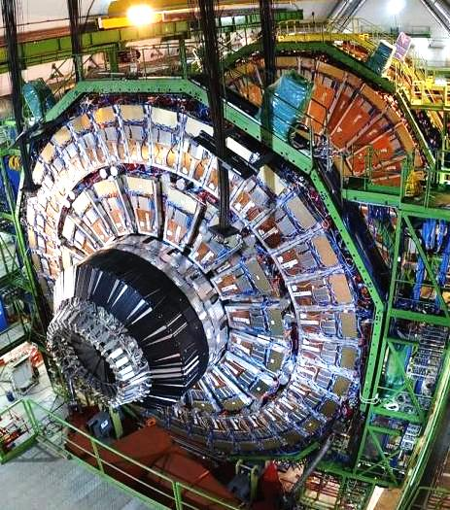
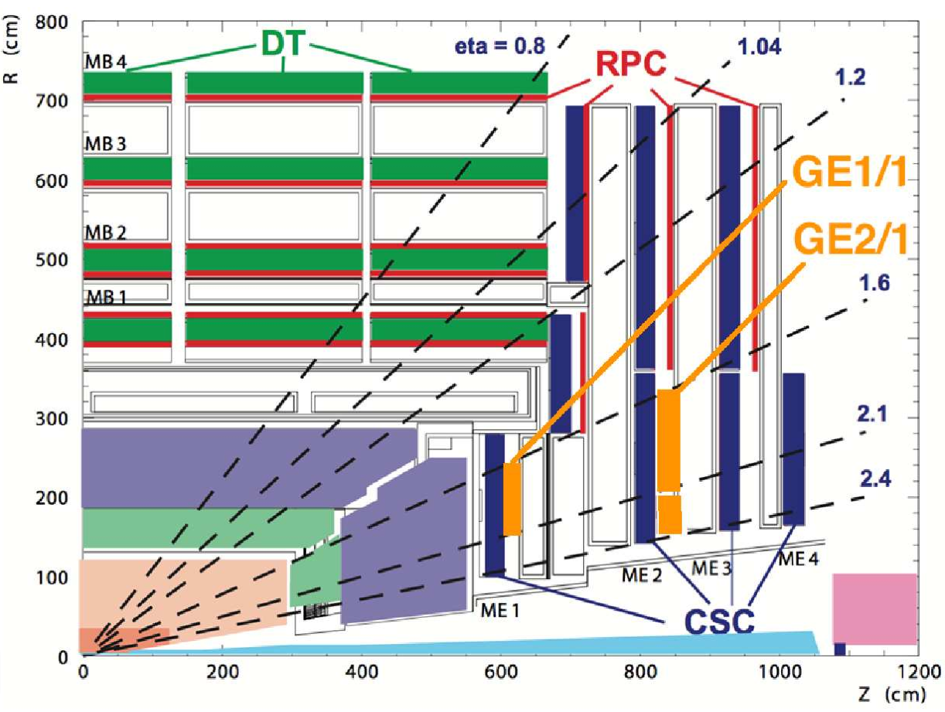
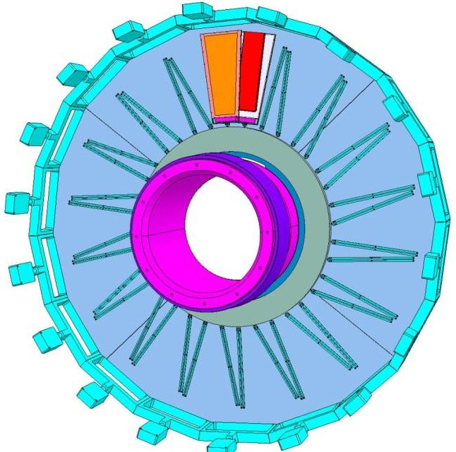
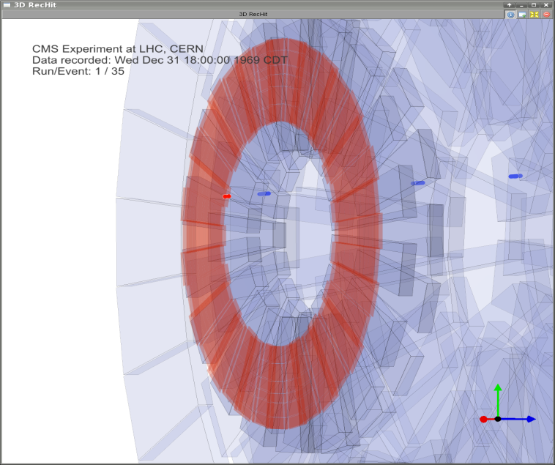
CMS GEM Endcap Chambers
The currently un-instrumented high-η RPC region of the muon endcaps presents an opportunity for instrumentation with a detector technology that could sustain the radiation environment long-term and be suitable for operation at the LHC and its future upgrades into Phase II: GEM Detectors
GE1/1
in nose of
first Endcap Yoke
GE1/1 simulation
geometry
CMS Detector

Slide 9
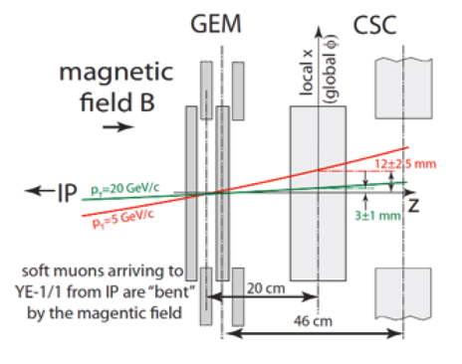
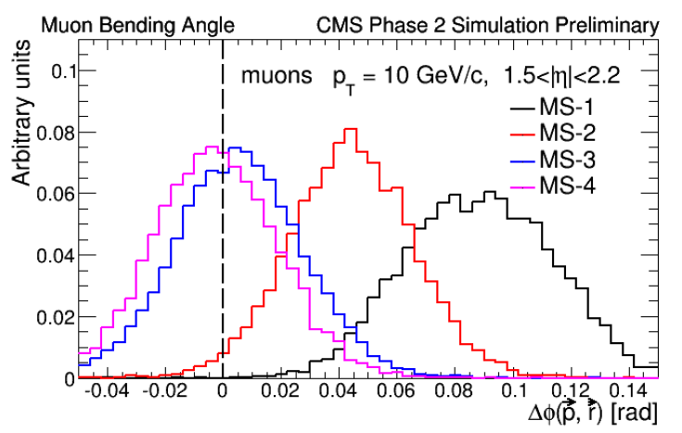
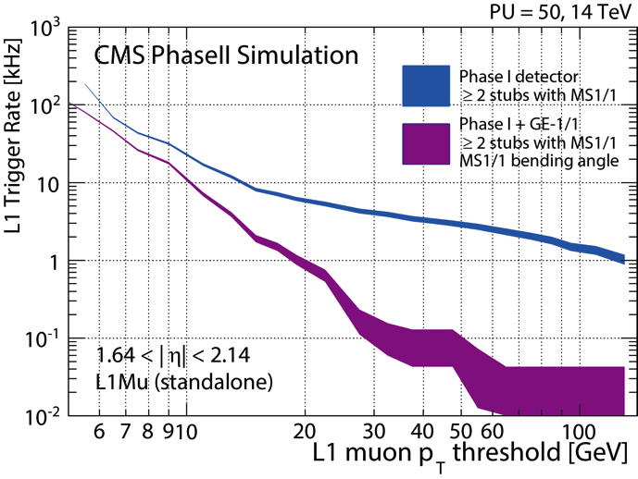
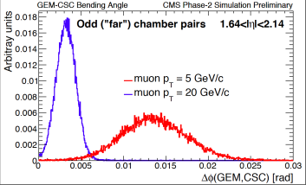
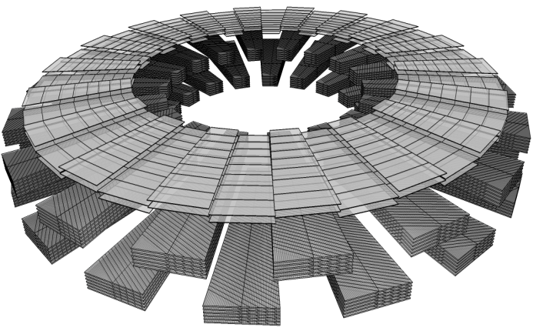
New handle: bending angle
Forward trigger for |η|>1.6 relies entirely
on the CSC system:
• Measurement driven by internal chambers:
least scattering, strong B field.
GEM detector in front of CSC can measure muon bending angle in magnetic field and add redundancy
Lever arm - trigger
X3 reduction
maintain 15 GeV online threshold, keep < 5 kHz rate, high efficiency

Slide 10
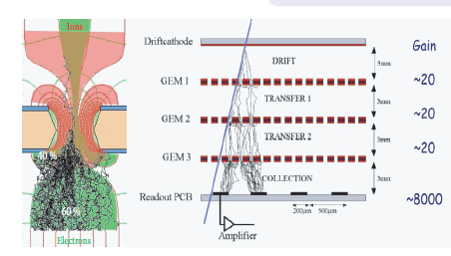
Detector requirements
10
• Maximum geometric acceptance within the given CMS envelope :
• Rate capabilities up to 100’s kHz/cm2 .
• Single-chamber efficiency > 98 % for mips
• Gain uniformity of 10% or better across a chamber and between chambers and no loss due to aging effect after 3000 fb⁻¹
• High spatial and good time resolution
GEM
Triple GEM
Micro-Pattern Gas Detectors (MPGD) due to their proven performance at HEP experiment (high rate capability and fine space resolution, high gain stability) are ideal tools. Dedicated studies for the large CMS detector:

Slide 11
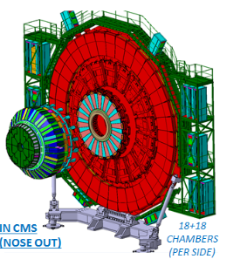
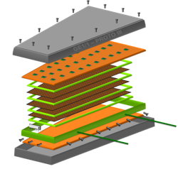
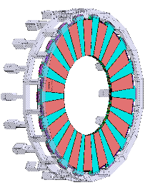
The GE1/1 design
11
  GE1/1 in high-η region 1.5<|η|<2.2
  10⁰ trapezioidal triple-GEM Superchambers
  Long (1.5<|η|<2.2) and short (1.6<|η|<2.2) version
  36 superchambers in each endcap
Muon
Endcap
Station 1
Chamber
GE1/1
Front-end
superchambers
10º
short
long
Installation in LS2

Slide 12
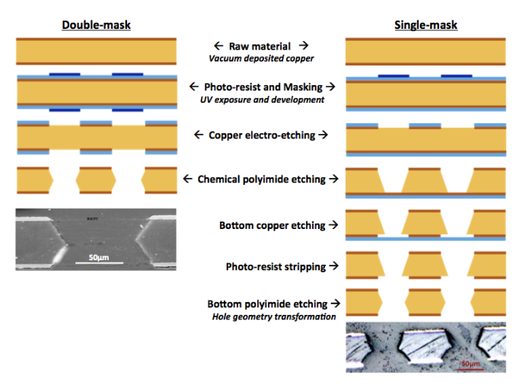
Challenge 1

Slide 13
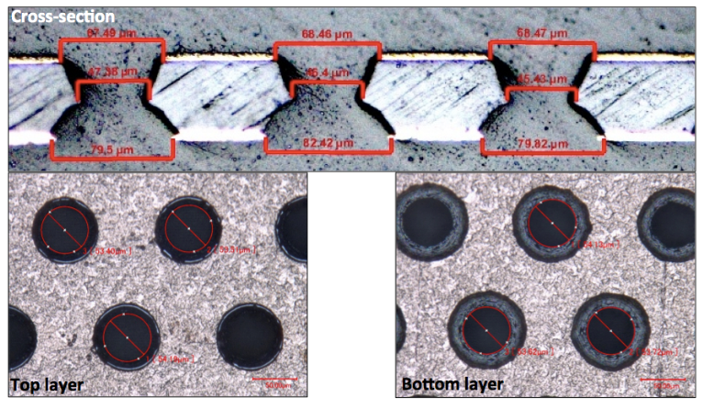

Challenge 1 ..

Slide 14
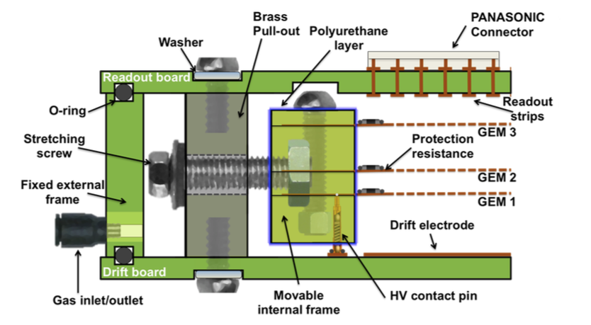
Challenge 2

Slide 15
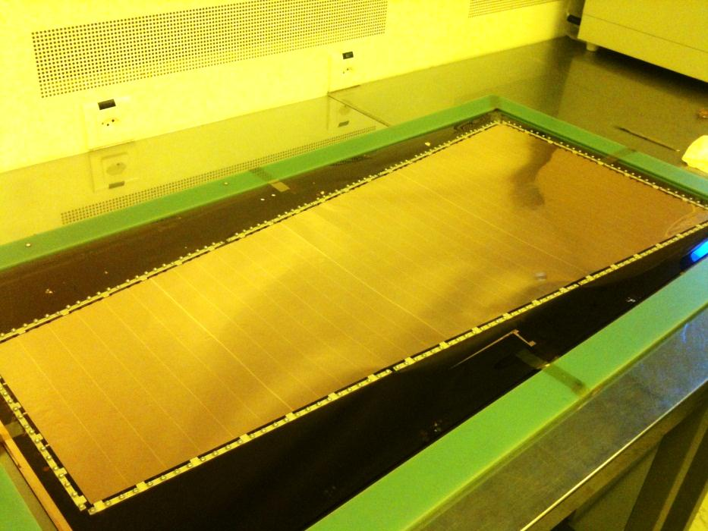
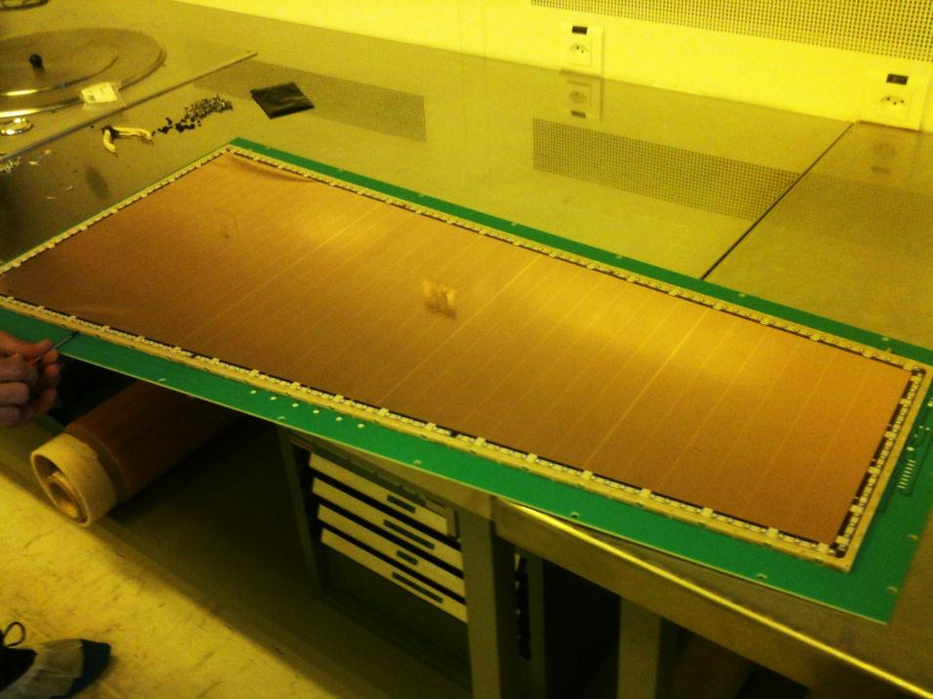
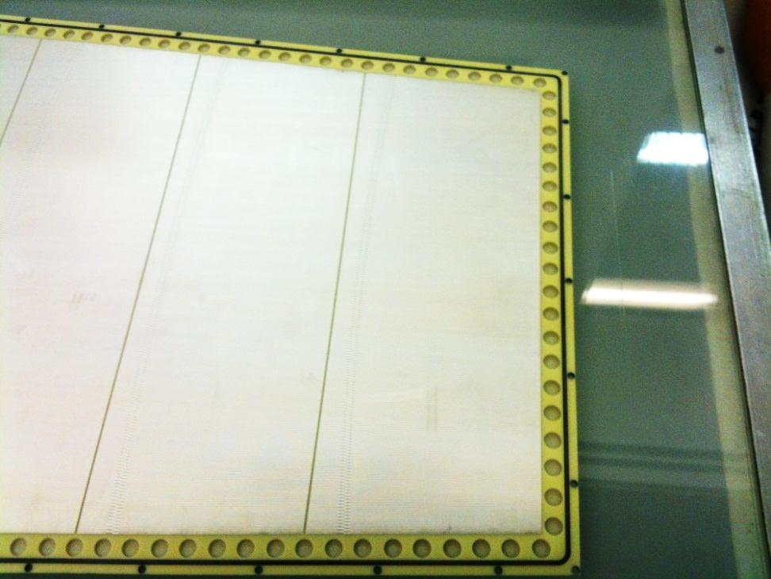
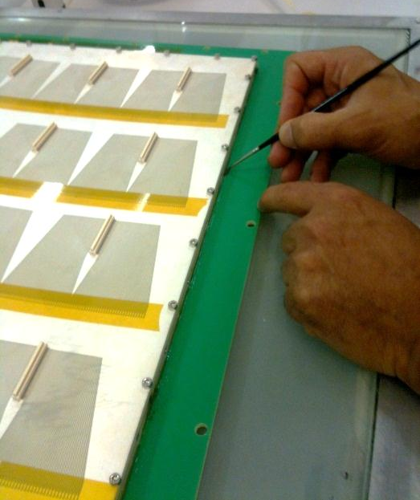
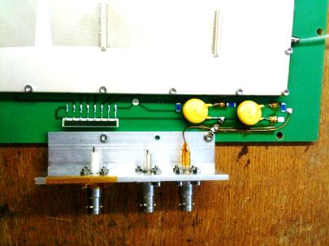
3rd GE1/1 Prototype:: NS2
No spacers in active volume
GEM foil with inner & outer frame
GEM foil in inner frame assembly
GEM tensioning
base pcb with drift electrode
Vias for strips sealed w/ kapton
compact HV divider
η-sector with
384 radial readout strips (12.4 cm long)
HV noise
filters
Chamber closed by
readout board with
Panasonic connectors
for frontend electronics
CERN
2012
Inside of readout board with O-ring seal

Slide 16
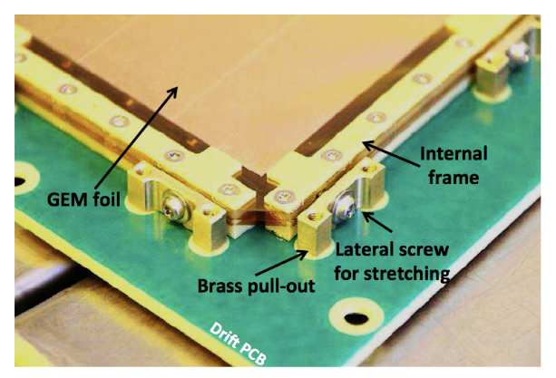

Slide 17
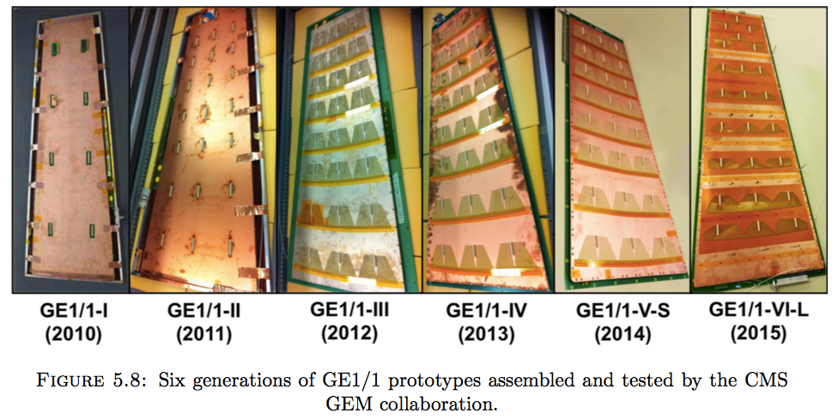
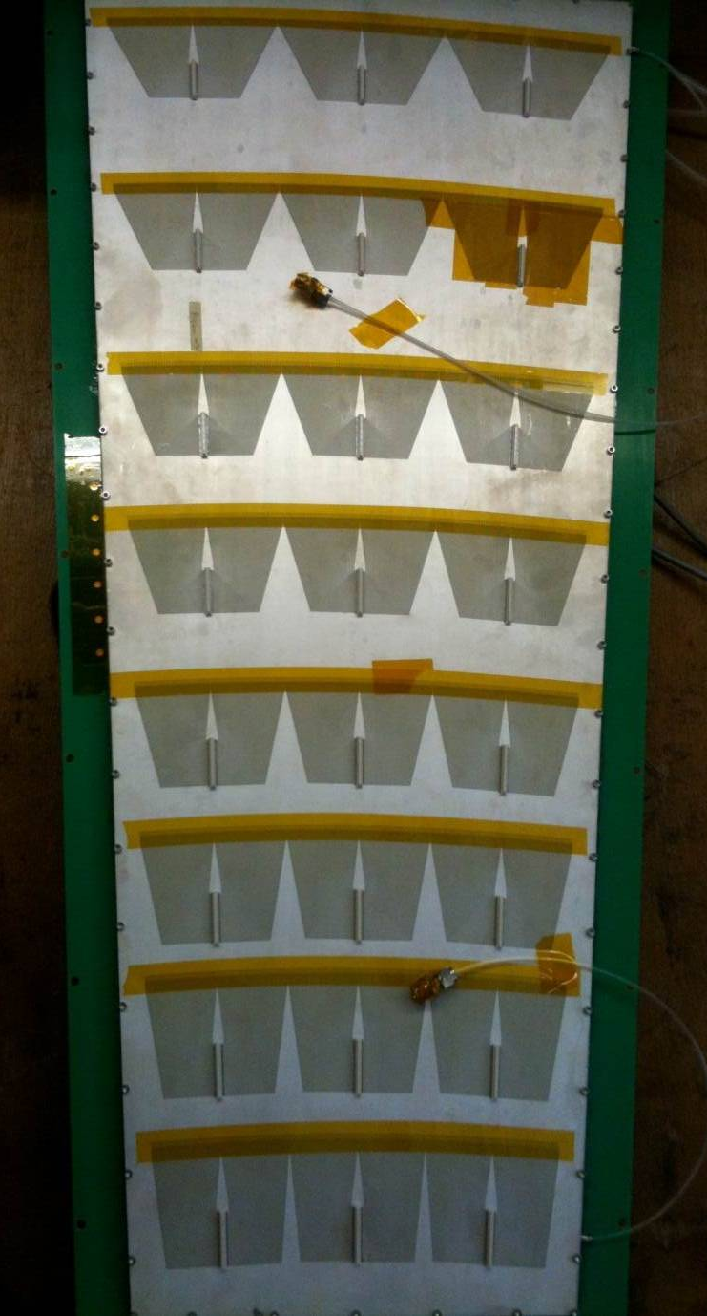
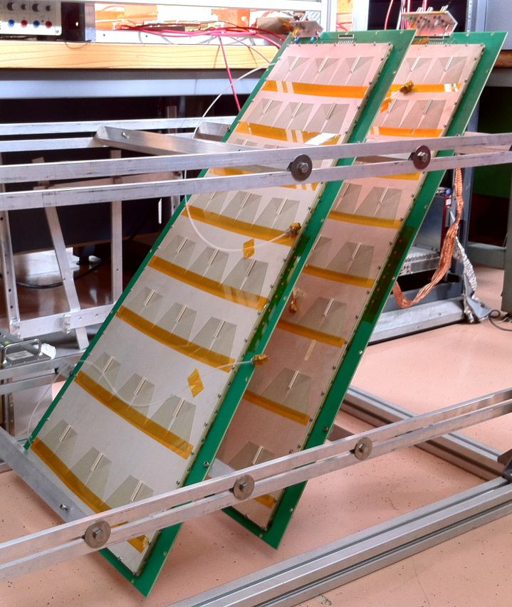
Full-size GE1/1 Detector Prototypes
GEM active area: 990 mm
× (220-445) mm
Single-mask technology
1D radial strip read-out with
3 × 8 × 128 = 3,072 channels
35 HV sectors
3/1/2/1 mm gap sizes
Gas mixtures:
  Ar/CO₂ (70:30; 90:10)
  Ar/CO₂/CF₄ (45:15:40;
  60:20:20)
Gas flow ≈ 5 l/h

Slide 18



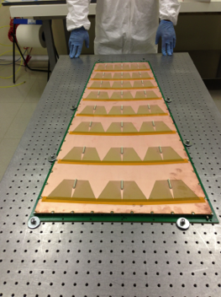



GE1/1 Project development
2010
2011
2012
2014
2014/2015
2010
2011
2012
2013
2014
2015
Generation I
The first 1m-class detector ever built but still with spacer ribs and only 8 sectors total.
Generation II
First large detector with 24 readout sectors (3x8) and 3/1/2/1 gaps but still with spacers and all glued.
Generation III
The first sans-spacer detector, but with the outer frame still glued to the drift
Generation IV
First detector with complete mechanical assembly; no more gluing parts together!
Generation V
Stretching apparatus that is now totally inside gas volume.
test beam campaign for final performance measurements.
Generation VI
Latest detector design; Optimized final dimensions for maximum acceptance and final eta segmentation.
Prototyping, DAQ &trigger and QC procedure of detectors. First prototype of VFAT3
electronics&chamber prototype installation-
Slice and trigger commissioning.
Production GE1/1 chambers with final electronics
2015
YETS 2016
2016/17
2017/18
2018/19
Full-production of
chambers and electronics started
Full installation of GE1/1 with final electronics
18

Slide 19
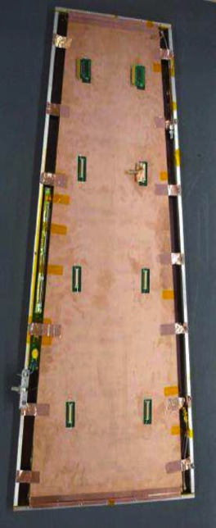
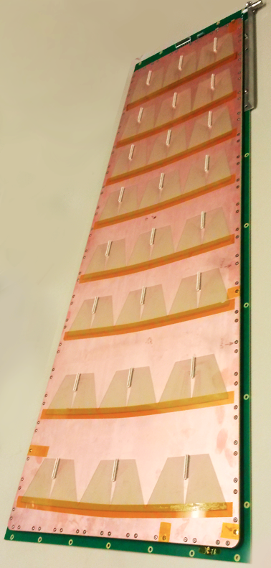
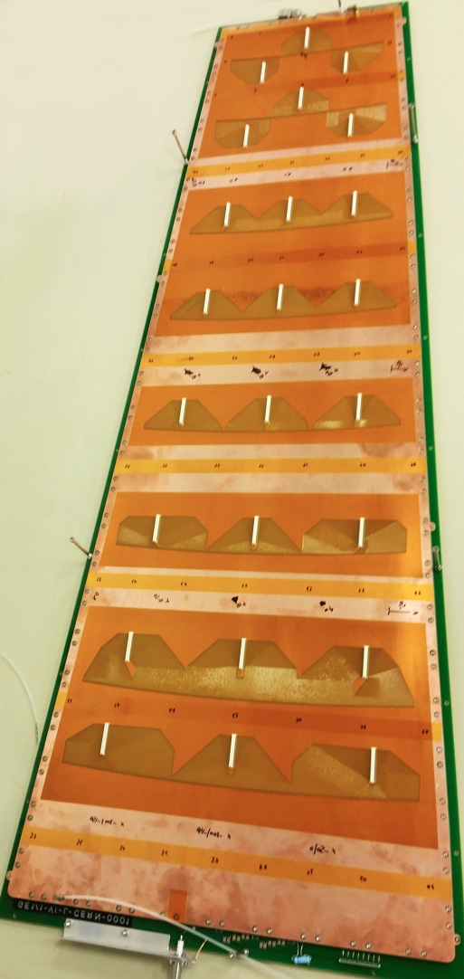
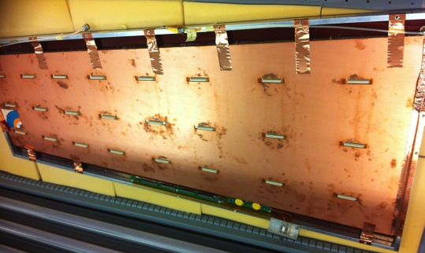
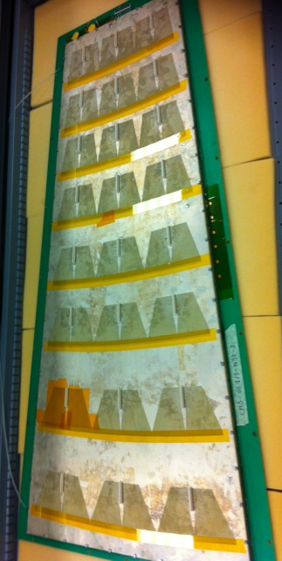
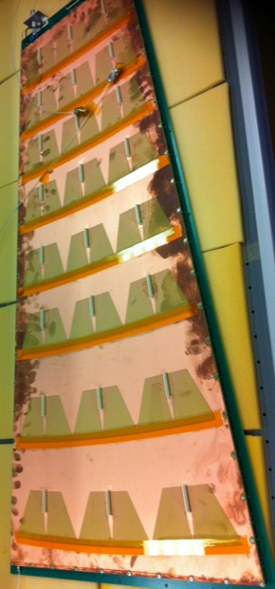
CHAMBERs
Project
Approved
30.9.2015
2010 2011 2012 2013 2014 2015
R&D phase
Toward production phase
TDR
GE1/1-I
-> first 1m-class GEM detector ever built
-> single-mask technology
-> 99x(22-45) cm²
-> 1024 readout channels
-> gap config. 3/2/2/2
-> use of spacer grid and glue
GE1/1-II
-> Optimization of the electric field configuration
-> single-mask technology
-> 99x(22-45) cm²
-> 3072 readout channels
-> gap config. 3/1/2/1
-> use of spacer grid and glue
GE1/1-III
-> first use of the self-stretching technique
-> single-mask technology
-> 99x(22-45) cm²
-> 3072 readout channels
-> gap config. 3/1/2/1
-> No spacers but glue on the external frame
GE1/1-IV
-> Optimization of the mechanics and assembly
-> single-mask technology
-> 99x(22-45) cm²
-> 3072 readout channels
-> gap config. 3/1/2/1
-> No glue/no spacers
GE1/1-V
-> Optimization of the mechanics
-> stretching apparatus inside the gas volume
-> single-mask technology
-> 99x(22-45) cm²
-> 3072 readout channels
-> gap config. 3/1/2/1
-> No glue/no spacers
GE1/1-VI
-> Optimization of the mechanics
-> single-mask technology
-> design for long and short detectors
-> 99x(22-45) cm²
-> 120x(20-50) cm²
-> 3072 readout channels (new mapping)
-> gap config. 3/1/2/1
-> No glue/no spacers

Slide 20
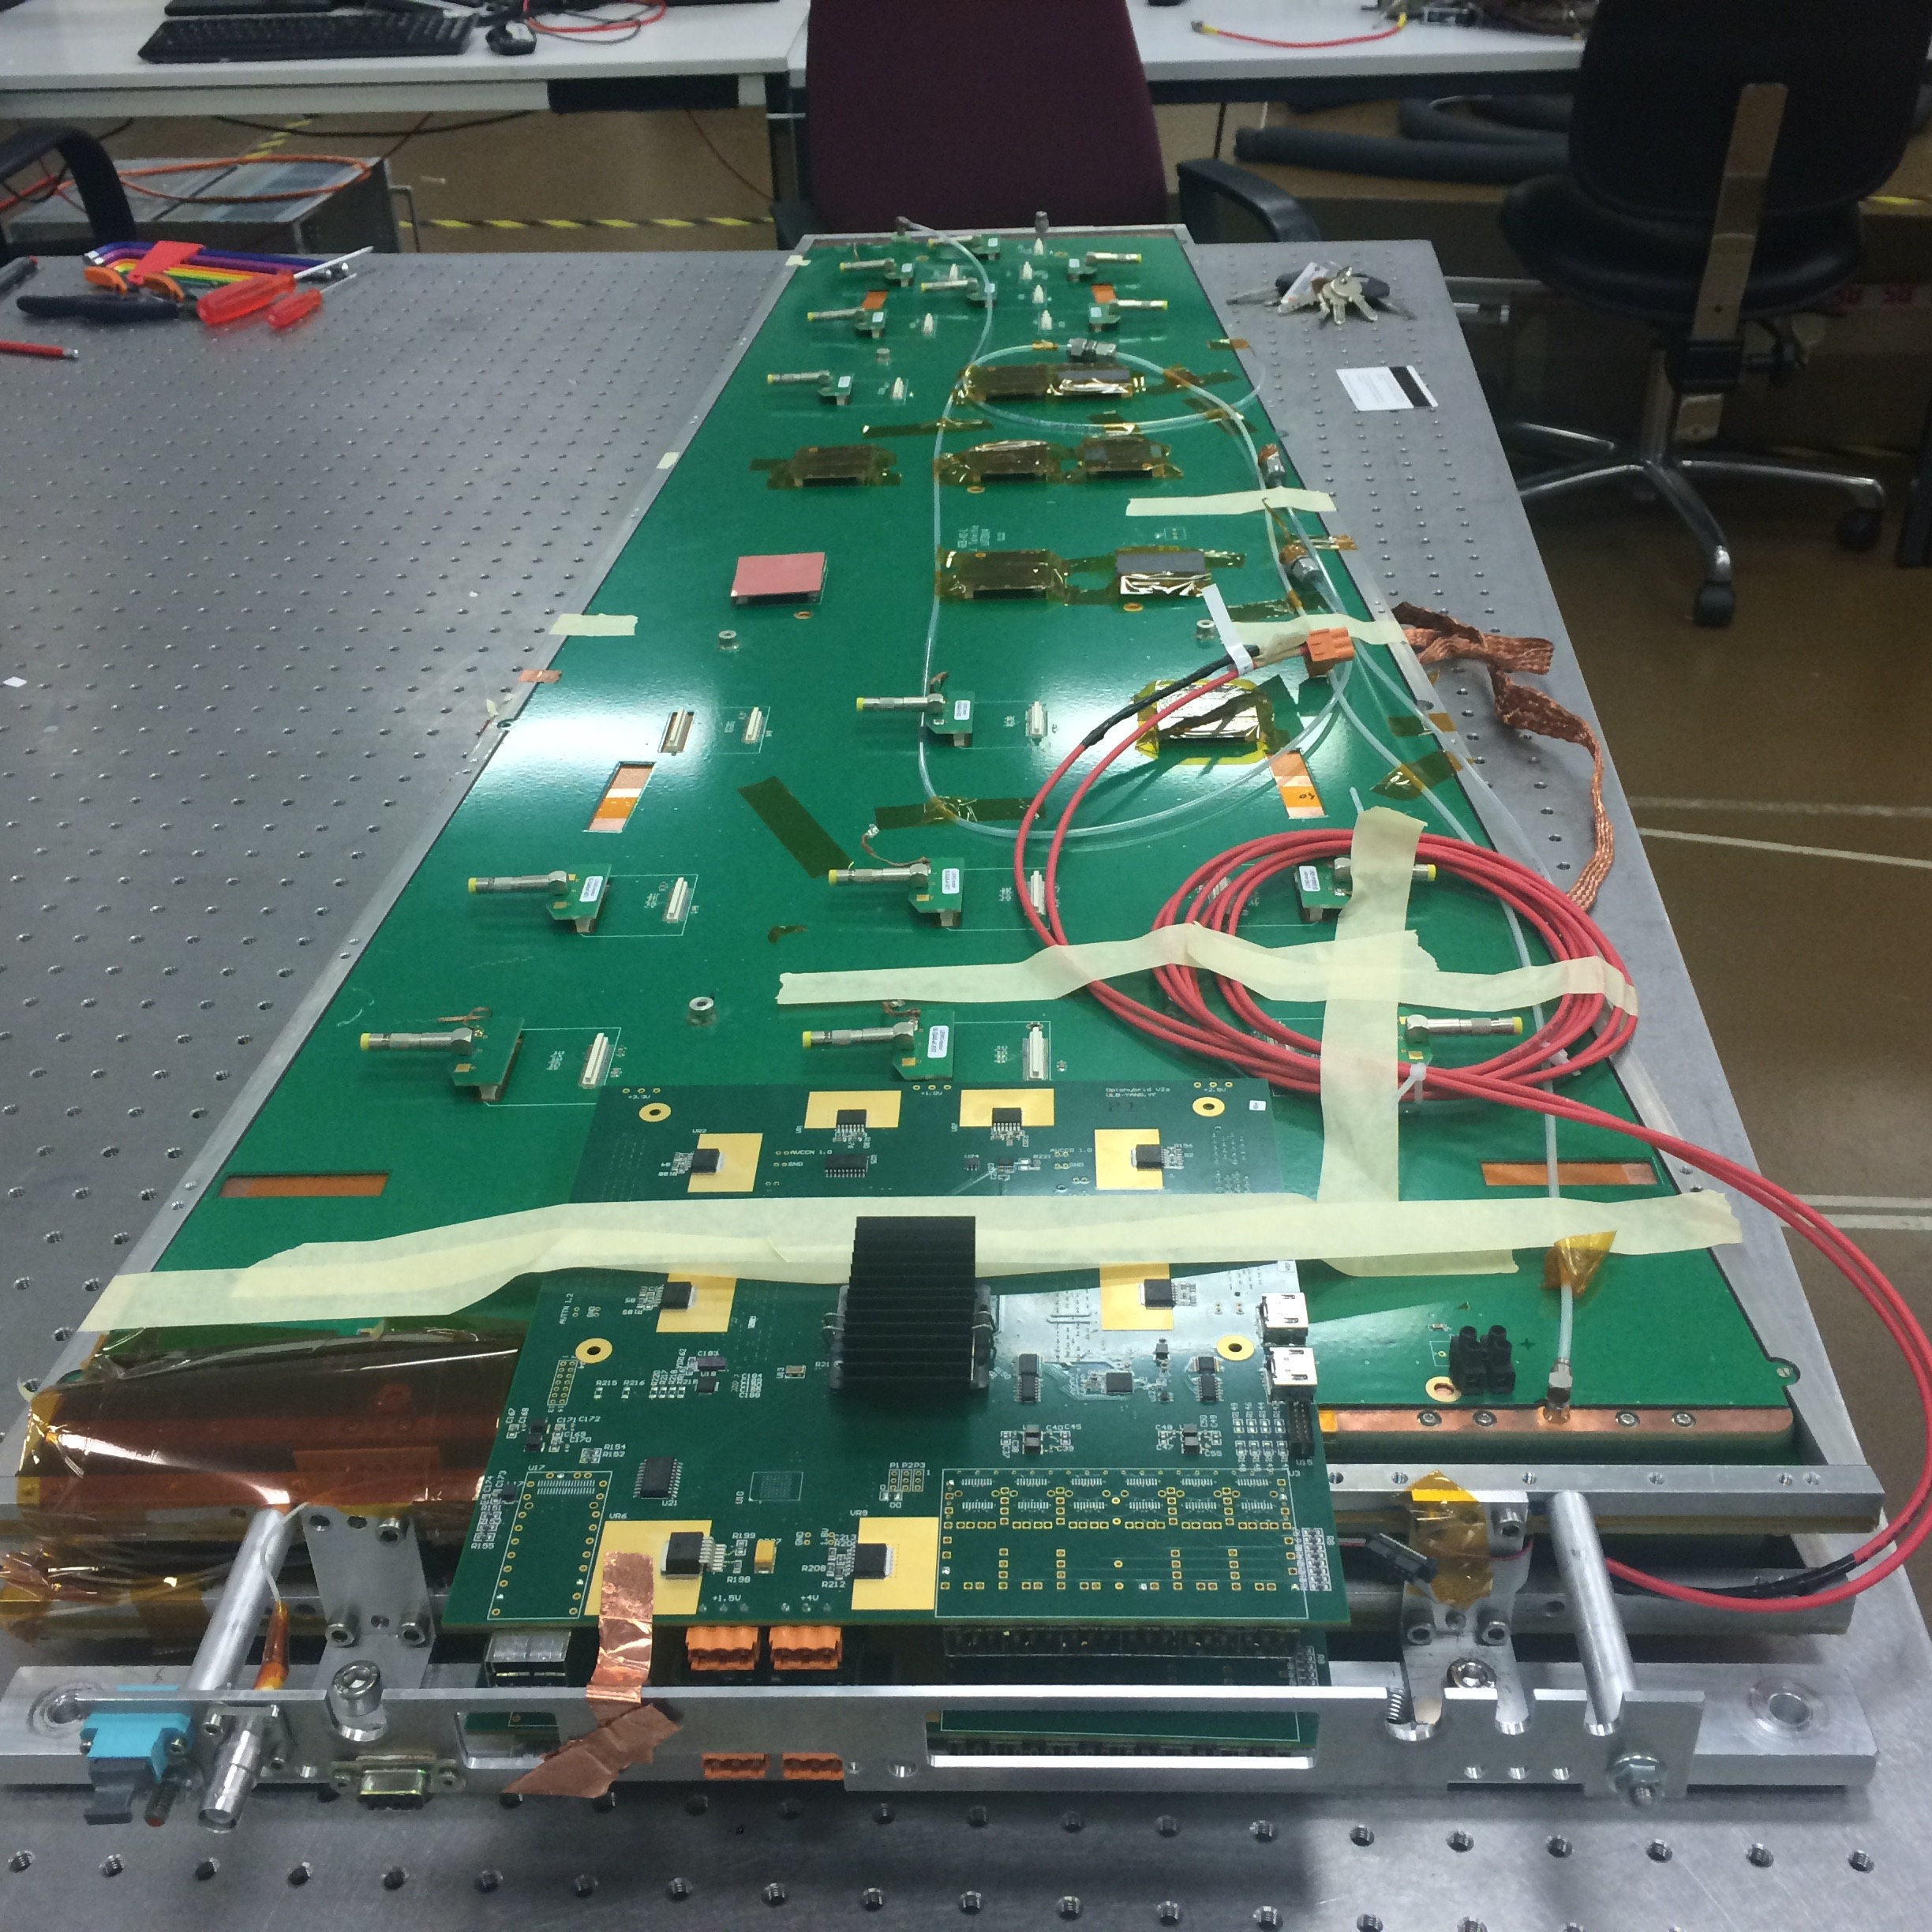
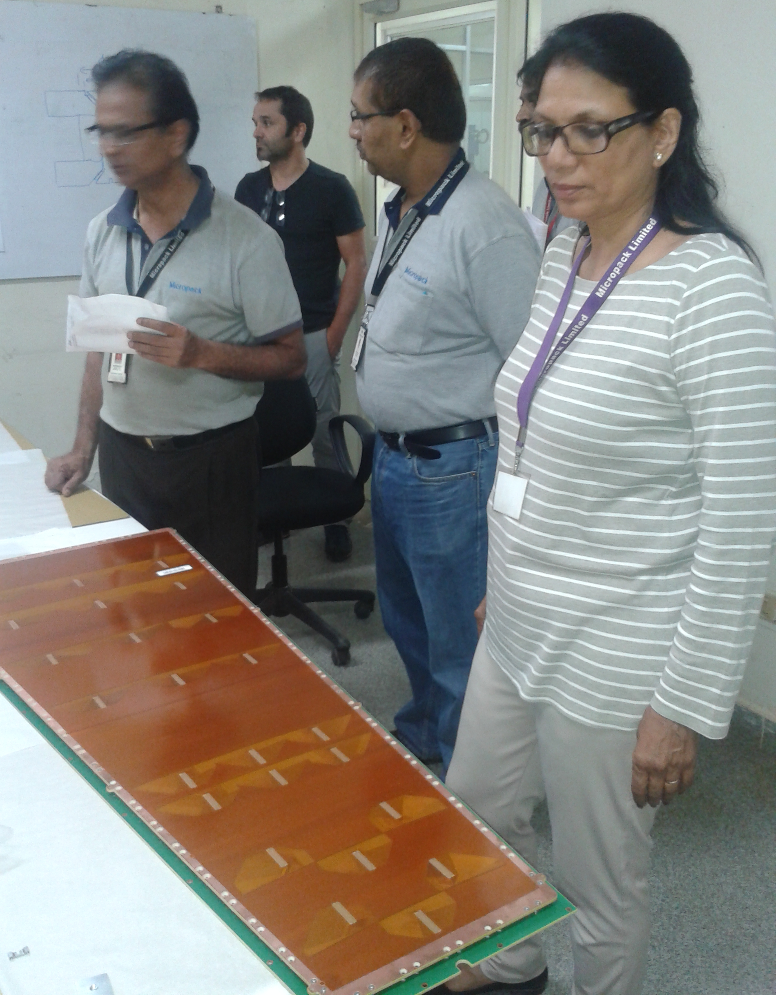
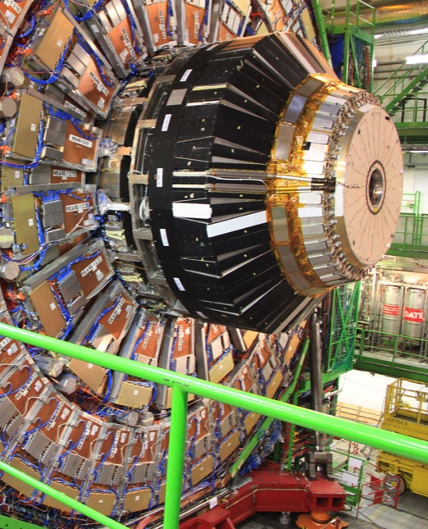
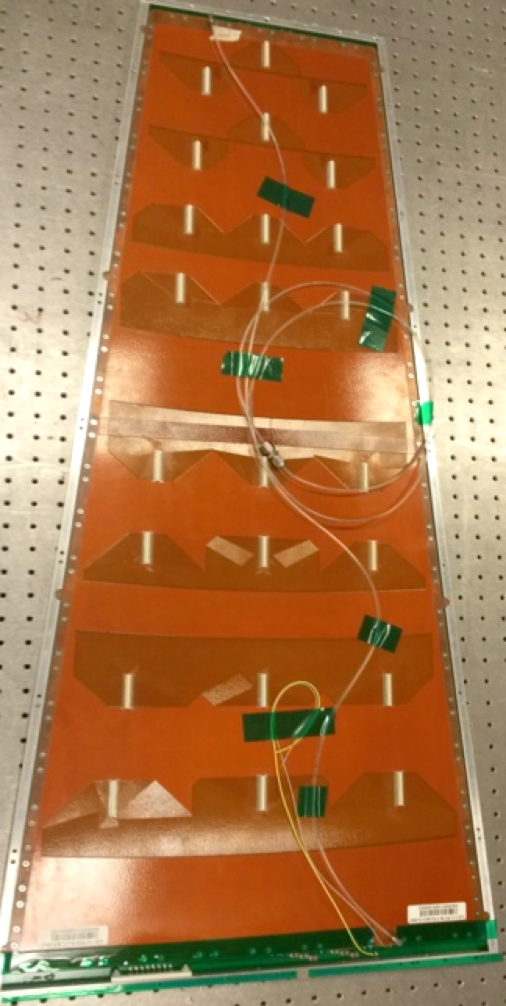
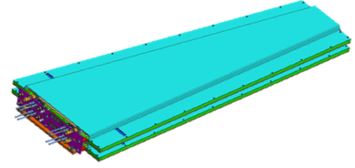
To Super CHAMBERs
First SC
2016 2017 2018 2019 2020
Slice test installation
Production phase & installation
GE1/1-VII (slice test)
-> Optimization of the mechanics
-> Optimization of the grounding
Optimization of the HV distribution
-> single-mask technology
-> 99x(22-45) cm²
-> 120x(20-50) cm²
-> 3072 readout channels
-> gap config. 3/1/2/1
-> No glue/no spacers
GE1/1-VIII (LS2)
-> External (w.r.t . CERN) production sites certification and chamber components shipment
-> GE1/1 chamber assembly and certification
-> Super chamber mechanics optimization
-> First test with final front-end electronics
-> GE1/1 super chamber assembly and certification with final front-end electronics
-> First batch of Superchamber shipped to P5
GE1/1 super chambers ready in P5 for installation
Installation and cabling of all super chambers
Commissioning in situ with cosmic muons
Super chamber characterization in situ with cosmic muon
First data with LHC beam

Slide 21
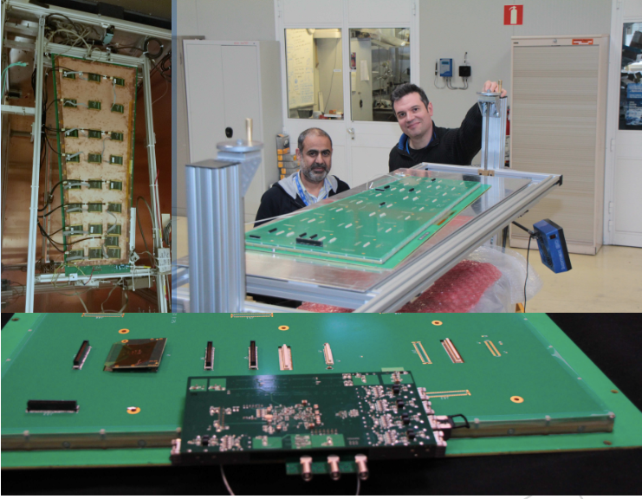
￼
￼

Slide 22
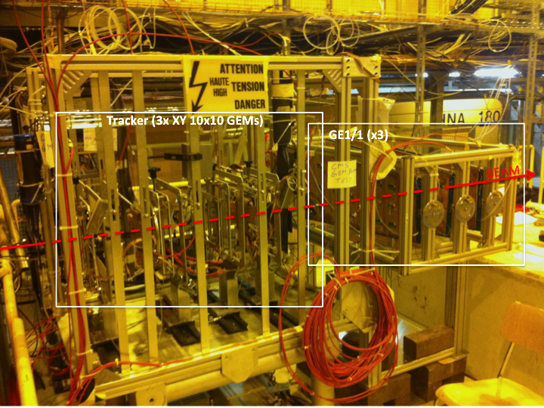
Beam Tests at CERN and Fermilab
CMS GEM GE1/1 - 3V5&2V6 :
CERN SPS
Beam Test 2014-16

Slide 23
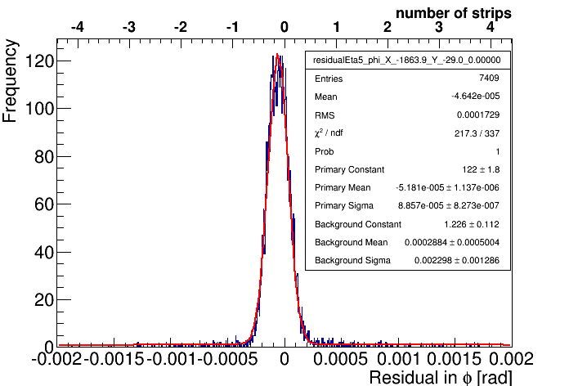


Resolutions for CMS GEM detector at eta sector 5
σ= 86μrad
σ= 111μrad
VFAT test beam
86 (111) μrad or 160 (207) μm
P. Barria

Slide 24


GEM GE1/1 Activity at the GIF++

Slide 25

Slice test in YETS2016
4 super chambers in slots 1,2,35, 36 on YE-1
Installation of 4 SuperChamber during 2016 YETS
DAQ system will be integrated in CMS DAQ;
combined CSC+GEM trigger
Operation procedure implemented
reconstruction included in official CMS software;
  validation done with standard tool;
  background and noise rate included in simulation.
INSTALLATION WINDOW : Early January (10.1.2017 – 31.3 March 2017
Motivations:
INSTALLATION WINDOW :LS2
GE1/1 Week 15 onwards – until Ready for beam minus 30 weeks)
gain integration experience
reduce the GEM commissioning period:
- Back-end electronics installed and commissioned in advance of the installation of the FE electronics.
- All components (Incl. detectors) will have been qualified beforehand at the TIF
trigger commissioning and performance check “CSC-TF”
background measurement.
opportunity to cross-check with data what expected by simulation.

Slide 26



GEM Detector Production
Slice Test
Assembled 2 of 8 detectors for P5!
Commissioning of quality control test stands on-going
Price inquiries for the LS2 chambers components are running
Slice Test chamber assembled

Slide 27



Toward the full production
Training and production site qualification

Slide 28





CMS: Industrialization of GEM Foils
40x40 cm2
Mecharonics: Korea M.Choi , I. Park
Completed:
Technology transfer license agreement with CERN signed
Foils made
Detectors made
Tests ongoing
Micropack : India
L. Pant
P. Menon
40x40 cm2
Tech Etch Florida USA : Collaboration with B. Surrow & M. Hohlmann
A. Sharma 22092015

Slide 29





Production site readiness
6 production sites are ready for final production, all have assembled GE1/1-IV prototypes , QC procedures have been initiated
Luigi Benussi
Brian Dorney
Michele Bianco
Many others !!
Delhi University
Site Visits
Scheduled
SINP
Panjab University
Chamber
Production Sites
QC Sites
https://www.youtube.com/watch?v=Ssuqh5GAVZ4

Slide 30

QA and QC:

Slide 31










CMS GE1/1 Electronics System
VFAT2
VFAT3 front-end ASIC development
MP7
GEM Electronic Board (GEB)
24 VFAT3
FPGA performs “concentrator” and drives the optical link @ 3.2Gbps.
FPGA programming and timing via the GBT.
Data PATH
Full granularity
(non zero suppressed)
1GBT for 8 VFATs
“s” signals
@ 320Mbps
μTCA
AMC13, MCH
Opto-Hybrid (OH)
E-links @ 320Mbps
FPGA: Concentrator
320Mbps
3.2Gbps
GBT
GBT
GBT
GBT
4.8Gbps
3.2Gbps
TMB
Trig data
(encoded)
GBT
uTCA
Trigger
The control, readout and power to/from the VFAT3 hybrid are delivered via electrical signals (E-links) running through the GEB to the opto-hybrid.
Versatile Link
Use of many common developments such as GBT, Versatile Link, μTCA backend

Slide 32

904: GE1/1 : Integration

Slide 33



Power Budget and Cooling
The GE1/1 Super-chamber will take cooling from the RBX loops. It will give an negligible impact to the cooling system in the YE1
The cooling circuit is designed such to provide direct thermal contact with all heat sources in the GE1/1 chamber.

Slide 34

904: GE1/1 : Integration
Alignment sensors
GE1/1 inside
The cooling box
Andrey Marinov
Zoltan Zillasi
ME1/1
GE1/1 Setup for VFAT and GEB tests.

Slide 35


Cooling Tests Ongoing
In CMS
The physical space of the GE1/1 Installation slots in YE1 is very compact.
No air flow or convection can be used for evacuating the heating power of the detector and the electronics.
In b 904
The GE1/1 chamber is placed in wooden box with cover to stop any airflow. It should simulate the same ambient conditions as it will be in CMS
The flow of the water trough the cooling pipe will be the same as in CMS – 2liters per minute.

Slide 36





Integration into CMS
Four superchambers in
their final position
on endcap yoke
Installation sequence:
Superchamber
(Two Triple-GEMs)
A. Conde Garcia
Mounting on yoke disk

Slide 37





Trial Installation in CMS

Slide 38
High η region upgrade with MPGD for Phase 2
Objectives:
  Sustain triggering at current trigger thresholds
  Increase offline muon identification coverage
  Maintain existing envelope by mitigating aging effects

Slide 39


ME0 requirements and technical choices
Detector requirement:
Multilayer structures
High rate capability O(MHz/cm²)
time resolution for triggering
No green house gases
Good spatial resolution O(100 μm) for tracking and triggering
  Baseline : Six layers of triple-GEMs
  Option : Fast Timing Micropattern
    gas detector (FTM)

Slide 40

New generation of MPGD:FTM
Standard MPGD
Resistive MPGD
Multi-layer Resistive MPGD
The overall structure is transparent to the signal
Signal can be extracted in each amplification stage

Slide 41


Structure of the FTM detector
Detector Layout & Parameters
400 μm pillars diameter & 3.3 mm pitch
2 kV/cm drift gap
DLC coating on the top
Perforated foils
Antistatic polymide foils
Two layers separated by Pillars
Pick-up electrode
250 μm thick gas gap
800 MΩ/ resistive layer
50 μm thick Apical KANECA
500 V amplification
stage
2 MΩ/ resistive kapton
Fullly resistive amplification stage:
Signals picked up by the external electrodes;
High rate capability;
Sub ns time resolution with several gaps in cascade;
Reference:arXiv:1503.05330v1
European Patent Application 14200153.6
M. Maggi, A. Sharma, R. De Oliveira

Slide 42

GE2/1 Detector requirements

Slide 43


GE2/1 Detector requirements
The baseline GE2/1 station consists of 36 20⁰ SuperChambers with the layout will be similar to GE1/1, but covering much larger surface. It will be the largest GEM detector ever built.
88 mm
For GE21 (only 88 mm available)
YE1
YE2
ME2/1 CSC
Foil stretching without spacers and NS2 technique developed for GE1/1
should be validated for the larger area of GE2/1
Shielding
27

Slide 44



Slide 45
GEM Database Current Activities - People
Vilnius University:
Valdas Rapsevicius: DB, DB loader, WBM framework (xfer from online to offline DB), etc.
Andrius Juodagalvis, Vytautas Mickus: Offline DB & interfacing with DPG
ENHEP (Egypt)
Ola Aboamer: DB GUI, DB, & WBM interface to DB
Safaa Salem: WBM interface to DB
Delhi University
Muhammad Hasib: DB & interface to detector construction
Texas A&M University
Alfredo Castaneda: DB & DAQ interface
Fermilab
Umesh Joshi: DB
Detector & DAQ Experts:
Brian Dorney, Michele Bianco, Jeremie Merlin, Jared Sturdy, etc.

Slide 46
GEM DB Near Term Goals
Store all GEM construction data of chambers for the Slice Test in DB and access & display all QC test data using WBM
Status
  The DB GUI has been used to store & “build” detectors in the DB
  All 6 super chambers have been constructed
  In the process of storing QC data & publish using WBM interface
Use DB to enable the DAQ system to configure the Slice Test detector using GEM DB
  Status: The DAQ group is working on using the DB to configure the system for the cosmic test stand and Slice Test
GEM offline conditions DB & WBM interface (developed by Valdas & his group)
  Goal: Have this system working for the Slice Test
Use the GEM Online DB (inP5) to store & publish all construction data from the various stations around the world
  Goal: enable physicists in all test stations around the world to automatically synchronize & store construction & QC data in the GEM online DB in P5

Slide 47





Muon Tomography for Homeland Security
GEM Muon tomography in The Economist:
http://www.economist.com/node/21552169
Triple GEM for Muon Tomography
Principle of Muon Tomography (MT) based on Cosmic Ray Muons: Five targets with various Z
≈1 ft³
^{active}
^{volume}
Pb
W
U
30 cm
Sn
Fe
Florida Tech Cubic-Foot MT Prototype

Slide 48

Luggage inspection, food inspection, defect scanners
GEM combined with a scintillation gas (CF₄) is used.
Very good spatial resolution in the method, shown on the right

Slide 49




Improving Digital Imaging
Radiography of a bat, recorded with a GEM detector

Slide 50

GEM Countries - 16
Korea
Finland
Lithuania
Belgium
Germany
Hungary
Switzerland
USA
Italy
Qatar
China
Bulgaria
Egypt
Pakistan
India
Colombia

Slide 51
GEM Institutes ~ 40

Slide 52

A lot of students !!

Slide 53
Summary
Several projects in the pipeline
GE11 to be delivered for LS2
GE21 & ME0 TDR in ~ 1 year
Promising outlook for a lot of work….
By the collaboration

