Slide 1


XBEAM Strategy Workshop
La falla de EUCARD2

Slide 2
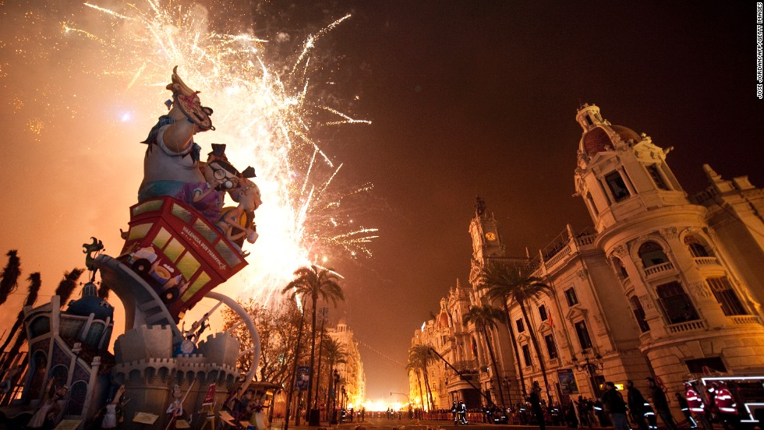
Welcome to Valencia: « Las Fallas »
Las ”Fallas Festival” is the most important event in the Valencia region. The event took place over a week 15-19 March, it is a tribute to St. Joseph celebrating the arrival of spring, with fireworks, processing, street fiestas and bonfires made from large puppets called ninots. Fallas are gigantic sculpted structures of cardboard and wood that satirize current events and personalities. Each of the city district makes its own ninots.

Slide 3
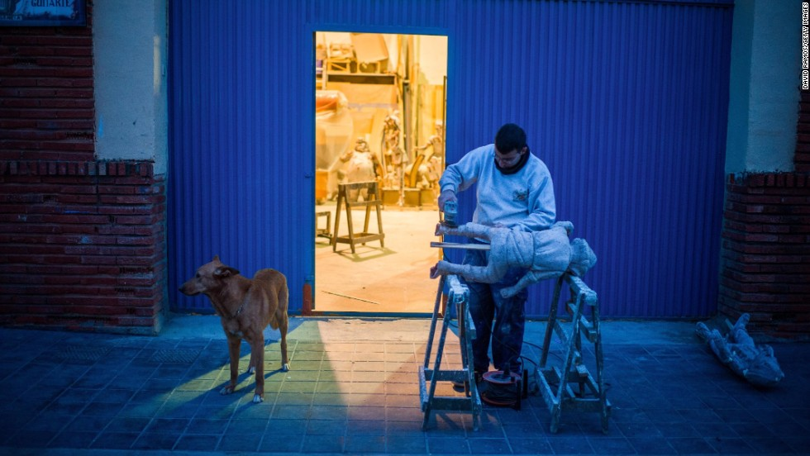
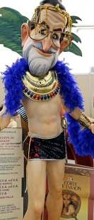
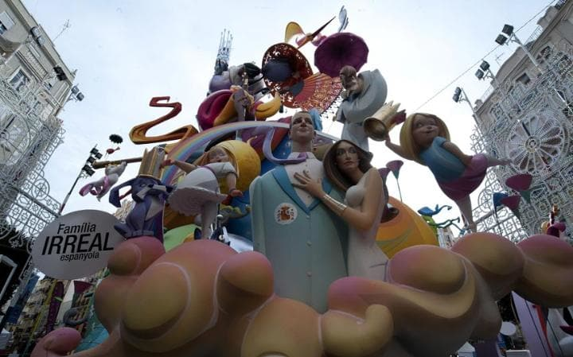
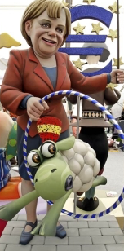
Welcome to Valencia: « Las Fallas »
Fundraising events are held throughout the year, and months are spent constructing the elaborated sculptures. The sculptures are made by the artistas falleros.
Figures are made of papier-maché and are often comical or satirical. Some of them are as tall as five-store building.
Ahead of the St-Joseph day the Fallas are displayed on the streets of the city. The monuments are visited by all the citizens during these days and a jury established a classification. The competition is really hard.

Slide 4
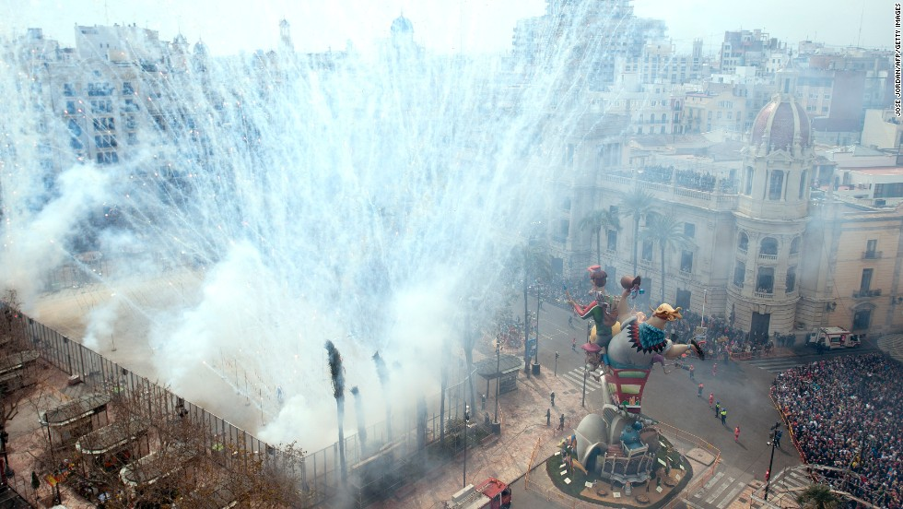
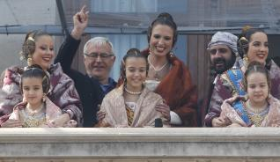
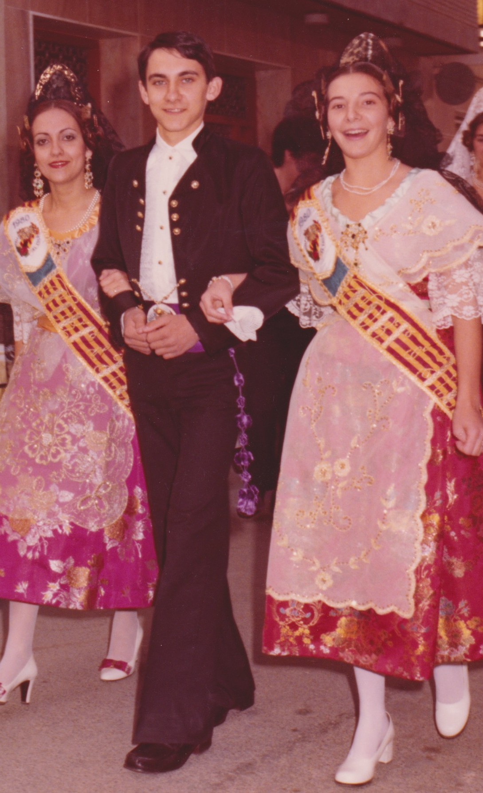
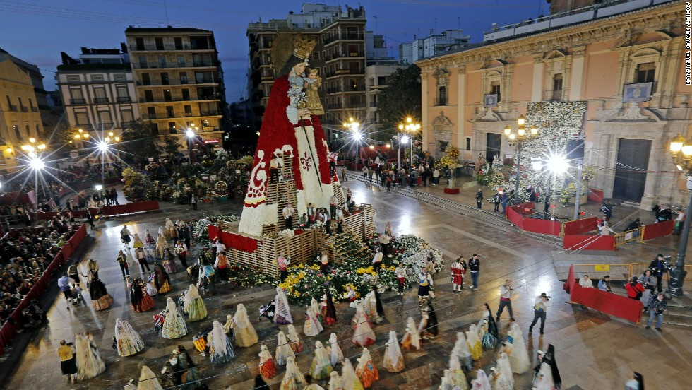
Welcome to Valencia: « Las Fallas »
Firecrackers or mascletá took place at midday during the week of the festival. The explosion starts when the Fallera Mayor from the balcony od the town hall pronounce the magical words: Senyor pirotècnic pot començar la mascletà (Mr. Firemaster you can start the fireworks).
The Offering of the Flowers is a whole ceremony. Over the days of 17th and 18th of March the city will be taken over by parades of traditional costume and music bringing flowers to the centre of Valencia - to make a huge statue of Virgin out of them

Slide 5
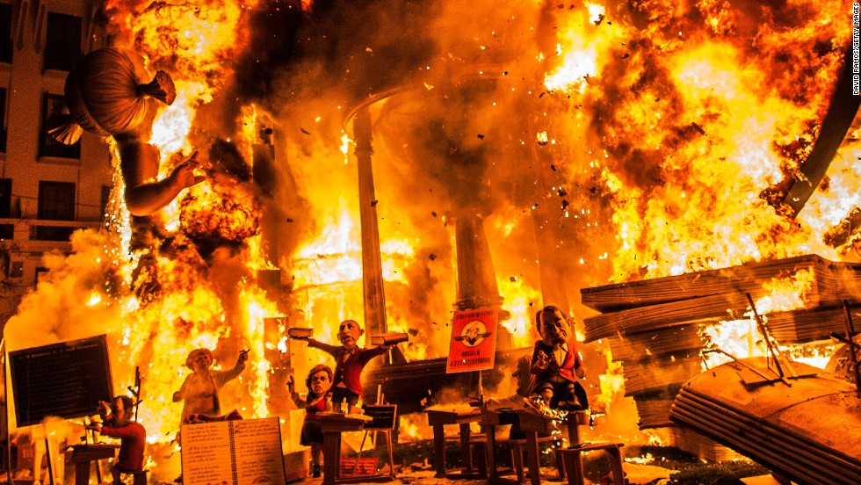
But eventually all Fallas are reduced to ashes as symbol of the renewal the night of 19th March. Valencian people loves the “fire”. The 20th of March people start to think about the Falla of next year….

Slide 6
This idea of the “reducing to ashes for renewal” is just the main objective of this meeting. Making a Falla of EUCARD2, i.e discuss about the pro and cons of the old and new accelerator projects and related techniques, the challenges, the issues, make some criticism and after the final burning of EUCARD2, ARIES will start.

Slide 7

This idea of the “reducing to ashes for renewal” is just the main objective of this meeting. Making a Falla of EUCARD2, i.e discuss about the pro and cons of the old and new accelerator projects and related techniques, the challenges, the issues, make some criticism and after the final burning of EUCARD2, ARIES will start.

Slide 8
This idea of the “reducing to ashes for renewal” is just the main objective of this meeting. Making a Falla of EUCARD2, i.e discuss about the pro and cons of the old and new accelerator projects and related techniques, the challenges, the issues, make some criticism and after the final burning of EUCARD2, ARIES will start.
More info on Wednesday afternoon during the tour and dinner

Slide 9
XBEAM Present and Future perspectives
An uncompleted view ...
EU Accelerator Projects
In operation
In construction
Under study
2017
2020
EUCARD2 ARIES EUPRAXIA EuroCircol, eJADE
International Large Scale Projects
2017
2019
2020
2025
2026
2028
2040
ESS
SC linac
HL-LHC
11T Nb₃Tn
HE-LHC
16T Nb₃Tn/NbTn
LHC
ATF2
Super B
XFEL
…
LBNF
CepC
PLC
ILC
1.3GHz SC
nano-beam/stabilization
CLIC
12 GHz two-beam
nano-beam/stabilization
FCC pp
16T Nb₃Tn/NbTn
EU Strategy:
FCC/CLIC, ILC
LBNF...
FAIR
FCC ee
High current Z-pole
CppC

Slide 10
XBEAM Accelerators and Techniques
XBEAM
Extreme Colliders: e+e-, hadrons, μ, γγ
Extreme Rings: space charge, e- cloud, optics, resonance islands, commissioning, advance concepts for coll and more
Extreme SC linacs: Protons, high power beam instrumentation, ERLs
Cost, Reliability and Availability
Extreme Polarization
Beam stabilization: beam instabilities, impedance mitigation, feedback

Slide 11
APEC Accelerator Performances and Concepts
APEC
Far Future Concepts and Feasibility
Beam Quality Control in Hadron Storage Rings and Synchrotrons
Beam Quality Control in Linacs and ERLs
Reliability and Availability
Improved Beam stabilization

Slide 12
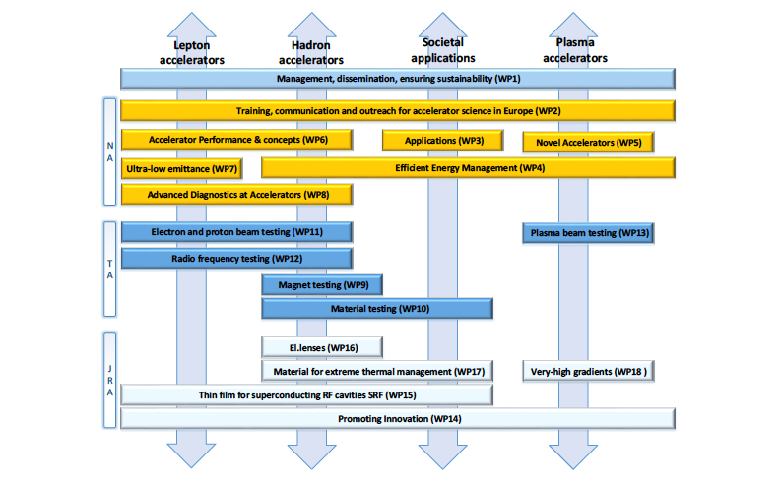
ARIES WPs structure and Organization

Slide 13

We have all the week to evaluate the current status of the Xbeam and to make a roadmap for APEC, we have presentations, discussions and time for writing…

Slide 14
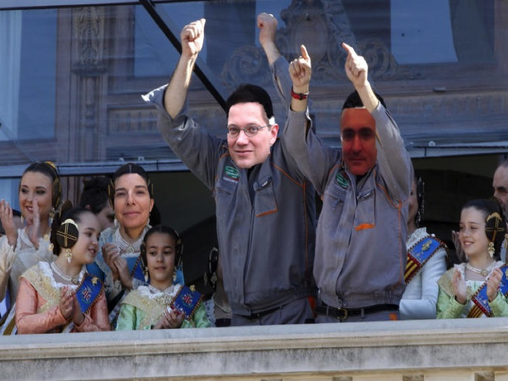
Mr Firemaster you can start the mascletá

