Slide 1




State of the Art and Efficiency for
Hadron Colliders
plus some Advanced Ideas
Frank Zimmermann
EuCARD-2 XBEAM Strategy Workshop,
Valencia, 13 February 2017
Work supported by the European Commission under Capacities 7th Framework Programme project EuCARD-2, grant agreement 312453, and the HORIZON 2020 project EuroCirCol, grant agreement 654305, as well as by the German BMBF

Slide 2


colliders and discoveries
Standard Model
Particles and forces
A. Ballarino
powerful instruments for discovery and precision measurement
Notes:
New slide from Davide.
Showing that conductor development is launched at international level, Russia, Japan, (Korea and Europe in preparation)
Underline importance of that development as main cost driver for the hadron collider machine.

Slide 3
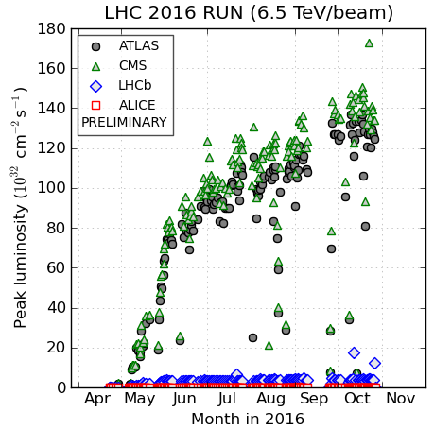
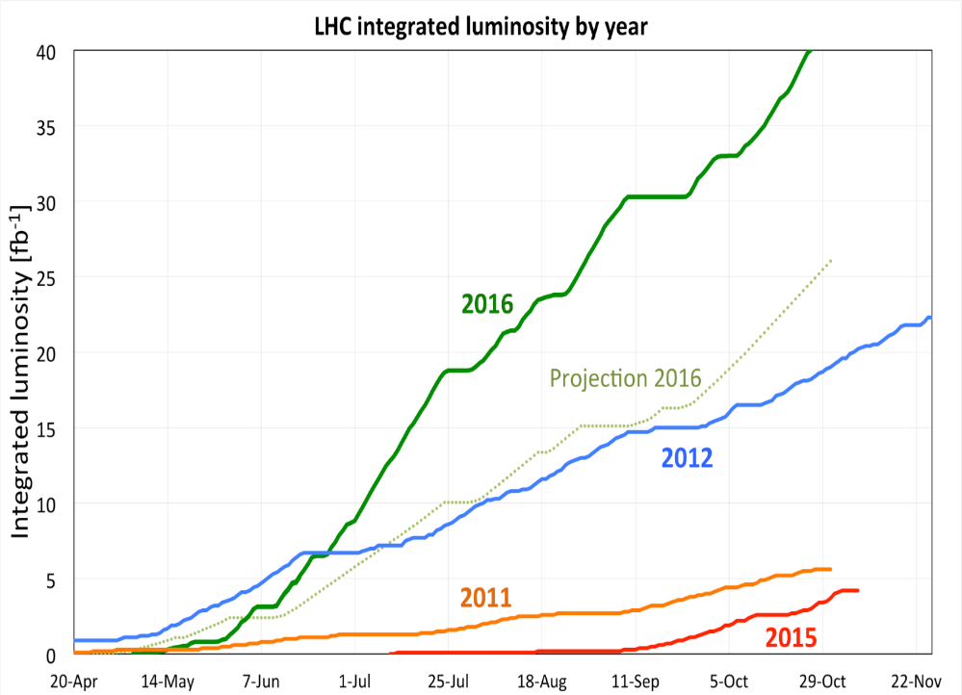
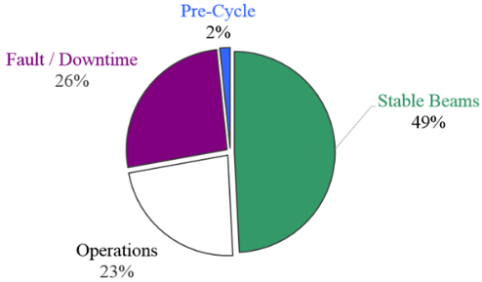
2016 LHC : production year
peak luminosity > 1.4 x 10³⁴ cm⁻²s⁻¹
OVER 25 fb⁻¹ in both ATLAS and CMS
F. Bordry
≈153 days physics ≈3738.7 hours
 | Duration [h]
Stable Beams | 1839.5
Fault / Downtime | 980.0
Operations | 857.9
Pre-Cycle | 61.3
TS1 - TS2 : stable beams 58 %
TS2 - TS3 : stable beams 54 %

Slide 4

energy frontier in the 21st century
very large circular hadron collider - only feasible approach to reach 100 TeV c.m. collision energy in coming decades
access to new particles (direct production) in few-TeV to 30 TeV mass range, far beyond LHC reach
much-increased rates for phenomena in sub-TeV mass range → much increased precision w.r.t. LHC
M. Mangano
hadron collider energy reach
Cf. LHC: factor ~4 in radius, factor ~2 in field → O(10) in E_{cms}
$$E∝B_{dipole}{×ρ}_{bending}$$

Slide 5
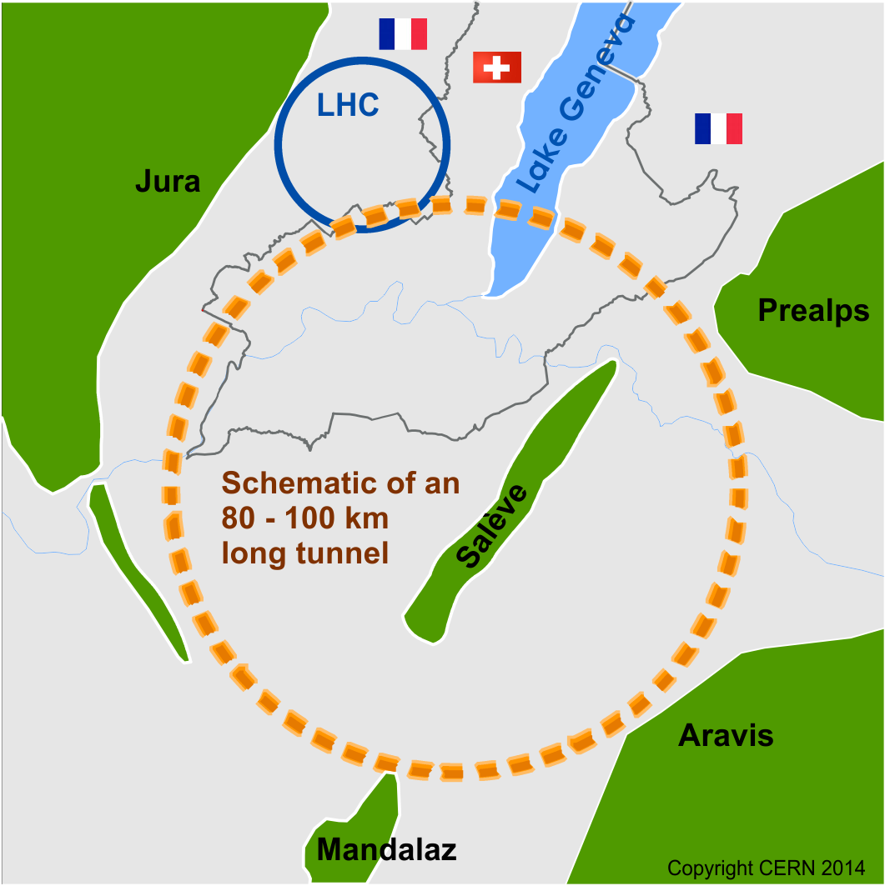
Future Circular Collider Study
Goal: CDR for European Strategy Update 2018/19
International FCC collaboration (CERN as host lab) to study:
pp-collider (FCC-hh) → main emphasis, defining infrastructure requirements
80-100 km tunnel infrastructure in Geneva area, site specific
e⁺e⁻ collider (FCC-ee), as a possible first step
p-e (FCC-he) option, integration one IP, FCC-hh & ERL
HE-LHC with FCC-hh technology
HE-LHC
~16 T ⇒ 100 TeV pp in 100 km
suggested
in 2010

Slide 6
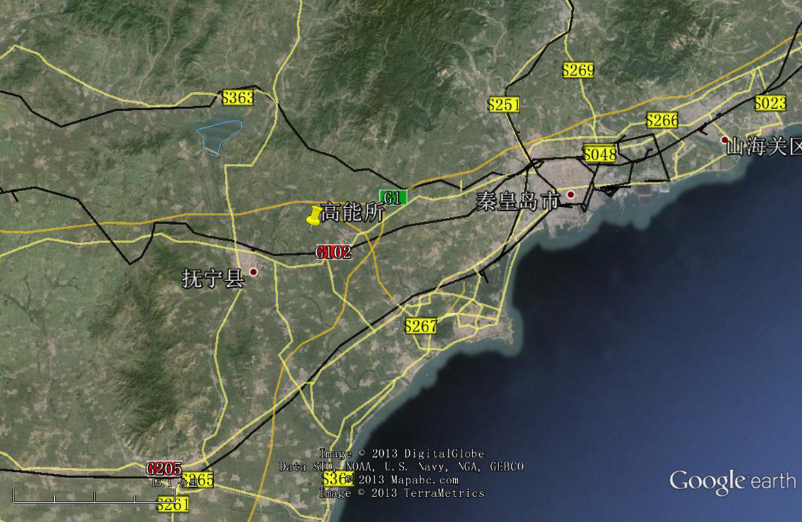
CepC/SppC study (CAS-IHEP) 100 km (new baseline!) , e⁺e⁻ collisions ~2028; pp collisions ~2042
Qinhuangdao (秦皇岛）
CepC, SppC
50 km
100 km
easy access
300 km east
from Beijing
3 h by car
1 h by train
“Chinese Toscana”
Yifang Wang

Slide 7
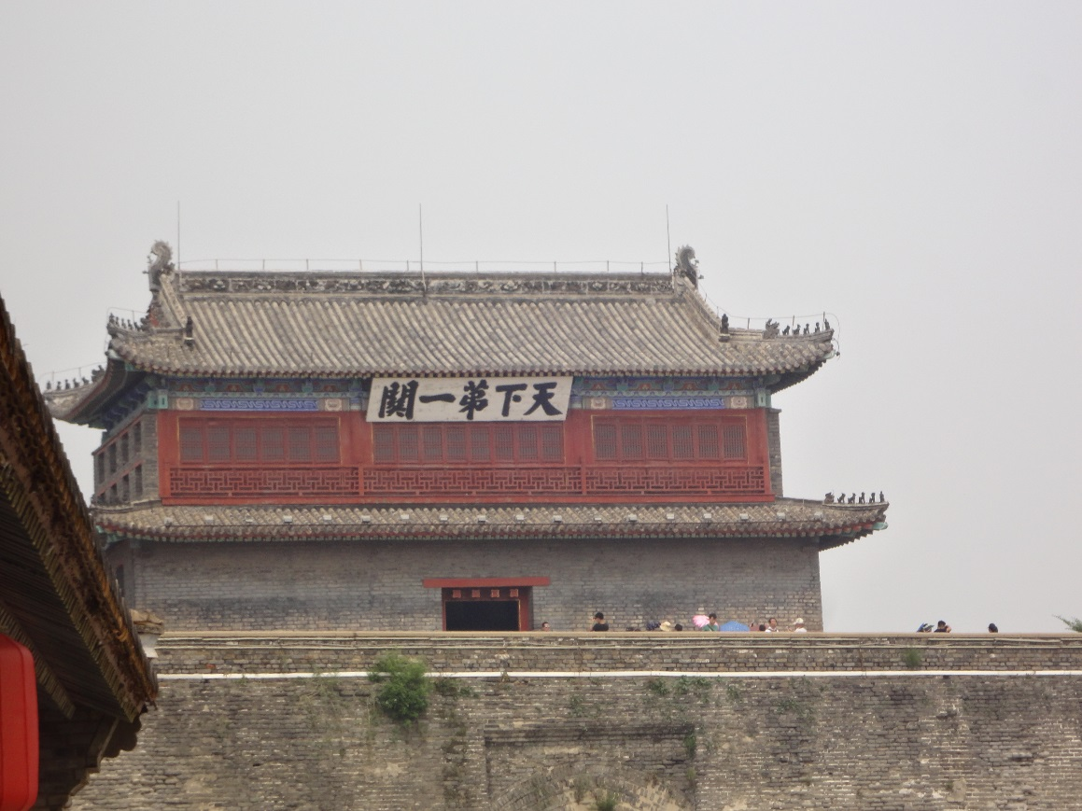
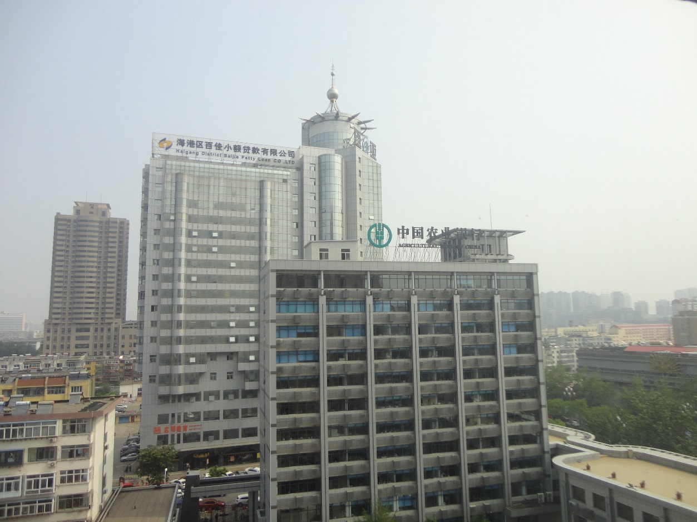
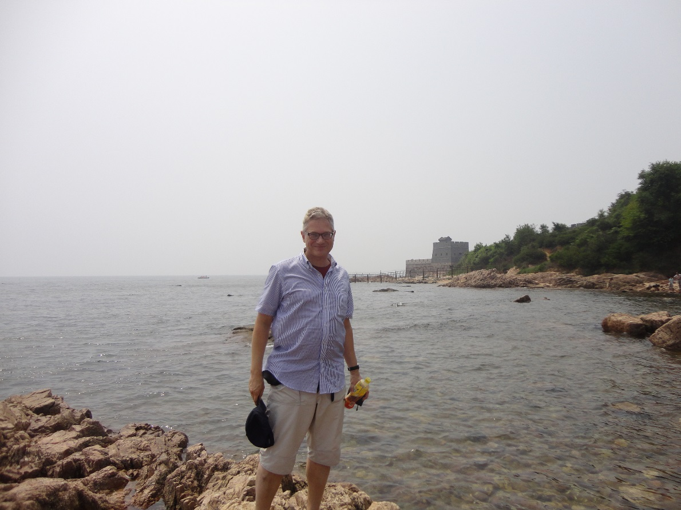

Qinhuangdao site visit July 2016

Slide 8
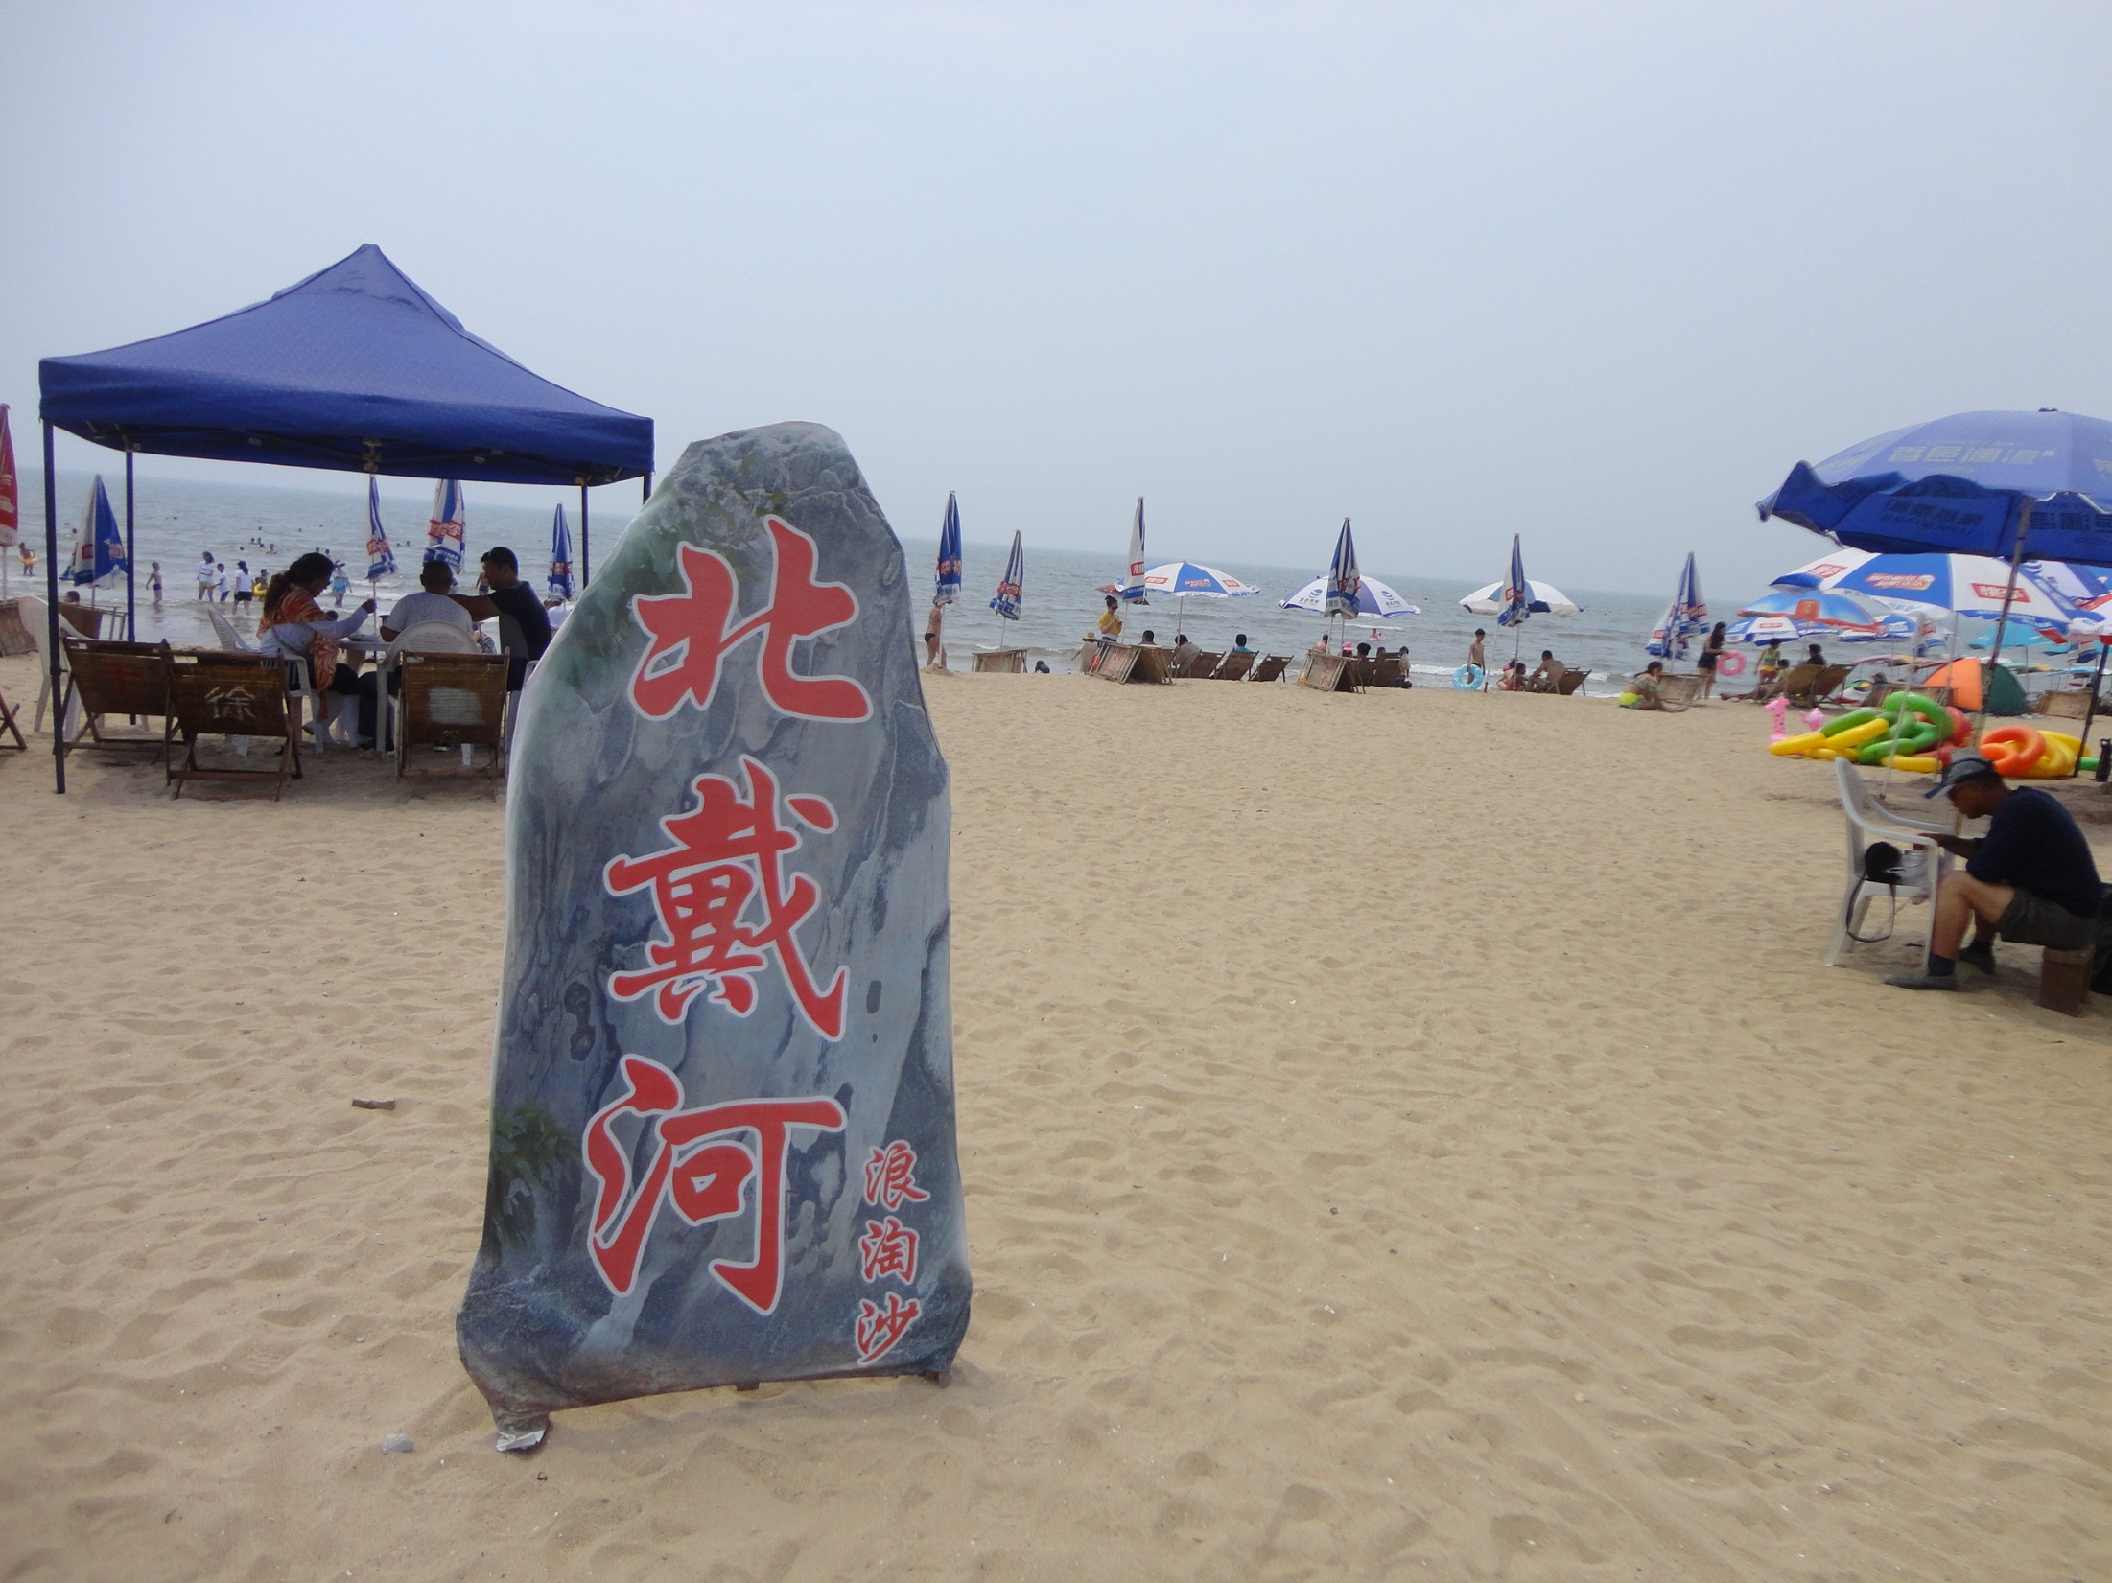
near proposed construction site and vinyards – bilingual beach resort (Chinese-Russian)

Slide 9
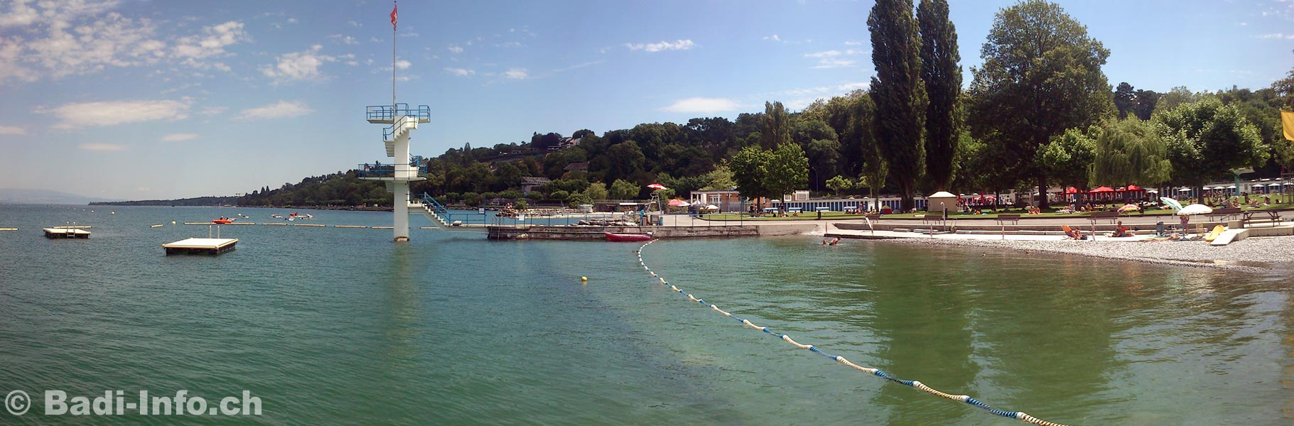
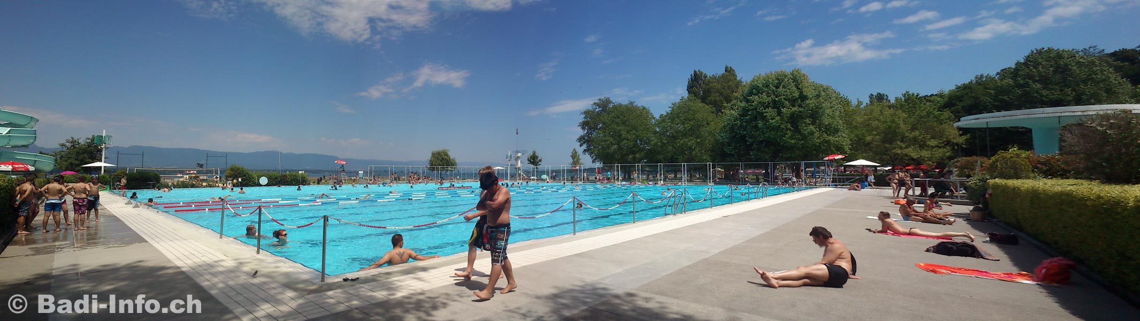
… Geneva beach for comparison

Slide 10
alternative CEPC sites
M. Koratzinos, HongKong

Slide 11
CERN Circular Colliders & FCC
1980
1985
1990
1995
2000
2005
2010
2015
2020
2025
2030
2035
2040
Constr.
Physics
LEP
Design
Proto
Construction
Physics
LHC – in operation
HL-LHC - ongoing project
Design
Construction
Physics
~20 years
FCC – design study
Design
Proto
Construction
Physics
must advance fast now to be ready for the period 2035 – 2040
milestone: CDR by end 2018 for next update of European Strategy

Slide 12
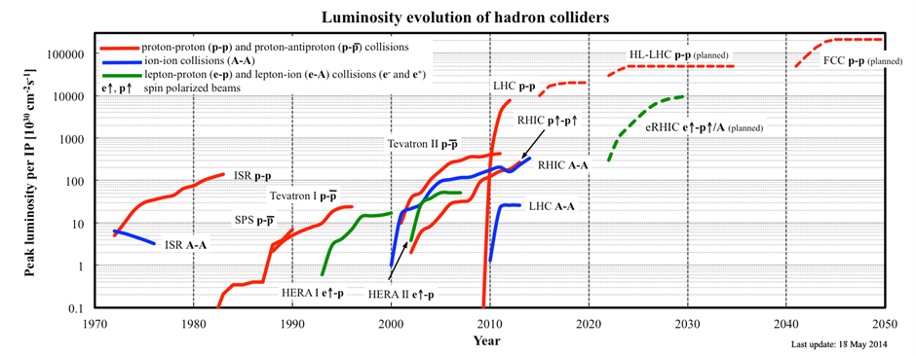
hadron collider history
hadron collider peak luminosity as a function of year – for past, operating, and proposed facilities [courtesy W. Fischer]

Slide 13
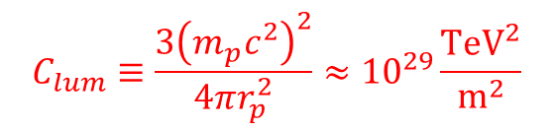


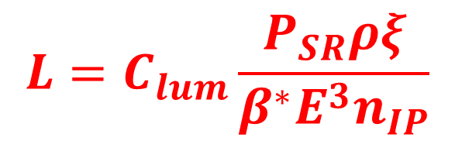

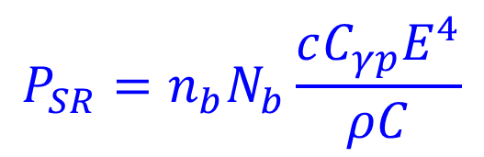
FCC-hh peak luminosity with constraints
synchrotron radiation power / beam:
$$P_{SR}=n_{b}N_{b}\frac{cC_{γp}E^{4}}{ρC}$$
$$ξ=\frac{{n_{IP}r}_{p}N_{b}}{4πε_{N}}$$
limited
total beam-beam
tune shift
maximum
acceptable
$$C_{γp}≡\frac{4π}{3}\frac{r_{p}}{{\left(m_{p}c^{2}\right)}^{3}}$$
ρ: bending radius
C: circumference
n_{b}: #bunches/beam
N_{b}: #p/bunch
E: beam energy
r_{p}: class. proton radius
$$L=\frac{c}{C}\frac{γn_{b}N_{b}^{2}}{4πβ^{∗}ε_{N}}$$
luminosity
luminosity formula for SR-power and
tune-shift limited hadron collider
$$L=C_{lum}\frac{P_{SR}ρξ}{β^{∗}E^{3}n_{IP}}$$
with
$$C_{lum}≡\frac{3{\left(m_{p}c^{2}\right)}^{2}}{4πr_{p}^{2}}≈{10}^{29}\frac{{\text{TeV}}^{2}}{{\text{m}}^{2}}$$

Slide 14



FCC-hh peak luminosity with other constraint
event
pile up / Xing
$$μ=σ_{\text{inel}}\frac{γN_{b}^{2}}{4πβ^{∗}ε_{N}}$$
maximum
acceptable
σ_{tot} [mbarn] ≈ 42.1s ^{-0.467}-32.19 s^{-0.540} +35.83 +0.315 ln²(s/34); s in units of GeV²
~112 mbarn at 14 TeV, ~156 mbarn at 100 TeV
σ_{inel} [mbarn] ≈ σ_{tot}-11.7 +1.59 ln s - 0.134 ln²s
~83 mbarn at 14 TeV, ~110 mbarn at 100 TeV
$$L=\frac{c}{C}\frac{γn_{b}N_{b}^{2}}{4πβ^{∗}ε_{N}}$$
luminosity
luminosity formula for
pile-up limited hadron collider
$$L=f_{rev}\frac{n_{b}μ}{σ_{\text{inel}}}$$
shorter bunch spacing could help?!
(e.g. 25→ 5 ns would increase n_{b} 5x!)

Slide 15
hadron collider parameters (pp)
parameter | FCC-hh |  |  | HE-LHC | (HL) LHC
collision energy cms [TeV] | 100 |  |  | 25 | 14
dipole field [T] | 16 |  |  | 16 | 8.3
circumference [km] | 100 |  |  | 27 | 27
beam current [A] | 0.5 |  |  | 1.27 | (1.12) 0.58
bunch intensity [10¹¹] | 1 (0.2) | 1 (0.2) |  | 2.5 | (2.2) 1.15
bunch spacing [ns] | 25 (5) | 25 (5) |  | 25 (5) | 25
IP β*_{x,y} [m] | 1.1 | 0.3 |  | 0.25 | (0.15) 0.55
luminosity/IP [10³⁴ cm⁻²s⁻¹] | 5 | 30 |  | 34 | (5) 1
peak #events/bunch crossing | 170 | 1020 (204) |  | 1070 (214) | (135) 27
stored energy/beam [GJ] | 8.4 |  |  | 1.4 | (0.7) 0.36
synchrotron rad. [W/m/beam] | 30 |  |  | 4.1 | (0.35) 0.18
transv. emit. damping time [h] | 1.1 |  |  | 4.5 | 25.8
initial proton burn off time [h] | 17.0 |  | 3.4 | 2.3 | (15) 40

Slide 16
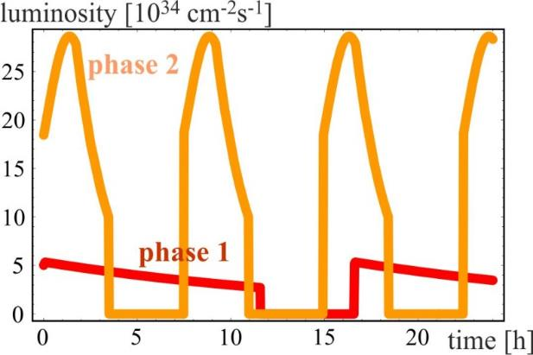
luminosity evolution over 24 h
radiation damping: τ~1 h
PRST-AB 18, 101002 (2015)
  for both phases:
  beam current 0.5 A, unchanged!
  total synchrotron radiation power ~5 MW.
phase 1: β*=1.1 m, ξ_{tot}=0.01, t_{ta}=5 h, 250 fb⁻¹ / year
phase 2: β*=0.3 m, ξ_{tot}=0.03, t_{ta}=4 h, 1000 fb⁻¹ / year

Slide 17
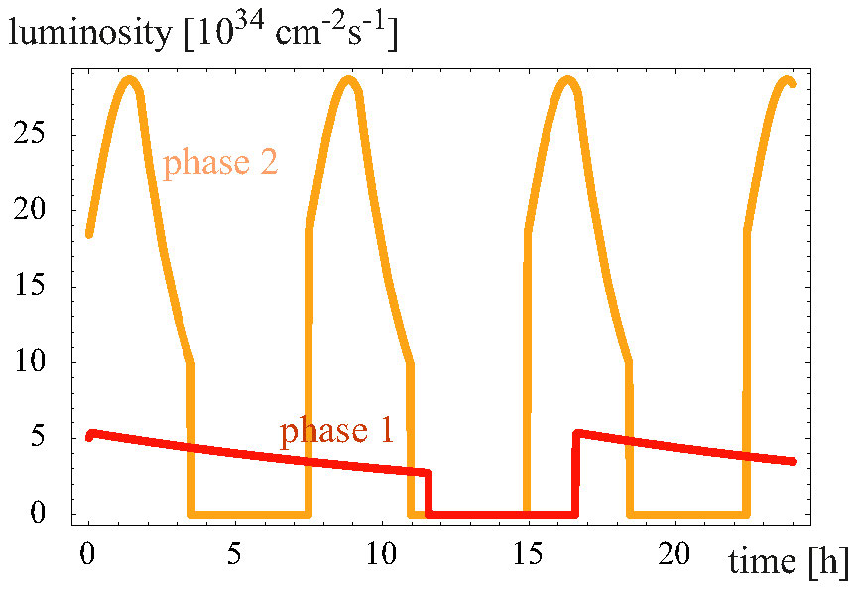
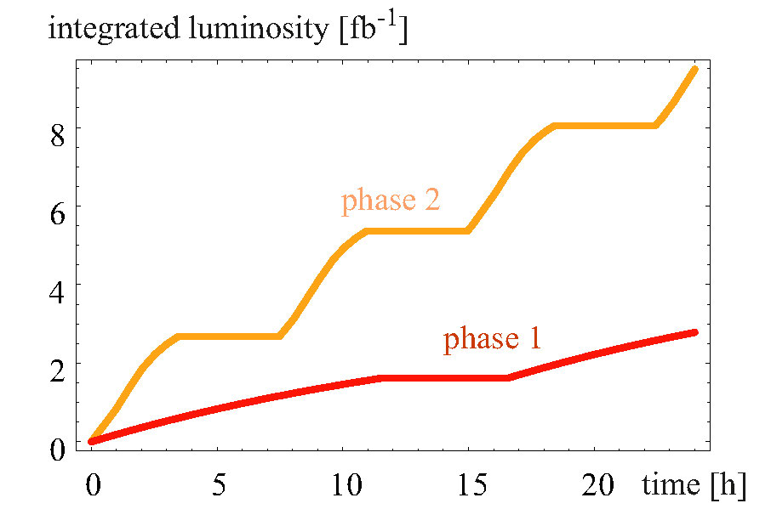
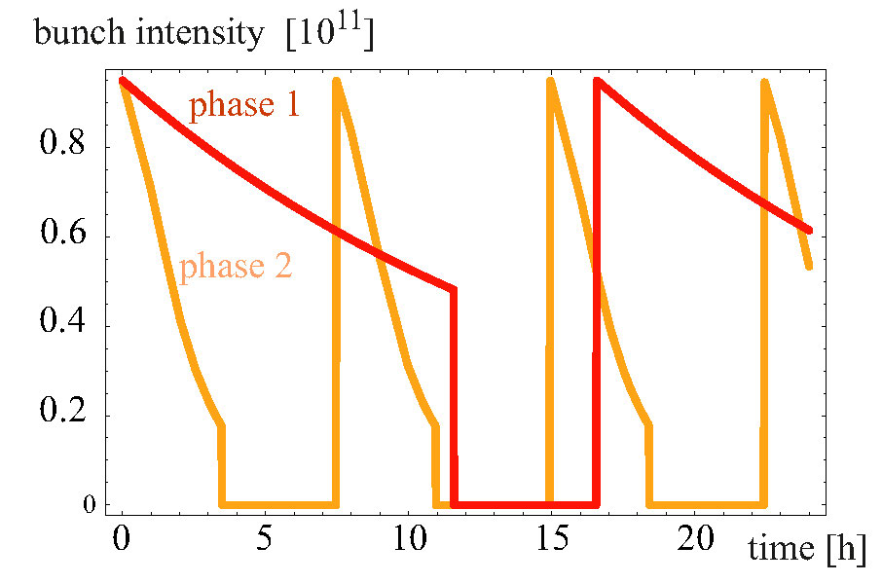
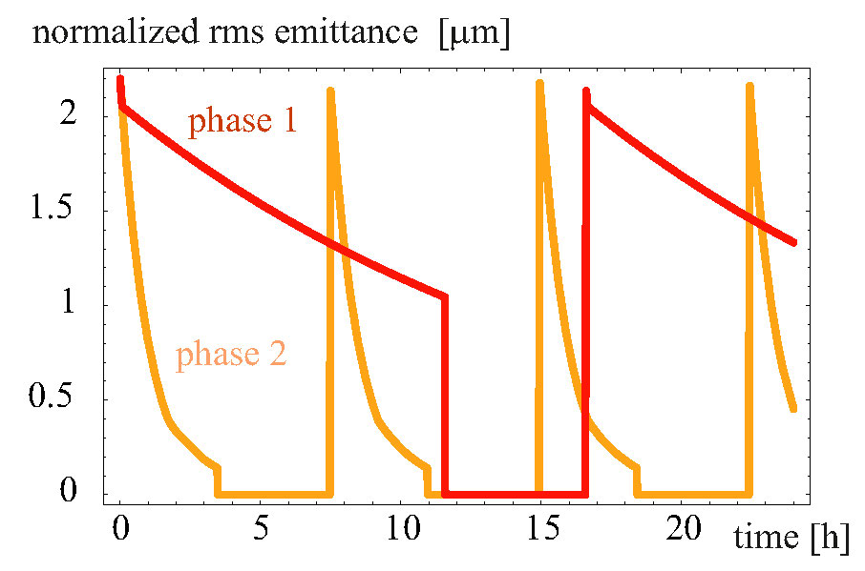
FCC-hh - 100 TeV c.m., 25 ns
burn off slower than emittance
damping → emittance control

Slide 18
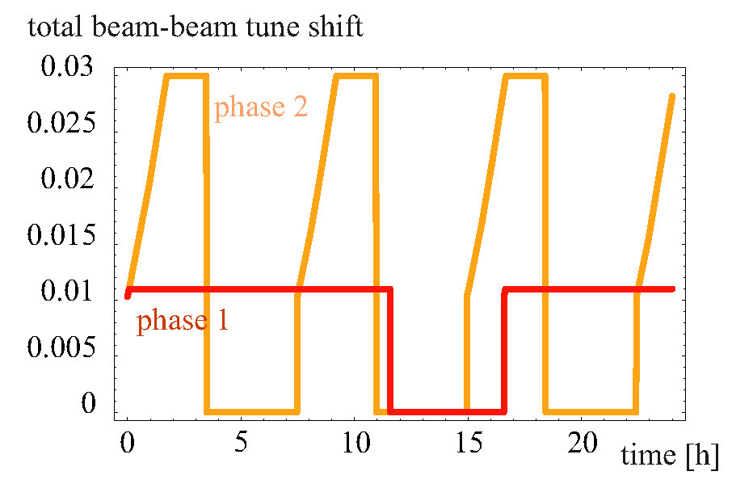
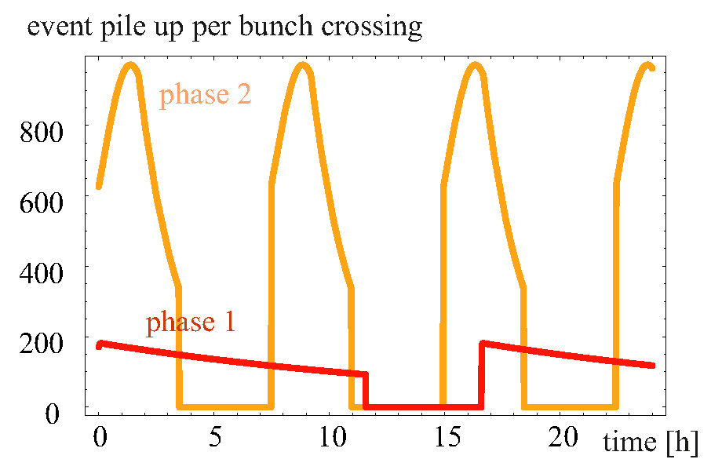
FCC-hh - 100 TeV c.m., 25 ns
in phase 2, β* 1.1→0.3 m,
without (or with less)
emittance control:
tune shift increases during fill
until reaching maximum of 0.03

Slide 19
SPPC main parameters
Parameter | Unit | SPPC |  |  | FCC
 |  | PreCDR | “CDR” | “Ultimate”
Circumference | km | 54.4 | 100 | 100 | 100
c.m. energy | TeV | 70.6 | 75 | 125-150 | 100
dipole field | T | 20 | 12 | 20-24 | 16
injection energy | TeV | 2.1 | 2.1 | 4.2 | 3.3
#IPs |  | 2 | 2 | 2 | 2
luminosity per IP | 10³⁵ cm⁻²s⁻¹ | 1.2 | 1.0 | - | 0.5 |  | 3.0
IP beta function | m | 0.75 | 0.75 | - | 1.1 |  | 0.3
beam current | A | 1.0 | 0.7 | - | 0.5
bunch separation | ns | 25 | 25 | - | 25 (5) | 25 (5)
bunch population | 10¹¹ | 2.0 | 1.5 | - | 1.0 (0.2) | 1.0 (0.2
SR power /beam | MW | 2.1 | 1.1 | - | 2.5
SR heat load/ap | W/m | 45 | 13 | - | 30
J. Tang

Slide 20
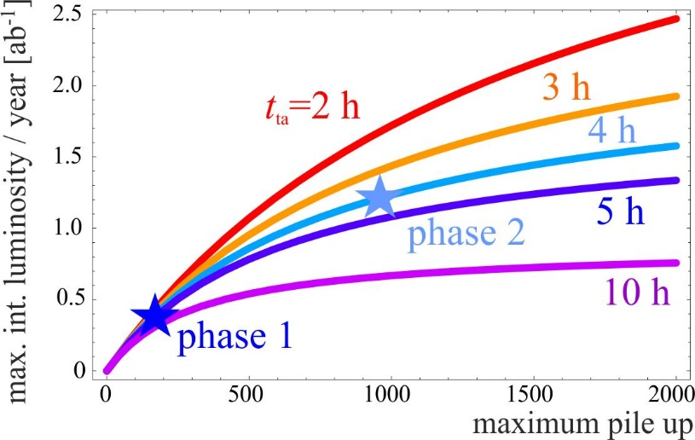
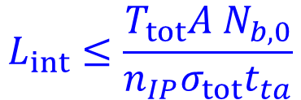
limits on integrated luminosity
turnaround challenge
asymptotic limit:
$$L_{int}≤\frac{T_{tot}A N_{b,0}}{n_{IP}σ_{tot}t_{ta}}$$
T_{tot}: total time
allocated for physics
/ year
case for
availability
F.Z. et al,
IPAC’16
integrated luminosity per year vs maximum pile-up, assuming 160 days of physics run, a machine availability A of 71%, two primary collision points (n_{IP}=2), n_{b}=10600 bunches per beam, and a maximum beam intensity of N_{b,0}=10¹⁵ protons; curves for different av. turnaround times t_{ta}

Slide 21
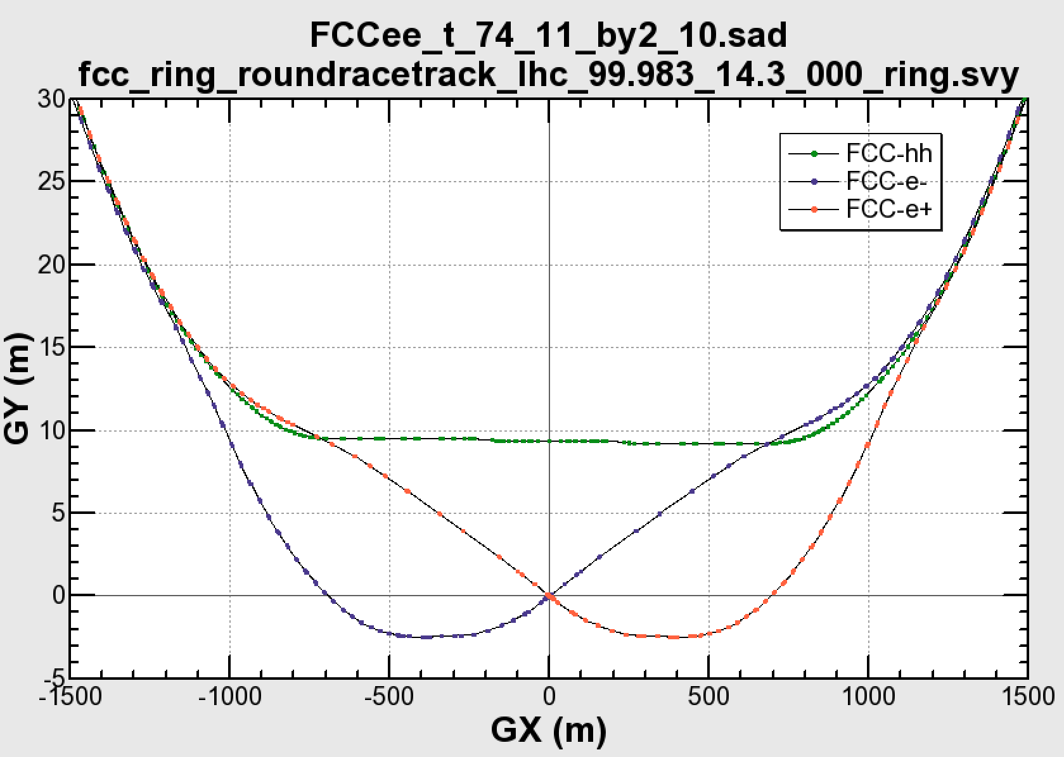

common layouts for hh & ee
FCC-ee 1, FCC-ee 2,
FCC-ee booster (FCC-hh footprint)
11.9 m
IP
30 mrad
FCC-hh/
ee Booster
FCC-hh
layout
9.4 m
0.6 m
Lepton beams must cross over through the common RF to enter the IP from inside.
Only a half of each ring is filled with bunches.
Common
RF (tt)
Common
RF (tt)
Max. separation of 3(4) rings is about 12 m:
wider tunnel or two tunnels are necessary around the IPs, for ±1.2 km.
2 main IPs in A, G for both machines
asymmetric IR optic/geometry for ee to limit synchrotron radiation to detector
IP
K. Oide
Notes:
Check with Katsunobu to have latest layout.
Check with detector people if 9 m offset is acceptable for ee detector

Slide 22
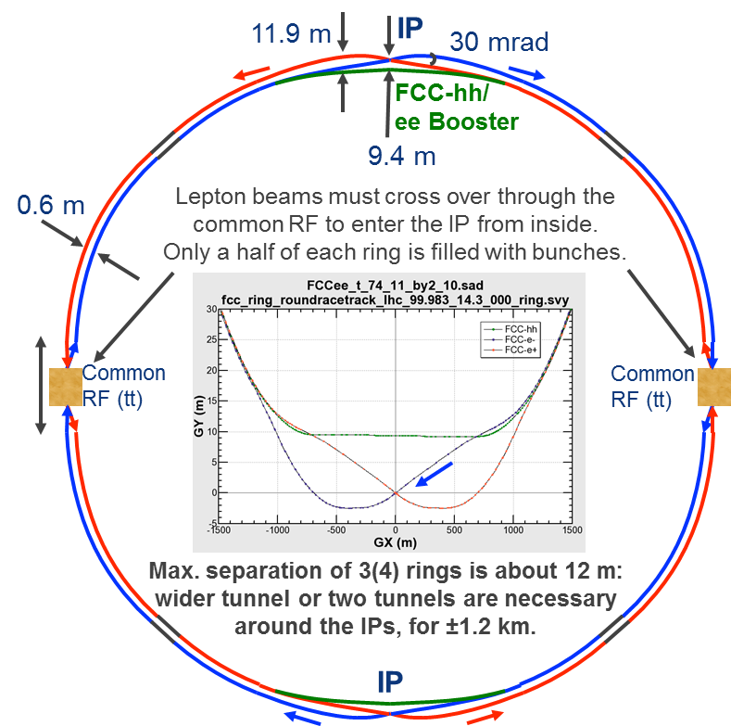
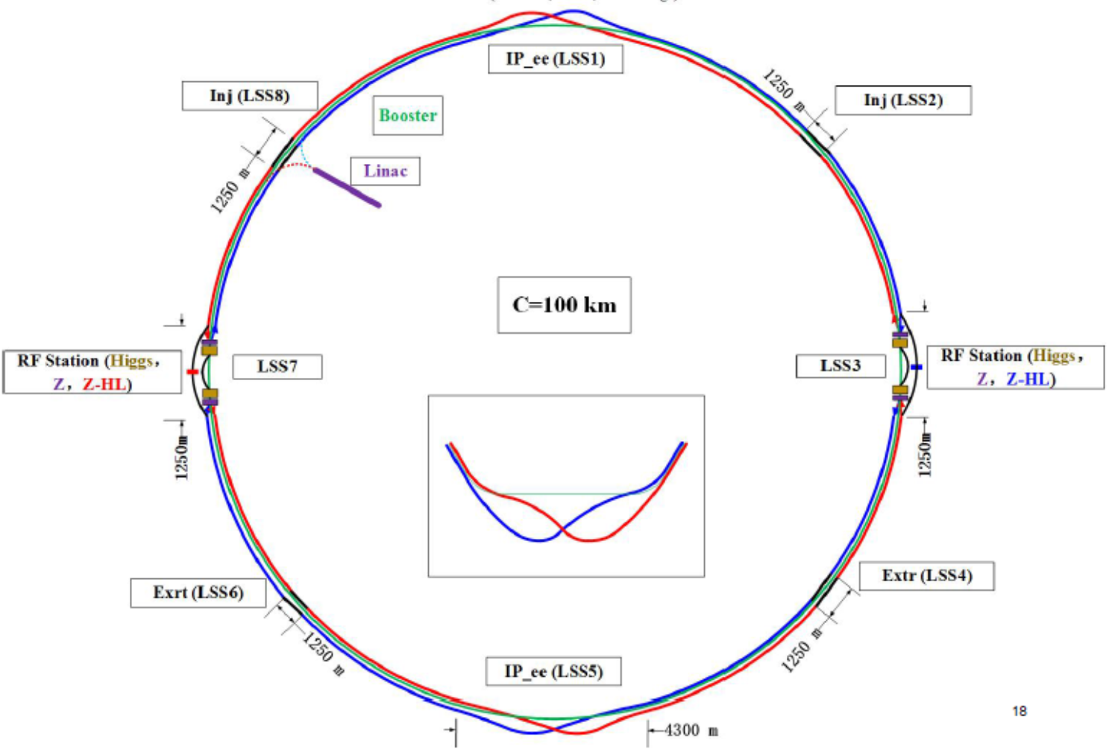
FCC and CEPC convergence
FCC-ee design, K. Oide, 2015
CEPC design, J. Gao, 2017
Notes:
Check with Katsunobu to have latest layout.
Check with detector people if 9 m offset is acceptable for ee detector

Slide 23
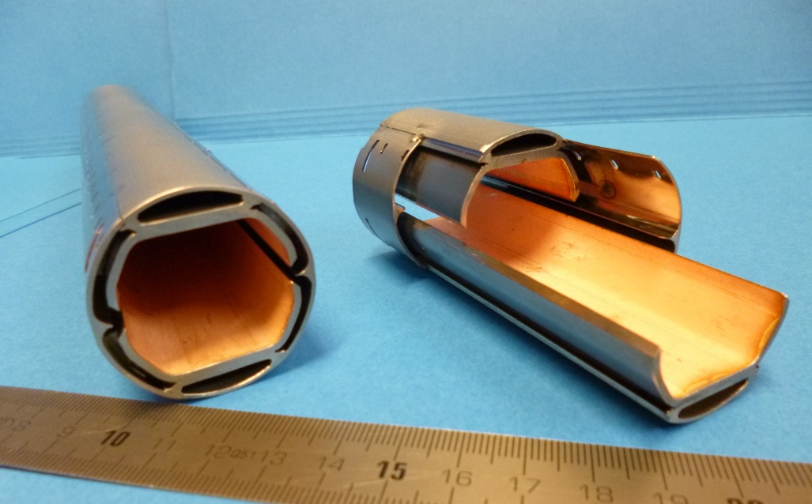
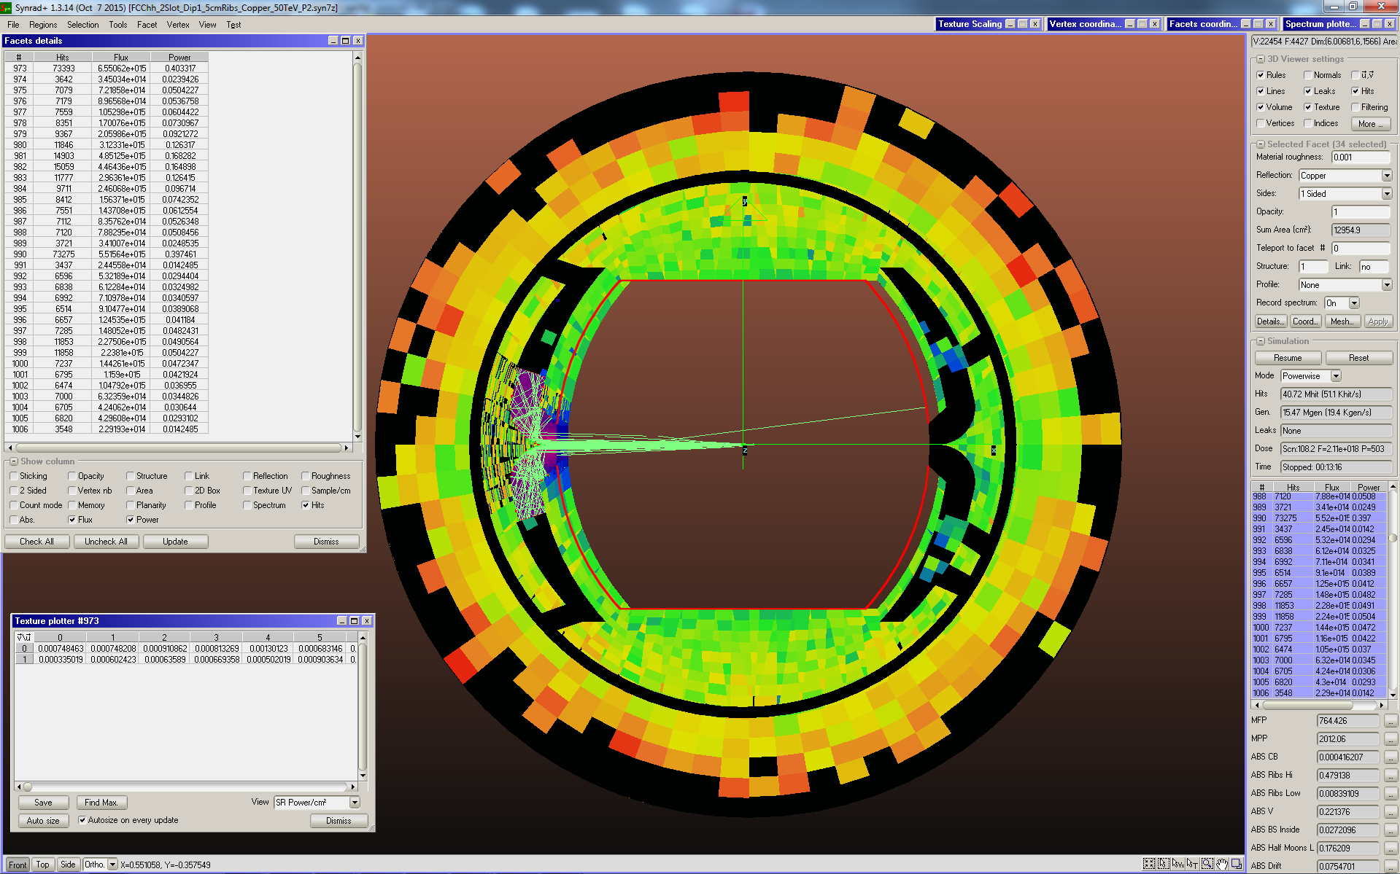
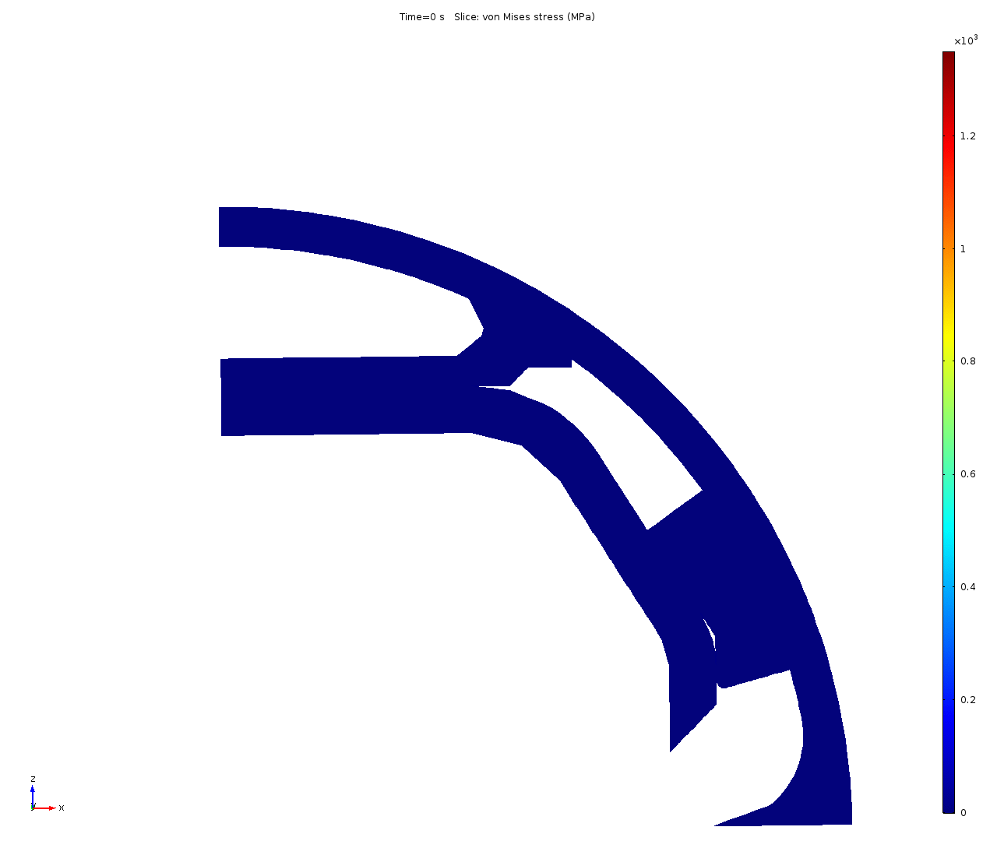
intercepting synchrotron radiation:
- beam screen
high synchrotron radiation load of proton beams @ 50 TeV:
~30 W/m/beam (@16 T) (LHC <0.2W/m)
5 MW total in arcs (@1.9 K!)
new beam screen with ante-chamber
absorption of synchrotron radiation at 50 K to reduce cryogenic power
factor 50! reduction of cryo power
FCC-hh beam screen prototypes
ready for Testing 2017 in ANKA within EuroCirCol study
simulation of
quench behaviour
photon distribution

Slide 24
synchrotron radiation – cryopower & beam-screen temperature
total
cryo
power
50 K chosen for efficiency and beam stability;
but for 4.5 K magnets can also consider 110 K
Ph. Lebrun
L. Tavian
V. Baglin
based on LHC screen
300 MW
200 MW
100 MW
D. Schulte

Slide 25
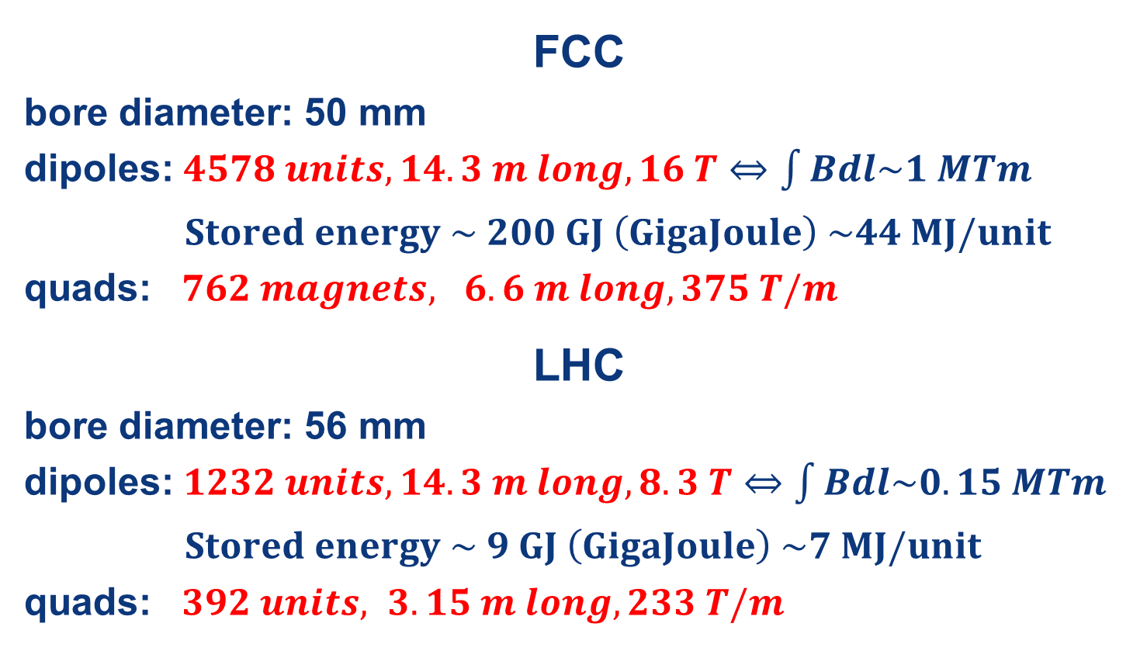
main SC magnet system
FCC (16 T) vs LHC (8.3 T)
FCC
bore diameter: 50 mm
dipoles: $4578 units, 14.3 m long, 16 T⇔\int{Bdl\sim 1 MTm}$
$Stored energy \sim 200 GJ \left(GigaJoule\right) \sim 44 MJ/unit$
quads: $762 magnets, 6.6 m long, 375 T/m$
LHC
bore diameter: 56 mm
dipoles: $1232 units, 14.3 m long, 8.3 T⇔\int{Bdl\sim 0.15 MTm}$
$Stored energy \sim 9 GJ \left(GigaJoule\right) \sim 7 MJ/unit$
quads: $392 units, 3.15 m long, 233 T/m$

Slide 26
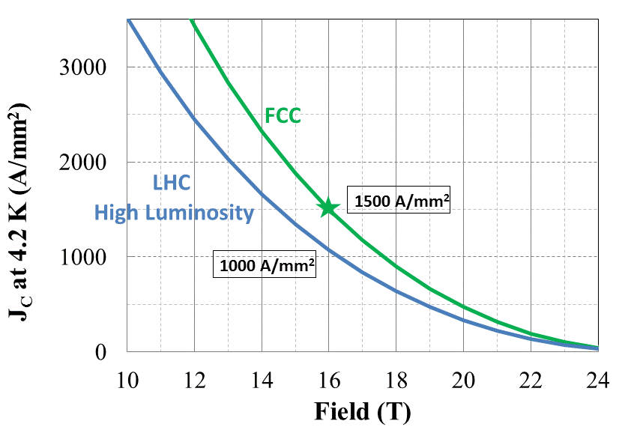
Nb₃Sn conductor program
Nb₃Sn is one of the major cost & performance factors for FCC-hh and is given highest attention
D. Tommasini et al.
main development goals until 2020:
J_{c} increase (16T, 4.2K) > 1500 A/mm² i.e. 50% increase wrt HL-LHC wire
reference wire diameter 1 mm
potentials for large scale production and cost reduction
5400 mm²
3150 mm²
~1.7 times less SC
~10% margin
HL-LHC
~10% margin
FCC ultimate
Notes:
New slide from Davide.
Showing that conductor development is launched at international level, Russia, Japan, (Korea and Europe in preparation)
Underline importance of that development as main cost driver for the hadron collider machine.

Slide 27

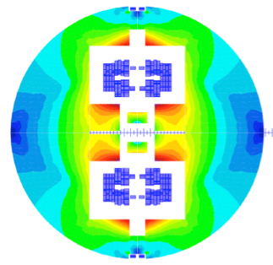
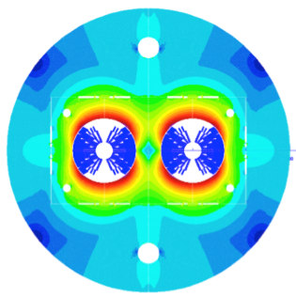

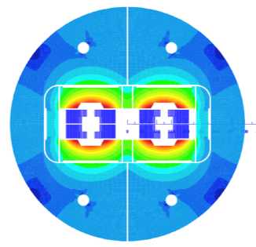
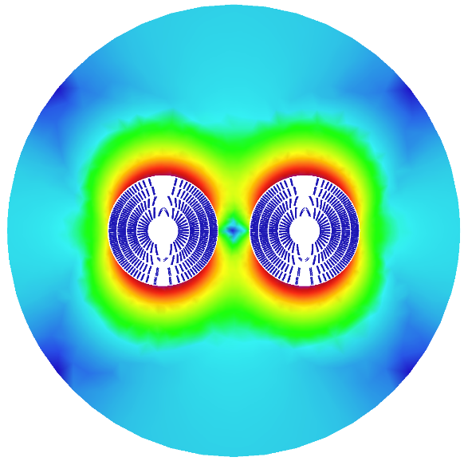
16 T dipole options and plans
Cos-theta
Common coils
Swiss contribution
via PSI
Canted
Cos-theta
Blocks
down-selection of options end 2017 for detailed design work
model production 2018 – 2022
prototype production 2023 - 2025
Notes:
New slide from Davide.
Showing that conductor development is launched at international level, Russia, Japan, (Korea and Europe in preparation)
Underline importance of that development as main cost driver for the hadron collider machine.

Slide 28
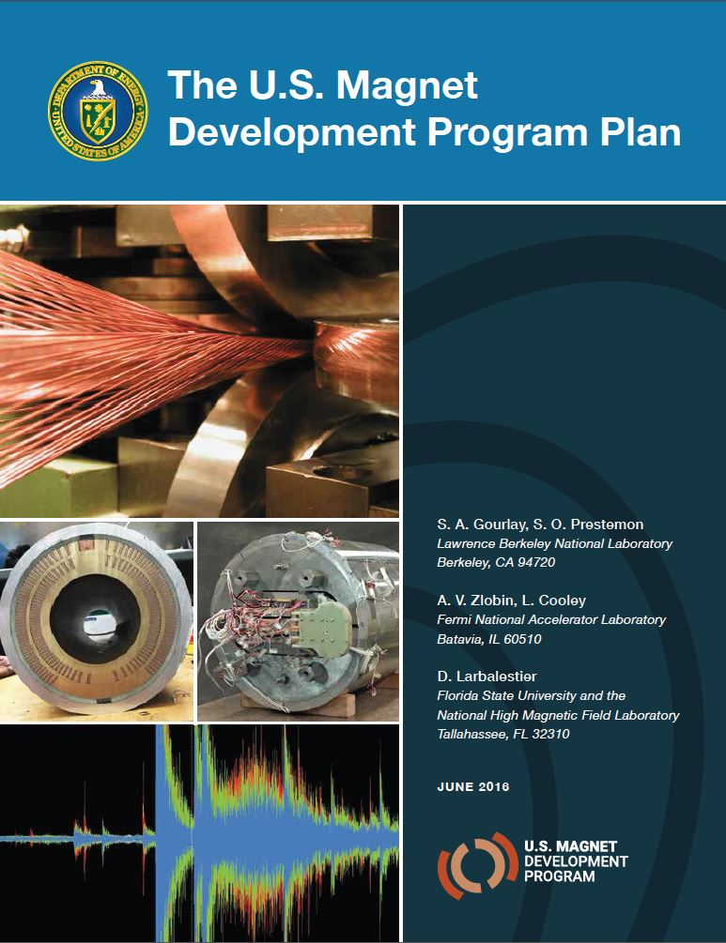
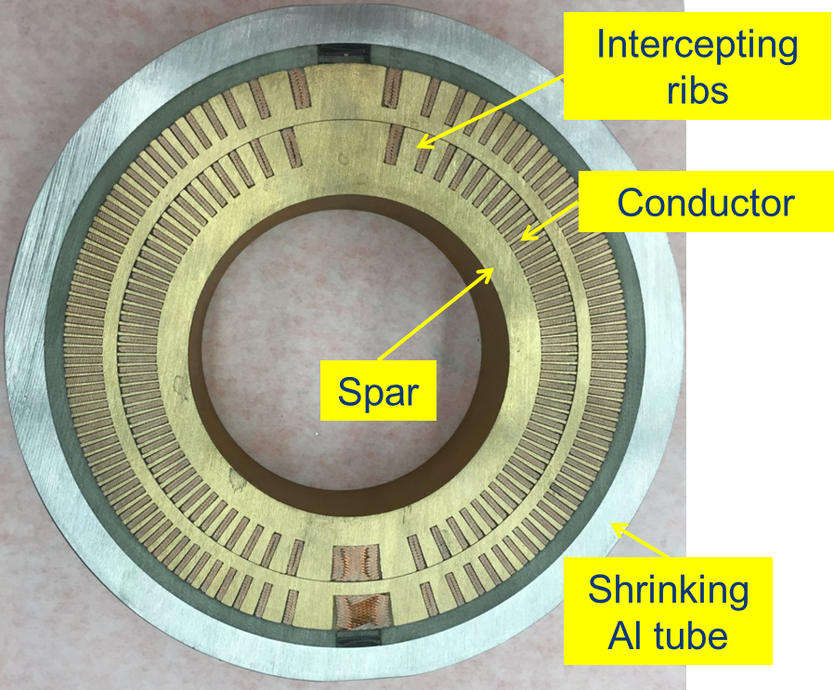
US Magnet Development Program
S. Gourlay
Under Goal 1:
16 T cos theta dipole design
16 T canted cos theta (CCT) design

Slide 29
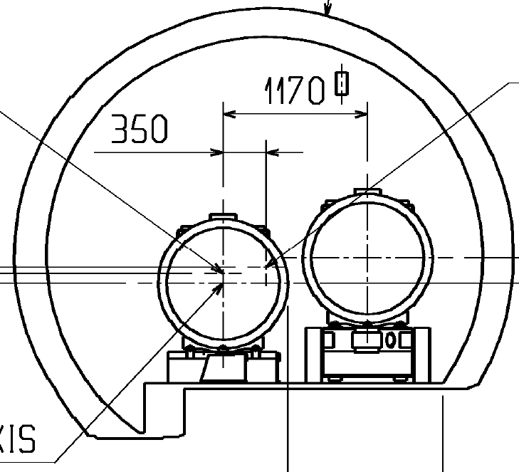
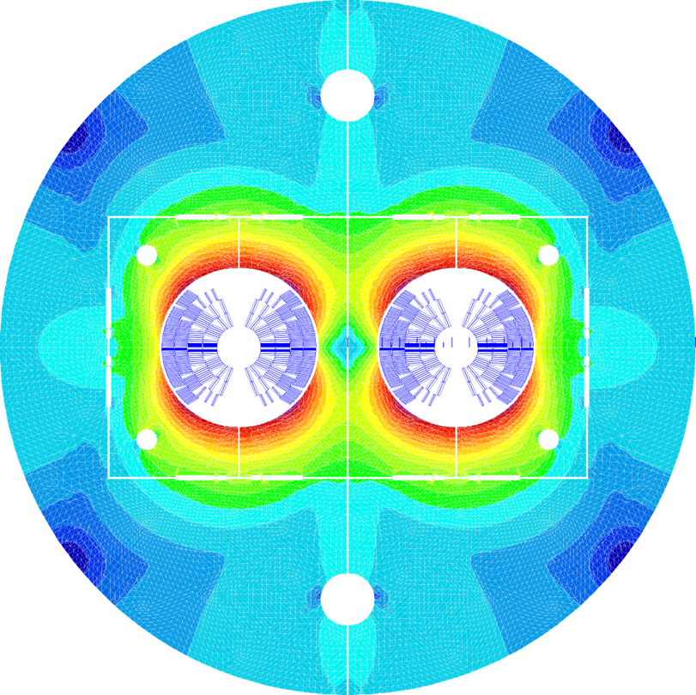
HE-LHC integration & transport
FCC-hh tunnel diameter: 6.0 m
LHC tunnel diameter: 3.8 m
cryostat outer diameter: 1.18-1.3 m
very preliminary
115
115
options:
remove QRL
reduce margin
  for transport
  - automatic
  guiding system?
shrink cryostat
enlarge tunnel?
…
Φ 1180
Φ 1300
Φ 1180
Φ 1300
1250 min.
V. Mertens., V.. Parma, D. Schoerling, L. Tavian,
Y. Muttoni, et al.

Slide 30
S. Prestemon, HongKong

Slide 31
S. Prestemon, HongKong

Slide 32
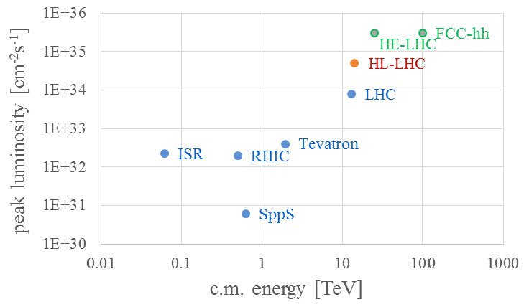
pp/p-pbar in the L-E plane

Slide 33
hadron-collider beam power
Collider | c.m. energy [TeV] | P_{el}: tot. el. power [MW] | P_{b}: IP beam power [GW] | luminosity L [nb⁻¹s⁻¹] | P_{b}/P_{el} | L/P_{el} (/IP) [nb⁻¹s⁻¹ / MW]
LHC | 13.0 | ~150 | 8000 | 10 | 50000 | 0.07
HE-LHC | 25.0 | ~250 (guess) | 32000 | 340 | 128000 | 1.4
FCC-hh | 100.0 | 500 (target) | 50000 | 300 (phase 2) | 100000 | 0.6
SPPC | 75 | 600 (guess) | 53000 | 100 | 90000 | 0.2

Slide 34
collaboration & industry relations
98
Institutes
20
Companies
30
Countries

Slide 36
beyond FCC
beyond FCC
muon colliders?
γγ colliders? (low energy or high energy – CLICHÉ/SAPPHiRE)
crystal accelerators?
gravitational waves
detection and/or generation
others (piggyback, single particles, black holes)

Slide 37
low-energy γγ colliders
Photon-photon scattering probes the structure of the QFT vacuum.
Measurements of photon-photon scattering at LCLS-2 and at XFEL:
Energy hn =10 keV or c.m. energy 20 keV. Total Cross Section 1.0 ab.
2 FEL beam pulses colliding head-on against each other
(at 20 keV γ’s, cross section goes to 64 ab , scaling like hν⁶)
 | LCLS-2 | XFEL weak focusing | XFEL strong focusing
# photons per pulse | 2.10¹² | 2.10¹² | 2.10¹²
FEL pulse energy (mJ) | 3.2 | 3.2 | 3.2
repetition rate | 1 MHz | 30 kHz | 30 kHz
spot size at collision (mm) | 1. | 1. | 0.2
Luminosity (cm⁻²s⁻¹) | 3.2.10³⁷ | 9.6.10³⁵ | 2.4.10³⁷
photon-photon scattering events per second | 3.2.10⁻⁴ | 9.6.10⁻⁶ | 2.4.10⁻⁴
photon-photon scattering events per hour | 1.2 | 0.034 (0.83 per day) | 0.86
L. Serafini, F3iA 2016

Slide 38
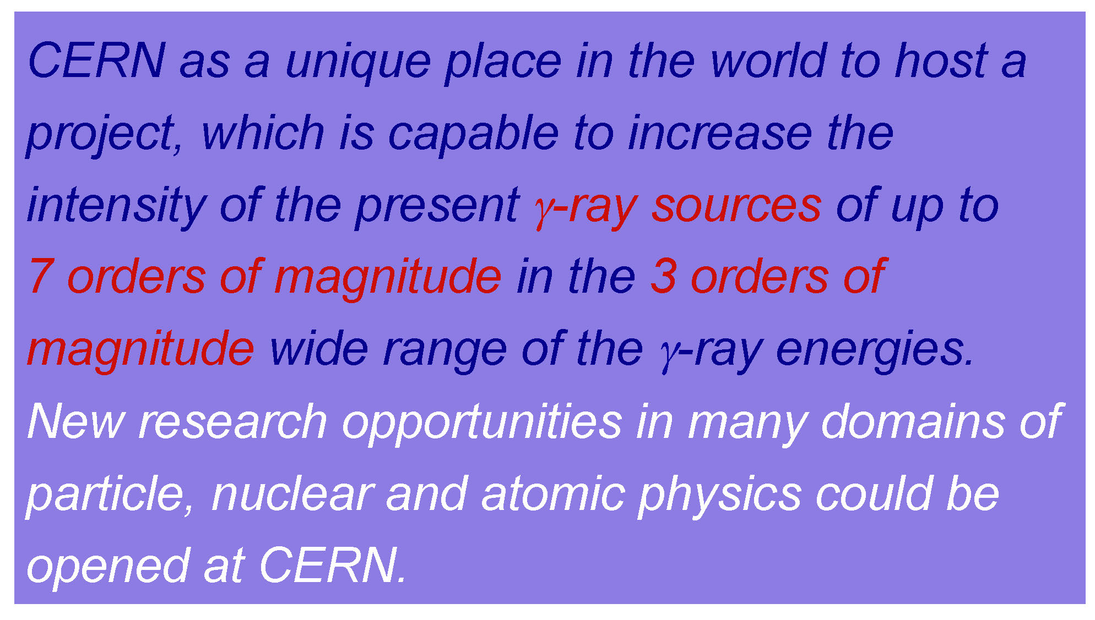
“Gamma factory” initiative
W. Krasny, PBC

Slide 39
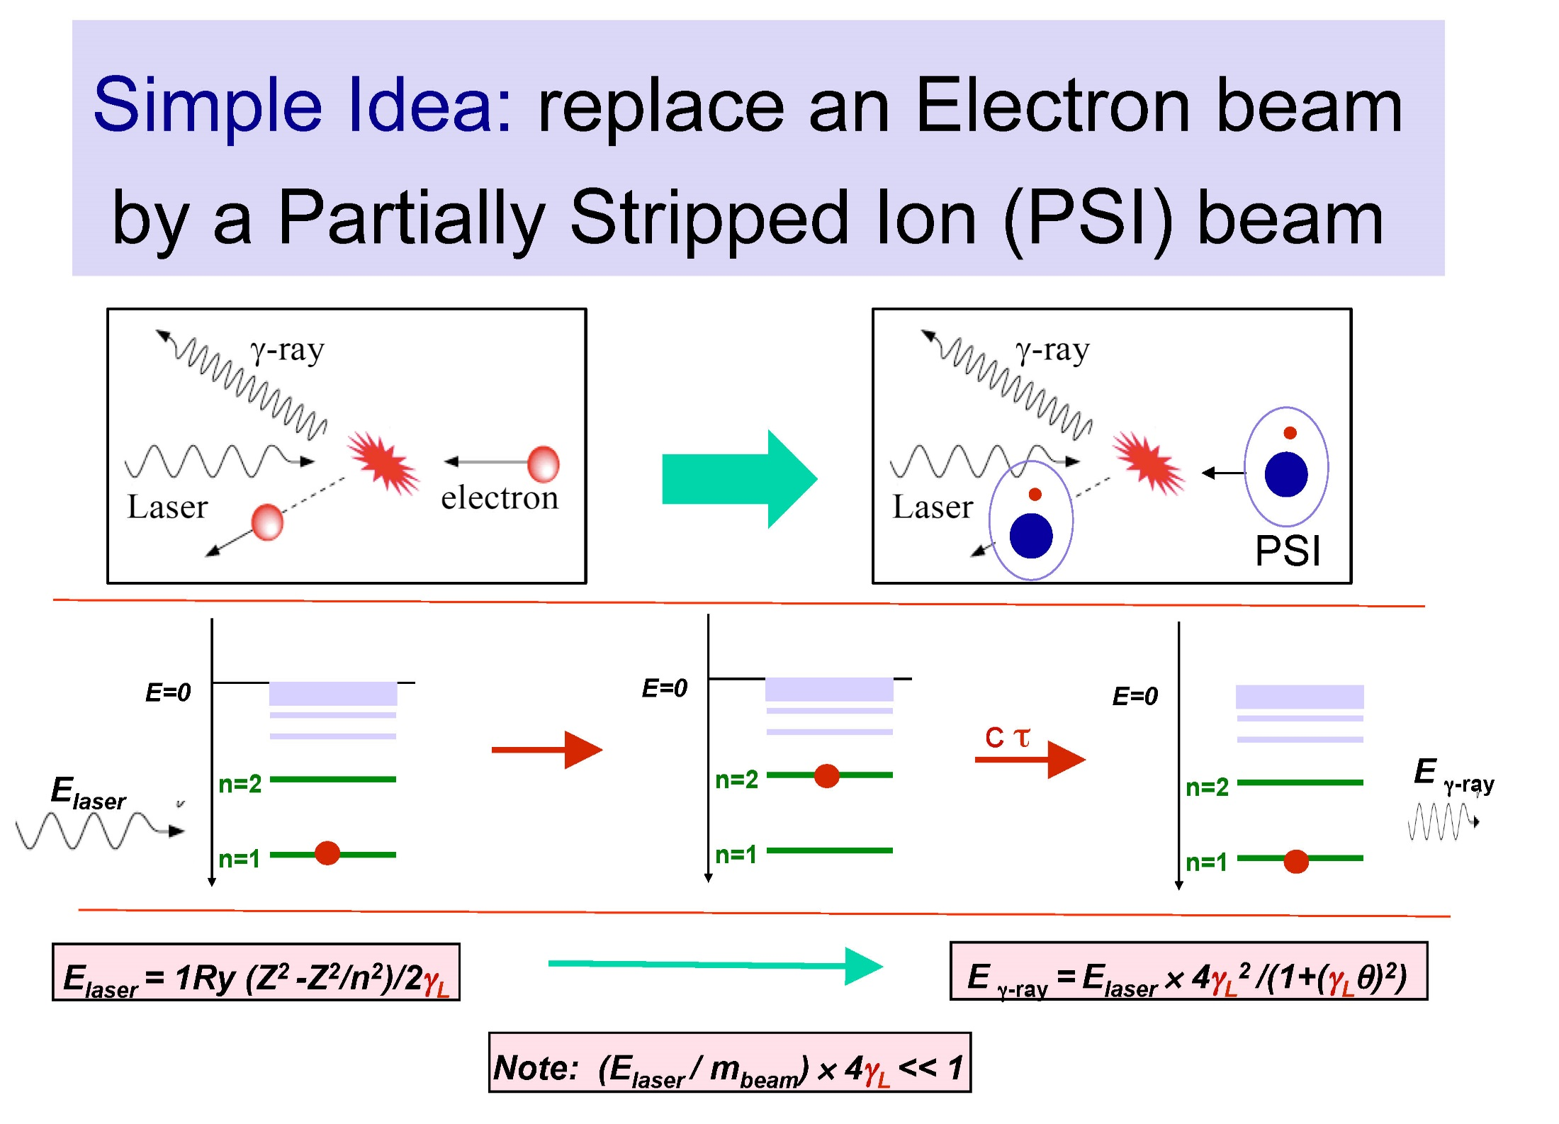
W. Krasny, PBC

Slide 40
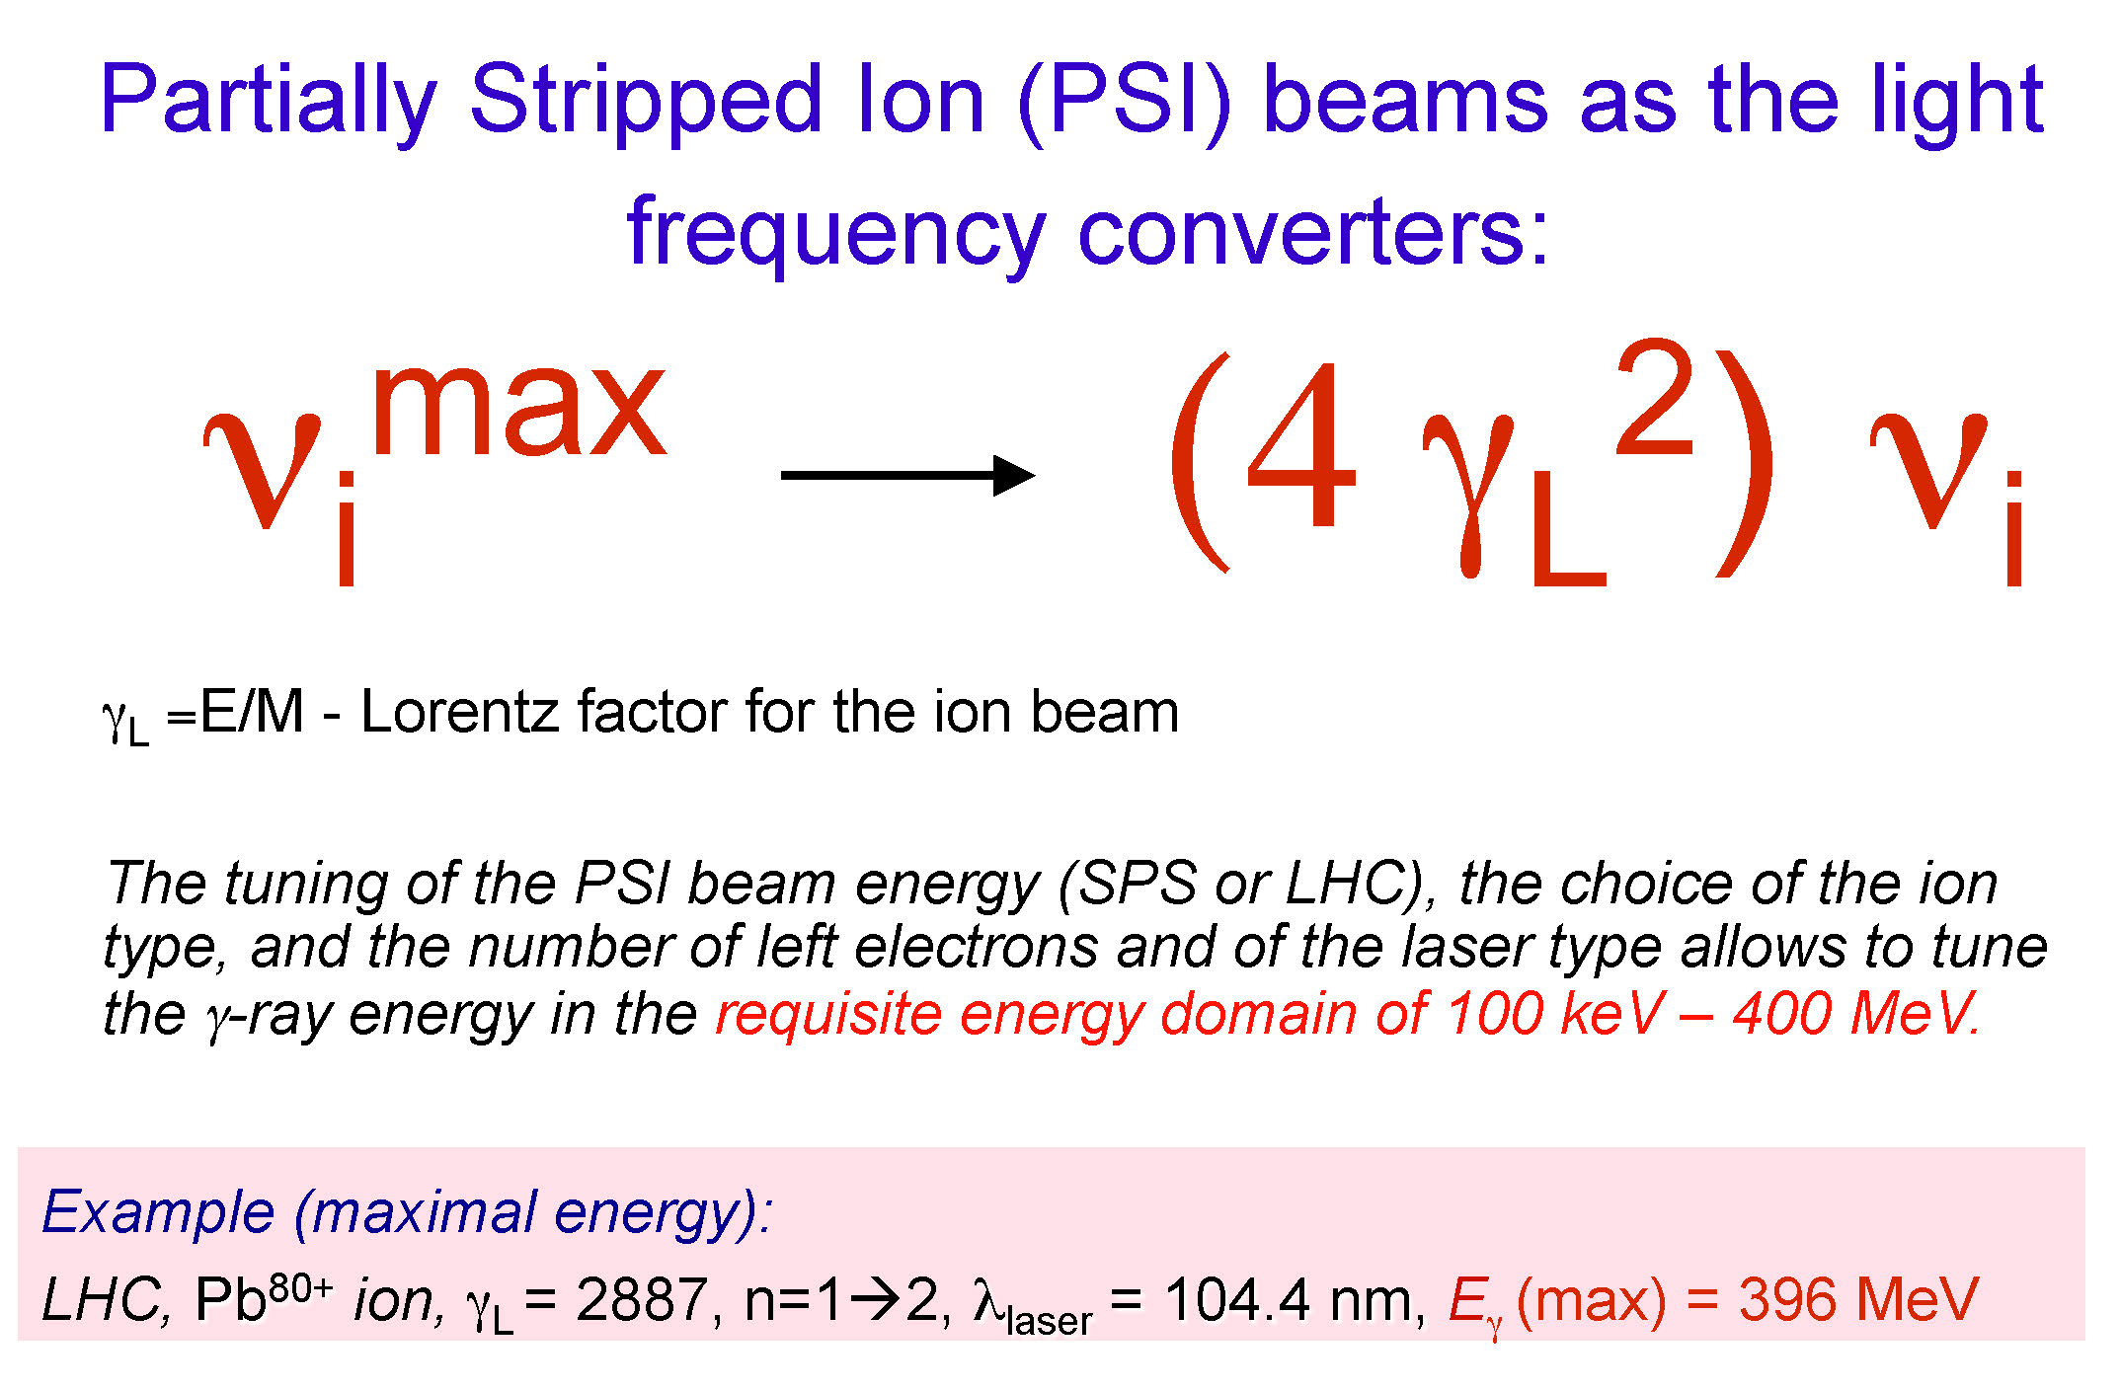
W. Krasny, PBC

Slide 41
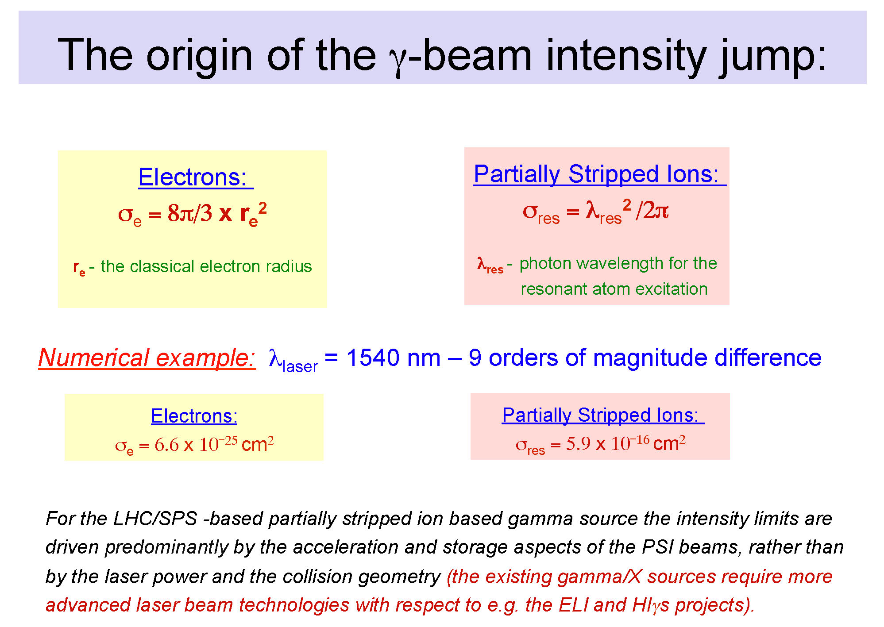
W. Krasny, PBC

Slide 42
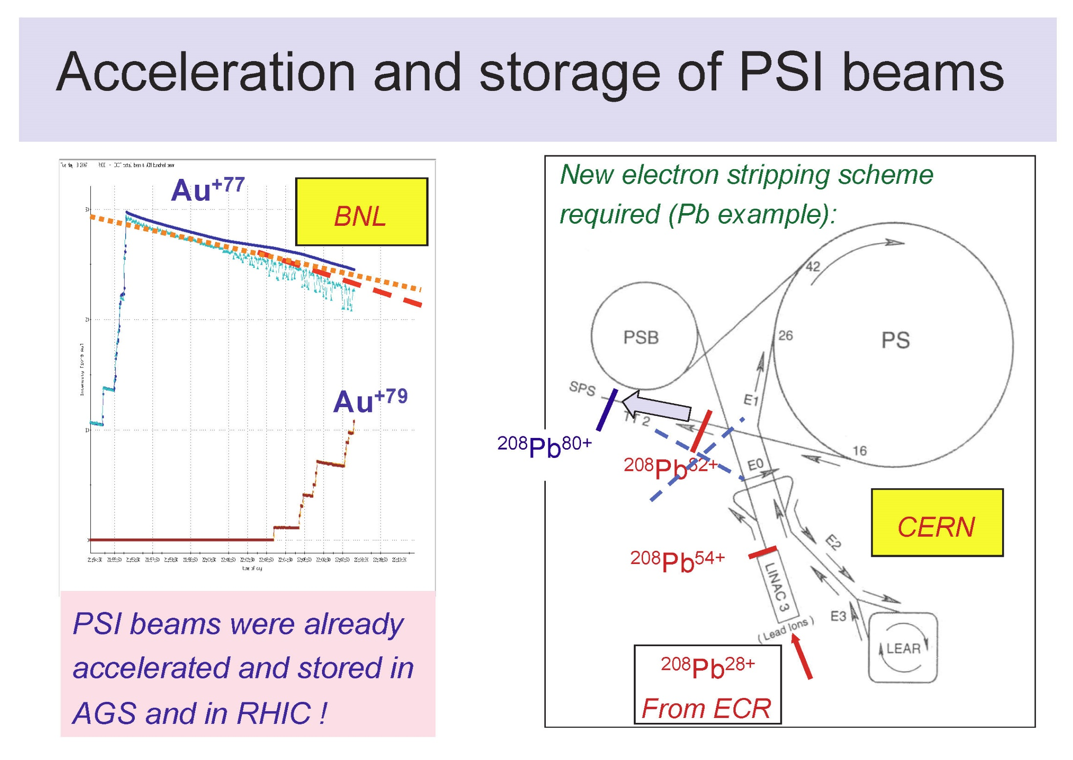
W. Krasny, PBC

Slide 43
“beams may be holding us back”
single particle accelerators
- wave function propagating through lattice
  use emerging ultra-cold and precision alignment technology (e.g. LIGO)
  cleaner, more customised physics output in detector, better luminosity (per particle) – perhaps get rid of beamstrahlung?
creating a big black hole (10⁶xE_{planck} in 10⁶xL_{planck})?
cheating with entanglement?
S. Brooks, F3iA 2016

Slide 44
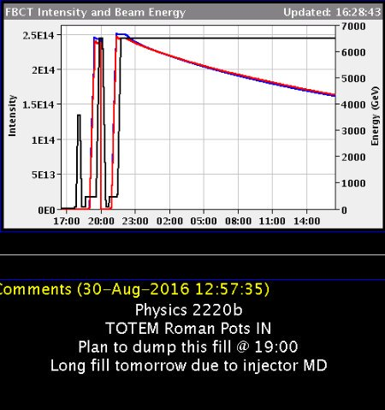
“the case for optimism”
2 * 2.5e14 * 6500 GeV
= 521 MJ
= 0.266 E_{Planck}
total energy is OK but it’s in too many particles
@JoshMcFayden (UCL/ATLAS) via Twitter
S. Brooks, F3iA 2016

Slide 45

Tokyo/Ueno – similar to Fallas
… but where/who is the European guy?

