Slide 1
Muon-Collider R&D Activities in Italy, and a Novel Muon Production Scheme
Manuela Boscolo (INFN-LNF)
on behalf of
Low EMittance Muon Accelerator (LEMMA) Study Group
Valencia, February 13 2017

Slide 2
Introduction
The muon based colliders have a great potential:
  they are the ideal technology to extend lepton high energy frontier in the multi-TeV range with reasonable dimension, cost and power consumption.
The feasibility of the muon beam technology has still to be demonstrated.
Muon source Options:
  CONVENTIONAL: Tertiary production through proton on target
  NOVEL : e⁺e⁻ annihilation: positron beam on target

Slide 3
Activity in Italy
In addition to C. Rubbia proposal for an experimental demonstrator on the parametric resonance cooling
We are studying a cooling-less muon source for muon collider based on a positron beam on target
  which would allow very low emittance of the μ+ μ- beams.
The key challenge of this proposal is the μ beam current:
  study of high momentum acceptance low emittance positron ring with thin target insertion
Low rate experimental test at CERN planned:
  μ+ μ− production from tertiary positron beam on target (CERN H4 beam line)
The design study is at an early stage, we are open to collaborations!

Slide 4
Proton-Based Source
Muon Accelerator Program (MAP) at Fermilab together with other muon based facilities carried on a design study
Key R&D Challenge:
  Source: MW proton driver, MW class target
  Cooling: high field solenoids (30T), High temp. SC, RF in magnetic field
    C. Rubbia R&D proposal: experimental demonstration of the parametric resonance cooling
  Fast acceleration: cost effective low RF SC fast pulsed magnet (1kHz)
  Backgrounds, μ decay: Detector/ Machine interface

Slide 5
Muon Accelerator Program (MAP)
Muon based facilities and synergies
Mark
Palmer
~10¹³-10¹⁴ μ / se
Tertiary prby MW p+
od.: pgπgFast μ: cosund
(1kHz0
Key Challenges
~10¹³-10¹⁴ μ / sec
Tertiary particle pgπgμ:
Fast cooling
(τ=2μs)
by 10⁶ (6D)
Fast acceleration
mitigating μ decay
Background
by μ decay
MW proton driver
MW class target
NCRF in magnetic field
Ionization cooling
High field solenoids (30T)
High Temp Superconductor
Cost eff. low RF SC Fast pulsed magnet
(1kHz)
Detector/machine
interface
Key R&D

Slide 6
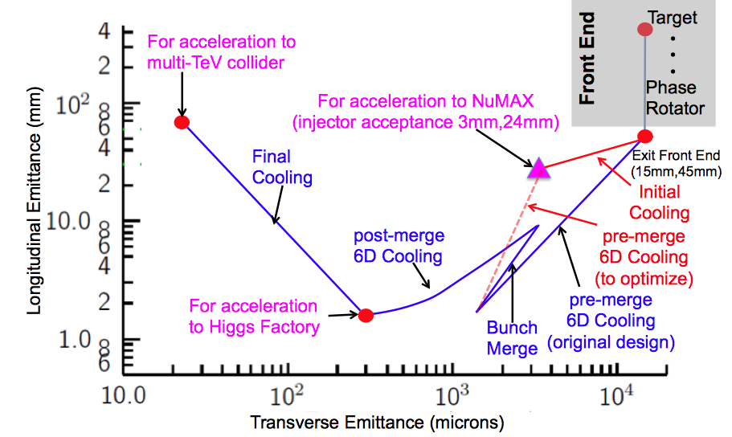
Muon Ionization Cooling
M. Palmer
Advanced techniques a
Improved HF Luminosity
Simplified Final Cooling requirements
MAP Higgs
Factory Target
PIC assumed in Carlo
Rubbia’s Proposal

Slide 7
3.-PIC, the Parametric Resonance Cooling of muons
C. Rubbia
Combining ionization cooling with parametric resonances is expected to lead to muon with much smaller transv. sizes.
A linear magnetic transport channel has been designed by Ya.S. Derbenev et al where a half integer resonance is induced such that the normal elliptical motion of particles in x-x' phase space becomes hyperbolic, with particles moving to smaller x and larger x' at the channel focal points.
Thin absorbers placed at the focal points of the channel then cool the angular divergence by the usual ionization cooling.
LEFT ordinary oscillations
RIGHT hyperbolic motion
induced by perturbations near an (one half integer) resonance of the betatron frequency.
x x’ = const
V. S. Morozov et al, AIP 1507, 843 (2012);

Slide 8
Details of PIC
C. Rubbia
Without damping, the beam dynamics is not stable because the beam envelope grows with every period. Energy absorbers at the focal points stabilizes the beam through the ionization cooling.
The longitudinal emittance is maintained constant tapering the absorbers and placing them at points of appropriate dispersion, vertical β and two horizontal β.
. Comparison of cooling factors (ratio of initial to final 6D emittance) with and without the PIC condition vs number of cells: more than 10x gain

Slide 9
Parametric Resonance Cooling
The first muon cooling ring should present no unexpected behaviour and good agreement between calculations and experiment is expected both transversely and longitudinally
The novel Parametric Resonance Cooling (PIC) involves instead the balance between a strong resonance growth and ionization cooling and it may involve significant and unexpected conditions which are hard to predict.
Therefore the experimental demonstration of the cooling must be concentrated on such a resonant behaviour.
On the other hand the success of the novel Parametric Resonance Cooling is a necessary premise for a viable luminosity of the initial proton parameters of the future CERN accelerators since the expected Higgs luminosity is proportional to the inverse of the transverse emittance, hence about one order of magnitude of increment is expected from PIC.
Carlo Rubbia – FNAL May 2015

Slide 10
Idea for low emittance μ beam
Conventional production: from proton on target
π, K decays from proton on target have typical P_{μ}~ 100 MeV/c (π, K rest frame)
whatever is the boost P_{T} will stay in Lab frame → very high emittance at production point → cooling needed!
Direct μ pair production:
Muons produced from e⁺e⁻→μ⁺μ⁻ at √s around the μ⁺μ⁻ threshold (√s~0.212GeV) in asymmetric collisions (to collect μ⁺ and μ⁻ )
NIM A Reviewer: “A major advantage of this proposal is the lack of cooling of the muons…. the idea presented in this paper may truly revolutionise the design of muon colliders … “

Slide 11
Muon Source: e⁺ on target (i.e. e⁺ on e⁻ at rest)
e+ on standard target, including crystals with channeling
  Need Positrons of ~45 GeV
  γ(μ)~200 and μ laboratory lifetime of about 500 μs
e+ on Plasma target (first simulation results were not encouraging because of the extreme density of the plasma needed)

Slide 12
Advantages:
Low emittance possible: Pμ is tunable with √s in e⁺e⁻→μ⁺μ⁻ Pμ can be very small close to the μ⁺μ⁻ threshold
Low background: Luminosity at low emittance will allow low background and low ν radiation (easier experimental conditions, can go up in energy)
Reduced losses from decay: muons can be produced with a relatively high boost in asymmetric collisions
Energy spread: Muon Energy spread also small at threshold, it gets larger as √s increases, one can use correlation with emission angle (eventually it can be reduced with short bunches)
Disadvantages (key challenge!):
Rate: much smaller cross section wrt protons
σ(e⁺e→μ⁺μ⁻) ~ 1 μb at most
i.e. Luminosity(e+e-)= 10⁴⁰ cm⁻² s⁻¹ → gives μ rates 10¹⁰ Hz
use e+ ring to reduce request on positron source

Slide 13
Muon Collider:
Schematic Layout for positron based muon source
Positron Beam
e+ ring
μ⁺
LHeC-class e+ source & e+ acceleration at 45 GeV
(circular/linear options)
μ⁻
isochronous rings
100 KW target
Key Challenges
~10¹¹ μ / sec from e+e-gμ+μ−
Key
R&D
10¹⁵ e+/sec, 100 kW class target, NON distructive process in e+ ring

Slide 14
Key Feasibility Issues
Positron Source
Muon Target
Positron Ring
HIGH rate
NEEDS
deep investigation
(design study)
Non destructive
Mom. acceptance
Targets survival
μ Acceleration
Collider Ring
Collider MDI
Collider Detector
(mostly) independent on muon source
Benefit from MAP studies

Slide 15
Conclusions
Very low emittance muon beams can be obtained by means of positron beam on target
Interesting muon rates require:
  Challenging positron source (synergy with LHeC, ILC…)
  Positron ring with high momentum acceptance (synergy with next generation SL sources)
  Challenging target system
Fast muon acceleration concepts deeply studied by MAP
Final focus design can profit of studies on conventional muon studies
Notes:
focus on the critical key points, but also have a baseline set of parameters and design,

Slide 16
Back-up

Slide 17
Exploring the potential for a
Low Emittance Muon Collider
with muon source from e⁺ beam on target
References:
    M. Antonelli, “Muon Collider Status”, NuFact (2016)
    M.Antonelli, “Very Low Emittance Muon Beam using Positron Beam on Target”, ICHEP (2016)
    M.Antonelli, E.Bagli, M.Biagini, M.Boscolo, G.Cavoto, P.Raimondi and A.Variola, “Very Low Emittance Muon Beam using Positron Beam on Target”, IPAC (2016)
    M. Antonelli, “Performance estimate of a FCC-ee-based muon collider”, FCC-WEEK 2016
    M. Antonelli, “Low-emittance muon collider from positrons on target”, FCC-WEEK 2016
    M. Antonelli, M. Boscolo, R. Di Nardo, P. Raimondi, “Novel proposal for a low emittance muon beam using positron beam on target”, NIM A 807 101-107 (2016)
    P. Raimondi, “Exploring the potential for a Low Emittance Muon Collider”, in Discussion of the scientific potential of muon beams workshop, CERN, Nov. 18th 2015
    M. Antonelli, Presentation Snowmass 2013, Minneapolis (USA) July 2013, [M. Antonelli and P. Raimondi, Snowmass Report (2013) also INFN-13-22/LNF Note
    After this Snowmass2013 presentation, SLAC team investigated this idea:
  L. Keller, J. P. Delahaye, T. Markiewicz, U. Wienands:
    “Luminosity Estimate in a Multi-TeV Muon Collider using e⁺e⁻→ μ⁺μ⁻ as the Muon Source”, MAP 2014 Spring workshop, Fermilab (USA) May ’14
    Advanced Accelerator Concepts Workshop, San Jose (USA), July ‘14

Slide 18

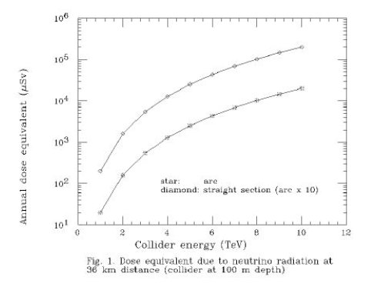
Annual dose
Straight section
p on target
arc
1 mS/year
Straight section
e⁺ on target
arc
muon rate: p on target option 3 10¹³ μ/s
e⁺ on target option 9 10¹⁰ μ/s

Slide 19
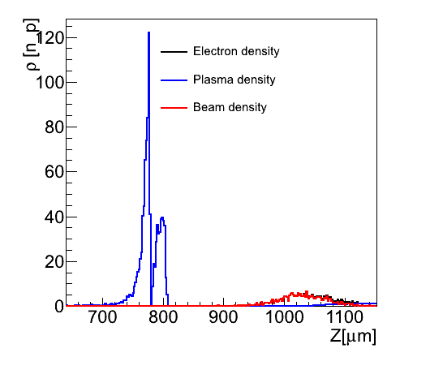
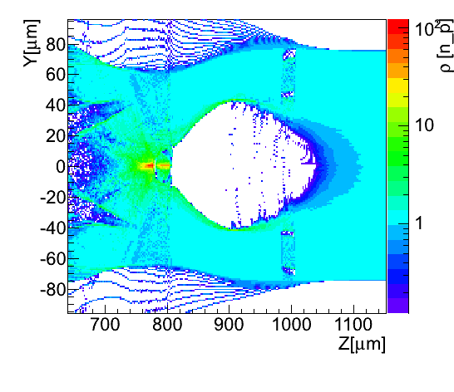
A quasi Ideal e- target: Few statements on the plasma option
Plasma would be a good approximation of an ideal electron target ++ autofocussing by Pinch effect
enhanced electron density can be obtained at the border of the blow-out region (up x100)
Simulations for n_{p}=10¹⁶ electrons/cm³ (C. Gatti, P. Londrillo)
  ρL~10 ²⁵ cm⁻² ρ∼10¹⁸ e+/cm³ L~ 10⁷cm
Region size decreases with 1/√n_{p} even don’t know if blowout occurs at n_{p}~10²⁰electrons/cm³

