Slide 1
Space charge and electron cloud in the CERN accelerators
G. Rumolo
With the input of H. Bartosik, G. Iadarola, K. Li, L. Mether, A. Romano, M. Schenk
EuCARD-2 XBEAM Strategy Workshop, Valencia, Spain, 13/02/2017

Slide 2
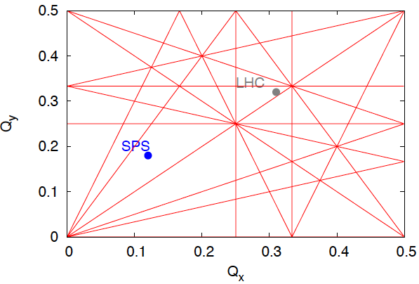
Beam brightness limitation due to direct space charge
Tune spread is proportional to beam brightness
y
z
x
Particles oscillating close to the bunch peak density

Slide 3
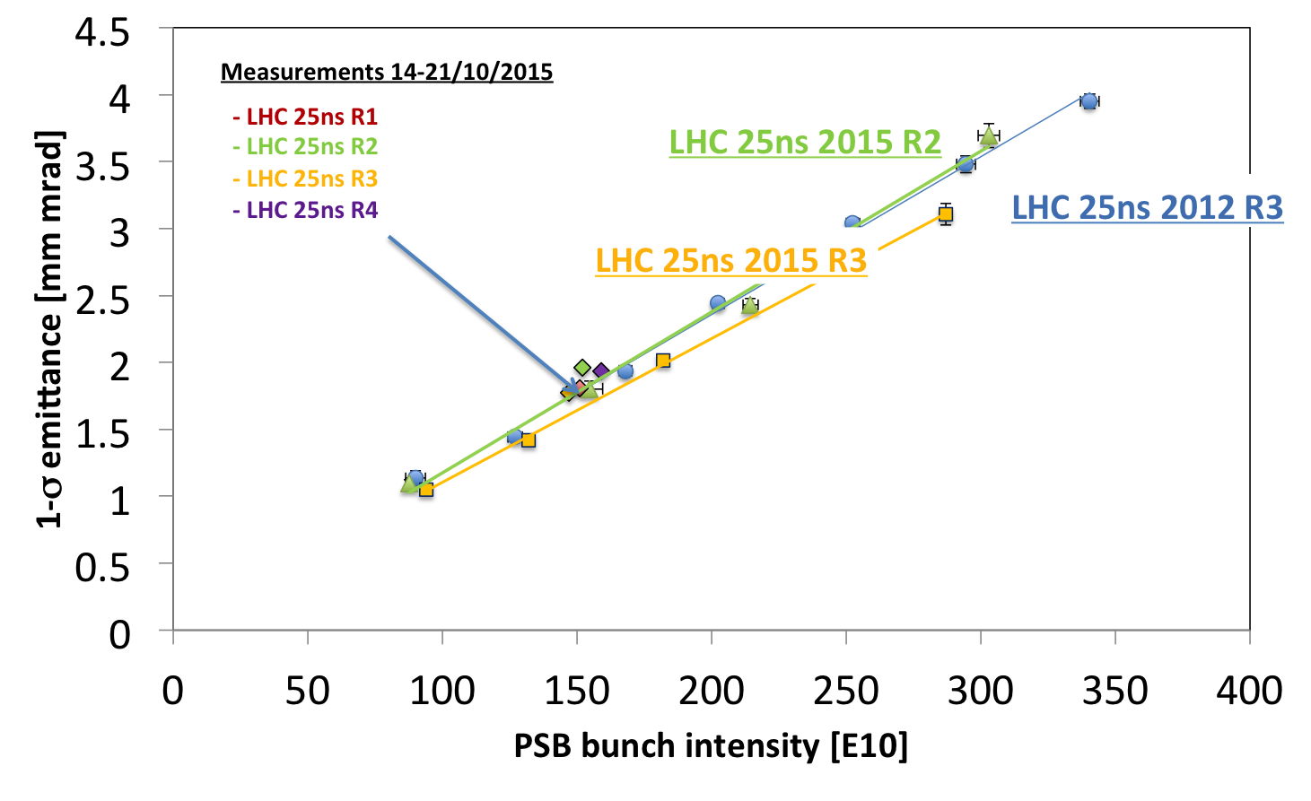
Beam brightness limitation due to direct space charge
Tune spread is proportional to beam brightness
We need to stay clear of resonances, else
  Blow-up (e.g. from integer)
  Beam losses
  Emittance increases with intensity
LHC injectors
  Suffer space charge mainly at low energy
  Long injection plateau for multiple injections → very challenging for beam degradation
  Tune areas to be carefully determined to allow reaching the required performance
  Future beam requirements pose a big challenge!
  Space charge can remain a limitation even at higher energy due to increasing circumference and short bunch length (high peak currents)

Slide 4
Space charge activities at CERN
Space charge important subject at CERN in view of the upgrade of the accelerators of the LHC injectors chain (LIU project)
Experimental observations and studies
  Space charge effects in the injector chain (PSB, LEIR, PS, SPS)
    Study of beam loss and emittance growth on long injection plateaus (working point dependence, resonance characterisation)
    Dedicated experiments with purposely excited nonlinearities
    Assessment of brightness limitations in the different machines
  Mitigation techniques, e.g. hollow bunches, second harmonic, resonance compensation, enhanced dispersion
Numerical simulations
  Several codes presently used (PTC-ORBIT/PyORBIT, MAD-X space charge, PyHEADTAIL) or collaborations (e.g. with G. Franchetti – MICROMAP)
  Interest in assessing both incoherent effects over long times and effect of space charge on coherent effects

Slide 5
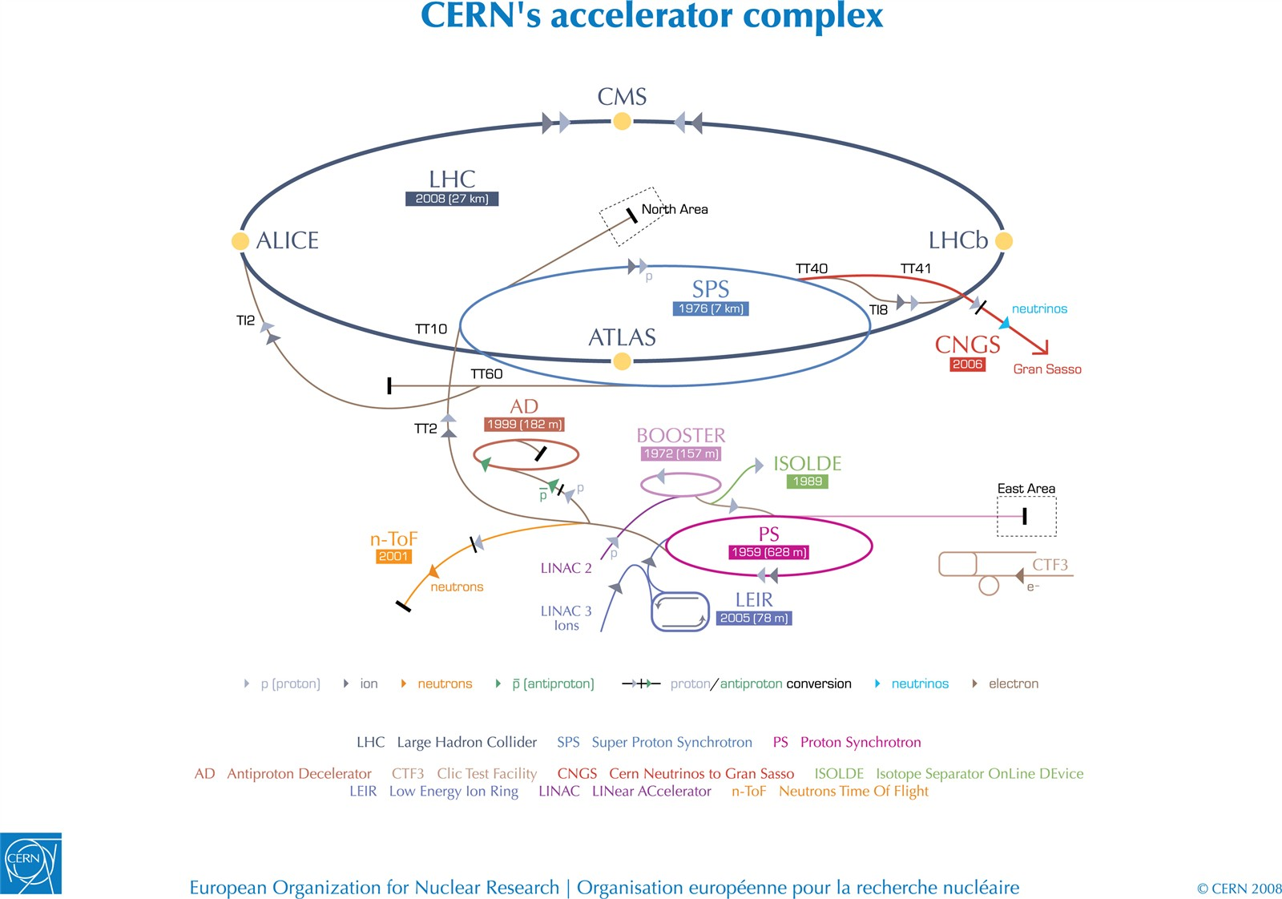

Slide 6
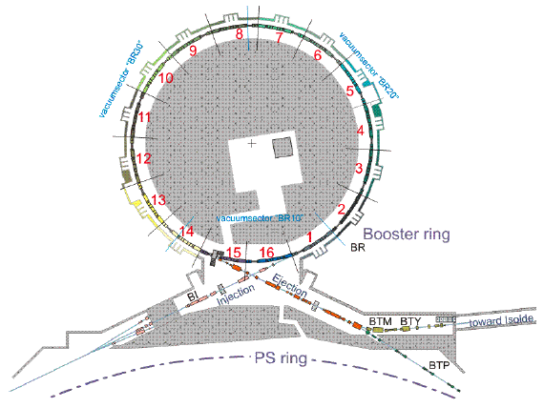
The PSB
C = 157 m
From Linac2
E_{kin} =50 MeV
To PS
E_{kin} =1.4 GeV

Slide 7
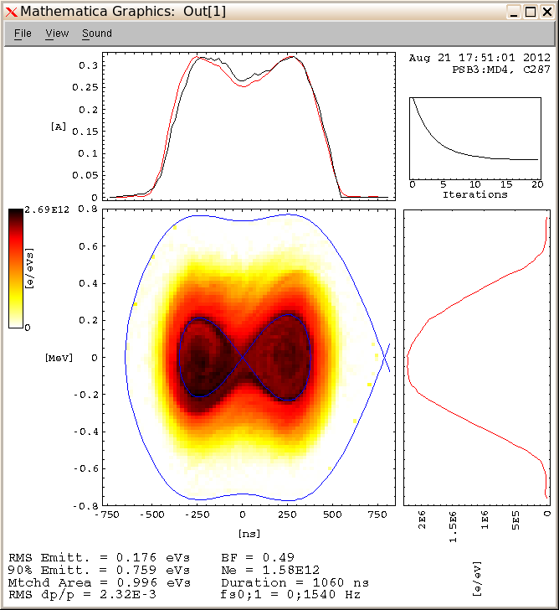
The PSB
β
Extraction@805
PSB acceleration cycle
Injection@275
Space charge eased at low energy thanks to the double harmonic and flattened bunch profile
No plateau at injection energy alleviates space charge effects due to rapid acceleration

Slide 8
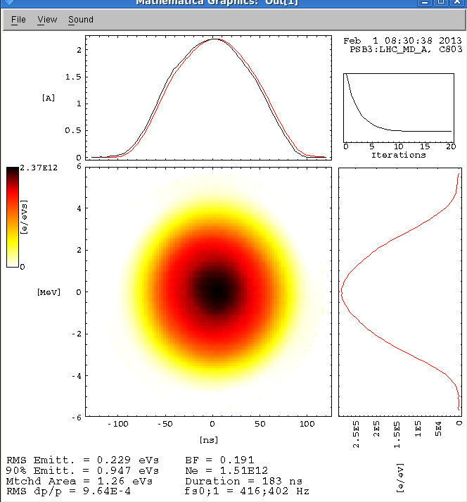
The PSB
β
Extraction@805
PSB acceleration cycle
Injection@275
Tune spreads about 3-5x lower (from βγ², bunch length and longitudinal distribution)
Six of these bunches are then sent to the PS over two successive injections (4 + 2)

Slide 9
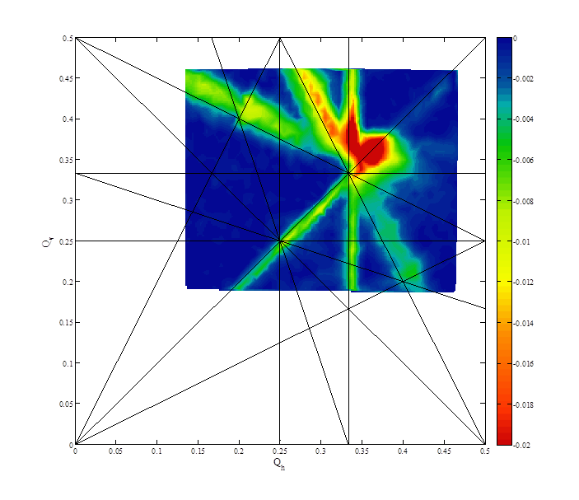
The PSB
Injection
Dynamic working point
Multipoles are used to compensate for resonances and limit losses along the cycle
Injection at 160 MeV from Linac4 will preserve the tune spreads for double intensity (βγ² will be half)
Extraction

Slide 10
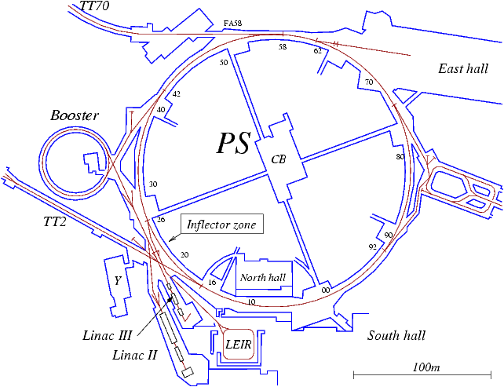
The PS
From PSB
E_{kin} =1.4 GeV
C = 628 m
To SPS
p₀ =26 GeV/c

Slide 11
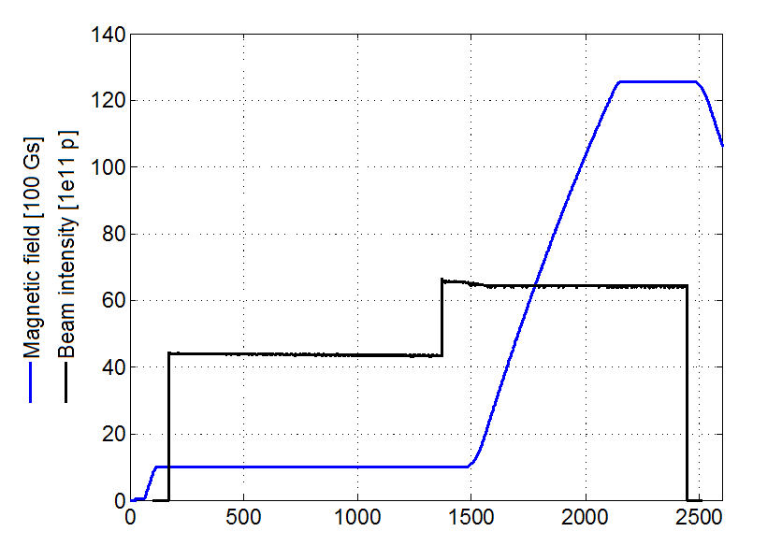
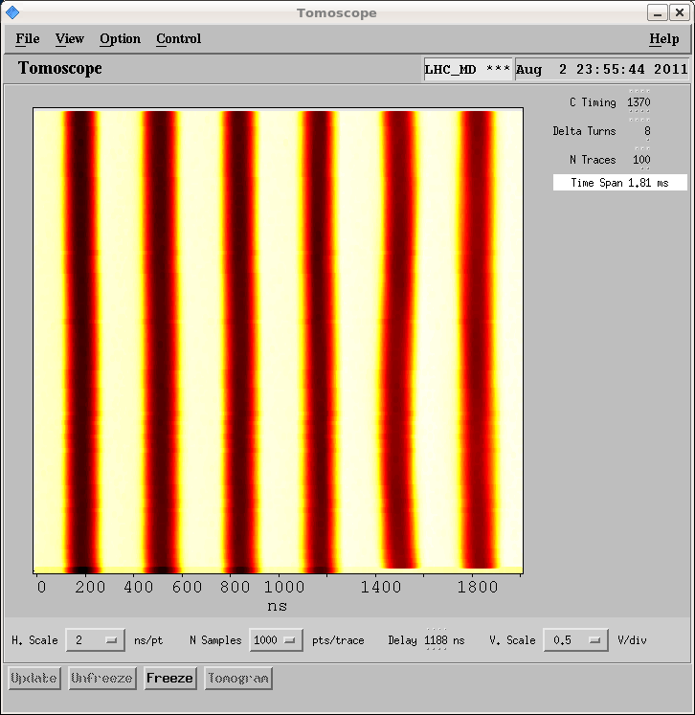
The PS
PS acceleration cycle (LHC beams)
First train of four bunches from the PSB sits for 1.2 s waiting for the second train
After second injection, there is the triple splitting and acceleration (mitigated space charge)

Slide 12
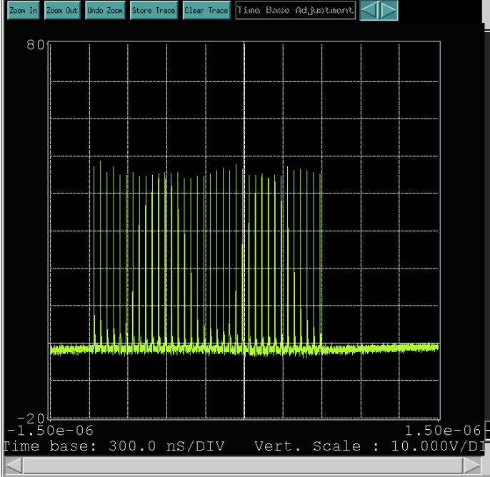
The PS
PS acceleration cycle (LHC beams)
Acceleration, diluted longitudinal emittances strongly reduce space charge along the cycle
Before extraction there is a fast bunch rotation to fit the bunches into the 5 ns buckets of the SPS

Slide 13
The PS
Nominal tune in “resonance free” region
Tune spread necktie from space charge extends by ~0.30 in the vertical plane for LHC beams
Spread fits tightly between integer resonance and 6.25 structure resonance

Slide 14
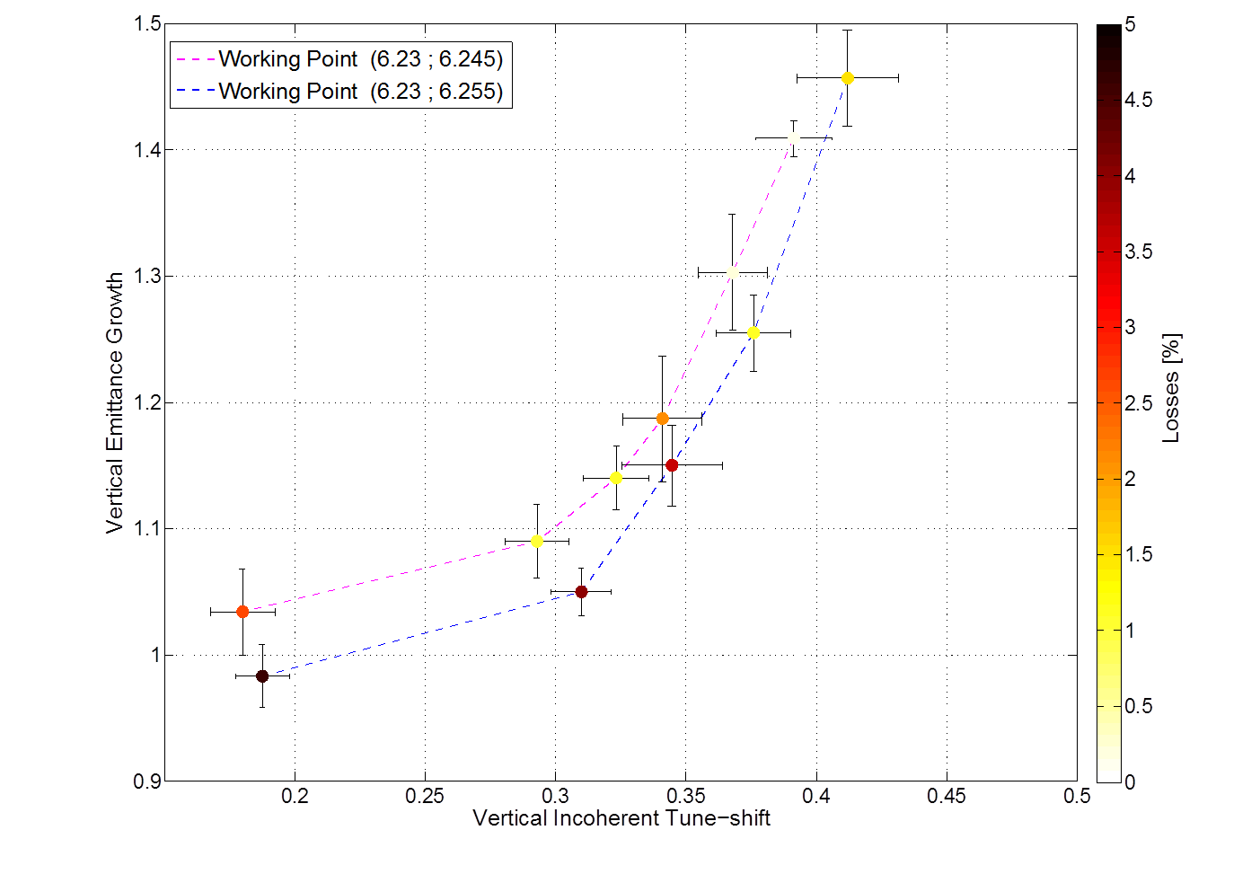
The PS
Measurements of losses and emittance growth for different tune spreads reveal the effects of resonance crossing
To guarantee 5% loss and emittance growth we are limited to 0.31 tune spread with a ‘high’ working point
Assuming 0.31 as a brightness limit for the PS, the increase of the injection energy to 2 GeV and the transfer of larger longitudinal emittance bunches will provide the margin to double the intensity injected into the PS

Slide 15
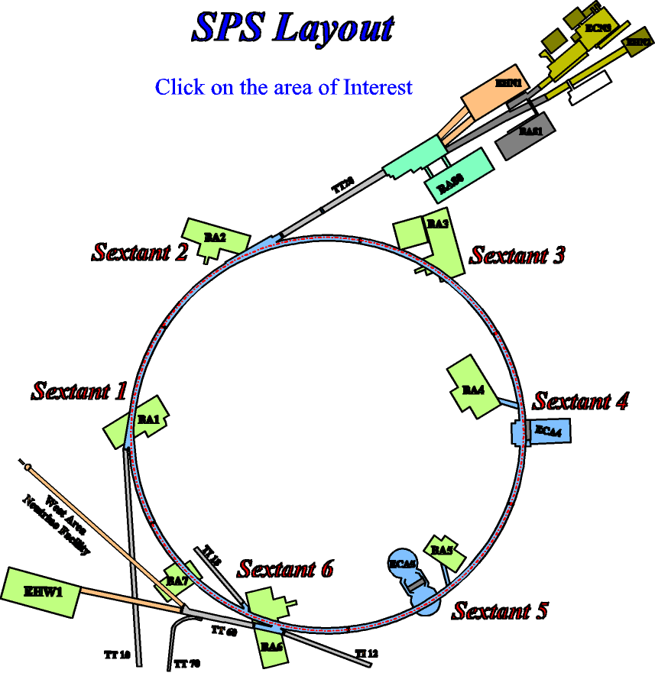
The SPS
C = 6911 m
From PS
E_{kin} =25 GeV

Slide 16
The SPS
Different types of beams produced by the PS (50 and 25 ns, trad, BCMS)
Quoted values are for the ‘worst’ beams now, i.e. 50 ns or future (LIU) 25 ns beams
First trains of 36 (24) or 72 (48) bunches from the PS sit for several seconds at injection energy

Slide 17
The SPS

Slide 18
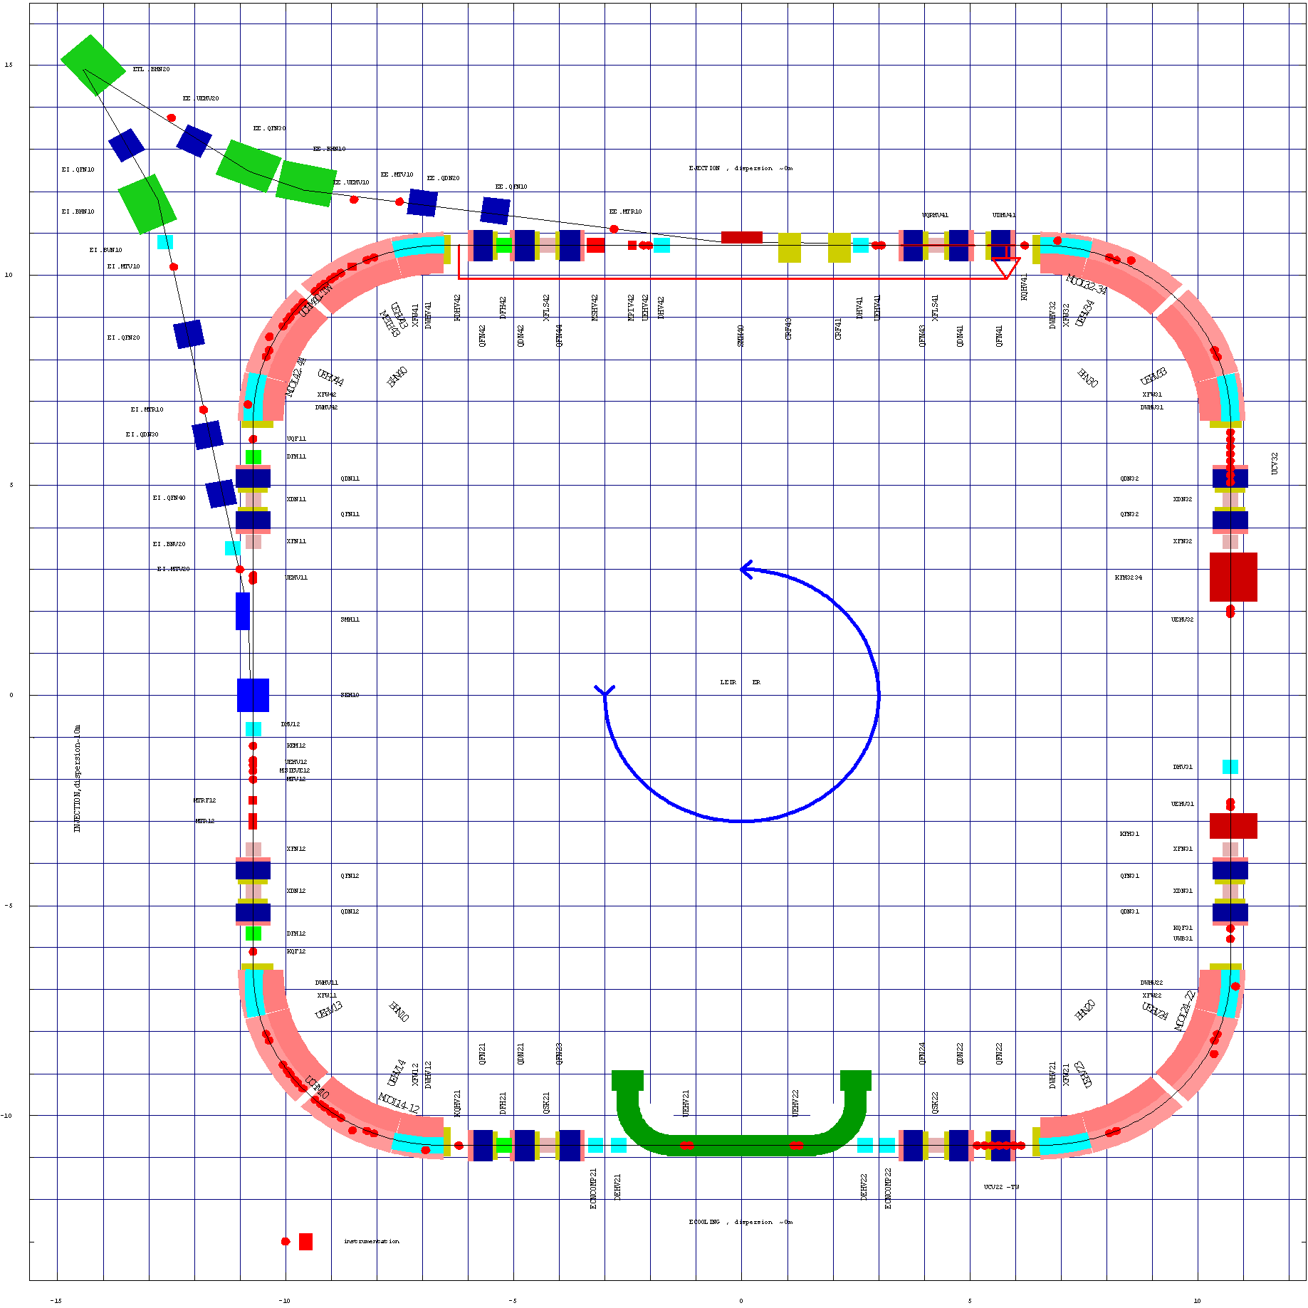
The LEIR
C = 78 m
To PS
E_{kin} =72 MeV/u
From Linac3
E_{kin} =4.2 MeV/u

Slide 19
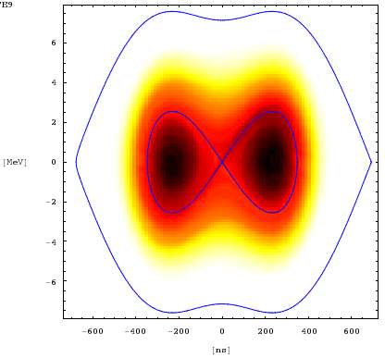
The LEIR cycle
Electron cooling:
Coasting beam
RF capture: h=2 and double harmonic
Multi-turn injections:
6D painting with typical efficiency of 50-70%
E_{ext} = 72 MeV/n
E_{inj} = 4.2 MeV/n
Longitudinal Schottky spectrum: cooling, dragging and stacking
Regime of beam loss

Slide 20
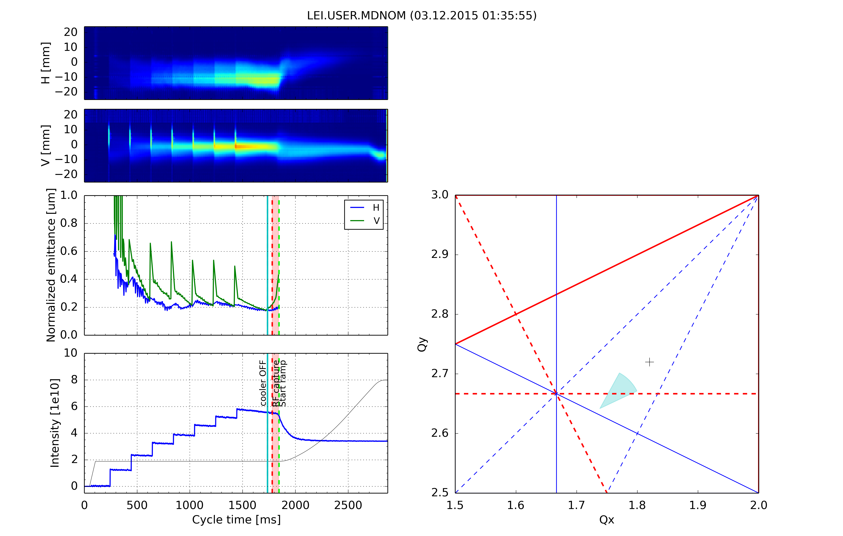

The LEIR

Slide 21
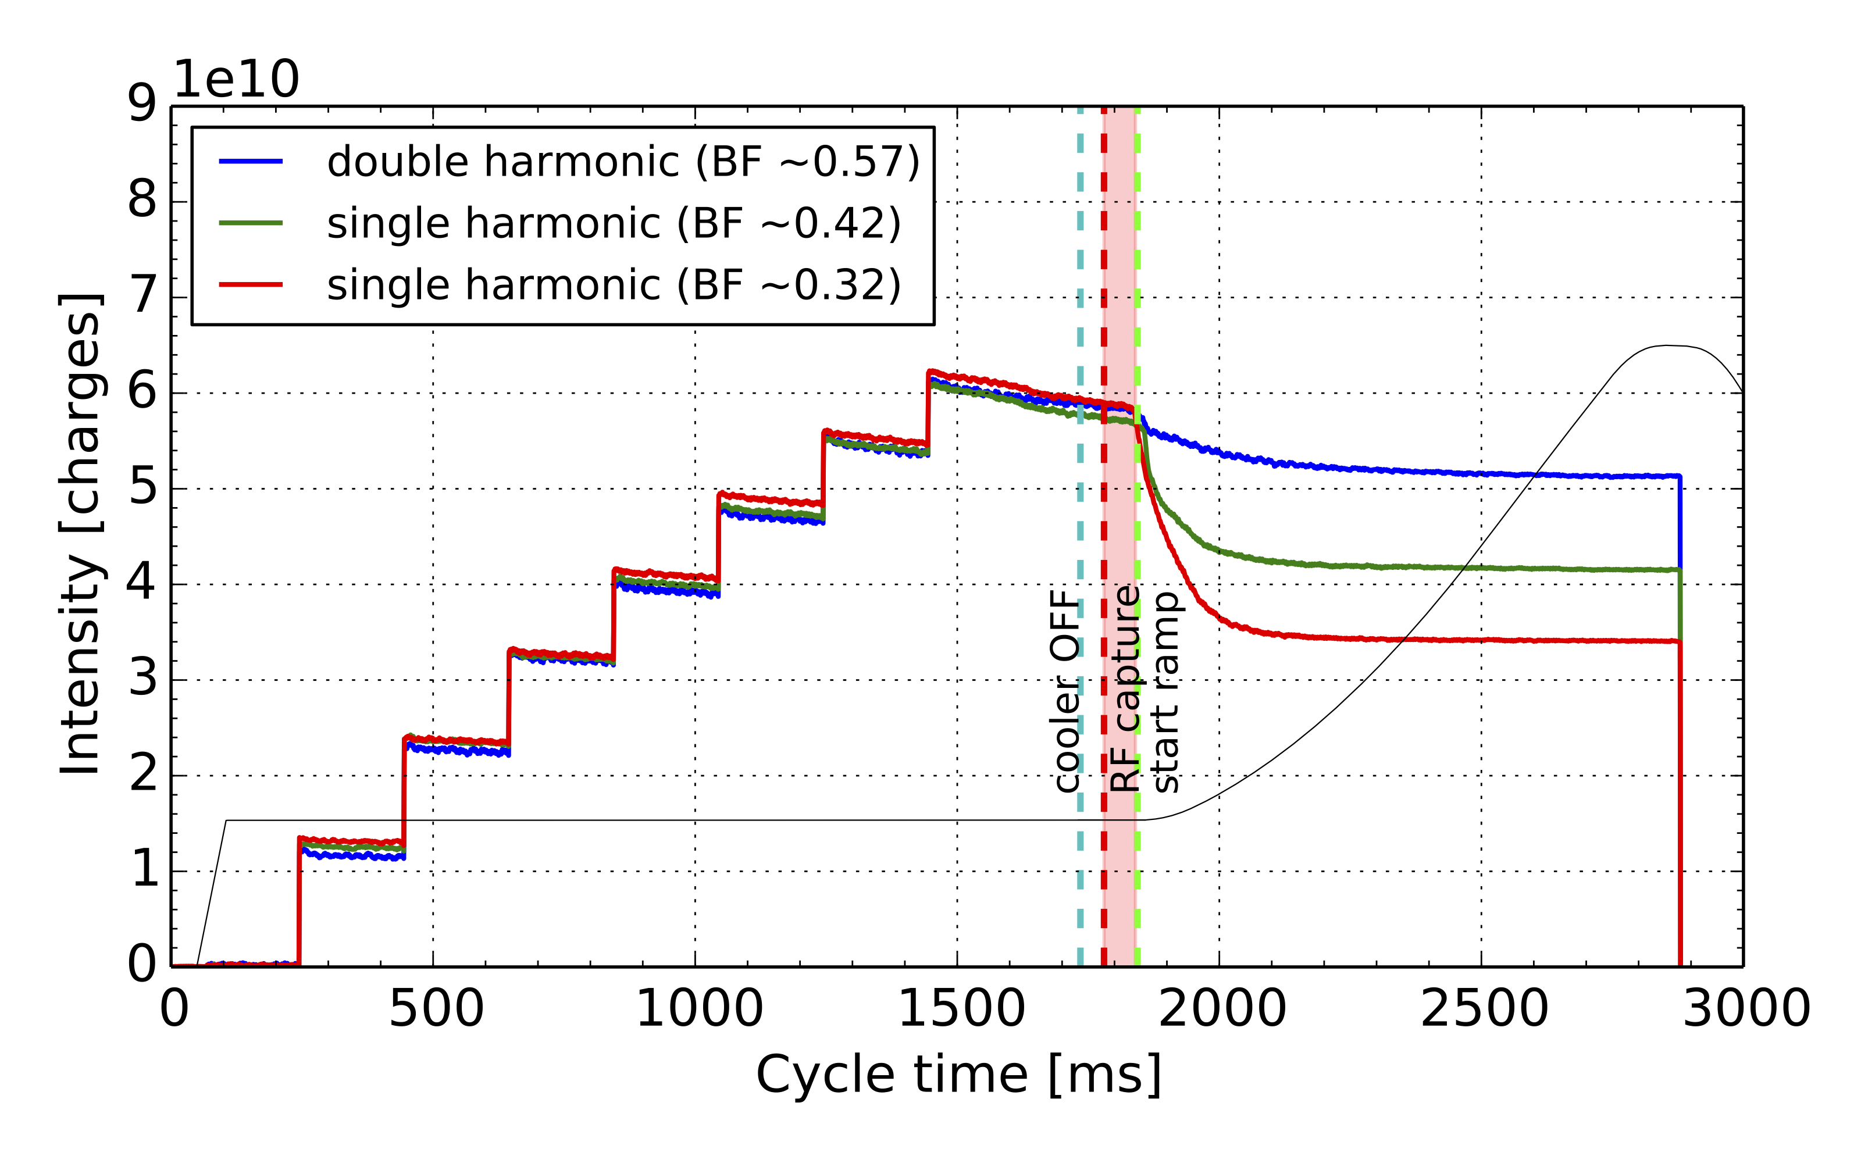
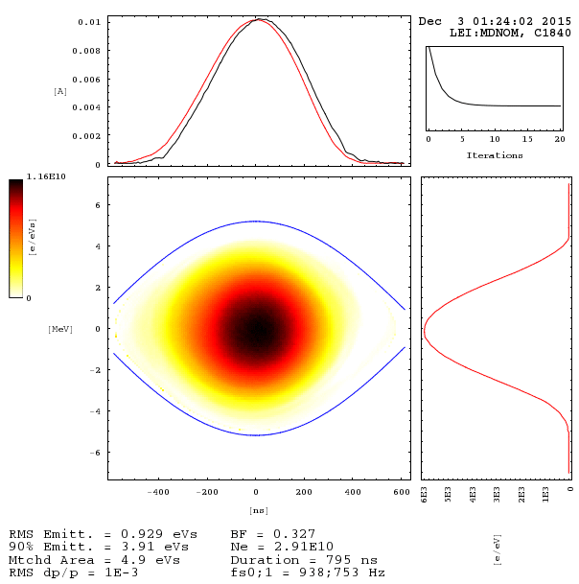
The LEIR
Iso-adiabatic capture in single/double RF with and without longitudinal blow-up
  Clear dependence of losses on line charge density

Slide 22
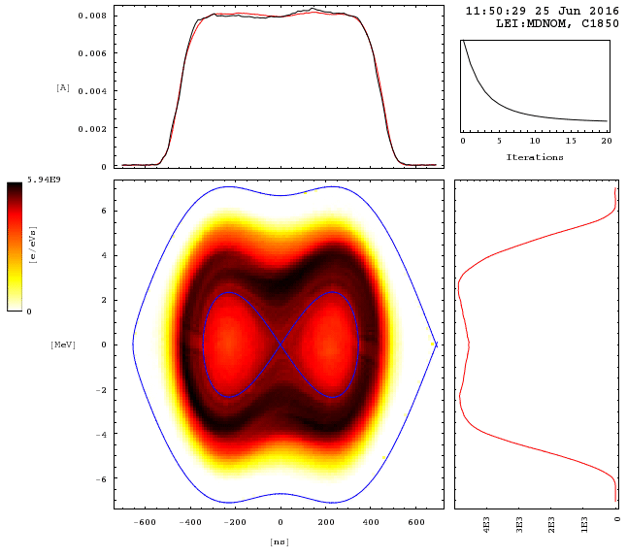
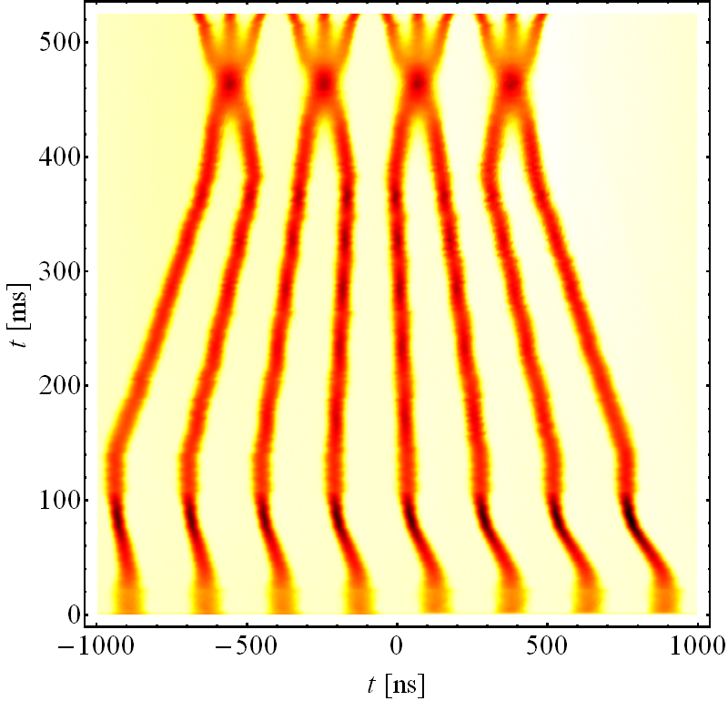
Space charge mitigation techniques
Increase of injection energy
Reduction of peak line density (flat profile)
  Maximize bunch length
  Flat bunches with longitudinal hollow distribution
  generated by parametric resonance in single harmonic
  Off-energy RF capture of coasting beam in double RF
Overcome low energy brightness limitation by longitudinal
bunch merging at intermediate energy plateau
Optimization of working point and compensation of
betatron resonance to reduce losses and blow-up
Compensation of space charge forces
  Studies of using e-lenses (e.g. proof-of-principle experimental studies at GSI)
  Use of RFQ?
Optics optimization (e.g. large horizontal and/or vertical dispersion)

Slide 23
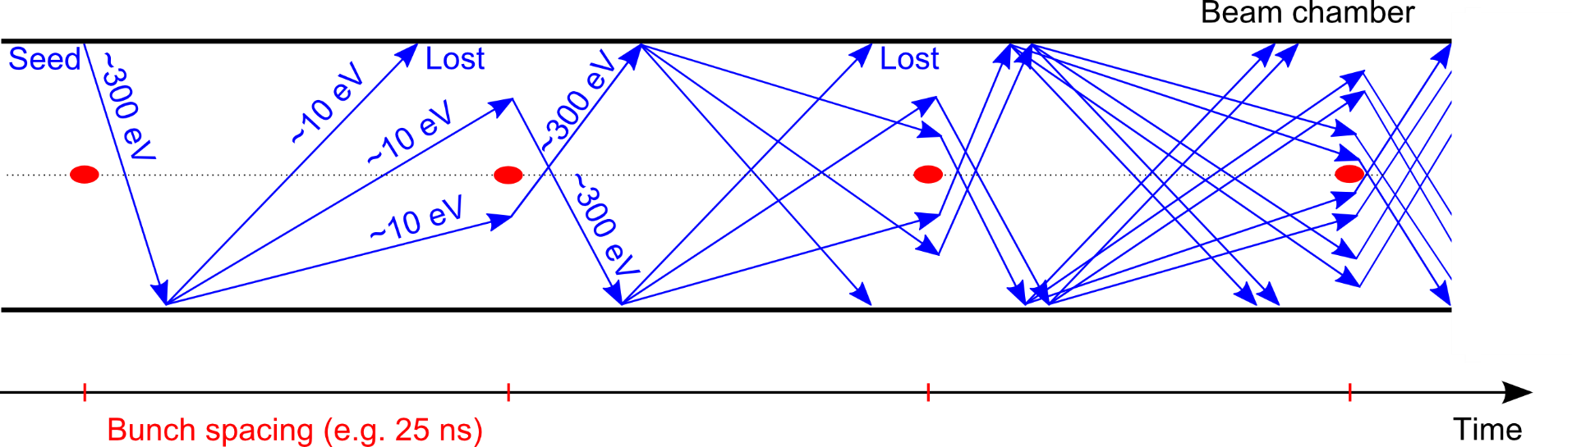

Electron cloud in one slide
    e⁻ is emitted (photoelectric effect)
    Secondary Electron Emission can drive an avalanche multiplication effect filling the beam chamber with an electron cloud
    Proton bunch
    Secondary Electron Emission
Trailing bunches of the train interact with a dense e-cloud
Transverse instabilities, energy loss
Transverse emittance blow-up
Particle losses
e-cloud induces other unwanted effects like:
Heat load on the beam chambers
Vacuum degradation
Something like this…

Slide 24
Electron cloud activities at CERN
Electron cloud is a key subject for both the upgrade of the LHC injectors chain (PS and SPS) within LIU, and for the HL-LHC era, due to the limitations observed in LHC
Experimental observations and studies
  Direct electron cloud measurements with dedicated detectors (shielded pick ups, strip monitors)
  Monitoring of other electron cloud observables: vacuum rise, heat load in LHC cold regions, stable phase shift along a bunch train
  Electron cloud effects on the beam → fast beam instabilities, emittance growth, poor lifetime
  Scrubbing runs in SPS and LHC: strategies, beam parameters, machine settings
  Laboratory measurements of scrubbing curves (different surfaces, conditions, etc)
  Mitigation techniques and their assessment in the machines, e.g. coating, LESS, clearing electrodes

Slide 25
Electron cloud activities at CERN
Numerical simulations
  Development, optimization and massive application of build up code PyECLOUD
    It has required steady development over the years to include all required features (e.g. import measured beam structures, load arbitrary magnetic field configurations, use arbitrary chamber shapes with holes and non-uniform SEY, simulate chambers with two beams, handle limiting cases of tiny beams in large chambers, etc.)
  Development, optimization and massive application of beam dynamics code PyHEADTAIL (interaction between beam and electron cloud)
    To study both coherent and incoherent effects, establish instability thresholds, produce tune footprints
  Integration of build up and beam dynamics simulations into a single tool
    Use PyECLOUD module in PyHEADTAIL for electron tracking
    Use snapshot distributions from PyECLOUD to initialise electrons in PyHEADTAIL
    Eventually run build up and beam dynamics simulations self-consistently to study multi-bunch effects → parallelisation, being tested

Slide 26
Electron cloud activities at CERN
Experimental studies (BE/ABP, BE/RF, BE/OP, TE/VSC, TE/CRG)
Direct electron cloud measurements
Monitoring of electron cloud observables
Electron cloud effects on the beam
Scrubbing runs in SPS and LHC and strategies
Laboratory measurements of SEY and scrubbing
Coating and mitigation techniques (LESS, clearing electrodes)
Numerical simulations (BE/ABP)
PyECLOUD
PyHEADTAIL
Integration of build up and beam dynamics simulations into a single tool
Interpretation, planning, steering
Modeling, benchmarking, steering

Slide 27
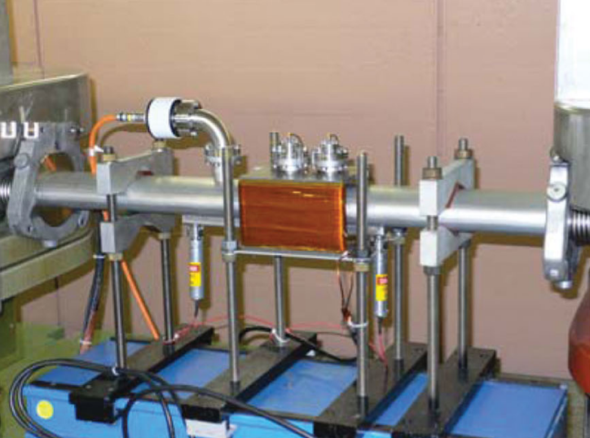
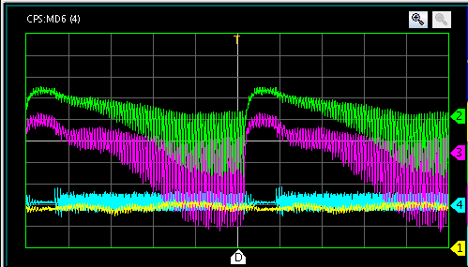
Electron cloud in the PS
Most of the direct electron cloud measurements in the PS were made in a straight section equipped with shielded pick ups
However, the electron cloud is expected in the main magnet units (combined functions) for 25 ns beams and SEY of the surface above 1.5

Slide 28
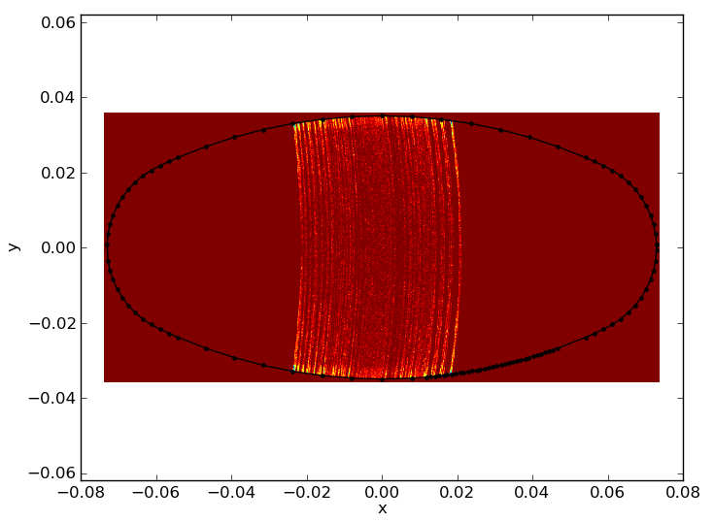
Electron cloud in the PS
Most of the direct electron cloud measurements in the PS were made in a straight section equipped with shielded pick ups
However, the electron cloud is expected in the main magnet units (combined functions) for 25 ns beams

Slide 29
Electron cloud in the PS
Most of the direct electron cloud measurements in the PS were made in a straight section equipped with shielded pick ups
However, the electron cloud is expected in the main magnet units (combined functions) for 25 ns beams
300
4 ns
250
200
40 MHz RF Voltage [kV]
150
100
11 ns
50
b.l.≈14 ns
0
10
20
30
40
50
60
Time [ms]

Slide 30
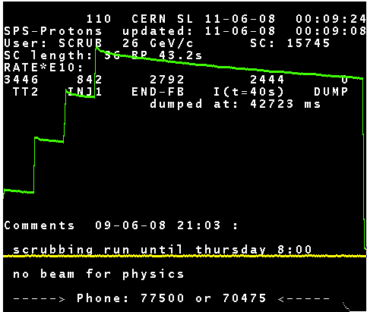
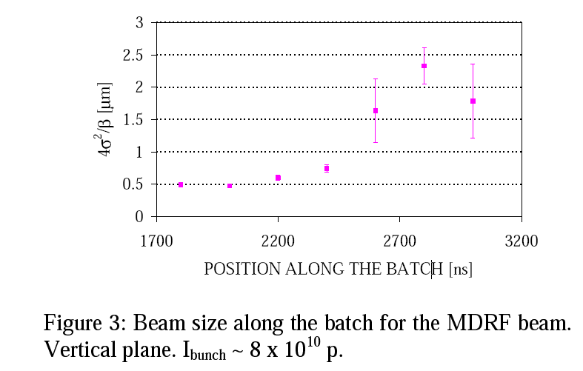
Electron cloud in the SPS
Strong limitation due to e-cloud with 25 ns beams until ~2011
  Instabilities at injection + incoherent effects: high chromaticity needed
  Severe pressure rise around the machine
  Strong emittance growth along bunch trains
  Scrubbing runs since 2002 with long cycles at 26 GeV/c
  Typically limited by heating/outgassing of specific elements
2000 (48 b. - 0.8x10¹¹ p/b @inj.)
400%
3.5 μm
43.2 s

Slide 31
Electron cloud in the SPS
Strong limitation due to e-cloud with 25 ns beams until ~2011
  Instabilities at injection + incoherent effects: high chromaticity needed
  Severe pressure rise around the machine
  Strong emittance growth along bunch trains
  Scrubbing runs since 2002 with long cycles at 26 GeV/c
  Typically limited by heating/outgassing of specific elements
Several years with systematic scrubbing runs led to a point in which SPS could successfully accelerate four batches of 72 bunches of nominal 25 ns beam (1.2e11 p/b) to 450 GeV/c without significant beam degradation
2002
(14d)
2003
(8d)
2004
(10d)
2006
(5d)
2007
(7d)
2008
(2.5d)
2009
(1.5d)
2010-11
(-)
2012
(5d)
Shutdown
~1 month before 2005 long shutdown
16 days in 2006 – 2009

Slide 32
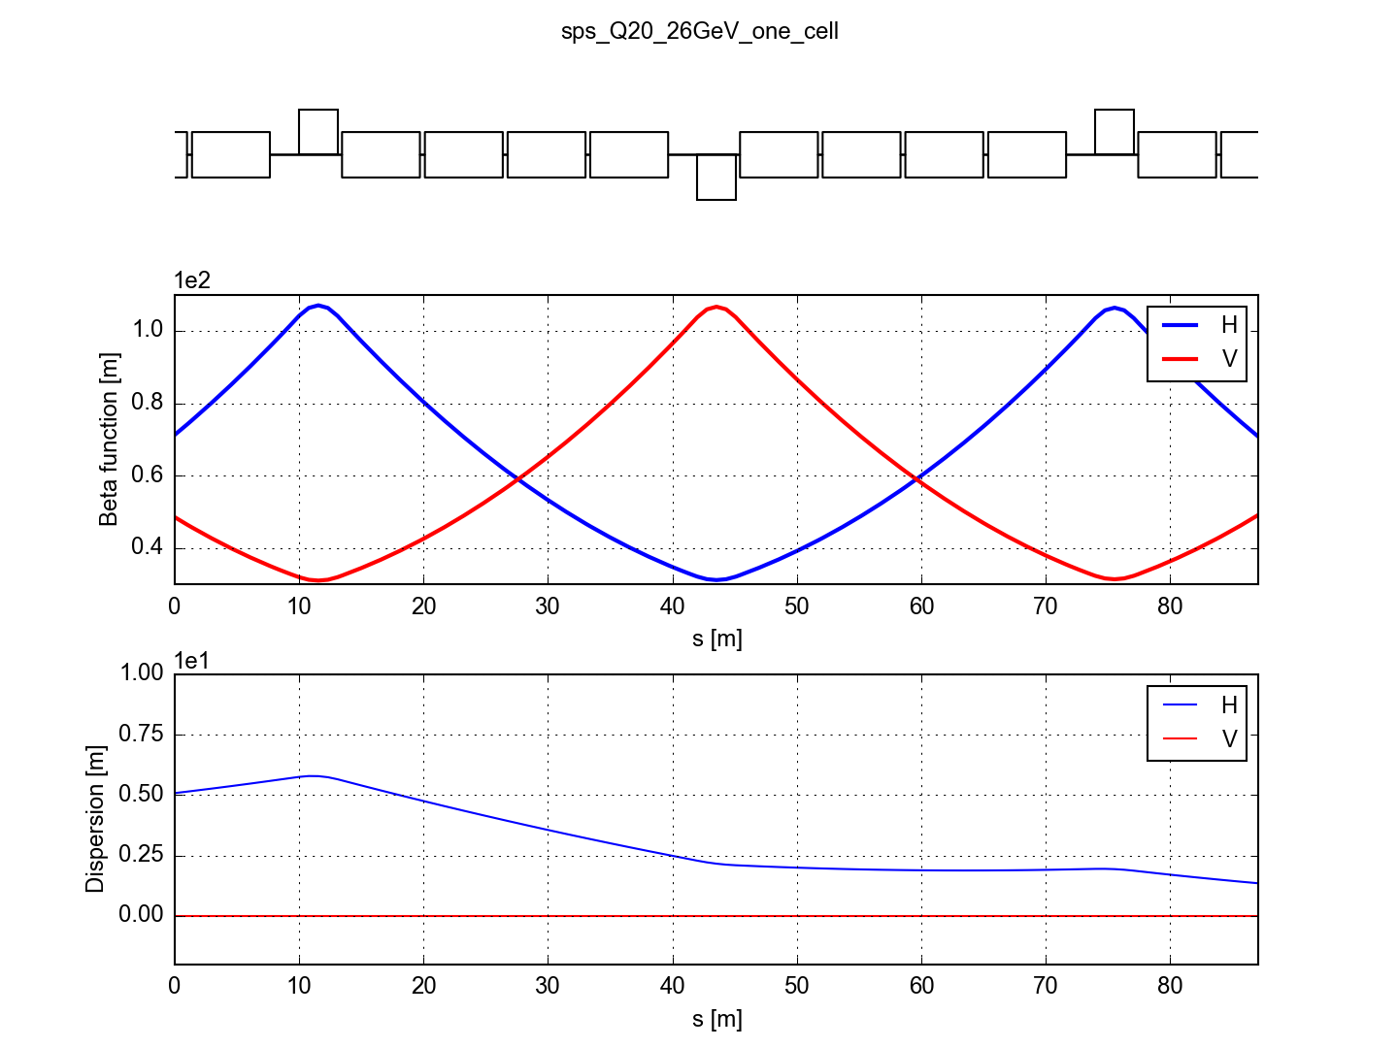
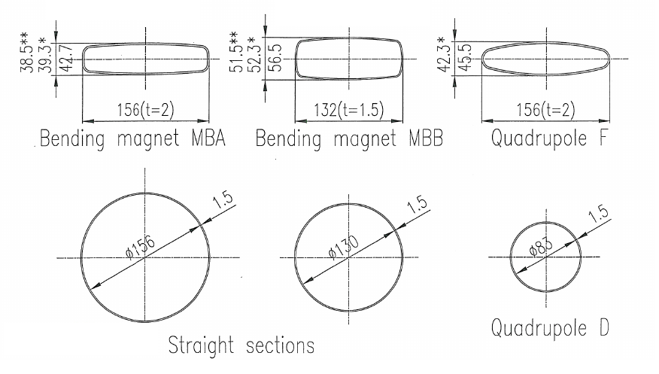
The SPS main magnets
Four types of main magnets and their chambers (following beam envelope)
MBA
QF
MBA
MBA
MBB
MBB
QD
MBB
MBB
MBA
MBA
QF
MBA
Machine element | Field/Gradient | Length | N. installed | Fraction of the SPS
MBA dipole magnet | 0.12 T at 26 GeV/c 2.1 T at 450 GeV/c | 6.3 m | 360 | 32.8 %
MBB dipole magnet | 0.12 T at 26 GeV/c 2.1 T at 450 GeV/c | 6.3 m | 384 | 35.0 %
QF quadrupole magnet | 14.2 T/m at 450 GeV/c 0.82 T/m at 26 GeV/c | 3.1 m | 108 | 4.8 %
QD quadrupole magnet | 14.2 T/m at 450 GeV/c 0.82 T/m at 26 GeV/c | 3.1 m | 108 | 4.8 %
QF
MBA
MBB
QD

Slide 33
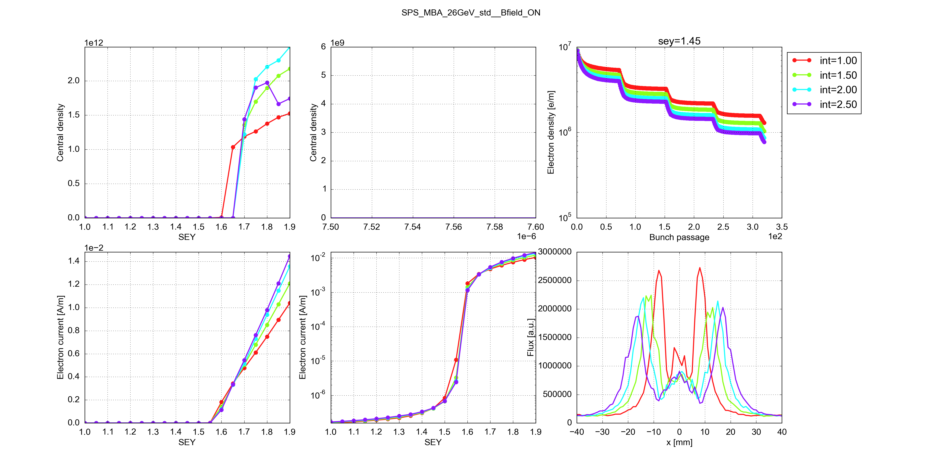
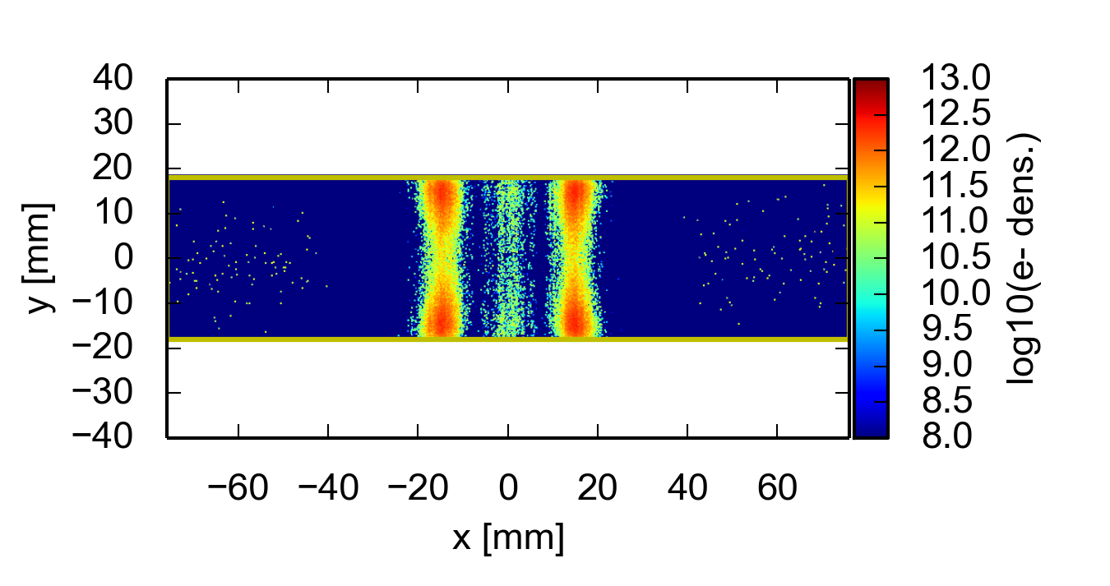
SPS MBA-type chambers
1.0 x 10¹¹ ppb
1.5 x 10¹¹ ppb
2.0 x 10¹¹ ppb
2.5 x 10¹¹ ppb
Transverse distribution with two vertical stripes (typical of e-cloud in dipoles)
Multipacting threshold at SEY_{thr}=1.55
Dependence on bunch intensity is quite weak, but in reality increasing the intensity moves stripes to unscrubbed regions and may re-awaken e-cloud

Slide 34
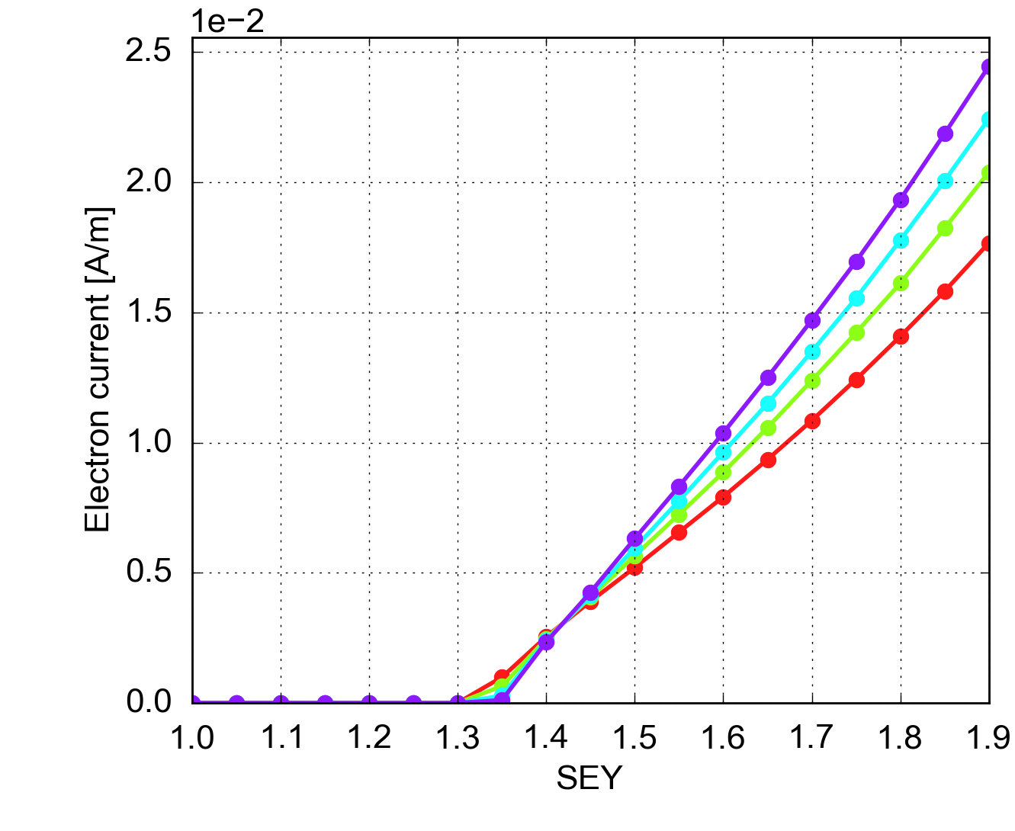
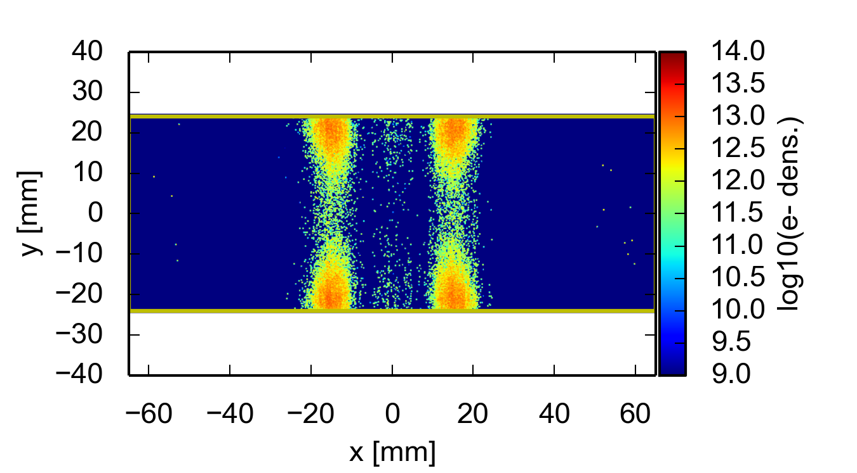
SPS MBB-type chambers
1.0 x 10¹¹ ppb
1.5 x 10¹¹ ppb
2.0 x 10¹¹ ppb
2.5 x 10¹¹ ppb
Transverse distribution with two vertical stripes (typical of e-cloud in dipoles)
Multipacting threshold at SEY_{thr}=1.3
Dependence on bunch intensity is quite weak, but in reality increasing the intensity moves stripes to unscrubbed regions and may re-awaken e-cloud

Slide 35
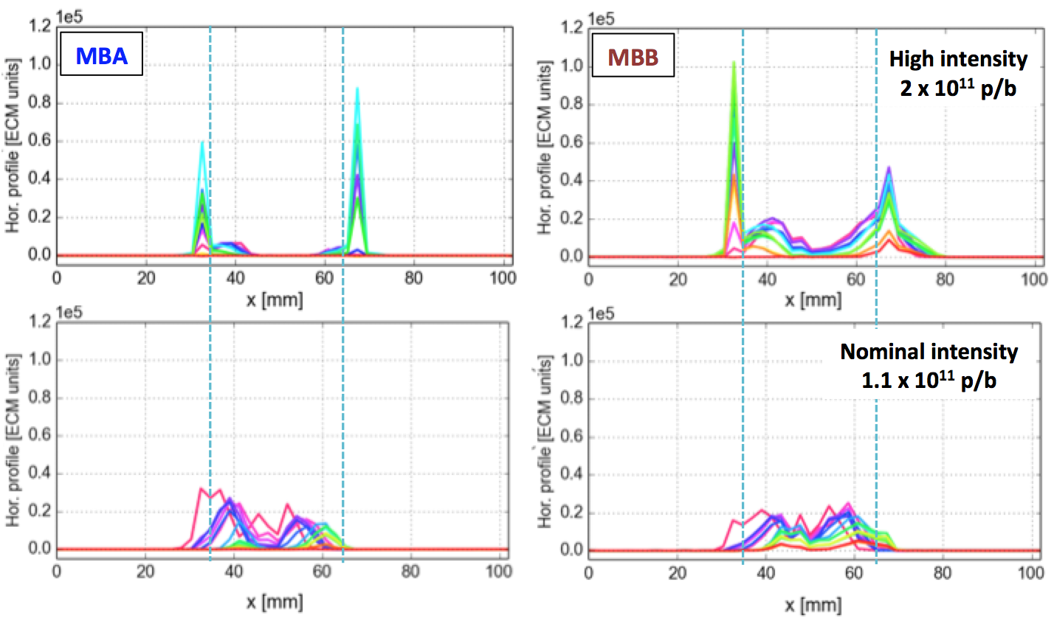
SPS MBB-type chambers
SPS measurements from e-cloud strip monitors
1.0 x 10¹¹ ppb
1.5 x 10¹¹ ppb
2.0 x 10¹¹ ppb
2.5 x 10¹¹ ppb
Transverse distribution with two vertical stripes (typical of e-cloud in dipoles)
Multipacting threshold at SEY_{thr}=1.3
Dependence on bunch intensity is quite weak, but in reality increasing the intensity moves stripes to unscrubbed regions and may re-awaken e-cloud

Slide 36
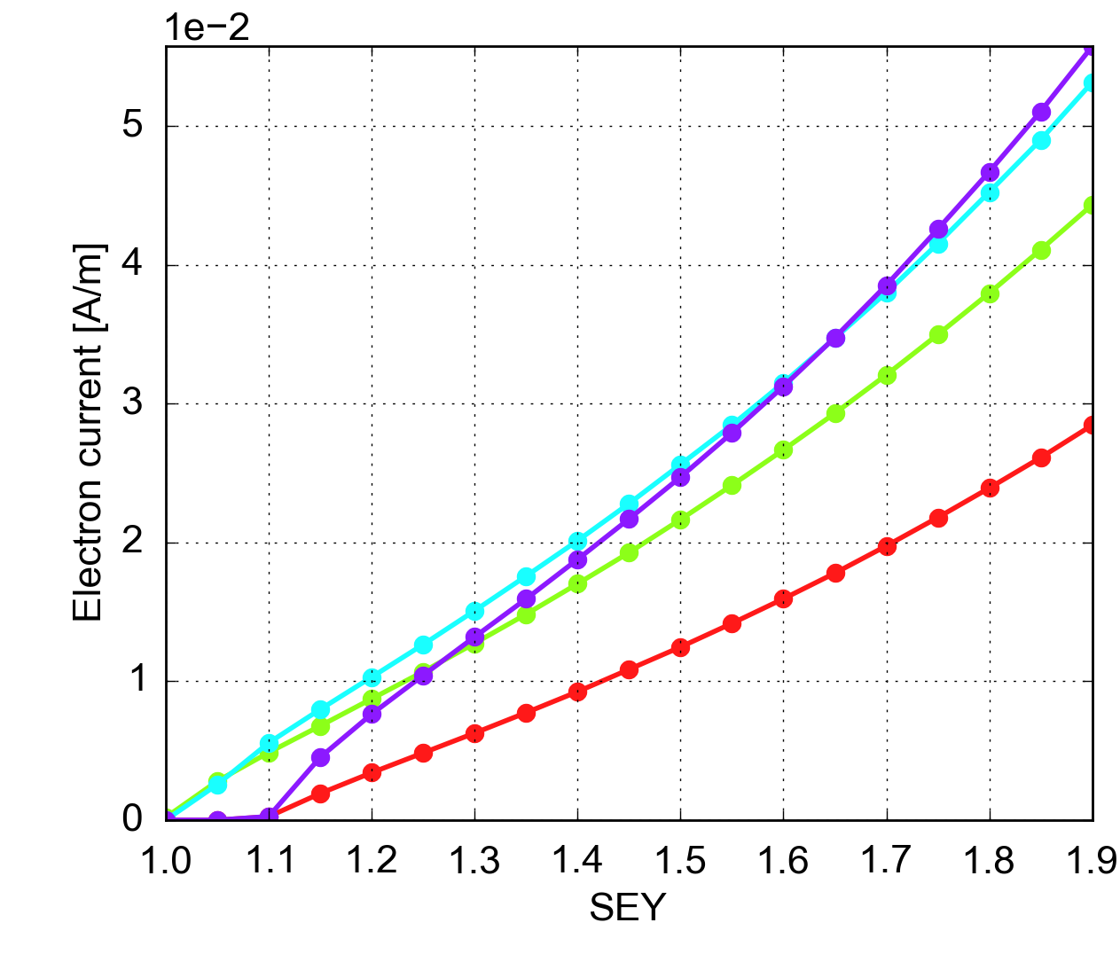
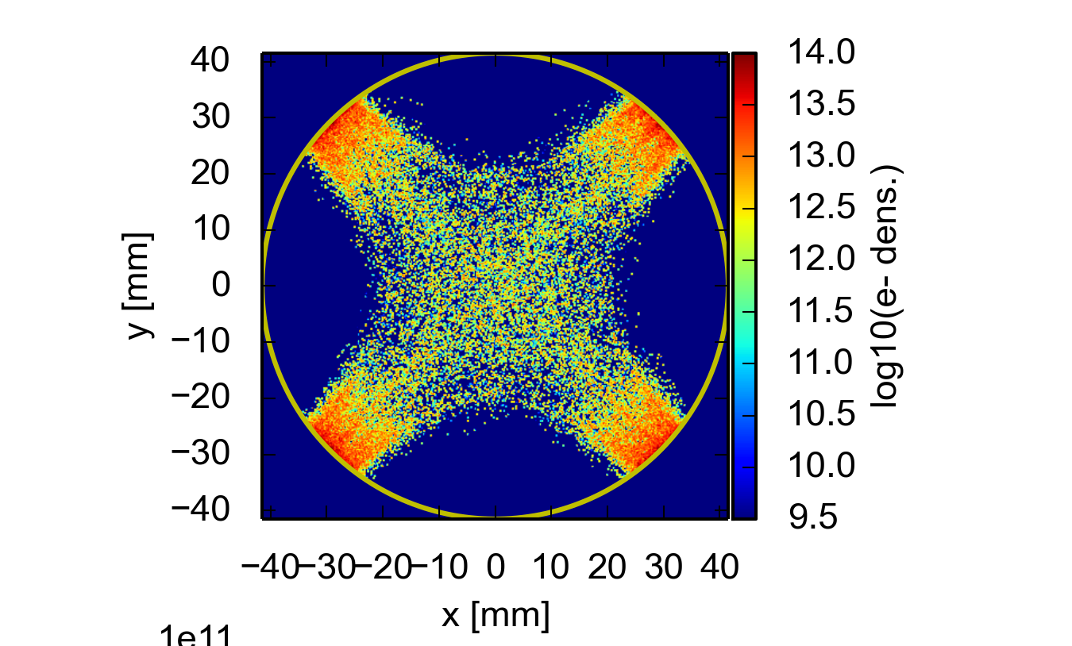
SPS QD-type chambers
1.0 x 10¹¹ ppb
1.5 x 10¹¹ ppb
2.0 x 10¹¹ ppb
2.5 x 10¹¹ ppb
Trapping of electrons along the field lines
Very low multipacting threshold at SEY_{thr}=1.0-1.1
Dependence on bunch intensity is quite weak

Slide 37
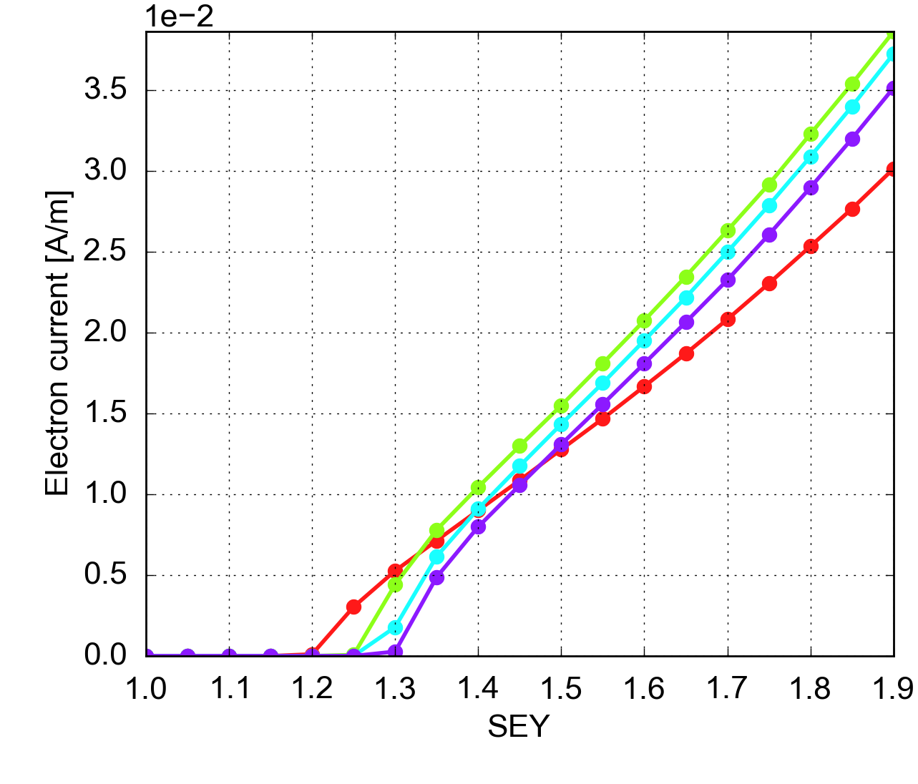
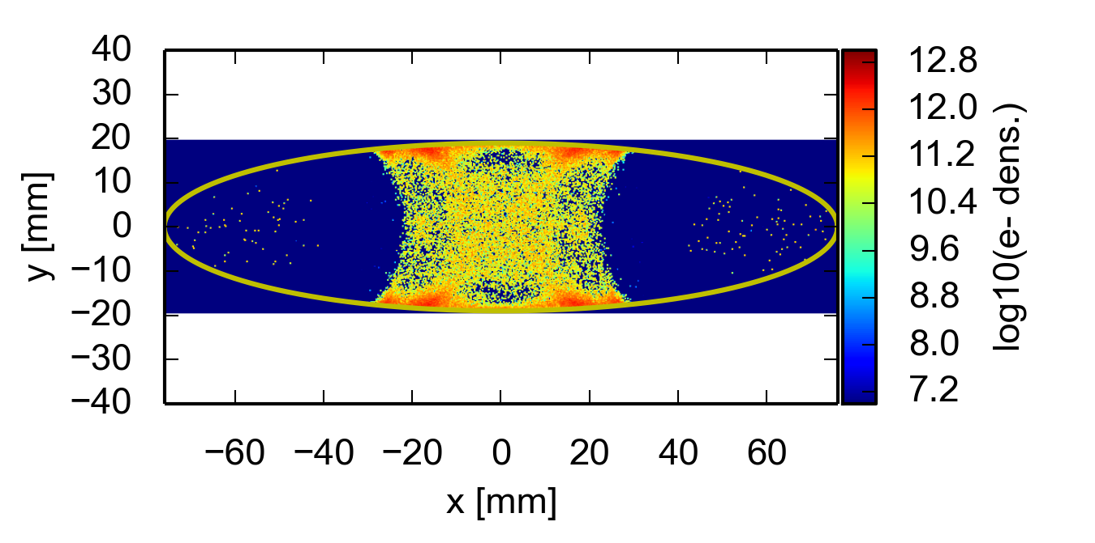
SPS QF-type chambers
1.0 x 10¹¹ ppb
1.5 x 10¹¹ ppb
2.0 x 10¹¹ ppb
2.5 x 10¹¹ ppb
Trapping of electrons along the field lines
Multipacting threshold at SEY_{thr}=1.2-1.3
“Inverse” dependence on bunch intensity (higher thresholds for higher currents)

Slide 38
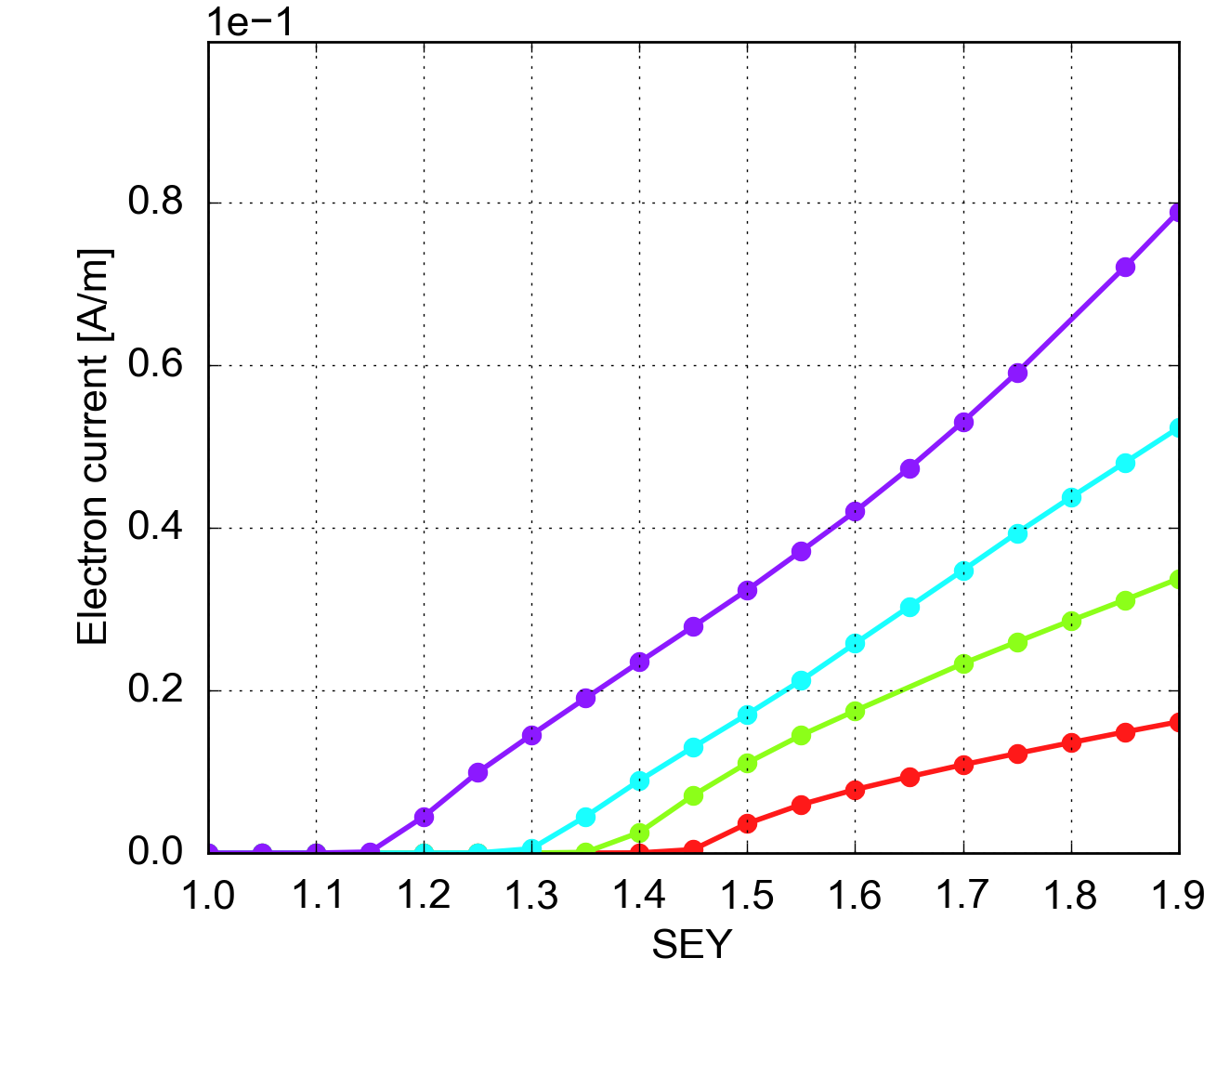
SPS large drift chambers
Typical build up in field-free region
Multipacting threshold decreasing for larger bunch intensities SEY_{thr}=1.15-1.45

Slide 39
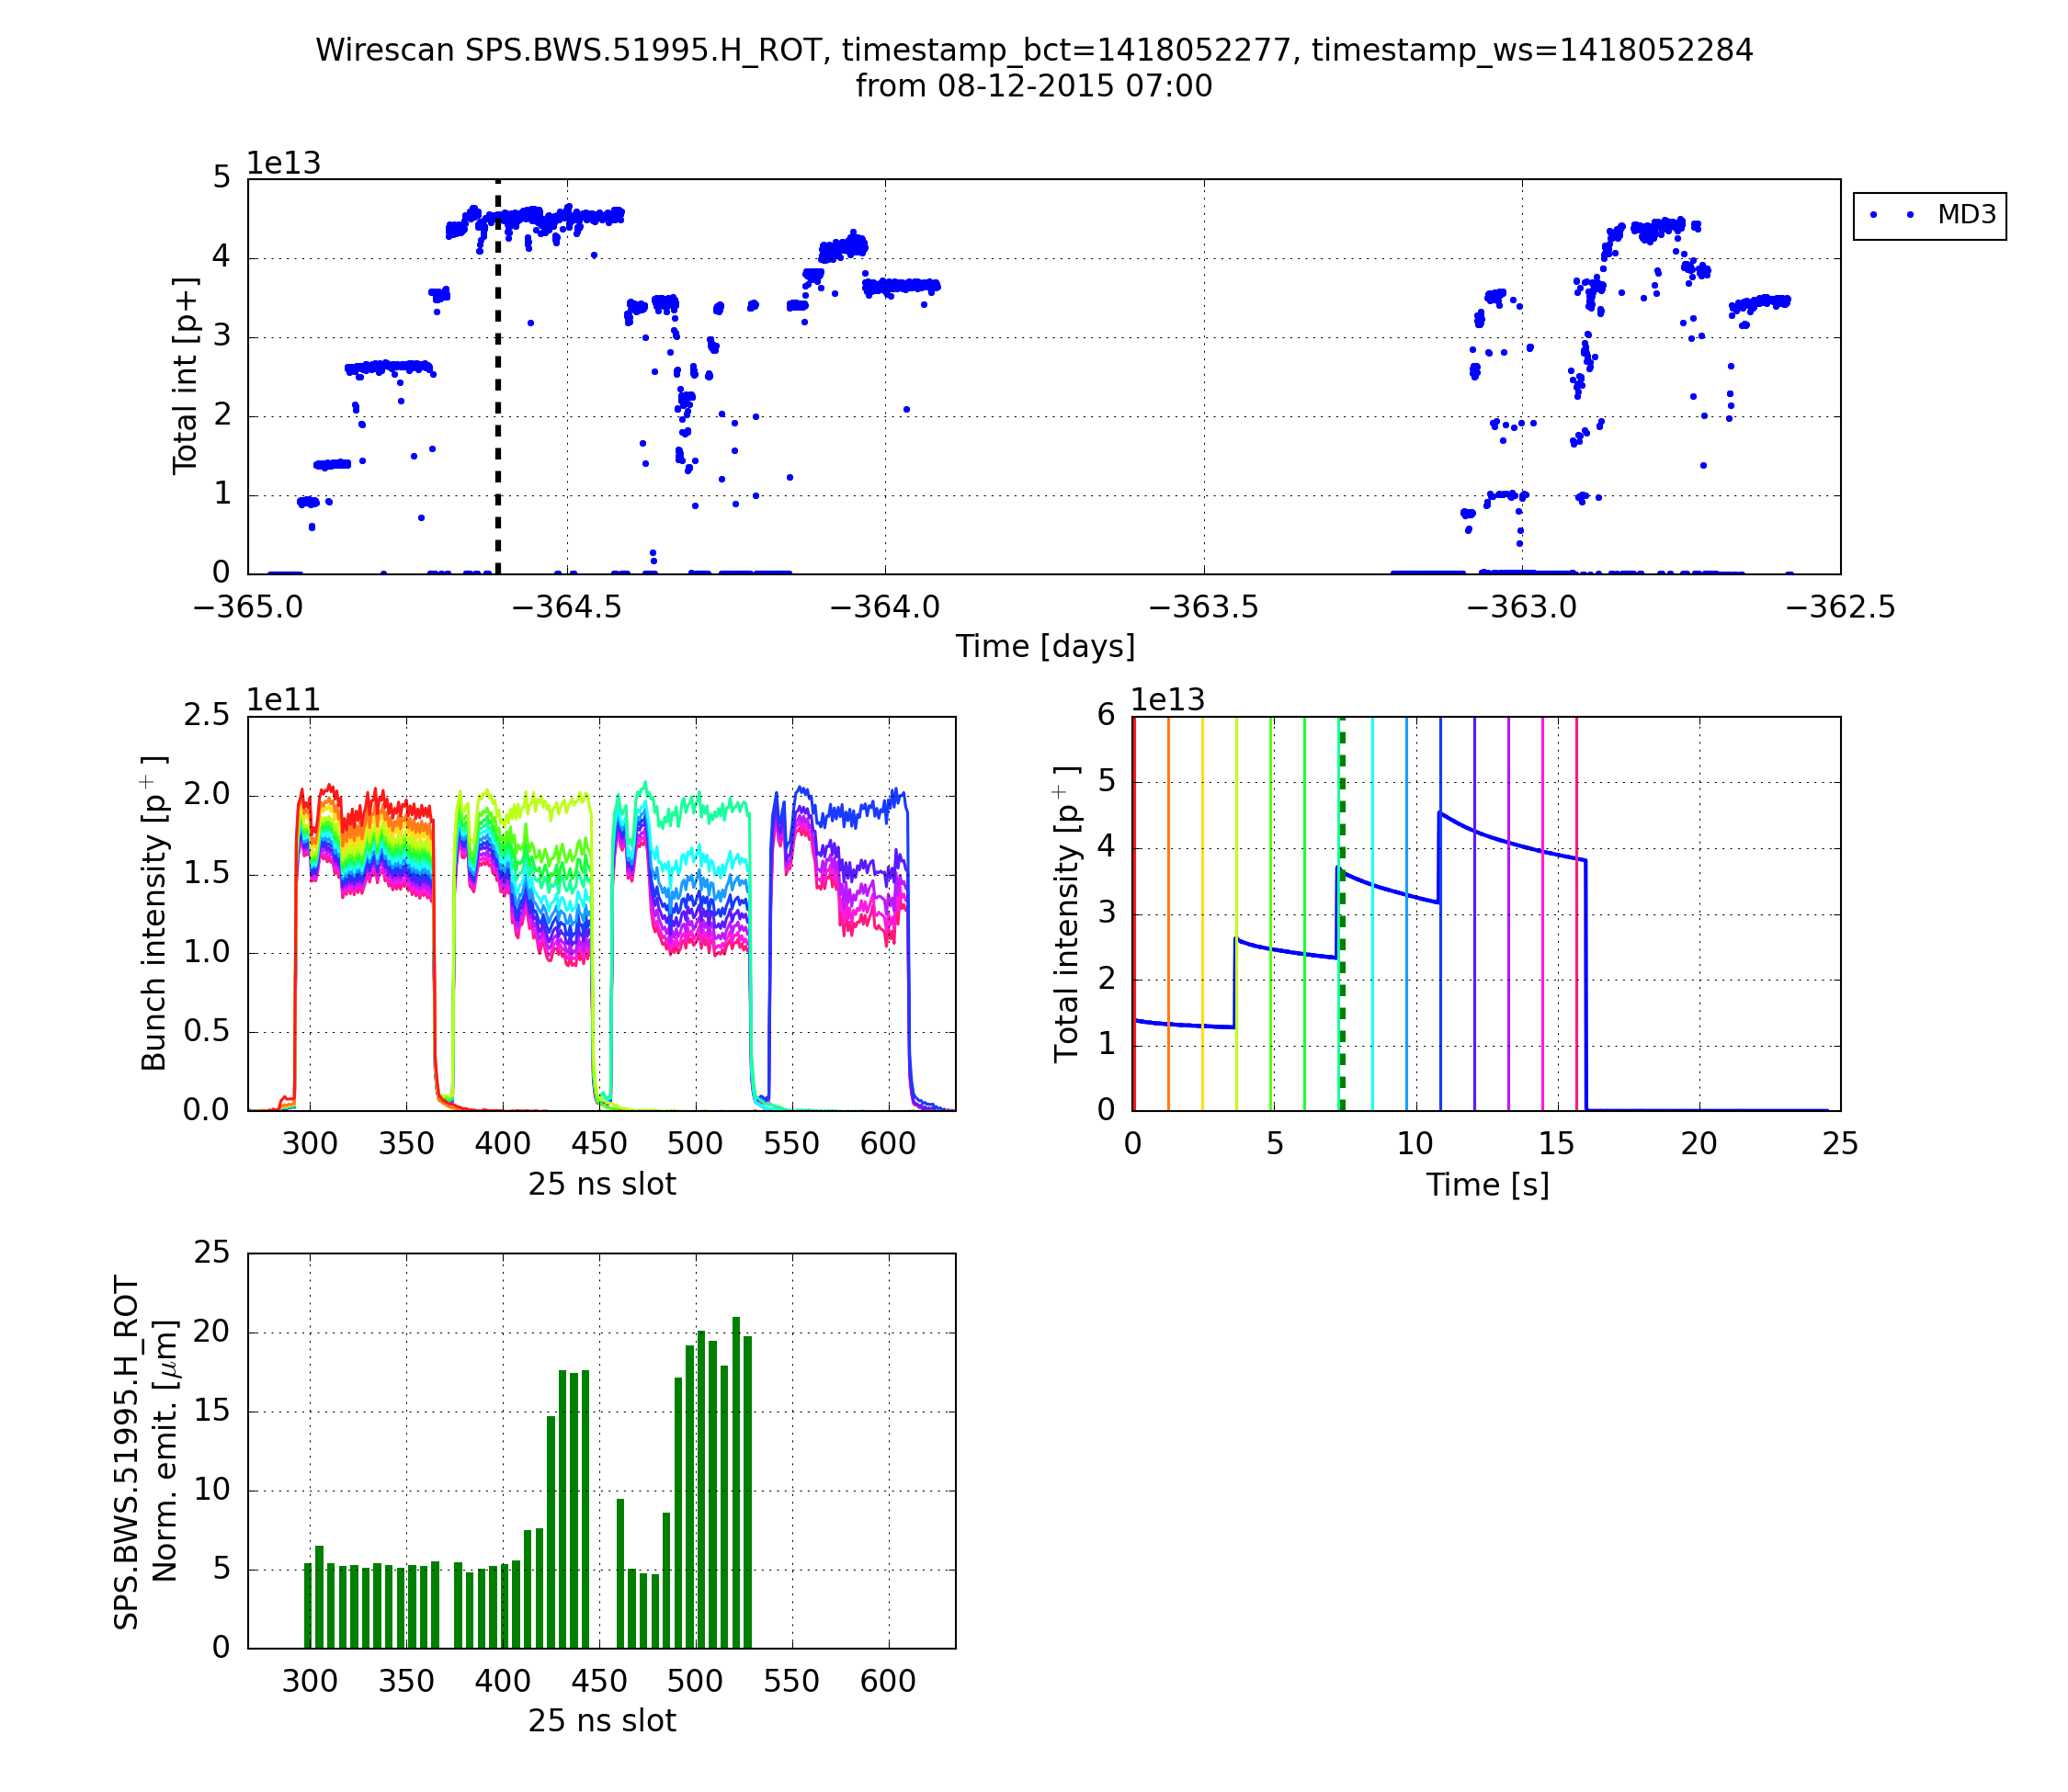
High intensity LHC beams in the SPS
LHC beams with 2e11 p/b exhibited transverse instability, emittance blow up and poor lifetime when it was first injected into the SPS
Beam quality improved with ~10 days scrubbing and tuning, but losses could not be decreased below 11% over 10 s (length of SPS injection plateau)

Slide 40
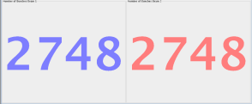
Electron cloud in the LHC: 25 ns beams in 2011-12
2011
2012
6-8/12

Slide 41
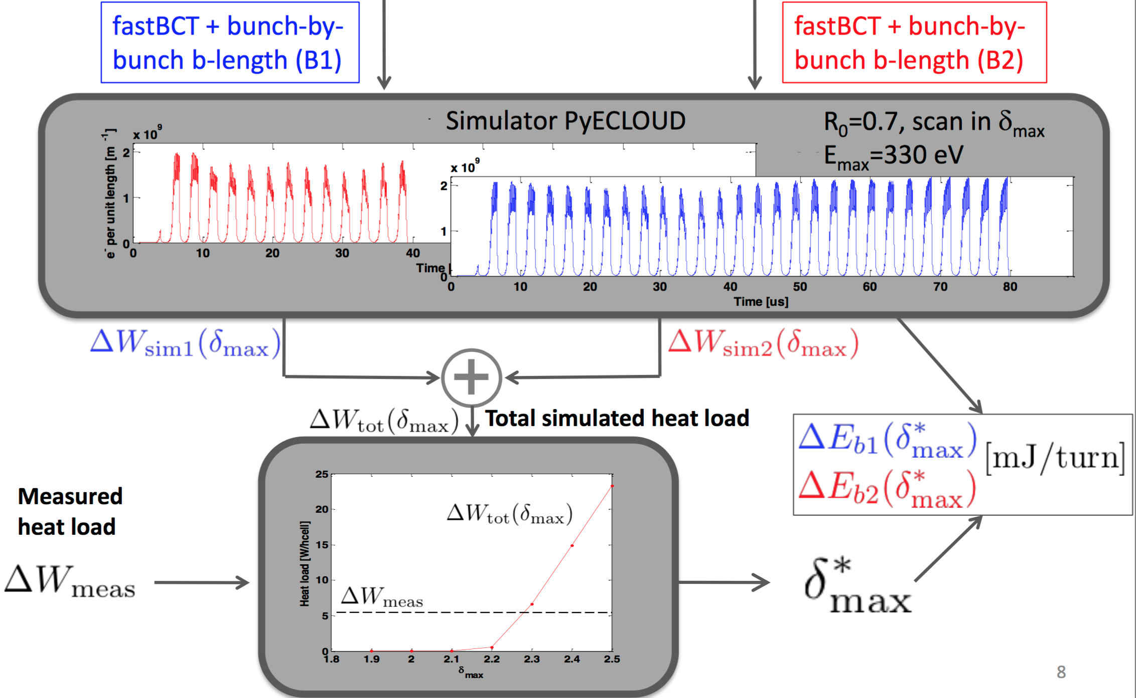
Electron cloud in the LHC: 25 ns beams in 2011-12
Calculation of beam screen SEY (δ_{max}) from heat load measurements
6-8/12

Slide 42
Electron cloud in the LHC: 25 ns beams in 2011-12
2011
2012
42

Slide 43
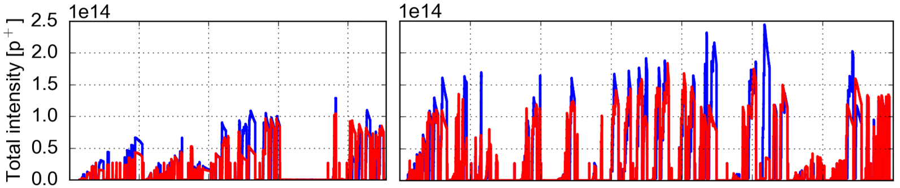
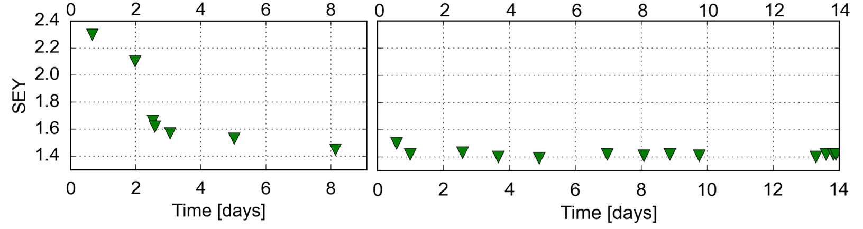
Electron cloud in the LHC during Run II: 2015 scrubbing
Scrubbing Run 1: 24/6 – 2/7
Scrubbing Run 2: 25/7 – 8/8
50 ns
After Long Shutdown 1
  SEY of beam screens reset to pre 25 ns values
  Lots of limitations from instabilities, vacuum on sensitive equipment, cryogenic transients → defined machine settings also for physics ramp (tunes, chromaticities, octupoles, transverse feedback)
  By end of scrubbing run, return to SEY values around 1.4 (beam quality improvement in last part)
  Deconditioning evident, took time to recondition

Slide 44
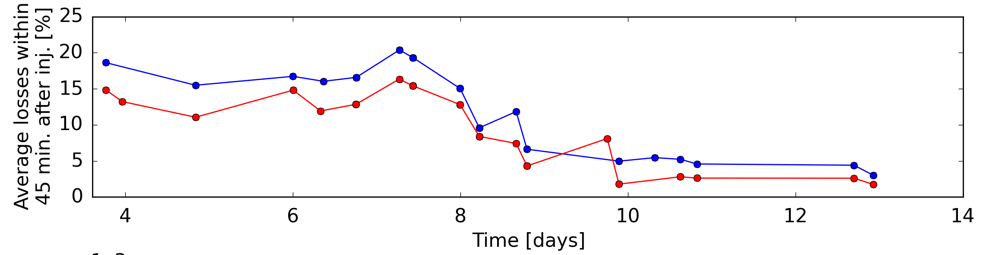
Electron cloud in the LHC during Run II: 2015 scrubbing
Scrubbing Run 1: 24/6 – 2/7
Scrubbing Run 2: 25/7 – 8/8
50 ns
After Long Shutdown 1
  SEY of beam screens reset to pre 25 ns values
  Lots of limitations from instabilities (machine settings, speed of progress), vacuum on sensitive equipment, cryogenic transients
  By the end of scrubbing run, return to SEY values around 1.4
  Deconditioning evident, took time to recondition

Slide 45
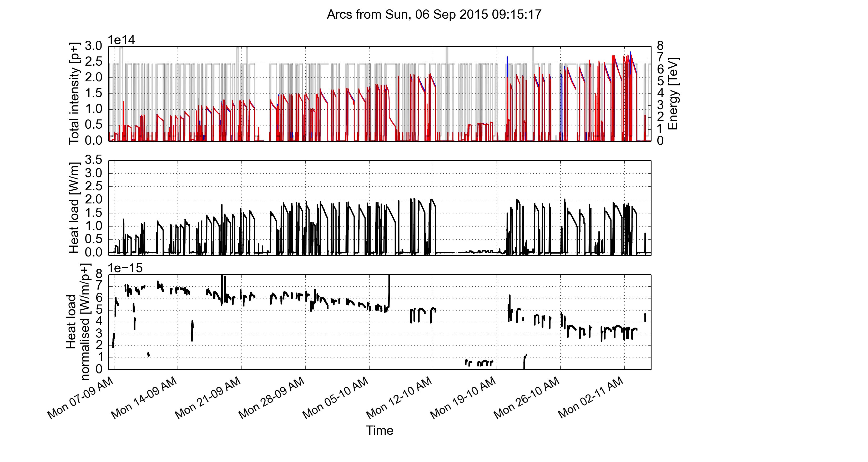
Electron cloud in the LHC during Run II: 2015
In 2015, first operation at 6.5 TeV with 25 ns beam
  In spite of long scrubbing campaign with 25 ns beams (~ 2 weeks), heat load induced by electron cloud limited the intensity that could be stored in physics
Slow intensity ramp-up (defined by heat loads on the beam screens)
Reached 2040 bunches in trains of 72b and 2244b in trains of 36b
Conditioning was observed throughout the year, but full e-cloud suppression did not occur

Slide 46
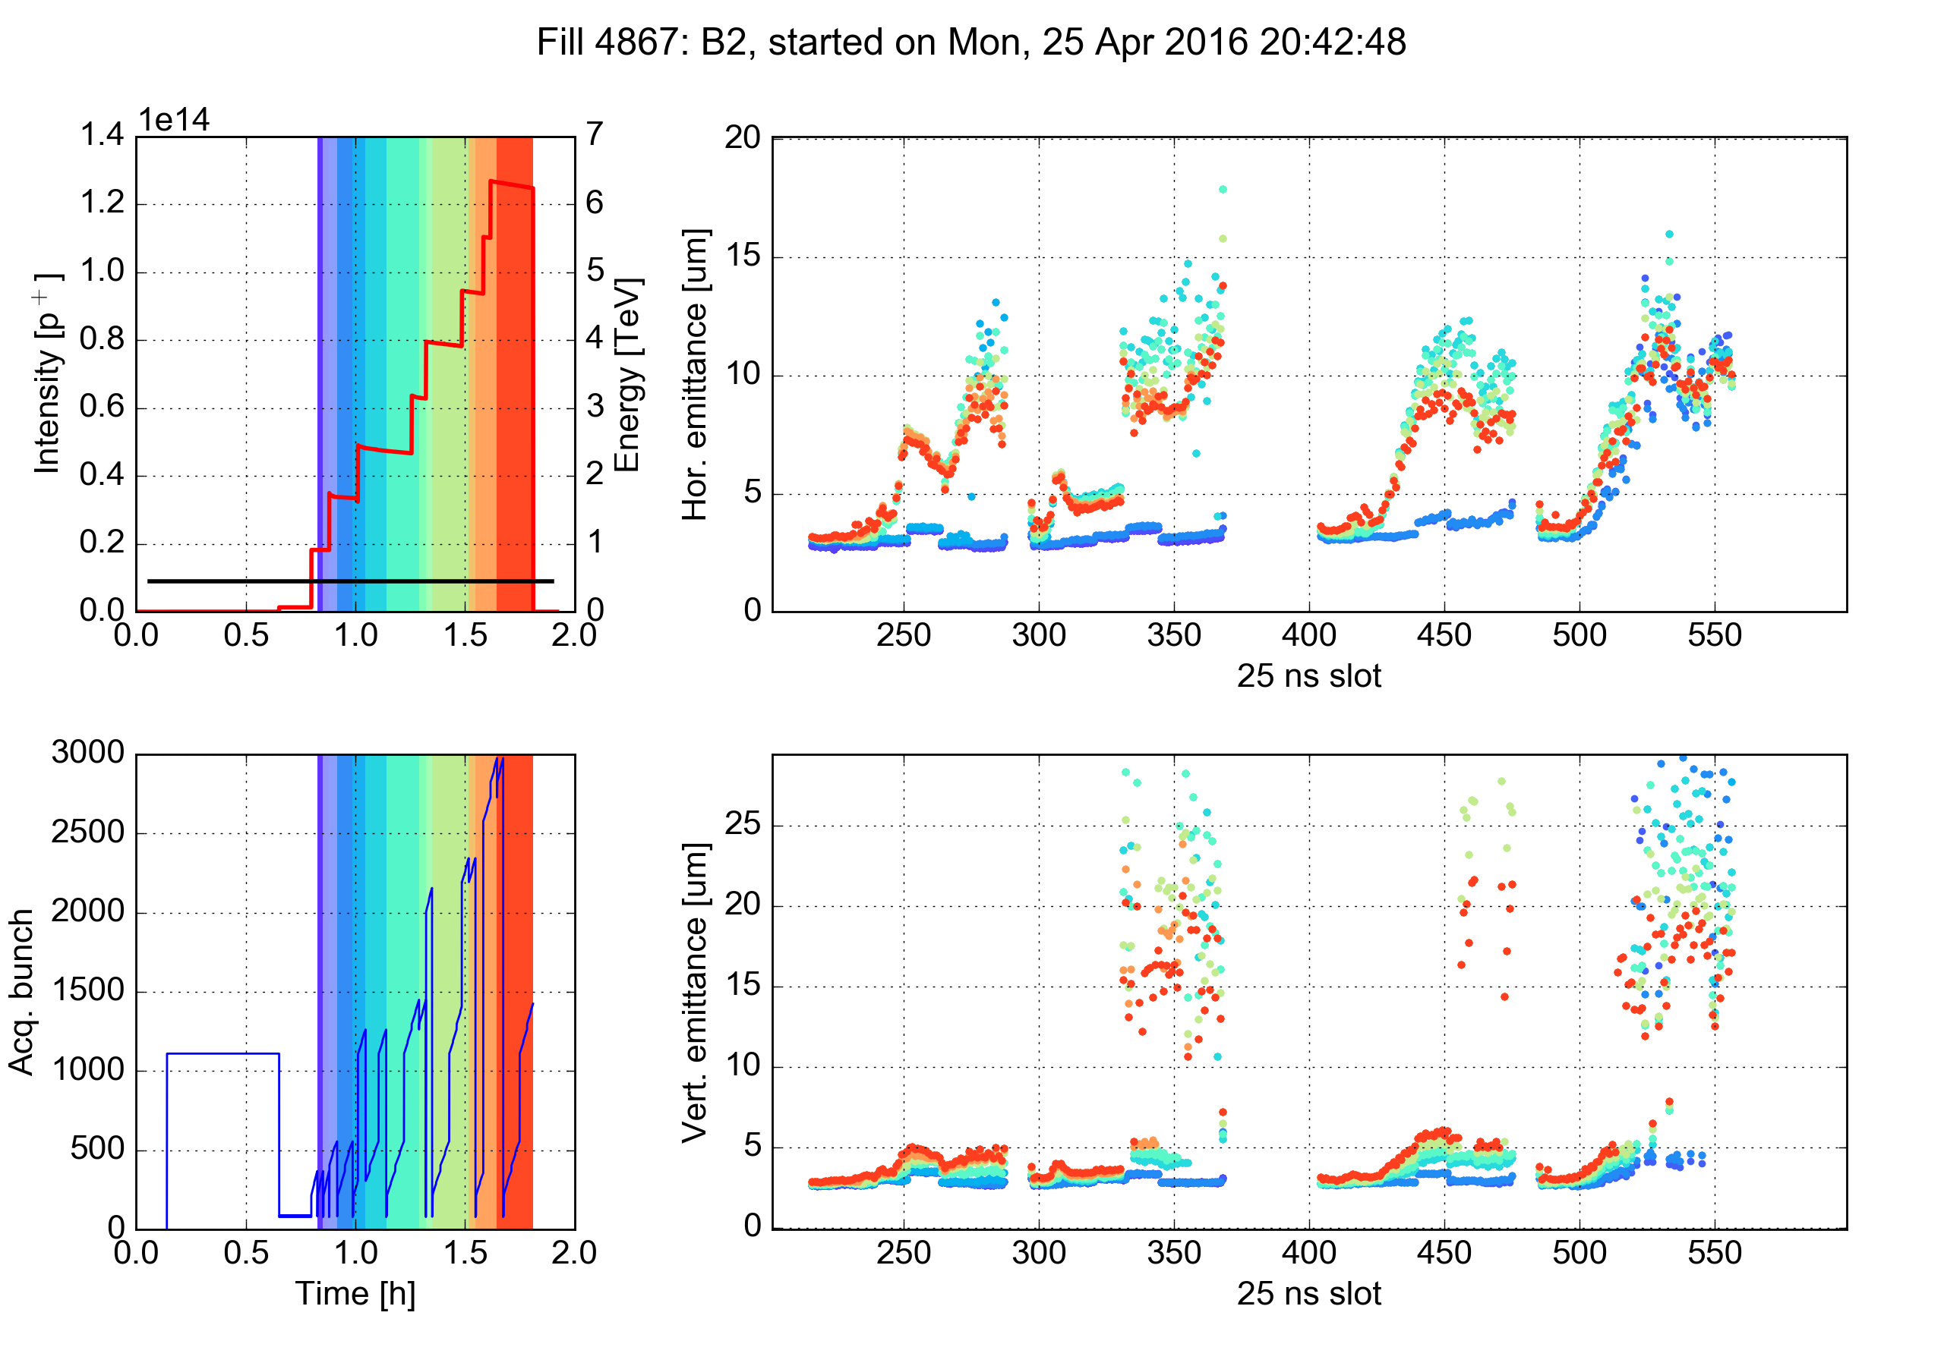
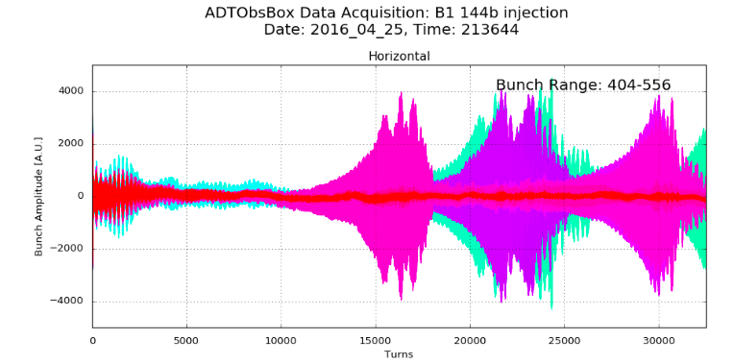
Electron cloud in the LHC during Run II: 2016
Clear signs of deconditioning w.r.t. end-2015
  Transverse instabilities and emitt. blow-up, larger heat load and stable phase shift
Reconditioning very fast → 1 day at 450 GeV sufficient to recondition machine up to ~1800 bunches/beam with injections 216b at injection energy
Generally less problems than in 2015 thanks to:
  Scrubbing accumulated in 2015
  Improved cryogenics feed-forward (heat load transients)
  Settings optimized for e-cloud (Q, Q’, octupoles, feedback) → better beam quality
25 April 2016

Slide 47
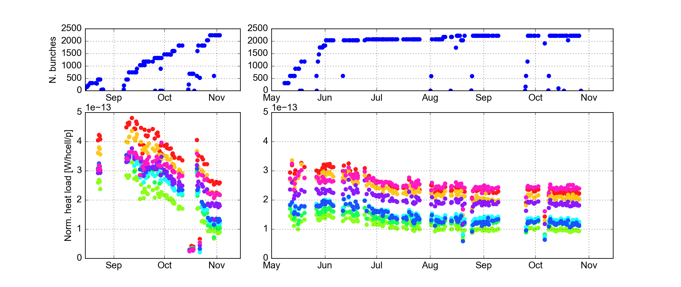
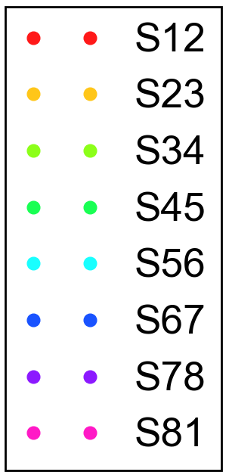
Electron cloud in the LHC during Run II: 2016
2015
2016
2x72b
72b
4x36b
72b
2x48b
Train
type
Conditioning experienced in 2015 continued over the first two months of 2016
Very little change in the following months
No correlation of this evolution with changes of settings and beam configuration

Slide 48
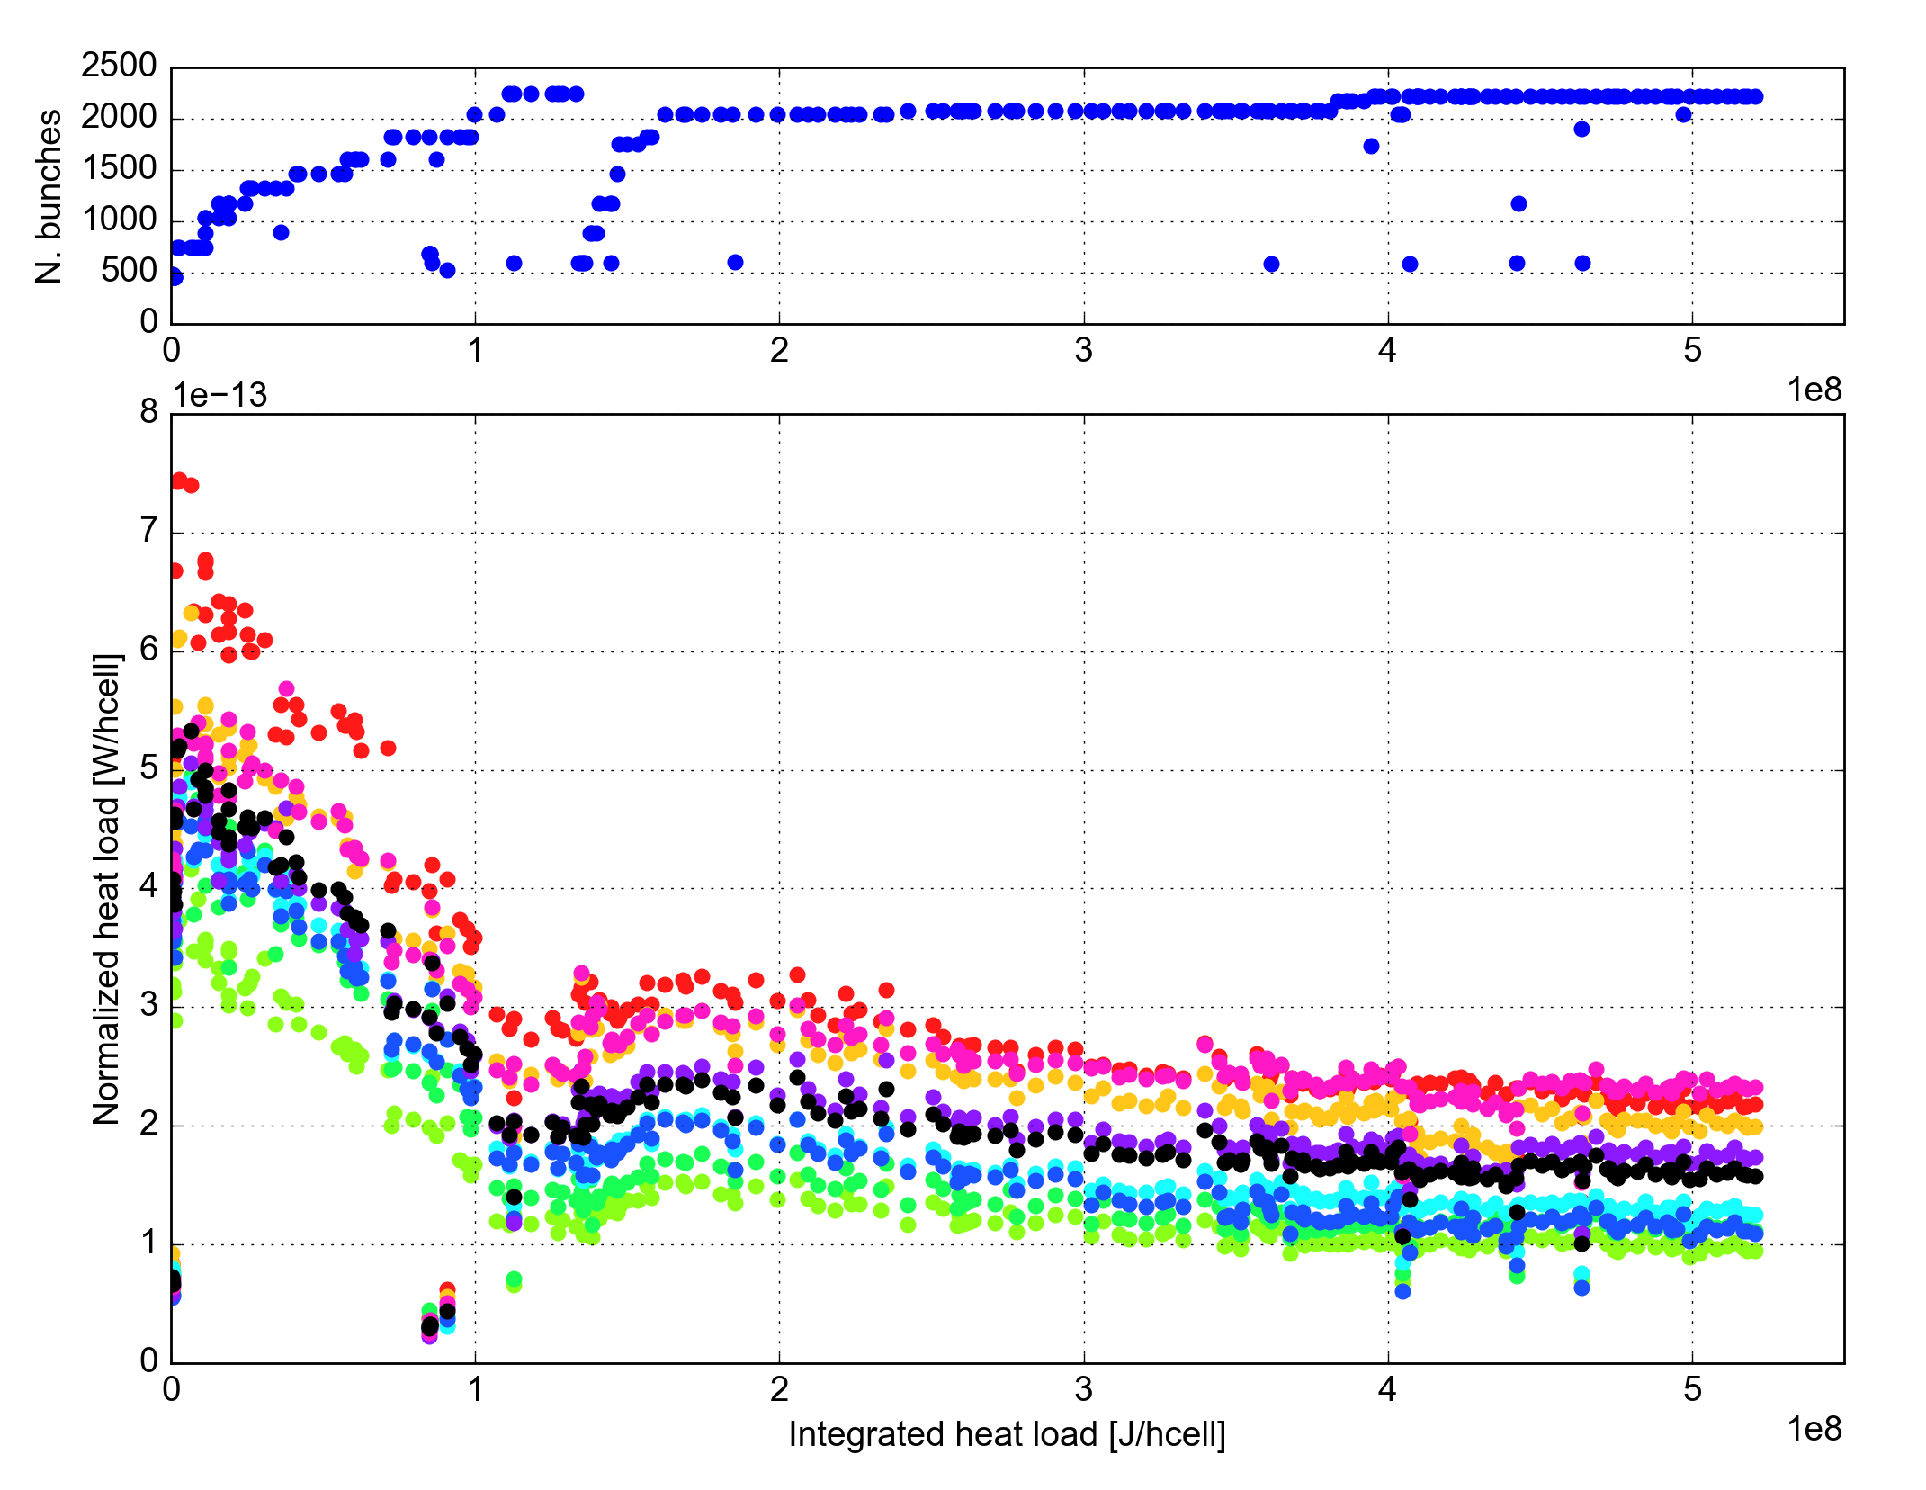
Electron cloud in the LHC during Run II: 2016
2015
2016
2x72b
72b
4x36b
72b
2x48b
Train
type
2015
2016
Conditioning experienced in 2015 continued over the first two months of 2016
Very little change in the following months
No correlation of this evolution with changes of settings and beam configuration

Slide 49




Electron cloud in the LHC: General
At the LHC beam induced surface conditioning (scrubbing) was sufficient to mitigate e-cloud but full suppression was not achieved
  Need high feedback gain, chromaticity and octupole settings to keep the beam stable
The tunes at injection had to be modified to accommodate large footprint
A feedforward system had to be implemented to adapt the cryogenics setting to the heat load generated by the e-cloud (large fraction of the available capacity)
2244b.
Octupole knob at -1.5
Q’=15/20, 5 x 10¹¹ e/m³
(.28, .31)
Avg. half-cell
(.27, .295)
Average
Imp.+syn.rad

Slide 50
Electron cloud in the LHC: Some open questions
Difference between sectors
  Important info from thermal cycle in Sector 12 for dipole replacement
  Magnets around the exchanged dipole are being instrumented for detailed heat load measurements
Detailed arc half-cell heat load breakdown (dipoles, quadrupoles, drifts)
  Important information from new instrumented cell in S12
  Improvement of the simulation model (including synchrotron radiation tracking and photoelectron generation - synergy with FCC studies)
  Improvement of heat load data calibration
  Tests with 50 ns or 8b4e for heat load measurement calibration
Understanding on surface behavior
  Laboratory surface characterization: vital input to improve simulations
    Effect of electron energy on secondary emission and scrubbing
    Effect of surface temperature - further tests also in the machine?
  Beam configurations to improve scrubbing
    Longer 25 ns trains
    Slightly higher bunch intensity
    5 ns spaced doublet beams

Slide 51
Electron cloud mitigation
Scrubbing (but up to which point??...)
Coating of the beam pipes with amorphous carbon (a-C) has been developed at CERN to suppress e-cloud formation (a-C has very low Secondary Electron Yield)
  Validated for full scale deployment in a large accelerator (room temperature)
  In 2019-20 a large fraction of SPS will be coated with a-C
  Studies at an advanced stage to use a-C coating also in cold magnets:
    e-cloud suppression validated at the COLDEX experiment
    Developing methods to deploy the coating “in situ”, i.e. directly in the magnets installed in the LHC tunnel (inner triplets in IP2 and IP8)
Low Secondary Electron Yield can be obtained also using Laser Engineered Surface Structures (LESS)
  Developed by in universities and laboratories in the UK
  Being tested inside a particle accelerator at CERN SPS (strip monitor at room temperature, COLDEX cryogenic experiment)
Clearing electrodes, solenoids …
High bandwidth feedback system

Slide 52
Summary
Space charge and electron cloud are two key subjects for the future upgrades of all CERN machines
Space charge
  Limits brightness in injectors mainly due to long injection plateaus
  Effect on coherent instability thresholds not yet clear
Electron cloud
  Affects PS, but only in the last phase of LHC beam production
  Affects SPS, which is scrubbed for present LHC beams and will be partly coated with a-C for future beams
  Affects LHC potentially limiting its performance mainly due to the heat load on the cryogenic system
Notes:
Injection speed, downtime

Slide 53

LHC beams in the PS
4 ns
300
E-cloud expected and observed
Double splitting
250
x 4
Flat top
Bunch shortening
200
1st injection
2nd injection
Bunch rotation
40 MHz RF Voltage [kV]
150
x 3
Bunch splittings
100
11 ns
50
b.l.≈14 ns
Adiabatic shortening
0
10
20
30
40
50
60
Time [ms]
25ns bunch spacing

Slide 54
LHC beams in the PS
Before last bunch splitting
e-cloud neither expected nor observed
x 4
Flat top
Bunch shortening
1st injection
2nd injection
x 3
Bunch splittings
25ns bunch spacing
330ns

Slide 55


Electron cloud in the PS
Most of the direct electron cloud measurements in the PS were made in a straight section equipped with shielded pick ups
However, the electron cloud is expected in the main magnet units (combined functions) for 25 ns beams
This electron cloud can be source of instabilities → Studied by storing for about 100 ms a 25 ns beam with b.len.≈10 ns
H pickup signal – 357 kHz component
300
250
200
40 MHz RF Voltage [kV]
150
100
b.l.≈ 10 ns
50
b.l.≈14 ns
0
10
20
30
40
50
60
70
80
90
100
Time [ms]

Slide 56
Electron cloud in the PS
Most of the direct electron cloud measurements in the PS were made in a straight section equipped with shielded pick ups
However, the electron cloud is expected in the main magnet units (combined functions) for 25 ns beams
This electron cloud can be source of instabilities → Studied by storing for about 100 ms a 25 ns beam with b.len.≈10 ns
Instability onset can be efficiently delayed by means of transverse feedback system, which provides margin for future operation
10 ms

Slide 57
Electron cloud in the PS
Most of the direct electron cloud measurements in the PS were made in a straight section equipped with shielded pick ups
However, the electron cloud is expected in the main magnet units (combined functions) for 25 ns beams
This electron cloud can be source of instabilities → Studied by storing for about 100 ms a 25 ns beam with b.len.≈10 ns

Slide 58
Electron cloud in the PS
Most of the direct electron cloud measurements in the PS were made in a straight section equipped with shielded pick ups
However, the electron cloud is expected in the main magnet units (combined functions) for 25 ns beams
This electron cloud can be source of instabilities → Studied by storing for about 100 ms a 25 ns beam with b.len.≈10 ns

Slide 59
Electron cloud in the PS
Most of the direct electron cloud measurements in the PS were made in a straight section equipped with shielded pick ups
However, the electron cloud is expected in the main magnet units (combined functions) for 25 ns beams
This electron cloud can be source of instabilities → Studied by storing for about 100 ms a 25 ns beam with b.len.≈10 ns

Slide 60
Electron cloud in the PS
Most of the direct electron cloud measurements in the PS were made in a straight section equipped with shielded pick ups
However, the electron cloud is expected in the main magnet units (combined functions) for 25 ns beams
This electron cloud can be source of instabilities → Studied by storing for about 100 ms a 25 ns beam with b.len.≈10 ns

Slide 61
Electron cloud in the PS
Most of the direct electron cloud measurements in the PS were made in a straight section equipped with shielded pick ups
However, the electron cloud is expected in the main magnet units (combined functions) for 25 ns beams
This electron cloud can be source of instabilities → Studied by storing for about 100 ms a 25 ns beam with b.len.≈10 ns

Slide 62
Electron cloud in the PS
Most of the direct electron cloud measurements in the PS were made in a straight section equipped with shielded pick ups
However, the electron cloud is expected in the main magnet units (combined functions) for 25 ns beams
This electron cloud can be source of instabilities → Studied by storing for about 100 ms a 25 ns beam with b.len.≈10 ns

Slide 63
Electron cloud in the PS
Most of the direct electron cloud measurements in the PS were made in a straight section equipped with shielded pick ups
However, the electron cloud is expected in the main magnet units (combined functions) for 25 ns beams
This electron cloud can be source of instabilities → Studied by storing for about 100 ms a 25 ns beam with b.len.≈10 ns

Slide 64
Electron cloud in the PS
Most of the direct electron cloud measurements in the PS were made in a straight section equipped with shielded pick ups
However, the electron cloud is expected in the main magnet units (combined functions) for 25 ns beams
This electron cloud can be source of instabilities → Studied by storing for about 100 ms a 25 ns beam with b.len.≈10 ns

Slide 65
Electron cloud in the PS
Most of the direct electron cloud measurements in the PS were made in a straight section equipped with shielded pick ups
However, the electron cloud is expected in the main magnet units (combined functions) for 25 ns beams
This electron cloud can be source of instabilities → Studied by storing for about 100 ms a 25 ns beam with b.len.≈10 ns

Slide 66


LHC beams in the SPS
4th injection
Flat top
Extraction
3rd injection
2nd injection
2μs
1st injection
25ns bunch spacing
8μs (out of 23μs SPS circumference)

Slide 67
The SPS main magnets
Four types of main magnets and their chambers (following beam envelope)
MBA
QF
MBA
MBA
MBB
MBB
QD
MBB
MBB
MBA
MBA
QF
MBA
QF
MBA
MBB
QD

Slide 68
Electron cloud in the LHC during Run II: scrub with physics
2015
High β*
Filling pattern
72 bpi
144 bpi
72g72
72g72
(4x36) bpi
100 ns
Target b. length
1.25 ns
1.3 ns
1.35 ns
1.35 ns

Slide 69

Electron cloud in the LHC during Run II: scrub with physics
2015
14 September – Average arc half cells
4 November – Average arc half cells
Average
Impedance+synch. rad

Slide 70


Electron cloud in the LHC during Run II: deconditioning and reconditioning cycles
2015
Scrub.
MD2
TS2
High β*
MD3
TS3

Slide 71


Electron cloud in the LHC during Run II: deconditioning and reconditioning cycles
2015
Scrub.
MD2
TS2
High β*
MD3
TS3

Slide 72
Electron cloud in the LHC during Run II: deconditioning and reconditioning cycles
2015
Scrubbing checks at 450 GeV
Scrub.
MD2
TS2
High β*
MD3
TS3
deconditioning
decondit.
3h scrub.
3h scrub.
3h scrub.

Slide 73

Electron cloud in the LHC during Run II: deconditioning and reconditioning cycles
2015
Scrubbing checks at 450 GeV
From vacuum gauges
Scrub.
MD2
TS2
High β*
MD3
TS3
deconditioning
decondit.
3h scrub.
3h scrub.
Thanks to G. Bregliozzi, P. Chiggiato, C. Yin Vallgren
3h scrub.

Slide 74
Electron cloud in the LHC during Run II: deconditioning and reconditioning cycles
2015
Scrubbing checks at 450 GeV
From vacuum gauges
Scrub.
MD2
TS2
High β*
MD3
TS3
Scrubbing reasonably well preserved during Technical Stops and Machine Development with low intensity/low energy beams
Deconditioning mainly driven when running with low e-cloud/high synchrotron radiation schemes, however recovery can be achieved rather quickly
  Maybe it is the effect of synchrotron radiation cleaning other parts of the beam chamber, but ‘polluting’ the previously cleaned ones?
deconditioning
decondit.
3h scrub.
3h scrub.
Thanks to G. Bregliozzi, P. Chiggiato, C. Yin Vallgren
3h scrub.

