Slide 1


Using Resonance Islands for Optimum Performance and Advanced Commissioning Techniques
M. Giovannozzi - CERN
Summary:
Introduction
Stable islands: static case
Stable islands: dynamic case
Outlook
Acknowledgements: A. Bazzani, A. Franchi, C. Frye, S. Gilardoni, C. Hernalsteens, A. Huschauer, G. Sterbini, G. Turchetti.

Slide 2
Introduction - I
Application of stable islands in CERN machines started with PS, aiming at replacing the Continuous Transfer (CT) from PS to SPS
C_{SPS} = 11 C_{PS}
PS
PS
SPS circumference
First PS batch
Second PS batch
Gap for kicker

Slide 3
Introduction - II
Electrostatic septum
(beam shaving)
Fifth turn
Kicker strength
Four turns
Slow bump
Kicker magnets used to generate a closed orbit bump around electrostatic septum
Length
E_{field}=0
X’
E_{field}≠0
2
3
5
1
Slow bump
X
4
Extraction line
Electrostatic septum blade
Extraction septum
Slicing is performed during extraction

Slide 4
Introduction - III
Stable islands provided a more efficient way of extracting beams over few turns from a circular machine.
Starting from the original application, several others can be envisaged, well beyond the original goal.
Two scenarios can be considered
  Static use of stable islands
  Dynamic use of stable islands

Slide 5
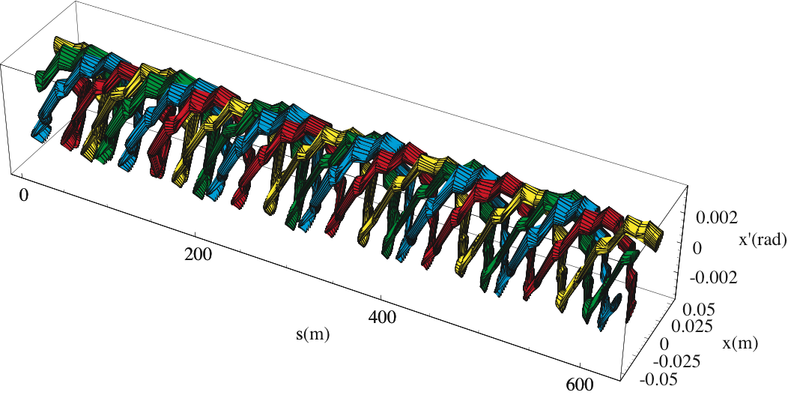
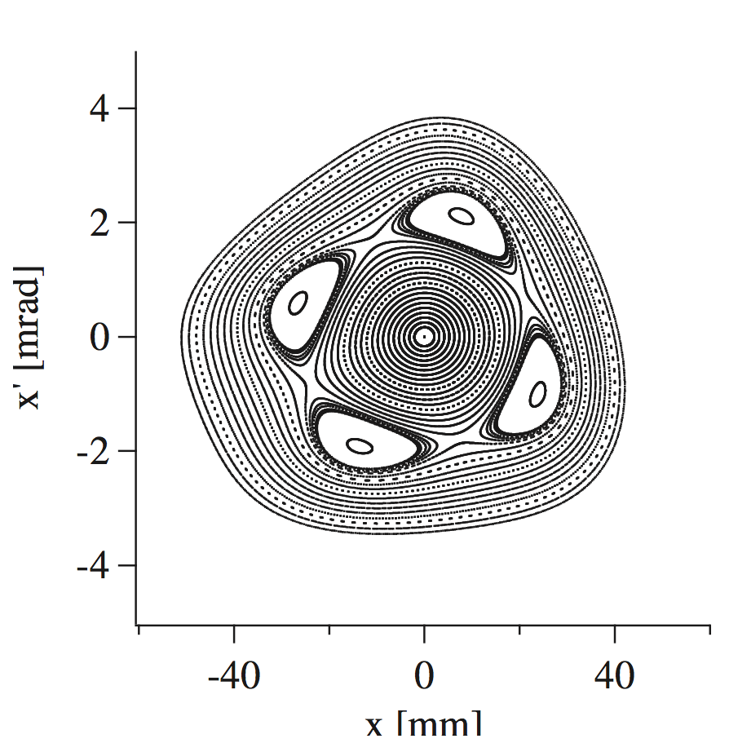
Static stable islands - I
Sextupoles and octupoles can be used to generate stable islands in phase space

Slide 6
Static stable islands - I
Some observations
  Two closed orbits are simultaneously available: the standard one and that related with the fixed points.
  The length of the closed orbit related to the fixed points is longer than the ring circumference.
  The orbit related to the fixed points is sensitive to non-linear fields: possibility of independent control of the two closed orbits.

Slide 7
Static stable islands - II
Some observations
  The linear optics around the two closed orbits is different.
  The optical parameters related to the fixed points is sensitive to non-linear fields: possibility of independent control of the two sets of optical parameters.
Implications
  Possibility to design septum-less injection/extraction
  Possibility to propose alternative schemes to perform transition jump.

Slide 8
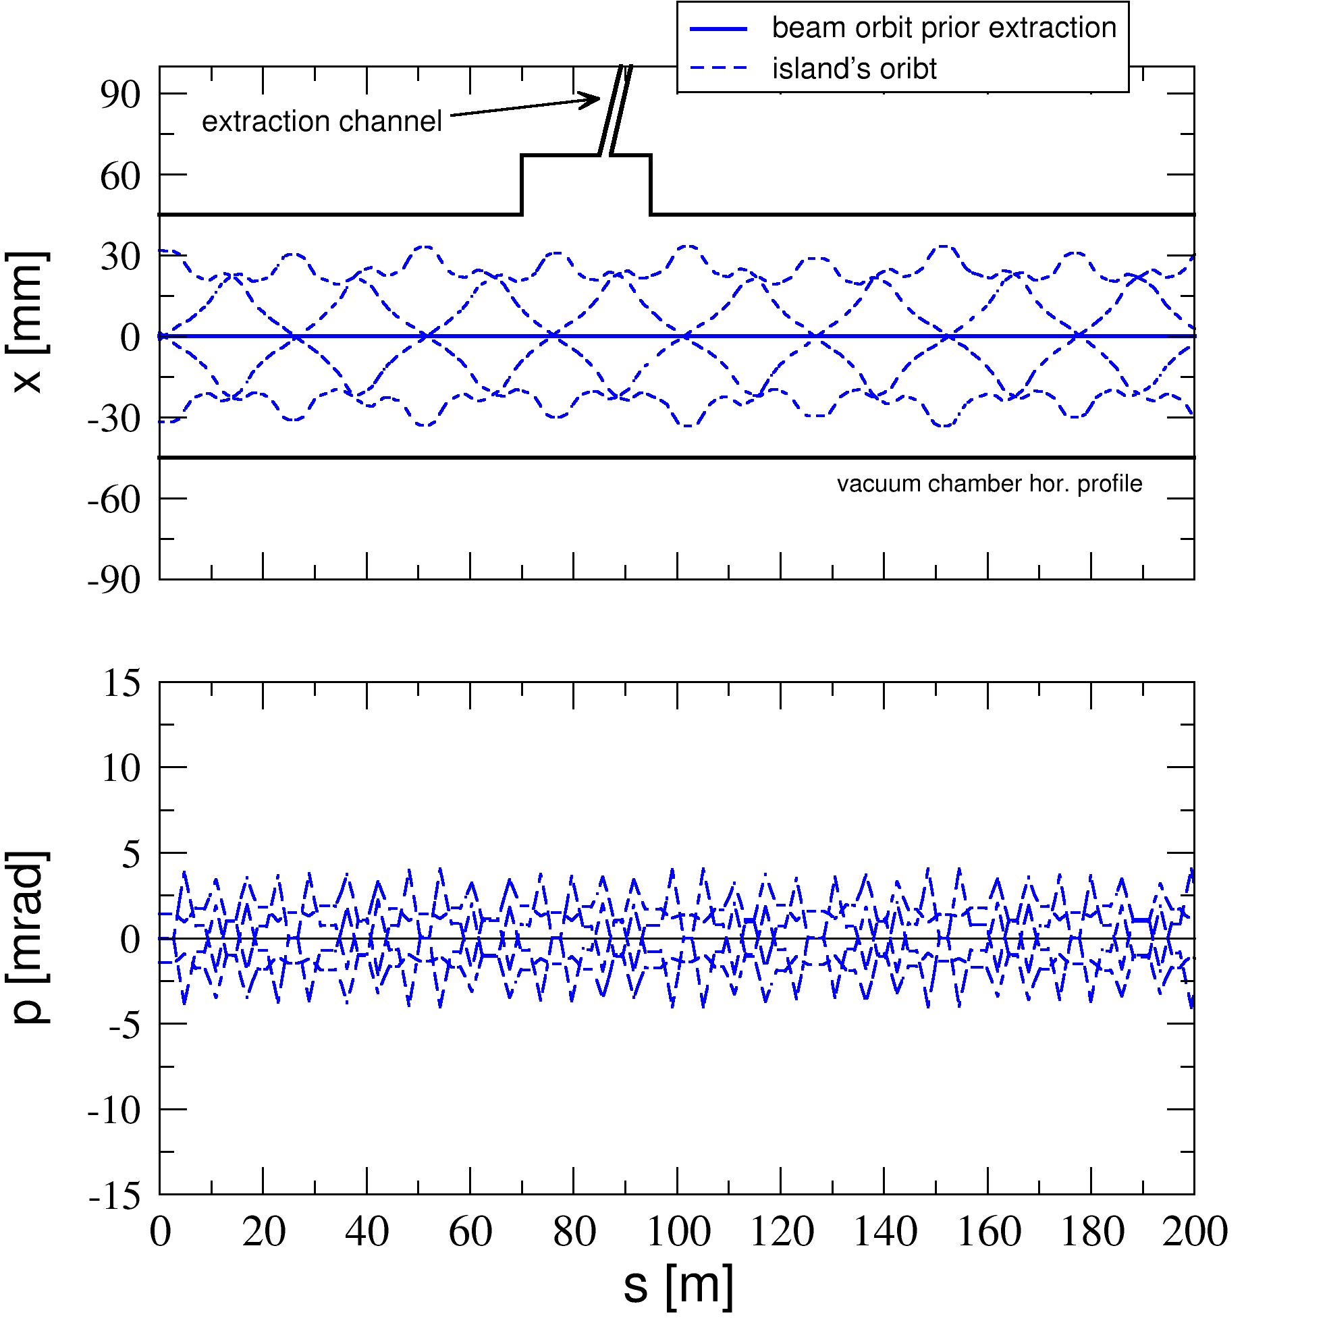
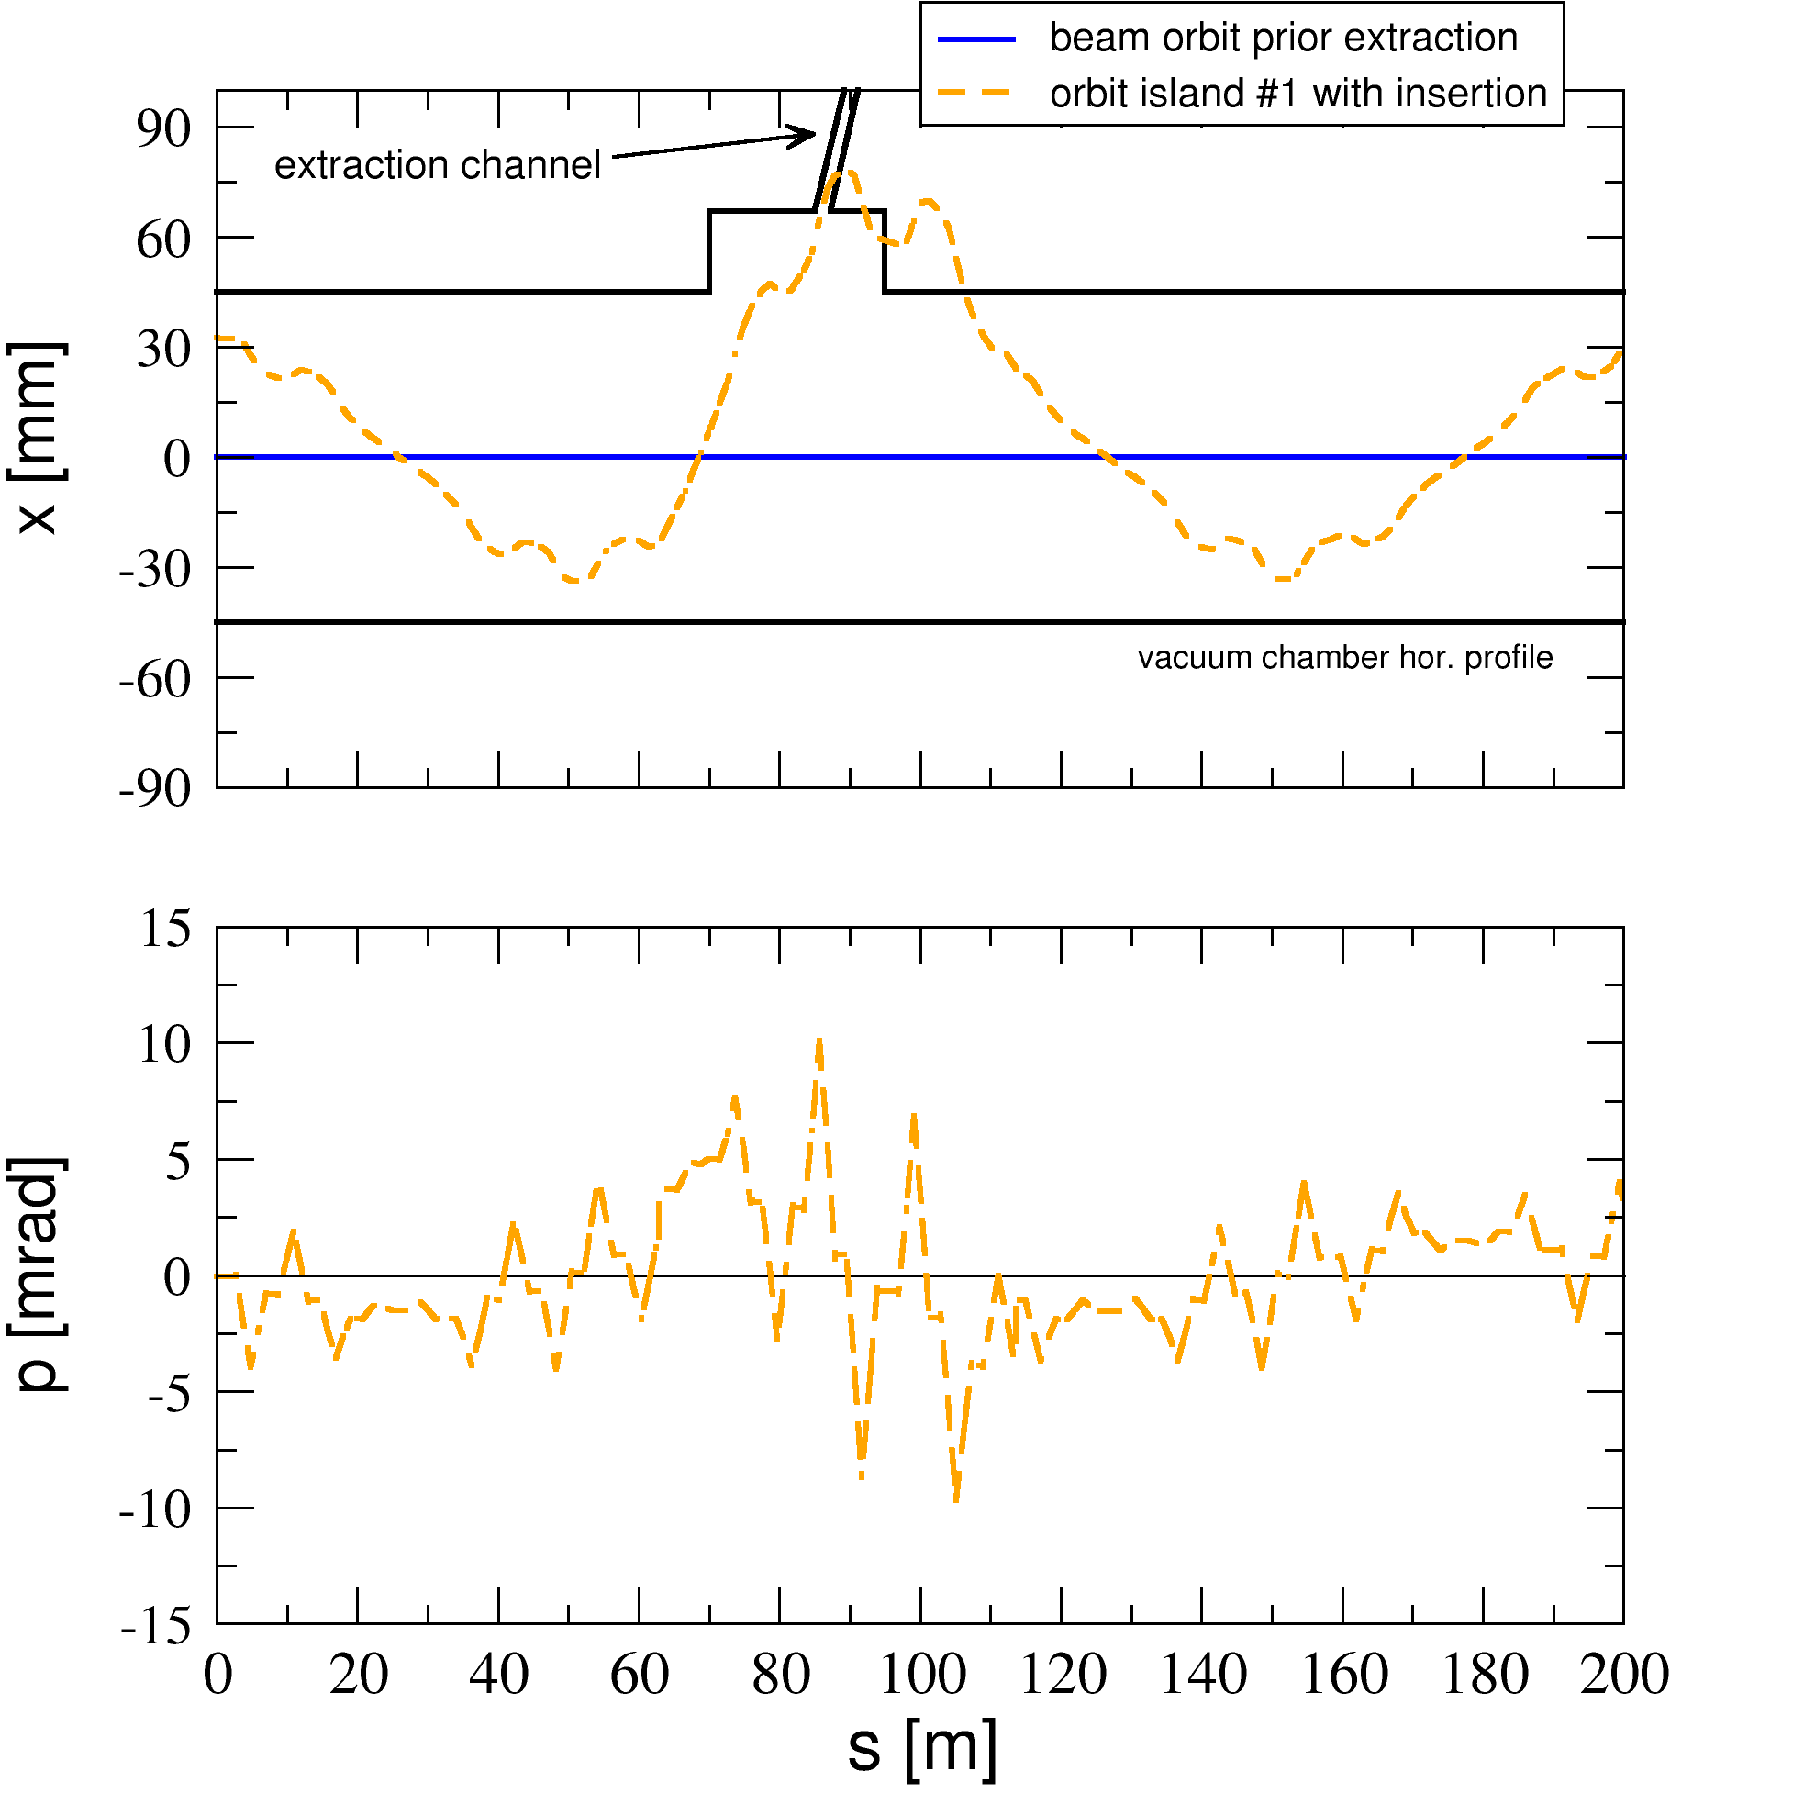
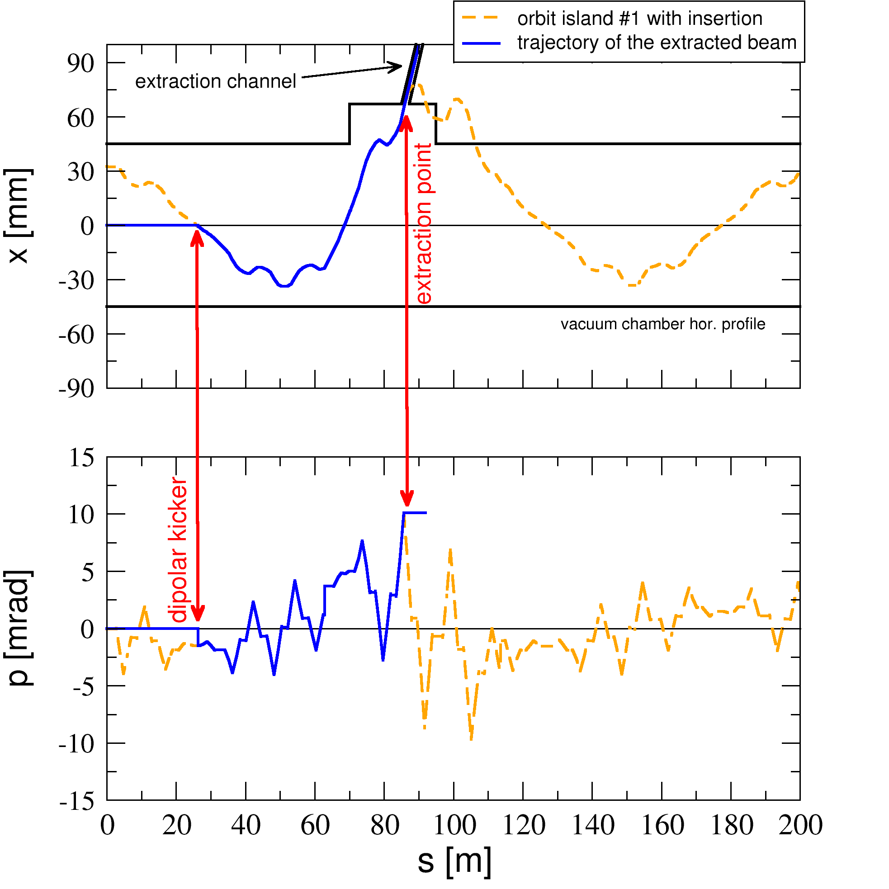
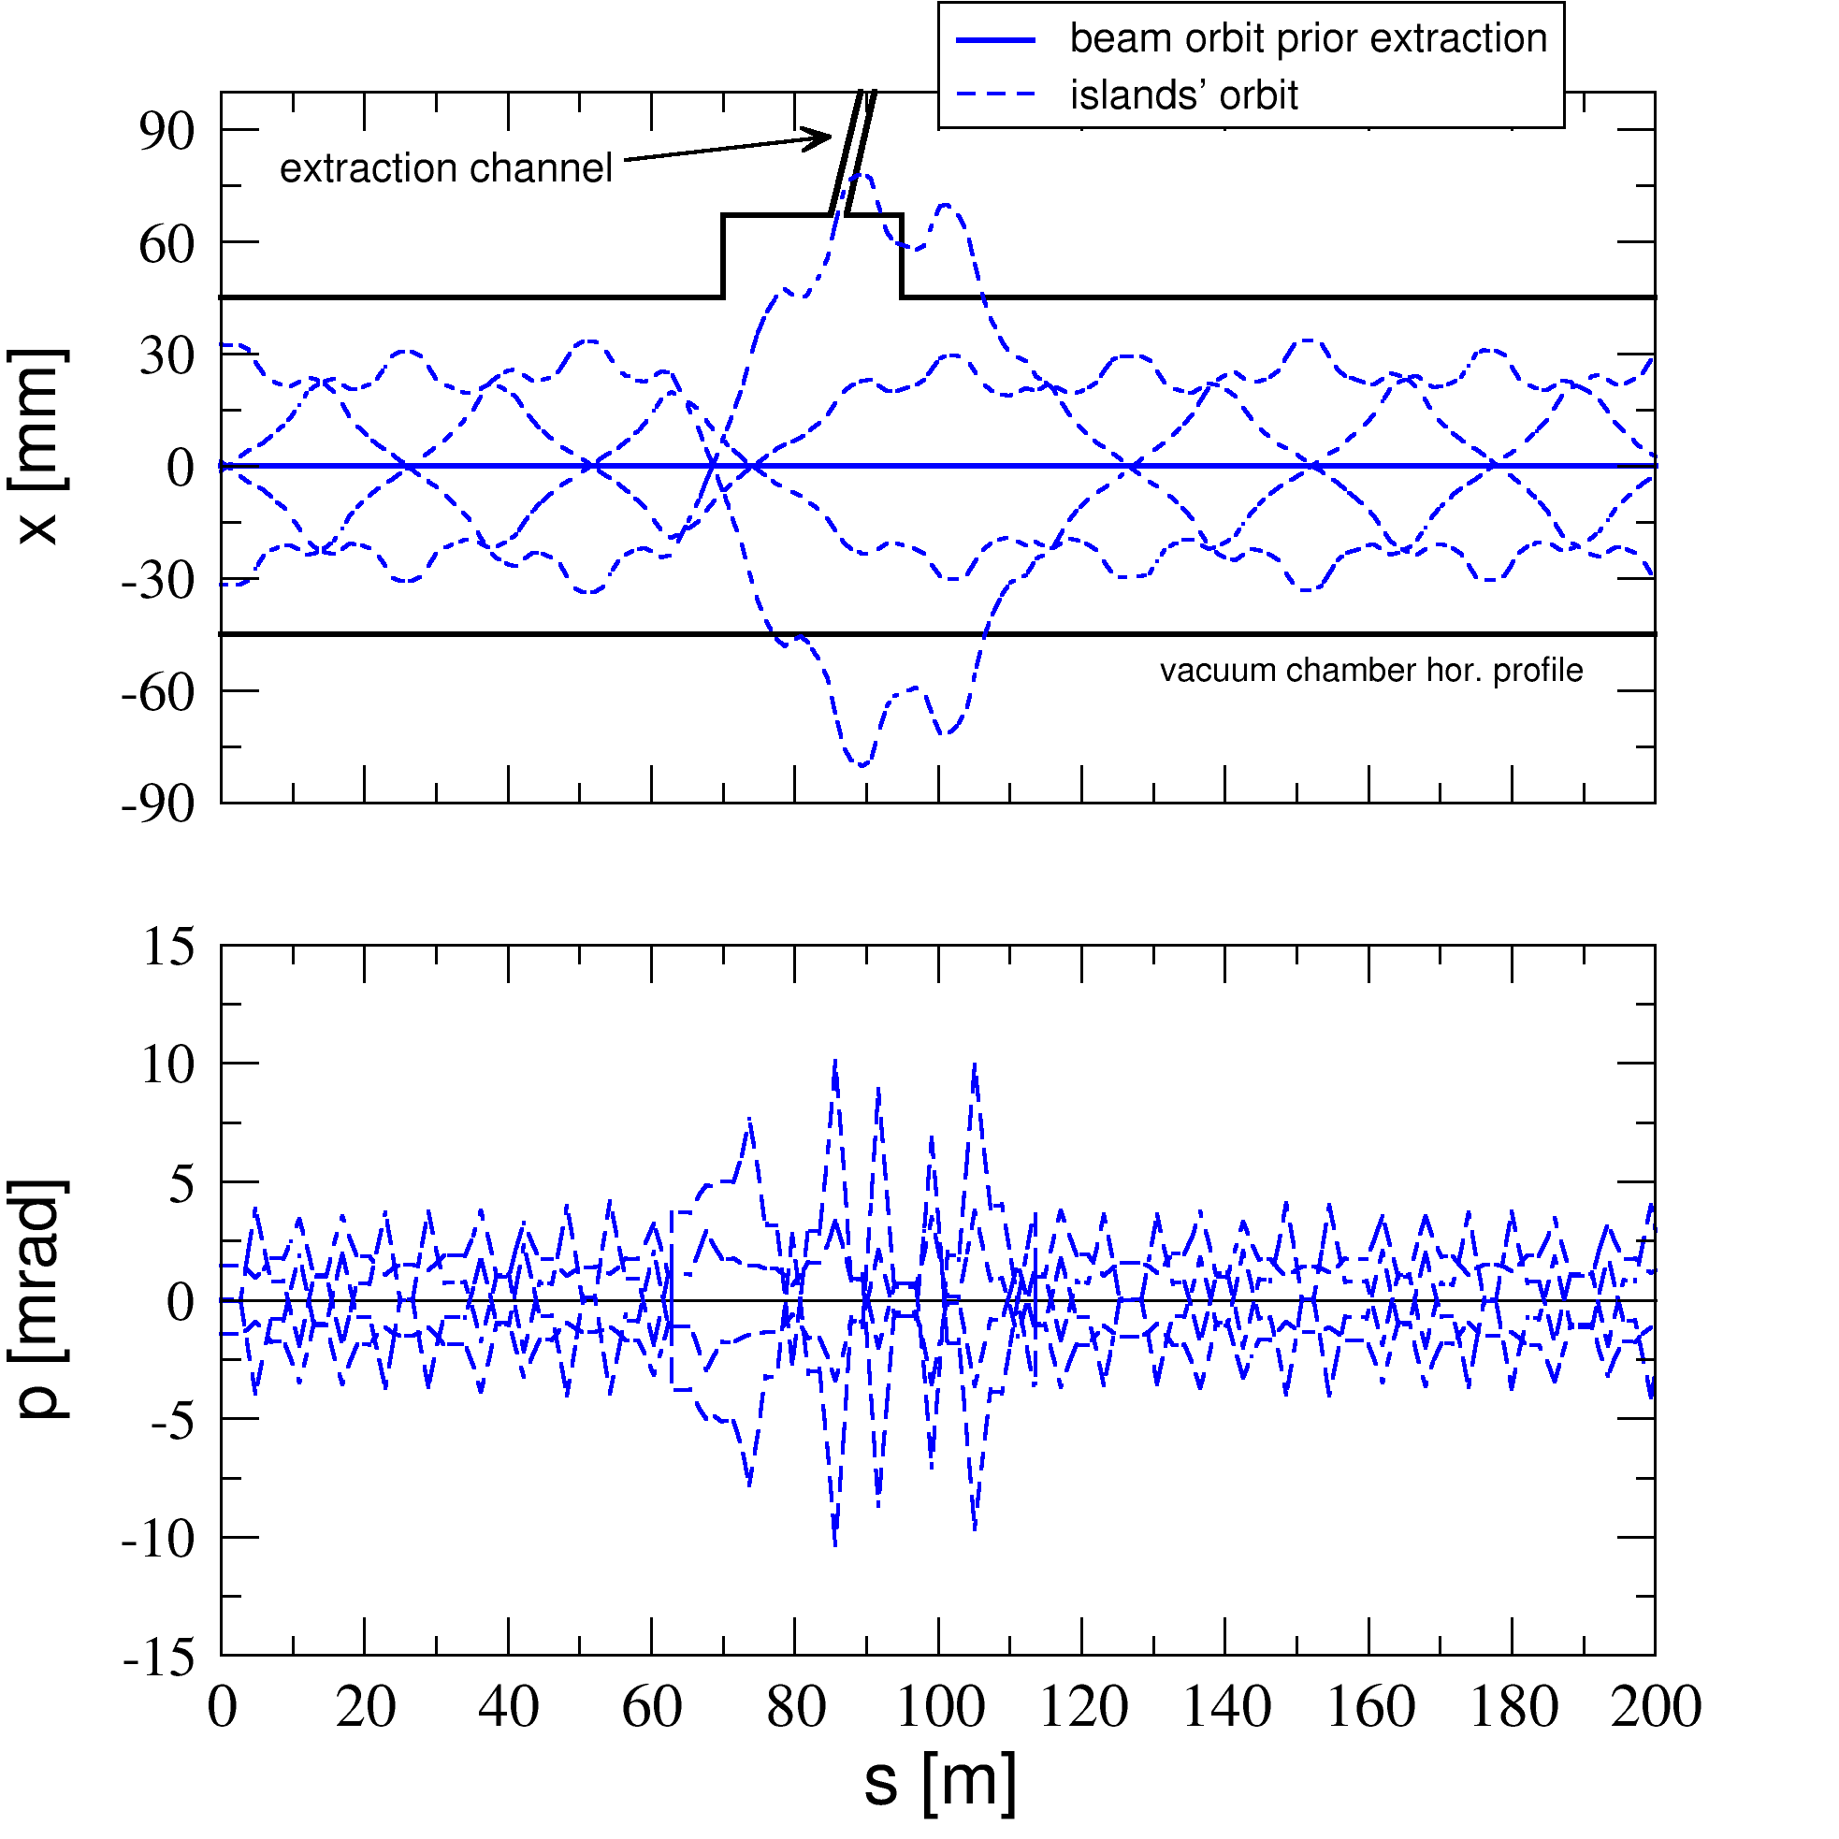
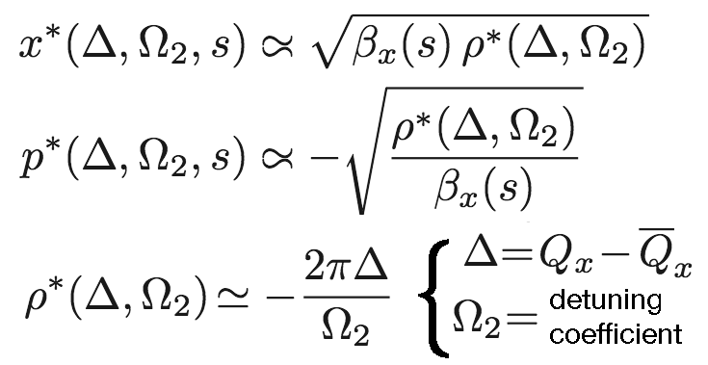
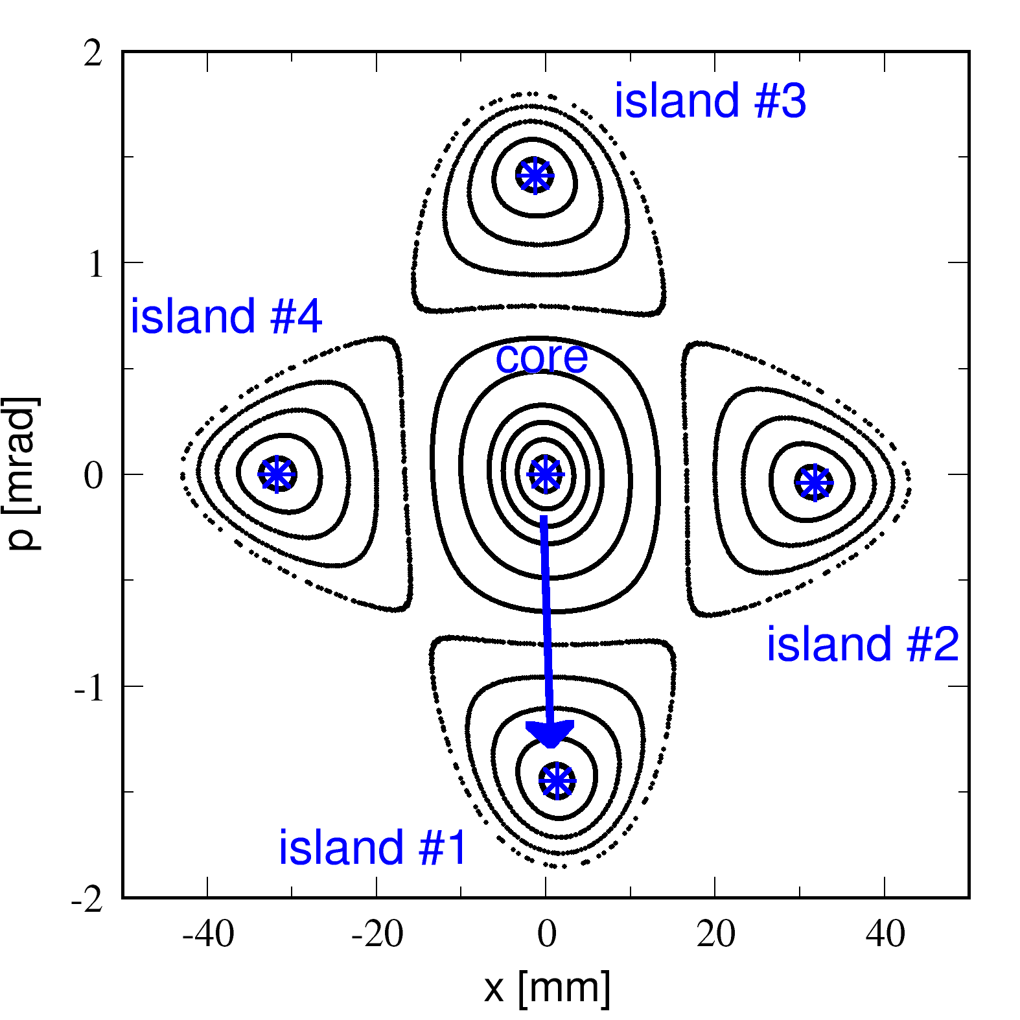
Septum-less extraction or injection
to avoid insertion optics (unpopulated) islands may be displaced by moving Q_{x} only
step 1: generate (though do not populate) four islands. the beam remain on axis
step 2: introduce the insertion optics via quadrupole bumpers, not kickers (actually not needed)
step 3: install and pulse a dipole kicker at a waist to move the beam from the axis to the island

Slide 9
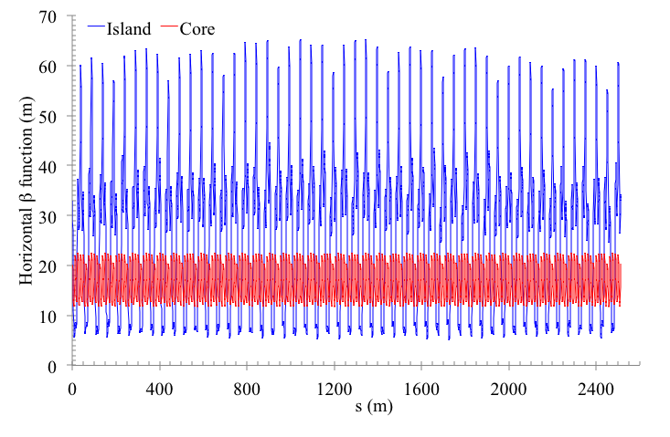
Examples based on PS ring - I
Clear difference between islands and core beta-function in H-plane: feed down from off-axis traversal of sextupoles and octupoles.

Slide 10
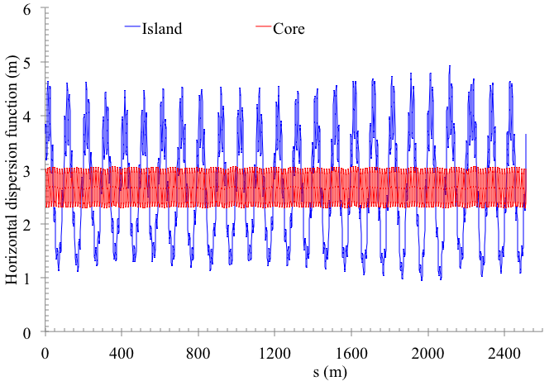
Examples based on PS ring - II
Clear difference between islands and core dispersion in H-plane: feed down from off-axis traversal of quadrupoles.

Slide 11
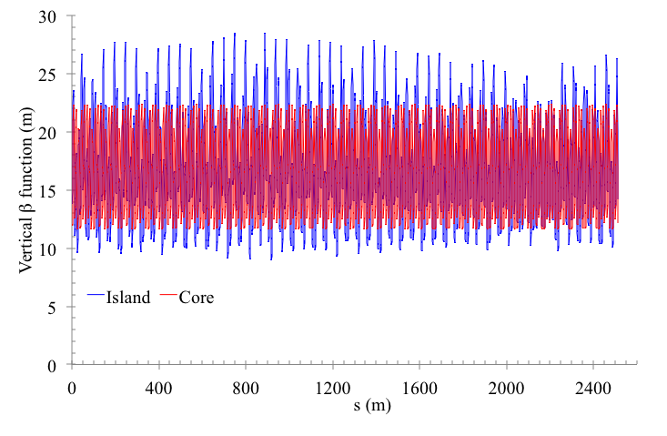
Examples based on PS ring - III
Difference between islands and core beta-function in V-plane: non-linear coupling due to sextupoles and octupoles.

Slide 12
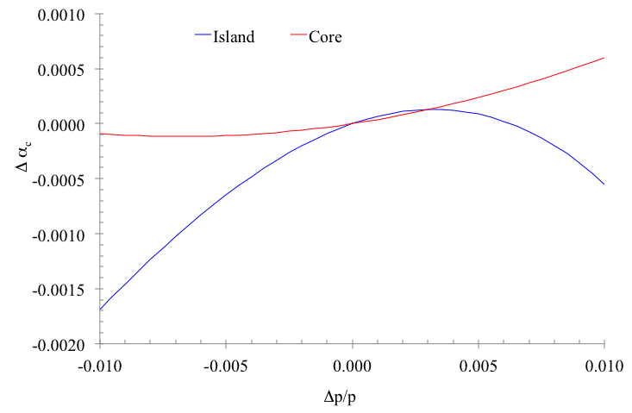
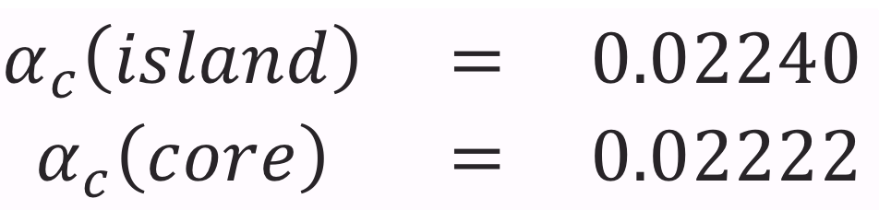
Examples based on PS ring - IV
Clear difference in momentum compaction between islands and core: in this case the difference is only 0.8%...

Slide 13
Alternative gamma-jump scheme
The optics around the fixed points can be designed to enhance the difference of gamma jump between the two closed orbits.
The transition can be jumped by kicking the beam from the central closed orbit to the fixed points (and back).
Simulations are on-going to assess the performance of such a technique.

Slide 14
Dynamic stable islands
The transverse position of the stable islands is controlled by: transverse tune, strength of sextupoles, octupoles etc.
By adiabatically changing any of these parameters it is possible to perform
  Splitting of a standard beam into several beamlets. This is the heart of the Multi-Turn Extraction (MTE) in use at CERN
  Merging several beamlets into a single one. This could be an option for Multi-Turn Injection (MTI).

Slide 15
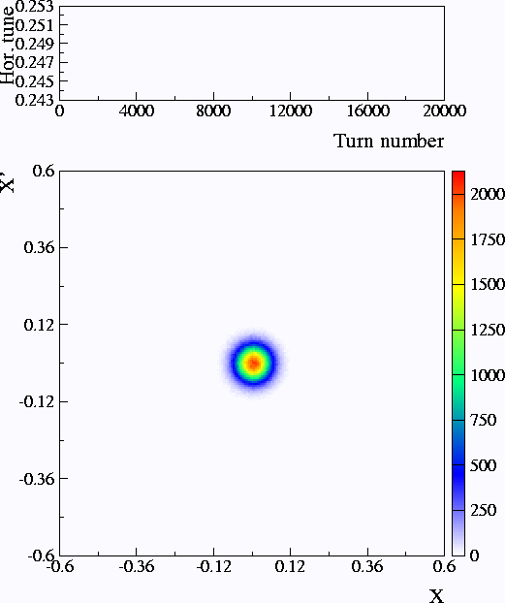
CT vs. MTE
Example of transverse beam splitting using a simple dynamical model
CT
  Losses are unavoidable due to electrostatic septum used for beam slicing.
  Slices feature different emittances and optical parameters.
  MTE
  Nonlinear magnets to create stable islands
  Slow tune variation to cross a resonance
  Extraction losses are reduced (virtually to zero).
  Beamlets have same emittance and optical parameters.
Splitting and extraction are well-separated processes

Slide 16
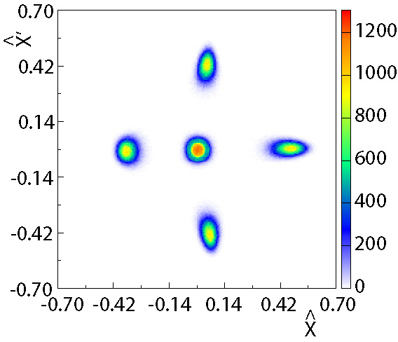
MTE: extraction process
Final stage after 20000 turns (about 42 ms for CERN PS)
At the septum location
B_{field} = 0
B_{field} ≠ 0
Slow (few thousand turns) bump first (closed distortion of the periodic orbit)
Fast (less than one turn) bump afterwards (closed distortion of periodic orbit)
About 6 cm in physical space

Slide 17
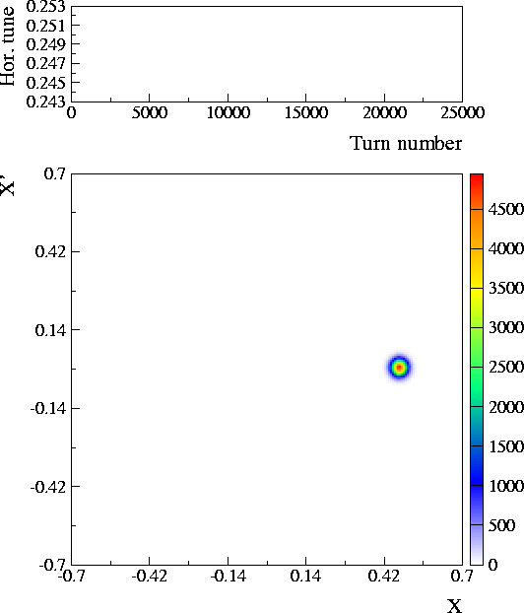
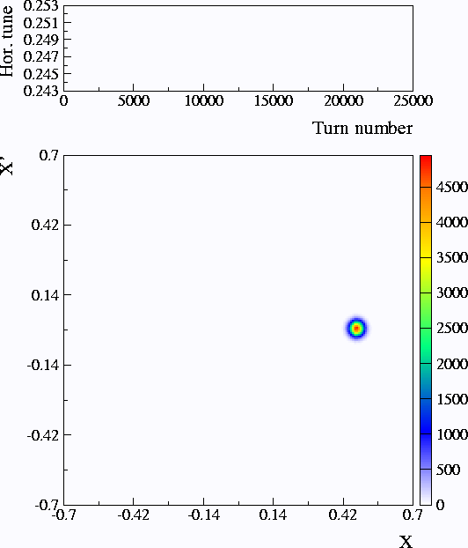
Multi-Turn Injection
The fourth-order resonance is used for a four-turn injection
Flat beam distribution obtained by injecting a fifth turn in the centre.
Efficient method to generate hollow beams!
Hollow beam distribution

Slide 18
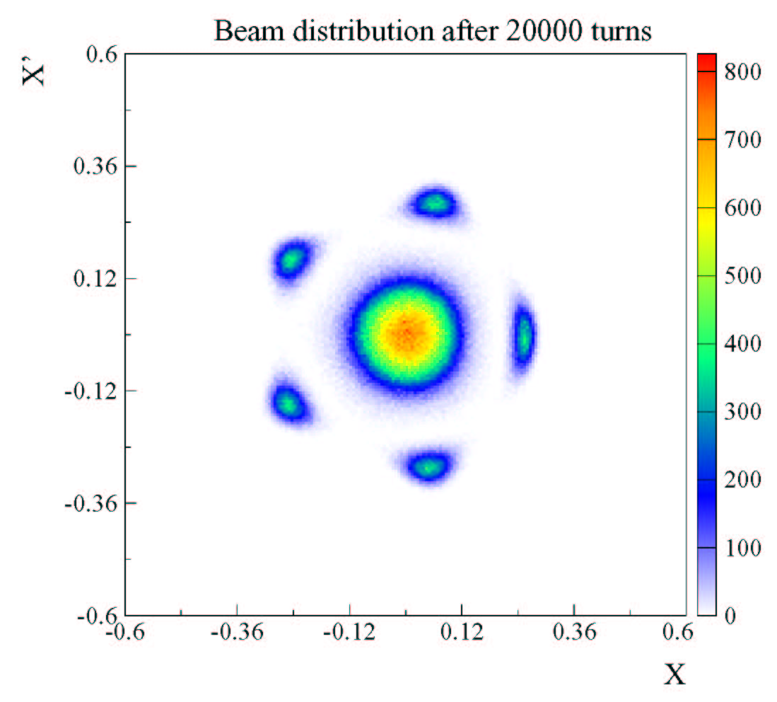
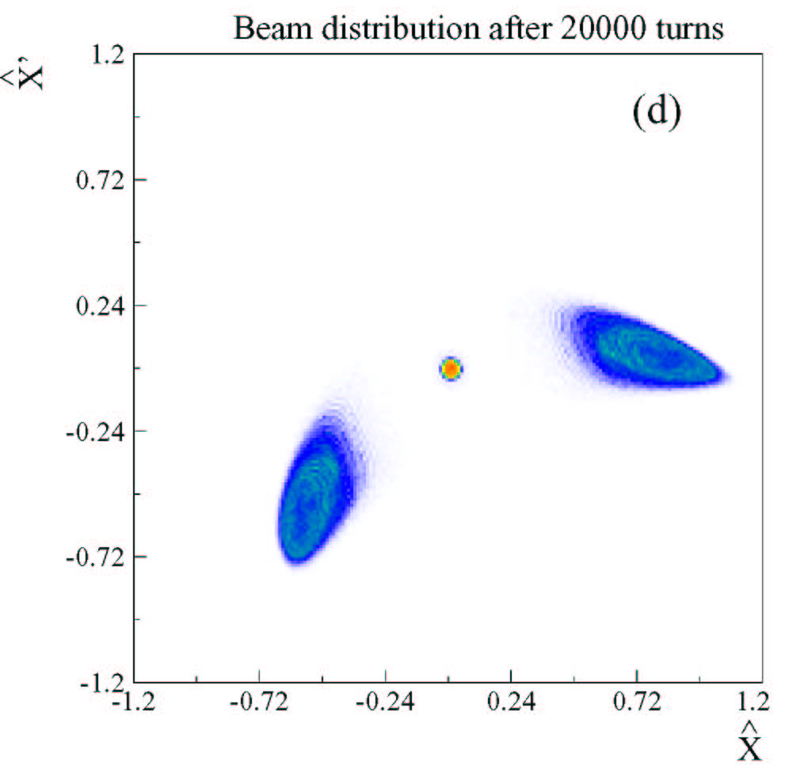
Multi-Turn Extraction with other resonances
The second-order resonance is used, thus giving a two-turn extraction
The fifth-order resonance is used, thus giving a six-turn extraction

Slide 19
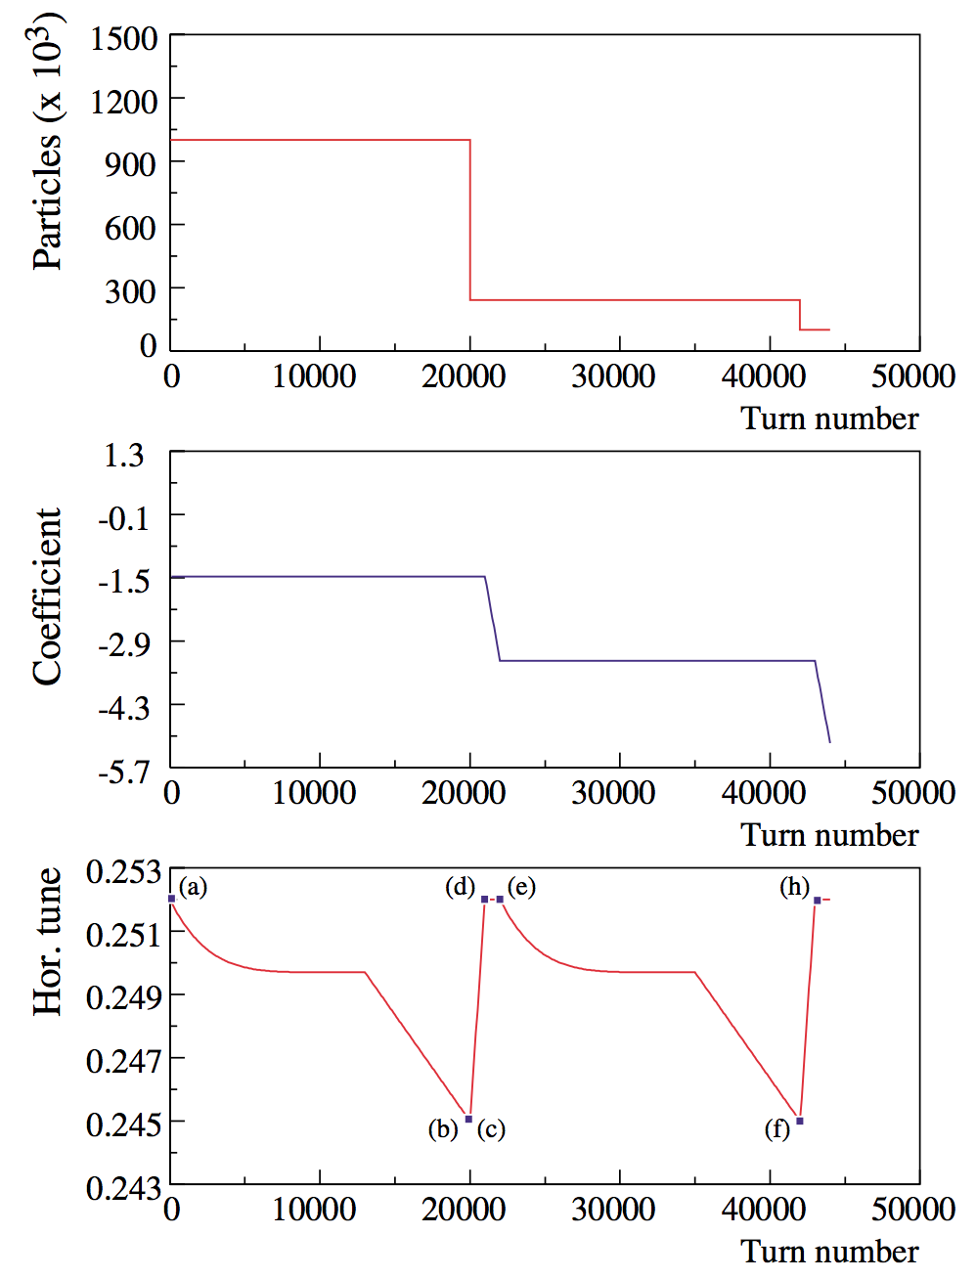
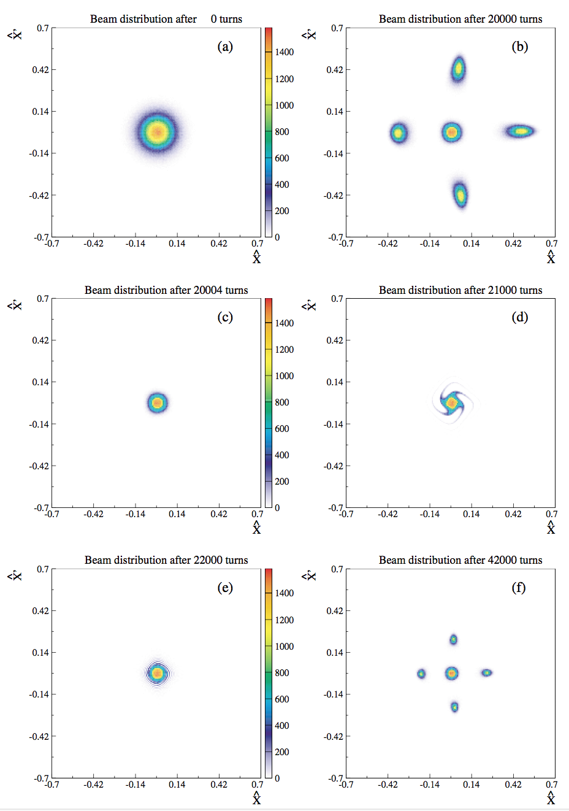
Multiple Multi-Turn Extraction

Slide 20
Outlook
Several applications of stable islands to circular accelerators have been proposed.
Till now, the main domain of applicability is hadron machines.
Beam splitting has been proven in operation.
The next step is to extend some of the proposals to lepton machines.

Slide 21
Thank you!

Slide 22
Selected references
S. Abernethy at al., Phys Rev. Accel. Beams 20, 014001 (2017).
J. Borburgh et al., EPL 113 34001 (2016).
A. Franchi, M. Giovannozzi, Phys. Rev. ST Accel. Beams 18, 074001 (2015).
A. Bazzani et al., Phys. Rev. E 89, 042915 (2014).
S. Gilardoni, M. Giovannozzi, C. Hernalsteens, Phys. Rev. ST Accel. Beams 16 051001 (2013).
M. Giovannozzi, D. Quatraro, G. Turchetti, Phys. Rev. ST Accel. Beams 12 024003 (2009).
A. Franchi, S. Gilardoni, M. Giovannozzi, Phys. Rev. ST Accel. Beams 12 014001 (2009).
M. Giovannozzi and J. Morel, Phys. Rev. ST Accel. Beams 10 034001 (2007).
S. Gilardoni at al., Phys. Rev. ST Accel. Beams 9 104001 (2006).
R. Cappi, M. Giovannozzi, Phys. Rev. ST Accel. Beams 7 024001 (2003),
R. Cappi, M. Giovannozzi, Phys. Rev. Lett. 88 104801 (2002).

Slide 23
Reserve slides

Slide 24
A brief history of MTE - II
2008-9: Initial beam commissioning. Bunched beams used and occasionally sent to SPS.
2010: Short operational period. Observed:
  Increase of irradiation of the extraction region. This is due to the longitudinal beam structure (continuous).
  Poor reproducibility of the trapping efficiency
  Poor reproducibility of extraction trajectories
2010-12: Reproducibility studies. Looking for physical observable(s) correlated with the trapping.
2013-14: Installation of dummy septum and beam commissioning. This is the solution to the increased irradiation in the extraction region.
2015: Successful beam commissioning and operation.

Slide 25
2015 beam commissioning and operation - VII
History of the 2015 MTE run
CT
Courtesy C. Hernalsteens

Slide 26
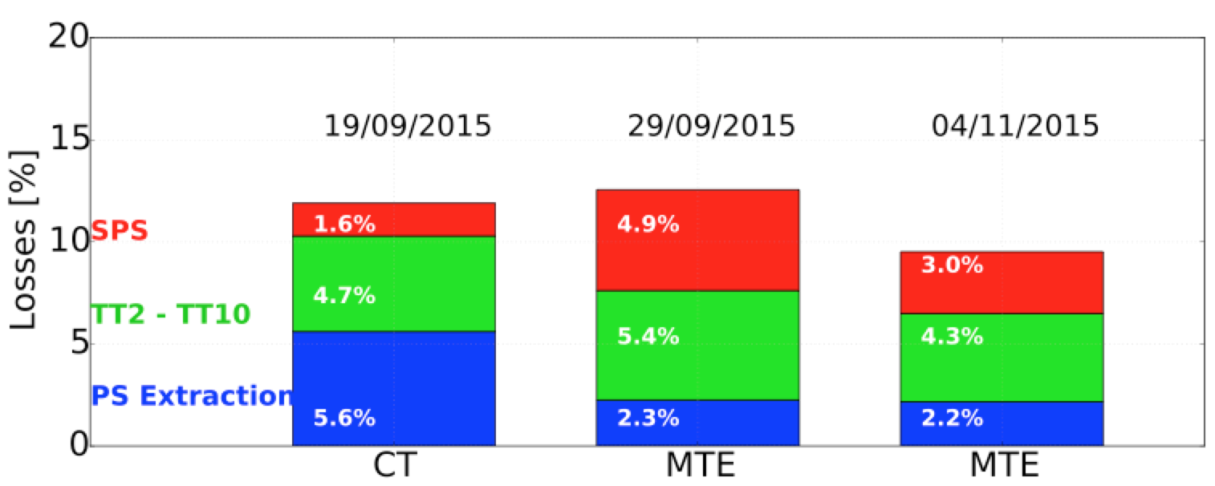
2015 beam commissioning and operation - VIII
History of the 2015 MTE run
Losses from PS flattop to SPS flattop. Three configurations are shown: CT operation early 2015 (left), initial MTE operation (centre) and improved MTE operation (right).
Courtesy C. Hernalsteens

