Slide 1
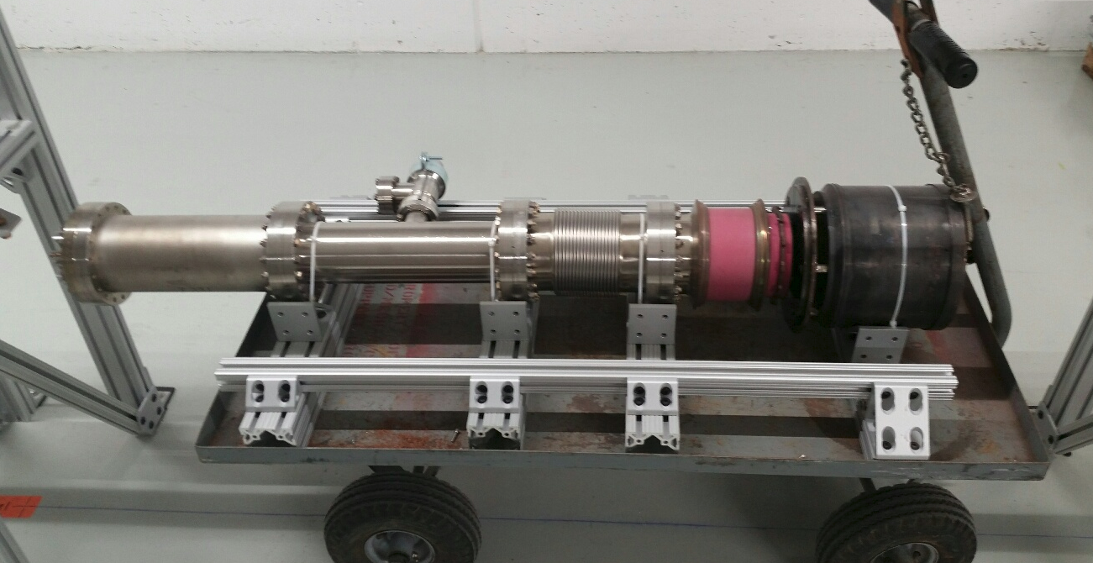
New Uses of Electron Lenses
Electron gun and collector from TEL-1
Waiting for installation in the IOTA ring
Vladimir Shiltsev,
Fermilab
Eucard-2 Meeting, Valencia
February 14, 2017

Slide 2
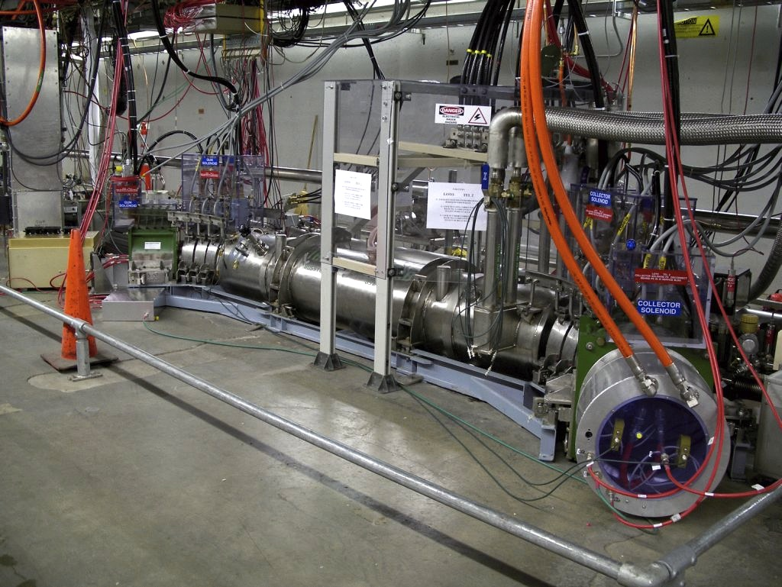
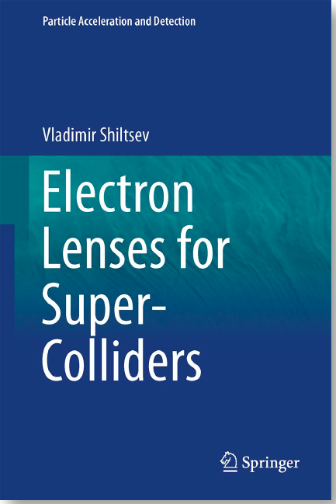
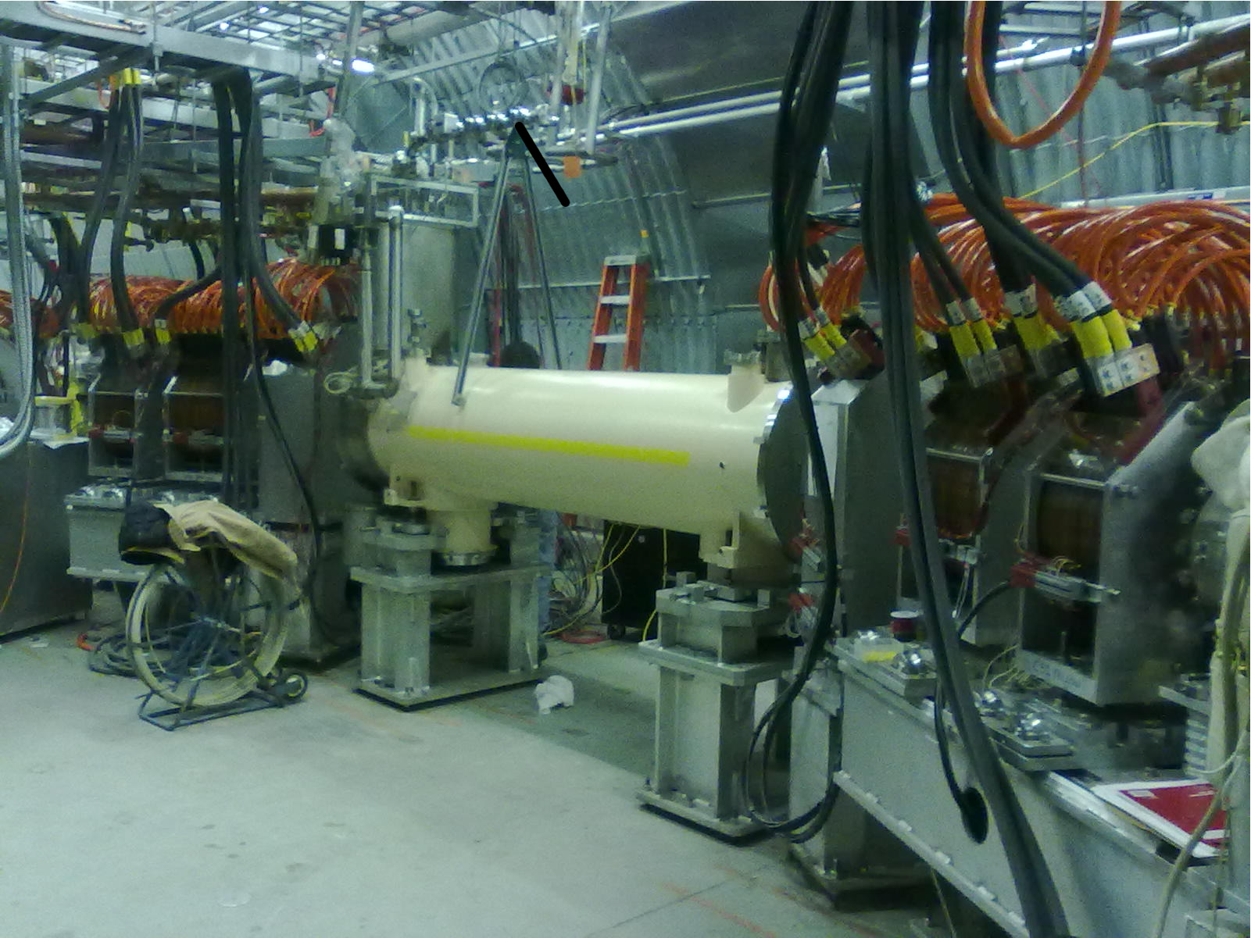
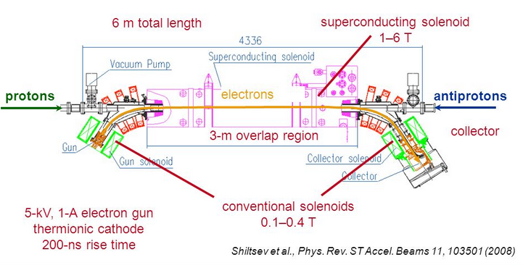
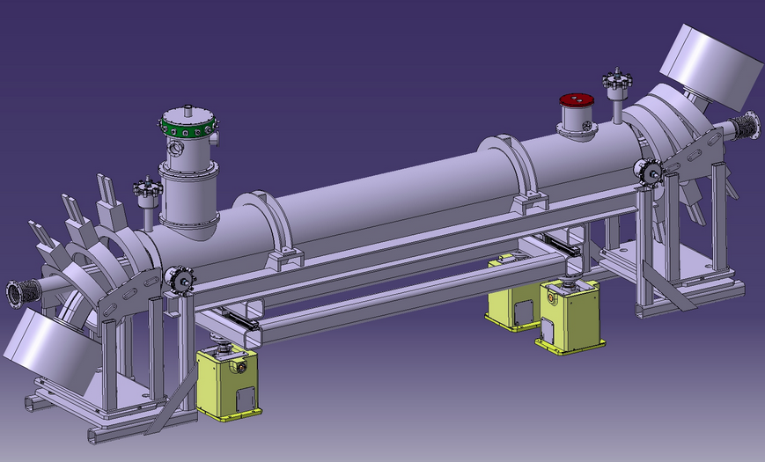
Electron Lenses: Tevatron, RHIC, LHC, FCC
Proposed HOBBC-1993, LRBBC-97
TEL-1 and TEL-2 : 2001, 2004
RHIC electron lenses : 2014
Springer Book : 2016
LHC electron lenses : ~2021 (?)
FCC e-lenses: ~2035 (??)
Tevatron Electron Lens - 2
Uniquely effective for:
Beam-beam compensation
Halo collimation
Space-charge compensation
  now in textbooks
LHC Electron Lens
RHIC Yellow Electron Lens

Slide 3
Today: New Uses of Electron Lenses
Electron lenses for Space-Charge Compensation
Electron lenses for Integrable Optics
Electron lenses for Landau damping

Slide 4
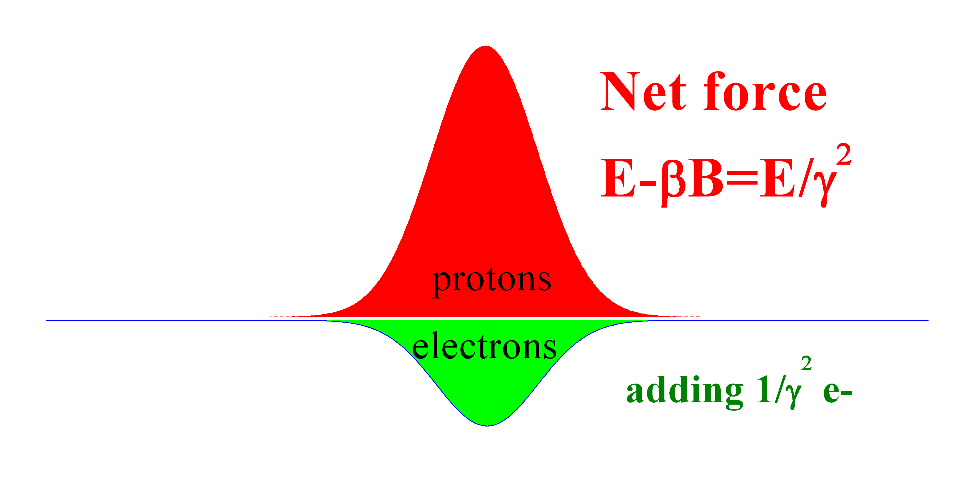

Part 1: Space Charge Compensation
Z, beam
direction
B=βE
r, across the beam

Slide 5
SCC with electron lenses
Instead of uniformly distributing electrons around the ring with low concentration :
Electron columns will generate HIGH concentration of electrons but over a small fraction of ring circumference:

Slide 6
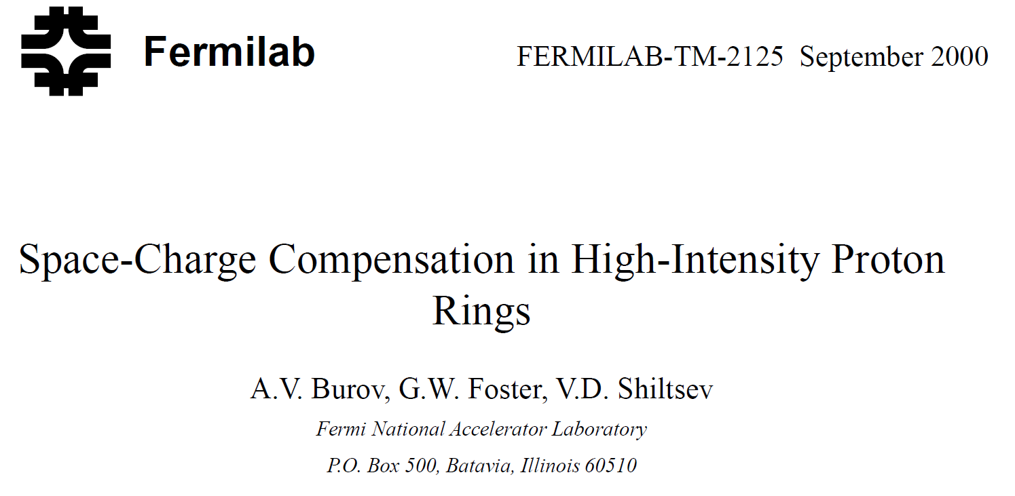
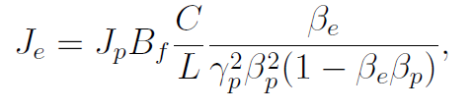
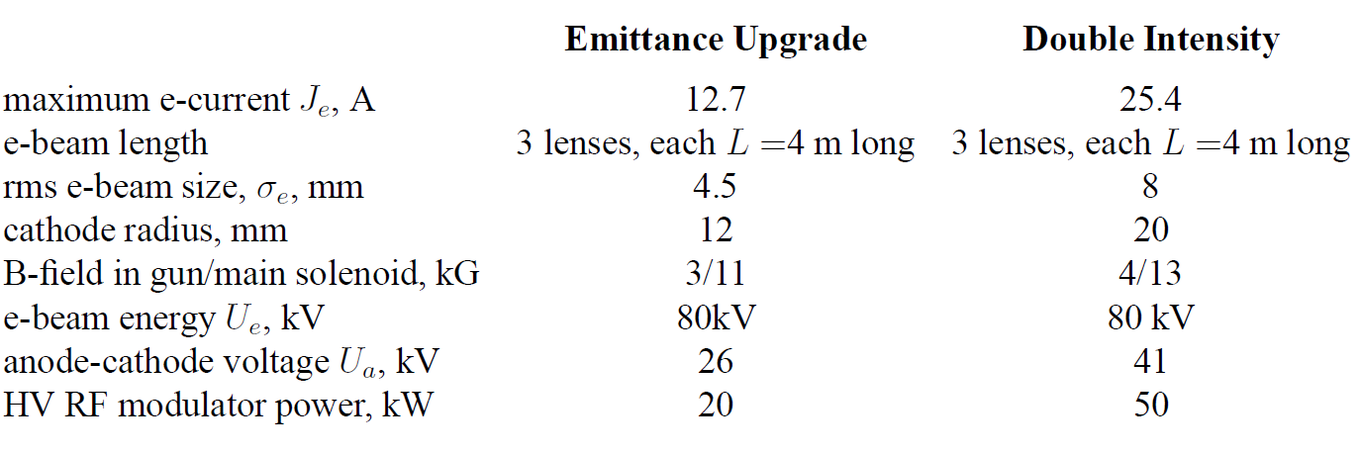
First Example: SCC in 8 GeV Booster
2000
To study: coherent modes and emittance growth

Slide 7
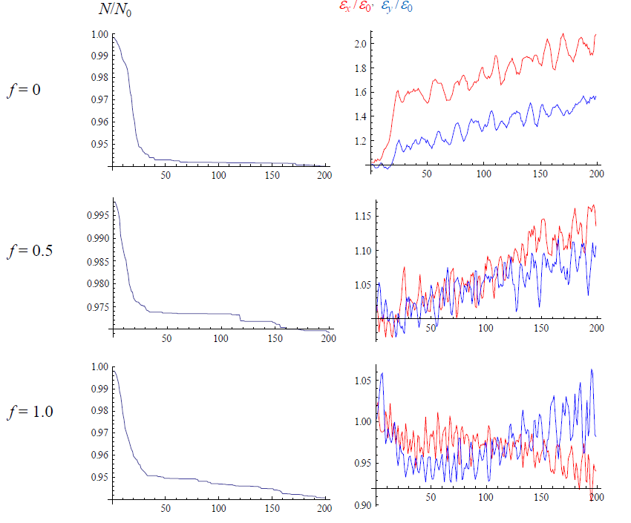
Simulations : FNAL Booster (Yu.Alexahin & V.Kapin, 2007)
Booster:
400 MeV, 474 m
P=24
N_p~4.5e12
dQ_sc=-0.3
“space charge compensation with e-lenses works”
More compensators the better (24→12→3 minimum)

Slide 8
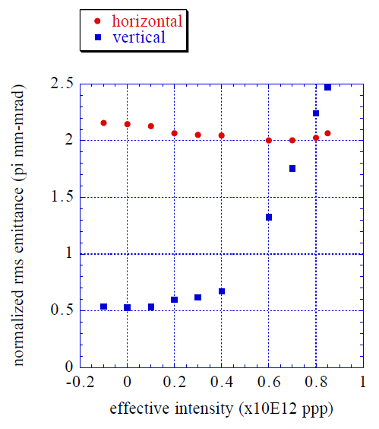

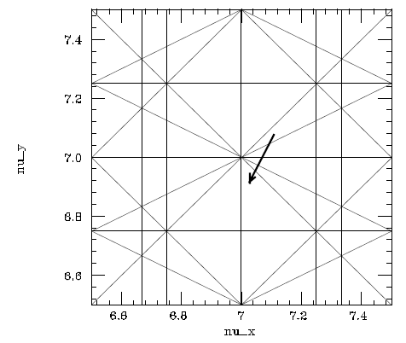
Simulations :KEK PS (S.Machida, 2001)
KEK PS:
500 MeV, 340 m
N_p~1e12
dQ_sc=-0.2
“space charge compensation with e-lenses works”
+0.1-0.2 sigma e-p displacement tolerable

Slide 9
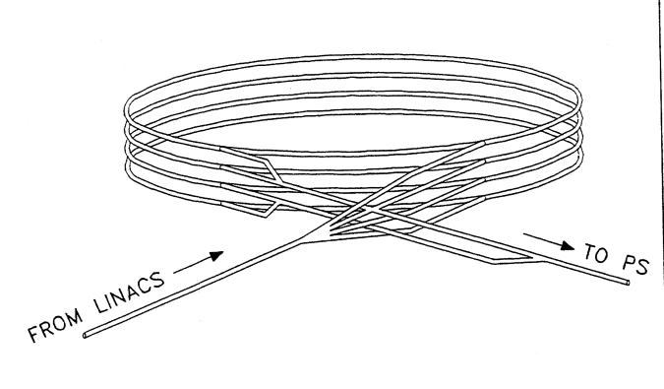
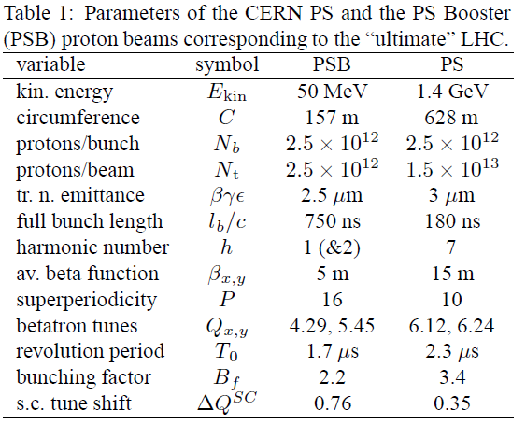
Simulations: CERN PS-B (M.Aiba,2007)
PS Booster:
50 MeV, 157 m
P=16
dQ_sc ~ -0.5
Need to increasee for LHC ultimate intensity →

Slide 10
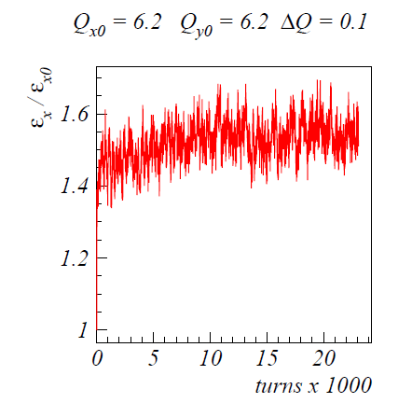
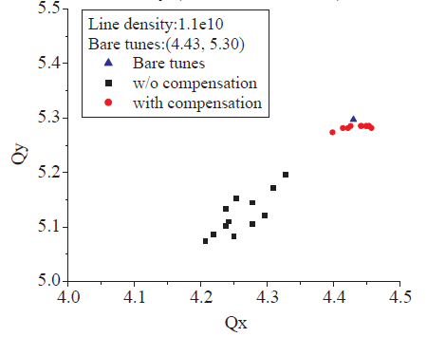
Simulations: CERN PS-B (M.Aiba,2007)
“space charge compensation with e-lenses works in principle… desrves further studies”
No evidence for coherent modes limitation in PSB and PS
Concern of overcompensation in the head and tail
More compensators the better (8 is better than 4)

Slide 11
Issues to Explore in Theory & Experiment
Stability of the system (transverse motion)
(Dynamic) matching of transverse p-charge distribution
Appropriate longitudinal compensation (for not-flat proton bunches)
Electron lenses vs electron columns
Practical implementation (in existing facilities)
= the Need of Experimental Study at a dedicated facility → IOTA ring (see slides later)

Slide 12
Part 2 : Electron Lenses for Integrable Optics
(Danilov, Shiltsev 1997, Danilov,Nagaitsev 2010)
Employment of special nonlinear fields to stabilize particle’s motion:
  Make motion limited and long-term stable (usually involves additional “integrals of motion”)
  Can be Laplacian (with magnets, no extra charge density involved)
  Or non-Laplacian (with externally created charge – e.g. special electron lens with E(r) ~r / (1+r^2)
  (That’s what IOTA is for – test with electrons)
  Should be directly applicable to protons with SC

Slide 13
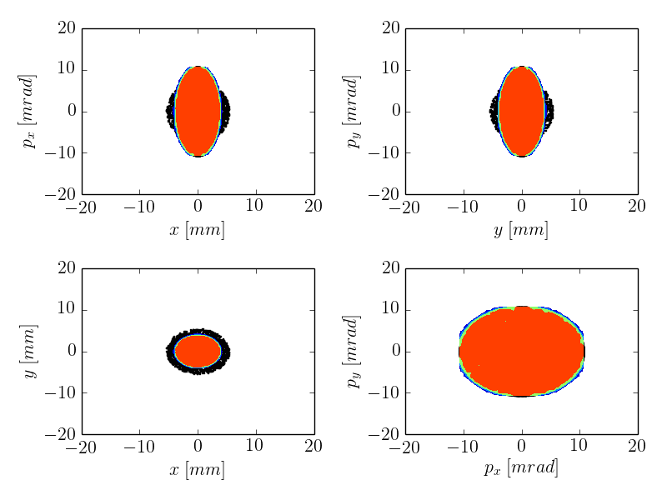
Space Charge in Linear Optics
ΔQ_{sc} ~ –0.7
System: linear FOFO 100 A linear KV w/mismatch
Result: quickly drives test-particles into the halo
Tech-X, RadiaSoft simulation

Slide 14
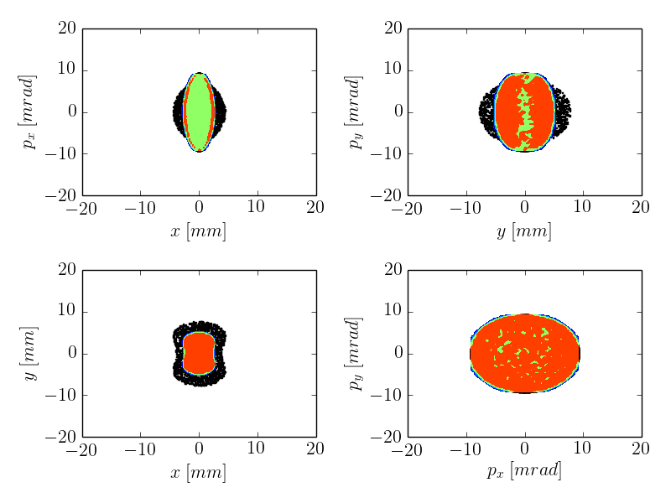
Space Charge in NL Integrable Optics
ΔQ_{sc} ~ –0.7
System: linear FOFO 100 A linear KV w/mismatch
Result: nonlinear decoherence suppresses halo
Tech-X, RadiaSoft simulation

Slide 15
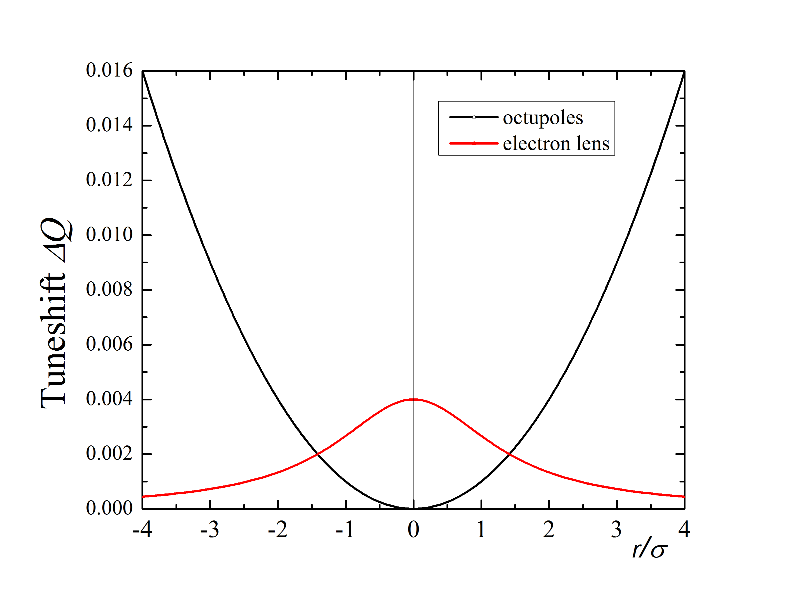
Part 3: Landau damping by e-lens
E-lens effectively generates the tunespread needed for Landau damping of coherent beam instabilities
Contrary to octupoles, e-lens does that without affecting the dynamic aperture (no impact on large A particles)

Slide 16
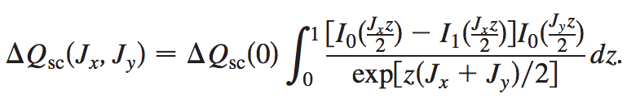
Analysis of the Stability Diagram with e-lens
Stability diagram (SD) is defined as a map of real axes on the complex plane :
To be stable, the coherent tune shift has to be below the SD.
For Gaussian E-Lens, the tune shifts (G. Lopez, 1993)

Slide 17
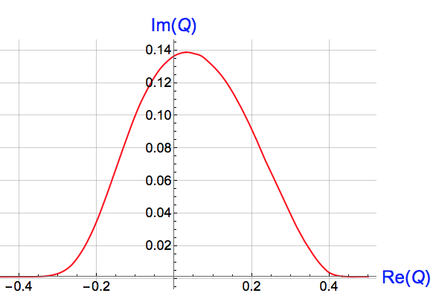
Both beams are round Gaussian, same rms sizes
Stability diagram in the units of the maximal tune shift
AB

Slide 18
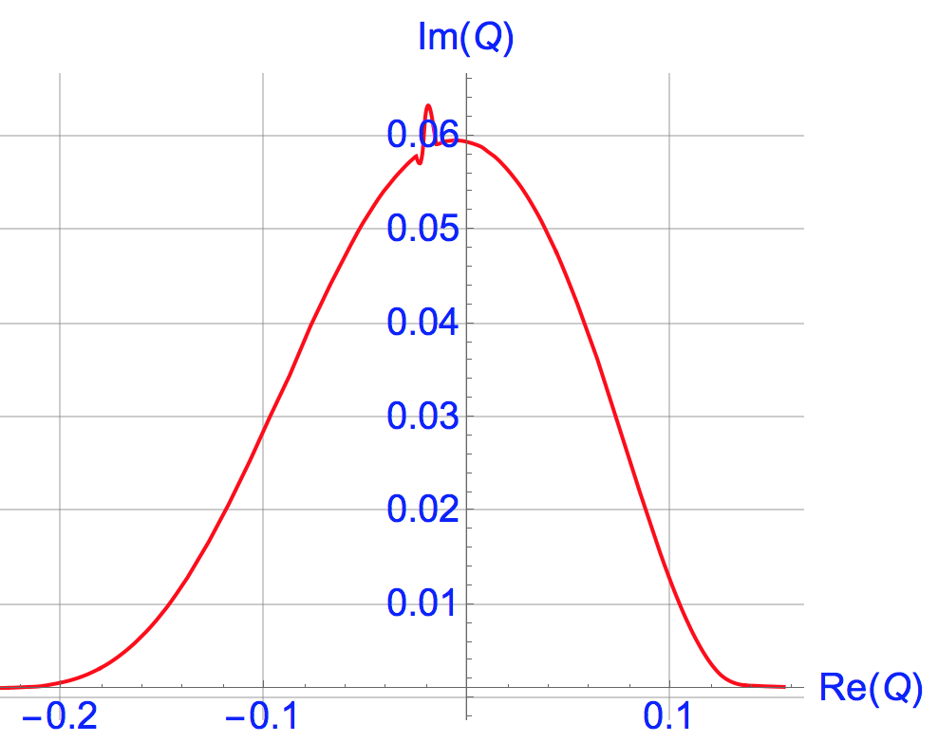
Both beams are round Gaussian, unequal sizes
Stability diagram in the units of the maximal tune shift
AB

Slide 19
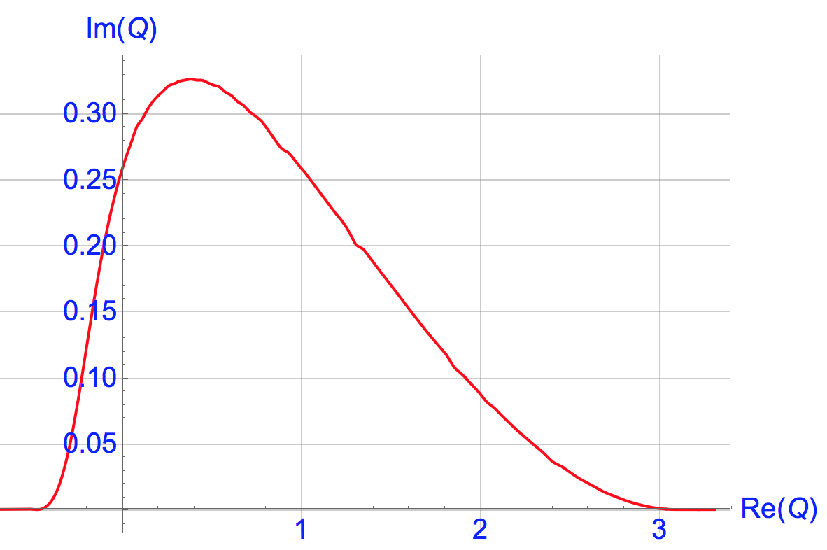
Both beams are round Gaussian, unequal sizes
Same total current as before,
AB

Slide 20
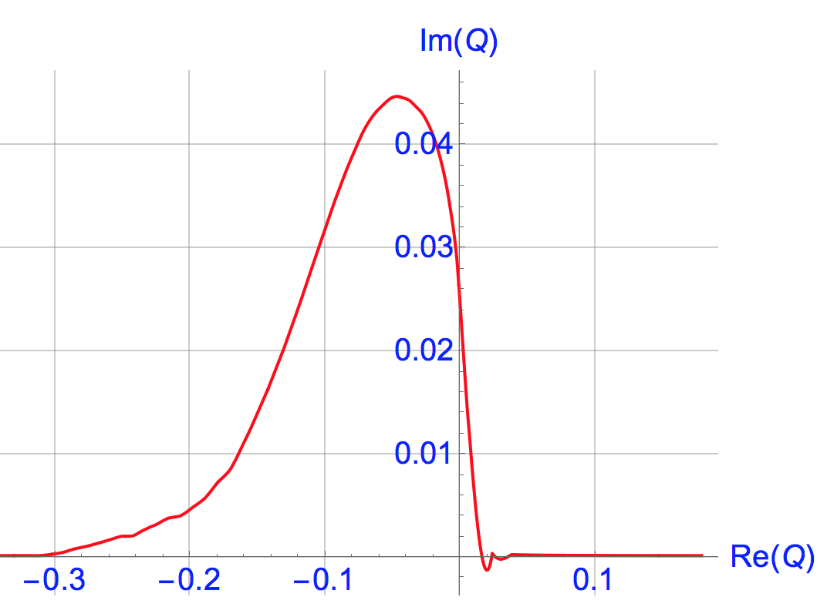
Another degree of flexibility: hollow e-lens
Hollow e-lens, same total current,
AB

Slide 21
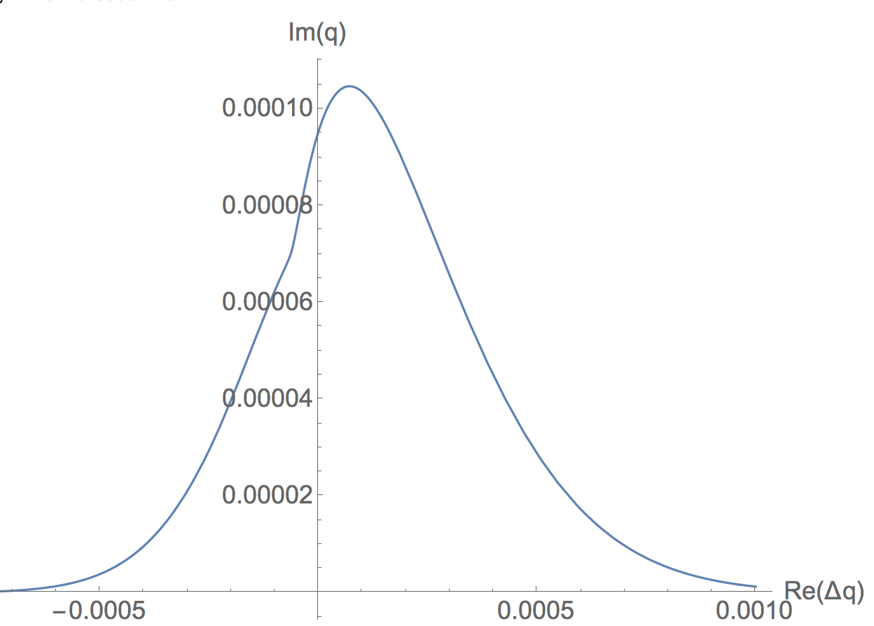
Compare SD for LHC octupoles, +500A
AB

Slide 22
What e-lens could do for, e.g., LHC?
Let us assume the following e-lens parameters (very modest):
Beta_x,y | 1 km
sigma_e/sigma_p | 1
sigma_e | 0.6 mm
sigma_cath | 3 mm
j_max | 2 A/cm^2
I_e | 1.1 A
L_e | 3 m
E_e | 20 KeV
This rather moderate set of parameters corresponds to dQ_max=0.015, yielding 10-20 times larger SD than the Landau octupoles at 500 A.
AB

Slide 23
That brings us to….
IOTA
Integrable Optics Test Accelerator
(the ring with 70 MeV/c p+ injector)
at FAST
Fermilab Accelerator Science & Technology facility
50 MeV e- photoinjector and 250 MeV SRF Cryomodule e- linac
(e- injector to IOTA)

Slide 24
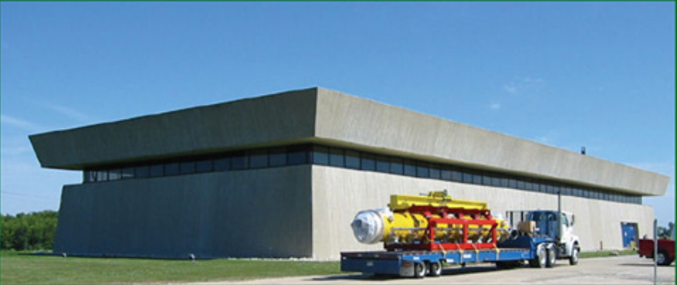

IOTA R&D complex @Fermilab
NML building
~300-MeV e- injector section
RF gun
cryomodule
test beamlines
Bunch
compressor
2.5 MeV
p source
SRF cavities
IOTA
beam
dumps
IOTA facility complex includes:
  IOTA (integrable-optics test accelerator) ring,
  150-300 MeV linear accelerator (that nominally
  serves as an electron injector to IOTA),
  70 MeV/c proton source & injector for IOTA
Facility is located in the New Muon
Lab (NML) building
FAST

Slide 25
IOTA Ring Parameters
Nominal kinetic energy | e⁻: 150 MeV, p+: 2.5 MeV
Nominal intensity | e⁻: 1×10⁹, p+: 1×10¹¹
Circumference | 40 m
Bending dipole field | 0.7 T
Beam pipe aperture | 50 mm dia.
Maximum b-function (x,y) | 12, 5 m
Momentum compaction | 0.02 ÷ 0.1
Betatron tune (integer) | 3 ÷ 5
Natural chromaticity | -5 ÷ -10
Transverse emittance r.m.s. | e⁻: 0.04 μm, p+: 2μm
SR damping time | 0.6s (5×10⁶ turns)
RF V,f,q | e⁻: 1 kV, 30 MHz, 4
Synchrotron tune | e⁻: 0.002 ÷ 0.005
Bunch length, momentum spread | e⁻: 12 cm, 1.4×10⁻⁴

Slide 26
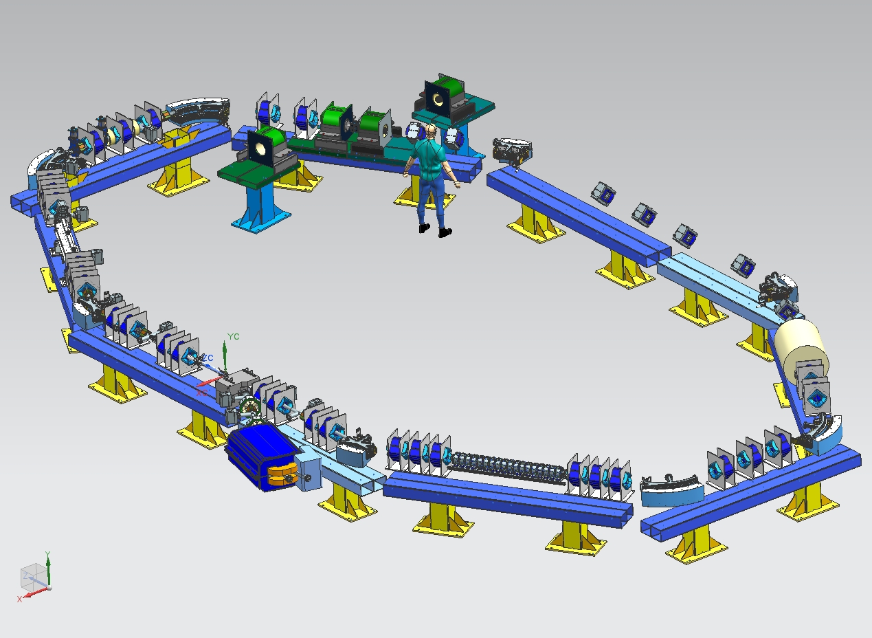
IOTA Layout
SCC, IO, LD
Various regimes
dQ_sc= 0.25 → 1.0
~1m electron lens
OSC experiment
IO-NL-2
RF
~12 m
IO-NL-1
150 MeV
e- injection
2.5 MeV
p source

Slide 27
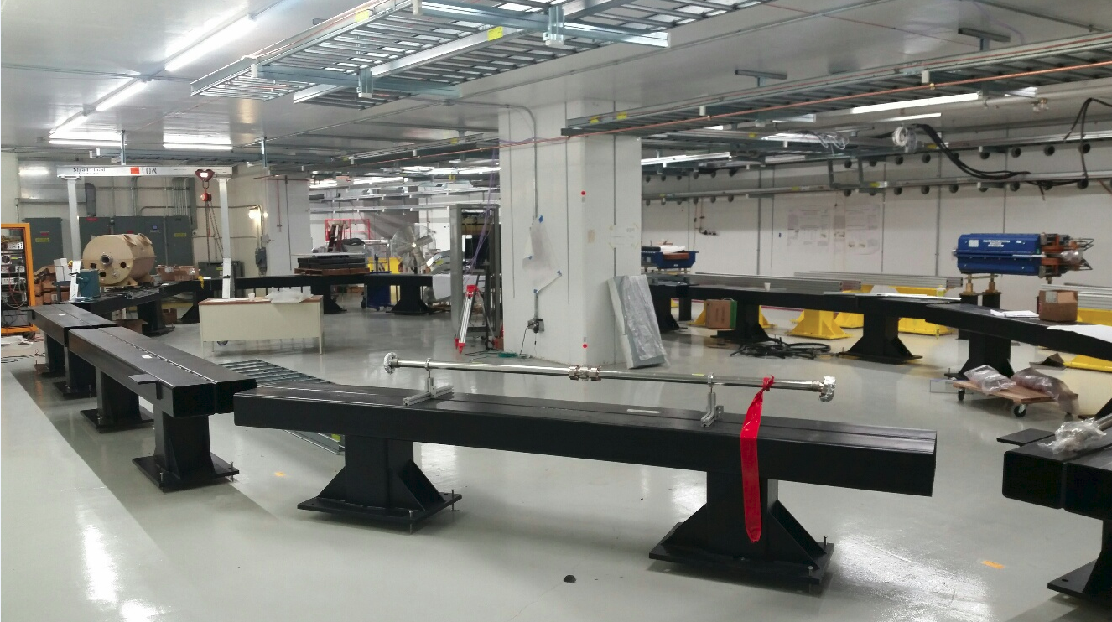
Girders aligned, RF cavity installed, magnets ready, injection magnets and cable trays installed, etc etc

Slide 28
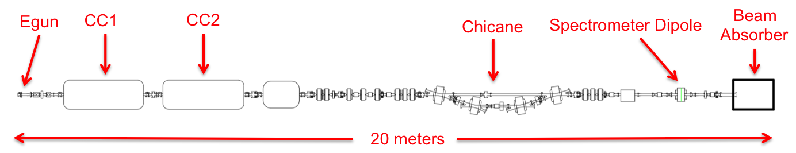
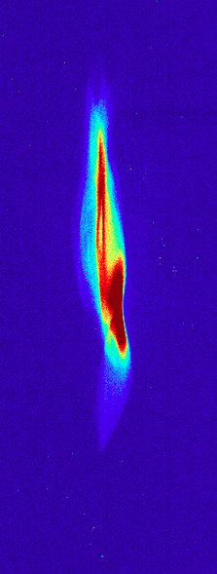
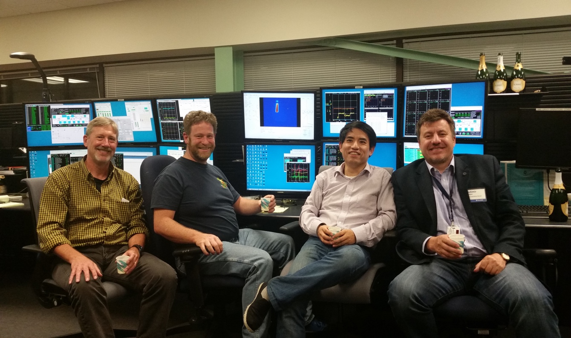
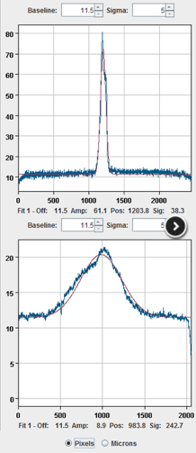
May 2016 : IOTA Electron Injector 50 MeV
52.5 MeV e⁻ beam through FAST injector !
May 16, 2016: Beam accelerated by both Capture Cavities #1 and #2: 4.5 MeV (gun)+28MeV+20MeV

Slide 29
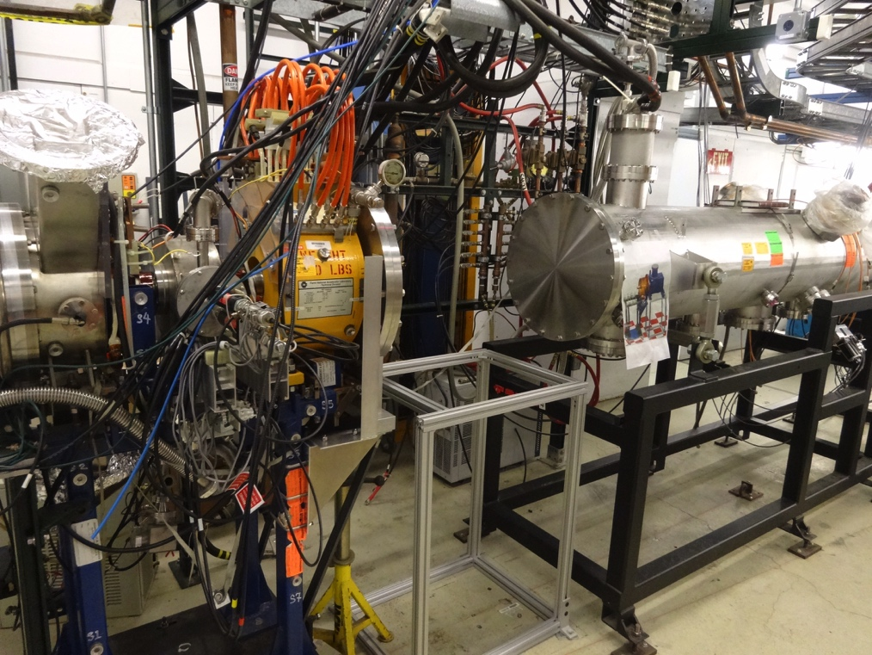
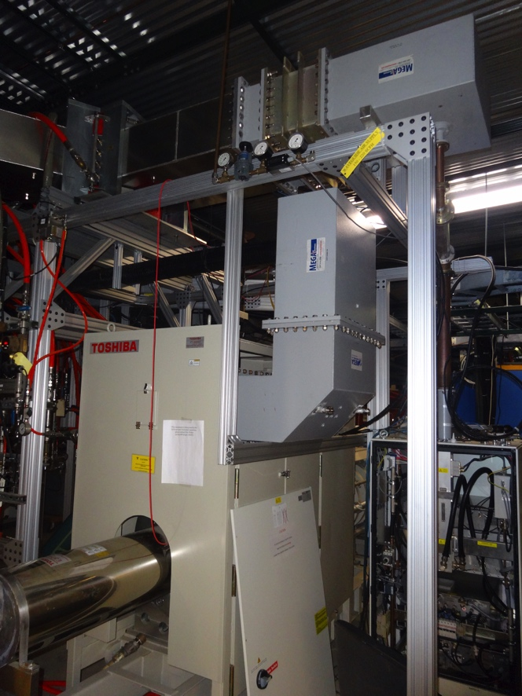
IOTA Proton Injector
2.5 MeV Proton RFQ re-commissioning began:
Ion source separated from RFQ in preparation for instrumentation.
All parts requisitioned for refurbishment
On track to re-commission in Q3 FY2017
Reconnected 325 MHz klystron to waveguide and coax.
Continuing reconnection to RFQ
On track to deliver beam in Q1 of FY2018

Slide 30
Summary
Electron lenses is now a proven, operationally tested technology… very flexible
New applications of e-lenses include
  Electron lenses for space-charge compensation
  Electron lenses for Integrable Optics
  Electron lenses for Lanmdau damping
All this concepts need thorough development theory, modeling, prototyping, experimental beam tests (at IOTA or elsewhere)
It is highly collaborative activity – we all can participate and benefit – let’s join forces!

Slide 31
Acknowledgements
Input from:
  Yu. Alexahin
  A. Burov
  S. Nagaitsev
  G. Stancari
  A. Valishev
Back-Up Slides

Slide 32
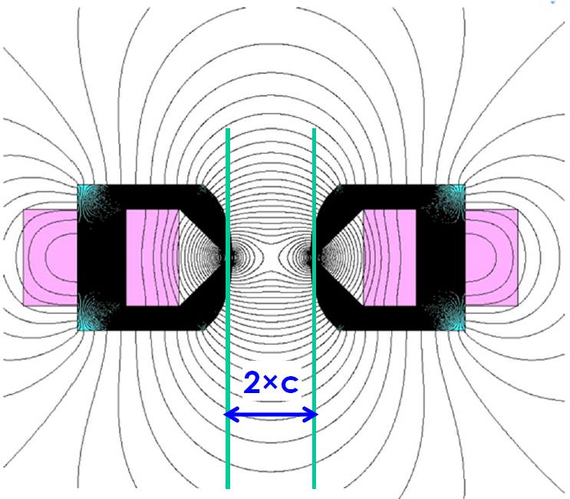
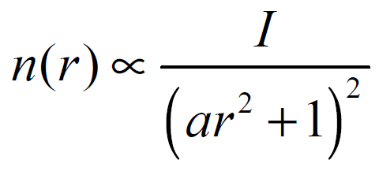
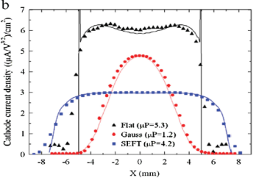
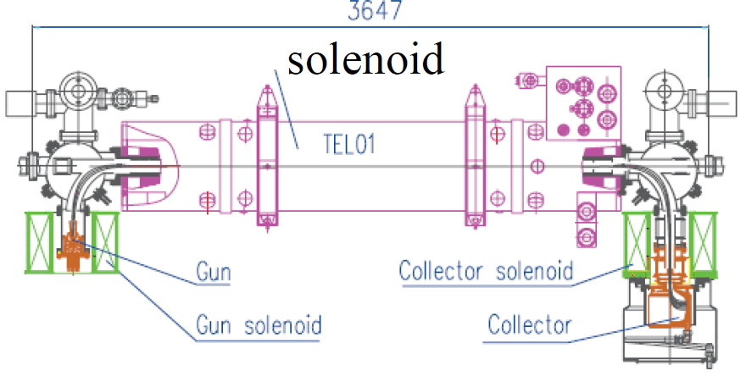
Integrable Optics Concept
“Integrable Optics” solutions:
  Make motion limited and long-term stable (usually involves additional “integrals of motion”)
Can be Laplacian (with special magnets, no extra charge density involved)
Or non-Laplacian (with externally created charge by special e-lens E(r) ~r/(1+r^2)
Effect is fascinating

Slide 33


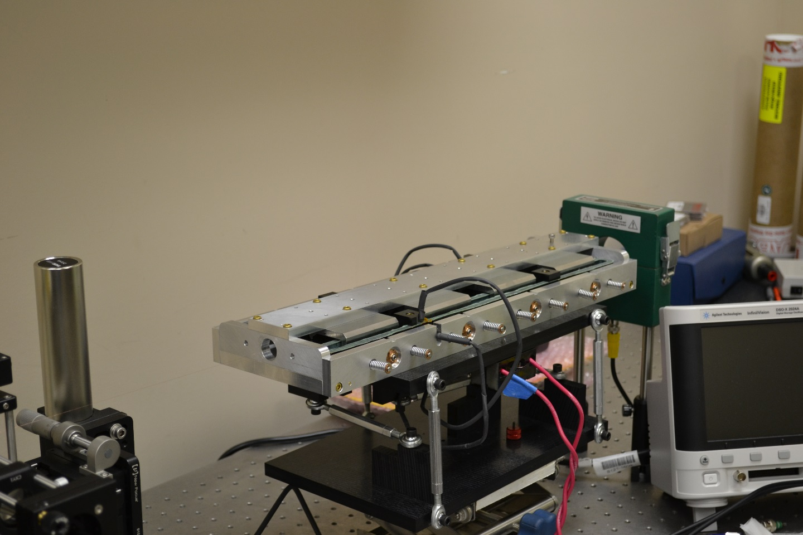








IOTA Collaboration
Non-linear IOTA Magnet prototype on a test stand

Slide 34
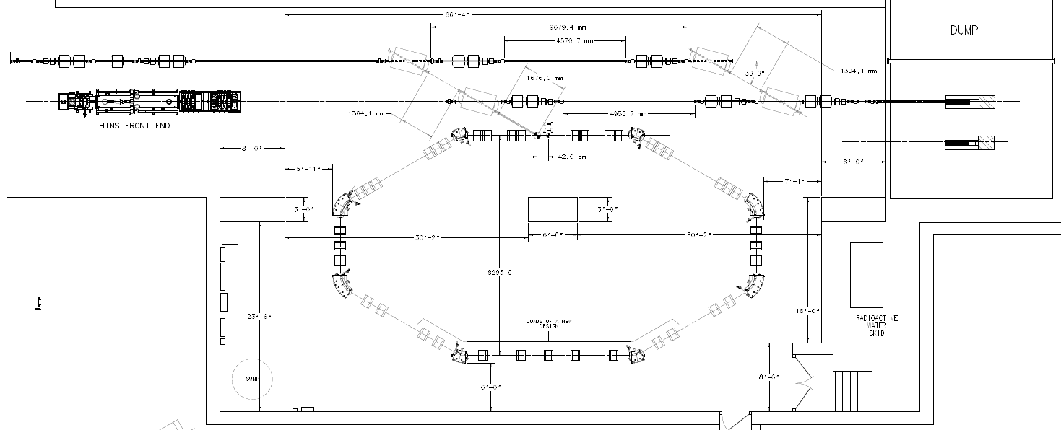
IOTA Ring: 40 m ; 2.5 MeV p+ or 150 MeV e-
e- beam line
p beam line
2.5 MeV RFQ
NL2
NL1
EL
OSC

Slide 35
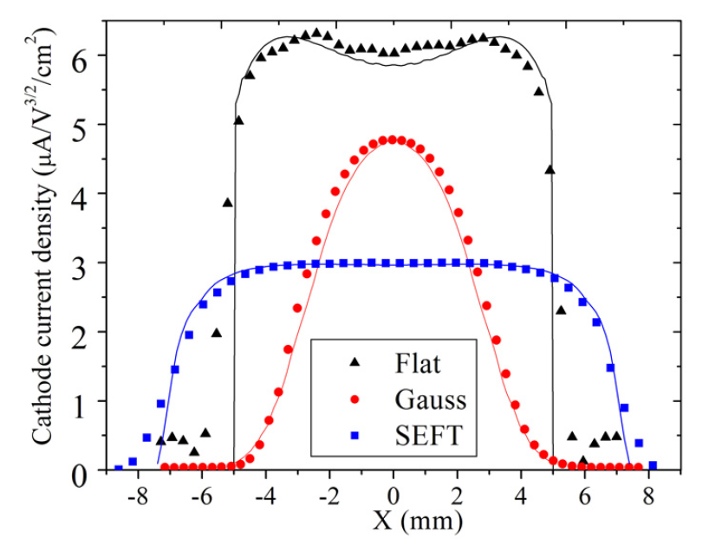
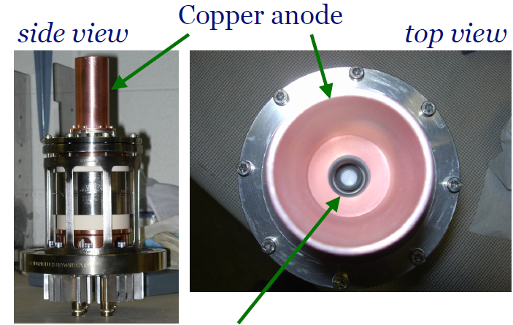
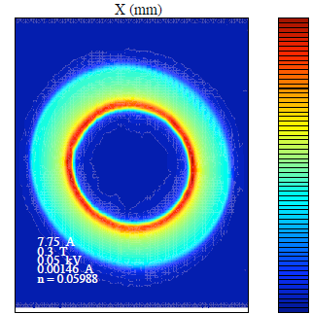

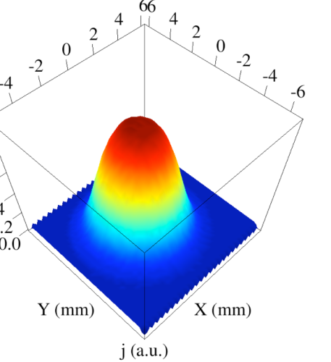
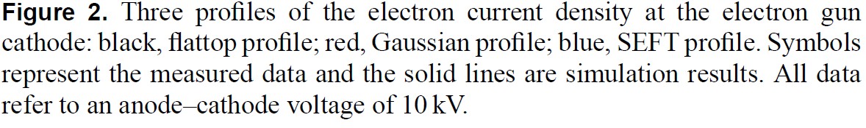
Electron Charge Distribution
Similar development for RHIC-ELs
Electron gun
Shiltsev et al., PRL 99, 244801 (2007). Shiltsev et al., NJP 10, 043042 (2008).
G. Stancari, et al., (2011)
Phys. Rev. Lett. 107, 084802

Slide 36
Some Facts on Electron Lenses
~4 mm dia 2 m long very straight beam of ~10kV ~1A electrons (~10¹²) immersed in 3T solenoid
generates strong radial electric field E ~ 0.3MV/m

Slide 37

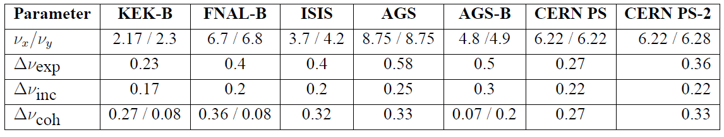
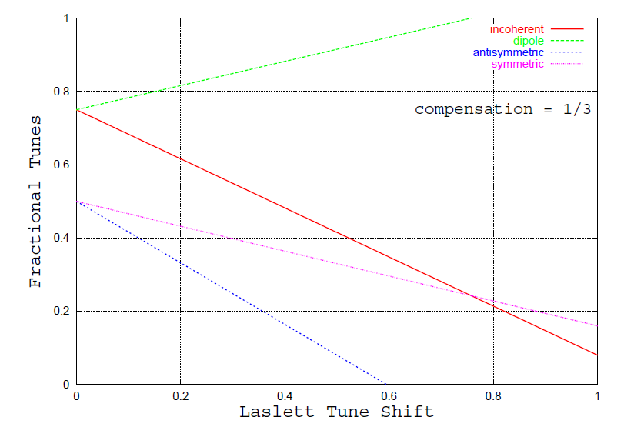
Coherent Modes
dipole
symmetric
Is that a real concern? – need computer modeling
Even if yes – dipole FB may help
asymmetric

Slide 38
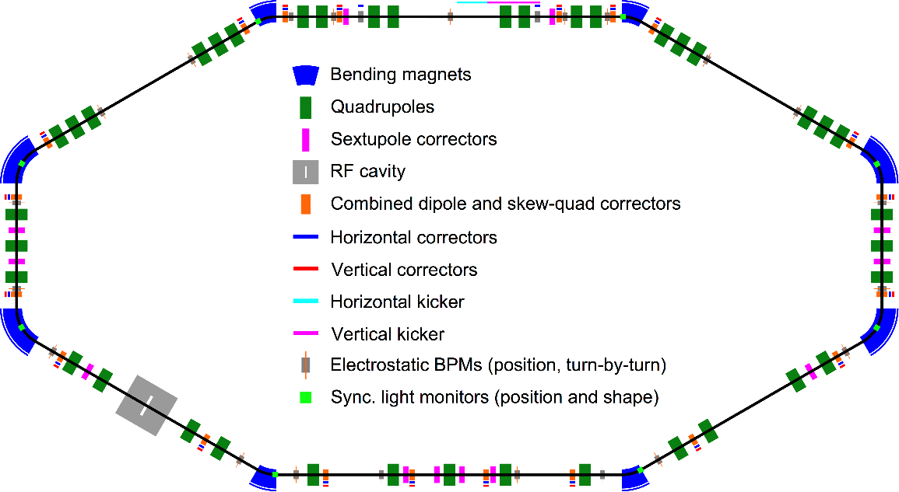
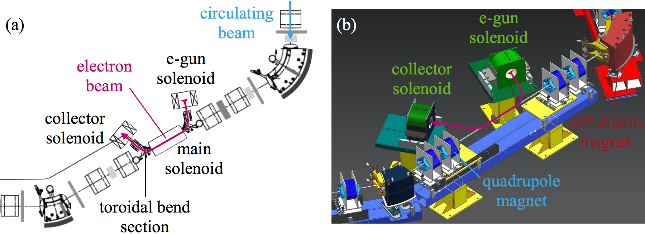

Space Charge Compensation in IOTA
Integrable Optics Test Accelerator
For beam physics research
Under construction now
  40 m
  150 MeV/c e-
  70 MeV/c p+
Space-charge dominated
Electron lens
SCC, IO, LD
Various regimes
dQ_sc= 0.25 → 1.0
IOTA

