Slide 1


State of the Art and Expected/Desirable Evolution of Energy Recovery Linacs
Florian Hug

Slide 2
Outline
  Introduction
  Possible ERL Applications
  Internal target Experiments for dark matter searches
  Linac-Ring hadron-electron colliders
Challenges in ERL Operation
  Energy spread optimization
  RF control
Summary and Outlook

Slide 3
Introduction
When does it make sense to built a new type
of accelerator? … taking into account
risks of new concepts
One promise (argument):
If experiments become
possible that have not been possible before

Slide 4
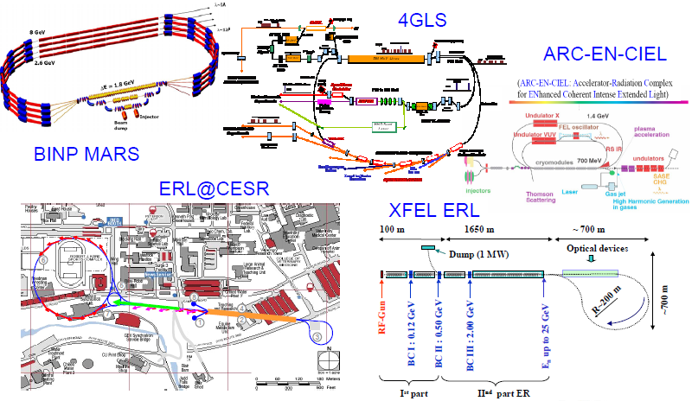
~10 years before:
ERL seen most likely as 4th generation radiation source
L Merminga, FEL 2005

Slide 5
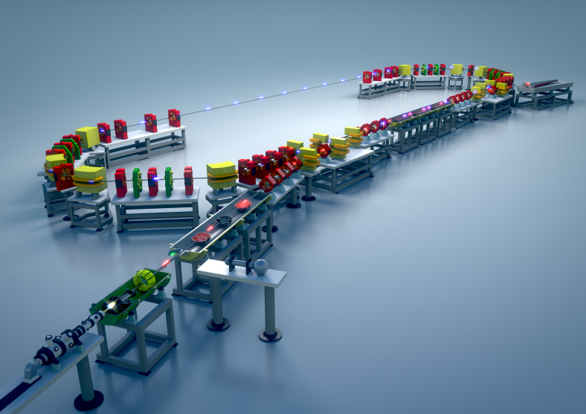
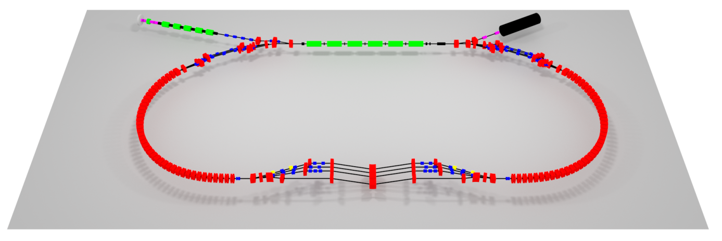
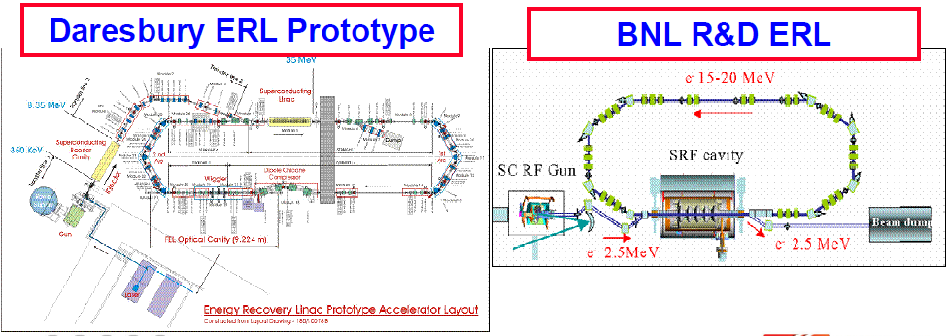
Examples for ERL demonstrators
bERLin Pro:
CBETA @ Cornell (FFAG Demonstrator):
L Merminga, FEL 2005

Slide 6
Possible ERL applications
Type 1: Fixed target experiment:
Detektor
Pseudo Internal Target
PIT
Recirculation
LINAC: ~100 MeV
Injector
Source
Dump
†
Promises:
Stationary beam conditions even at very low energies due to Pseudo internal target (PIT)
Reasonable reaction rates even without any target enclosure
- Superior for reactions searching for rare events („Dark particles“)
- All types of reactions investigating low momentum transfer
Planned Experiments: Dark light (JLAB) / MAGIX (MESA)

Slide 7
Possible ERL applications
Type 2: Linac-Ring Collider
Collision point
Recirculation
Detektor
LINAC ~ few GeV
Injector
Source
Dump
†
Promises: - strong beam beam tuneshift for lepton beam possible
- spin polarization of electron beam easier to manage than in ring/ring designs
- multiturn designs feasible (typically 3-6 turns)
Planned set-ups: LHeC (CERN) eRHIC (Brookhaven National Loboratory ;BNL)

Slide 8
Possible ERL applications
Type 1: Fixed target experiment:
The requirements are somewhat
relaxed wrt to radiation generation:
in general longer bunches
→ less coherent radiation problems
→ less problems with instabilities
Additional tasks/challenges Type 1
- Target/Detector design
- small energy spread required
- Halo Control/Collimation
Additional tasks/challenges Type 2
- multiturn desirable
(→beam dynamics, rf control)
- spin polarisaton/spin orientation
required
Detektor
PIT
Recirculation
LINAC: ~100 MeV
Injector
Source
Dump
†
Type 2: Linac-Ring Collider
Collision point
Recirculation
Detektor
Injector
LINAC ~ few GeV
Source
†
Dump

Slide 9
Possible ERL applications
Type 1: Fixed target experiment:
The requirements are somewhat
relaxed wrt to radiation generation:
in general longer bunches
→ less coherent radiation problems
→ less problems with instabilities
Additional tasks/challenges Type 1
- Target/Detector design
- small energy spread required
- Halo Control/Collimation
Additional tasks/challenges Type 2
- multiturn desirable
(→beam dynamics, rf control)
- spin polarisaton/spin orientation
required
Detektor
PIT
Recirculation
LINAC: ~100 MeV
Injector
Source
Dump
†
Type 2: Linac-Ring Collider
Collision point
Recirculation
Detektor
Injector
LINAC ~ few GeV
Source
†
Dump

Slide 10
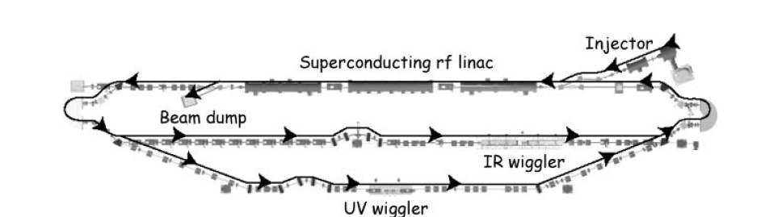
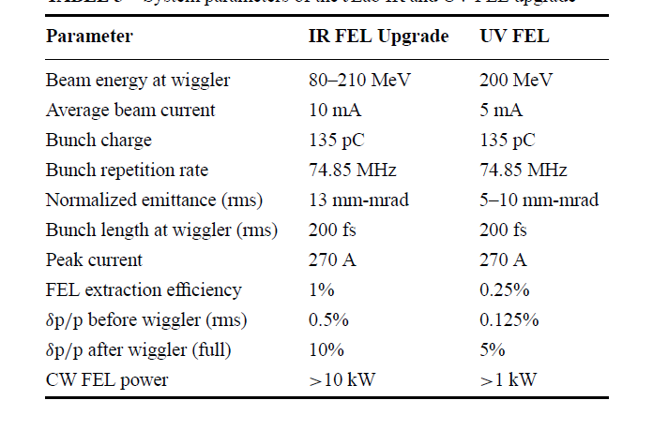
Dark Light @ JLAB
Replace wiggler
by „Pseudo“
internal target
JLAB ERL Laser output: 10kW
Beam Power in Wiggler: ~1MW
R.F power needed: ~100kW
The energy taken away by scattered particles
in one passage of the target can be much smaller
than the one extracted in the FEL
Experiments with „Pseudo“
internal targets could be attractive.
(Proposed for dark matter search
by Heinemayer et al. (2007): arXiv:0705.4056v2 )
L Merminga et al. Ann. Rev. Part. Sci 53 387 (2003)

Slide 11
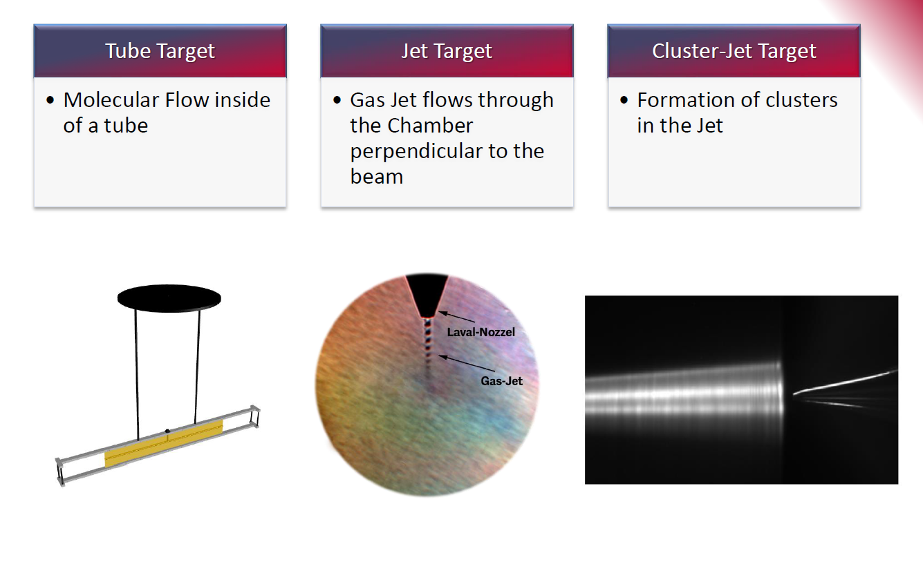
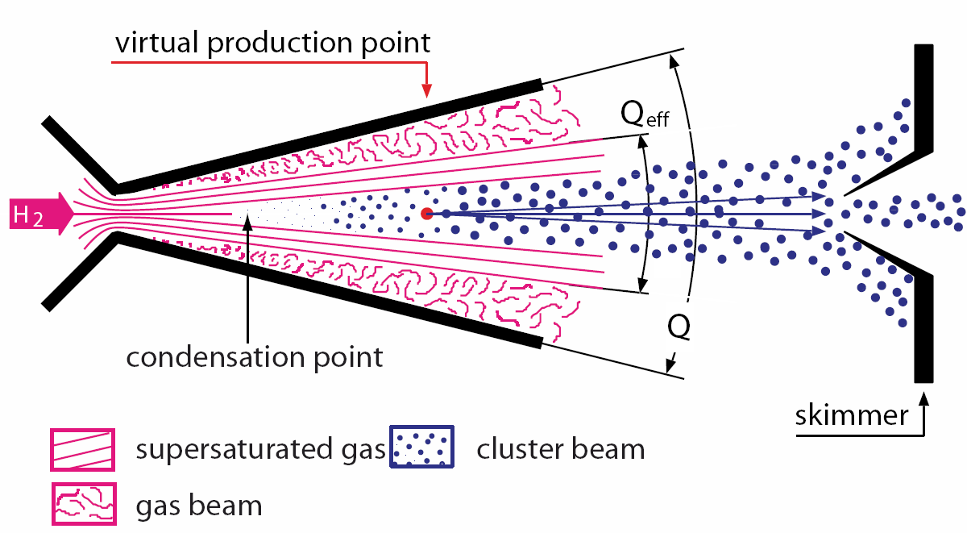
Internal targets: state of the art
This is needed for POLARIZED
Target (a la HERMES at HERA)!
S. Aulenbacher
https://indico.mitp.uni-mainz.de/event/66/session/5/contribution/48/material/slides/0.pdf

Slide 12
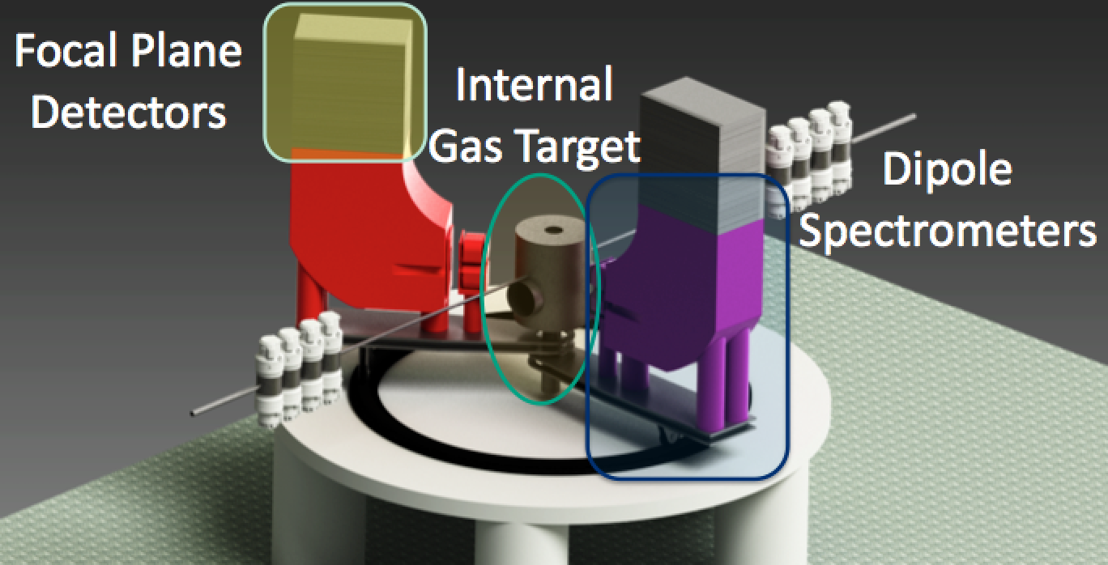
MAGIX @ MESA (JGU Mainz)
Operation of a high-intensity (polarized) ERL beam
in conjunction with light internal target
a novel technique in nuclear and particle physics
measurement of low momenta tracks with high accuracy
competitive luminosities
Small device if compared to GeV scale spectrometer set ups!
High resolution spectrometers MAGIX:
double arm, compact design
momentum resolution: Δp/p < 10⁻⁴
acceptance: ±50 mrad
GEM-based focal plane detectors
Gas Jet or polarized T-shaped target
Different ERL Applications

Slide 13
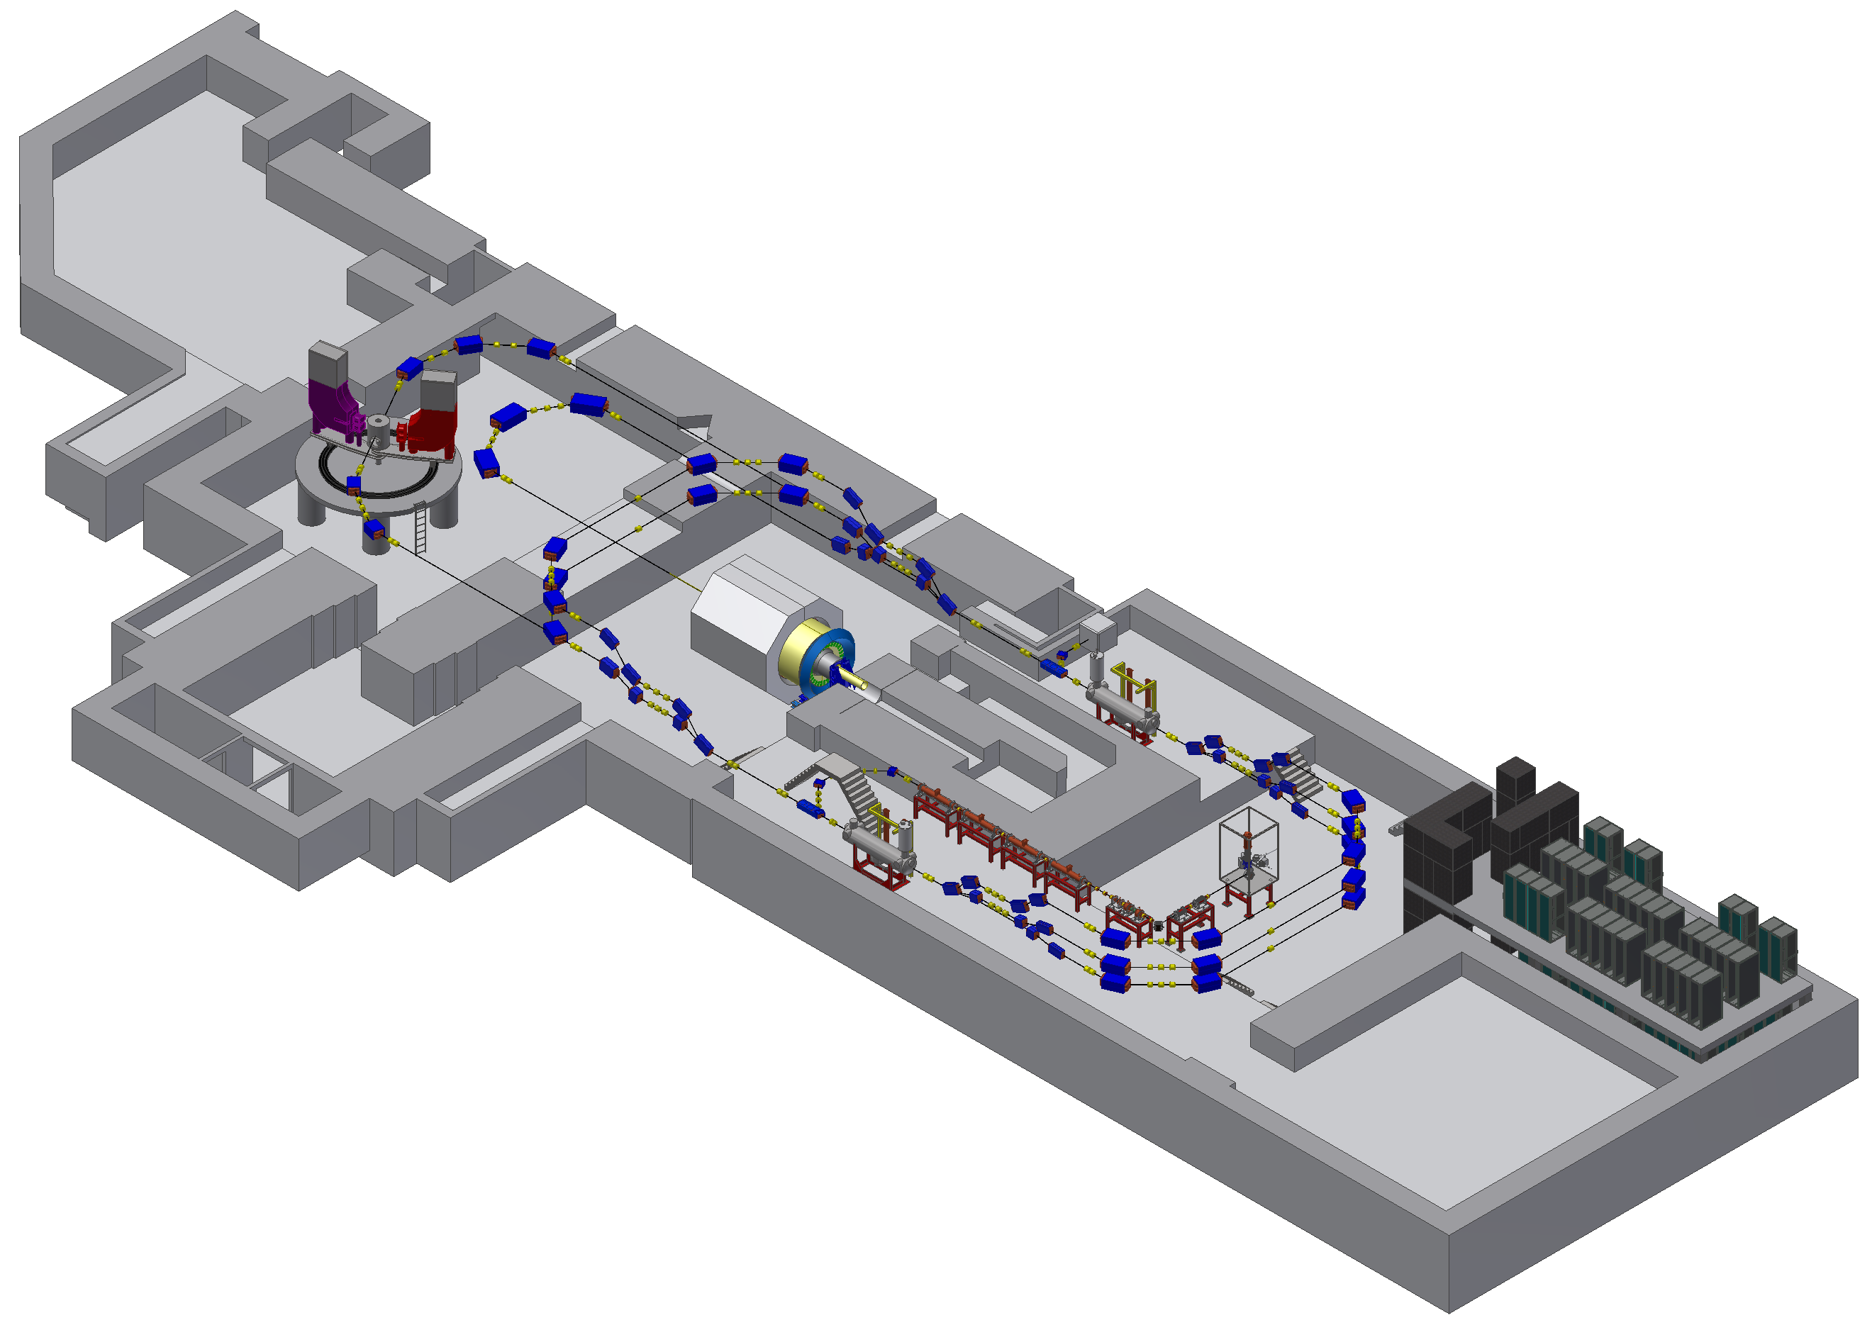
MESA accelerator layout
Two main experiments:
EB-operation (P2 experiment)
→ non-isochronous working point
planned
ERL-operation (MAGIX experiment)
→ non-isochronous working point
useful but maybe difficult
Picture by D. Simon

Slide 14
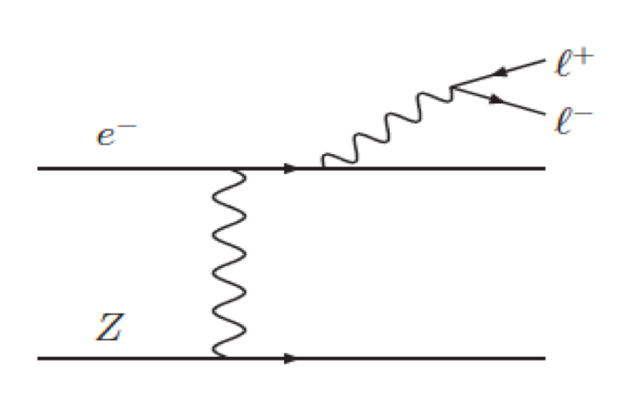

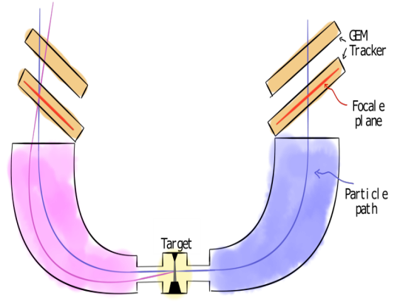
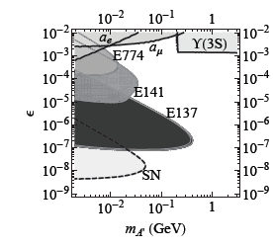
Dark Matter Experiments
Presently, there is no clear evidence if dark matter particles exist
Searches for WIMPS so far not succesful
Other possibility New forces and force carriers: „ Dark Photons“ „ Dark Z“ „A‘“
These are detectable by the so-called kinetic mixing effect
Status in 2016
→ Pseudo internal target experiment: Initially foreseen for dark photon search
Status in 2013
The strong suggestion that it would be possible
to discover the partice has covered the „red line“
(without finding the dark photon…)

Slide 15
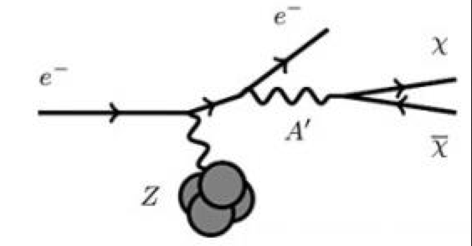
Dark Matter Experiments
Presently, there is no clear evidence if dark matter particles exist
Searches for WIMPS so far not succesful
Other possibility New forces and force carriers: „ Dark Photons“ „ Dark Z“ „A‘“
These are detectable by the so-called kinetic mixing effect
Status in 2016
→ Pseudo internal target experiment: Initially foreseen for dark photon search
g-2 band could as well be motivated by „invisible“ decay into dark matter…
By measuring the (very small) recoil of the Nucleus (proton)
One reconstract if particles of the A‘ type have been
Produced – very good conditions for this in the PIT regime
Nucleus

Slide 16
ERL‘s in the LINAC ring configuration
Physics motivation is mainly deep inelastic lepton/hadron scattering
Collider mode: Luminosity given by
Beam beam tune shift
The large tune shift for the electrons can be tolerated because of ERL operation!
Spin polarization is mandatory, at least for the ERL beam, better for both
(Double polarized collider)

Slide 17
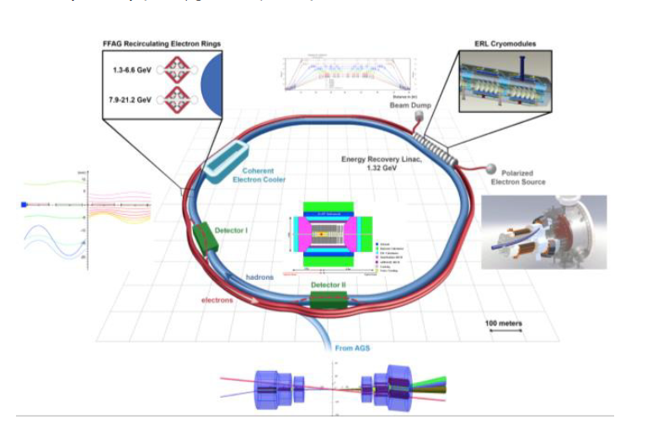
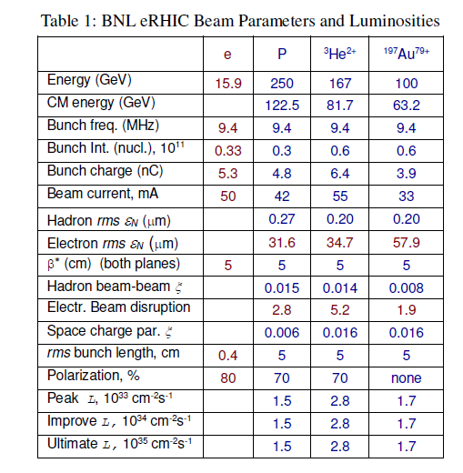
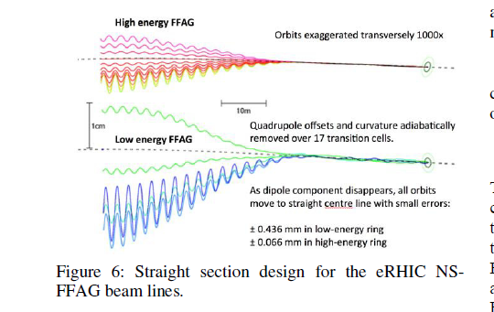
ERL‘s in the LINAC ring configuration: eRHIC
16 recirculations in two beamlines!
Only on 1,3 GeV Linac required
FFAG test set up presently being designed at Cornell University
V. Litvinenko et al.
TUPTY047 Proceedings of IPAC2015, Richmond, VA, USA

Slide 18
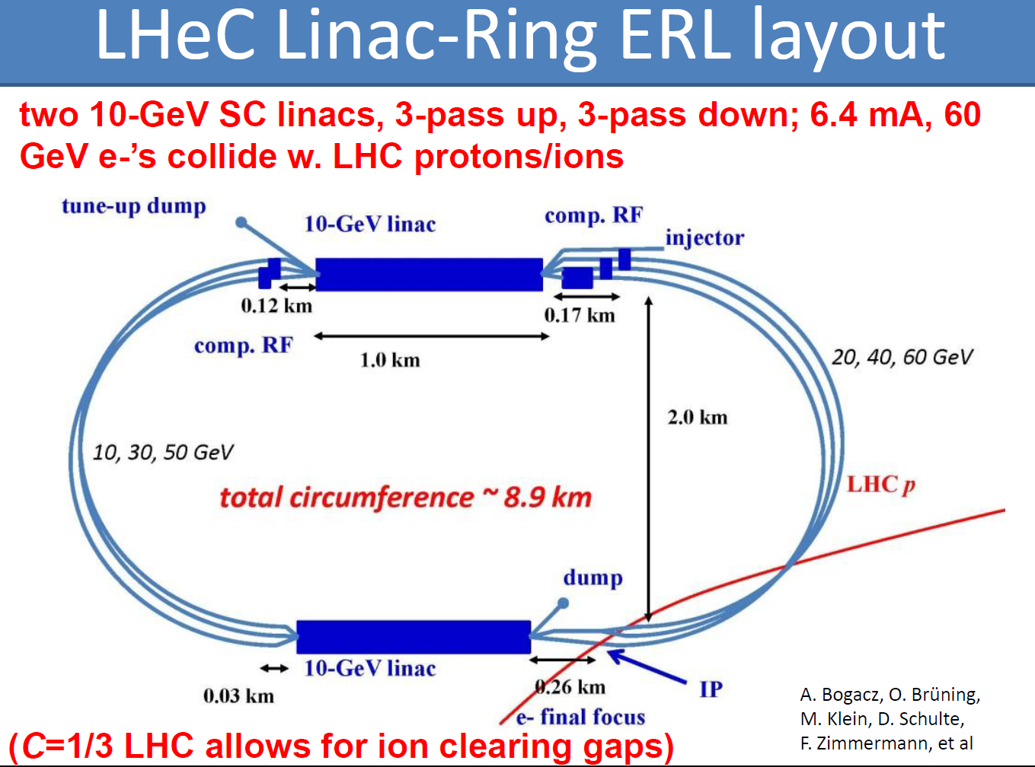


ERL‘s in the LINAC ring configuration: LHeC
„Single“ polarised collider
Higher CM energy than eRHIC
Luminosity ~10^33
Seperate recirculation orbits
Frank Zimmermann, LHeC workshop 2014
https://indico.cern.ch/event/278903/contributions/631178/attachments/510300/704305/LHeC_overview.pdf

Slide 19
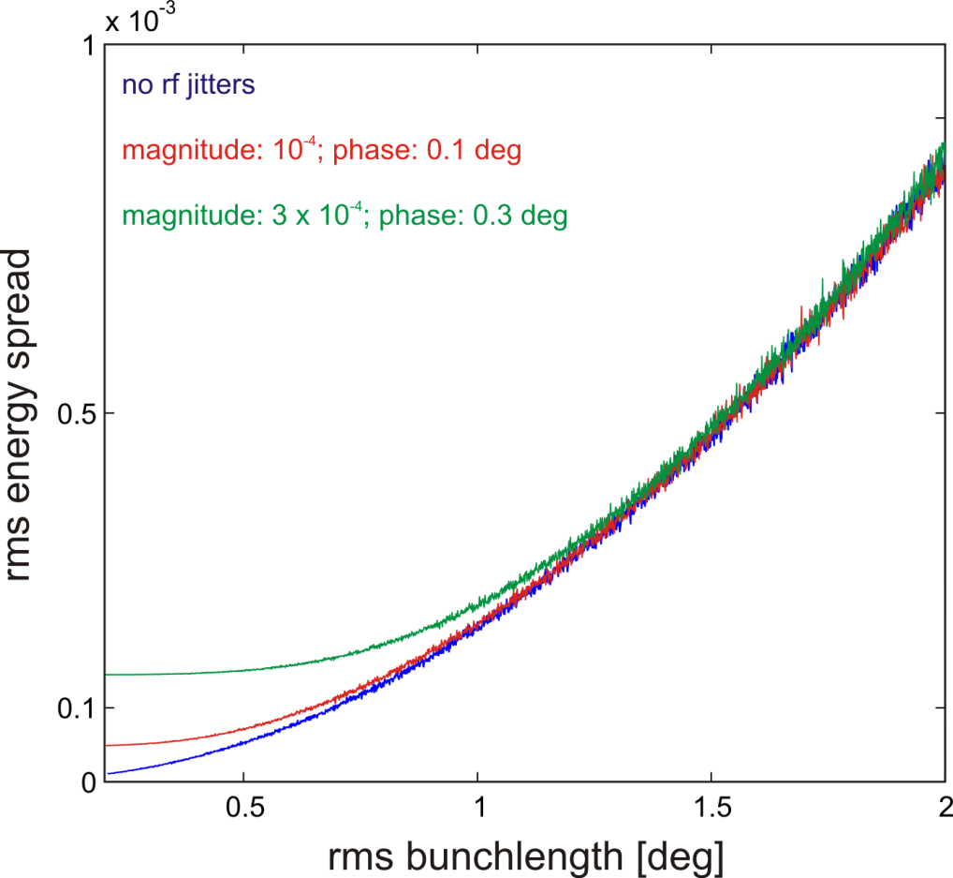
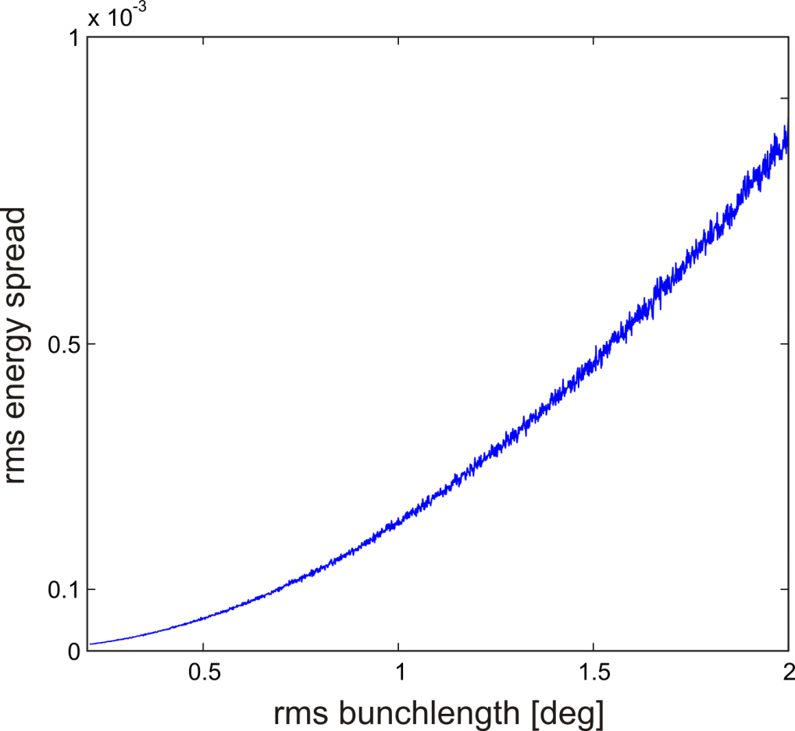
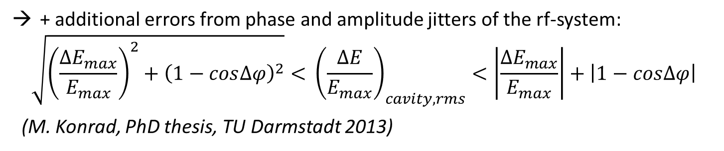
Energy spread in electron linacs
For relativistic electrons (v≈c):
almost no changes
in longitudinal position within bunch
Acceleration on crest of the rf-wave:
Short bunches needed because
bunchlength causes energy spread!
Particles stay “frozen” at their
longitudinal position within the bunch
+ additional errors from phase and amplitude jitters of the rf-system:
$$\sqrt{{\left(\frac{{∆E}_{max}}{E_{max}}\right)}^{2}+{\left(1−cos∆φ\right)}^{2}}< {\left(\frac{∆E}{E_{max}}\right)}_{cavity, rms}<\left|\frac{{∆E}_{max}}{E_{max}}\right|+\left|1−cos∆φ\right|$$
(M. Konrad, PhD thesis, TU Darmstadt 2013)

Slide 20
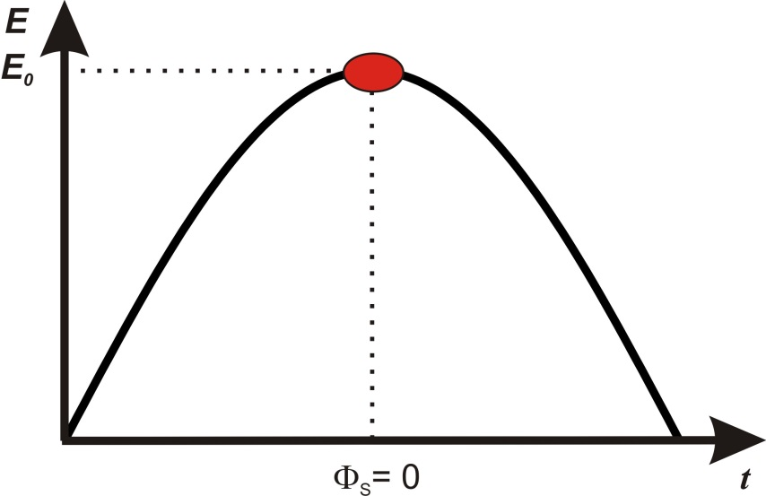
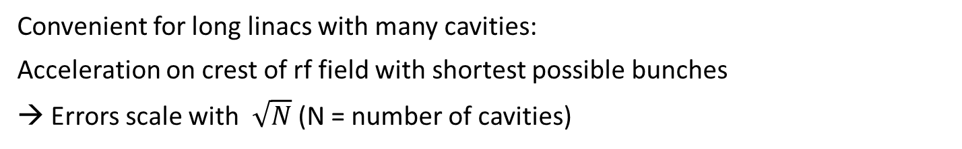
Isochronous recirculation scheme
Convenient for long linacs with many cavities:
Acceleration on crest of rf field with shortest possible bunches
→ Errors scale with $\sqrt{N}$ (N = number of cavities)
LINAC
injector
extraction
Φ_{S}= 0
isochron (r₅₆=0)‏
no long. dispersion (r₅₆=0)
no long. dispersion (r₅₆=0)
recirculations
In (short) few turn recirculators:
Amplitude errors of accelerating cavities can add up coherently over all turns → no averaging of errors when t_{linac} << τ_{cavity}
→ Energy spread can exceed experimental requirements

Slide 21
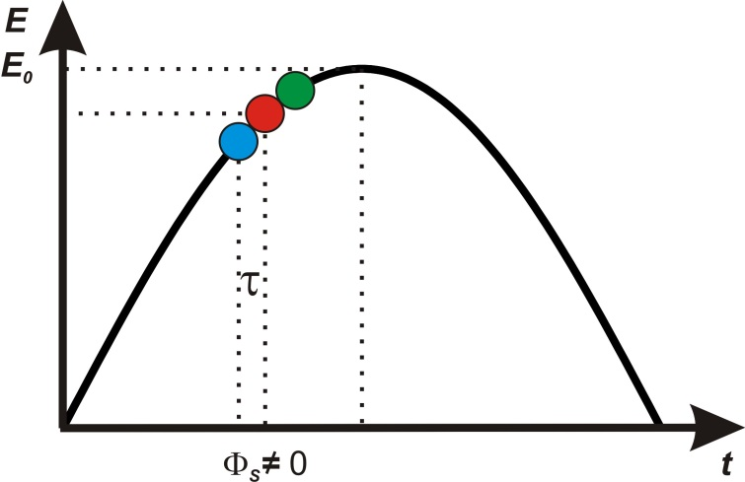
Non-isochronous recirculation scheme
Common operation mode for microtrons and synchrotrons
Acceleration on edge of rf field
Different time of flight for particles having different energies
LINAC
injector
extraction
Φ_{S} ≠ 0
long. dispersion (r₅₆)
long. dispersion (r₅₆)
recirculations
Particles perform synchrotron oscillations in longitudinal phase space
Half- or full integer oscillations lead to reproduction of the longitudinal phase space at injection [Herminghaus, NIM A 305 (1991) 1].
→ complete compensation of rf phase- and amplitude jitters possible

Slide 22
Non-isochronous recirculation scheme
ΔE_{max}
: reference particle
ΔE
...
...
...
...
ϕ_{s}<0
k_{rf}•z - ω•t
(Jankowiak/Aulenbacher, lecture on accelerator physics)

Slide 23
Example: MESA External Beam Operation
Simulations for a new longitudinal working point
Goal: Find optimal combination of r₅₆ and
Φ_{S} for MESA 6-pass external beam mode
Import longitudinal phase space from MAMBO 150 µA simulation
Create randomized cavity parameters
(4 cavities, ΔA_{rms}= 1 ∙ 10⁻⁴, Δφ_{rms}= 0.1°)
For each pair of r₅₆ and Φ_{S} track each particle through the accelerator
Calculate rms energy spread for each pair of r₅₆ and Φ_{S}
Energy [MeV]
Phase [deg]

Slide 24
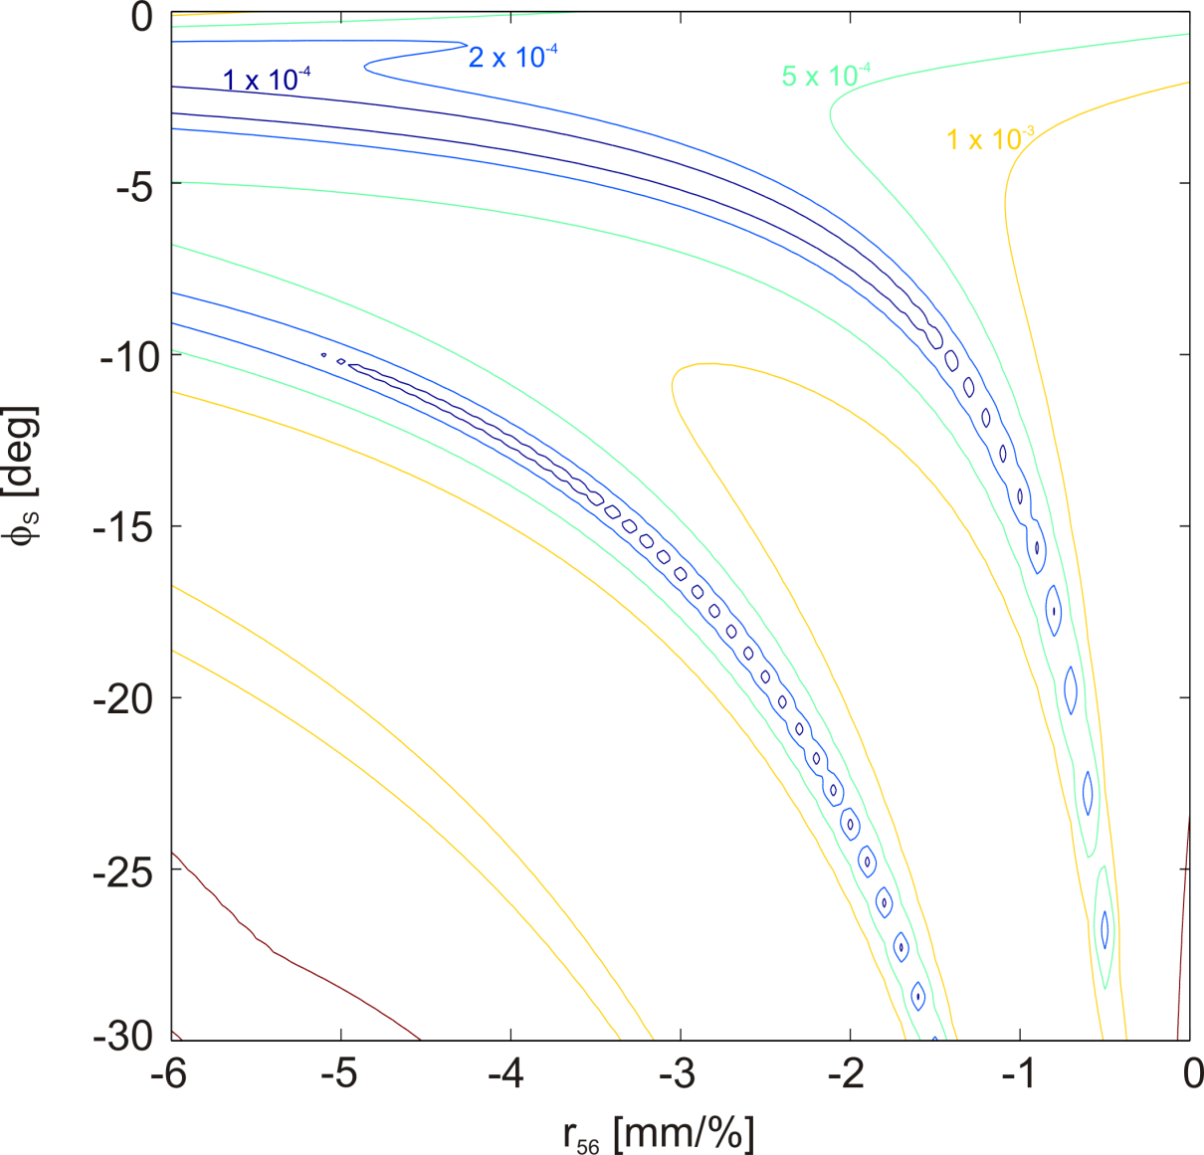
Example: MESA External Beam Operation
Results for 6-pass external beam mode:
best energy spread at:
r₅₆ = -2.6 mm/% and
Φ_{S} = -5.8°
ΔE_{rms}/E = 5.5 ∙ 10⁻⁵
isochronous: ΔE_{rms}/E = 3.4 ∙ 10⁻⁴

Slide 25
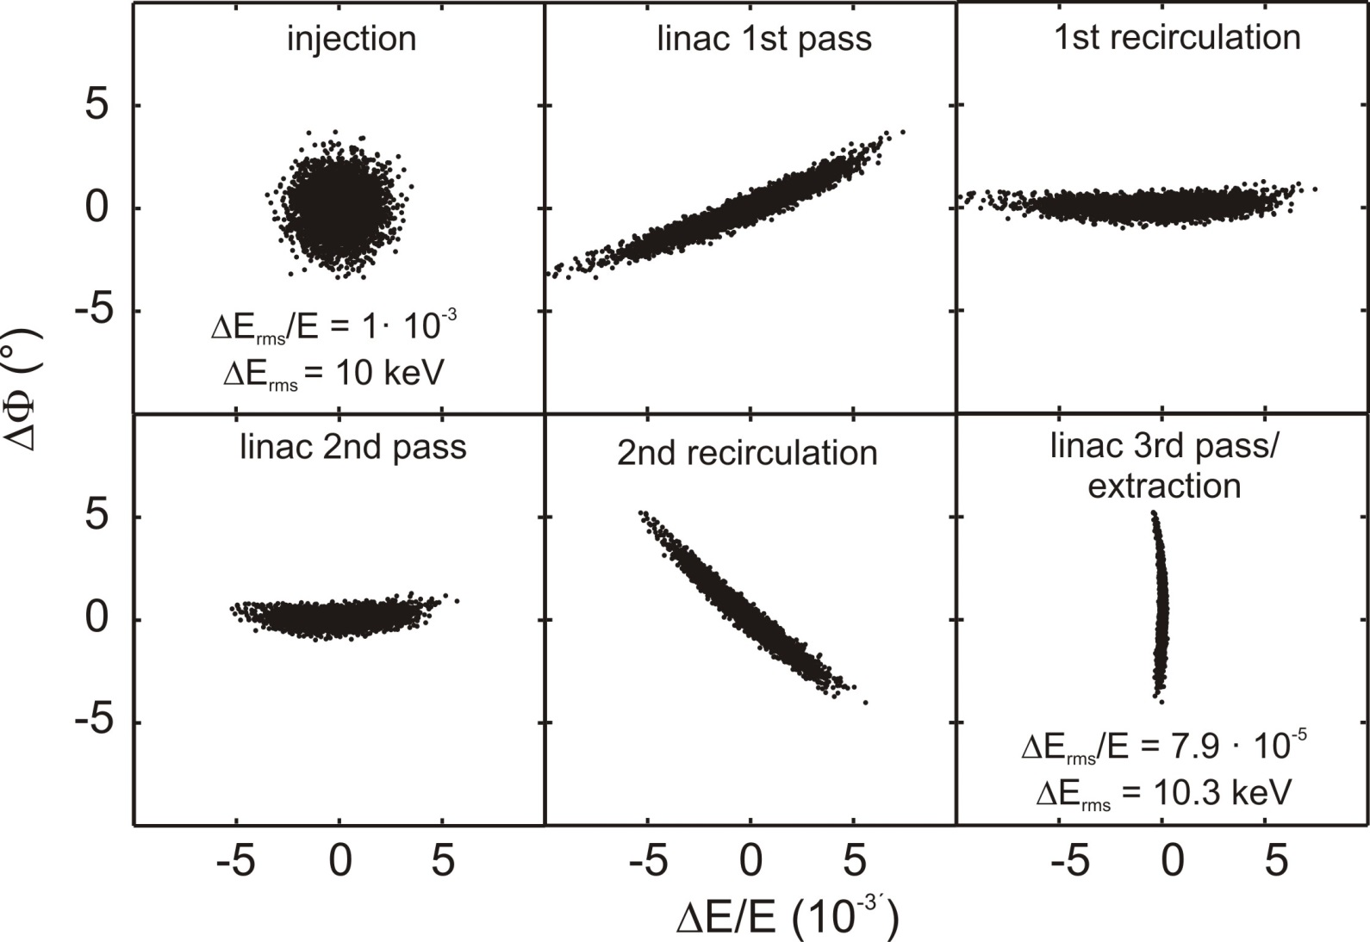
Half-integer turn in action
(S-DALINAC at TU Da)
Compare with
assumption (no additional
errors from linac):
Energy spread at
Injection (10 MeV):
ΔE_{I;rms}/E_{I} = 1 ∙ 10⁻³
ΔE_{I;rms} = 10 keV
After acceleration to
full energy (130 MeV):
ΔE_{rms}/E =
10 keV/130 MeV =
7.7 ∙ 10⁻⁵

Slide 26
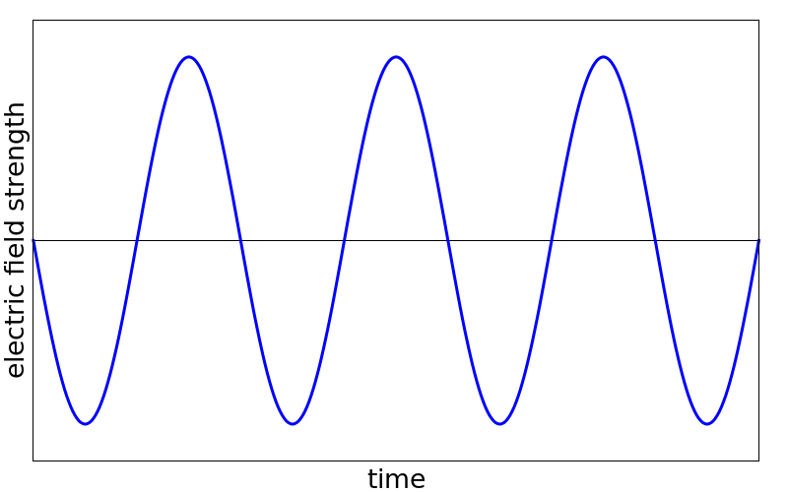
Non-Isochronous ERL Operation
Compare the two different ERL operation modes:
isochronous operation
non-isochronous operation
Accelerating and decelerating bunches in phase with maximum/minimum of
rf-field
Decelerating bunches re-enter cavities at a different phase
→ possible disturbance on accelerating phase as well
On the non-isochronous working efficiency of energy recovery decreases
Challenging/Impossible for rf-control system to sustain desired accelerating field

Slide 27
Non-Isochronous ERL Operation
Maybe a different non-isochronous scheme in ERL operation possible?
Use the double sided design of MESA
First two passes acceleration on
edge
Use r₅₆ for a half turn in
phase space
Second two passes acceleration on
opposite edge
Use r₅₆ for a half turn in
phase space (other direction)
end up with better energy spread
Deceleration vice-versa

Slide 28
LLRF in ERLs
Main challenges controlling SC-ERL cavities :
RF power for accelerated beam comes from decelerated beam
→ the decelerated beam is the main power source
Microphonics cause mismatch between beam frequency and cavity frequency
„usual“ RF control loop is weak compared to the power demand
ERL mode (100 mA, 12.5 MV/m, 2 recirculations):
Max. -2.5 MW
beamloading (acc. beams)
Max. +2.5 MW
beamloading (dec. beams)
Typ. +10-15 kW RF-power
(+4.5 kW used for microphonics compensation)

Slide 29
LLRF for cold systems: challenges in ERL mode
Phase and magnitude stability in ERL mode:
Accelerating and decelerating bunches need to be in phase with maximum/minimum of rf-field
What if the decelerating bunches arrive at the wrong phase wrt to the accelerating ones?
Decelerating bunches force rf-field to different phase,
this needs to be compensated by LLRF-control system
→ Maybe active Feedback needed to stabilize reentering phase of the decelerated beam

Slide 30
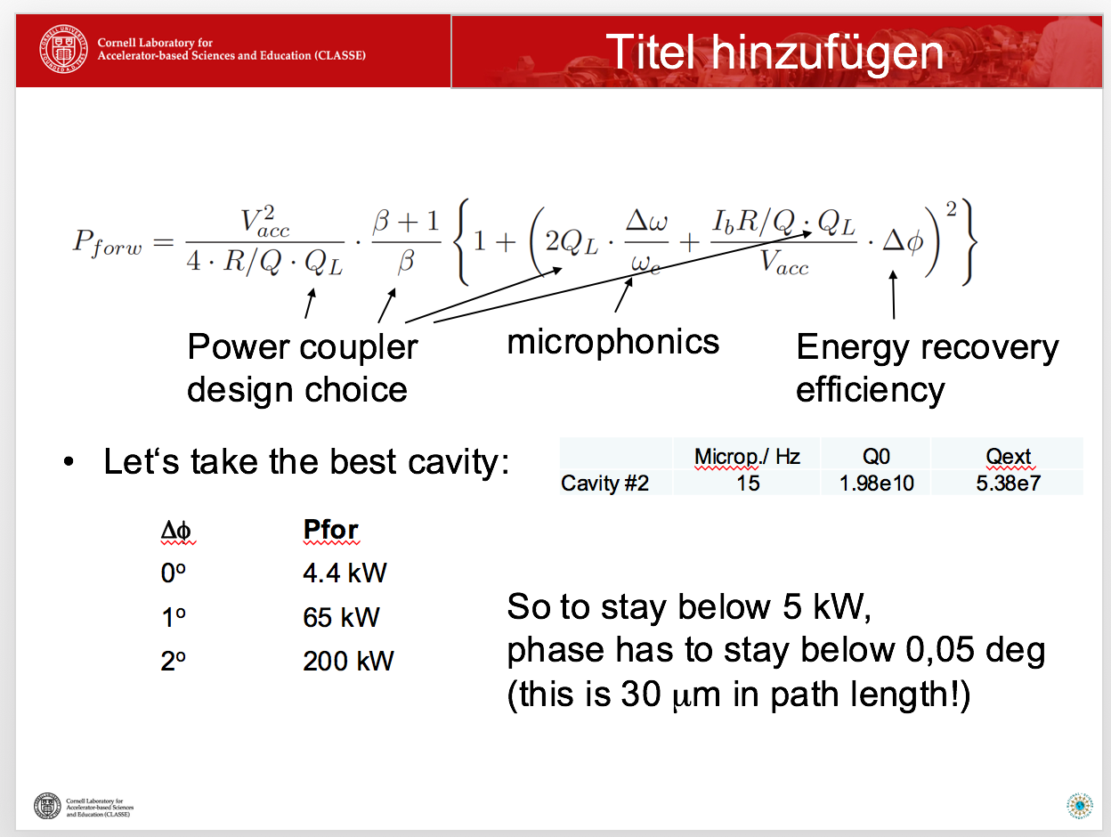
LLRF for cold systems: challenges in ERL mode
Example for Cornell demonstrator (by Ralf Eichhorn):

Slide 31

Summary & Outlook
ERLs can provide huge beam power in cw operation at moderate
costs
recently ERL-based light sources have become somehow
unpopular, but ERLs for particle physics remain very interesting
demonstrators and small ERLs exist and/or are under construction
→ the next step: SC high current multiturn ERLs
beam energy spread optimization through non-isochronous beam
dynamics and rf control can be very challenging and need to be
investigated further
but there are much more challenges in operation
of ERLs than presented here like e.g. BBU, high power
diagnostics, FFAG lattices, machine protection,
sources, injectors…

