Slide 1
Polarization and electric dipole moments – the grand picture
Kurt Aulenbacher,
Institut für Kernphysik,
Johannes Gutenberg-Universität Mainz
From EuCARD-2 XBEAM to ARIES APEC, Valencia, Spain
February,14, 2017

Slide 2
OUTLINE
- What did we learn from XBEAM WP-5.5 “Polarization” ?
Polarization in upcoming accelerator projects
The role of polarization measurement
Electric Dipole Moments

Slide 3
Polarization at the low energy scale („small“ accelerators)
Discovery (strong CP and T violation )
Precision experiments (weak P violation ) with small scale accelerators
EUCARD-2 workshop "Search for the electron EDM in an electrostatic storage ring"
10-11 September 2015
Mainz
https://indico.mitp.uni-mainz.de/event/38/

Slide 4
Polarization at the high energy scale...
(future BIG projects).
EUCARD-2 workshop "Spin optimization at Lepton accelerators"
12-13 February 2014
Mainz
https://indico.mitp.uni-mainz.de/event/18/
EuCARD-2 XPOL workshop on
“Polarization Issues in Future
High Energy Circular Colliders”
16 April 2016
Rome
https://indico.mitp.uni-mainz.de/event/62/

Slide 5
Polarization at the high energy scale...
(future BIG projects).
Precision measurements at the ILC
    Polarized positron source technologically challenging
    Polarization measurement via Compton backscattering promising (ΔP/P ~0.1%)
Precision beam parameters at the FCC-(ee)
-absolute energy calibration (by resonant depolarization) order
ΔE/E ~ 10-6
High energy pol. proton beam at the fcc-hh is not completely impossible (would increase circumference by „only“ a few %)
Fixed Target pol. at LHC or FCC-hh is possible
LHeC collider arrangement (linac-ring) is feasible with polarized electron beam

Slide 6
Observables in future accelerator
spin physics
Storage ring: EDM (CP „JEDI“ )
- Aiming at discovery of an effect
- FCC-ee: Precision energy calibration for resonance
Linac : Parity violating electron scattering , e.g. At JLAB, SLAC or MESA, ILC: Precision measurements
-neutron skins ( PREX, .... ) (program ongoing→ JLAB & MESA)
- weak charge (E166, QWEAK, program ongoing → Moller, P2)
- elctroweak production and precision measurements
at ILC e.g. 350 GeV (tt-threshold)

Slide 7
Observables in NEAR and MEDIUM FUTURE
future accelerator spin physics
LINAC example : Parity violating electron scattering
- accurate measurement of electro weak mixing angle „sin²θ_{W}“

Slide 8
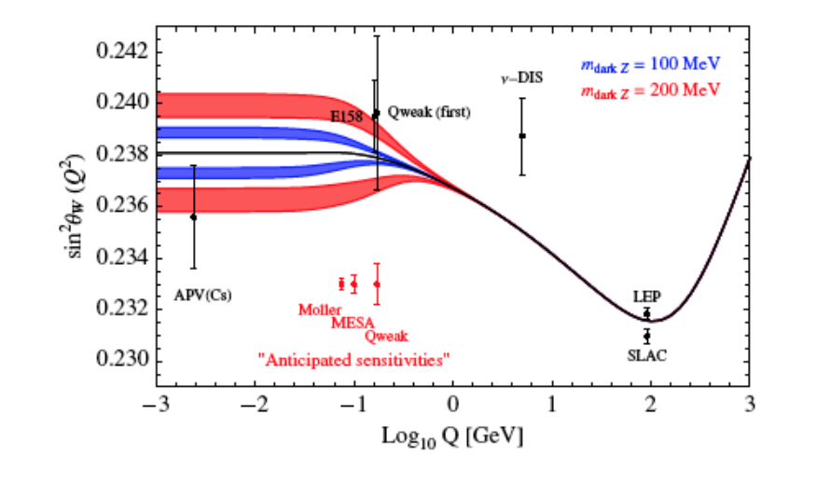
Influence of
„dark Z boson“
which also contributes
to muon anomalous
magnetic moment..
F. Maas, PAVI2014 conf.
„Elastic electron scattering on proton measures 1-4sin²Θ_{W} → small asymmetry , high sensitivity
Supressing hadronic contributions favours low momentum transfer and low beam energy

Slide 9
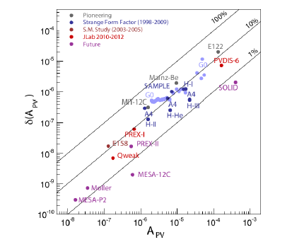
Challenge: low signal, high accuracy
S. Baunack
PAVI 2016

Slide 10

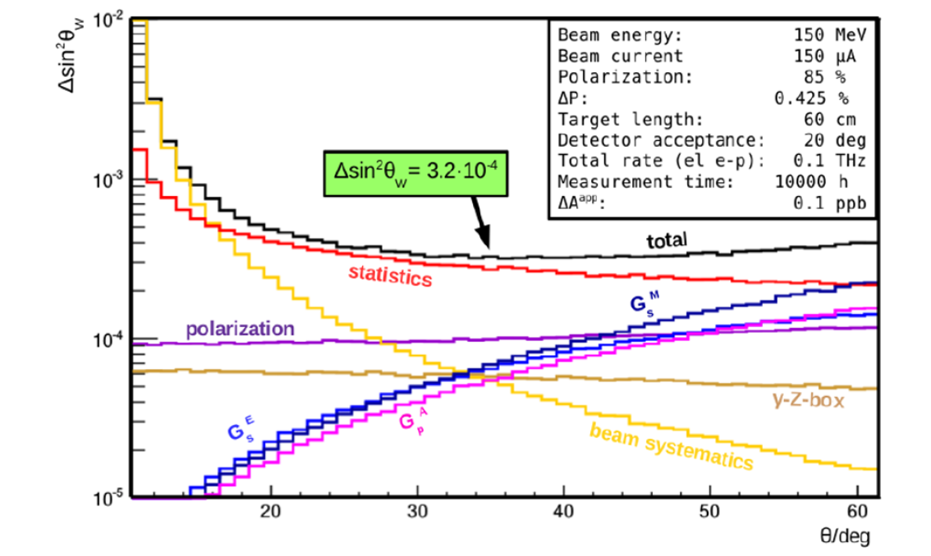
The P2 Experiment at MESA
-basic demands
150 μA Beamcurrent , 60cm lq. H2, Beampol: 85%.
10000 h Data-taking (~13-15000 h Runtime)
High accuracy polarization measurement (ΔP/P=0.5% !!)
Extremely high demands on control of HC-fluctuations!
Good option at energies > a few GeV is Laser-Compton backscattering with
Potential error ~10⁻³
Two independent methods seem to be required anyway: Hydro Möller & Double scattering
F. Maas PAVI2014 conf.

Slide 11

Observables in NEAR and MEDIUM FUTURE
future accelerator spin physics
Storage ring example: Jülich Electric Dipole Moment Investigations
EDM (CP „JEDI“ ) - Aiming at discovery of effect in „electrostatic storage ring“
Why is this important?

Slide 12
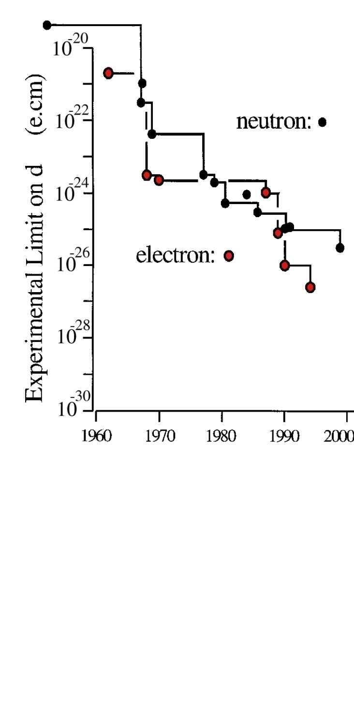
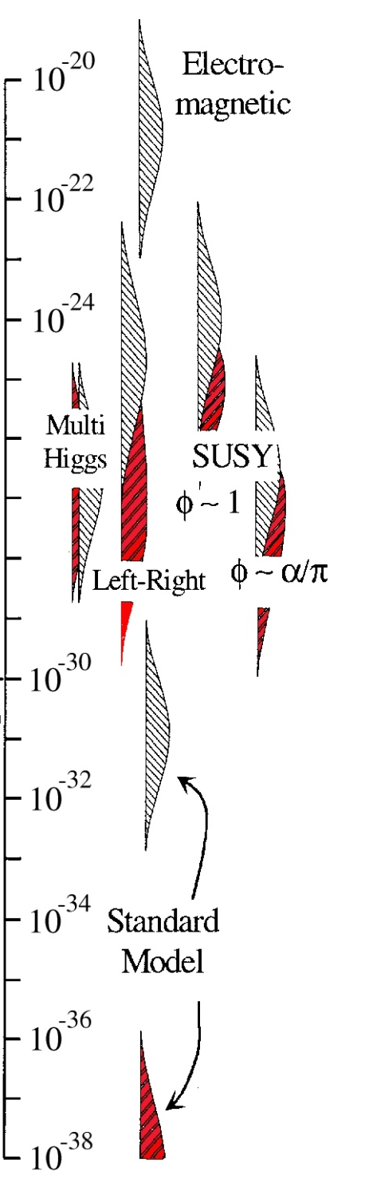
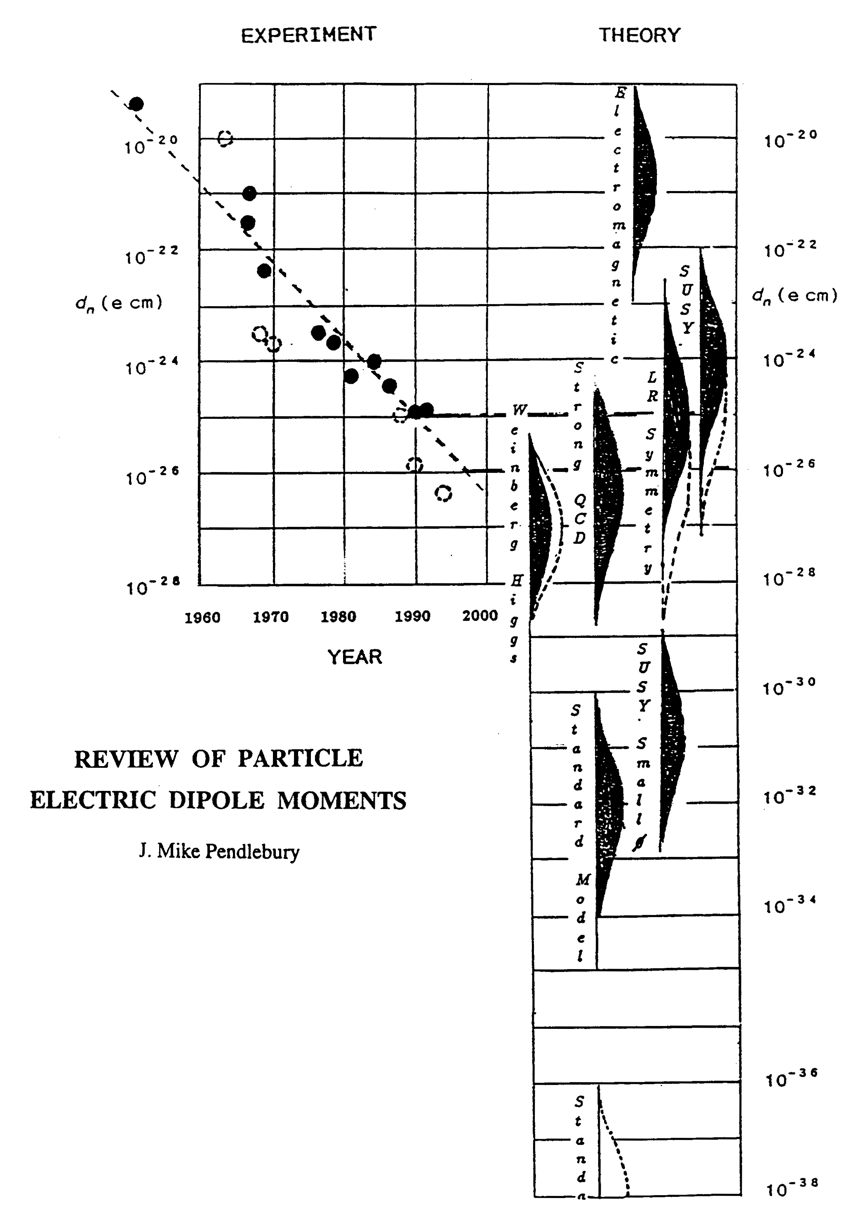
Sensitivity to Rule on Several New Models
Gray: Neutron
Red: Electron
If found it could explain
Baryogenesis (p, d, n, ³He)
n current
e current
GUT SUSY
Electroweak
Baryogenises
n target
p, d target
e target
1st upgrade
Electron EDM (molecules)
new physics reach: 1-3 TeV
Statistics limited
From Y. Smerzidis
Talk at EUCARD
workshop
e-cm
J.M.Pendlebury and E.A. Hinds, NIMA 440 (2000) 471

Slide 13
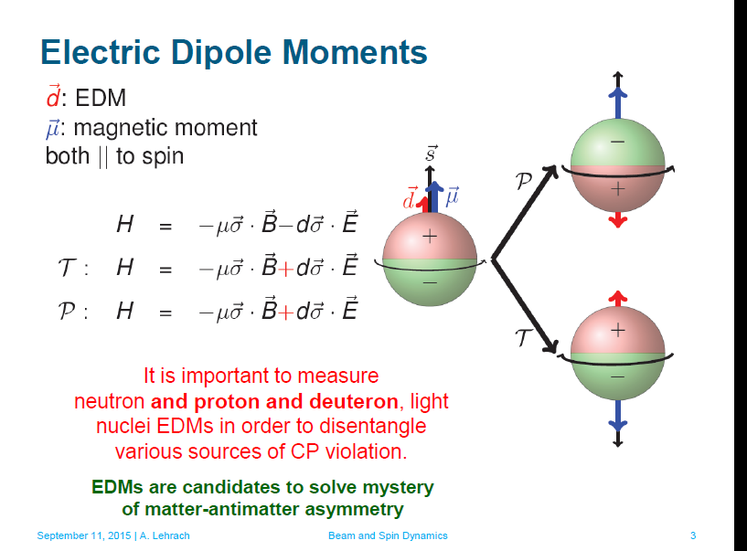
Observables in NEAR and MEDIUM FUTURE
future accelerator spin physics
From A. Lehrachs talk at the EUCARD-2 workshop

Slide 14
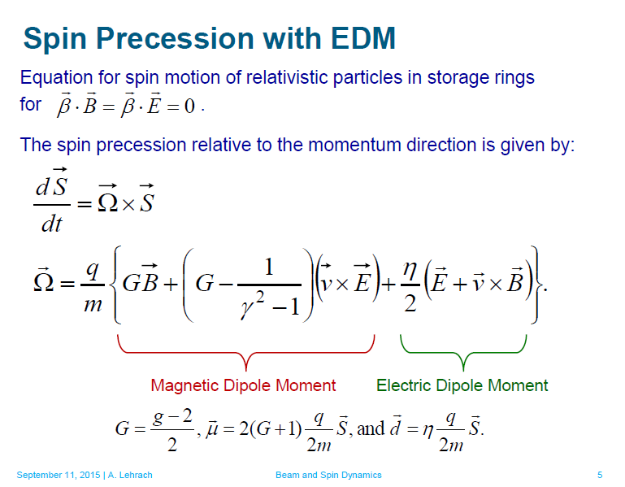
Observables in NEAR and MEDIUM FUTURE
future accelerator spin physics
From A. Lehrachs talk at the EUCARD-2 workshop

Slide 15
Momentum
vector
Spin vector
E
E
E
E
15

Slide 16
Observables in NEAR and MEDIUM FUTURE future accelerator
spin physics
- stat. Sensitivity for EDM detection
(*) many challenges of spin physics unitied in one formula!

Slide 17
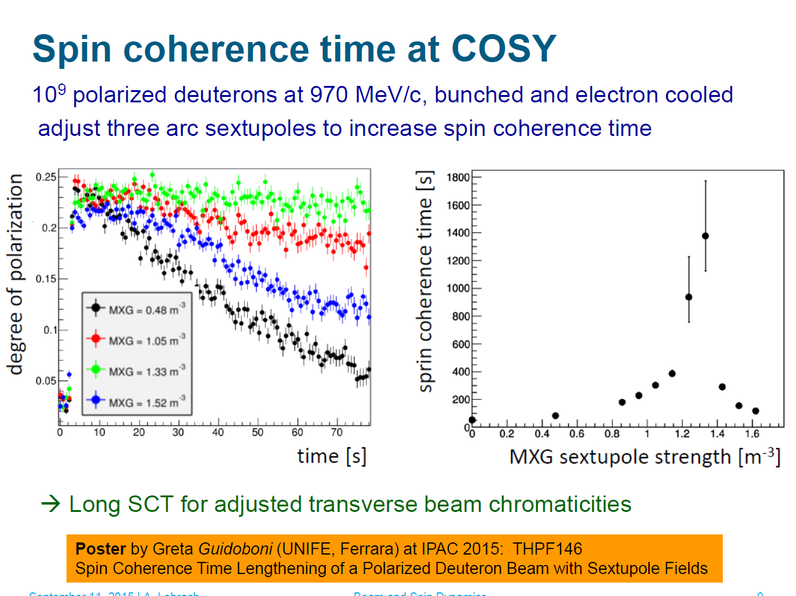
A. Lehrach, FZJ

Slide 18
Signals and systematic errors in ....
EDM (CP „JEDI“ )
- spurious polarization occurs
- P_{y,imperfect} are caused by , e.g., horiz B-field
PV electron scattering
- „false Asymmetries“

Slide 19
Signals and systematic errors in ....
Spurious effects are far too large !
Example: estimation for EDM precursor experiment at COSY
(non optimized, magnetic ring)
“Rotations of the RF Wien filter by 0.1 mrad or normally distributed vertical shifts of the quadrupoles with y = 0.1mm introduced signals mimicking a deuteron EDM of about 5 · 10−19 e cm” (PhD thesis Rosenthal, Aachen, 2016)
Example: PV
The Helicity correlated Intensity variation is given by:

Slide 20
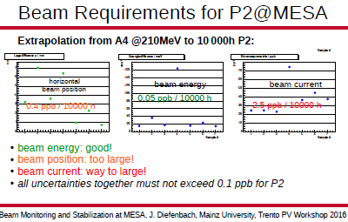

Slide 21
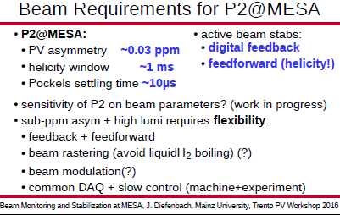

Slide 22
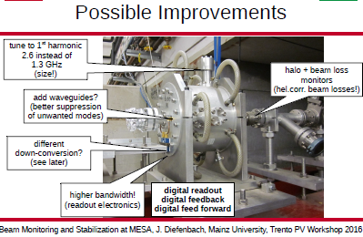

Slide 23
Summary
BIG projects: requirements well defined
Mostly feasible, somewhat challenging (pol positron production,
energy calibration in fcc-ee)
Small and feasible projects in near future: good playground for
„extreme beam control“ („identical orbits, helicity correlated
fluctuations)
Progress is realized under demand!
→ Small projects needed while /if waiting for the larger ones

Slide 24
Thank you for your attention!

Slide 25
The Hydro Möller proposal
Chudakov&Luppov, Proceedings IEEE Trans. Nucl. Sc. 51, 1533 (2004)
+ measurement is
non-invasive and
+ provides sufficient
statistical accuracy
at the beam current level
of the PV experiment
~1m
„Prototype“ of atomic trap was donated by UVA/Don Crabb
Template for cryostate development

Slide 26

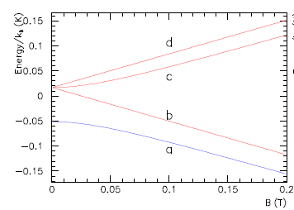
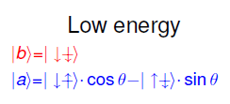
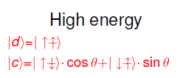
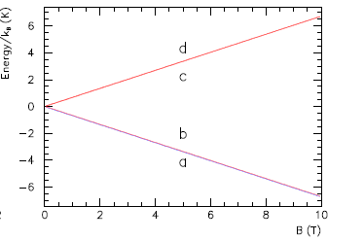


A completely polarised electron target
Magnetic field B splits H₁ ground state
H₁ in B = 8T at T = 300 mK at thermodynamical
equilibrium:
10⁻¹⁶
Mixing angle
At B =8T 0.3%

Slide 27
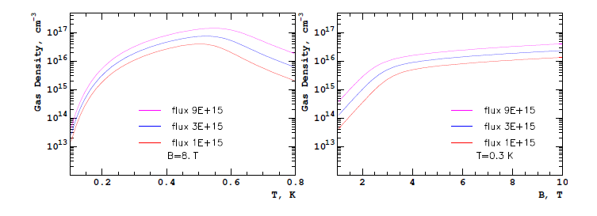
A completely polarised electron target
Gas Lifetime in the Cell
Loss of hydrogen atoms from the cell due to:
Thermal escape through the magnetic field gradient dominates at T > 0.55 K
Recombination in the gas volume negligible up to densities of ~ 10¹⁷ cm⁻³
Recombination in the cell surface constant feeding the cell with atomic hydrogen
Requires powerful dilution refrigerator….

Slide 28
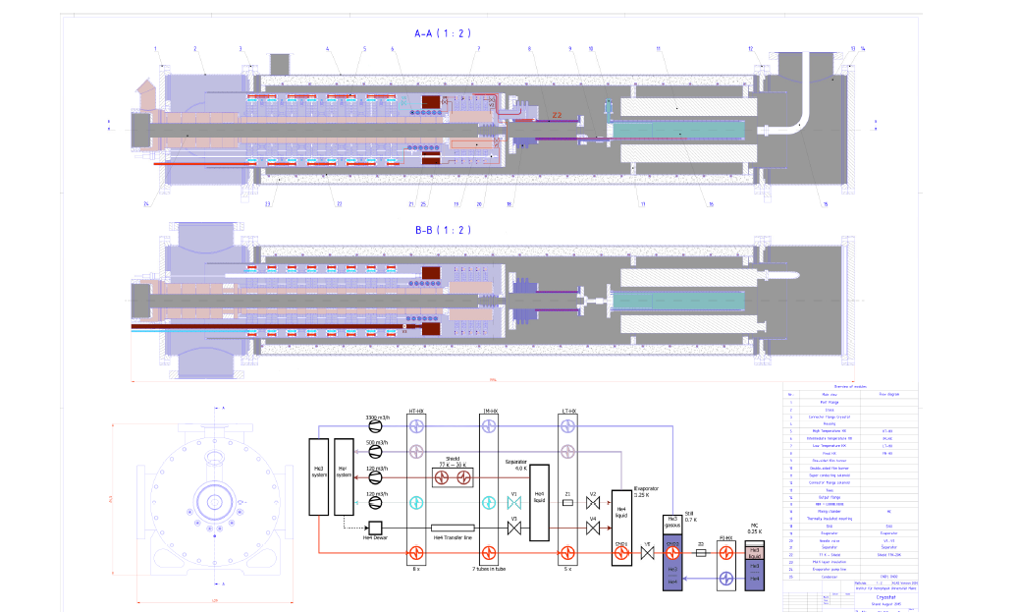
Draft of cryostat design for P2-Hydro-Möller (V. Tioukine with lots of help from Dubna, CERN, JLAB)

Slide 29
Status Hydro Möller
Challenge: Functionality can only be tested when trap is working!
Detailled cryostat design accomplished
Will build 4K precooling stage from available funding
~200 k€ for remainig cryostat parts and magnet
Substantial amount of 3He needed : 50-100 cm^3 lq. (~200k€ ??)
Pumping stages for the precooling and the mixing circuit (~300k€ ??)
No detection system designed yet!
Full design report needed for funding request

Slide 30
The P2 Experiment at MESA
-basic demands
150 μA Beamcurrent , 60cm lq. H2, Beampol: 85%.
10000 h Data-taking (~13-15000 h Runtime)
High accuracy polarization measurement (ΔP/P=0.5% !!)
Extremely high demands on control of HC-fluctuations!
→ ~4000h/Year Runtime
Accelerator must be optimized for reliability& stability
Count rate several hundred Gigahertz→ Integrating detector + spectrometer
F. Maas PAVI2014 conf.

Slide 31
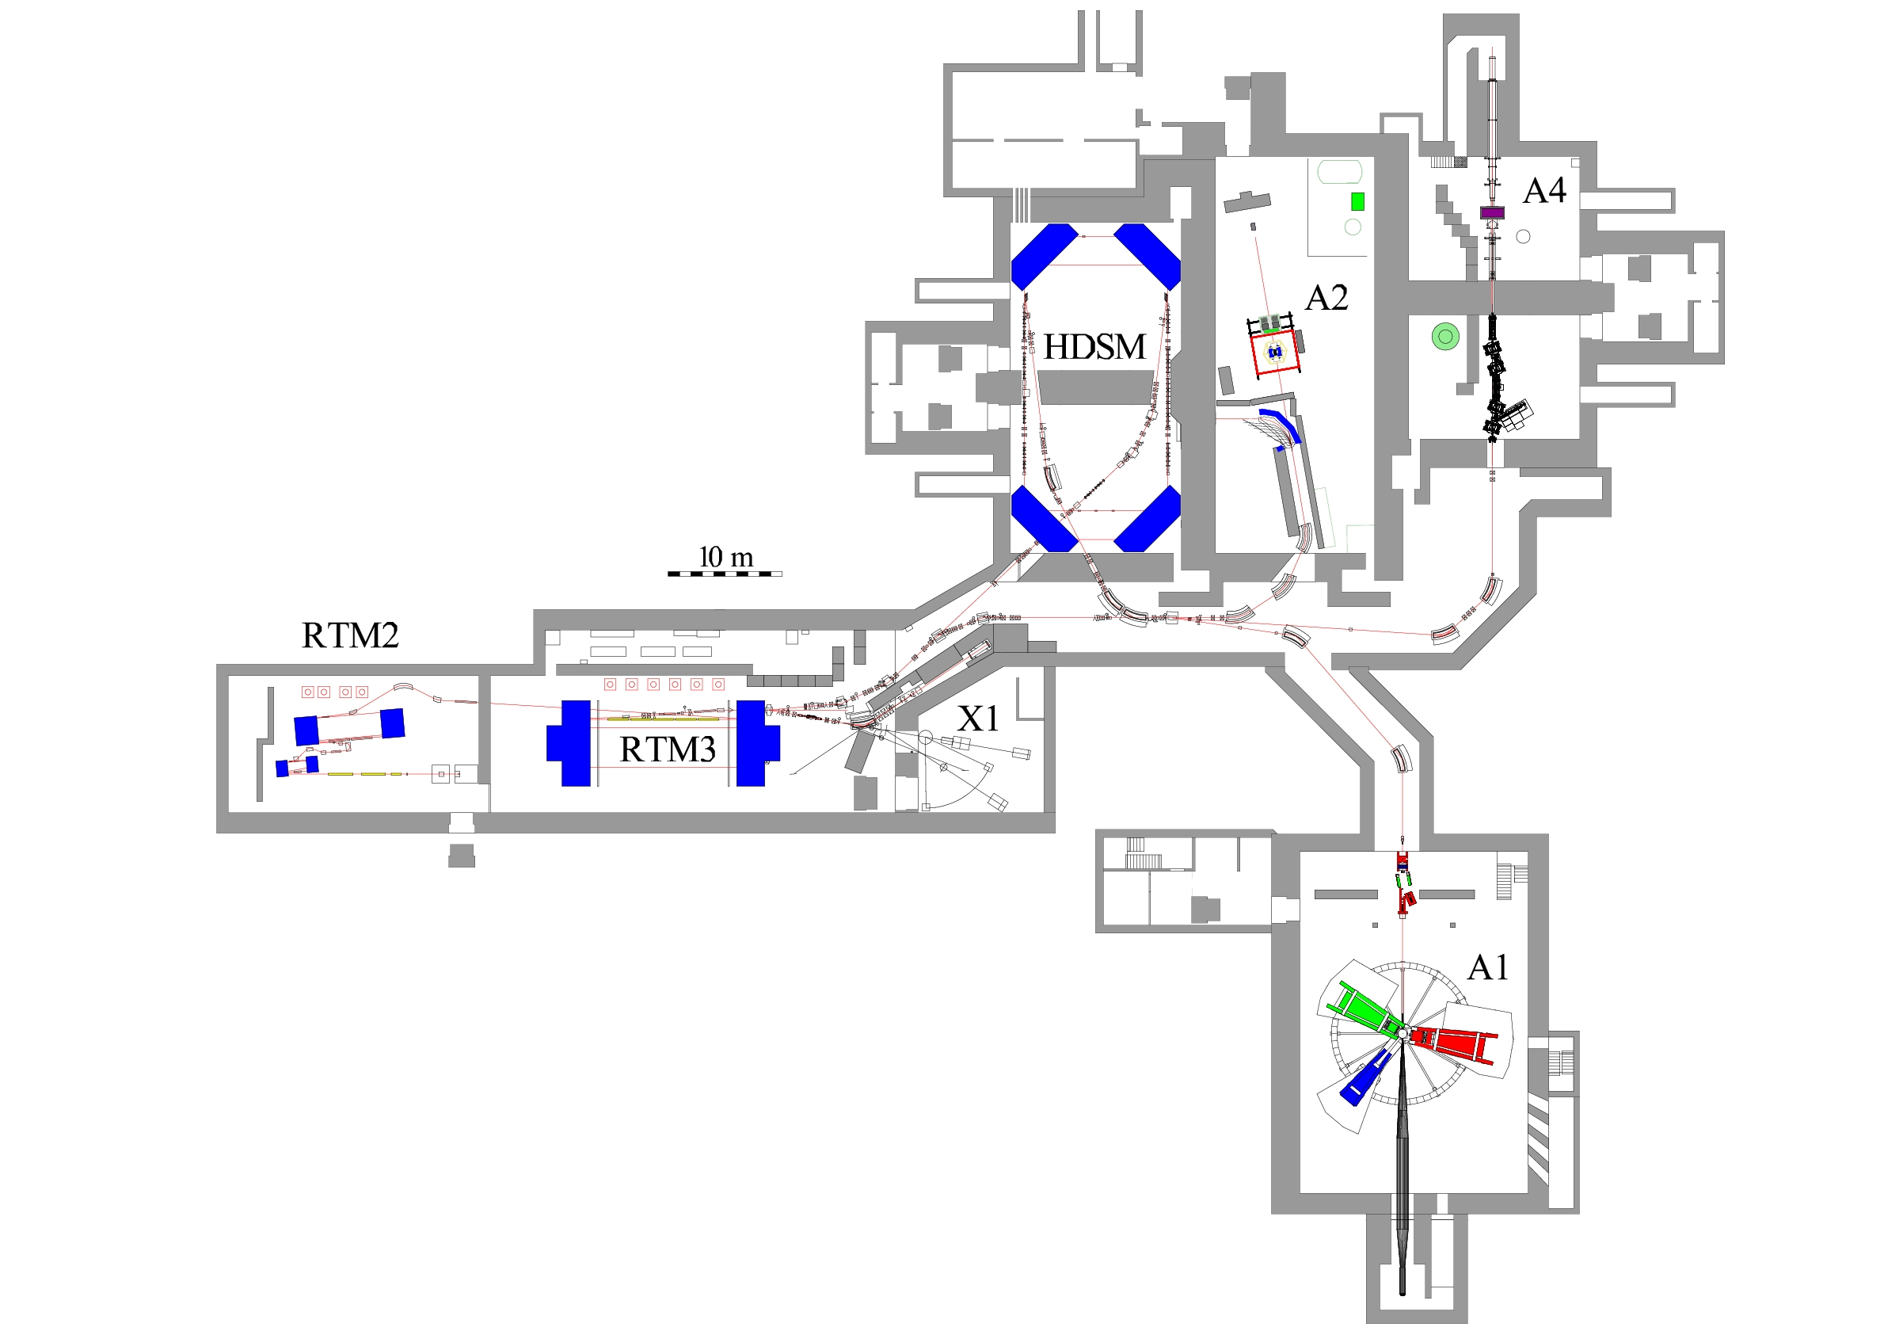
Expanding the MAMI facility by “MESA”
1.6 GeV c.w. electron accelerator “MAMI-C”
in operation since 2007
Insufficient space (and budget) for
further extension
no MAMI D project, but
use available space for 100 MeV scale,
high intensity accelerator “MESA”
The MAMI facility will be complemented by
MESA , the Mainz Energy-recovering Superconducting
Accelerator, with dedicated experiments at energies
below or at the pion threshold

Slide 32
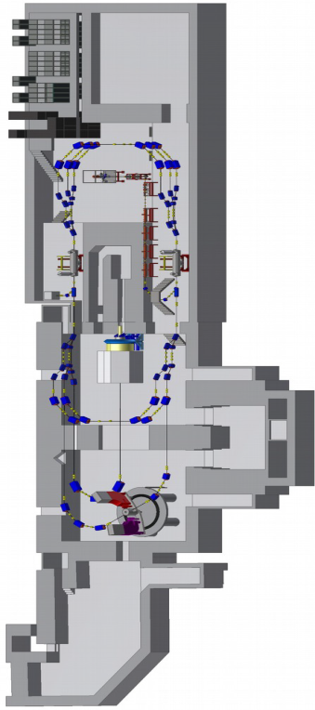
Expanding the MAMI facility by “MESA”

Slide 33
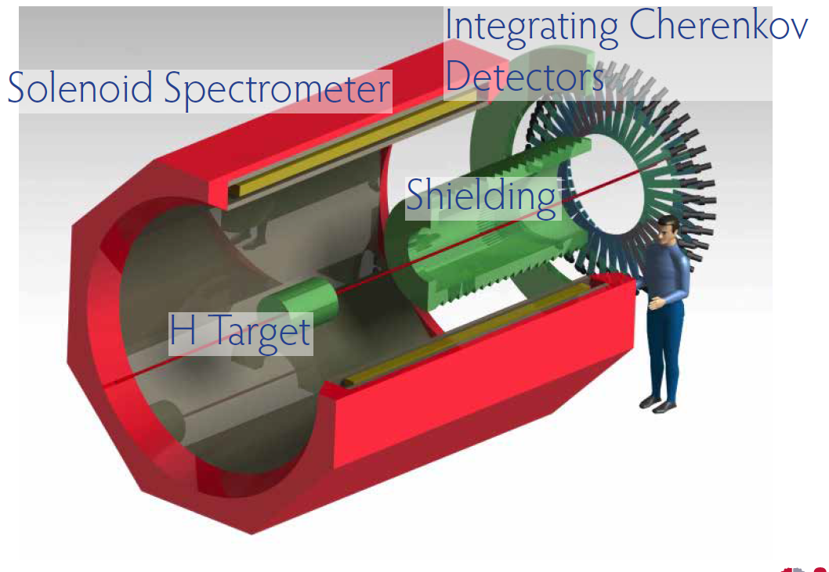
The P2 Experiment at MESA
- detector
F. Maas PAVI2014 conf.

Slide 34
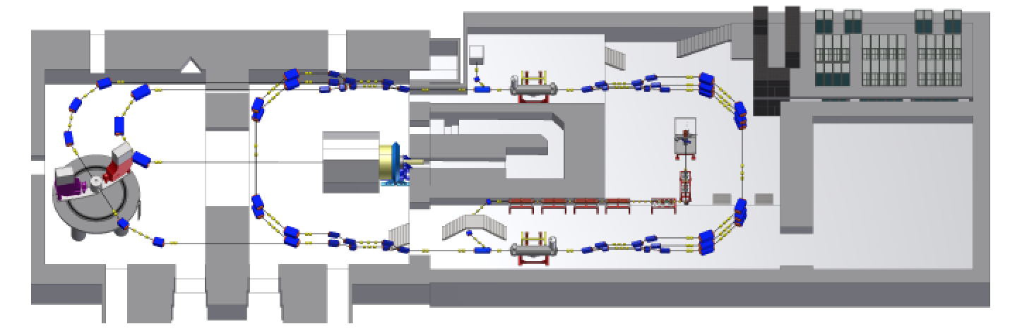
The P2 Experiment at MESA
Beam Dump Experiment (BDX) @ MESA
Electron Scattering on Beam Dump → Collimated pair of Dark Matter particles !
BDX
MESA
This existing beam dump is going to
be the P2 beam dump
10,000 hours @ 150 µA
10²³ electrons on target (EOT)

Slide 35
The P2 Experiment at MESA:
False asymmetry control

Slide 36
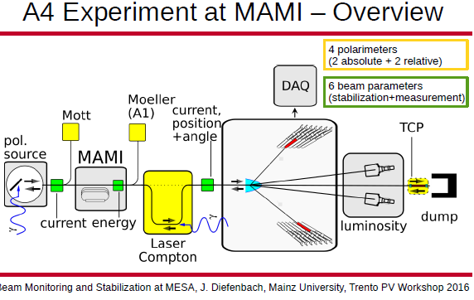

Slide 37
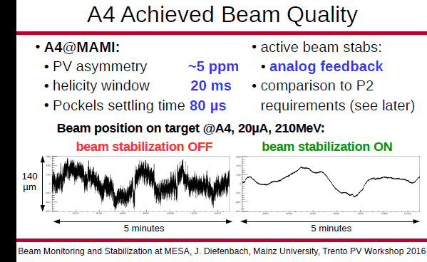

Slide 38
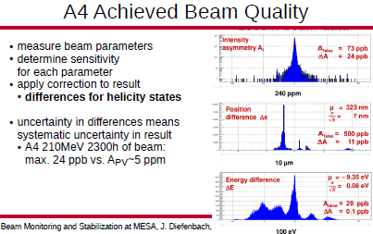

Slide 42
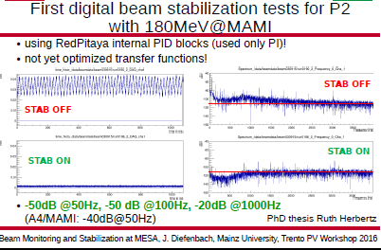

Slide 43
The role of Polarization measurement
- accuracy and efficiency
Storage ring experiment : efficiency matters!
- Strong interaction polarization analysis by single spin asymmetry
is at least two orders of magnitude more ffective than electromagnetic –
disadvantage for lepton EDM rings!
Possibility to use Stern Gerlach forces in superconicting cavity (R. Talman)
to detect spin precession non invasively would reverse this argument...
(new idea, not tested in practice)

Slide 44
The role of Polarization measurement
- accuracy and efficiency
S. Baunack
PAVI 2016

Slide 46
The role of Polarization measurement
- accuracy and efficiency
At lepton energies >> 1GeV : Laser Compton Scattering is a useful tool,
- can achieve Accuacies well below 1% (SLAC,JLAB)
Experiments with enrgies below 1GeV require improvement of new techniques
Standard Möller or Mott ca be improved to below 1%
New techniques for P2: „Hydro-Möller“ and Double scattering Mott may achieve
<0.5%.

Slide 47
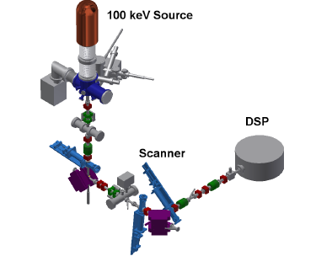
Present set-up of DSP at PKA2

Slide 48
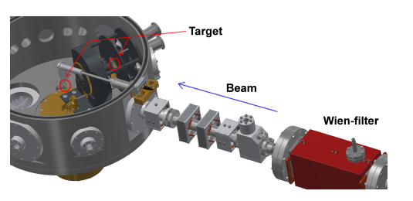
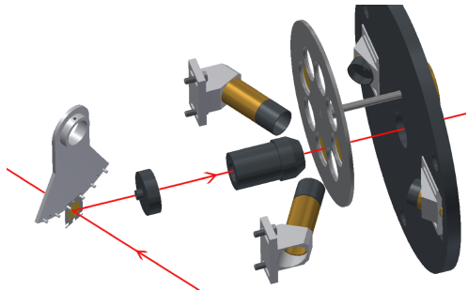
Inside the scattering chamber...
Polarisation
counters
Monitor
counters
Primary
target
Secondary
target

Slide 49
Double scattering (Kesslers Method)
Gellrich and J.Kessler
PRA 43 204 (1991)

Slide 50
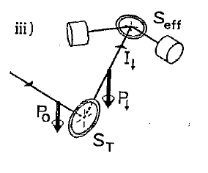
Kessler/HopsterAbraham/Kessler Method
5 equations with four unknowns→
consistency check for apparative asymmetries!
→ Results achieved by Kessler were consistent <0.3%
S. Mayer et al
Rev. Sci. Instrum. 64 952 (1993)

Slide 51
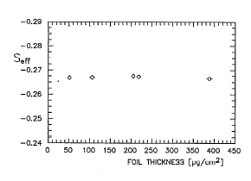
Kessler/HopsterAbraham/Kessler Method
5 equations with four unknowns→
consistency check for apparative asymmetries!
→ Results achieved by Kessler were consistent <0.4%
S. Mayer et al
Rev. Sci. Instrum. 64 952 (1993)

Slide 52
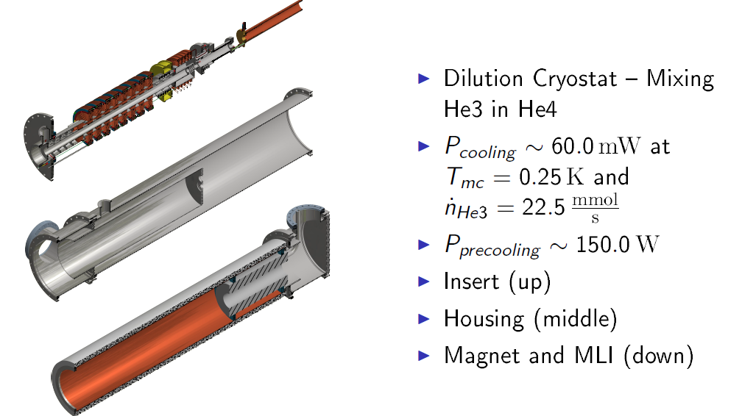
2 m long cryostat
Engineering challenge!

Slide 53
Supplementary transparencies

Slide 54
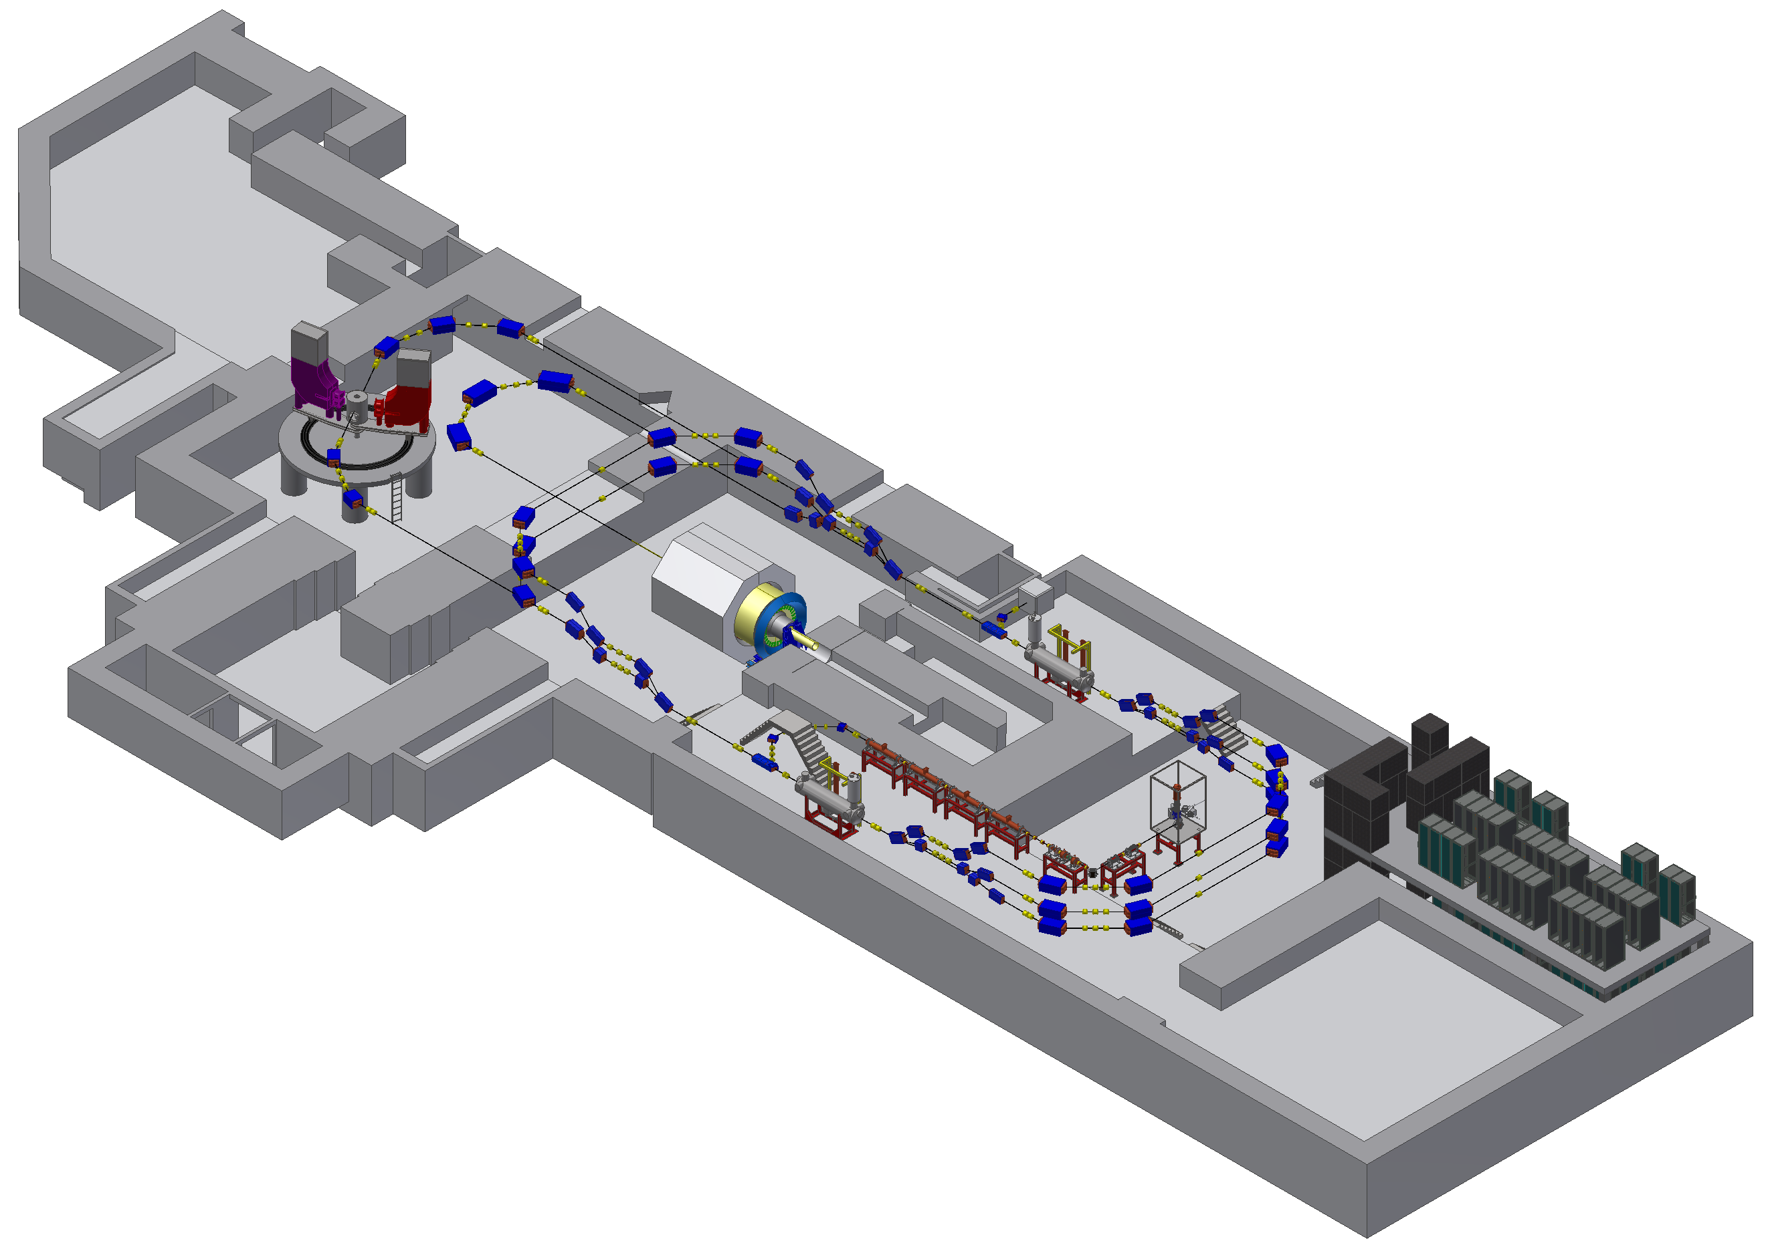
PLAN “B” (April-Oktober)
MESA in old/new building structure
4
#
=hall number
3
2
OLD
MAGIX
NEW (u-CFP)
P2
1
P2 Experiment: external beam, 155 MeV,
0,15mA, spin-polarized
MAGIX experiment: ERL beam, internal target
>1mA beam current.
Additional experiments possible: BdX and „Hall-4“
BDX
D. Simon

Slide 55
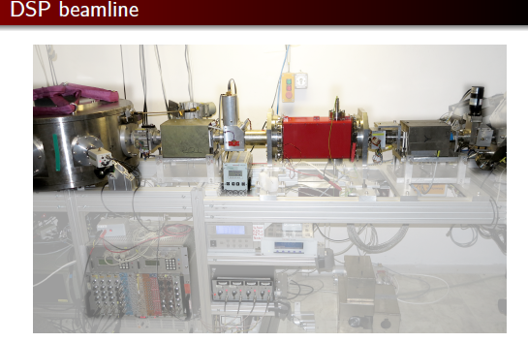
Present set-up of DSP at PKA2
beam
beam

Slide 56
Present set-up of DSP at PKA2

Slide 57
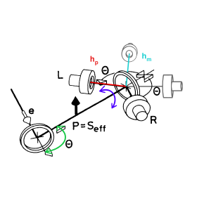
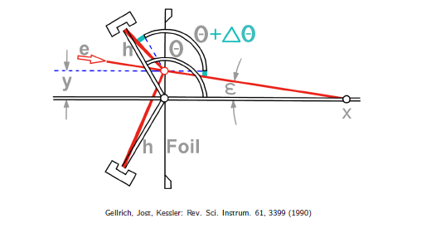
Elimination of apparative asymmetries (when spin cannot be flipped)
Rotating counters to eliminate efficienciy differences
Monitor counters to measure false asymmetries (solid angles, scattering angle)
Caveat: a zero asymmetry of monitor countors may be result of compensation between
changes of solid angle and scattering angle due to misalignement!

Slide 58
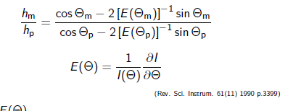
Elimination of apparative asymmetries
(when spin cannot be flipped)
It can be shown that the false asymmetry of the MONITOR counters is proportional
to the false asymmetry measured in the POLARISATION counters IF AND ONLY IF

Slide 59
The Hydro Möller-general remarks
„internal target“ with complete (>99.99% )electronic polarization
Thin target → online capability
But thick enough to prvide frequent polarization measurements
Expected accuracy ΔP/P <0.5%
Technologically demanding

Slide 60
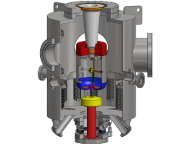
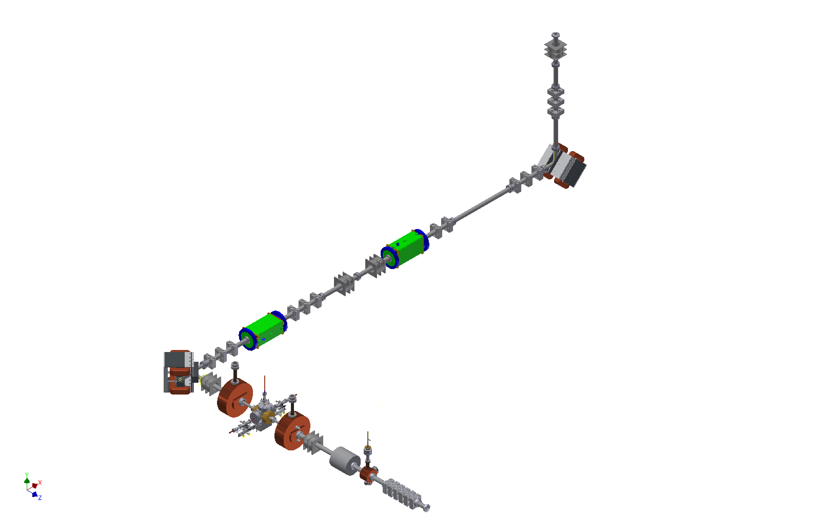
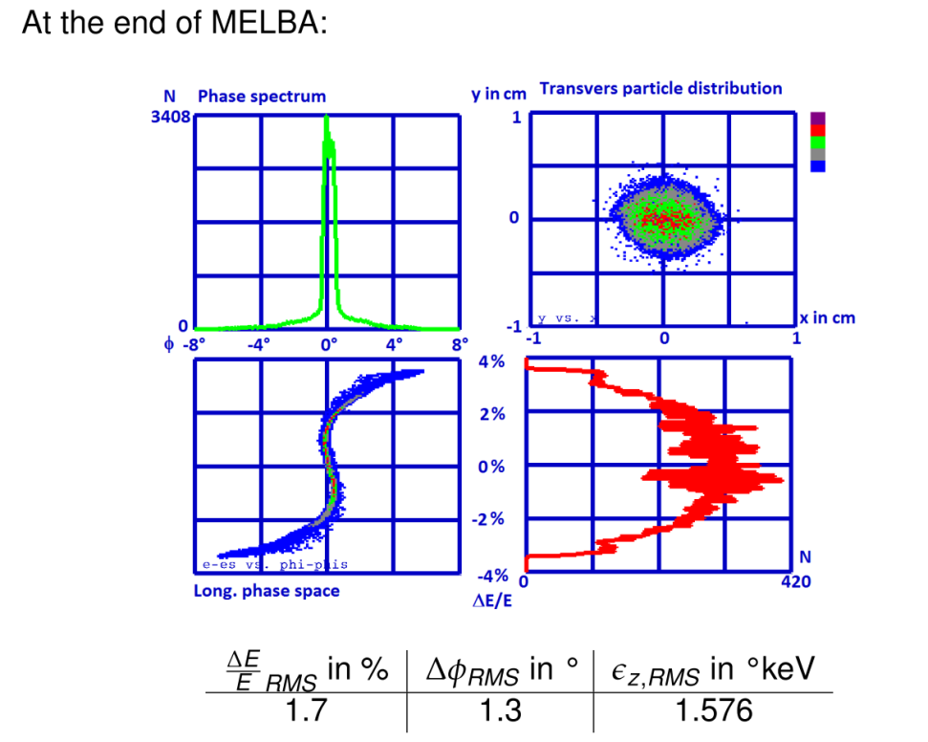
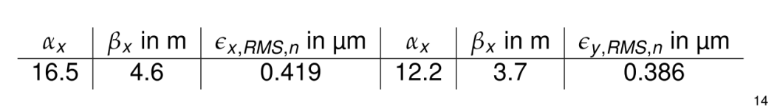
Full Assembly of MELBA planed until early 2017
„Start to end“ Simulation predicts for 100keV beam:
-Compatibility with spin rotation
Sufficient beam quality
for injection into MAMBO
with 1pC bunches (=1,3mA)
Source
Polarisation
Vacuum
Matching
C. Matrejcek

Slide 61
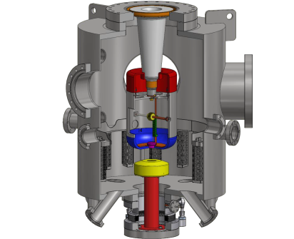
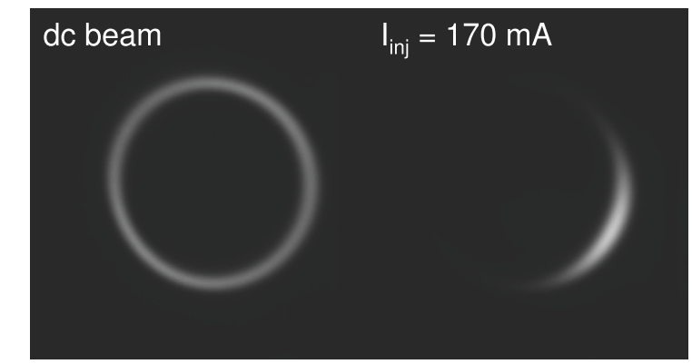
Assembly of MELBA (MEsa Low Energy Beam Apparatus) in 2016
Blue ray disc laser and longitudinal diagnostics
already tested….
Source
I. Alexander
Polarisation
Vacuum
Longitudinal diagnostics at
Bunch charges corresponding to
> 1mA average current
Matching

Slide 62
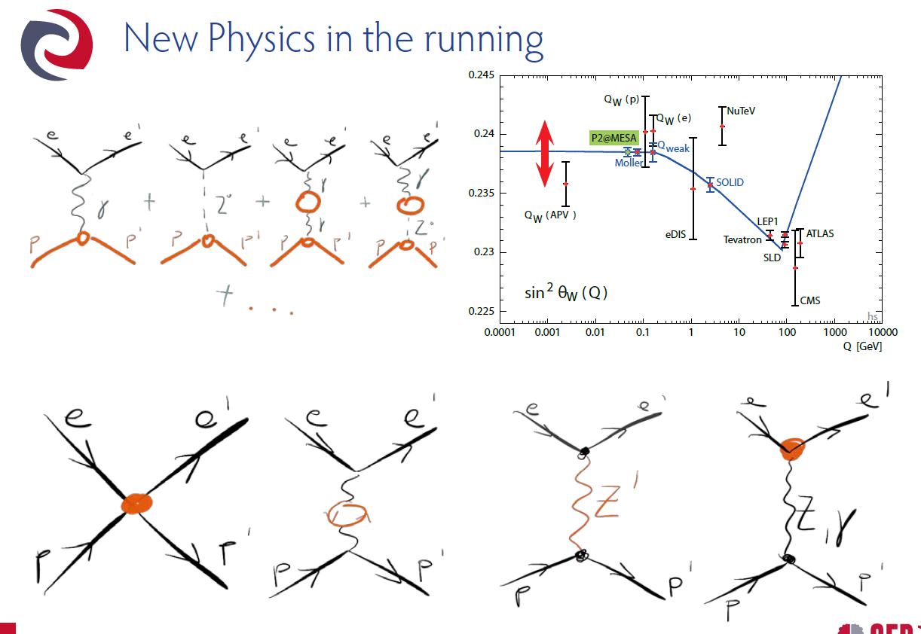
The P2 experiment at MESA
N. Berger

Slide 63
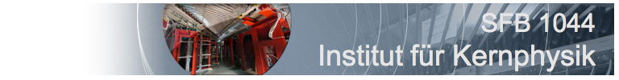

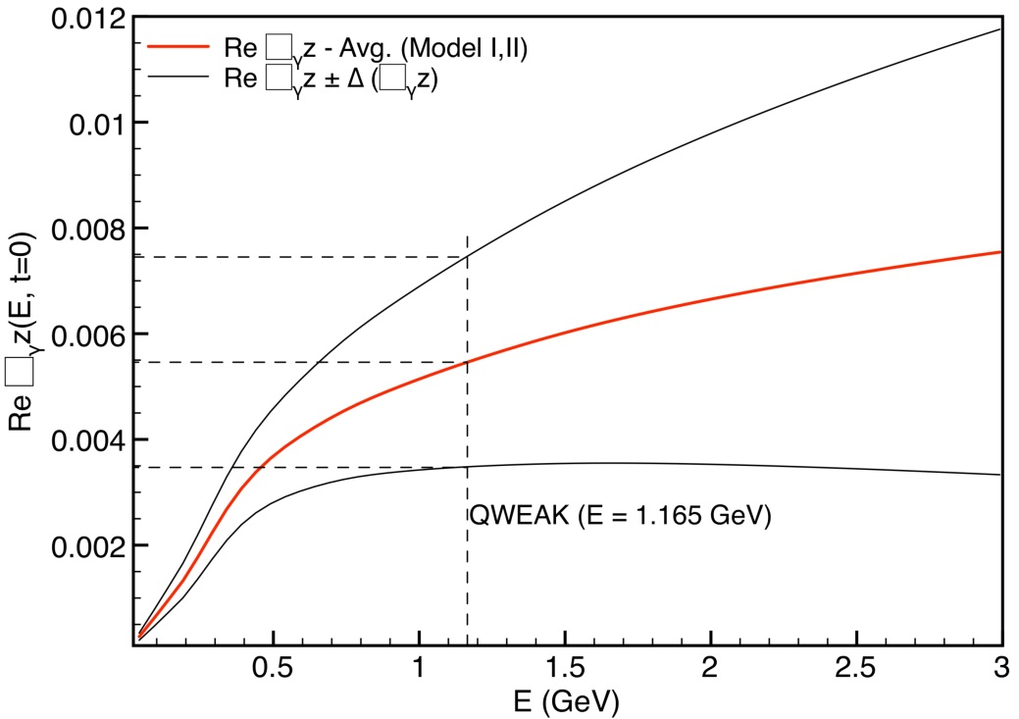
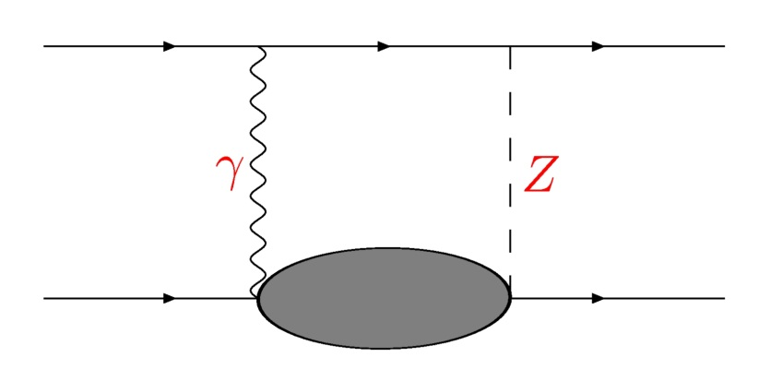
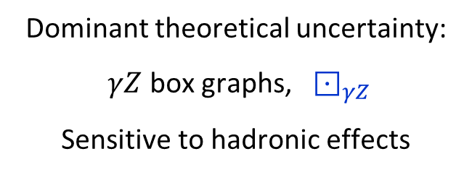
$γZ$ box graph contributions obtained by modelling hadronic effects:
Hadronic uncertainties suppressed at lower energies
Low beam energy experiment:
  P2 @ MESA
P2
[Gorchstein, Horowitz & Ramsey-Musolf 2011]
Dominant theoretical uncertainty:
$γZ$ box graphs, $⊡_{γZ}$
Sensitive to hadronic effects

Slide 64
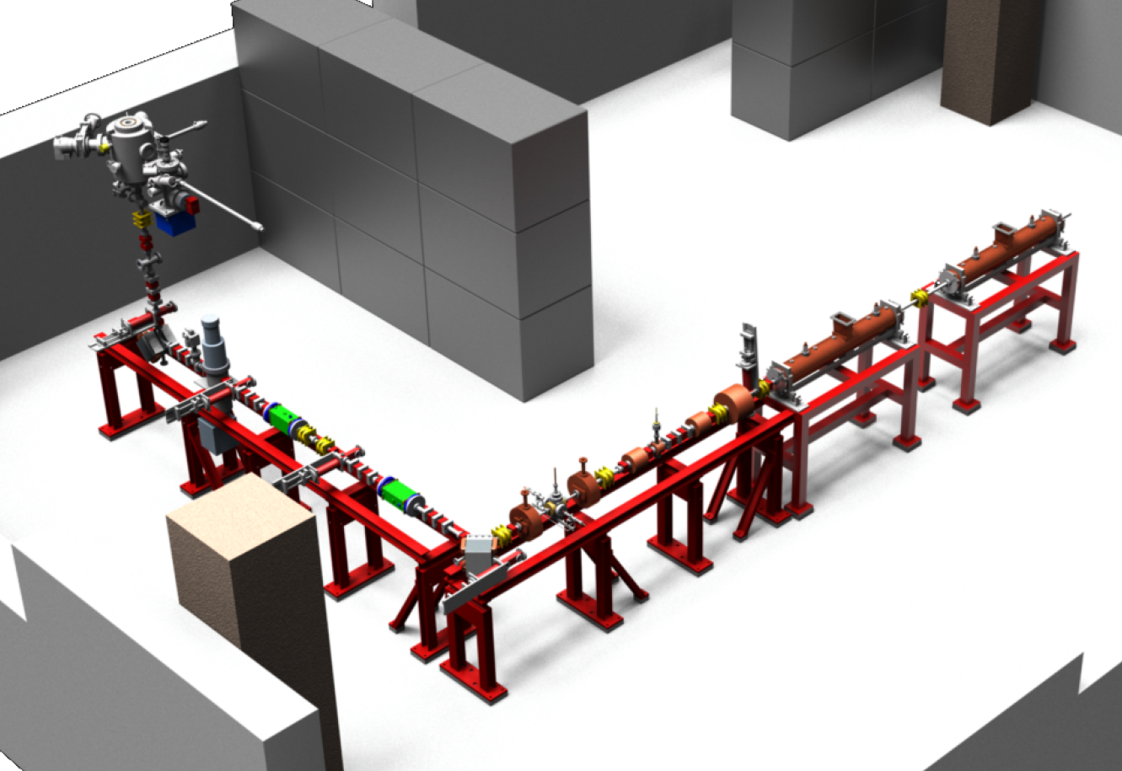
Beam test of MELBA and “50%” MAMBO
planed until end 2018
First two sections of MAMBO will be installed. →2.5 MeV „full relativistic“ beam
1300 MHz Rf power generated by solid state amplifiers with up to 80kW c.w.
Beam current >1mA can be tested

Slide 65
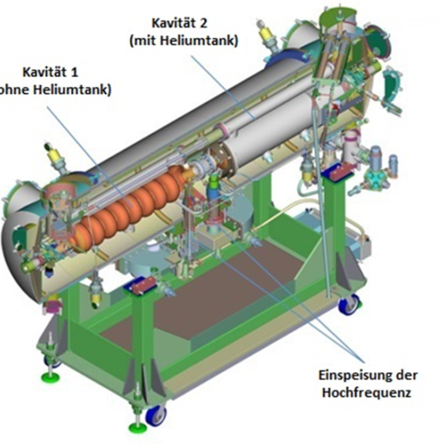

MEEK (Mesa Elbe Enhanced Kryomodules)
Installation at ELBE
J. Teichert et al. NIMA 557 (2006) 239
Design Gradient 13MV/m at Q₀ =1.5*10^{10.}
2 Cryomodules with four cavities will yield 50MeV energy gain/turn
„Enhancements“: -faster tuner and improved HOM capabilities for higher current
Under fabrication at RI Instruments Bergisch Gladbach
Delivery date for the two modules and April/June 2017
Performance tests at new „HIM experimental hall“

Slide 66


MEEK Cryomodules
-preparing for the test phase
„Helmholtz Institut Mainz“ (HIM) will by ready for operation this summer….
P
I
He
C
Test bunker for SRF cryomodules
Experimental Hall
01 June 2016
He: Lq. Helium supply line from liquifier in nuclear physics institute: >50l/hour through 220 m
long pipe demonstrated. P: 4g/s pump stage at 16mbar is presently being ordered.
I: Instrumenttion platform, C: Clean room for cryomodule maintenance

Slide 67

Experiments at MESA
Mode 2: ERL
Internal Target
MAGIX Experiment
Mode 1:
Extracted Beam
P2 Experiment
http://www.prisma.uni-mainz.de/1795.php#imagefilm

Slide 68
Highlights and roadmap from EuCARD-2 XPOL
Kurt Aulenbacher

Slide 69
Content XPOL
Deliverables: One workshop per year
So far three workshops took place:
12-30 participants..
General remark: Spin at accelerators is a “fundamental” science issue.
- particle physics meets accelerator people..perhaps more directly than in other cases…
But: Almost no applied Physics yet
(→small community!)

Slide 70

  XPOL workshop
  Spin optimization at Lepton accelerators
  (Mainz, February, 12-13 2014)
  23 Participants: -national research centers (DESY,BNL)
  & - Many german universities (Bonn, Heidelberg, Munich, Mainz, )
  Highlights: high energy circular proton machines, polarized positron source , “Spin at work” (in linear collider)

Slide 71
  XPOL workshop
  Spin optimization at Lepton accelerators
  (Mainz, February, 12-13 2014)
  23 Participants: -national research centers (DESY,BNL)
  & - Many german universities (Bonn, Heidelberg, Munich, Mainz, )
  Highlights: high energy circular proton machines, polarized positron source , “Spin at work” (in linear collider)

Slide 72


Slide 74

(Polarized) Positron
Bunch population not
Completely safe…

Slide 75
Positron source is located at the end of the electron linac
required positron yield Y = 1.5 e+/e-
Superconducting helical undulator – 231m maximum active length
  → positron beam is polarized
Photon-Collimator to increase e+ pol
  Removes part of photon beam with lower polarization
e+ Production Target, 400m downstream the undulator
Positron Capture: OMD (Optical Matching Device)
  Pulsed flux concentrator

Slide 76
Positron Target
Material: Titanium alloy Ti-6%Al-4%V
Thickness: 0.4 X₀ (1.4 cm)
Incident photon spot size on target: σ ∼ 2 mm (rms) (Ee- = 150GeV)
~ 1.2 mm (Ee- = 250GeV)
Power deposition in target: TDR 5-7% (~4kW)
small beam size ⬄ high peak energy density
spinning wheel to avoid damage due to high energy deposition density
  2000 r.p.m. (100m/s)
  Diameter: 1m
  Wheel is in vacuum
  water-cooled
Potential problems
  Stress waves due to cyclic heat load ⬄ target lifetime
  High peak energy deposition
  Eddy currents
  rotating vacuum seals to be confirmed suitable (design and prototyping is ~ongoing)
S. Riemann

Slide 77
Positron Target
„EUCARD SPIN-OFF“: POSITAR Experiment
„MIMIC“ impact of photon beam by ionization loss due to focussed electron beam at several
MeV. High repetition rate possible at c.w. electron accelerators.
1 day of operation at MAMI mimicks 1 year operation at the ILC.
(first experiment on Titanium alloy 2/2016)
S. Riemann

Slide 78

  XPOL workshop
  Search for the electron EDM in an electrostatic storage ring.
  Mainz, September 10-11 2015
  Participants: 27 Particle physics meets storage ring! (No collider!)
  US (BNL, CORNELL), Korea (CAPP), Germany (COSY-Jülich), Italy (Ferrara),
  Russia (Dubna),
  Highlights: Spin coherence, non-invasive effective polarimetry, Particle physics without collisions!

Slide 79
Electric Dipole Moment=EDM
EDM‘s imply CP-violation (bigger than present standard model)
So far only effective experiments with NEUTRAL (composite) systems
(exception: neutron)
Storage rings allow for measurement on truely elementary systems (p, e, μ,... )
Electric

Slide 80

Assuming CPT is invariant,
this implies that
CP is violated too…

Slide 81
Sensitivity to Rule on Several New Models
Gray: Neutron
Red: Electron
If found it could explain
Baryogenesis (p, d, n, ³He)
n current
e current
GUT SUSY
Electroweak
Baryogenises
n target
p, d target
e target
1st upgrade
Statistics limited
Electron EDM new physics reach: 1-3 TeV
Much higher physics reach
than LHC; complementary
e-cm
J.M.Pendlebury and E.A. Hinds, NIMA 440 (2000) 471

Slide 82
A. Lehrach, FZJ

Slide 83
at the magic momentum
Momentum
vector
E
Spin vector
E
E
E
83

Slide 84
Signal can be mimicked by radial magnetic fields
eliminate those by all electric ring operaqting at „magic“ momentum
(„frozen spin“ points always in direction of motion)
Hadrons promise easier success, but require much more expensive ring
Problem with electron: efficiency of Polarimetry.
Way out: Transfre from intensity to frequency measurement (Talman)

Slide 85


Slide 86

  XPOL workshop
  Polarization issues in future high energy circular colliders
  Rome, April 16 2015
14 Particpants
(China, Germany, Japan,
Switzerland, Russia, US,)
Small, but extremely
intense meeting with vivid
Discussions…
Highlights: Vertical polarization
In fcc-ee → energy calibration
(Ginafelice, Hillert, Koop,
Fcc-hh: polarization
not hopeless (Ptytsin) internal
Target also (Lenisa)
Again ,polarimetry is the key…

Slide 87


Slide 88
  Next XPOL workshop End of 2016
  New venues in polarimetry
Beam Polarimetry is the key issue for several project in acclerator based research
fcc-ee energy calibration
eEDM determination („Resonant polarimter“)
Highly accurate polarimeters for precision observables
(Hydro Moller completely polarized internal target, double scattering, )

