Slide 1
A Brief Survey of Beam Instabilities at the LHC
G. Rumolo
Based almost 100% on the Chamonix material of Kevin Li!
With the input of G. Arduini, H. Bartosik, X. Buffat, L. Carver, G. Iadarola, L. Mether, E. Métral, N. Mounet, T. Pieloni, S. Redaelli, A. Romano, G. Rumolo, B. Salvant, M. Schenk, R. Tomás
EuCARD-2 XBEAM Strategy Workshop, Valencia, Spain, 13/02/2017

Slide 2
Outline
Brief history of instability observation in LHC
2015-2016:
  25 ns beam and 6.5 TeV
  LHC hypercycle and types of instabilities observed
  Role of electron cloud
Lesson learnt and open questions

Slide 3
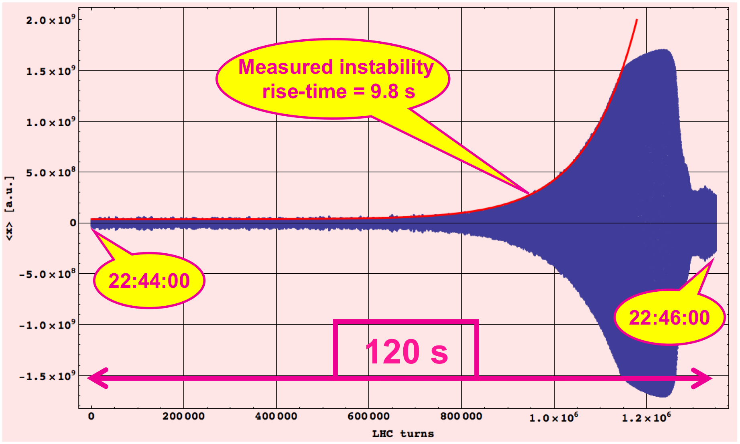
Recap of LHC operation over the years
2010-2011
  Bunch spacing gradually decreased from 150 ns to 50 ns
  Nominal bunch intensity (1.2e11 p/b)
  Transverse emittance gradually decreased from 2.5 to 1.2 μm at injection
  Single bunch instabilities observed during early commissioning phase over the ramp suppressed with octupoles
  In general, beams stable except residual ecloud effects in 2011(?)!
Beginning of instability
m = -1
Advanced phase of instability
Courtesy E. Métral

Slide 4
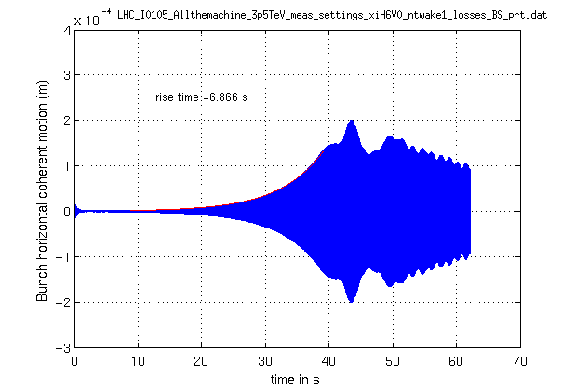
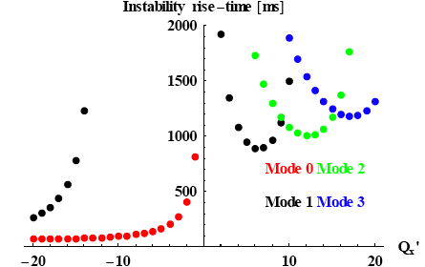
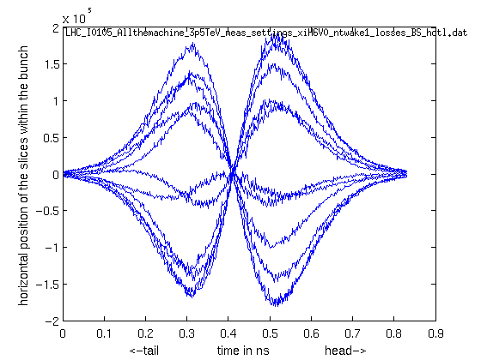
Recap of LHC operation over the years
2010-2011
  Bunch spacing gradually decreased from 150 ns to 50 ns
  Nominal bunch intensity (1.2e11 p/b)
  Transverse emittance gradually decreased from 2.5 to 1.2 μm at injection
  Single bunch instabilities observed during early commissioning phase over the ramp suppressed with octupoles → expected with LHC impedance model
  In general, beams stable except residual ecloud effects in 2011(?)!
HEADTAIL simulation
Question still being addressed: why did it only appear at ~2 TeV ?

Slide 5
Recap of LHC operation over the years
2010-2011
  Bunch spacing gradually decreased from 150 ns to 50 ns
  Nominal bunch intensity (1.2e11 p/b)
  Transverse emittance gradually decreased from 2.5 to 1.2 μm at injection
  Single bunch instabilities observed during early commissioning phase over the ramp suppressed with octupoles
  In general, beams stable except residual ecloud effects in 2011(?)!
2012
  50 ns operation in almost fully ecloud-free environment
    Ecloud only in uncoated interaction regions, notably the triplets
  Bunch intensity increased up to 1.7e11 p/b (1.7 μm emittance at injection)
  Many instabilities mainly observed at top energy (4 TeV) before colliding

Slide 6
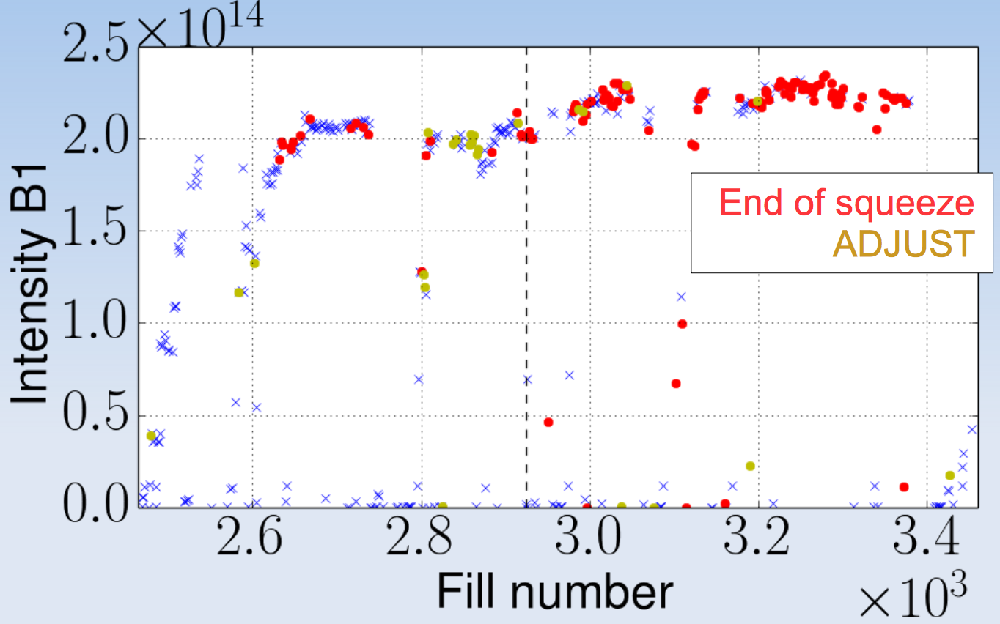
Recap of LHC operation over the years
2012 Instabilities
Mainly observed in the phases just before going into colliding beams (betatron squeeze and adjust)
First part of the year (before Fill #2950)
  Low positive chromaticity (~2 units) and negative polarity of octupoles
  Many fills without instabilities, but impact of instabilities important, when present
Second part of the year (after Fill #2950)
  High positive chromaticity (~15 units) and positive polarity of the octupoles
  Instabilities were observed at the end of the squeeze, continuing through ADJUST, stabilised by head-on collision – no large impact of instabilities

Slide 7
Recap of LHC operation over the years
2010-2011
  Bunch spacing gradually decreased from 150 ns to 50 ns
  Nominal bunch intensity (1.2e11 p/b)
  Transverse emittance gradually decreased from 2.5 to 1.2 μm at injection
  Single bunch instabilities observed during early commissioning phase over the ramp suppressed with octupoles
  In general, beams stable except residual ecloud effects in 2011(?)!
2012
  50 ns operation in almost fully ecloud-free environment
    Ecloud only in uncoated interaction regions, notably the triplets
  Bunch intensity increased up to 1.7e11 p/b (1.7 μm emittance at injection)
  Many instabilities mainly observed at top energy (4 TeV) before colliding
2015-2016
  25 ns operation with strong electron cloud
  Nominal bunch intensity (1.2e11 p/b)
  Transverse emittance gradually decreased from 2.7 to 1.6 μm at injection
  Focus of the next slides …

Slide 8
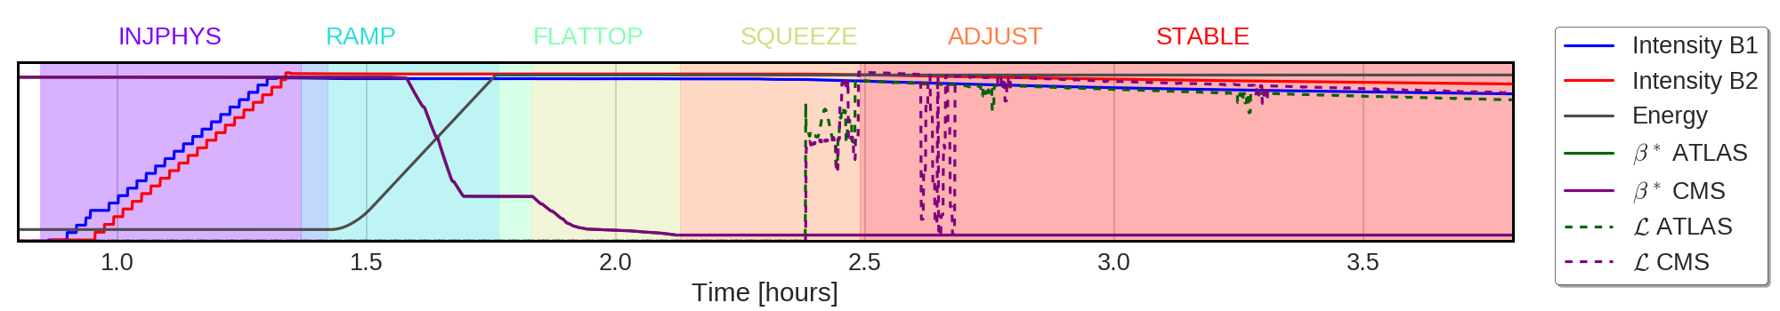
Injection
→ Up to 23 injections for 2220 bunches, crucial phase for instabilities, incoherent blow-up observed
Ramp
→ Roughly 20 minutes of combined ramp and squeeze, beam typically stable, mainly incoherent blow-up observed
Flat-top
→ Uncritical, beta* at 3 m, beam stable
Squeeze
→ Down to 40 cm, very dynamic phase, highly relying on good control of machine parameters – some issues with instabilities when linear coupling not well corrected, surge of strong non-linearities now blurring the workspace
Adjust
→ Long-range beam-beam comes into play, instabilities sporadically observed
Stable/colliding beams
→ Luminosity production, instabilities observed and vanished later during the year – possible mechanism related to electron cloud identified
23/01/2017

Slide 9
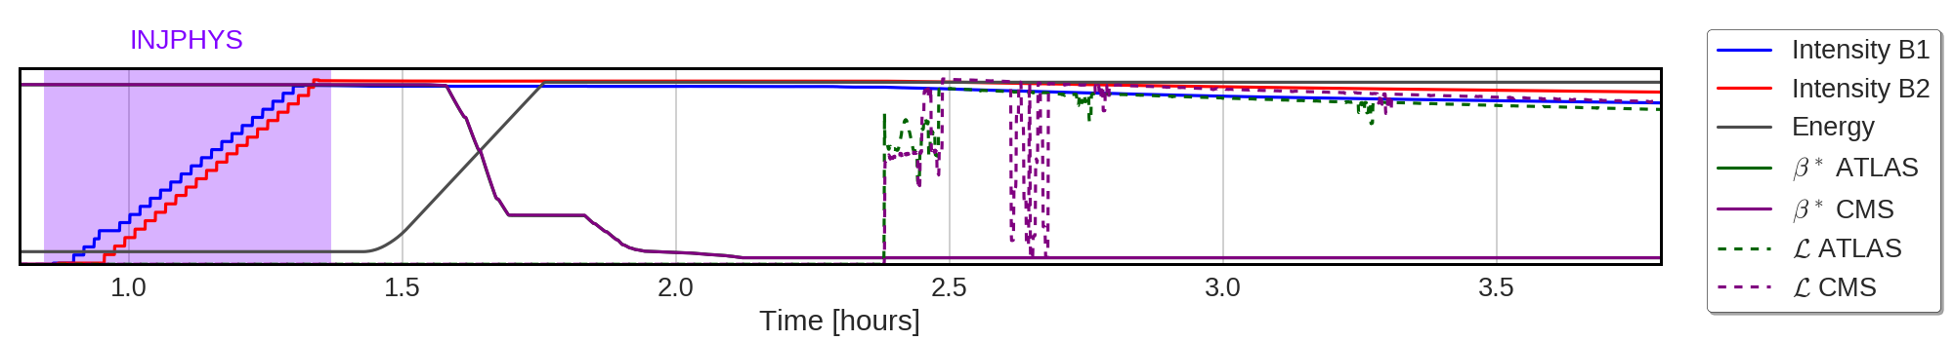
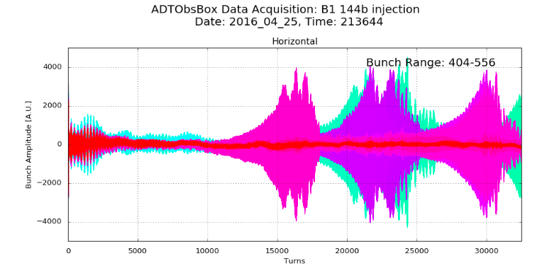
Electron cloud instability determines the machine settings at injection
Key lesson: machine settings for stable operation in e-cloud dominated environment
  Tunes farther from third order resonance – (0.27, 0.295) instead of (0.28, 0.31) – to better accommodate electron cloud tune spread
  Chromaticities of 20/20 and octupoles at 10 A for 2.5 μm emittance, high gain for the transverse damper
23/01/2017

Slide 10
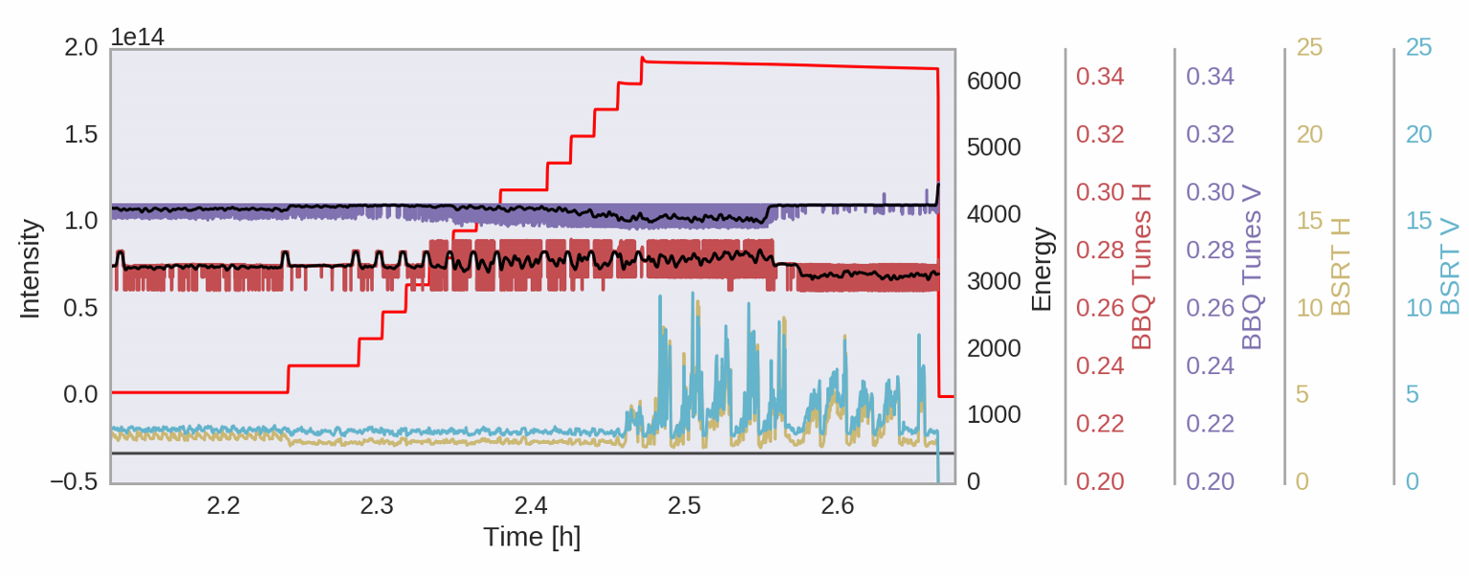
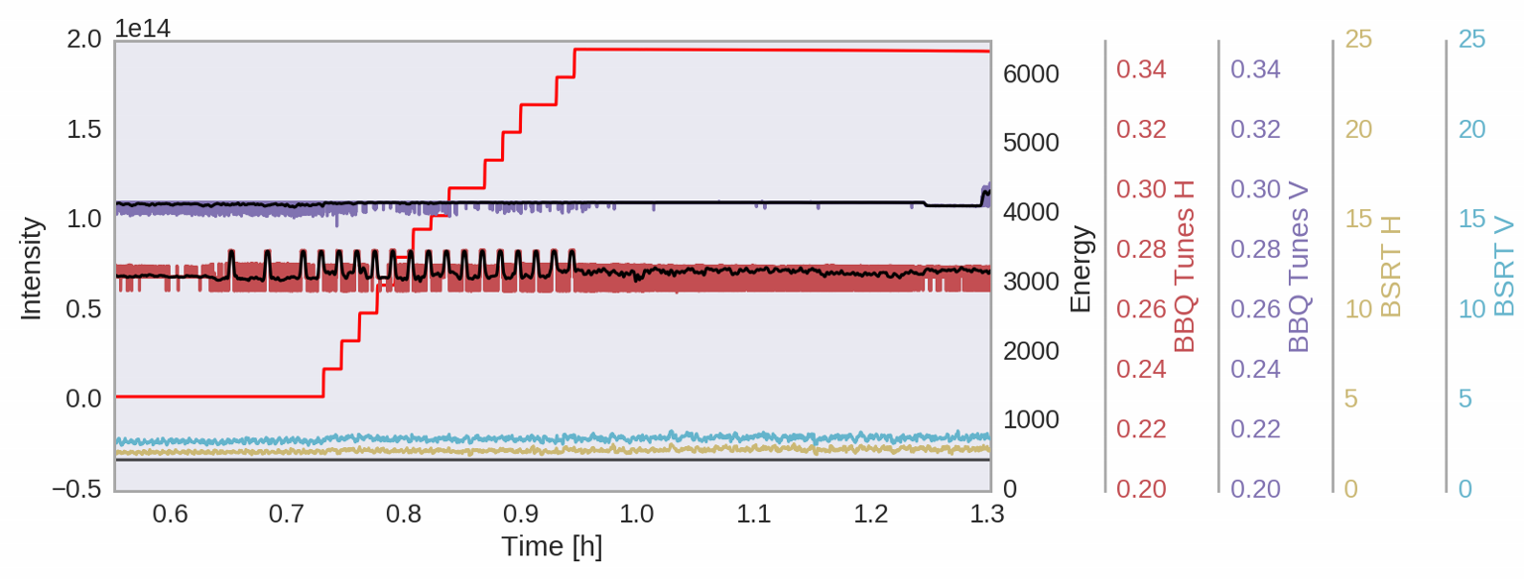
Not enough, if tunes drift close to each other, coupling makes beam unstable (loss of Landau damping)
Fill 4642 with uncorrected tune drift
→ blow-up during injection
Coupling C- for these fills was below 0.004
Fill 4643 with tune correction
→ no blow-up
Measurement, monitoring and correction of tunes and coupling are crucial especially during injection
23/01/2017

Slide 11
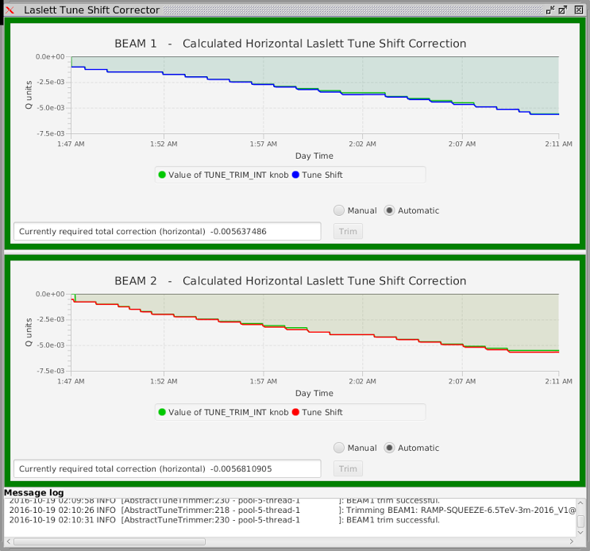
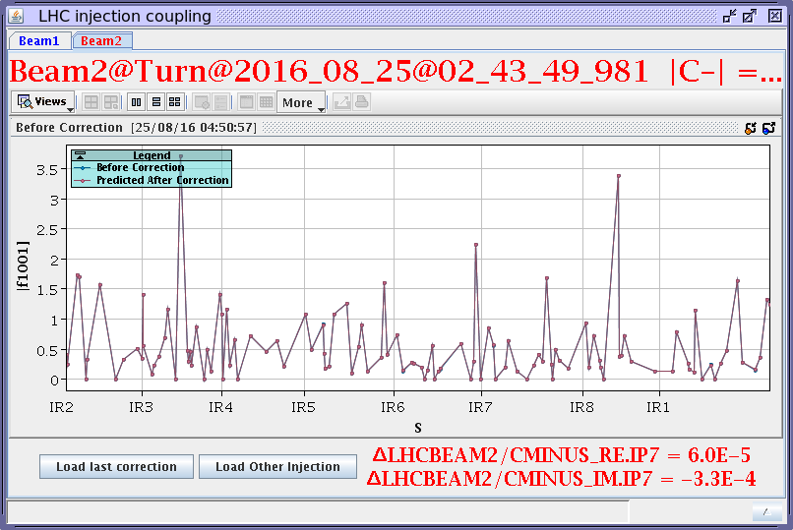
Not enough, if tunes drift close to each other, coupling makes beam unstable (loss of Landau damping)
Two vital applications have been in put in place to prevent the issues with linear coupling observed in 2015
Measures: tune control with coupling correction + e-cloud tunes (.27, .295) with improved separation.
Conclusion: There have been no issues with instabilities relating to coupling at injection in 2016
Application for correction for Laslett tune shift – M. Schaumann
Application for coupling correction at injection – T. Persson
23/01/2017

Slide 12
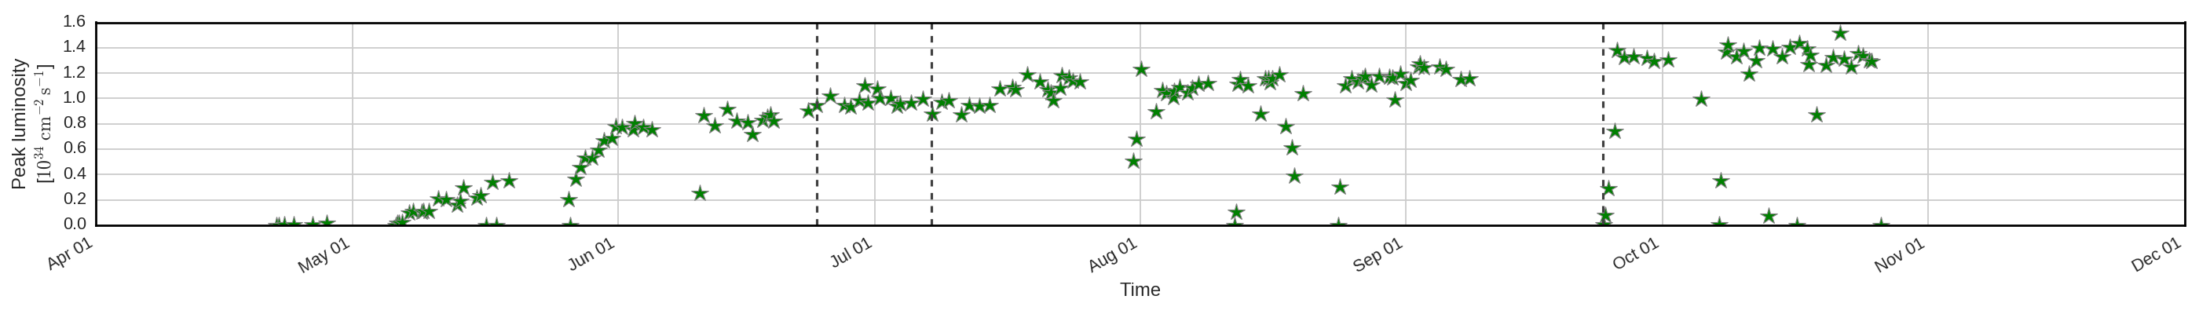
BCMS beam (low emittance variant of 25 ns beam)
Reduction of transverse emittance from injectors (BCMS beam) awakened beam instabilities
Strong blow-up required an increase in octupole current to 40 A (by a factor 2)
The required machine settings to ensure beam stability were confirmed in a dedicated study
23/01/2017

Slide 13
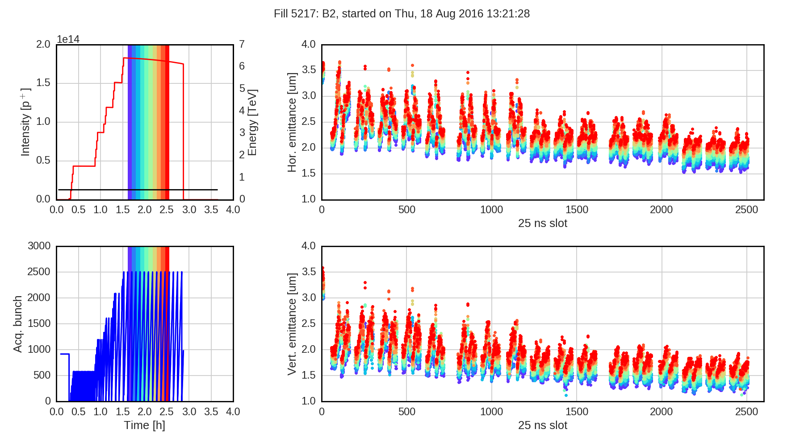
Octupole knob | -1.5 | -1.5 | -2.5 | -2.5 | -3.0 | -4.0 | -4.0 | -4.0
Damper gain | normal | double | double | normal | normal | 15/15 | 10/15 | 20/15
Fill 5217 – Thursday, 18. August afternoon – BCMS physics beam with operational settings
Injected BCMS beams with different octupole and damper settings
Signature: strong blow-up of BCMS beam at injection
Measures: increase octupole current from 19.5 A to 40 A (damper gain has little impact)
Conclusion: running at increased octupole currents renders the BCMS beam stable with no critical impact on beam lifetime
BCMS beam
23/01/2017

Slide 14
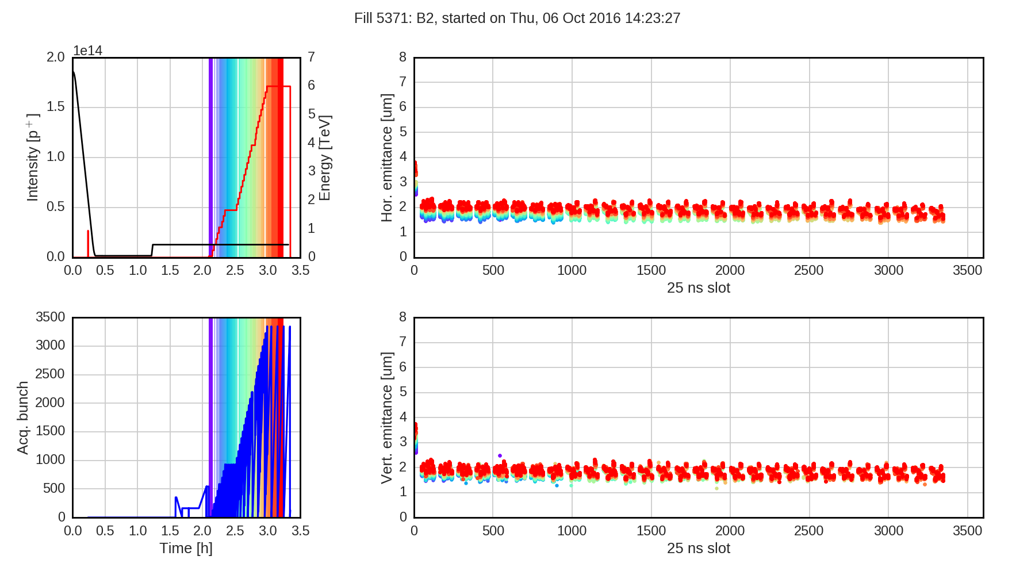
Octupole knob | -0.5 | -1.0 | -1.0 | -1.0 | -2.0 | -4.0 | -4.0 | -4.0
Chromaticity | 5/5 | 5/5 | 10/10 | 15/15 | 15/15 | 15/15 | 10/15 | 20/15
Fill 5217 – Thursday, 18. August afternoon – BCMS physics beam with operational settings
Injected BCMS beams with different octupole and damper settings
Injection of 8b+4e filling scheme designed to suppress e-cloud, confirmed experimentally in 2015
Without e-cloud, beam can indeed be injected at very low levels of chromaticity and octupoles!
8b+4e beam
23/01/2017

Slide 15
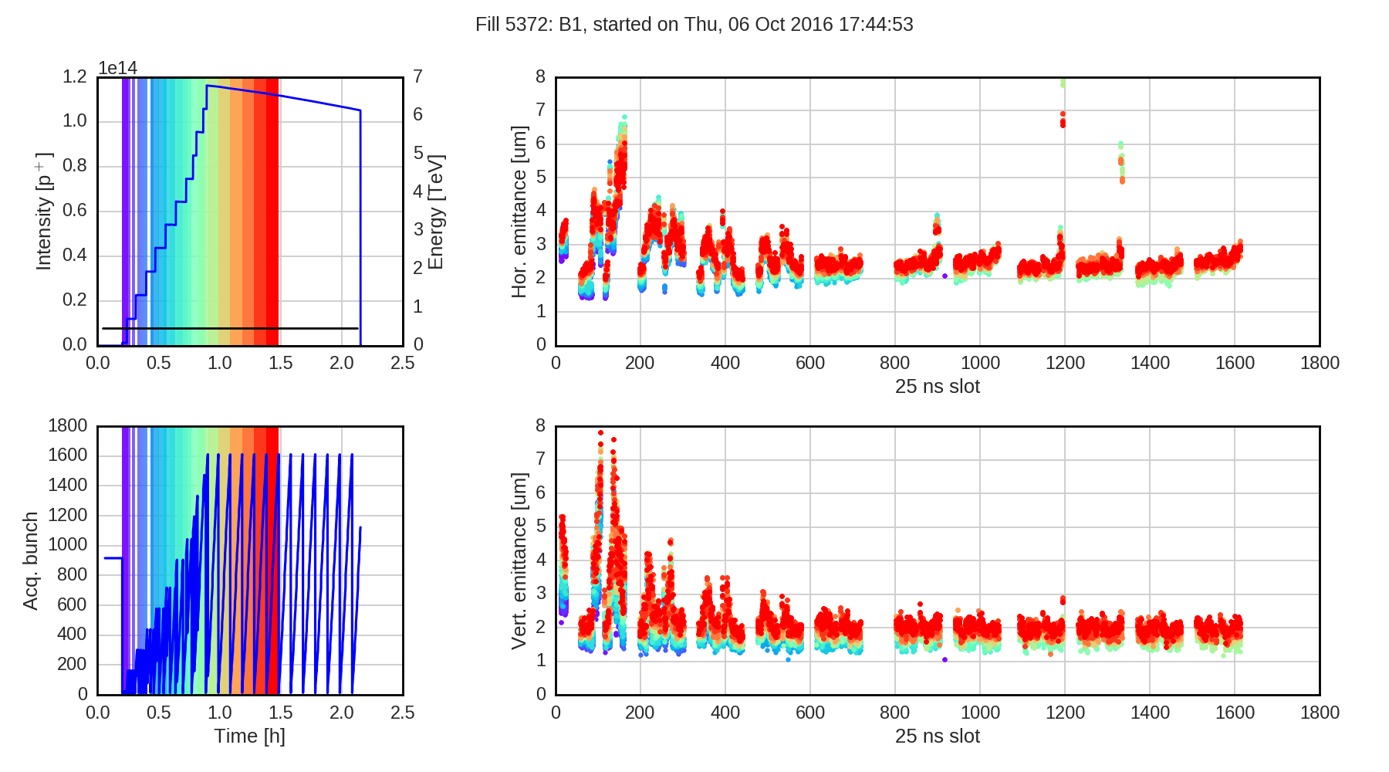
Octupole knob | -0.5 | -1.0 | -1.0 | -1.0 | -2.0 | -4.0 | -4.0 | -4.0
Chromaticity | 5/5 | 5/5 | 10/10 | 15/15 | 15/15 | 15/15 | 10/15 | 20/15
Fill 5217 – Thursday, 18. August afternoon – BCMS physics beam with operational settings
Injected BCMS beams with different octupole and damper settings
Signature: the 8b+4e scheme allows for stable operation at very low levels of chromaticity and octupoles – the BCMS continues to blow up
Measures: adjust machine parameters, in particular chromaticity, to stabilizing regime
Conclusion: e-cloud still present in 2016 and defining the machine settings at injection (and throughout the cycle) with practically no margins – chromaticity being the main knob as was already expected from simulations
23/01/2017

Slide 16
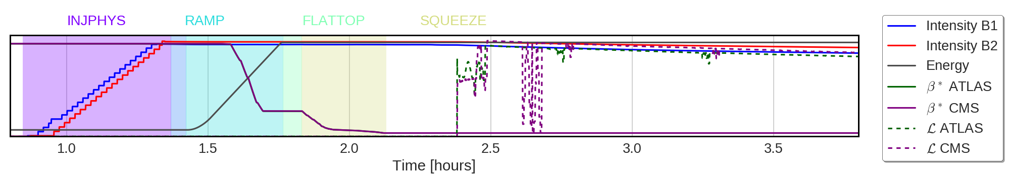
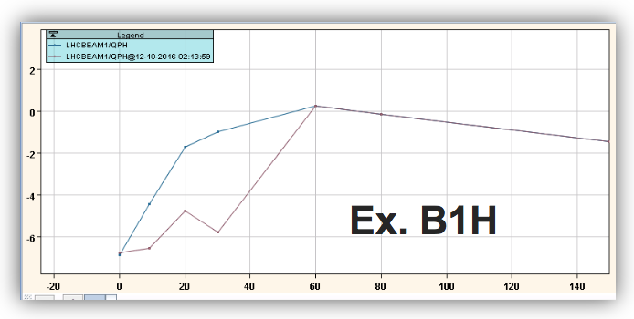
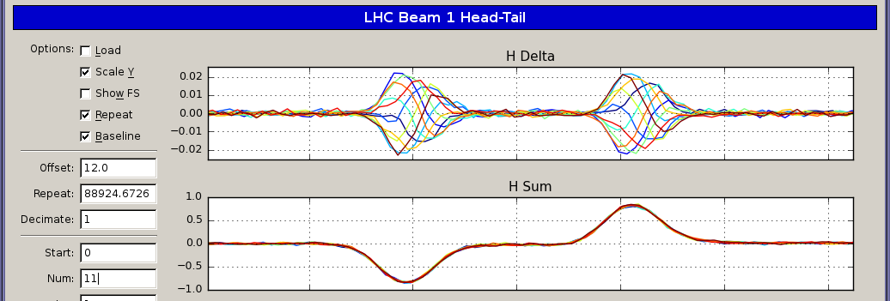
Only instabilities observed at beginning of ramp were due to overcorrected snapback right after an MD block
23/01/2017

Slide 17
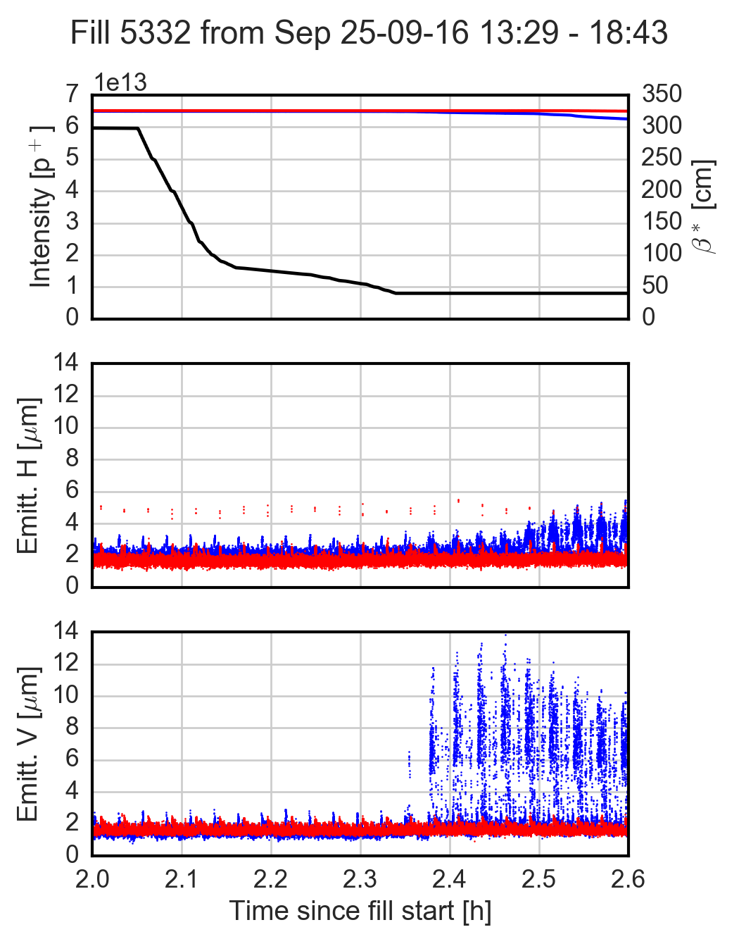
Only instabilities observed at beginning of ramp were due to overcorrected snapback right after an MD block
Coupling during the squeeze is critical due to reduced tune separation
  Losses and emittance blow-up in beam 1 right after squeeze
  Coupling not well corrected caused instabilities after a Technical Stop
  |C⁻| re-measured by OMC team: ~5e-3 at end of squeeze
23/01/2017

Slide 18
Injection
→ Up to 23 injections for 2220 bunches, crucial phase for instabilities, incoherent blow-up observed
Ramp
→ Roughly 20 minutes of combined ramp and squeeze, beam typically stable, mainly incoherent blow-up observed
Flat-top
→ Uncritical, beta* at 3 m, beam stable
Squeeze
→ Down to 40 cm, very dynamic phase, highly relying on good control of machine parameters – some issues with instabilities when linear coupling not well corrected, surge of strong non-linearities now blurring the workspace
Adjust
→ Long-range beam-beam comes into play, instabilities sporadically observed
Stable/colliding beams
→ Luminosity production, instabilities observed and vanished later during the year – possible mechanism related to electron cloud identified
23/01/2017

Slide 19
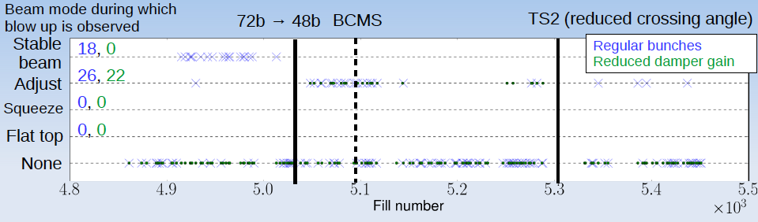
No coherent instabilities observed in most of the fills
  Some vertical instabilities in stable beams at beginning of 2016
  Sporadic instabilities in adjust, after switching to low transverse emittances
Usually only few bunches affected and no large impact on luminosity
23/01/2017

Slide 20
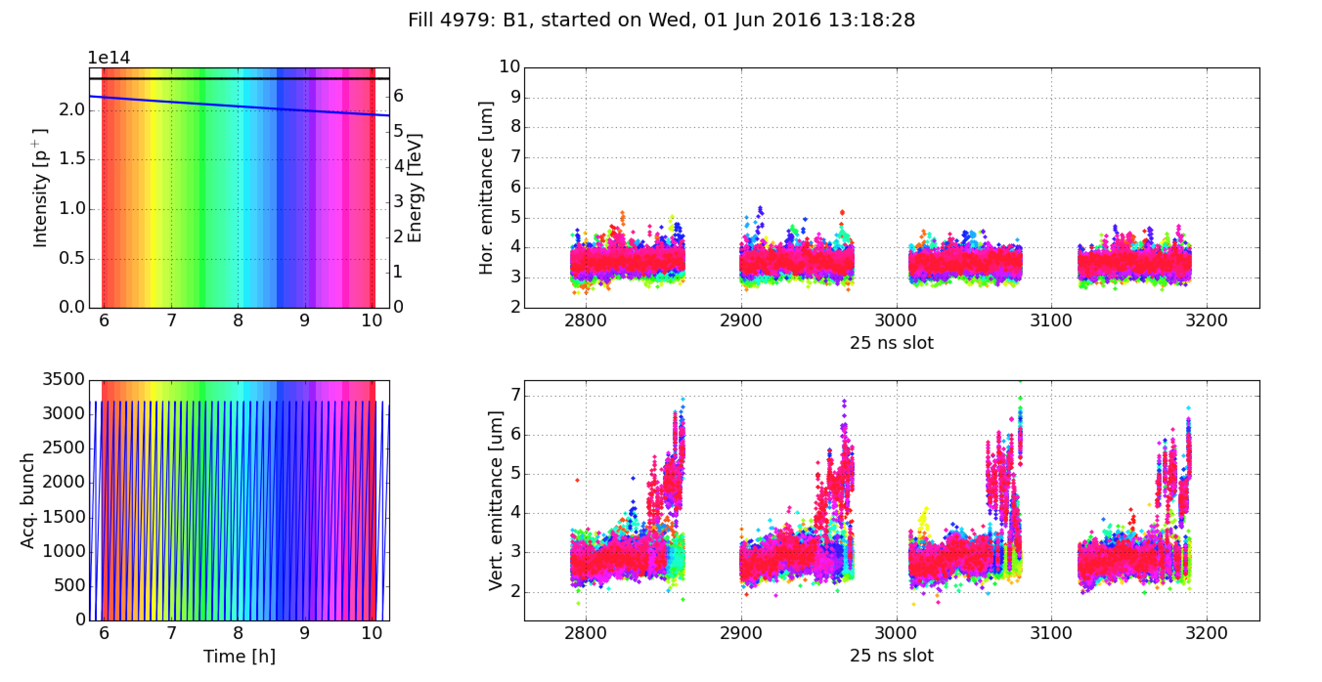
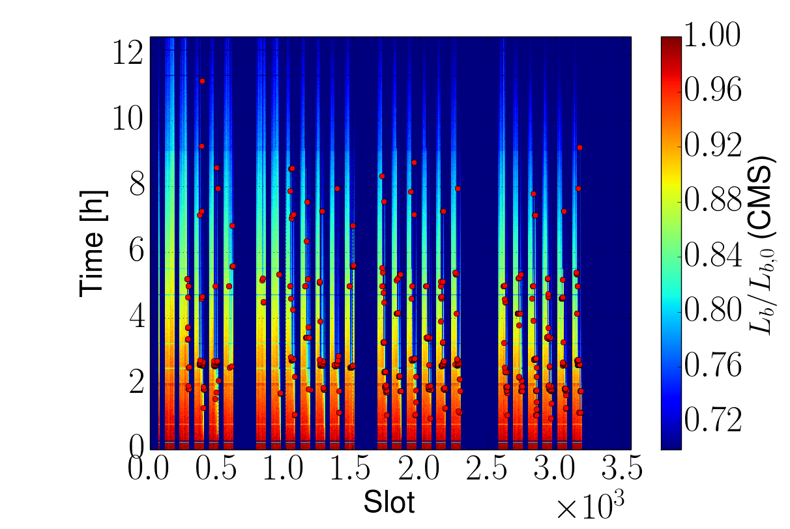
Coherent instabilities in stable beams
  Always in the vertical plane and affecting the last bunches of long trains
  Resulting in emittance growth but no beam loss
23/01/2017

Slide 21
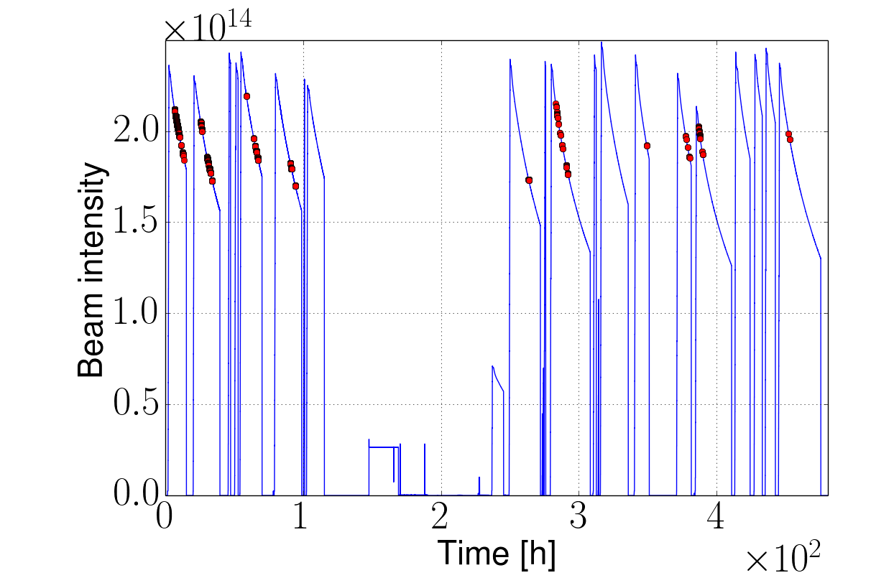
Coherent instabilities in stable beams
  Always in the vertical plane and affecting the last bunches of long trains
  Resulting in emittance growth but no beam loss
  Data analysis showed that most of instabilities occurred for bunch intensities between 0.7e11 and 1.1e11
23/01/2017

Slide 22
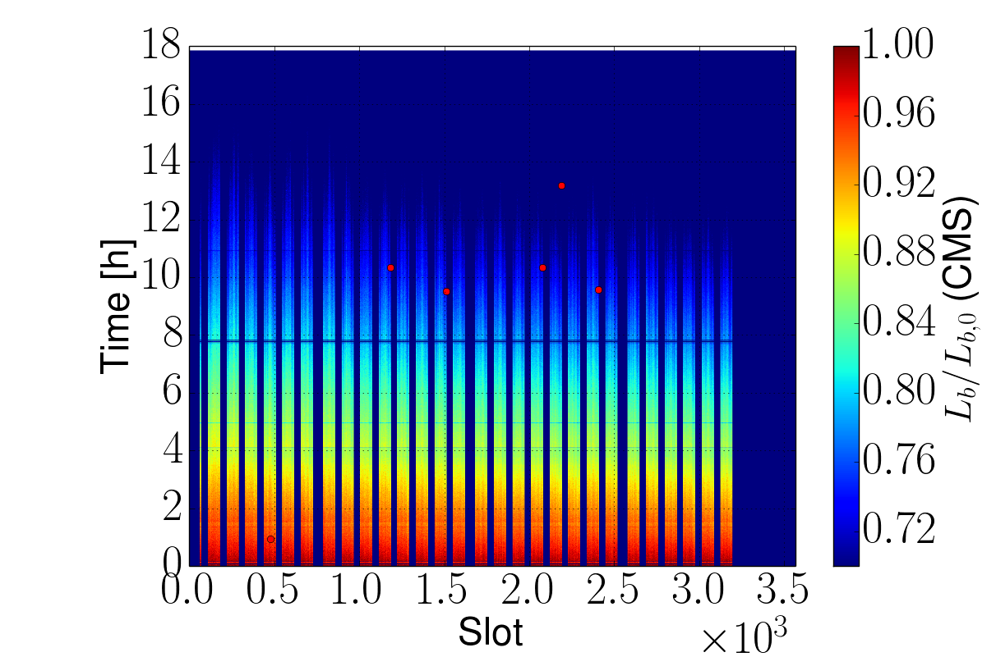
Coherent instabilities in stable beams
  Always in the vertical plane and affecting the last bunches of long trains
  Resulting in emittance growth but no beam loss
  Data analysis showed that most of instabilities occurred for bunch intensities between 0.7e11 and 1.1e11
Vertical chromaticity increased from 15 to 22 units after going in collision
  Blow-up mitigated, instability still sporadically detected on the bunch-by-bunch luminosity data
  Clear improvement on the number of unstable bunches
Fill 4964, Q’_{v} = 15
Fill 4988, Q’_{v} = 22
23/01/2017

Slide 23
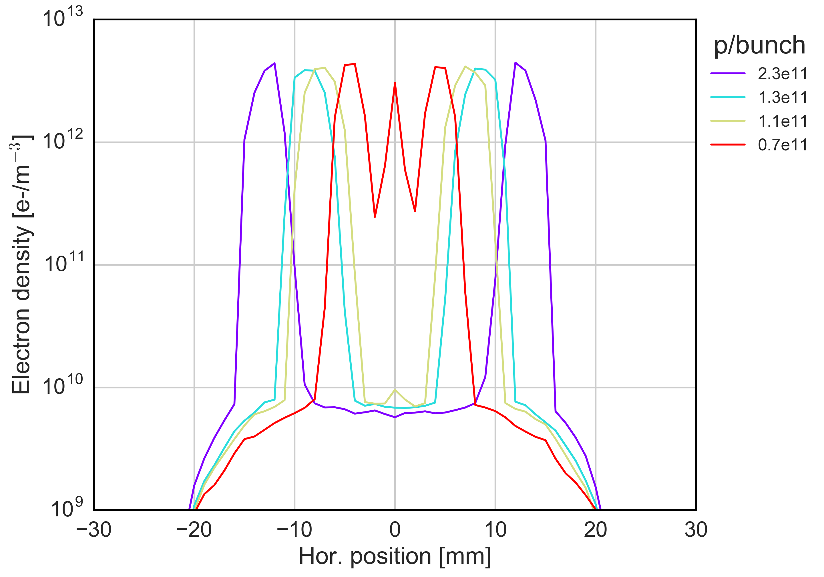
Coherent instabilities in stable beams → Simulations
  Electron cloud in the dipoles tends to form a central stripe for lower bunch intensities
23/01/2017

Slide 24
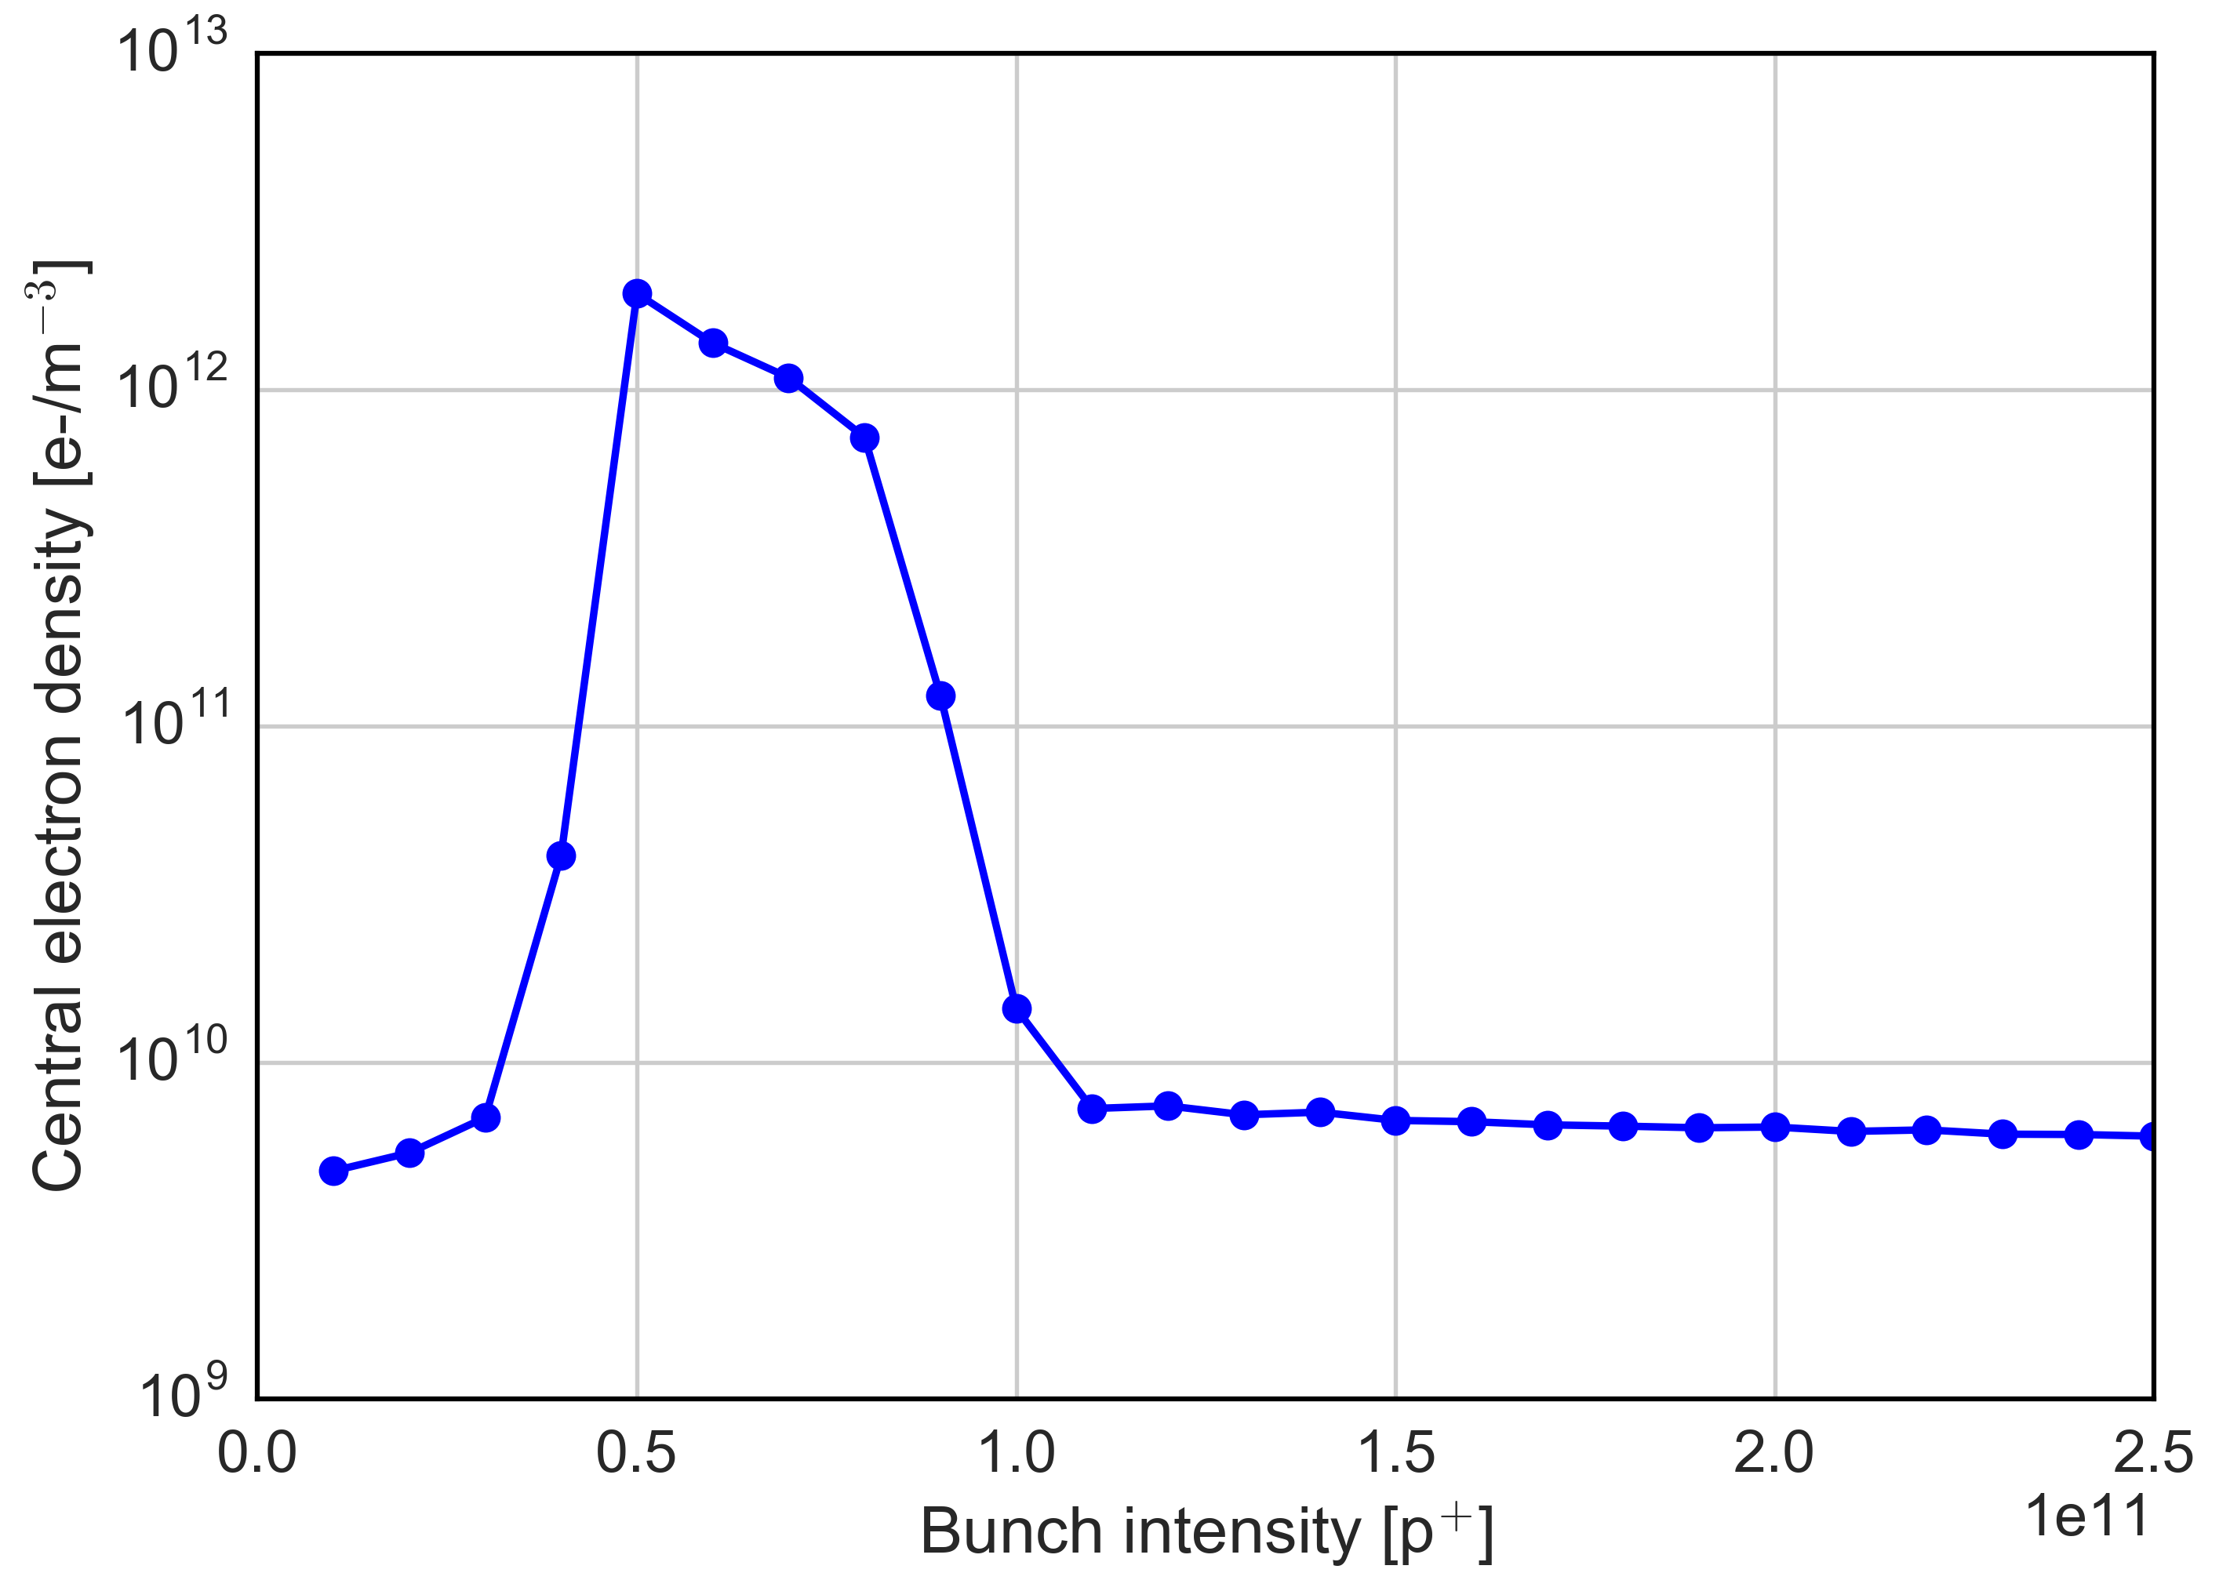
Coherent instabilities in stable beams → Simulations
  Electron cloud in the dipoles tends to form a central stripe for lower bunch intensities
  The central density threshold (5e11 m⁻³) is crossed when the bunch intensity decreases with Q’=15
  The threshold becomes much higher for Q’>20
Explanation also consistent with the disappearance of this phenomenon (due to scrubbing)
0.7e11
Instability threshold estimated by PyEC-PyHT simulations
2.3e11
HL-LHC
1.1e11
23/01/2017

Slide 25
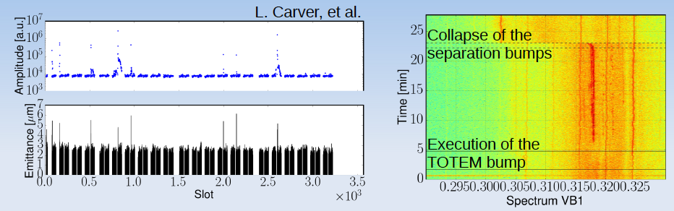
Coherent instabilities in Adjust mode
  Mainly affecting bunches at the head and tail of trains
  Coherent signal seems to appear in correlation with the TOTEM bump
  No observations in single beam
Still under study!
23/01/2017

Slide 26
Summary
Beam instabilities have been observed at the different LHC beam processes. Some lesson learnt:
  Narrow range of machine settings to keep beam stable along the cycle
  Instabilities occur if coupling exceeds a certain threshold (at different stages)
  Chromaticity settings are crucial along the cycle and can’t be relaxed
  Octupoles settings have to be adapted according to beam emittance
  Transverse damper indispensable to preserve beam stability all along the cycle
Sources of instability
  Electron cloud (with 25 ns beams) → tends to become better with scrubbing
  Machine impedance and loss of Landau damping
Main question is to gain confidence in the scaling with bunch intensity (both of electron cloud and instability thresholds based on the models)
Notes:
Injection speed, downtime

Slide 27
See you in Benevento on 18-22 September!
23/01/2017

