Slide 1
Impedance Mitigation Schemes and Beam Feedbacks – State of the Art and Trends
Alessandro Drago (INFN/LNF & Tor Vergata Univ.), Mauro Migliorati (La Sapienza Univ.),
Catia Milardi, Mikhail Zobov (INFN/LNF)
EuCARD-2 XBEAM Strategy Workshop
Universitat de Valencia
Colegio Mayor Rector Peset
13-17 February 2017

Slide 2
Summary
This talk presents some points of view under discussion by the authors. Due to the colloquial style in some slides repetitions are possible.
Large part of the comments are also based on the experience developed at DAFNE and, as consequence, the study is devoted mainly to lepton colliders.
The main topics are committed to lowering the vacuum chamber impedance and to evaluating mitigation techniques.
Feedback systems are presented both as active instability mitigation technique and as diagnostic tool.

Slide 3
A first point of view (MZ, CM)…

Slide 4
Advanced Accelerator Physics Studies @ DAFNE
Low impedance vacuum chamber components (using)
Sofisticated feedback systems (using, in constant evolution)
Wigglers with «wiggling» poles (using)
Parasitic crossings compensation with wires (used for FINUDA, KLOE)
Collisions with negative momentum compaction factor (tested experimentally)
e-Cloud clearing electrodes and solenoids (using)
Collisions with a very high crossing angle (proposal)
Strong RF focusing (proposal)
Crab Waist collision scheme (in operation)

Slide 5
Problems and Solutions
Rotation of IR quadrupoles
More bunches
Higher chromaticity
Higher lattice momentum compaction factor
Stronger CW sextupoles
Nonlinear dynamics optimization
Vacuum conditioning and beam scrabbing
Feedback noise improvement
....
Residual coupling
e-cloud effects
Microwave single bunch instability
TMCI single bunch instability
....

Slide 6
DAΦNE as a Test Bench for Future Colliders?
1. Test of all kinds of vacuum chamber components
under high current : impedance, power losses, functionality
2. Development of new feedback systems
3. e-Cloud studies: mitigations techniques, engineered surfaces etc.
4. Beam dynamics studies: X-Z beam-beam instabilty,...
5. New diagnostic devices
6. Students and personnel training
7. Other eventual proposals

Slide 7
A second point of view (MM)…

Slide 8
Improved Beam Stabilization (ARIES WP 6.4)
  Review existing strategies & methods for beam-impedance assessments and impedance models
  Propose and evaluate novel methods to reduce accelerator impedance
  Identify or develop strategies for electron-cloud mitigation at future accelerators
  Conceptual design of advanced beam feedback systems for future machines

Slide 9
  Review existing strategies & methods for beam-impedance assessments and impedance models
One issue is the beam pipe coating (NEG, TiN, other?)
For large accelerators the resistive wall impedance plays an important role in both longitudinal and transverse planes
What is the effect of the coating on the resistive wall impedance. Evaluation with codes. Importance of the thickness. Importance of the conductivity
Another issue related to a large machine is the following: nowadays great improvements have been reached in designing machine components with very low impedance, almost at the limit of numerical noise of electromagnetic codes. However for a large machine, generally a very high number of these devices are required, making critical the impedance evaluation

Slide 10
  Propose and evaluate novel methods to reduce accelerator impedance
Reduce the thickness of the coating
Use long tapers for any transition
Use smart design for vacuum chamber (e.g. similar to KEKB)

Slide 11
  Propose and evaluate novel methods to reduce accelerator impedance
Try to use novel ideas:
e.g. RF fingers
Alessandro Drago

Slide 12
  Identify or develop strategies for electron-cloud mitigation at future accelerators
Coating?
Proper beam filling pattern
…?
Alessandro Drago

Slide 13
  Conceptual design of advanced beam feedback systems for future machines
Q: Longitudinal single bunch instability: microwave … any idea for a possible feedback or action to increase the instability threshold?
Q: Transverse single bunch instability: transverse mode coupling. It there a possibility to develop a feedback system for short bunches (electrons)? [note: working on bunch slice]
Q: Why do we need new feedback design for coupled bunch instability?
A: For very large machines, even if the rise time of the instability is not critical, due to the large revolution time, the instability may occur in few turn, making necessary the use of novel concepts for distributed feedback …

Slide 14
Experimental results presented at Beam Instrumentation Workshop 2012

Slide 15


Mitigation and Control of Instabilities in DAFNE Positron Ring
TUPG001
A. Drago, D. Alesini, T. Demma, A. Gallo,
S. Guiducci, C. Milardi, P. Raimondi, M. Zobov
INFN-LNF, Frascati
2012 Beam Instrumentation Workshop (BIW12)
April 15-19, 2012 - Newport News, VA, USA

Slide 16
Abstract
The positron beam in the DAFNE e+e- collider has always been suffering from strong e-cloud instabilities.
In order to cope with them, several approaches have been adopted along the years: flexible and powerful bunch-by-bunch feedback systems, solenoids around the straight sections of the vacuum chamber and, in the last runs, e-cloud clearing electrodes inside the bending and wiggler magnets.
Classic diagnostics tools have been of course used to evaluate of the effectiveness of the adopted measures and the correct setup of the devices, in order to acquire the total beam current and the bunch-by-bunch currents, to plot in real time synchrotron and betatron instabilities, to verify the vertical beam size enlargement in collision and out of collision.
Besides, to evaluate the efficacy of the solenoids and of the clearing electrodes versus the instability speed, the more powerful tools have been the special diagnostics routines making use of the bunch-by-bunch feedback systems to quickly compute the growth rate instabilities in different beam conditions as well as bunch-by-bunch betatron tune spread.

Slide 17
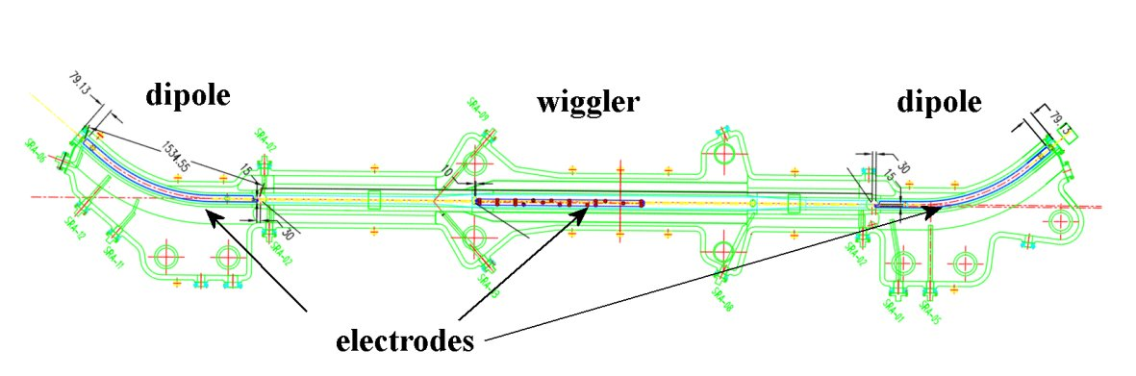
Metallic clearing electrodes have been designed to absorb the photo-electrons in the DAFNE positron ring. They have been inserted in the wiggler and bending magnet vacuum chambers and have been connected to external voltage generators.

Slide 18
A short description
The electrodes have been made in copper and have a distance of 0.5 mm from the vacuum pipe. This small distance has been chosen to reduce the beam coupling impedance of the devices. Special ceramic supports sustain the strips.
Analytical calculations and electromagnetic simulations have been done to estimate the power released from the beam to the electrodes. We expect a maximum temperature increase of the order of 100ºC with a 2A beam for the wiggler electrodes. This temperature increase has been considered acceptable since the electrodes have been heated up to this level without damage and also because it is in the range of operation of all the components (SHAPAL and feed-throughs).
The electrodes are connected to external generators and have been tested (with the beam) applying dc voltages of up to 250 V.
RF measurements have been done to precisely measure the resonant frequencies of the electrodes modes.

Slide 19
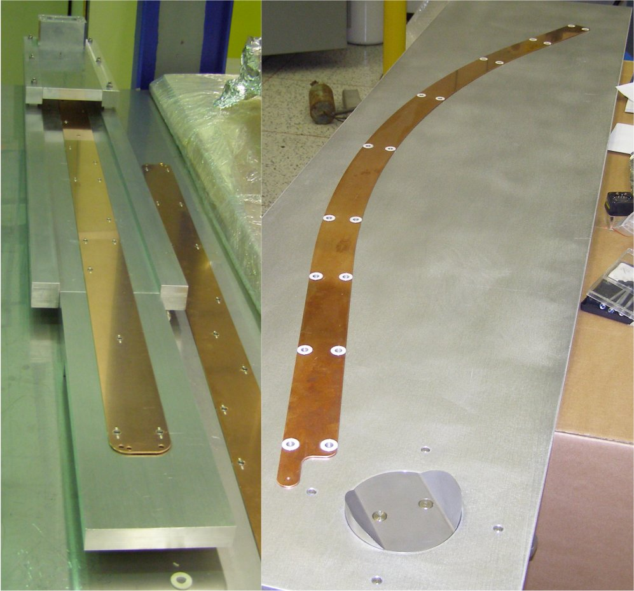
The electrodes before installation
The distance of the electrodes from the beam axis is 8 mm in the wigglers and 25 mm in the bending magnets.
In the wigglers
In the bending magnet

Slide 20
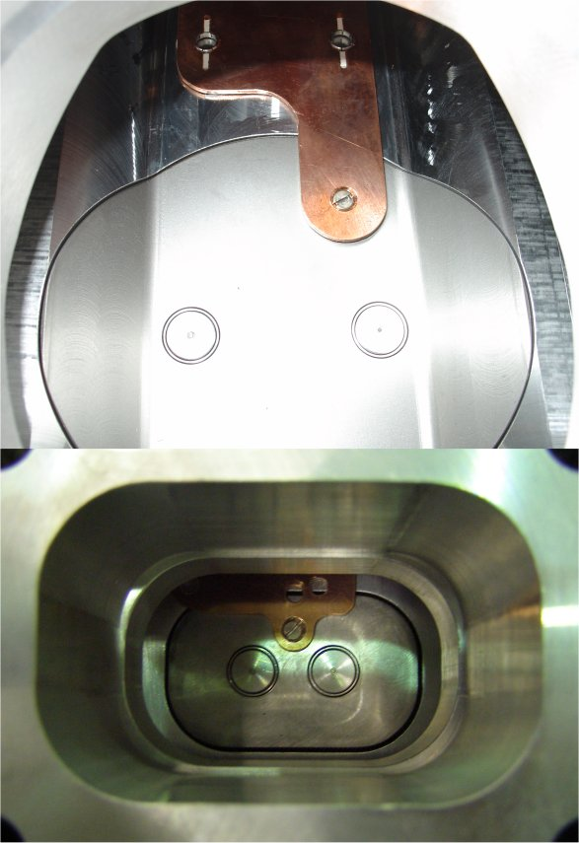
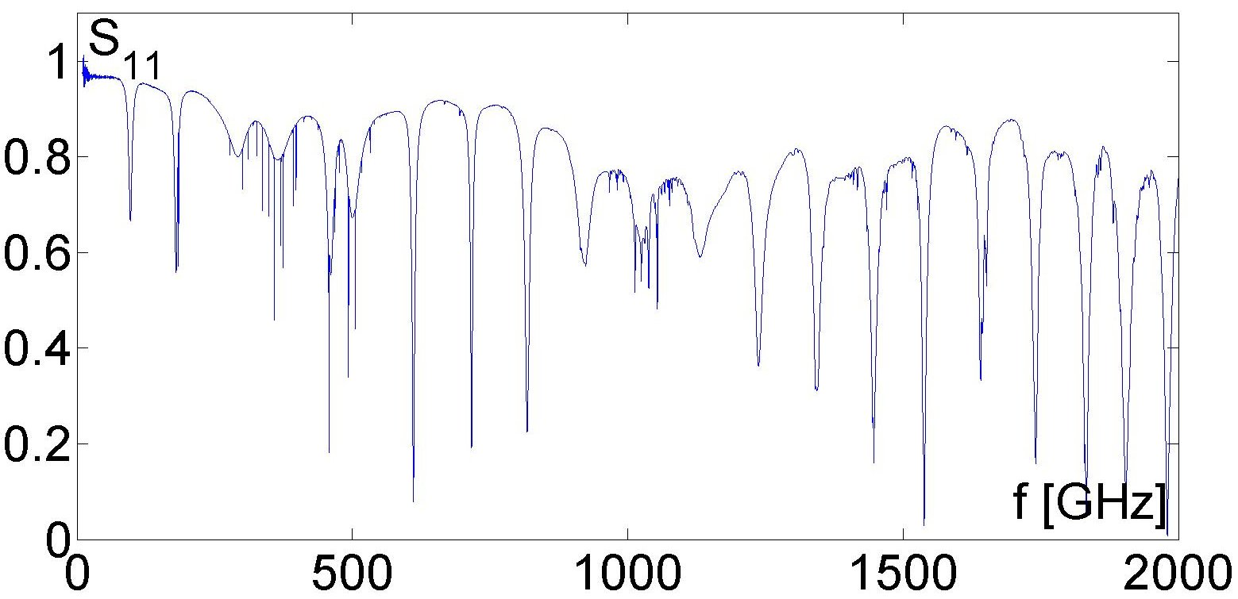
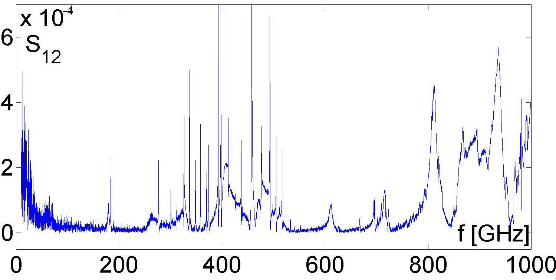
RF measurements with a network analyzer have been performed before and after the electrode installation. We have done two types of measurements: reflection coefficient at the feedthrough port and transmission coefficient between one BPM near to the strip and the feedthrough. In both cases it was possible to measure the resonant frequencies of the strip modes.
Detail of the electrode output connection

Slide 21
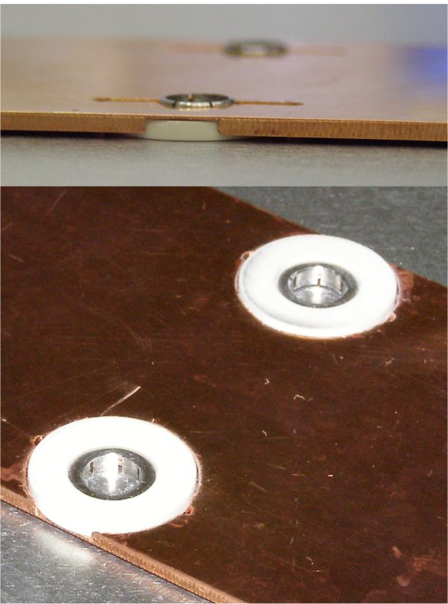
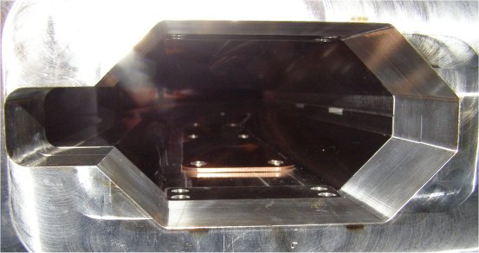
The dipole electrodes have a length of 1.4 or 1.6 m depending on the considered arc, while the wiggler ones are 1.4 m long. They have a width of 50 mm, thickness of 1.5 mm and their distance from the chamber is about 0.5 mm.
This distance is guaranteed by special ceramic supports made in SHAPAL and distributed along the electrodes.
Installed electrodes

Slide 22
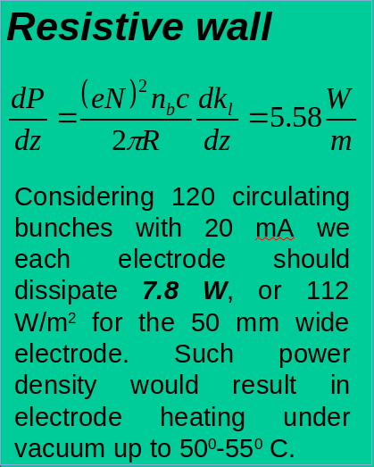
The electrode impedance consists of two contributions: a resistive wall impedance due to a finite conductivity of the electrode and a strip-line impedance created between the electrode and the vacuum chamber wall.

Slide 23
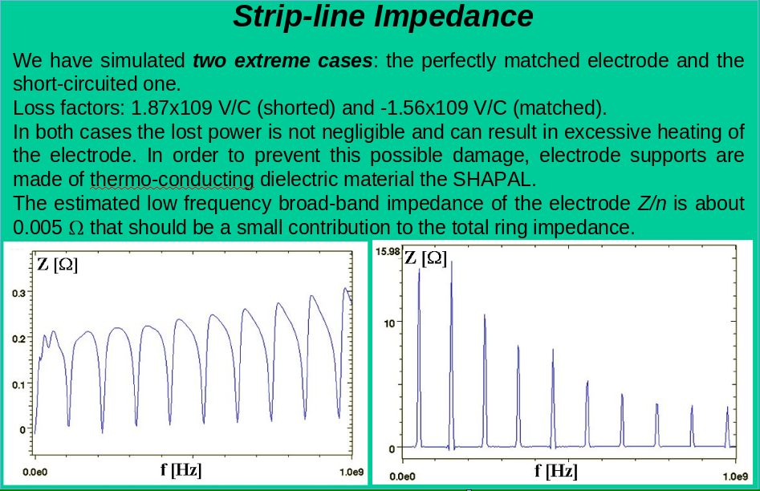

Slide 24
Performance analysis methods
Synchrotron light monitor (not bunch-by-bunch)
Spectrum analyzer (by using FFT)
Instability grow rates made by using bunch-bunch feedback (H/V) with its capability to stop damping actions
H/V tune spreads measured by using bunch-by-bunch feedback system only as recording tool (i.e. parasitically)

Slide 25
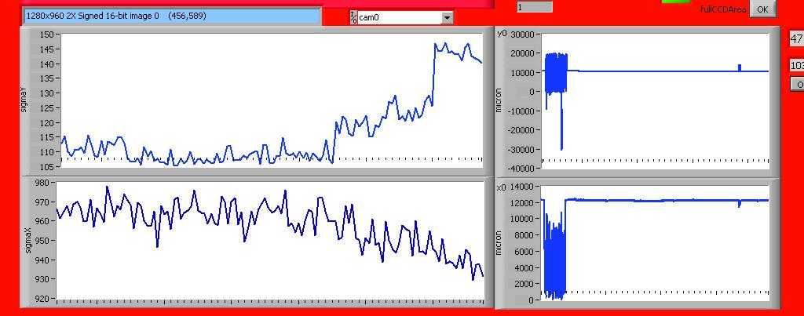
Turning off the electrodes, a vertical enlargement is evident on the SLM
Looking at the effect on the real positron beam, tests have been carried on by using the synchrotron light monitor, the FFT spectrum analyzer, and the bunch-by-bunch horizontal and vertical feedback systems.
12 on
10 on
8 on
All
off
5 on
3
on

Slide 26
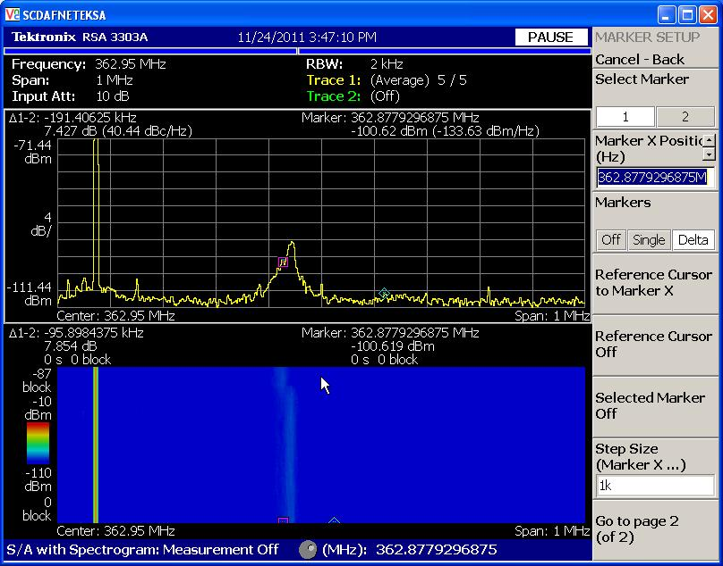
E+ horizontal tune shift goes up when (all) electrodes are turned off
550mA
e+ beam
current
Freq.diff=~20kHz
Tune difference=0,0065

Slide 27
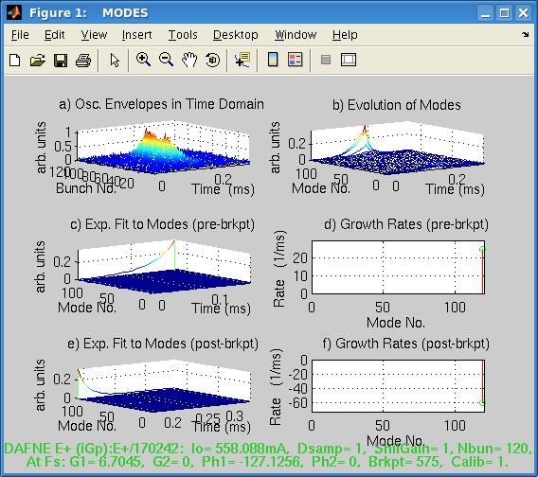
Growth rate measurements can be quickly done by using bunch-by-bunch feedback
In this picture
the horizontal
growth rate
measure is plotted showing a strong resistive wall
instability
(i.e. mode -1)

Slide 28
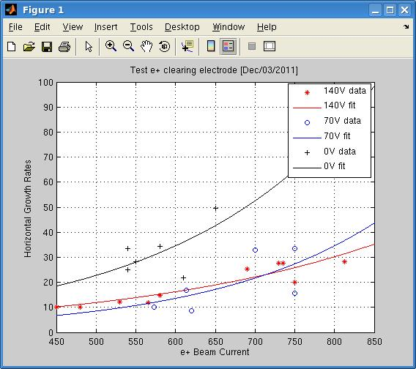
The e-cloud clearing electrodes are able to decrease the horizontal instability growth rates.
Voltages applied in this measure are 140V, 70V and 0V

Slide 29
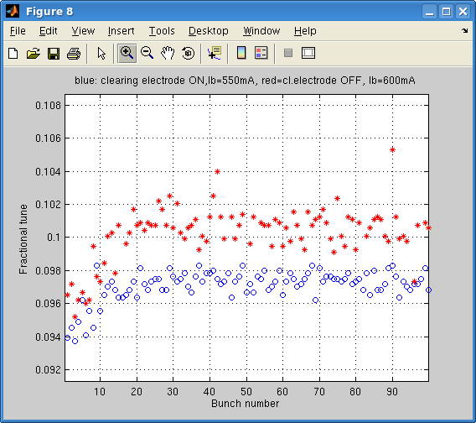
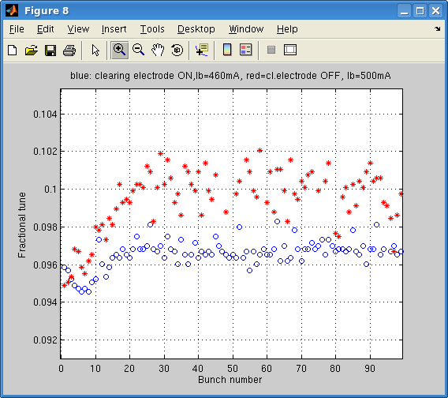
Horizontal bunch-by-bunch fractional tune measured by the feedback system
DAFNE e+ beam,
100 bunches, spaced by 2.7ns with 20 buckets gap
Turning off the electrodes in 4 wigglers and 2 dipoles, the horizontal tune goes up

Slide 30
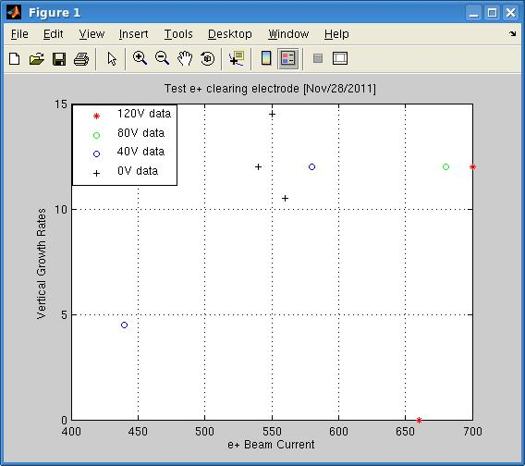
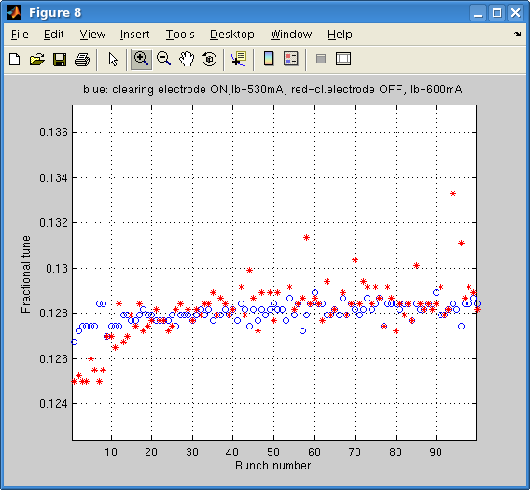
Vertical fractional tune spread (down) and vertical growth rates (right) measured by bunch-by-bunch feedback system
In the vertical plane
the spread has a different shape w.r.t.
the horizontal behavior
but, again, the electrodes are very effective !

Slide 31
BIW2012 poster conclusion
Metallic clearing electrodes have been inserted in the wiggler and bending magnet vacuum chambers of the DAFNE positron ring to fight the instability due to the e-cloud.
Electrode placement is complementary to solenoids that are allocated in the straight sections of the e+ ring.
- Experience with clearing electrodes in the DAFNE positron beam is largely positive: smaller vertical dimensions, less transverse tune spread and slower growth rates clearly indicates a good behavior of these devices.
Transverse bunch-by-bunch feedback systems with many diagnostics analysis tools are unique instruments to evaluate solenoid and e-cloud clearing electrode performances.

Slide 32
After 5 years
- We increased the applied voltage up to 500V
We tested both voltage polarity to evaluate the best performance
BAD NEWS: At the present we have only 2 clearing electrodes still working !!! (in the 2012 they were 12)
Failure reasons are not clear but we think that in the long term the heating of the beam have cooked the shapal insulators
Or the copper is damaged or bent
In conclusion loosing the initial dielectric features puts the striplines at ground
An evaluation should be carried on as soon as the vacuum chamber will be opened (for Siddartha run in 2018)

Slide 33
Future feedback schemes

Slide 34



Feedback Systems for FCC-ee
Alessandro Drago
INFN/LNF & Tor Vergata Rome University
eeFACT2016
58th ICFA Advanced Beam Dynamics workshop
On High Luminosity Circular e+e- Colliders
24-27/10/2016 Cockcroft Institute at Daresbury Laboratory, UK
[also FCC Week 2016, Rome]

Slide 35
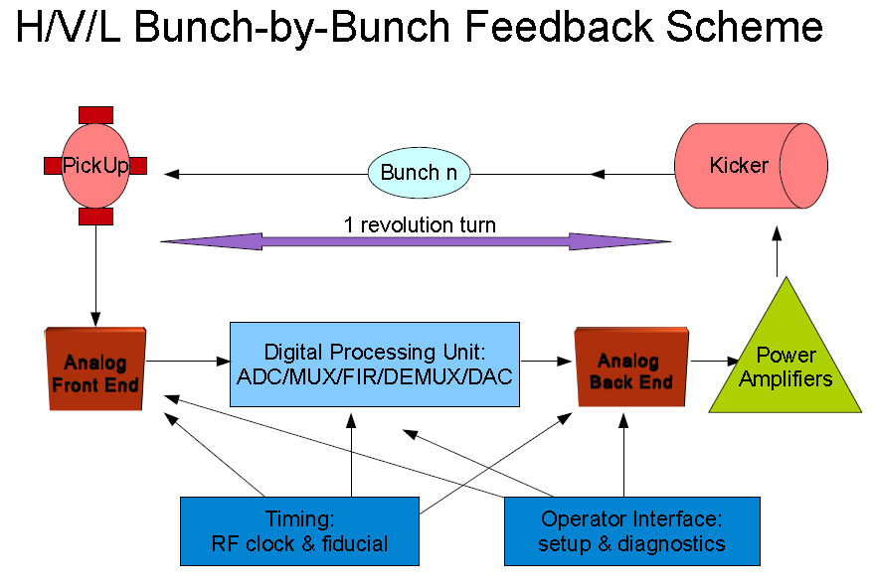

Slide 36
Critical points/1: high number of bunches
The number of colliding bunches is very high, furthermore the bunch-by-bunch feedback systems currently implemented do not use a lookup table to select the filled and the empty buckets, so they have to process all the buckets (= harmonic number = 133600) even if empty.
Summarizing for FCC-ee each feedback system has to be able to process 133600 / 5120 = 26 times the SuperKekB systems.
In conclusion the DPU design is not trivial, requesting an extremely high computing power that has to be implemented by custom modules based mostly on FPGA technology.
Luckily the FPGA technology is growing fast, so the goal is very high but feasible. Of course a new DPU design is necessary.

Slide 37
Critical points/2: feedback damping rate
It is an experimental result (tune >0.09) that a bunch-by-bunch feedback in e+/e- collider can damp the instabilities in about 10 revolution turns
This result should be checked at very low fractional tune.
This result is achieved by implementing a "standard" feedback system for relatively high beam currents (1-3A) by using a total of 1 or 2 kW power amplifiers.
Nevertheless in the year 2008 at DAFNE we did an experiment by implementing two feedback systems cooperating in the same plane (horizontal e+).
This was necessary for damping a very strong horizontal mode induced by e-clouds and because we were waiting for a stripline kicker with a better shunt impedance.

Slide 38
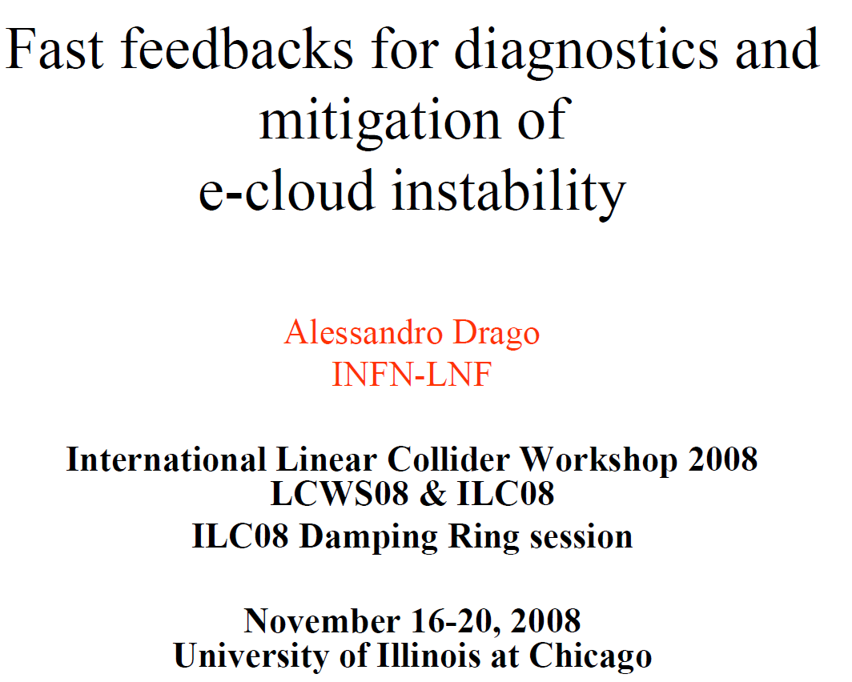
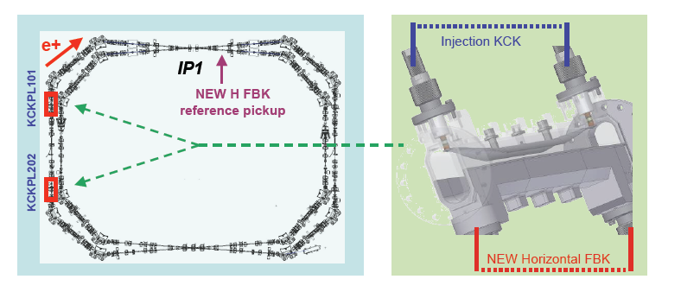
DAFNE, year 2008
New e+ Transverse Horizontal Feedback
The damping times of the two feedback's add up linearly
Damping time measured:
~100 ms-1 (1 FBKs) ➔ fb damps in 30 revolution periods (~10 us)
~200 ms-1 (2 FBKs) ➔ fb damps in 15 revolution periods (~ 5 us)
The power of the H FBK has been doubled

Slide 39
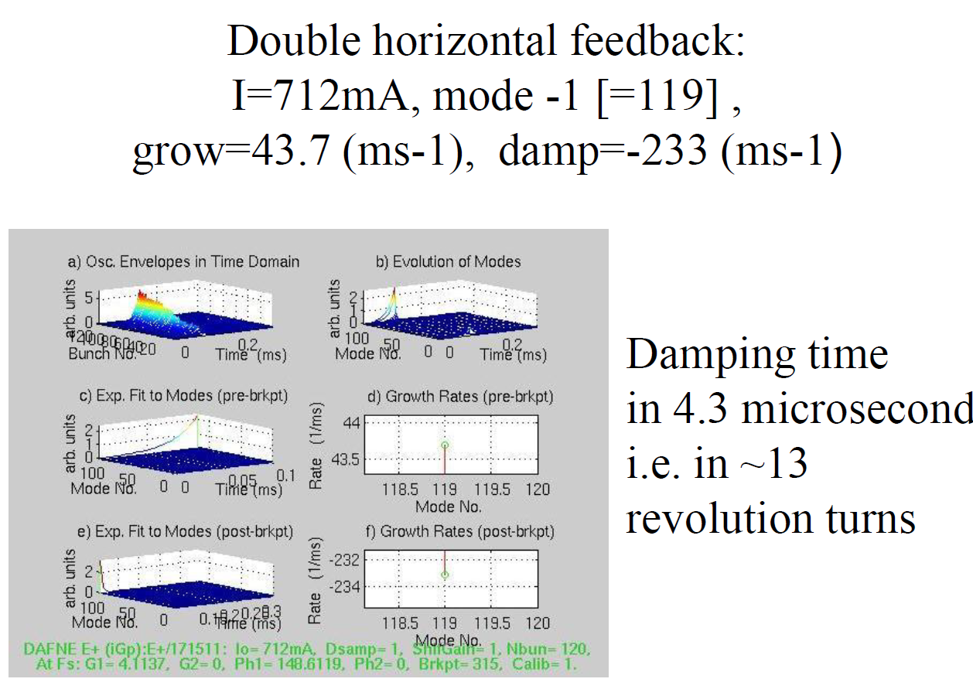
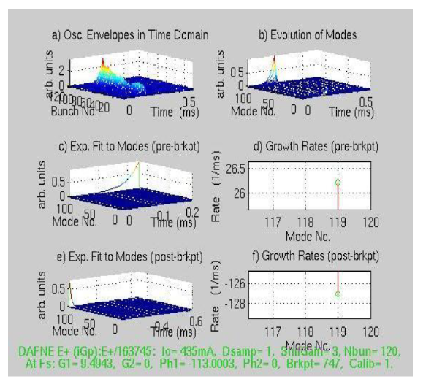

Single horizontal feedback
I=560mA, mode -1 [=119],
Grow = 34.5 ms-1,
Damp = -127 ms-1
Single horizontal feedback
I=560mA, mode -1 [=119],
grow=34.5 ms-1, damp=-127 ms-1
Note: in DAFNE, the
mode 119=-1 is the
Mode of the resistive
wall instability

Slide 40
Comment to the 2008 Dafne experiment
Two feedback systems in the same ring and damping plane cooperate perfectly without loss of power.
Having more kickers placed in different parts of the ring asks for a complete duplicate of the feedback system because both timing and phase response would be different.
The inverse damping time scales about linearly versus number of feedback systems having the same power.
Note that in the test the fractional tune is 0.10
In the previous case we used 2x250W amplifiers for each feedback. After implementing the new kicker with a much better shunt impedance, there was no more need of the second system.

Slide 41
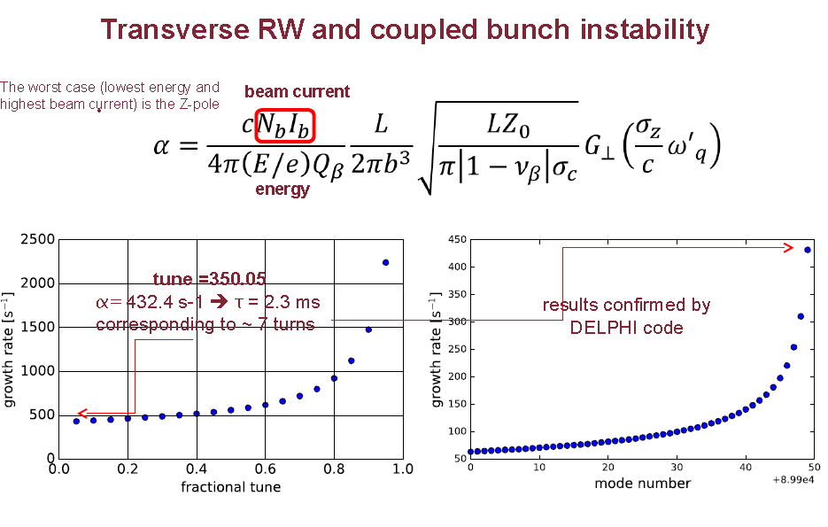
From M.Migliorati talk

Slide 42
Solution: multiple and distributed feedback stations
Considering a damping time of 10 turns for each feedback system (feasibility demonstrated in other colliders), it will be necessary to implement more feedback stations, most likely between 4 and 6.
Drawback: more kickers and pickups increase the ring impedance.
Other drawback: more complicated timing and setup operations.
Advantage: correction kick distributed along the ring.
Other advantage: by implementing this strategy it could be possible to achieve the theorical damping limit of 1 revolution turn installing more feedback stations.
Looking at the feedback scheme, it is clear that a damping rate faster than 1 turn is not possible because the correction kick is applied after the acquiring of the pickup signal with 1 turn delay.

Slide 43
Q&A
Question: why do not implement only one feedback with a very high gain and more power amplifiers to have a faster damping time ?
Answer: because the noise entering from the pickup cannot be filtered completely. Increasing gain and power it makes an enlargement effect of the bunches (very evident in the vertical plane) and/or feedback performance saturation.

Slide 44
1 Feedback systems (1 stations)
Foreseen damping rate: 10 turns
FCC-ee main ring
Kicker1
Station1
PU1

Slide 45
4 Feedback systems (4 stations)
Foreseen damping rate: 2.5 turns
FCC-ee main ring
Kicker1
PU4
Station1
Station4
PU1
Kicker4
PU3
Kicker2
Station 3
Station2
Kicker3
PU2

Slide 46
Critical (?) point/3: ring lenght
Of course the ring lenght is a critical point to manage the feedback in terms of timing and controlling the correct performance of the system
Nevertheless the ring lenght is also a very interesting opportunity to build "feeding forward" systems, short, that could produce damping rate faster than 1 revolution turn.
The "feeding forward" design will change a bit the usual scheme but not so much. The phase response will be controlled by individual bunch FIR filter inside the DPU in this case too.
The implementation would be a big challenge from a technological point of view: it will be necessary to send the correction signal in such a way to arrive to the kicker location before the arrival of the bunch to be corrected.

Slide 47
1 "Feeding forward" system (2 stations)
Foreseen damping rate: 2.5 turns
FCC-ee main ring
Station1
PU1
NOTE: the DPU
insertion delay is
about 400-600 ns
arc=25Km
Chord=22.5 Km
Chord is 8.25 μs shorter
than arc going at light speed
Kicker1
Station2
Beam runs counterclockwise

Slide 48
4 "Feeding forward" systems (4 stations)
Foreseen damping rate: 0.625 turns
FCC-ee main ring
kicker4
PU4
Station1
Station4
PU1
Kicker3
NOTE: the DPU
insertion delay is
about 400-600 ns
arc=25Km
Chord=22.5 Km
Chord is 8.25 μs shorter
than arc going at light speed
PU3
Kicker1
Station 3
Station2
Kicker2
PU2
Beam runs counterclockwise

Slide 49
eeFACT 2016 talk Conclusion
For FCC-ee the feedback systems can be based on the designs developed for other previous e+/e- colliders (PEP-II, KEK, DAFNE, SuperB, SuperKekB).
Same DPU for longitudinal and transverse systems, different analog parts and kicker.
A DPU managing more than 100k separate bunch signals is feasible but not trivial and it requests a big effort for (re)designing the system in a compact way.
By implementing multiple cooperative feedback systems and maintaing the "traditional" design scheme it will be possible to damp up to 1 revolution turn, if necessary.
Damping in less that 1 revolution turn is possible only changing the usual feedback strategy and implementing an innovative bunch-by-bunch "feeding forward" system.
This new approach can be implemented because of course a chord is shorter than the arc and this makes possible to compensate the DPU insertion delay (400-600ns).
A "feeding forward" system, very challenging to implement, asks for strong tecnological efforts to modify (partially) the DPU and to find an extremely fast data trasmission method for distances in the range of 22-32 Km.

Slide 50
Final comments
What we could propose for future studies?
First of all: models for impedance, for e-clouds, for beam-beam and for feedback performance can be developed or improved
Can it be possible to plan new experiments?
Where? As lepton collider test, DAFNE and KEK are available? For example I’m going to implement again the double feedback scheme in 2019 Dafne runs
Most likely we could carry on experiments and measurements going in depth with the new models [see Roberto Cimino work at DAFNE beamlines]
But…note that DAFNE has a very tight schedule to collect integrated luminosity for KLOE within March 2018 and there is only very little time for MD

