Slide 1

On Cost of Future Colliders and Options/Preemptive Measures
Vladimir Shiltsev
Fermilab *, Batavia, IL , USA
Accelerator Physics Center
February 15, 2016
*FRA, LLC operates Fermilab under contract No. DE-AC02-07CH11359 with the U.S. DOE

Slide 2
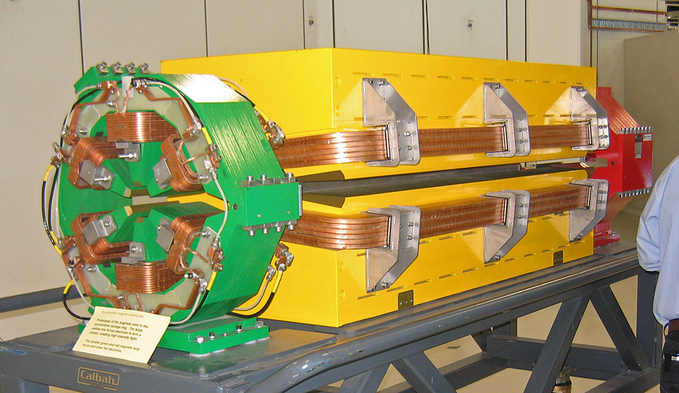
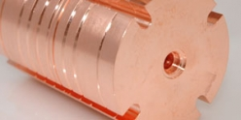
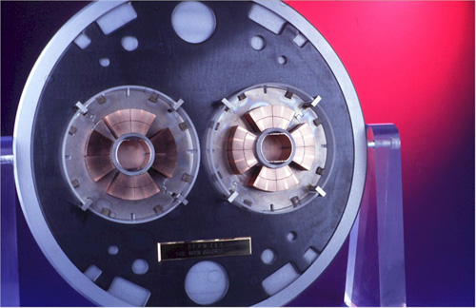
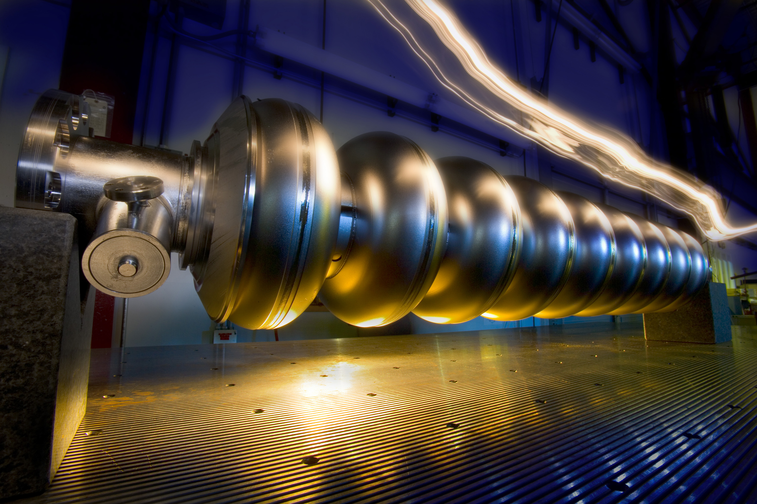
Four “Feasible” Technologies
Normal Conducting Magnets
Normal Conducting RF
SC magnets
SC RF
… in addition to “traditional” technologies of tunneling, electric power and site infrastructures, etc …

Slide 3
Analysis:
2014 JINST 9 T07002
17 “Data Points” - Costs of Big Accelerators:
Actually built:
  RHIC, MI, SNS, LHC
Under construction:
  XFEL, FAIR, ESS
Not built but costed:
  SSC, VLHC, NLC
  ILC, TESLA, CLIC, Project-X, Beta-Beam, SPL, ν-Factory
V.Shiltsev, A phenomenological cost model for high energy particle accelerators
Wide range :
  4 orders in Energy, >1 order in Power, >2 orders in Length
  Almost 2 orders in cost
    (normalized to US TPC)

Slide 4

αβγ - Cost Estimate Model:
Cost(TPC) = α L^{1/2} + β E^{1/2} + γ P^{1/2}
±33% estimate, for a “green field” accelerators
“US-Accounting” = TPC ! ( ~ 2 ×European Accounting )
Coefficients ( units: 10 km for L, 1 TeV for E, 100 MW for P )
  α≈ 2B$/sqrt(L/10 km)
  β≈ 10B$/sqrt(E/TeV) for SC/NC RF
  β≈ 2B$ /sqrt(E/TeV) for SC magnets
  β≈ 1B$ /sqrt(E/TeV) for NC magnets
  γ≈ 2B$/sqrt(P/100 MW)

Slide 5
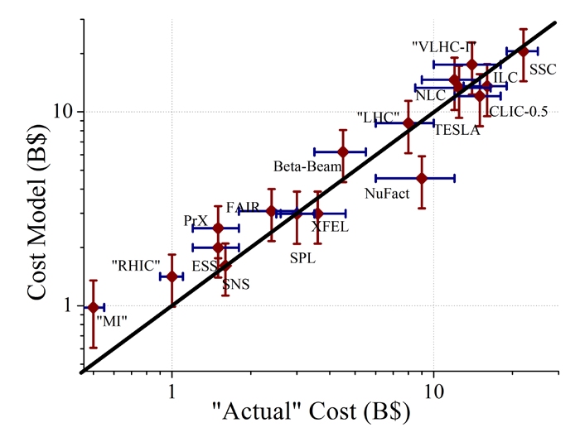
Total Cost vs Model (Log-Log)
The αβγ-model is good to +-30%
αβγ -

Slide 6
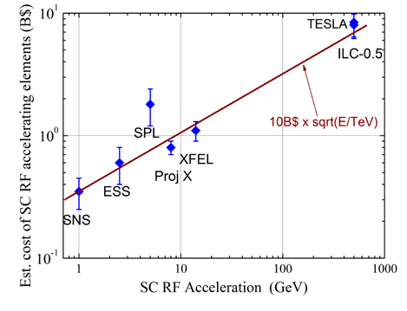
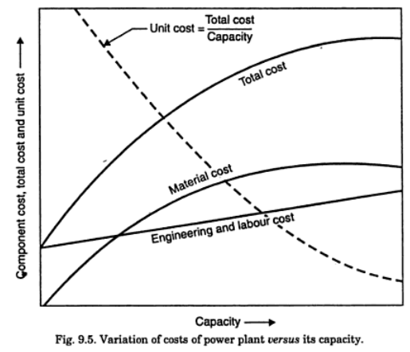
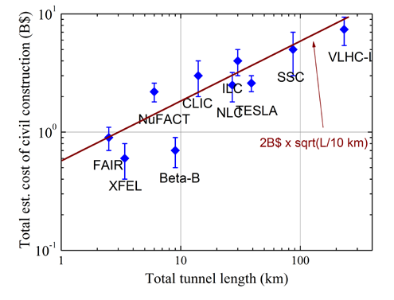

Illustrations
Comment:
Sqrt-functions are quite accurate over wide range because such dependence well approximates the “initial cost” – effect :

Slide 7



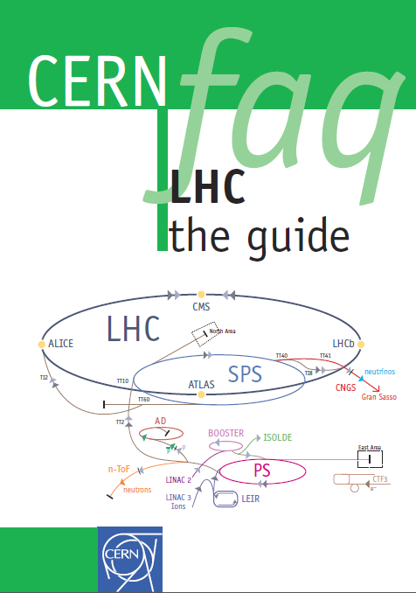
Take LHC as an Example:
αβγ – Model:
  40 km of tunnels
  14 TeV c.o.m SC magnets
  ~150 MW of site power
TOTAL PROJECT COST : 14B$ ± 4.5B$
CERN LHC Factbook (2009):
  6.5 BCHF, incl. 5 BCHF for accelerator
  (European Accounting)
  x 2 to US TPC → 10 BCHF=10B$
  Cost of existing injector complex ~30-40% 3-4 B$
  TPC : ~13-14B$
  (of which CERN paid 10 over ~8 yrs)
2009-003

Slide 8
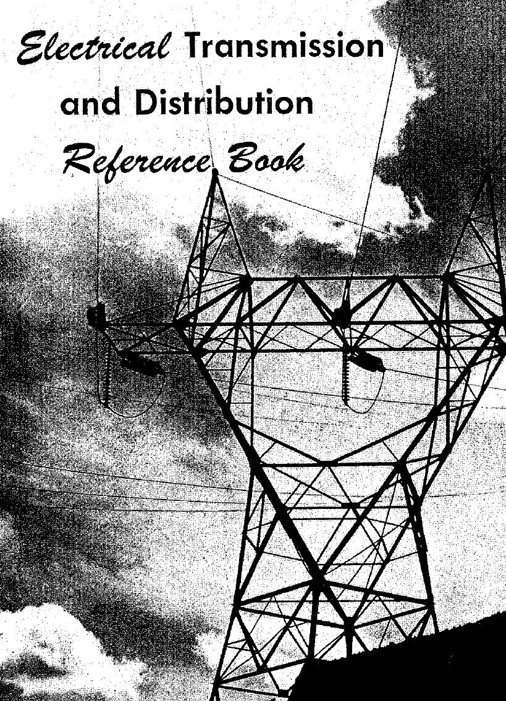
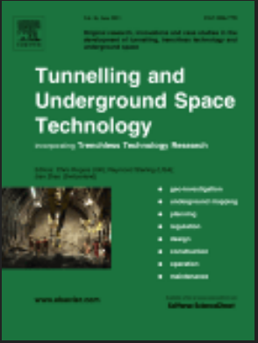
Important Note: Two out of Three Factors in the Model are Inde- pendent from Our R&D Efforts – Tunneling, Power Infrastructure
Do not expect Cost ~
(L×D²) = meter^3 !
Data on 270 tunnels world wide
Cost ~Power ^(1/2)
Cost ~ L^(0.4-1) D^(0.6-1.5)

Slide 9
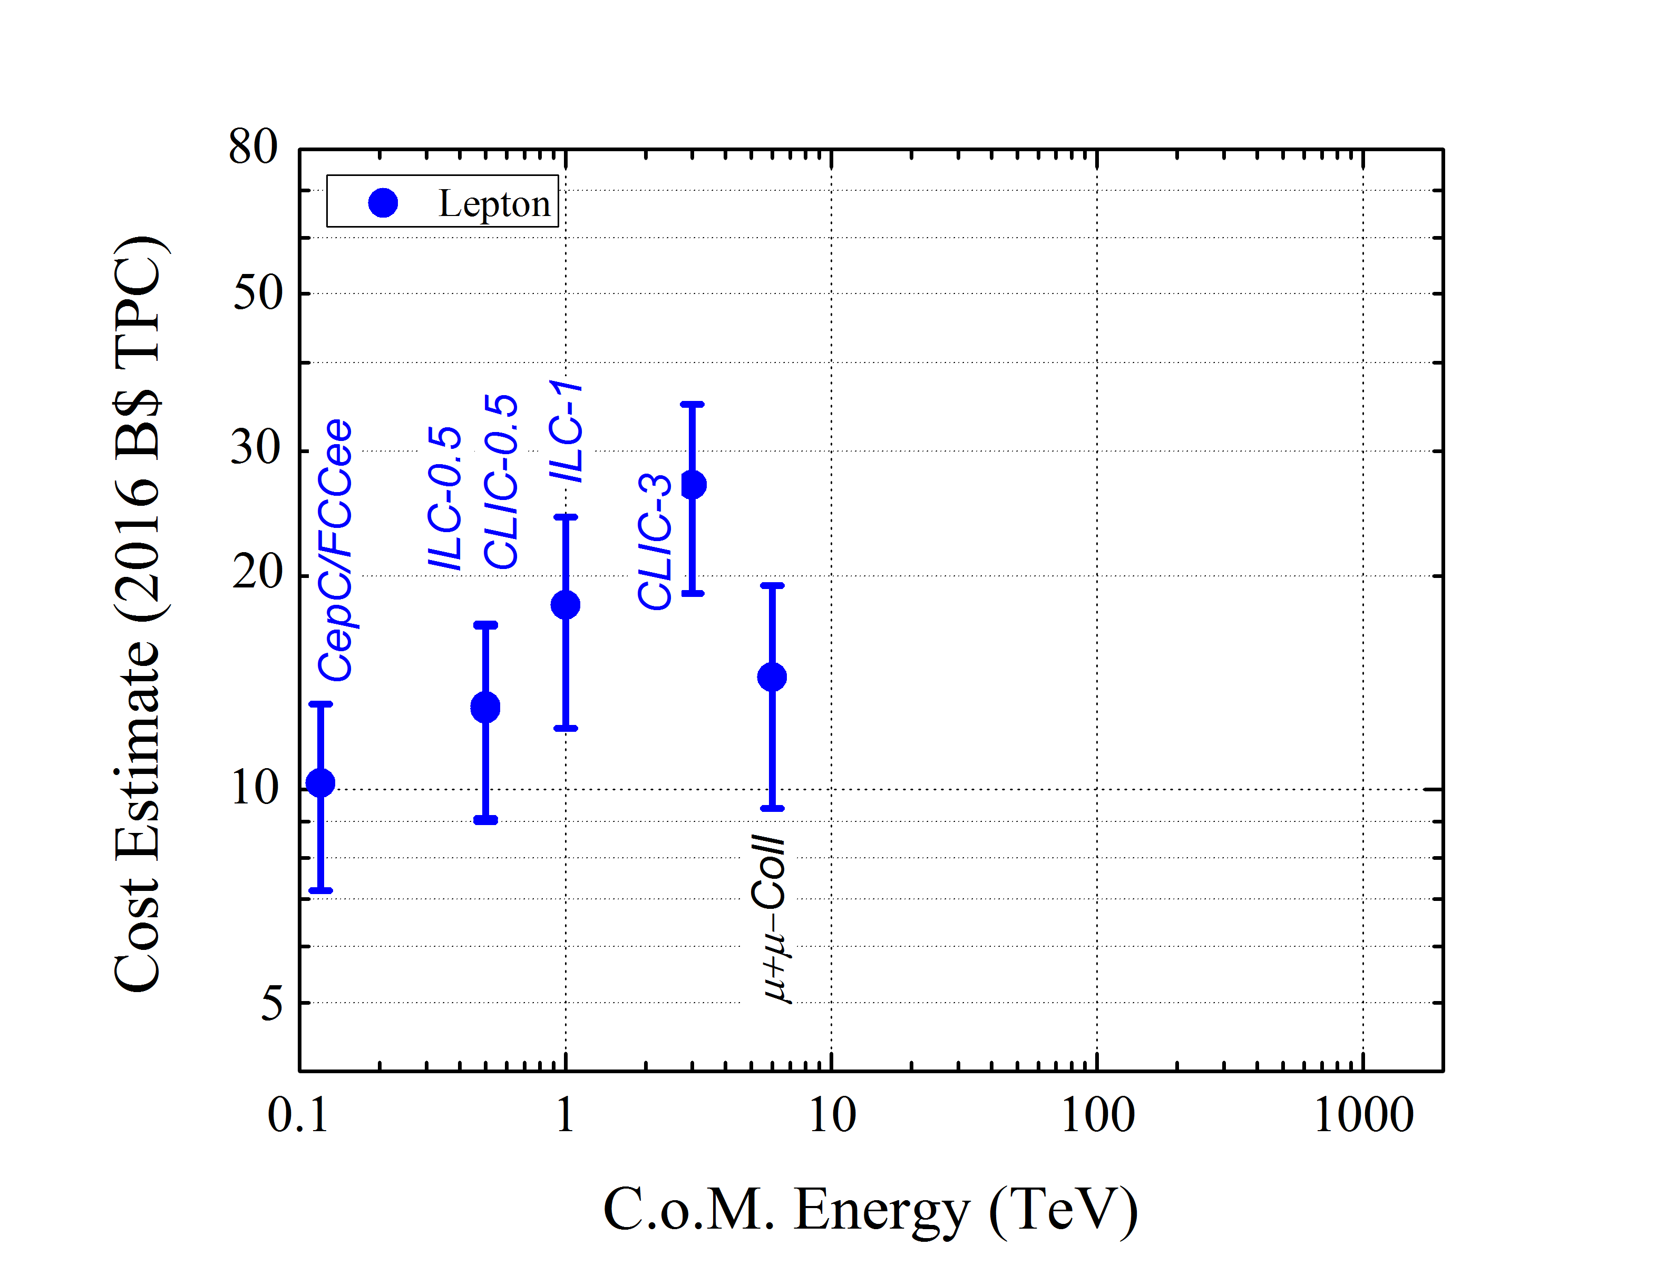
LHC reference

Slide 10
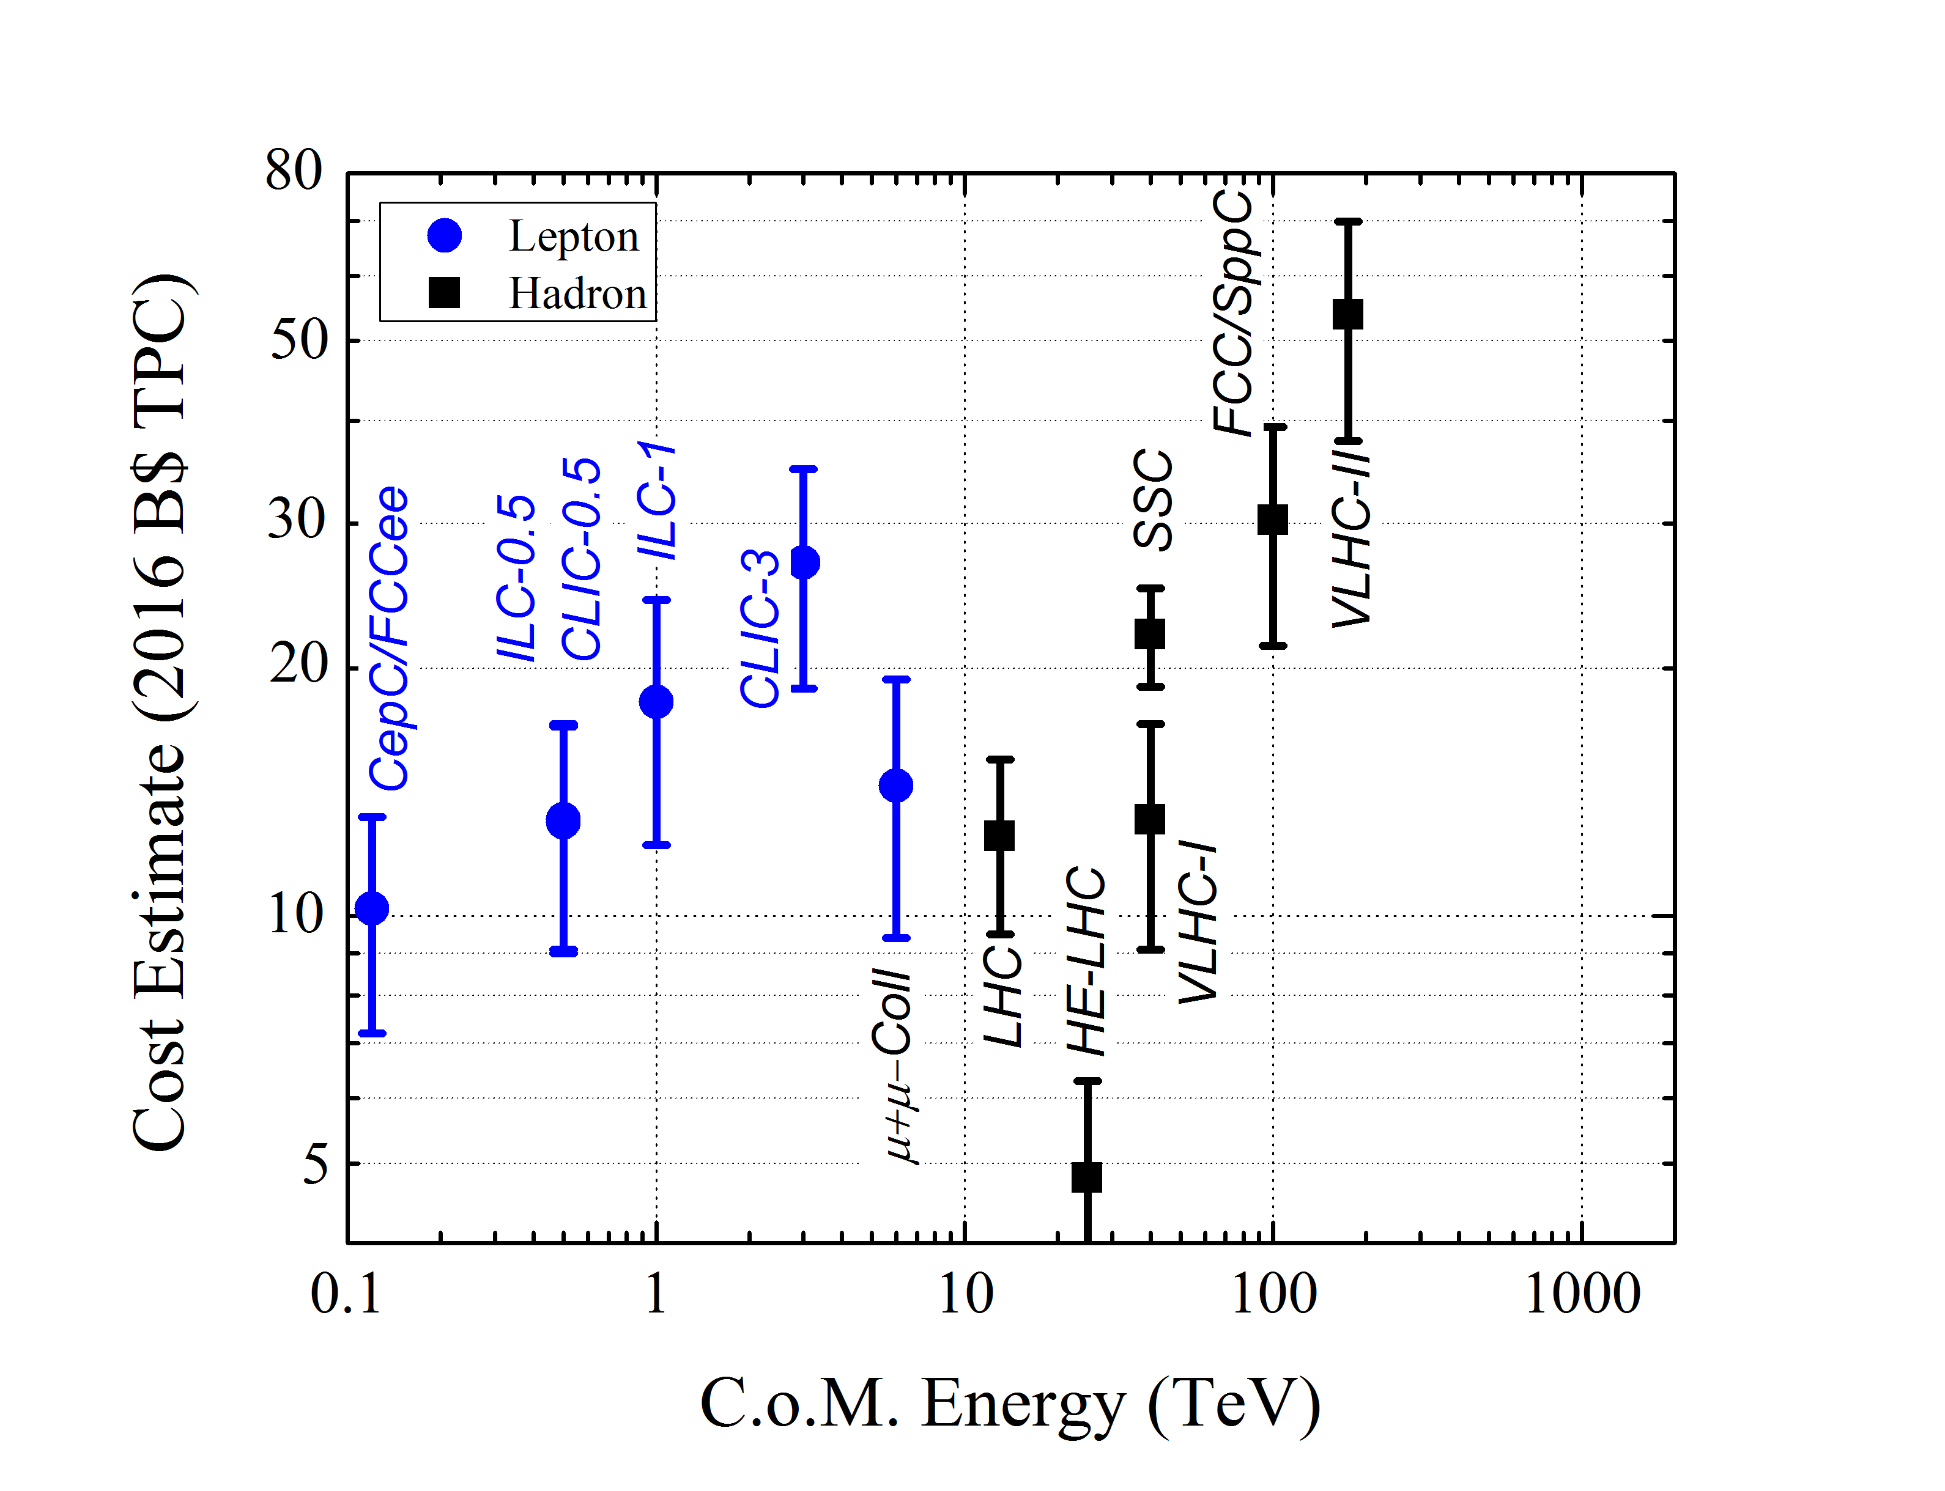
Option 1: re-use
LHC, inj, infrastr.

Slide 11
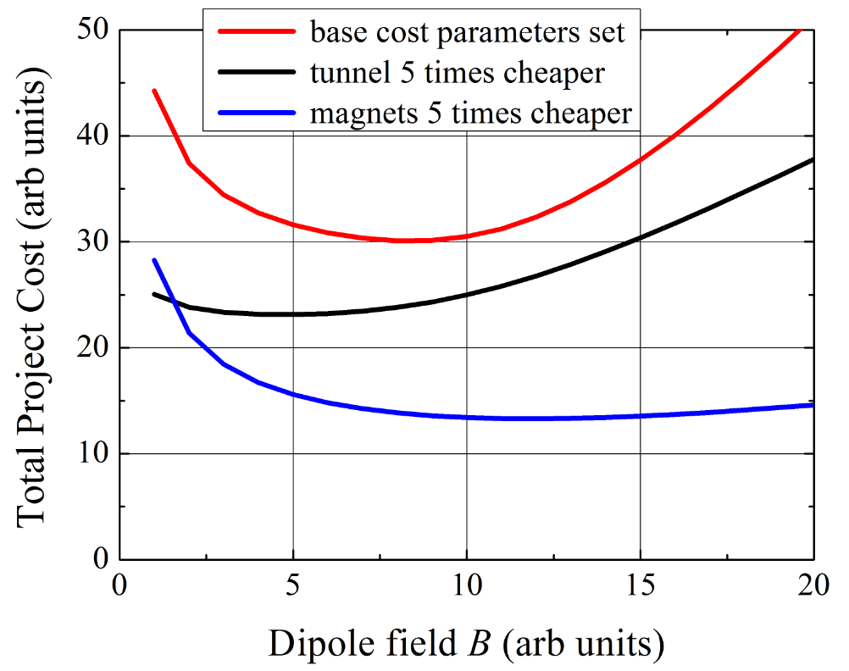
100 TeV pp : Qualitative Cost Dependencies
Option 2 : Develop Technology to Lower Cost
* for illustration purposes only

Slide 12
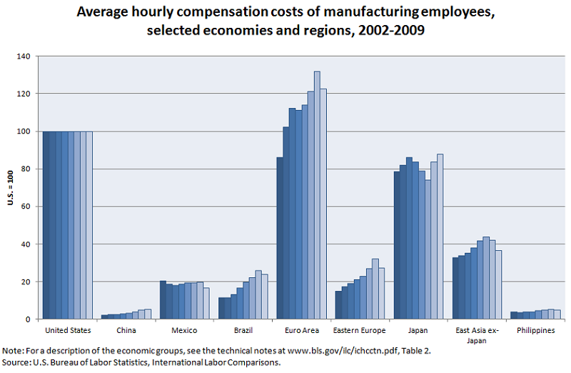
Option 3: “Move to China !”

Slide 13
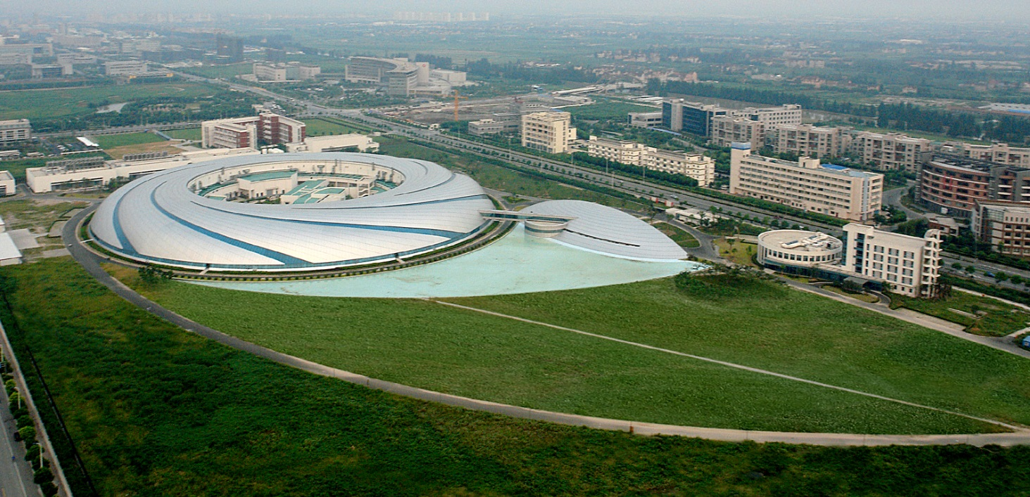
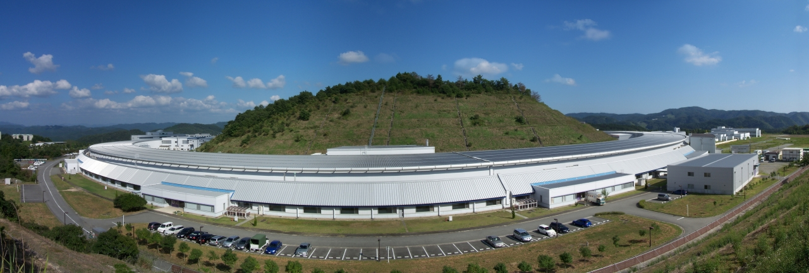
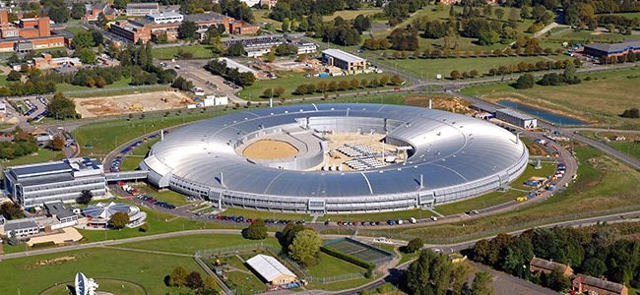
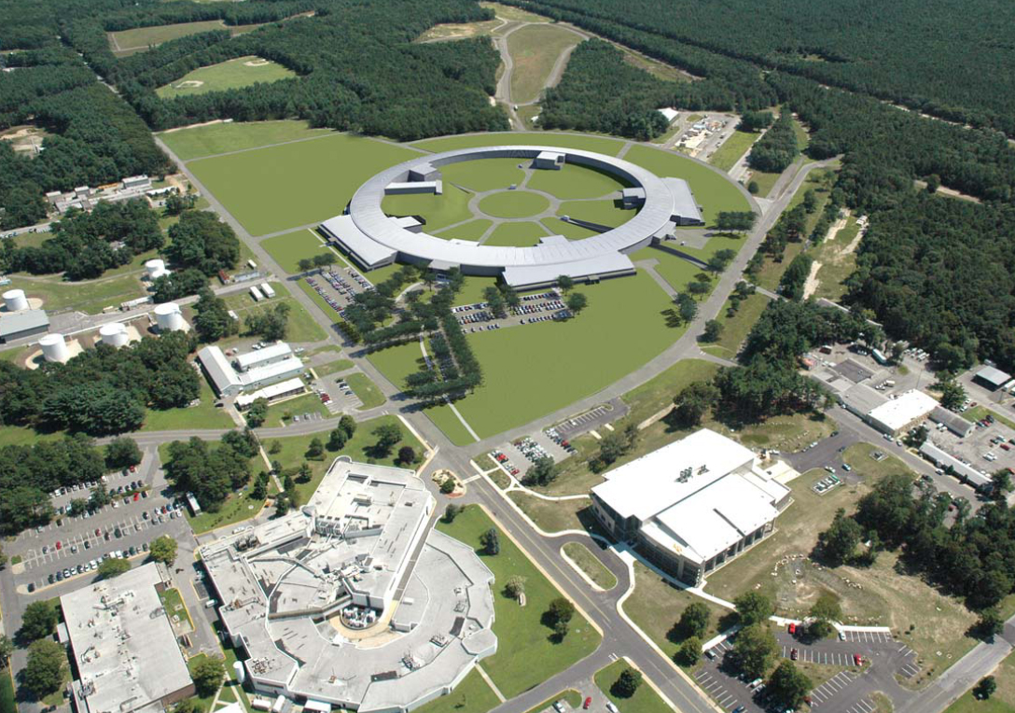
SSRF Spring-8 Diamond NSLSII
China Japan UK USA
432 m
3.5 GeV
1.2B RMB 2007
1436 m
8 GeV
11 BY
1997
562 m
3 GeV
383 M £
2007
792 m
3 GeV
912 M$
2015
Account infl’n, convert to USD and scale to sqrt(1 km):
350 M$ 772 M$ 1040 M$ 1024 M$

Slide 14
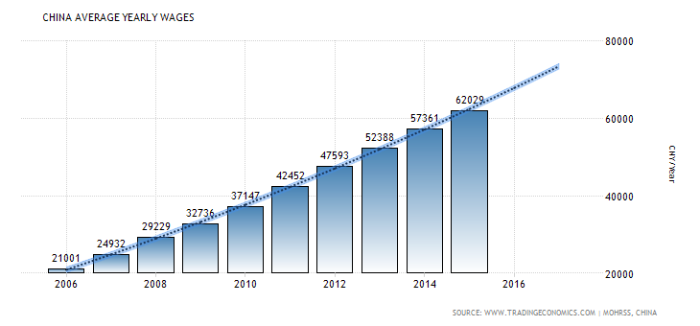
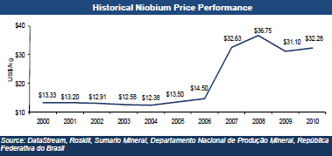
“Move to China !” - Caveats

Slide 15
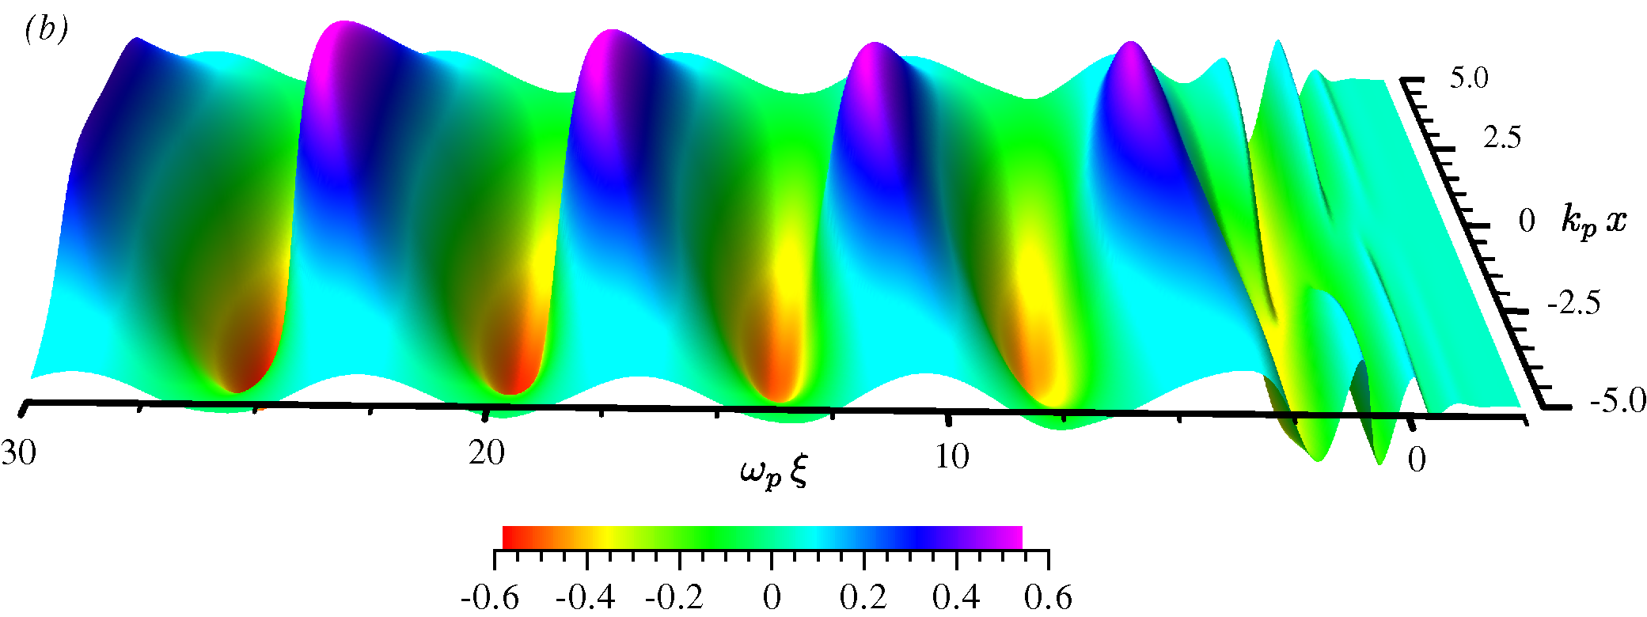
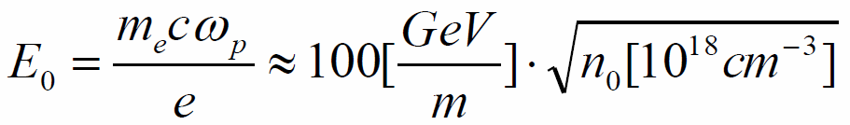
Option 4: New Technology- Plasma
Idea- Tajima & Dawson, Phys. Rev. Lett. (1979)
Plasma wave: electron density perturbation
Laser/beam pulse ~ λ_{p}/c
Option A:
Short intense e-/e+/p bunch
Few 10¹⁶cm⁻³, 6 GV/m over 0.3m
Option B:
Short intense laser pulse
~10¹⁸cm⁻³, 50 GV/m over 0.1m
First looks into “Plasma-Collider”: staging kills ! <E>~2 GV/m,ε

Slide 16
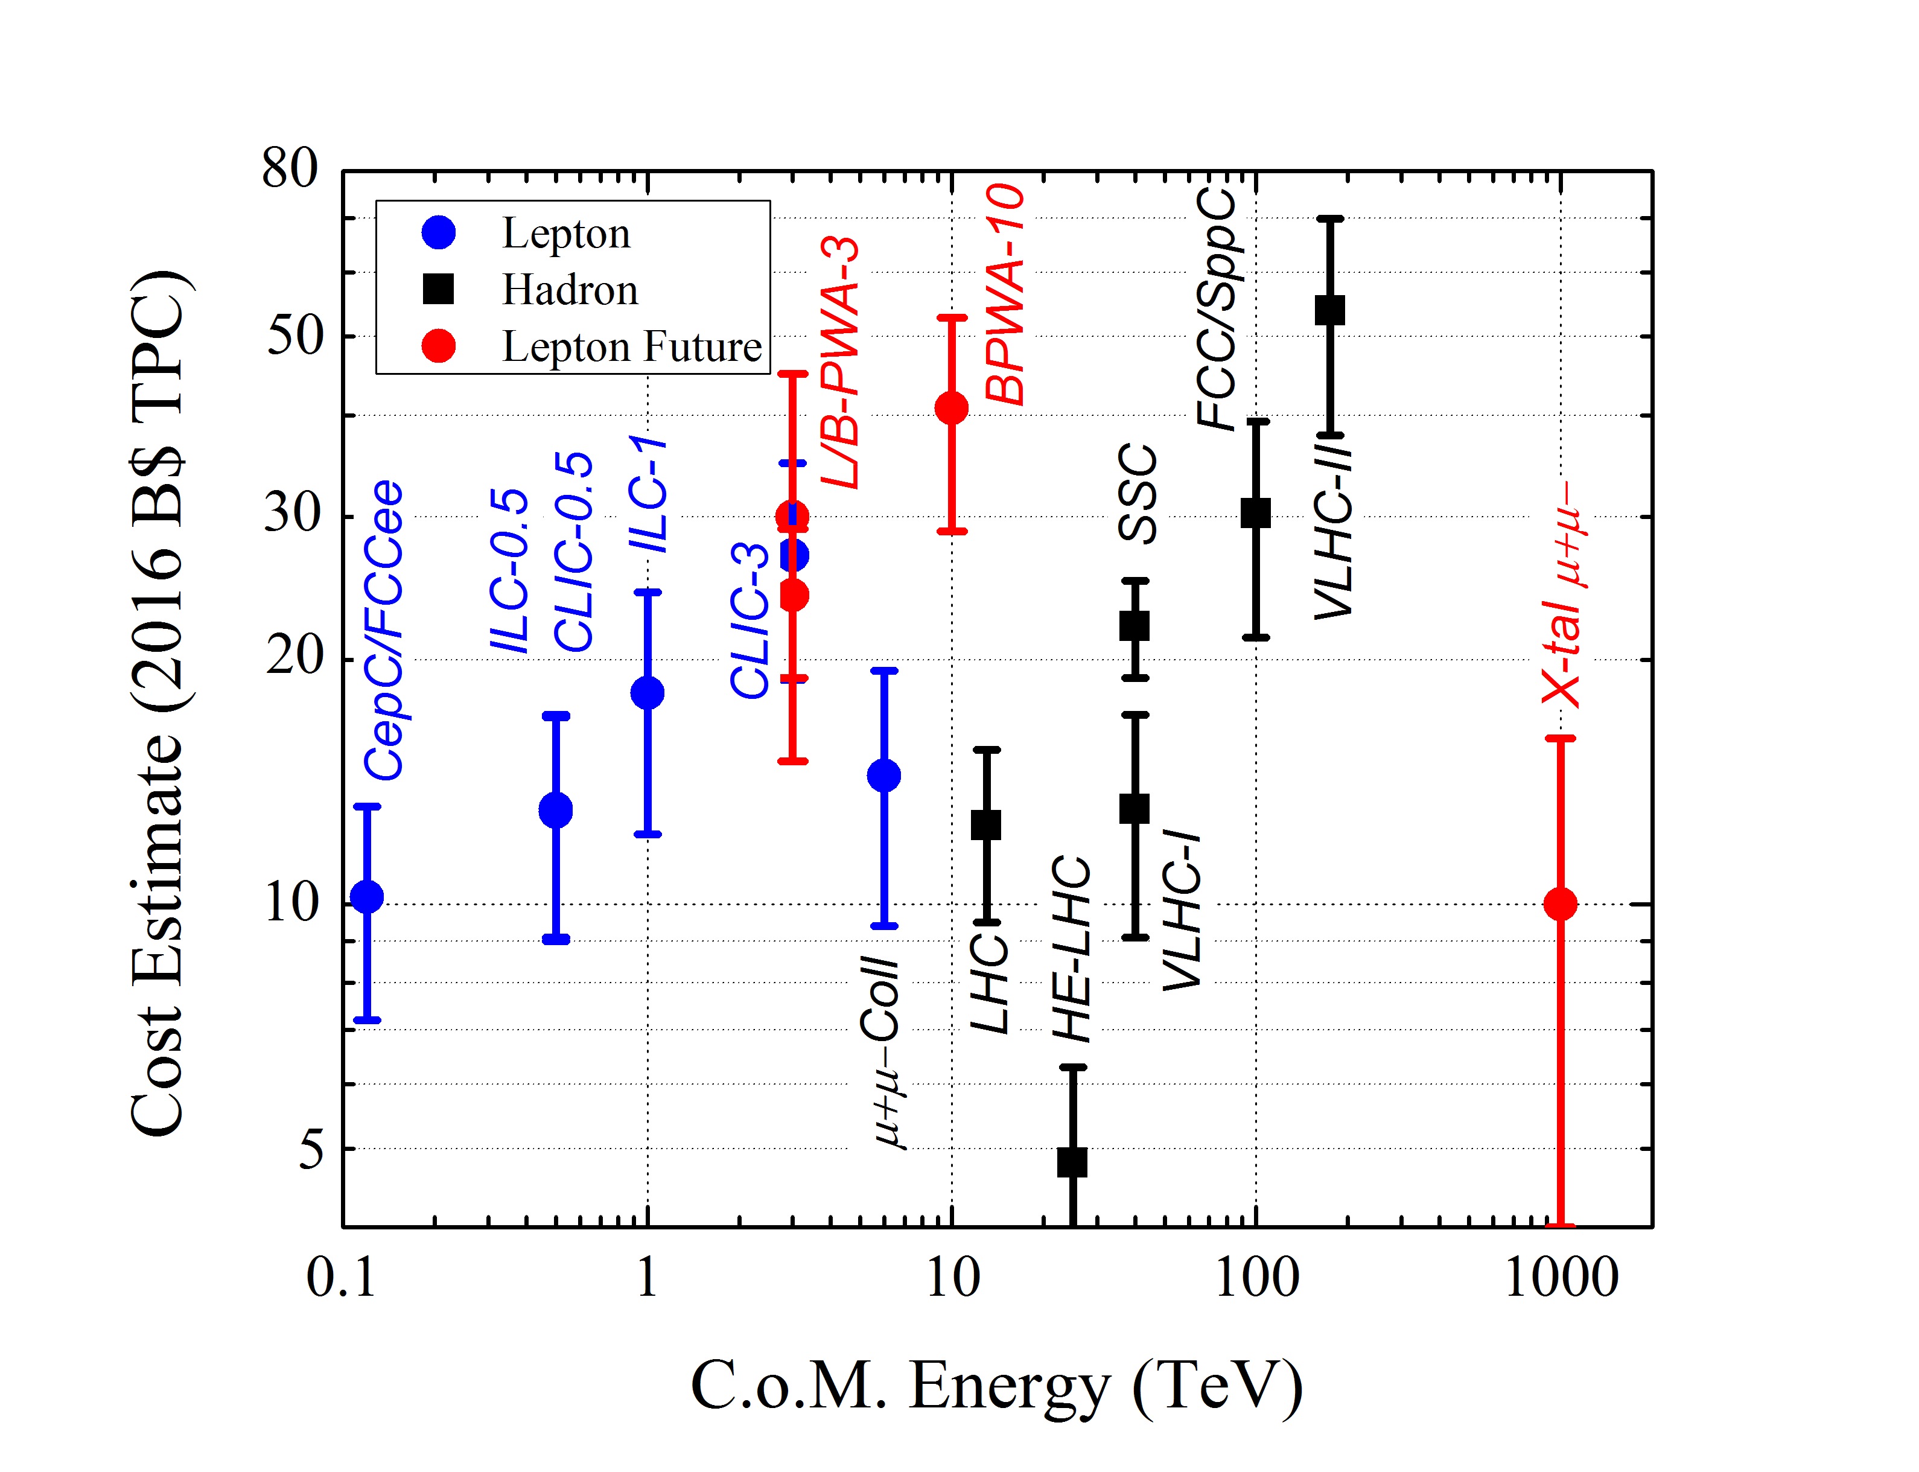
“Dream”
collider

Slide 17
Option 5: μ+μ- Collider x5-10 more E_{cm} for same E_{beam}
Muons are particles for the far-future anyway
  The only option for a 1000 TeV collider
  As convincingly shown Monday
There are opportunities even now:
  Even with fully traditional technology MC shows much more economical design options than any e+e-, approaching LHC in terms of Energy/$$ and facility power/Energy
  MICE shows that muon cooling works
  Great savings for labs having either proton complex or big tunnels
  Novel approaches, like shown Mon, can offer further gains… need R&D
The past tells us that we were much more successful in improving performance than the energy

Slide 18

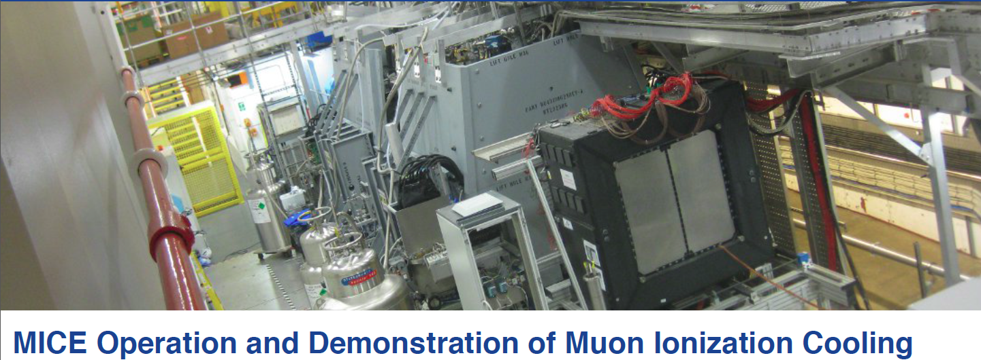
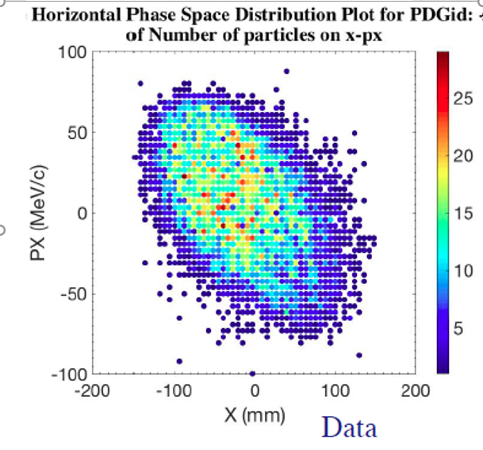
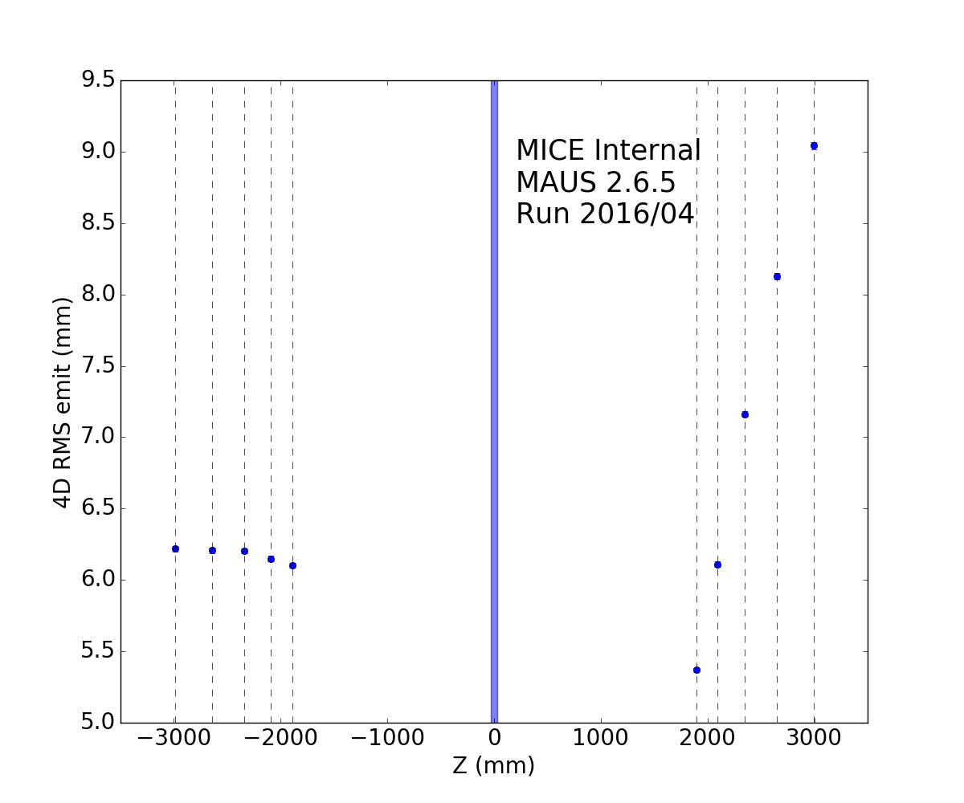
MICE
at RAL
10M muon tracks
cooling observed
  w/o RF yet
Re-accel’n in 2018
Ref. plane upstream
Ref. plane downstream
MICE (very) preliminary A.Bross, A.Liu, F.Drielsma

Slide 19
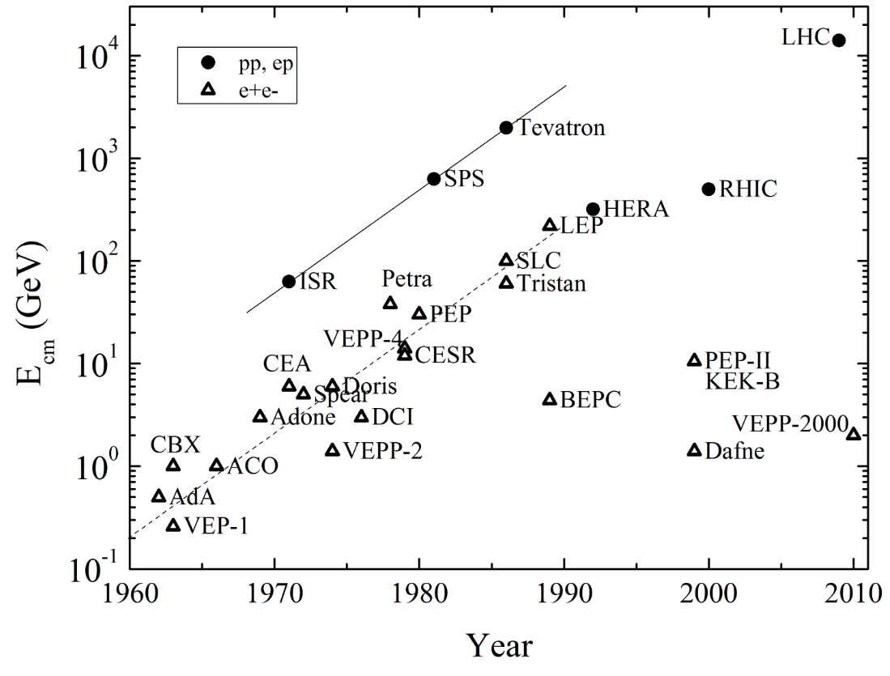
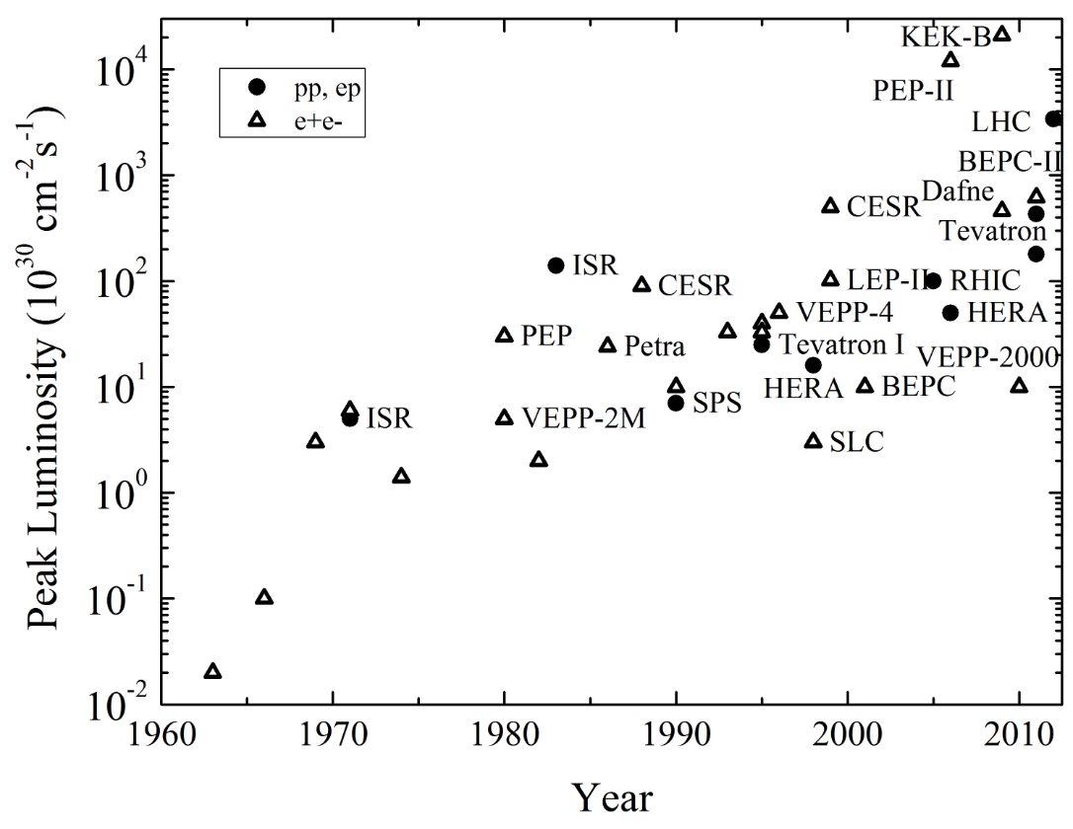
Race : Energy vs Luminosity
V.Shiltsev, Physics–Uspekhi, 2012, 55:10, 965–976
Over the 5 decades of developments of the particle colliders
~4 orders of magnitude in E
~6 orders of magnitude in L
The reason (of faster pace of L) is economical – the cost of new technological advances in acceleration is much higher than the cost of advances in performance (focusing, cooling, sources, etc)… and the latter are thus much more numerous

Slide 20
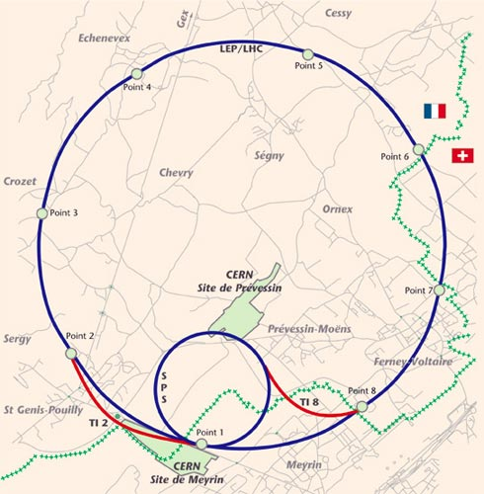
CMC
CERN
Muon
Collider
SRF
SRF
14 TeV cme
LHC tunnel
SPS tunnel and mb PS
~7GeV SRF
Cost ~LHC
SRF
SRF

Slide 21
Assume RCS Acceleration
B_{max} : DC
B_{min} : pulsed from –B_{min} to + B_{min}
Packing factor П<1
B
<B>C= 2π E_{beam} /0.3, e.g. 146 Tm
for 7 TeV and 26.7 km

Slide 22
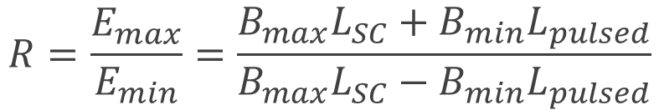
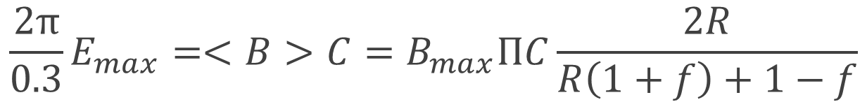
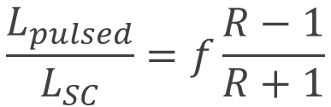
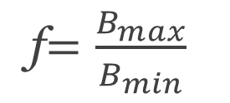
(Simple math)
Acceleration range:
$$R=\frac{E_{max}}{E_{min}}=\frac{B_{max}L_{SC}+B_{min}L_{pulsed}}{B_{max}L_{SC}−B_{min}L_{pulsed}}$$
f$=\frac{B_{max}}{B_{min}}$
$$\frac{L_{pulsed}}{L_{SC}}=f\frac{R−1}{R+1}$$
If the ratio of fields :
then :
and equation for the required fields reads :
$$\frac{2π}{0.3}E_{max}=<B>C=B_{max}ПC\frac{2R}{R\left(1+f\right)+1−f}$$

Slide 23
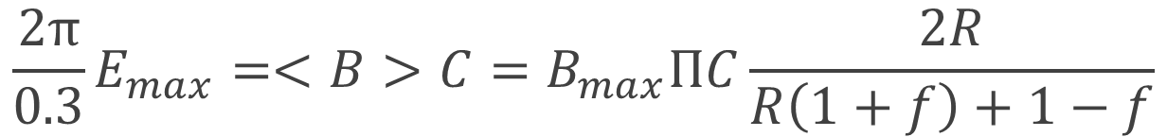




Example: 7 TeV, 26.7 km tunnel, 16T max
$$\frac{2π}{0.3}E_{max}=<B>C=B_{max}ПC\frac{2R}{R\left(1+f\right)+1−f}$$
146 T×km 26.7km 16T 0.85 0.4=1/2.5
4.2 | 16 | 3.8T | 0.45TeV
4.5 | 7 | 3.5T | 1TeV
5 | 4 | 3.2T | 4TeV
8 | 1.75 | 2.0T | 9.1TeV
then :
$$R=\frac{f−1}{f−4}$$
f$=\frac{B_{max}}{B_{min}}$
$$B_{min}$$
$$E_{inj}$$

Slide 24




Example 2: 1 TeV, 6.9km tunnel, 16T max
$$\frac{2π}{0.3}E_{max}=<B>C=B_{max}ПC\frac{2R}{R\left(1+f\right)+1−f}$$
20.9 T×km 6.9km 16T 0.9 0.21=1/5
10 | 9 | 1.6T | 110 GeV
9.5 | 17 | 1.7T | 60 GeV
then :
$$R=\frac{f−1}{f−9}$$
f$=\frac{B_{max}}{B_{min}}$
$$B_{min}$$
$$E_{inj}$$

Slide 25

Example 3: 60GeV,0.7km tunnel,16T max
$$\frac{2π}{0.3}E_{max}=<B>C=B_{max}ПC\frac{2R}{R\left(1+f\right)+1−f}$$
1.26 T×km 0.7km 16T 0.9 0.125=1/8
16 | 15 | 1.0T | 5 GeV
then :
$$R=\frac{f−1}{f−15}$$
f$=\frac{B_{max}}{B_{min}}$
$$B_{min}$$
$$E_{inj}$$

Slide 26
To sum up: 14 TeV CMC
One can build a 14 TeV cme μ+μ- collider at CERN if:
  Re-use tunnels 26.7km LHC, 6.9km SPS, 0.7km PS
  16 T SC magnets (DC), need ~5 km
  Pulsed ±3.5 T magnets, with ramp ~100ms, need ~20km
  Pulsed ±2 T magnets, with ramp ~10ms, need ~6km
  Pulsed ±1 T magnet, with ramp ~1ms, need ~1km
The αβγ-model predicts TPC ~12B$ ±4
  5B$ SC magnets, 3B$ NC magnets, 2B$ SRF, 2B$ 100MW power infrst.
  ~ cost of LHC; ~6B$ in European accounting
“Free cookie” – if one has 24 T SC magnets
  Either 4x luminosity can be achieved with collider in SPC tunnel – that requires 7 km of 24T magnets
  Or 7 TeV cme in the LHC tunnel with just 3T pulsed magnets

Slide 27
Summary
Future energy frontier colliders are expensive:
  αβγ-model approx. well NC/SC Magnets and RF
  Significant fraction is in civil and site power infrastructure
Possible options/preemptive measures:
  Re-use existing (injectors, tunnels, etc)
    Though saves a lot, works only at few places (big existing labs)
  Develop traditional technology to lower cost by a factor (SC mag, SRF)
    Decade(s) of R&D, ongoing… need to be more aggressive
  “Move to China!” or some other place to save big factor
    The advantage might disappear in 10-15 years from now
  Wait till new acceleration technology matures (plasma) and lower cost
    Progress over past 2 decades impressive but no sign of cost feasibility yet… R&D
  “Get more with same energy” = μ+μ- (e.g., 14 TeV CERN MC)
    Need to develop challenging pulsed magnets (NC? SC?), other smart ideas
    But the switch to muons is inevitable in a long run…

Slide 28
Thank You for Your Attention!

Slide 29
Back up slides

Slide 30
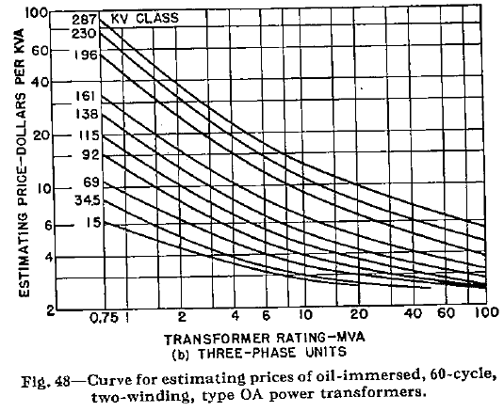
As an example: transformers
Cost ~ Size^3
Power (MVA) ~ Size^4
So , Cost ~ (Power )^(3/4)
From basic theory
Cost ~Power ^(1/2)

Slide 31
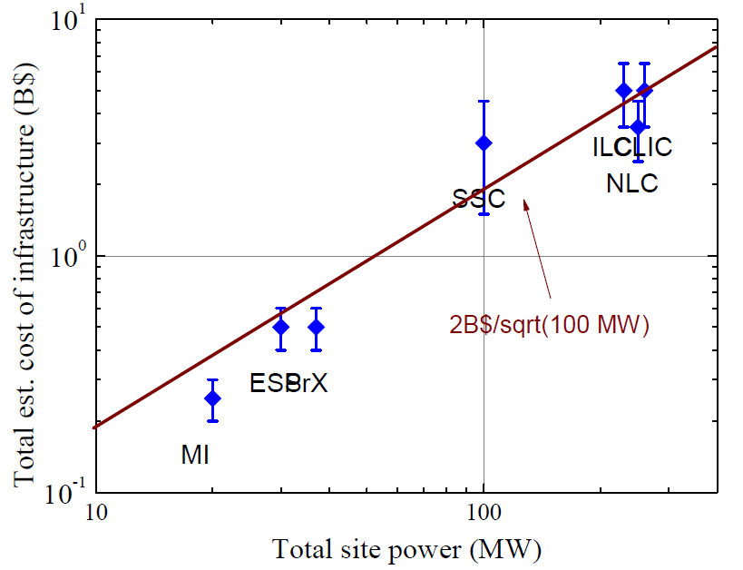
“Infrastructure”

Slide 32
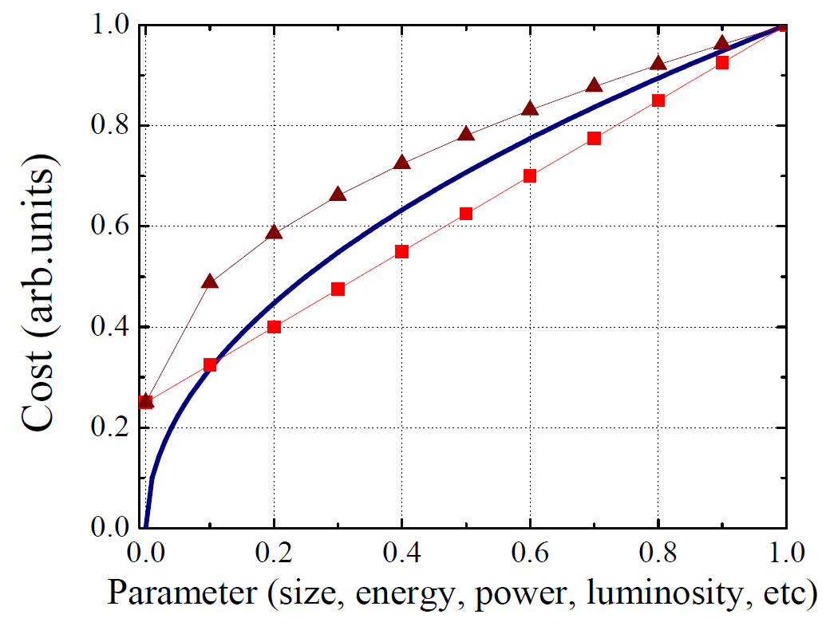
Functional dependence
Recurring theme: “zero-cost” + some growing function can be reasonably well described by sqrt(Parameter)

Slide 33
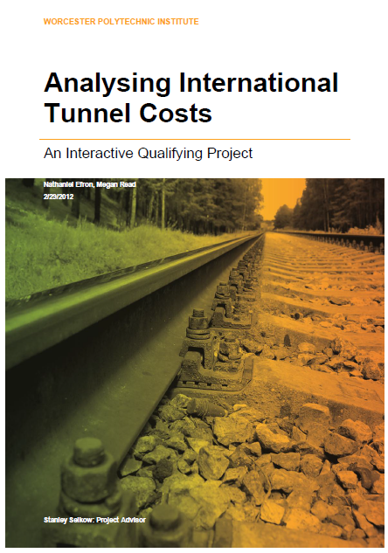
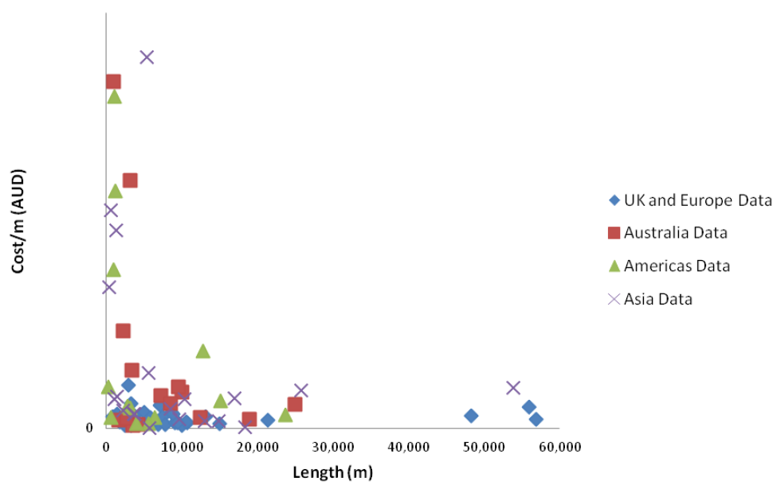
Cost of Tunnel
Some 100 tunnels world wide

Slide 34
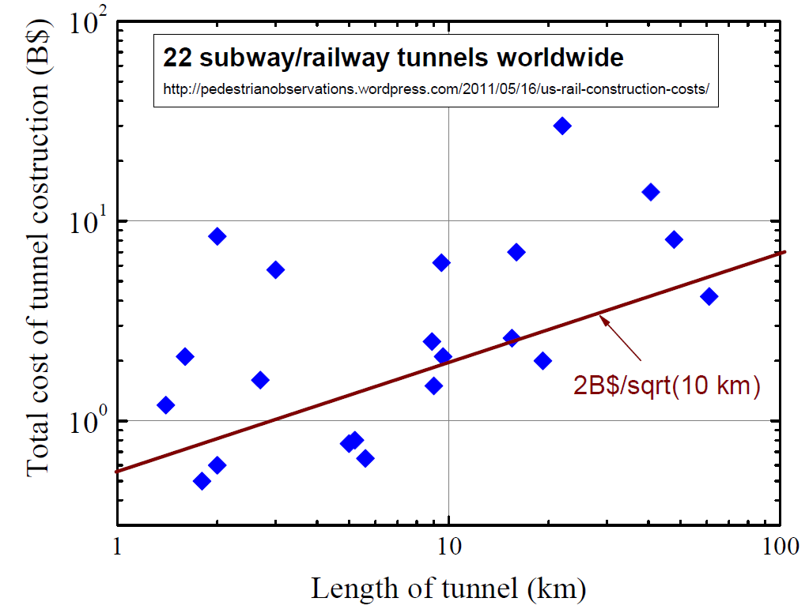
Tunnels: Worldwide

Slide 35
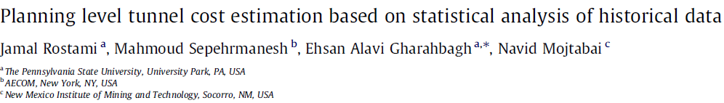
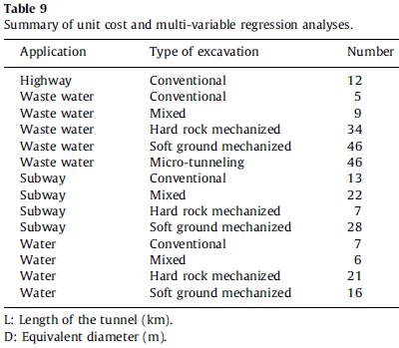
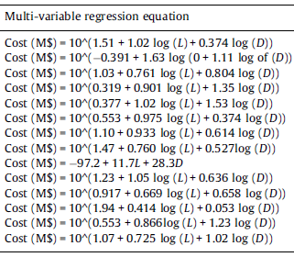
More on Tunneling cost
Do not expect Cost ~ (L×D²) = meter^3 !
Data on 270 tunnels world wide
Cost ~ L^(0.4-1) D^(0.6-1.5)

Slide 36
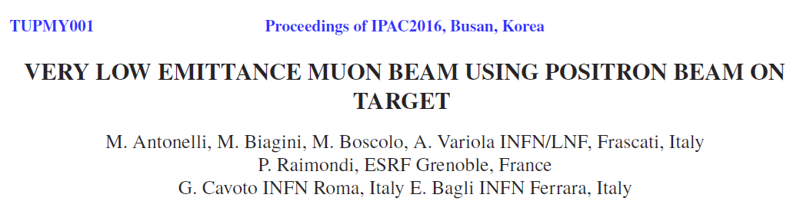



New Approaches (1)

