Slide 1
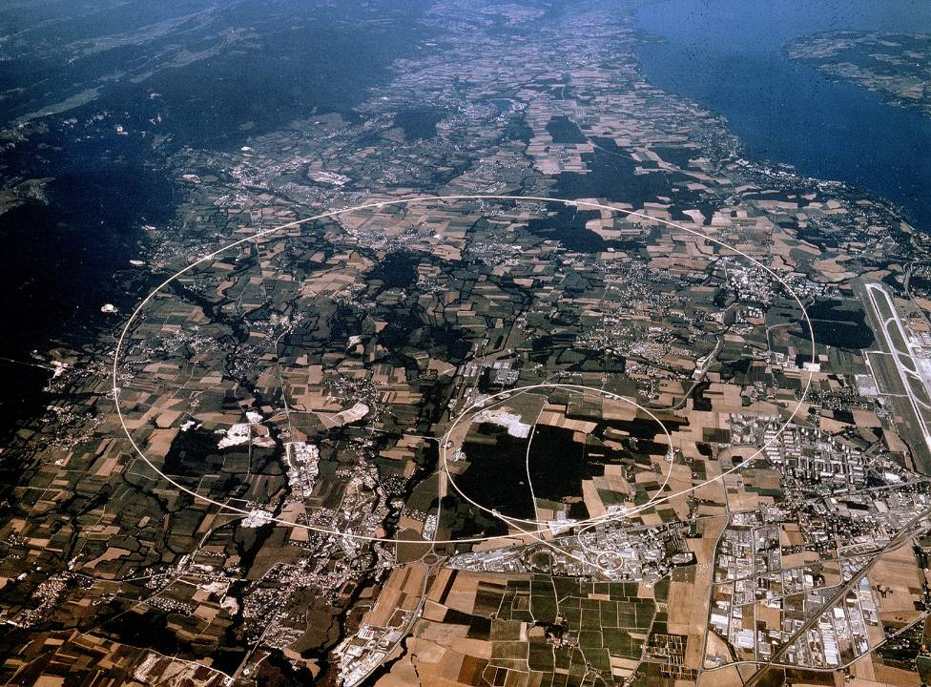
Reliability and Availability of Particle Accelerators: Concepts, Lessons, Strategy
A. Apollonio
CERN Machine Protection Group (TE-MPE)
Xbeam Strategy Workshop– 15/02/2017
andrea.apollonio@cern.ch
Acknowledgements: R. Schmidt, B. Todd, M. Kwiatkowski, F. Bouly, A. Lechner, A. Niemi, J. Gutleber.

Slide 2
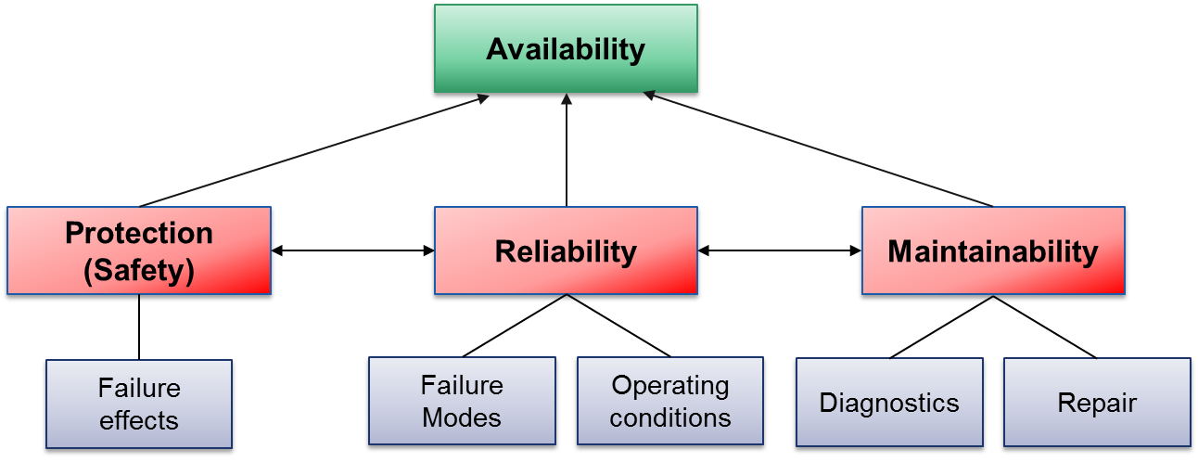
RAMS/Outline
NB: in the context of particle accelerators, we speak about ‘Protection’ rather than ‘Safety’, if no personnel is involved

Slide 3
Basic Definitions
Reliability (0-1) is the probability that a system does not fail during a defined period of time under given functional and environmental conditions
  Example of reliability specification: “An accelerator must have a reliability of 60 % after 100 h in operation, at an operating current of 40 mA”
Availability (0-1) is the probability that a system in a functional state at given point in time
  Example of availability specification: “An accelerator must ensure beam delivery to a target for 90 % of the scheduled time for operation”

Slide 4
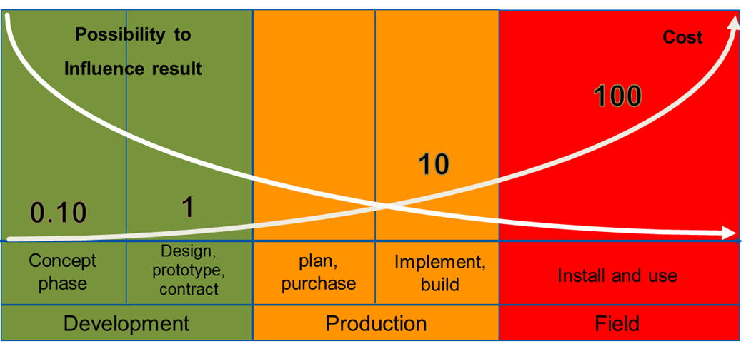
Importance of Reliability Analyses
Prof. Dr. B. Bertsche, Dr. P. Zeiler, T. Herzig, IMA, Universität Stuttgart, CERN Reliability Training, 2016
Product/Accelerator Lifecycle
The earlier reliability constraints are included in the design, the more effective the resulting measures will be

Slide 5
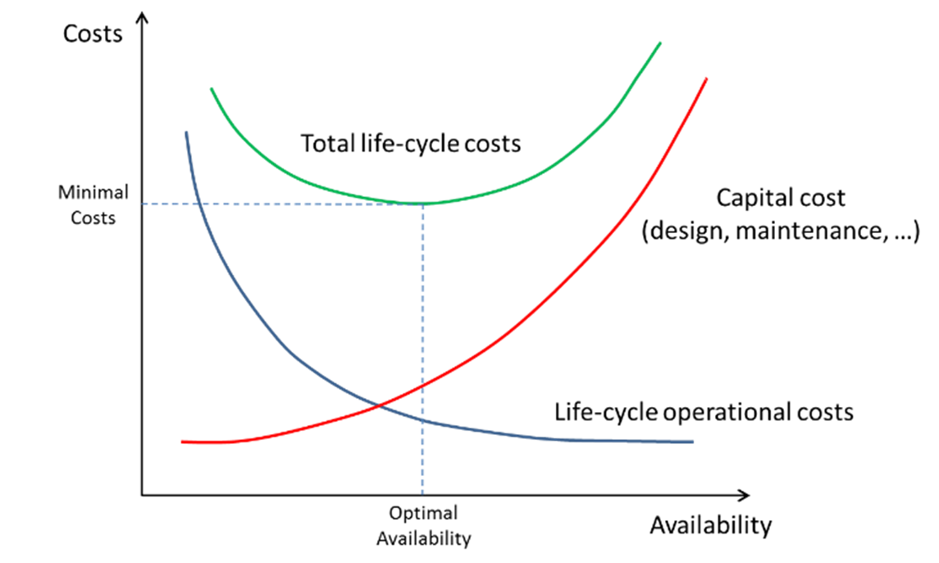
Importance of Reliability Analyses
Given a target performance reach (neutron fluence, number of patients treated, luminosity production, …), an optimal balance between capital costs and operational costs must be found

Slide 6
Risk

Slide 7

Risks for Particle Accelerators
Not to complete the construction of the accelerator
  Happened to other projects, the most expensive was the Superconducting Super Collider in Texas / USA with a length of ~80 km
  Cost increase from 4.4 Billion US$ to 12 Billion US$, US congress stopped the project in 1993 after having invested more the 2 Billion US$
Not to be able to operate the accelerator
Damage to the accelerator beyond repair due to an accident
SSC

Slide 8
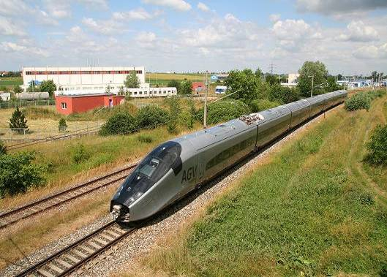
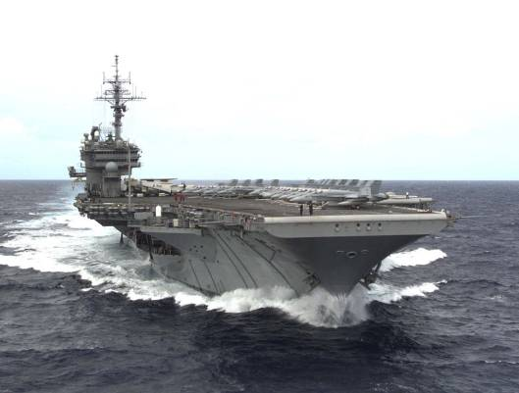
Energy stored in the LHC
Picture source: http://en.wikipedia.org/wiki/File:Alstom_AGV_Cerhenice_img_0365.jpg
Shared as: http://creativecommons.org/licenses/by-sa/3.0/deed.en
Picture source: http://militarytimes.com/blogs/scoopdeck/2010/07/07/the-airstrike-that-never-happened/
Shared as: public domain
3⋅10¹⁴ protons in each beam
Kinetic Energy of 200 m Train at 155 km/h ≈ 360 MJoule
Stored energy per beam is 360 MJ
Stored energy in the magnet circuits is 9 GJoule
Kinetic Energy of Aircraft Carrier at 50 km/h ≈ 9 GJoule
….can melt 14 tons of copper
[11]

Slide 9
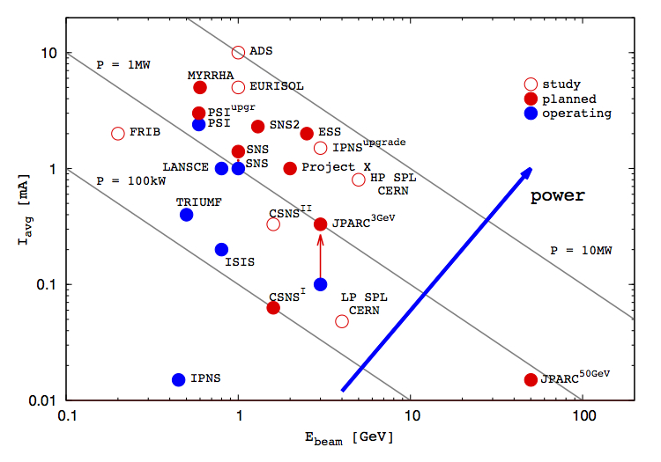
Spallation Sources + High Intensity Accelerators

Slide 10
Risk Assessment (1/2)
B. Todd, M. Kwiatkowski, “Risk and Machine Protection for Stored Magnetic and Beam Energies”
Risk is the product of the probability of occurrence of an undesired event x its impact (financial, reputation, downtime,…)
‘Acceptable’ or ‘Unacceptable’ risk depends on the context!
  Different for user-oriented facilities, medical accelerators, fundamental research,…

Slide 11
Risk Assessment: Example
Machine Protection Concern
Availability Concern
IMPACT
 | 1/year | Catastrophic | Major | Moderate | Low | Very Low
Very likely | 10
Frequent | 1
Probable | 0.1
Occasional | 0.01
Remote | 0.001
Improbable | 0.0001
Cost [MCHF] |  | > 50 | 1-50 | 0.1-1 | 0.01-0.1 | 0-0.01
Downtime [days] |  | > 180 | 20-180 | 3-20 | 1-3 | 0-1
FREQUENCY
IMPORTANT: this matrix depends on the application!

Slide 12
Failure Frequency

Slide 13
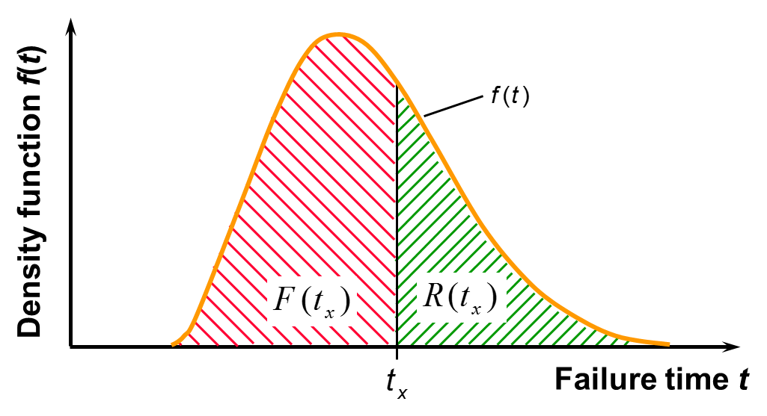
Failure Behaviour of Components
Prof. Dr. B. Bertsche, Dr. P. Zeiler, T. Herzig, IMA, Universität Stuttgart, CERN Reliability Training, 2016
F: Failure Probability
R: Reliability
The failure behaviour of a component is described by a density function
Its integral over a certain time tx gives the failure probability
Reliability is the complement to 1 of the Failure Probability (‘Survival’ Probability)

Slide 14
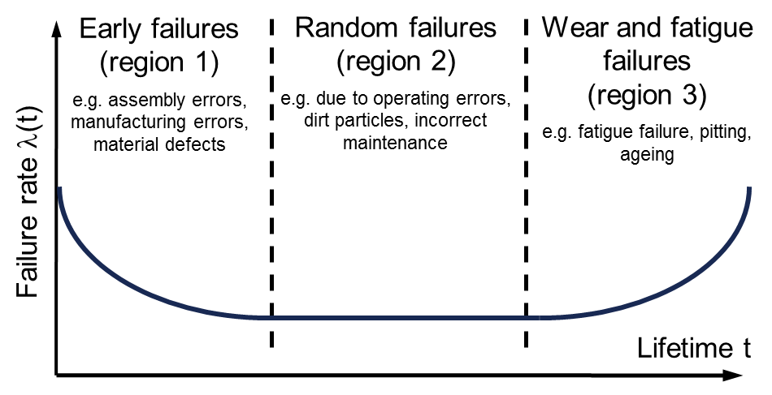
Failure Rate and Bathtub Curve
In practice, it is often assumed that failures occur randomly, i.e. they are described by an exponential density function → constant failure rate λ
Only in the latter case Mean Time Between Failures (MTBF) = 1/λ
Clearly a simplification in some cases…
Prof. Dr. B. Bertsche, Dr. P. Zeiler, T. Herzig, IMA, Universität Stuttgart, CERN Reliability Training, 2016

Slide 15
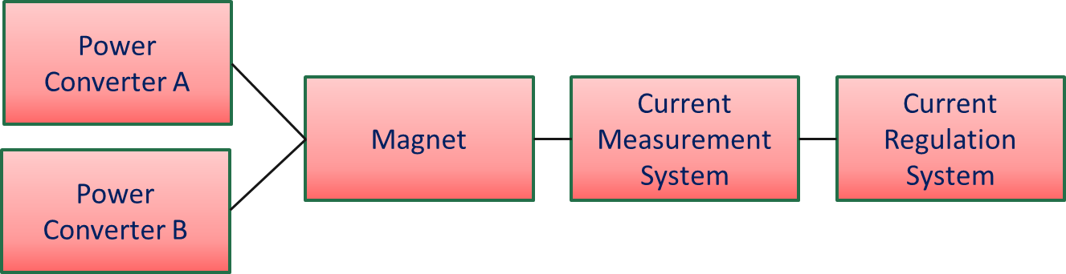
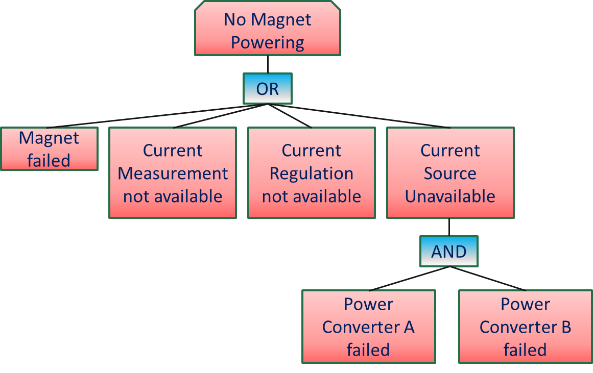
Description of System Failure Behaviour
Reliability Block Diagram:
  Question: what is the minimum set of components that allows fulfilling the system functionality?
A
B
Fault Tree:
  Question: what are the combinations of failures that lead to a system failure?
Boolean Algebra allows calculating system reliability from component reliability

Slide 16
Component Failure Rate Estimates
Tests:
  Large number of samples to be tested / long time for testing
  May be impractical in some cases
  Accelerated lifetime tests (if applicable)
Experts’ estimates
  Big uncertainties on boundary conditions
  Good approximation for known technologies
  Good for preliminary estimates
Using Standards (Mil. Handbooks for electronic components)
  Very systematic approach
  Boundary conditions can be taken into account (quality of components, environment)
  Difficult to follow technology advancements (e.g. electronics)
IMPORTANT: The power of these methods is not in the accuracy of failure rate estimates, but in the possibility to compare architectures and show the sensitivity of system performance on reliability figures

Slide 17
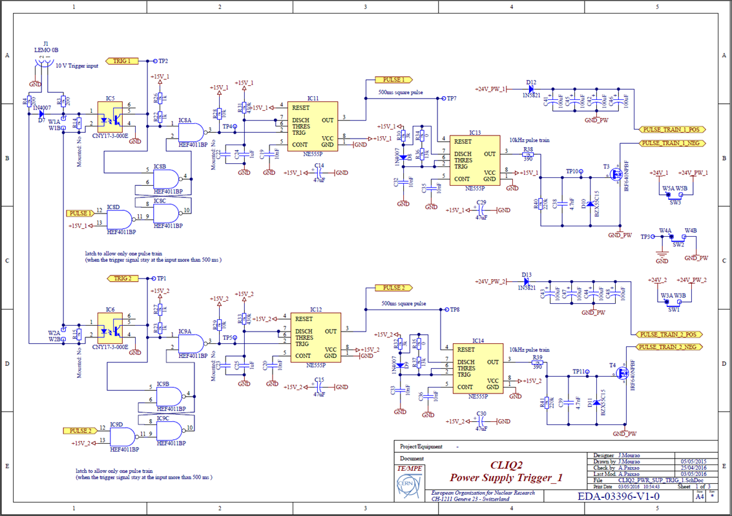
Example of Failure Rate Calculations

Slide 18
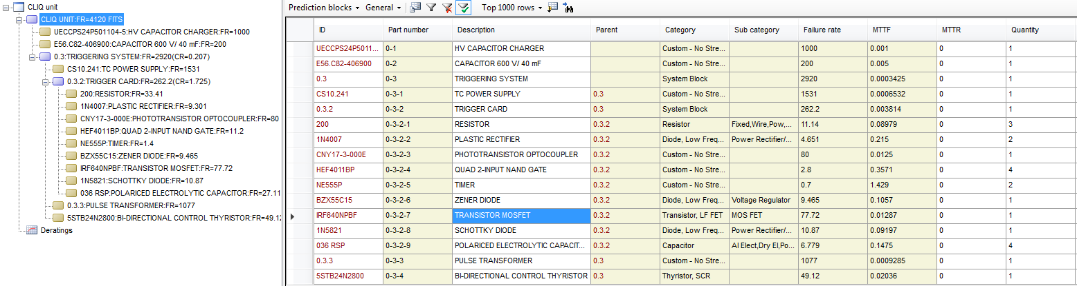
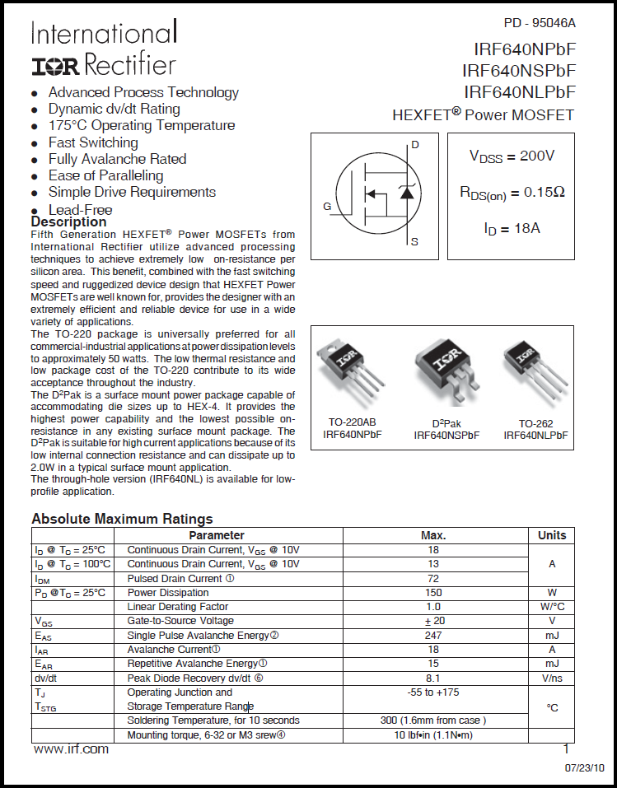
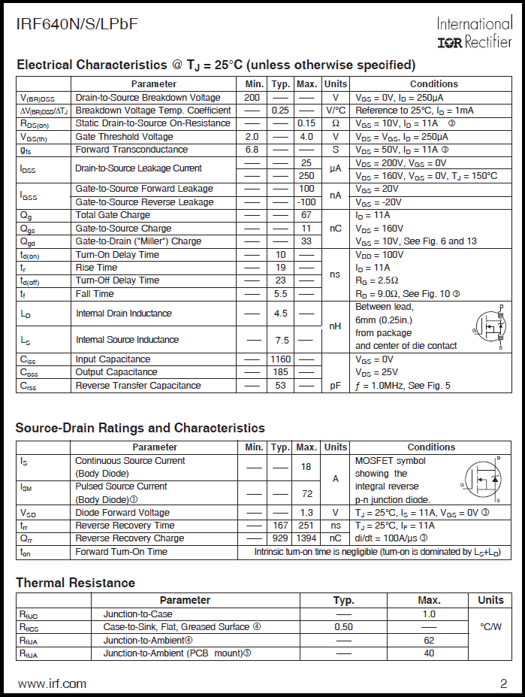
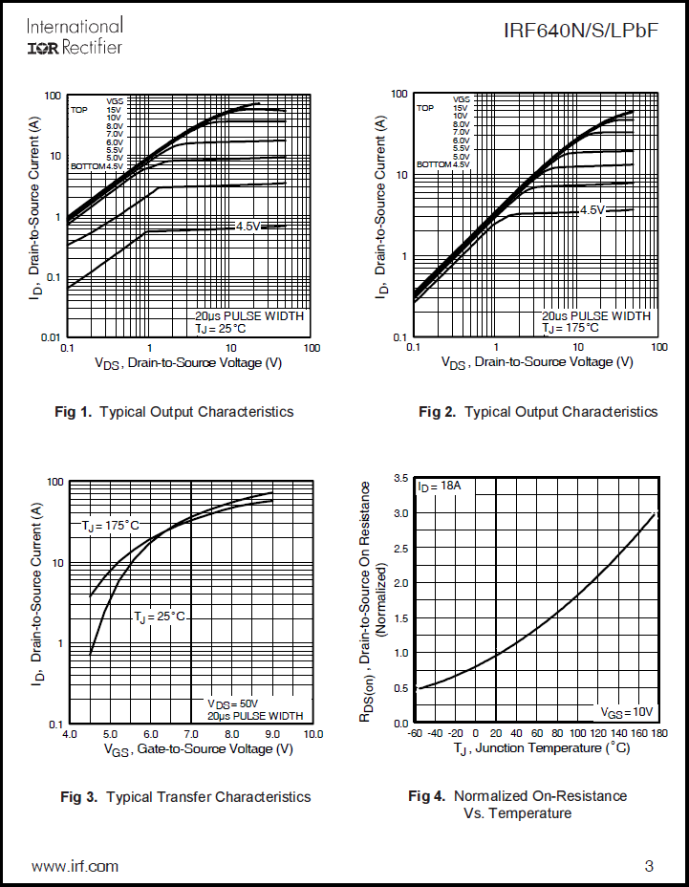
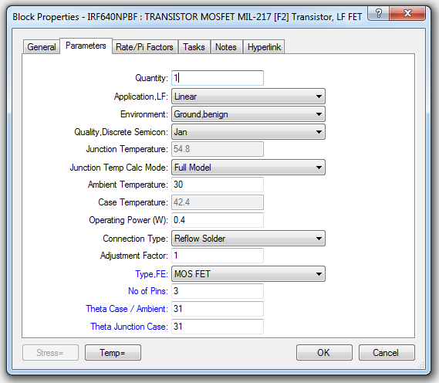
Example of Failure Rate Calculations

Slide 19
Redundancy: Example from MYRRHA
Source
LEBT
RFQ
MEBT
Switching Magnet
SC Cavities
Source
LEBT
RFQ
MEBT
The switching magnet becomes the reliability bottleneck in this architecture
  It should be designed for high reliability
  How should it be operated? (only when required, at predefined times,…)
A strategy has to be defined on how to operate the ‘spare’ Linac:
  Continuously running – ‘hot spare’ (quantify operation costs)
  When required (consider additional time to recover nominal operation)
When introducing redundancy, think about remaining single points of failure!

Slide 20
Failure Impact: Downtime

Slide 21
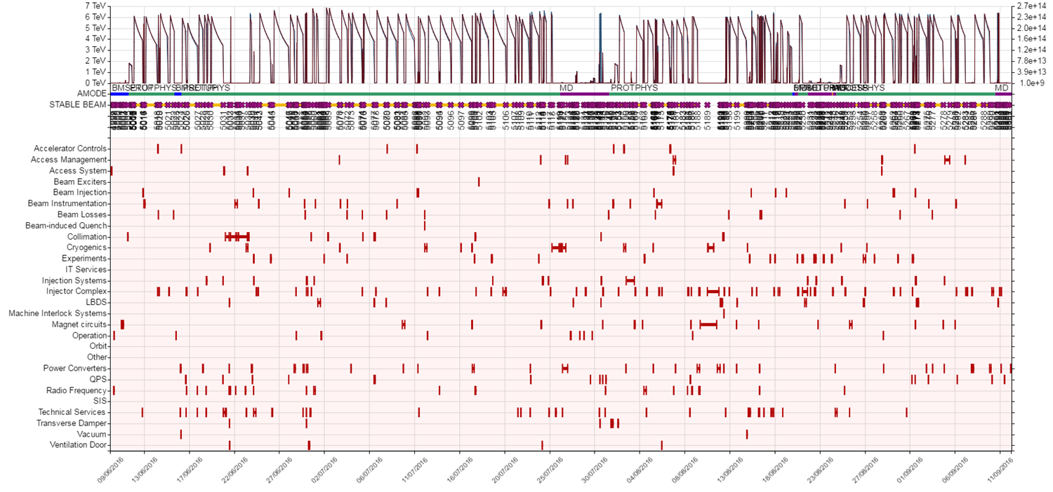
Accelerator Downtime
Systematic follow-up of failures → learn from experience → possible reduction of recovery times (faster diagnostics, faster repairs, management of spare parts,…)

Slide 22
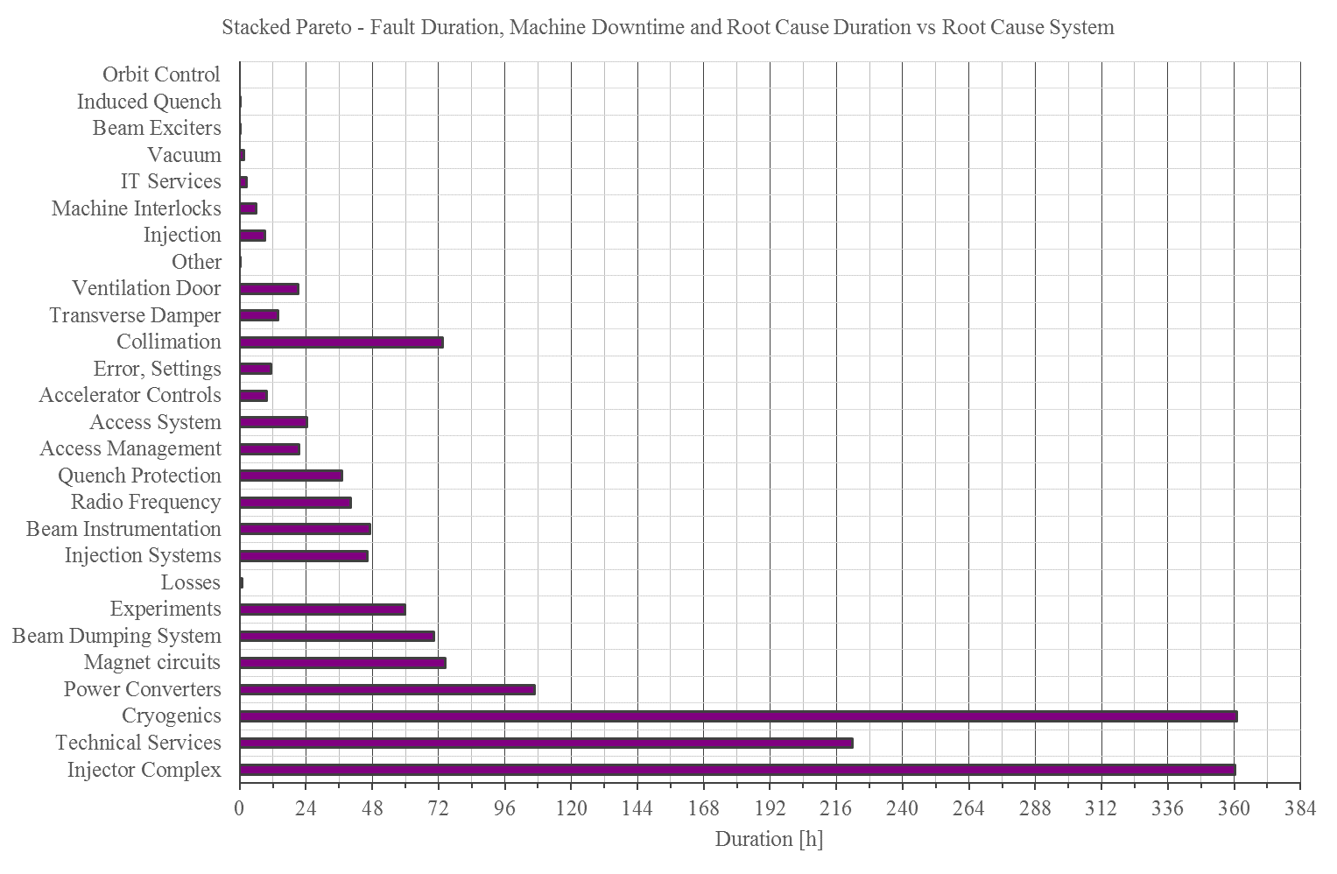
Faults
Fault Duration =
Integrated time logged for fault
Machine Downtime =
Corrects for parallelism
Root Cause Duration =
Corrects for dependencies
parent / child / shadow

Slide 23
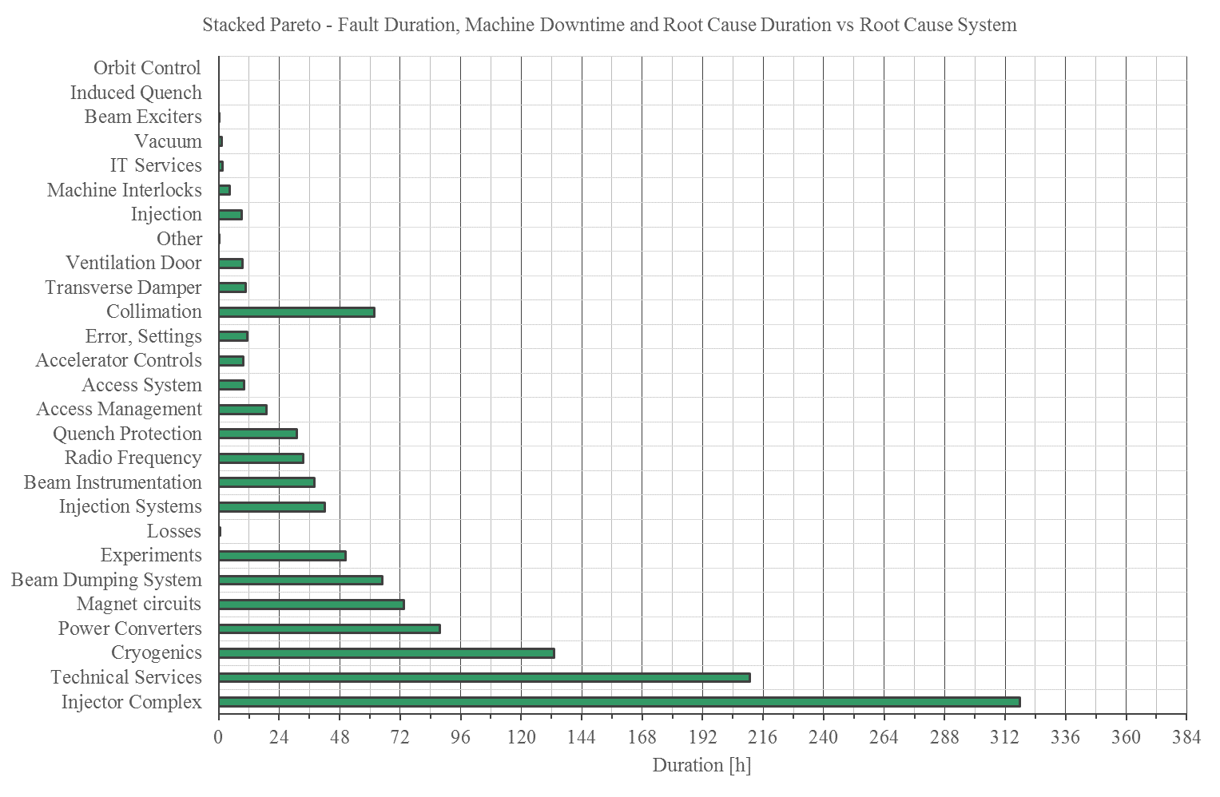
Faults
Fault Duration =
Integrated time logged for fault
Machine Downtime =
Corrects for parallelism
Root Cause Duration =
Corrects for dependencies
parent / child / shadow

Slide 24
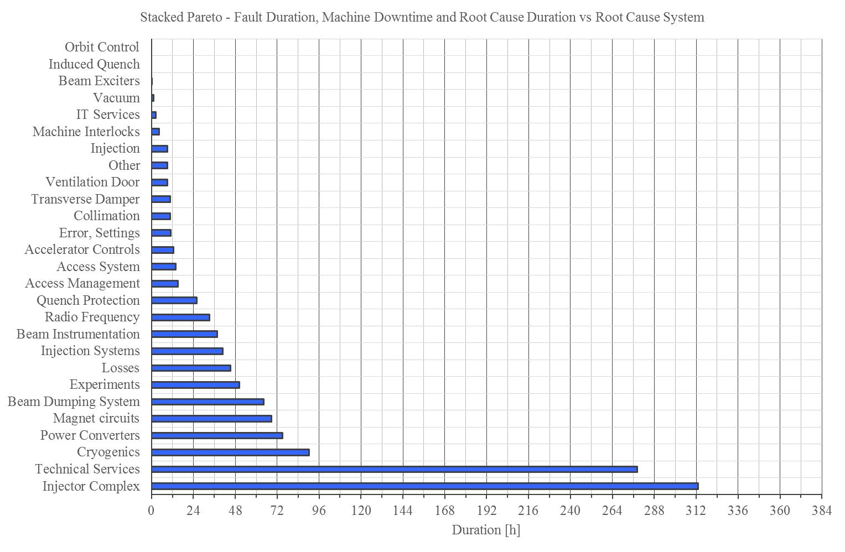
Faults
Fault Duration =
Integrated time logged for fault
Machine Downtime =
Corrects for parallelism
Root Cause Duration =
Corrects for dependencies
parent / child / shadow

Slide 25
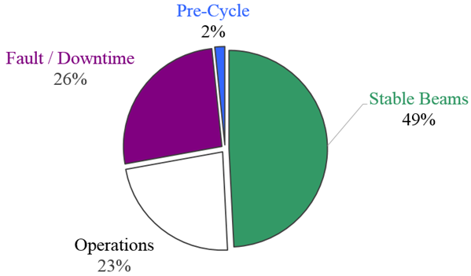
Mode Breakdown
153 days physics ≈ 3738.7 hours
[4 %]
 | Duration [h]
Stable Beams | 1839.5
Fault / Downtime | 980.0
Operations | 857.9
Pre-Cycle | 61.3
[31 %]
[33 %]
= 3738.7
Operations contains nominal cycle + extra measurements (116h) + injection setting-up (23h) + some loss maps (35h) + planned accesses
[32 %]
[25 ns Run in 2015]

Slide 26
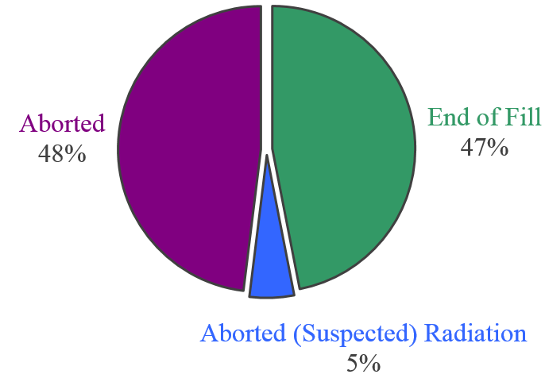
Physics Beam Aborts
 | [#]
Total Fills | 762
Fills with Stable Beams | 175
Fills with Physics in Adjust | 4
→ End of Fill | 84
→ Aborted | 86
→ Aborted (suspected) R2E | 9
[31 %]
[69 %]
[25 ns Run in 2015]

Slide 27
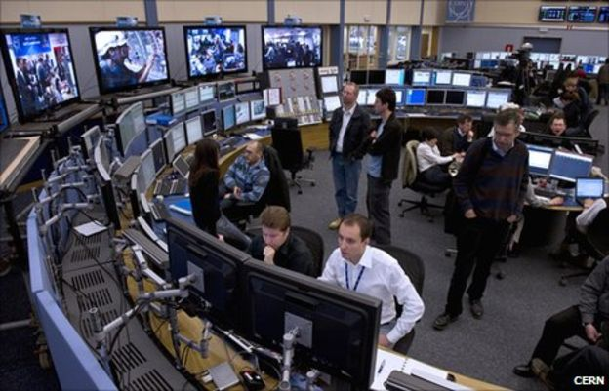
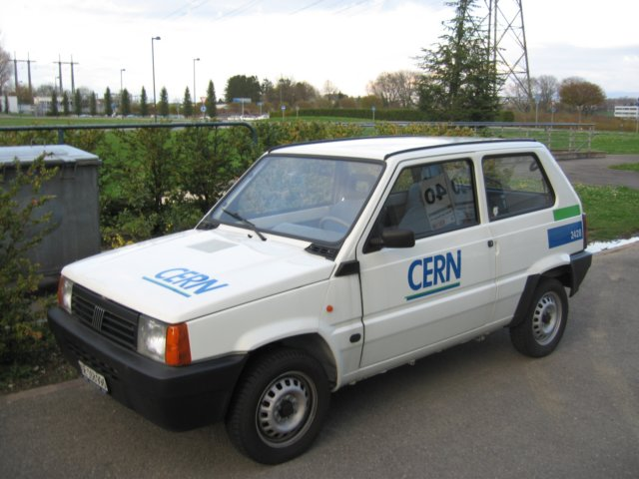

Failure Duration
Failure Duration
Identification
Diagnostics
Logistics
Repair
Mean Time to Repair (MTTR): the average time required to repair a failed component or device.
In addition, some time might be required to recover nominal operating conditions (e.g. beam-recommissioning, source stabilization, magnetic pre-cycles,…)

Slide 28
Maintenance and Operability
Maintenance and operability should be considered from early design phases of the accelerator
System architectures can strongly influence maintainability
Modular designs help optimizing maintenance tasks and commissioning
Accessibility of equipment (when possible) ensures faster recoveries after failures
Advanced diagnostics capabilities help identifying failure root causes
Important: reliability analyses provide the means for spare part management

Slide 29
From Reliability Data to Availability Modelling

Slide 30
Accelerator Schedule
Shutdown
Operation
Shutdown
Operation
Years
HW Commissioning
Beam Commissioning
Luminosity Production
Technical Stop
Machine Studies
Weeks
Machine Cycle
Stable Beams
Failure
Precycle
Hours

Slide 31
Modelling Concept
Year schedule
Year schedule
Machine studies
Physics production
Technical stop
Cycle
Cycle
Accelerator Complex
Phase dependent failures
rates and repairs

Slide 32
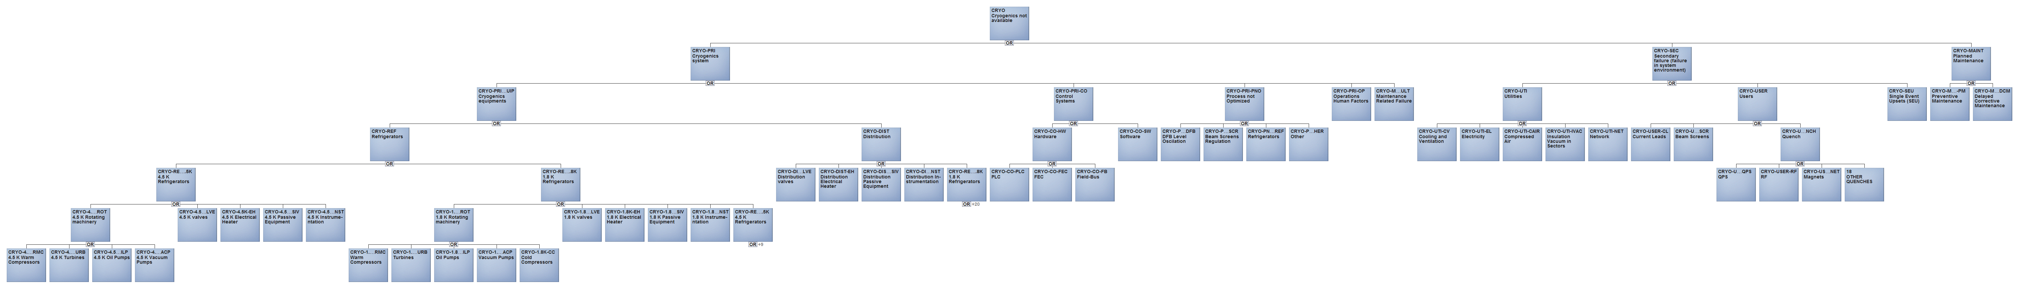
Cryogenics Example
Goal: Define faults that lead to loss of cryogenic conditions
Built in collaboration with Cryo experts + E. Rogova from TU Delft
Basis for current Cryo fault categories in logbooks
Cryogenics system
Primary faults
Secondary faults
    Users related failures
    Utility related failures

Slide 33
Monte Carlo Simulation Concept
Recovery
Ramp Down
Idle
Injection
Premature
Dump
Otherwise operation continues as planned…
Operator
Dump
Idle
Injection
Ramp
Stable Beams
Ramp Down
Idle
Injection
Ramp
Premature
Dump
Randomness creates infinite number of paths on how the simulation run can be completed
Ramp Down
Idle
Injection
Recovery

Slide 34
Results: Model Validation
Actual production vs. one model round
Note the intensity ramp up at start of the year
Assumptions: e.g. constant time between TS → Visual differences in actual and modelled productions

Slide 35
Results: Model Validation
Luminosity production distribution based on 1000 simulation rounds
Simulation result: 23.38 fb⁻¹ sufficiently close to actual production 23.27 fb⁻¹

Slide 36
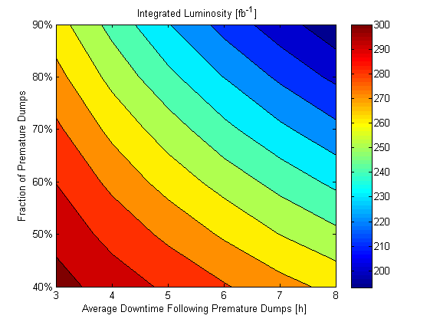
Sensitivity Analysis: HL-LHC
New systems
7 TeV +
HL-LHC Beams + ageing
7 TeV +
HL-LHC Beams
?
?
Ultimate HL Target
2016 Availability Figures

Slide 37
Machine Protection

Slide 38
Hazard Analysis: Top-Down or Bottom-Up?
Consequences of component failure on system behaviour
Definition of high level accidents / failure scenarios
Identification of causal factors leading to accidents
Component Level
Maybe impractical for large projects
Limited to ‘component failures’
Suitable for increasing complexity
Extends further than ‘component failures’

Slide 39

System-Theoretic Process Analysis
Increasing accelerator complexity requires a systematic approach for identification of machine protection requirements
  Address and optimize contradictory requirements (safety vs availability)
  Applicable from early design stages (not applied to a given design)
  Results should not regard only the system architecture, but also provide recommendations for correct operation and management of the accelerator
Long-term goal:
  Identify suitable method for the design of machine protection systems for the next generation of particle accelerators
As a start…
  Apply method for the first time to a small accelerator to verify its suitability → Linac4

Slide 40
Identify Causal Factors
J. Thomas, RSRA2015

Slide 41
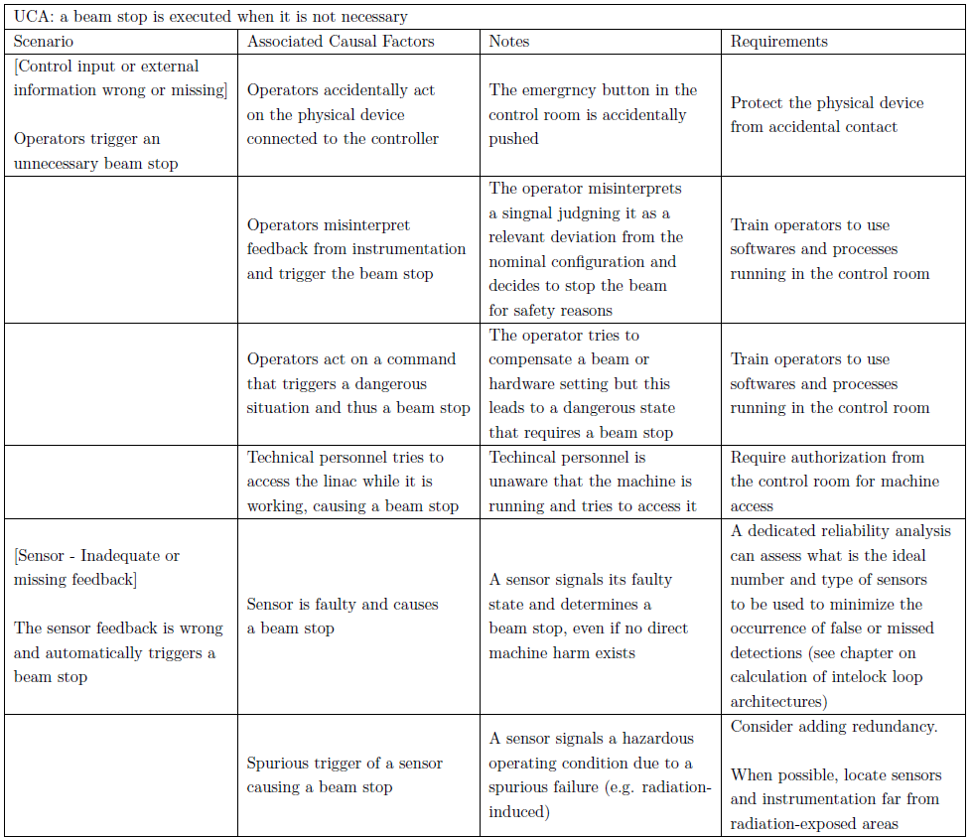
Step 4: Causal Factors
‘Practical’ measures
Managerial and organizational measures
Procedural measures
Technical requirements: trigger further analyses with traditional methods

Slide 42
Protection vs Availability

Slide 43
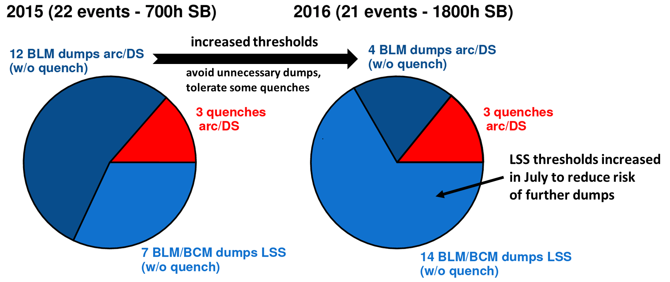
UFO-induced Dumps & Quenches in 2015/16
A. Lechner
Number of dumps & quenches depends on:
  BLM threshold settings
  UFO rates -> strong conditioning observed since Oct 2015, rates much lower in 2016 than in 2015

Slide 44
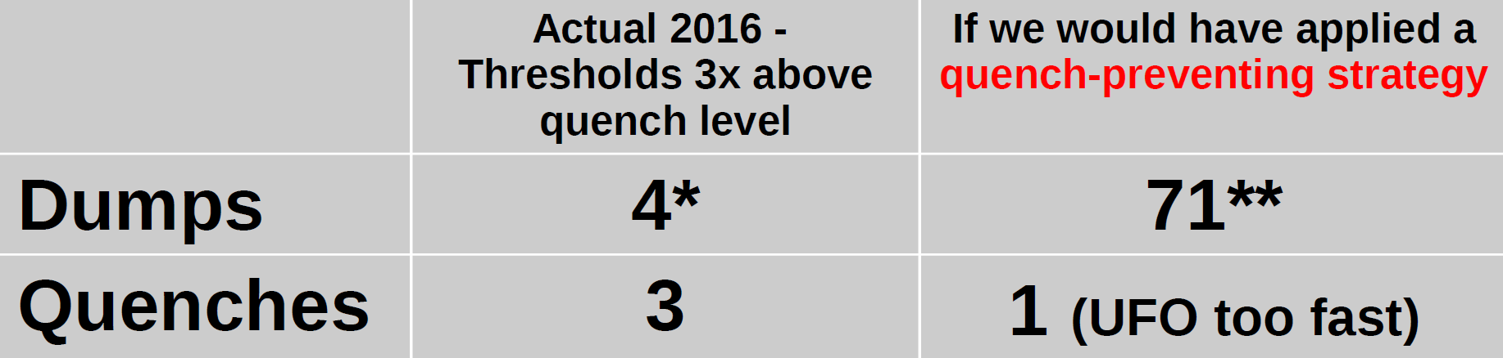
BLM threshold strategy for UFOs
A. Lechner
Arcs and dispersion suppressors:
  If we try to prevent quenches, unnecessary dumps are unavoidable
  For availability it is better to avoid unnecessary dumps, tolerate some quenches, as confirmed by 2016 experience:
  Would adopt same strategy at 7 TeV -> “only” consequence is increased risk of quenches
Long straight sections:
  Expect that local UFO hot spots can be mitigated with threshold increase (as done in 2015 and 2016)
*3 out of 4 dumps were in S12 (temporary reduction of thresholds due to suspected inter-turn short)
** Simple count of 2016 fills which would have been prematurely dumped if tenfold lower thresholds would have been applied in all sectors throughout the whole year. Multiple occurrences per fill are only counted once.

Slide 45
BLM Thresholds and UFOs
High
Low

Slide 46
ADS: An Exceptional Case
In most of the accelerators it is frequent to experience preventive shutdowns of accelerator operation in case of equipment failures
A preventive shutdown for ADS is considered to be a SCRAM
Huge thermal stresses induced in the reactor following a SCRAM
In addition, ~24 h needed for recovery of operating conditions due to legal procedures
Limited number of SCRAMs tolerated → avoid ‘false failures’
For example: for MYRRHA all failures in the accelerator lasting more than 3 s potentially lead to a SCRAM

Slide 47
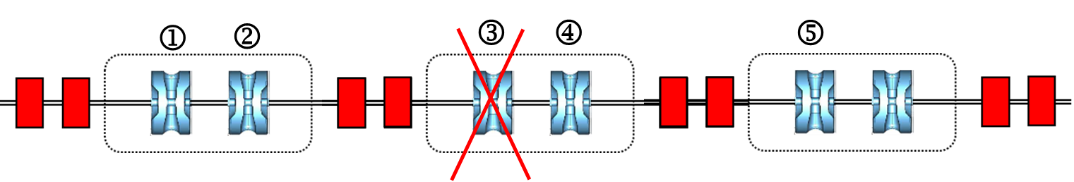
Solution: Dynamic Failure Compensation
Beginning of the retuning area
End of the retuning area
 1st criterion: recover the same transfer matrix of the retuned area than in nominal condition nonlinear least-squares problems.
 2nd criterion: the total Energy gain should remain the same than in the nominal case
 3rd criterion: the time of flight should remain the same than in the nominal case
To be done in less than 3 seconds for MYRRHA…
Courtesy F. Bouly, MYRTE WP2 Meeting, October 2016

Slide 48
Additional Factors Influencing the Achieved Protection Level

Slide 49
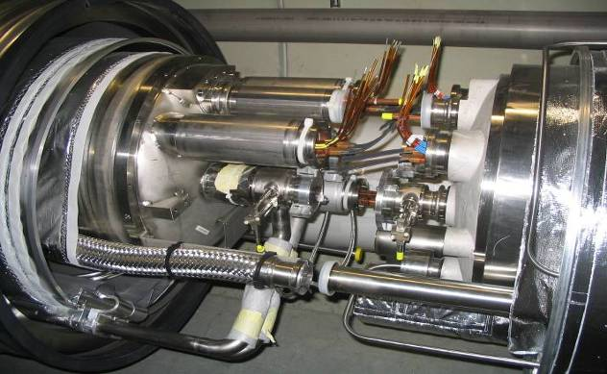
The incident of 19 September 2008
10000 high current superconducting cable joints – all soldered in situ in the tunnel and one of these connections was defective
One joint ruptured, with 600 MJ stored in the magnets – 70% of this energy was dissipated in the tunnel, electric arcs, vaporizing material, and moving magnets around
Notes:
49

Slide 50
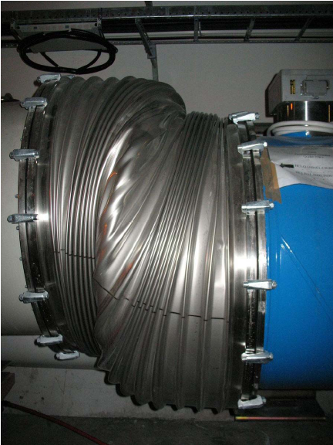
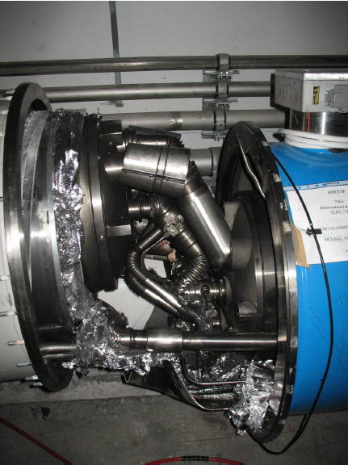
The incident of 19 September 2008
Other factors play a role: quality assurance, time constraints,…
Notes:
50

Slide 51
Damage to Linac4 Vacuum Bellow
Severe misalignment between the RFQ and the MEBT
Optic that favoured amplification of this misalignment (test)
Phase advance such that the loss occurred on the “wave” of the bellow (200 µm) and it is an aperture limitation
Accidents might occur due to a combination of different factors (change of boundary conditions, non-standard operation, design flaws, human intervention,…)

Slide 52
Conclusion

Slide 53
3 Pillars
Actions
Performance
reporting
Implementation
proposals
Infrastructure
Consolidation
Construction
Projects
Design
Studies
Continuous Reliability and Availability Analysis & Assessment
Invest in ‘reliability culture’
Develop system and accelerator models
Improve failure data recording
Trainings, Workshops
Accelerator Fault Tracker
Predict Performance

Slide 54
Ideas for the Future
Protection for future High-Power / High-Energy accelerators will be fundamental to prevent long stops due to equipment damage
  Evaluate methods for the design of the future generation of Machine Protection Systems
Limiting maintenance actions on accelerator equipment will be a key factor for the success of the next generation of large-scale accelerators
  Conceive from the design phase systems with a high degree of redundancy and flexibility
  Reduce only to ‘essential’ equipment located in the tunnel
  Invest in advanced diagnostic techniques (e.g. failure prediction via pattern recognition,…)
  Explore the potential of developments in robotics for remote maintenance
Optimize accelerator schedules
  Today for the LHC only ~150 days per year are allocated for luminosity production
  Design systems thinking about faster commissioning (with and without beam)
  Limit the number of technical stops (synchronize with injectors)

Slide 55
Thanks a lot for your attention!!

