Slide 1
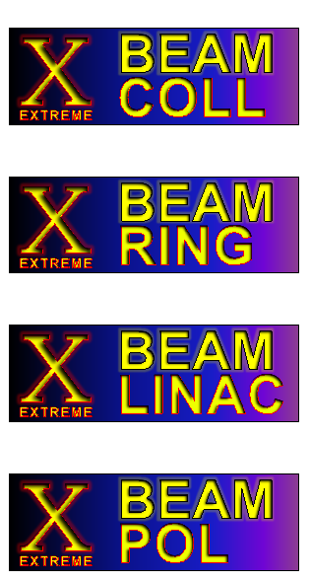
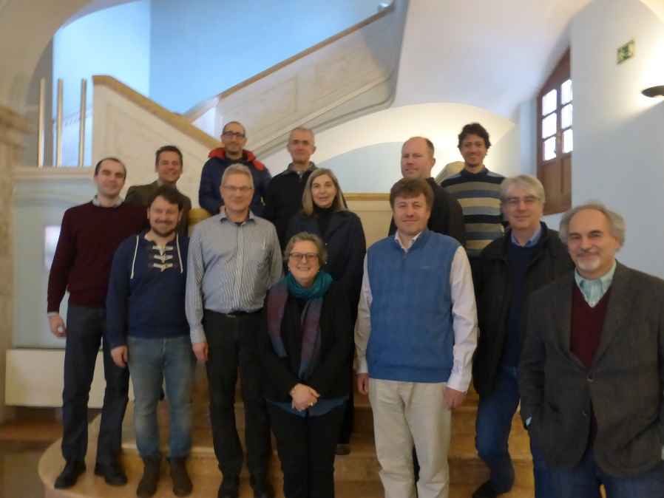


Strategy for
Future Extreme Beam Facilities
compiled by G. Franchetti and F. Zimmermann, based on presentations at XBEAM Strategy Workshop, Valencia 13-17 February 2017
Work supported by the European Commission under Capacities 7th Framework Programme project EuCARD-2, grant agreement 312453.

Slide 2

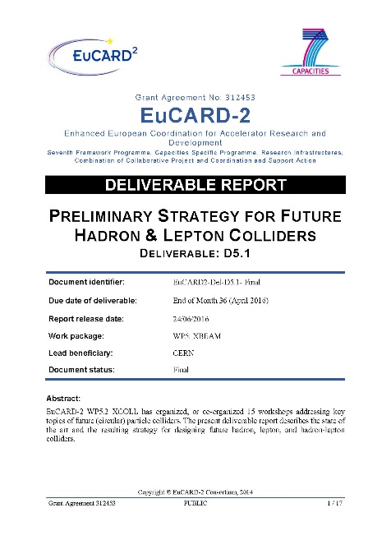
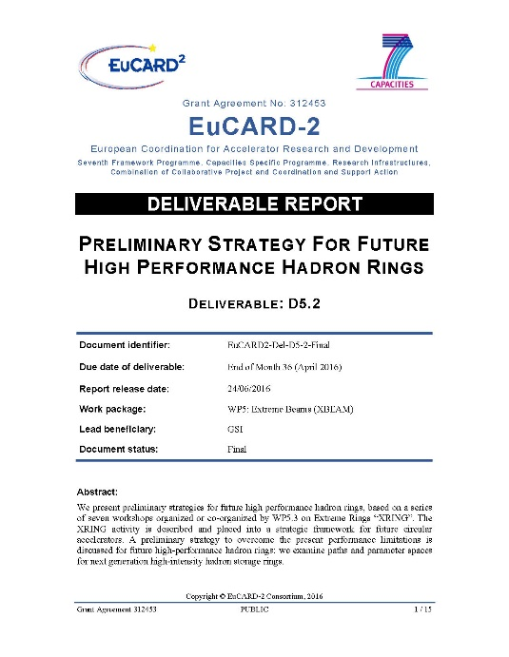
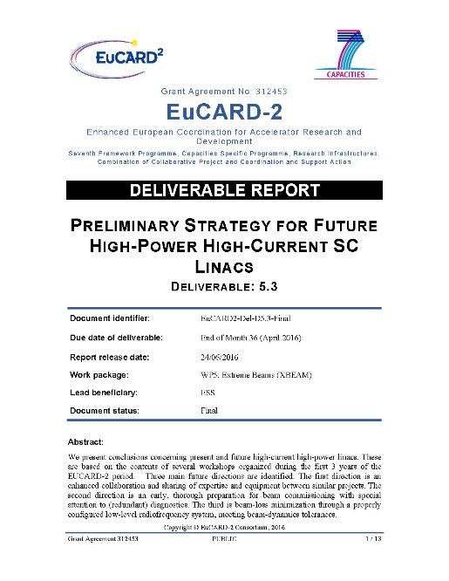
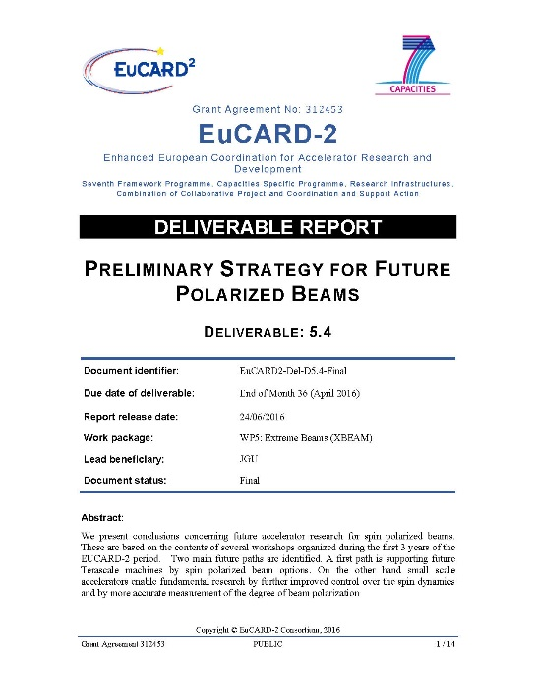
EuCARD-2 WP5 XBEAM strategies
four strategy reports delivered in 2016
preliminary strategies
for future hadron & lepton colliders
for future high-performance hadron rings
for future high-power high-current SC linacs
for future polarized beams

Slide 3
7 WP5 XBEAM Workshops May 2015 – April 2016
XLINAC mini-workshop "LLRF and Beam Dynamics Mutual Needs in Hadron Linacs," Lund, 1-2 June 2015 (35 participants)
XCOLL “Future electron–hadron colliders at CERN,” CERN & Chavannes-de-Bogis, 24-26 June 2015 (120)
XPOL workshop “Search for the Electron EDM in an Electrostatic Storage Ring,” JGU Mainz, 10-11 September 2015 (28)
XCOLL "Collimation Tracking Workshop," CERN, 30 Oct. 2015 (35)
XRING/XLINAC workshop "Beam Dynamics meets Diagnostics," Firenze, 4-6 November 2015 (65)
XCOLL co-org. workshop “FCC Week 2016”, Rome, 11-15 April 2016 (468)
XPOL workshop “Polarization Issues in Future High Energy Circular Colliders,” Rome, 16 April 2016 (14)

Slide 4
9 WP5 XBEAM Workshops May 2016 – April 2017
XRING “The Slow Extraction Workshop," Darmstadt (DE), 1-3 June 2016 (53 participants)
XRING/XLINAC coorg. “HB2016,” Malmö (SE), 1-3 July 2016 (~150)
XCOLL coorg. “Channelling 2016,” Sirmione (IT), 25-30 Sept. ‘16 (158)
XCOLL “eeFACT2016,” Daresbury (UK), 24-27 October 2016 (75)
XLINAC “Upgrading Existing High Power Proton Linacs,” Lund (SE), 8-9 November 2016 (22)
XPOL “New Polarimeter Techniques for Symmetry Breaking Experiments at Accelerators,” Mainz (DE), 2 Dec. 2016 (5)
XCOLL/EuroNNACc “Focus: Future Frontiers in Accelerator (F3iA) ”, Scharbeutz (DE), 5-9 December 2016 (25)
XBEAM “Strategy Workshop”, Valencia (ES), 13-17 Feb. 2017 (17)
XRING “Beam Dynamics meets Vacuum, Collimations, and Surfaces”, Karlsruhe (DE), 8-10 March 2016 (~60)

Slide 5
extreme colliders
1. lepton colliders

Slide 6
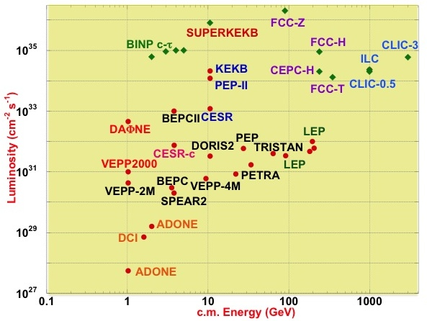
luminosity vs. c.m. energy for past, present and future e⁺e⁻ colliders
M. Biagini
past [orange, black, green centre- right], present (2015) [red] and future e+e- colliders [blue, purple, green top-left] around the world

Slide 7
lessons learnt from past&present e⁺e⁻ colliders
high beam currents possible : control of HOMs & e-cloud
crab waist works: special lattice
top-up injection needed: reliable injection complex
e-cloud mitigation possible: solenoids, low SEY, coating, clearing electrodes, grooves, NEG, scrubbing
bunch-by-bunch feedbacks work well: upgrades
backgrounds increase with I_{beam}, L and E: masking, shielding, beamstrahlung control
emittance tuning essential: machine error minimization (girders), fast online procedures for orbit/beta /dispersion/ coupling correction
IP orbit control needed: IP feedback
nano-beams require vibrations control for FF quads
M. Biagini

Slide 8
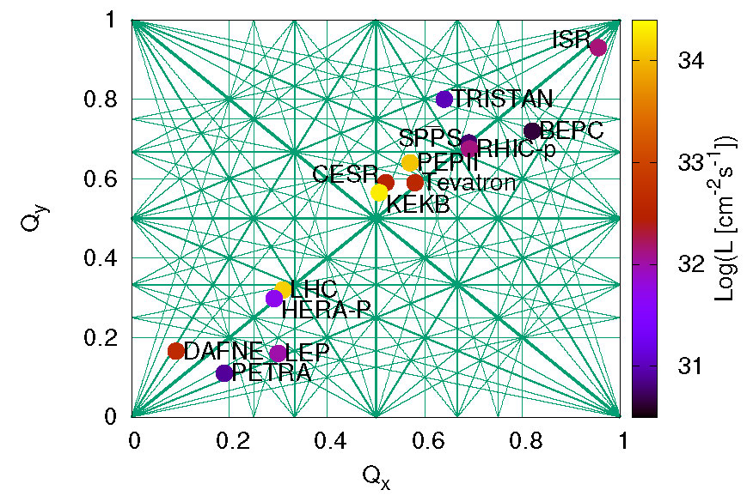
collider operating points and performance
R. Tomas

Slide 9
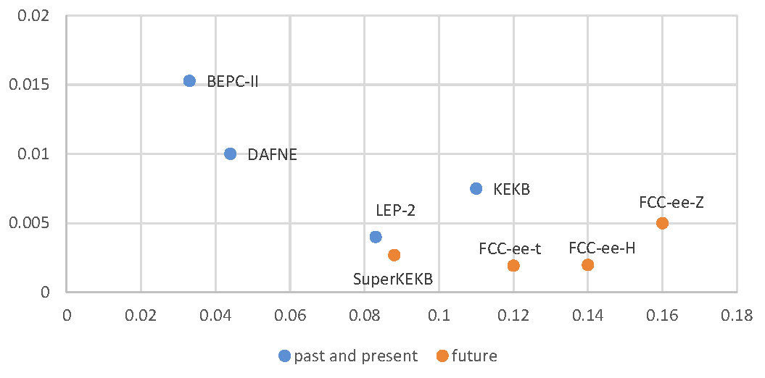
emittance ratio versus b-b tune shift
ε_{y}/ε_{x}
ξ_{y}

Slide 10
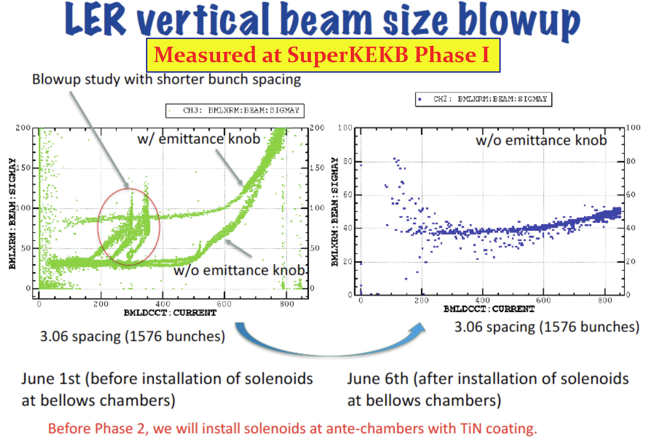
starting to learn from SuperKEKB: extremely low β_{y}*, top-up injection, and-e-cloud mitigation
M. Biagini

Slide 11
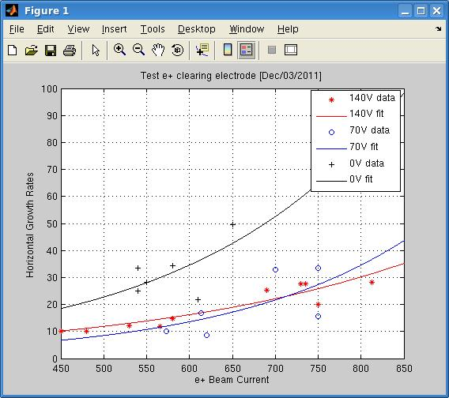
e-cloud clearing-electrodes at DAFNE
smaller vertical dimensions, less transverse tune spread and slower growth rates clearly indicate a positive effect
after 5 years 10/12 electrodes grounded (destruction of shapal insulators or damage of copper? check in 2018)
A. Drago

Slide 12
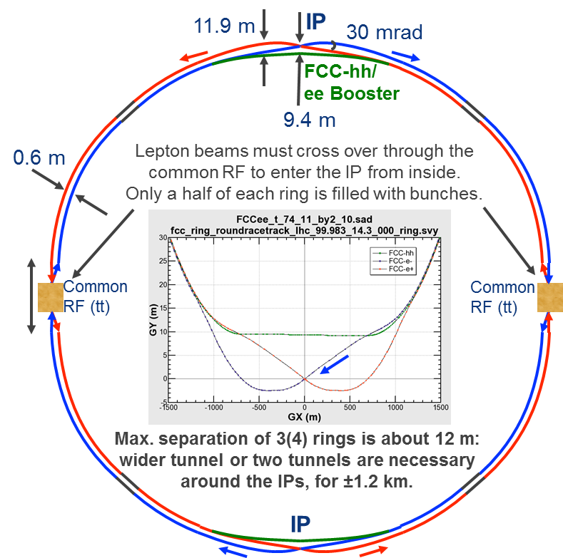
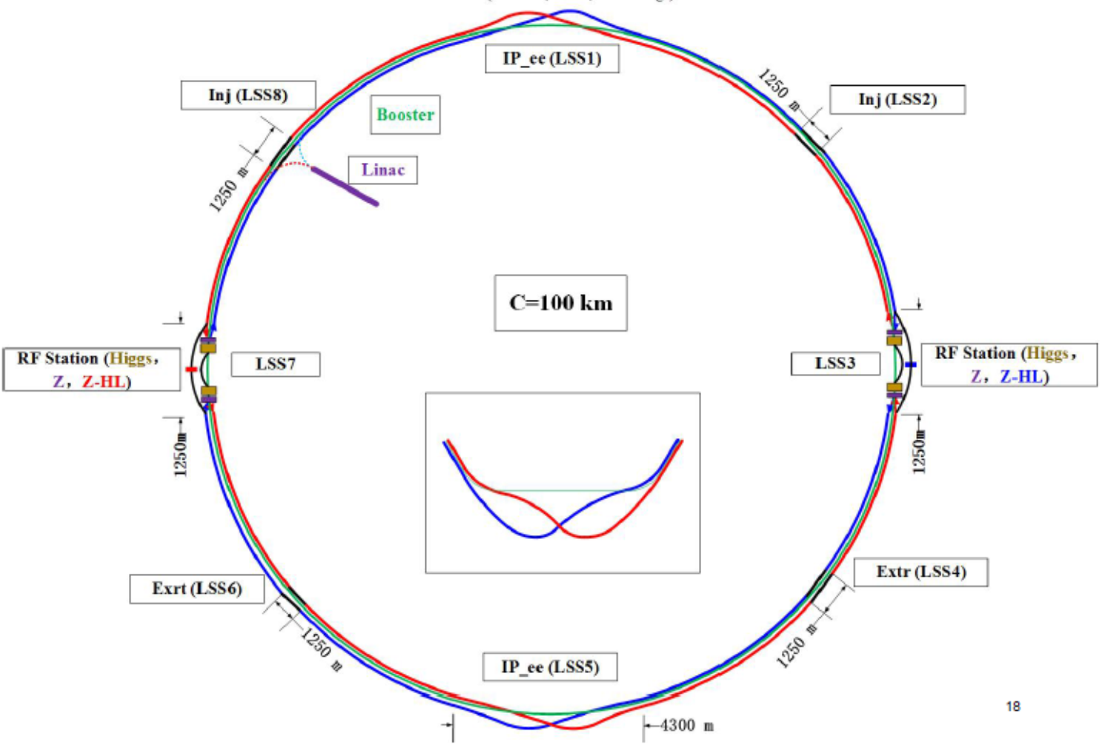
designs for future e+e- colliders are converging
FCC-ee design, K. Oide, 2015
CEPC design, J. Gao, 2017
F. Zimmermann

Slide 13
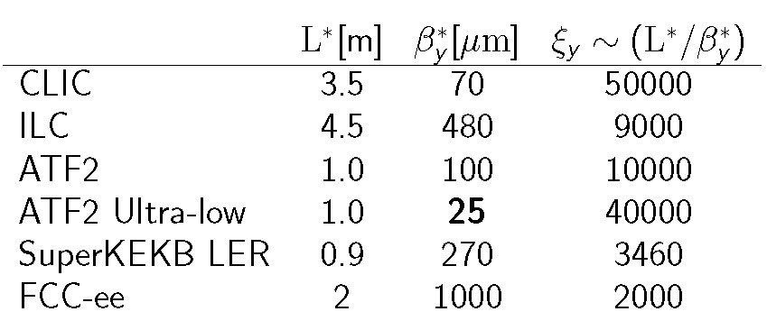
final-focus systems of lepton colliders
SuperKEKB = proof-of-principle for FCC-ee
LC final foci extremely challenging
R. Tomas

Slide 14
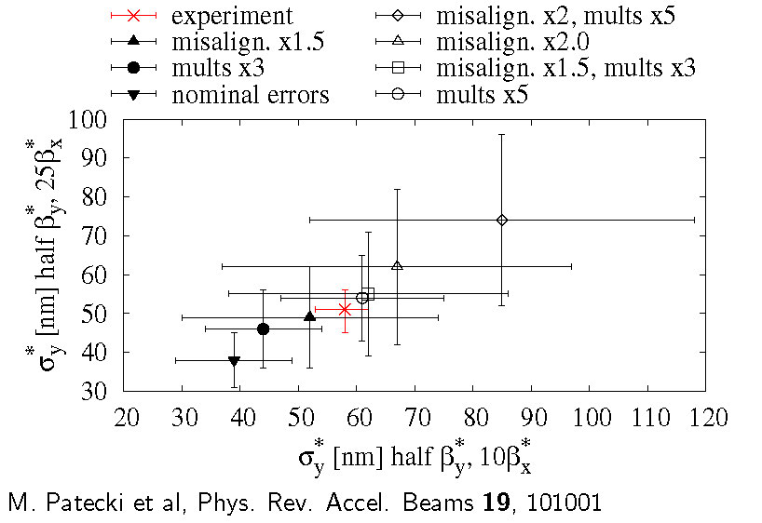
linear collider final foci – ATF2 tests
predictions were/are too optimistic (reminiscent of SLC, but for ATF2 even at low intensity)
R. Tomas

Slide 15
comparison of proposed future e+e- colliders
 | Unit | ILC - TDR |  |  | CLIC – CDR+ |  | FCC-ee
Technology |  | Linear SRF, Klystron driven |  |  | Linear NRF, 2-beam driven |  | Circular (2 IPs)
Energy | GeV | 250 | 500 | 1,000 | 380 | 3,000 | 91 | 240 | 350
Acc. Length | km | ~21 | 31 | 50 | 11 | 48 | 100
Tot Lumin. | 10³⁴ cm⁻²s⁻¹ | 0.82 | 1.8 | 3.6 | 1.5 | 5.9 | 200 - 400 | 10 | 2.6
Acc. Gradient | MV/m | 31.5 | 31.5 | 31.5/45 | 72 | 100 | 7 | 10 | 10
Res. Frequency | GHz | 1.3 | 1.3 | 1.3 | 12 | 12 | 0.4
IR, v. beam-size | nm | 7.7 | 5.9 | 2.7 | 2.9 | 1 | 32 | 49 | 70
Beam Power (/IP) | MW (2-beams) | 2 x 2.9 | 2 x 5.2 | 2 x 10.6 | 2x2.8 | 2 x 14 | 2x66000 | 2x3600 | 2x1160
SR loss | MW | 4 | 4 | 4 | 3 | 2 | 100
AC Power | MW | 129 | 163 | 300 | 252 | 589 | 275 | 308 | 364
L / AC | Relative | 0.64 | 1.1 | 1.2 | 0.60 | 1.0 | 72 - 145 | 3.2 | 0.71
M. Biagini, F. Zimmermann

Slide 16

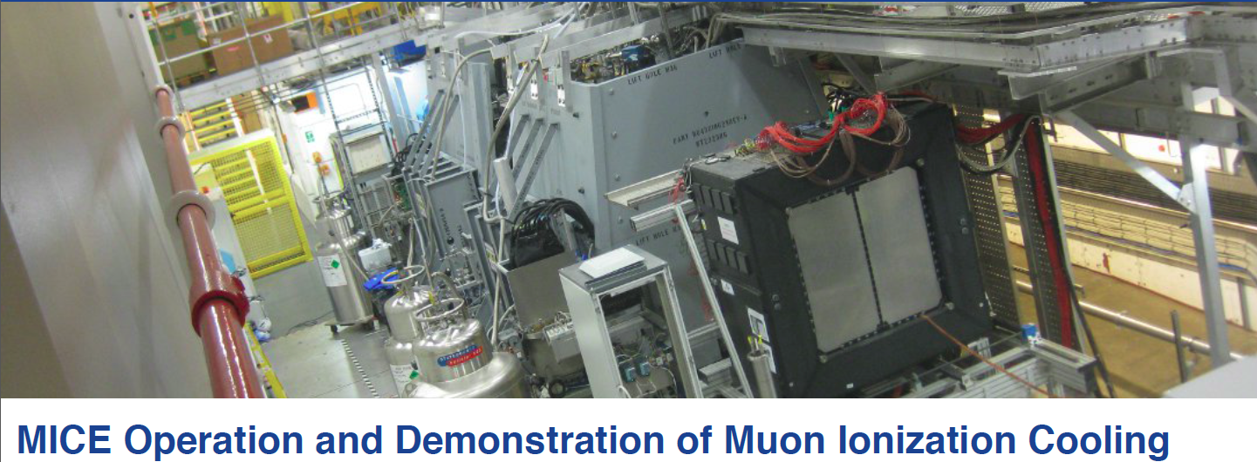
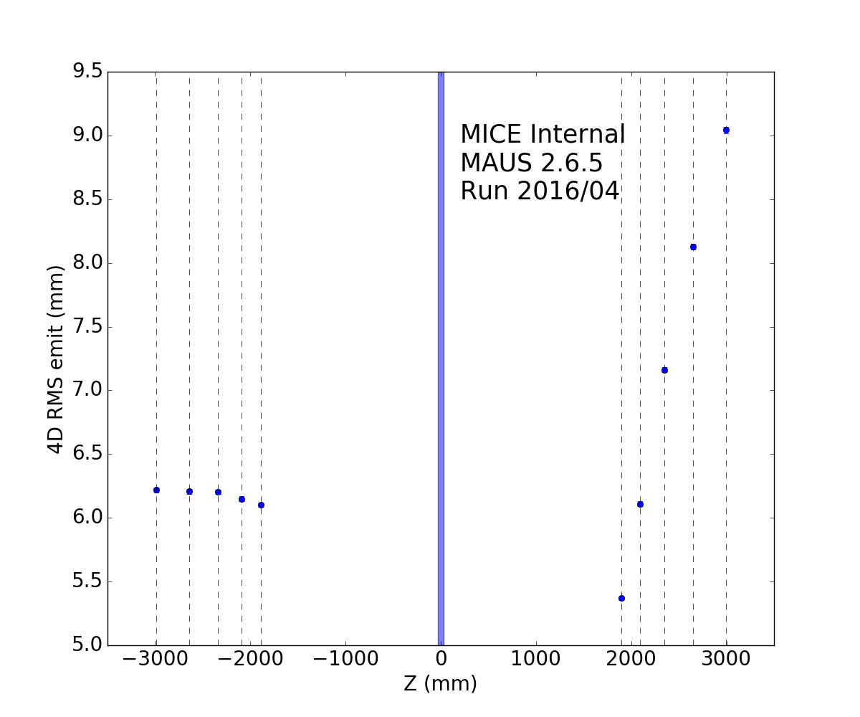
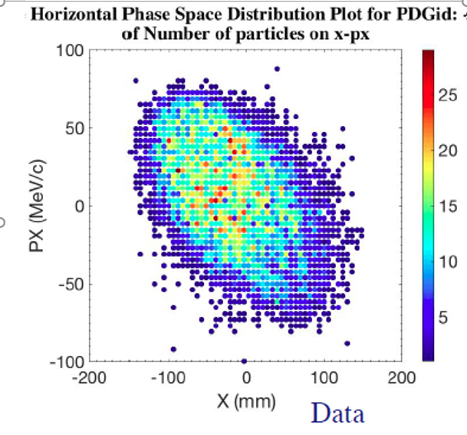
MICE success
at RAL
10M muon tracks
8% cooling observed
  w/o RF yet
re-accel’n in 2018
Ref. plane upstream
Ref. plane downstream
V. Shiltsev
MICE (very) preliminary A.Bross, A.Liu, F.Drielsma

Slide 17
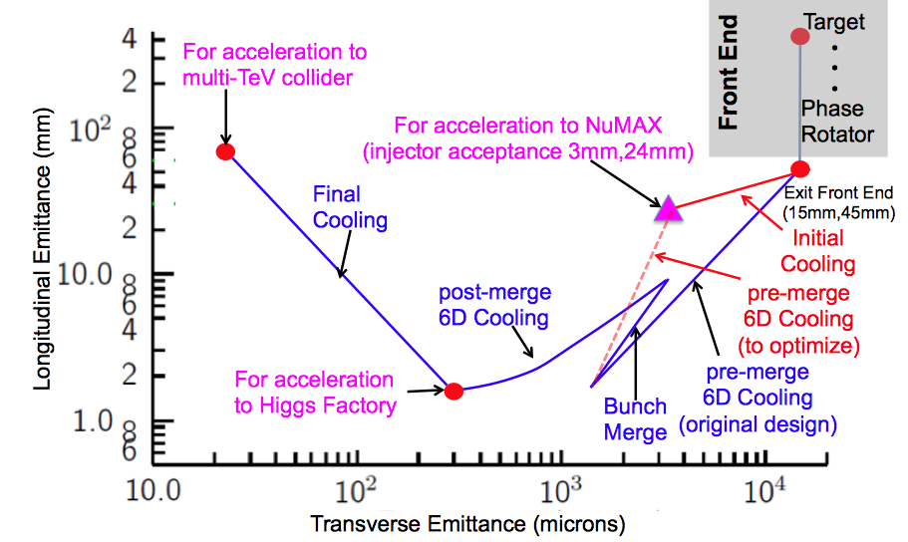
two novel approaches boosting muon collider
no. 1: parametric res. ionization cooling (PIC)
Advanced techniques a
Improved HF Luminosity
Simplified Final Cooling requirements
MAP Higgs
Factory Target
PIC assumed in Carlo
Rubbia’s Proposal
M. Boscolo

Slide 18
two novel approaches boosting muon collider: no. 2: direct muon pair production e⁺e⁻→μ⁺μ⁻
M. Boscolo
advantages:
Low emittance
Low background
Reduced losses from decay
Reduced energy spread
disadvantage (key challenge!):
rate: much smaller cross section wrt protons
σ(e⁺e→μ⁺μ⁻) ~ 1 μb at most
i.e. Luminosity(e+e-)= 10⁴⁰ cm⁻² s⁻¹ → gives μ rates 10¹⁰ Hz
use e+ ring to reduce request on positron source
→ we should compare cross sections of competing processes

Slide 19
from US-MAP (2015) to Italian μ-collider (2017)
Key Challenges
~10¹³-10¹⁴ μ / sec
Tertiary particle pgπgμ:
Fast cooling
(τ=2μs)
by 10⁶ (6D)
Fast acceleration
mitigating μ decay
Background
by μ decay
Positron Beam
e+ ring
μ⁺
LHeC-class e+ source & e+ acceleration at 45 GeV
(circular/linear options)
μ⁻
isochronous rings
100 KW target
Key Challenges
~10¹¹ μ / sec from e+e-gμ+μ−
Key
R&D
10¹⁵ e+/sec, 100 kW class target, NON distructive process in e+ ring
M. Boscolo

Slide 20
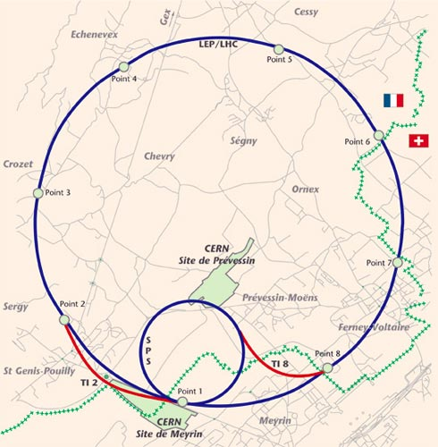
CMC
CERN
Muon
Collider
SRF
SRF
14 TeV cm
LHC tunnel
SPS tunnel and mb PS
~7GeV SRF
pulsed magnets
cost ~LHC
SRF
SRF
V. Shiltsev

Slide 21
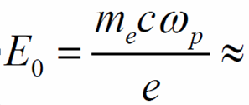
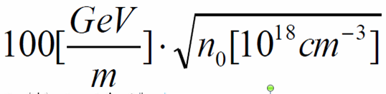
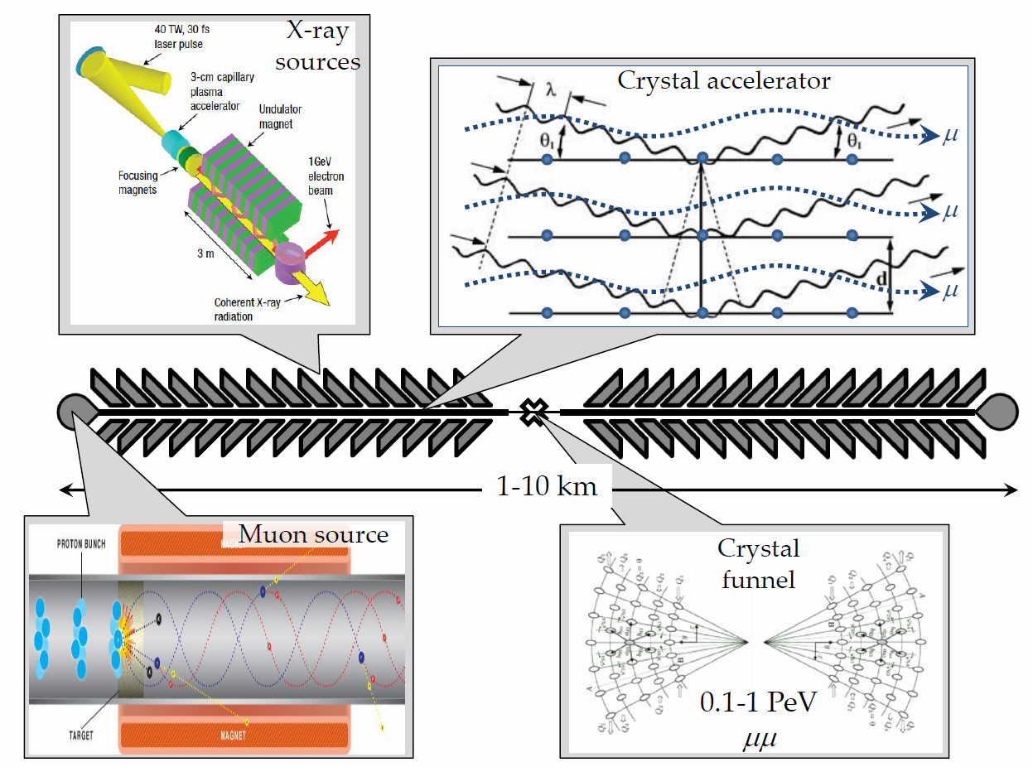
“dream” collider = muon crystal acceleration
n~10²² cm⁻³,
10 TeV/m →
V.Shiltsev, Phys. Uspekhy 55 965 (2012)
1 PeV =
1000 TeV
n_{μ} ~1000
n_{B} ~100
f_{rep} ~10⁶
L ~10³⁰⁻³²
V. Shiltsev

Slide 22
extreme colliders
2. hadron colliders

Slide 23
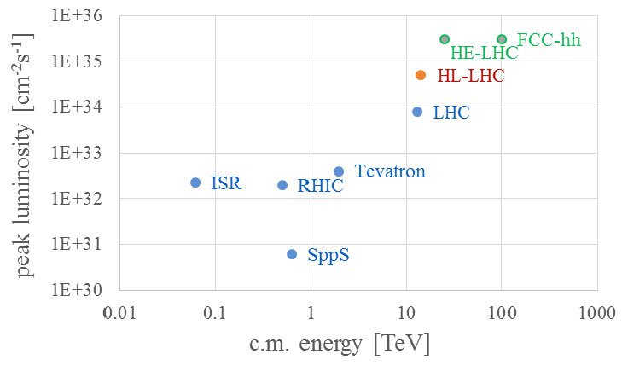
luminosity vs. c.m. energy for past, present and future hadron colliders
past and present [blue], upcoming [red], and longer-term future hadron (pp or p-pbar) colliders [green] around the world
F. Zimmermann

Slide 24
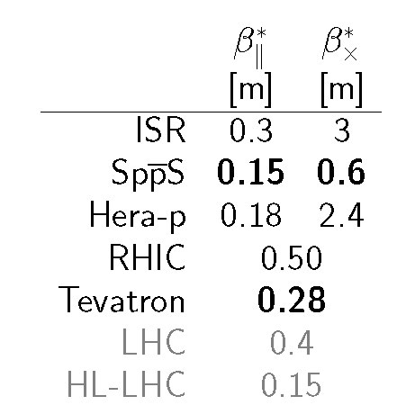
beta* of hadron colliders
pushing FCC-hh β* down to 5 cm ?
R. Martin et al., submitted to PRAB
R. Tomas

Slide 25
hadron-beam instabilities & cures (LHC)
beam instabilities observed for different LHC beam processes
some lesson learnt:
  narrow range of machine settings to keep beam stable along the cycle
  instabilities occur if coupling exceeds a certain threshold (at different stages)
  chromaticity settings are crucial along the cycle and can’t be relaxed
  octupole settings have to be adapted according to beam emittance
  transverse damper indispensable to preserve beam stability all along the cycle
sources of instability
  electron cloud (with 25 ns beams) → tends to become better with scrubbing
  machine impedance and loss of Landau damping
G. Rumolo

Slide 26
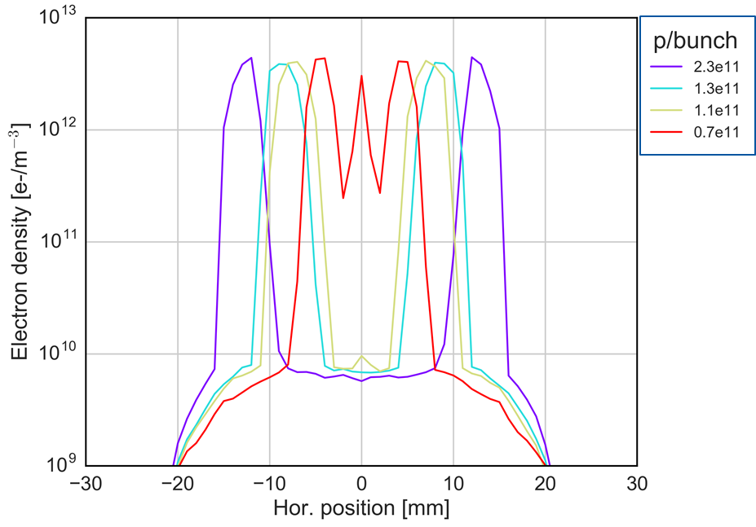
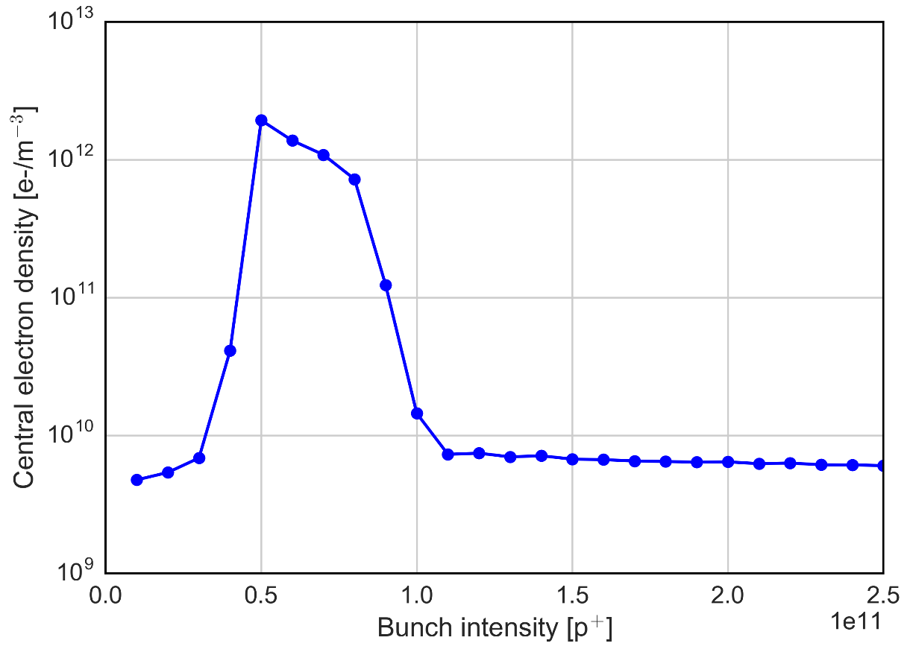
e-cloud causes coherent instability in collision
coherent instabilities in stable beams → simulations
  electron cloud in the dipoles tends to form a central stripe for lower bunch intensities
  the central density threshold (5e11 m⁻³) is crossed when the bunch intensity decreases with Q’=15
  the threshold becomes much higher for Q’>20
explanation also consistent with the disappearance of this phenomenon (due to scrubbing)
0.7e11
Instability threshold estimated by PyEC-PyHT simulations
2.3e11
HL-LHC
1.1e11
G. Rumolo

Slide 27
extreme colliders
3. efficiency & cost

Slide 28
two possible figures-of-merit for the efficiency
beam power at collision point(s) divided by total electrical power of the facility
luminosity per electrical input power
F. Zimmermann
collider | c.m. energy [TeV] | P_{el}: tot. el. power [MW] | P_{b}: IP beam power [GW] | luminosity L [nb⁻¹s⁻¹] | P_{b}/P_{el} | L/P_{el} (/IP) [nb⁻¹s⁻¹/MW]
CEPC | 0.24 | ~500 | 4.0 | 20 | 8000 | 0.04
FCC-ee | 0.091 | 276 | 132 | 2000 | 500000 | 7.2
FCC-ee | 0.24 | 308 | 7.2 | 50 | 23000 | 0.16
FCC-ee | 0.35 | 364 | 2.3 | 13 | 6300 | 0.04
LHeC | 1.3 | 75 (e- only) | 0.4 (e-only) | 1 | 5 | 0.01
LHeC-HF | 1.3 | 100 (e- only) | 1.5 | 16 | 15 | 0.16
ILC | 0.25 | 122 | 0.0059 | 7.5 | 0.05 | 0.06
ILC | 0.5 | 163 | 0.0105 | 18 | 0.06 | 0.11
CLIC | 0.5 | 271 | 0.009 | 23 | 0.03 | 0.08
CLIC | 3.0 | 582 | 0.028 | 59 | 0.05 | 0.10
laser-plasma | 3.0 | 282 | 0.045 | 100** | 0.05?? | ??
LHC | 13.0 | ~150 | 8000 | 10 | 50000 | 0.07
FCC-hh | 100.0 | 500 (target) | 50000 | 300 (phase 2) | 100000 | 0.6
SPPC | 70.2 | 600 (guess) | 53000 | 100 | 90000 | 0.2

Slide 29
some efficiency lessons
linear colliders must operate with much smaller IP spot sizes to compete in luminosity
ERLs do not (yet) reach the efficiency of circular machines
future circular lepton and hadron colliders offer outstanding luminosities / input power
figures of merit for plasma linear colliders highly uncertain

Slide 30
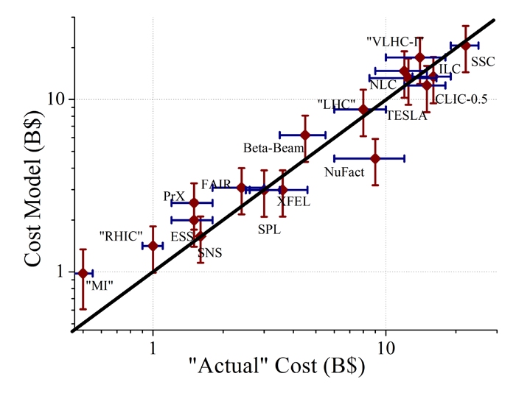
project costs fitted by αβγ model
Cost(TPC) = α L^{1/2} + β E^{1/2} + γ P^{1/2}
The αβγ-model is good to +-30%
V. Shiltsev

Slide 31
technology cost drivers
“SRF is the most expensive technology ever invented”
β≈ 10B$/sqrt(E/TeV)
“only plasma acceleration is even more expensive”
β≈ XX B$/sqrt(E/TeV)
V. Shiltsev

Slide 32
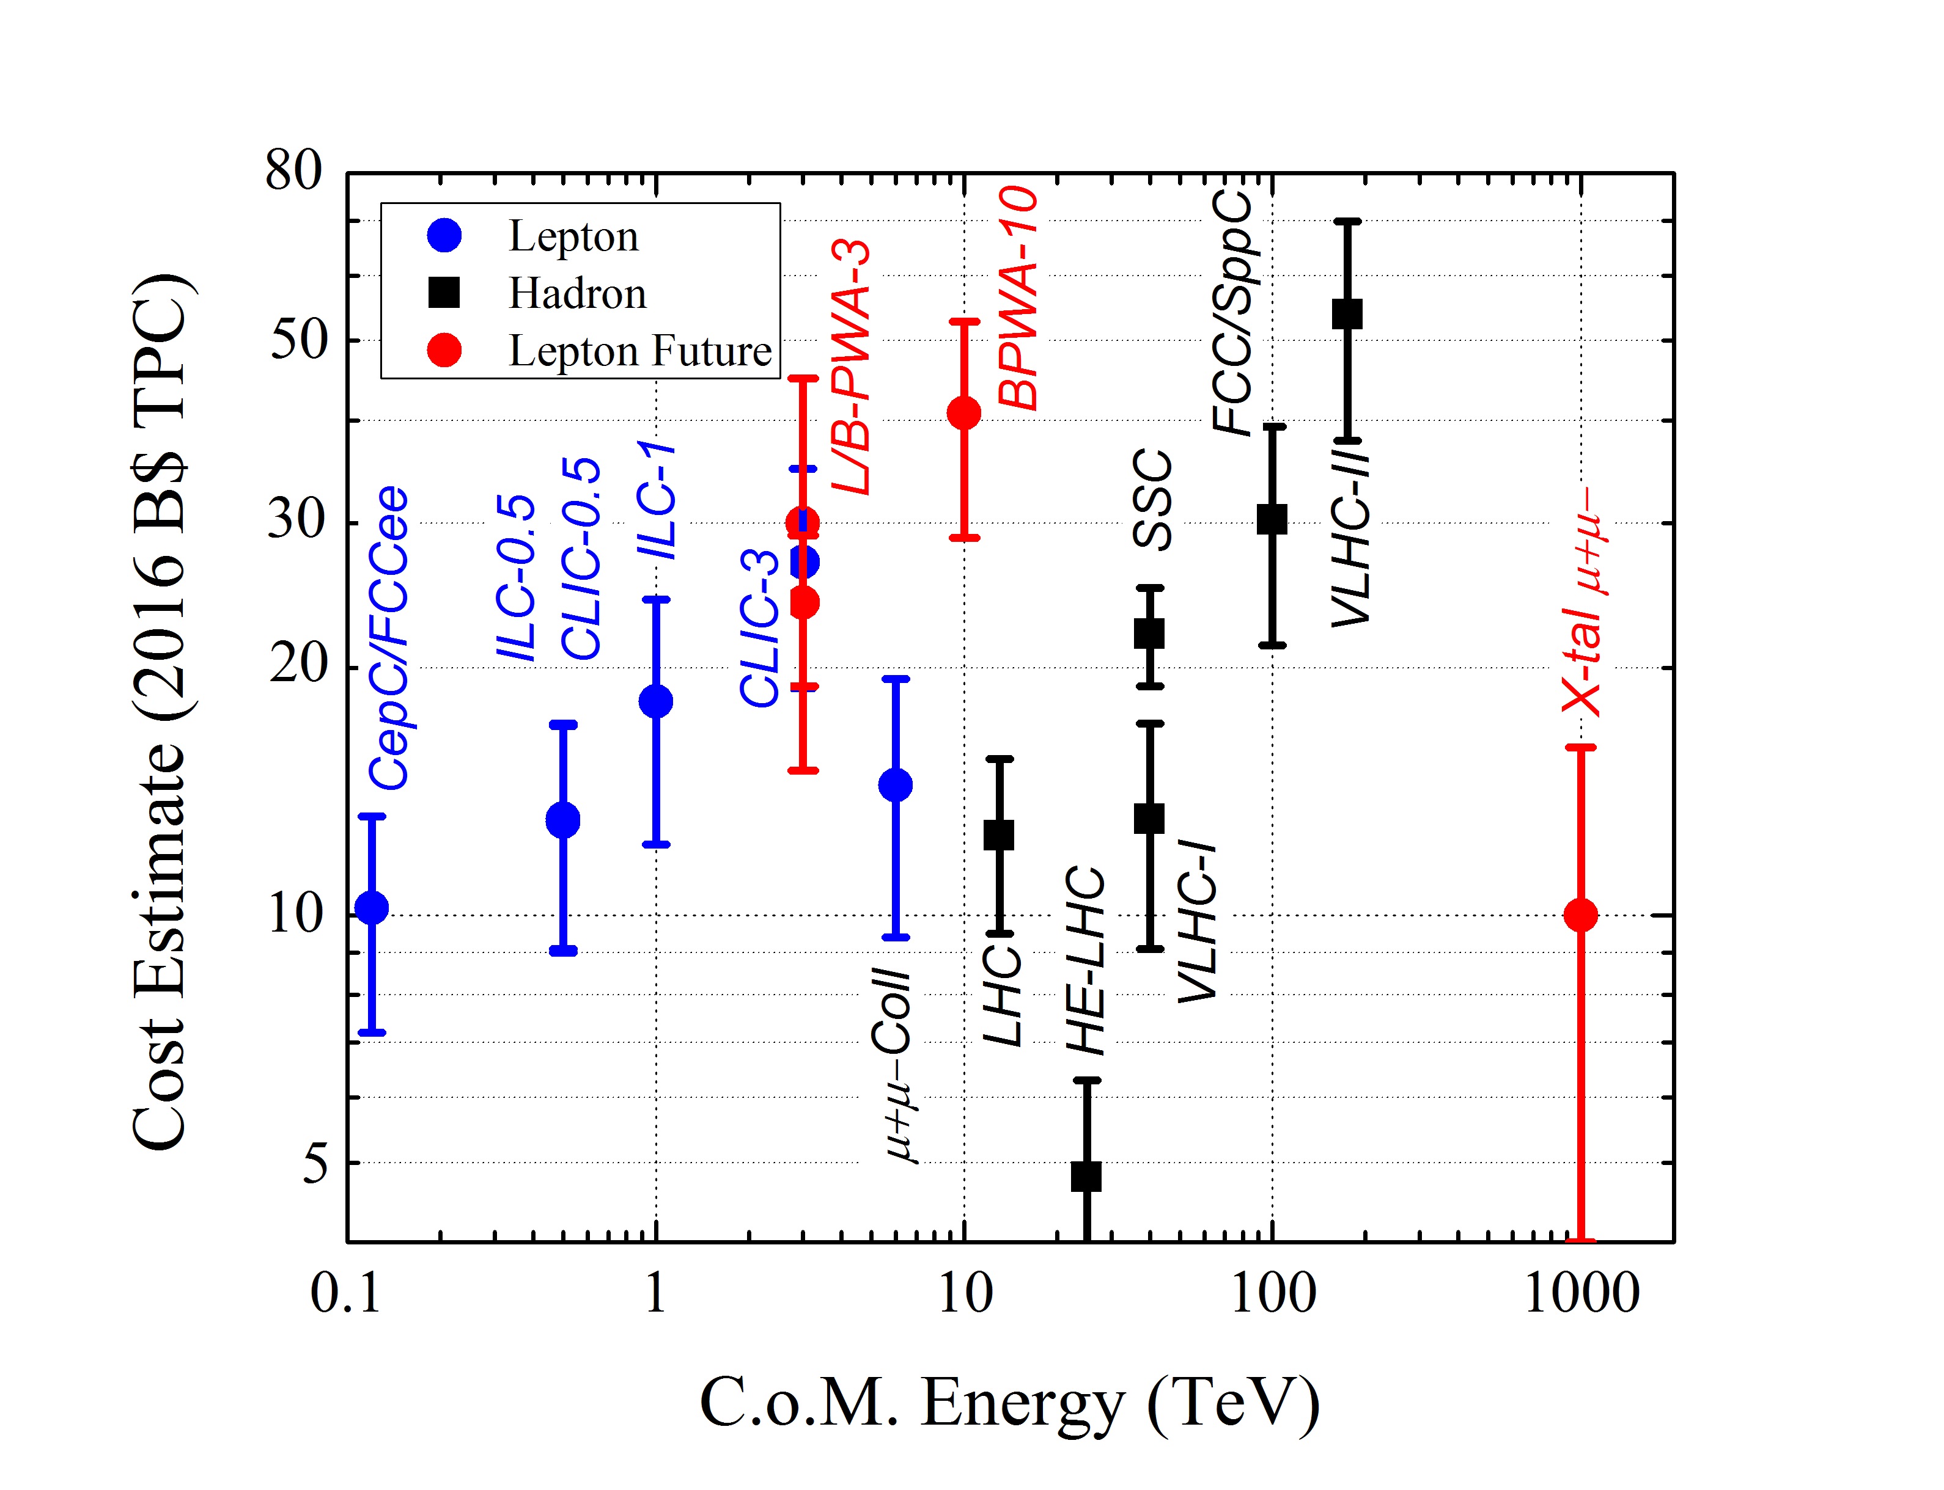
predicting costs by αβγ model
V. Shiltsev

Slide 33
3 steps to lower the cost of future 100 TeV pp collider
build on site with existing injector complex
consider staging (e⁺e⁻ 1st, pp 2nd)
reduce SC/magnet cost

Slide 34
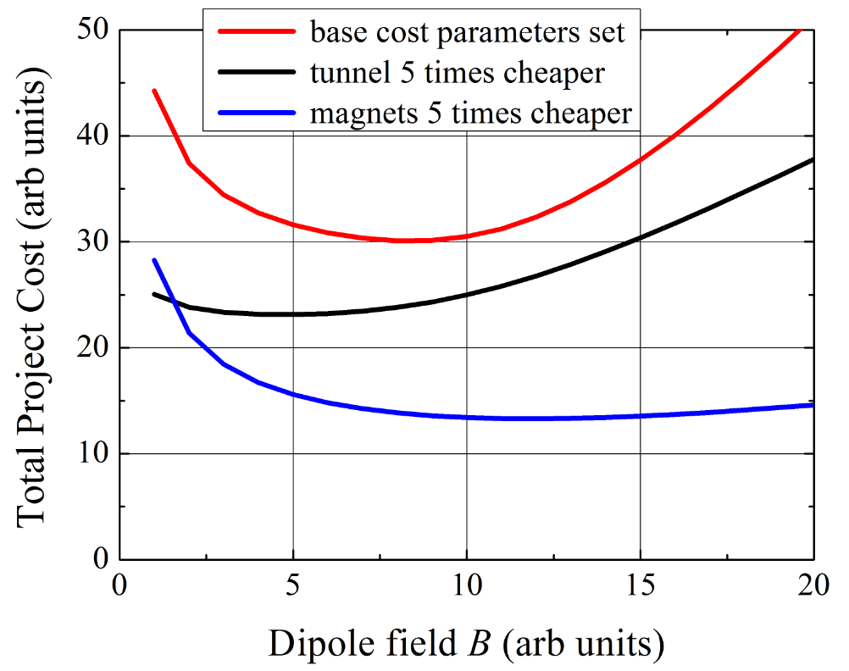
100 TeV pp : Qualitative Cost Dependencies
develop technology to lower the cost
* for illustration purposes only
V. Shiltsev

Slide 35
extreme rings

Slide 36
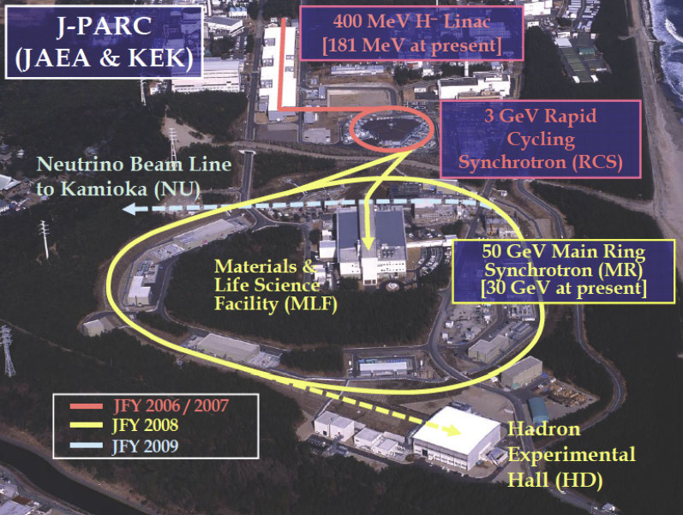
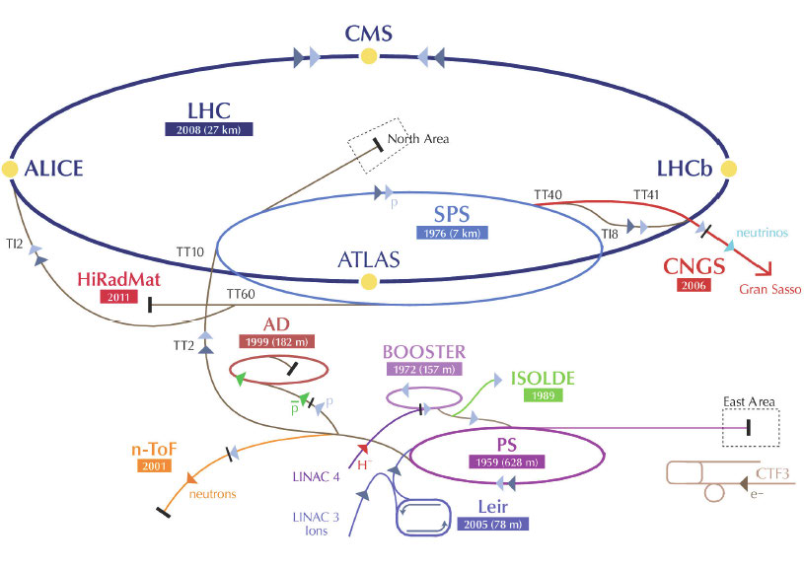
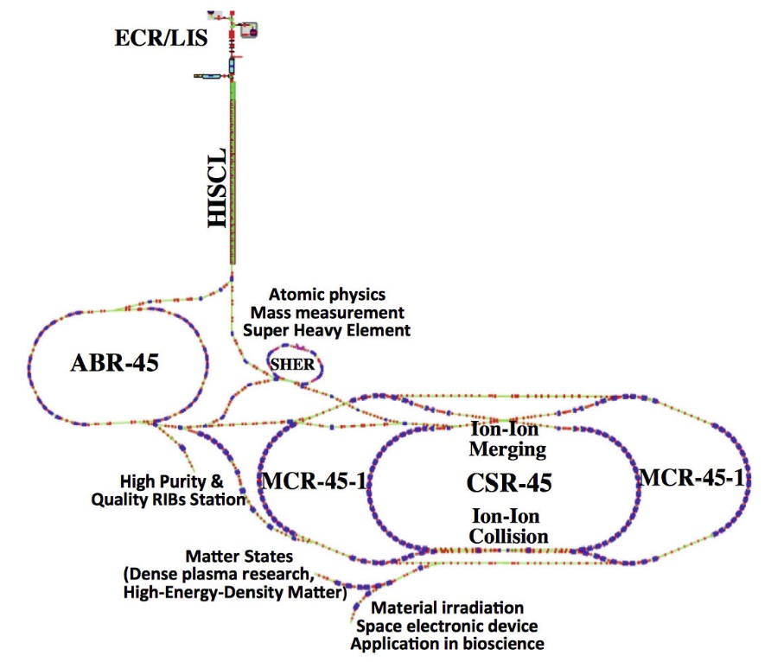
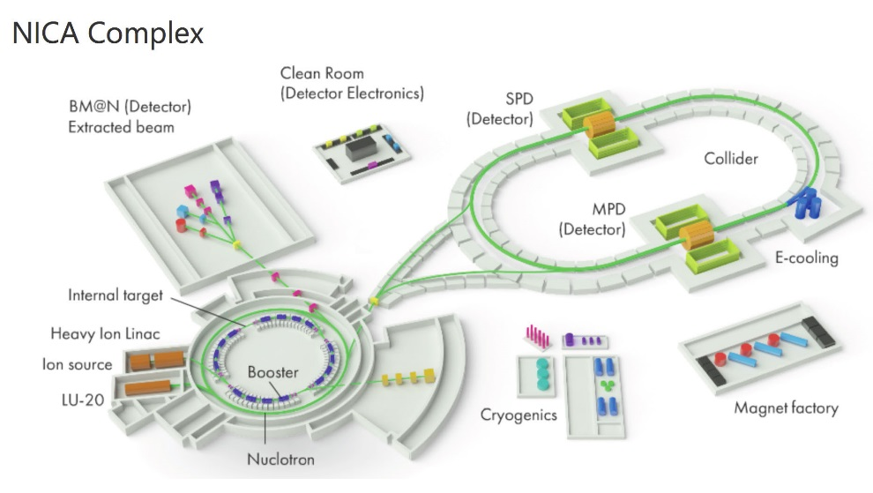
more hadron rings & becoming more powerful
FAIR
LIU/HL-LHC
G. Franchetti
HIRFL Lanzhou
Dubna

Slide 37
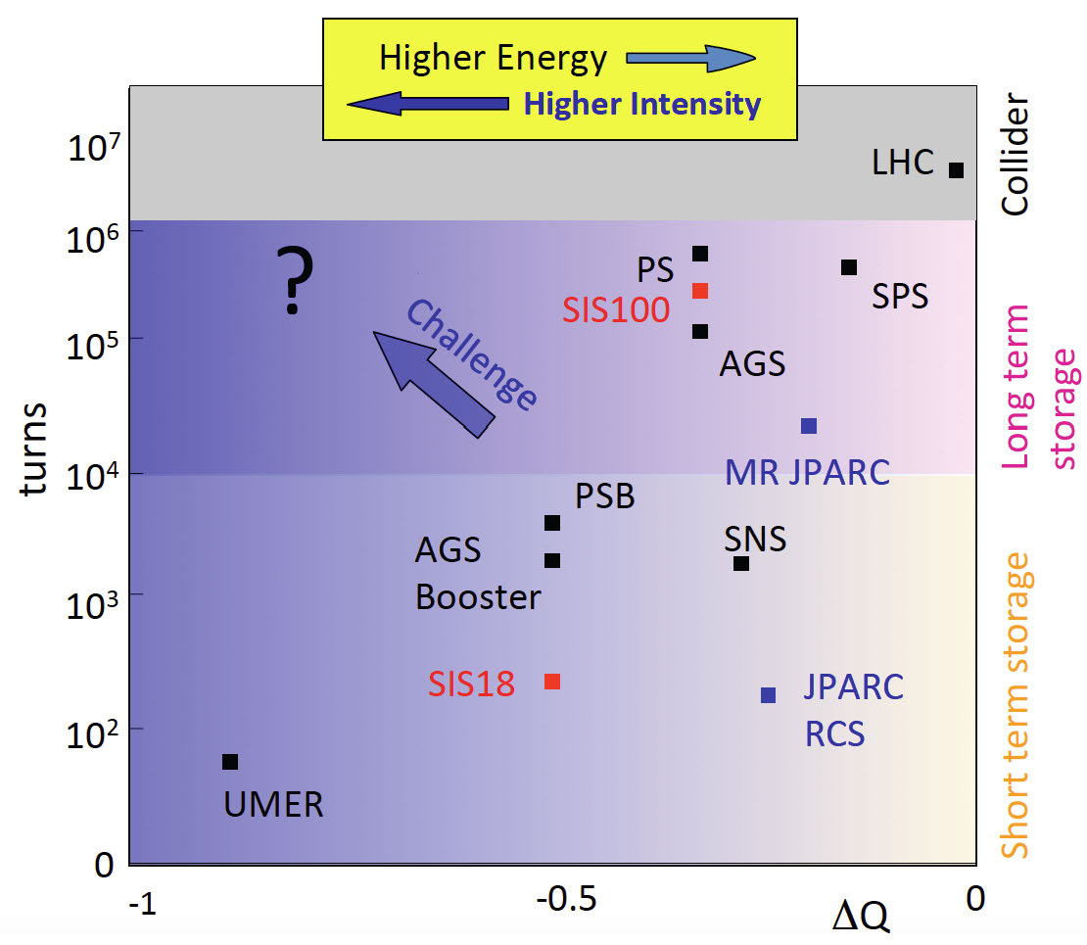
hadron rings becoming more extreme
G. Franchetti

Slide 38
key topics and trends for extreme rings
space charge limit & mitigations (resonance compensation, improved optics control, e-lenses …)
magnet alignment & more accurate field models
dynamic vacuum pressure & ion beam lifetime
multi-turn injection and extraction (novel loss-free or septum less schemes based on resonance islands)
slow extraction with reduced micro-spill structure (spill feedback)
electron cooling, stochastic cooling, laser cooling, advanced schemes (opt. stoch. cooling, coh. el. cooling) – beam tests and developments at FNAL and BNL
“making beams great [=stable] again” (e-lenses for Landau damping, integrable systems – IOTA)
isochronous operation mode
transition crossing (jump, optics change, islands)

Slide 39
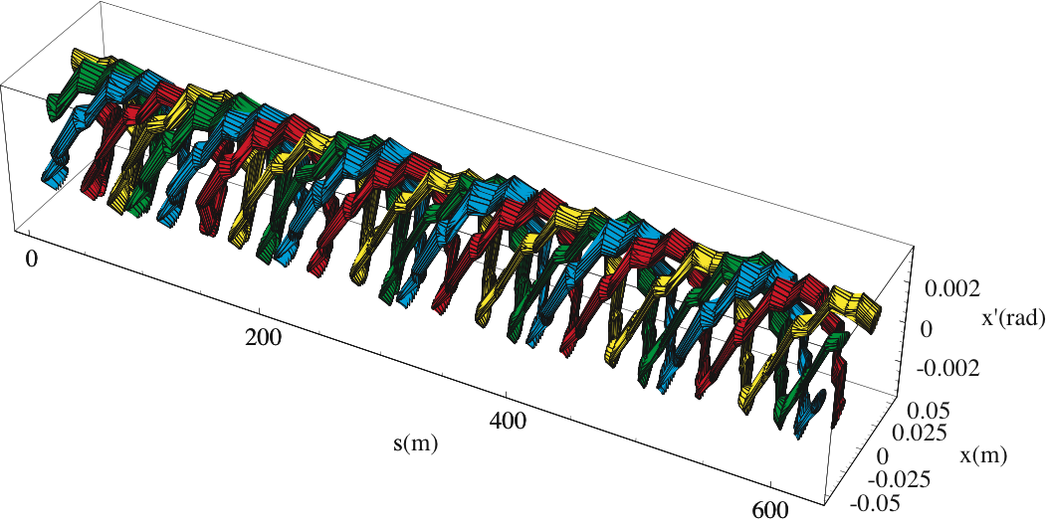
sextupoles and octupoles can generate stable islands in phase space -
- used at SPS, multiple advanced applications
M. Giovannozzi

Slide 40
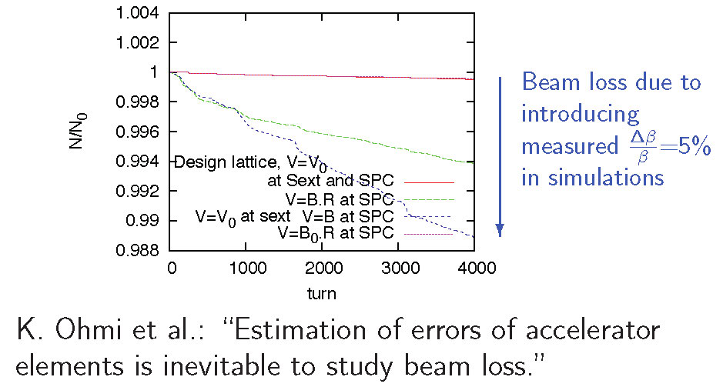
optics control needs for extreme rings
space-charge limited rings would beneﬁt from sub-% optics control ;
new diagnostics: AC ORM? other?
R. Tomas

Slide 41
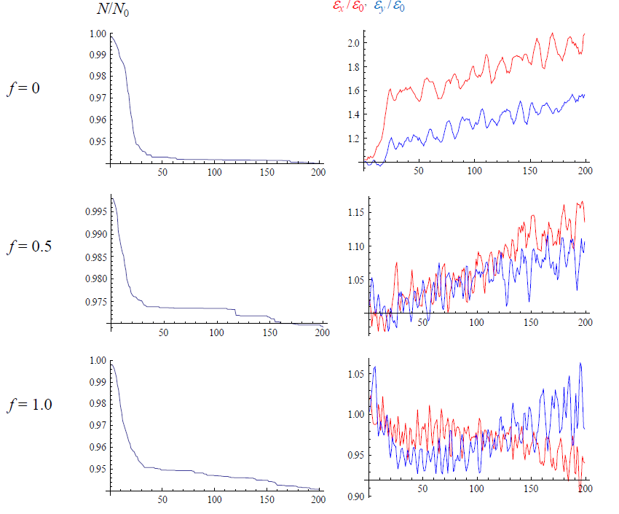
simulations for FNAL Booster (Yu. Alexahin & V. Kapin, 2007)
SC compensation with e-lenses: FNAL booster
Booster:
400 MeV, 474 m
P=24
N_p~4.5e12
dQ_sc=-0.3
“space charge compensation with e-lenses works”
the more compensators the better (24→12→3 minimum)
V. Shiltsev

Slide 42
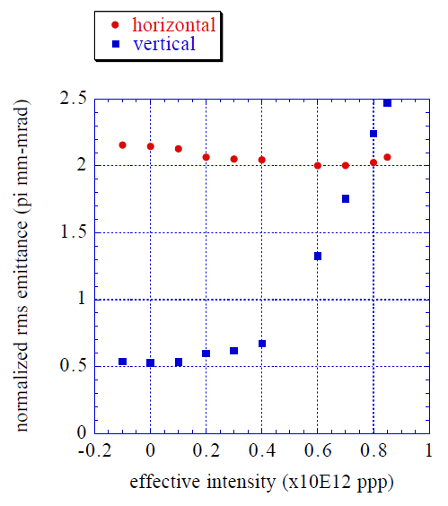

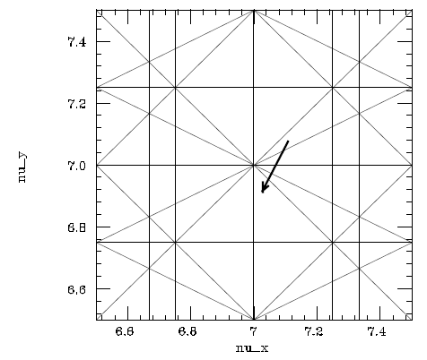
simulations for KEK PS (S. Machida, 2001)
SC compensation with e-lenses: KEK PS
KEK PS:
500 MeV, 340 m
N_p~1e12
dQ_sc=-0.2
“space charge compensation with e-lenses works”
+0.1-0.2 sigma e-p displacement tolerable
V. Shiltsev

Slide 43
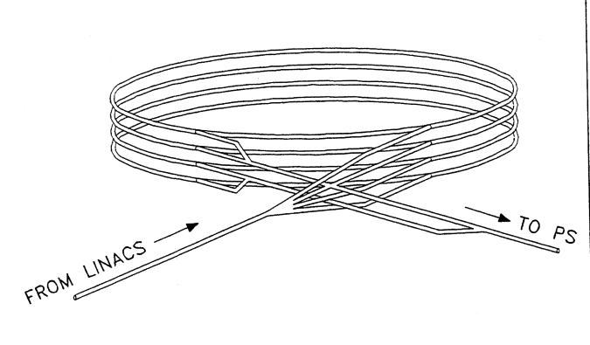
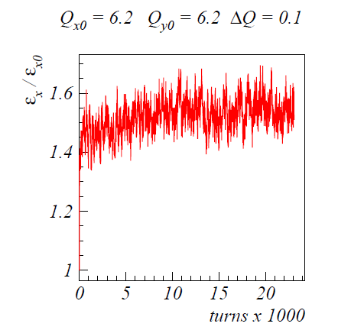
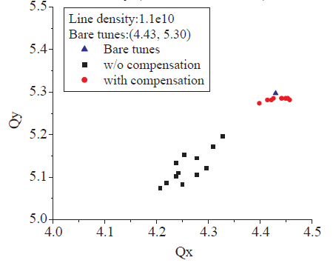
SC compensation with e-lenses: CERN PS-B
simulations for CERN PS-B (M. Aiba et al.,2007)
PS Booster:
50 MeV, 157 m
P=16
dQ_sc ~ -0.5
“space charge compensation with e-lenses works in principle… deserves further studies”
no evidence for coherent modes limitation in PSB and PS
concern of overcompensation in the head and tail
the more compensators the better (8 better than 4)
V. Shiltsev

Slide 44
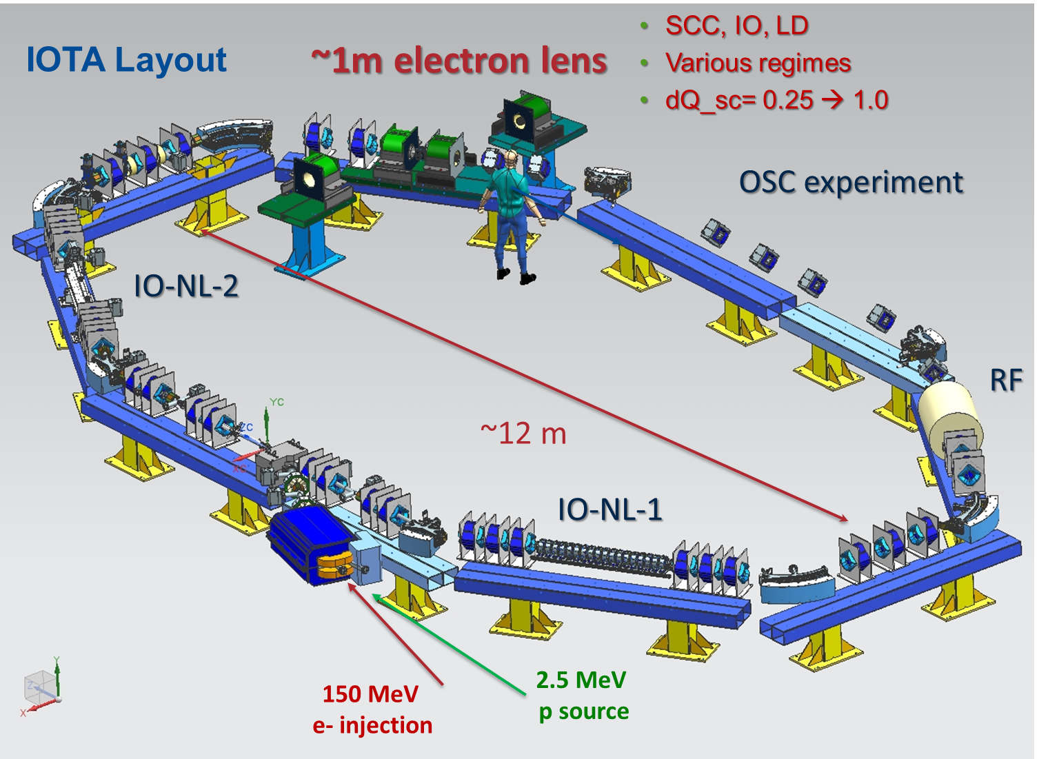
beam test facility IOTA at FAST turns on soon
V. Shiltsev

Slide 45
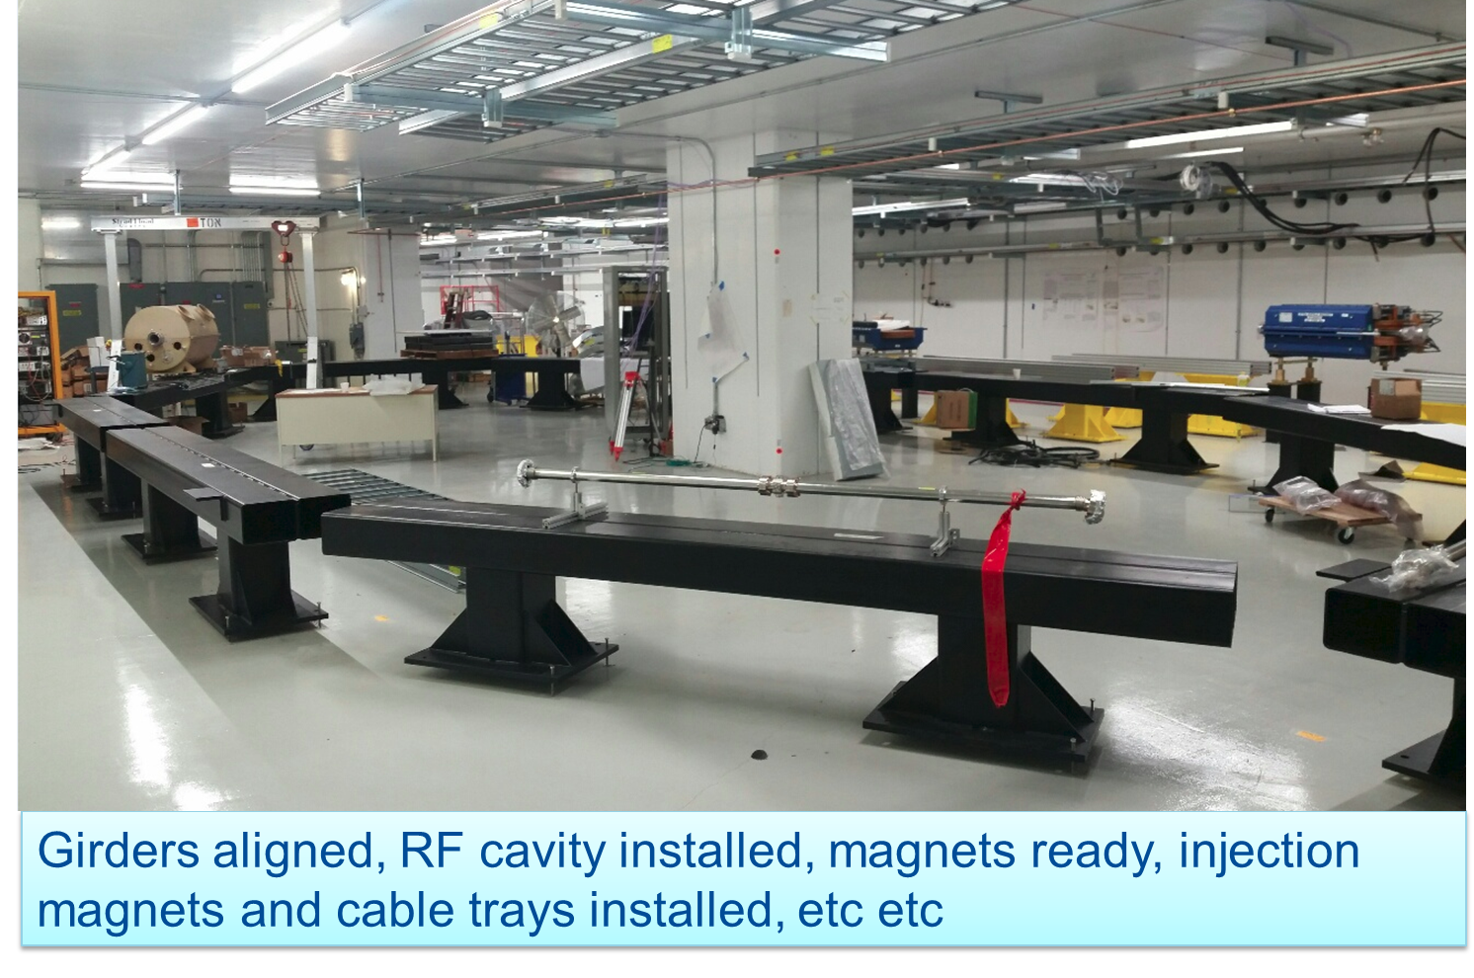
IOTA construction status, beam in 2018?
V. Shiltsev

Slide 46
IOTA beam tests of electron lens applications
new applications of e-lenses include:
  electron lenses for space-charge compensation
  electron lenses for integrable optics
  electron lenses for Landau damping
V. Shiltsev

Slide 47
extreme linacs

Slide 48
extreme superconducting linear accelerators
 | Particle | Duty factor | Energy/Nucleon resp. energy per e- [MeV] | (Pulse) Current [mA] | Av.power [kW]
ATLAS at ANL | ions | up to CW | 10 to 20 | 0.0002-0.06 | 2
ELBE | e | CW | 40 | 1 | 40
SNS | H- | 8% | 1000 | 38 | 1400
SPIRAL-2 | p, d, ions | up to CW | 8 to 33 | 1 to 6 | 200
CEBAF Upgr. | e | CW | 12000 | 0.1 | 1000
ESS | P | 4% | 2000 | 62.5 | 5000
FRIB | ions | up to CW | 200 to 320 | 0.65 | 400
LCLS-II | e | CW | 4000 | 0.06-0.3 | 300-1200
Europ. XFEL | e | 0.7% | 17500 | 5 | 900
Chinese ADS | p | CW | 1500 | 10 | 15000
MESA Mainz | e | CW | 105-155 | 1-10 | 1600
MYRRHA | P | CW | 600 | 4 | 2400
eRHIC (ERL) | e | CW | 20000 | 50 | 1000,000
LHeC (ERL) | e | CW | 60000 | 6.6 | 400,000
SPL at CERN | p | 4% | 5000 | 20 (40) | 4000
ESS+ESSnuSB | p | ~9% | 2000 | 62.5 | 10000
ILC | e | 0.4% | 250 | 5.8 | 2x5200
linacs in operation (blue), under construction (green), or being proposed (red)

Slide 49
issues for extreme linacs
cost reduction
more efficient production of SC cavities (large grain, hydroforming)
beam halo and losses
HOM couplers
pushing 1-MW limit of fundamental power couplers
M. Eshraqi

Slide 50
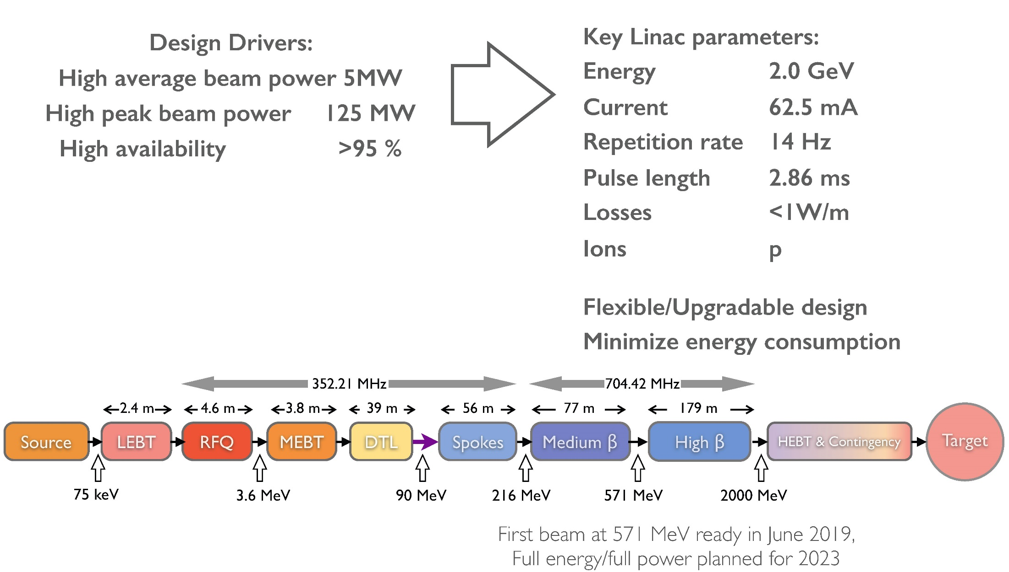
the ESS linac
M. Eshraqi

Slide 51
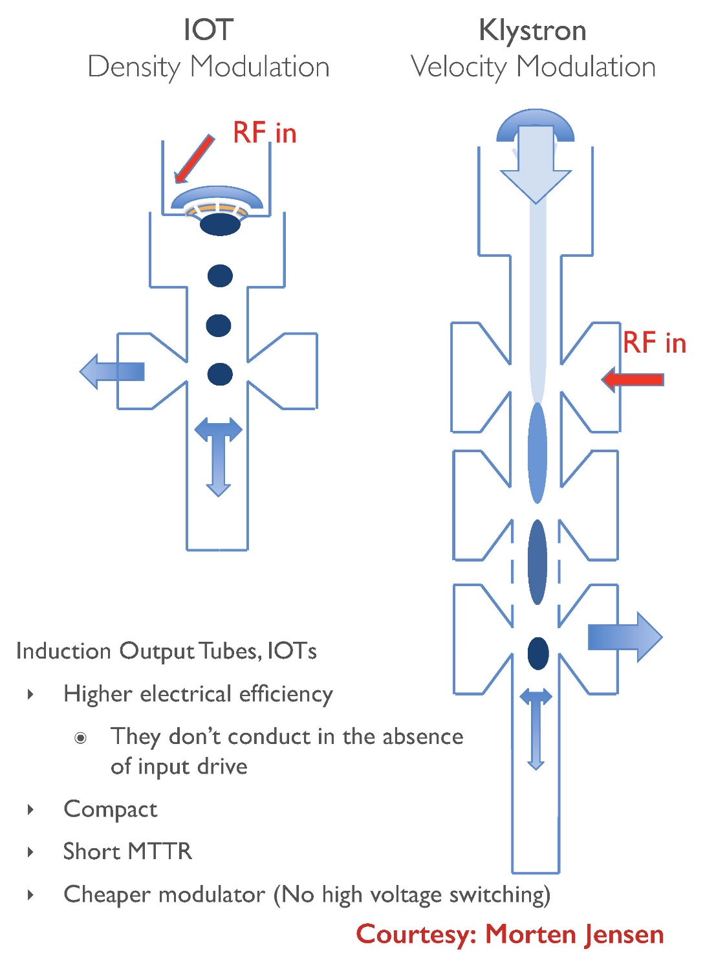
are IOTs more efficient than klystrons?
M. Eshraqi

Slide 52
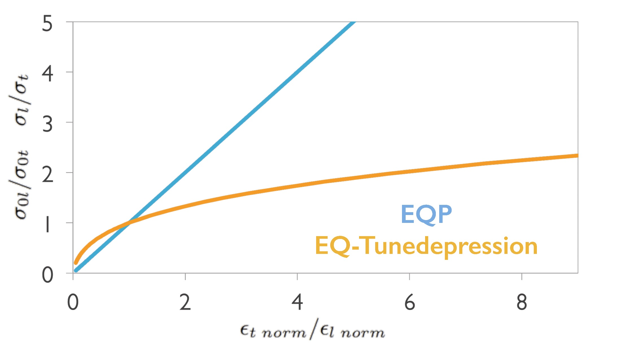
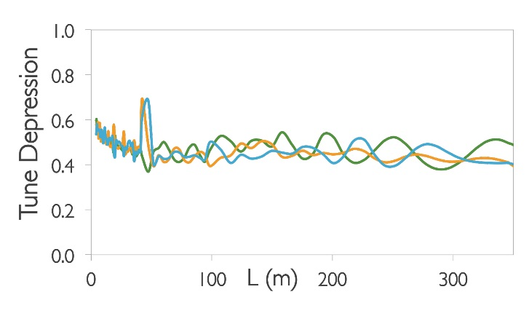
optimized beam physics
equipartition versus equal tune depression
M. Eshraqi

Slide 53
diagnostics for high-power proton linacs
3 B’s (BCT, BLM, BPM, + BPhaseM)
- controlling beam loss
- trigger fast abort in case of failure
profile measurements
- minimally invasive diagnostics
- wire scanner, ionization, BIF (w. pump laser?)
advanced beam instrumentation
- fast neutron monitor
- differential BCM, bunch shape monitor
- gas jets, e-beam scanner, 6D emittance
advanced use of 3B instrumentation
- “Shishlo method” BPM sum & cavity scan
A. Jansson

Slide 54
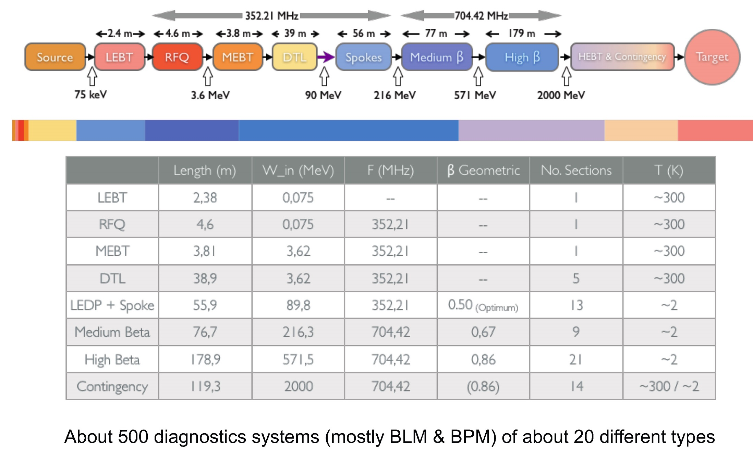
the ESS linac & its diagnostics
A. Jansson

Slide 55

longitudinal bunch shape monitor
A. Feschenko,, INR
A. Jansson

Slide 56

6D emittance measurement
A. Aleksandrov, SNS
A. Jansson

Slide 57

“Shishlo method” –longitudinal optics
A. Shishlo, SNS
A. Jansson

Slide 58

ESSnuSB proposal
M. Olvegard,
Uppsala
M. Eshraqi

Slide 59
extreme
polarization

Slide 60
lessons from EuCARD-2 XPOL
polarization in upcoming accelerator projects
the role of polarization measurement
electric dipole moments
advances in polarimetry
K. Aulenbacher

Slide 61
polarization in future experiments
low-energy “small” accelerators (EDM JEDI, MESA)
discovery (strong CP and T violation )
precision experiments (weak P violation)
high-energy “big” accelerators:
precision measurements at the ILC
  - pol e+ source technologically challenging
  - polarization measurement via Compton backscattering promising (ΔP/P ~0.1%)
precision beam parameters at the FCC-ee
- absolute energy calibration (by resonant dep.) ΔE/E ~ 10⁻⁶
high energy pol. proton beam at the FCC-hh
  not completely impossible
  fixed target pol. at LHC or FCC-hh is possible
  LHeC feasible with pol. e- beam
K. Aulenbacher

Slide 62

electro weak mixing angle „sin²θ_{W}” at MESA
influence of
„dark Z boson“
which also contributes
to muon anomalous
magnetic moment..
„Elastic electron scattering on proton measures 1-4sin²Θ_{W}
→ small asymmetry , high sensitivity
supressing hadronic contributions favours low momentum transfer and low beam energy
K. Aulenbacher

Slide 63

Jülich Electric Dipole Moment Investigation „JEDI“
- aiming at discovery in„electrostatic storage ring“
K. Aulenbacher

Slide 64

Jülich Electric Dipole Moment Investigation „JEDI“
K. Aulenbacher

Slide 65
concluding
thoughts

Slide 66
circular colliders and storage rings work well and
advance further thanks to new concepts (crab
waist, top up, monochromatization,…) and
tools (e-lenses, e-cloud mitigation, cooling,…)
one route forward: e+e- → hadrons →muons
technology cost to be reduced
crystal and nanotubes concepts to be explored
beam power of rings and linacs is increasing
polarization offers additional handle for discovery
and precision studies at lower energy
SuperKEKB, IOTA, ESS, HEPS, and MESA upcoming,
will teach us new lessons
ESSnuSB, JEDI, FCC, CEPC, … proposed

Slide 67


The end of EuCARD-2 XBEAM …
… becomes the start of ARIES APEC

