Slide 1
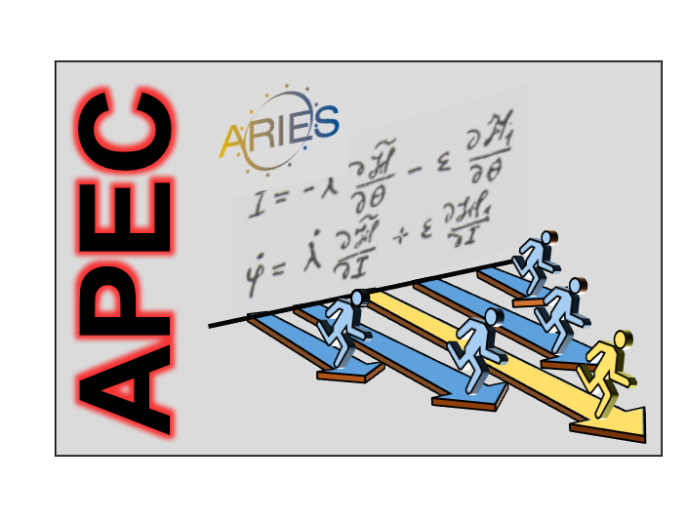

ARIES task 6.3
Giuliano Franchetti & Frank Zimmermann
on behalf of WP6
Valencia 15 February 2017

Slide 2
objectives of Task 6.3 (from proposal)
Task 1.3. Reliability and Availability of Particle Accelerators task leaders: J. Gutleber, CERN; K. Hoeppner, HIT Heidelberg establish standard body of RAMS* knowledge for particle accelerator applications compile and rank existing RAM standards, methods and practices in major laboratories analysis of optimal RAMS characteristics for particle accelerator systems spread the identified best RAM practices in order to introduce a common RAM baseline assess the feasibility of an Open Data Infrastructure for accelerator reliability *RAMS = Reliability, Availability, Maintainability, Safety

Slide 3
this task has the highest budget in WP6
what shall actually happen, who may do
which work, and when?
reliability & availability of task leaders??

