Slide 1
availability & reliability at linear colliders
- historical studies
Frank Zimmermann
Valencia 15 February 2017

Slide 2
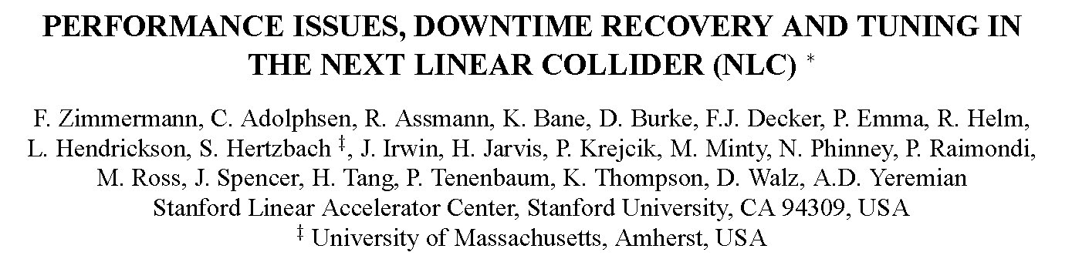
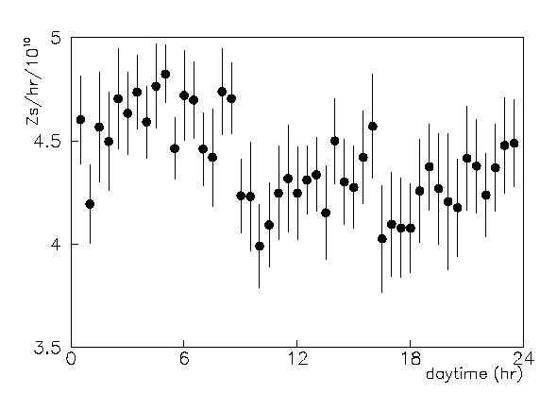
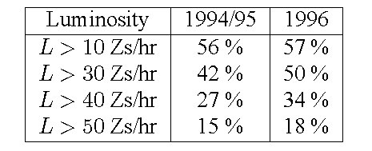
PAC’97
Fraction of time (not including overall down-time) during which a certain luminosity was exceeded in the 1994/95 and 1996 SLC runs.
Diurnal luminosity during the 1996 SLC run. Shown is luminosity normalized to 10¹⁰ particles per bunch. Actual luminosity would be ~12x higher. A rate of 1 Z/hr is equal to ~10²⁸ cm⁻² s⁻¹.

Slide 3
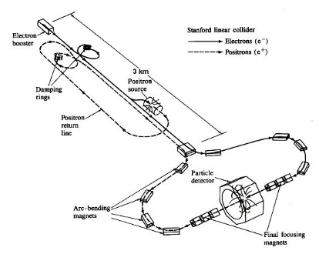
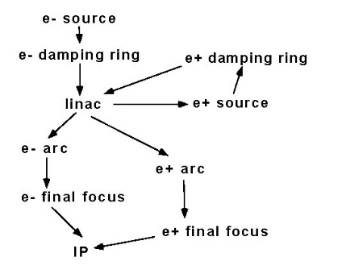
Stanford Linear Collider (SLC)
1987-1998
Markov model of the SLC.

Slide 4
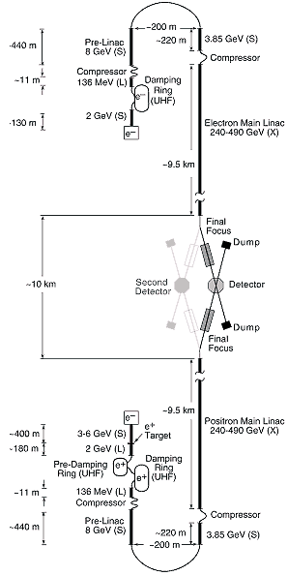
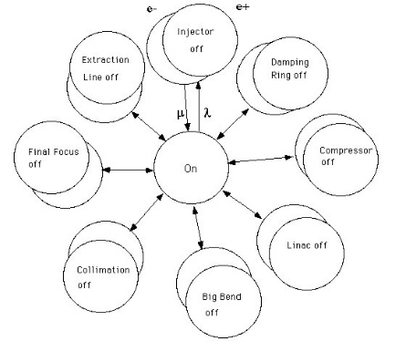
Design of the Next Linear
Collider (NLC) as of ~1996
Markov model of the NLC
’OFF’ indicates a failure of the respective
subsystem

Slide 5

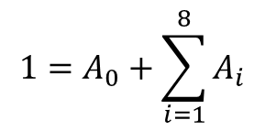

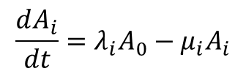
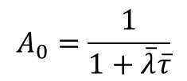
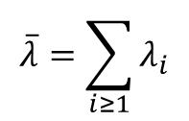
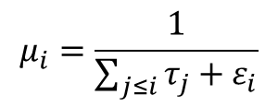
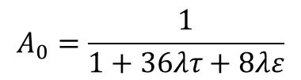
example equations for the Markov models
system state
$$μ_{i}=\frac{1}{\sum_{j≤i}{τ_{j}+ε_{i}}}$$
$$\frac{dA_{i}}{dt}=λ_{i}A_{0}−μ_{i}A_{i}$$
tuning recovery time
average repair time
failure rate
recovery rate
$$1=A_{0}+\sum_{i=1}^{8}{A_{i}}$$
total failure rate
$$\overline{λ}=\sum_{i≥1}{λ_{i}}$$
availability of e+ or e- system
$$A_{0}=\frac{1}{1+\overline{λ}\overline{τ}}$$
$$\overline{τ}:$$
effective recovery time
$$A_{0}=A_{0}\left(\vec{λ},\vec{τ},\vec{ε}\right)$$
in general:
various assumptions possible -
e.g. for equal subsystem failure rate, equal repair and recovery times
another scenario: equal luminosity impact …
$$A_{0}=\frac{1}{1+36λτ+8λε}$$

Slide 6
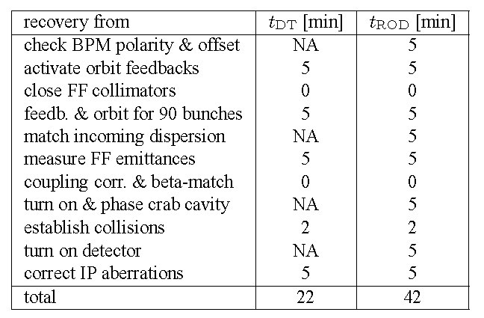
performance recovery time - example
Performance recovery time ε of the NLC ﬁnal focus after a 1-hr down time (DT) and after a 24-hr repair day (ROD).

Slide 7
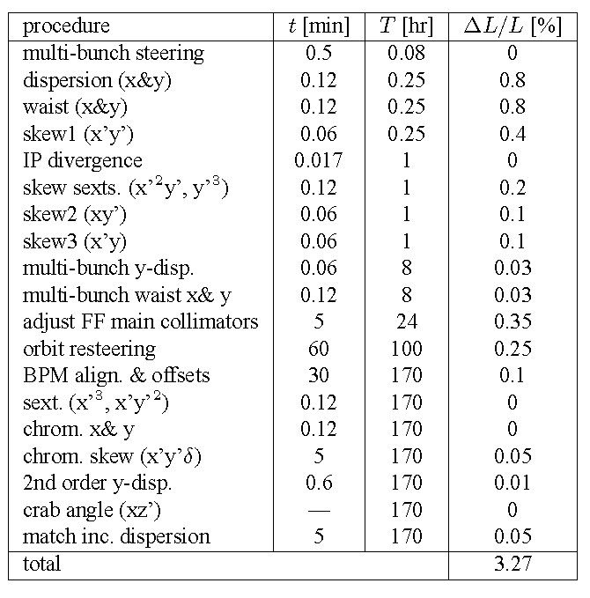
Continual tunings procedures in the NLC ﬁnal focus: required time t, tuning period T, and estimated luminosity impact ΔL/L

Slide 8
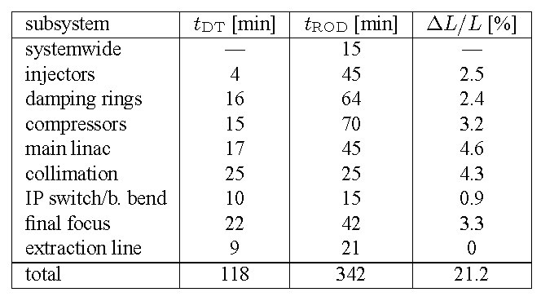
Recovery times and luminosity reduction due to continual tuning for all NLC subsystems

Slide 9
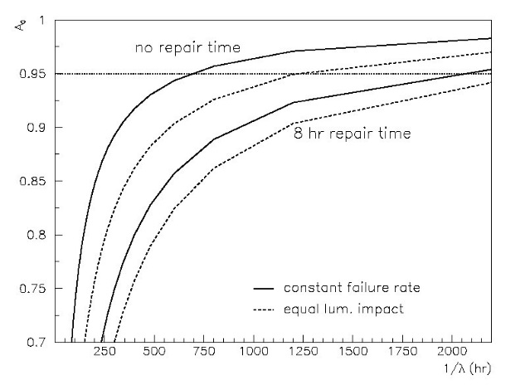
Availability A_{e±} versus MTBF (=inverse failure rate 1/λ), for an individual recovery time τ =1hr, two different repair times ε and two different assumptions on failure rate scaling.

Slide 10
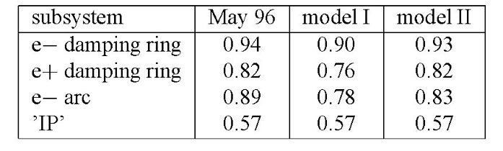
Comparison of actual beam availability for various SLC subsystems with that predicted by two different models; the recovery-time was adjusted to give equal IP availability.
While the data appear to favour models with a longer recovery time for the last subsystems (model II), they would also be consistent with upstream systems being tuned over extended periods of time.

