Slide 1

Measurements of passive structures on irradiated HV-CMOS detectors
12th Trento Workshop, 21.02.2017
Bojan Hiti, Vladimir Cindro, Andrej Gorišek, Gregor Kramberger, Igor Mandić, Marko Mikuž, Marko Zavrtanik
On behalf of ATLAS Strip CMOS collaboration
Jožef Stefan Institute, Experimental Particle Physics Department (F9)
Ljubljana, Slovenia

Slide 2
Outline
CHESS 2 chip introduction
Edge-TCT measurements
Acceptor removal parameters
⁹⁰Sr measurements
Summary

Slide 3
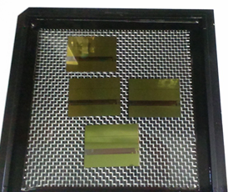
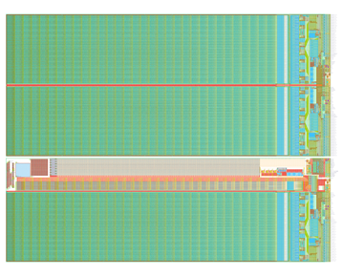
CHESS 2 chip
Developed by the ATLAS Strip CMOS collaboration as a candidate for HVCMOS strip detector for ATLAS Phase II upgrade
Design by UCSC, SLAC and KIT, produced in AMS H35 process, max. bias 120 V
  H. Grabas, Chess2 front end readout of the multi-segmented HV CMOS sensors, FEE 2016
Reticle size demonstrator chip, follow up of CHESS 1
  3 striplet arrays with fully digital encoding and readout
  1 pixel array with an in-strip amplifier and analog readout
  Several passive arrays for material studies – subject of this talk
digital
18.6 mm
passive
analog
24.3 mm

Slide 4
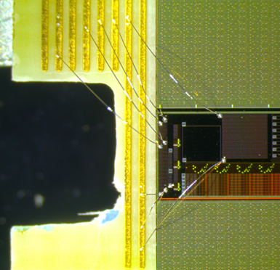
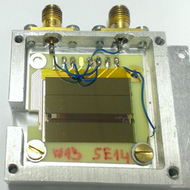
Passive test structures on CHESS 2
Edge-TCT arrays, 3 x 3 pixels, pixel size: 630 x 40 μm² (six 90.2 μm x 24.3 μm nwells in each pixel)
Large Passive Array, 1.3 x 1.3 mm² for ⁹⁰Sr measurements, implants ganged together (Large n-well, not used here)
Chips produced on four different substrate resistivities
  20 Ω·cm, 50 Ω·cm, 200 Ω·cm, 1 kΩ·cm
Irradiation study:
  Samples irradiated with neutrons in Ljubljana
  Fluences: 0, 1e14, 3e14, 5e14, 1e15, 2e15 n_{eq}/cm²
  Total 24 chips (4 x 6)

Slide 5
Edge-TCT

Slide 6
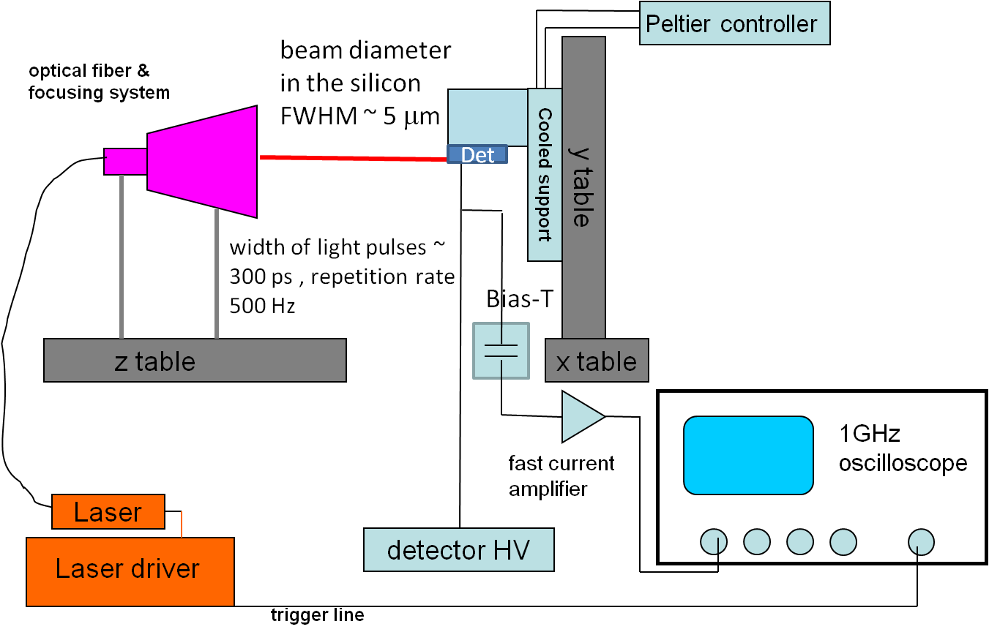
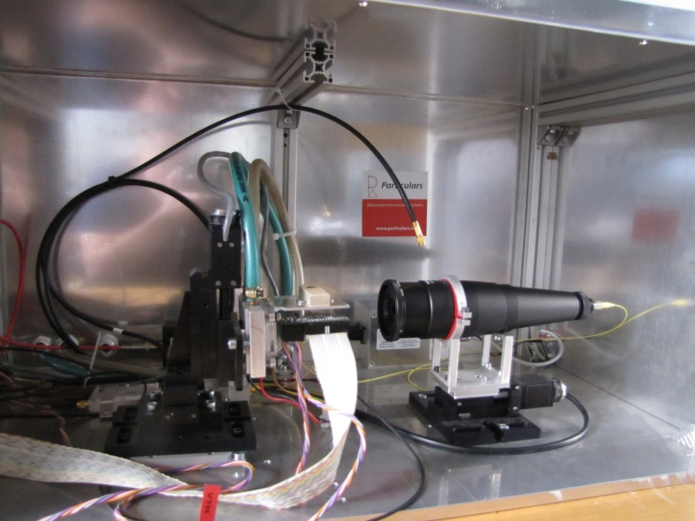
Edge-TCT setup
Edge TCT setup
25 ns integr. time
( more details: www.particulars.si )
Detector connection scheme:
TCT measurements with passive pixels (no amplifier in the n-well)
➔ collecting electrode connected to the amplifier
Substrate (p-type)
HV
scope
GND
y
Beam direction
x
Pixels (n-well)

Slide 7
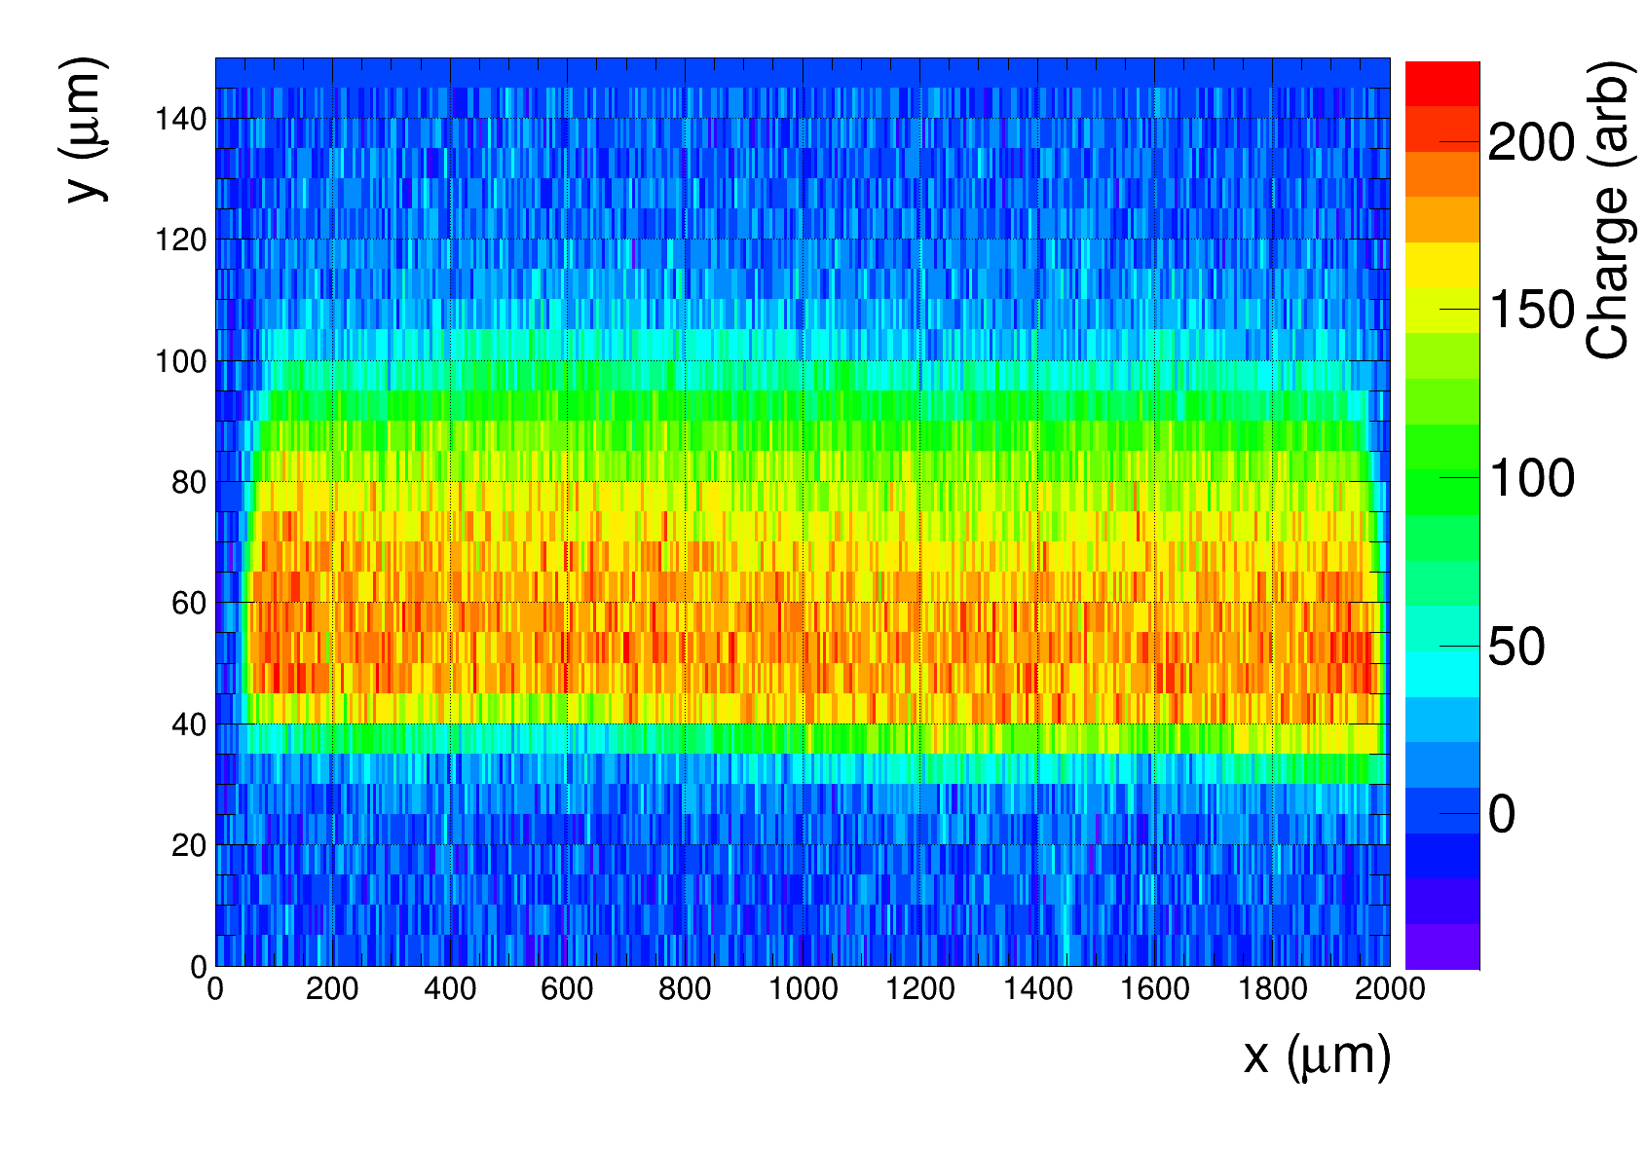
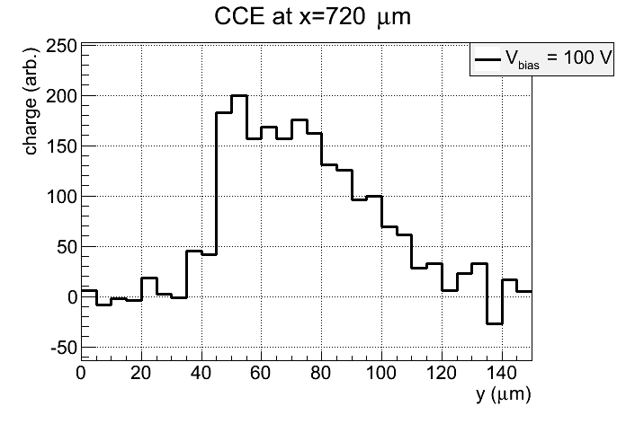
Edge-TCT measurements
beam
depth
surface
FWHM
projection
Chip surface
depth
Sensors only partially depleted
Edge-TCT allows to study the depletion depth dependence on voltage/fluence
Charge collection width = FWHM of the charge collection profile

Slide 8
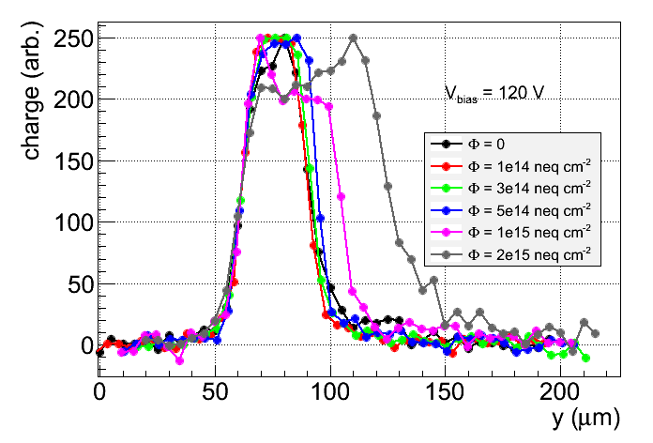
20 Ω·cm Edge-TCT charge collection profiles
Preliminary!
20 Ω·cm
depth
charge collection width
surface
Charge collection width at 120 V changes with irradiation
  Increase at fluences above 5e14 n_{eq}/cm² – initial acceptor removal
Low substrate resistivity → late acceptor removal

Slide 9
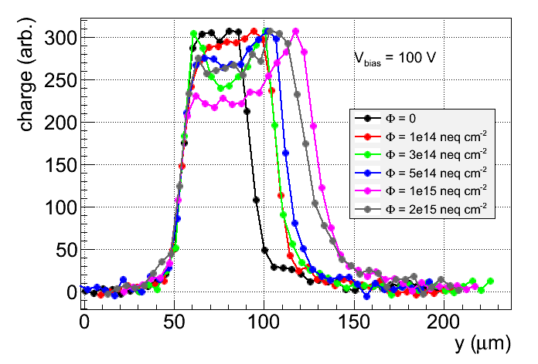
50 Ω·cm Edge-TCT charge collection profiles
Preliminary!
50 Ω·cm
surface
Charge collection width increases up to 1e15 n_{eq}/cm², then reducing
Acceptor removal finished earlier than with 20 Ω·cm substrate

Slide 10
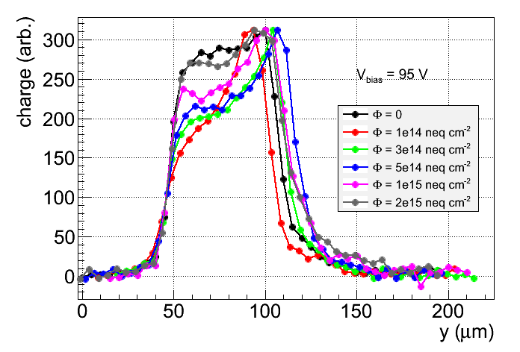
200 Ω·cm Edge-TCT charge collection profiles
Preliminary!
200 Ω·cm
surface
variations of charge collection width are small
Maximal width reached around 5e14 n_{eq}/cm²

Slide 11
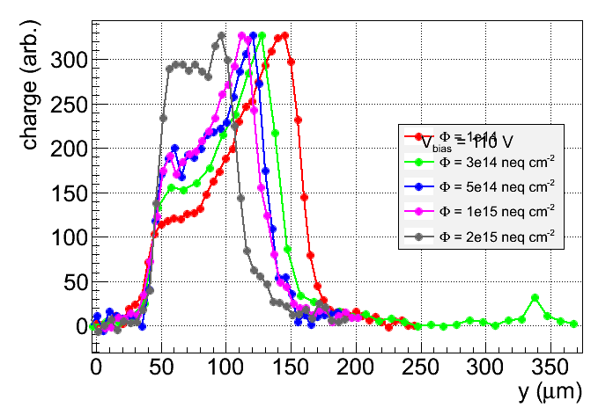
1000 Ω·cm Edge-TCT charge collection profiles
Preliminary!
1000 Ω·cm
V_{bias} = 110 V
Φ = 1e14 neq cm⁻²
surface
Unirradiated sample could not be biased (breakdown)
Initially large charge colleciton width > 100 μm
Charge collection width monotonously falling with irradiation
High resistivity → acceptor removal completed below 1e14 n_{eq}/cm²

Slide 12
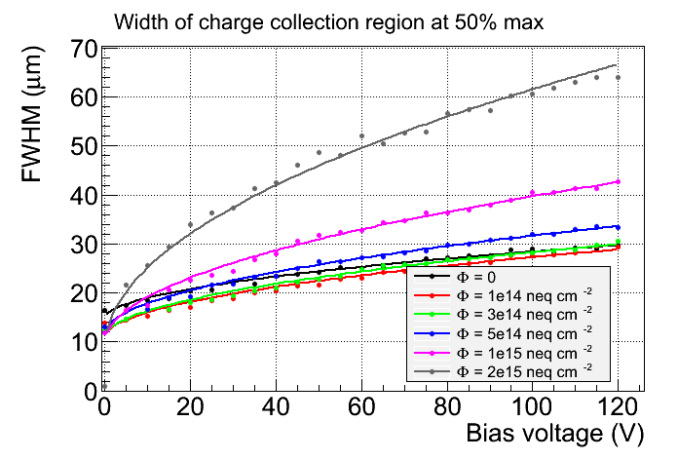
20 Ω·cm charge collection width vs. bias voltage
Preliminary!
20 Ω·cm
At Ф = 0:
N_{eff} = 6.7e14 cm⁻³ ➔ 20 Ω∙cm
Good agreement with nominal resistivity
0 V offset
Extract value of N_{eff} from fit

Slide 13
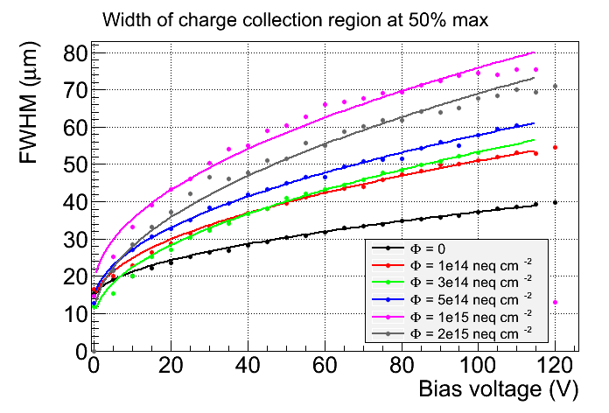
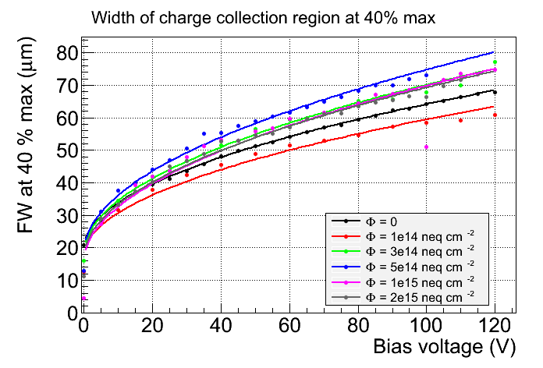
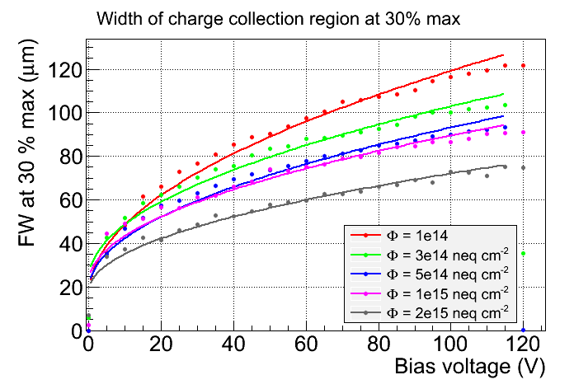
50 Ω·cm charge collection width vs. bias voltage
Preliminary!
Preliminary!
N_{eff}(0) = 0.65e14 cm⁻³
➔ 205 Ω∙cm
50 Ω·cm
200 Ω·cm
At Ф = 0:
N_{eff} = 2.3e14 cm⁻³ ➔ 58 Ω∙cm
Preliminary!
1000 Ω·cm best material in terms
of depletion depth
But sensitive breakdown behaviour
neq cm⁻²
1000 Ω·cm

Slide 14
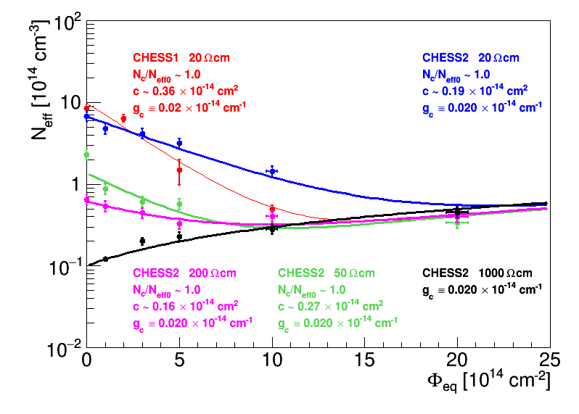
N_{eff} vs. fluence
acceptor removal
radiation induced deep acceptors (g_{C} = 0.02 cm⁻¹ fixed)
N_{eff} evolves differently for different initial wafer resistivities
Behaviour converges for fluences above 1e15 n_{eq}/cm²
Removal completed below 1e14 n_{eq}/cm²
Preliminary!

Slide 15
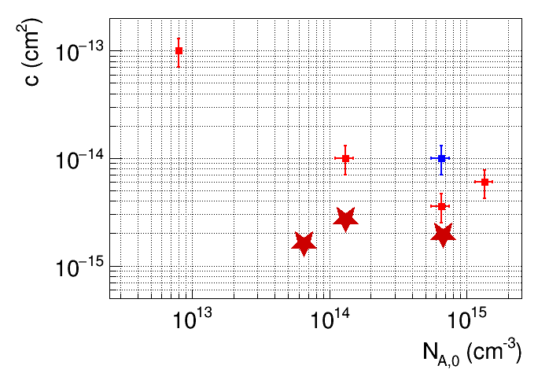
Acceptor removal constant vs. initial doping
LFoundry,
Mandić et al.,
arXiv 1701.05033
X-Fab
B. Hiti et al.,
arXiv 1701.06324
HVFEI4, CHESS 1,
G. Kramberger et al., JINST 2016
CHESS 2
Blue marker – charged hadron irradiated
Red marker – neutron irradiated
Measurements by Edge-TCT in Ljubljana
High resistivity fast acceptor removal (finished at low fluence)
Low resistivity slow acceptor removal (finished at high fluence)
CHESS2 (partly) fits in this picture
Removal constant for CHESS2 1kOhm-cm still not measured

Slide 16
Charge collection width vs. fluence in CHESS 2
Charge collection width at 100 V for different wafers/fluences
Calculated from N_{eff} measured with Edge-TCT using formula

Slide 17
⁹⁰Sr measurements

Slide 18
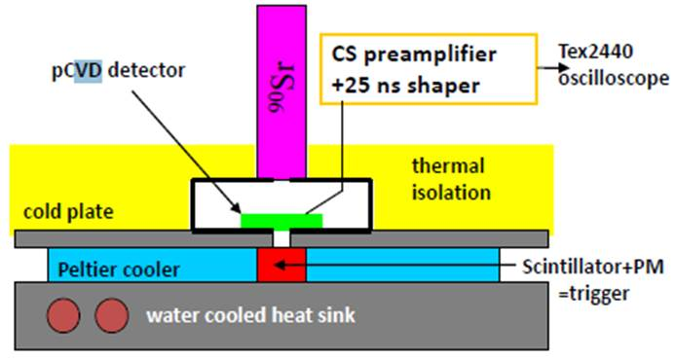
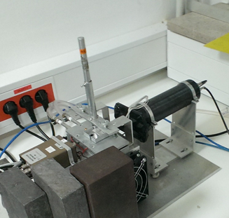
⁹⁰Sr setup
ORTEC 142 charge sensitive amplifier + custom made shaper (25 ns)
+ digital oscilloscope
detector
⁹⁰Sr
PMT
ampl.
cooling jig
DUT
HV-CMOS: small signals, large noise → S/N very low
  clean sample of events needed (no hits missing DUT)
  require a large detector (trigger rate), good collimation, small scintillator
Measurement:
  Calibration with a 300 µm thick Si pad detector
  1) Record N ( = 2500) waveforms
  2) Average over all waveforms and determine time of the signal peak
  3) Sample waveforms at the peak
  4) Fill spectrum

Slide 19
20 Ω·cm, ⁹⁰Sr
not irr.
Diffusion contribution of approx. 1000 e⁻ vanishes after irradiation
Signal increase due to acceptor removal at high fluences
Minimal mean charge at 100 V: 1000 e⁻ (but would expect > 1600 el from N_{eff} )

Slide 20
50 Ω·cm, ⁹⁰Sr
Minimal mean charge at 100 V: 1300 e⁻ (extrapolated)

Slide 21
200 Ω·cm, ⁹⁰Sr
Minimal mean charge at 100 V: 2000 e⁻ (extrapolated)

Slide 22
1000 Ω·cm, ⁹⁰Sr
Minimal mean charge at 100 V: 2000 e⁻ (extrapolated)

Slide 23
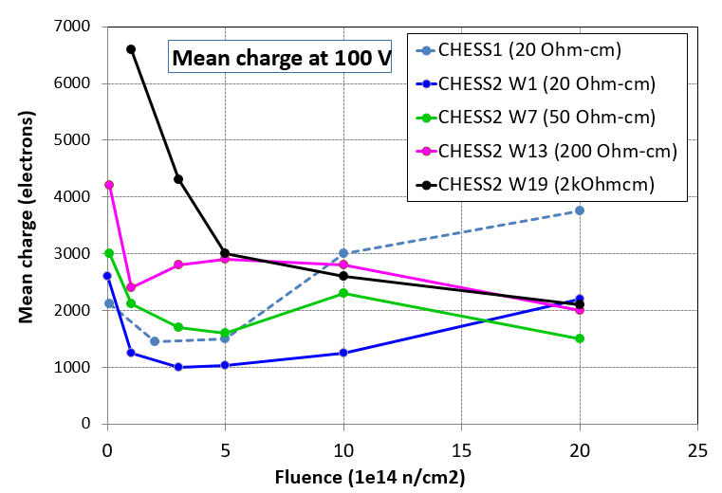
⁹⁰Sr comparison for different substrates
Preliminary!
CHESS 1 vs. CHESS 2 (20 Ω·cm) : trend is similar, but mean charge differs
could be due to a different wafer composition → different acceptor removal
More than 2000 el in whole fluence range for 200 Ohm-cm and 1 kOhm-cm
Measured charge after irradiation smaller then expected from depleted depth calculated from N_{eff}

Slide 24
Summary
Completed measurements of charge collection on passive structures on CHESS 2
  4 wafer resistivities 20 – 1000 Ω·cm, each wafer 6 neutron fluences up to 2e15 n/cm2
  Edge-TCT and ⁹⁰Sr MIPs
Edge-TCT:
  Study of charge collection width for different substrates / irradiation levels
  Charge collection width may increase with irradiation → acceptor removal
  Determined parameters of the acceptor removal model
⁹⁰Sr
  Mean collected charge at least 1000 electrons for any substrate and fluence
  Collected charge roughly follows the behaviour from Edge-TCT (increase due to acc. removal)
  Mean signals more than 2000 e⁻ in whole fluence range for 200 Ω·cm and 1000 Ω·cm
  200 Ω·cm: smallest changes over whole fluence range

Slide 25
BACKUP

Slide 26
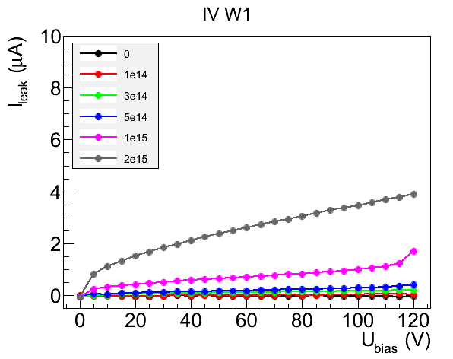
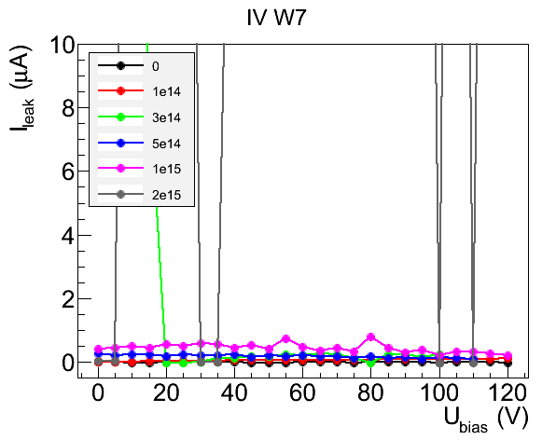
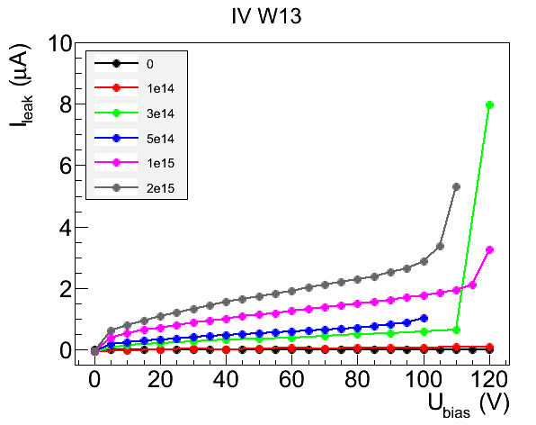
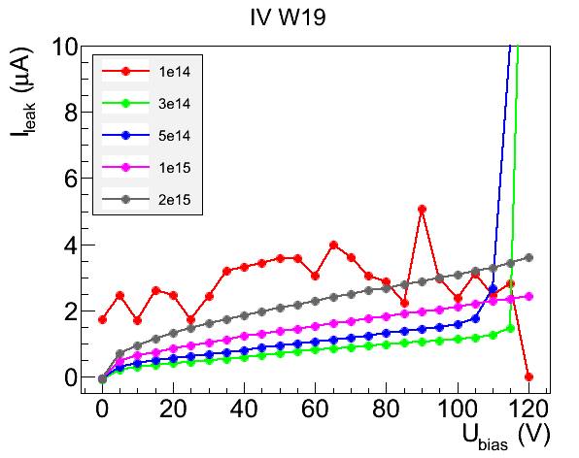
I-V characteristics
20 Ω·cm
50 Ω·cm
Measured on a TCT array
(3 x 3 pixels, pixel size 630 x 40 μm²)
At room temperature
not all measurement are good
200 Ω·cm
1000 Ω·cm

Slide 27
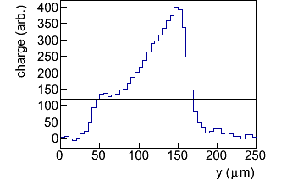
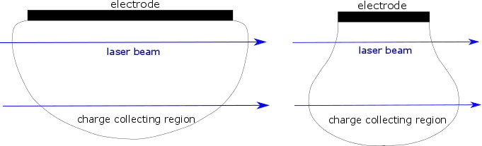
Depletion zone shape at large depths
Large peak at the back side of charge collection profiles is commonly observed (especially with high resistivity samples)
This is due to an expansion of the depletion zone along the direction of the beam (pear shape)
Extra charge is due to an increased path of the beam in the sensitive region
This occurs for depleted depth ≥ structure width and on narrow structures (few neighbours)
chip surface
FW @ 30 %
Case A: depleted depth << structure size
no back peaks
Case B: depleted depth ≈ structure size
pear shape

Slide 28
2d Edge-TCT scan
beam
depth
Chip surface
200 Ω·cm, 3e14 n_{eq}/cm²
Good response uniformity – no gaps between n-wells

Slide 29
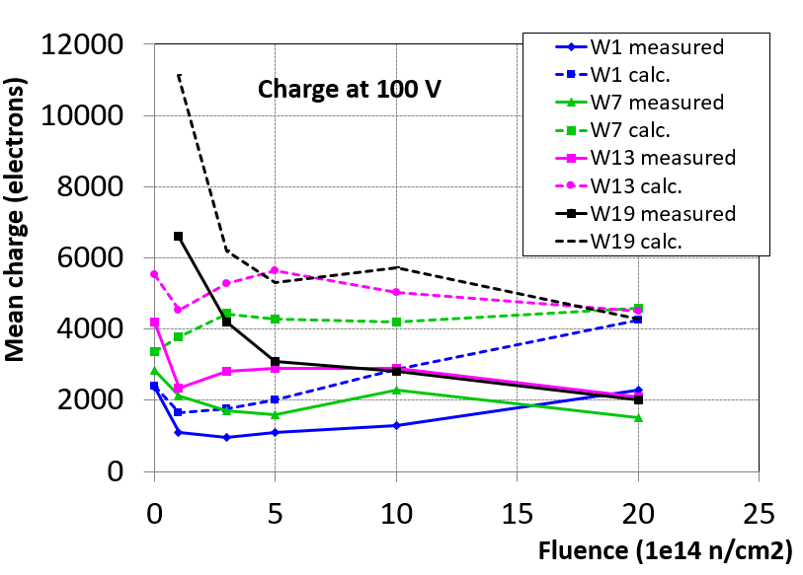
Comparison of results from Edge-TCT and ⁹⁰Sr
From Edge-TCT (N_{eff}) calculate depleted depth W
assume 1000 e from diffusion before irradiation
Simulate charge collection in a pad detector of thickness W to estimate trapping loss
Observation: with ⁹⁰Sr less charge is collected than expected from Edge-TCT
The reason is not understood: maybe simple pad detector approximation not correct, hints: different behaviour of border vs. central pixels (see backup)

Slide 30
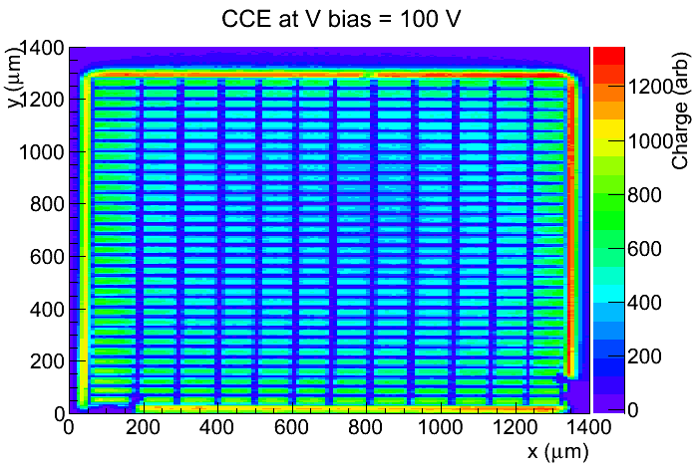
Top TCT 1
On irradiated samples charge from ⁹⁰Sr measurements systematically less than expected for the depletion depth measured by Edge-TCT
Investigation with top TCT
  IR light – 980 nm, absorption depth in Si 100 μm → no reflections from back plane
W19 5e14
Large pass. array for ⁹⁰Sr
(1.3 mm x 1.3 mm)
Gaps between pixels due to metalization on top of the chip
But on the large scale intensity in central pixels less than on edges !

Slide 31
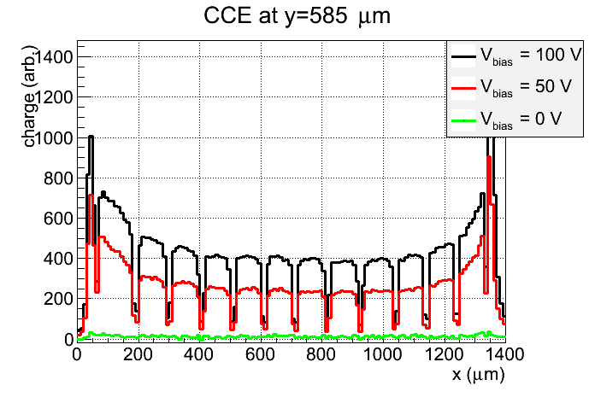
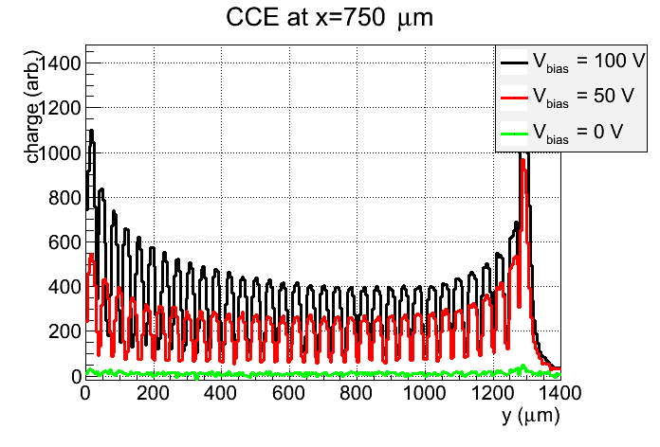
Top TCT 2
Difference in the collected charge indicates a larger depletion depth on the edges of the ⁹⁰Sr array.
Edge-like pixels also measured in Edge-TCT. This may be a reason for discrepancy between the measurements.
W19 5e14

Slide 32
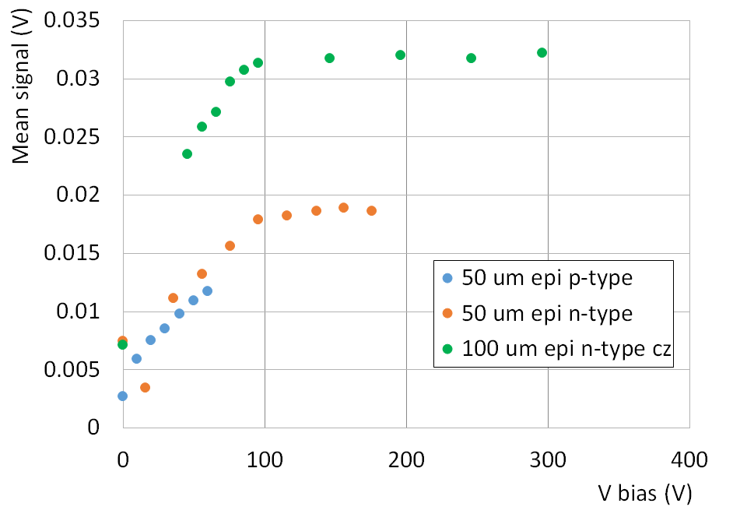
Q-TCT calibration 1
Sr90 calibration procedure
using epitaxial diodes with known thickness (d = 50 and 100 μm) – similar thickness to CHESS 2, well known response
after epi-layer is fully depleted extract scaling factor A = d x 100 pairs/μm / V_{sig}
Only n-type diodes could be biased highly enough for calibration
p-type breaks down at 60 V, before full depletion

Slide 33
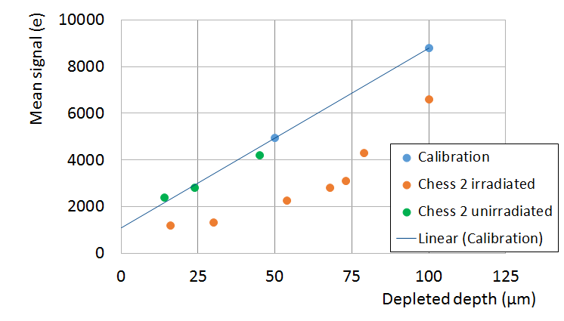
Q-TCT calibration 2
Results:
calibration with n-type epi diodes
unirradiated CHESS 2 devices are compatible with the calibration
irradiated CHESS 2 devices (different wafers) have less charge than expected:
* Depleted depth for CHESS 2 is determined from the formula:

Slide 34
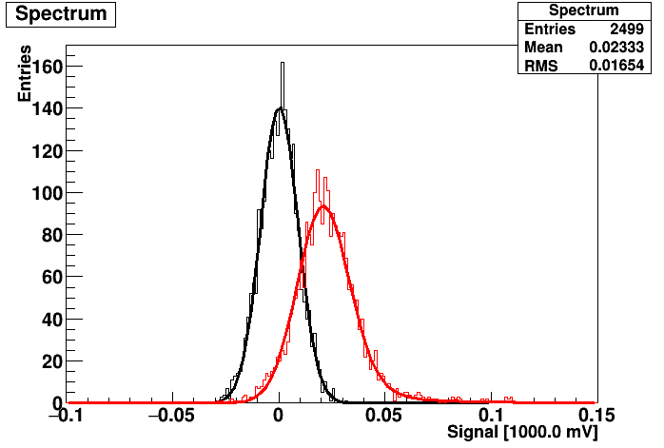
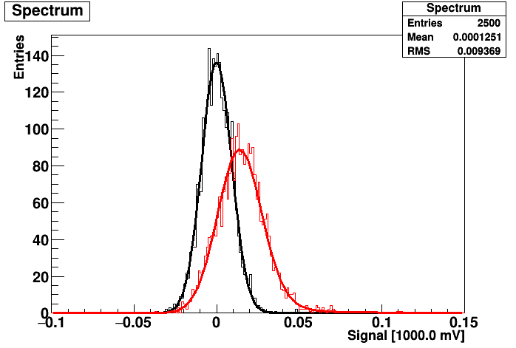
⁹⁰Sr spectra 1000 Ω·cm
1e14 100 V
– Noise
– Signal
3e14 100 V
– Noise
– Signal
High resistivity wafer - Relatively good separation between signal and noise
No peak around 0 in signal spectrum → misalignment does not seem to be the main factor for smaller charge

