Slide 1
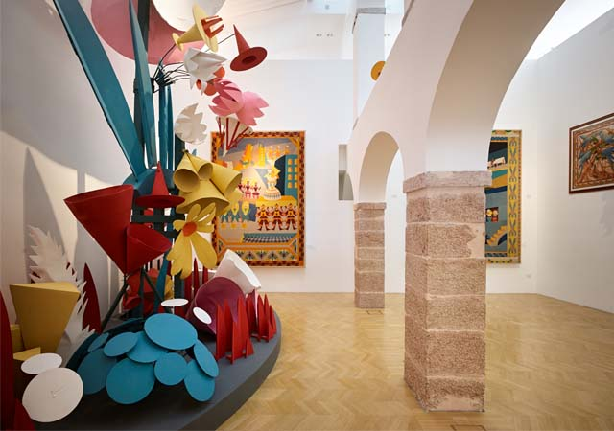
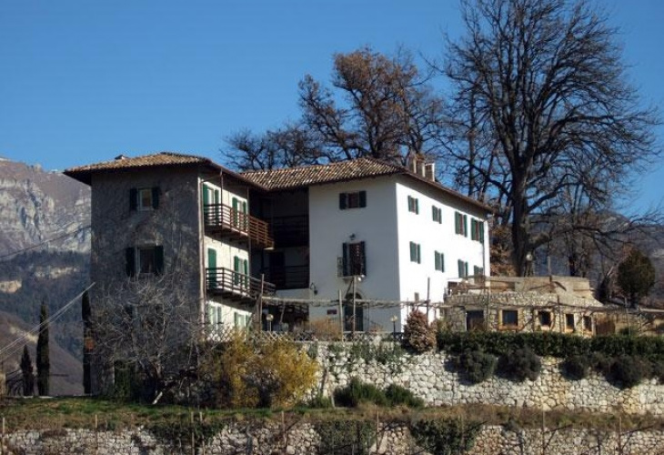
«TREDI 2017 SOCIAL DINNER TIMETABLE»
BUS leaves from Trento at 17:15
and arrives in Rovereto in a half hour
From 18:00 to 19:00 guided visit to
«Casa d'Arte Futurista Depero»
two groups: one in italian and one in english
BUS leaves from Rovereto at 19:30
The dinner will take place in «Locanda D&D» at 20:00 (http://www.locandaded.it/)
We plan to came back to Trento at about 22:30
the bus will arrive in front of Trento Railroad Station

Slide 2
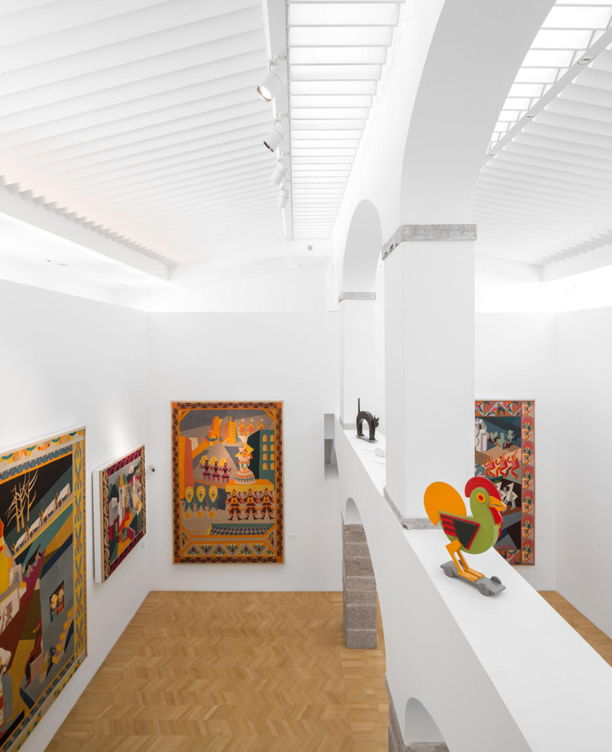
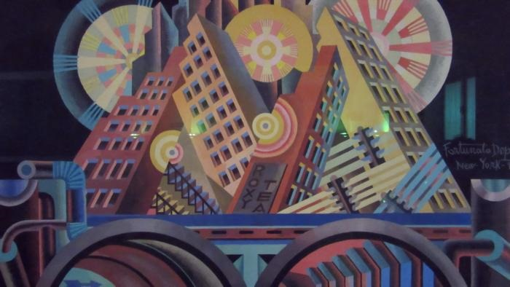
Casa d'Arte Futurista Depero
http://www.mart.trento.it/context.jsp?ID_LINK=683&area=137
The Casa d'Arte Futurista Depero is the only museum founded by a futurist – Depero in 1957 – in accordance with an irreverent and prophetic project: innovation, irony, the knocking down of all hierarchy in the arts. The building was located in the elegant historic centre of medieval Rovereto. Depero, a pioneer of contemporary design, personally oversaw every detail: the mosaics, furniture, painted panels.

Slide 3
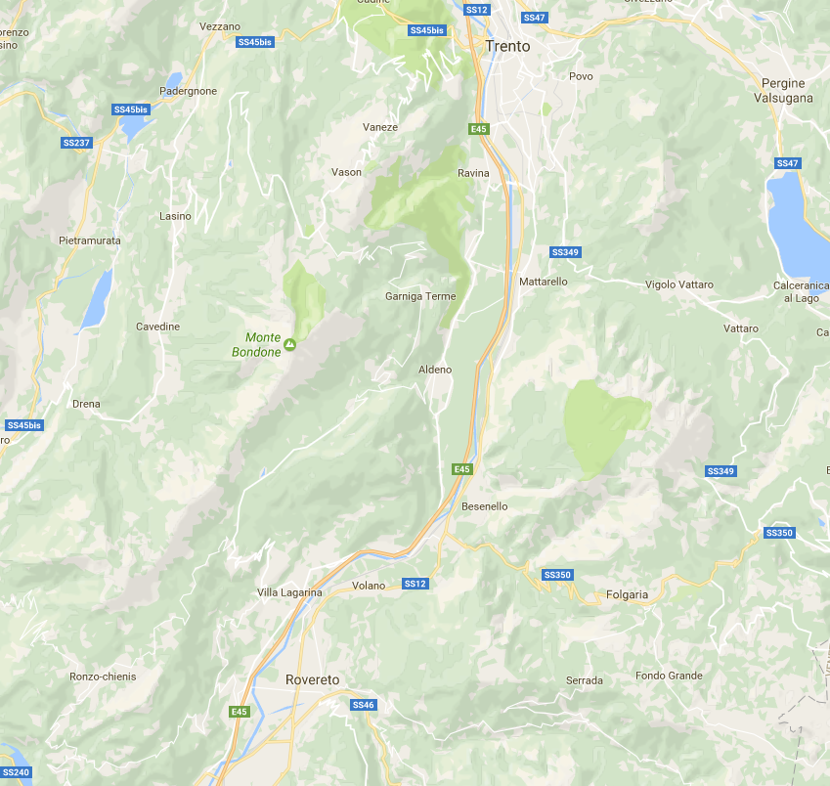
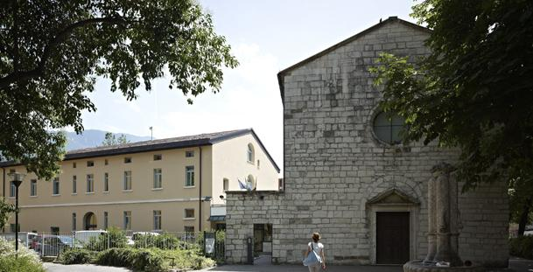
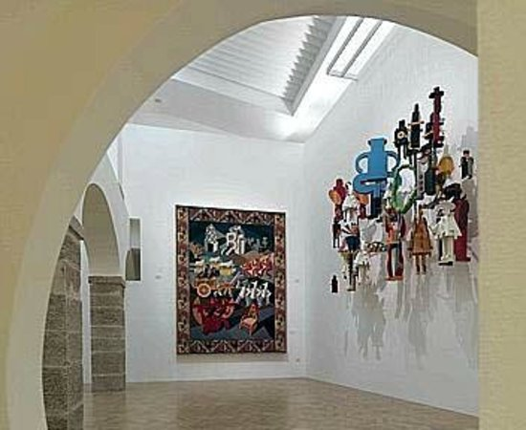
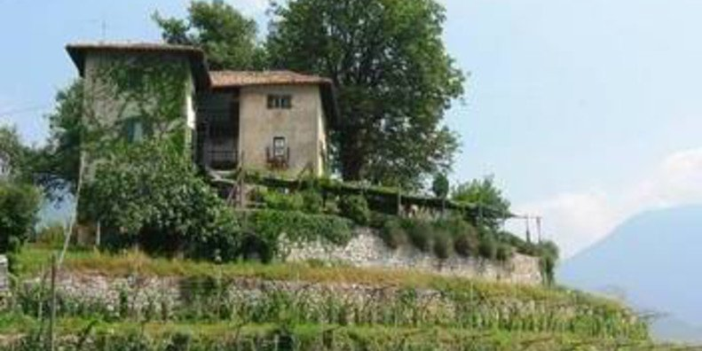
FBK – Santa Croce
Locanda D&D
Casa Depero

