Slide 1


A scalable online monitoring system based on Elasticsearch for distributed data acquisition in CMS
Presenter: Dainius Šimelevičius on behalf of CMS DAQ group
Primary authors: Luciano Orsini - CERN, Dainius Šimelevičius - CERN/Vilnius University
CHEP 2018
23rd International Conference on Computing in High Energy and Nuclear Physics
9-13 July 2018, Sofia, Bulgaria

Slide 2
Outlook
CMS Data Acquisition System
Motivation
About Elasticsearch technology
Elasticsearch-based monitoring system
Conclusion

Slide 3
CMS Data Acquisition System

Slide 4
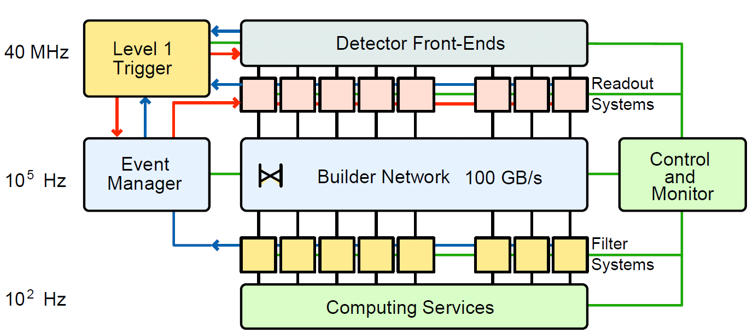
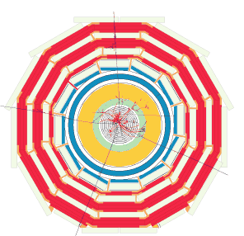



CMS DAQ
Detector Front-End
L1 Trigger
CMS DAQ
High-Level
Trigger
*
*
Andre, J-M et al. “A Scalable Monitoring for the CMS Filter Farm Based on Elasticsearch.”
Journal of Physics: Conference Series 664, no. 8 (December 2015): 082036.

Slide 5
Monitoring of CMS DAQ
Monitoring of DAQ is a data acquisition on its own which runs in parallel with event data flow and shares hardware and software resources with the DAQ system
It is used to collect, present and store monitoring data in order to detect deviation from a normal DAQ behavior
Users of the monitoring are shifters, DAQ experts on-call, expert system, etc.
Data space is f(sources, variables) ≈ 200,000 updated every 1-5 seconds
Data items are time-stamped collections of fields, namely, flashlists

Slide 6
Motivation

Slide 7
Motivation
Current monitoring system is custom made
  Uses custom protocols and formats
Two different approaches are used for keeping data
  In-memory for instant data
  Oracle DB for persistent data
Usage of off-the-shelf components
Usage of standard protocols and formats
Inherent scalability and reliability (fault tolerance/redundancy)

Slide 8
About Elasticsearch technology

Slide 9
About Elasticsearch
NoSQL database
RESTful API with JSON over HTTP
Horizontally scalable architecture
Seamless data indexing and searching throughout the cluster
Based on Apache Lucene

Slide 10
Elasticsearch terminology
Elasticsearch cluster
Index
Node 1
Node 2
Document 1
Index 1
Index 1
Shard 1 (primary)
Shard 1 (replica)
Document 2
Shard 2 (primary)
Shard 2 (replica)
…
…
…
Document n
Index n
Index n
Shard 1 (primary)
Shard 1 (replica)
Shard 2 (primary)
Shard 2 (replica)
{
“name“: „ferol2“,
“slotNumber“: 2,
“rate“: 1.2,
“busy“: true,
“values“: [4.5, 2.3, 12.1]
}
Fields

Slide 11
Elasticsearch-based monitoring system

Slide 12
Data life cycle
Most of the monitoring data has a defined lifetime (timetolive) and has to be removed when expires
Time based indices are created automatically according to a timeinterval
Efficient data removal is achieved by index deletion
Index
Document 1
Document 2
…
Document n
Full data available
Index
n
Index
n+1
Index n+2
Index n+3
Index n+4
Index n+5
timeinterval
expired data
timetolive

Slide 13
Indices, documents and aliases
i_{n}
i_{n+1}
i_{n+2}
i_{n+3}
i_{n+4}
i_{n+5}
Full history
Last updates
Access to full data set
Access to the latest data for instant monitoring
Expired
Searchable
Flashing
Alias
Index
Document

Slide 14


Managing the load
Scalability is achieved by distributing the load among several Elasticsearch nodes using round-robin DNS for reading and writing
…

Slide 15





Cloud oriented architecture
Expert Systems
Monitoring Systems
…
Data Sources
External Users

Slide 16



Coping with backpressure
Index creation is an expensive operation. Red and yellow
states indicate that shards are not fully allocated.
Data Source

Slide 17



Rotation of aliases and indices
Indices with expired data are removed by scripts started periodically by cronjob
“Last updates” aliases are moved to the most recent indices
Delete expired indices
Update aliases of indices

Slide 18
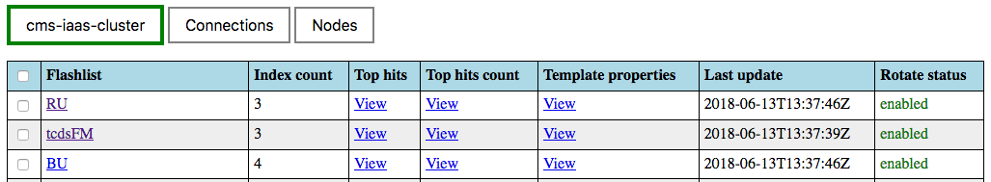

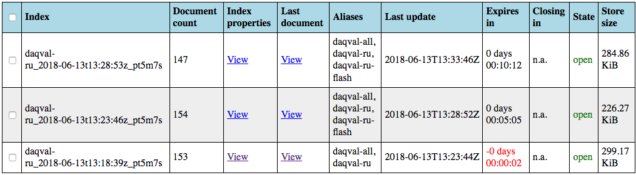
System diagnostics

Slide 19
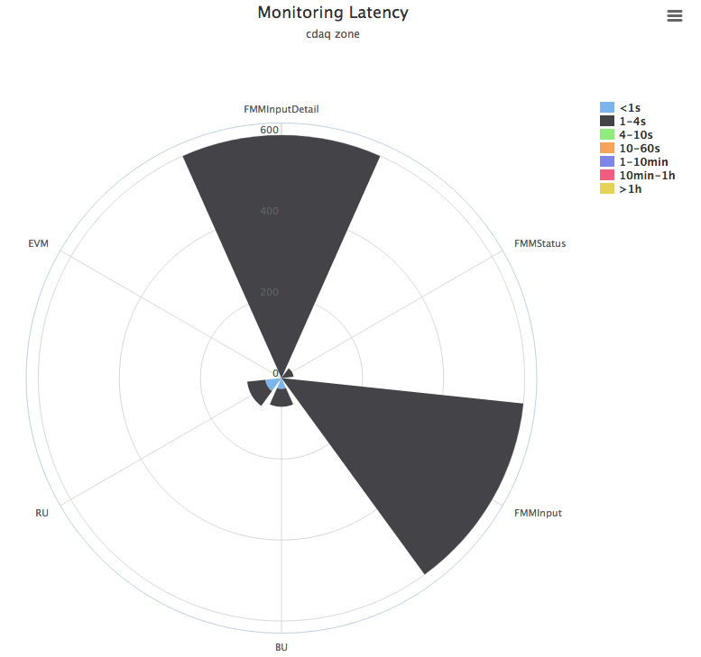
Monitoring data age

Slide 20
Conclusion

Slide 21
Conclusion
Used in parallel with existing monitoring system with comparable performance and functionality
Valuable solution for a future monitoring system
Pros
  Scalability
  Fault tolerance/redundancy
  Uniform access for reading and writing
  Free, well documented software
Cons
  Frequent Elasticsearch releases with deprecated features
  Tedious porting of client software after major Elasticsearch releases
  Limited number of data types (e.g., lacks unsigned integer 64)
  Burden on client software to manage time-to-live

Slide 22
Thank you for your attention

