Slide 1



Conditions evolution of an experiment in mid-life…
...without the crisis
L. Rinaldi, A.Formica, E. Gallas, N. Ozturk, S. Roe
on behalf of the ATLAS Collaboration
CHEP2018 - Sofia (Bulgaria)

Slide 2
Outline
The COOL experience: ATLAS Conditions DB during LHC Run-1 and Run-2
  Description of the COOL/CORAL infrastructure
  Conditions usage and COOL DB access
CREST: the new Conditions REST DB infrastructure
  Description of the infrastructure: the server and the client
  Comparison of the CREST DB system with respect to COOL
  Athena access to CREST
The transition from COOL to CREST (during Run-3)
  COOLR: a tool for COOL Rest access
  Performance test: Gatling and Frontier like access
Outlook and conclusions
L. Rinaldi Conditions evolution of an experiment in mid-life… without the crisis CHEP2018 - Sofia (Bulgaria)

Slide 3
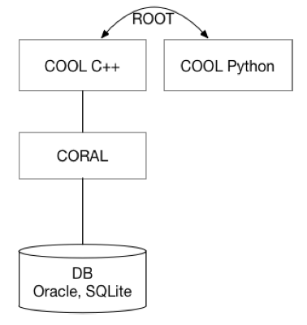
The COOL experience
Conditions data describe the state of ATLAS detector (very heterogeneous information)
During LHC Run-1 and Run-2, ATLAS Conditions data were managed by the COOL/CORAL system (by CERN-IT).
COOL is a C++ API based on CORAL client for access to the Relational (Oracle) DB instances (online, offline) and python binding is provided via PyROOT
COOL high level functionalities:
Sub-systems have their own “COOL databases” (Schemas) and store payload data in dedicated tables (Folders)
Payload data are stored according to Interval Of Validity (IOV)
  Single-versioned Folders: IOVs can be appended (no overwrite, no Tag defined)
  Multi-versioned Folders: IOVs can be stored in arbitrary way, Folder are Tagged (payload can be overwritten)
    A Global Tag is a collection of multiple FolderTags
Payloads are retrieved by providing IOV boundaries (and related Tag name)
L. Rinaldi Conditions evolution of an experiment in mid-life… without the crisis CHEP2018 - Sofia (Bulgaria)
Notes:
Coral (COmmon Relational Abstraction Layer) database client software layer
PyROOT is a Python extension module that allows the user to interact with any ROOT class from the Python

Slide 4
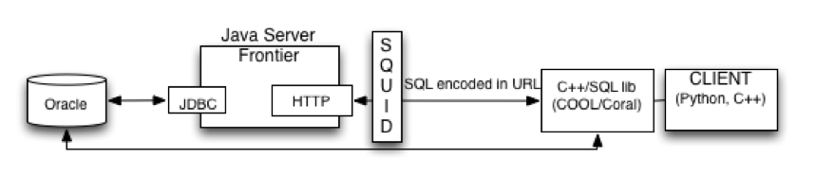
COOL access in Distributed Computing
Conditions data are concurrently accessed by large number of clients, i.e. jobs from Athena (the ATLAS software framework).
Access managed via COOL API using the intermediate Squid/Frontier services:
DB queries (HTTP URL) created in the client code and sent to Frontier
Access to the Oracle DB managed by Frontier via Java DB Connectivity (JDBC)
PAYLOADs are cached for identical queries at the level of Squid Proxy
L. Rinaldi Conditions evolution of an experiment in mid-life… without the crisis CHEP2018 - Sofia (Bulgaria)

Slide 5
Motivation for a new DB architecture
A new architecture should be operational after LHC Run-3
Caching: Conditions data payload loaded at the same time as the IOV (some workflows are badly cached! )
DB structure: Conditions data spread over 30 Schemas and 10k Folders (about 1TB per data taking period). Every system change corresponds to new set of Folders
Long Term Maintenance: COOL API and CORAL will be supported by CERN IT until the start of LHC Run-3
Tags and Global Tags management: delicate and time consuming activity
Data preservation: use of sqlite files can become complex
L. Rinaldi Conditions evolution of an experiment in mid-life… without the crisis CHEP2018 - Sofia (Bulgaria)

Slide 6
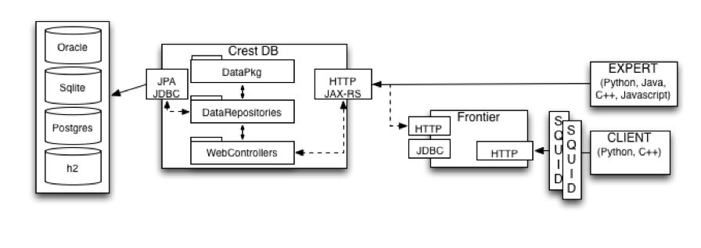
CREST: a RESTful service for Conditions data
CREST is based on a Server-Client architecture, enhancing the role of the Frontier servers.
The CREST development is a common activity with CMS (already in use by CMS during Run-2)
CREST DB server provides a full set functionalities to interact with backend DB (where Conditions data and metadata are stored):
Functionalities exposed via Representational State Transfer (REST) architecture
SQL not involved in server-client communication, internal resources accessible via URL and HTTP methods
Resource management is disentangled from the Client, allowing big simplification of the Client layer and giving more flexibility to backend implementation.
L. Rinaldi Conditions evolution of an experiment in mid-life… without the crisis CHEP2018 - Sofia (Bulgaria)

Slide 7
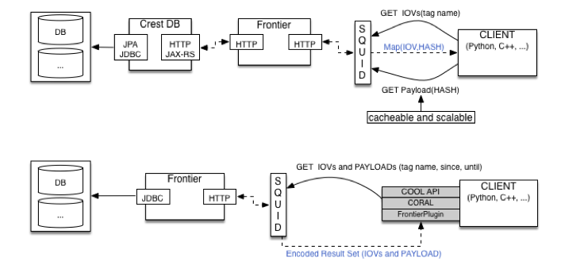
CREST vs COOL: Client communication
COOL: SQL queries encoded in the URL containing IOV ranges parameter
retrieved response will contain IOV and PAYLOAD data
when cache is invalidated, the response is thrashed
multiple HTTP calls needed
The Big Change
CREST: presence of the server interacting with DB backend and functionalities exposed via HTTP methods
PAYLOAD is disentangled from IOV access
even if IOV is invalidated, PAYLOAD is kept cached
Payload requests never change (same url access same data on the backend): only 1 HTTP call is needed!
Tag content information
L. Rinaldi Conditions evolution of an experiment in mid-life… without the crisis CHEP2018 - Sofia (Bulgaria)

Slide 8
Athena CREST access
Athena use of COOL is via a central service, IOVDbSvc
This has been modified to use HTTP requests accessing the CREST server, and data is provided in JSON format:
Simple (single IOV) jobs run transparently (client/subsystem code unchanged) switching between COOL/CREST
Can also produce or consume local data files in JSON format
Now being extended to multiple IOVs
L. Rinaldi Conditions evolution of an experiment in mid-life… without the crisis CHEP2018 - Sofia (Bulgaria)

Slide 9

COOLR: a tool for COOL REST access
Full CREST architecture will be ready by the end of Run-3
In the transition phase we need to preserve client COOL access in order to have a smoother migration, we are developing COOLR for a COOL REST access.
The COOLR server is accessed behind Frontier/Squid and can “read-only” COOL
The queries are stored in PL/SQL and, as in CREST, the URLs only contains query parameters: identical URLs can be cached by the Frontier/Squid with one HTTP call only!
Squid/Frontier
The COOL-REST API has been specified using Swagger. Code has been generated to produce a REST API implemented using Java / Java API for RESTful Web Services
L. Rinaldi Conditions evolution of an experiment in mid-life… without the crisis CHEP2018 - Sofia (Bulgaria)

Slide 10
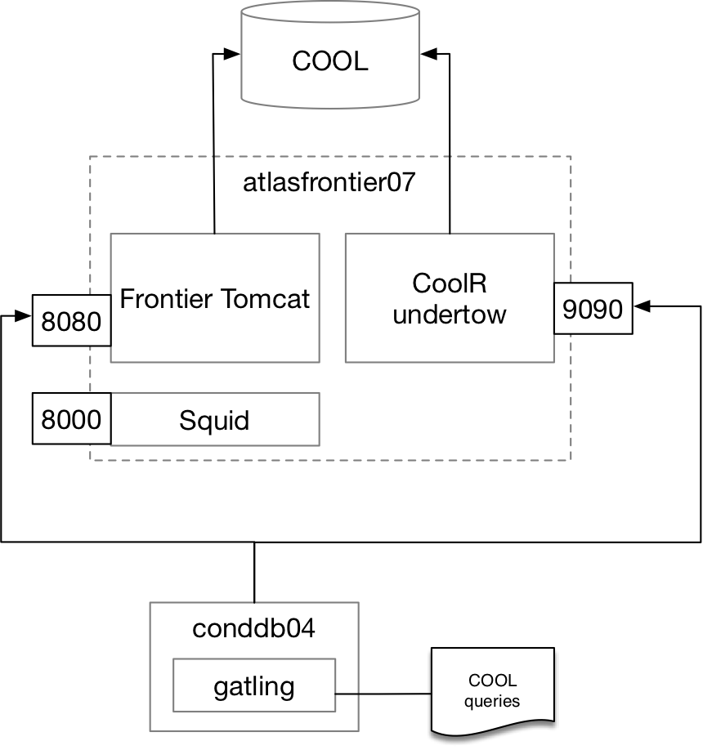
Prototype for Gatling test
Testing machine enabled with an official Frontier launchpad installation.
Frontier launchpad and COOLR server are listening on different ports.
Gatling framework and scripts (automatically generated via swagger) are deployed on another VM at CERN.
A set of “real” COOL queries was provided as input. 2000 queries are randomly taken by Gatling to simulate a load on the servers.
L. Rinaldi Conditions evolution of an experiment in mid-life… without the crisis CHEP2018 - Sofia (Bulgaria)

Slide 11
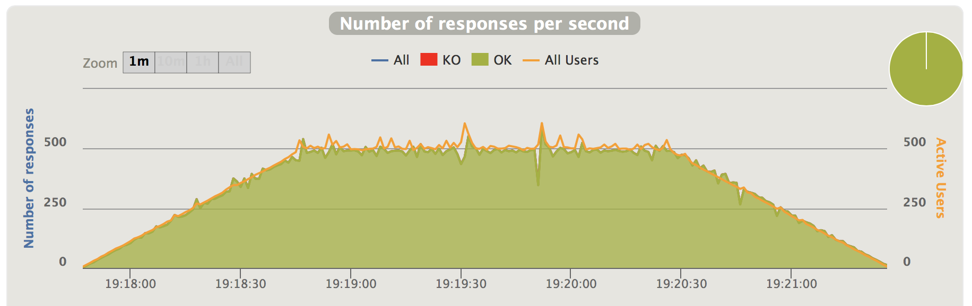
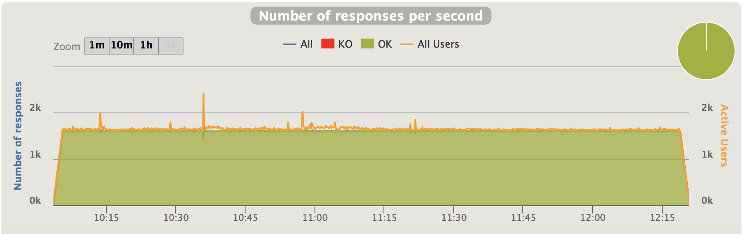
Gatling testing COOL-REST
Aim: compare Frontier and COOLR server using the same input (encoded SQL).
This guarantees that we see a performance similar to the one of Frontier launchpad.
Without Cache
Gatling test shows we can reach a pic point of 500 Req/s, without errors arising
With Cache
Appending the SQUID to the launchpad we managed to reach > 1.5K Req/s (without errors).
This preliminary test shows that COOL REST access can sustain high request loads with respect standard Frontier access; more tests are in progess
L. Rinaldi Conditions evolution of an experiment in mid-life… without the crisis CHEP2018 - Sofia (Bulgaria)

Slide 12
Outlook and conclusions
COOL DB has been used for storing Conditions data during LHC Run-1 and Run-2
  The architecture is solid but it is not scalable with the future increase of ATLAS data processing jobs
A new Conditions REST DB infrastructure (CREST) has been developed
  The new system is based on a server-client architecture that allow a more simple and light management of Conditions payload and IOV data requests
The transition from COOL to CREST is foreseen during LHC Run-3
  Full CREST architecture at the end of LHC Run-3
  Design IOVDbSvc for a REST access in Athena
  COOLR: introducing REST technology into our existing DB framework
    a prototype for COOL REST access is under evaluation
  Preliminar Gatling test showed good performance of COOLR
L. Rinaldi Conditions evolution of an experiment in mid-life… without the crisis CHEP2018 - Sofia (Bulgaria)

Slide 13
THANK YOU!
lorenzo.rinaldi@unibo.it
CHEP2018 - Sofia (Bulgaria)

Slide 14

Backup slides
CHEP2018 - Sofia (Bulgaria)

Slide 15
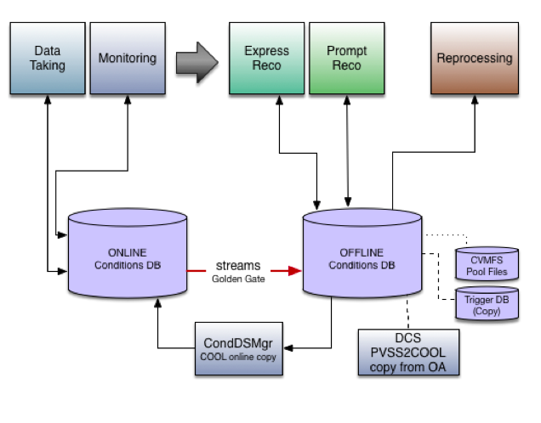
Conditions DB usage and data flow
“users” (client)
On-line realm
TDAQ
LUMI
(SUB-)Detectors
Off-line realm
Athena processing of real data and simulation data
L. Rinaldi Conditions evolution of an experiment in mid-life… without the crisis CHEP2018 - Sofia (Bulgaria)

Slide 16
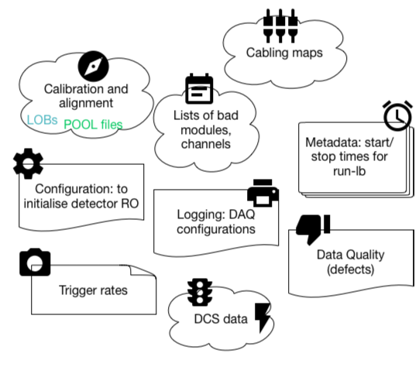
What is stored in the Conditions DB
Conditions data contain a large variety of information (such as Detector Control, trigger and DAQ, Data Quality, information from LHC and sub-detectors).
Heterogeneous information in:
data type (single column, Blobs, Clob, ext ref, POOL ROOT,...)
granularity (from 1 IOV spanning 0-INF to sub-lumi level IOV)
L. Rinaldi Conditions evolution of an experiment in mid-life… without the crisis CHEP2018 - Sofia (Bulgaria)
Notes:
We store in Cond DB all that information charaterizing the state of (sub) detector
BLOB: Binary Large OBject
CLOB: CHaracter Large OBject

Slide 17
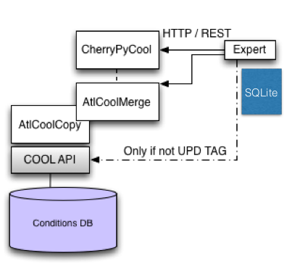
Writing data to COOL DB
Single-version Folders directly updated by expert
Multi-version Folders need special python tool for careful TAG handling (UPD TAG locking mechanism implemented)
L. Rinaldi Conditions evolution of an experiment in mid-life… without the crisis CHEP2018 - Sofia (Bulgaria)

Slide 18
The CREST DB server
Crest DB SERVER: functionalities exposed via REST architecture
SQL not involved in server-client communication, internal resources accessible via URL and HTTP methods
Requests and Responses formatted in JSON
Based on standard Java technologies (JEE, Spring) and specifications (JAX-RS, JPA)
Can be deployed in the same Tomcat server as Frontier
L. Rinaldi Conditions evolution of an experiment in mid-life… without the crisis CHEP2018 - Sofia (Bulgaria)

Slide 19
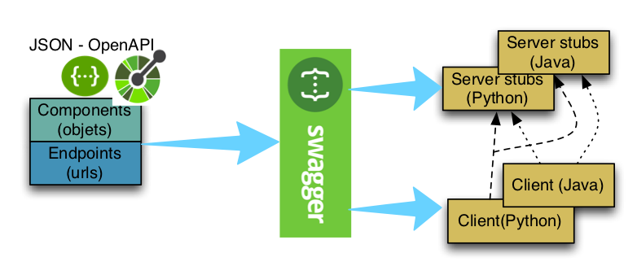
The CREST DB client
The client based on The Crest API (a set of REST methods), allowing external clients to interact with the resources represented in the data model.
Crest API is written using OpenAPI specifications
A JSON file describe the URLs and their parameters, and the Request and Response bodies
Clients and server stubs are generated via the the swagger-codegen library
19
L. Rinaldi Conditions evolution of an experiment in mid-life… without the crisis CHEP2018 - Sofia (Bulgaria)

Slide 20
COOL-REST caching mechanism
One of the main goals is to improve the caching mechanism.
Using the information provided in the query parameters it is easy to decide caching policy based only on the expiration time (max-age parameter in the response header). Few examples:
the query accesses a Tag: check if it is locked
the query accesses an IOV range: check if it is in the “past”
The Tag/IOVs insertion policies adopted in ATLAS and implemented via COOL do not allow for changes of conditions in the past for locked tags or for single version folders. This kind of query can thus be extended to large max-age values, without a check on update times.
L. Rinaldi Conditions evolution of an experiment in mid-life… without the crisis CHEP2018 - Sofia (Bulgaria)

Slide 21
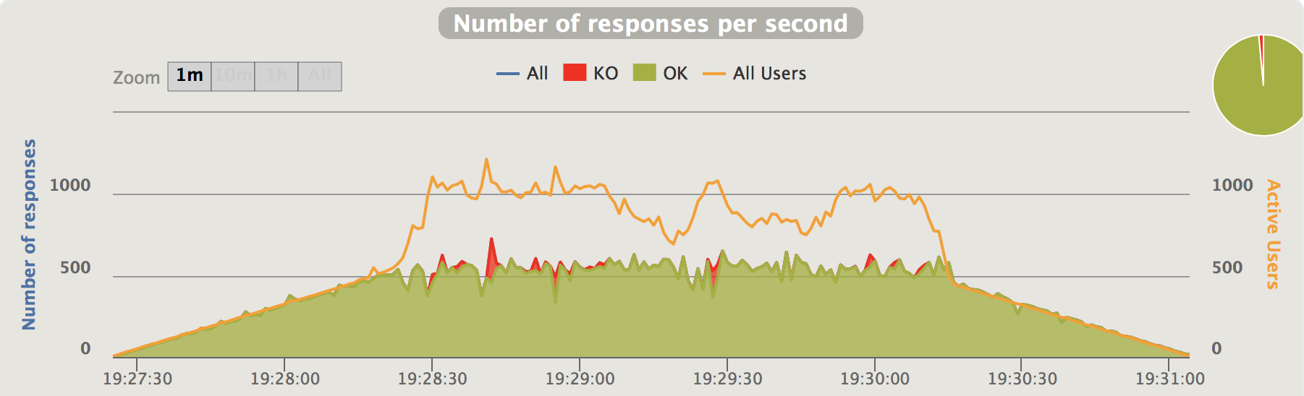
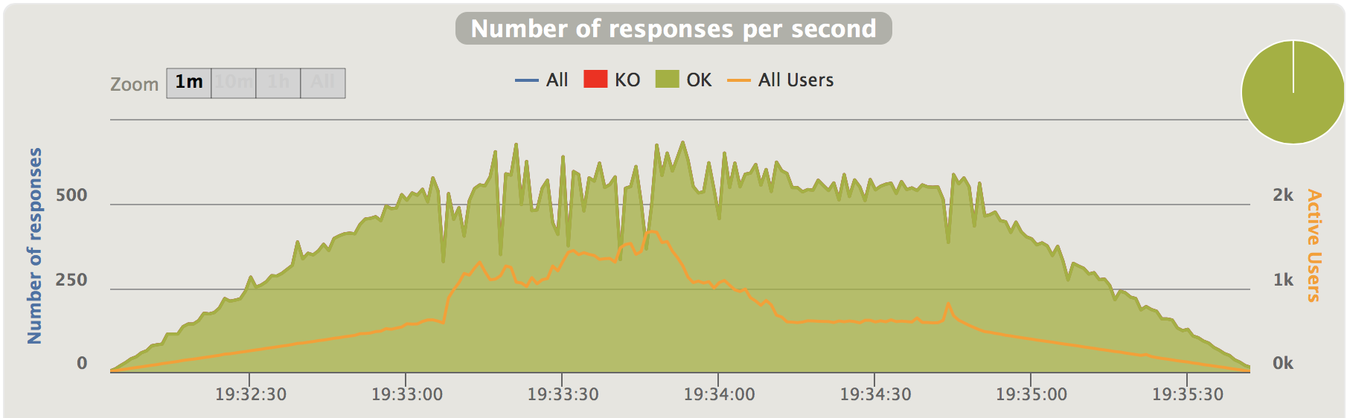
Gatling testing COOL-REST: no cache
Compare Frontier and COOLR server using the same input (encoded SQL). This guarantees that we see a performance similar to the one of Frontier launchpad.
We show here a “working” example for Gatling tests (until about a pic point of 500 Req/s) and some other examples where we see the systems which are starting to suffer (in the pic range of 600 Req/s).
Frontier (left): server errors appear (config limit at 400 threads).
CoolR (right): number of active users increase because of queuing of Req.
L. Rinaldi Conditions evolution of an experiment in mid-life… without the crisis CHEP2018 - Sofia (Bulgaria)
Notes:
remove plots and add a line sayng “work in progress”

Slide 22
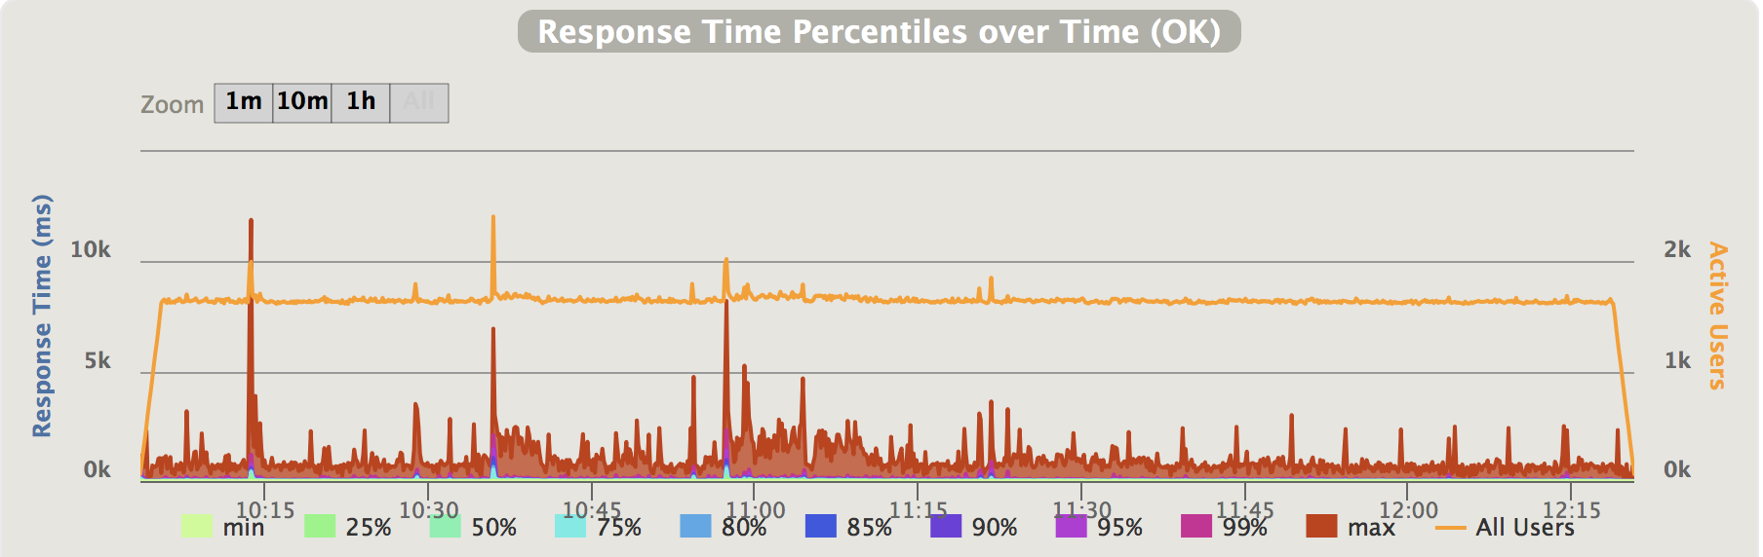
Gatling testing COOL-REST: via Squid
The SQUID of the launchpad was configured to redirect the requests containing in the URLs “CoolR-API” into port 9090. We managed to reach > 1.5K Req/s in this way (without errors).
L. Rinaldi Conditions evolution of an experiment in mid-life… without the crisis CHEP2018 - Sofia (Bulgaria)
Notes:
we obtained this rate without getting errors

