Slide 1
Building a global file system for data access using Large Scale CVMFS and DynaFed
Alastair Dewhurst, Catalin Condurache, Louise Davies, Sam Skipsey

Slide 2
Motivation
Effective Distributed Data Management has proven to be an extremely difficult problem to solve.
  Large experiments have managed it but at significant effort costs.
For most experiments, difficulty accessing their data limits where they can run their work.
  Experiments are producing ever more data
  Experiments have less effort and expertise in data management.
We need to make it significantly easier for experiments to access their data.
  POSIX and Web browser access.
  No jump in difficulty as the amount of data grows.

Slide 3
CVMFS
CVMFS has been primarily developed for distributing large software stacks.
  Provides read only POSIX access.
  Extremely effective and popular.
Large Scale CVMFS is an extension to the base software which allows it to distribute large, non-public datasets.
  Presented at CHEP16 by Derek Weitzel et al

Slide 4
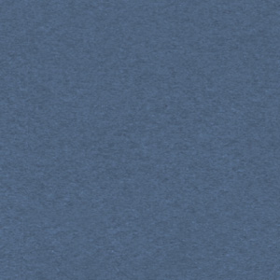
Large Scale CVMFS
VO data
Stratum 0
The SHA1 checksum is calculated and added to the catalog file. The files are marked non-compressed and externally stored making them accessible via their logical name.
The CVMFS client has a list of endpoints it will try in turn to access the data.
A separate relatively small cache on each WN acts as a buffer for each requested file.
Catalog
Stratum 1
Data
Site Squid
WN
WN
WN

Slide 5
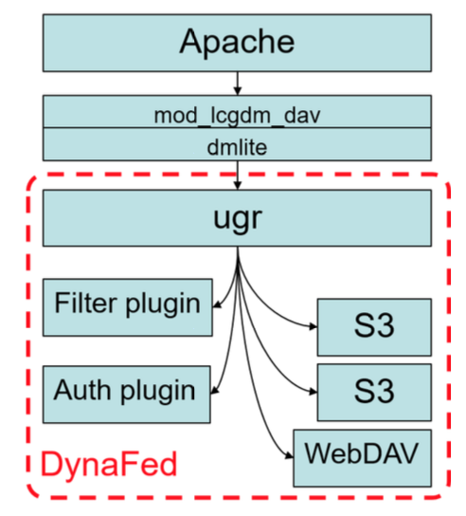
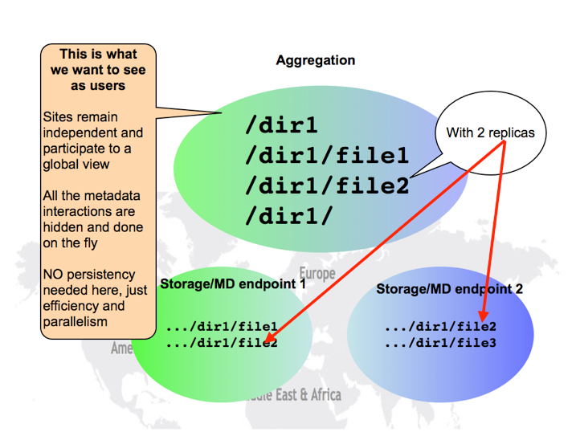
DynaFed
DynaFed aims to provide a “Dynamic HTTP storage federation”.
  Provides single namespace.
  Redirects clients to closest file replica.
DynaFed also provides access to Cloud storage.

Slide 6
Setup
VO data
Stratum 0
Used DynaFed to federate endpoints.
CVMFS config file lists DynaFed endpoint.
Catalog
Stratum 1
DynaFed
Site Squid
SE
WN
Data
WN
WN

Slide 7
What does DynaFed add?
Allows access to data stored on RAL’s S3 storage.
Provides a single name space so that CVMFS doesn’t have to try each endpoint in turn to access the data.
If data is available at multiple sites, it will select the closest.
Simplifies CVMFS configuration (which is needed on every client e.g. WN).
  Makes it much easier to use opportunistic storage.
Bonus: Provides access to data via a web browser.
  We have written LDAP plugin for DynaFed

Slide 8
LIGO
LIGO were the original user of Large Scale CVMFS for some of their work on the Grid.
  The PyCBC workflow which needs ~10TB data.
Number of UK LIGO collaborators rapidly growing.
Data was being exported to Cardiff.
  Rest of UK still accessing data direct from US.
Data has been placed at RAL and started to be replicated to Glasgow.
  Using DynaFed just works!
Relatively small numbers of LIGO jobs running at RAL to make any performance/scalability claims.

Slide 9
Filter Plugin
The Filter plugin is normally referred to as the geolocation plugin.
  Because that is the default plugin available.
Plugin will take list of endpoints and return one.
  Is the same for both reads and writes.
We looked at using “Rucio closeness” to select best replica.
  Still need geolocation to map host to site.
  Geolocation works pretty well.
  Useful to add exceptions but unnecessary optimization most of the time.

Slide 10
Limitations?
LS-CVMFS + DynaFed provides a solution for the problem of how to access data but:
  Can’t upload files by just “cp” to a CVMFS directory.
  Uploaded files need to be grafted before they are available.
    Workflows that have the output of one job being the input of the next job would need to wait if relying on LS-CVMFS
Data distribution is a separate problem.
  At RAL we are testing Rucio which would handle this half of the problem.

Slide 11
Next steps
Euclid is a visible to near-infrared space telescope currently under development by the ESA.
In August they are planning on running a MC campaign across the UK requiring ~10 Million CPU hours.
Euclid have one person doing this who has developed his workflow on a local batch farm with a shared file system.
  Output from some jobs are the input to the next.
Challenge is to see how quickly we can graft files into LS-CVMFS

Slide 12
Conclusions
Adding DynaFed to LS-CVMFS was a simple improvement that added many benefits.
  All the components were already setup at RAL.
I believe that LS-CVMFS + DynaFed will avoid problems as an experiments data grows.

Slide 13
References
Large Scale CVMFS documentation: http://cvmfs.readthedocs.io/en/stable/cpt-large-scale.html
Accessing data federations through CVMFS (2017): https://drive.google.com/file/d/0B_RVv_OjWcURUi15cmtUaXotVkU/view
CVMFS for data federations (2016): https://indico.fnal.gov/event/10571/session/7/contribution/34/material/slides/0.pdf
DynaFed whitepaper (May 2017): http://svnweb.cern.ch/world/wsvn/lcgdm/ugr/trunk/doc/whitepaper/Doc_DynaFeds.pdf
Data Access for LIGO on the OSG (May 2017): https://arxiv.org/pdf/1705.06202.pdf
StashCache documentation: http://opensciencegrid.github.io/StashCache/

