Slide 1
The eXtreme-DataCloud project
Daniele Cesini
With contribution by: Patrick Fuhrmann, Lukasz Dutka, Cristina Duma, Alessandro Costantini, Oliver Keeble, Fernando Aguilar, Giacinto Donvito
info<at>extreme-datacloud.eu

Slide 2
XDC Objectives
The eXtreme DataCloud is a software development and integration project
Develops scalable technologies for federating storage resources and managing data in highly distributed computing environments
  Focus efficient, policy driven and Quality of Service based DM
The targeted platforms are the current and next generation e-Infrastructures deployed in Europe
  European Open Science Cloud (EOSC)
  The e-infrastructures used by the represented communities

Slide 3
XDC Foundations
XDC take the move from
  the INDIGO Data management activity
  the experience of the project partners on data-management
Improve already existing, production quality, Federated Data Management services
  By adding missing functionalities requested by research communities
  Must be coherently harmonized in the European e-Infrastructures
  TRL 6+ ➔ TRL8 (as requested by the H2020 call)

Slide 4
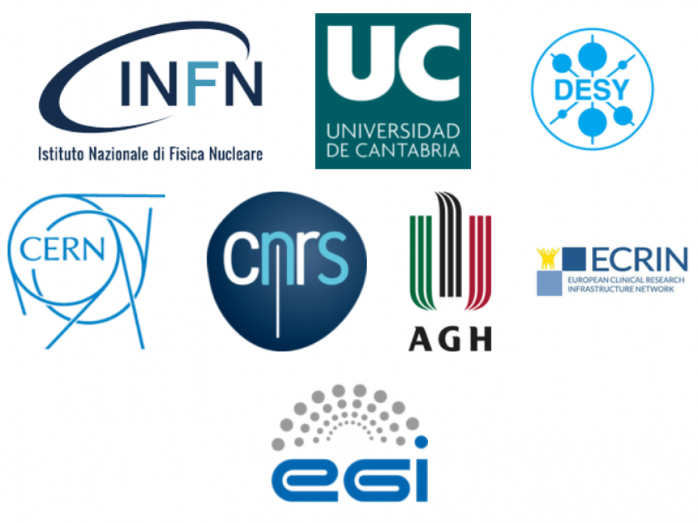

XDC Consortium
ID | Partner | Country | Represented Community | Tools and system
1 | INFN (Lead) | IT | HEP/WLCG | INDIGO-Orchestrator
2 | DESY | DE | Research with Photons (XFEL) | dCache
3 | CERN | CH | HEP/WLCG | EOS, DYNAFED, FTS
4 | AGH | PL |  | ONEDATA
5 | ECRIN | [ERIC] | Medical data
6 | UC | ES | Lifewatch
7 | CNRS | FR | Astro [CTA and LSST]
8 | EGI.eu | NL | EGI communities
8 partners, 7 countries
7 research communities represented + EGI
XDC Total Budget: 3.07Meuros
XDC started on Nov 1st 2017 – will run for 27 months until Jan 31st 2020

Slide 5
XDC Technical Topics
Intelligent & Automated Dataset Distribution
  Orchestration to realize a policy-driven data management
  Data distribution policies based on Quality of Service (i.e. disks vs tape vs SSD) supporting geographical distributed resources (cross-sites)
  Data lifecycle management
Data pre-processing during ingestion
Smart caching
  Transparent access to remote data without the need of a-priori copy
Metadata management
Data management based on access patterns
  Move to ‘glacier-like’ storage unused data, move to fast storage “hot” data
    at infrastructure level
Sensitive data handling
  secure storage and encryption

Slide 6




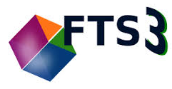

XDC Toolbox
Orchestration
c
c
Storage
Rucio
dCache
INDIGO
Orchestrator
QoS
CDMI
HTTP
Cache
xRootD
Cache
Federation

Slide 7
Expected Control Flow for Orchestration
Rucio
INDIGO
Orchestrator
TOSCA
Control
Control
Quality of
Storage
Data Location
Location
dCache

Slide 8
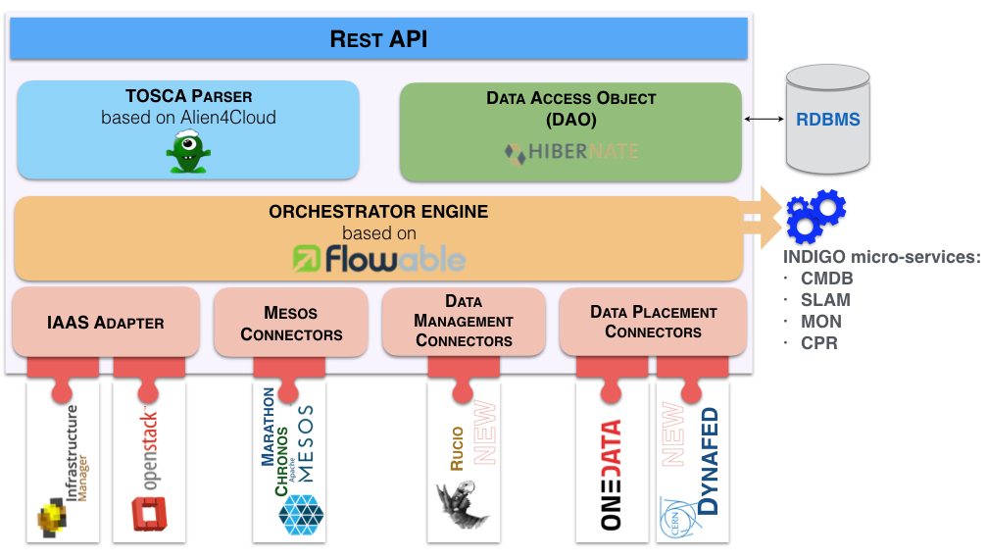
INDIGO Orchestrator Overview
The Orchestrator accepts TOSCA requests
It can run three main workflows in the PaaS:
  Deploy
  Undeploy
  Update
The Orchestration layer is being extended in order to address the new requirements:
  move data between distributed storages
  specify different QoS for replicas
  launch and monitor user defined processing jobs at ingestion time
XDC extensions

Slide 9
Quality of service in storage
Modern Storage offers go beyond the WLCG model of disk and tape
  Often the actual cloud storage technology is not even known to the end user or might change over time
  Mostly only quality attributes are known, like Glacier:
    Durability (Retention Policy): 99.999999999%
    Access Latency : a) 5 minutes, b) 5 hours, c) 12 hours
XDC aims to provide
  help to standardize the different attributes
  a prototype of rendering those attributes through a network protocol
  a set of reference implementations to be used by the Orchestration system
Work is based on INDIGO-DataCloud prerequisites

Slide 10
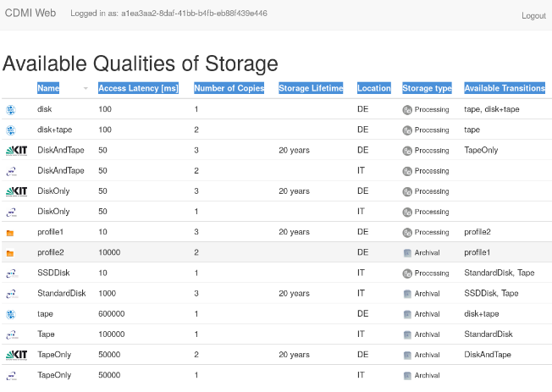
Work in progress for QoS
Definition currently based on a RDA working group
”Cloud Data Management Interface” chosen as control protocol.
  Defined by SNIA.
  INDIGO acknowledged by SNIA as contributor to the reference implementation.
Implementing the defined API into GFAL, dCache, EOS and StoRM
Access Latency [ms]
Number of Copies
Storage Lifetime
Location
Available Transitions
From INDIGO-DataCloud

Slide 11
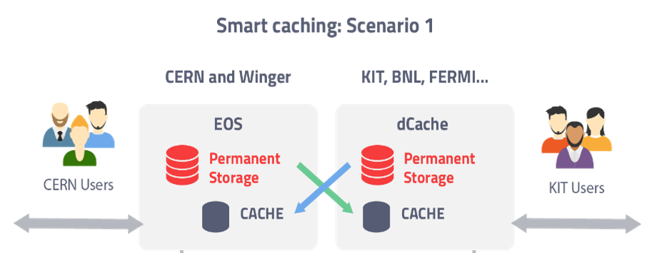
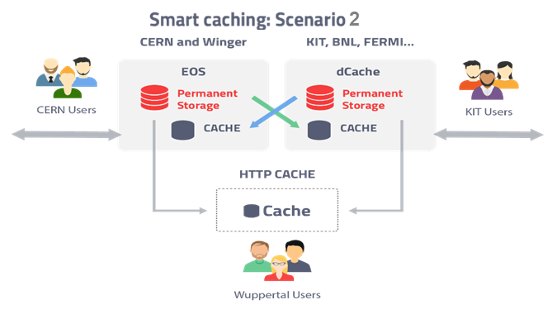
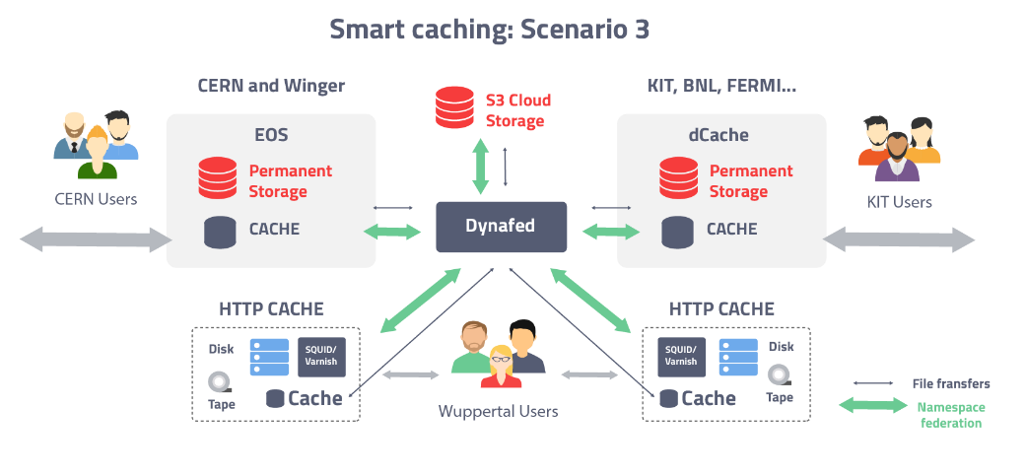





Smart caching
Smart caching
  Develop a global caching infrastructure supporting the following building blocks:
    dynamic integration of satellite sites by existing data centres
    creation of standalone caches modelled on existing http and xrootd solutions
    federation of the above to create a large scale, regional caching infrastructure
For an use case implementing XDC results on Scenario2 using xcache in collaboration with CMS and HNSciCloud see D.Spiga presntation on Monday: «Exploiting private and commercial clouds to generate on-demand CMS computing facilities with DODAS»
https://indico.cern.ch/event/587955/contributions/2937198/attachments/1682105/2702791/CHEP-2018-Spiga.pdf

Slide 12


EOS-dCache integration with cached access
Sync Namespace
Request
CERN
DESY
Advantages
Same software stack as we currently have at the sites.
After the data has been transferred to the local storage system, a name space entry has been created locally and the data is available at the local site independently of the remote network link and the availability of the central service.

Slide 13
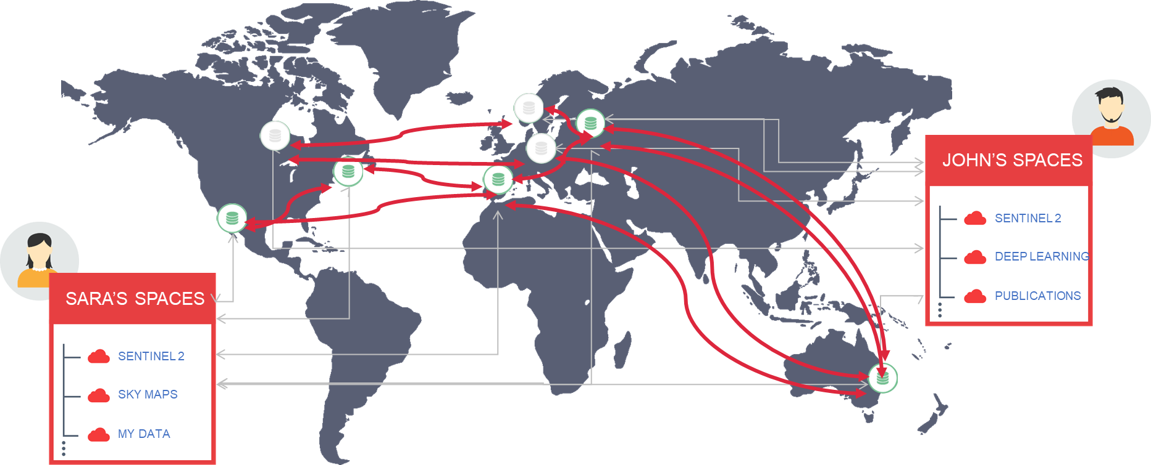
Data in Hybrid Cloud Environments: Onedata
ONEDATA is a storage federator that allows to use resources backed by providers worldwide
  Providers deploy Oneprovider services near physical storage resources
  Users use Onezone web interfaces
    APIs available
    Local mounting on users machines available
  Storage is organized into Zones
    federations of providers
    enable the creation of closed or interconnected communities
https://onedata.org

Slide 14
Onedata XDC Goals
Improve scalability and stability
  Provide unified Exascale data access and management platform for processing on multi-cloud infrastructures
Next Generation Replica Management Engine
  Multi level priority queues and Adaptive buffering and TCP/IP connection management
  Weighted source selection in case of many possible sources
Enable advanced metadata mechanisms supporting legacy metadata solutions and open data publishing
  Use cases from ECRIN, CTA, LIFEWATCH
Ensure secure data storage and provisioning for sensitive data sets
Smart Cache Management and Advanced file popularity index
QoS management at federation and data centre level

Slide 15
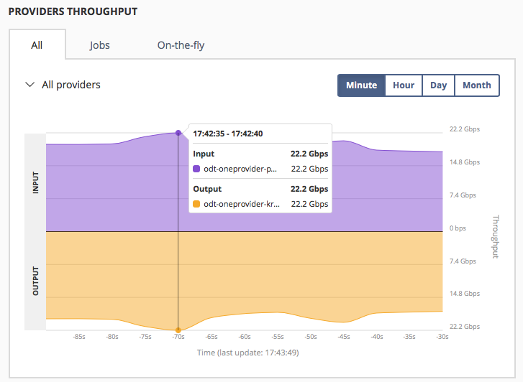
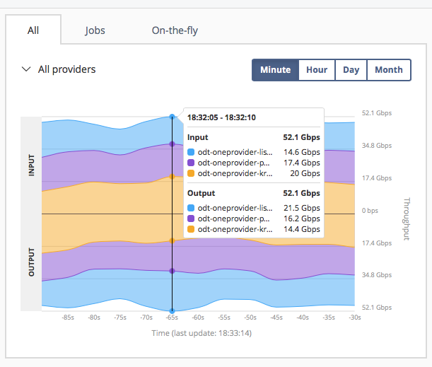
Next Generation Replica Management Engine Released
External tests were done in OTC infrastructure under Helix Nebula Science Cloud
  Heavily tested on real infrastructures
  Very close to iperf3 – multistream throughput ~95-120% tested on several long distance real infrastructures
Current results shows we are able to transfer data between two providers at the speed of
~2Gbps/core. The communication and data transfers are encrypted.

Slide 16
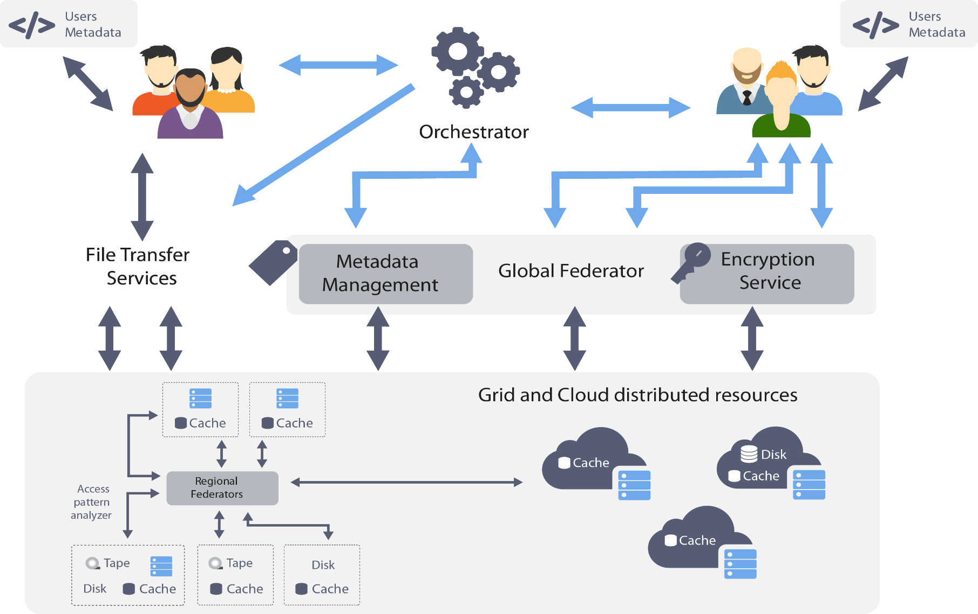
XDC high level architecture

Slide 17
The Plan for the Next Months
Functionalities and Scalability demonstrated
Pilot tb in place
Architecture finalized
Kickoff@INFN
Reference Release -1
Dissemination event@IFCA
XDC started
All-Hands@DESY
Reference Release - 2
Nov ‘17
May‘18
Jul ‘18
Nov ‘18
Nov ‘19
Jan ‘18
Jun ‘18
Sep’18
Jan ‘20
XDC end

Slide 18
XDC Contacts
Website: www.extreme-datacloud.eu
@XtremeDataCloud on Twitter
Mailing list: info<at>extreme-datacloud.eu

Slide 19
Backup slides

Slide 20
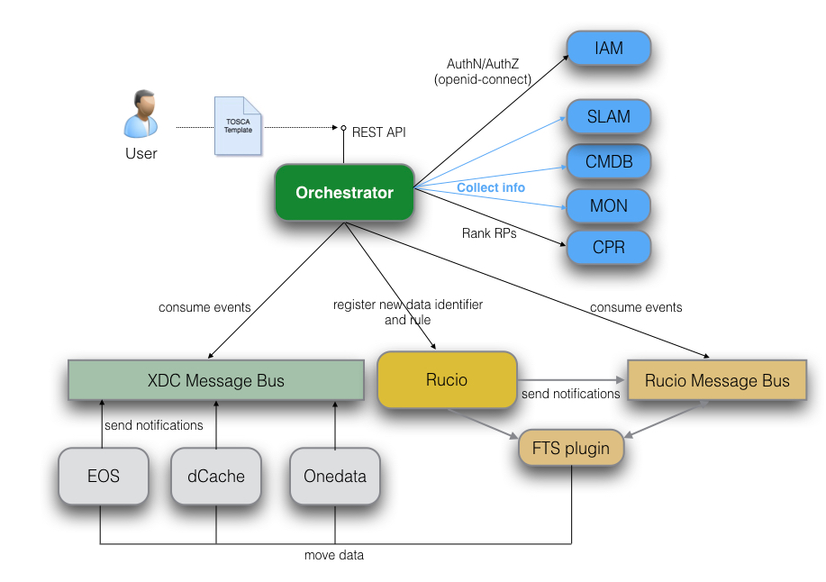
Orchestration System draft architecture

Slide 21
Reference workflow I: DLC management
The user submits the DLC policy request to the Orchestrator, specifying:
  Either the data identifier, in case the file is already known to Rucio or the physical location of the data if not. In the latter case, the Orchestrator has to register the data into Rucio before it proceeds.
  The DLC policies, which are the initial and time dependent attributes of the data.
The Orchestrator calls Rucio on behalf of the user and creates the replication rule using the information provided by the user.
Rucio orchestrates the data movement using the input information provided by the Orchestrator to create the data transfer requests (e.g. to copy the data to some specified endpoint).
The transfer tool (e.g. FTS) initiates and monitors the requested transfers. Depending on the set up, the transfer tool may choose from a set of source locations
  by using its transfer history to find the best performing data source
  and by evaluating the network topology.
Rucio continuously compares its rules against reality until the rule is manually deleted or becomes obsolete based on its time dependencies.
At any time after the request was submitted to the Orchestrator, the user can query the Orchestrator for:
A list of rules submitted.
Activity details, including the status, on a specific rule.

Slide 22
Reference workflow II: Preprocessing on data ingestion
The user submits his workflow request to the Orchestrator including the following information:
  the space to watch for incoming data
  the application to be run on incoming data
  the replication rule to be enforced on the incoming or preprocessed data.
The storage system, holding the watched storage, notifies the presence of new data by sending a message to the XDC message queue.
The INDIGO Orchestrator receives the notification and registers the ingested data file into Rucio, including the replica policy, specified by the user.
The Orchestrator selects the best compute site to perform the requested processing. To do so, it might collect information from different sources: CMDB, SLAM, Monitoring, Storage endpoints.
The Orchestrator triggers a data movement through Rucio in order to copy the data to the selected compute center.
The Orchestrator gets notified on the completion of the data transfer, by listening to the Rucio Message Queue.
The Orchestrator triggers the processing Job by submitting the request to those computing clusters (Mesos/Kubernetes) available at the site.
As soon as the job output is produced, its availability is notified to interested parties, in particular Rucio, via the XDC message bus.
The data, generated by the processing step, is automatically registered into Rucio though the Orchestrator.
Rucio takes care that the policies requested for the raw and preprocessed data are applied.

Slide 23
Federation, Orchestration
CERN Dynafed
Federates endpoints to a virtual global namespace.
Supports http, WebDAV, S3
CERN FTS
Orchestrates reliable wide area data transfers
Supports multiple protocols, GridFTP, http, xrootd
Can select most appropriate source
Has knowledge on network topology and health

Slide 24
The INDIGO PaaS Orchestrator
The INDIGO PaaS Orchestrator is a component of the PaaS layer that allows to instantiate resources on Cloud Management Frameworks (like OpenStack and OpenNebula) and Mesos clusters.
It takes the deployment requests, expressed through templates written in TOSCA YAML Profile 1.0 and deploys them on the best cloud site available. In order to do that
  it gathers SLAs, monitoring info and other data from other platform services,
  it asks to the cloud provider ranker for a list of the best cloud sites.
Exposes REST APIs
Stolen from the INDIGO PaaS Orchestrator GitHub

Slide 25
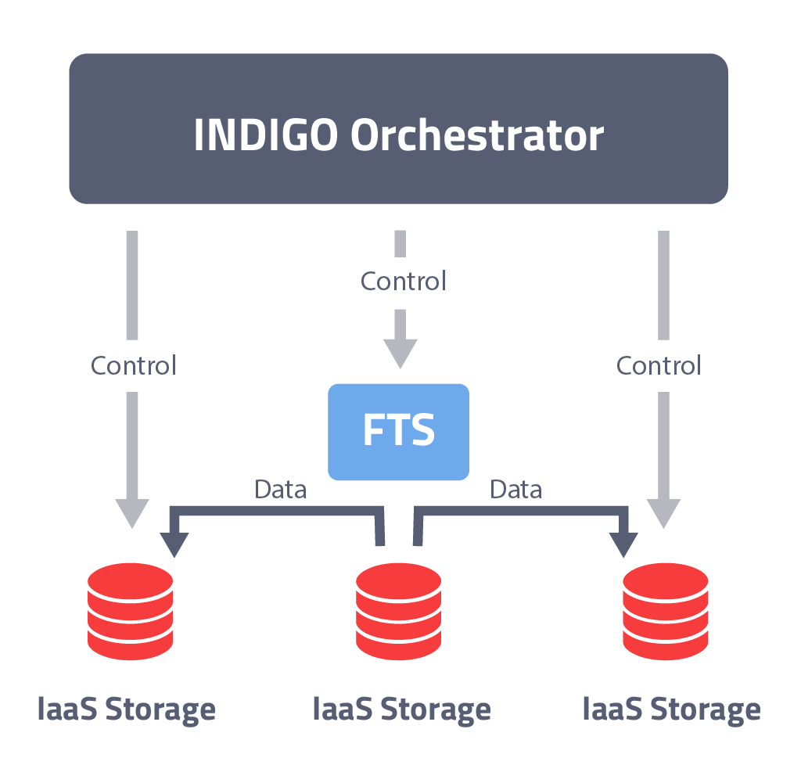
Policy driven Data Management
Intelligent & Automated Dataset Distribution
  A typical workflow
    Initially the data will be stored on low latency devices for fast access
    To ensure data safety, the data will be replicated to a second storage device and will be migrated to custodial systems, which might be tape or S3 appliances
    Eligible users will get permission to restore archived data if necessary
    After a grace period, Access Control will be changed from “private” to “open access”
  Data management based on access pattern

Slide 26
Data pre-processing
Data pre-processing during ingestion
  Automatically run user defined applications and workflows when data are uploaded
    i.e. for Skimming, indexing, metadata extraction, consistency checks
  Implement a solution to discover new data at specific locations
  Create the functions to request the INDIGO PaaS Orchestrator to execute specific applications on the computing resources on the Infrastructure
  Implement a high-level workflow engine, that will execute applications defined by the users
  Implement the data mover to store the elaborated data in the final destination

Slide 27
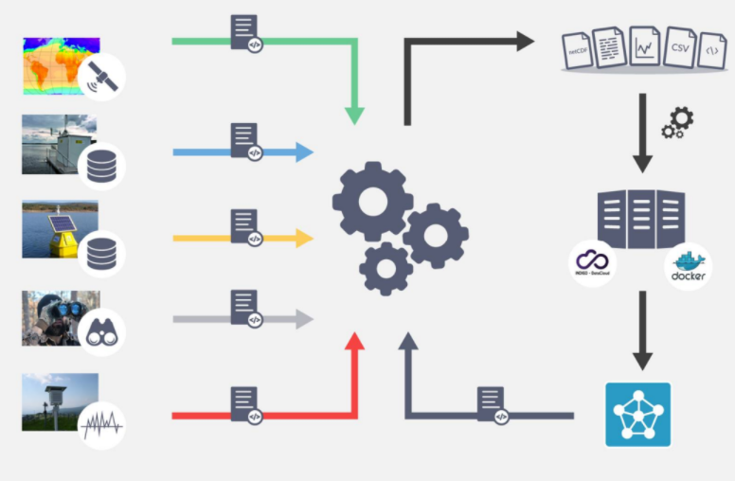
LifeWatch Use Case
Problem: Life Cycle Management of data related to Water Quality involving heterogeneous data sources
  Satellite, Real-time monitoring, meteorological stations.
Goal: Integrate data sources and different types of modelling tools to simulate freshwater masses in a FAIR data environment
  Use of standards like EML (Ecological Metadata Language)
XDC Solution:
  Onedata
    Metadata management and discovery, Digital Identifier minting, storage
  PaaS Orchestrator
    automatic preprocessing for data harmonization and model deployment

Slide 28
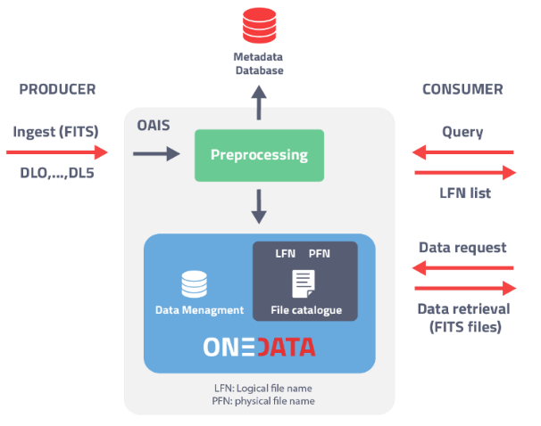
CTA Use Case
Problem: Complex and Big Data management in a distributed environment. Data quality Assurance
  The CTA distributed archive lies on the « Open Archival Information System » (OAIS) ISO standard.
  Event data are in files (FITS format) containing all metadata.
Goal: Metadata are extracted from the ingested files, with an automatic filling of the metadata database.
  Metadata will be used for querying of archive.
  The system should be able to manage replicas, tapes, disks, etc, with data from low-level to high-level
XDC Solutions
  Onedata
    Metadata management and discoverability
  PaaS Orchestrator + QoS

Slide 29
ECRIN Use Case
Problem: Distributed files and data objects across different repositories. Metadata heterogeneity. Sensitive Data
Goal: Single environment to make clinical trial data objects available for sharing with others. Sources are spread over
  a variety of access mechanisms
  several different locations
    growing number of general and specialised data repositories
    trial registries
    Publications
    the original researchers’ institutions
XDC Solution: Onedata
  Metadata management and discovery
  Secure Storage

Slide 30
Next Generation Replica Management Engine Released
External tests were done in OTC infrastructure under Helix Nebula Science Cloud
  Heavily tested on real infrastructures
  Very close to iperf3 – multistream throughput ~95-120% tested on several long distance real infrastructures
Current results shows we are able to transfer data between two providers at the speed of
~2Gbps/core. The communication and data transfers are encrypted.
QoS on the line, the RTRansfer system is now able to prioritize traffic on the existing tunnel and make fair network resources distribution amongst different requests.
The combined overhead in terms of the latency is ~5ms on top of network connection latency – mainly due to scheduling algorithms for QoS
The source and the target protection algorithm to now overload the resources and automatically adopts the request pace

Slide 31
Dedicated Circuit Tests
Two oneproviders
Data is stored in one and replicated to the second one.
Each running 12 cores
Results thanks OTC devoted resources for testing.
iperf3 –P 32 showed average throughput range 21 Gbps

Slide 32
Dedicated Circuit Mesh Tests
Three oneproviders
Each running 12 cores
Data collection is distributed in three places
The migration job is making replica of all files cached in all three providers
Each provider needs to deliver data to two others
Each provider needs to download data from two others

