Slide 2

Scaling the EOS namespace
Quick overview, and current status
Georgios Bitzes, Elvin Sindrilaru, Andreas J. Peters, Andrea Manzi (speaker)
CERN

Slide 3
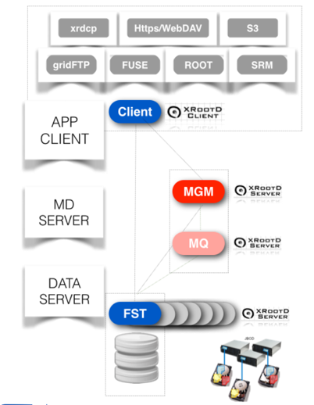
EOS Architecture
File Storage Nodes (FST): Management of physical disks, file serving
Metadata Servers (MGM): Namespace + client redirection to FSTs
Message Queue (MQ): Inter-cluster communication, heartbeats, configuration changes

Slide 4
The namespace subsystem
EOS presents one single namespace to files it manages
  … even though they are typically spread across hundreds of disk servers and thousands of physical disks
Handles file permissions, metadata, quota accounting, mapping between logical filenames and physical locations
-rw-rw-r-- 1 user group 21 Jul 2 10:02 dir1/filename

Slide 5
In-memory namespace implementation
The MGM held the entire namespace in-memory. Each file / directory entry allocates up to 1kb as a C++ structure in memory.
Linear on-disk changelogs to track all namespace changes
  file additions, metadata changes, physical location migrations …
  One for files, one for directories
The in-memory contents are reconstructed on reboot by replaying the changelogs

Slide 6




In-memory namespace implementation (2)
Need for a new namespace implementation
  Long boot time, proportional to the number of files on an instance. For large namespaces can exceed 1hour
  Requires a lot of RAM

Slide 7
The need for high-availability
EOS has become critical for data at CERN. MGM loss means long downtime, great disruption.
Ideally:
  Transparent failover, no service interruption
  No single point of failure

Slide 8
Architectural evolution
We’ve designed and implemented QuarkDB, a highly available datastore for the namespace.
  Redis protocol, supports a small subset of Redis commands.
  RocksDB as the underlying storage backend.
  High availability: Raft consensus algorithm.
Implement the minimum necessary, and keep the system simple
  QuarkDB runs as a plug-in to the XRootD server framework used by EOS

Slide 9
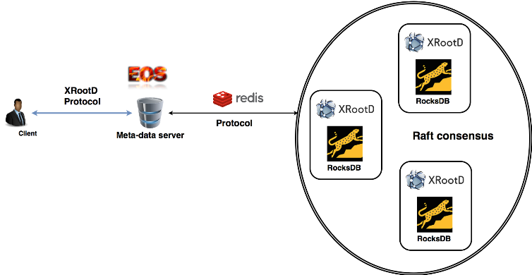
Architectural evolution(2)

Slide 10
Replication
Raft consensus algorithm – simplified
One of the nodes is elected to become the master (or leader)
Node 1
Change metadata of /eos/dir/file
Client
Node 2
Client says: Change metadata of /eos/dir/file
ok
Leader
Node 3

Slide 11
Leader election (1)
Raft consensus algorithm – simplified
Haven’t heard from the leader for 2 sec… Something is wrong
Follower

Slide 12
Leader election (2)
Raft consensus algorithm – simplified
A successful election: 2 out of 3 nodes agree on the new leader
Vote for me for term 20
Vote for me for term 20
Candidate
Follower
Vote granted
Used to be leader for term 19

Slide 13
Log replication
Raft consensus algorithm – simplified
Leader
Hey, are you there?
Follower
Yeah, my last index is #149
You’re missing entries 150 to 203.. Here they are…

Slide 14
QuarkDB Testing
QuarkDB is being tested extensively.
  Unit, stress, chaos tests: From testing parsing utility functions, to simulating constant leader crashes and ensuring nodes stay in sync.
  Test coverage: 91%, measured on each commit.
  All tests running under AddressSanitizer & ThreadSanitizer, on each commit.

Slide 15
Problem: Network latency
Previous assumption throughout the MGM code: Access latency to the NS is minimal, all lives in-memory.
But with QDB, metadata lives a network roundtrip away…
  Caching frequently accessed entries in the MGM helps a lot.
Certain locks which were fine to hold for in-memory NS operations, were causing trouble for new NS.

Slide 16
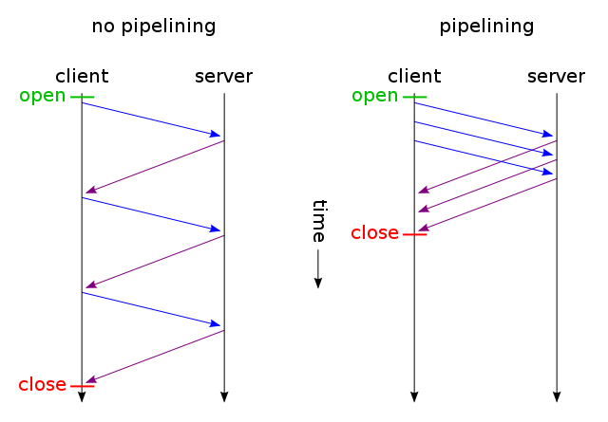
Problem: Network latency (2)
Using prefetching to first load metadata into the MGM cache, before holding any locks.
  Allows staging in-flight requests from many clients simultaneously.
  Allows pipelining, virtually eliminating effects of network latency for many operations (notably “ls”)

Slide 17

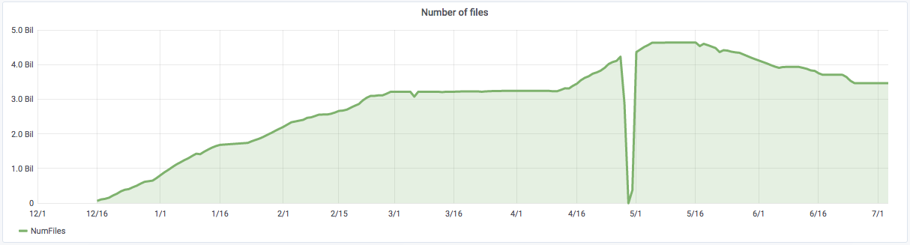
Current status
EOSPPS: our pre-production instance runs NS on QuarkDB since 7 months
  4.6 billion files reached– larger namespace than all other instances combined
  Boot time: A couple of minutes

Slide 18
Current status (2)
Some more numbers:
  Namespace size on disk: ~0.6 TB
  QuarkDB has been able to sustain 7-11kHz of writes for weeks, translates to around ~1kHz file creations.
First production instance under deployment for the EOS HOME project

Slide 19
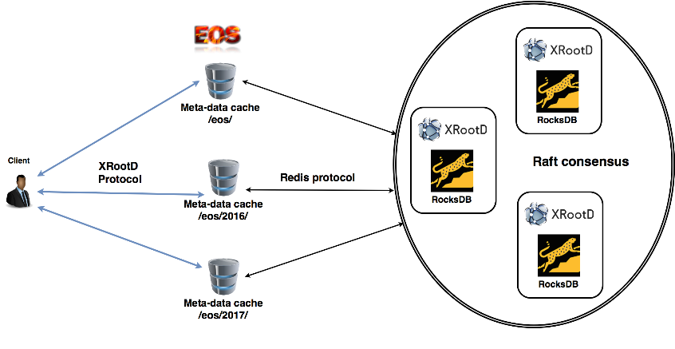
Next Steps
Implementing HA at the MGM level. Multiple standby MGMs, coordination through QuarkDB on who becomes active

Slide 20
Thanks
https://gitlab.cern.ch/eos/quarkdb
Current status: ~18k lines of code
  including tests, tools
  excluding dependencies
More on Raft:
  https://raft.github.io/raft.pdf
  https://thesecretlivesofdata.com/raft/
Questions, comments?

Slide 21
Backup Slides

Slide 22



Possible alternatives
RDBMs: scalability issues, complicates our setup
Redis: scalable and fast, but…
  high per-entry RAM overhead
  redis cluster can lose acknowledged writes
Cassandra: scales very well, but…
  adds significant complexity to setup & operation
  performance / resource cost is high

Slide 23
Redis command translation
Redis command
rocksdb
Key descriptor: “dmyhash” =>
“This key is a hash, current size is 5”
HSET myhash field contents
“bmyhash##field” => “contents”
Key descriptor: “dmyset” =>
“This key is a set, current size is 8”
SADD myset element
“cmyset##element” => “1”

Slide 24
Consistency guarantees
QuarkDB is a strongly consistent datastore (CP from CAP theorem)
Linearizability: once a client receives an ACK to a write, all future reads (from any client) are guaranteed to return that value, or a future one.
  even if the leader crashes right after the ACK

