Slide 2

WLCG Space Accounting in the SRM-less world
CHEP 2018, Sofia, 09.07.2018
Julia Andreeva on behalf of the team contributing to the WLCG Storage Space Accounting project
CERN

Slide 3

Motivation
Lack of global storage space accounting for the WLCG infrastructure
Existing solutions are working in the scope of a single experiment or a given infrastructure (EGI APEL-based)
Looking for a common solution which can work across experiments, Grid infrastructures and can be used for operations and accounting purposes
Gradually get rid of the SRM dependencies
Julia Andreeva , CHEP 2018, Sofia, 09.07.2018

Slide 4
Directions of work (1)
Enable storage space topology description
Enable possibility to query storage space accounting information for all kinds of storage implementation
Implementation of the WLCG Storage Space Accounting service (WSSA) which implies data collection, storage, processing and visualization
Julia Andreeva , CHEP 2018, Sofia, 09.07.2018

Slide 5
Directions of work (2)
Enable storage space topology description
Enable possibility to query storage space accounting information for all kinds of storage implementation
Implementation of the Storage Space Accounting service which implies data collection, storage, processing and visualization
First two goals are being addressed by the joined effort of the WLCG Data Steering group in collaboration with storage providers and the WLCG Accounting Task Force. The technical proposal is described in detail in Storage Resource Reporting (SRR) document. Presented at approved at the Grid Deployment Board. The initial proposal considered disk storage space accounting. Implementation is in progress.
Julia Andreeva , CHEP 2018, Sofia, 09.07.2018

Slide 6

Storage topology description
The goal is to provide description of the storage services with space quotas (storage shares) which have to be accounted separately. Storage shares should be independent with no physical overlap in terms of space. Aggregation of occupied/free space of storage shares of a given storage service should provide a complete view of the storage service capacity.
According to SRR every storage should provide an URL with the file in JSON format.
URL will be recorded as an attribute of the storage service in GocDB/OIM
It is foreseen that Computing Resource Information Catalogue (CRIC) which is currently under development will collect and record storage topology description and will serve as an information provider for global WLCG view. Fore more details see presentation
Julia Andreeva , CHEP 2018, Sofia, 09.07.2018
Notes:
.

Slide 7
“Space quota” level resource reporting
Requirement : Storage systems should provide total used and total free space for all distinct space quotas available to the experiment through a non-SRM protocol.
  Query frequency - order of minutes
  Accuracy – order of tens of GB depending on storage implementation
  Freshness – tens of minutes
At least one non-SRM protocol (gridFTP, HTTP and xrootd) should be enabled for storage occupancy queries (used/free if possible)
An alternative solution is a JSON file as for topology description complemented with accounting data
Julia Andreeva , CHEP 2018, Sofia, 09.07.2018
Notes:
.

Slide 8
SRR implementation
Implementation by all storage providers is ongoing.
  EOS – done. Already enabled at CERN
  DPM – enabled in DPM 1.10. Needs special configuration performed by the sites. Will be followed up by SRR deployment campaign
  dCache – work in progress
  Other storage providers are also planning to work on SRR implementation
Julia Andreeva , CHEP 2018, Sofia, 09.07.2018

Slide 9
Directions of work (3)
CRIC and SRR are work in progress
Deployment campaign for SRR might take quite some time
The system is constructed in a way to make progress using existing sources and to switch transparently to CRIC and SRR as they are in place
Enable storage space topology description
Enable possibility to query storage space accounting information for all kinds of storage implementation
Implementation of the WLCG Storage Space Accounting service (WSSA) which implies data collection, storage, processing and visualization
Julia Andreeva , CHEP 2018, Sofia, 09.07.2018

Slide 10
WSSA Data Flow
Storage topology source
Storage space queries
Storage
Storage
Request for storage topology
MONIT infrastructure
WSSA collector
WSSA Dashboard
Julia Andreeva , CHEP 2018, Sofia, 09.07.2018

Slide 11
WSSA Current Implementation
SRM queries and Monalisa APIs
Experiment-specific topology sources
Storage topology source
Storage
Storage
Request for storage topology
MONIT infrastructure
WSSA collector
WSSA Dashboard
MONIT infrastructure is used for data storage, processing and visualization
Data is stored on HDFS, Elasticsearch and InfluxDB
WSSA Dashboard is implemented in Grafana and uses InfluxDB storage backend
Julia Andreeva , CHEP 2018, Sofia, 09.07.2018

Slide 12
WSSA Implementation
Storage topology source
SRR queries
Storage
Storage
Request for storage topology
MONIT infrastructure
WSSA collector
WSSA Dashboard
Julia Andreeva , CHEP 2018, Sofia, 09.07.2018

Slide 13
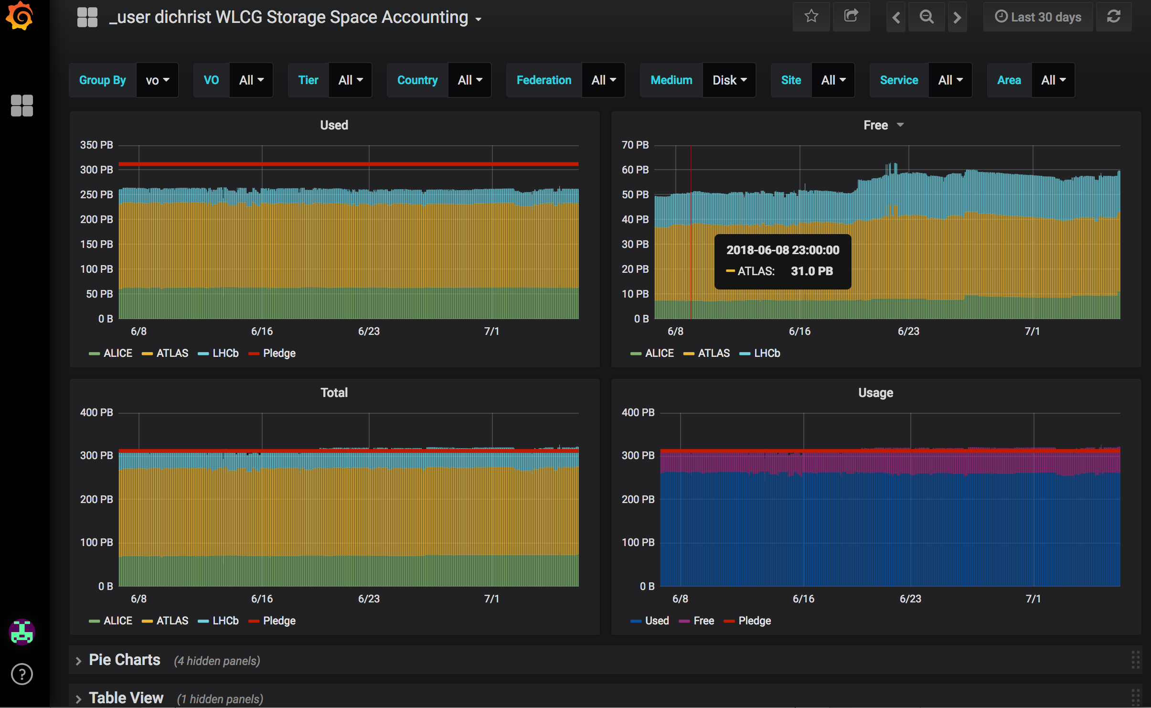
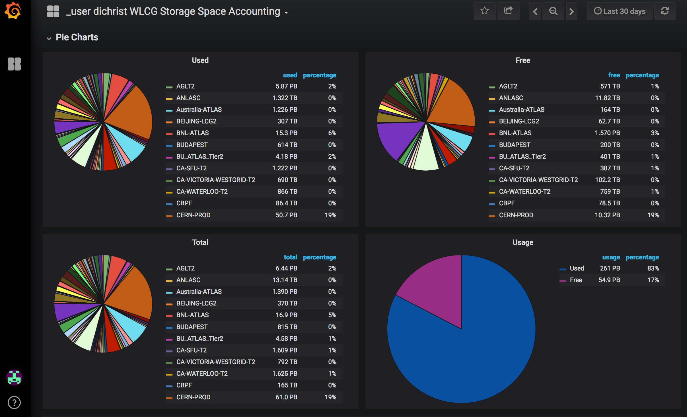
WSSA status (disk storage)
Space accounting for disk storage is provided in WSSA prototype for ALICE, ATLAS and LHCb. Work for CMS is ongoing.
Julia Andreeva , CHEP 2018, Sofia, 09.07.2018

Slide 14
Storage Space Accounting for tapes
In collaboration with the WLCG Archival Storage Working Group the progress has been done for tape storage accounting
File format very similar to SRR
Pull mechanism over HTTP
Can support any number of metrics, not just limited to the accounting data, but for other tape metrics which can help to understand and optimize tape usage for the LHC workflows
Julia Andreeva , CHEP 2018, Sofia, 09.07.2018

Slide 15
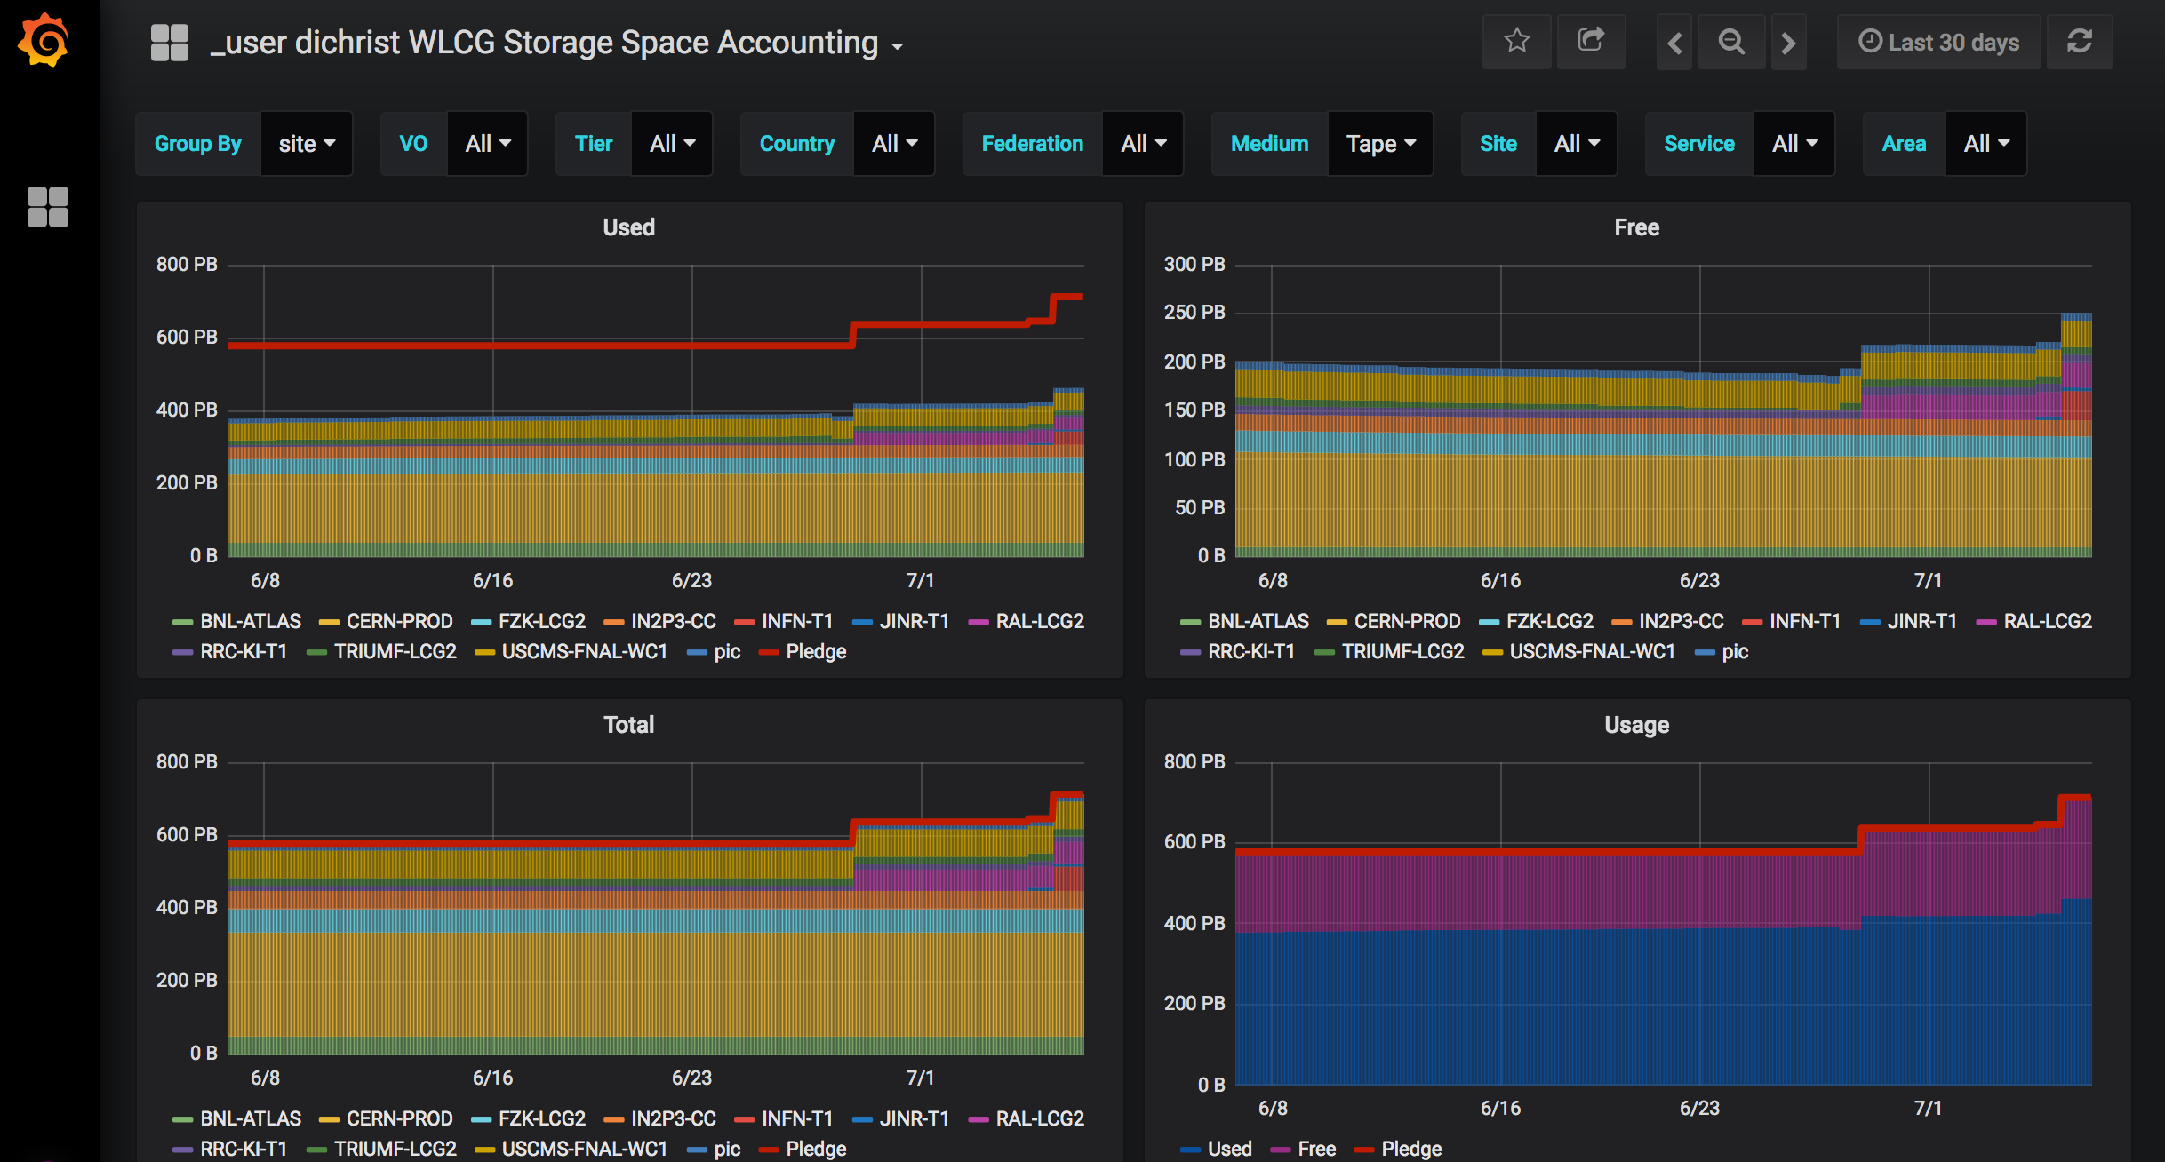
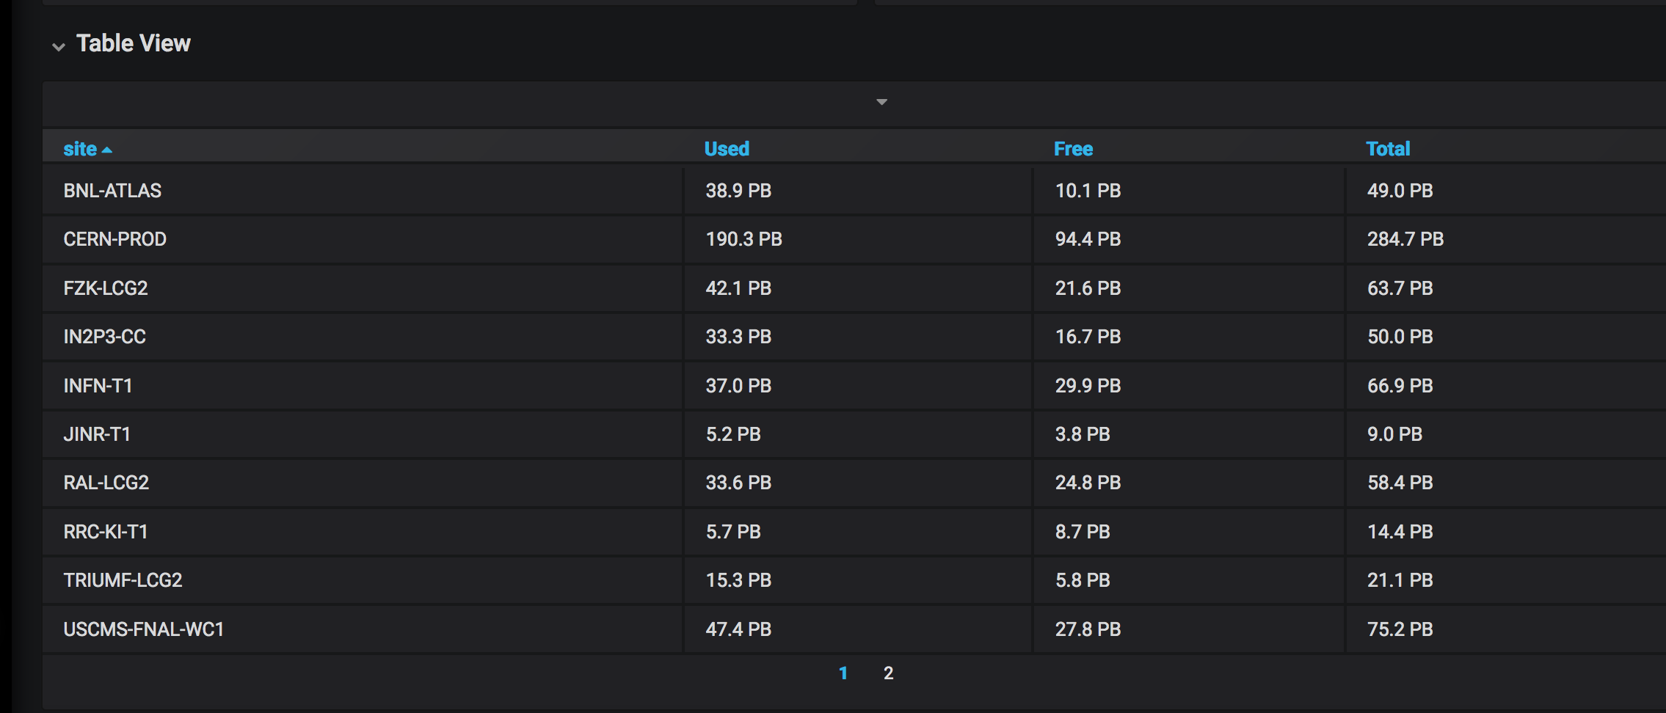
WSSA Status for tape storage
Implemented for 11 sites out of 14 running tape storage. 3 missing ones are on the way
Julia Andreeva , CHEP 2018, Sofia, 09.07.2018

Slide 16
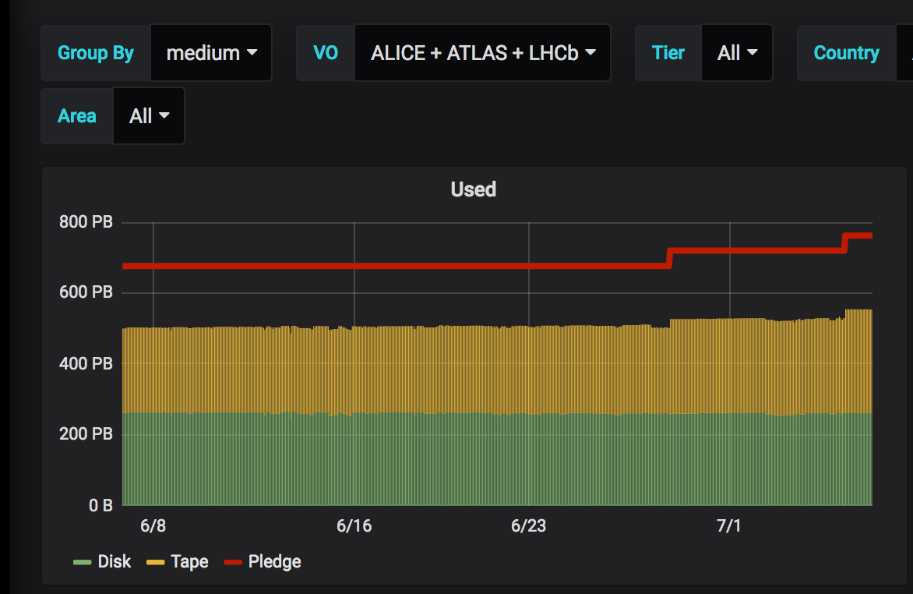
WSSA. Disk vs tape
Julia Andreeva , CHEP 2018, Sofia, 09.07.2018

Slide 17
Next steps
Enable WSSA for CMS
SRR implementation and deployment which requires effort of many people of the storage development teams , WLCG operations and sites.
Deployment of WSSA to production (planned for autumn this year)
Integration of the WLCG monthly accounting report generation with WSSA
Julia Andreeva , CHEP 2018, Sofia, 09.07.2018

Slide 18
Collaborative effort
This work requires contribution of many people for development, deployment and validation.
Would like to highlight important contribution of Oliver Keeble and Alessandro Di Girolamo (authors of SRR proposal) and Dimitrios Christidis (WSSA service developer)
Julia Andreeva , CHEP 2018, Sofia, 09.07.2018

Slide 19
Conclusions
WSSA provides a global view of storage occupancy for the WLCG infrastructure both for disk and tape storage
Current implementation is using available methods for getting information from the primary sources but we are moving forward to deploy SRM-free storage accounting
WSSA prototype is stable and ready for validation. Will move to production early autumn
Please, give a try and provide your feedback: http://cern.ch/go/B8vw
Julia Andreeva , CHEP 2018, Sofia, 09.07.2018

