Slide 1



Lightweight on-demand computing with Elasticluster and Nordugrid ARC
On behalf of the ATLAS Collaboration
Maiken Pedersen, University of Oslo (NO)
David Cameron, University of Oslo (NO)
Andrej Filipcic, Jozef Stefan Institute (SI)

Slide 2
Overview
Types of ATLAS sites in WLCG including the Nordugrid ARC and aCT INTERNAL mode grid site
Overview of the different ARC-CE submission interfaces
Setup and configuration of OpenStack grid site with Elasticluster
INTERNAL submission interface in use
Conclusion
Notes:
I will first give a quick overview of a few different types of ATLAS sites in the WLCG.
This will include the main topic of this talk which is the Nordugrid ARC and ARC Control Tower running in INTERNAL mode.
I will then give an slightly more detailed overview of the different ARC-CE submission interfaces.
Then move on to the cloud related part of the talk, with setting up and configuring an OpenStack grid site with Elasticluster
Finally show the INTERNAL submission mode in use
And then conclude.

Slide 3
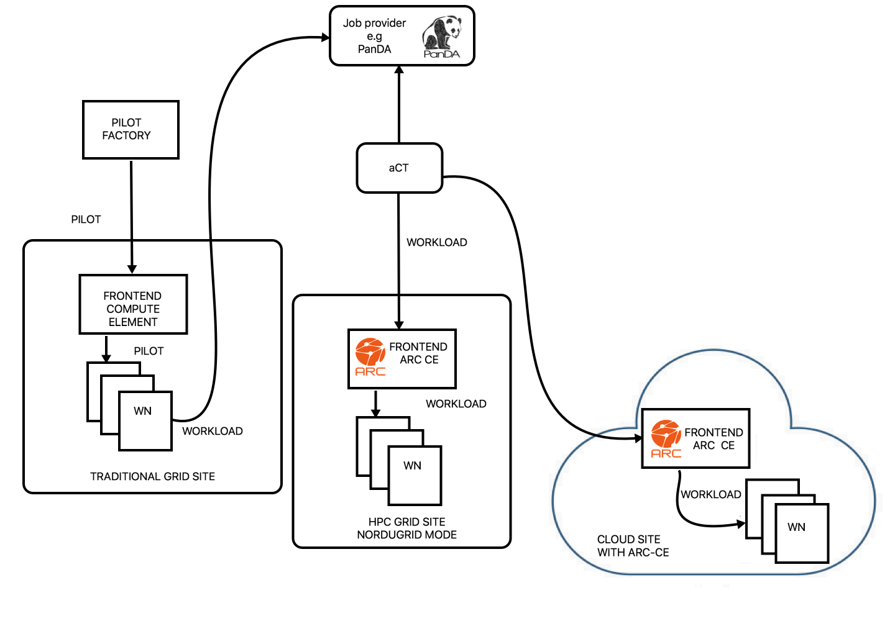
A handful different types of ATLAS sites in the WLCG
ARC: Advanced Resource Connector
aCT: ARC/ATLAS Control Tower
A site might offer several grid flavours
  Grid
  HPC
  Cloud
TRADITIONAL GRID MODE
Middleware on WN
Inbound connectivity on WN and frontend
Information publishing service for discovery
NORDUGRID STANDARD MODE
NO middleware on WN
NO inbound connectivity on WN
Inbound connectivity on frontend
Information publishing service for discovery
Notes:
There are many different flavours of grid sites in WLCG
A couple of examples are shown here
We have the traditional grid site, with dedicated machines running in pilot mode.
The compute element receives pilot jobs and passes them onto the worker noedes.
The worker nodes fetches the workload from the central ATLAS Job Provider, PaNDA
This mode requires middleware on the workernode (pilot), inbound connectivity, and a directory service must be running for the discovery of the site.
On Nordugrid sites you have the ARC Control Tower between the ARC-CE and PanDA. The ARC Control Tower (aCT) handles the communication with PanDA taking the role of the pilot.
This allows the worker nodes to be both middleware free, and without need of inbound connectivity. The worker nodes simply run the job via the local batch system.
As for the traditional grid site with pilots, a directory service must run also here.
This mode is well suited for example for HPC’s, where the cluster is shared with non-WLCG users.
The same model works for sites running in a cloud service.
As demand is constantly increasing for storage and cpu, sites are looking at how meet the demand.
One way is to offer a set of mixed resources, for instance HPC and cloud resources, where the cloud resource could operate in a flexible and opportunistic scheme, increasing and decreasing the cluster as needed.

Slide 4
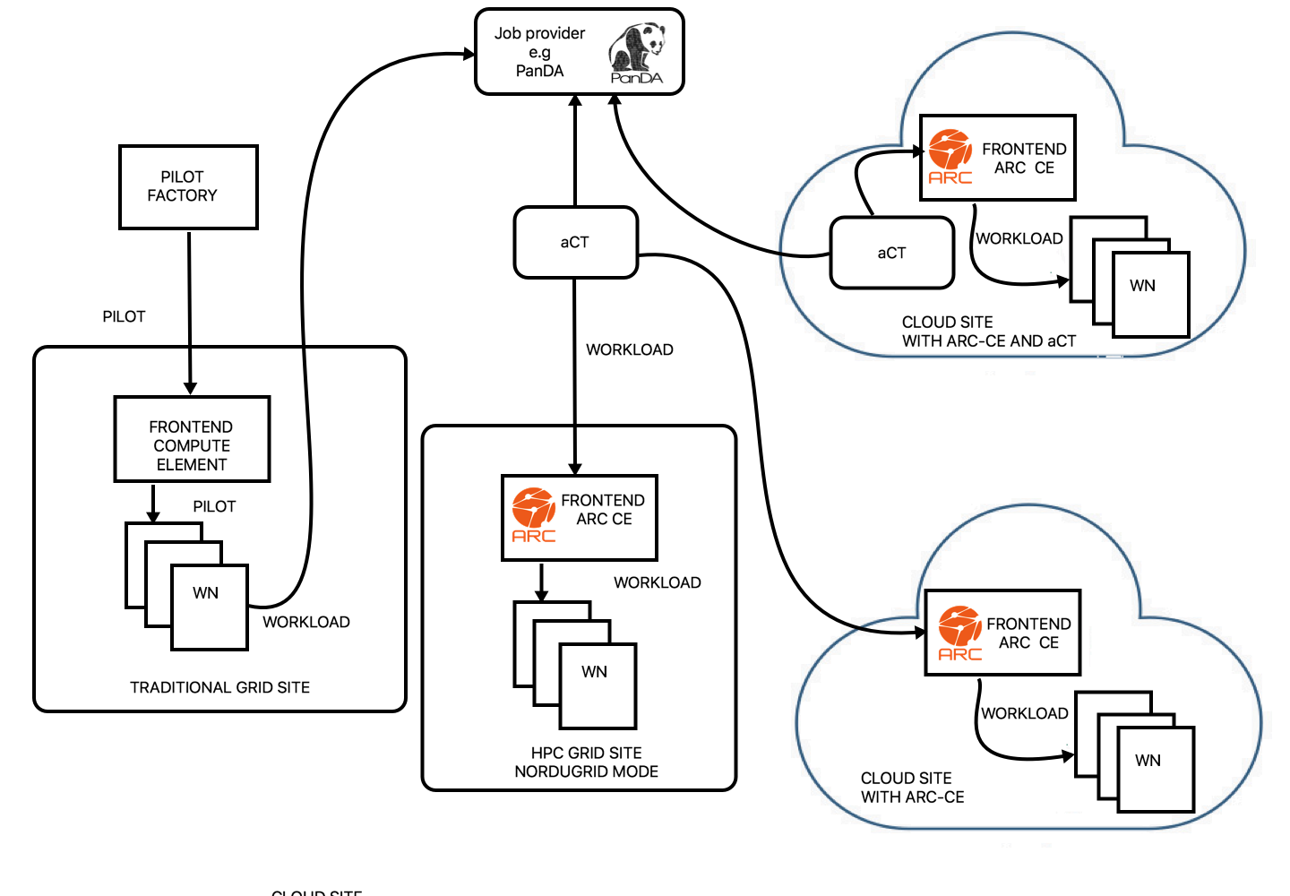
Nordugrid
ARC-CE and aCT
INTERNAL MODE
NORDUGRID INTERNAL MODE
NO middleware on WN
NO inbound connectivity
neither on WN nor frontend
NO information publishing
TRADITIONAL GRID MODE
Middleware on WN
Inbound connectivity on WN and frontend
Information publishing service for discovery
NORDUGRID STANDARD MODE
NO middleware on WN
NO inbound connectivity on WN
Inbound connectivity on frontend
Information publishing service for discovery
Notes:
One way of providing a lightweight cloud grid site is introduced with the new ARC INTERNAL submission mode together with a local installation of the ARC Control Tower (aCT).
As in the Nordugrid standard mode, no middleware is installed on the compute nodes and no inbound connectivity is required.
However, in the INTERNAL mode you need no inbound connectivity on the compute element either.
This is because aCT itself fetches jobs from PaNDA from within the site, instead of the sites receveing jobs pushed by an outside aCT.
The site does not have to publish its site information for discovery.

Slide 5
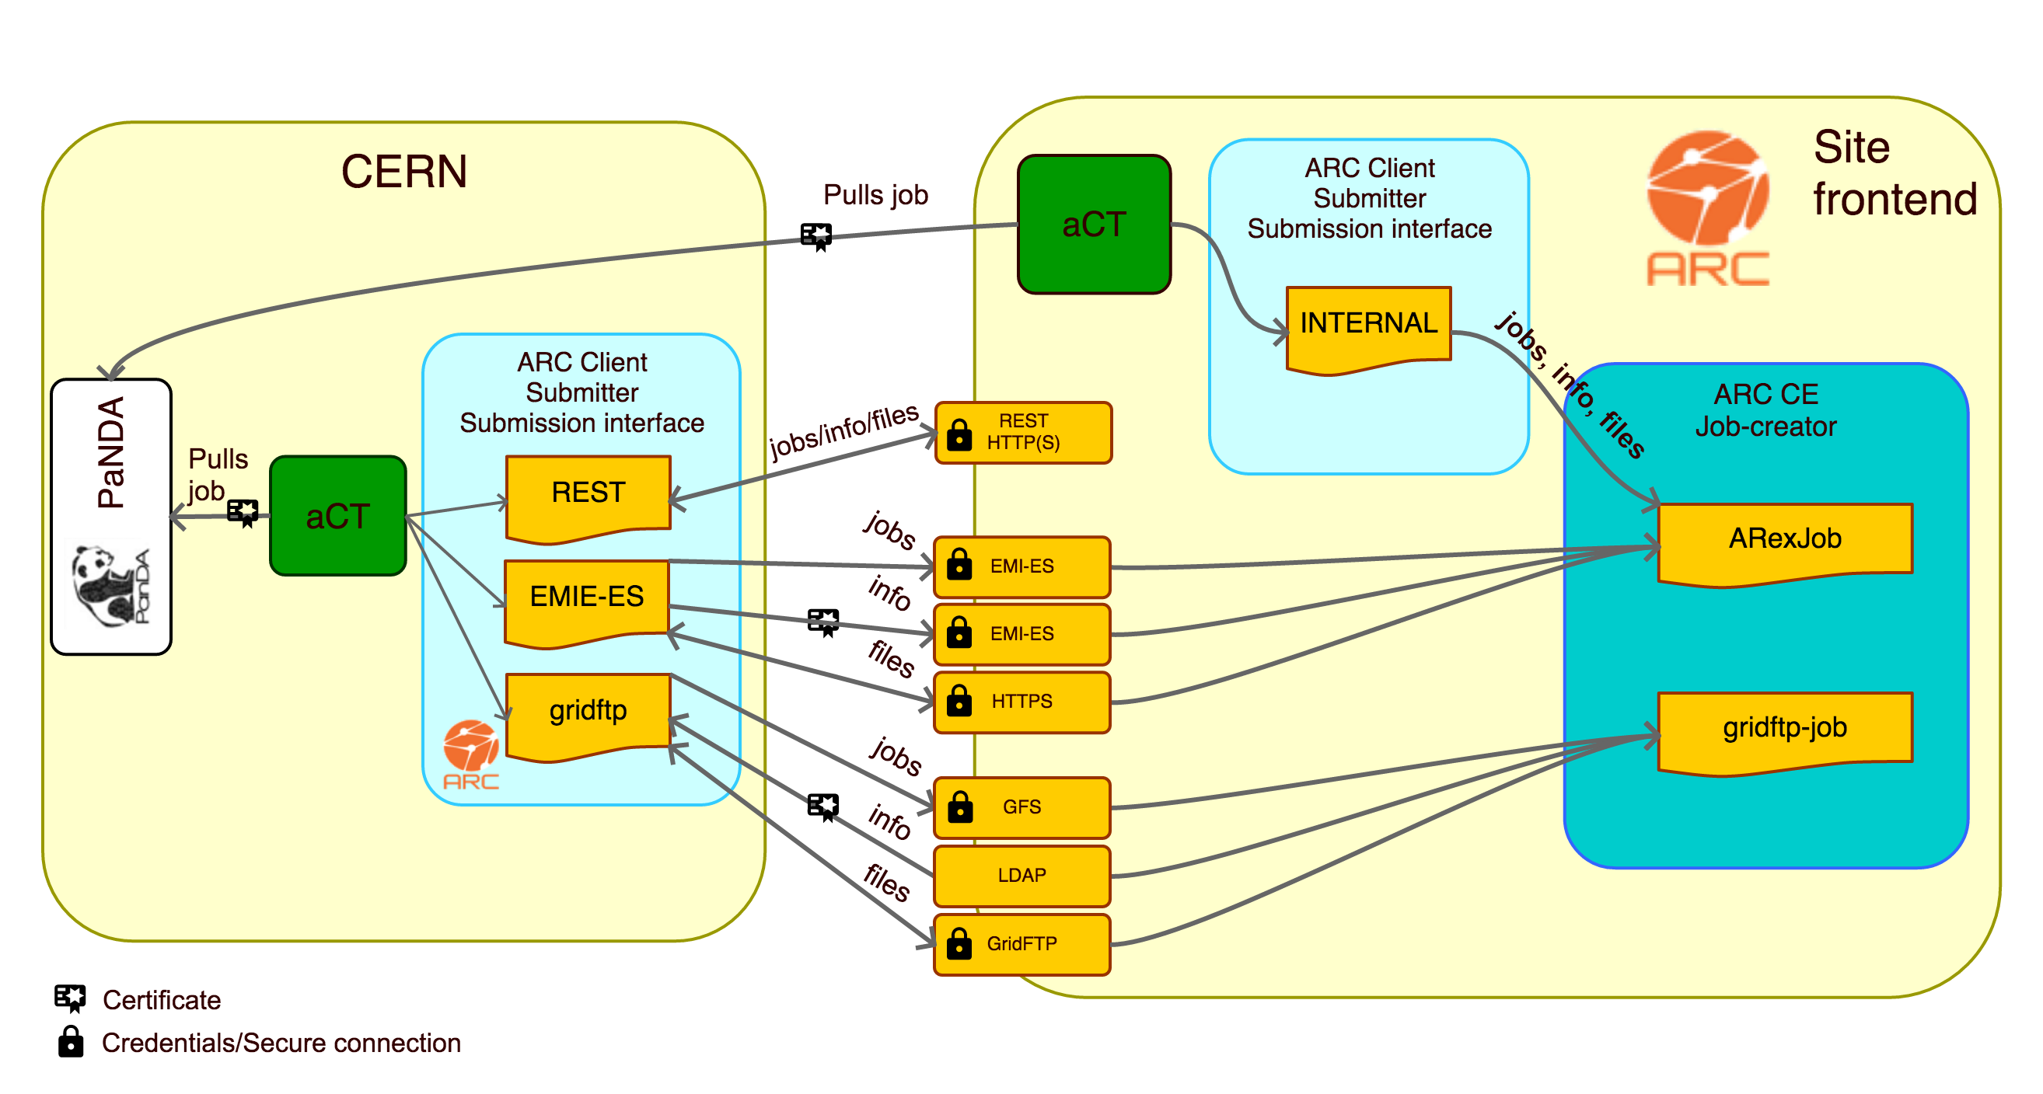
Overview of the ARC-CE submission interfaces
Notes:
Nordugrid ARC offers 4 submission interfaces, the Gridftp, EMIE-ES, a REST interface, and the new INTERNAL interface.
With the Gridftp, EMI-ES or REST interfaces, the CE listens for incoming jobs pushed to the site by a central aCT.
The communication between the client and the server are via request and response messages.
In Internal mode, there are no incoming connections since aCT pulls the jobs itself.
The jobs are passed onto the server internally by simple direct file placement in the file system shared by aCT, the ARC client and the ARC server.

Slide 6
INTERNAL submission interface
With aCT and ARC-CE installed at site running in “internal” mode: system administrator can run aCT and ARC-CE as non-root
  All files and jobs owned by this user
Since aCT and ARC are run on the same machine no host certificate is required
Minimal set of services, no gridftp server, no emi-es, no ldap, no host certificate
Lightweight ARC-CE beneficial for installation, configuration and maintenance
Notes:
ARC and aCT can be installed as normal user with the INTERNAL mode.
Also note that since the aCT and ARC are on the same machine no host certificate is needed.
To sum up: a minimal set of services are needed: no gridftp server, no emi-es, no ldap.
This results in a lightweight CE beneficial for installation, configuration and maintenance.
An example of the ARC configuration in the INTERNAL mode is available in the Extra material slides.

Slide 7
Setup and configuration of
OpenStack grid site with Elasticluster
Notes:
Elasticluster and ansible to initiate and configure cluster

Slide 8
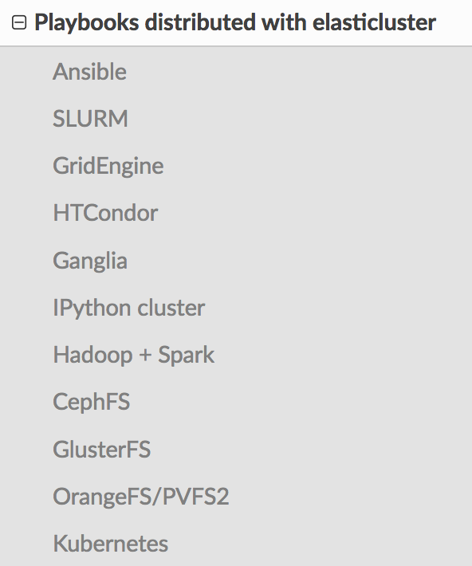

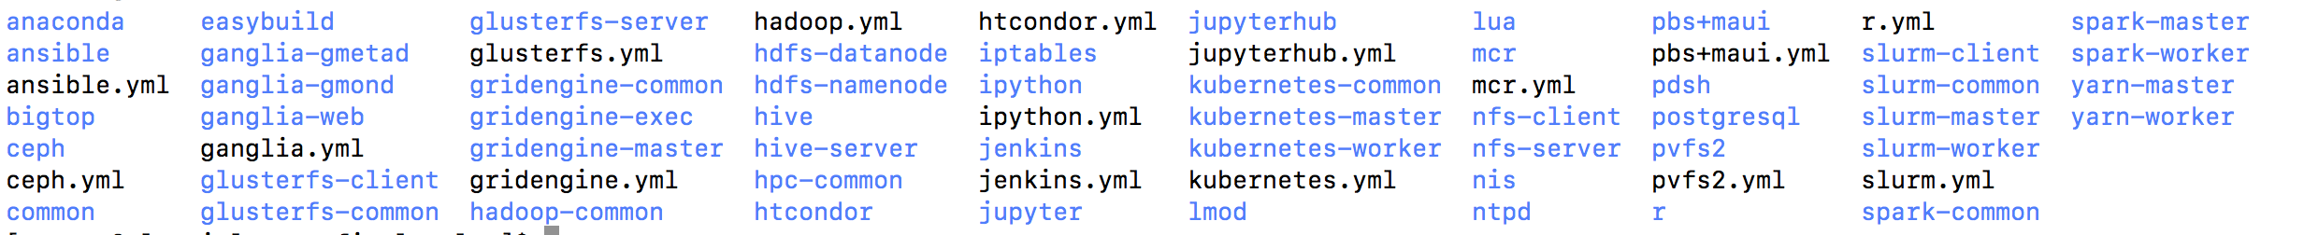
Elasticluster
http://elasticluster.readthedocs.io/en/latest/
Tool that uses ansible scripts to set up a cluster on a cloud service from inside or outside the cloud
Elasticluster supported cloud providers
  ec2_boto
  Google
  Openstack
  Libcloud
Batch system – slurm/gridengine/htcondor
NFS setup
HPC common software (… lmod, …), ganglia
Available roles in Elasticluster:
Notes:
I will describe how we have set up a test grid cluster in OpenStack using Elasticluster together with custom ansible scripts.
Elasticluster is a command line tool to create, manage and setup computing clusters hosted on cloud infrastructures.
The setup is done by running a series of ansible playbooks according to your needs.
The test cluster we set up in Oslo is a SLURM batch system.
Elasticluster sets up NFS and various common HPC software like lmod as a default.
Again, you can find an example of the configuration of Elasticluster in the Extra material slides.

Slide 9


Elasticluster in work for SLURM grid site
Elasticluster contacts the cloudprovider through the API
Fires up specified number of frontends and compute nodes with specified OS, size, memory, and what ports to open (through predefined security group)
Installs slurm server for frontend and client on compute nodes, NFS, ganglia (+ whatever else specified)
Elasticluster ”after” play used to customize the frontend and compute elements
FRONTEND
SLURM
master
ganglia
master
Elasticluster
NFS
ssh
WN
SLURM
master
ganglia
monitor

Slide 10
Steps to create an ARC-CE INTERNAL site
Ansible script tasks
On frontend
Install, configure ARC, aCT
Mounting of extra block storage for shared session directory, cache and runtime directory
Install CA’s for verification of incoming jobs
Modify $PATH and $PYTHONPATH for non-default installation and as non-root
Create griduser and add user to SLURM
FRONTEND
SLURM
master
aCT
ARC
Client
ARC
CE
Custom ansible
for ARC CE and aCT
setup
ganglia
master
NFS
ssh
On compute node
Cvmfs setup plus extra block storage to contain it
Create griduser and add user to SLURM
WN
SLURM
worker
cvmfs
Notes:
The necessary steps to set up a fully functional grid site in INTERNAL mode is the following.
A custom set up ansible scripts have been prepared to install and configure ARC-CE and aCT for the INTERNAL mode setup.

Slide 11
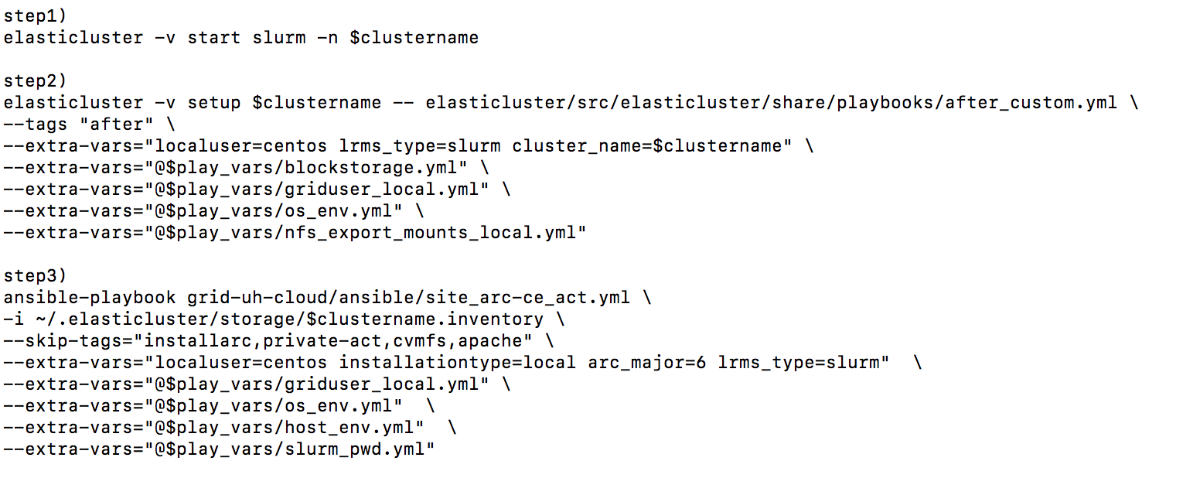
Elasticluster and ansible sequence
Link to playbook to install ARC and aCT (step 3)
https://source.coderefinery.org/nordugrid/contrib/tree/master/ansible/arc-ce
Notes:
Three steps needes
Initialize and setup cluster
Run custom after. play
Install and configure ARC-CE and aCT

Slide 12
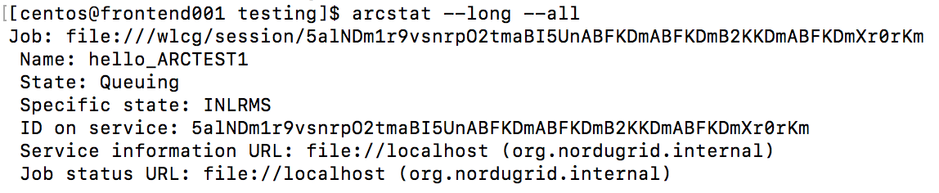
Testing submission with the INTERNAL submission mode
Specify local interface –S org.nordugrid.internal or leave blank as it is the default
Notes:
INTERNAL submission interface is the default interface, so no need to specify it
Uses the file protocol to submit the jobs

Slide 13

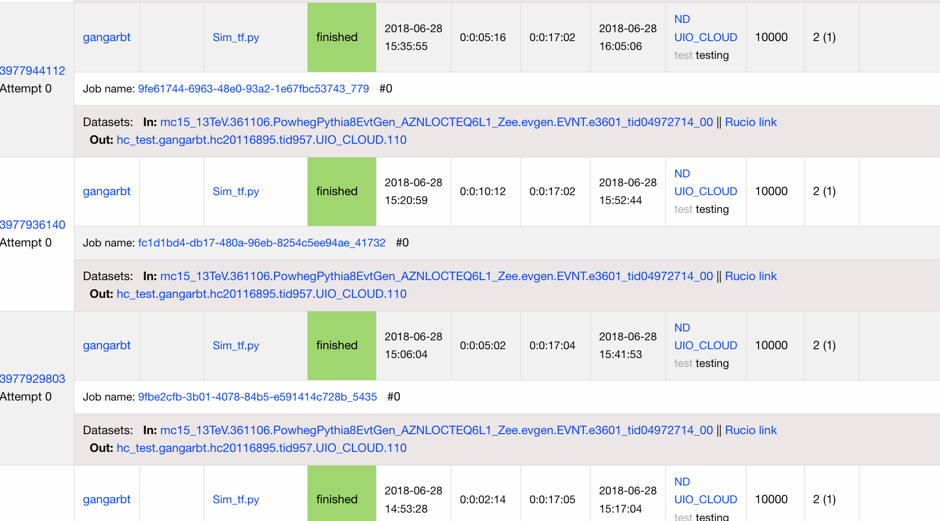
UIO_CLOUD queue
Hammercloud jobs with local submission in PanDA monitor
An ARC-CE and aCT INTERNAL test cluster has successfully been installed in the University of Oslo’s Openstack cloud service
Collects jobs from PanDA as the UIO_CLOUD queue
The jobs are so-called Hammercloud jobs
  Testing framework using realistic ATLAS jobs
  Jobs require cvmfs, download of input files etc.

Slide 14
Conclusion
ARC and aCT gives a new site configuration option for ATLAS sites
  Lightweight
  Good option for restrictive sites
  Suitable for cloud and HPC
Will be available in upcoming release of ARC 6
  Pre-release version already available
  https://source.coderefinery.org/nordugrid/arc

Slide 15
Extra material

Slide 16
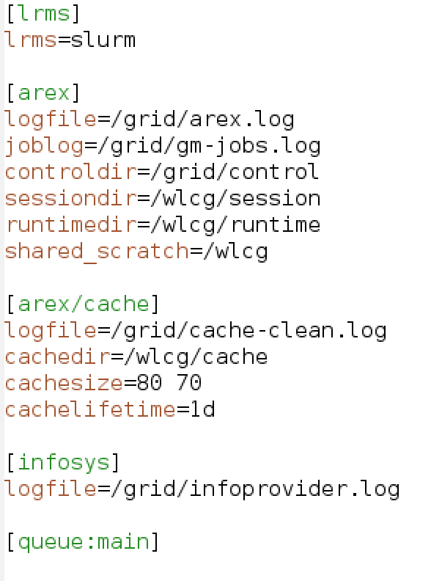
Minimalistic configuration of ARC for
INTERNAL submission only running ARC as normal user
For production site you would add VO configuration
Notes:
[common] block - removed as it should not be needed when final ARC 6 cleanup done
[cluster] block - removed as it should not be needed when final ARC 6 cleanup done
[infosys] block – I am using infosys in matchmaking – use info.xml

Slide 17
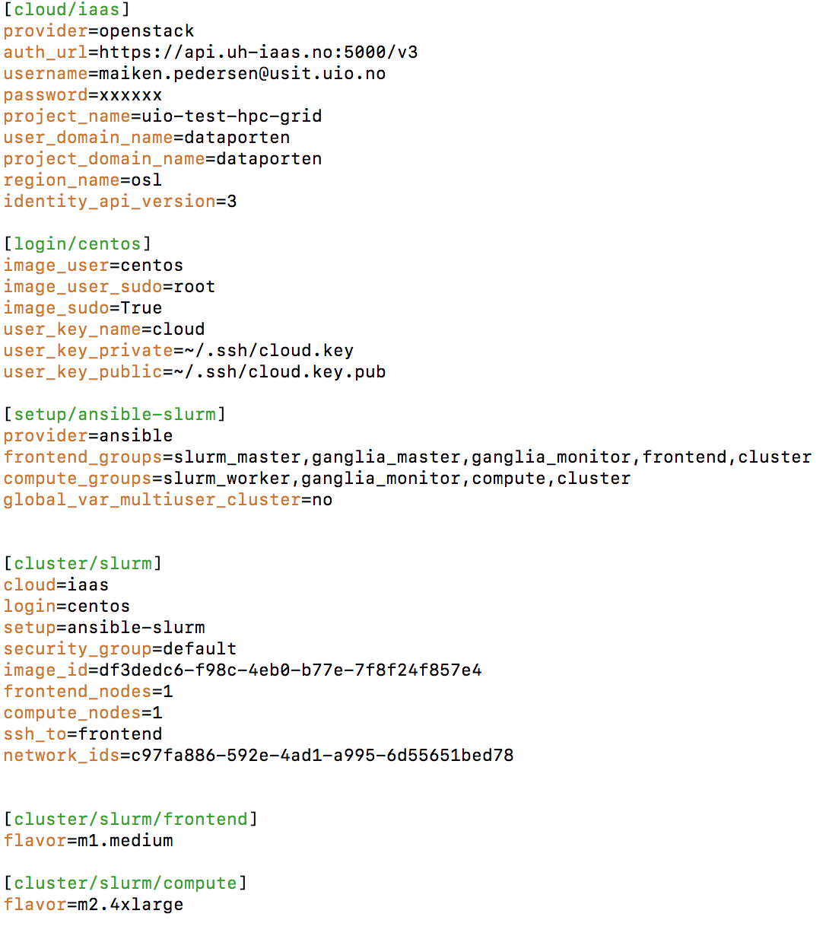
Example configuration of elasticluster
Openstack auth
Cluster login
Ansible groups
Cluster setup
Instance flavours
Notes:
Simple configuration of elasticluster – OS image is specified in image id.

Slide 18
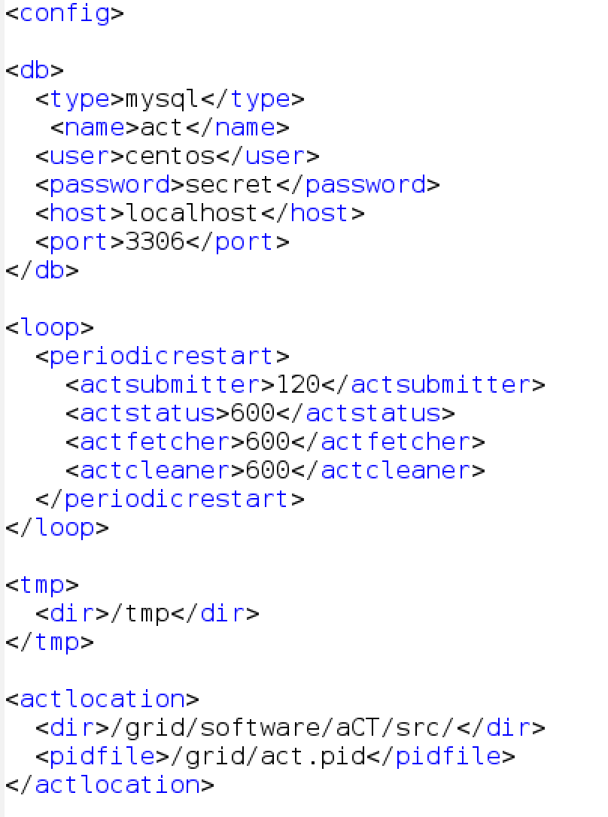
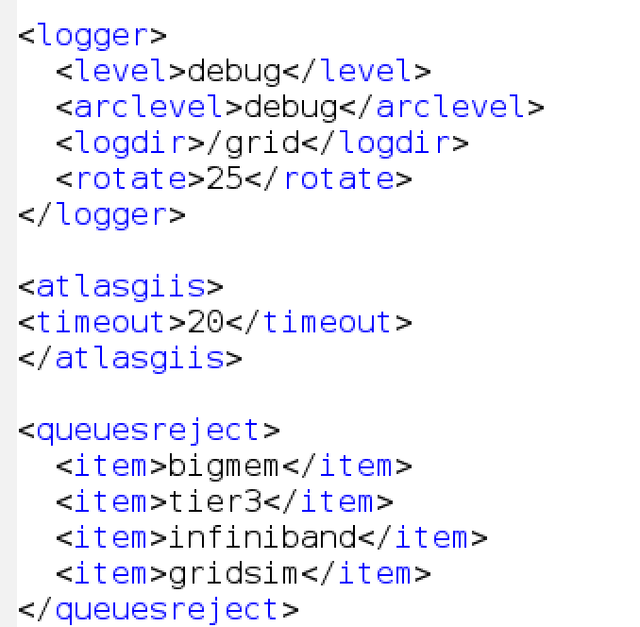
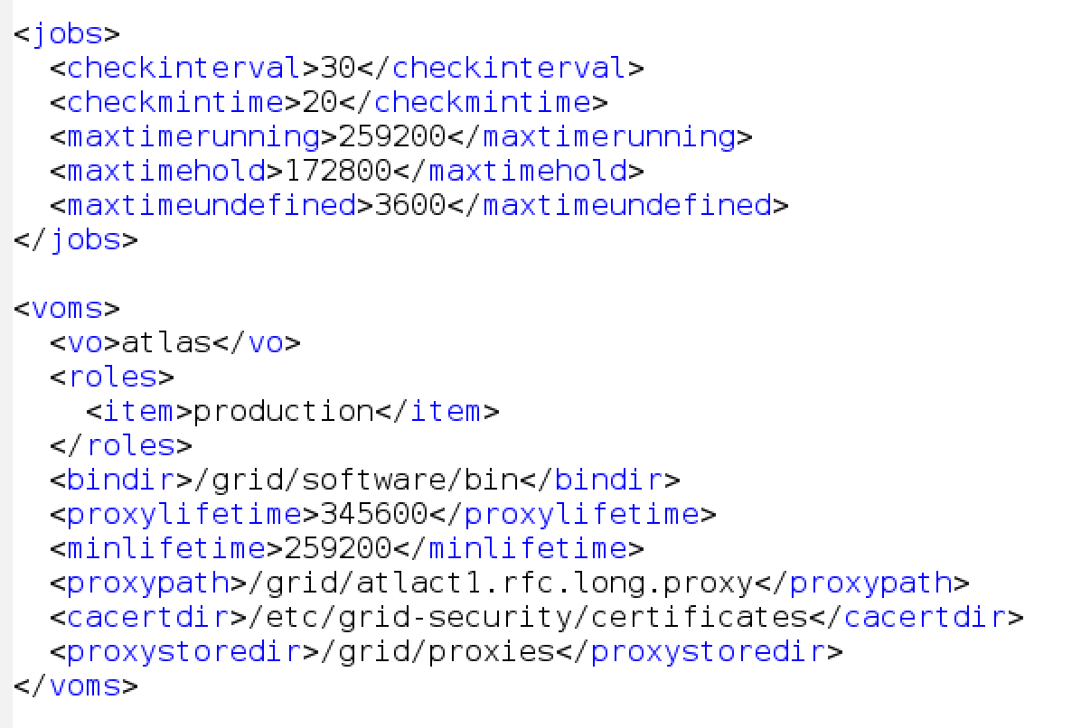
Configuration of aCT for INTERNAL mode
Notes:
What can I remove here? And what are reasonable values?

Slide 19
Nordugrid ARC CE modes
Pilot factory
True pilot
NDGF mode
Notes:
Full NDGF mode: ARC CE stages input and output files, aCT sends heartbeats for the full lifetime of the job. This mode is set by copytool=mv
True pilot mode: ARC CE acts as pilot gateway, pilot stages input and output files and sends heartbeats. In this case the pilot acts in the same way as an APF queue, the only difference is that the job description is pre-placed so getJob() is skipped. This mode is set by copytool!=mv

Slide 20
Nordugrid ARC CE modes for restrictive (HPC) sites and lightweight sites, including clouds
ssh-mode
INTERNAL mode HPC
INTERNAL mode cloud

