Slide 2
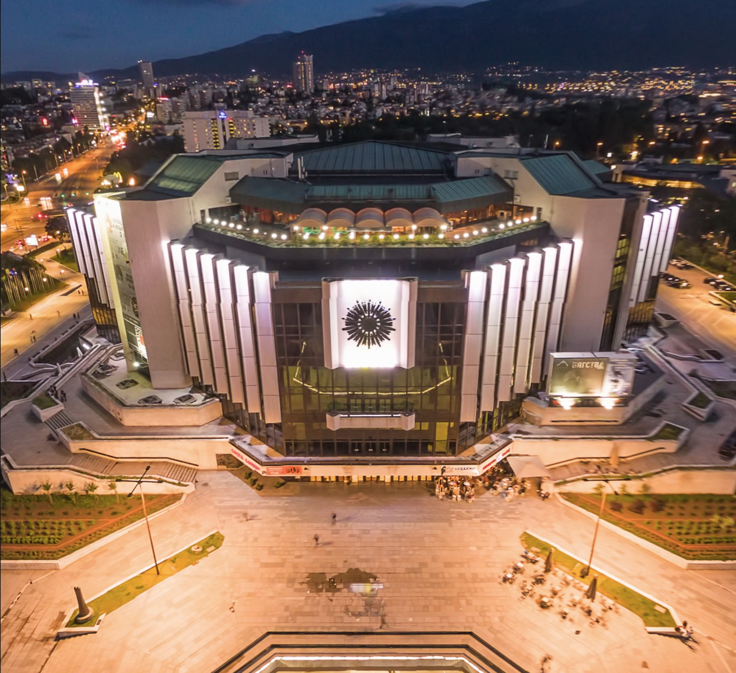

08/12/2016

Slide 3


HNSciCloud
a Hybrid Cloud for Science
CHEP 2018 Conference, Sofia, Bulgaria
9th July 2018
João Fernandes
CERN
IT department

Slide 4


The Helix Nebula Science Cloud
To provide a common cloud platform for the European research community
Via a collective effort of 10 procurer Research Organisations forming the Buyers Group
Expressing the need to increase the analysis capability and capacity offered to their users to keep pace with the growth in scientific data

Slide 5


Helix Nebula Hybrid Cloud Model
Medium Scale/Long Tail
Bringing together:
Research Organisations
Data Providers
Publicly funded e-infrastructures
Commercial cloud providers
with:
Procurement and Governance suitable for the dynamic cloud market
Data Intensive Science
Other sectors
Hybrid Cloud
Commercial Networks
Public Funded
On-Prem Resources
Commercial Cloud Providers

Slide 6
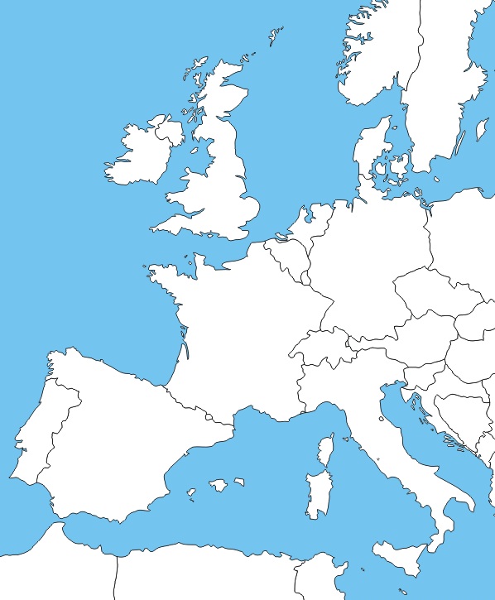
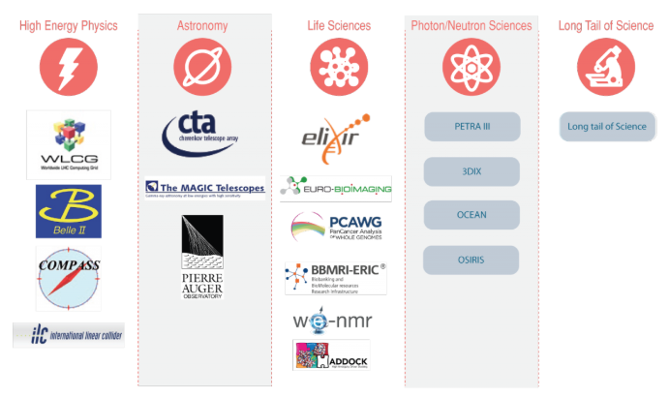












Helix Nebula Science Cloud Joint Pre-Commercial Procurement
Procurers: CERN, CNRS, DESY, EMBL-EBI, ESRF, IFAE, INFN, KIT, STFC, SURFSara
Experts: Trust-IT & EGI.eu
Resulting IaaS services support use-cases from many research communities
Deployed in a hybrid cloud mode:
procurers data centres
commercial cloud service providers
GEANT network, EduGAIN and ELIXIR Federated Identity Management
Co-funded via H2020 Grant Agreement 687614
Total procurement budget >5.3M€
Notes:
Research organisations from 7 countries have proposed to work together to develop a cross-border joint procurement of innovative cloud services. This is an important change: never before have research organisations across Europe pooled their funds and resources to procure cloud services to support their scientific programmes.
CERN is the lead procurer while EMBL-EBI & ESRF are members of the buyers group and co-organisers of this event.
The hybrid cloud platform brings together the data centres managed by the procurers, the publicly operated GEANT network and eduGAIN federated identity mgmt. providing consistent access to all cloud services.

Slide 7

Challenges
Innovative IaaS cloud services integrated with procurers in-house resources to support a range of scientific workloads
Compute and Storage
  Support a range of architectures, virtual machine and container configurations including HPCaaS, working with datasets in the petabyte range with transparent data access
Network Connectivity and Federated Identity Management
  Provide high-end network capacity via GEANT for the whole platform with common federated identity and access management
    AAI activities have been described as a ‘pilot’ use-case in a AARC2 project:
      https://aarc-project.eu/wp-content/uploads/2018/06/DSA1.1-v1.1FINAL.pdf
    More in Hannah Short (CERN) talk, Track 3:
      https://indico.cern.ch/event/587955/contributions/2936916/
Service Payment Models
  Explore a range of purchasing options to determine those most appropriate for the scientific application workloads, including vouchers or other means of easy integration in the organisations procurement models and production of a TCO study ready by end of 2018

Slide 8
HNSciCloud project phases
Preparation
Implementation
and sharing
  Analysis of requirements
  Current market offers
  Relevant standards
  Build stakeholder group
  Develop tender material
4 Designs
3 Prototypes
2 Pilots
Tender Jul’16
Call-off Feb’17
Call-off Dec’17
Jan’16
Dec’18
Each step is competitive - only contractors that successfully complete the previous step can bid in the next
Phases of the tender are defined by the Horizon 2020
Pre-Commercial Procurement financial instrument

Slide 9
Pilot Phase Timeline
We are here
10k/1PB
2 Pilots
5k/500TB
End User Access
3.5k/350TB
Scalability Testing
Cores/Storage per Provider
Call-off Dec’17
M-PIL-3.2 CERN 13th-14th June
M-PIL-3.3 Amsterdam
10th-11th Sept.
Feb’18
40Gbps to GEANT
Dec’18

Slide 10
What HNSciCloud is not
Not a zero cost research grant
  Contractual Relationship: Important to understand how to integrate commercial cloud services into scientific activities
Not a one-off test
  A predictable production-quality contribution to the scientific programme of the organisations involved
Not just a technical evaluation
  Legal: Where is the data stored? Under what jurisdiction? What are the contractual terms and conditions?
  Commercial: what are the commercialisation plans after the project? How much will it cost to use them in production? What purchase models are available?
Not a walk in the park
  2.5 years of intense collaboration for procurers and companies to get here
    From common requirements specification for workloads of multiple scientific disciplines to tender launch, design and prototype phases
    Required significant effort by the procuring organisations to follow the process, provide all the necessary material and performing tests on the developed services.

Slide 11











Cloud Providers
T-Systems
  IaaS based on OTC
RHEA
  IaaS provided by Exoscale

Slide 12







HEP Flagship Deployments
WLCG
  ALICE, ATLAS, CMS and LHCb
    Daniele Spiga (INFN) talk about DODAS, Track 7:
      https://indico.cern.ch/event/587955/contributions/2937198/
    Matthias Schnepf (KIT) talk about Dynamic Integration of resources, Track 8:
      https://indico.cern.ch/event/587955/contributions/2937900/
CERN Batch Service
Container Federation
  Openstack Summit, reference talk:
    https://www.openstack.org/summit/vancouver-2018/summit-schedule/events/20768/cern-experiences-with-multi-cloud-federated-kubernetes
Belle II
  Silvio Pardi (INFN) poster about experience of Belle II with commercial clouds, Track 7:
    https://indico.cern.ch/event/587955/contributions/2937060/
Interactive Analysis for End Users for TOTEM
  https://indico.cern.ch/event/727193/contributions/3039091/attachments/1667076/2674030/TotemTest_HNSciCloud.pdf
Machine Learning/Deep Learning for Fast Detector Simulation using GPUs
  Sofia Vallecorsa (CERN openlab), Track 2 and Jean-Roch Vlimant (CMS), Track 6:
    https://indico.cern.ch/event/587955/contributions/2937595/
    https://indico.cern.ch/event/587955/contributions/2937513/

Slide 13




WLCG Cloud Consolidation
8 of the 10 members of the Buyers Group are actively supporting the LHC programme
  Operating sites in WLCG
Agreement to consolidate to a shared WLCG tenant
  Reduce effort at sites to support WLCG workloads
  Reduce network traffic across each site and commercial cloud provider data centres
Hybrid Model bringing together WLCG sites and commercial cloud providers data centres linked via GEANT or/and NRENs
More WLCG procuring organisations can participate via the early adopter programme:
https://www.hnscicloud.eu/the-hnscicloud-adopter-group

Slide 14
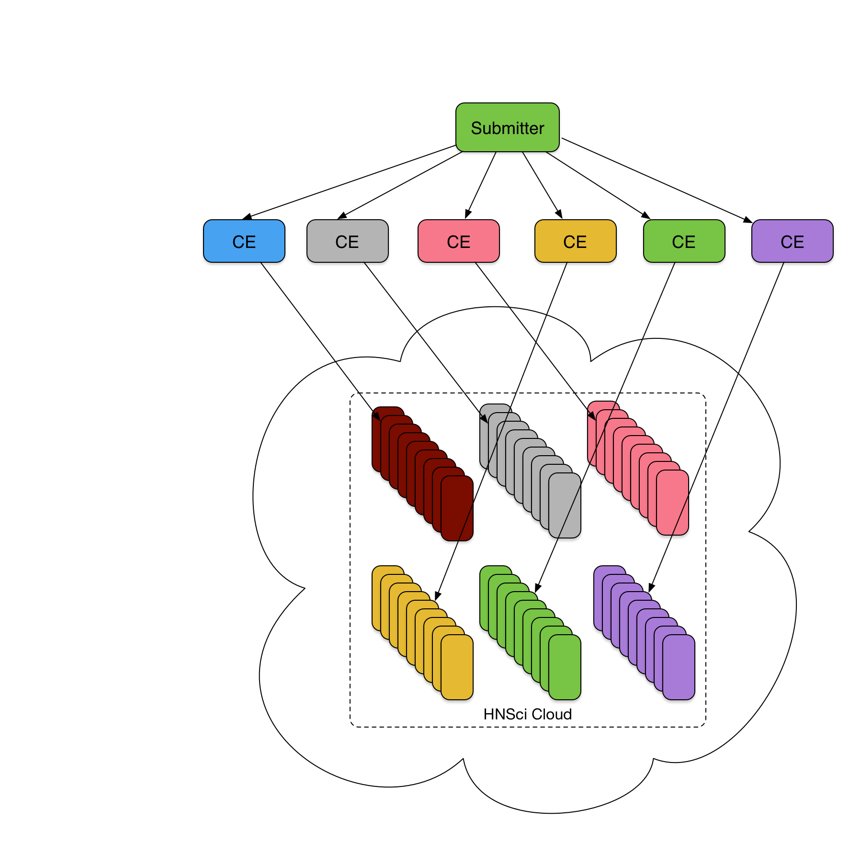
Unconsolidated
Slides from Ben Jones (CERN IT-CM)
In this setup, an experiment could have to define 8 additional sites to send jobs to the same resources

Slide 15
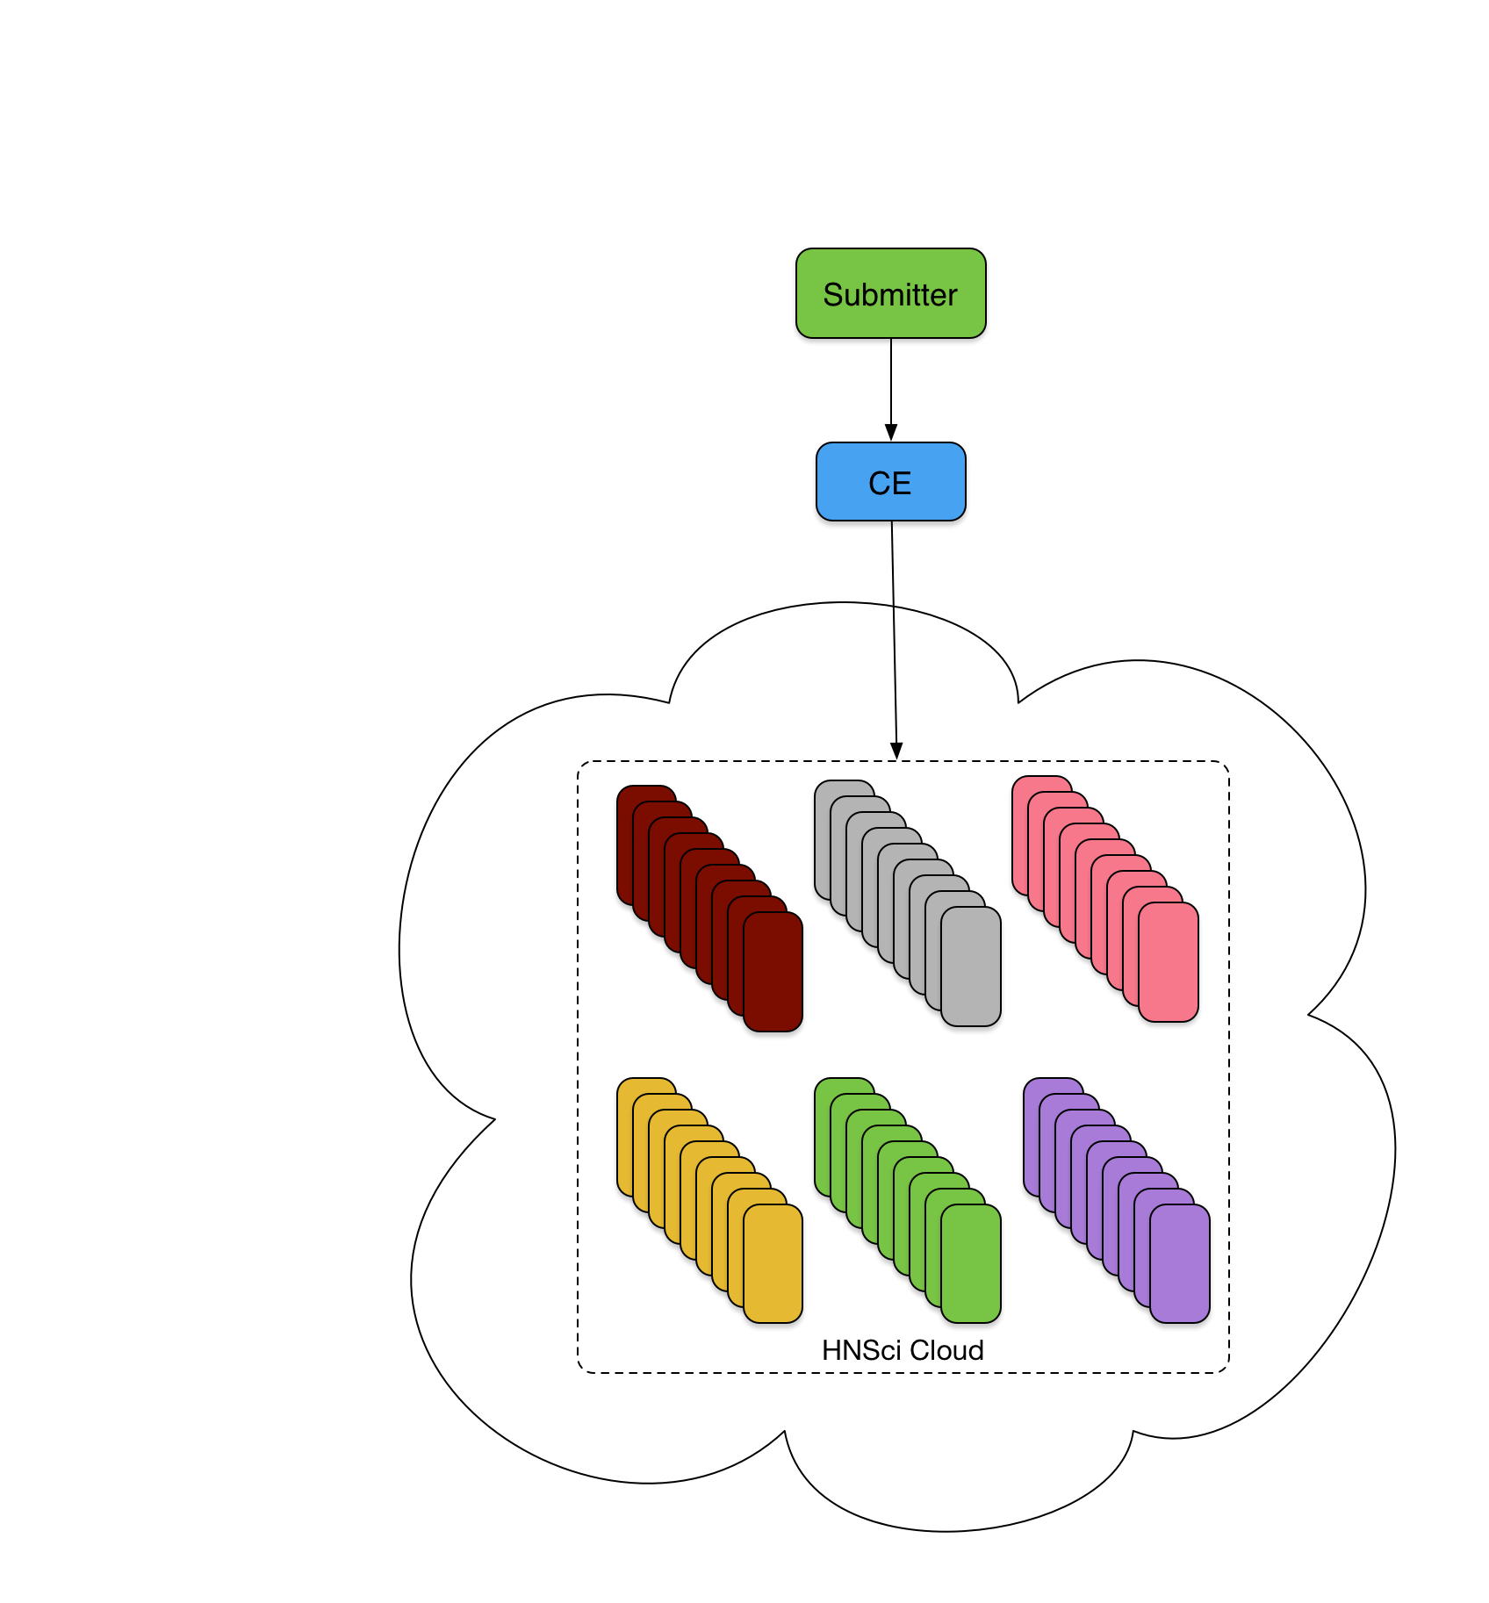
Shared Tenant
Slides from Ben Jones (CERN IT-CM)
With a shared tenant and single entry point (CE), only one site needs to be setup

Slide 16
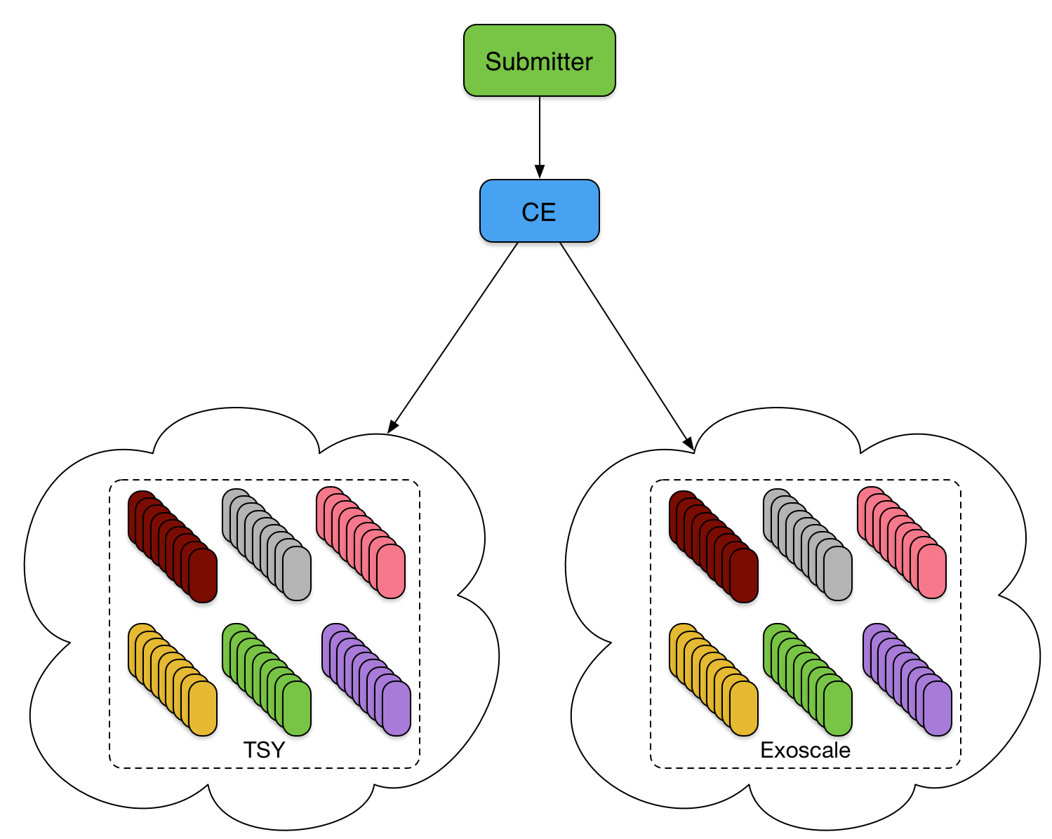
Multiple Clouds
Slides from Ben Jones (CERN IT-CM)
Current setup being explored at HNSciCloud with a single entry point

Slide 17

European Open Science Cloud
HNSciCloud promoted as a working example of an Open Science Cloud by the EC High Level Expert Group

Slide 18
Upcoming Events
August 28: GridKa School, Karlsruhe
Hands-On session organised by KIT
September 11: HNSciCloud meeting, Amsterdam
Organised by SURFsara
October 9-11: DI4R 2018, Lisbon
October 24th: Hamburg
Organised by DESY

